Slide 1
Tropical Diagnostics for NWP
Maria Gehne^{1,2}, Brandon Wolding^{1,2}, Juliana Dias², George Kiladis²
CIRES University of Colorado, Boulder
NOAA Earth Systems Research Laboratory, Physical Sciences Division

Slide 2
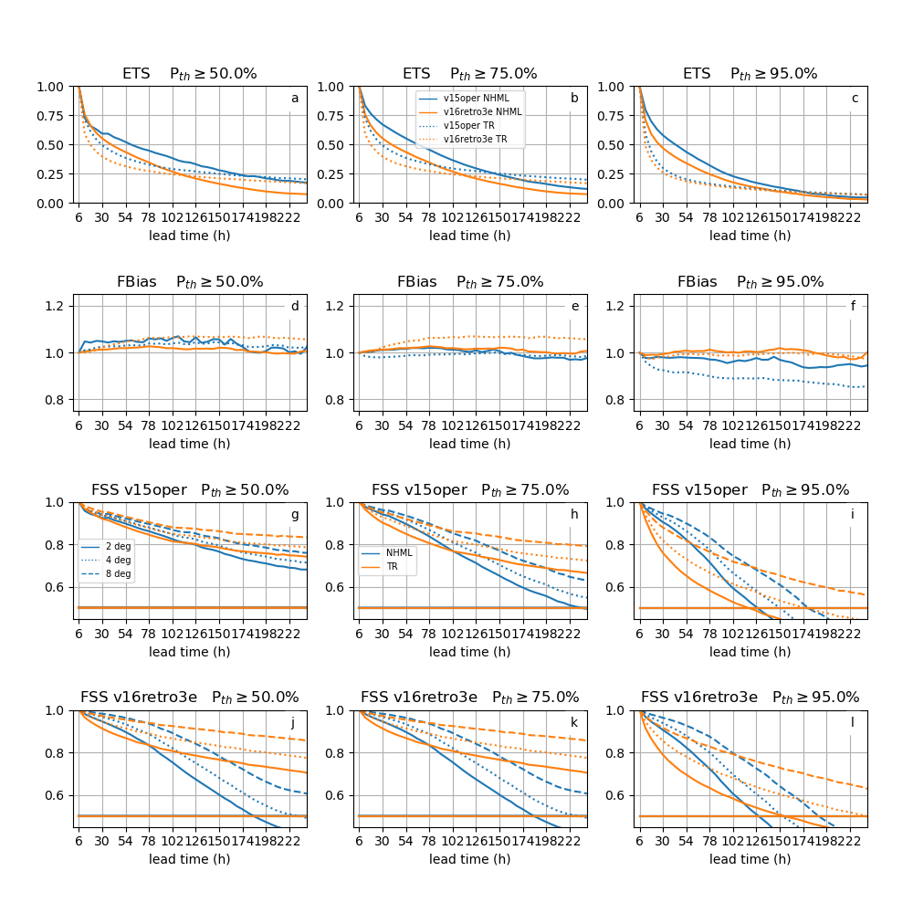
NWP models tend to perform better in mid-latitudes than in the Tropics.
The underlying dynamics are different in the Tropics and mid-latitudes.
Convection is main driver of precipitation in the Tropics.
Convective parameterization has a larger impact on precipitation in the Tropics.
There is evidence that better forecast skill in the Tropics can lead to improved forecasts in mid-latitudes.

Slide 3
Tropical Diagnostics for NWP
It is not very well understood which processes in the Tropics are most important to mid-latitude forecast skill. There are well-known sources of predictability beyond a few days in the tropical atmosphere such as the MJO and CCEWs.
Introduce metrics and diagnostics for NWP in the Tropics.
Better understanding of NWP model behavior with respect to tropical convection.
Identify forecast error sources in the Tropics related to moisture-convection coupling, CCEWs and the MJO.
NWP evaluation presents different challenges than climate model evaluation.
Forecasts are shorter: days-weeks.
Model versions change frequently.
It is rare to have long (multi-year) time series of operational model runs.
Consider diagnostics as a function of lead time.
If certain phenomena are initialized correctly, how long is the model able to keep that information?

Slide 4
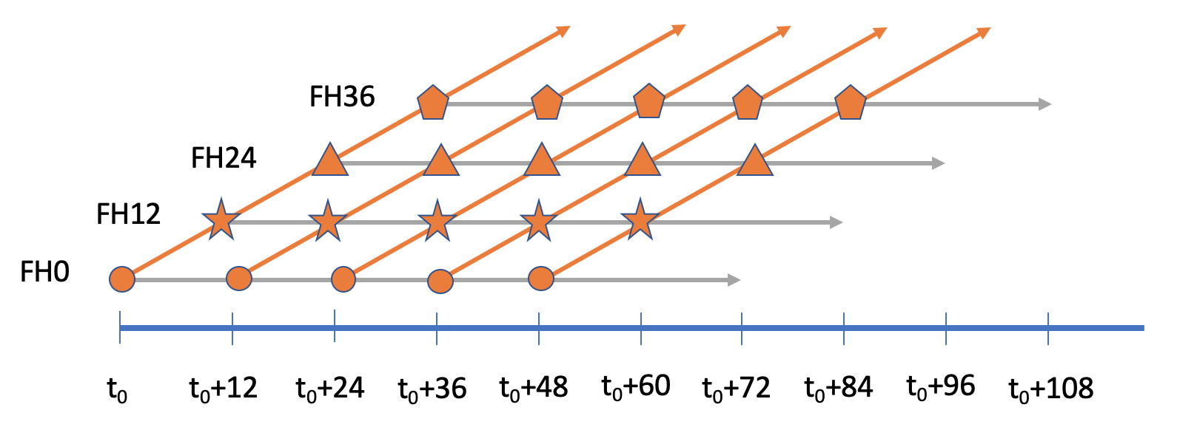
Diagnostics
Hovmoeller diagrams and pattern correlation (zonal propagation)
Space-time coherence spectra (scales of coupling to moisture)
Vertical structure of coherence between precipitation and dynamical fields (vertical structure and phase relationship within CCEWs)
Convectively coupled wave activity and skill (CCEW propagation)
Moisture - convection coupling (coevolution of precipitation and column saturation fraction)
Development of diagnostics are focused on FV3GFS operational V15 and retrospective V16 model versions together with ERA5 and observed precipitation data sets.
Model output needed:
gridded 2D fields of precipitation, surface pressure, land-sea mask
gridded 3D fields of temperature, specific humidity, winds

Slide 5
Model Evaluation
FV3GFS V15 operational vs FV3GFS V16 experimental runs.
Initialized 6 hourly from 20191201 to 20200331.
Run out to lead time 240h.
Planning on applying the diagnostics to the UFS S2S prototype 5 runs at https://registry.opendata.aws/noaa-ufs-s2s/ (or others if there are better suggestions)
Development of diagnostics are focused on FV3GFS operational V15 and retrospective V16 model versions together with ERA5 and observed precipitation data sets.

Slide 6
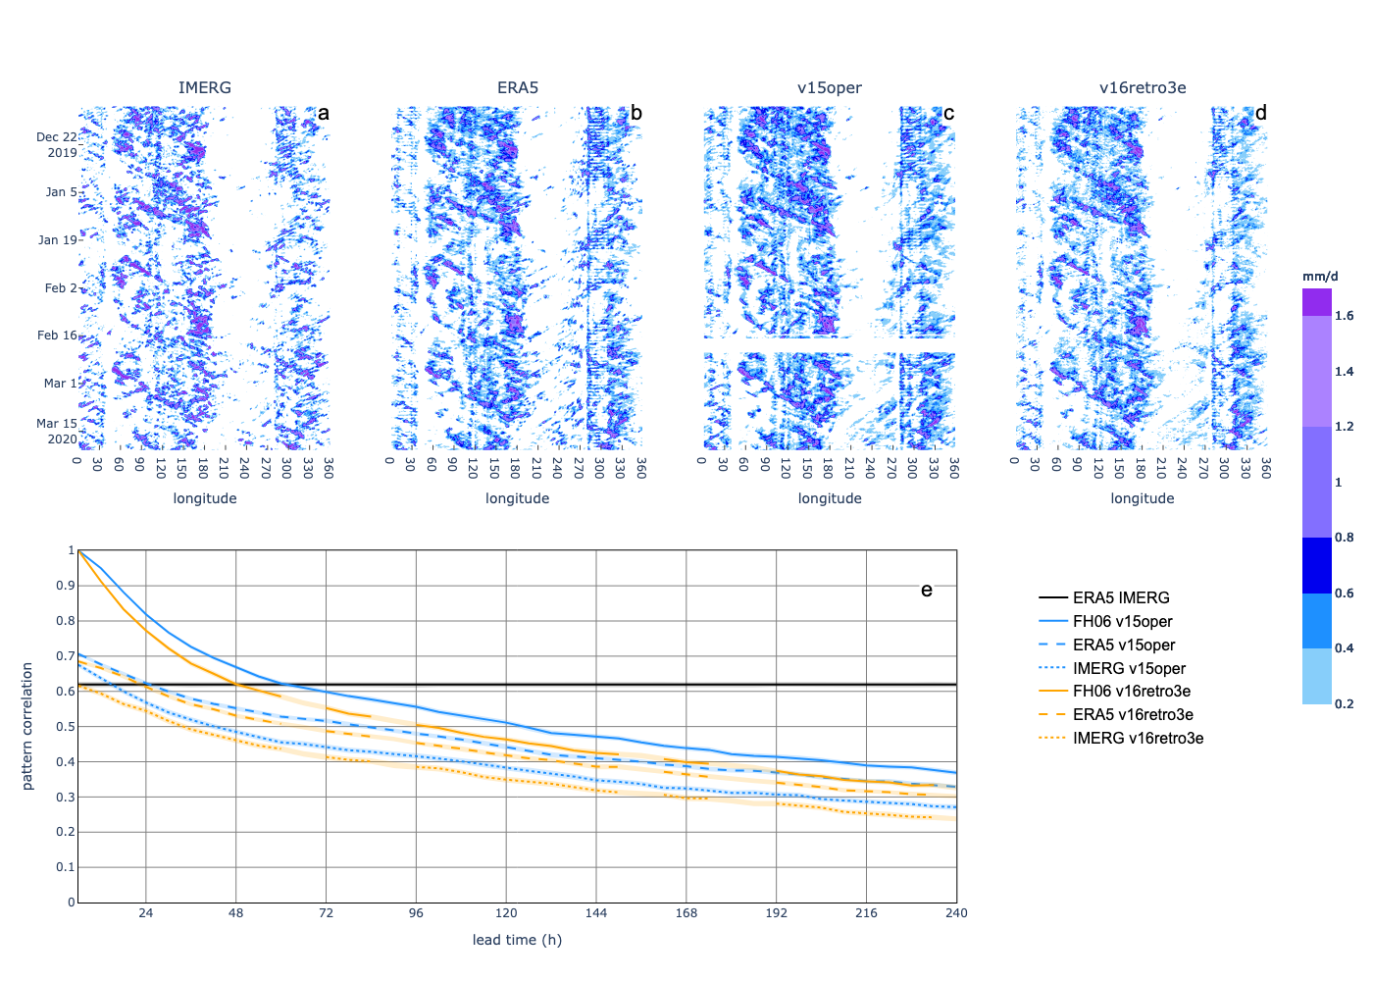
Hovmoeller diagrams and pattern correlation
Assess the zonal propagation of convective features.
Pattern correlation between forecast and ‘truth’ can be used as a skill score.
V15 operational vs V16 experimental shows only minor differences with V16 slightly underperforming V15.
Comparison to ERA5 precipitation is similarly skilled for both versions.
V16 diverges from FH06 precipitation more quickly.

Slide 7
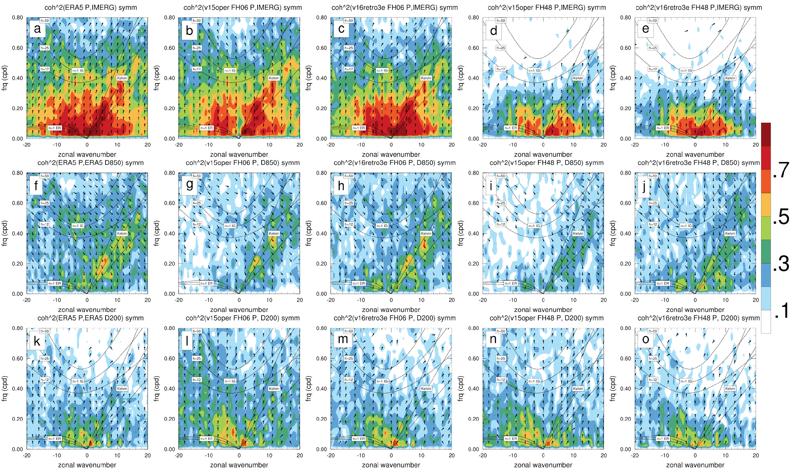
Space-time coherence spectra
How well do models initialize and propagate CCEWs?
Coherence spectra show space-time regions of tropical variability without having to estimate a background.
Evaluate the consistency in variability between modeled and observed precipitation at a range of spatial and temporal scales.
Possible to evaluate precipitation – dynamics relationship strength and how it changes with lead time.

Slide 8
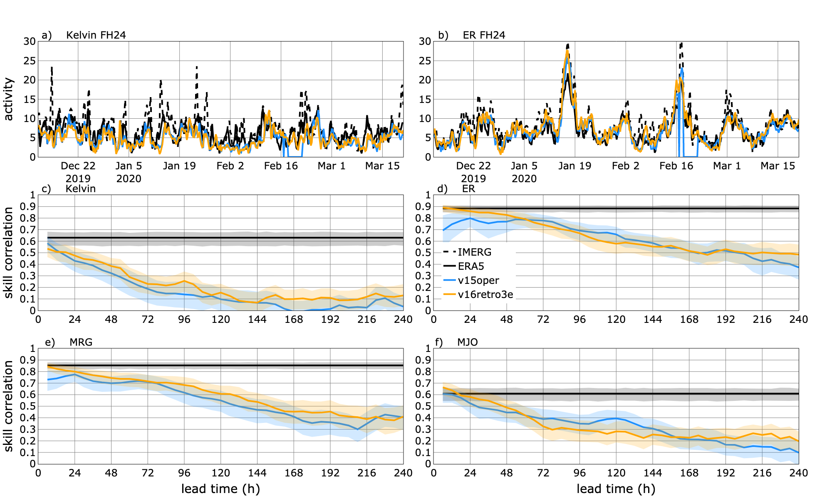
CCEW activity
How long and how well can the model predict CCEWs?
Use long time series (30+ years) of observed filtered precipitation to compute EOFs describing CCEW signal.
Project the model precipitation at each forecast hour onto these EOF patterns and compute a CCEW activity index.
Compute anomaly correlation between the observed and model index.
CCEW forecasts are generally improved for the first 48h lead time in V16 vs V15. Differences are significant only for the first 12h.

Slide 9
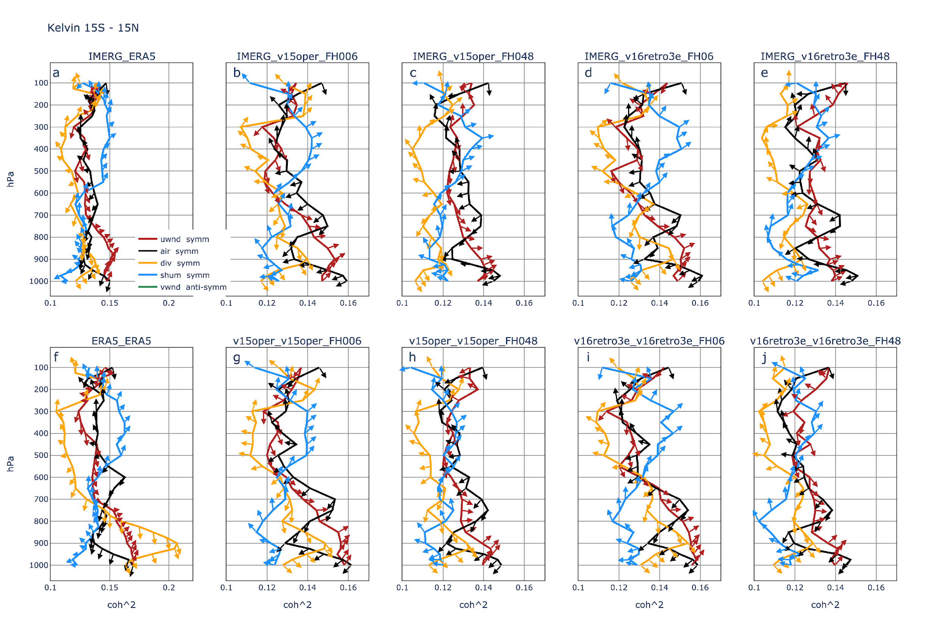
Vertical structure of coherence
Proxy for vertical profile of latent heating associated with deep convection.
Filtered P is used to compute coherence with dynamical variables at all vertical levels.
Results point to issues in the coupling between large-scale dynamics and convection.
The divergence coherence appears too weak and at slightly higher levels than observed and decreases with lead-time.
Mid-level peak in temperature coherence-squared is lower in V15 and V16.
Vertical structure of wave coherence is well represented at initialization.

Slide 10
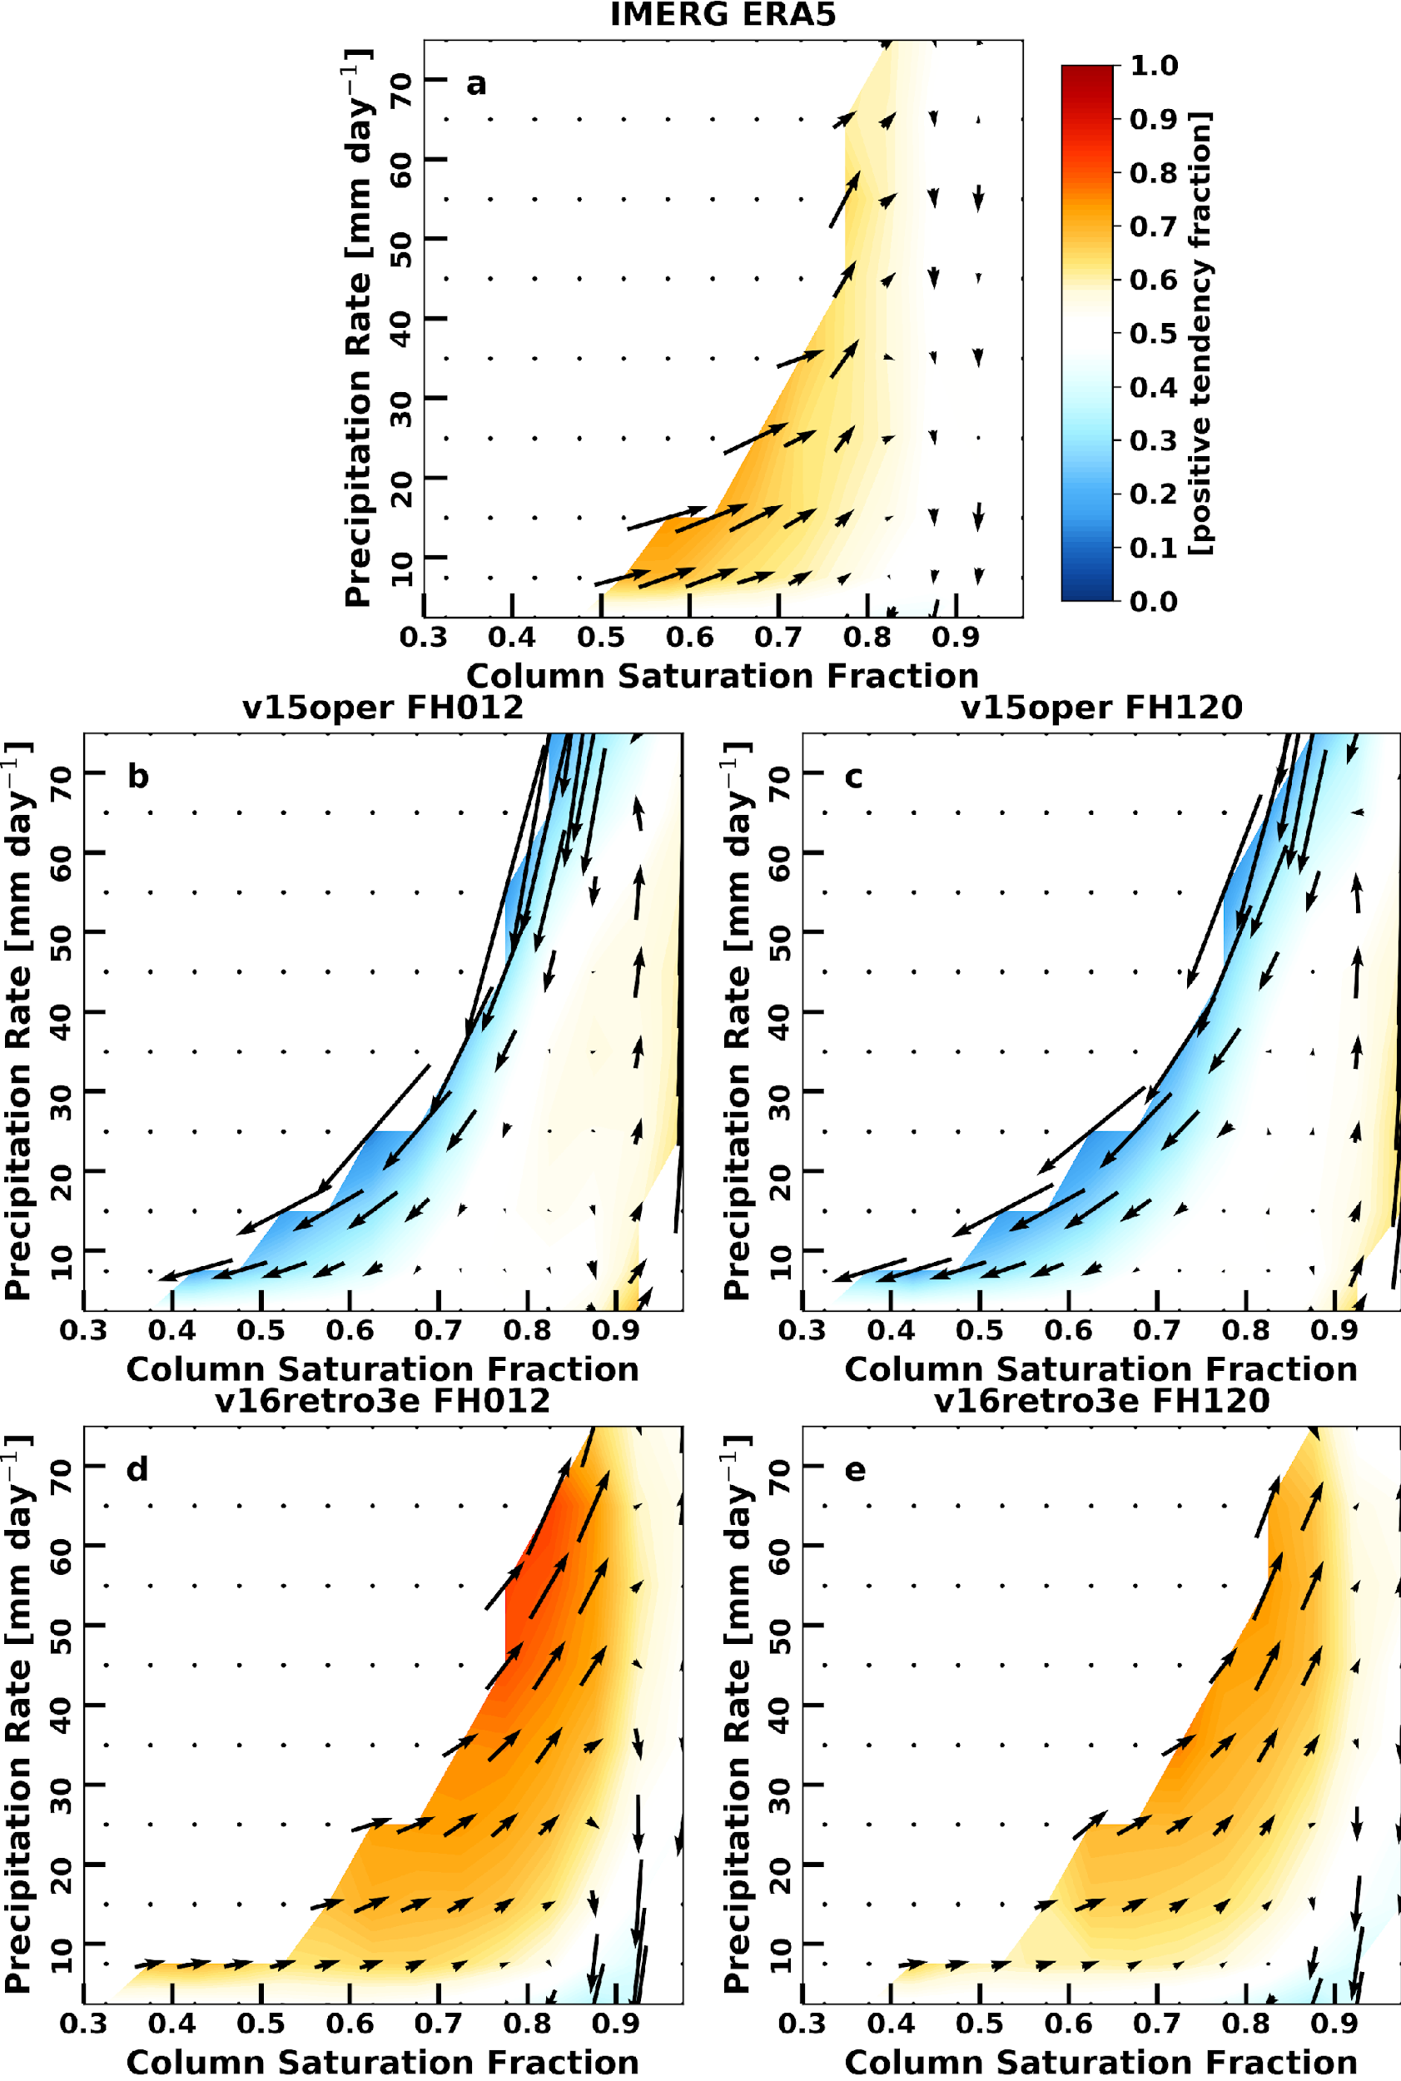
Moisture convection coupling
Coevolution of precipitation and column saturation fraction (CSF).
IMERG-ERA5 coevolution shows gradual moistening and increasing precipitation for intermediate precipitation rates. At very high CSF precipitation drops off and drying occurs.
At FH 12 the V15 shows the opposite evolution to IMERG-ERA5 and this evolution does not change very much after that.
The V15 adjusts its moisture - convection coupling within the first 24h of the forecast. The resulting moisture - convection relationship is not realistic.
V16 is much improved over V15 in this regard. The co-evolution shows the correct rotation, although it weakens with lead time.
Caveat: ERA5 may also not be showing the “real” evolution as there are differences between reanalyses and radiosonde data. This is being investigated in more detail at the moment.

Slide 11
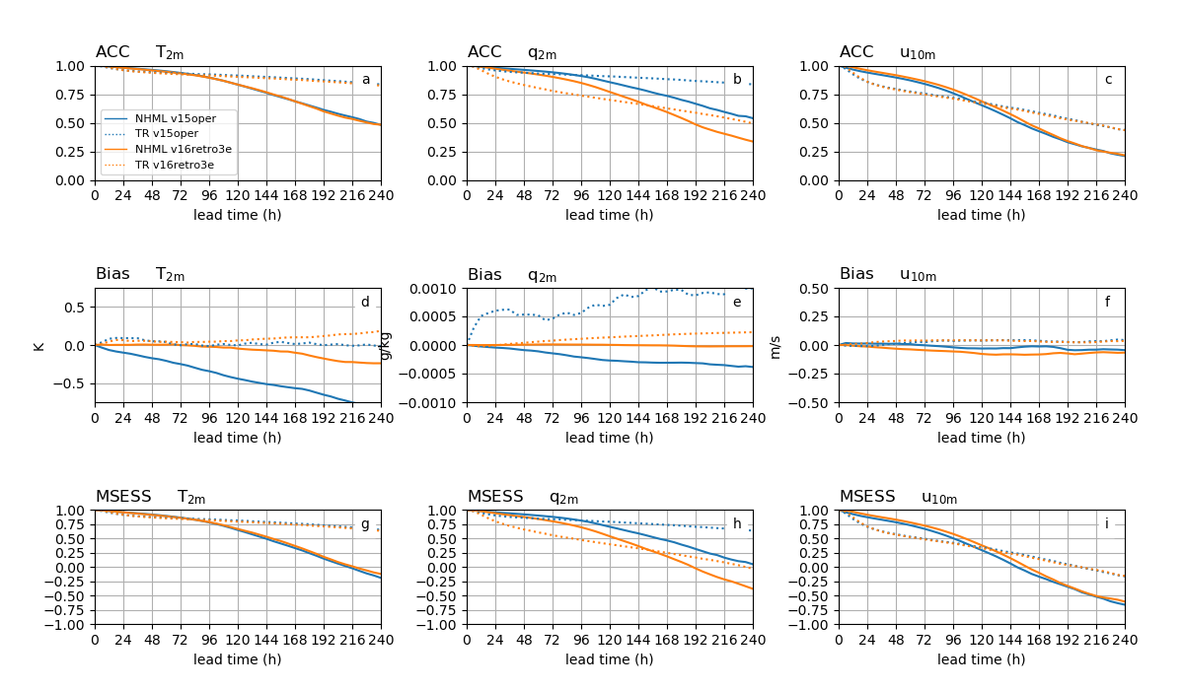
Near-surface moisture
While the moisture convection coupling evolution is much improved in V16 compared to V15, this is not reflected in the q2m ACC and MSESS in the Tropics.
This shows that the tropical diagnostics add value to model evaluation and capture different (potentially more physically based) aspects of the model performance than traditional statistical metrics.

Slide 12
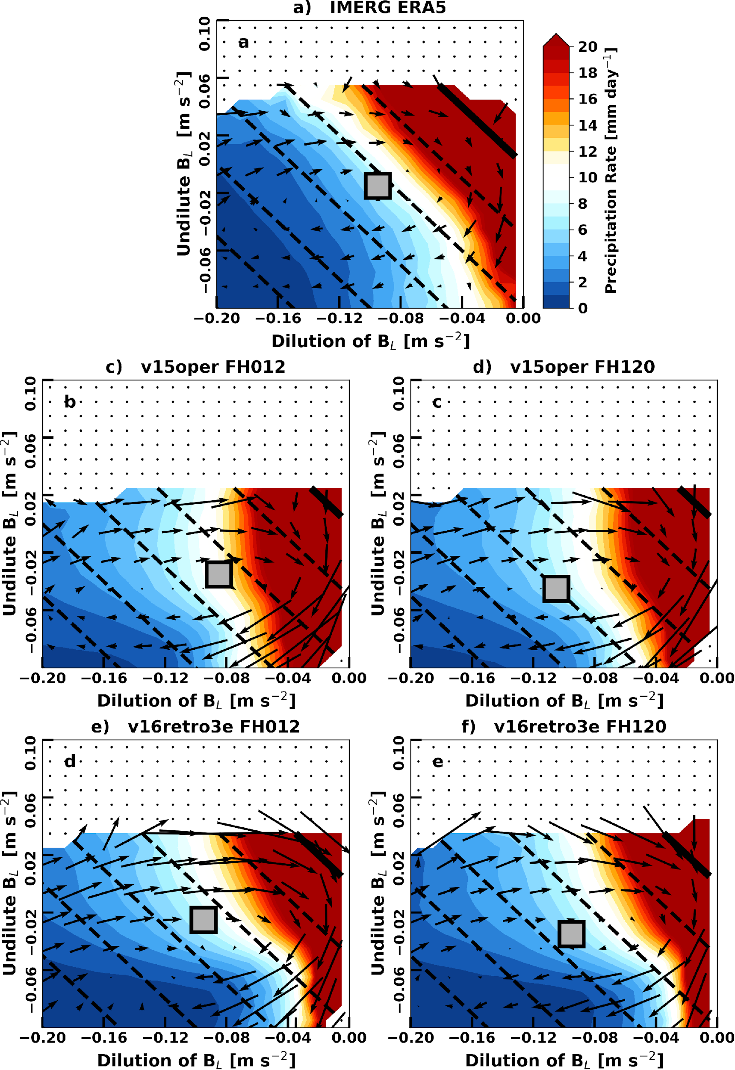
Moisture convection coupling
Precipitation pick-up and and convective life-cycle in buoyancy space.
The lower-free-tropospheric buoyancy measure B_{L} is split into two components: undilute B_{L}, which is a measure of undilute plume buoyancy, and the dilution of B_{L}, which is a measure of subsaturation in the lower-free-troposphere. The dilution of B_{L} part can be thought of as the effect of entrainment of subsaturated air into the plume.
When considering the evolution in undilute B_{L} - dilution of B_{L} space for ERA5 the convective life-cycle appears as a clock-wise circulation around the mode of observations. IMERG precipitation increases mainly as a function of total buoyancy.
The convective life-cycle in the v15oper model runs shows a stronger circulation from what can be seen in the reanalysis. The precipitation increase is mainly a function of dilution of B_{L}.
Slight differences can be seen in the v16retro model runs where for values of undilute B_{L} > -0.04 the precipitation increases mainly with total buoyancy.
Both model versions do not show a strong dependence on lead time in this relationship.

Slide 13
Summary
Diagnostics for NWP model evaluation in the tropics primarily for NOAA’s NGGPS.
Help identify forecast error sources in the Tropics related to moisture-convection coupling, CCEWs and the MJO.
Consider diagnostics as a function of lead time in order to assess origins of forecast errors (e.g. initial conditions vs model error).
A comparison of FV3GFS V15 and V16 model forecasts shows that performance improvement with respect to traditional metrics does not necessarily imply similar improvement in the tropical diagnostics.
A stand-alone python GitHub repo for these diagnostics exists (tropical_diagnostics) and a release is public for testing.
Several of these diagnostics were included a recent release of METplotpy and METcalcpy of METplus. More will be added in the future.
Planning on adding these capabilities to the Model Diagnostics Task Force (MDTF) diagnostics package (https://www.gfdl.noaa.gov/mdtf-diagnostics/) in the next few months.

