Slide 1
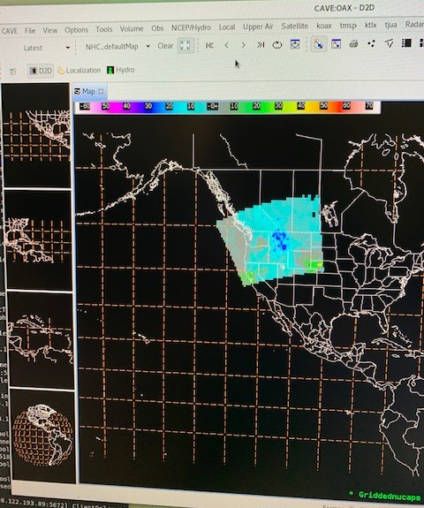
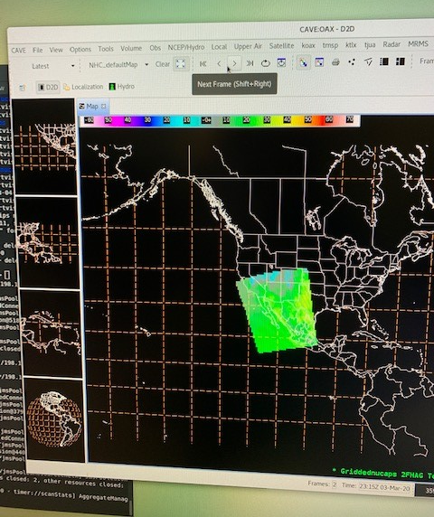
Gridded NUCAPS often breaks swaths into separate frames
Not optimal for analysis, sometimes frames have 1-2 granules only or gaps
Frames are minutes apart
Default is to display the “latest” grid record (yellow circle)

Slide 2
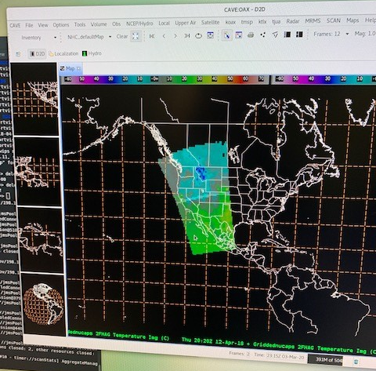
By changing the option (circled in yellow) to “Inventory” multiple frames can be displayed on the same display
Instructions
  1. Change to “Inventory”
  2. Choose field to display (e.g., Temperature 2m)
  3. In dialog box choose time to display
  4. Repeat 2 and 3 until you’ve added all the needed frames

Slide 3
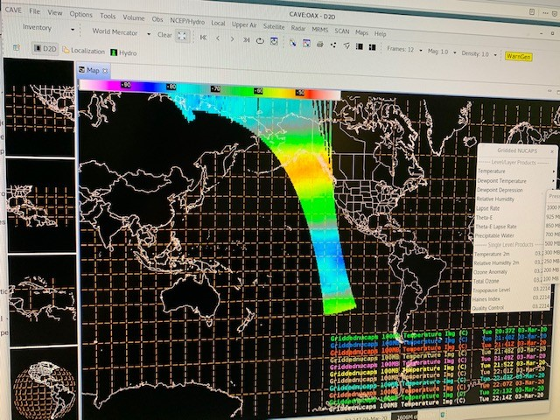
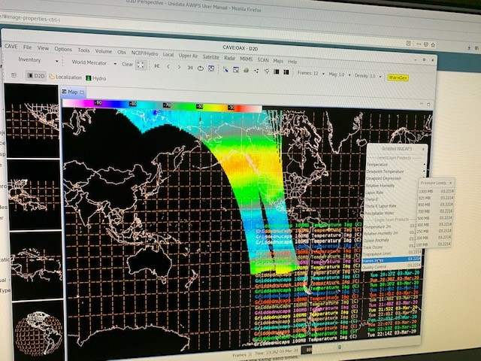
Examples of displaying 1-2 entire swaths
**** Note we are working on a display bundle to make this process less cumbersome ****

