Slide 1
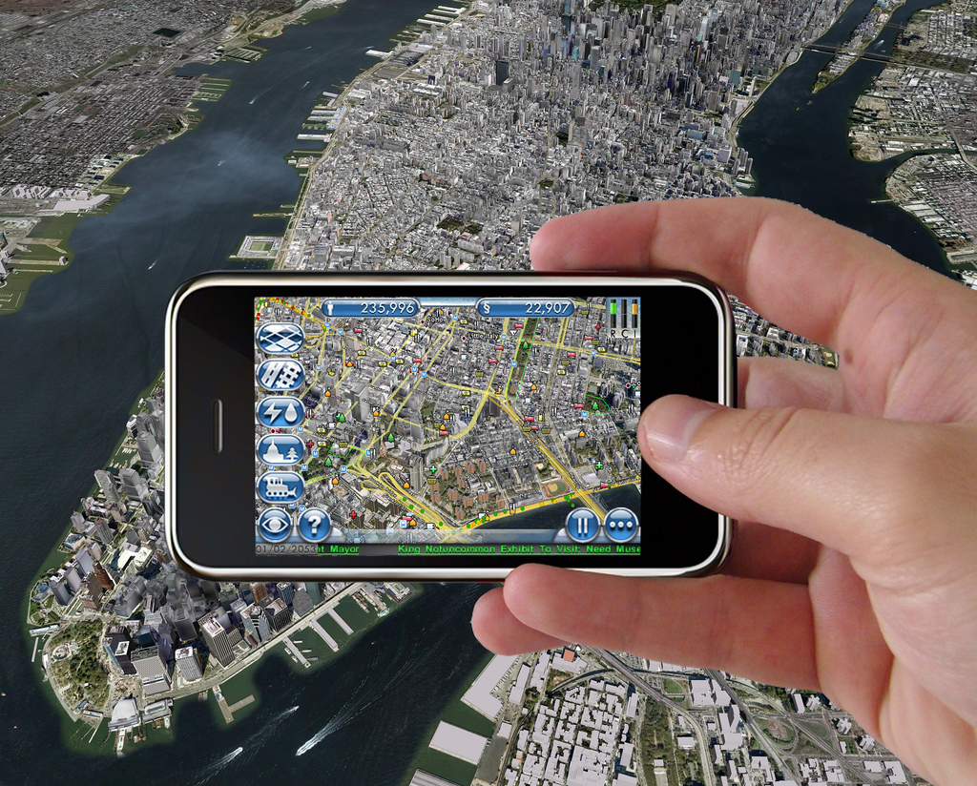
Virtual Worlds and NWS Operations
http://slidesha.re/vw-nws
Eric Hackathorn
RITT Forum Presentation
February 16, 2011
Notes:
Augmented reality holds an interesting future for data in context
The ability to disseminate large amounts of data to a caring public and to solicit their feedback and input

Slide 2
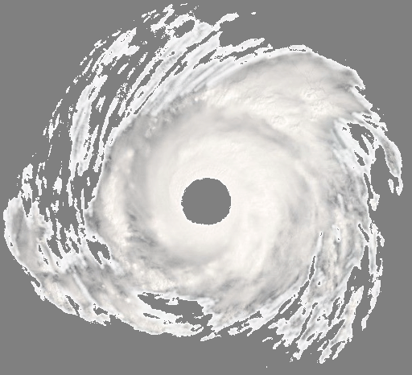
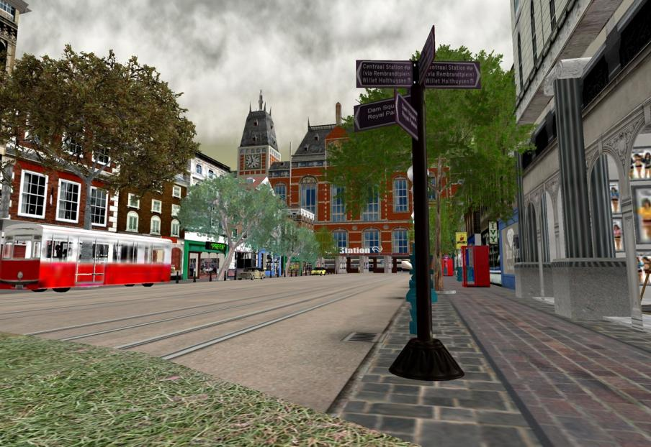
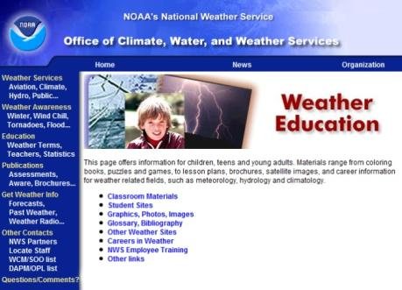
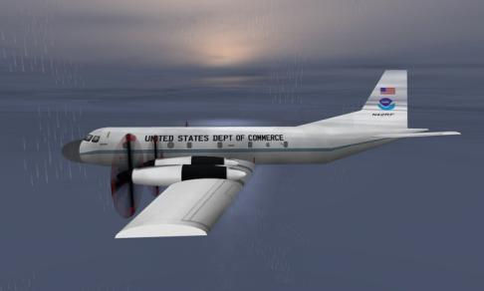
what are virtual worlds?
an extension of the traditional 2-D web
3-D Visualizations
Immersive storytelling
Social Interaction
Communication
Community
Global Audience
Scalable experiences
Untapped market
Collaboration
Bringing NOAA’s data and research to life
Notes:
In this example we created a mockup of a P3 hurricane hunter and flew through a virtual hurricane
Outreach and education
Transition to operations => the power of GIS software with the community of weather briefings

Slide 3
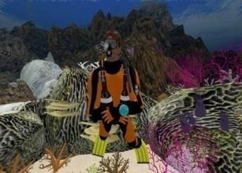
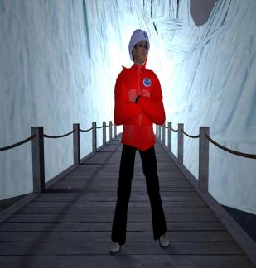
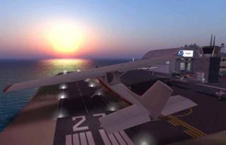
http://www.esrl.noaa.gov/gsd/tob/virtualworlds.html
Notes:
First island opened Jan 2007
First person experience of NOAA science
NOAA has over 20 islands now, part of Scilands that has over 70
Heavy focus on education and outreach

Slide 4
http://bit.ly/vgov
Notes:
There are a lot of other VW activities in the government. vGov was born out of the Federal Consortium for Virtual Worlds
vGov is a federal government virtual world project. Sponsored by the OCIO office in the USDA it has tremendous high level support. The purpose of the project is to provide a secure virtual world environment. Watch the movie at the URL for a brief project overview and the founding member’s experimentations.
vGov is actively seeking new memberships and your agency could be next!

Slide 5
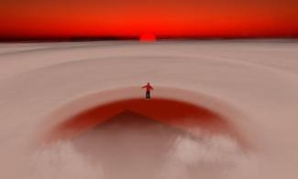
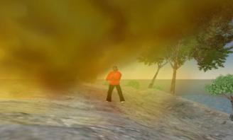
mitigating societal impacts
understanding the effects of droughts
forecasting a virtual hurricane
situational awareness
Notes:
http://www.ncdc.noaa.gov/img/reports/billion/billion2010.pdf
Its not enough to just model impacts, how do you make people care?
Situational awareness is about comprehension of meaning

Slide 6
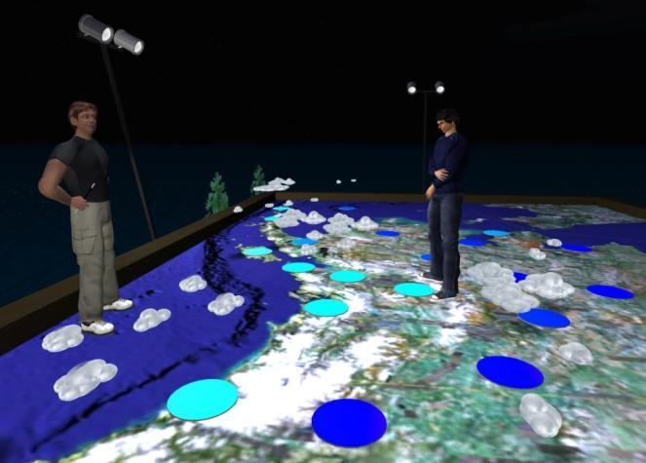
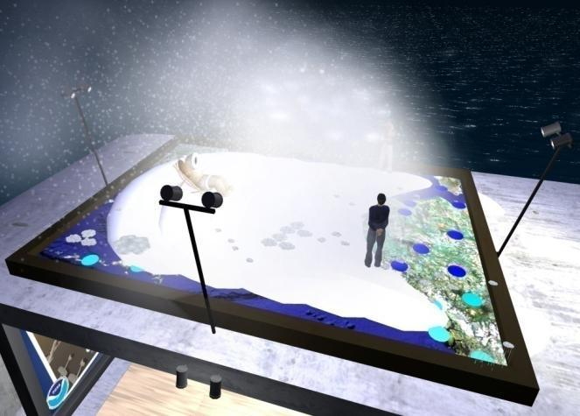
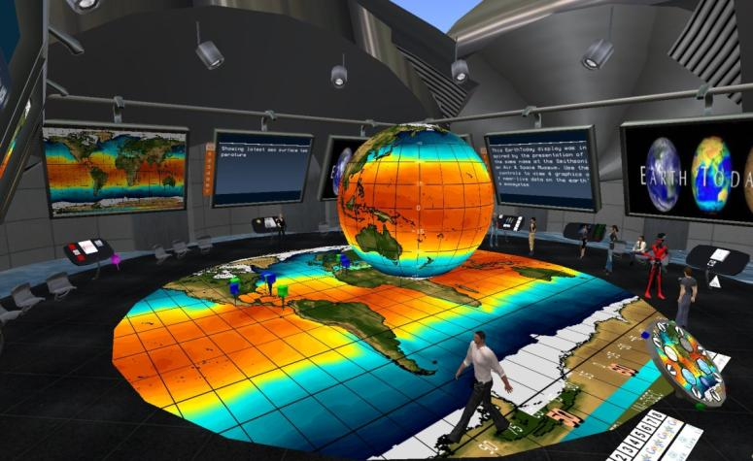
virtual forecasting office
Notes:
The power of GIS software with the community of weather briefings

Slide 7
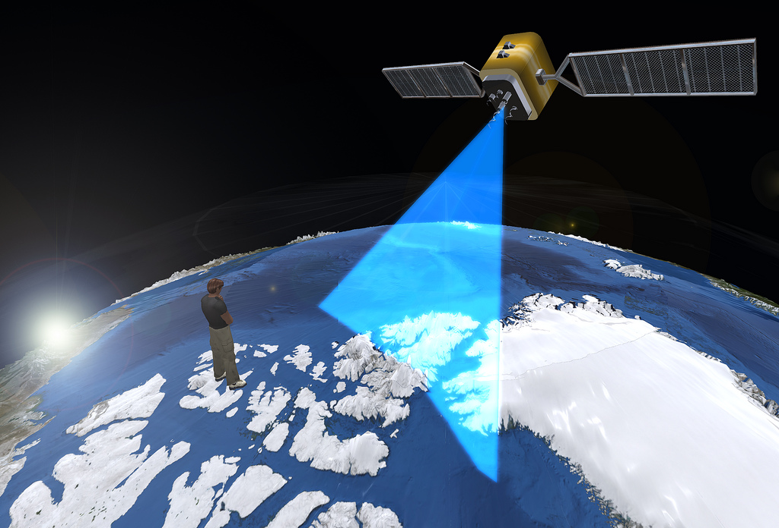
http://bit.ly/secondearth
Notes:
Combining a virtual world tool like Second Life with a more traditional data visualization application like Google Earth.

Slide 8
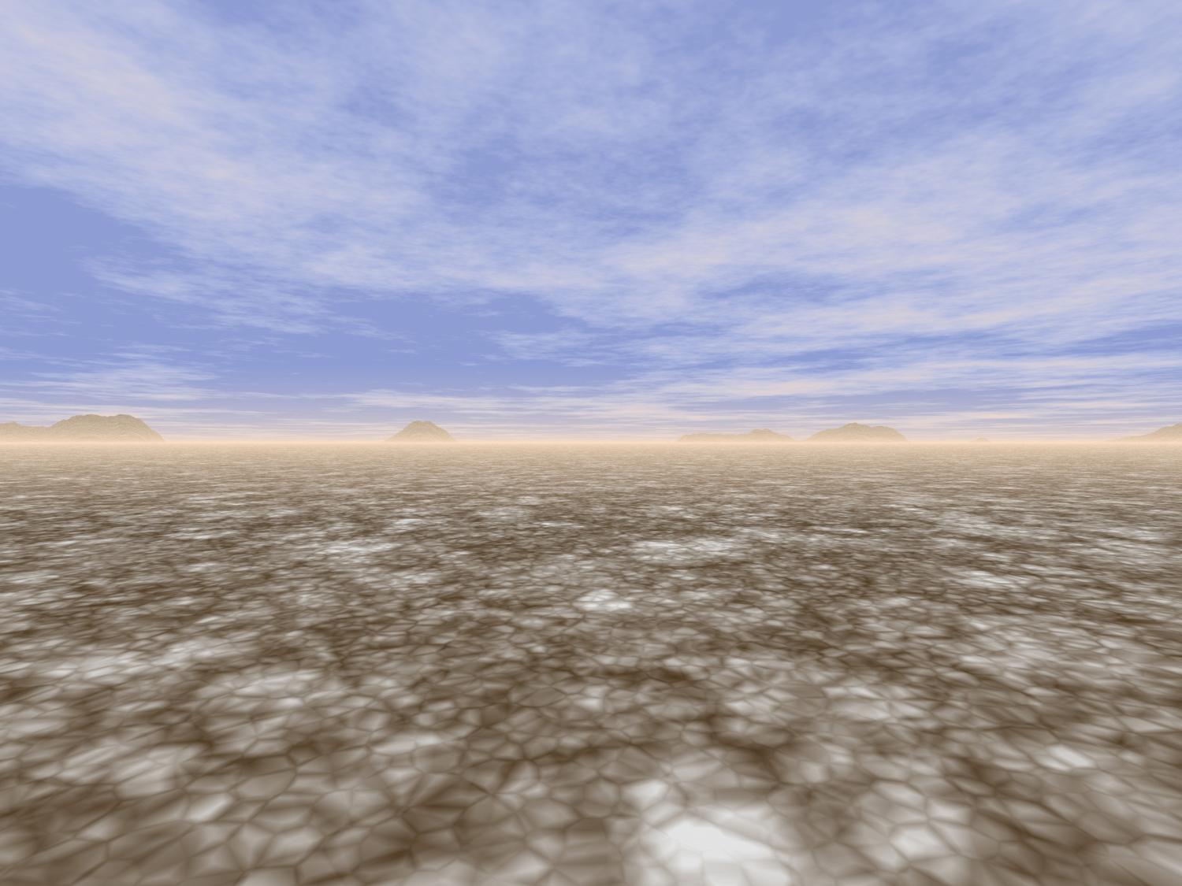
Imagine a vast virtual work area….
http://im-tel.org/
Notes:
A virtual canvas can be as large as you need, only bounded by computational limits.

Slide 9
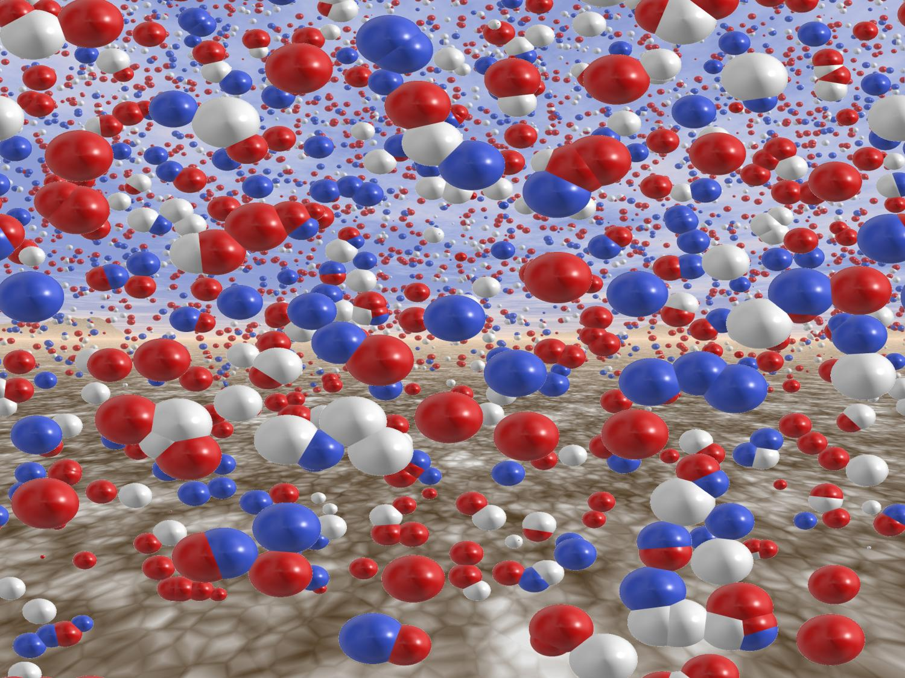
Populated with millions of data objects…

Slide 10
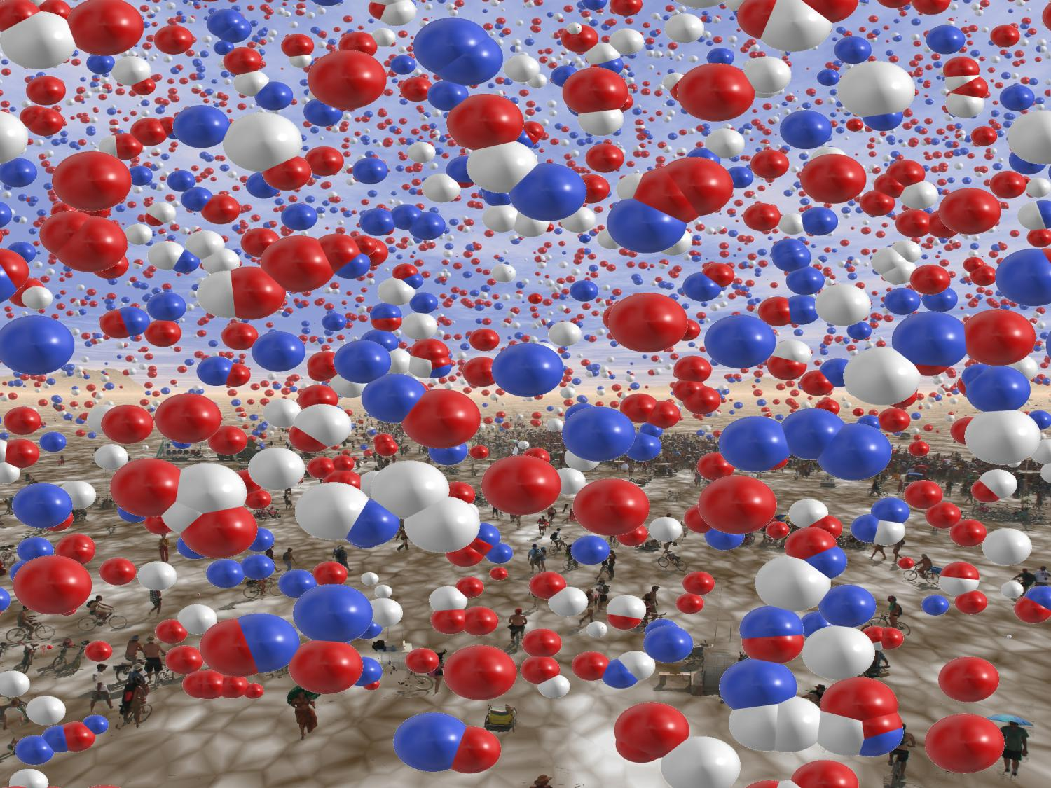
Analyzed by thousands of people…
Notes:
What would happen if all the regional forecast offices could operate in the same “space?”
What would happen if members of the public could contribute to that space?

Slide 11
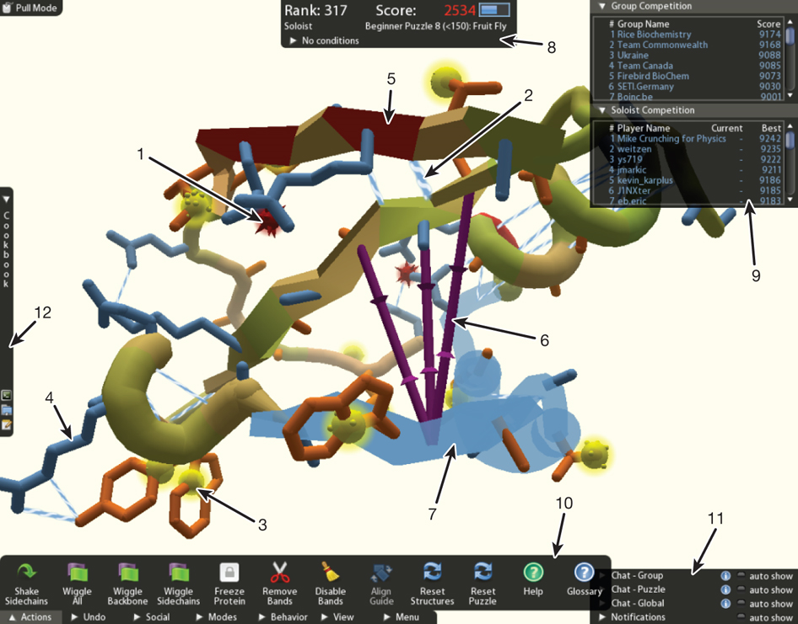
http://bit.ly/folditgame
Notes:
Foldit is a revolutionary new computer game enabling you to contribute to important scientific research surrounding protein folding. Knowing the structure of a protein is key to understanding how it works and to targeting it with drugs. Figuring out which of the many, many possible structures is the best one is regarded as one of the hardest problems in biology today and current methods take a lot of money and time, even for computers.
The best players had no background in chemistry or biology
The best players out performed the best models

Slide 12
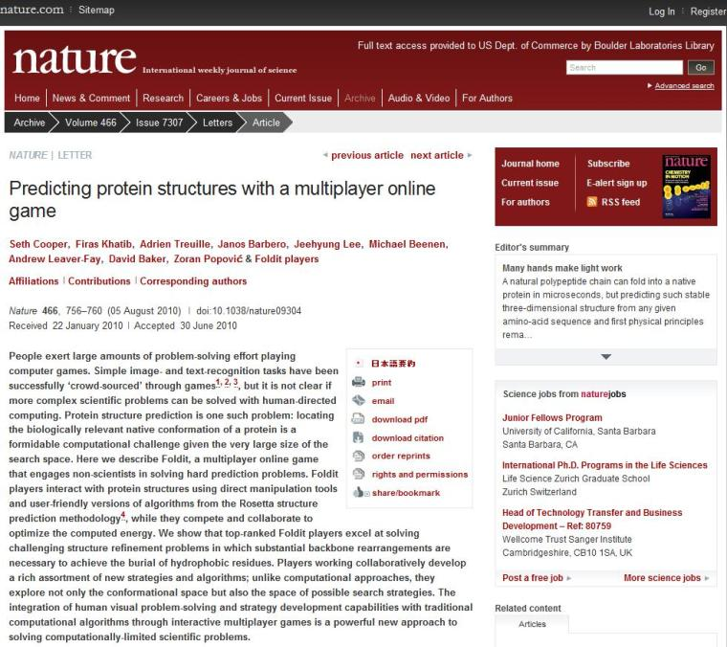
“The integration of human visual problem-solving and strategy development capabilities with traditional computational algorithms through interactive multiplayer games is a powerful new approach to solving computationally-limited scientific problems.”
http://www.nature.com/nature/journal/v466/n7307/full/nature09304.html
Notes:
University of Washington computer science department
Written up in nature, strong evidence to support than introducing a human component into the computer models improves our scientific understanding.
“Computationally-limited scientific problems” “integration of human visual problem-solving”

Slide 13
Interactive learning potential
Leveraging the crowds in games and simulations
Competition awards successful “players”
Creates repeat customers hungry for NOAA’s data
Notes:
“Computationally-limited scientific problems” “integration of human visual problem-solving”
Anecdotal evidence of the old farmer whose knee starts to hurt when it’s going to rain.
How do we visualize raw weather data in a way to allow massive public input?
How do we make it fun?
How do we reward successful players?

Slide 14
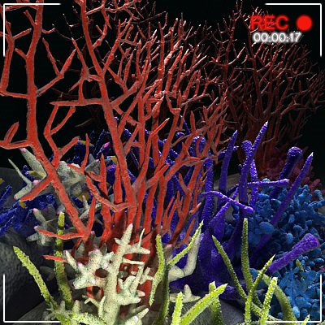
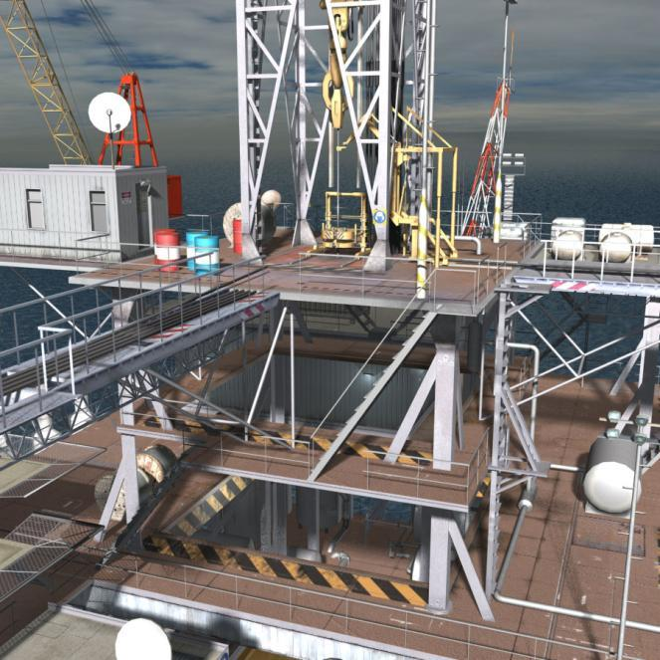
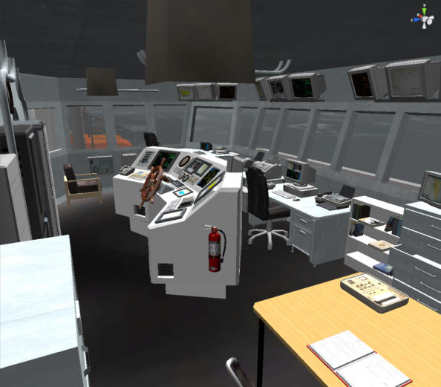
Notes:
It is important to note that once again all these images are renderings, not actual photographs.
Hhopefully you can tell where NOAA is headed.

Slide 15
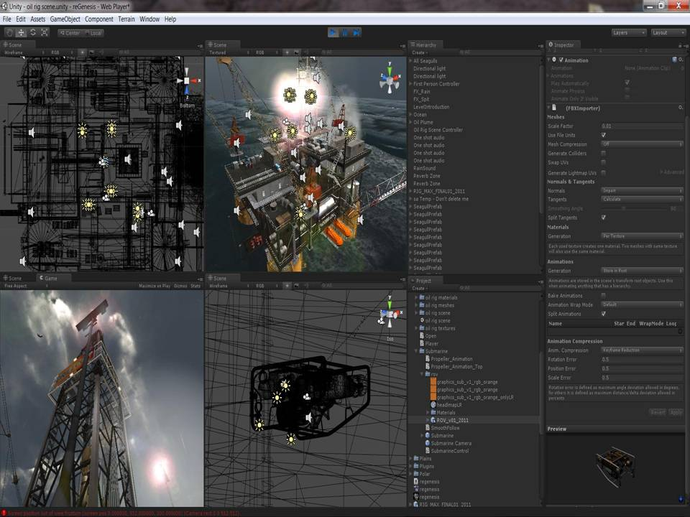
Notes:
Unity3d.com
A traditional game engine that you can write once and compile for desktops, web streaming, mobile, and even video game consoles
This implies a huge and basically untapped market for NOAA

Slide 16
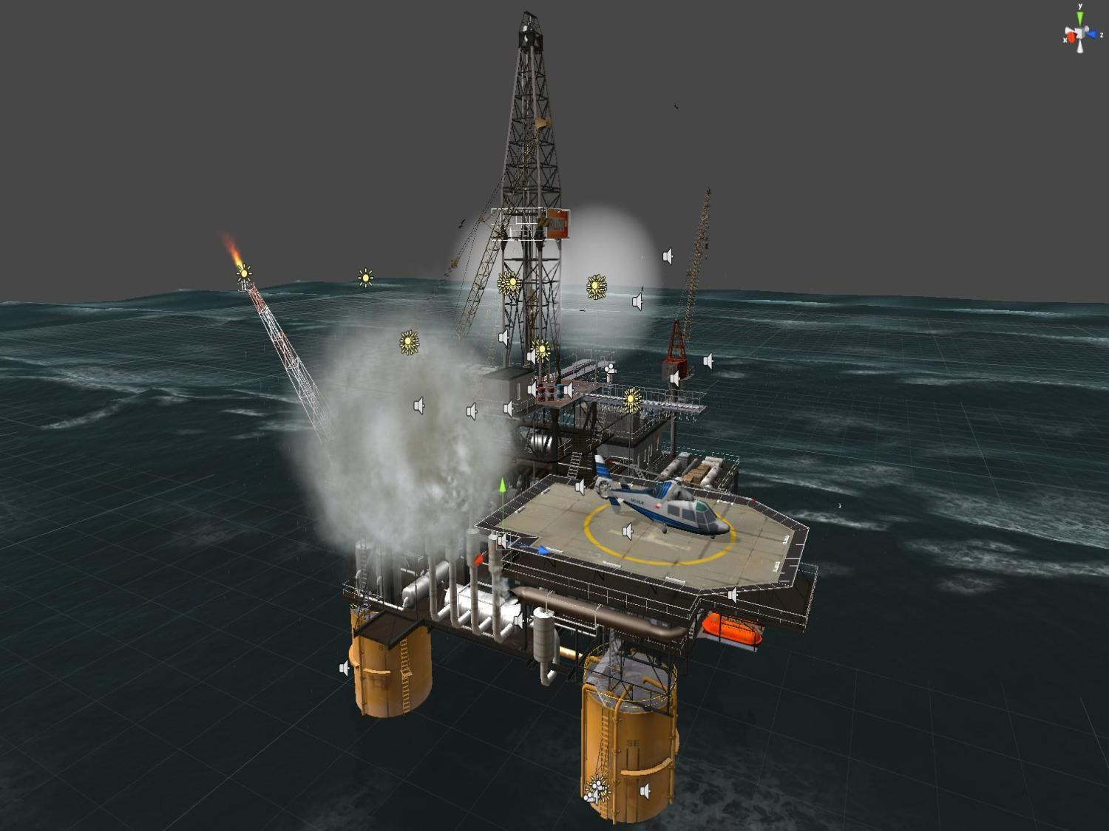
http://bit.ly/oilplatform
Notes:
Lets see if we can visit!
Could potentially be used in emergency response training
A great way to show high resolution data
Impact of severe weather
Oil plume models, ecosystems etc.

Slide 17
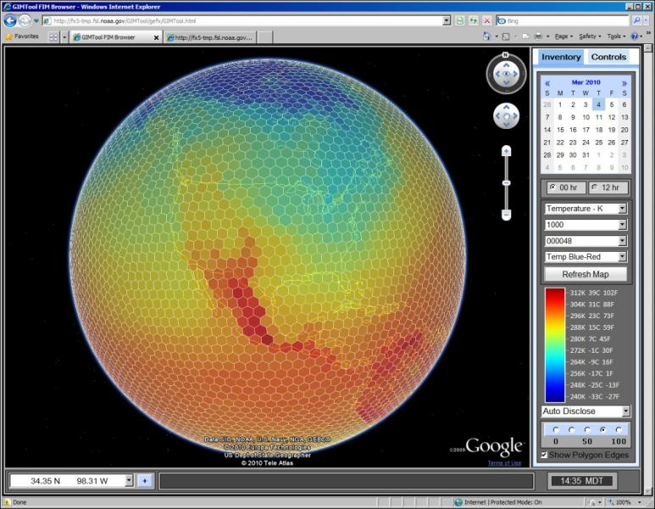
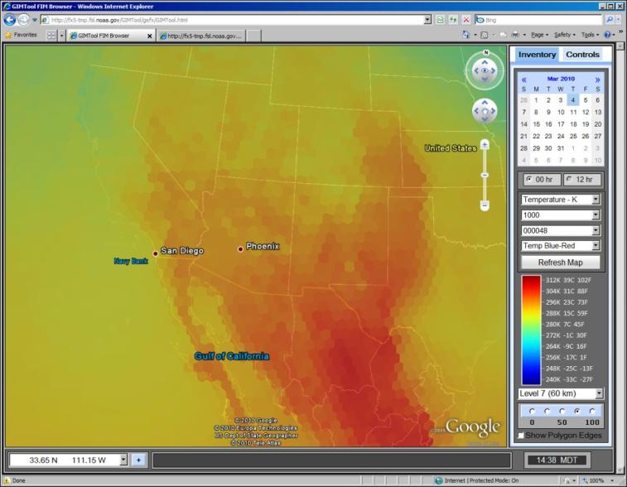
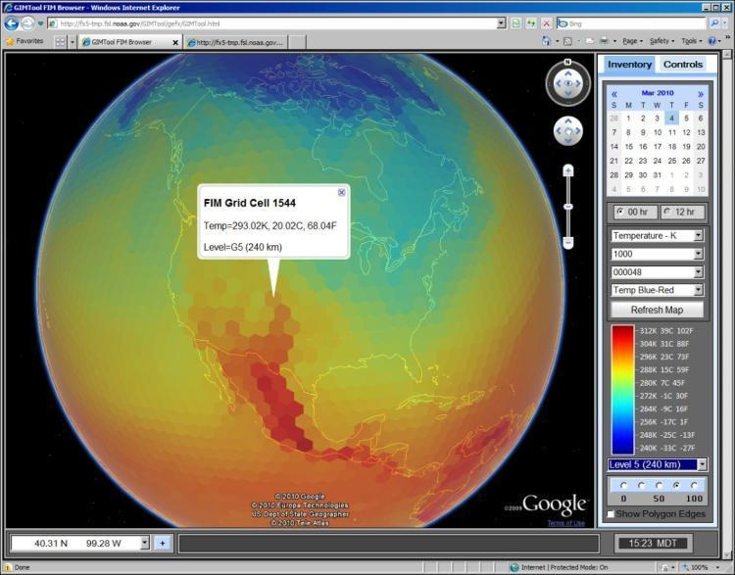
cloud-based visualizations of large data sets
http://fim.noaa.gov/
Notes:
Moving on to a related topic… Some unique challenges!
large data sets
Cloud-based load balancing of the data
96 TB per week from NIM
G12 which is 167,772,162 points 128 levels vertical resolution Output every 3 hours 20 3D variables Amount of data: 85,899,346,944 bytes per file (one 3D variable) 1,717,986,938,880 bytes per output (20 3D variables) 13,743,895,511,040 bytes per day (output every 3 hours) 96,207,268,577,280 bytes per run (7 day run)

Slide 18
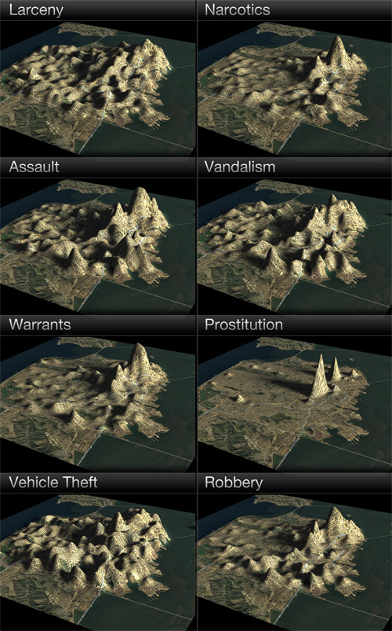
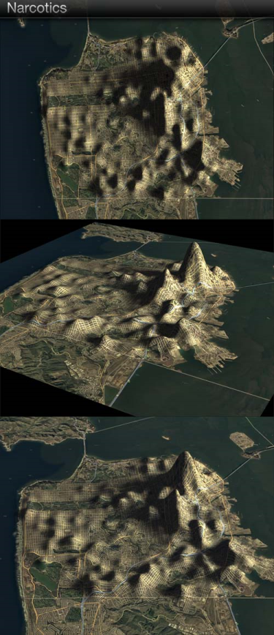
data viz examples
http://dougmccune.com/blog/2010/06/05/if-san-francisco-crime-was-elevation/
Notes:
3D offers original ways of visualizing data
Imagine walking through the streets while picking out a place to live
Translate this type of visualization to severe weather impact in decision support

Slide 19
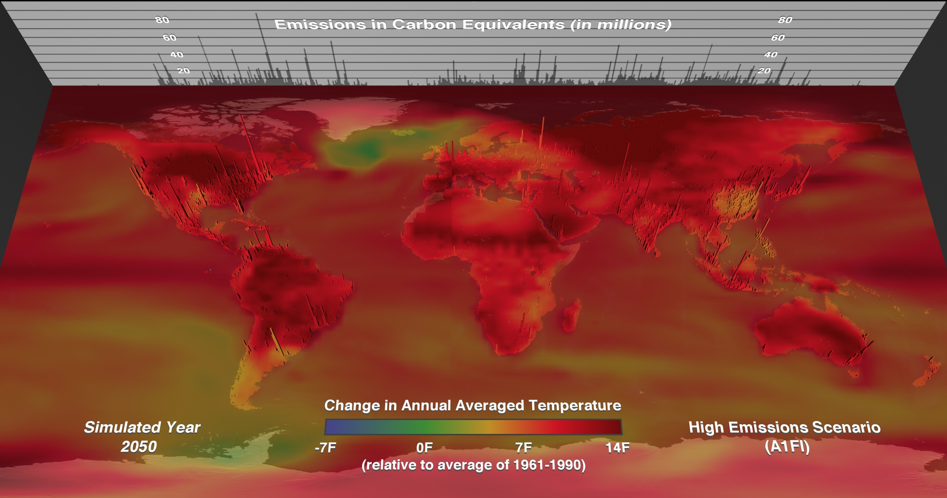
http://www.ncsa.illinois.edu/News/Stories/cooler_path/
Notes:
Same sort of visualization but with carbon data

Slide 20
virtual forecasting office
Notes:
Mobile technology has a great potential not only to visualize complex information in a 3D “real world” context
…but to ingest data either as a remote sensor or ultimately in a massively multiplayer scientific game

Slide 21
An Executive Guide for
Keeping Up with Virtual Worlds
Contact me!
Join a virtual world and create an avatar
Ask your kids about virtual worlds
Attend the Federal Consortium for Virtual Worlds: http://www.ndu.edu/iCollege/fcvw/index.htm
Bookmark several virtual world news sites
Check out: http://www.esrl.noaa.gov/gsd/tob/virtualworlds.html
Notes:
Virtual.worlds@noaa.gov

Slide 22
Questions?
Eric Hackathorn
Eric.J.Hackathorn@noaa.gov

