Slide 1
vLab Forum Automated High-Resolution Ensemble-Based Hazard Detection Guidance
20 April 2016
Curtis Alexander, Trevor Alcott, Isidora Jankov, Stan Benjamin, Steve Weygandt
NOAA/ESRL/GLOBAL SYSTEMS DIVISION

Slide 2
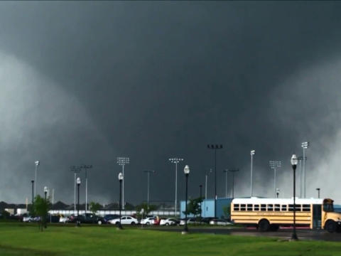
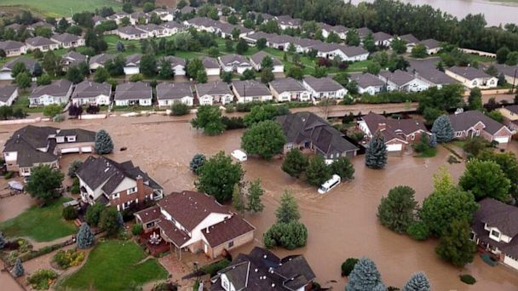
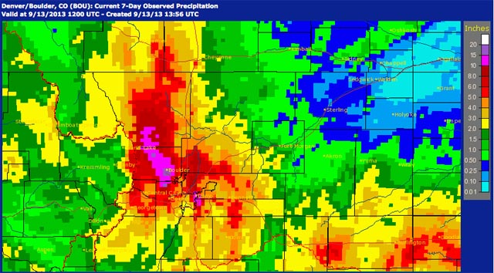
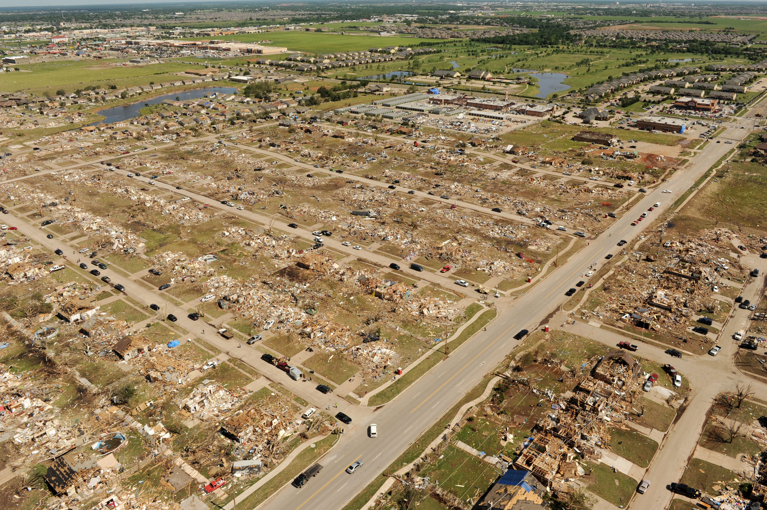
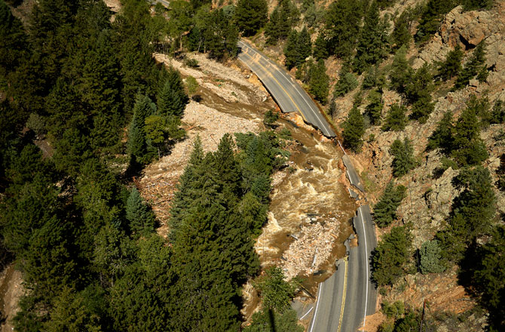
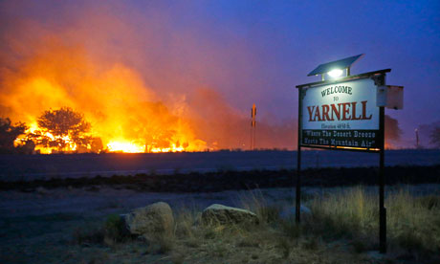
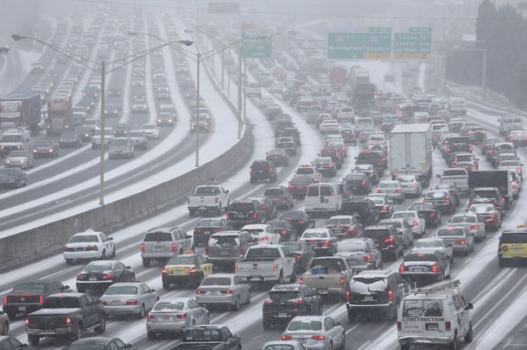
Research to Reduce Disasters and Enhance Resilience
Moore, OK Tornado
20 May 2013
Colorado Floods
9-15 September 2013
25 fatalities
1,150 homes
destroyed
10,000 properties
damaged or
destroyed
Atlanta, GA Snowstorm
28 January 2014
Yarnell, AZ Wildfire
30 June 2013
$75 million in
insurance claims
19 firefighter
fatalities
Ensemble-Based Hazard Detection Guidance

Slide 3
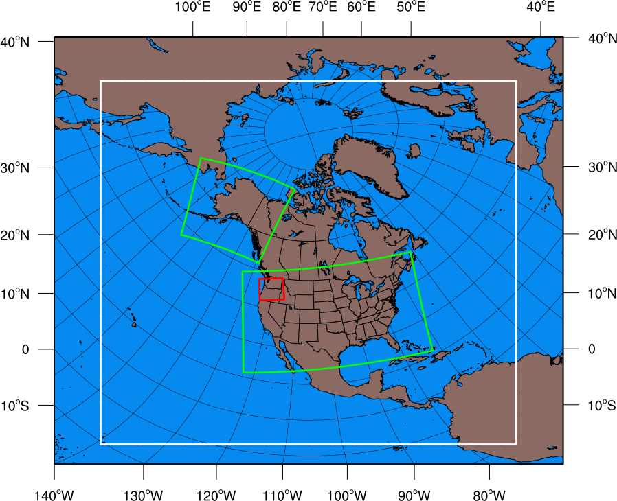
RAP/HRRR: Hourly-Updating Weather Forecast Models
Expanded RAP to match NAM for SREF
(June 2016)
13-km Rapid Refresh (RAP) – to 21h (June 2016)
Initial & Lateral Boundary Conditions
3-km High-Resolution Rapid Refresh Alaska Testing (HRRR-AK) w/MRMS radar data
(Spring 2016)
3-km High-Resolution Rapid Refresh (HRRR) – to 18h (June 2016)
Initial & Lateral Boundary Conditions
Prototype 3-km storm-scale HRRR ensemble (HRRRE)
(Spring 2016)
750-m HRRR nest Wind Forecast Improvement Project Experiment (ongoing)
3-km High-Resolution Time Lagged Ensemble (HRRR-TLE)
Ensemble-Based Hazard Detection Guidance

Slide 4
Project Overview
Multiple runs from the HRRR can provide additional forecast insight and can be grouped into categories:
Run-to-run consistency (at least 3 consecutive runs)
More common in strongly-forced events and can enhance forecast confidence
Solution, on limited occasions, could be erroneous, particularly in more weakly-forced events
Trend in guidance towards a particular solution (3 or more consecutive runs)
Examples including increasing convective initiation/coverage
Forecasters should be judicious when extrapolating trends
Trend (at least 3 consecutive runs) then an abrupt change to a different solution/trend
First run after convective initiation
First run assimilating new RAOB data (00/12 UTC)
Latest GFS cycle used (10/22 UTC)
No consistency and no trend with 3 or more consecutive runs with very different solutions
Ensemble-Based Hazard Detection Guidance

Slide 5
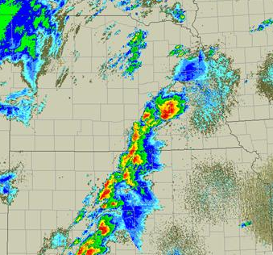
HRRR Forecast Consistency Example
Radar Obs at 2200 UTC
11 May 2014
Storm Reports
HRRR Forecasts valid at 2200 UTC
Updraft Helicity
Time-Lagged Ensemble
15 UTC (7hr)
16 UTC (6hr)
17 UTC (5hr)
Ensemble-Based Hazard Detection Guidance

Slide 6
Project Overview
Challenge:
About 5 trillion bits of data from a single 15-hr HRRR forecast
How to extract most useful information for forecasters?
Goal:
Automated monitoring of hourly-updating model forecasts
Measure run-to-run consistency/trends in forecasted hazards
Provide accurate measure of confidence (uncertainty) for hazards
How:
Post-process model output (computationally inexpensive)
Create multi-run ensemble of HRRR (and other) forecasts
Identify forecasted hazards (heavy rainfall, snow bands, severe storms)
Form probabilistic gridded guidance of the hazards and bias correct for statistical reliability
Ensemble-Based Hazard Detection Guidance

Slide 7
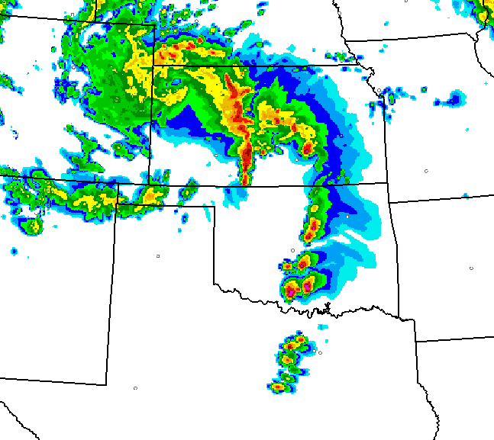
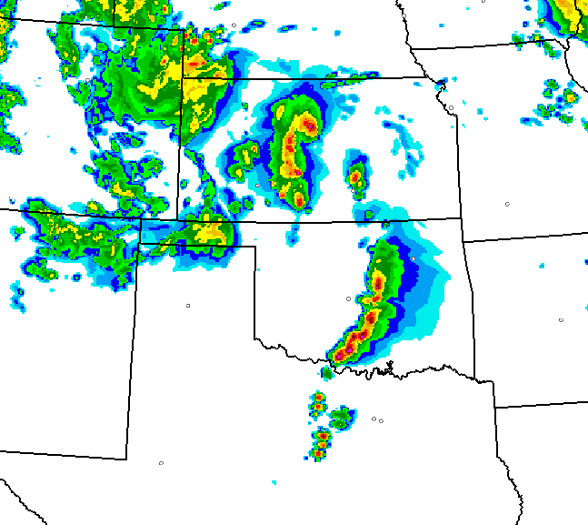
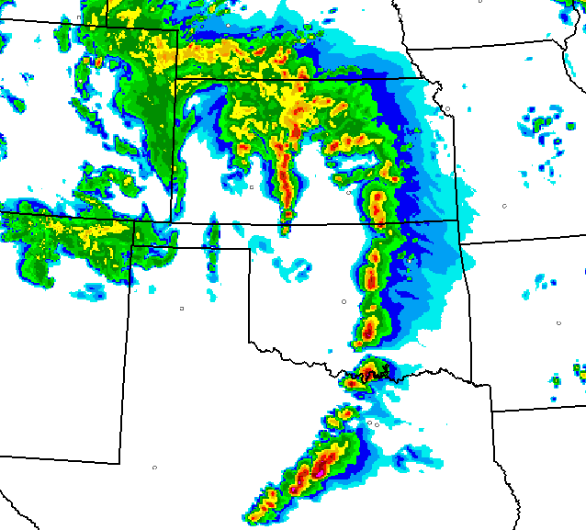
HRRR Time-Lagged Ensemble (HRRR-TLE)
Real-time
Deterministic HRRR:
High-resolution forecast provides small-scale details
Hourly-updating with fresh forecast always available
Time-Lagged Ensemble (HRRR-TLE):
Leverage runs in ensemble of opportunity
Form hazard likelihood probabilities
Less small-scale detail
Proxy for confidence/certainty
Underdispersive
HRRR Ensemble (HRRRE):
More expensive ensemble
More spread/dispersive/skill
Member 1
Member 2
Member 3
00 UTC
Obs
Supercell
probability
past hour
00 UTC
Ensemble-Based Hazard Detection Guidance

Slide 8
HRRR-TLE Severe Weather Example
Forecasts valid 22-23z
Forecasts valid 23-00z
Neighborhood Search
Point Probability
HRRR 13z Init
8 - 9 hr
forecast
11 - 12 hr
forecast
Spatial radius 45 km
Time radius 1 hr
UH threshold 25 m²/s²
HRRR 12z Init
9- 10 hr
forecast
10- 11 hr
forecast
HRRR 11z Init
10 - 11 hr
forecast
11 - 12 hr
forecast
All six forecasts
combined to form
probabilities valid
22z 27 April 2011
Tornadic Storm
Probability (%)
Ensemble-Based Hazard Detection Guidance

Slide 9
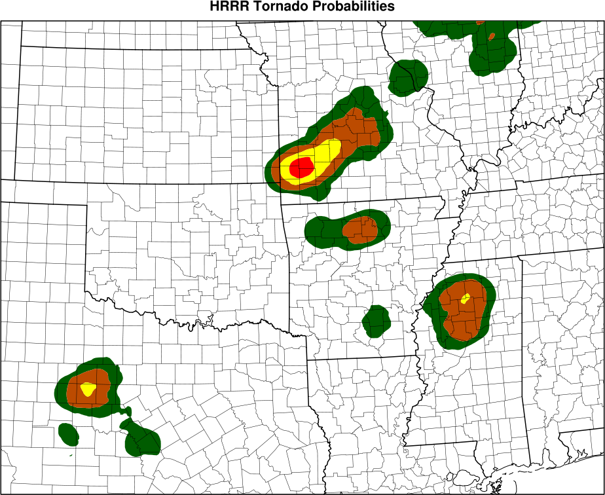
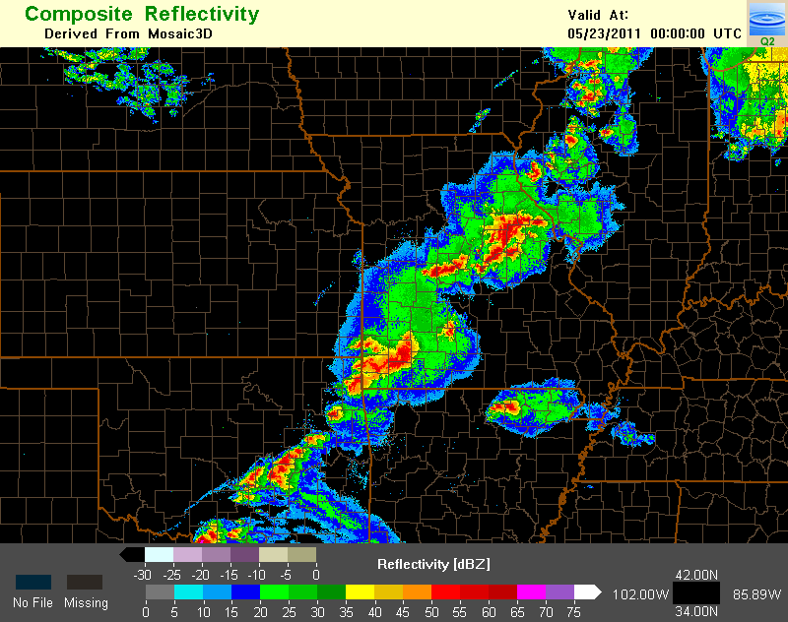
HRRR-TLE Severe Weather Example
11 Hour Forecast Valid 00z 23 May 2011
22 May 2011
Storm Reports
Observed
Reflectivity
00z 23 May
Joplin, MO
Tornado = Red Dots
Tornadic Storm Probability (%)
Ensemble-Based Hazard Detection Guidance

Slide 10
HRRR-TLE Aviation Weather Example
Observations 18z 14 July 2014
HRRR forecast radar
HRRR-TLE probability
12z + 6h fcst
18z
NSSL Radar mosaic
General convection problem (aviation application)
90 km search radius
≥ 1 m/s upward vertical motion in model column
≤ 2K best lifted index
HRRR Convective Probability Forecast (HCPF) → HRRR-TLE product
Reflectivity
Thunderstorm Probability (%)
Ensemble-Based Hazard Detection Guidance

Slide 11
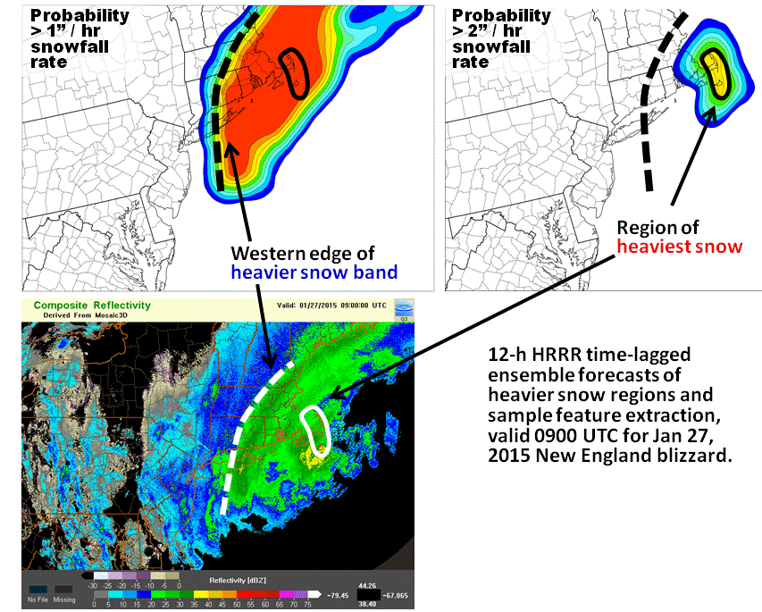
HRRR-TLE Winter Weather Example
Winter Weather Application
12 hr HRRR-TLE Forecast
27 Jan 2015 New England Blizzard
Three consecutive runs
45 km spatial radius
No time radius (1hr accumulation)
Probability of snowfall > 1”/hr
Probability of snowfall > 2”/hr
Ensemble-Based Hazard Detection Guidance

Slide 12
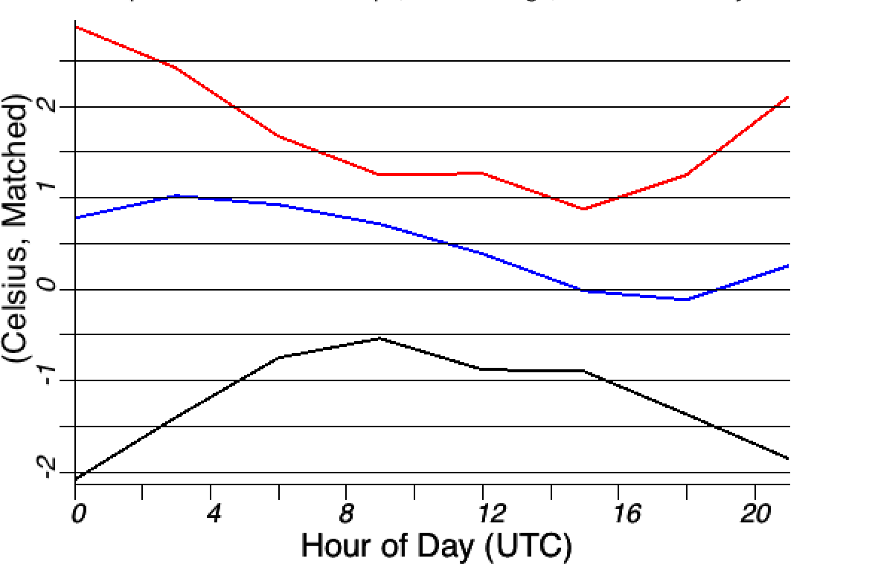
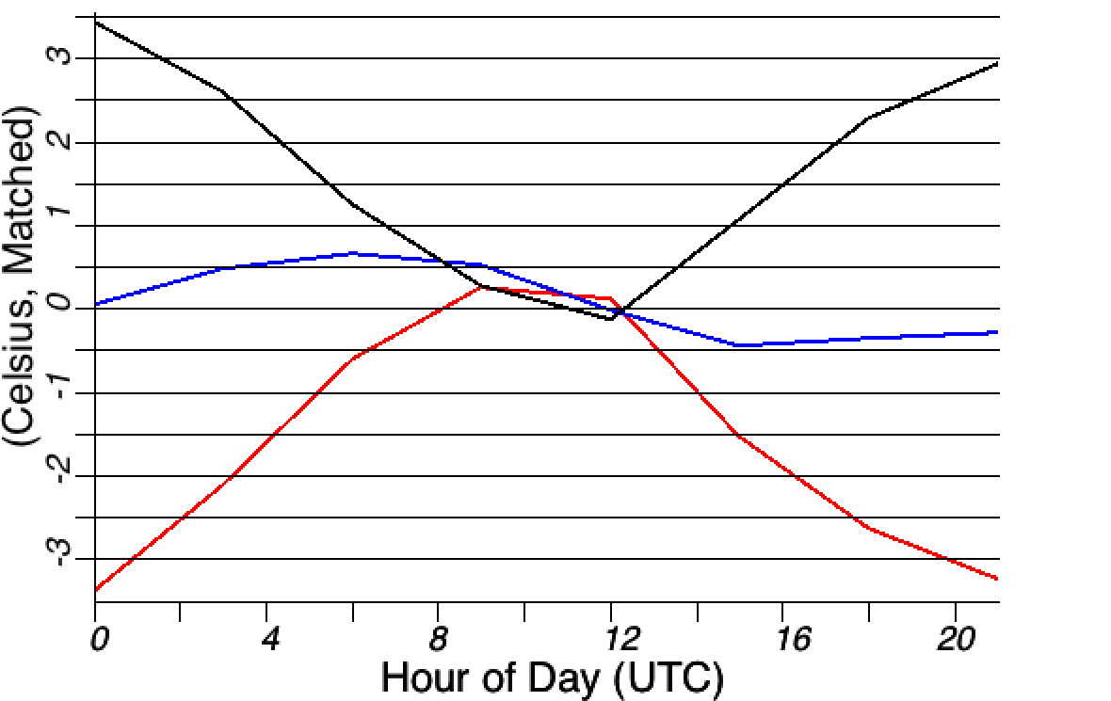
HRRR Model Improvements (HRRRv2)
HRRR component improvements to address warm/dry bias in RAPv3/HRRRv2
Reduced warm / dry bias
Exper RAPv3
Oper RAPv2
Difference
Component | Items
GSI Data Assimilation | Canopy water cycling Temp pseudo-innovations thru model boundary layer More consistent use of surface temp/dewpoint data
GFO Convective Parameterization | Shallow cumulus radiation attenuation Improved retention of stratification atop mixed layer
Thompson Microphysics | Aerosol awareness for resolved cloud production Attenuation of shortwave radiation
MYNN Boundary Layer | Mixing length parameter changed Thermal roughness in surface layer changed Coupling boundary layer clouds to RRTMG radiation
RUC Land Surface Model | Reduced wilting point for more transpiration Keep soil moisture in croplands above wilting point
Warm Cool
2m Temp
Exper RAPv3
Oper RAPv2
Difference
Moist Dry
2m Dewpt
Ensemble-Based Hazard Detection Guidance

Slide 13
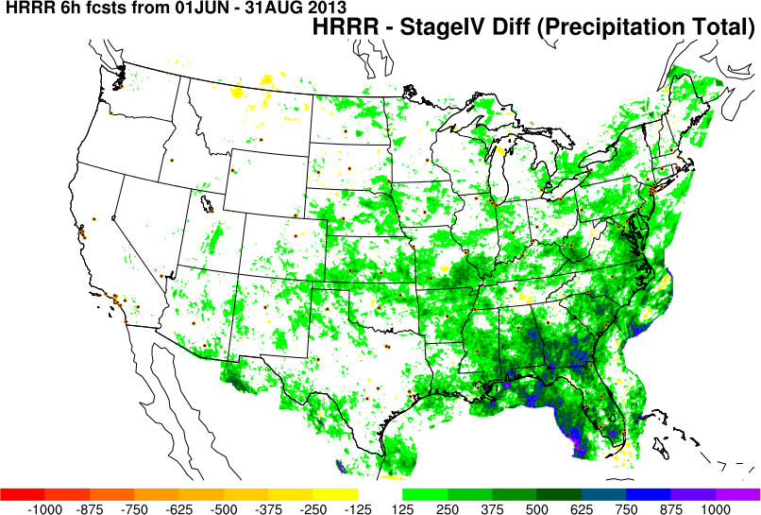
HRRR Model Improvements (HRRRv2)
2013 Warm Season (June-August)
HRRR 0-6 hr precipitation forecast
Difference against Stage IV
Ensemble-Based Hazard Detection Guidance

Slide 14
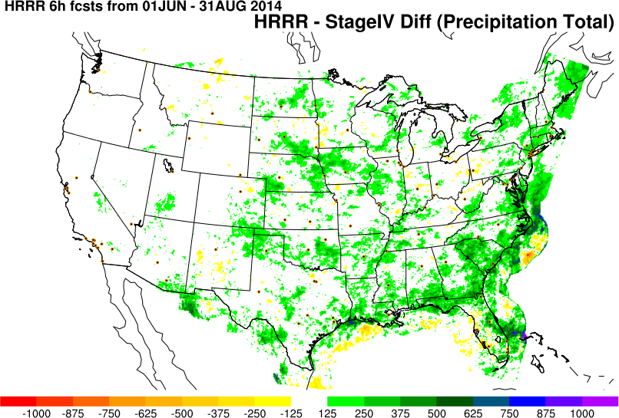
HRRR Model Improvements (HRRRv2)
2014 Warm Season (June-August)
HRRR 0-6 hr precipitation forecast
Difference against Stage IV
Dry Moist
Ensemble-Based Hazard Detection Guidance

Slide 15
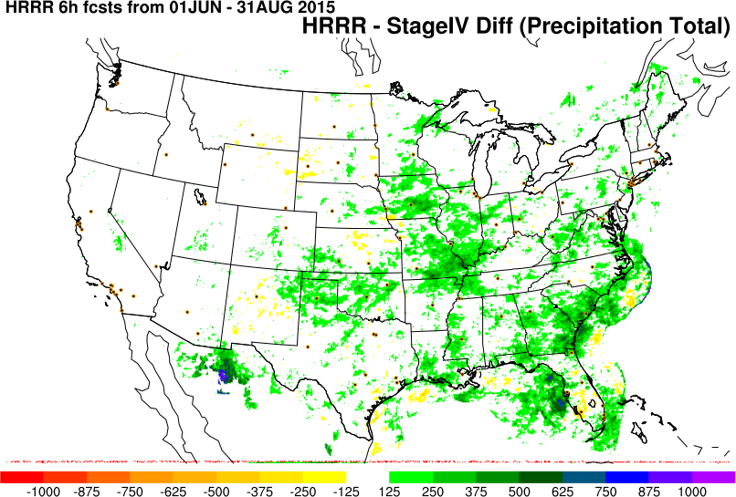
HRRR Model Improvements (HRRRv2)
2015 Warm Season (June-August)
HRRR 0-6 hr precipitation forecast
Difference against Stage IV
Reduction in high precipitation bias
Dry Moist
Ensemble-Based Hazard Detection Guidance

Slide 16
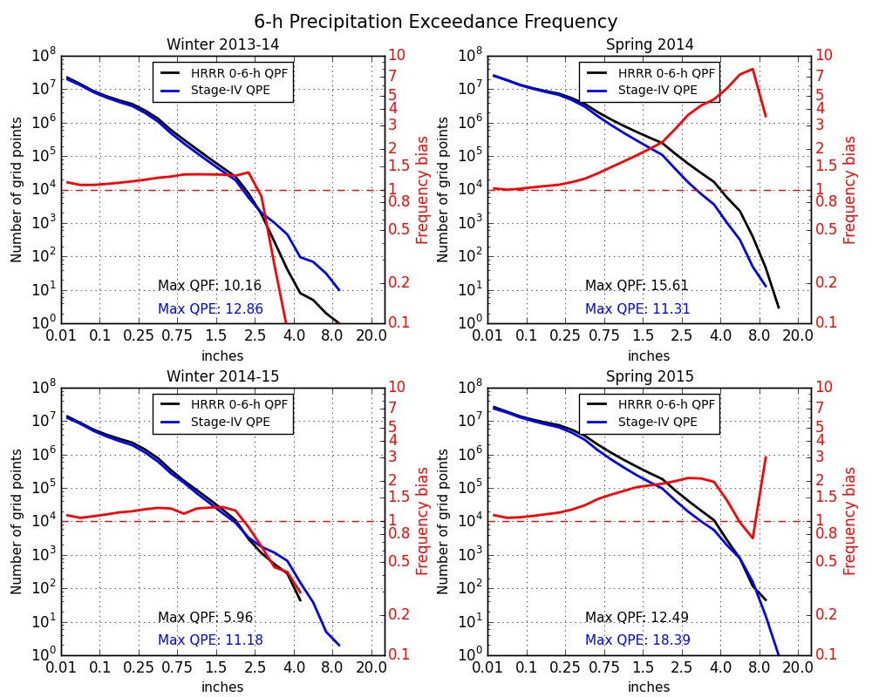
HRRR Model Improvements (HRRRv2)
Statistical Improvement in QPF skill
Reduction in bias from 2014 to 2015
Particularly at higher thresholds
Ensemble-Based Hazard Detection Guidance

Slide 17
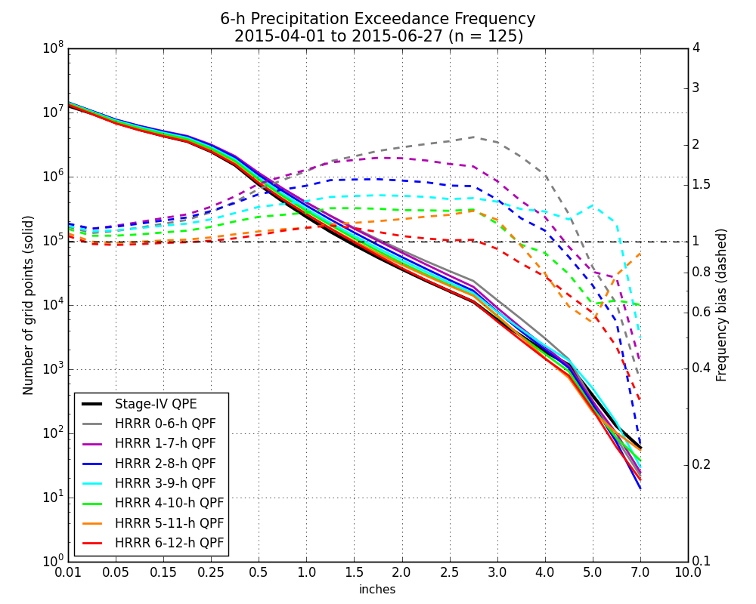
HRRR-TLE Development: Bias Correction
PQPF Product Development
Bias Correction
Frequency Bias Correction Using
“Quantile Mapping”
Adjust model forecast climatology to
observation climatology for a
particular threshold (1 in / 6 hrs)
99th %ile analysis climatology = 1.00”
99th %ile model climatology = 1.23”
Ensemble-Based Hazard Detection Guidance

Slide 18
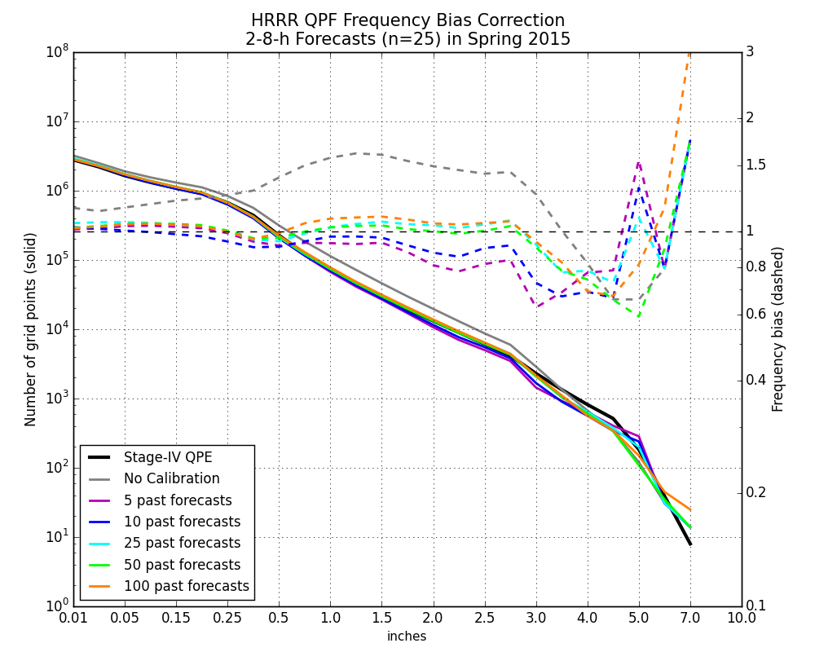
HRRR-TLE: Real-Time Bias Correction
Efficient, real-time bias correction is possible with a small training dataset
Want to limit sample size to single season or even
weather regime
Unbiased
Ensemble-Based Hazard Detection Guidance

Slide 19
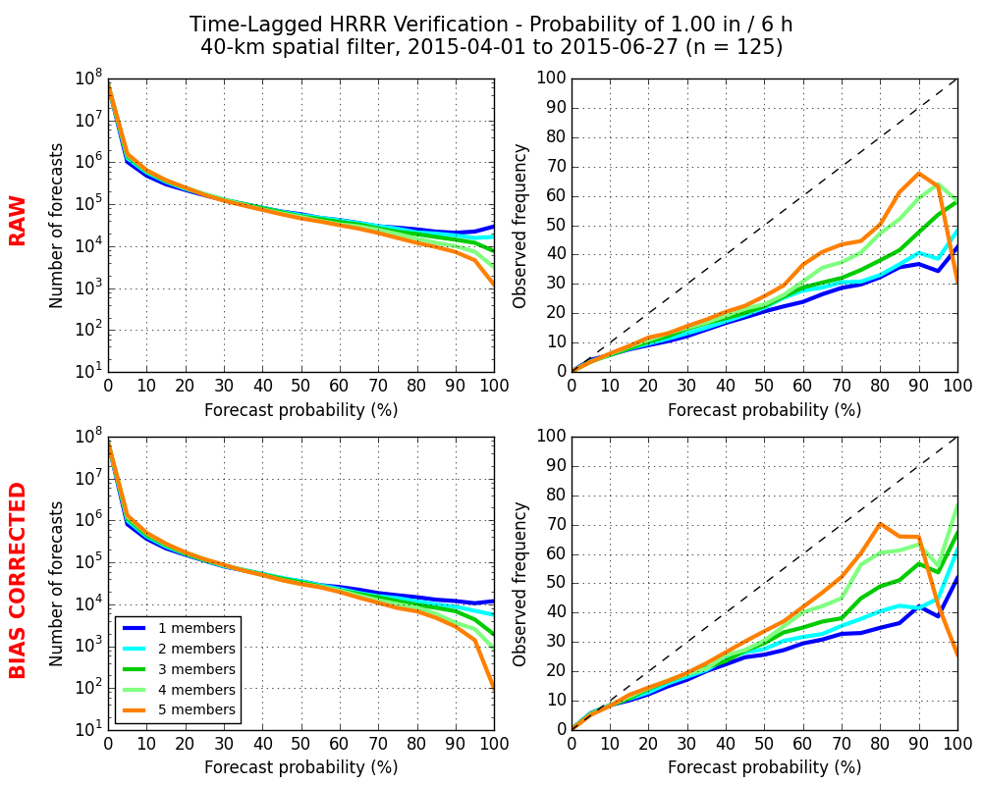
HRRR-TLE Development: Ensemble Size
Membership Size
Maximize available forecast
lengths (smaller ensemble)
Maximize spread/skill relationship (larger ensemble)
Under- confident
Over- confident
Under- confident
Three members (runs) appears
sufficient but still underdispersive
Over- confident
Ensemble-Based Hazard Detection Guidance

Slide 20
HRRR-TLE Development: Spatial Filtering
Probability of 0.5” Precipitation in 6 hours
Spatial Filter Size
Minimize forecast phase error penalty (larger filter)
Minimize forecast forcing variability in complex terrain and different weather regimes (smaller filter)
Ideal
Under- confident
40-60 km appears sufficient
Over- confident
Ensemble-Based Hazard Detection Guidance

Slide 21
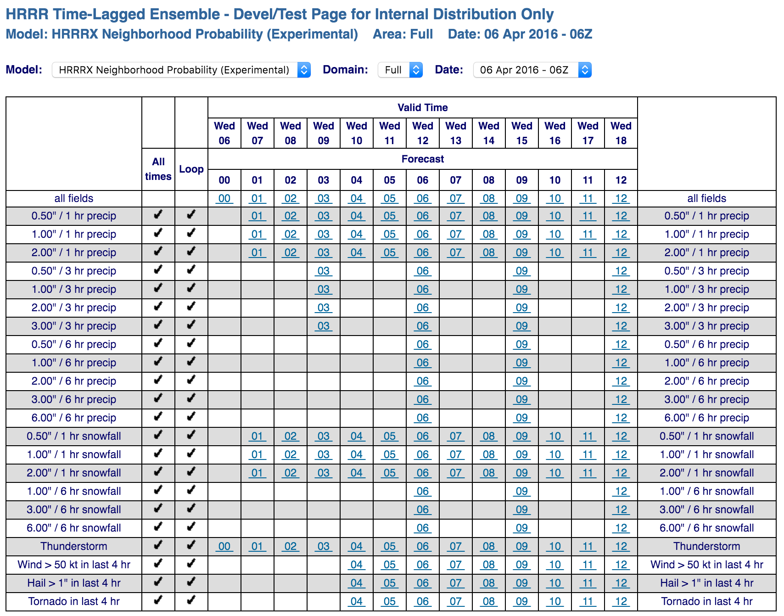
HRRR-TLE: Products
Current Experimental Probability Products:
Based on 3 HRRRX runs (equal weight)
Starting with forecast hour two
40 km neighborhood probabilities
1-hr, 3-hr, 6-hr QPFs
1-hr time filter (not on 3 or 6)
1-hr snowfall rates
+/- 1-hr ASNOW time filter
6-hr snowfall accumulations
Uses ASNOW (variable density/melt)
General Thunderstorm
UVV > 1 m/s, LI < -1C, > 0.01 precip
4-hr Wind
10 m max wind speed > 50 kts
4-hr Hail
VIG > 25 kg/m²
4-hr Tornado
UH > 100 m²/s², LCL < 1.5 km,
0-1 km shear > 10 m/s, SBCAPE > 75% max
Real-Time Web Graphics
http://rapidrefresh.noaa.gov/hrrrtle
Thunderstorms
Wind
GRIB2 grids available on GSD LDM and FTP pull
Ensemble-Based Hazard Detection Guidance

Slide 22
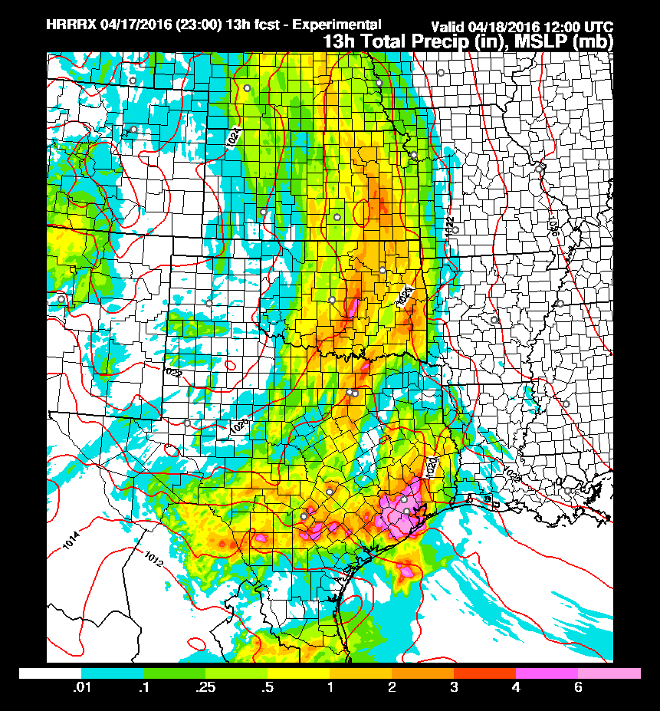
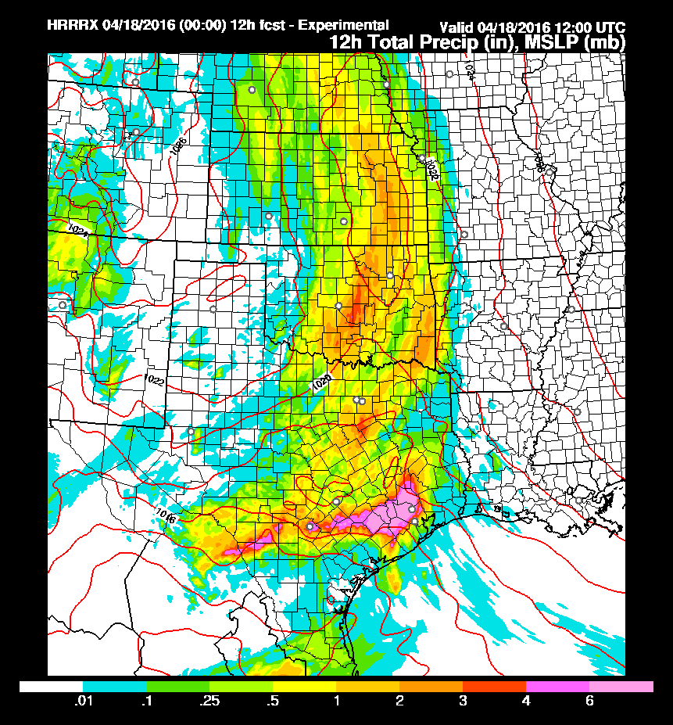
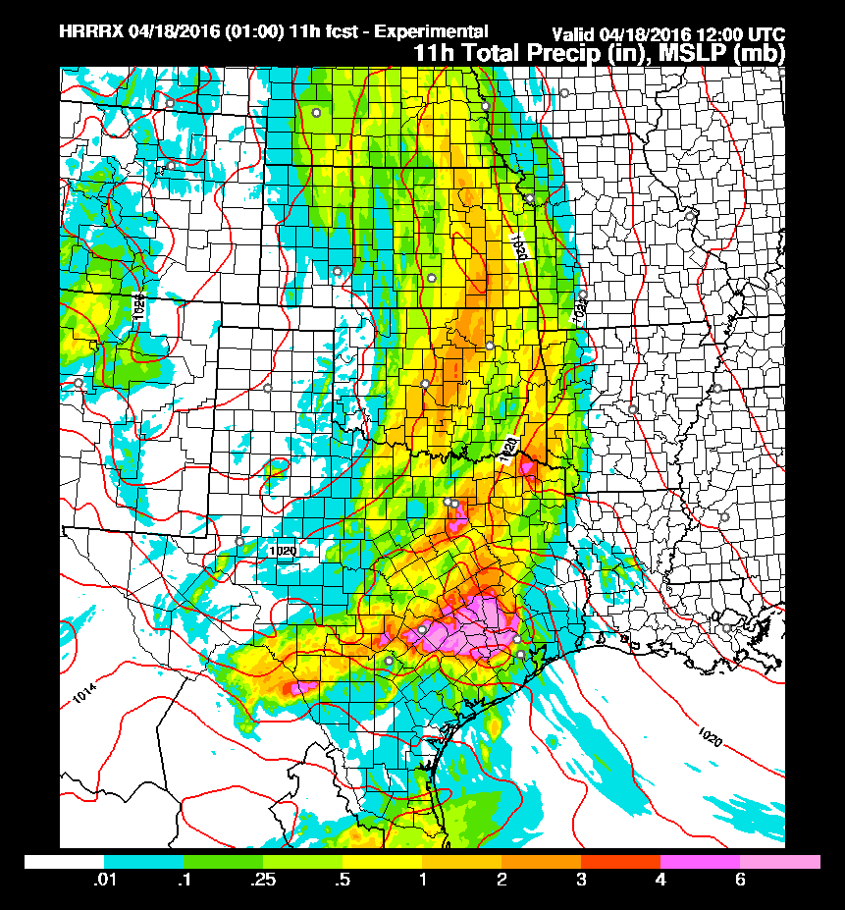
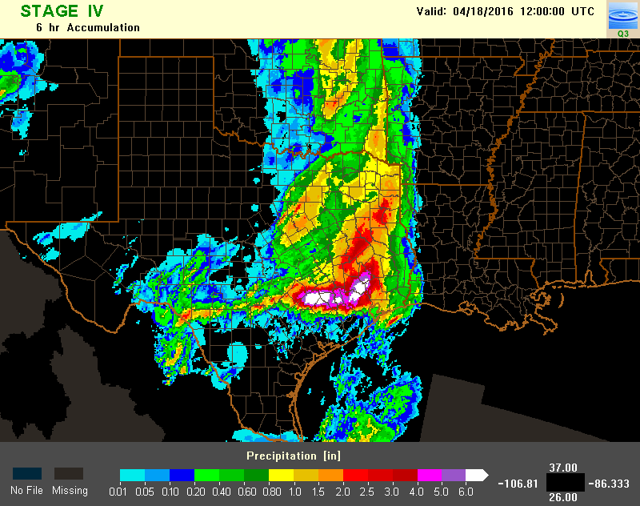
Houston, TX Flash Flooding 12 UTC 18 April 2016
HRRR 23z 13hr pcp fcst
HRRR 00z 12 hr pcp fcst
HRRR 01z 11 hr pcp fcst
06hr QPE
Consecutive HRRR runs produced > 6” precip in ~12 hrs
in/near Houston, TX
Ensemble-Based Hazard Detection Guidance

Slide 23
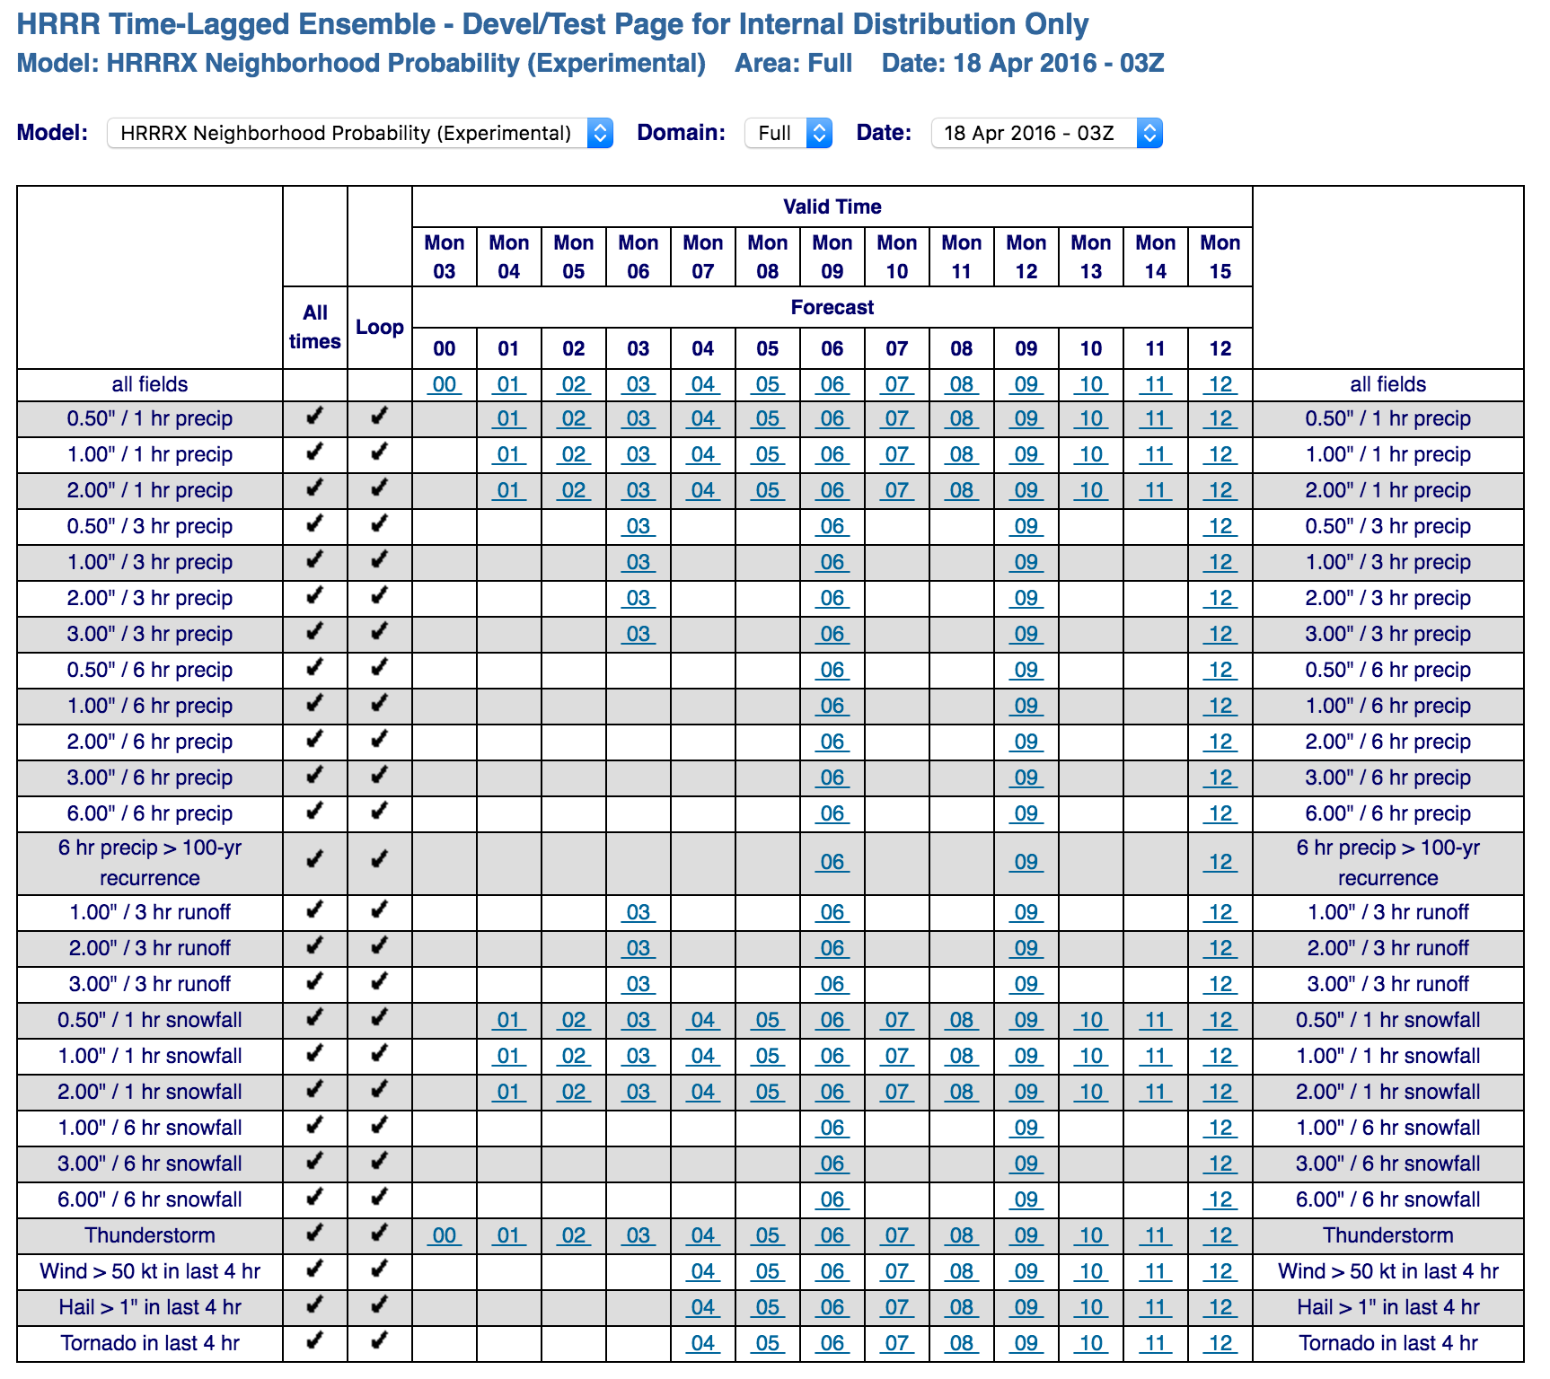
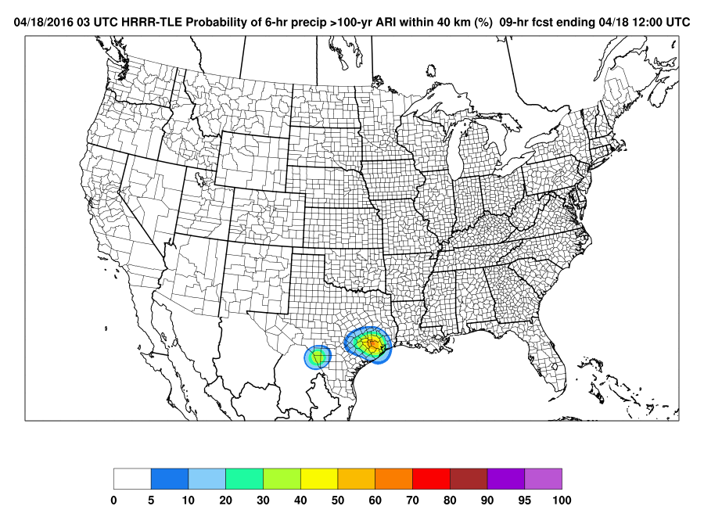
Houston, TX Flash Flooding 12 UTC 18 April 2016
06hr QPE
HRRR-TLE forecasts
> 60% probability of
6hr QPF exceeding
100 year average
return interval (ARI) in Houston area
based on ATLAS14
Ensemble-Based Hazard Detection Guidance

Slide 24
HRRR-TLE: Project Timeline
Product
Development
Timeline
Engage
National
Center
Testbeds
Organization/Experiment | Hazards | Platform | Timeline
WPC WWE | PQPF, Snowfall, Snow Rate | NAWIPS and web site | January 2016
NSSL/SPC EFP/EWP | Tornadoes, Hail, Wind | NAWIPS and AWIPSII | May 2016
WPC FFaIR | Refined PQPF and FF guidance | NAWIPS | June 2016
AWC Summer Experiment | Initial aviation hazards: ceiling, visibility, convection | NAWIPS | August 2016
WPC WWE | Refined winter hazards and PQPF | NAWIPS | January 2017
NSSL/SPC EFP/EWP | Refined severe weather guidance | NAWIPS and AWPSII | May 2017
WPC FFaIR | Refined FF guidance | NAWIPS | July 2017
AWC Summer Experiment/OPG | Refined aviation hazards | NAWIPS and AWPSII | August 2017
Initiate NCO ‘on-boarding” | All | IDP | 2018
Ensemble-Based Hazard Detection Guidance

Slide 25
HRRR-TLE: Product Development
Product
Development
Methodology
Hazard | Proxy | Truth
Heavy rainfall | QPF | Stage-IV / MRMS
Snowfall rate | Microphysics-based | ASOS visibility
Precipitation type | Microphysics-based | ASOS type
Accum Snow | Explicit snow depth | Point observations
Severe wind | 80-m hourly max wind or 10-m gust | METAR/mesonet observations
Large hail | Column graupel, updraft speed, ? | MESH
Tornado* | Updraft helicity | Post-processed MRMS rotation tracks
Visibility/Ceiling | Post-processed field in development | ASOS or future CIMSS technique
Ensemble-Based Hazard Detection Guidance

Slide 26
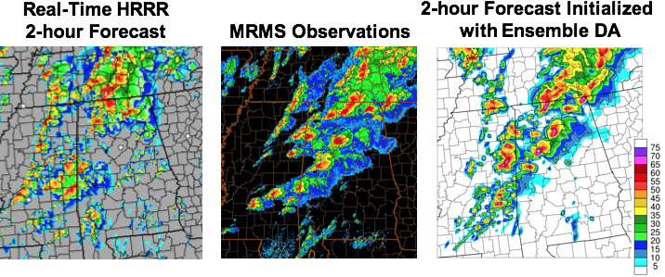
HRRRE
Real-Time Web Graphics
http://rapidrefresh.noaa.gov/HRRRE
Single core (ARW)
Ensemble DA (EnKF) – RAPX mean, GDAS (GFS) perturbations
Conventional observations only (no radar data)
Prototype 3-km storm-scale HRRR ensemble domain 2016
Assimilation Forecast
20+ members 00z - Three mem to 27 hr
1 hr cycling 03z - Three mem to 24 hr
21 fcsts / day 12z - Six mem to 15 hr
Start 21z day zero 15z - Eighteen mem to 12 hr
End 18z day one 18z - Eighteen mem to 9 hr? (resources allowing)
Beginning development
of formal 3-km
data assimilation and
forecast ensemble where
these same post-processing
techniques can be applied
More accurate
storm-details
from ensemble
data assimilation
Ensemble-Based Hazard Detection Guidance

Slide 27
HRRR-TLE: Summary
Three-year USWRP-Funded HRRR Time-Lagged Ensemble Development
Producing Probabilistic Hazard Prediction Guidance
Ensuring Statistically Reliable Probabilities
Engaging NCEP National Centers and Participating in Testbed Evaluations
Transition to Operations Plan
Experimental Real-Time GRIB2 LDM/FTP Feed Available
Web Page Graphics Also Available
An Evolutionary Step on the Path to Full 3-km Data Assimilation and Forecast Ensemble
Ensemble-Based Hazard Detection Guidance

