Slide 1
Improving Understanding and Prediction of High Impact Weather Associated with Low-Topped Severe Convection in the Southeastern U.S.
Keith Sherburn
PIs: Matthew Parker, Gary Lackmann, Lian Xie
Students: Lindsay Blank, Dianna Francisco, Jessica King, Xia Sun
Collaborators: ESRL; EMC; SPC; WFOs Birmingham, Blacksburg, Charleston (SC), Columbia, Greer,
Huntsville, Morehead City/Newport, Peachtree City, Raleigh, Sterling, Tallahassee,
Wakefield, Wilmington (NC), Wilmington (OH)
June 2017 NOAA VLab Forum
Wednesday, June 21st, 2017

Slide 2
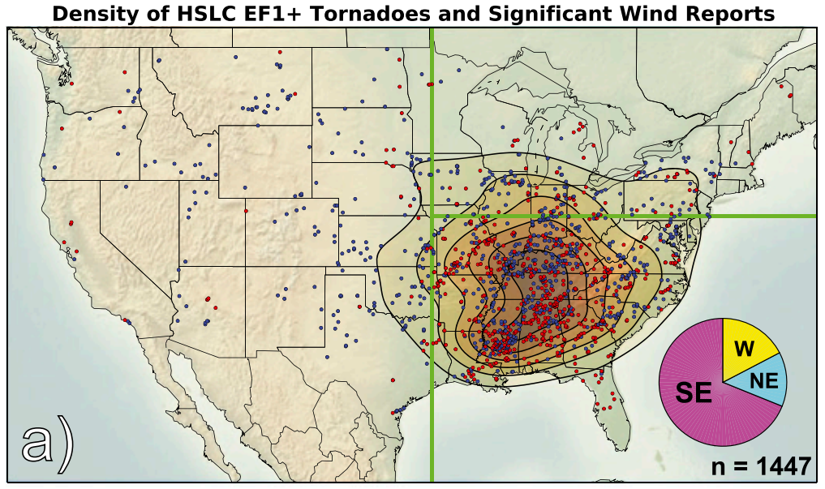
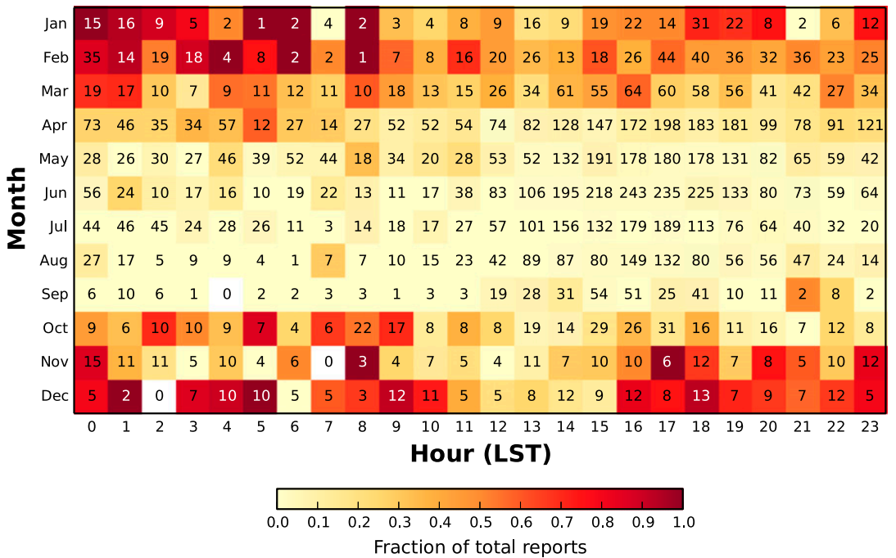
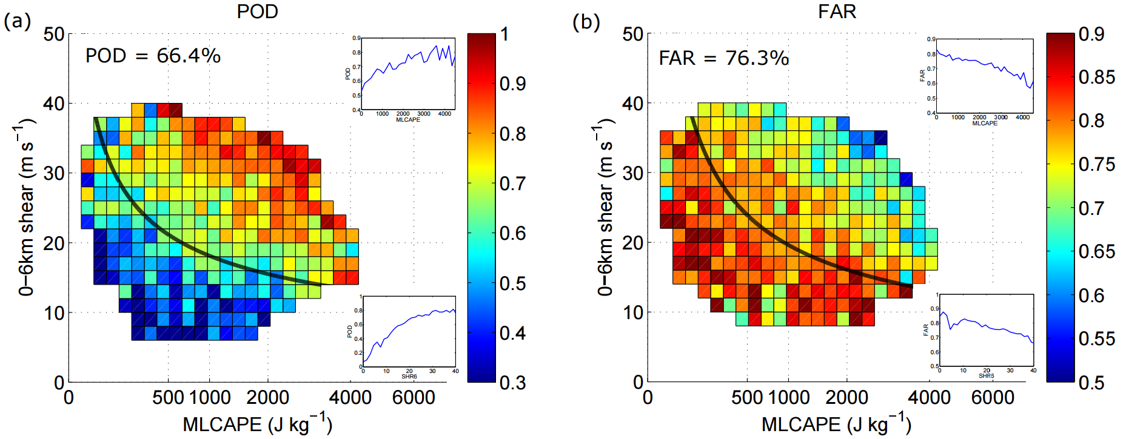
Problem overview
High-shear, low-CAPE (HSLC*) severe convection is a considerable forecasting challenge across the eastern U.S., particularly during the cool season and overnight
Sherburn et al. (2016)
Sherburn et al. (2016)
Anderson-Frey et al. (2016)
*Here, defined as SBCAPE ≤ 500 J kg⁻¹, MUCAPE ≤ 1000 J kg⁻¹, and 0-6 km bulk wind difference ≥ 18 m s⁻¹

Slide 3
Project overview
Five components:
Composite maps and parameters:
Determine typical features associated with severe/nonsevere HSLC events (Sherburn et al. 2017)
Assess operational utility of existing and new forecasting parameters (Sherburn et al. 2017)
Process studies 1: Case simulations to study mesoscale/synoptic scale evolution (King et al. 2017)
NWP studies: Case simulations to investigate resolution requirements
Process studies 2: Idealized simulations to study convective-scale dynamics
Statistical studies: Dynamical-statistical downscaling to investigate predictability

Slide 4
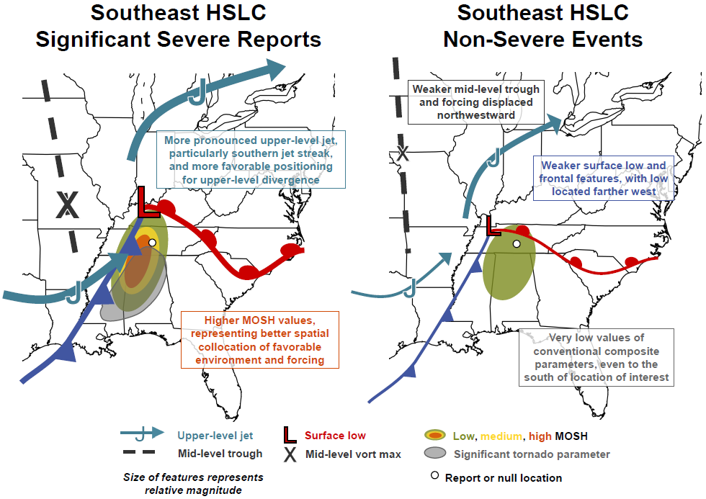
HSLC composites: Key points
Created using NARR data and severe reports versus false alarm warnings
Stronger, more closely collocated features are conducive to severe HSLC events
Release of potential instability and/or strong low-level θ_{e} advection are responsible for rapid destabilization immediately ahead of HSLC convection
Low-level lapse rates and shear vector magnitudes remain skillful

Slide 5
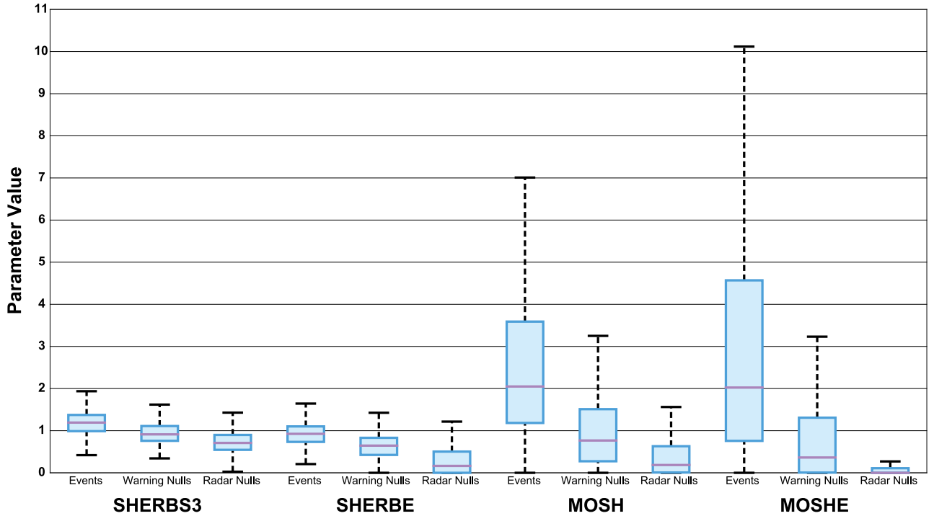
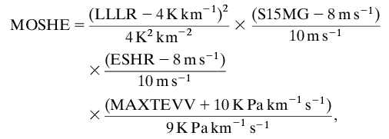
HSLC composites: Updated forecasting parameter
Recurring theme of low-level stability and shear vector magnitudes being skillful in discrimination of severe/non…
However, poor understanding of the processes governing these sensitivities…
LLLR: 0-3 km lapse rate
S15MG: 0-1.5 km shear vector magnitude
ESHR: Effective shear magnitude
MAXTEVV: Maximum dθ_{e}/dz * ω product from 0-2 km through 0-6 km, calculated at 0.5 km intervals (positive: unstable/upward motion)

Slide 6
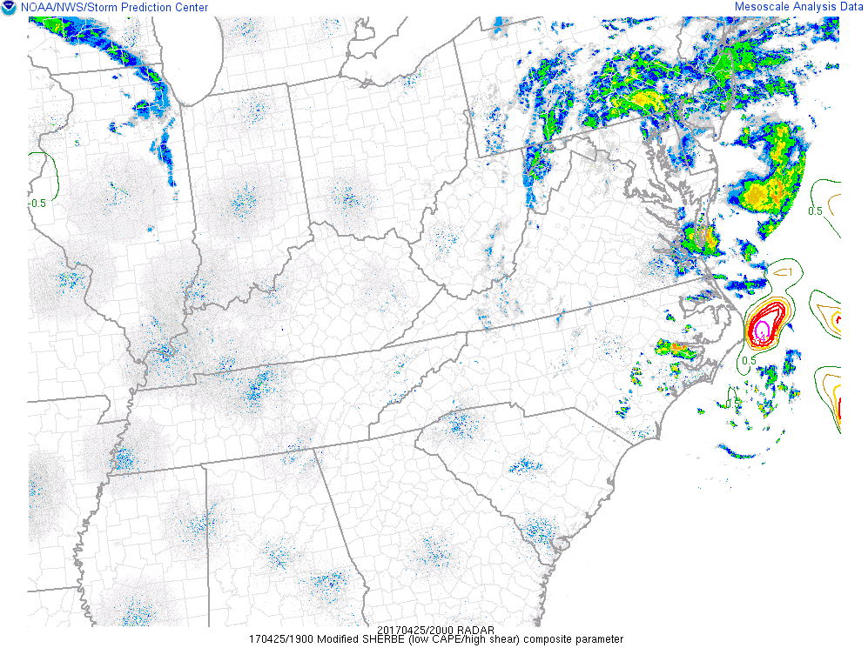
HSLC composites: MOSHE on SPC Mesoanalysis
Adjustments potentially necessary; NARR values biased low
For now: Worth monitoring, but may be more appropriate to focus on maxima rather than exact values
Could “cap” terms to limit contributions or reevaluate normalization values
LLLR: 0-3 km lapse rate
S15MG: 0-1.5 km shear vector magnitude
ESHR: Effective shear magnitude
MAXTEVV: Maximum dθ_{e}/dz * ω product from 0-2 km through 0-6 km, calculated at 0.5 km intervals (positive: unstable/upward motion)

Slide 7
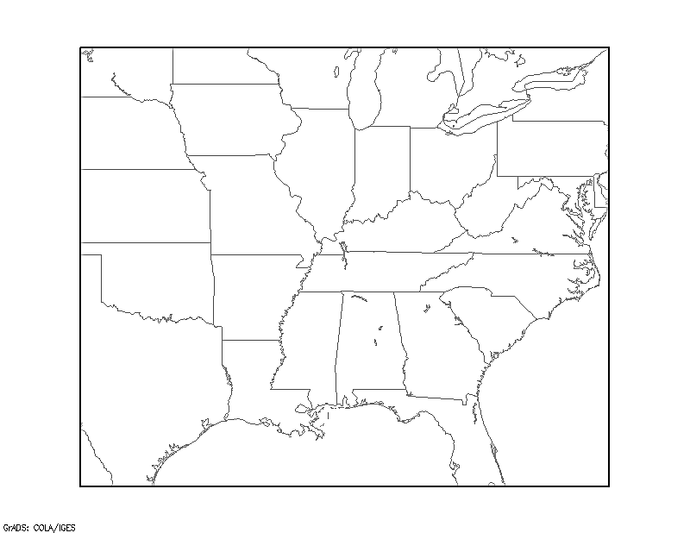
Process studies: Case study selection
Requirements:
At least “slight” risk for severe convection
SPC mesoanalysis CAPE ≤ 1000 J kg⁻¹
0-3 km shear ≥ 18 m s⁻¹
6 non-severe events (no storm reports)
11 severe events (multiple reports)
Simulations run with ARW-WRF, v3.5.1
50 vertical levels
6-h NAM 12-km analyses as IC/LBC
At least 30 hrs simulation time
3km
9km

Slide 8
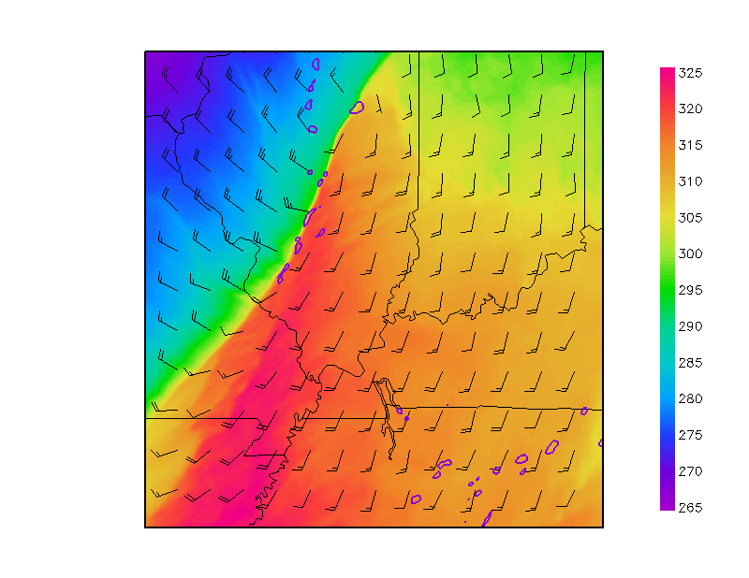
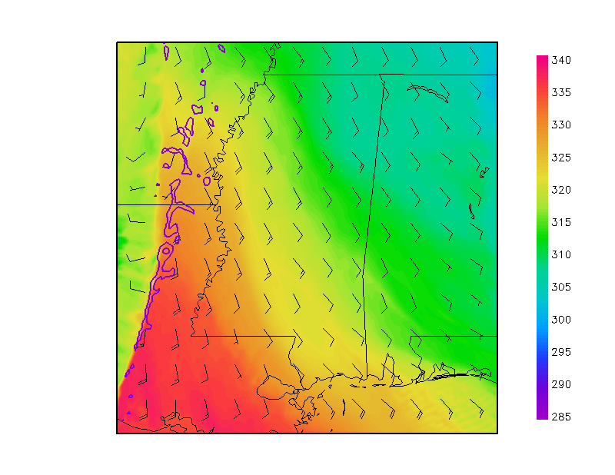
Process studies: Simulated environments
Jan. 29, 2008: 2pm – 6pm
Dec. 22, 2007: 4pm – 8pm
Surface θ_{e}, 10 m wind barbs [kts], 40 dBZ contour
Surface θ_{e}, 10 m wind barbs [kts], 40 dBZ contour
θ_{e} [K]
θ_{e} [K]
Severe
Nonsevere
Linear cold frontal boundary

Slide 9
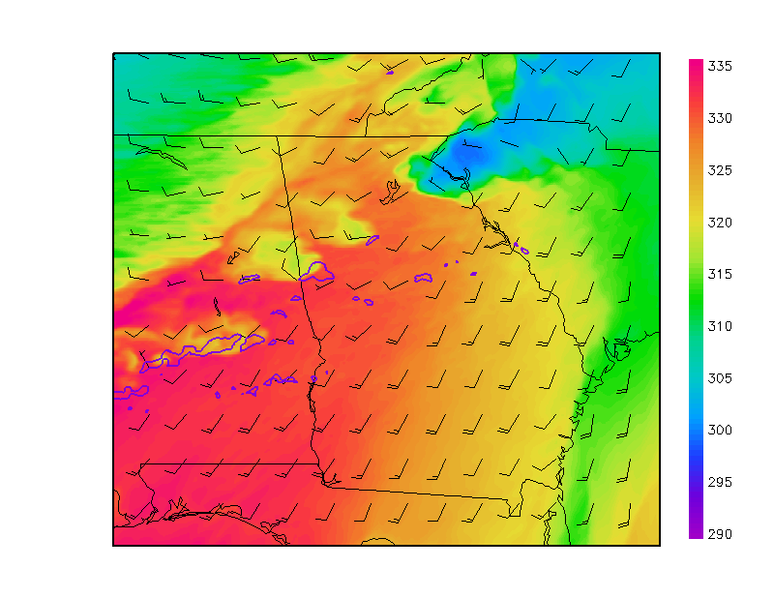
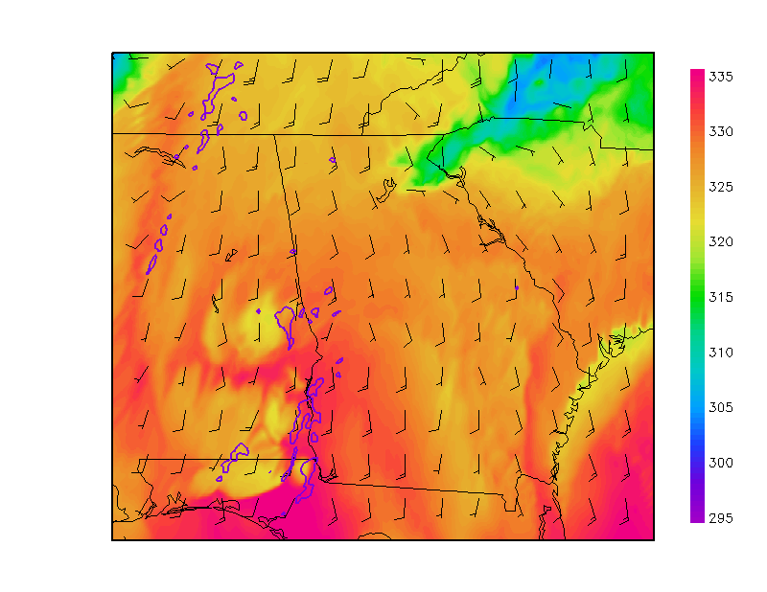
Process studies: Simulated environments
Feb. 18, 2009: 5pm – 9pm
Jan 26, 2012: 5pm – 9pm
Surface θ_{e}, 10 m wind barbs [kts], 40 dBZ contour
θ_{e} [K]
Surface θ_{e}, 10 m wind barbs [kts], 40 dBZ contour
θ_{e} [K]
Severe
Nonsevere
Isolated convection

Slide 10
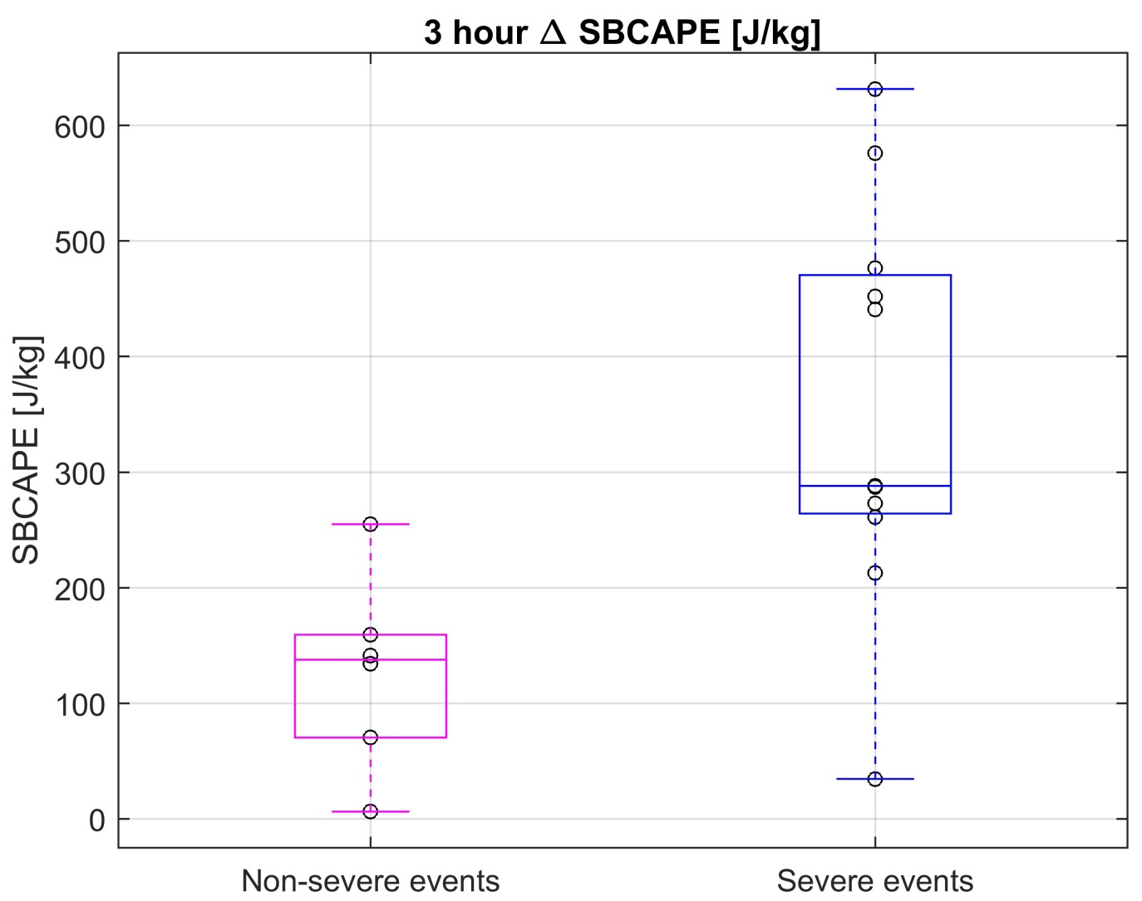
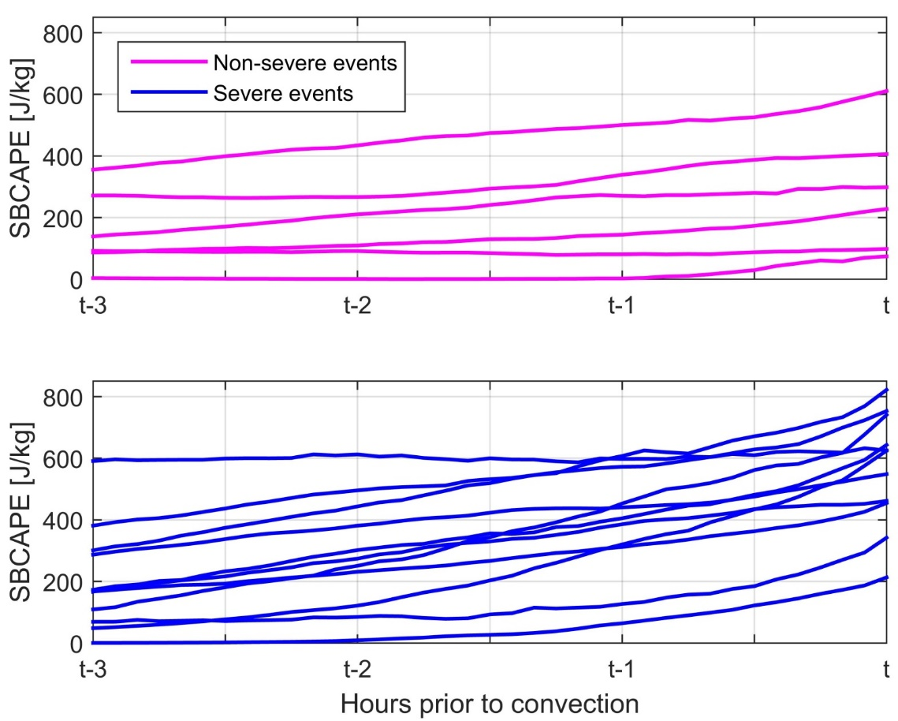
Process studies: CAPE increases
CAPE increases could arise from:
Increased surface temperature
Increased surface moisture
Decreased temperature aloft
Goal: Determine which processes are most important by calculating contributions to CAPE from each process

Slide 11
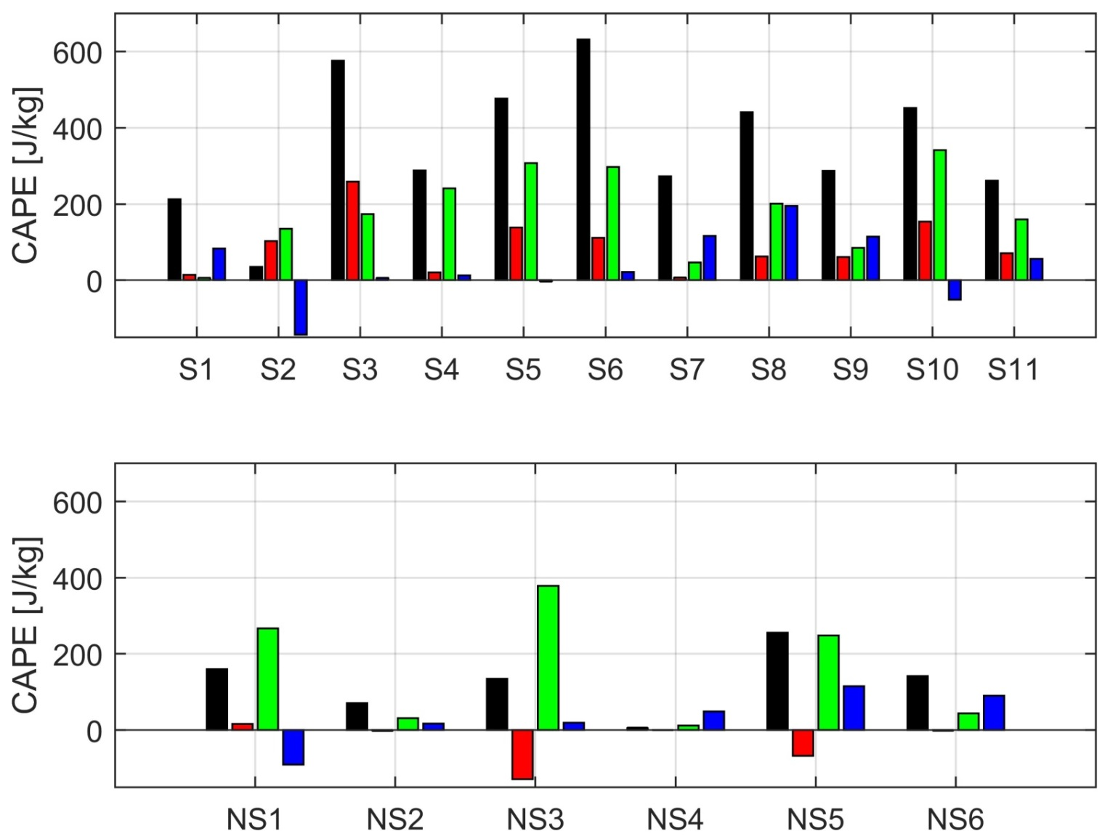
Process studies: CAPE increases
3 hour Δ SBCAPE
Total change
Change from surface θ
Change from surface q_{v}
Change from upper θ

Slide 12
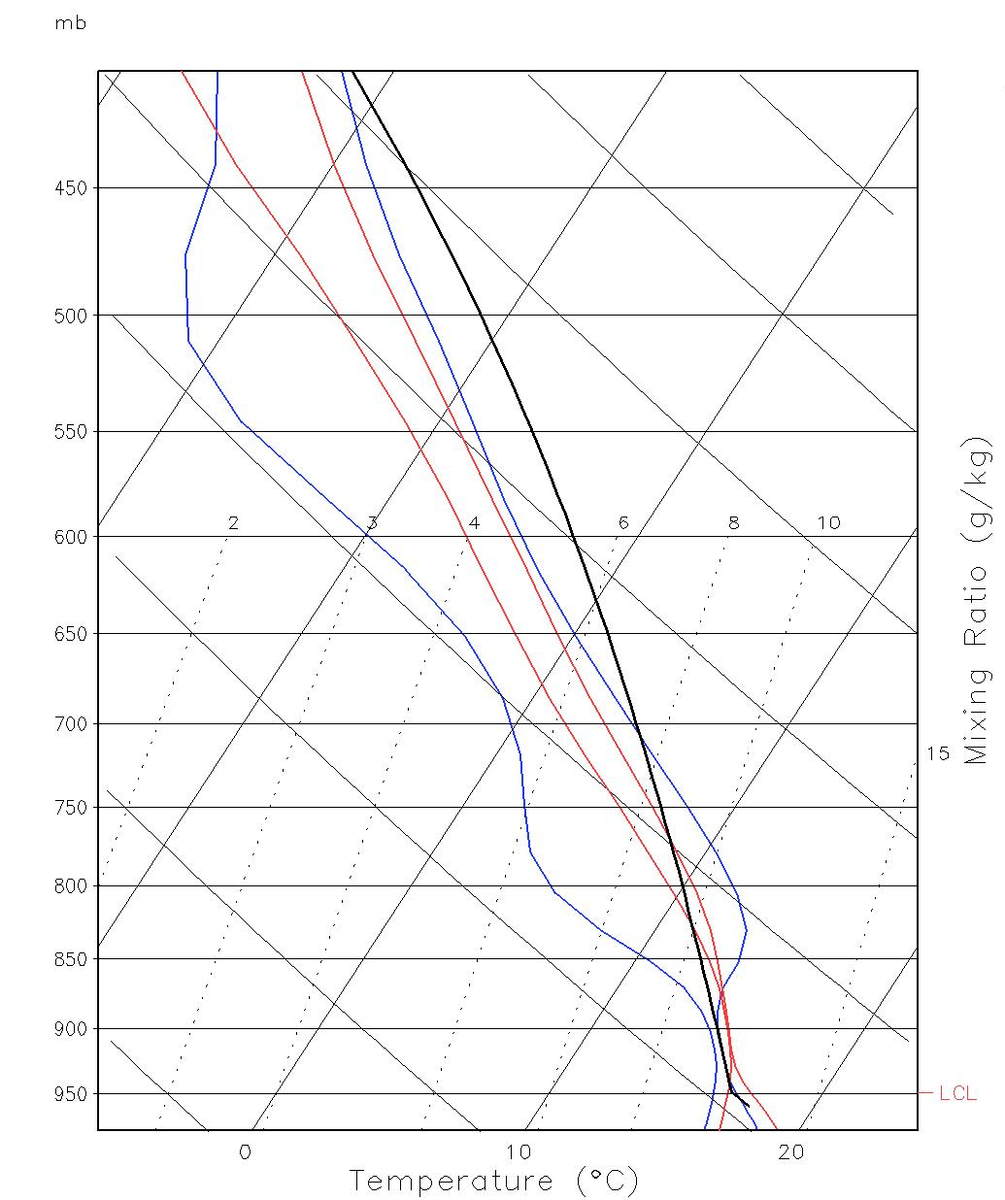
Process studies: Potential instability
January 30, 2013 simulated event
Potentially unstable sounding (θ_{e} decreasing with height)
Lifting = cooling and moistening
Potential instability released, increase in CAPE
3 hours prior to convection
Just prior to convection (parcel path)

Slide 13
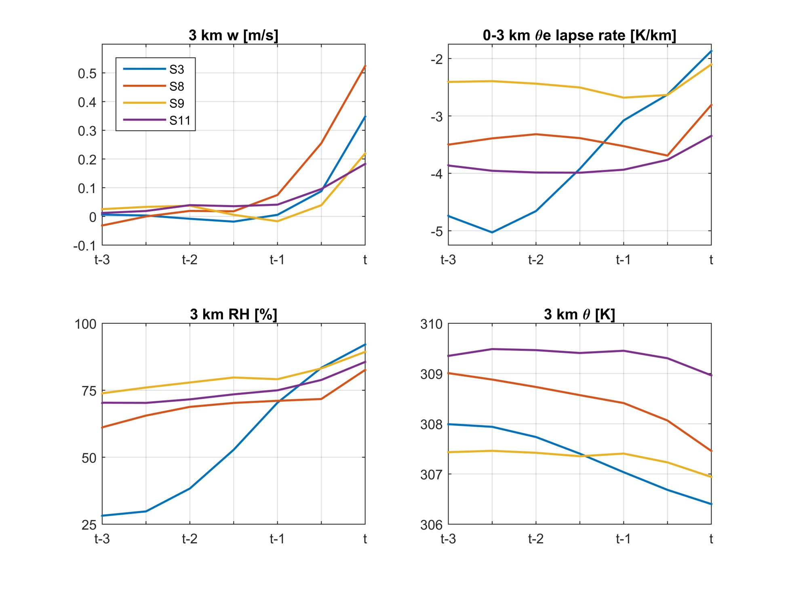
Process studies: Synoptic ascent

Slide 14
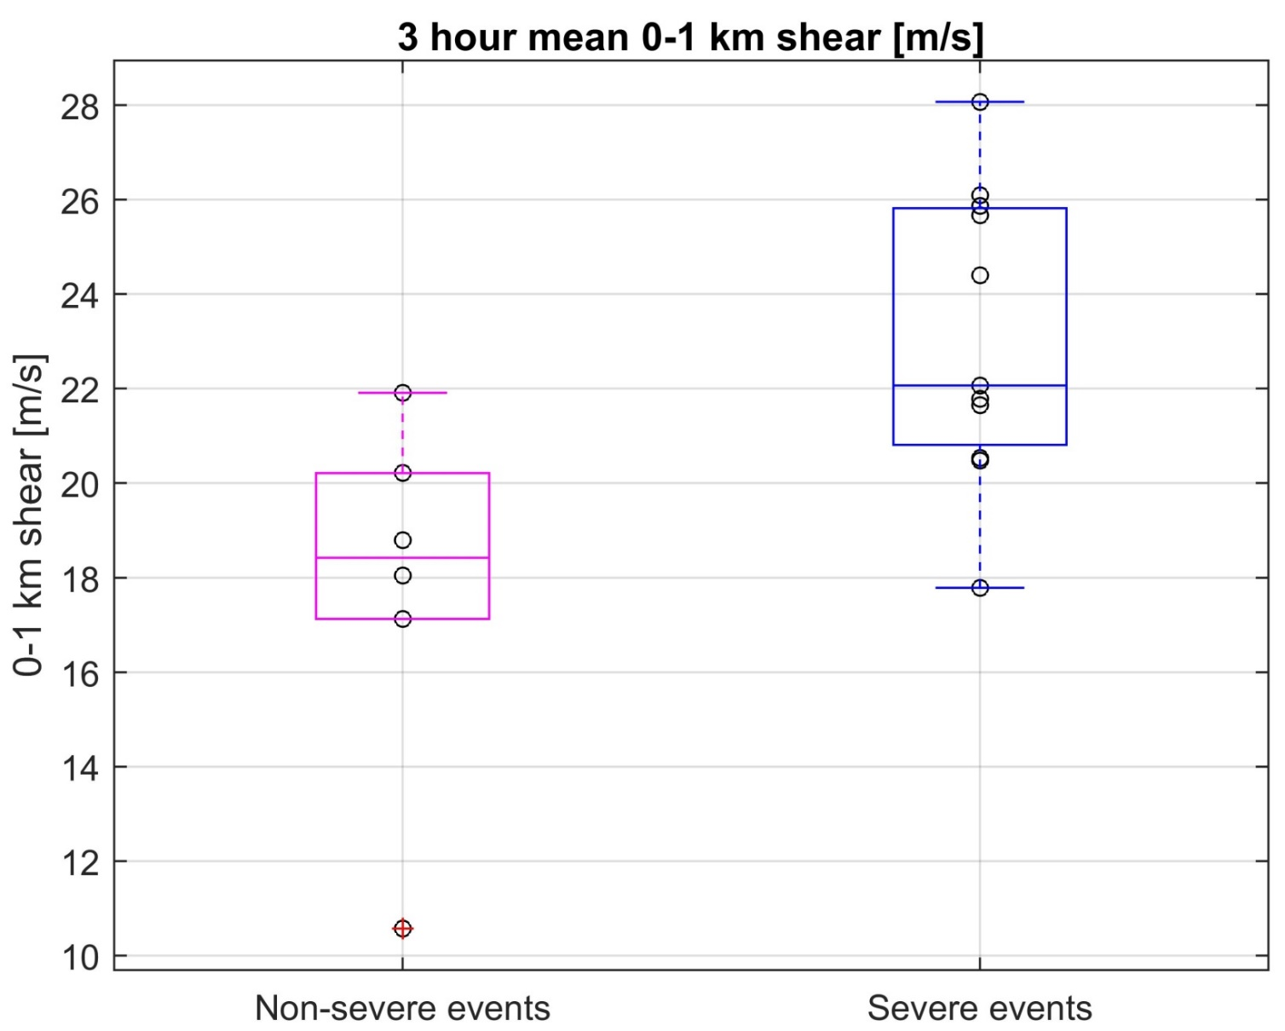
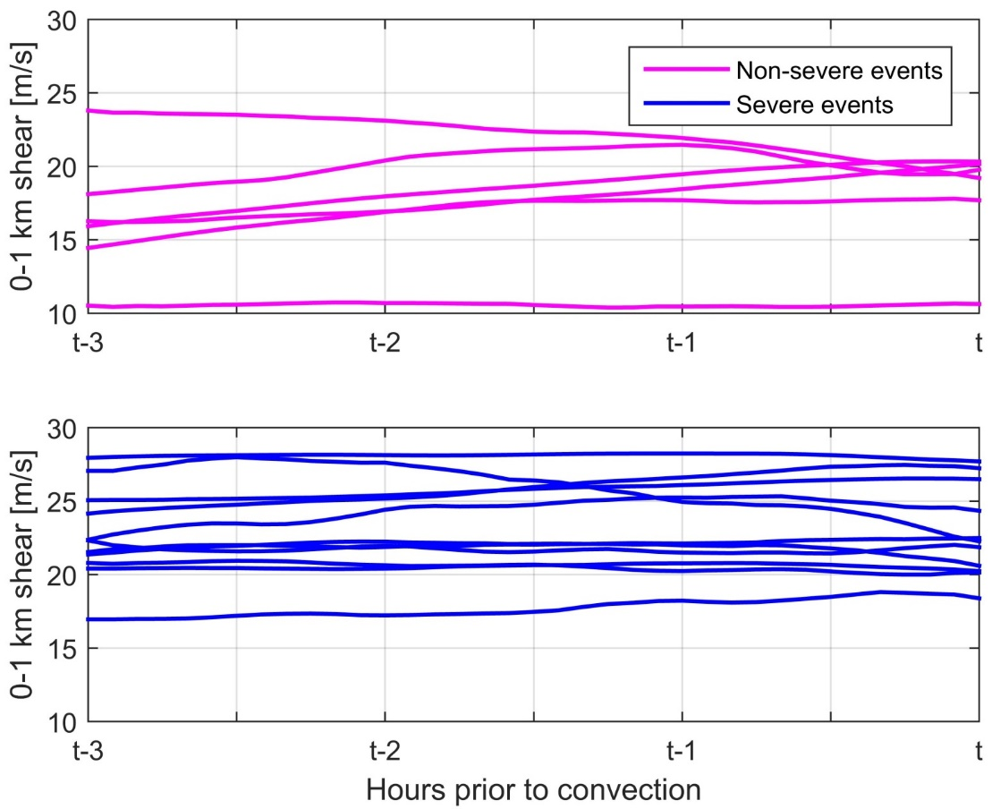
Process studies: Low-level shear
Discrimination between severe/nonsevere…
…but relatively constant over time

Slide 15
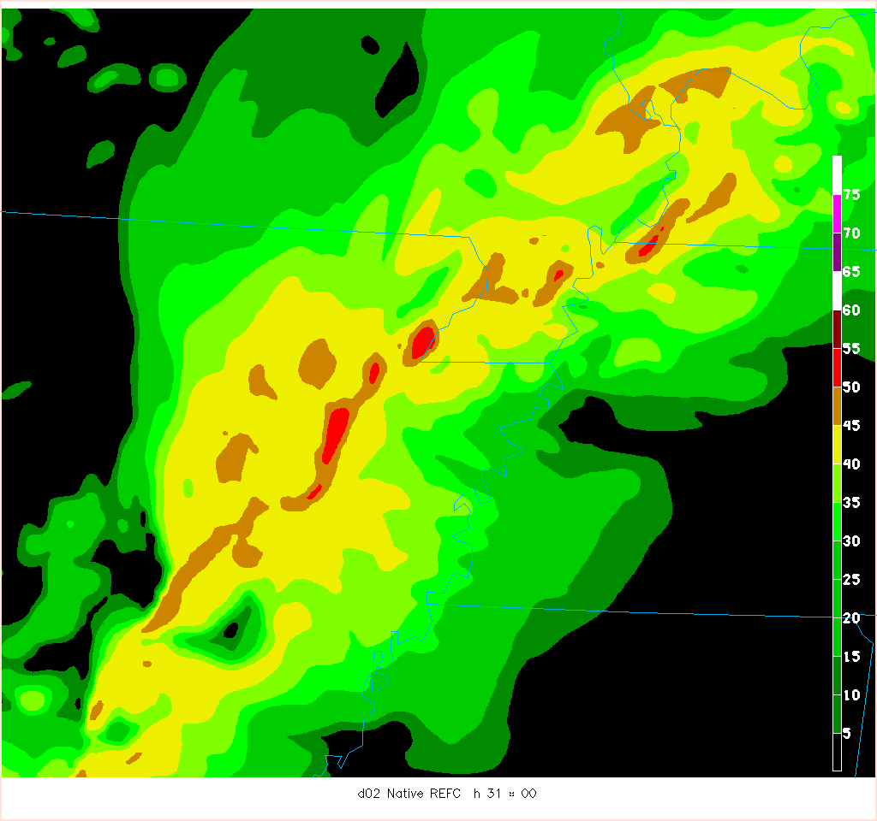
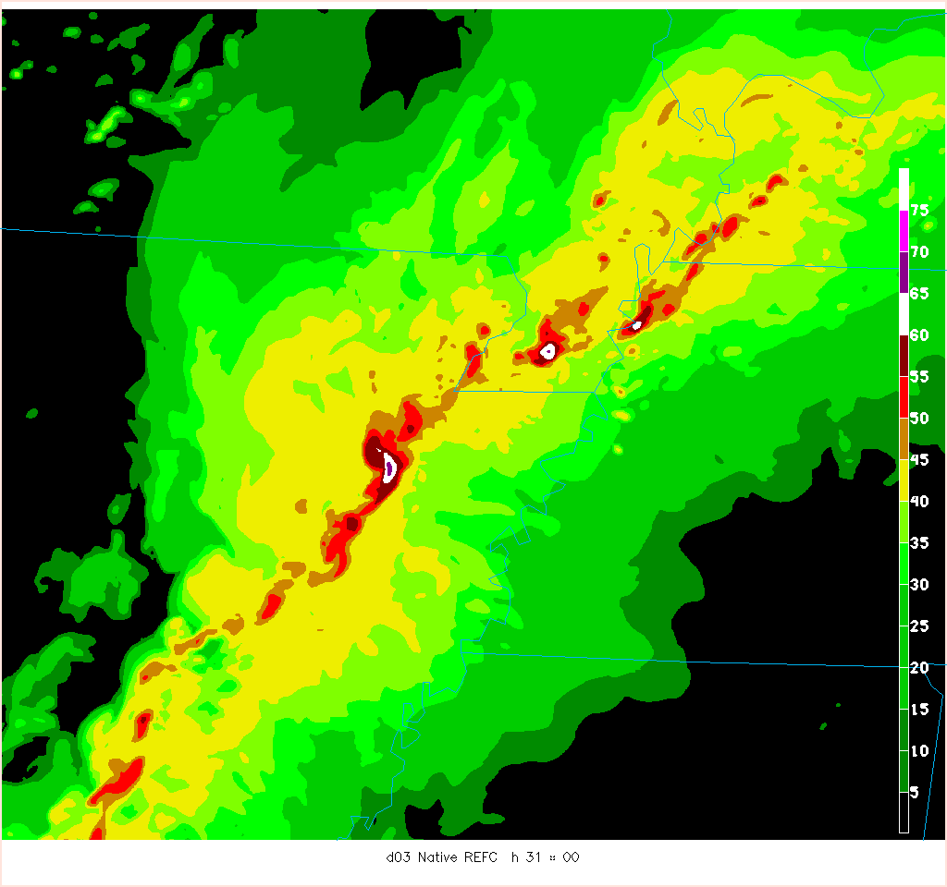
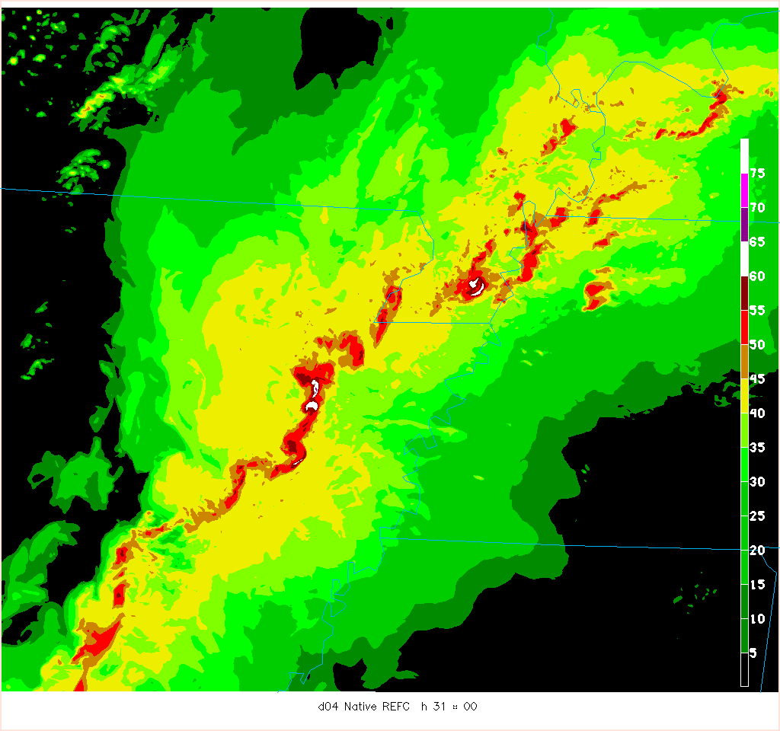
NWP studies: Resolution differences
Native 3.6-km
NEXRAD 2-km
Convective characteristics well-handled at all resolutions, though finer resolution obviously captures more detail
Native 1.2-km
Native 400-m
Differences clearer when evaluating fields such as 10-m wind speeds…

Slide 16
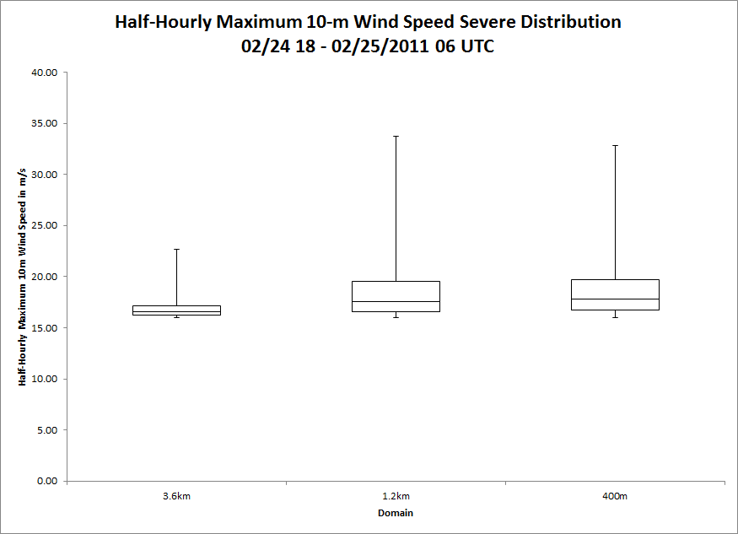
NWP studies: Resolution differences
Fairly large difference between 3.6-km and 1.2-km grid spacing, particularly when compared to jump from 1.2-km to 400-m
Similar findings for second case investigated
Suggests convergence of solution between 3.6-km and 1.2-km grid spacing, at least for sensible hazards
Work continues; more cases needed to corroborate initial findings

Slide 17
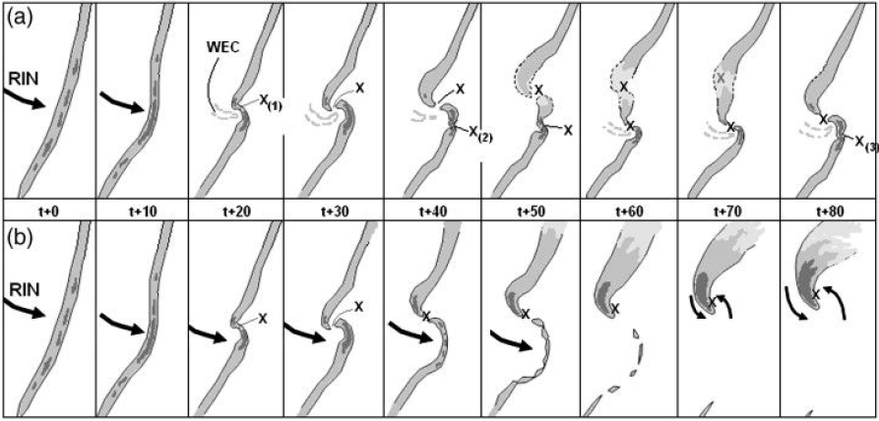
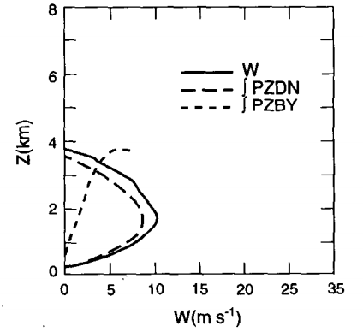
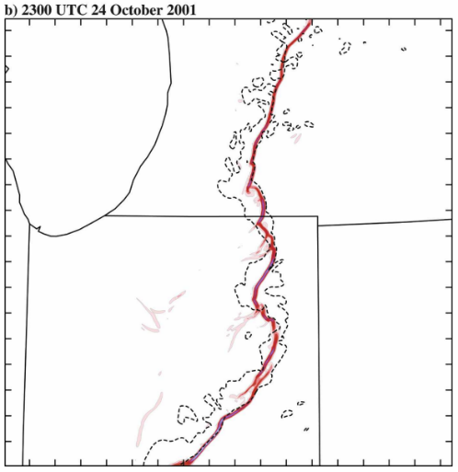
Idealized simulations: Motivation
Poor radar resolution and discrimination
Some potential radar precursors (such as broken-S, right), but high associated FAR
Rapid destabilization
Clark (2011)
Prior HSLC simulations mainly tropical mini-supercells with insufficient resolution
Very few HSLC QLCS studies, limited in scope
QLCS mesovortex genesis mechanisms uncertain
McCaul and Weisman (1996)
Wheatley and Trapp (2008)

Slide 18
Idealized simulations: Overview
Two primary goals:
Determine environmental parameter space within HSLC environments where long-lived, strong, low-level vortices capable of producing severe hazards are likely
Determine precursors for the development of strong, low-level vortices to determine the dynamics governing documented sensitivities
We must first understand the links in the chain that extend from the development of HSLC convection to the development of strong, near-surface vortices therein before we can assess which links are broken or missing.
Control base-state environment

Slide 19
Idealized simulations: Sensitivity tests
Based on prior environmental studies and skill tests leading to the development of the SHERB/MOSH
Focus on varying low-level CAPE (here, equivalent to low-level lapse rates) and low/mid-level shear vector magnitudes
+LLs
+MLs
Increased low-level CAPE (+LLc)
Decreased low-level CAPE (-LLc)
-LLs
-MLs

Slide 20
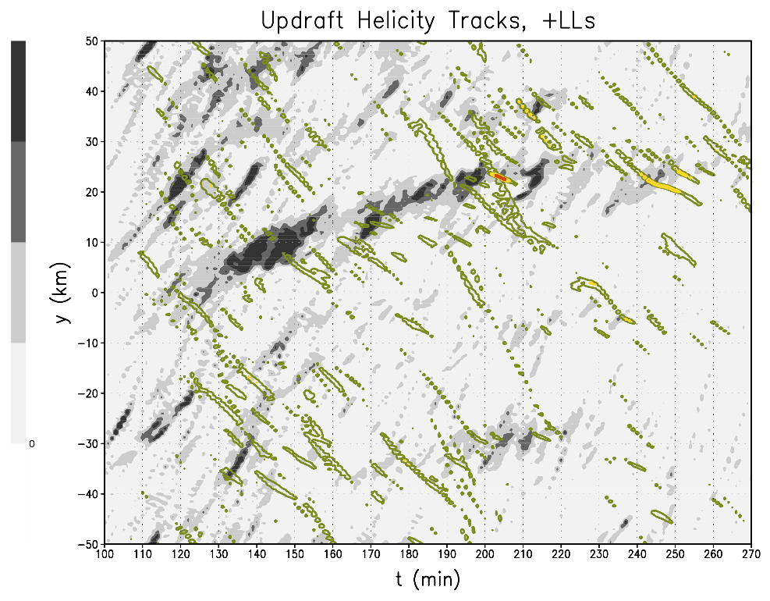
Idealized simulations: Informed hypotheses
A strong, low-level updraft (~20 m s⁻¹ in the lowest 2 km) is a necessary but insufficient precursor to low-level vortexgenesis
m² s⁻²
1000
ζ = 0.02 s⁻¹ 0.04 s⁻¹ 0.06 s⁻¹ 0.08 s⁻¹
750
Increasing this variable… | …will lead to these results
Low-level shear | Increased number of strong low-level updrafts and near-surface ζ centers Increased probability of producing a strong, near-surface vortex
Low-level CAPE | Increased number and magnitude of strong low-level updrafts Increased probability of producing a strong, near-surface vortex
500
250
0

Slide 21
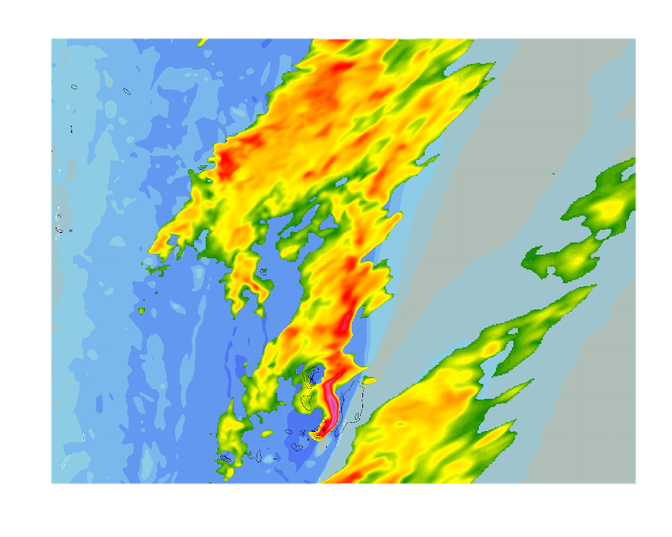
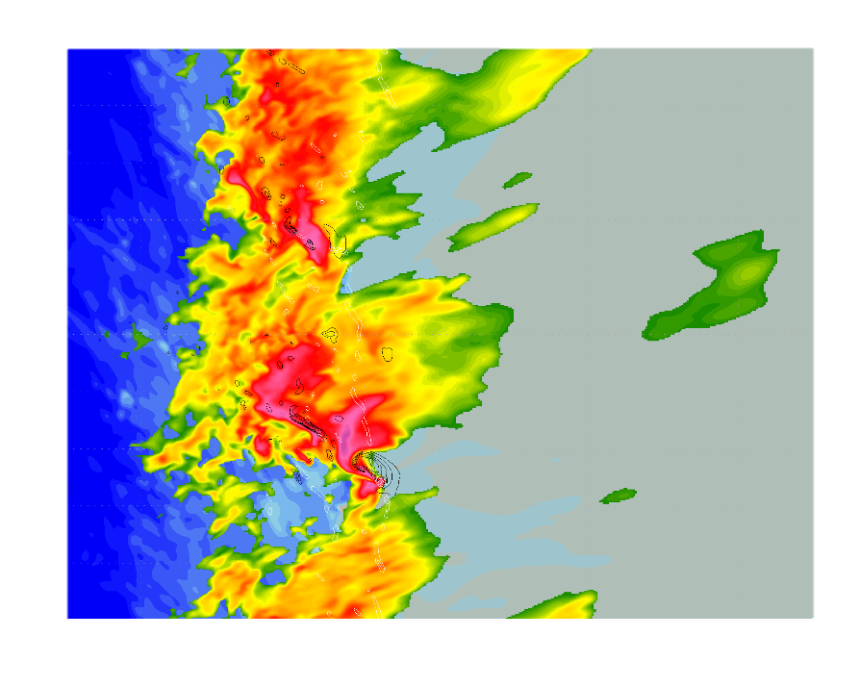
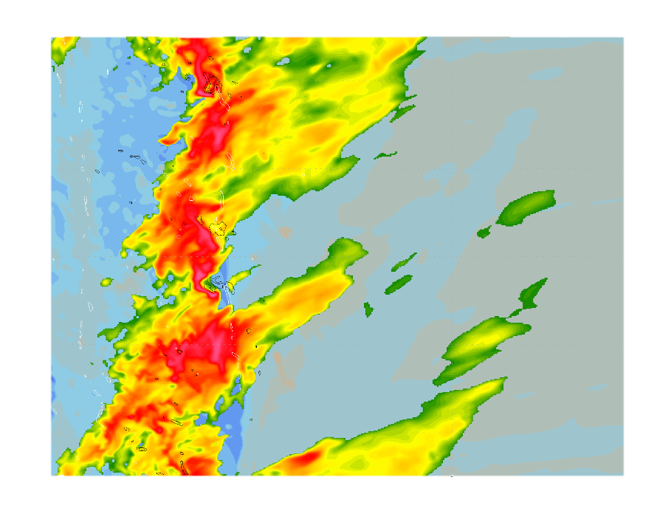
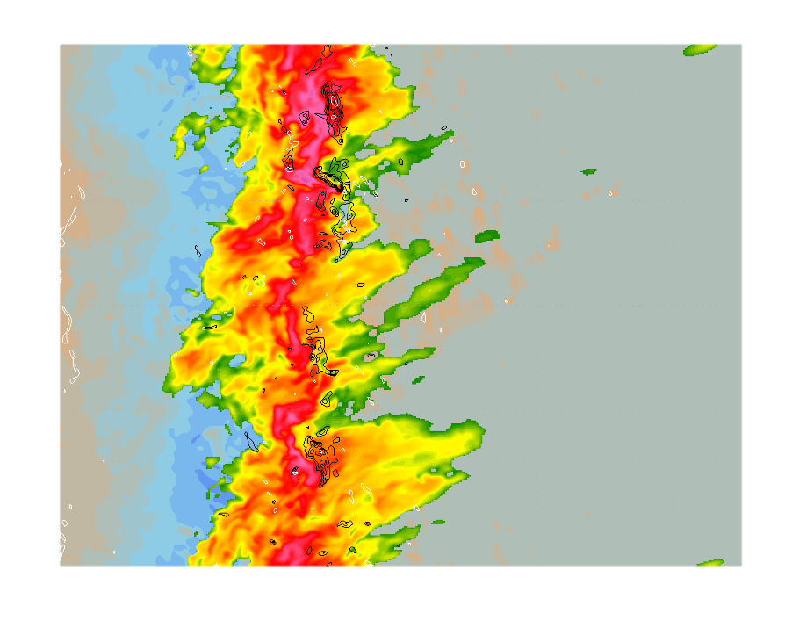
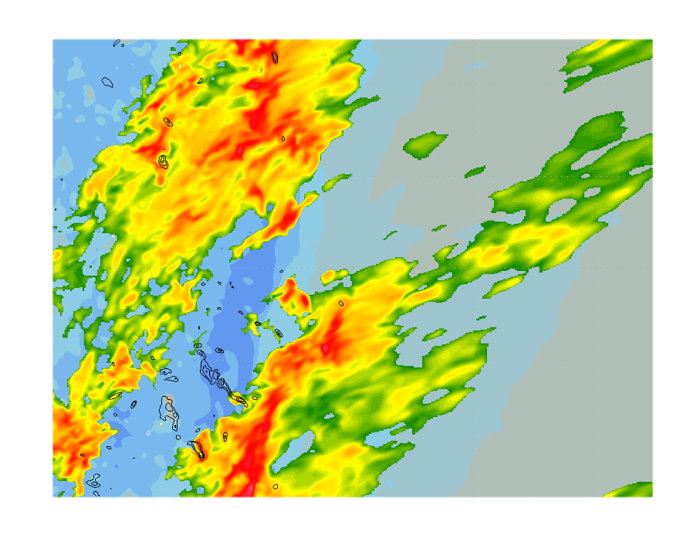
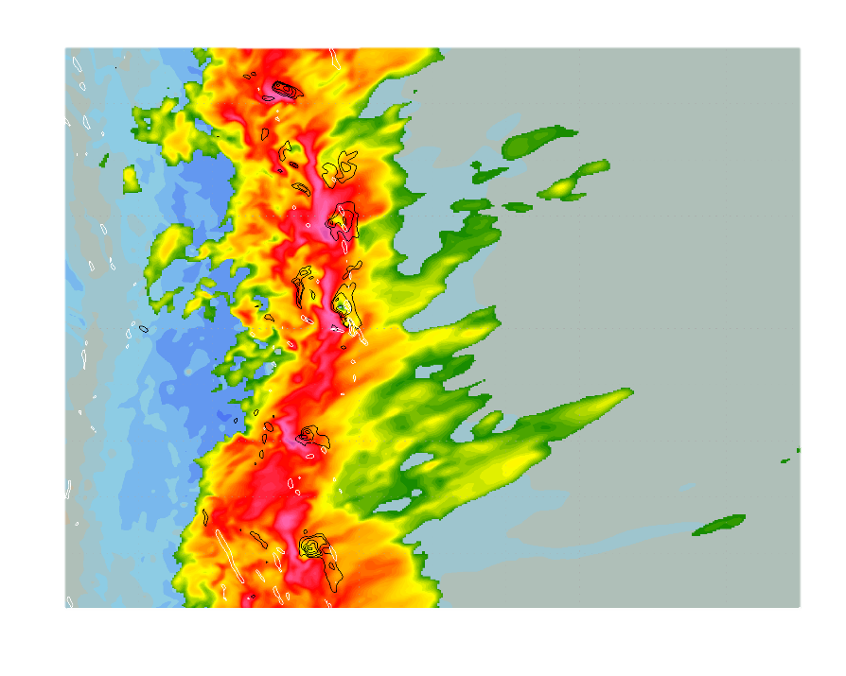
Idealized simulations: Results
Black contours: 1-km vertical velocity
White contours: 10-m vertical vorticity
Reflectivity (dBZ)
Surface θ’ (K)
-LLs
-MLs
-LLc
+LLs
+MLs
+LLc

Slide 22
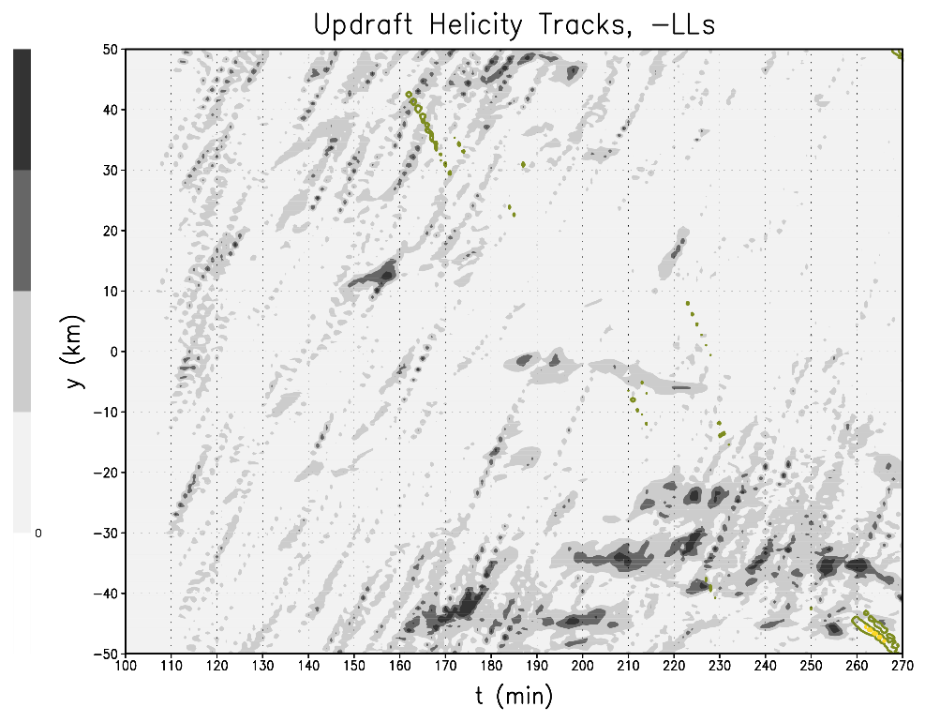
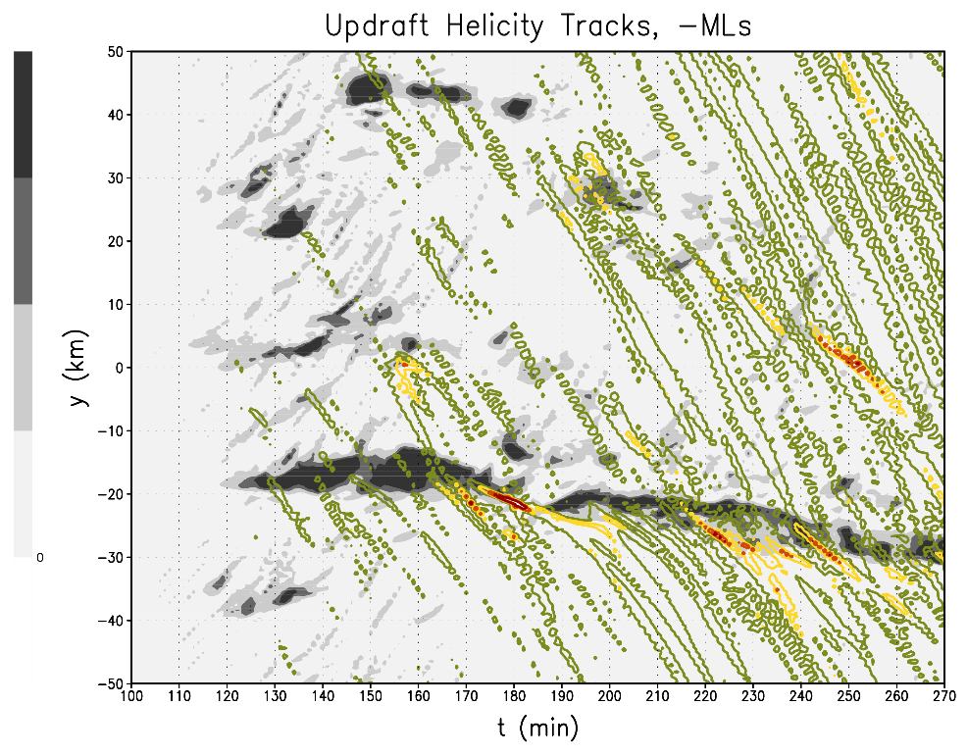
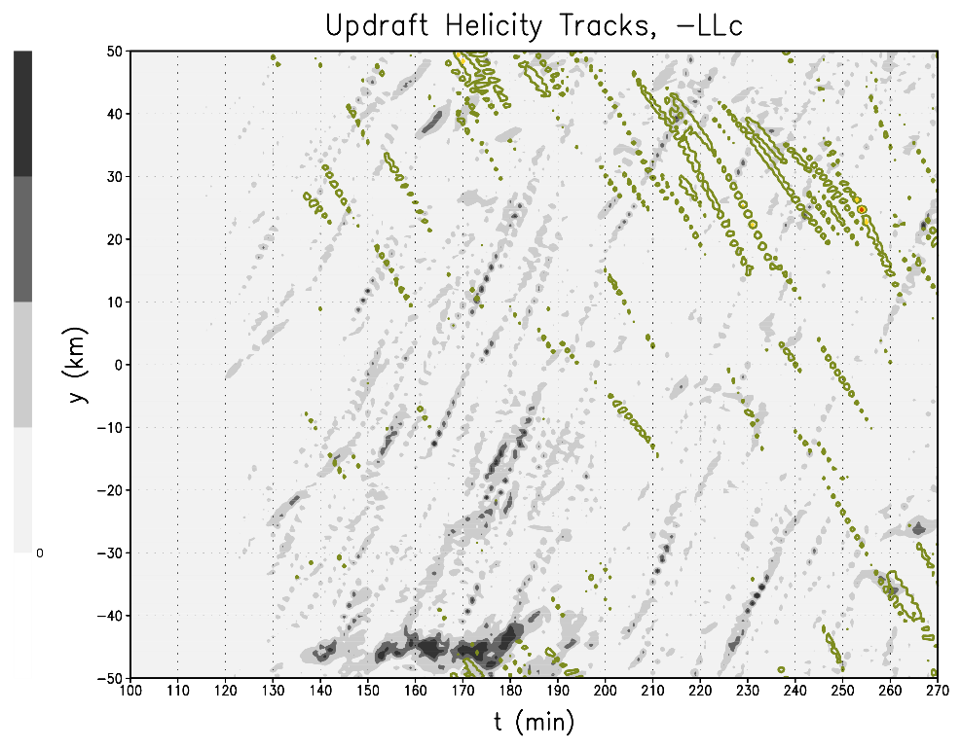
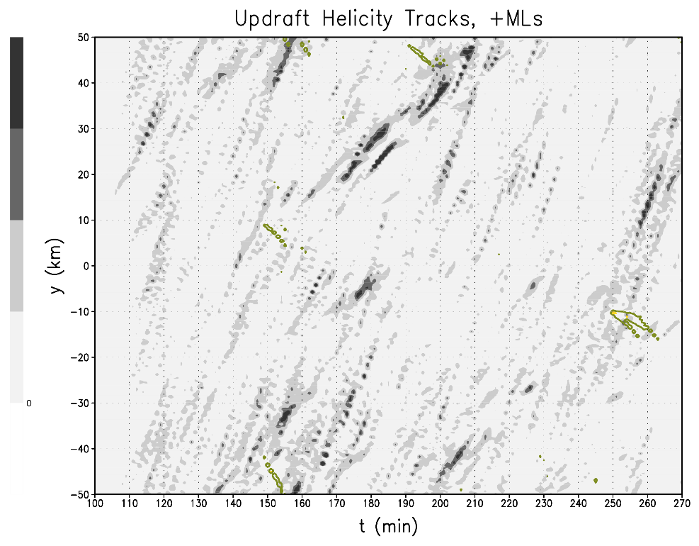
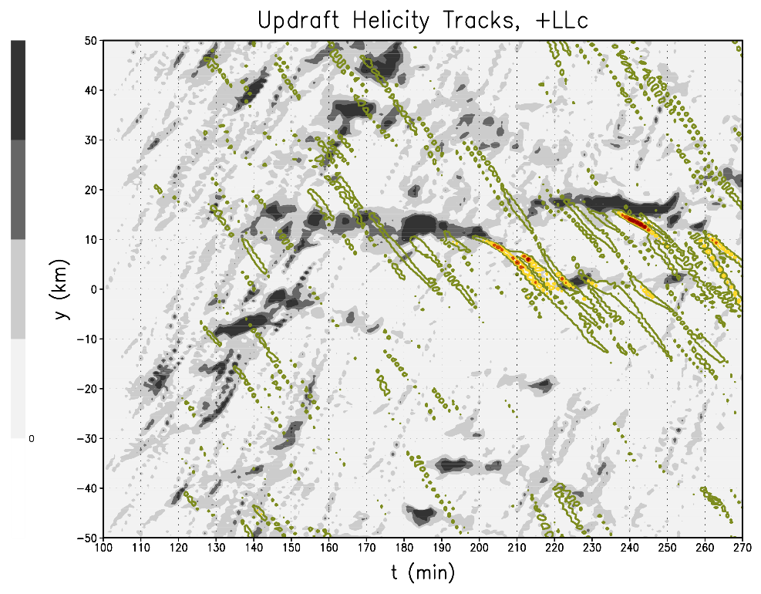
Idealized simulations: Results
ζ = 0.02 s⁻¹ 0.04 s⁻¹ 0.06 s⁻¹ 0.08 s⁻¹
1000
750
500
250
0
1000
750
500
250
0

Slide 23
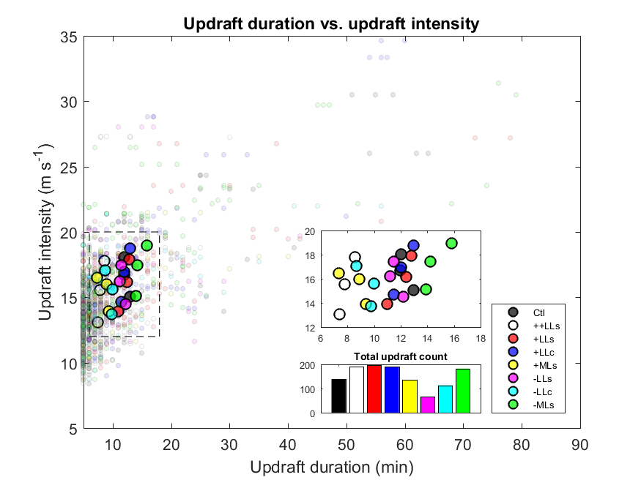
Idealized simulations: Results
zoomed

Slide 24
Idealized simulations: Ongoing tests
Control
Maintain hodograph shape, vary orientation
relative to initiating boundary
Similar to prior hodograph sensitivity tests, but based upon control hodograph in this matrix
Maintain hodograph shape,
vary diameter of “ball cap”

Slide 25
Statistical modeling: Research questions
Two primary questions:
Are there statistically significant differences between a tornado-producing environment and an null environment at operational grid lengths, as described by a set of pre-selected variables in HSLC severe environments?
What statistical techniques (and in what order/combination) can identify predictive variables, as well as determine the variables’ corresponding weights of influence, to differentiate severe/nonsevere environments?
Techniques include: Clustering, linear regression, development of statistical models
Clustering technique

Slide 26
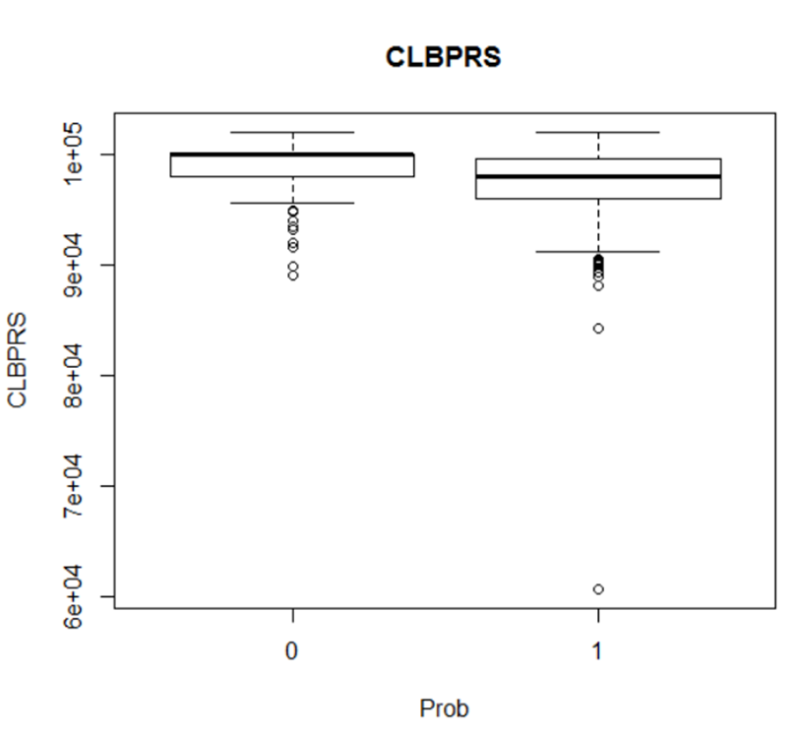
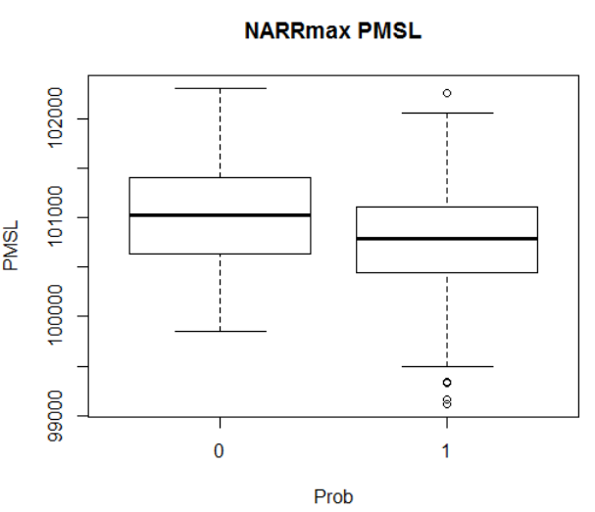
Statistical modeling: Preliminary results
0 = null
1 = tornado report
Discriminators that were identified across several techniques/datasets
Proxy for upper-level forcing?
Proxy for low-level stability?
Proxy for synoptic-scale forcing/shear/advection?

Slide 27
Summary
Five components:
Composite maps and parameters (Sherburn et al. 2017):
Favorable environment coupled with strong synoptic-scale forcing for ascent critical in discriminating between severe/nonsevere
Combined factors distilled into MOSHE parameter available in beta form on SPC Mesoanalysis; adjustments maybe coming
Process studies 1: Case simulations to study mesoscale/synoptic scale evolution (King et al. 2017)
Rapid destabilization evident in narrow temporal/spatial zone ahead of severe convection
Low-level θ_{e} advection and/or release of potential instability responsible for this destabilization
NWP studies: Case simulations to investigate resolution requirements
3.6-km, 1.2-km, and 400-m domains all represent convective mode and structure fairly well
From 3.6-km to 1.2-km grid spacing, potential convergence of solution
Process studies 2: Idealized simulations to study convective-scale dynamics
Sensitivity studies aimed at understanding prior environmental discriminators
Increasing low-level shear or lapse rates appears to increase potential for strong low-level updrafts and vortices to interact
Statistical studies: Dynamical-statistical downscaling to investigate predictability
In progress; several factors indicate large-scale forcing and low-level stability again among most important considerations

