Slide 1
NWC Enterprise GIS and Visualization Services
JANUARY 22, 2020
Presenters: Mark Glaudemans, Fernando Salas, Corey Krewson
Geo-Intelligence Division, NOAA/NWS Office of Water Prediction

Slide 2
Acknowledgements Space Laura Keys, Corey Krewson, Zach Wills, Brad Bates, Brian Cosgrove, Shawn Crawley, Whitney Flynn, Derek Giardino, Dave Gochis, Monica Stone, Mark Glaudemans, Darone Jones, Trey Flowers, Ed Clark, Tom Graziano Space Large integrated team across: Office of Water Prediction (OWP), West Gulf River Forecast Center (WGRFC), Southern Region HQ, NCEP, Lynker, Esri, UCAR/NCAR and others

Slide 3
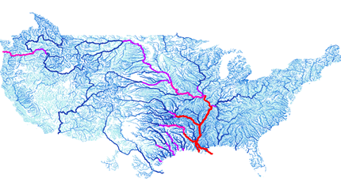
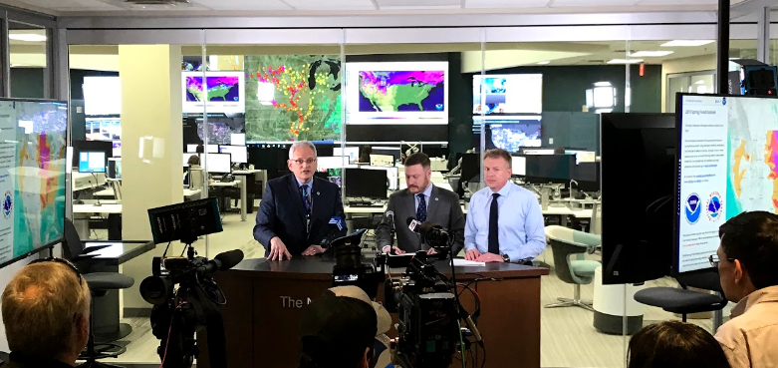
Evolving NWS Hydrologic Services
Water Prediction Services - Centralized summit to sea water prediction capabaility through the establishment of the National Water Model.
Water Resources Data Services – Spatial and temporal data services providing access to multidimensional hydrologic datasets and value added information.
Impact Based Decision Support Services – Operational support helping partners understand depth of hydrologic forecast across scales of space and time.

Slide 4
NOAA/NWS National Water Model
Domains
Contiguous U.S.
Hawaii
Operational Configurations
Analysis (Nowcast)
Short-Range (18-hr forecast)
Medium-Range (10-day ensemble forecast)
Long-Range (30-day ensemble forecast)
Multi-decade Reanalysis Simulation
Driven by downscaled NLDAS forcing. Future versions will driven by Analysis of Record for Calibration (AORC) dataset.

Slide 5
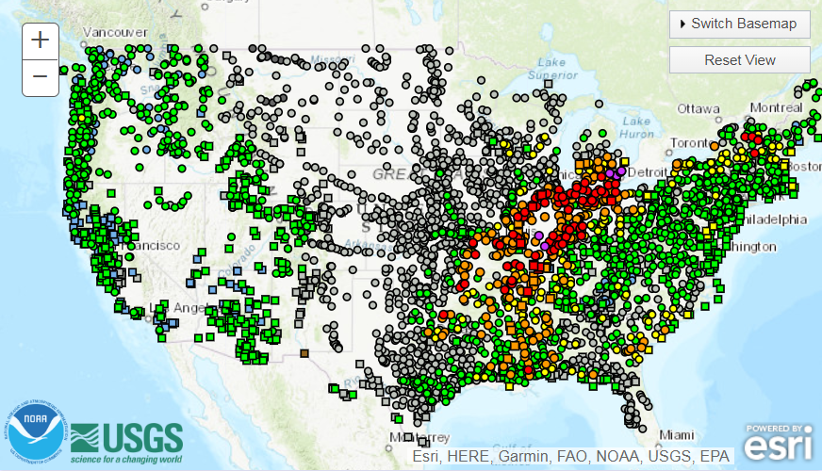
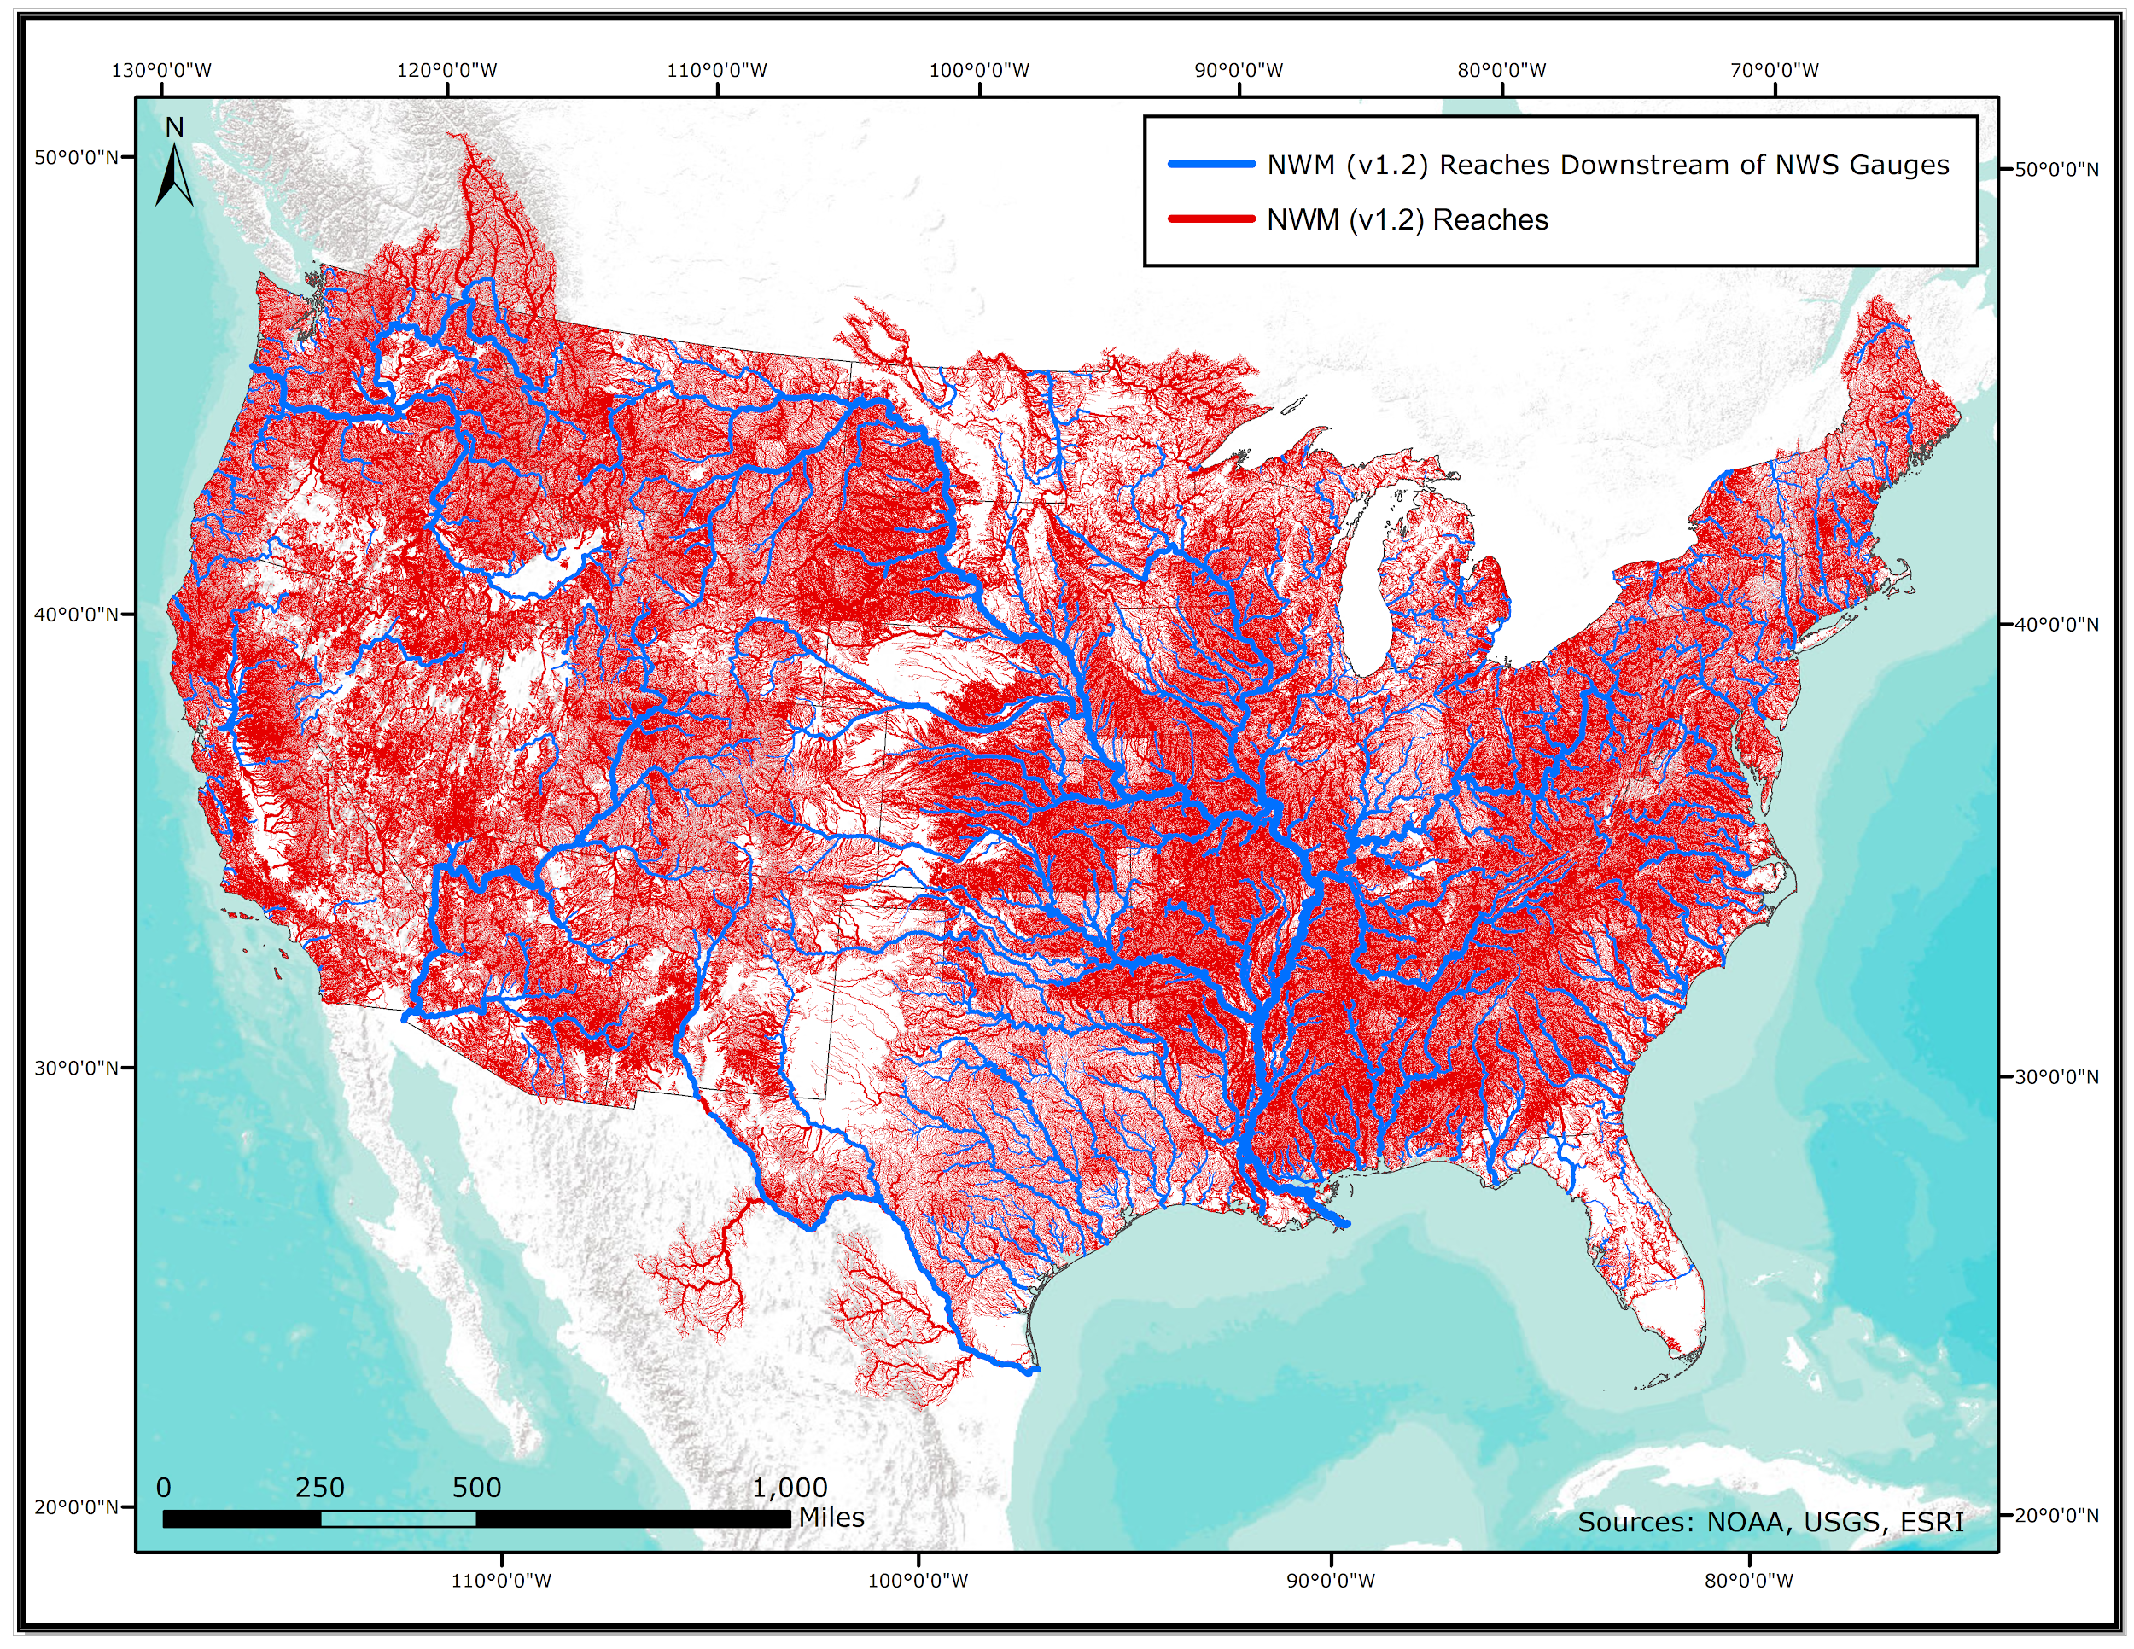
Complimentary Hydrologic Prediction Systems
Advanced Hydrologic
Predictions Service
Route
Replace
and
1 forecast point for every 1,000 river miles
National Water Model

Slide 6
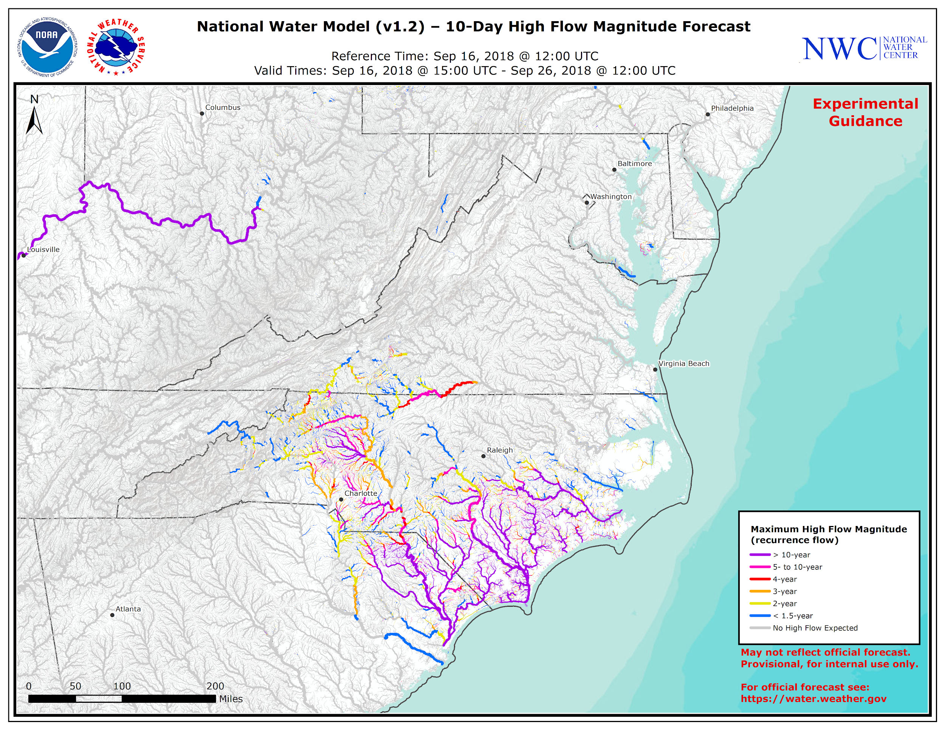
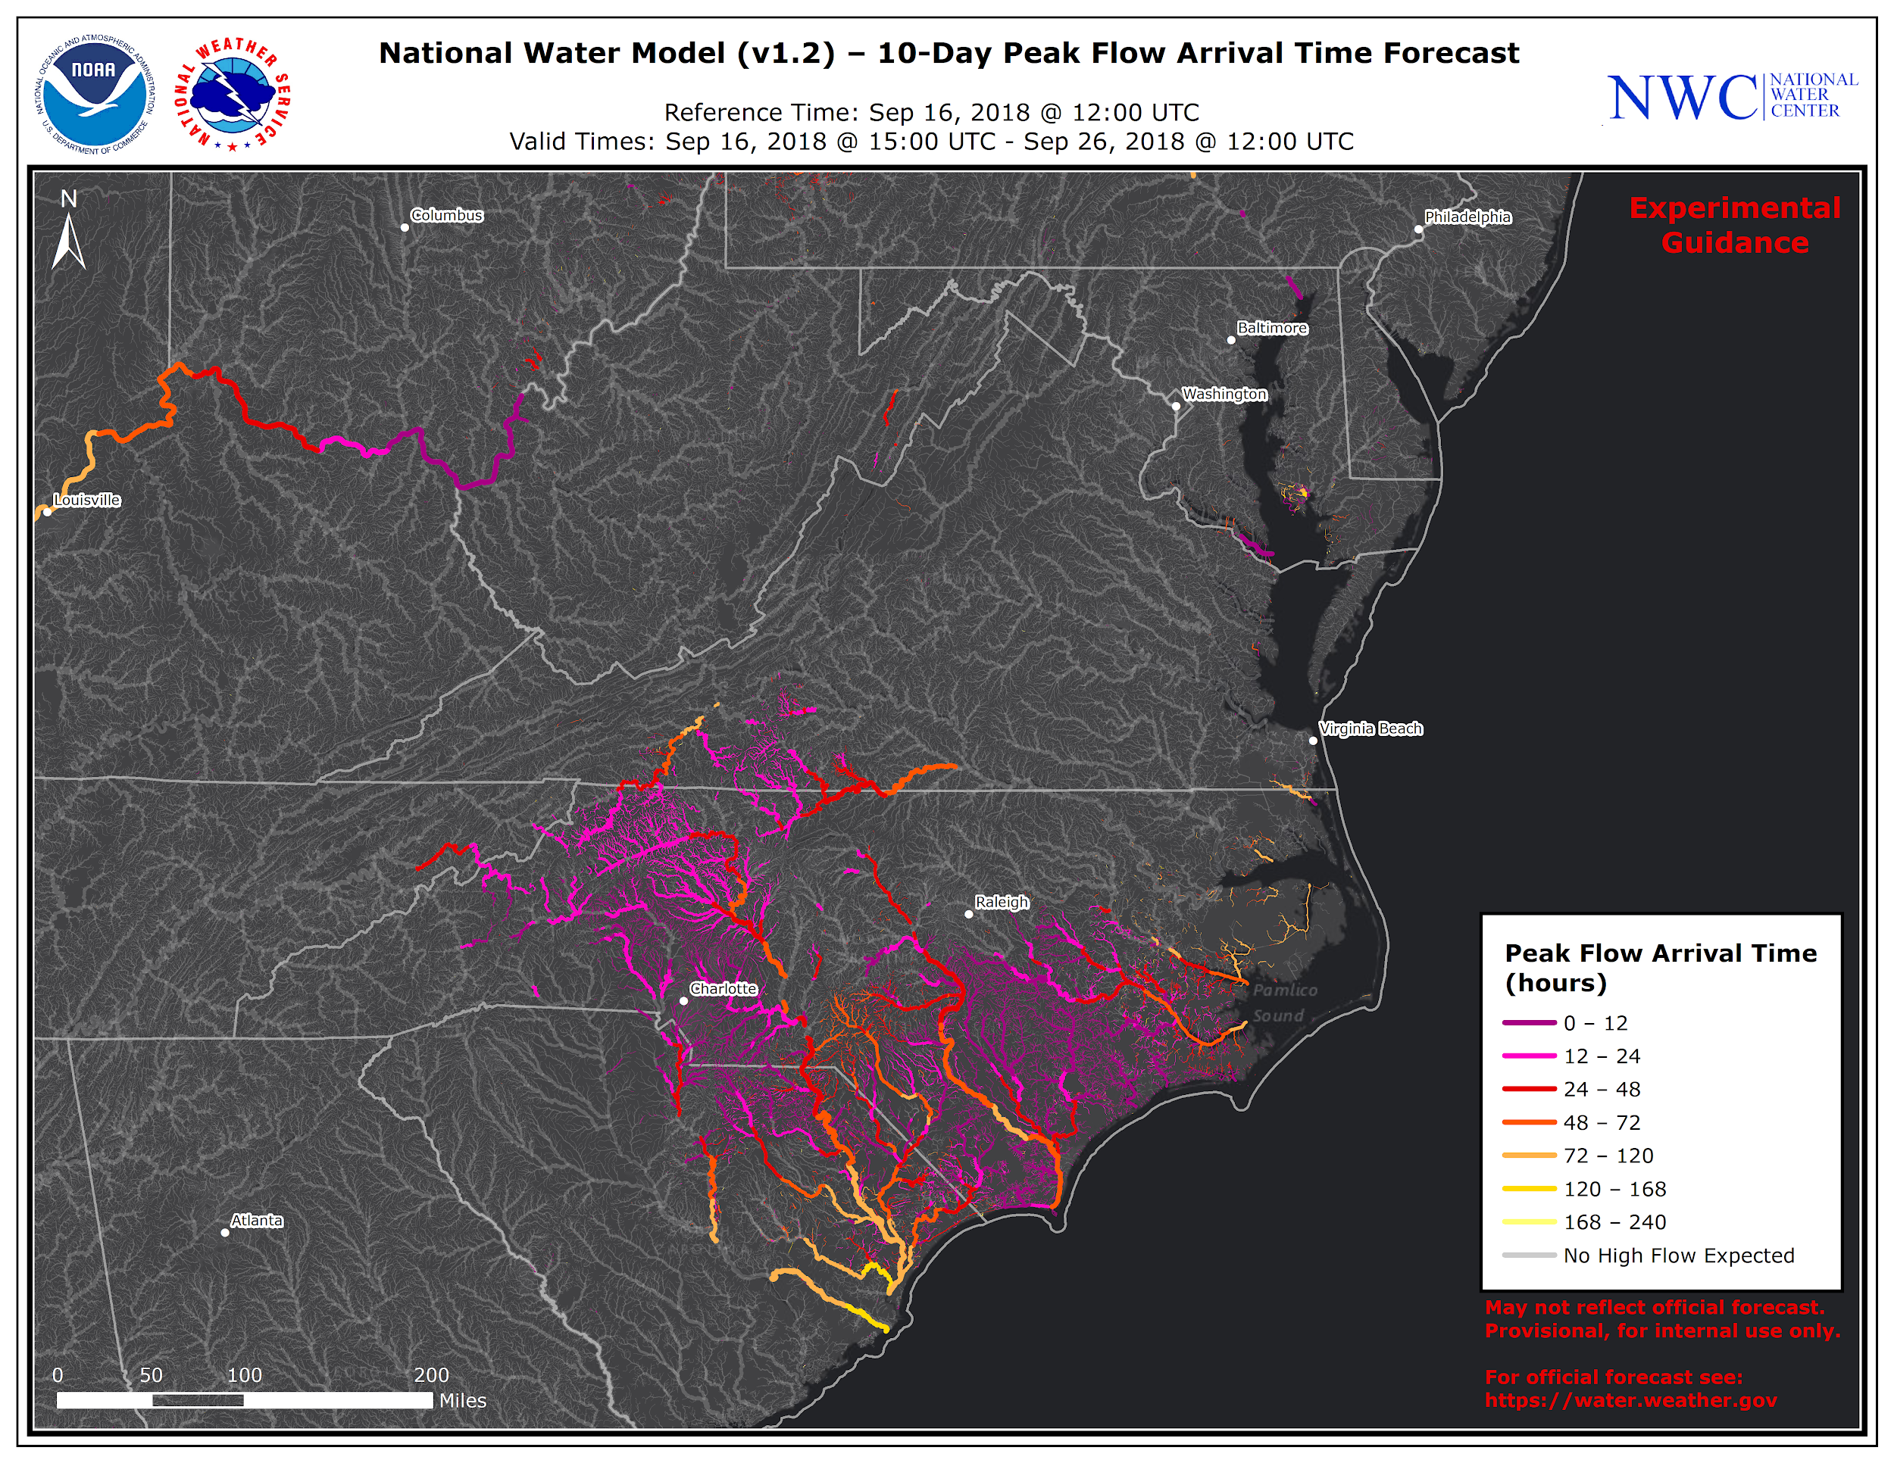
Synthesizing Hydrologic Forecasts
Legend
Legend
> 10% Exceedacnce
0-12 hours
When will the
event occur?
> 20% Exceedacnce
12-24 hours
> 25% Exceedacnce
24-48 hours
Where is the event?
How bad?
48-72 hours
> 33% Exceedacnce
> 50% Exceedacnce
72-120 hours
> Bankfull
> 120 hours
What is the probability
of the event?
Where?
When?
10-Day High Flow Magnitude
10-Day High Flow Arrival Time

Slide 7
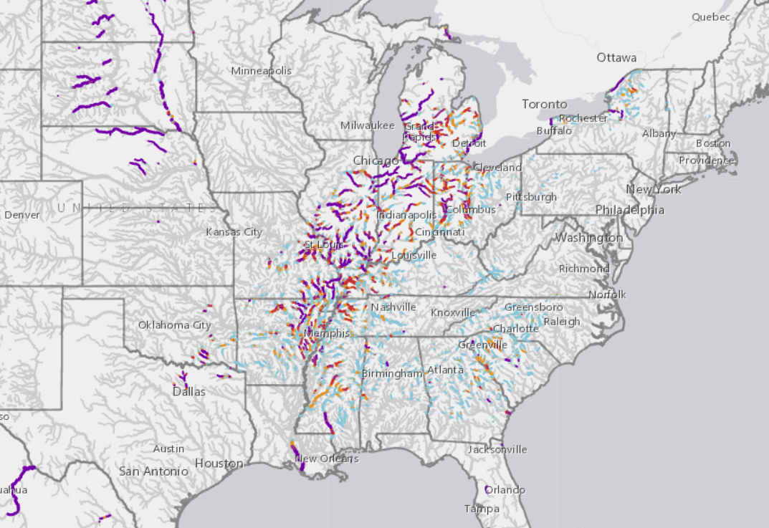
Synthesizing Hydrologic Forecasts
Legend
> 80% Probability
60 – 80% Probability
40 – 60% Probability
20 – 40% Probability
0 – 20% Probability
10-Day High Flow Probability

Slide 8
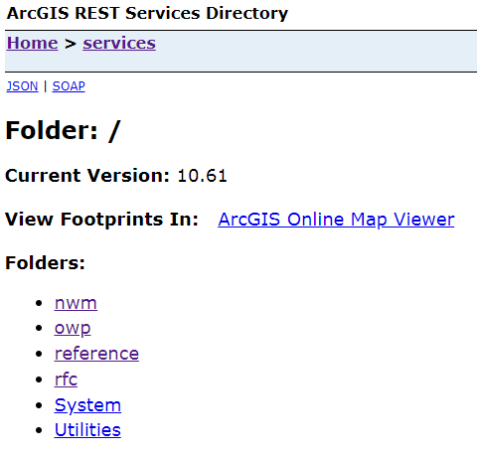
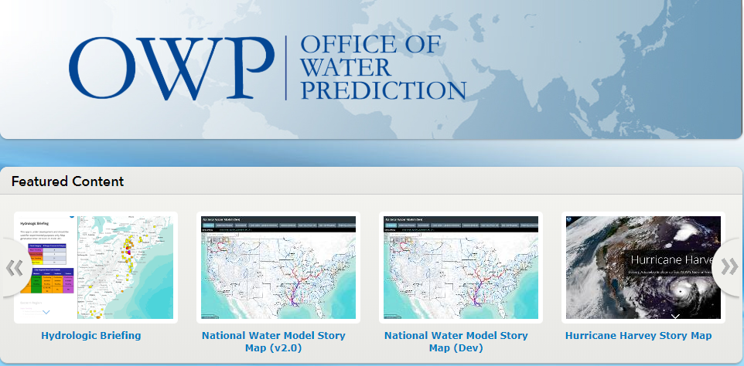
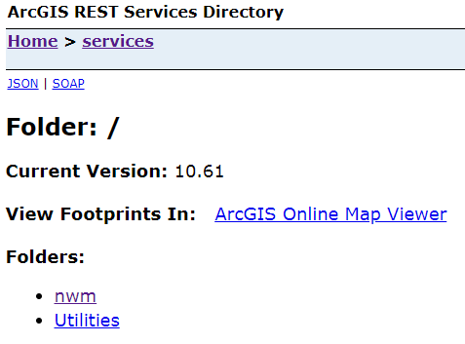
National Water Center Enterprise GIS (EGIS)
Map Server
Portal
Image
Server

Slide 9
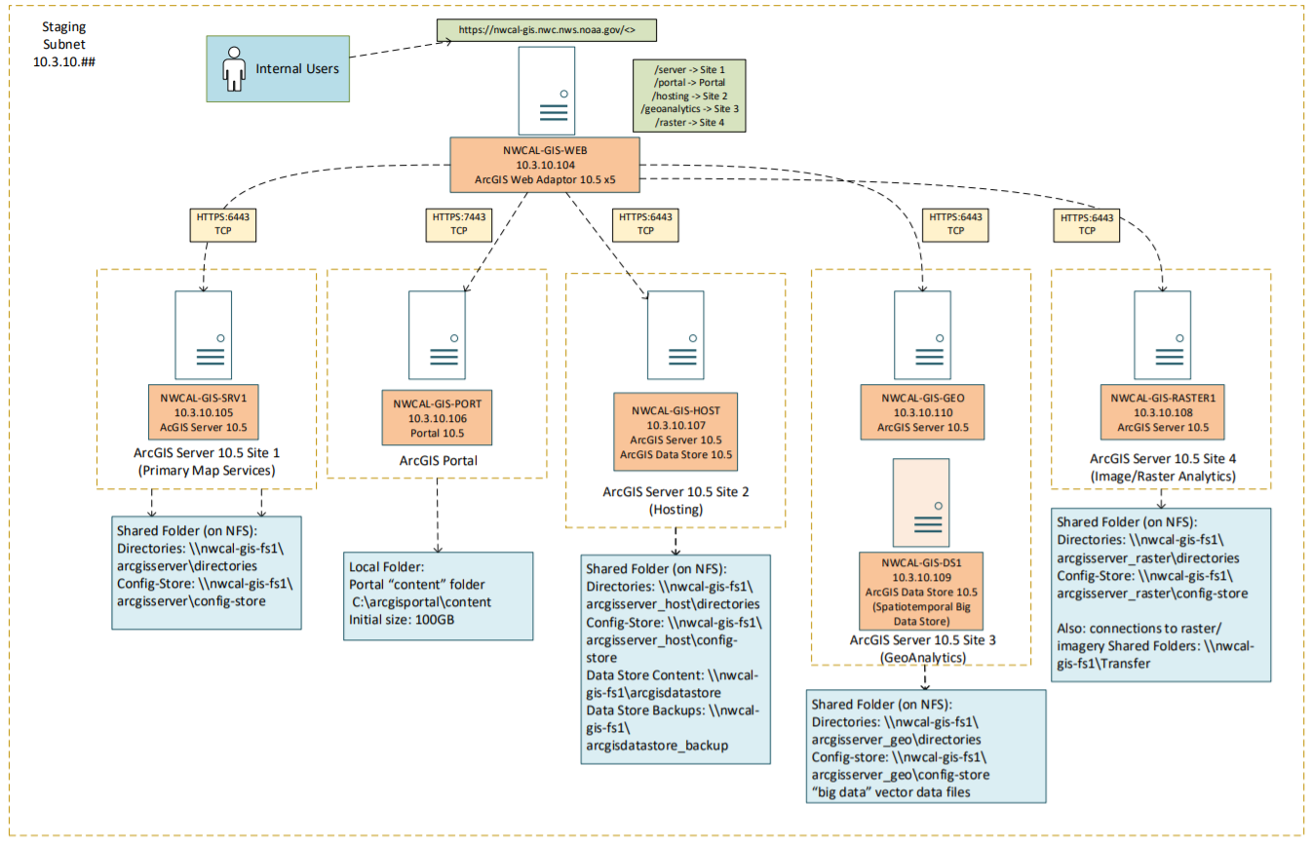
Web
Server
NWC EGIS v1.0
Primary Server
Portal
Server
HostingServer
Image
Server
Federated Federated
ArcGIS Enterprise 10.5.1

Slide 10
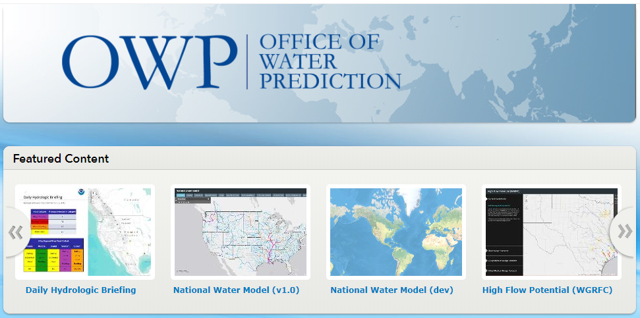
Visualization Processing Servers
nwcal-gis-proc1
nwcal-gis-proc4
NWC dstore
Watch and pull data
Data and Processing
Esri File GDBs
Launch Processes
Viz Processing
Pipeline
EGIS Data
\\nwcal-gis-fs1\Transfer\primary\data\*
\\nwcal-gis-fs1\Transfer\image\data\*
ArcGIS Enterprise Servers
nwcal-gis-srv1 (Primary Map Services)
nwcal-gis-raster1 (Raster Analytics)
nwcal-gis-geo (GeoAnalytics)
nwcal-gis-port (ArcGIS Portal)
nwcal-gis-host (Hosting)
Data and
Web Services
Create Service
Definitions
Note: Pink indicates function of NWM-Viz Processing Pipeline
Update Apps
Publish Services/
Update
Services
Load Balancer/Reverse Proxy
ArcGIS Web Adapter (nwcal-gis-web)
Web Service Interface
Examples (REST)
https://nwcal-gis-web.nwc.nws.noaa.gov/server/rest/services/nwm_v11/ana_v11_anomaly_v20/MapServer
https://nwcal-gis-web.nwc.nws.noaa.gov/raster/rest/services/nwm_v11/ana_v11_soil_moisture_v10/MapServer
NOAA Geoplatform
http://noaa.maps.arcgis.com/home/index.html
NWC Portal for ArcGIS
https://nwcal-gis-web.nwc.nws.noaa.gov/portal/home/
Maps, Apps and
Platforms
Web Maps/
Web Apps
Web Maps/
Web Apps
Users, Apps and Platforms
NWC and VPN Users

Slide 11
Visualization Processing Server (production)
NWC dstore
Visualization Processing Server (dev)
Data and Processing
Watch and Pull Data
Watch and Pull Data
Copy
Mount
NWM-Viz Processing
Pipeline
NWM-Viz Processing
Pipeline
Firewall 1
File
GDBs
ArcGIS Enterprise
Servers
At least two primary
servers
ArcGIS Enterprise
Servers
nwcal-gis-srv1 (Primary)
nwcal-gis-raster1 (Raster)
nwcal-gis-geo (Geo)
nwcal-gis-port (Portal)
nwcal-gis-host (Hosting)
EGIS Data
\\nwcal-gis-fs1\Transfer\*
Data and
Web Services
File
GDBs
EGIS Data
Note: Pink indicates function of NWM-Viz Processing Pipeline
Update
Services
DMZ
Behind NWC
Firewalls
Update
Services
Load Balancer/Reverse Proxy
HAProxy/NGINX
ArcGIS Web Adapter (nwcal-gis-web)
Web Service Interface
Examples (REST)
https://xxx.nwc.nws.noaa.gov/server/rest/services/
(“Public NWS” Map Service URL)
https://nwcal-gis-web.nwc.nws.noaa.gov/server/rest/services/
(NWC Map Service URL)
Firewall 2
NOAA Geoplatform
http://noaa.maps.arcgis.com/home/index.html
NWC Portal for ArcGIS
https://nwcal-gis-web.nwc.nws.noaa.gov/portal/home/
Maps, Apps and
Platforms
Web Maps/
Web Apps
Web Maps/
Web Apps
Users, Apps and Platforms
NWC/VPN
Local Users
NWC/VPN
Users, Apps and Platforms
NWC/VPN and WGRFC, WPC etc.

Slide 12
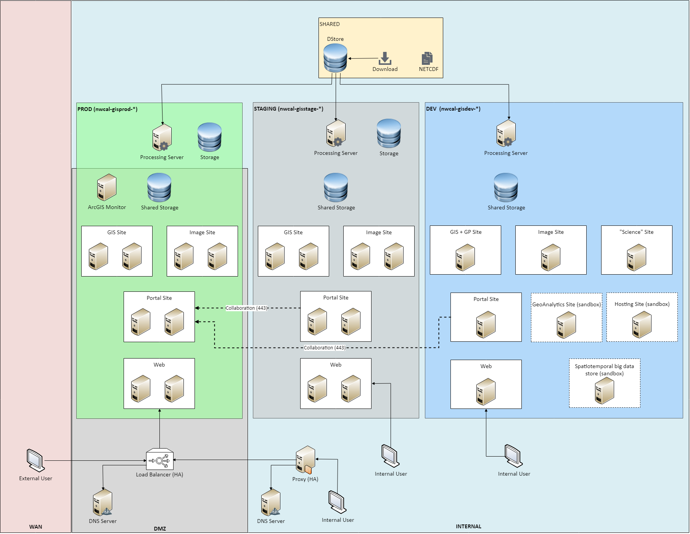
NWC EGIS v2.0
ArcGIS
Enterprise 10.6.1

Slide 13
Quick Demo…

Slide 14
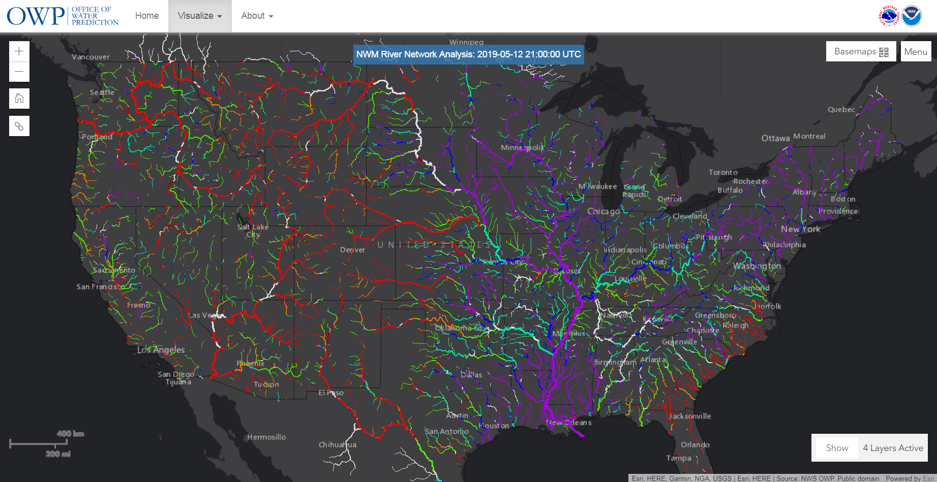
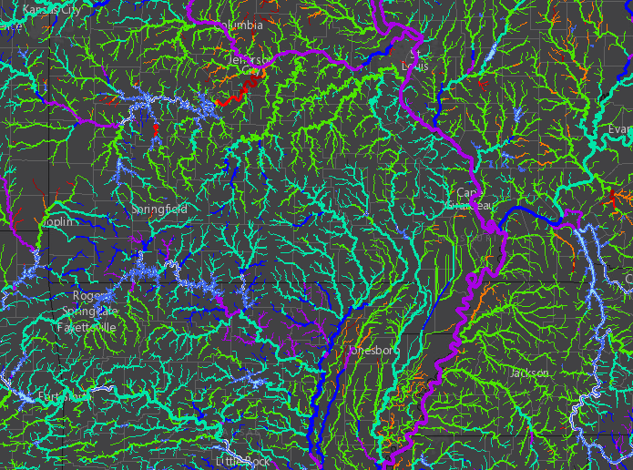
NWM Guidance on water.noaa.gov

Slide 15
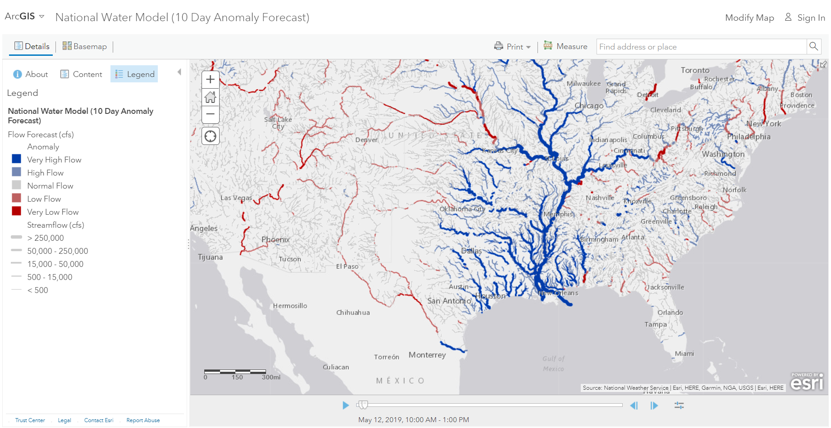
NWM Guidance in Esri Living Atlas
Source: Esri Living Atlas

Slide 16
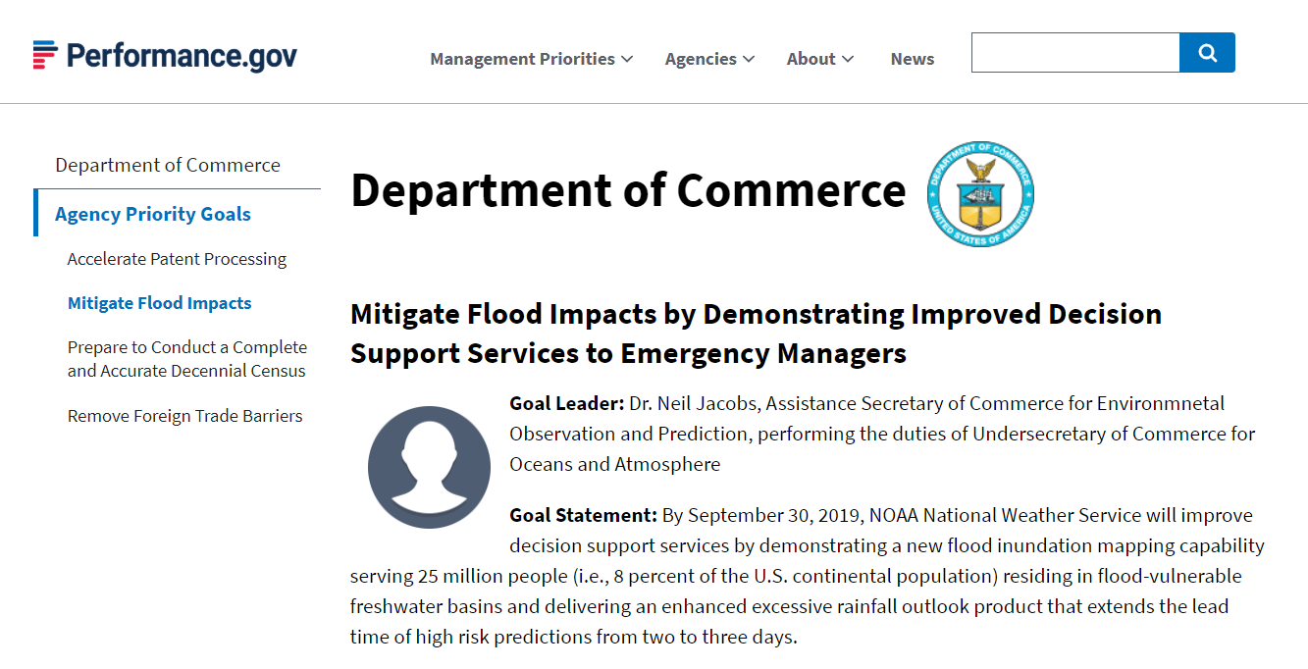

Slide 17
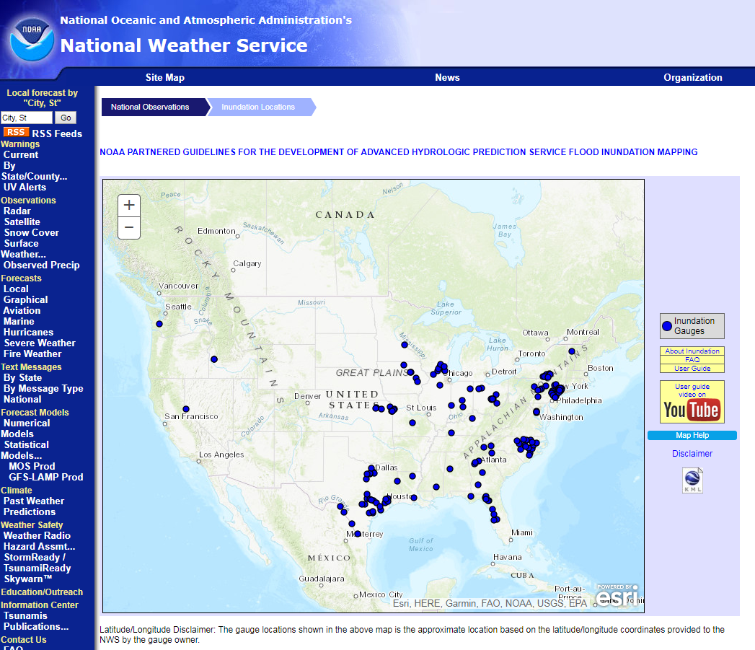
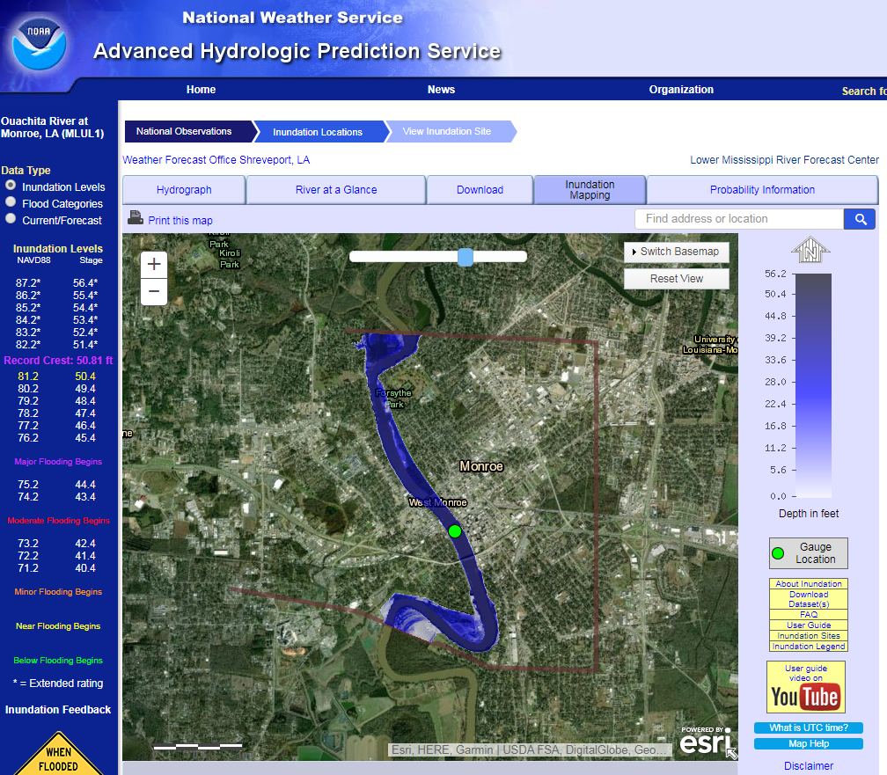
AHPS Flood Inundation Map Libraries

Slide 18
Height Above Nearest Drainage (HAND)
80.1
80.2
80.3
0.1
0.1
0.2
0.2
0.3
0.3
2.1
2.1
80.1
80
80
80.5
0.1
0.1
0
0
0
0
0.5
0.5
2.1
HAND = 2
HAND
Geospatial
HAND = 1
80.8
79
78.6
1.2
1.2
0.8
0.8
0
0
0.6
0.6
1.5
1.5
78.3
78
76.2
Processing
2.1
1.3
1.3
0.3
0.3
0
0
0.2
0.2
76.1
76
3.1
2.5
1.2
1.2
0.1
0.1
0
0
Height Above Mean Sea Level (MSL)
Height Above River (nearest drainage)
Notes:
Infer

Slide 19
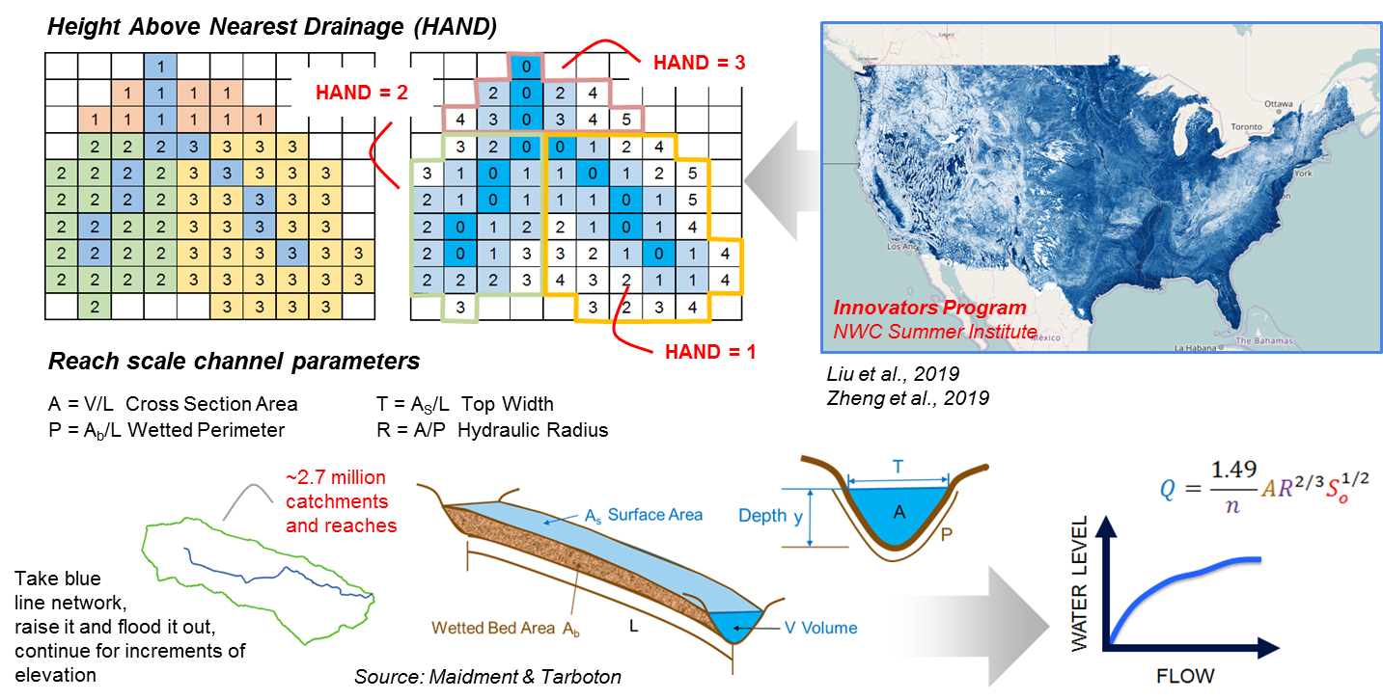

Slide 20
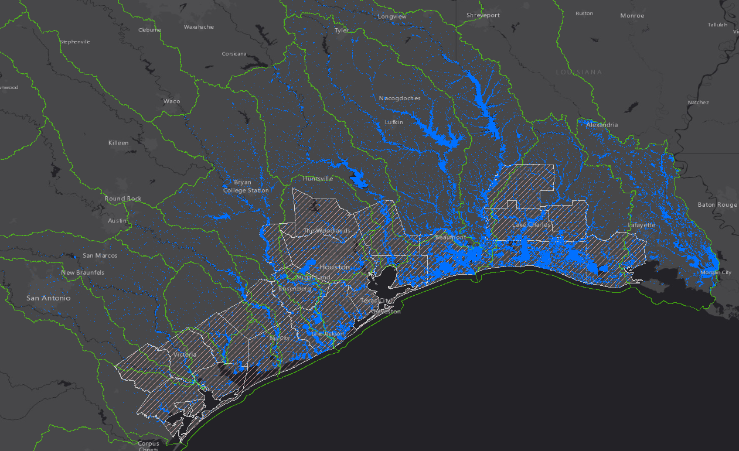

Slide 21
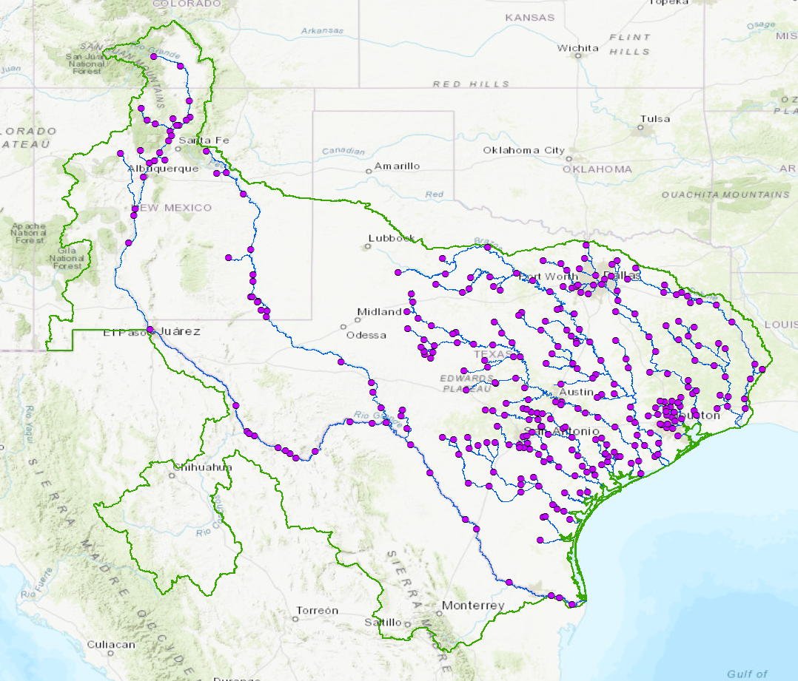
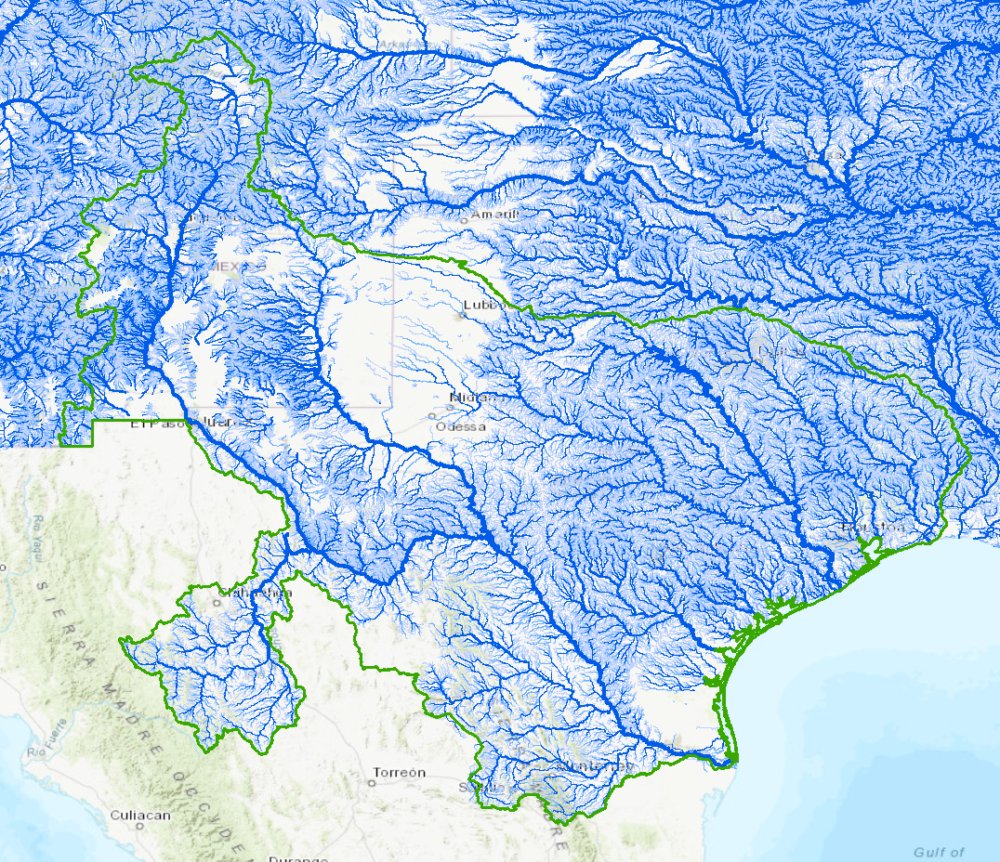
Modeling Domains for Texas/WGRFC
~ 8k guidance points based on 336 AHPS forecast points
~ 360k guidance points
Replace and Route (RnR)
National Water Model (NWM)

Slide 22
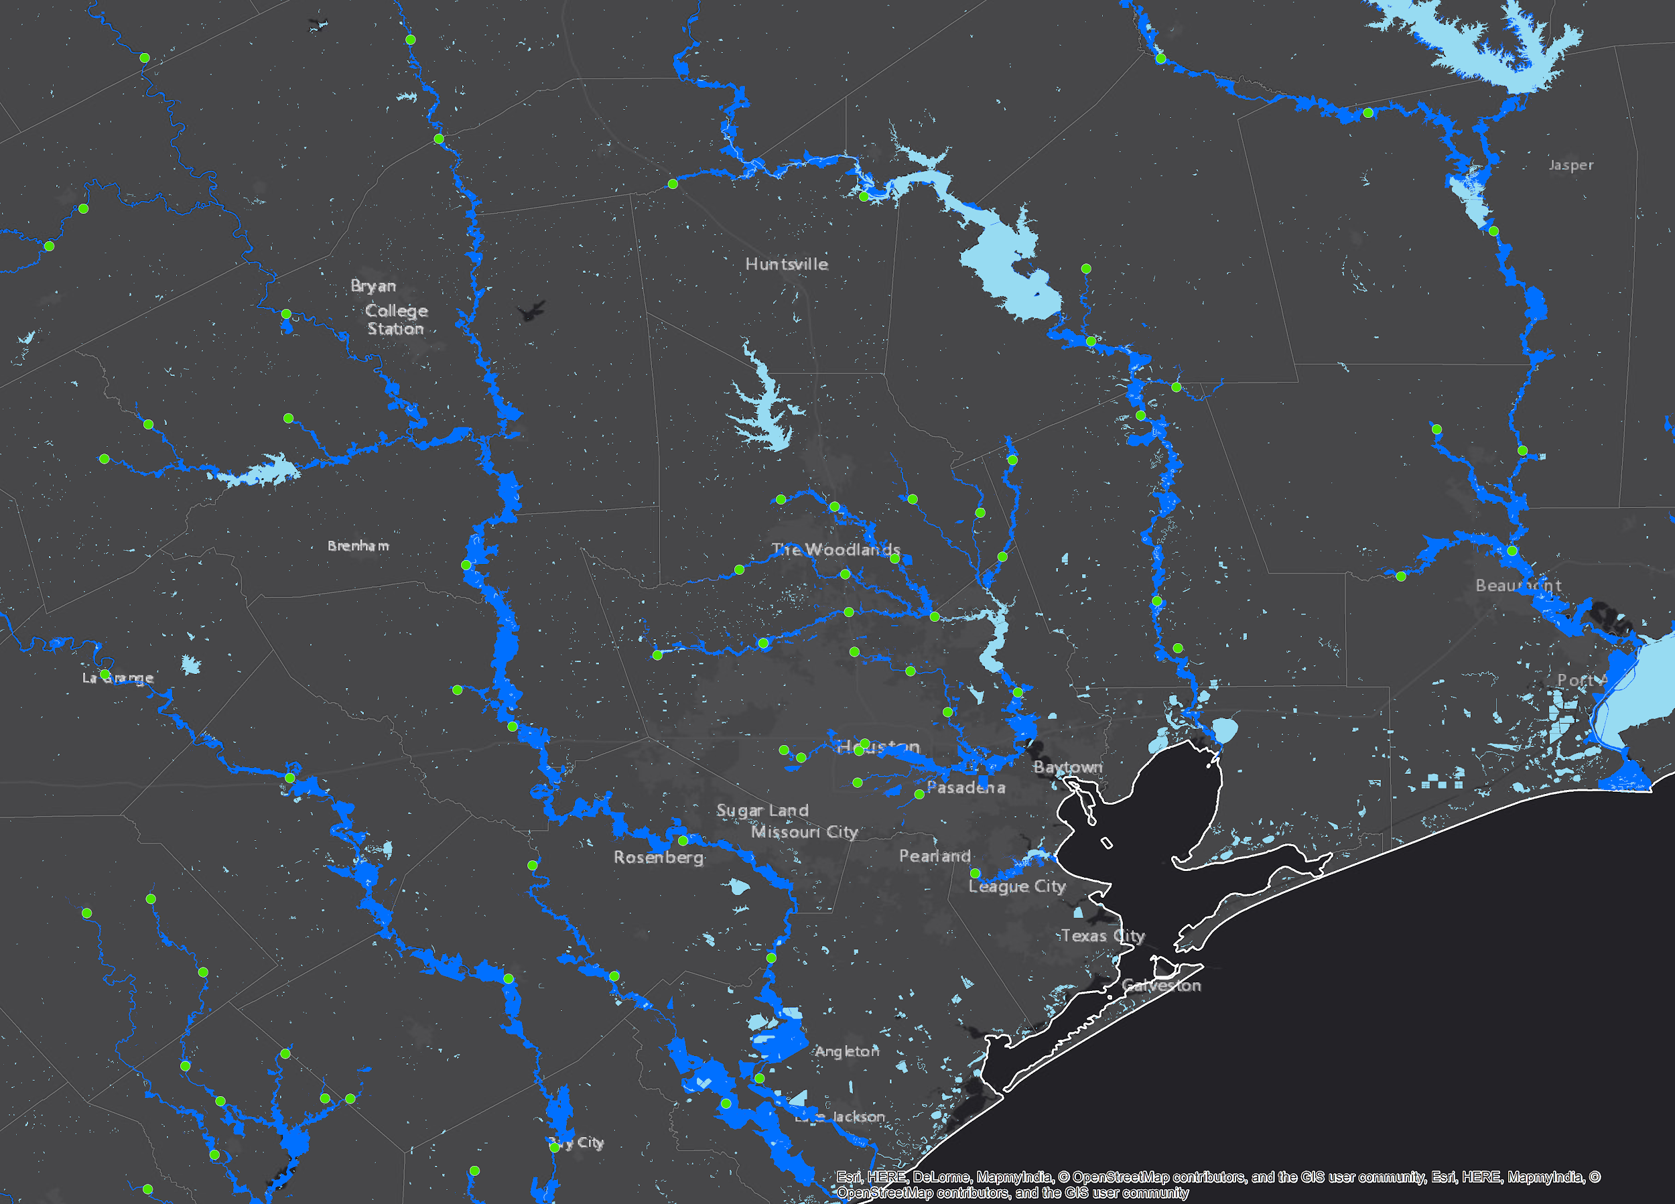
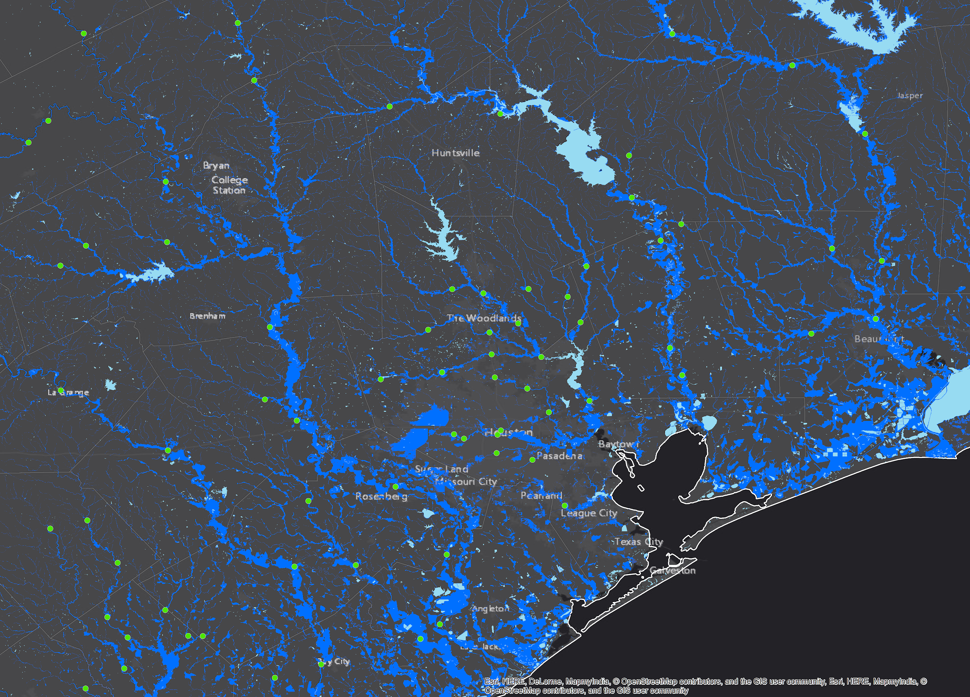
Complimentary Inundation Mapping Systems
Houston, TX
Houston, TX
Replace and Route (RnR)
National Water Model (NWM)

Slide 23
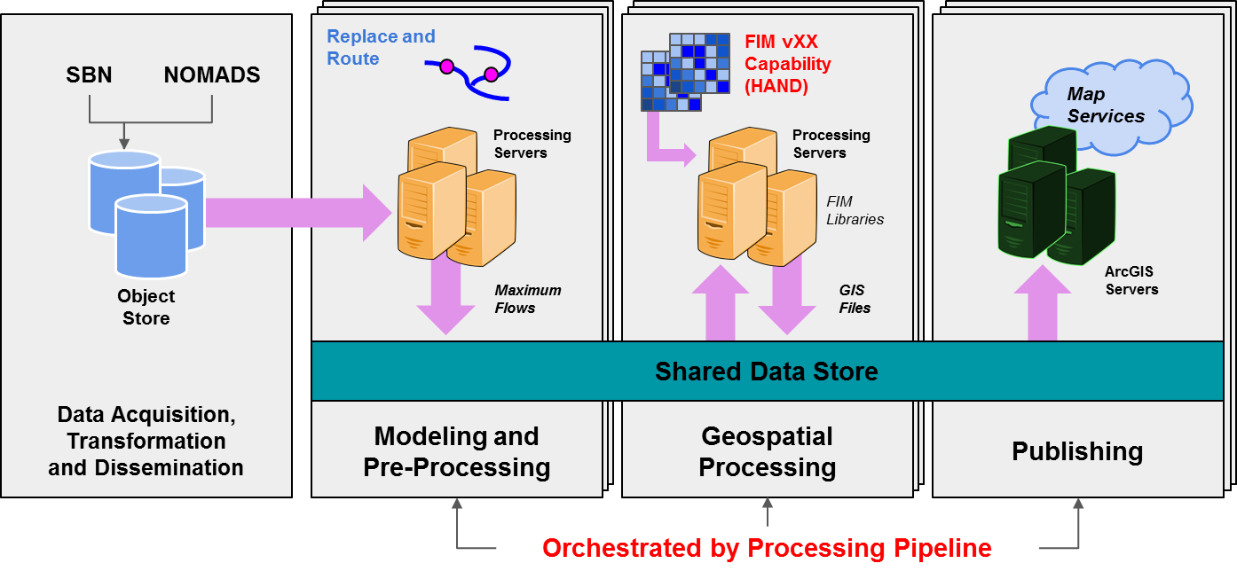
Automated Forecast Inundation Mapping System

Slide 24
Forecast Flood Inundation Map Services
5-Day Forecast Maximum Inundation Extent
RnR
Analysis Inundation Extent (i.e. Nowcast)
18-Hour Forecast Maximum Inundation Extent
3, 5 and 10-Day Forecast Maximum Inundation Extent
NWM

Slide 25
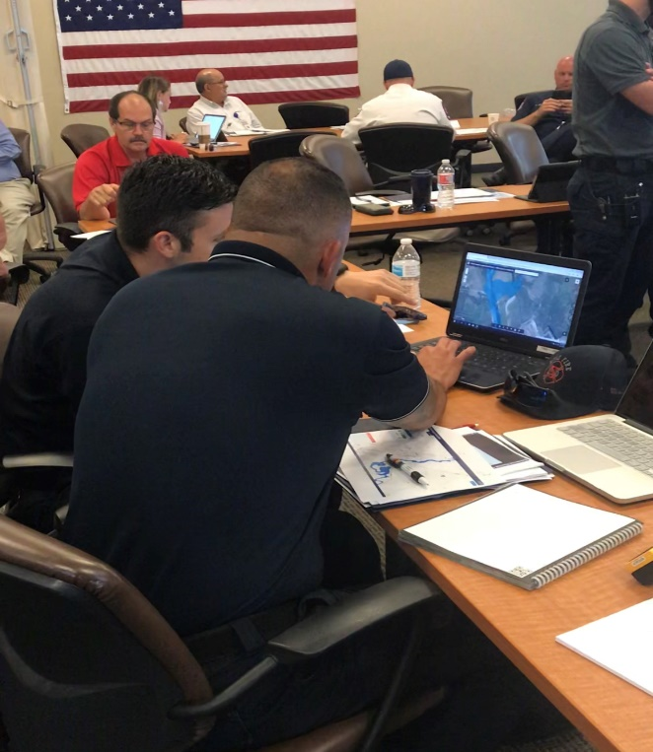
Feedback from Table Top Exercises
Led by NWS Field Offices
Source: Derek G, WGRFC
Depth
What kind of rescue to anticipate.
“If you don’t see the whole picture, bad decisions can be made”
Complete
Implementation
What’s the best way to communicate this? Move towards probabilistic maps?
Confidence
Assessment of past, current and future conditions.
Timing
Velocity
High Water vs. Swift Water
NATIONAL WEATHER SERVICE
Protecting Lives and Property for 150 Years
Building a Weather-Ready Nation //
13

Slide 26
Impact Based Decision Support Services
ON FOOT
IN VEHICLE
IN BOAT
BY HELO
~ 1 Foot
~ 3 Foot
~ 6 Foot
~ 9 Foot
“How many helicopters, boats, and high profile vehicles and where to send them”
– Texas State Operations Center
Source: D. Giardino, WGRFC

Slide 27
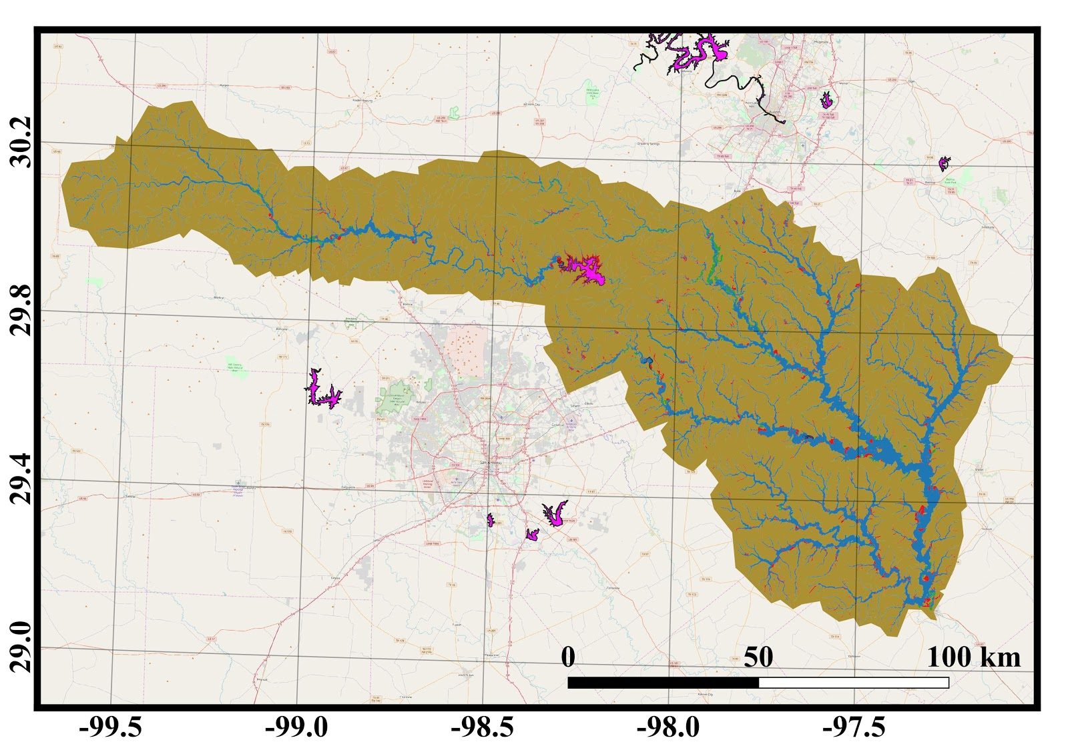
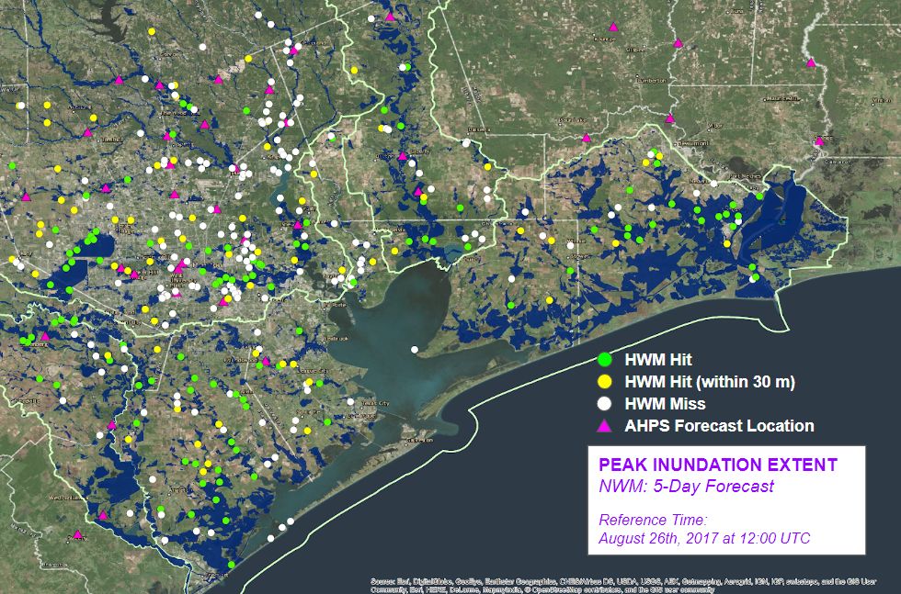
Evaluation of Inundation Map Capabilities
Observed High Water Mark Analsysis
Legend
True Positive
True Negative
False Positive
False Negative
Engineering Scale Hydraulic Models
Model Uncertainty: Weather, Hydrology, Hydraulics, Mapping, Forecast
Observation Uncertainty: Terrain, Image Resolution, Visible Coverage (e.g. cloud and tree cover)

Slide 28
Questions…
Contact:
Fernando Salas – fernando.salas@noaa.gov
Geo-Intelligence Division | NOAA/NWS Office of Water Prediction

