Slide 1

The Joint Hurricane Testbed
Chris Landsea – NOAA/NWS/NCEP/National Hurricane Center
Shirley Murillo – NOAA/OAR/AOML/Hurricane Research Division
The Joint Hurricane Testbed is funded by the US Weather Research Program in NOAA/OAR's Office of Weather and Air Quality
Vlab Forum – November 19, 2014

Slide 2





The Forecasters (Us)
How to bridge the “valley of death”?
The Researchers (Them)

Slide 3
Joint Hurricane Testbed (JHT)
Bridge hurricane research and operations
Began in 2001 under the USWRP
Our Mission: successfully transfer new technology, research results & observational advances from research groups to operational centers
Testing is done at National Hurricane Center or Environmental Modeling center

Slide 4
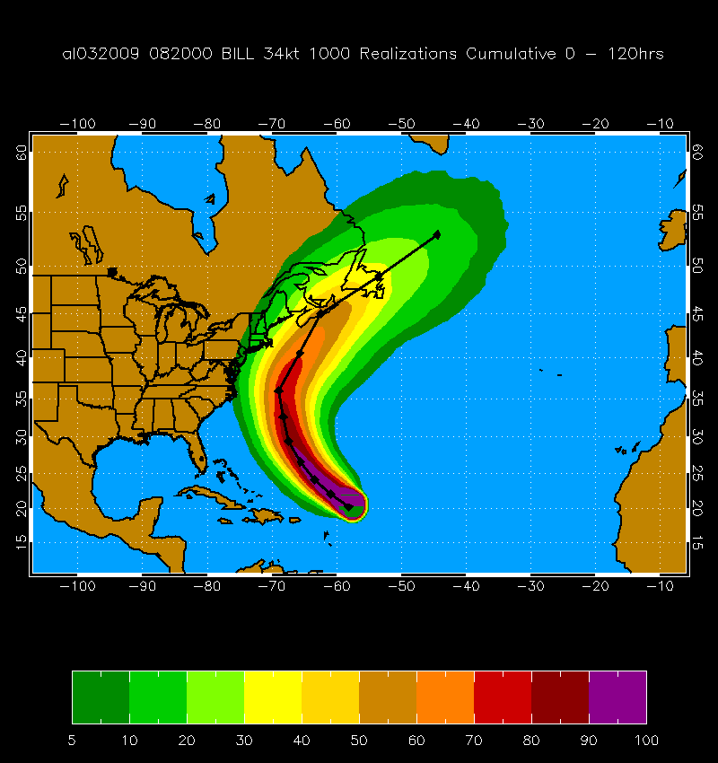
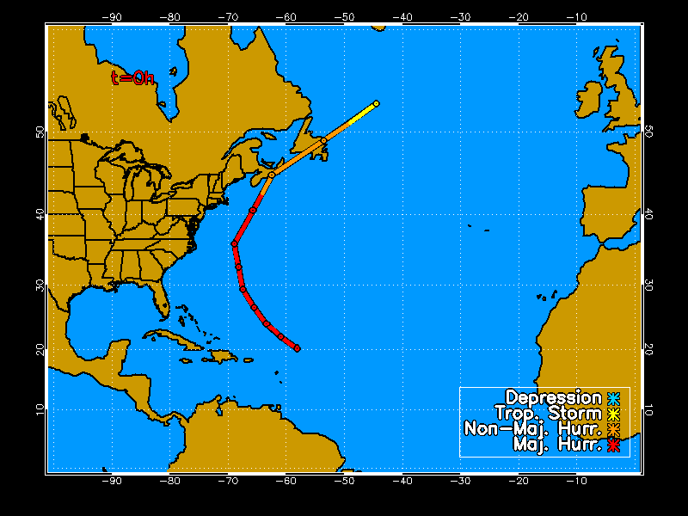
Wind Speed Probabilities
Hurricane Bill 20 Aug 2009 00 UTC
1000 Track Realizations 34 kt 0-120 h Cumulative Prob.

Slide 5

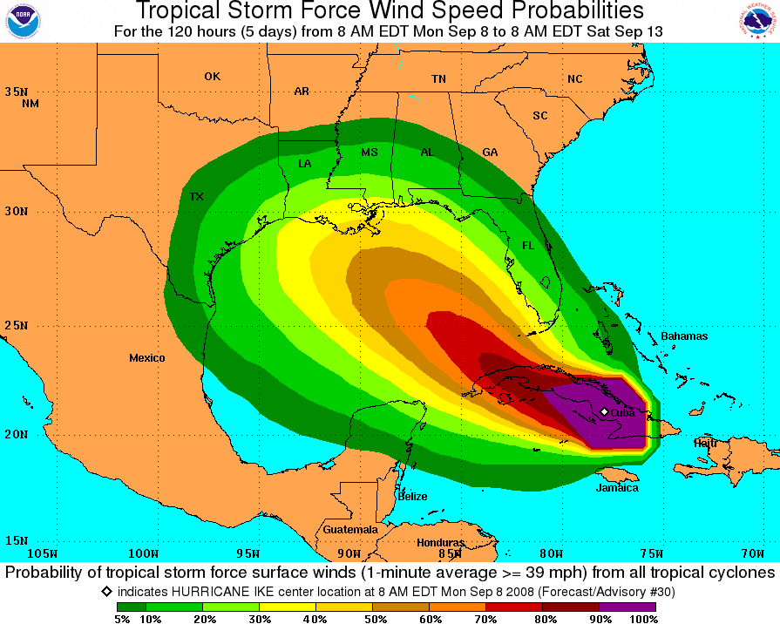
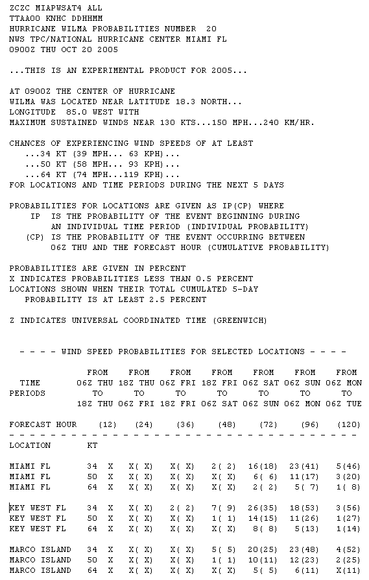
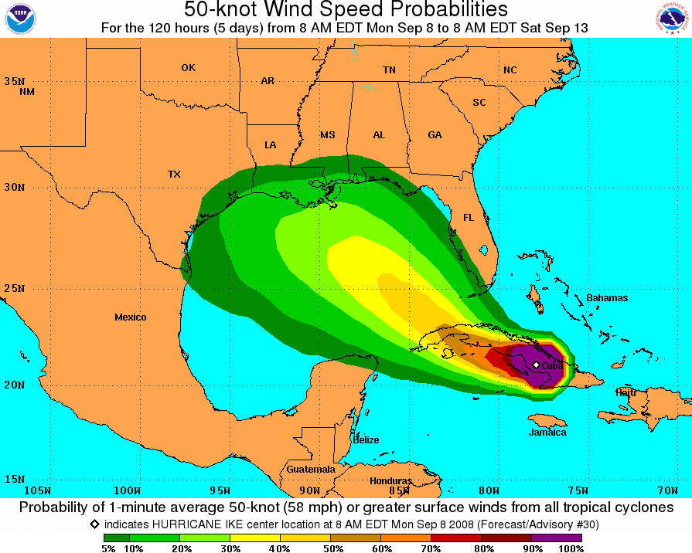
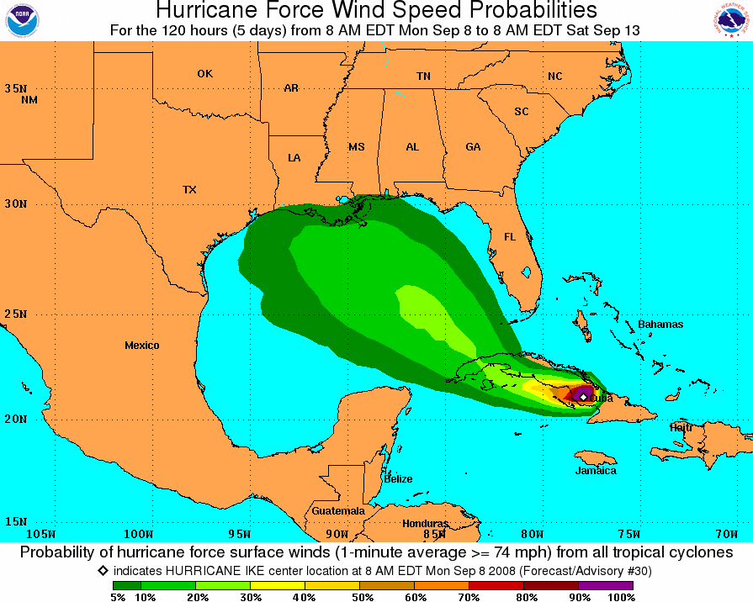
Wind Speed Probabilities

Slide 6
JHT: The Process
Call for Proposals – drafted and disseminated (bi-annually)
Principal Investigators apply for funding through NOAA
7 member Steering Committee rates all proposals
Funded projects are tested during 1 or 2 hurricane seasons in conjunction with NHC/EMC points of contact
At the project’s end, each are evaluated by NHC/EMC staff
Implementation of successful projects are then carried out by NHC/EMC staff/PIs

Slide 7
JHT: The statistics
Number of projects supported: 81
  74 completed
    50 accepted for operational implementation
    9 projects completed but rejected
    10 projects completed, deferred pending further investigation
    5 projects with decisions soon forthcoming
  7 projects started in fall 2013
Implementation
  43 projects implemented:
    13 numerical modeling projects implemented by EMC/NCO
    30 projects implemented by NHC
  5 projects accepted but not yet fully implemented by NHC
  2 projects unable to be implemented after acceptance

Slide 8
On-going JHT Activities
6th Round Projects
  All 12 completed after the 2013 hurricane season
  Implementation decisions being finalized
7th Round Projects
  7 projects begun September 2013
  On-going testing during 2014/2015 hurricane seasons
  Implementation decisions to be made in 2015/2016
8th Round Projects
  New projects to begin September 2015
Notes:
8
Forecast or Analysis Benefit: expected improvement in operational forecast and/or analysis accuracy
Efficiency: adherence to forecaster time constraints and ease of use needs
Compatibility: IT compatibility with operational hardware, software, data, communications, etc.
Sustainability: availability of resources to operate, upgrade, and/or provide support

Slide 9
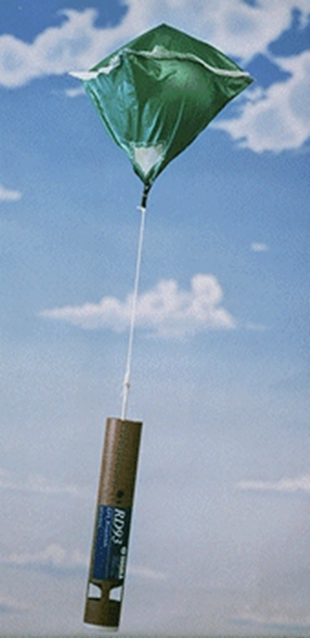
Projects Accepted for Operational Implementation - 6th round
Assimilation of Non-NOAA and Non-AF GPS Dropwindsonde Data into NOAA Numerical Models - Aberson
Improvements in Statistical Tropical Cyclone Forecast Models - DeMaria

Slide 10
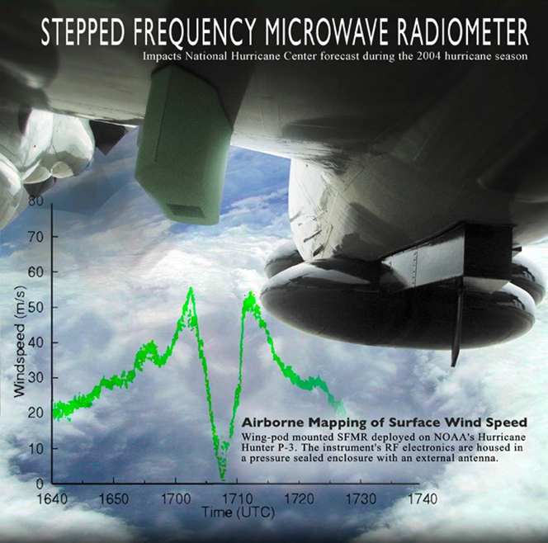
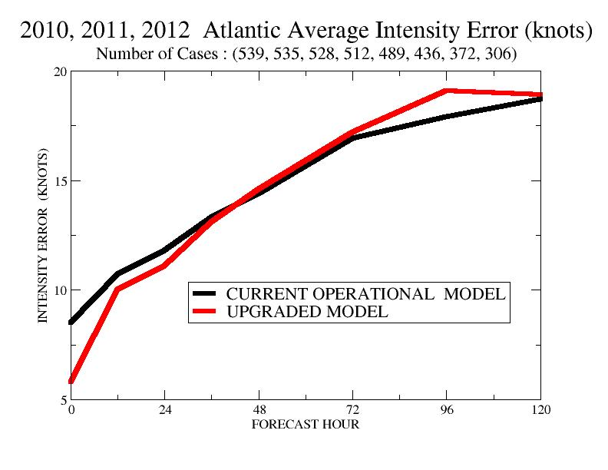
Projects Accepted for Operational Implementation - 6th round
Improved Stepped Frequency Microwave Radiometer Surface Wind Measurements in Intense Rain conditions - Uhlhorn
Improving the Operational Tropical Cyclone Models at NOAA/NCEP and Navy/FNMOC- Bender/Ginis

Slide 11
Factors Considered in NHC Decisions on Operational Implementation
Forecast or Analysis Benefit: expected improvement in operational forecast and/or analysis accuracy
Efficiency: adherence to forecaster time constraints and ease of use needs
Compatibility: IT compatibility with operational hardware, software, data, communications, etc.
Sustainability: availability of resources to operate, upgrade, and/or provide support

Slide 12
7th Round Timetable
August 2012
  Announcement of Opportunity released
October 2012
  36 Letters of Intent reviewed by Steering Committee
December 2012 - January 2013
  22 Full proposals reviewed by Steering Committee
February - April 2013
  Rank and select 7 proposals for funding
  Point-of-contacts established among NHC/EMC staff
  Work with PIs to setup timelines for their projects
September 2013 – May 2014
  PIs begin projects in coordination with points-of-contact
March 2014
  Present progress at Interdepartmental Hurricane Conf.

Slide 13
7th Round Timetable (continued)
April 2014
  Mid-year report and renewal proposal due
May-June 2014
  Steering Committee reviews progress and renewal proposals - all 7 projects are renewed for year two
June – November 2014
  Begin real-time testing during hurricane season
December 2014 – April 2015
  PI refine their projects and interact with points-of-contact
March 2015
  Present progress at Interdepartmental Hurricane Conf.
June – November 2015
  Continued real-time testing during hurricane season

Slide 14
7th Round Timetable (continued)
December 2015
  PI provide their final report
January-May 2015
  Operational implementation decisions made by NHC/EMC
June 2015 – April 2016
  Implementation of accepted projects by NHC/EMC

Slide 15
7th Round Timetable (continued)
December 2015
  PI provide their final report
January-May 2015
  Operational implementation decisions made by NHC/EMC
June 2015 – April 2016
  Implementation of accepted projects by NHC/EMC
FOUR YEARS FROM ANNOUNCEMENT TO IMPLEMENTATION

Slide 16
7th Round JHT Projects – 2013 to 2015
Project Title | Principal Investigator(s) | NHC Point of Contact
A Visualization Application for Distributed ADCIRC-based Coastal Storm Surge, Inundation, and Wave Modeling | Brian Blanton, Rick Luettich (Univ. of N Carolina) | Feyen (NOS), Rhome, Berg, Schauer, Landsea
Improving the GFDL/GFDN Operational Tropical Cyclone Models at NOAA/NCEP and Navy/FNMOC | Isaac Ginis (Univ. of Rhode Island), Morris Bender (NOAA/GFDL) | Pasch, Mattocks, Tallapragada (EMC), Landsea
A Probabilistic TC Genesis Forecast Tool Utilizing an Ensemble of Global Models | Bob Hart, Henry Fuelberg (Florida State Univ.) | Pasch, Mattocks, Kimberlain, Blake, Landsea
Improvement to the Satellite-based 37 GHz Ring Rapid Intensification Index | Haiyan Jiang (Florida Intl Univ.) | Stewart, Cangialosi, Landsea
Guidance on Intensity Guidance | Dave Nolan (U of Miami/RSMAS), Andrea Schumacher (CSU/CIRA) | Avila, Blake, Landsea
Upgrades to the Operational Monte Carlo Wind Speed Probability Program | Andrea Schumacher (CSU/CIRA) | Brown, Brennan, Mattocks, Landsea
Integration of an Objective, Automated TC Center-fixing Algorithm Based on Multispectral Satellite Imagery into NHC/TAFB Operations | Tony Wimmers, Chris Velden (Univ. of Wisc./CIMSS) | Beven, Mundell, Landsea

Slide 17
8th Round Timetable
August 2014
  Announcement of Opportunity released
October 2014
  35 Letters of Intent reviewed by Steering Committee
December 2014
  Full proposals due
Review criteria and their maximum points are:
Importance/relevance and applicability of proposal to the program goals (30 points),
Technical merit (50 points),
Overall qualifications of applicants (10 points),
Project Costs (10 points), and
Outreach and education (0 points)

Slide 18
Top 5 Priorities for New Funding
NHC-1/JTWC-1. Guidance for tropical cyclone intensity change, especially for the onset, duration, and magnitude of rapid intensification events, as well as for over-water rapid weakening events.
NHC-2/JTWC-2. Improved capability to observe the tropical cyclone and its environment to support forecaster analysis and model initialization.
NHC-3/JTWC-8. Statistically based real-time guidance on guidance to assist in the determination of official track and intensity forecasts. This could include multi-model consensus approaches, provided in probabilistic and other formats.
NHC-4/JTWC-9. Enhancements to the operational environment (e.g., ATCF, AWIPS-II) to increase forecaster efficiency, by expediting analysis, forecast, coordination, and/or communication activities.
NHC-5/JTWC-11. Techniques or products to support pre-genesis disturbance track, intensity, size, and wind speed probability forecasts.

Slide 19
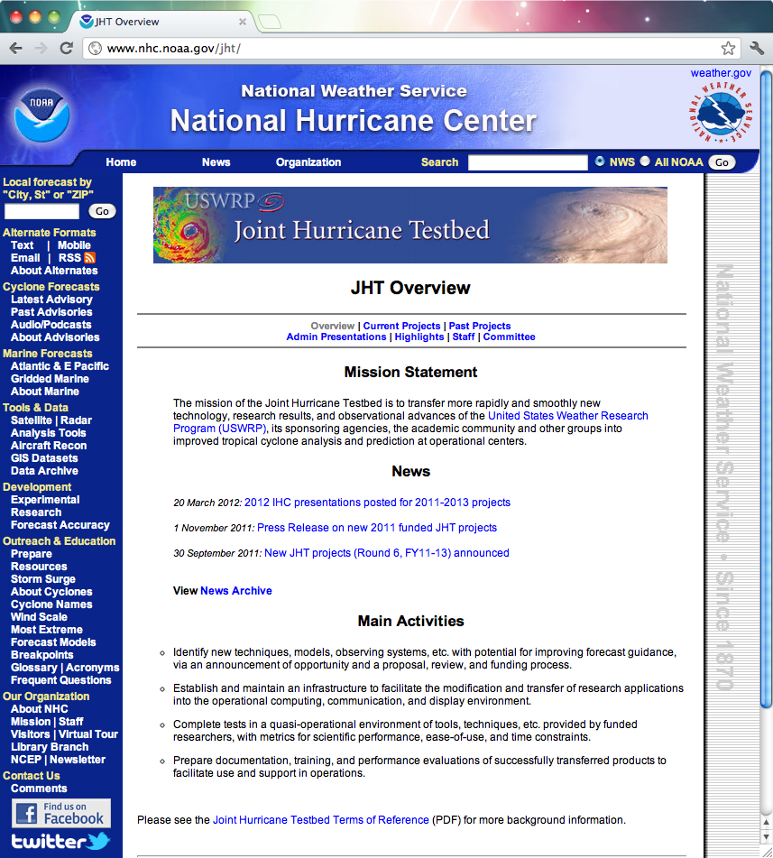

The Joint Hurricane Testbed
www.nhc.noaa.gov/jht
Rappaport et. al., 2012 - BAMS

