Slide 1
INSITE – An IDSS Tool for Aviation
Missy Petty, Geary Layne, Brian Etherton, Paul Hamer, Mike Rabellino
VLab Forum
17 February 2016

Slide 2
Forecast Impact and Quality Assessment Section
Mission: Advance the understanding and use of weather information through impact-based assessments and targeted information delivery to benefit decision making in response to high-impact weather events
Sponsors
NWS: NextGen Program and Aviation and Space Weather Services Branch
FAA: Aviation Weather Research Program (QA PDT)
Activities
Independent quality assessments
Verification in operational context
Technologies
Notes:
Focus is measuring skill of products when it matters

Slide 3
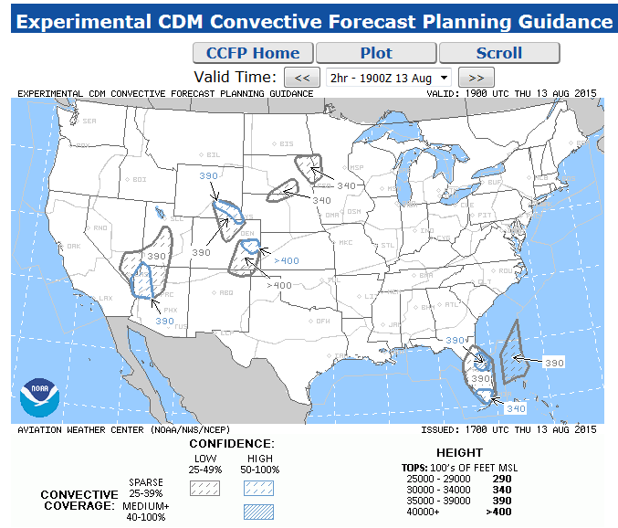
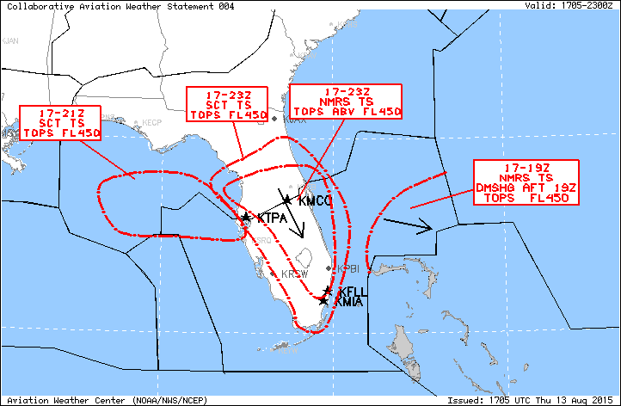
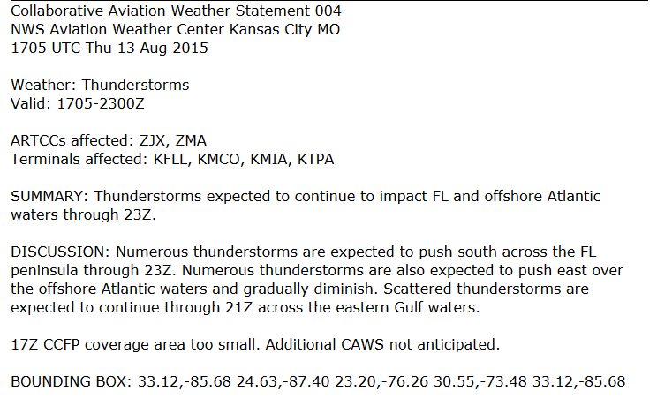
Collaborative Aviation Weather Statement (CAWS)

Slide 4
INSITE
Development sponsored by NWS NextGen Program
Aligned with NWS Weather Ready Nation initiative of Impact-based Decision Support Services

Slide 5
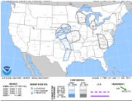
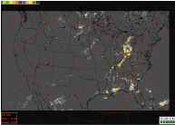
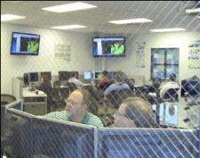
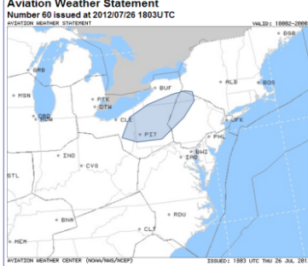
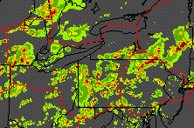
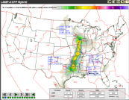
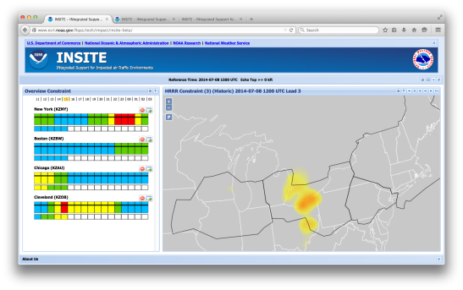
Impact-based Decision Support
Weather Forecasts & Observations
NWS Forecaster
Impact-based Forecast Information
TFM Planner
CCFP
CoSPA
CIWS
LAMP
A weather decision service for
common situational awareness
and forecast preparation
INSITE
Weather
Forecasts,
Observations
Decision Criteria
Traffic Flow Information
INSITE: INtegrated Support for Impacted air Traffic Environments

Slide 6
INSITE Features
Features support forecaster identification of convective weather potentially impactful to air traffic
Several convective forecast products, plus observations
Overlays of routes and Control Centers (ARTCCs)
Airspace constraint fields (Flow Constraint Index) derived from blend of weather and traffic data
Confidence information for forecast constraint
Displays of both raw weather and constraint fields
‘Synthesis’ product, where different forecast products are blended into a single forecast of constraint using performance information
Summary constraint information for regions of interest (default ARTCCs or user-drawn)
Drill-down capabilities to identify potential impacts to related routes or ARTCCs
Historical playback feature to review past events

Slide 7
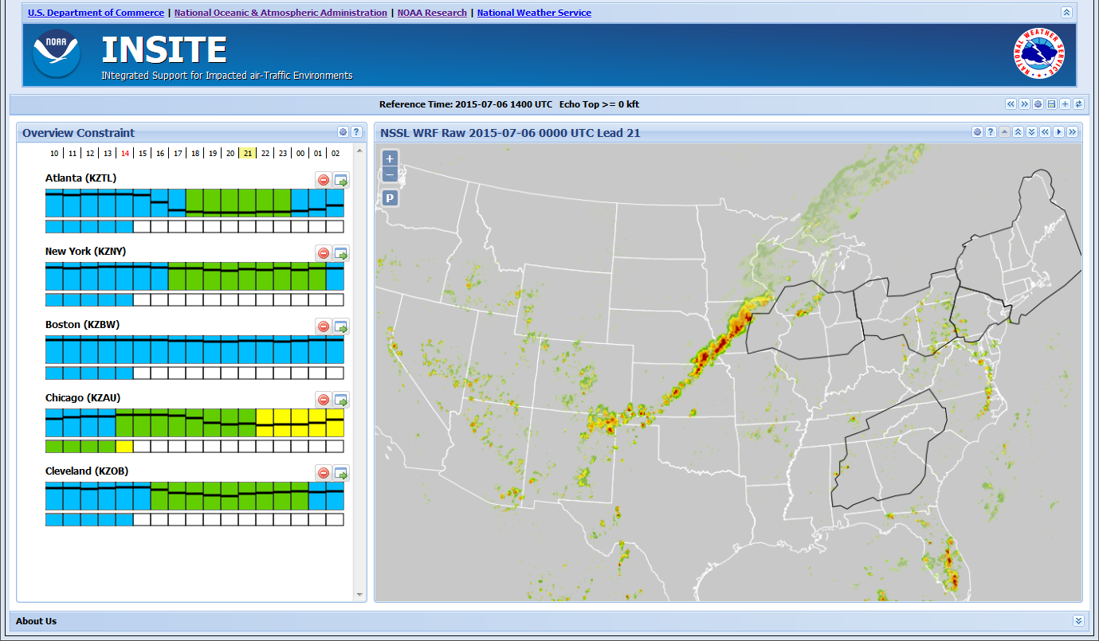
INSITE – Main Page

Slide 8
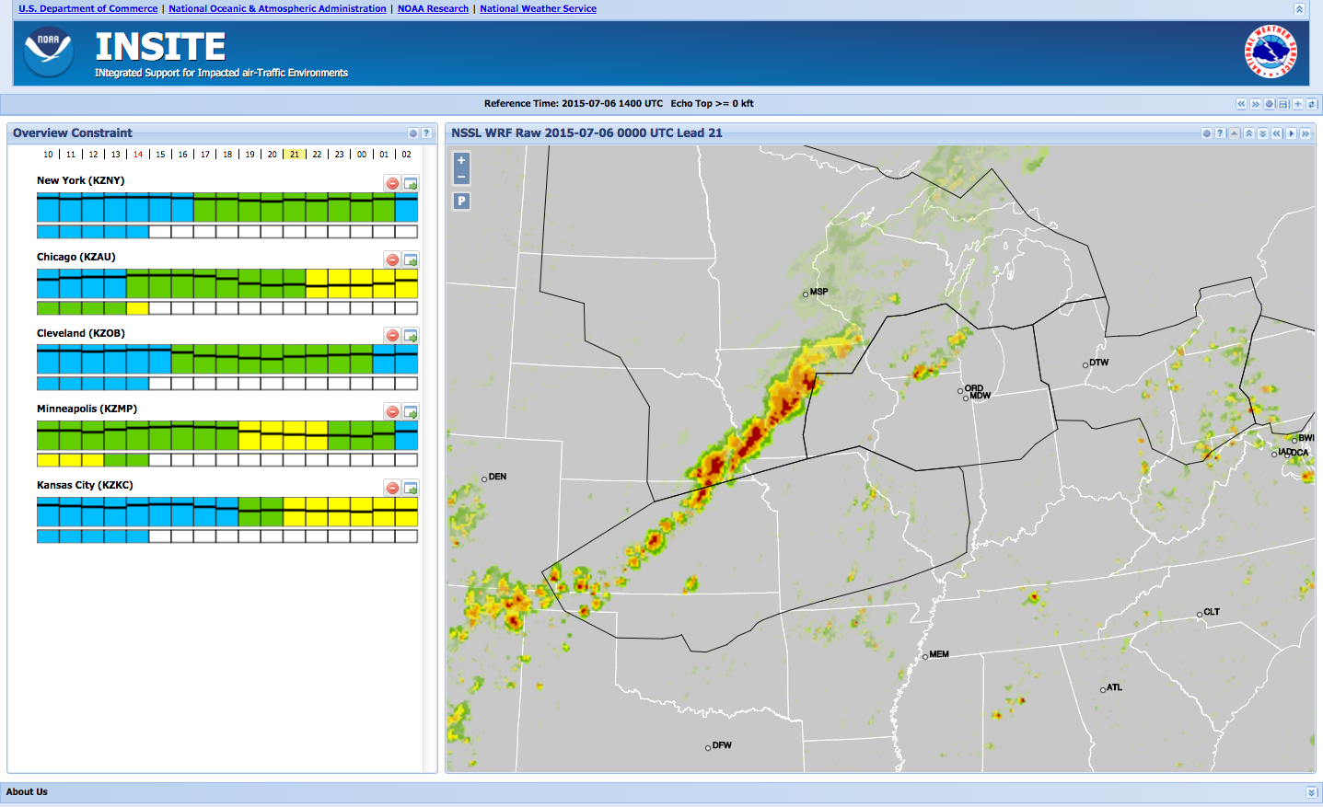
INSITE
Raw weather with core airport overlays

Slide 9
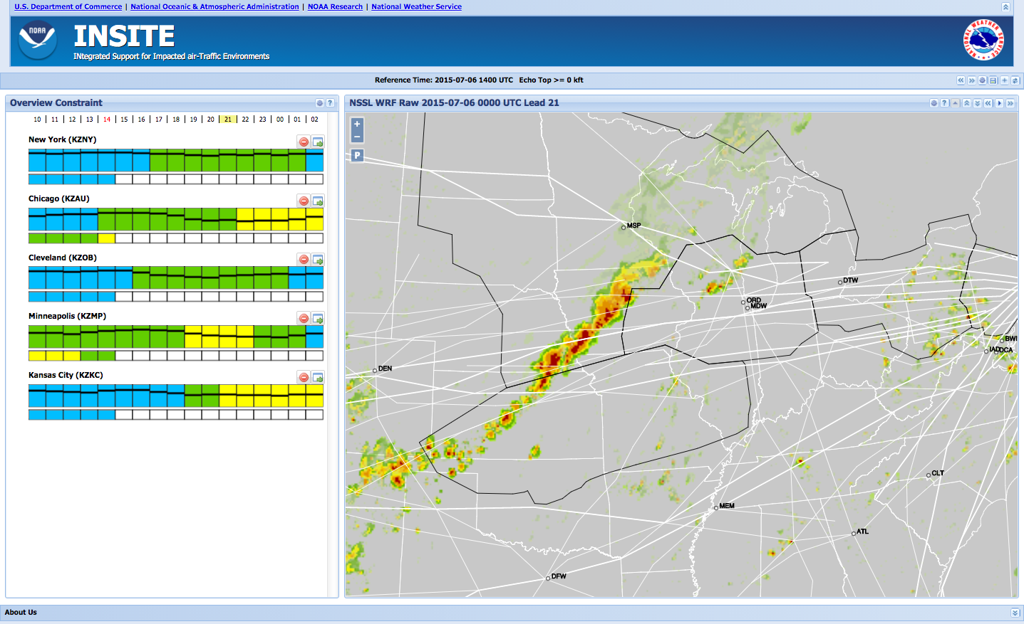
INSITE
Raw weather graphics and route overlays indicate this line of convection could be impactful to East-West traffic
INSITE provides a metric that is a quantitative measure of how much impact is likely

Slide 10
Flow Constraint Index (FCI)
Blue lines: Corridor boundaries.
Red area: Area of hazardous weather.
Arrow A: Distance across corridor in absence of hazards.
Arrows B and C: Distance across the available airspace around a hazard.
Flow constraint is 1- (Mincut_{Hazard}/Mincut_{Corridor})
Apply weighting scheme (traffic density)
FCI of 1.0 corresponds to most constrained, 0.0 corresponds to none.
Can compute FCI for any type of forecast (probabilistic, deterministic)
Corridor Axis
Corridor
A
Hazard
Mincut_{Corridor}
B
C
Mincut_{Hazard}

Slide 11
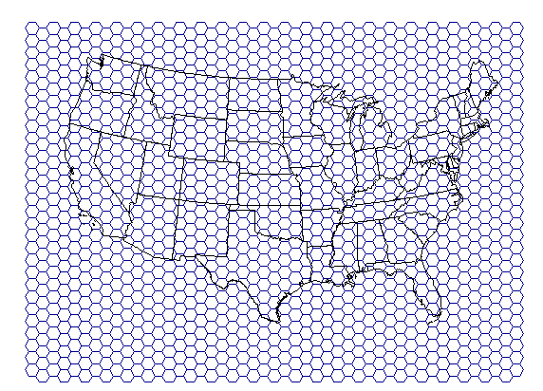
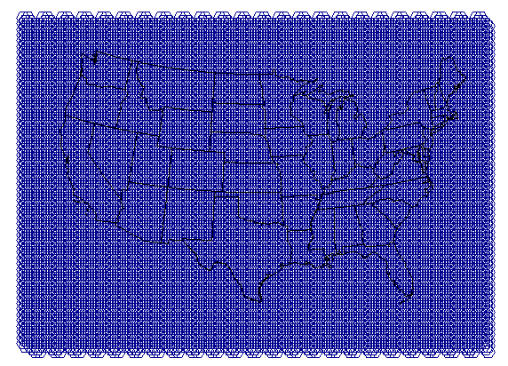
FCI Hexagonal Grid
Corridor

Slide 12
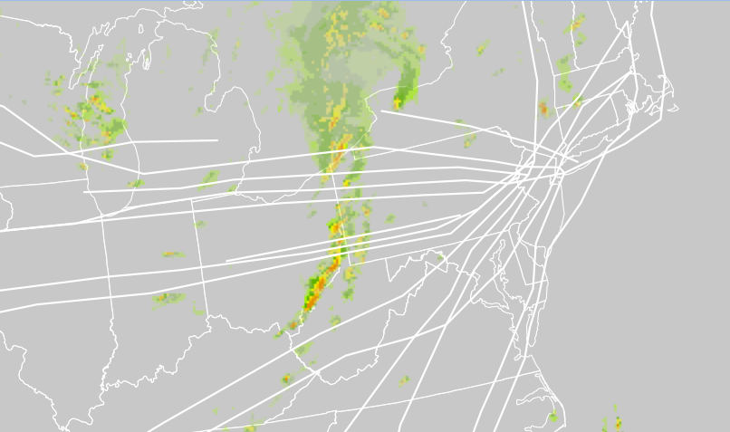
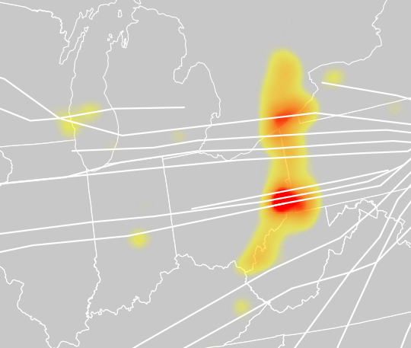
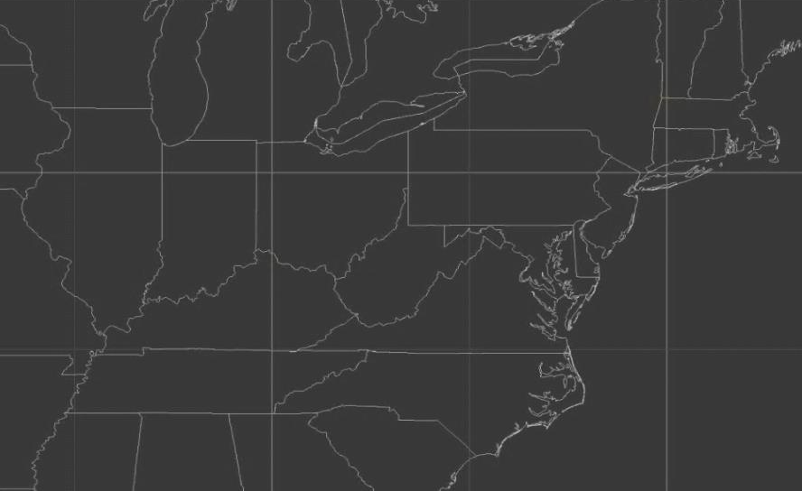
FCI Example in INSITE
AIR TRAFFIC FLOW CONSTRAINED BY WEATHER
CONVECTION FORECAST
FCI
TRAFFIC FORECAST

Slide 13
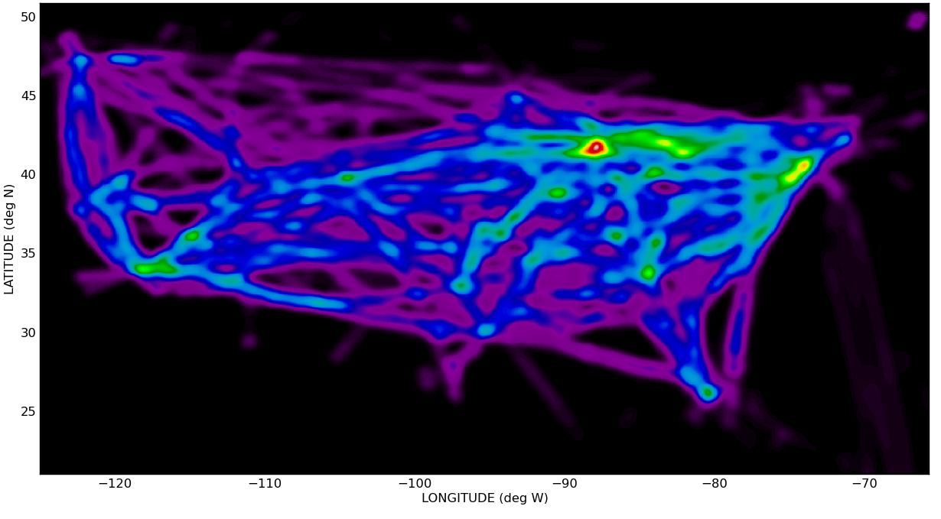
FCI Traffic Weighting – Historic Data
ASDI Data from 2014 convective season (May-Sept)
Flights corresponding to major carriers, operating at OEP 35 airports
Data representing ‘ideal scenario’ for standard routes
Clear air days
First flight plan
Traffic density stratified by day of week and hour of day

Slide 14
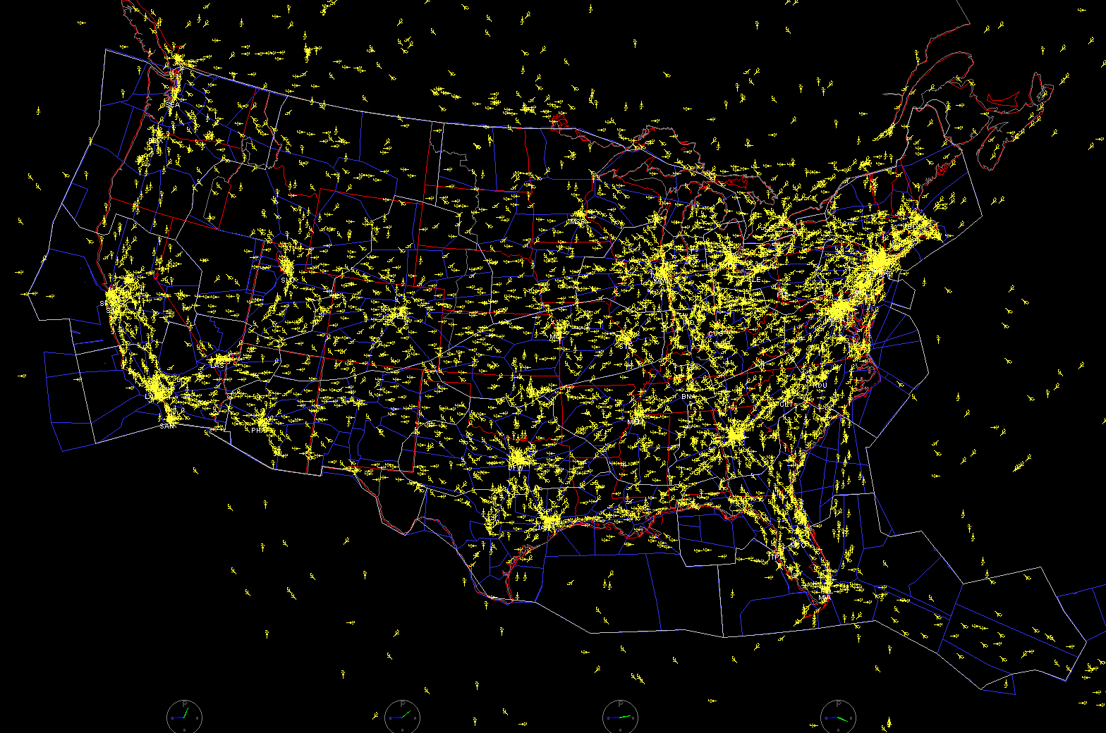
FCI Traffic Weighting – Current Data
Ingest real time air traffic from the ASDI data set
Determine the set of most recent flight plans, planned aircraft locations
Incorporate ‘planned’ traffic density into the FCI
A FACET snapshot of air traffic over the United States on July 10, 2006, at 2:45 p.m. EST.
Image Credit: NASA Ames Research Center

Slide 15
INSITE
Raw weather graphics and route overlays indicate this line of convection could be impactful
INSITE provides a metric that is a quantitative measure of how much impact is likely

Slide 16
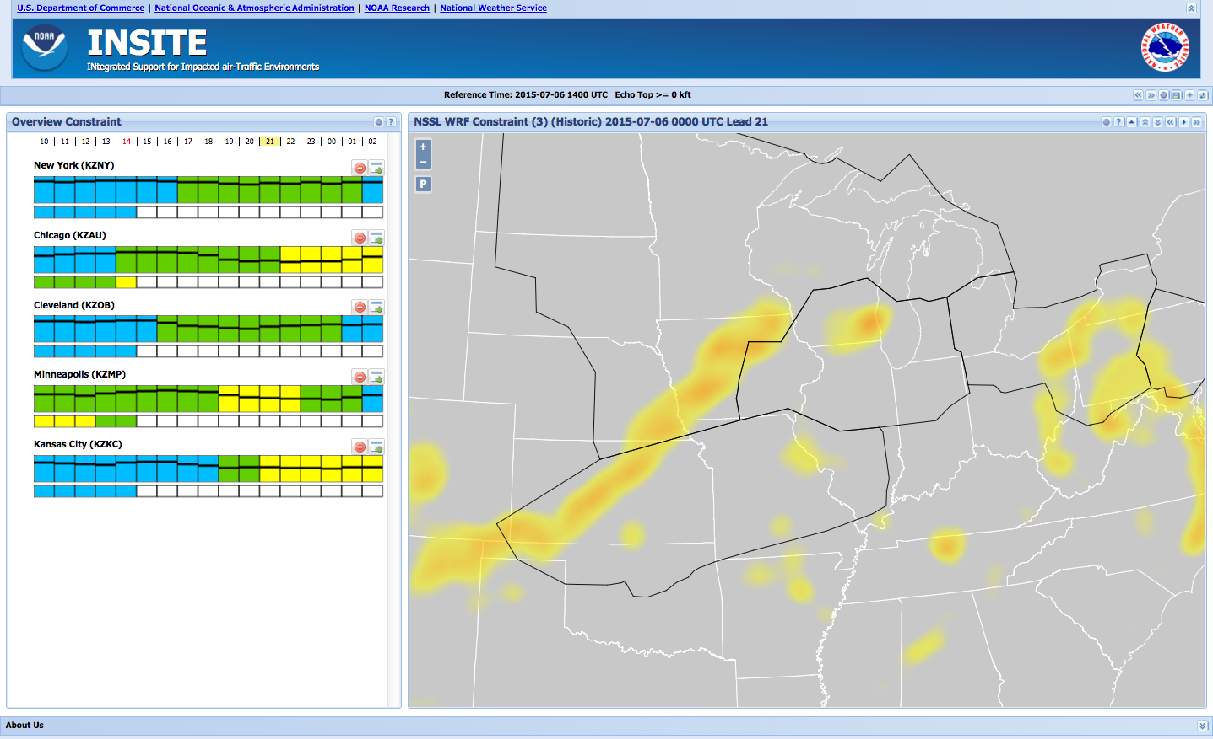
FCI in INSITE – Our Case
FCI is depicted via ‘heat map’
For this case, FCI indicates a large area of constraint as forecast by the NSSL WRF

Slide 17
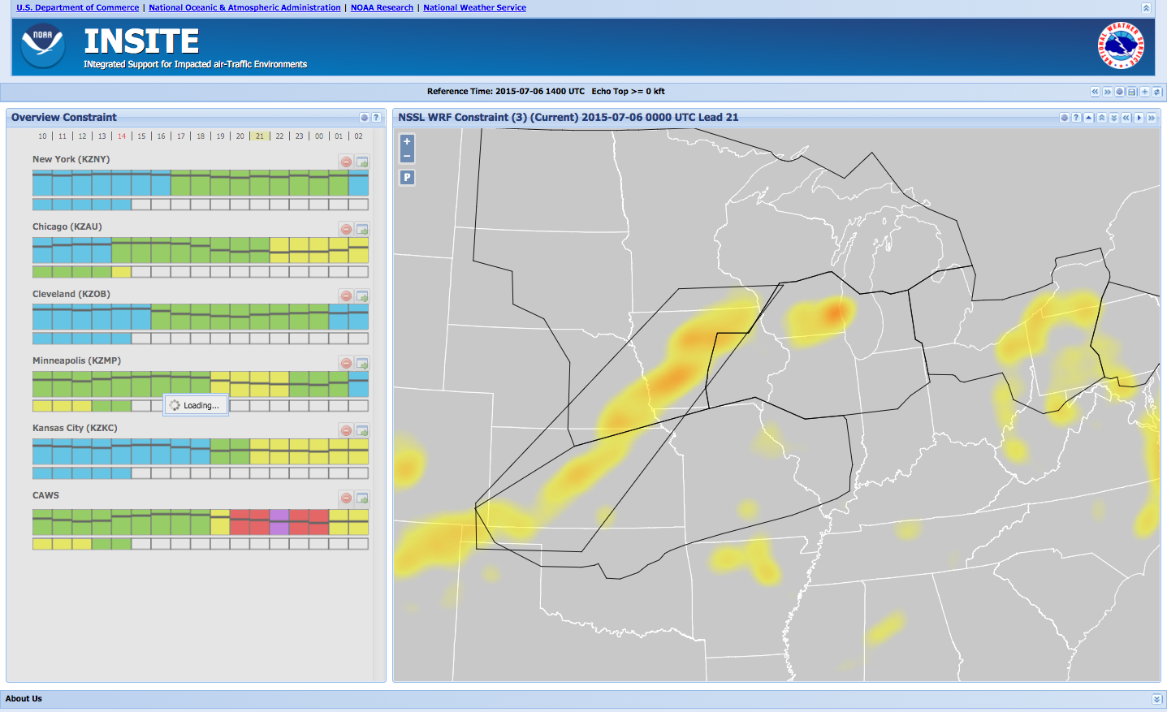
FCI in INSITE – Our Case
Users can click on the ‘up arrow’ button on to view FCI computed with current traffic
‘Current traffic’ view indicates that planned routes are still impacted by the convection depicted by the NSSL WRF

Slide 18
FCI in INSITE – Areas of Interest
Users can draw their own polygons for more detailed interrogation of a specific region

Slide 19
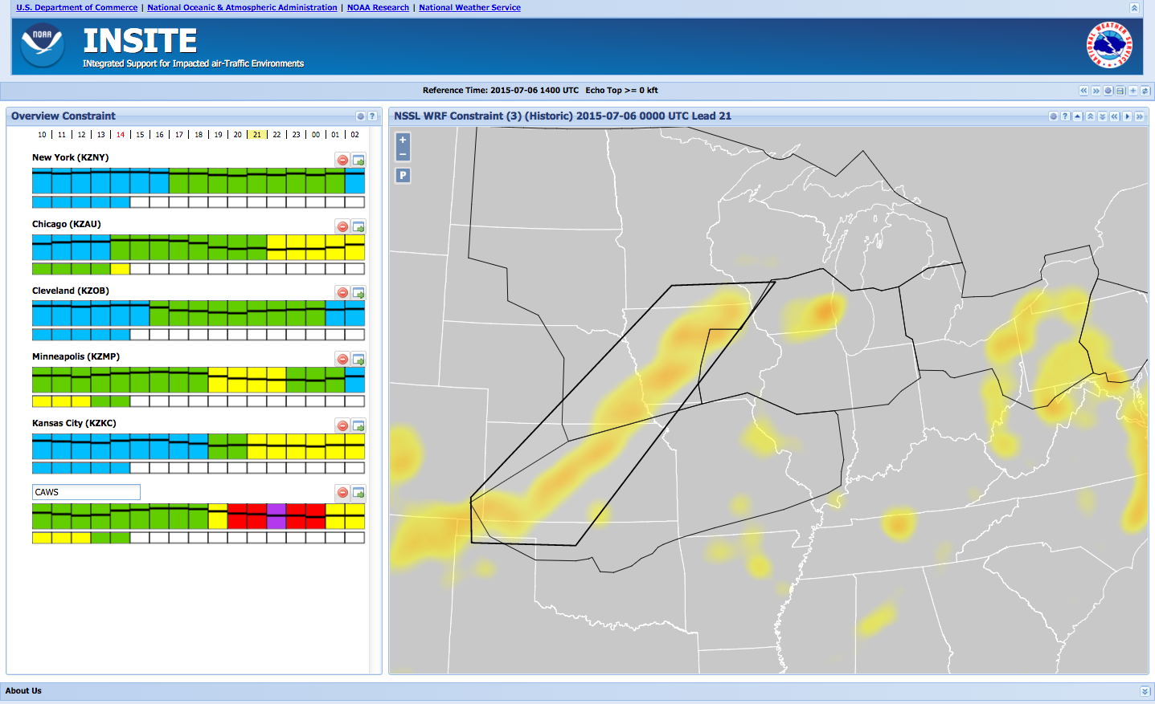
FCI – Summary Information
Bar charts on far left are time series of constraint as identified by FCI
Each bar corresponds to a polygon drawn on the geographical map

Slide 20
Constraint and Confidence Bars (CC-Bars)
Now (Reference Time)
Past Valid Times
Future Valid Times

Slide 21
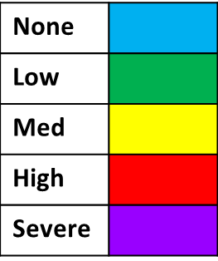
Constraint and Confidence Bars (CC-Bars)
Click to navigate to constraint details for polygon
Polygon text: Click to rename polygon
Click to delete polygon
Top bar: Forecast constraint
Severity Categories
Bottom bar: Constraint derived from observations
Black horizontal line: Forecast confidence level between 0 and 100

Slide 22
Constraint and Confidence bars
Constraint and Confidence (or Consistency) bars (CC bars) are provided on the left side
Confidence Information
Confidence is based on long-term historical performance of the forecast products, and also includes a prolonged forecast latency penalty

Slide 23
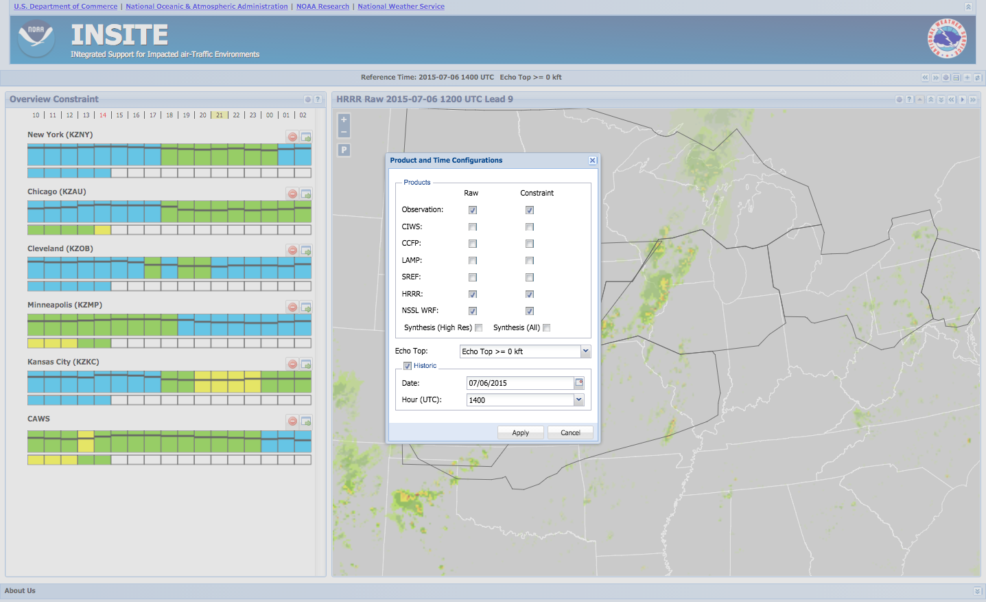
Products Featured in INSITE
INSITE products:
HRRR
NSSL WRF
SREF
LAMP
CCFP
CIWS
Raw product or derived constraint (FCI)

Slide 24
Synthesis Product
The synthesis is a blend of the individual FCI’ed products
All
High-res only
Product weights based on historical performance, inter-model consistency

Slide 25
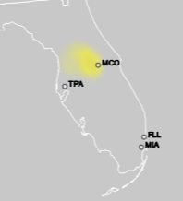
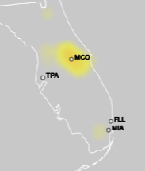
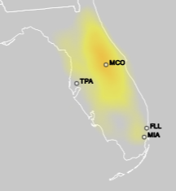
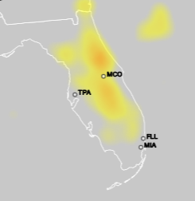
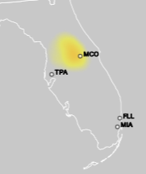
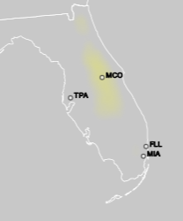
Synthesis
CCFP
Synth Hi-res
HRRR
LAMP
Synth All
SREF
NSSL WRF

Slide 26
Constraint and Confidence bars
Constraint and Confidence (or Consistency) bars (CC bars) are provided on the left side
Confidence Information
Confidence is based on long-term historical performance of the forecast products, and also includes a prolonged forecast latency penalty
For synthesis product, horizontal line is grey and indicates level of consistency between constituent forecasts

Slide 27
Further Regional Interrogation
Clicking on the ‘green arrow’ icon above the CC-bar navigates the user to more detailed information about the corresponding polygon

Slide 28
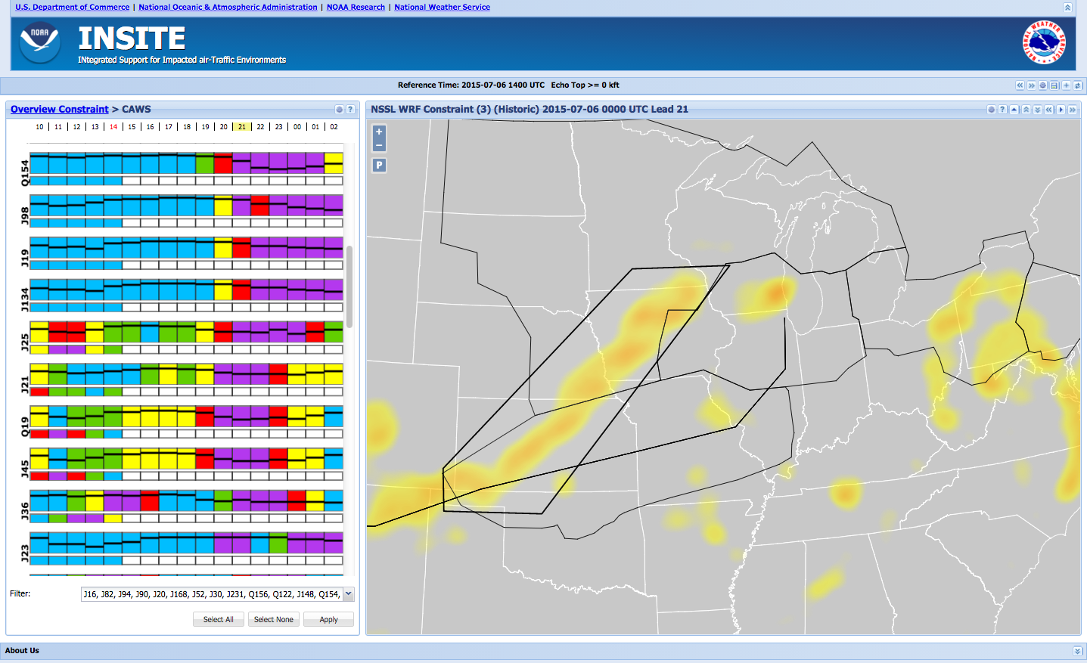
NAS Elements Within a Polygon/Area
CC-bars correspond to high altitude routes that pass through the selected polygon area

Slide 29
NAS Elements Within a Polygon/Area
Routes are listed by rank, with the most impacted at the top of the list, the least impacted at the bottom of the list
Impact, as used to rank the routes, is for future times only
Intersecting ARTCCs are also viewable, using the gear symbol

Slide 30
NAS elements within a polygon/area
Hovering over one of the CC-bars highlights the route associated with that CC-bar on the FCI image

Slide 31
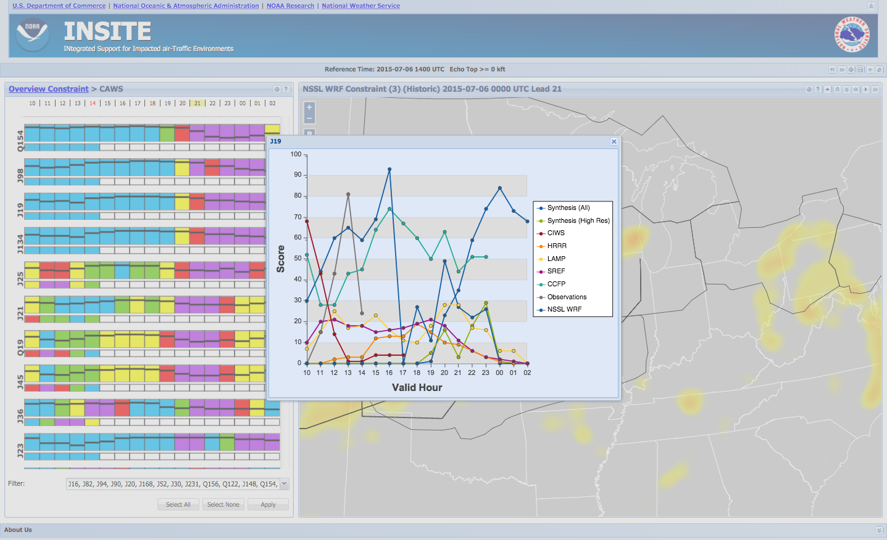
NAS elements within a polygon/area
Clicking on one of the CC-bars brings up a time series of the FCI values from all products for the time period from 4 hours before to 12 hours after the reference time

Slide 32
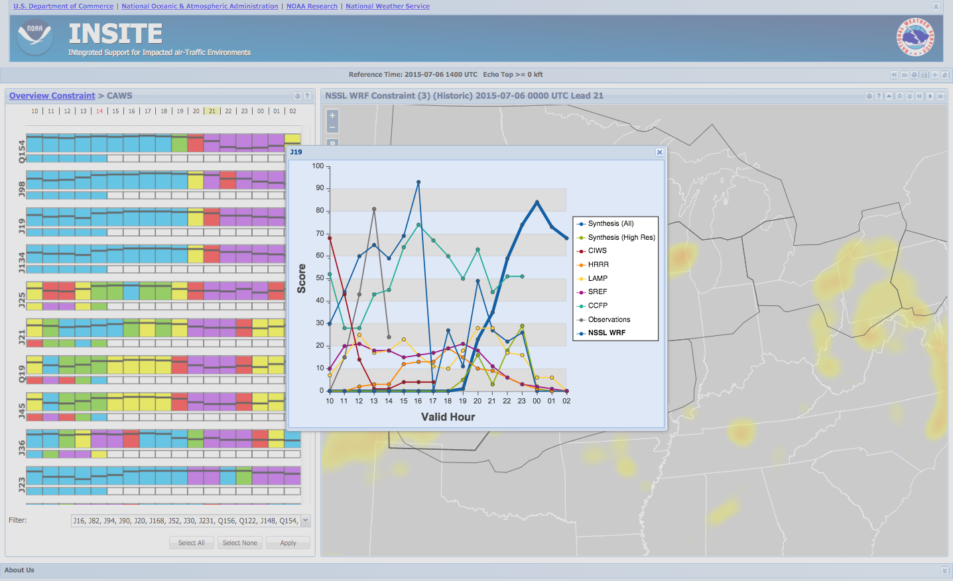
NAS elements within a polygon/area
Hovering over a product name causes that product’s time series to become bold (in this case, the dark blue NSSL WRF)

Slide 33
Use Case
INSITE Operational Scenario Steps
Identify potential areas of air-traffic constraints in area of responsibility
Narrow down area of interest using polygon drawing tool
Use these areas of constraints as first guess impact areas in CAWS
Identify geographic areas with constraints above moderate severity threshold
Identify potential time of onset and cessation
Adjust forecast based upon model trends using confidence in CC bars
Adjust forecast based upon model consistency in CC bars
Compare potential areas of air-traffic constraints with other model guidance

Slide 34
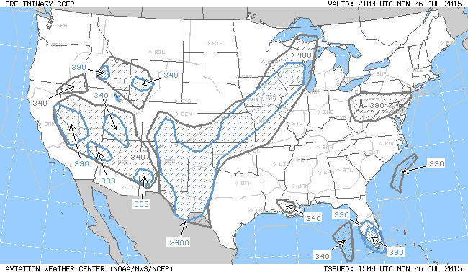
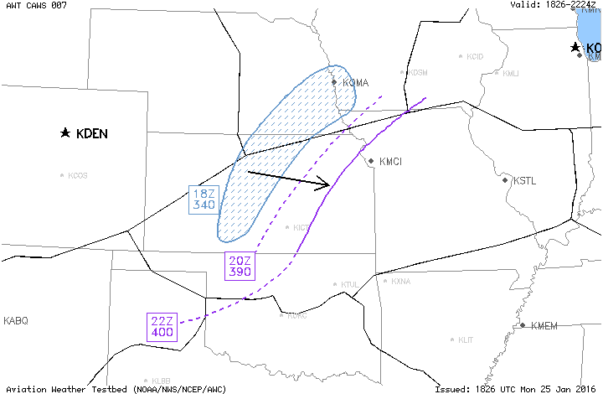
Collaborative Aviation Weather Statement (CAWS)
CCFP
Collaborative Aviation Weather Statement 003 NWS Aviation Weather Center Kansas City MO 1450 UTC Mon 06 Jul 2015 Weather: Thunderstorms Valid: 1800-2200Z ARTCCs affected: ZFW, ZKC, ZMP Terminals affected: CCFP: 15Z - Coverage too low SUMMARY: Thunderstorms expected to develop across ZKC by 18Z and intensify into a line by 20-22Z. DISCUSSION: Current storms across N KS/SE Neb will intensify after 18Z and form a broken line by 20Z and a significant solid line by 22Z with tops FL400+. Further south across the panhandle TX and W OK a broken line should begin to form around 22Z. An additional CAWS may be needed as the storms pushes eastward.
CAWS

Slide 35
INSITE v4
35
Funding organization: NWS NextGen Program
INSITE 4 to be released late May 2016, available for OB/CAWS activities
Addition of MRMS analyses
Switch from AWC SREF product to NCEP/NCO SREF product
Numerous UI updates (such as black background, improved product navigation, more help info)
New “Alert” feature – system identification of areas that are in excess of a given FCI value

Slide 36
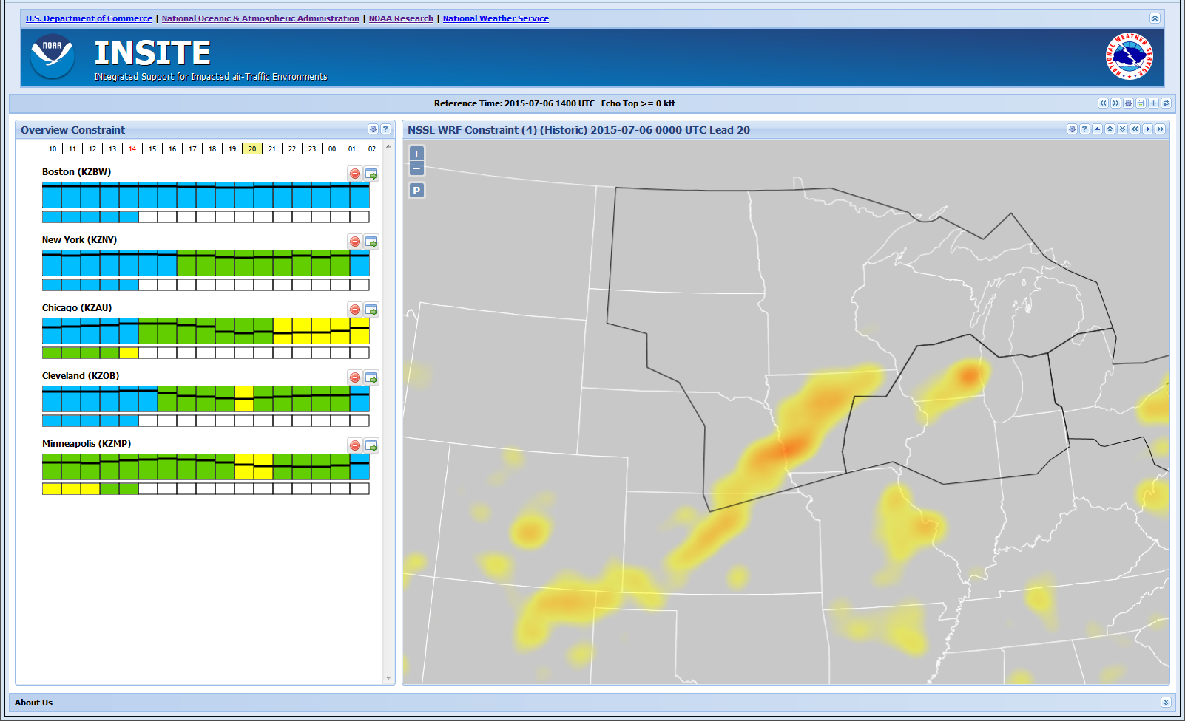
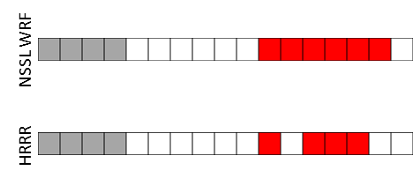
INSITE Alert Feature – Mockup
Alert dashboard
When user clicks specific valid time, the alert polygons and heat map for that valid time will be displayed

Slide 37
Transition to NWS Operations
37
Operational host: IDP
IOC
INSITE v4
Switch to all operational NWS products (replace CIWS with MRMS, NSSL-WRF with HiRes NMM/ARW runs)
May 2017
Where in the process?
Have begun the necessary coordination with IDP
Initial design review
Technical documentation

Slide 38
Contacts
Feedback and questions on INSITE and its use are welcomed
NOAA/ESRL contact:
Missy Petty melissa.a.petty@noaa.gov
NOAA/NWS contact:
Jamie Vavra jamie.vavra@noaa.gov

