Slide 1
A probabilistic tropical cyclone genesis forecast guidance tool using global numerical models
Dan Halperin, Bob Hart, Henry Fuelberg, Josh Cossuth
VLab Forum
21 October 2015

Slide 2
Motivation
National Hurricane Center (NHC) forecasters are interested in TC genesis guidance products for the Tropical Weather Outlook (TWO).
Global models are an important piece of guidance for TC genesis, but interpreting the raw forecast output can be subjective.
Our goal: Develop an automated, objective TC genesis guidance product based on output from three global models (GFS, UKMET, CMC).

Slide 3
Guidance product requirements
Provide probabilistic forecasts of TC genesis within 48 and 120 h.
Cover the North Atlantic and eastern North Pacific basins.
Products must be available at least 30 minutes prior to TWO issuance.
Products must be formatted for quick/easy interpretation to accommodate the forecasters’ time constraints.

Slide 4
Product development summary
Verified model-indicated TC genesis forecasts since 2004.
Used logistic regression to calculate objective, bias-corrected TC genesis probabilities for real-time model-indicated TC genesis forecasts.
Developed a separate logistic regression equation for each global model, basin, and forecast window.
Developed a consensus probability.

Slide 5
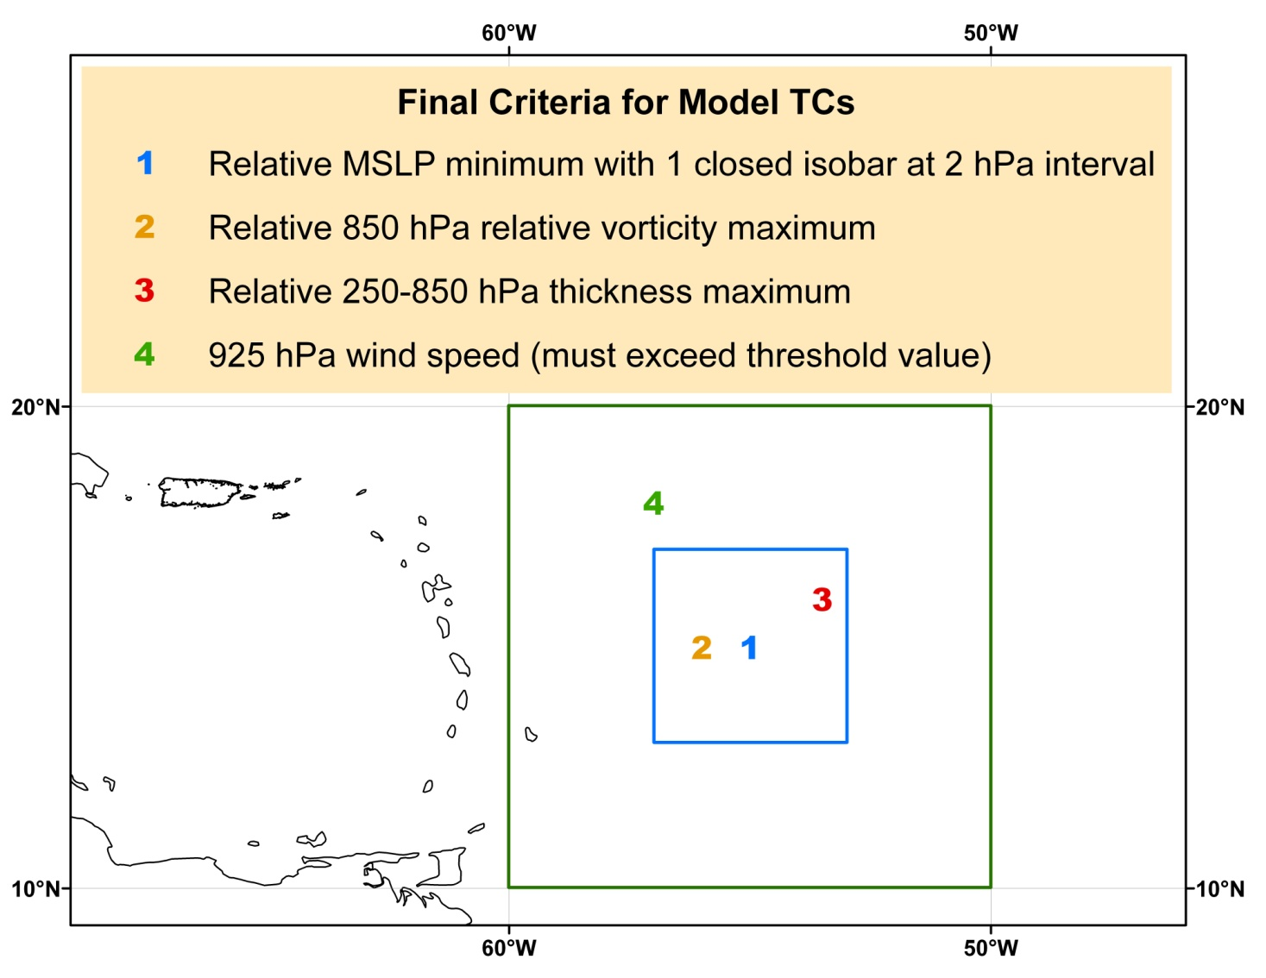
Methodology – TC genesis definition
Genesis Criteria for Model TCs
1 Relative MSLP minimum with 1 closed isobar at 2 hPa interval
2 Relative 850 hPa relative vorticity maximum*
3 Relative 250-850 hPa thickness maximum*
4 925 hPa maximum wind speed*
*must exceed a threshold value based on model climatology.
Criteria 1-4 must be satisfied for 24 consecutive h in the forecast cycle

Slide 6
Methodology – Verification
Does the forecast valid time match a time in the ATCF a-decks or b-decks?
Yes
Is the model forecast genesis position within 5° lat/lon of the a-deck/b-deck position?
Yes
Model initialization time is:
> 48/120 h before the Best-Track genesis time.
6-48/120 h before the Best-Track genesis time.
At or after Best-Track genesis time.
No
No
False Alarm
False Alarm
False Alarm
Hit
Forecast discarded

Slide 7
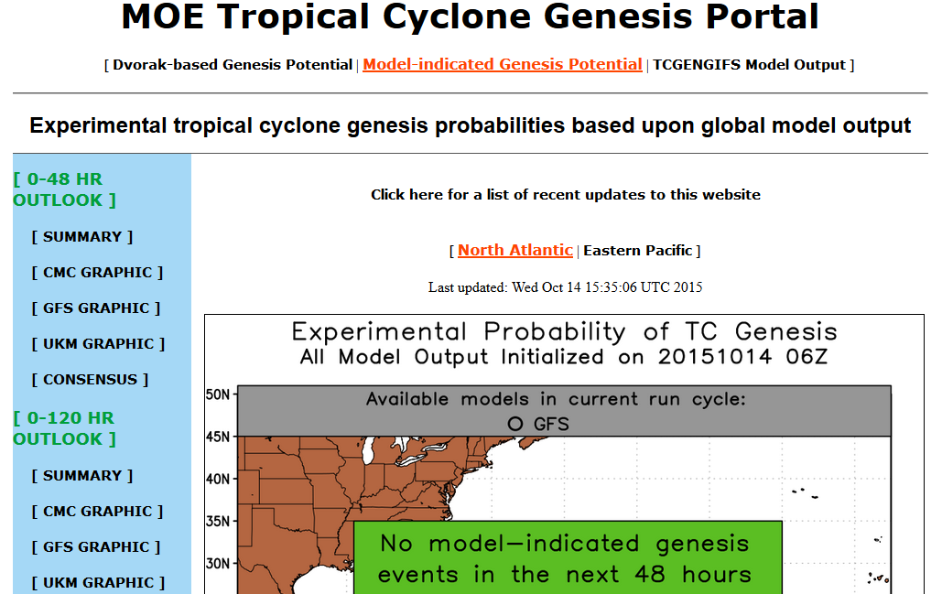

Slide 8
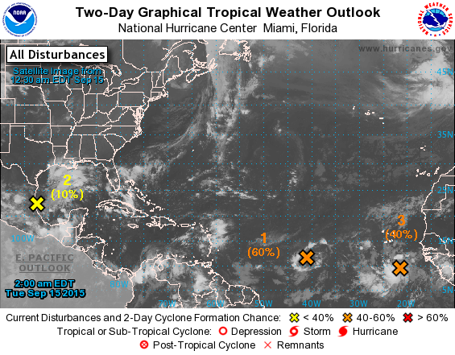
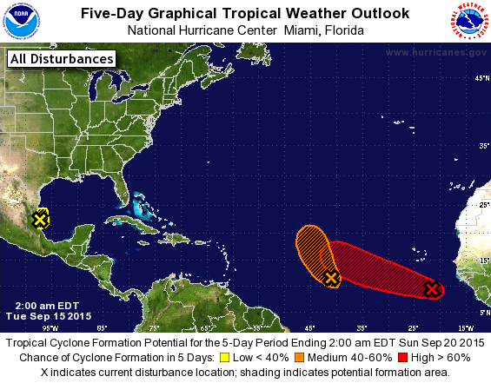
Case Study
10%
60%
70%

Slide 9
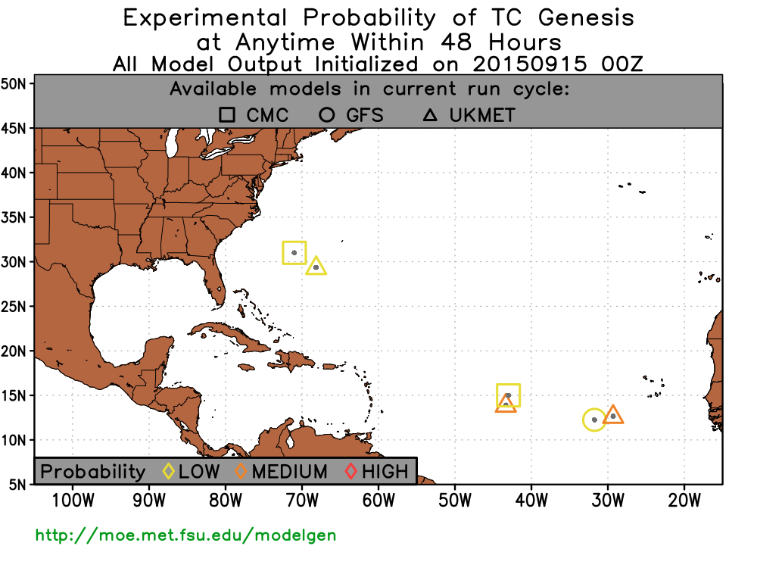

Slide 10
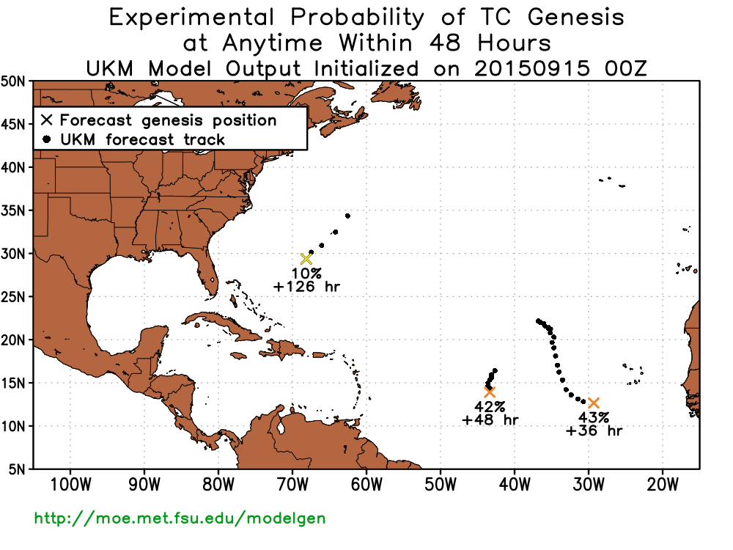

Slide 11


Slide 13
** Tropical Disturbance #2 Information **
** GFS output initialized 2015091500 **
**GENESIS PREDICTED? YES, at forecast hour 60**
TIME (hr) 36 42 48 54 60 66 72 78 84 90 96 102 108 114 120
GEN PROB (%) 20 51
CRIT MET? N N N N Y Y Y Y Y Y Y Y Y Y Y
LAT (N) N/A 11.25 11.50 11.75 12.25 12.50 13.00 13.50 14.00 14.25 14.75 15.00 15.25 15.50 16.00
LON (W) N/A 29.00 30.00 30.80 31.80 32.50 33.30 34.00 34.80 35.50 36.30 37.30 38.50 39.30 40.30
925VMAX N/A (14.61) (15.78) (15.70) 17.65 16.58 16.97 17.69 21.87 24.38 24.62 24.32 27.58 26.05 26.02
(m/s)
850RV N/A 26.04 24.55 22.29 20.33 19.67 17.89 19.06 22.88 34.78 32.53 26.51 38.59 33.23 26.25
(*10^-5 1/s)
H25-85 THCK N/A 9487 9484 9476 9481 9490 9486 9479 9479 9491 9487 9479 9478 9489 9479
(m)
SFC LH FLUX N/A 152.78 160.26 174.45 172.48 161.52 150.34 147.25 141.78 136.15 131.53 137.98 141.31 133.79 131.60
850RVPERT N/A 24.66 22.98 20.50 18.37 17.81 17.39 17.30 21.32 33.44 31.27 25.36 37.46 32.30 25.14
H2-85 SHEAR N/A 10.12 11.11 12.32 12.77 12.51 12.74 13.72 14.22 14.18 14.58 15.47 15.12 13.09 12.66
( ) indicates that the threshold value was not met

Slide 14
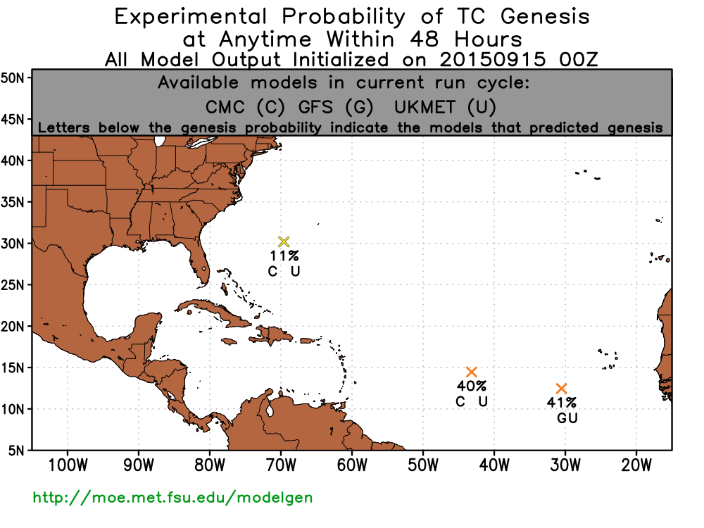
How to calculate consensus forecast:

Slide 15
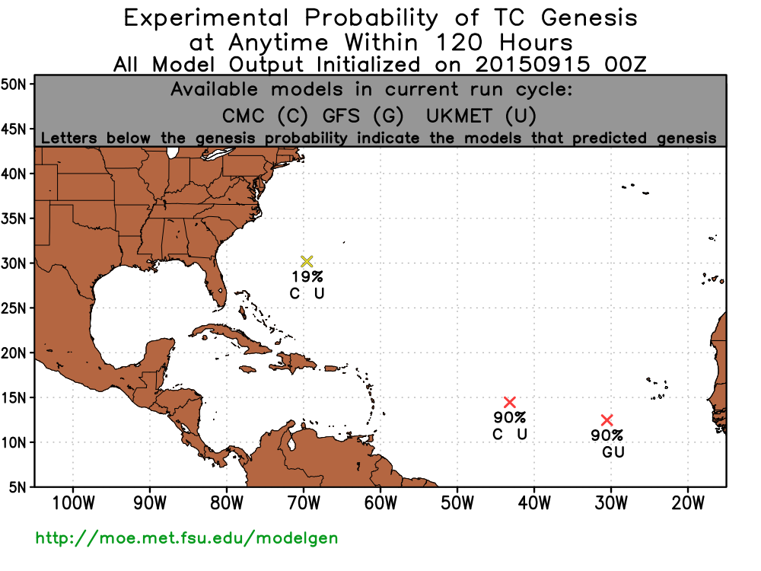

Slide 16
** TC Genesis Summary **
** Consensus output initialized 2015091500 **
ID # LAT (N) LON (W) PROB48 (%) PROB120 (%)
1 12.46 30.60 41 90
2 14.46 43.20 40 90
3 30.18 69.60 11 19
** TC Genesis Summary **
** GFS output initialized 2015091500 **
ID # FHR LAT (N) LON (W) PROB48(%) PROB120(%)
1 60 12.25 31.80 20 51
** TC Genesis Summary **
** UKM output initialized 2015091500 **
ID # FHR LAT (N) LON (W) PROB48(%) PROB120(%)
1 36 12.66 29.40 43 73
2 48 13.91 43.40 42 78
3 126 29.36 68.20 10 18
** TC Genesis Summary **
** CMC output initialized 2015091500 **
ID # FHR LAT (N) LON (W) PROB48(%) PROB120(%)
1 54 15.00 43.00 19 46
2 126 31.00 71.00 2 6

Slide 18
10%
60%
70%
NINE
IDA
NINE
IDA

Slide 19
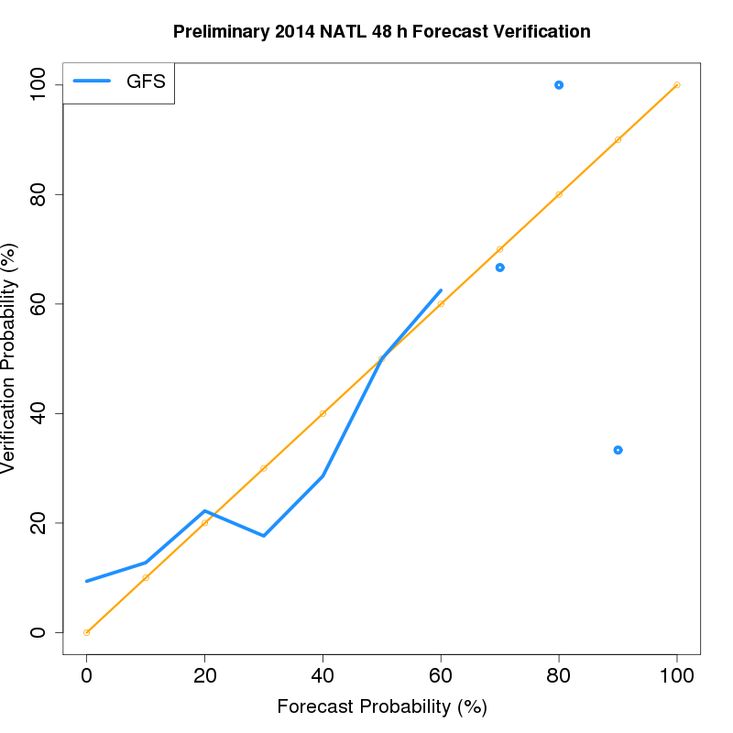
2014 NATL 48 h verification
Underprediction
Overprediction

Slide 20
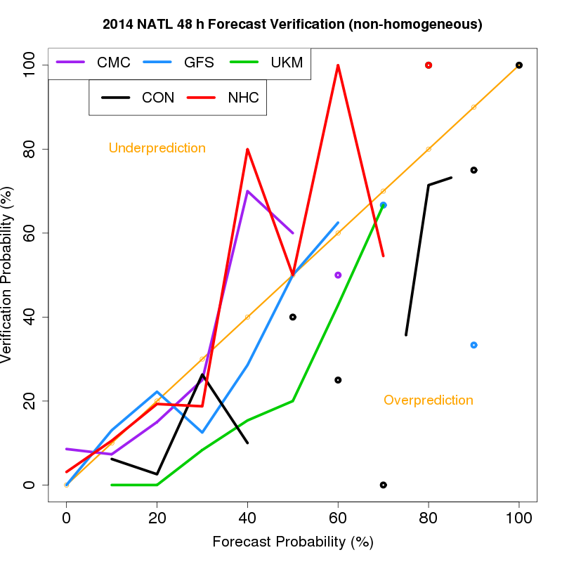
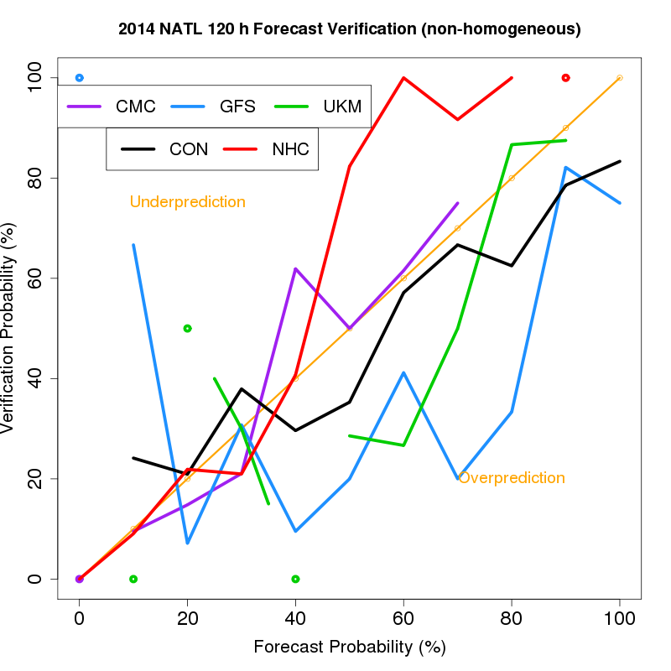

Slide 21
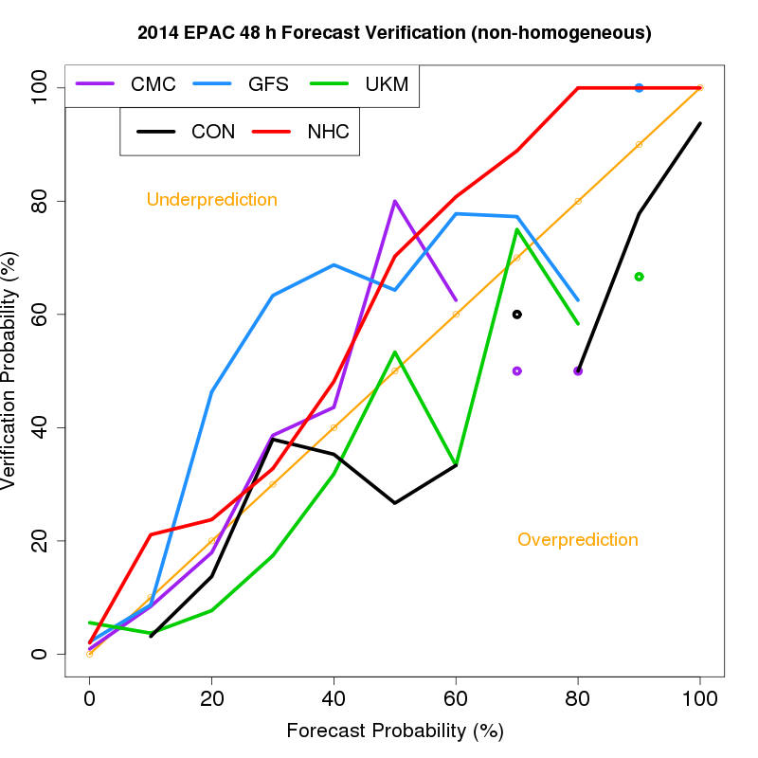
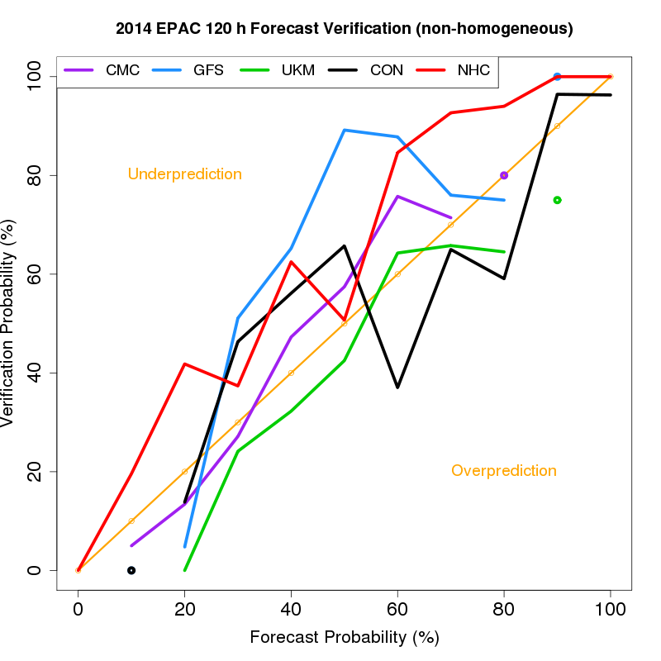

Slide 22
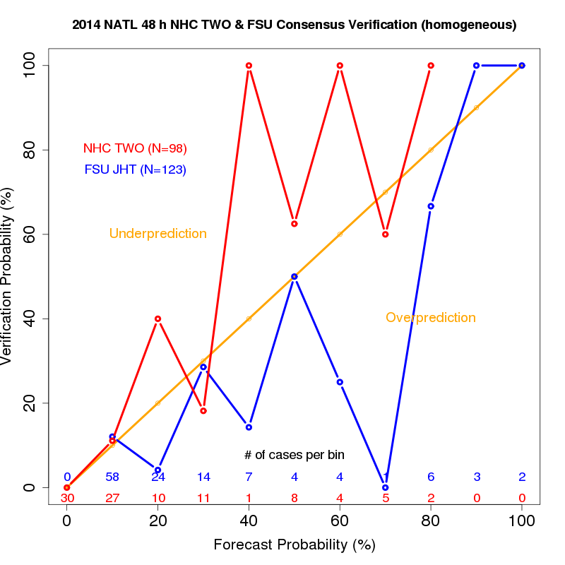
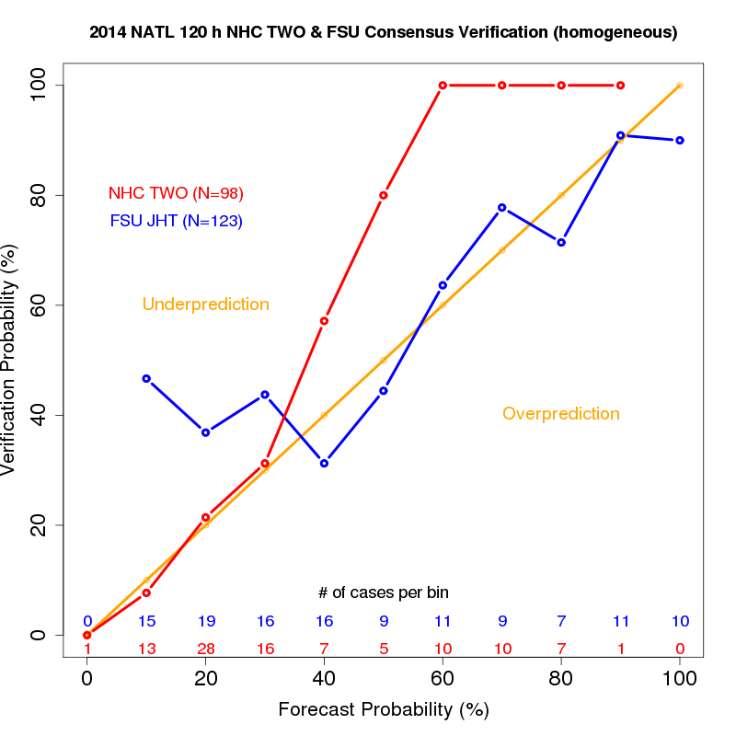

Slide 23
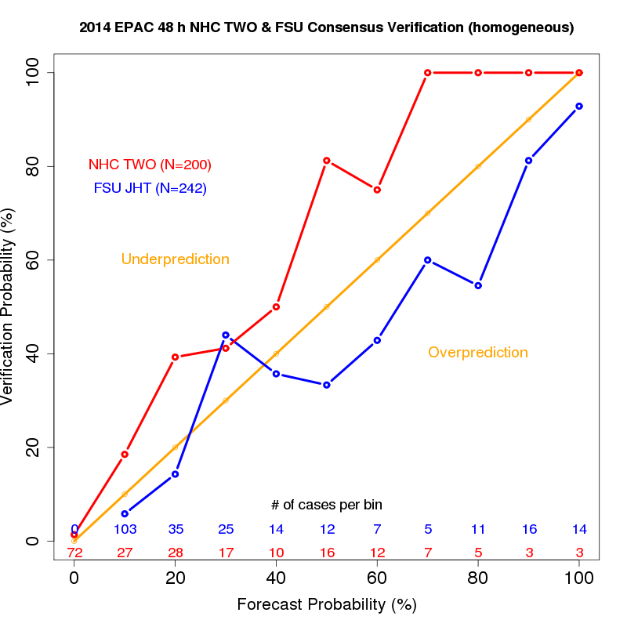
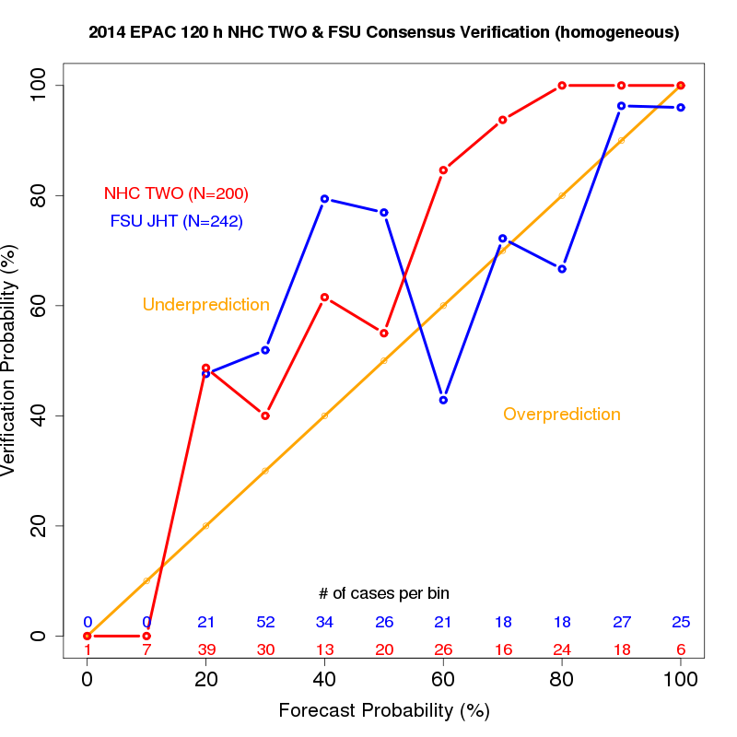

Slide 24
Project status
Guidance products currently are being evaluated by NHC.
Nearly all components are compatible with NHC’s IT platform.
  Plans in place to convert the few incompatible scripts to a suitable language.
Decision for project implementation expected in early 2016.

Slide 25
Summary
Historical model-indicated TC genesis events were verified since 2004.
These forecasts served as the training set for logistic regression equations that provide TC genesis probabilities in real-time.
Several text and graphical products currently are available to the Hurricane Specialist Unit.
2014 verification shows that the guidance products are fairly well-calibrated and provide the most additional value at the higher forecast probability bins at the 120 h forecast window.

Slide 26
Acknowledgements
Joint Hurricane Testbed points of contact Eric Blake, Todd Kimberlain, Chris Landsea, Craig Mattocks, Richard Pasch.
Joint Hurricane Testbed (NOAA Grant).

Slide 27
Questions?
http://moe.met.fsu.edu/modelgen

