Slide 1
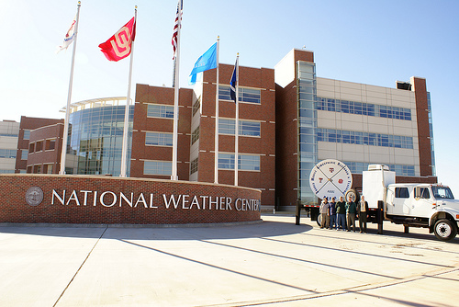
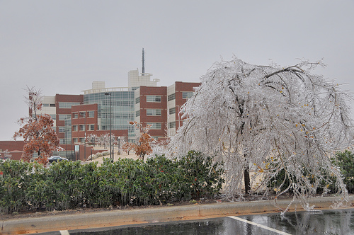
Jonathan J. Gourley
National Severe Storms Lab
University of Oklahoma
Norman, Oklahoma, USA
The Past, Present, and Future of Flash Flood Prediction

Slide 2
NWS Flash Flood Guidance System
Flash Flood Guidance (FFG): average rainfall over a specified area and time duration required to initiate flooding on small streams
FFG (mm) computed for accumulation periods of 1-, 3-, 6-hr (12, 24 also used)
If rainfall exceeds FFG, then a forecaster will consider issuing a flash flood warning

Slide 3
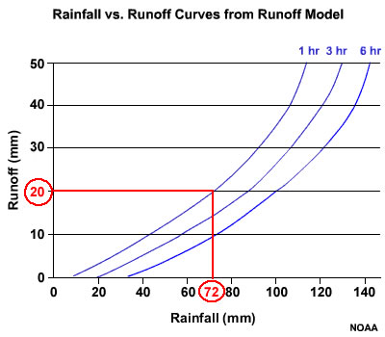
How is FFG derived ?
Lumped SAC-SMA model run under different rainfall scenarios to produce rainfall-runoff curves
Curves subject to change due to initial soil moisture states, evapotranspiration
Thresh runoff values (pre-computed) looked up on curves to get FFG
Saturated
soil states
ThreshR
1-hr FFG

Slide 4
Evaluation of the Operational Tools used for Flash Flood Forecasting in the US
Jess Erlingis
Race Clark
NWS Advanced Hydrologic Prediction Service
NSF Graduate Research Fellowship

Slide 5
FFG Production
LFFG – Lumped FFG
Lumped-parameter basins (~300 – 3,000 km²); SAC-SMA model
GFFG – Gridded FFG
high-res product based on NRCS Curve Number method
DFFG – Distributed FFG
Continuous-API (Antecedent Precipitation Index)
FFPI – Flash Flood Potential Index
Quasi-static; geographical characteristics (slope, land cover, wildfire, soil type, …)
R. Clark, et al. Evaluation of Flash Flood Guidance in the U.S.

Slide 6
Study Period
1 Oct 2006 – 31 Aug 2010
Changes in FFG generation method occurred in late 2007 or early 2008

Slide 7
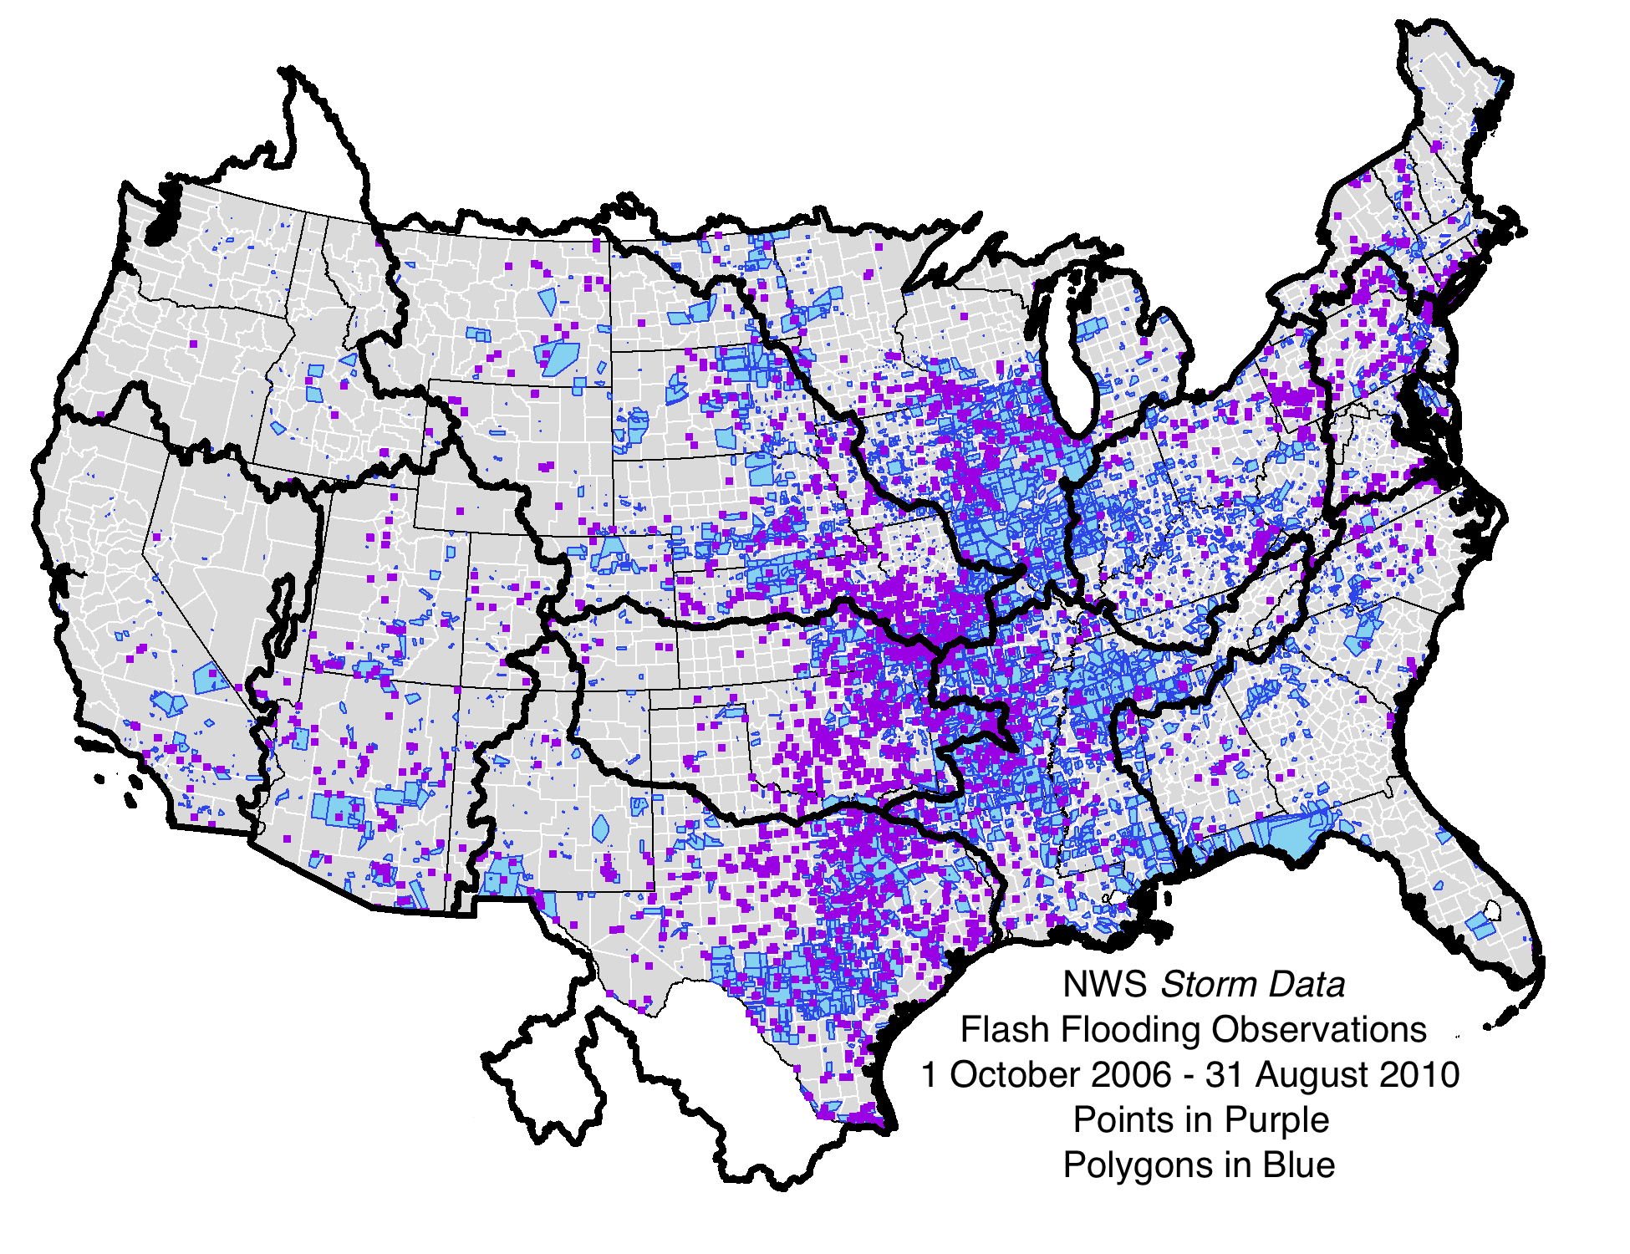
Map of what type of FFG runs at various RFCs

Slide 8
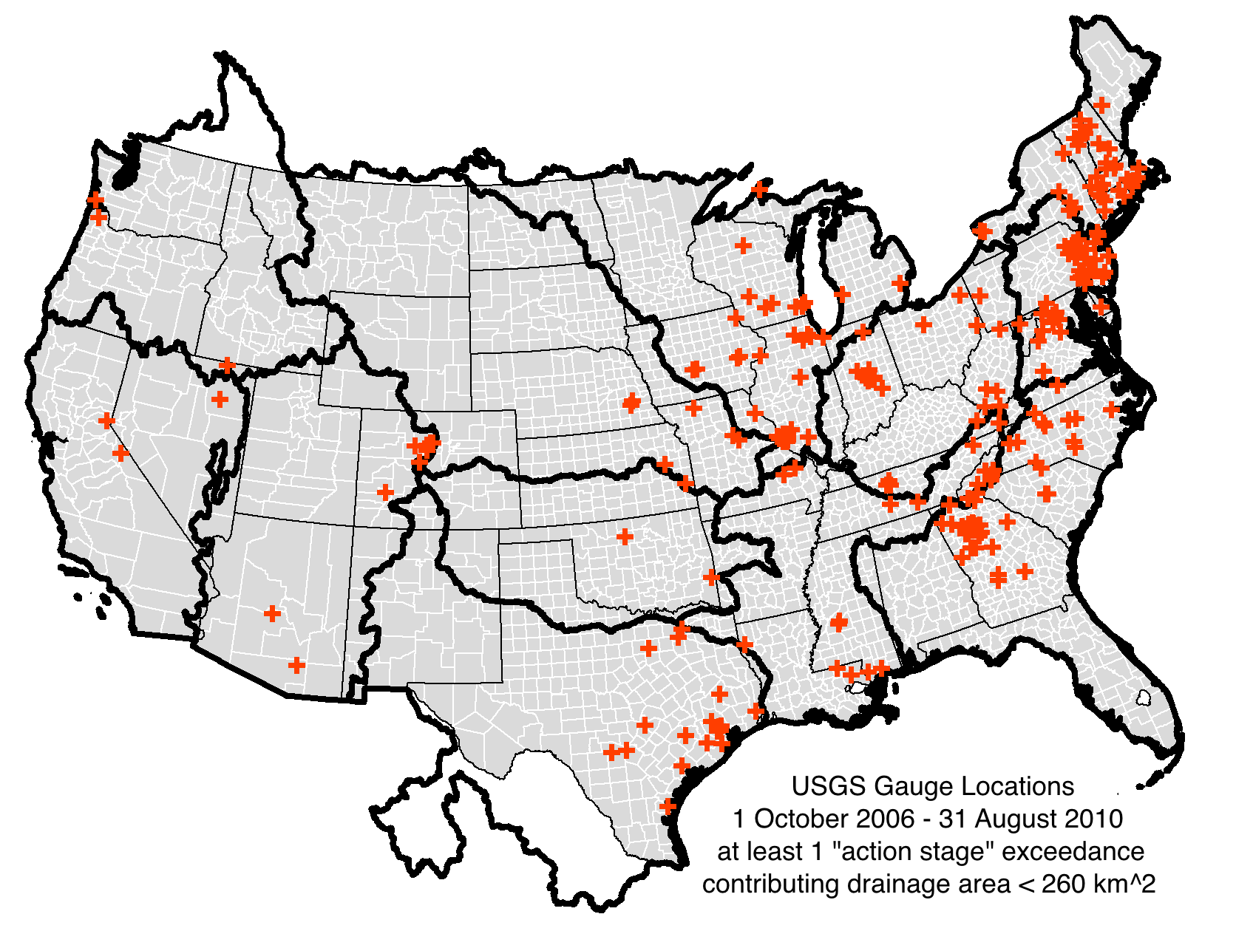
Map of what type of FFG runs at various RFCs

Slide 9
No FALSE ALARMS – all contiguous areas of ratio > 1.0 have at least one observation
MISSES – Red Arrows
HITS - Black Arrows

Slide 10
Results – NWS Storm Data Analysis

Slide 11
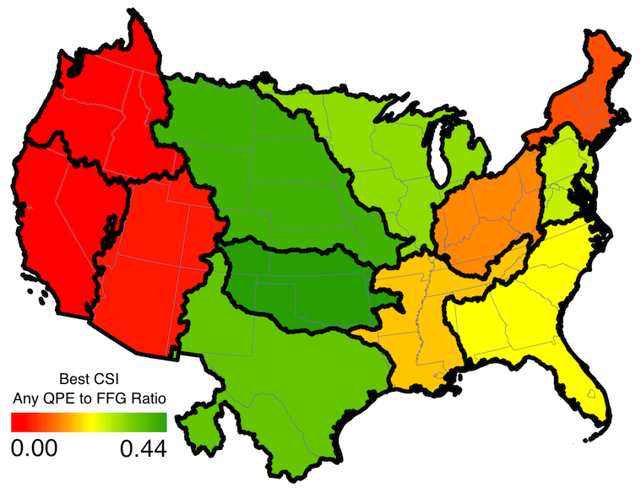
Results – USGS Stage Height Analysis

Slide 12
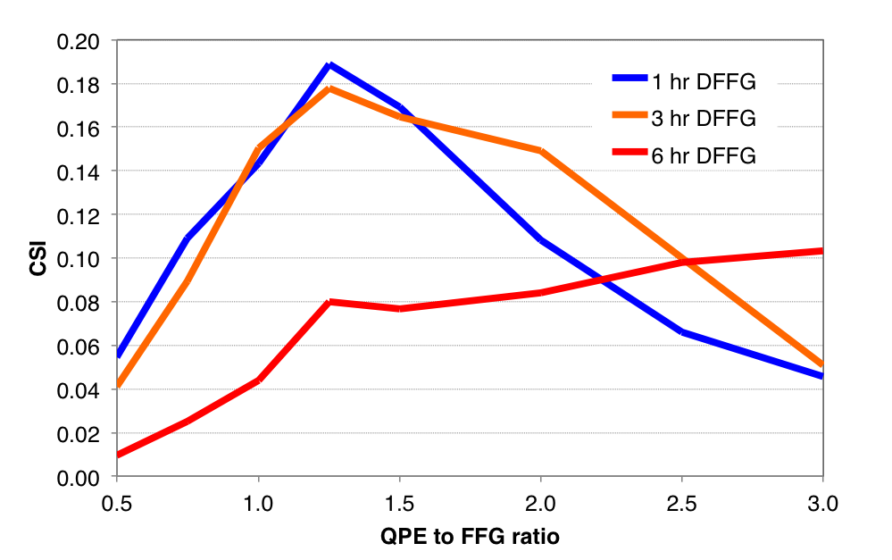
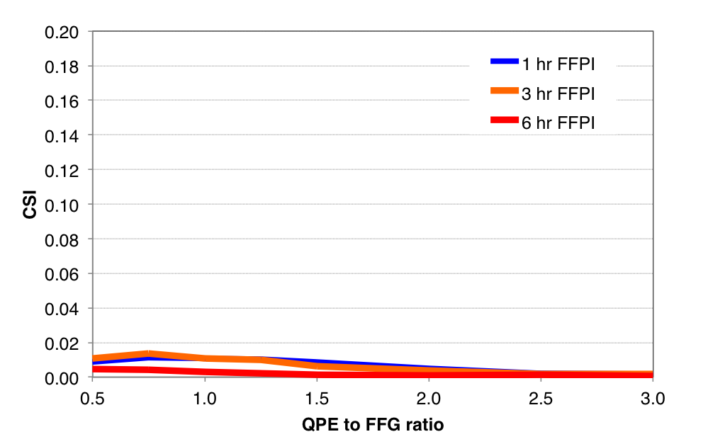
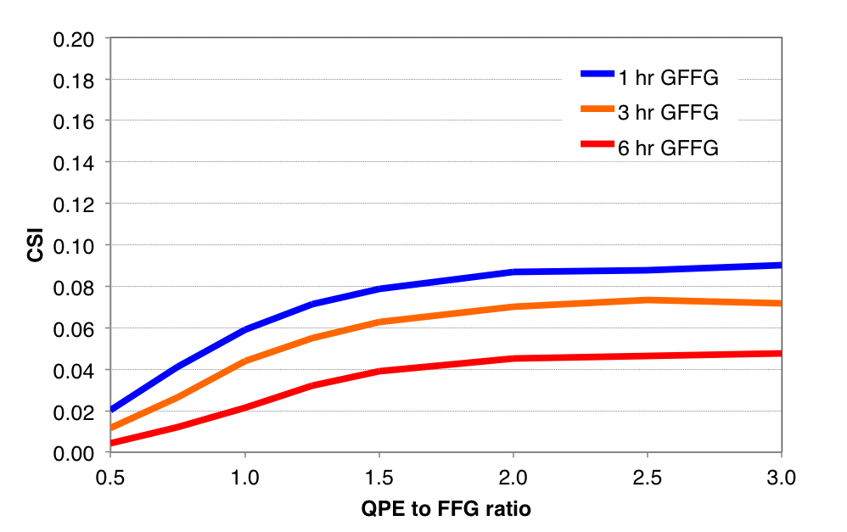
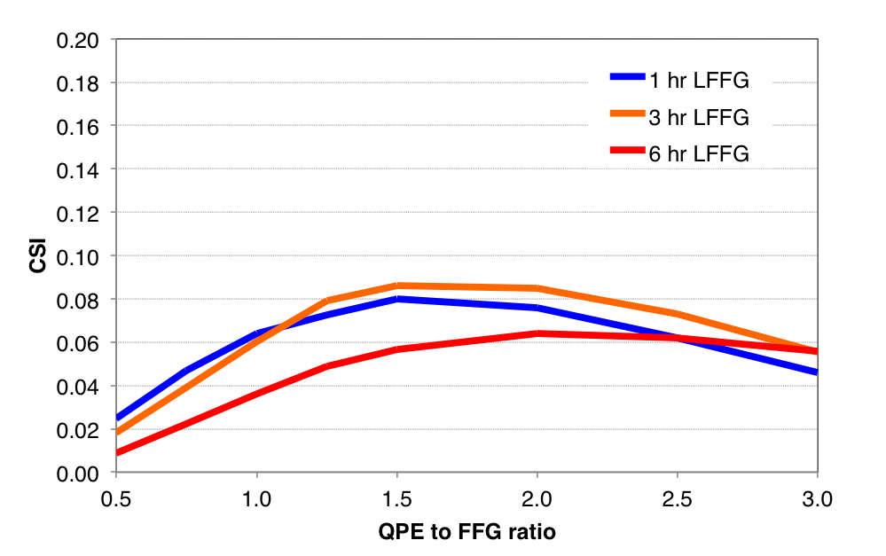
FFPI
N = 820
DFFG
N = 710
GFFG
LFFG
N = 5,530
N = 7,670
R. Clark, et al. Evaluation of Flash Flood Guidance in the U.S.

Slide 13
Conclusions/Recommendations
All methods of FFG in all regions have low CSI (high false alarms; low probability of detection)
CSI = 0.19 over Middle Atlantic RFC using 1-hr DFFG & 1.25 QPE-to-FFG ratio
This value should be considered as the benchmark skill for future developments
Both evaluations indicate the worst performance was in CNRFC, CBRFC, NWRFC, and NERFC
NWS Storm Data has large sample sizes, so we use it for intercomparison
DFFG is best method
LFFG and GFFG have similar skill but GFFG has better resolution
FFPI has lowest skill and should be used sparingly
National system w/consistent skill desirable; but include ability to include local modifications
http://www.nssl.noaa.gov/projects/flash
R. Clark, et al. Evaluation of Flash Flood Guidance in the U.S.

Slide 14
Threshold frequency method for flash flood prediction
Take longest available gridded rainfall record
Simulate flow with hydrologic model for period of rainfall recording annual maximum flows @ each grid cell
Compute Log-Pearson III distribution from annual maximum sim flows (gives mean, standard deviation and skew parameters)
From this distribution estimate we can estimate return period for any discharge value at every grid point
Inherent bias correction for inputs+model
Reed et al. (2007)
Return Period (years)
Streamflow (cms)
Q₂
2
Time

Slide 15
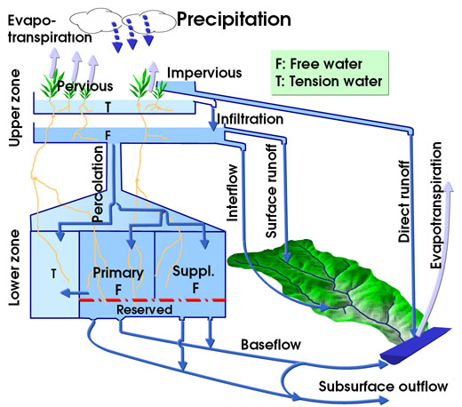
Ensemble Framework For Flash Flood Forecasting (EF5) supports 2 distributed models
CREST
HL-RDHM
Figure adapted from UC-Irvine
Wang et al. (2011) Hydrol. Sci. J.
Koren et al. (2004) J. Hydrol.
Concepts from Xinanjiang model
Runs operationally over globe at OU and NASA
Has a priori parameters
1-km/5-min resolution
Concepts from SAC-SMA model
Runs operationally in US NWS
Has a priori parameters
4-km/1-hr resolution

Slide 16
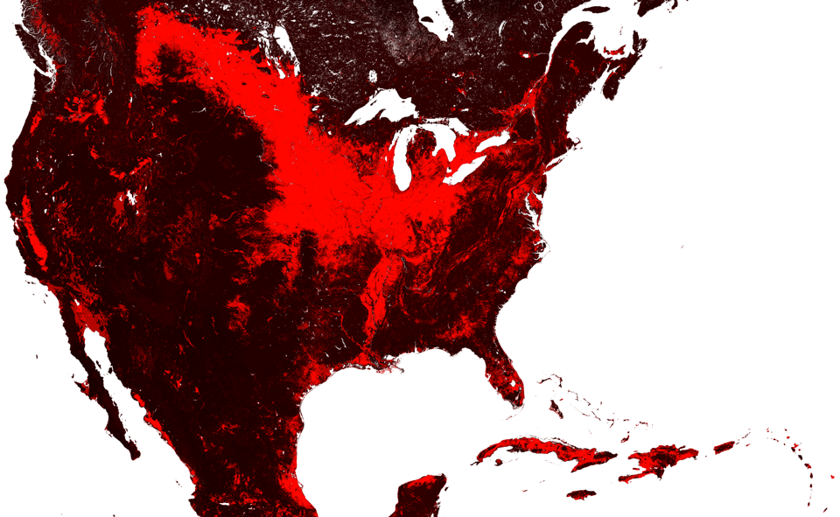
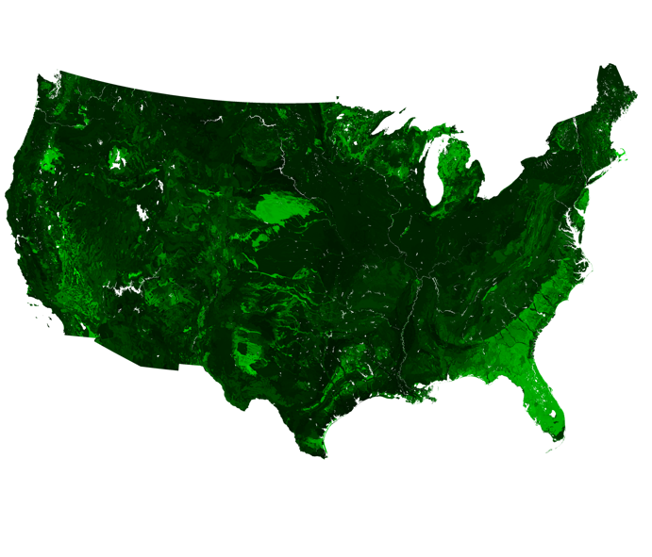
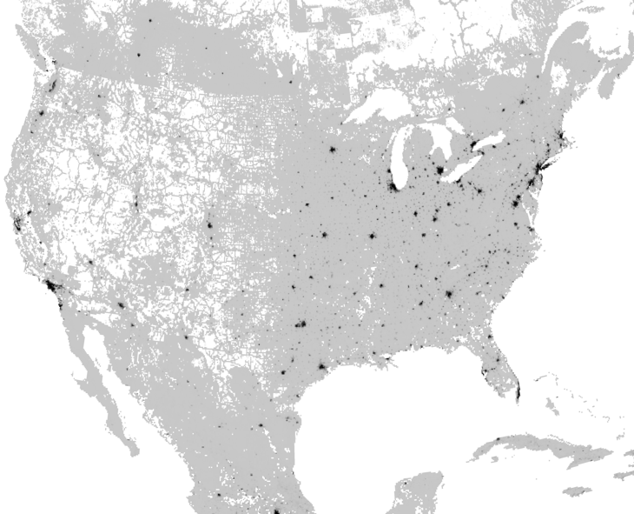
CREST – a priori parameters
Roughness coefficient controls quickflow routing speed
1/(Manning N)
Saturated hydraulic conductivity controls slowflow routing speed
Ksat
% Impervious Area

Slide 17
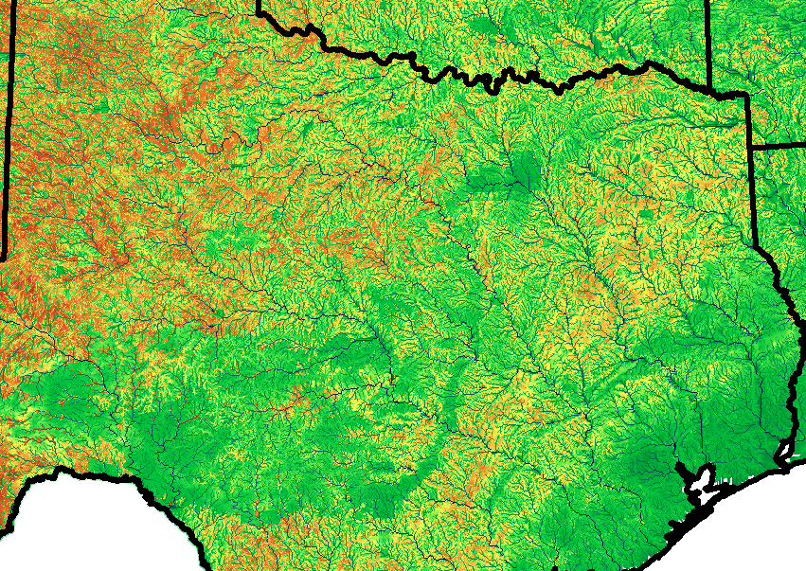
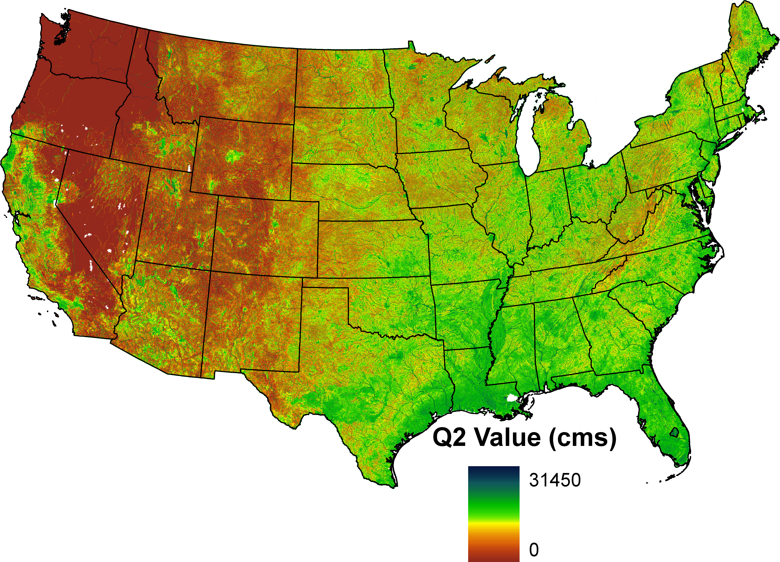
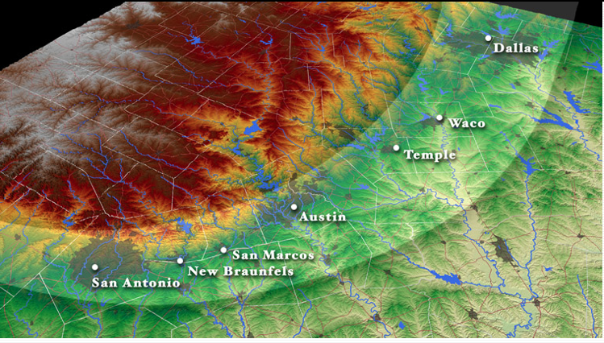
2-yr return period simulated flows from NEXRAD archive (2002-2010)
?
“Flash flood alley”
(floodsafety.com)

Slide 18
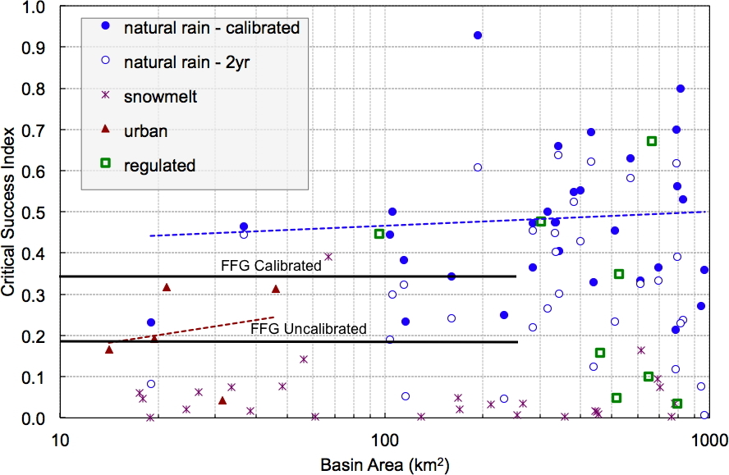
Gourley et al. (2012) Hydro. Sci. J.

Slide 19
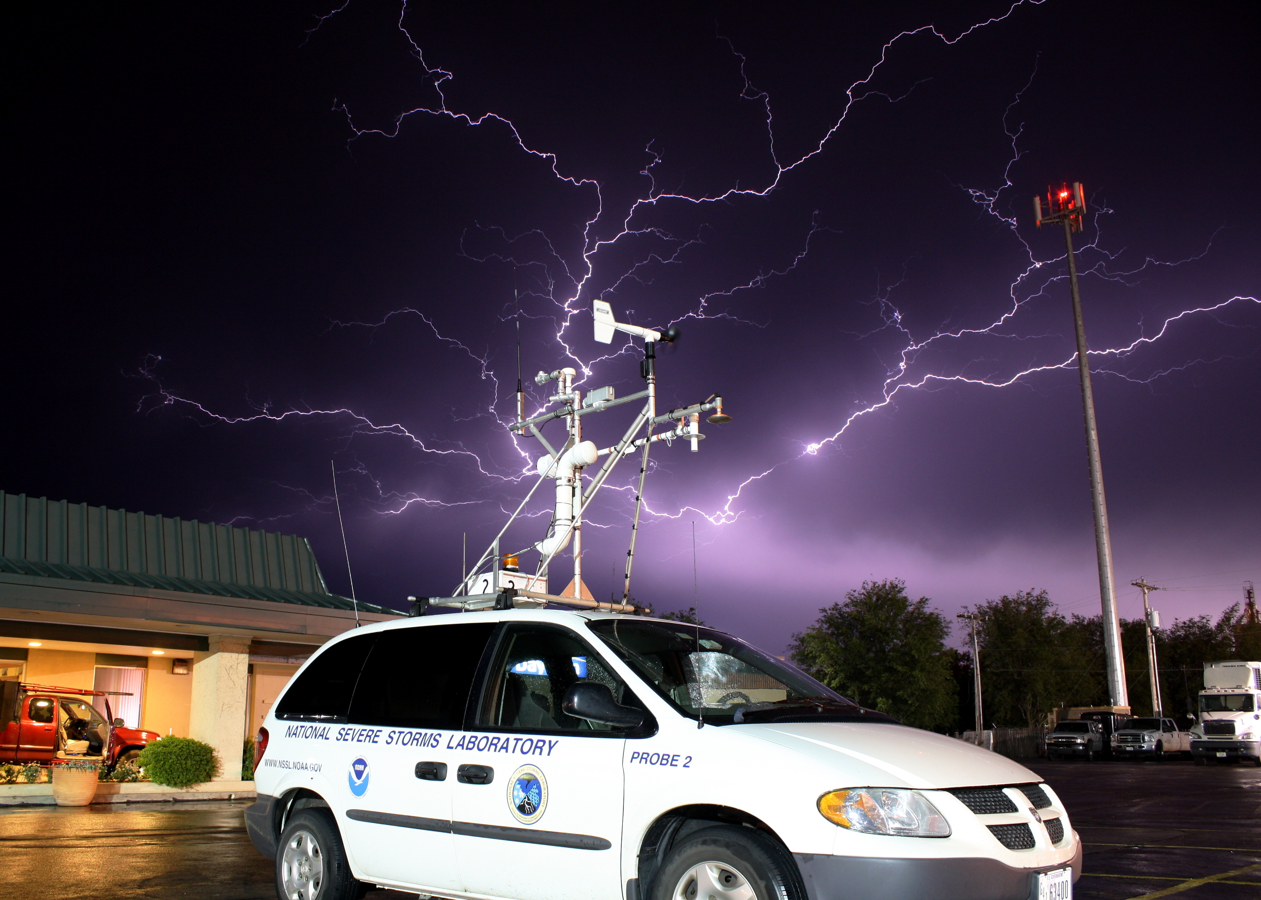
FLASH: Flooded Locations and Simulated Hydrographs
A demonstration system for real-time flash flood prediction

Slide 20
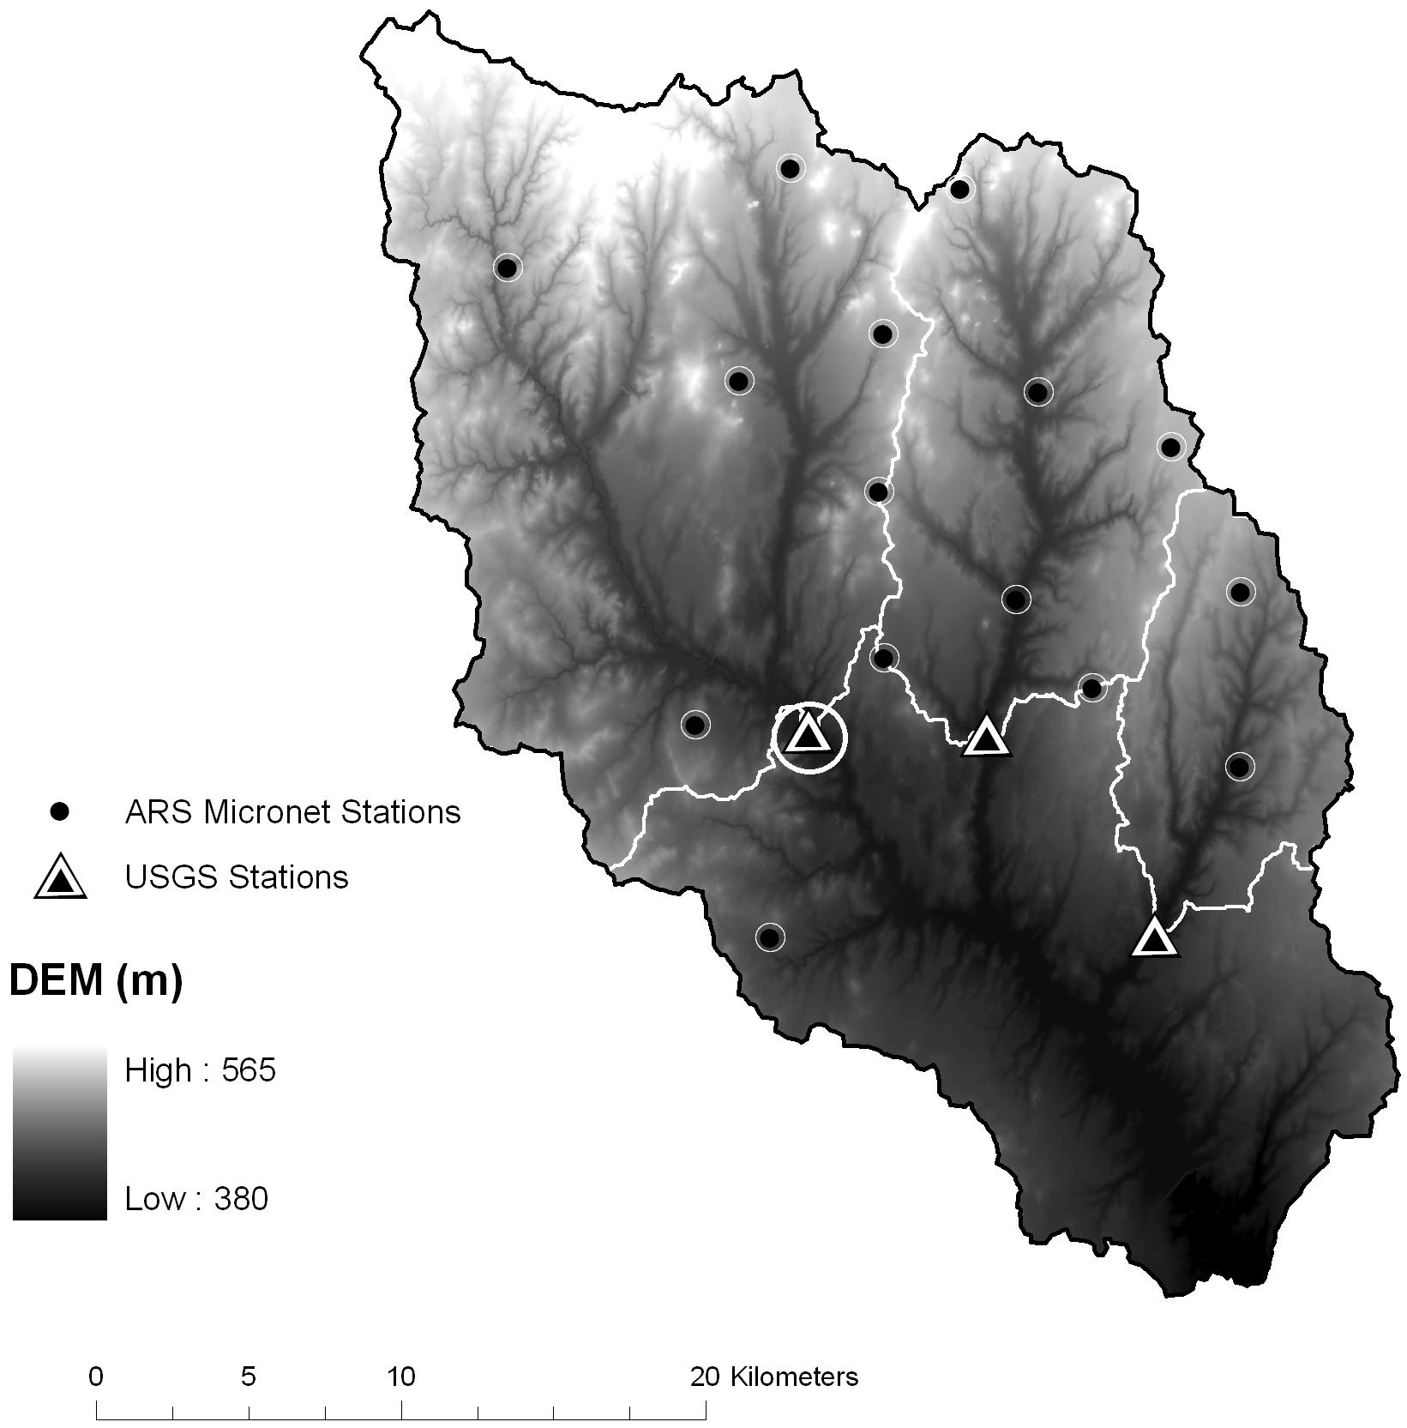
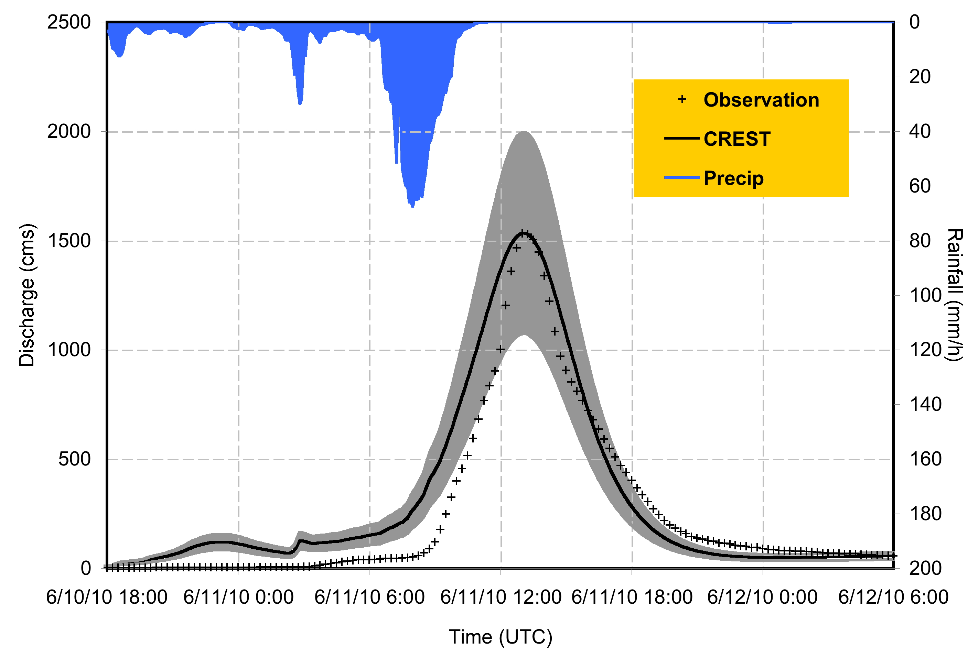
The 1D (traditional) way of doing hydrology

Slide 22
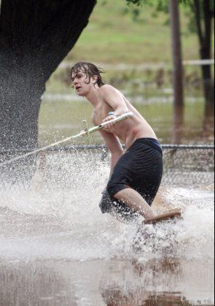
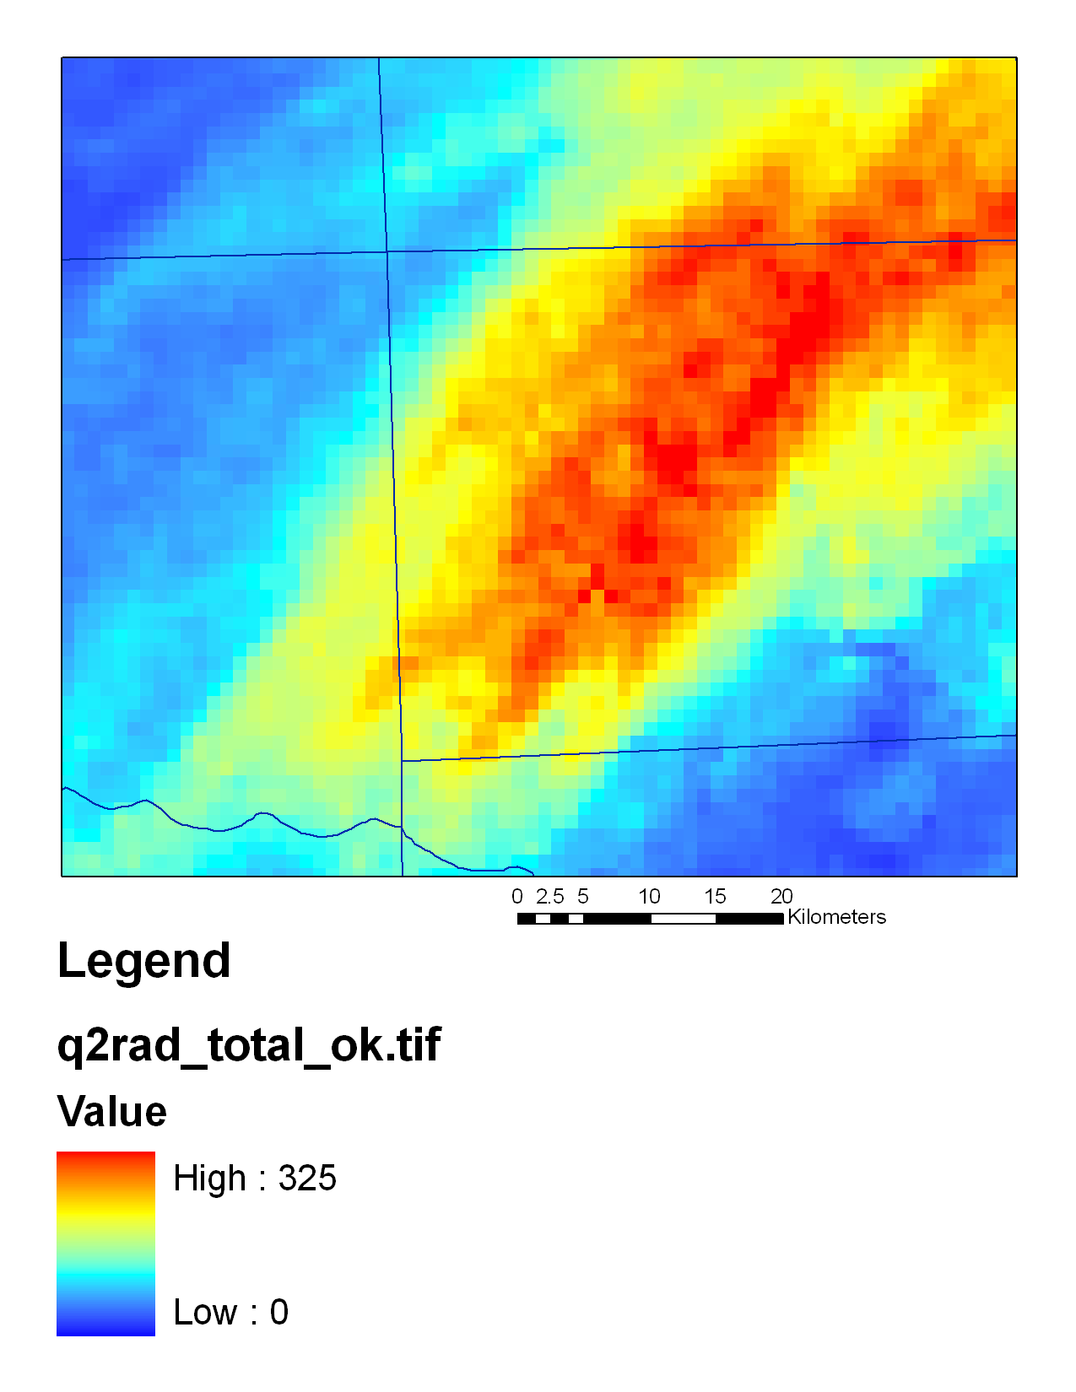
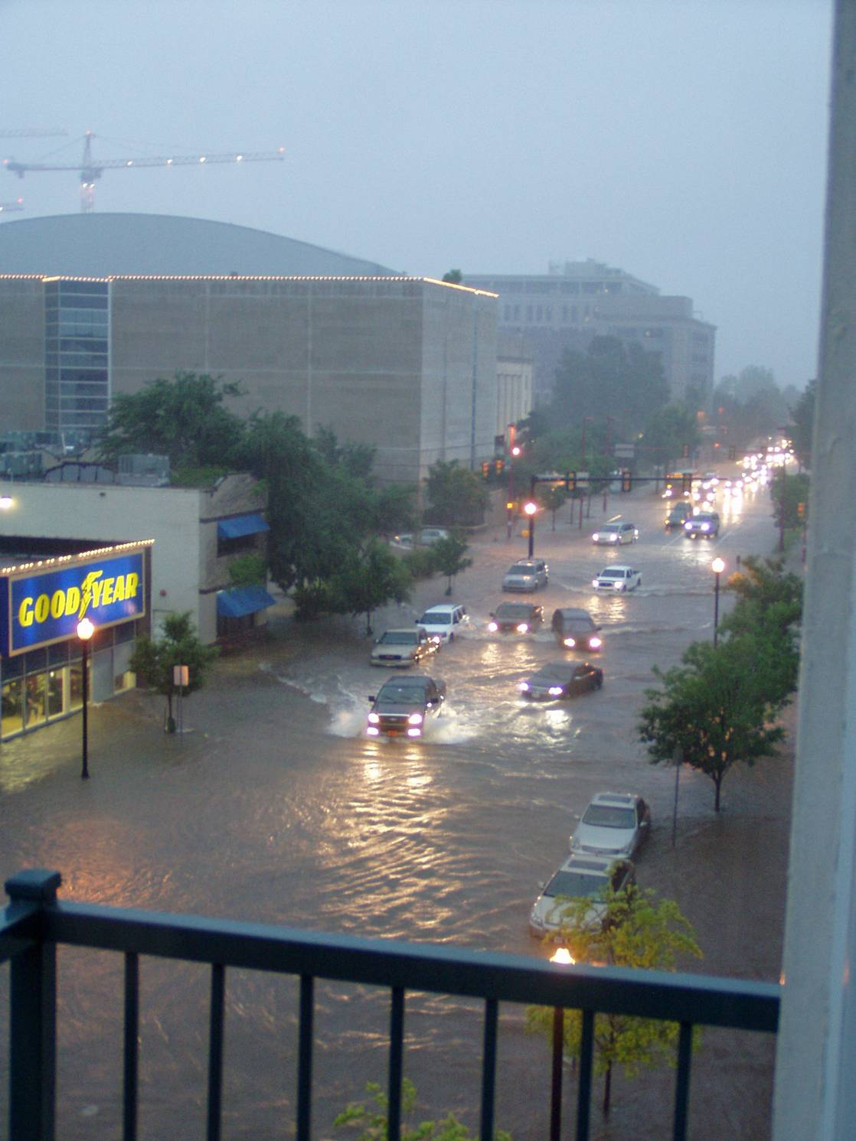
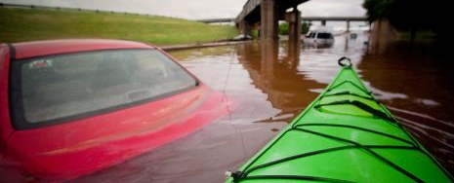
Oklahoma City Flash Flood
Morning of June 14th, 2010
12” of rain in < 6 hours!
Lots of flooding & property damage, thankfully no loss of life
Photos courtesy of OKC Dept. Public Works
0
325
Accumulation (mm)

Slide 23
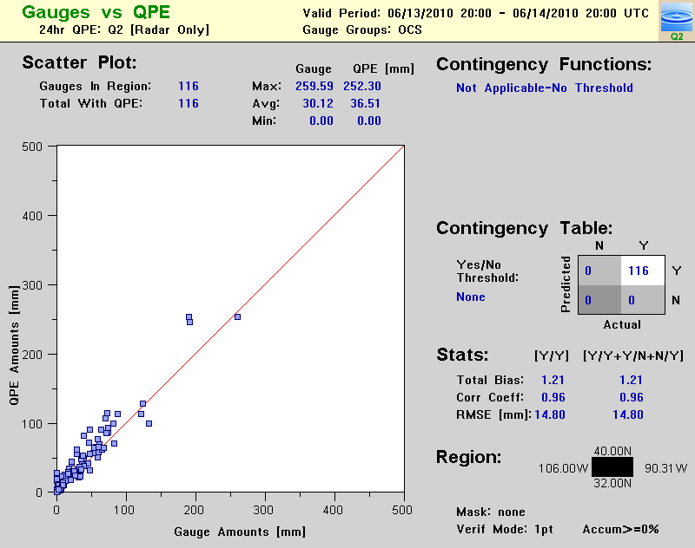
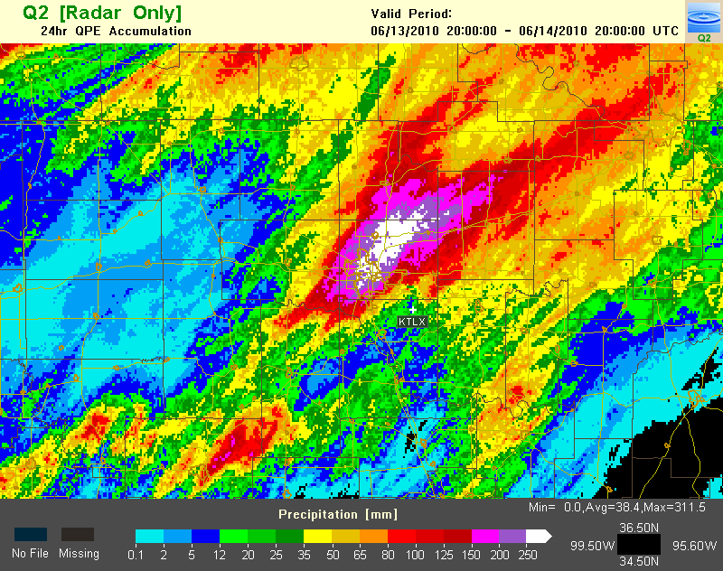
Comparison of Q2 radar-only 24-hr rainfall to Mesonet gauges

Slide 24
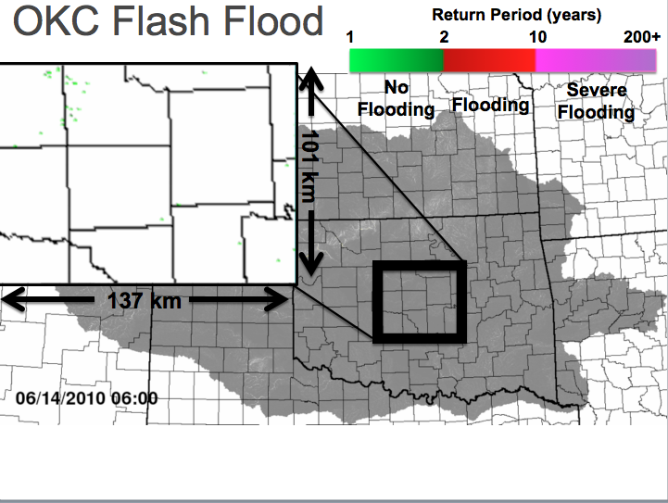

Slide 25
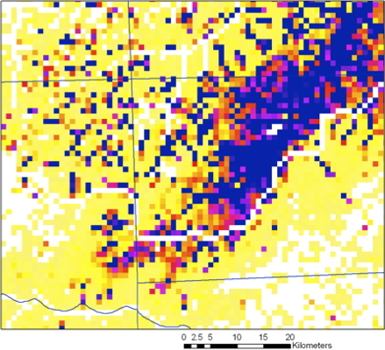
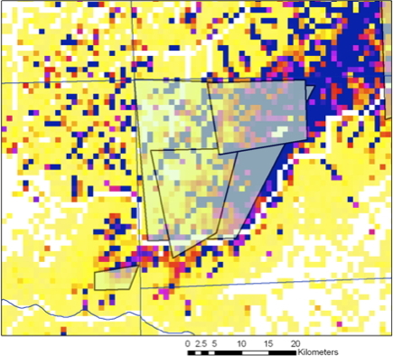
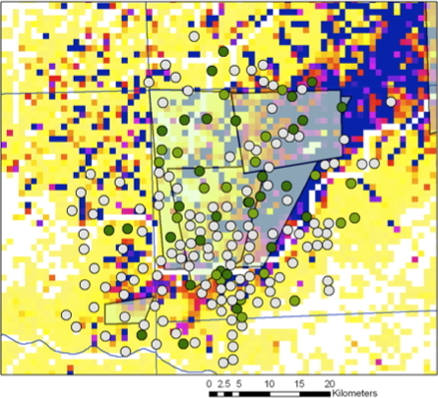
Evaluation of Flash Flood Simulations
SHAVE Reports
No Flooding
Flooding
Severe Flooding
US NWS Flood Report
Max Return Period (years)
10
Severe Hazards Analysis and Verification Experiment
Ortega et al., BAMS (2009)
1

Slide 26
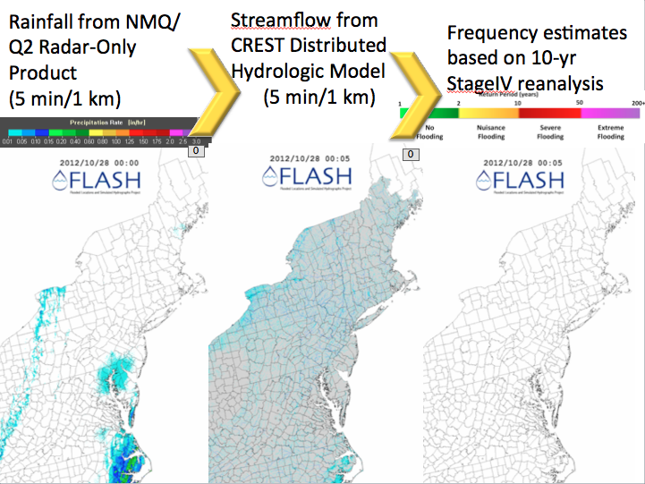

Slide 27
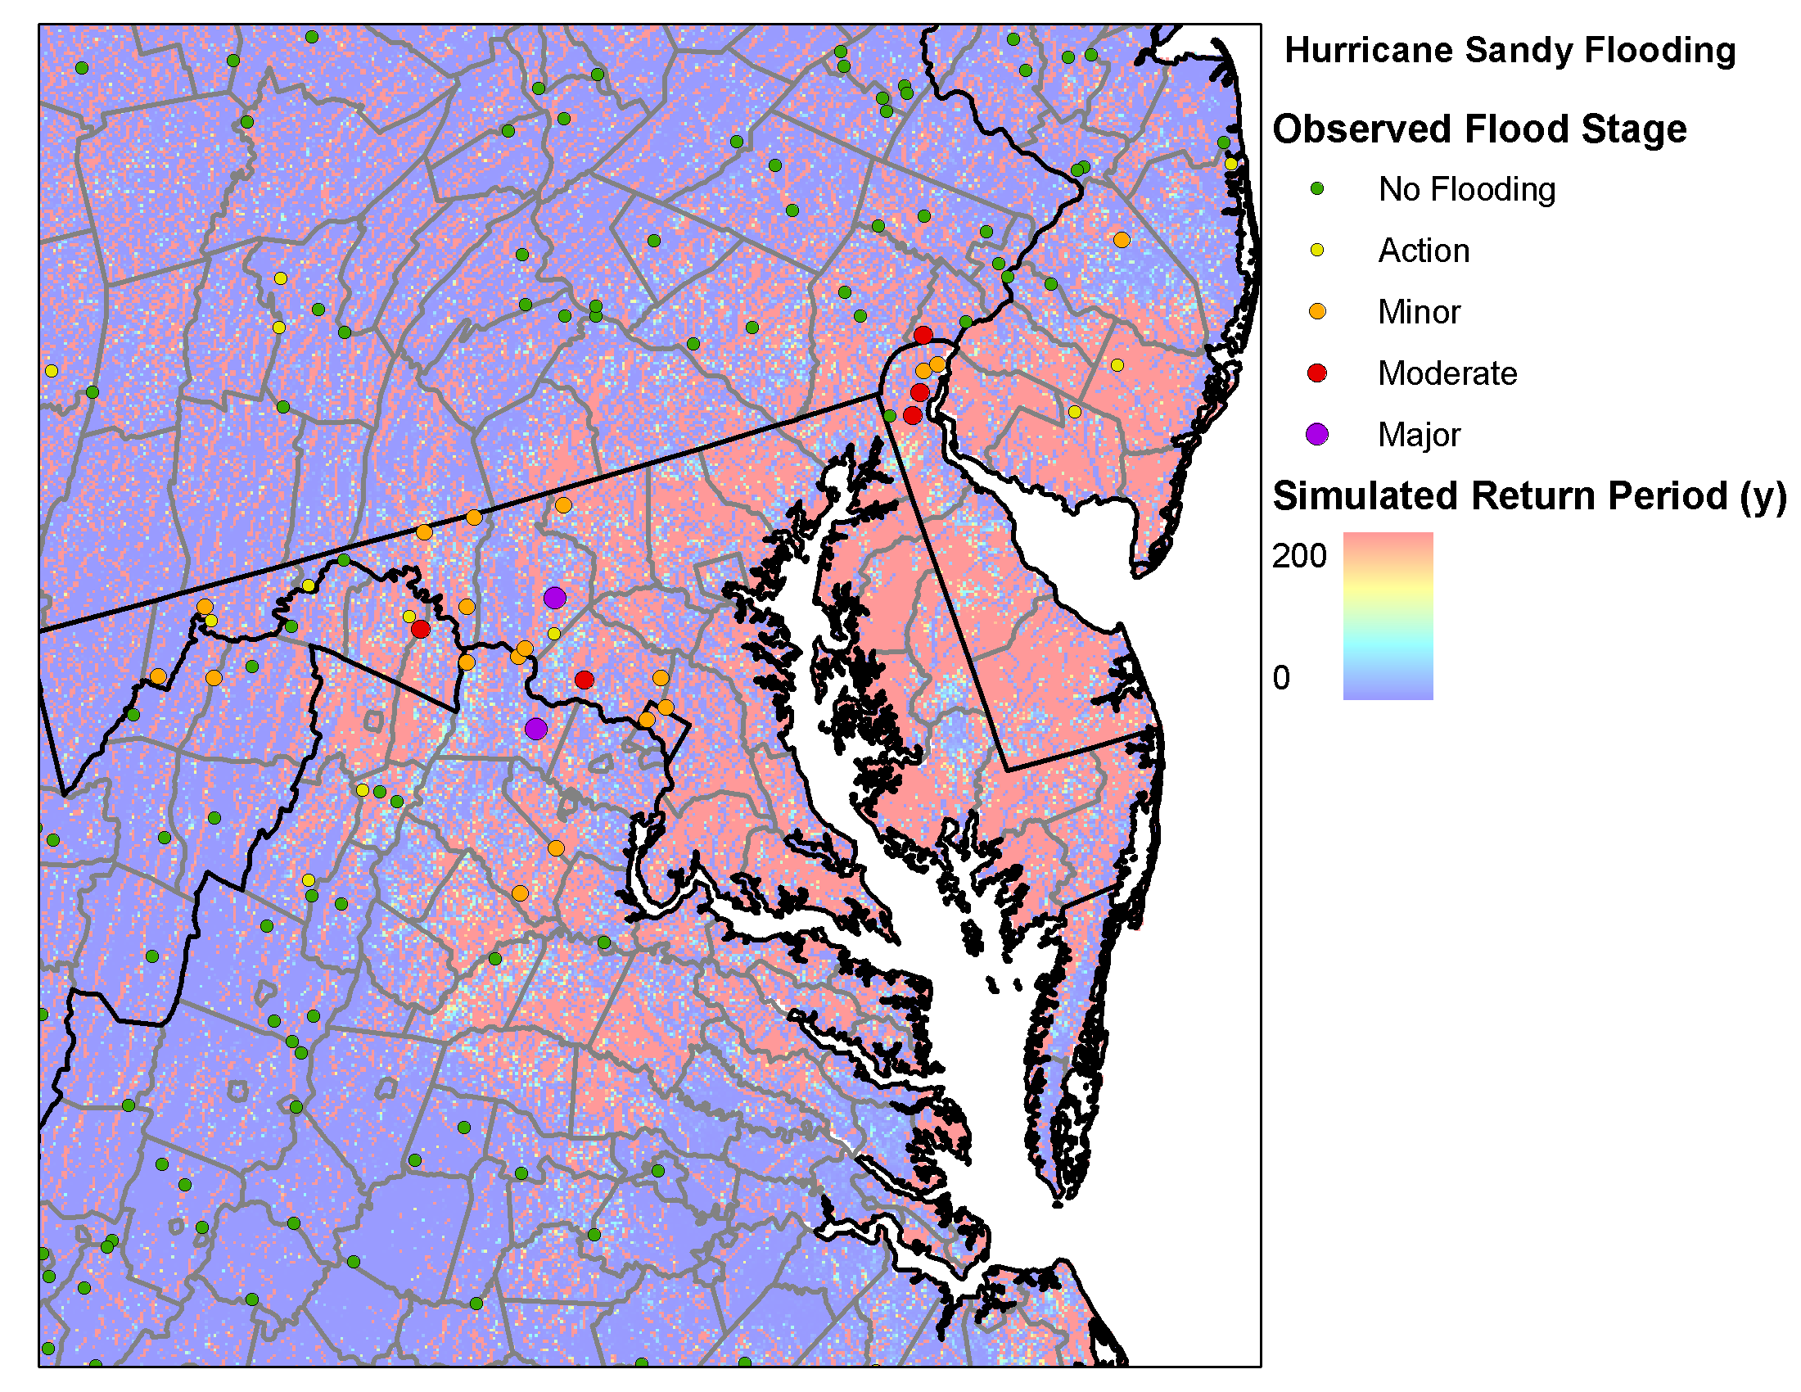
Hurricane Sandy

Slide 28
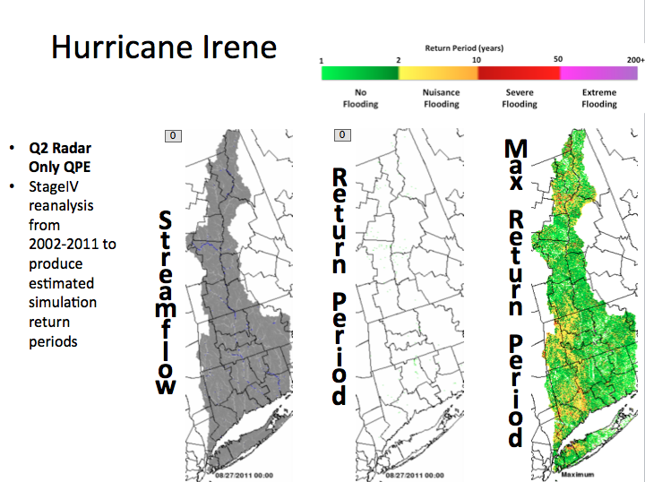

Slide 29
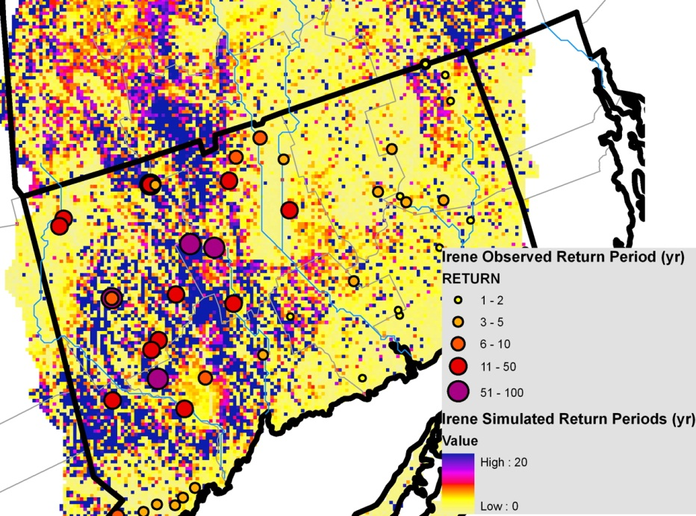
Distributed Flood Severity Index

Slide 30
Ensemble Framework For Flash Flood Forecasting (EF5)
Current Version
Precip Forcing
Q2 rainfall rate
Q2 precip type
TMPA-RT
NWP forecasts
Snowmelt
SNOW-17
HRRR temp
Evapotranspiration
FEWS NET PET
HRRR temp, etc
Land surface model
Future Addition
Surface Runoff
SAC (HL-RDHM like)
VIC (CREST like)
HyMOD
Routing
Kinematic wave
Linear reservoir
State Estimation (EnKF)
USGS streamflow
AMSR-E soil moisture
Forecast
Threshold frequency
Probability of flood
Probability of damage
Param Estimation (DREAM)
USGS streamflow
AMSR-E soil moisture
Groundwater
MODFLOW

Slide 31
Probabilistic Flash Flood Forecasting using Ensemble Stormscale Precipitation Forecasts
Jill Hardy
Gina Hodges
NSF Graduate Research Fellowship

Slide 32
Maximum Return Periods – OKC Flash Flood
Promising performance from a 12-hr forecast !
Q2 (observed)
Best member
Ensemble mean
Probability matched mean

Slide 33
The use of SHAVE and NWS flash flood reports for impact characterization and prediction
Martin Calianno
Laboratoire d'étude des Transferts en
Hydrologie et Environnement, Grenoble, France

Slide 34
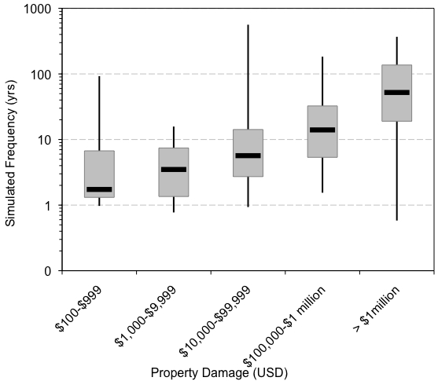
Are simulations of flash flood severity related to economic impact?
From hydrologic model
From NWS StormDat reports

Slide 35
How does FLASH differ from DHM-TF package?
Resolution: FLASH runs on back-end of NMQ/Q2 rainfall generation and provides forecasts at the flash flood scale (1 km/5 min presently, with upgrade to 250 m in March vs. 4 km/1 hr)
Probabilistic instead of deterministic
Will incorporate GIS exposure factors to yield impact-specific products
Framework readily accommodates forcing from contemporary QPFs (e.g., stormscale ensembles)
FLASH is a centerpiece for R&D

Slide 37
Relevant Literature
Calianno, M., I. Ruin, and J. J. Gourley, 2013: Supplementing flash flood reports with impact classifications, J. Hydrol., 477, 1-16. doi:10.1016/j.jhydrol.2012.09.036
Gourley, J. J., Y. Hong, Z. L. Flamig, A. Arthur, R. A. Clark, M. Calianno, I. Ruin, T. Ortel, M. E. Wieczorek, E. Clark, P.-E. Kirstetter, and W. F. Krajewski, 2013: A unified flash flood database over the US., Bull. Amer. Meteor. Soc., (in press)
Clark, R. A., J. J. Gourley, Z. L. Flamig, Y. Hong, and E. Clark, 2013: CONUS-wide evaluation of National Weather Service flash flood guidance products, Wea. Forecasting (in review).
Gourley, J. J., J. M. Erlingis, Y. Hong, and E. Wells, 2012: Evaluation of tools used for monitoring and forecasting flash floods in the United States. Wea. Forecasting, 27, 158-173, doi: 10.1175/WAF-D-10-05043.1.
Gourley, J. J., Z. L. Flamig, Y. Hong, and K. W. Howard, 2012: On the accuracy of the past, present, and future tools for flash flood prediction in the USA. IAHS Publ. 351, ISBN 978-1-907161-26-1, 435-440.
Wang, J., Y. Hong, L. Li, J. J. Gourley, S. I. Khan, K. K. Yilmaz, R. F. Adler, F. S. Policelli, S. Habib, D. Irwin, A. S. Limaye, T. Korme, and L. Okello, 2011: The coupled routing and excess storage (CREST) distributed hydrological model. Hydrol. Sci. Journal, 56, 84-98, doi: 10.1080/02626667.2010.543087.
Gourley, J. J., J. M. Erlingis, T. M. Smith, K. L. Ortega, and Y. Hong, 2010: Remote collection and analysis of witness reports on flash floods. J. Hydrol., 394, 53-62, doi: 10.1016/j.jhydrol.2010.05.
Ortega, K.L., T.M. Smith, K.L. Manross, K.A. Scharfenberg, A. Witt, A.G. Kolodziej, and J.J. Gourley, 2009: The severe hazards analysis and verification experiment. Bull. Amer. Meteor. Soc., 90, 1519-1530.

