Slide 1
AWIPS Reference Training Plugin (Just in Time Training Plugin)
Jason Burks
NWS MDL/DSB/CIRA

Slide 2
History of the project
Originally purposed at 2015 NOAA Satellite User Readiness Meeting
Prototype developed at NASA SpoRT
Tested at OPG Spring 2016
Development moved to MDL with partnership with WDTD

Slide 3
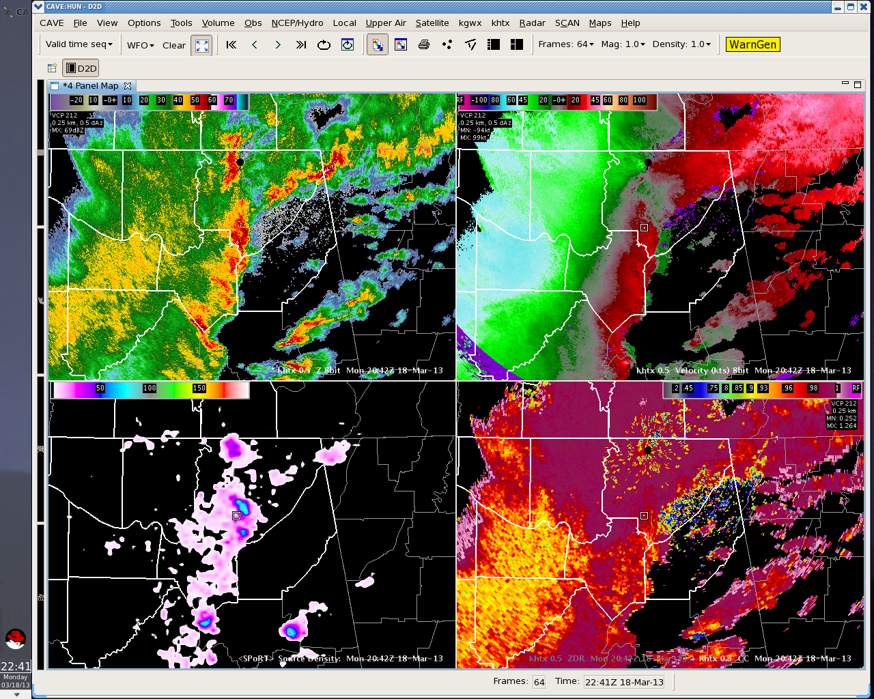
AWIPS
What is AWIPS?
Advanced Weather Information Processing System
Ingest, visualization, forecast creation tool of National Weather Service
What is EDEX?
Ingest, and Backend of AWIPS system
What is CAVE?
Visualization portion of AWIPS

Slide 4
What is VLab?
Virtual Lab Development Services (VLDS)
Virtual Lab Collaboration Services (VLCS)
VLCS uses platform called Liferay
VLCS supports communities through wiki, forums, document libraries, blogs, and web content.
VLCS supports science sharing and training

Slide 5
Need
Currently forecasters have different systems for composing the forecast versus reference and training material
No method to lookup training on a meteorological product within AWIPS or WES
TRAINING MATERIAL
FORECAST SYSTEM

Slide 6
Why is this a problem?
Warning Event Simulator (WES)
Train how you work
Train on the system you use to do your work
Current system does not have integrated reference
Having material on decision making system allows closer comparison
Currently no easy way to search available training
Training is spread across various locations
Reference material for less frequent applications is sometimes hard to find

Slide 7
Other issues to address
Don’t want to impose another set of training development tools
Some materials are only regional or locally useful
Need to provide a way for materials to be reused
Provide feedback on materials

Slide 8
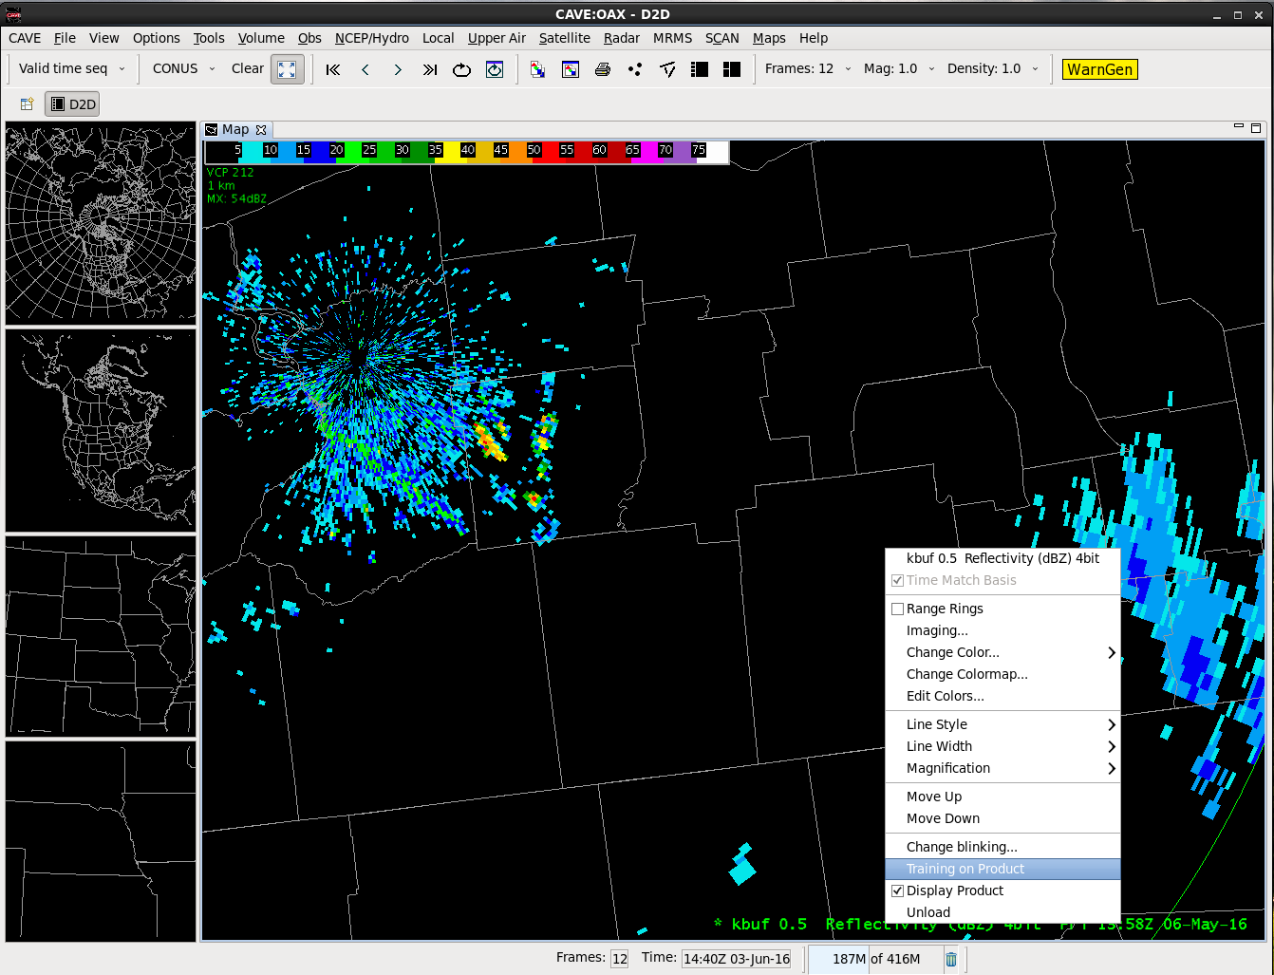
1
Accessing Training on a Product

Slide 9
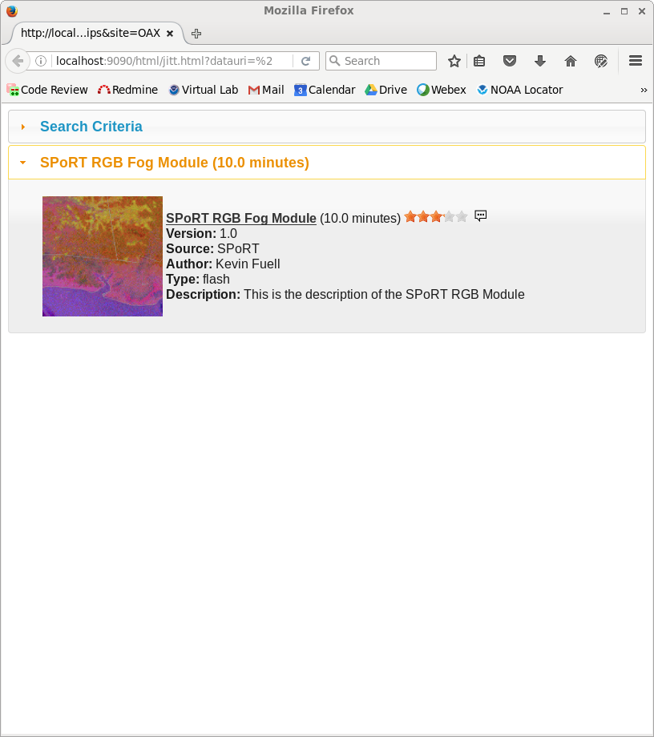
Search Results
2
Results are ordered by match score
Results are accessible from AWIPS
Material can be rated and commented upon

Slide 10
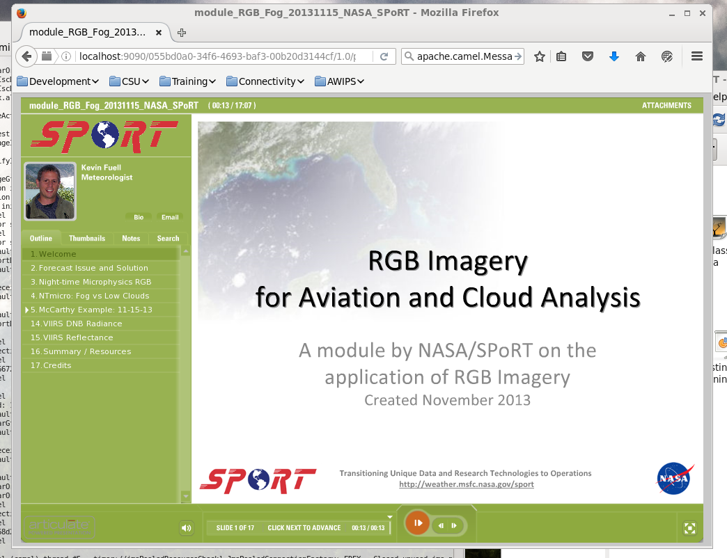
Training Material
3

Slide 11
What is happening behind the scenes?
Trainer creates material
on VLab
Forecaster
Searches for training from AWIPS
Trainer Develops Training/ reference material

Slide 12
Benefits
User initiates the search, but can change the parameters
Sorting of material is various ways, such as:
Keyword matching
By length of training
Source
Crowd sourcing
Comments
Rating

Slide 13
Evaluation at Operations Proving Ground Spring 2016
(AWIPS Reference) Just in Time Training Plugin was integrated with new products for RGB satellite data
Forecasters worked as in real-life forecasting
Forecasters were shown how to use the plugin to access training and reference material
Resounding success
Forecasters asked how they could get this plugin at their site ASAP

Slide 14
AWIPS Integration
Software was delivered with 16.4.1
Development of VLab Interface is ongoing
Appearing in offices in early Winter 2016 (currently scheduled for 12/8/16)

Slide 15
How do training/reference developers add content?
Once VLab integration is deployed…
Training developers will create training/reference content on VLab
Then create fill in a web page with some information about the training
Title
Description
Keyword tags
Duration
Source
Thumnail

Slide 16
Other Interesting Features
Training can be managed within Communities in VLab
Geotagging training
Ratings
Comments
Versioning
Flexibility

Slide 17
Materials can be managed in communities
Satellite Community
Radar Community

Slide 18
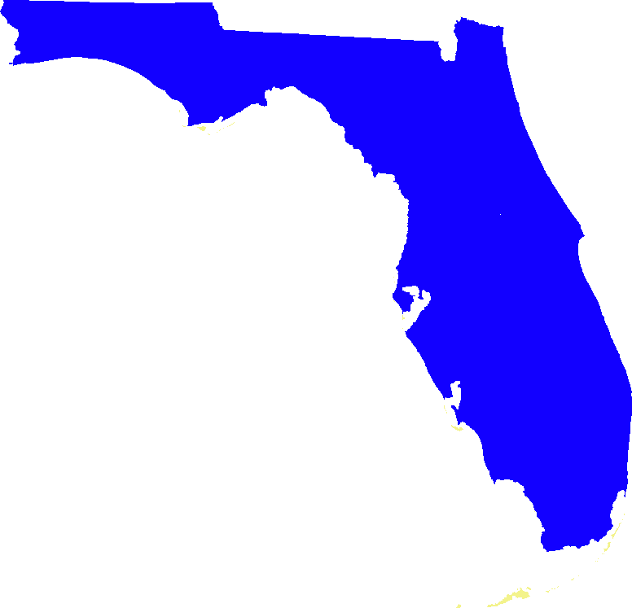
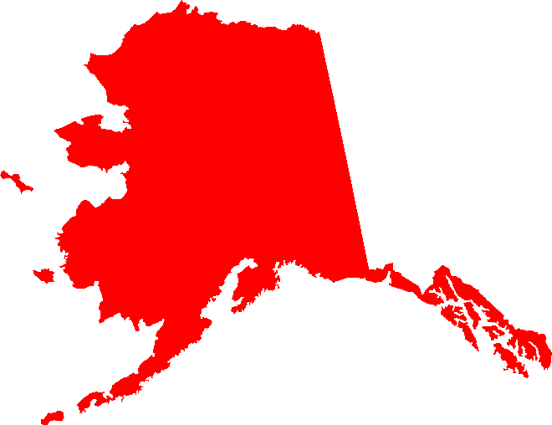
Geotagging Materials
Materials for Southeastern US may or may not be helpful in Alaska?
Searches contain view extent

Slide 19
Ratings and Comments
Use VLab existing rating and comment system
Provides feedback to other users
Provides feedback to training/reference developers

Slide 20
Versioning and Flexibility
VLab automatically has versioning
Material developers can easily provide updates
Material developers can adjust tags
Users can view inside and outside of AWIPS

Slide 21
Questions
Jason.Burks@noaa.gov

