Slide 1
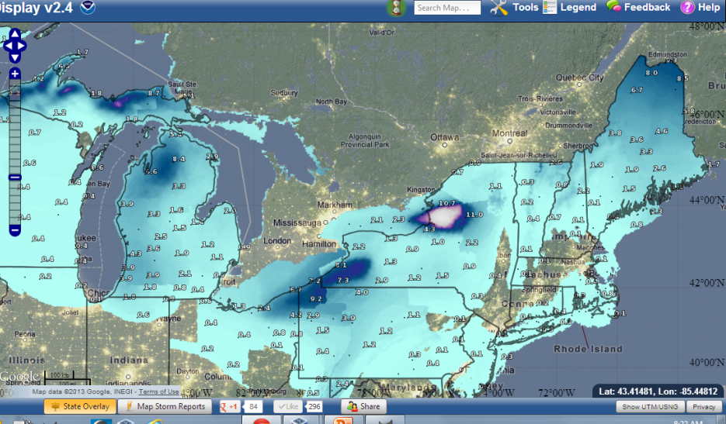
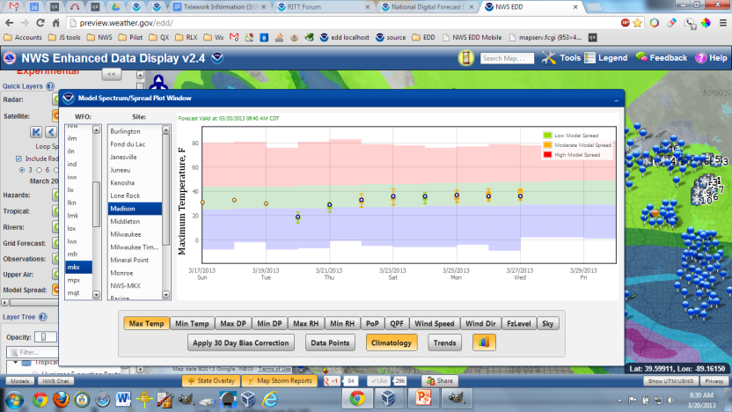
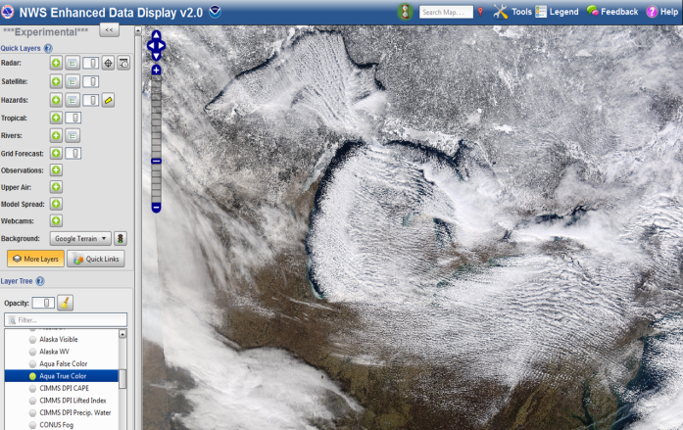
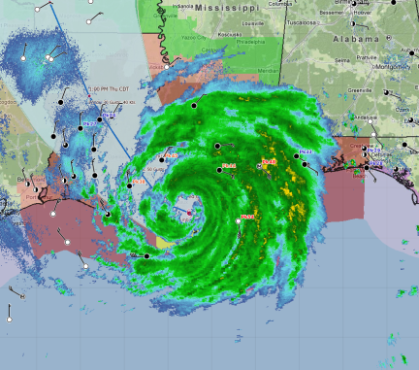
Introduction and Working with Layers
Meet EDD - Enhanced Data Display
Jonathan Wolfe, Chris Leonardi, and Julia Ruthford
Charleston, WV WRN Pilot Project

Slide 2
What is EDD?
The Enhanced Data Display (EDD) is simply a web-based GIS.
Data layering, querying, and extraction
Share layers with others that dynamically update with the latest data – shared data is never stale
Accelerates Research to Operations

Slide 3
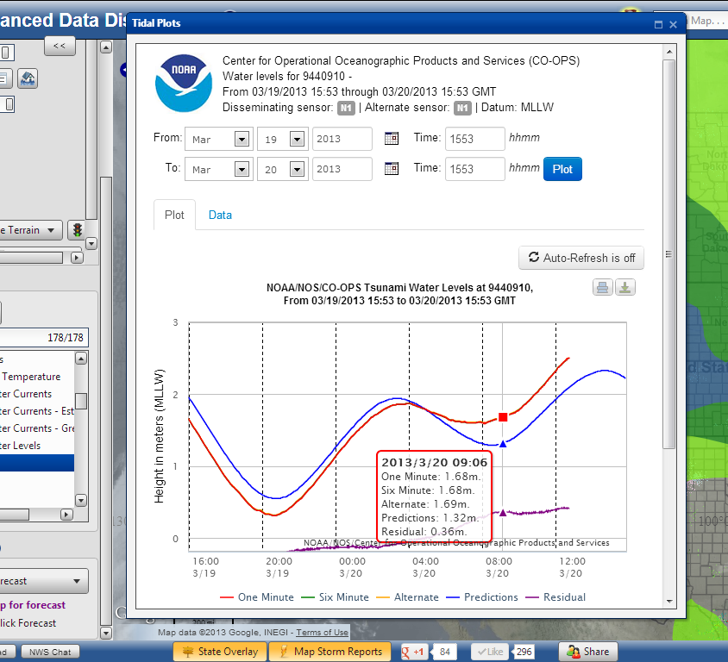
Plugins - Model Spread

Slide 4
Disclaimer
EDD is an experimental service and is under continuous development
Bugs and data issues are possible
Changes, additions, and deletions to the interface and/or features are possible

Slide 5
Recommendations for using EDD
Computer: Currently optimized for desktop/laptop (usable on smartphone or tablet)
Browser: Firefox, Chrome, Safari, IE 10
Internet speed: the faster, the better!
Screen resolution: the bigger, the better!

Slide 6
Let’s meet EDD!
http://preview.weather.gov/edd
(public-facing, more stable)
http://dev.nids.noaa.gov/~jwolfe/mwp/trunk/edd/build/
(NWS-only, more unstable, but possibly newer features)

Slide 7
Screenshots
Instant metrics on population affected by warnings using Night lights
Storm Total Snowfall

Slide 8
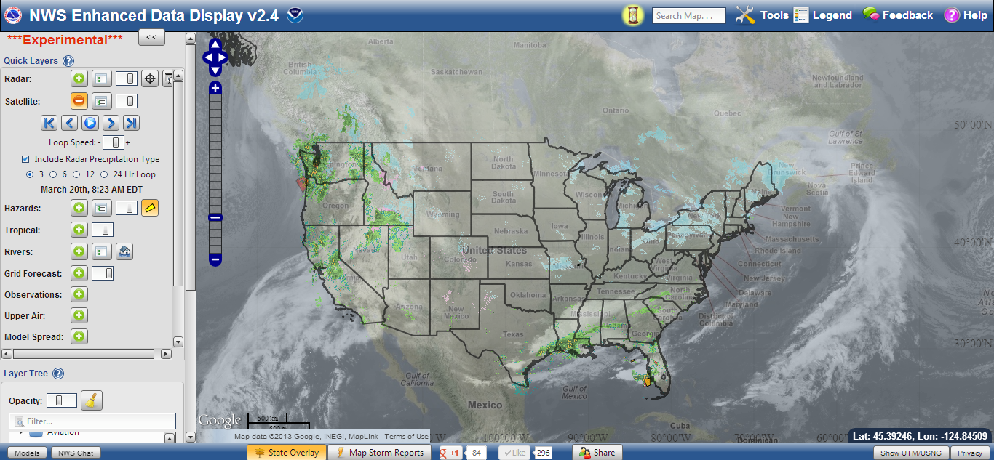
More Screenshots

