Slide 1
Web Services for the Next Generation Air Transportation System
Matt Peroutka
Meteorological Development Lab
September 2013

Slide 2
Background: Web Services for NextGen
4+ years of collaboration between NWS and FAA to make NextGen a reality
Many partners, including NCAR, MIT/LL, NOAA/ESRL, MDL, AWC, AFWA, and FAA Hughes Tech. Ctr.
Current effort has a clear path to operations between NWS and FAA

Slide 3
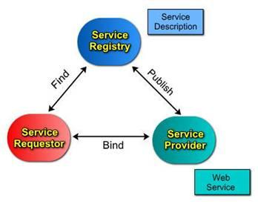
Web Services

Slide 4
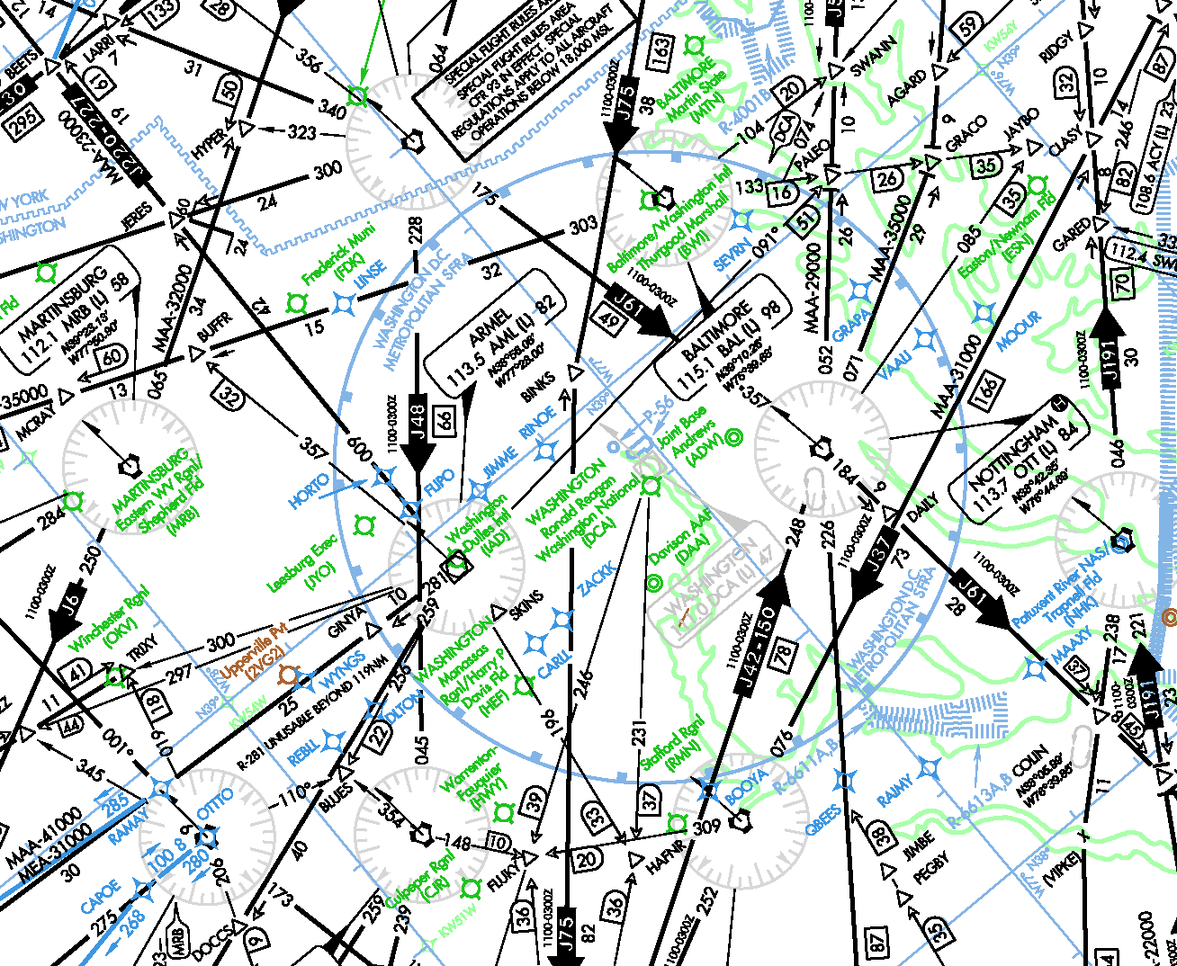
Next Generation Air Transportation System (NextGen)

Slide 5

Next Generation Air Transportation System (NextGen)

Slide 6
FAA Tech Center
Egg Harbor, New Jersey
Data-consuming Applications
Enhanced WINS Dissemination (EWD)
NWS OPSnet MPLS
NWS Meteorological Development Lab
Silver Spring, Maryland
Web Services
(WCS, WMS, WFS, RegRep)
Stage One: Prototypes

Slide 7
FAA National Testbed
ARTCCs ZTL and ZLC
FAA Tech Center
Egg Harbor, New Jersey
Data-consuming Applications
(pub/sub)
Data-consuming Applications
Enhanced WINS Dissemination (EWD)
NWS OPSnet MPLS
NWS Meteorological Development Lab
Silver Spring, Maryland
National Climate and Weather Prediction Center
College Park, Maryland
Web Services
(WCS, WMS, WFS, RegRep
Web Services
(WCS, WMS, WFS, RegRep)
Stage Two: Migration towards operations

Slide 8
FAA Operational Networks
Data-consuming Applications
(pub/sub)
NWS OPSnet MPLS
National Climate and Weather Prediction Center
College Park, Maryland
Web Services
(WCS, WMS, WFS, RegRep)
Stage Three: Operations

Slide 9
Feature? Coverage? Map?
Reg/Rep, WFS, WCS, WMS
Feature, coverage, and map are all concepts from Geospatial Information Systems…
...with useful applications in meteorology

Slide 10
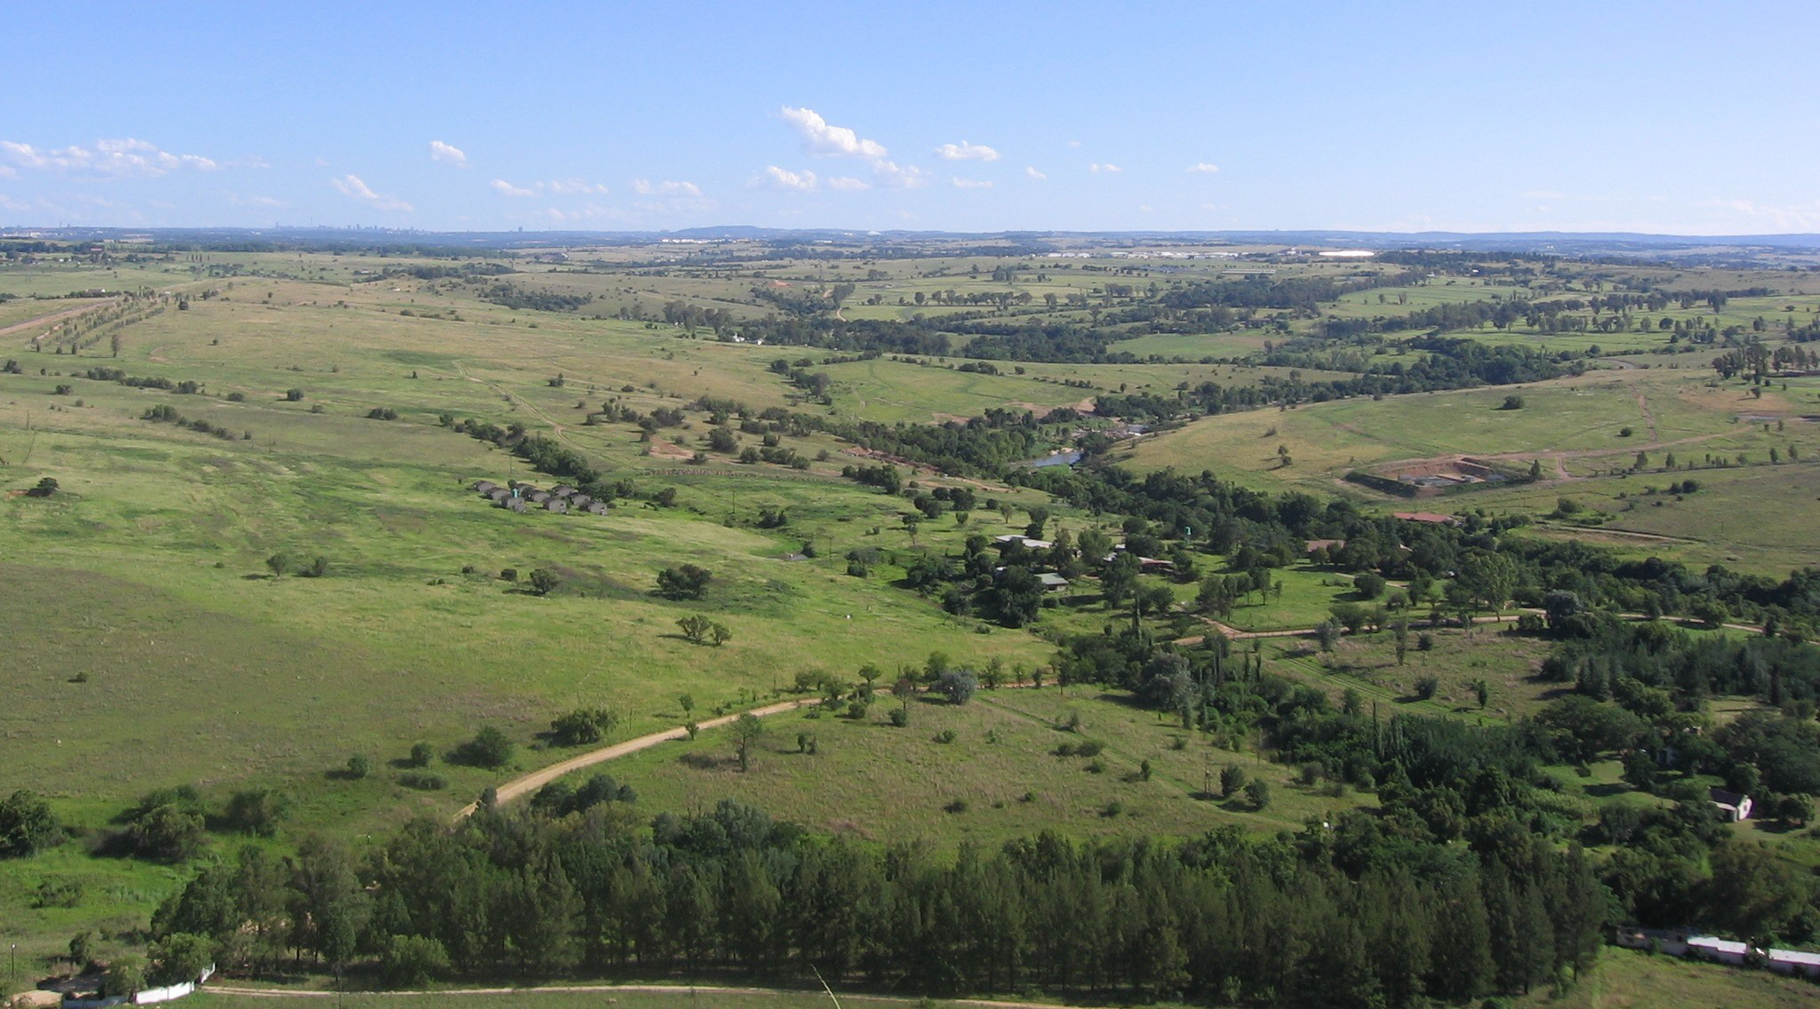
What’s a feature?

Slide 11
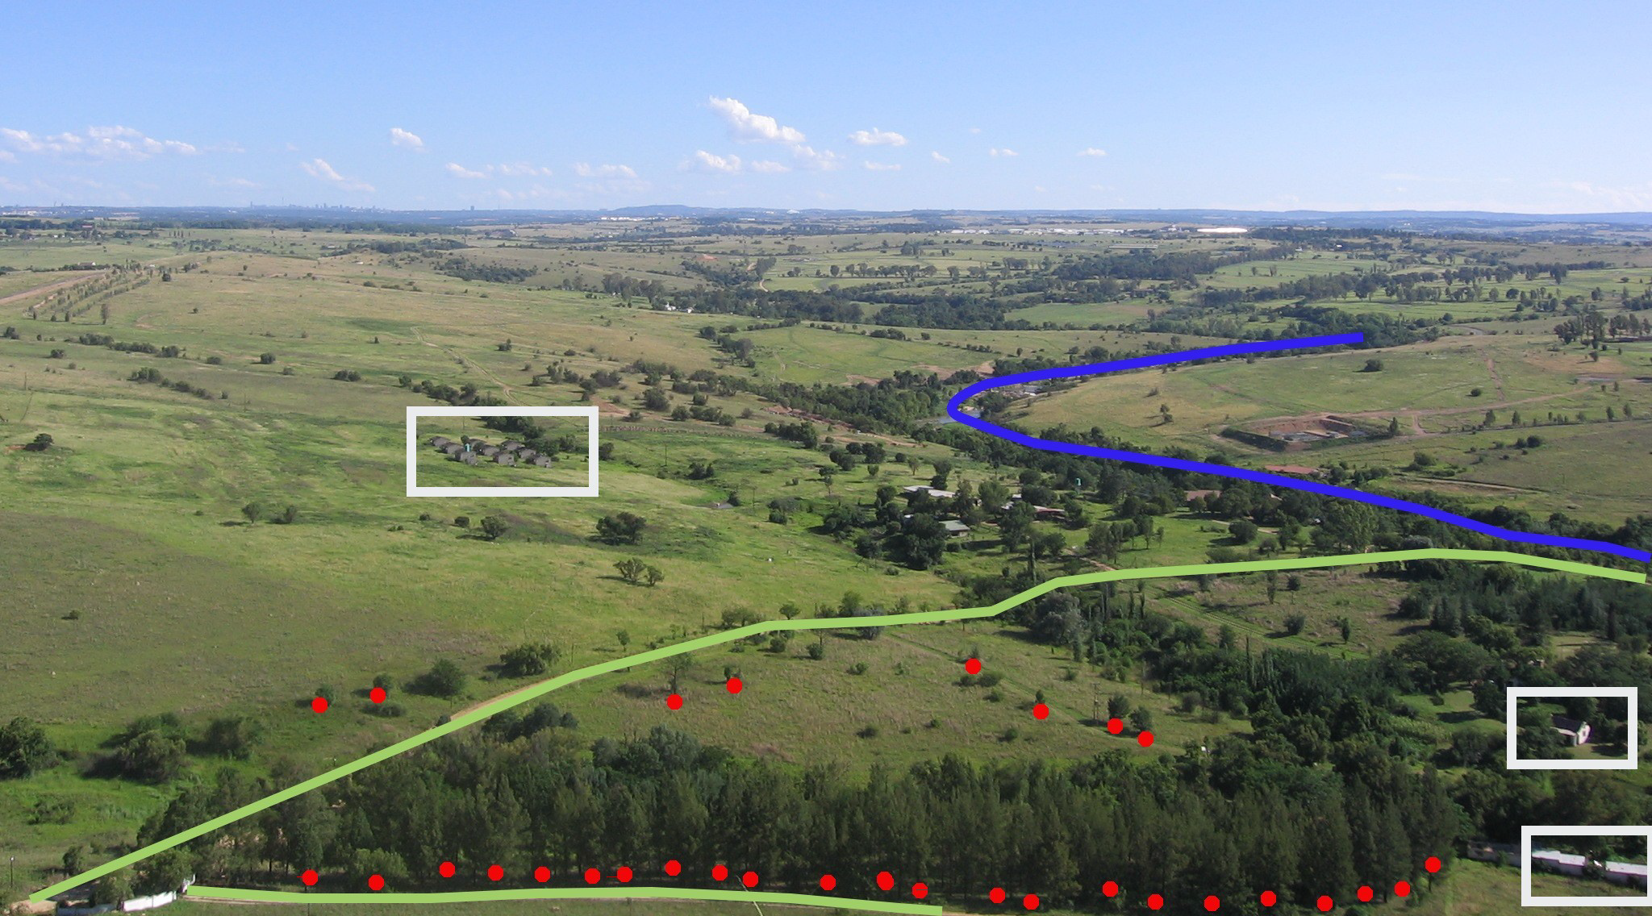
What’s a feature?

Slide 12
Features in GIS
Generally, anything you can see
E.g., stop signs, roads, houses
Often represented as points, polylines, and polygons

Slide 13
Features in meteorology
Point observations or forecasts (e.g., METAR, TAF, PIREP)
Geographic region where a weather forecast or warning is valid (e.g., Forecast Zone, County Warning Area, valid area of a Tornado Watch)
Airspace volume where a weather forecast or warning is valid (e.g., SIGMET)

Slide 14
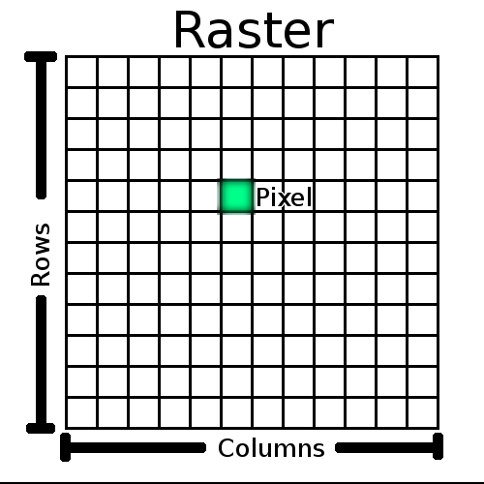
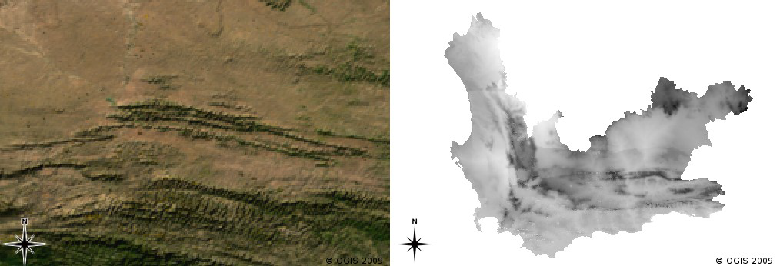
What’s a coverage?

Slide 15
Coverage in GIS
Geographic feature that conveys different values at different locations
Note: Regular spacing not required

Slide 16
Coverage in meteorology
Grids!
Gridded analyses, Numerical Weather Prediction (NWP) output
National Digital Forecast Database (NDFD)
Radar data
Satellite data

Slide 17
Others...
Maps: Images that convey interpretations of data.
Metadata: Information about the data. (E.g., Coordinate Reference System, location, beginning/end of record)
Methods for data discovery, including Registry/Repository (Reg/Rep)

Slide 18
Web Feature Service (WFS)
Client sends a query
Server accesses database
Server encodes response (often multiple data points) in XML
Server sends response to client
Subscription also supported

Slide 19
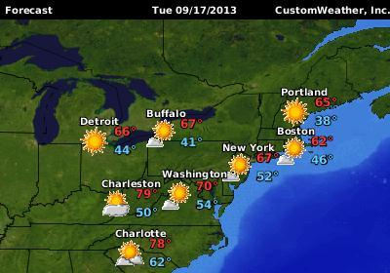
Example WFS in action
CustomWeather’s
MyForecast
Background map
is served by Web
Mapping Service
(WMS)
Station data are
served by WFS

Slide 20
Web Coverage Service (WCS)
Client sends a query
Server accesses data store
Server encodes response. GRIB2 and NetCDF are common response formats.
Server sends response to client
Subscription also supported

Slide 21
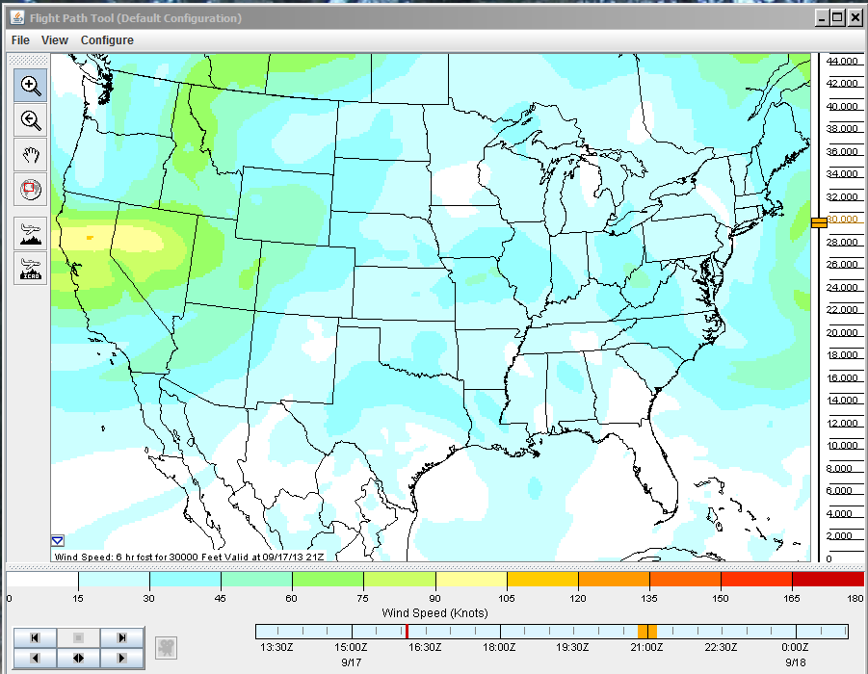
Example WCS in action
NCAR Flight Path Tool

Slide 22
Web Mapping Service (WMS)
Client sends a query
Server accesses data store
Server encodes response as a bitmapped graphic

Slide 23
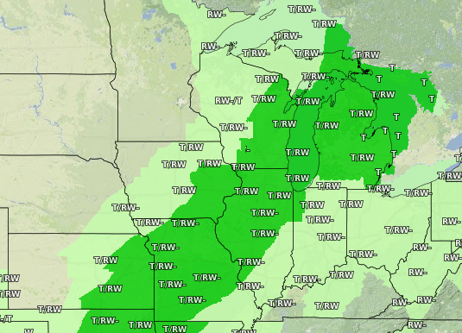
Example WMS in action
NDFD Map Viewer

Slide 24
WCS vs. WMS
Important point the images don’t show:
WCS: Server sends data to client
WMS: Server sends image to client

Slide 25
Web Services, Old and New
WCS, WMS Reference Implementation by NCAR
  Implemented at FAA Tech Center, NCAR, LL/MIT, NOAA/ESRL, AWC and MDL
WFS Reference Implementation by MIT/LL
  Implemented at FAA Tech Center, NCAR, LL/MIT, NOAA/ESRL, AWC and MDL
EbXML Registry/Repository by Wellfleet
  Implemented at FAA Tech Center, LL/MIT, GSD, and MDL
WCS, WMS, WFS prototype by ITT/Excellis
  Implemented and being evaluated at MDL
  Installing at NCWCP

Slide 26
Migrating Legacy Products
Input for FAA’s Common Support Services-- Weather (CSS-Wx)
~1000 grids (model, satellite)
~130 images (various aviation charts)
METAR, SPECI, TAF, SIGMET
Other Traditional Alphanumeric Codes (TAC). A small number, but many headaches
  Requires considerable xml schema extension and development

Slide 27
Data transport vs. contents
WFS
  XML documents
WCS
  Generally, grids encoded in NetCDF, HDF5, or GRIB2
WFS
  Bitmap images (JPEG, PNG, GIF)
Reg/Rep
  Metadata encoded in XML

Slide 28
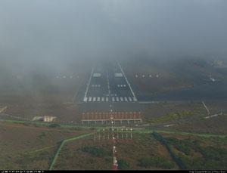
Legacy Aviation Products
METAR and SPECI: Weather observation at an aerodrome

Slide 29
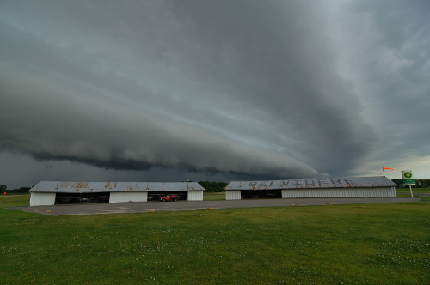
Legacy Aviation Products
TAF: Weather forecast at an aerodrome

Slide 30
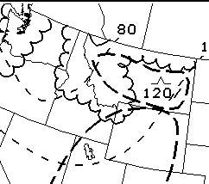
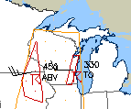
Legacy Aviation Products
SIGMET: Weather hazards for pilots en route

Slide 31
Traditional Alphanumeric Codes (TAC)
METAR/ SPECI | METAR KBWI 181254Z 00000KT 10SM FEW250 14/09 A3034 RMK AO2 SLP272 T01390089
TAF | KGTF 181140Z 1812/1912 23012KT P6SM BKN100 FM181800 25015G22KT P6SM VCSH SCT050 BKN080 FM190100 30010KT P6SM VCSH BKN060 FM190800 26007KT P6SM BKN120
SIGMET | CONVECTIVE SIGMET 19E VALID UNTIL 1455Z FL GA AND FL CSTL WTRS FROM 30NW CRG-60E OMN LINE TS 25 NM WIDE MOV LTL. TOPS TO FL430.

Slide 32
From TAC to XML
Traditional Alphanumeric Codes for aviation are regulated internationally
  International Civil Aviation Organization (ICAO)
  World Meteorological Organization (WMO)
  Strict 3-year update cycle
WMO Task Team for Aviation XML (TT_AvXML) developing data models and XML schemas
Will enable “states in a position to do so” to exchange XML data.

Slide 33
New Data Models
WMO: Modèle pour l'Échange des informations sur le Temps, le Climat et l'Eau (METCE)
  In English, it may also be known as the ‘METeorological Community Exchange’ model
ICAO: ICAO Meteorological Information Exchange Model (IWXXM)
  Possible point of confusion: NCAR and EUROCONTROL have developed another model named WXXM

