Slide 1
Using Feature-Based Methods to Improve Tropical Cyclone Forecasts
in the National Blend of Models
Geoff Wagner (CIRA) | Samantha Camposano (AceInfo) | MDL
November 19, 2020

Slide 2
Motivation
To better incorporate Direct Model Output (DMO) from Hurricane models and the official gridded Tropical Cyclone forecast Message (wTCM) product from the National Hurricane Center (NHC) into National Blend of Models (NBM) wind speed forecasts.
Specifically:
We want to avoid washing out wind speed magnitudes.
We want to leverage all the information we have from the inputs to create a single, coherent forecast feature to place on the NBM forecast background.
We want to maintain the integrity of the official NHC forecast (wTCM) when available.
So….what do we mean by that?

Slide 3
Motivation
NBM 4.0 Tropical Wind Speed (Left) and 10m Wind Speed (Right)
Tropical Storm Eta
2020 11 09 13z Cycle - 68 hour Forecast
Grid-based (Mean Absolute Error/Expert weighting of input forecasts) can create some odd forecasts for high magnitude forecast features such as TCs.
Magnitudes of blended models tend to be washed out (note lower magnitude, secondary cyclone south of wTCM forecast).
Can get multiple eyes and much broader wind field.
Conversely, a weighted average of global models may not represent the cyclone at all.
Notes:
Tropical Storm (at the time) Eta, Blend v4.0 from 2020 11 09 13z, 68-Hour Forecast.
“Tropical Wind Speed” guidance includes tropical guidance (HWRF, HMON, and wTCM), while 10m Wind Speed does not.

Slide 4
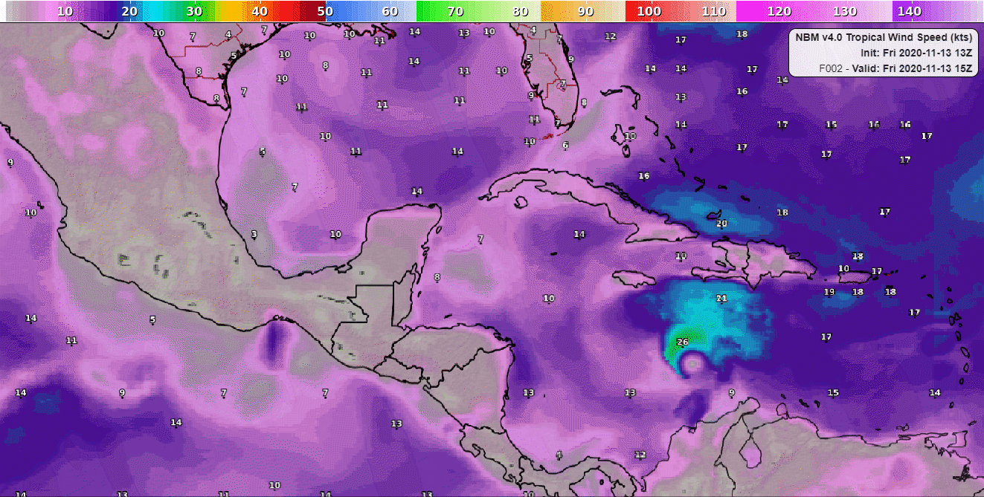
Diverging Forecasts can be a problem

Slide 5
Motivation (continued)
Feature-based (alternately referred to as object-based) techniques that take individual features of interest from a whole-domain forecast are not a new concept. Tools exist to perform tasks like verification based on these methods already (Model Evaluation Toolkit’s MODE tool, for example).
By applying this concept to blending forecast inputs, we can combine the representation of the TC from various models by combining them over their respective centers, preserving magnitude.
These “hybrid” features can then be placed on a background forecast (NBM Wind Speed in our case) at a specific location.

Slide 6
What this technique IS:
What this technique is NOT:
A collection of simple techniques to apply feature-based concepts to Blending forecasts from multiple input models.
A physical, dynamical, or statistical model that considers the structure of the TCs as we combine them.
Machine learning (although there is certainly opportunity to apply this to assist with classification and matching).
An algorithm that makes decisions on combining features of interest based on empirically decided thresholds and fuzzy (non-binary) logic added for matching.
A specialized tool to address the requirements of NBM and to apply specific rules to preserve the wTCM forecast when available.

Slide 7
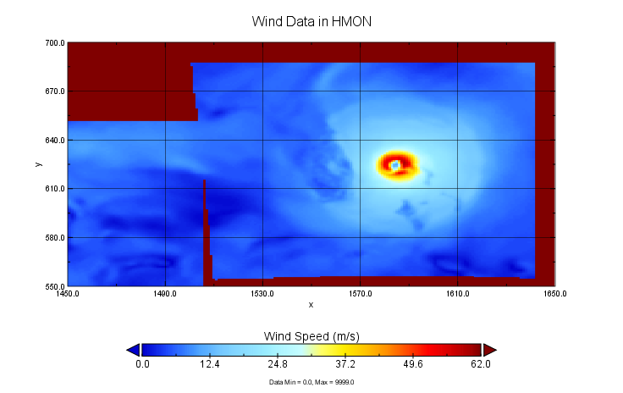
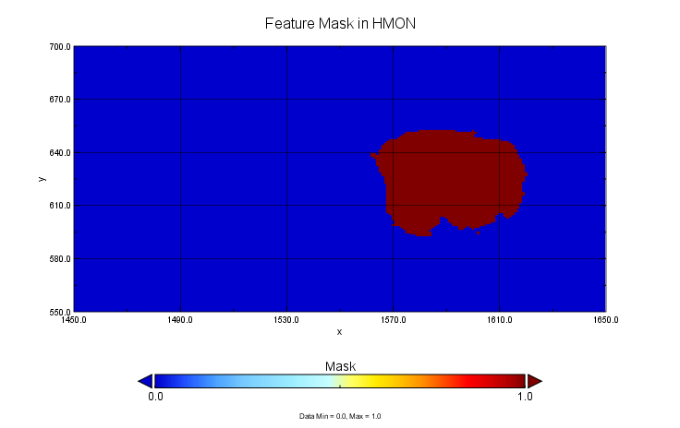
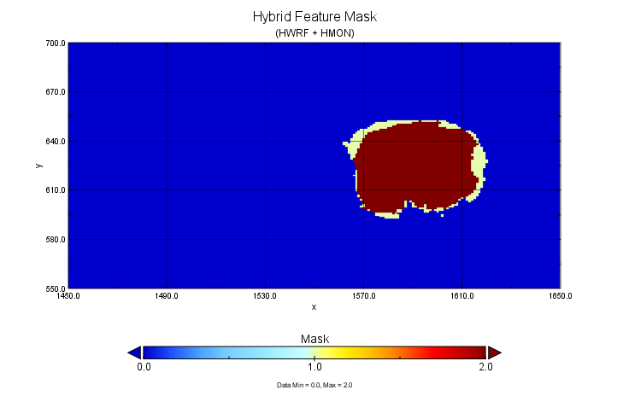
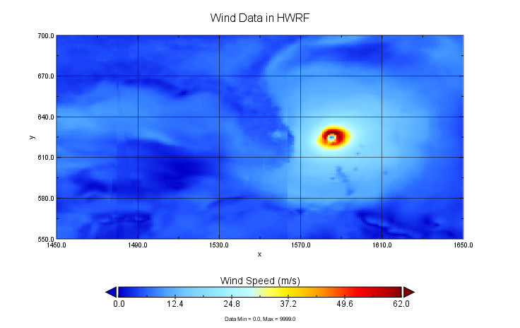
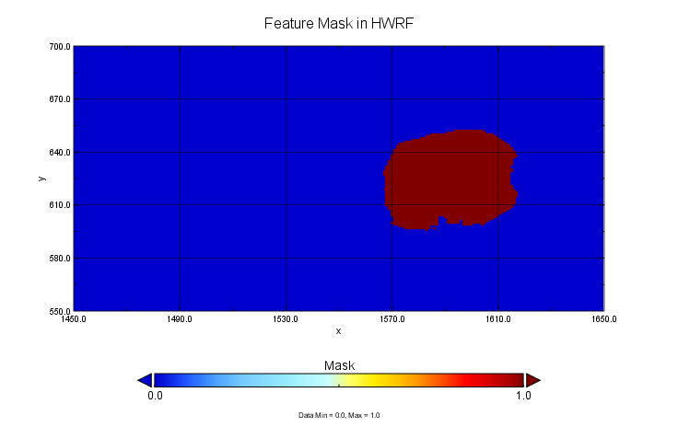
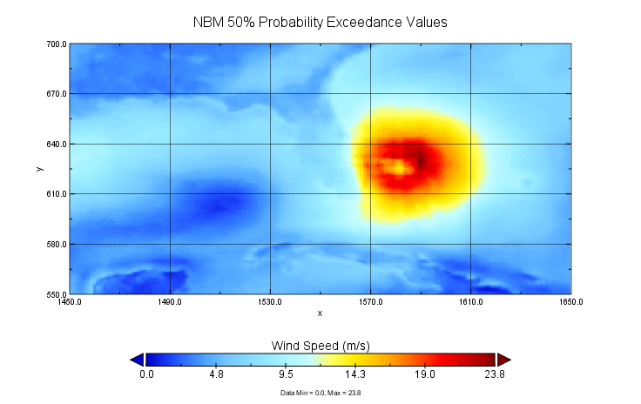
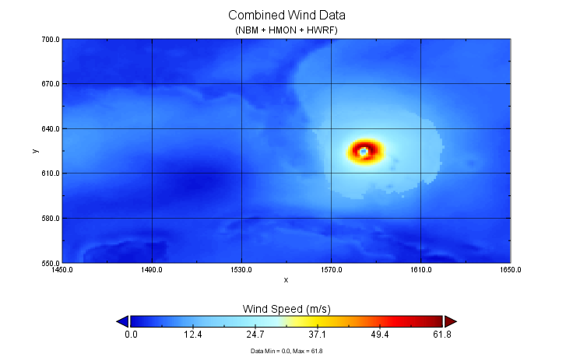
Process Overview (Rough)
Identify
Combine
Place

Slide 8
Process Overview
1
Identify Features
2
Feature Adjustments
3
Match Features
4
Build Hybrid Features
5
Place Hybrids on Background

Slide 9
“Is This a Feature?” Thresholds
Threshold
DMO (HWRF/HMON)
>= 14.0 m/s
wTCM
>= 14.0 m/s *preserved at >= 17.49 m/s
Notes:
Our base threshold for “features” here is 14.0 m/s, which sits just above the NWS Wind Advisory criteria: https://www.weather.gov/ctp/wwaCriteria
17.49 m/s corresponds to 34 kts.

Slide 10
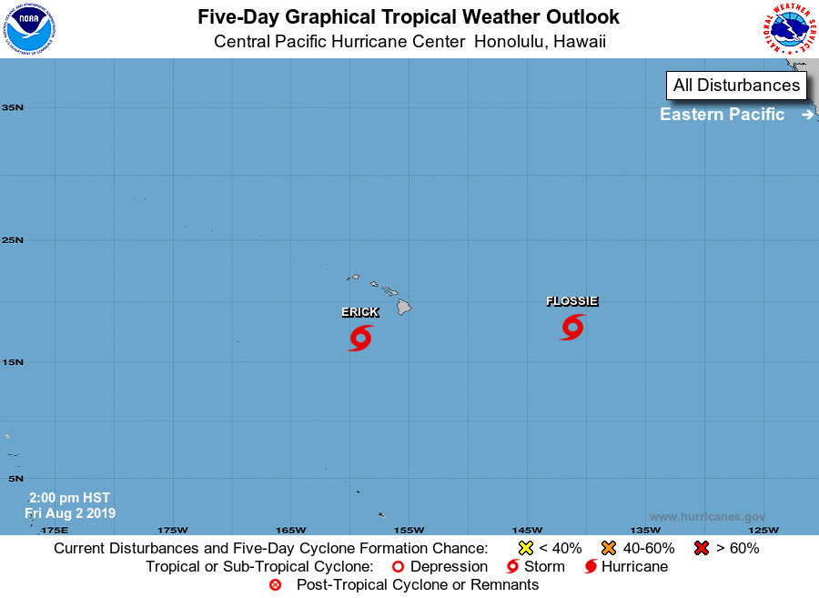
NHC Central Pacific 2-Day Outlook
20190803 0245Z
Notes:
NHC Five-Day Outlook showing the location of Erick and Flossie at the initialization time of the model.

Slide 11
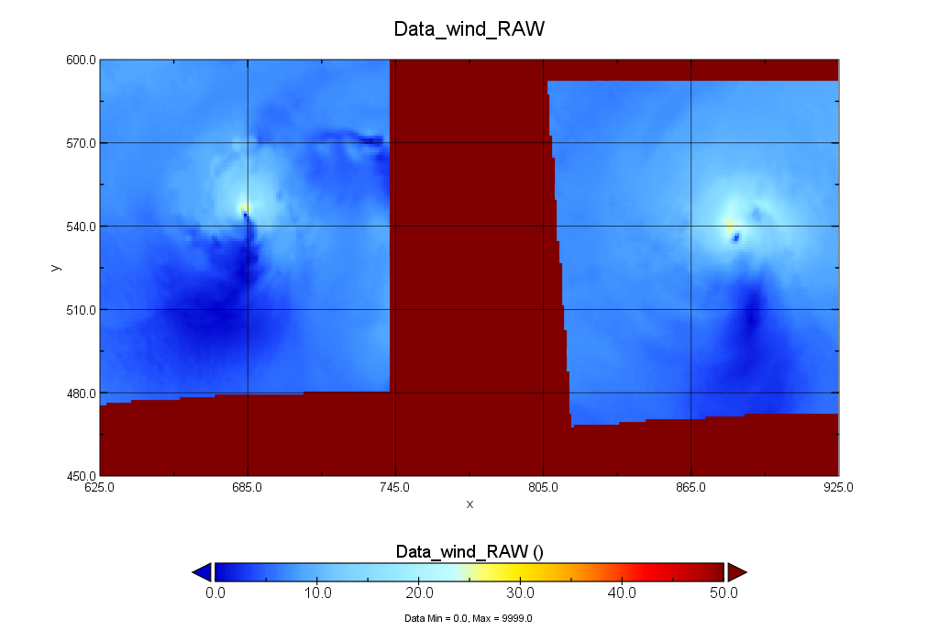
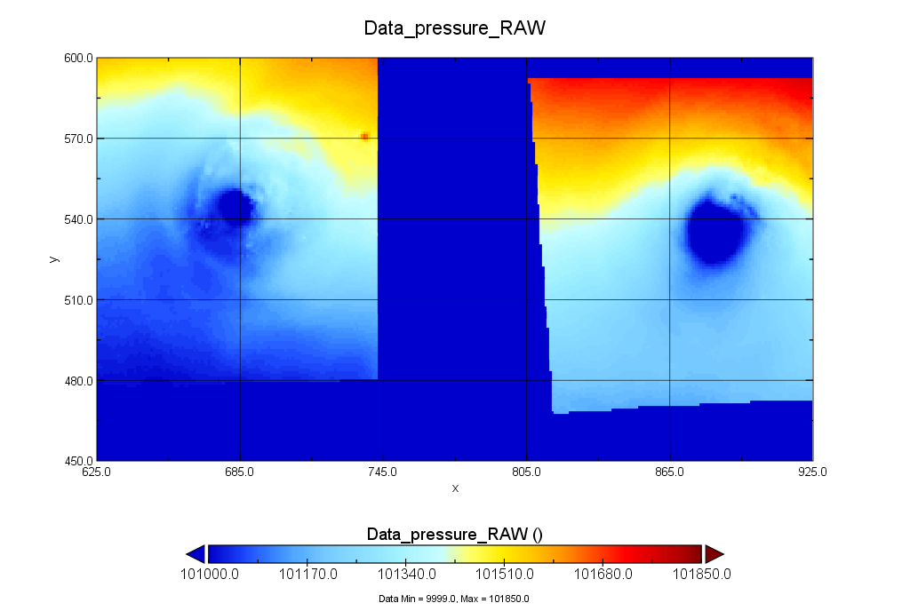
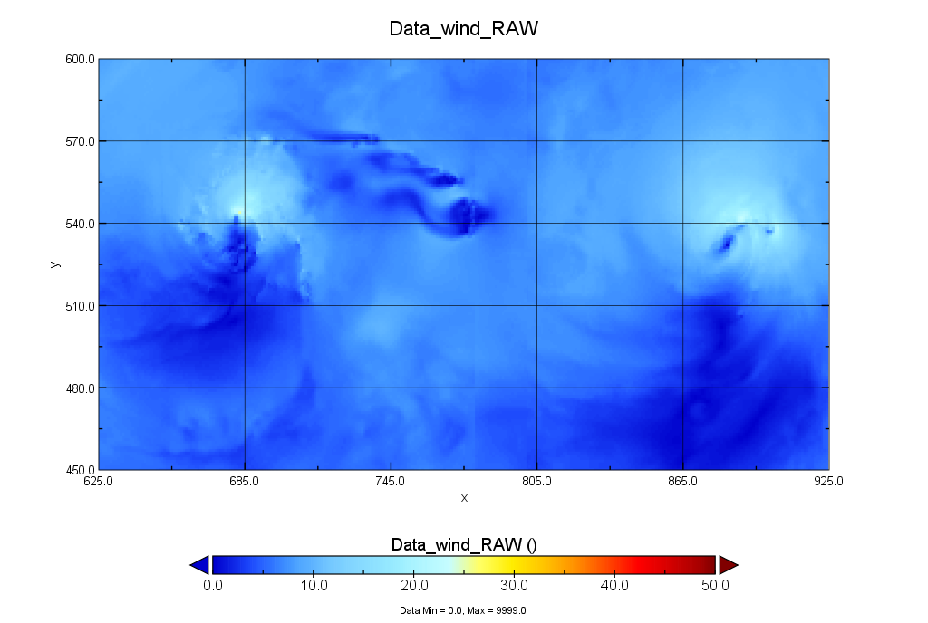
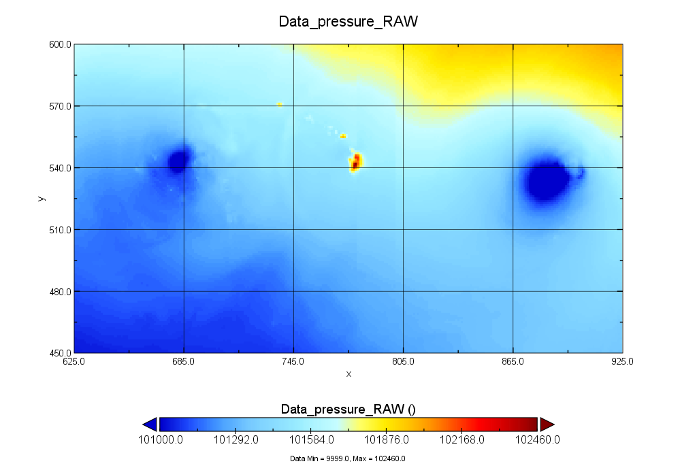
HMON and HWRF 30-Hour 10m Wind Speed and MSLP
20190803 00z Run
HMON
HWRF
Notes:
HMON 10m wind speed forecast from which features are derived. (NBM Oceanic 10km Mercator grid)

Slide 12
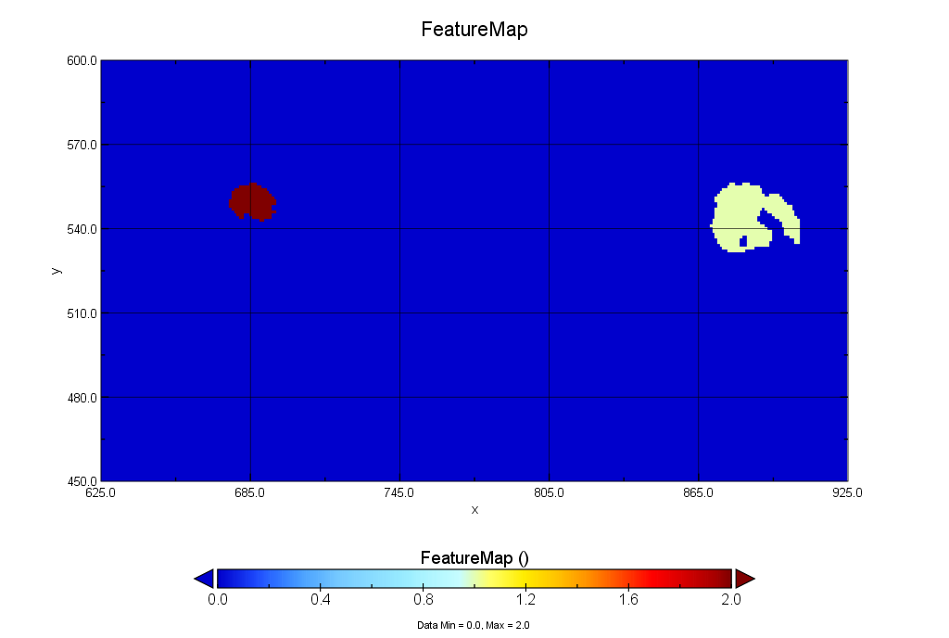
HMON 30-Hour Forecast Features
20190803 00z Run
2
1
Notes:
Note: Feature for us means any continuous area of wind speeds above threshold* that is separated from any other continuous area by 1 or more gridpoints (including in the diagonal). Feature identification is discussed in more detail here.
*14 meters per second, just above the 13.85 mps value for NWS Wind Advisory criteria

Slide 13
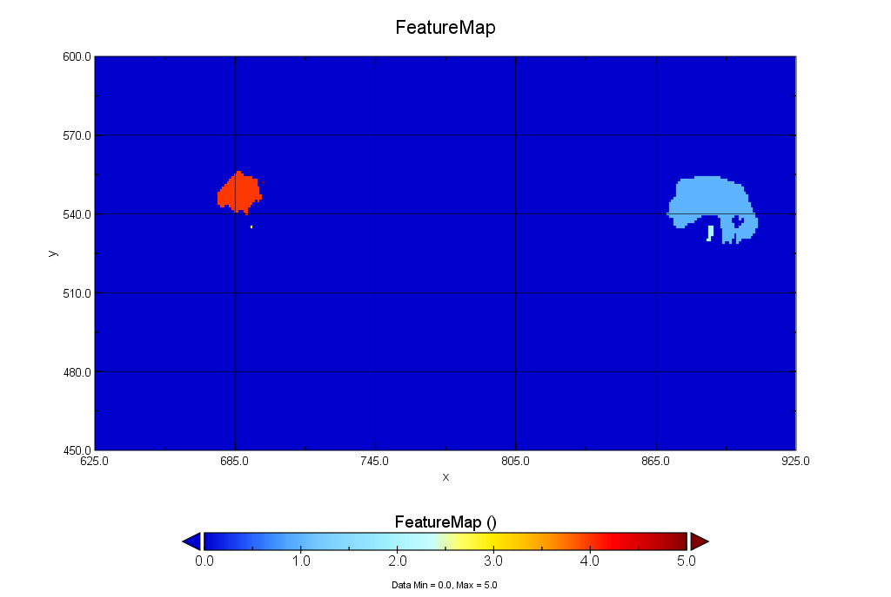
HWRF 30-Hour Forecast Features
20190803 00z Run
4
5
1
3
2
Notes:
Note: Feature for us means any continuous area of wind speeds above threshold* that is separated from any other continuous area by 1 or more gridpoints (including in the diagonal).
*14 meters per second, just above the 13.85 mps value for NWS Wind Advisory criteria

Slide 14
Process Overview
1
Identify Features
2
Feature Adjustments
3
Match Features
4
Build Hybrid Features
5
Place Hybrids on Background

Slide 15
2 Feature Adjustments
At this point it is helpful to make a few tweaks to input features before we try to match between models. Primarily:
Combining nearby features to reduce noise and group together “features” that are actually part of the same meteorological feature.
Fill in gaps within a feature (such as the eye).
Once we’ve completed this step, a “Feature” as defined by the code should be representative of a true meteorological feature (e.g., each feature represents a Tropical Cyclone).
From this point on we operate on Features on their own subgrid, essentially pulling them off the larger domain grid.

Slide 16
HWRF 30-Hour Forecast Features
Before Combining
4
1
5
3
2
Notes:
Note: Feature for us means any continuous area of wind speeds above threshold* that is separated from any other continuous area by 1 or more gridpoints (including in the diagonal).
*14 meters per second, just above the 13.85 mps value for NWS Wind Advisory criteria

Slide 17
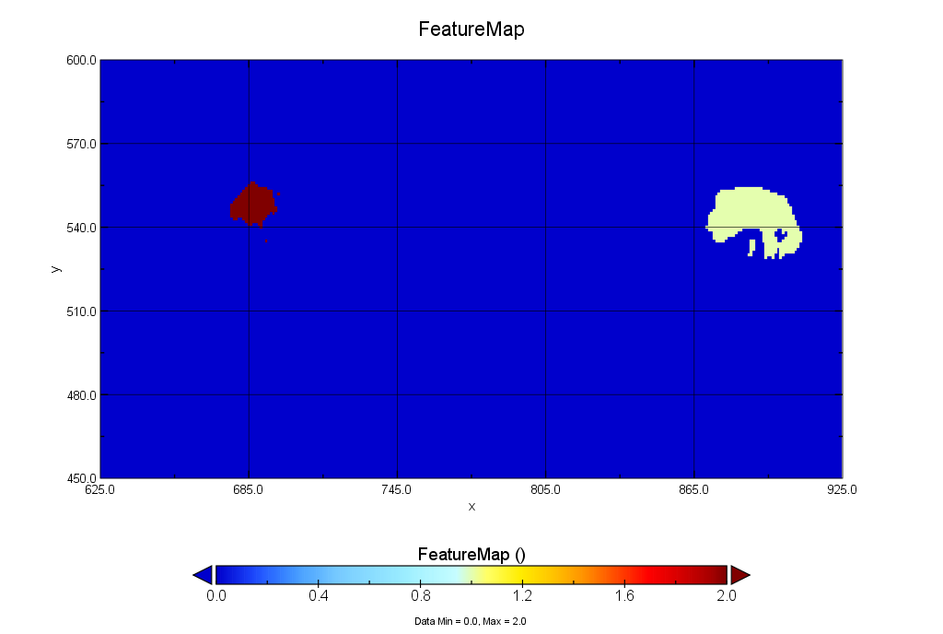
HWRF 30-Hour Forecast Features
After Combining
2
1
Notes:
Note: Feature for us means any continuous area of wind speeds above threshold* that is separated from any other continuous area by 1 or more gridpoints (including in the diagonal).
*14 meters per second, just above the 13.85 mps value for NWS Wind Advisory criteria

Slide 18
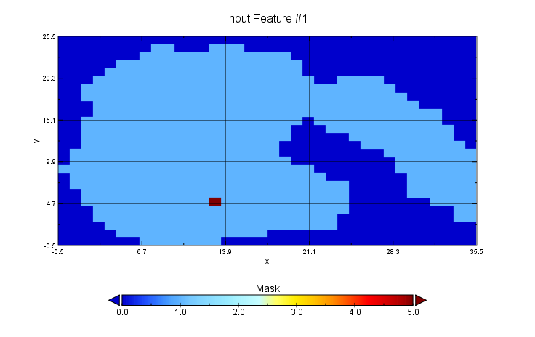
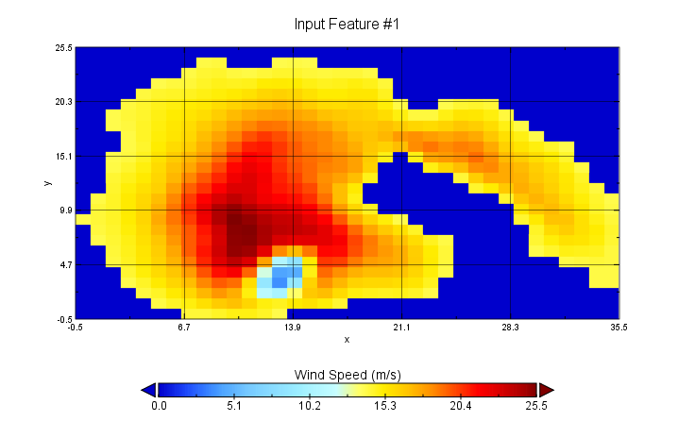
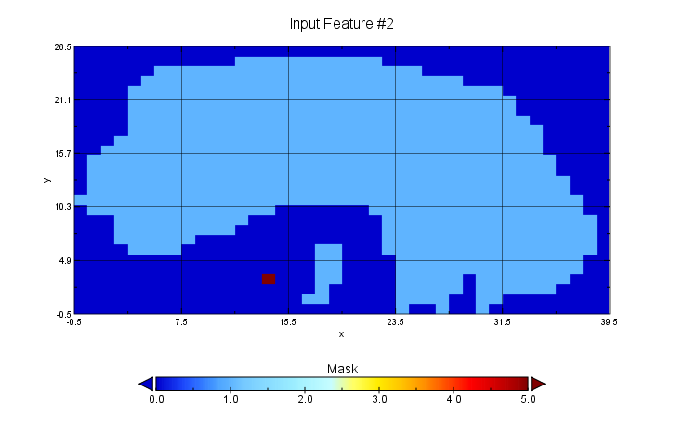
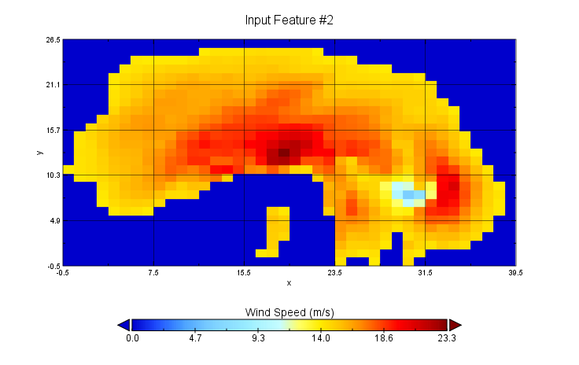
TS Flossie Features
Mask and Wind Speed Data (HWRF & HMON)
HMON
HWRF
Notes:
TS Flossie
Central Minimum Pressure marked by red dot on mask plot
Note that Pressure Center can exist outside of the mask (but also that we intend to be filling in the eye and any other internal gaps in features eventually)

Slide 19
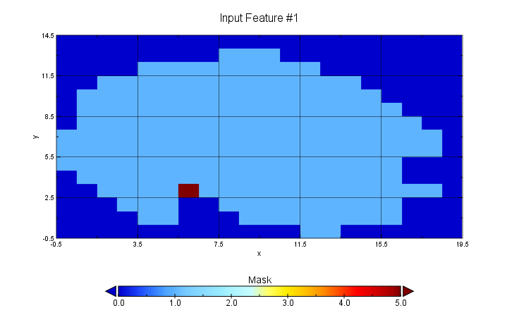
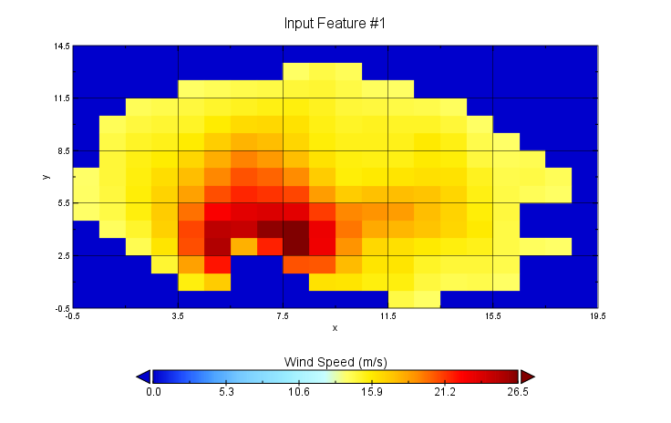
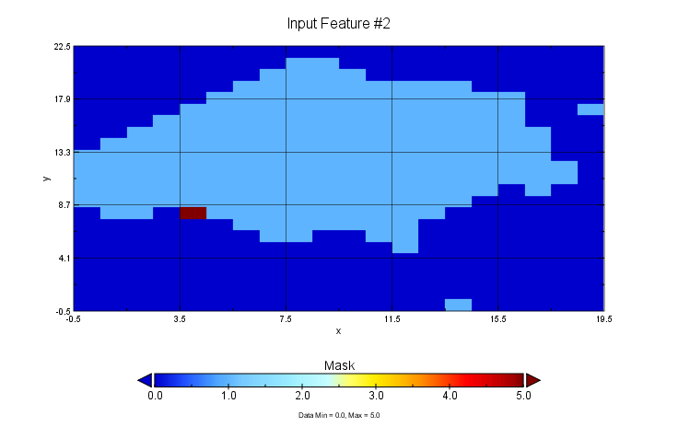
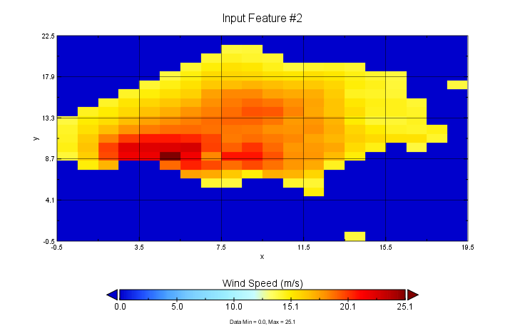
TS Erick Features
Mask and Wind Speed Data (HWRF & HMON)
HMON
HWRF
Notes:
TS Erick
Central Minimum Pressure marked by red dot on mask plot
Note that Pressure Center can exist outside of the mask

Slide 20
Process Overview
1
Identify Features
2
Feature Adjustments
3
Match Features
4
Build Hybrid Features
5
Place Hybrids on Background

Slide 21
3 Match Features
Now we have a list of features associated with each model forecast.
The next step is to iterate over the list of features for each input model, and calculate a match score between it and each feature in the other input models.
Match scores are the mean of three component scores which are the normalized difference between the two features in three logical criteria:
Distance* (based on minimum pressure when available, or minimum central wind speed),
Size (based on area, counted in gridpoints),
Magnitude (based on mean wind speed within the feature area).
Component scores are normalized by largest value to reduce influence from scale/units.
Scores near zero indicate the best match (least difference).
*Distance score currently receives double weight

Slide 22
HMON
HWRF
Matching Results HWRF
Feature Map Comparison
2
2
1
1
HMON Matching Feature Number
HWRF Feature #1
1
2
HWRF Feature #2

Slide 23
Process Overview
1
Identify Features
2
Feature Adjustments
3
Match Features
4
Build Hybrid Features
5
Place Hybrids on Background

Slide 24
4 Build Hybrid Features
Now that we’ve determined the match score and best match for each feature we have all the information we need to build Hybrid Features -- which are the single features that combine the various model inputs for a specific TC, and what we will be placing back on the background forecast.
The first step of doing that is to collapse information into a single table to determine the total number of Hybrid Features to generate and specify which TC features from each model to use in each Hybrid Feature.
Our current method constrains the number of hybrid features to number of features present in the model with the least total features.
Most typically this will be the wTCM.
The intent of this is to only generate Hybrid Features where we are likely to have agreement across all input models.

Slide 25
Sample Hybrid Table
2 Hybrid Features will be created
Model 1
Model 2
Model 3
Feature 1
1
1
1 (Highest Score)
Feature 2
2
2 (Highest Score)
1 (Lowest Score)
Feature 3
--
2 (Lowest Score)
2 (Lowest Score)
Feature 4
--
--
2 (Highest Score)
2 Features
3 Features
4 Features
0 Duplicate Matches
1 Duplicate Match
2 Duplicate Matches
Total number hybrid features determined by model with fewest features

Slide 26
4 Build Hybrid Features
Now that the number of Hybrid Features and their corresponding inputs have been determined, we can begin combining the features. We do this by:
Defining a new gridspace for each Hybrid Feature that is large enough to contain the input TC features from each model when they are stacked on the center point.
The Hybrid Feature grid subgrid is just a snip of the full domain grid at the same resolution.
Building a Hybrid Feature Mask to determine where and how much overlap we have between input TC features.
Calculate the final hybrid Wind Speed feature grid and location.

Slide 27
Building the Hybrid Grid and Mask
Fitting input features of different extents
Feature 1
Feature 2
Non-Feature Gridpoint
Feature Gridpoint
Pressure Center
NX | 4
NY | 4
Center Location | (3, 2)
Center on Map* | (1876, 15)
NX | 3
NY | 3
Center Location | (2, 2)
Center on Map* | (1822, 25)
* For this example these are completely fictitious coordinates on the CONUS grid
Notes:
For clarity: Feature 1 refers to a specific TC feature in Model 1, and Feature 2 refers to the matched feature as resolved in Model 2

Slide 28
Building the Hybrid Grid and Mask
Fitting input features of different extents
First we need to create a hybrid grid space the covers the combined area of both features extending out from the center point:
4
3
3
2
2
1
1
1
2
3
1
2
3
4
In this case all of Feature 2 can fit entirely on the subgrid for Feature 1, so only feature 2 needs adjustment, and Feature 1 will translate directly onto the hybrid grid space.

Slide 29
Hybrid Mask
Combining Translated Feature Masks
Stacking by center location, we get a combined mask on the hybrid grid space:
Feature 1 Mask
Feature 2 Mask
Hybrid Mask
No Features (0)
One Feature Only
(1)
Both Features
(2)

Slide 30
Creating Hybrid Wind Speed
When wTCM is Present:
Mean speed calculated at each gridpoint, based on number of input models
Cap all values at a maximum of 33.9 kts and then place wTCM values >33.9 kts back on top
Smooth boundaries between differing numbers of features
Run check on non-wTCM values > 33.9 kts and re-assert wTCM > 33.9 kts
When wTCM is Not Present:
Mean speed calculated at each gridpoint, based on number of input models
Smooth boundaries between differing numbers of features

Slide 31
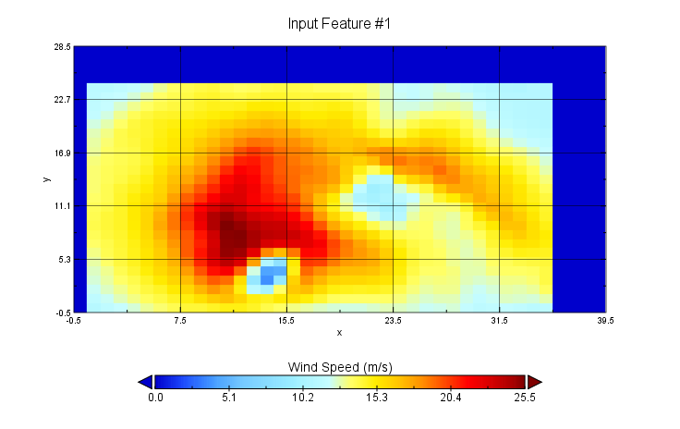
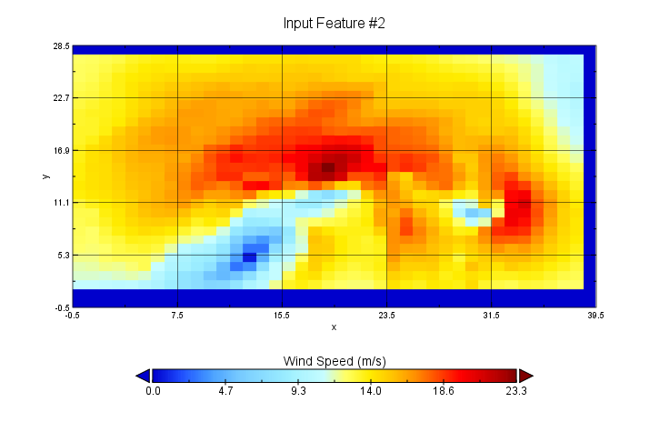
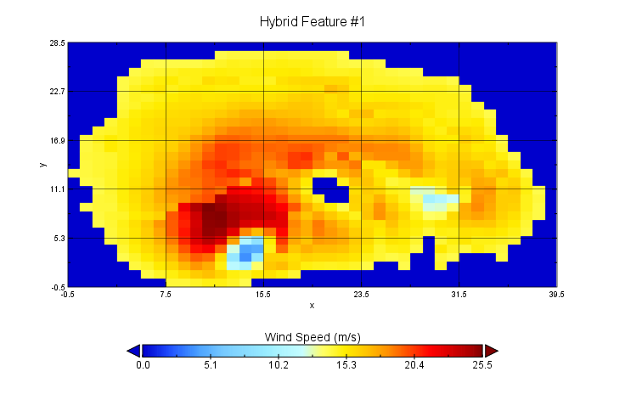
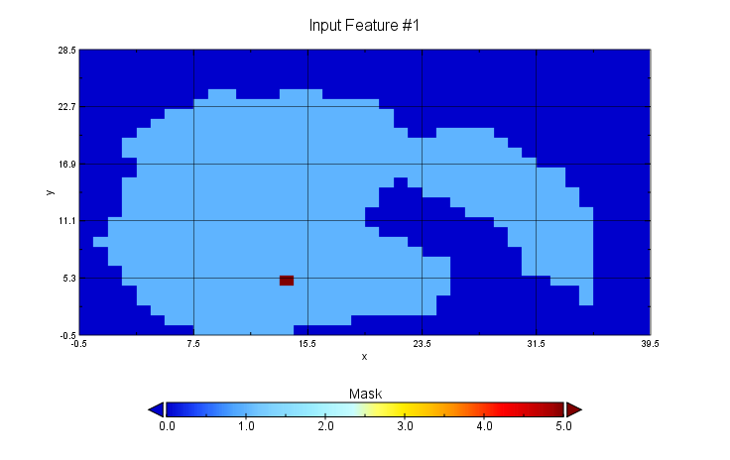
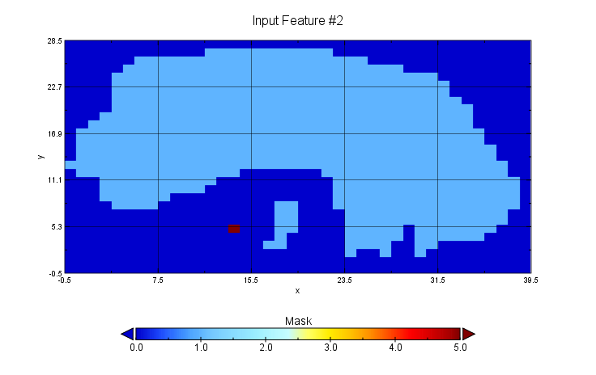
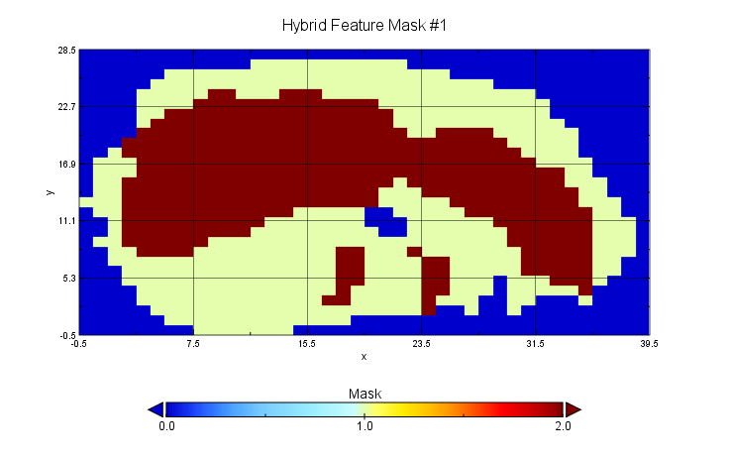
HMON
HWRF
Hybrid Feature
Build Hybrid Feature: TS Flossie
Data
Mask
Notes:
Input Wind Speed/Masks from HMON and HWRF (left) and Hybrid Mask and Wind Speed (right) for Hurricane Flossie, 2019080300f030

Slide 32
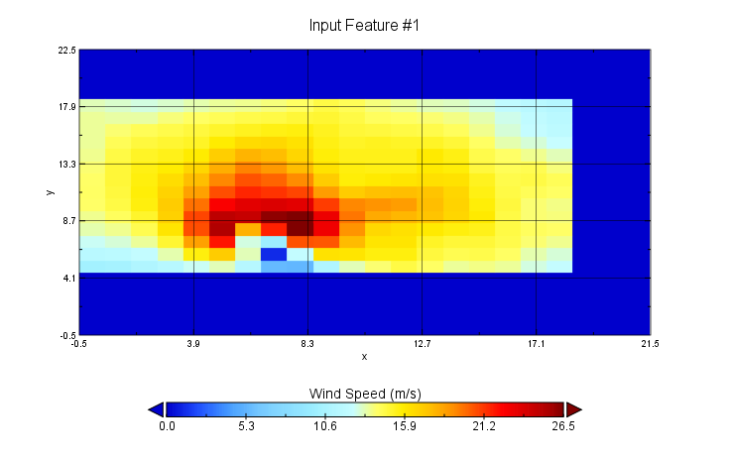
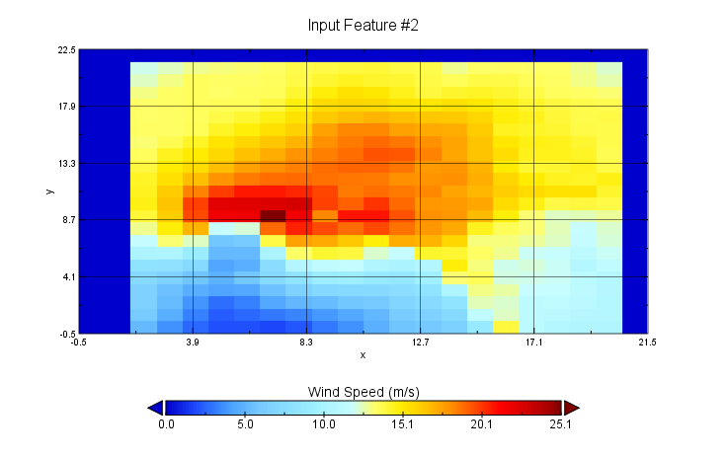
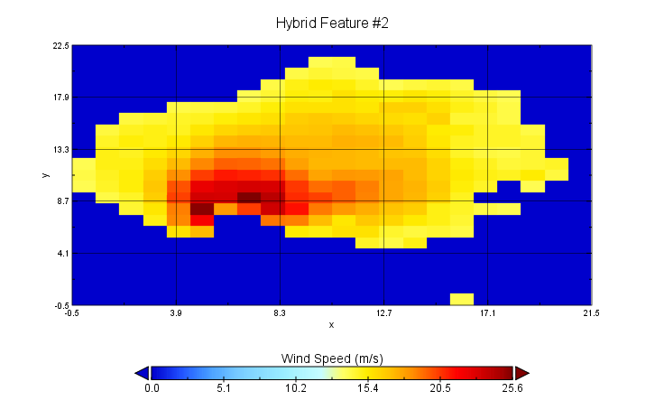
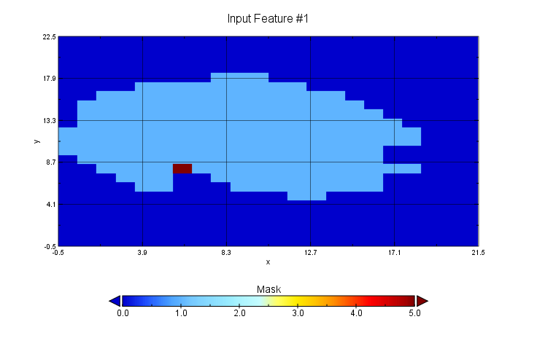
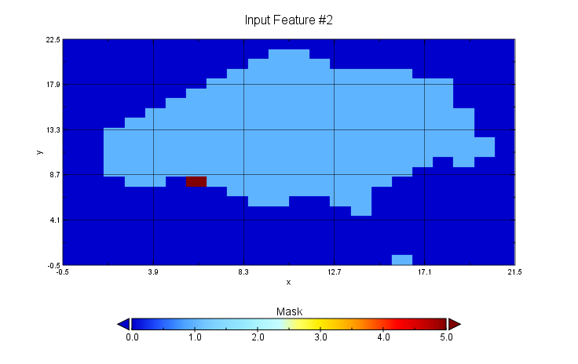
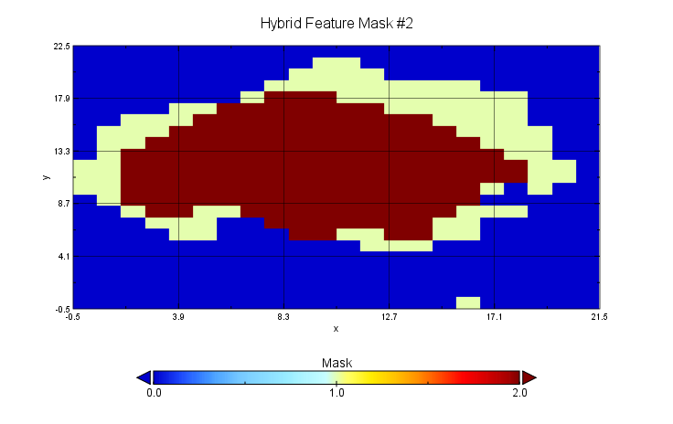
HMON
HWRF
Hybrid Feature
Build Hybrid Feature: TS Erick
Data
Mask
Notes:
Input Wind Speed/Masks from HMON and HWRF (left) and Hybrid Mask and Wind Speed (right) for Hurricane Flossie, 2019080300f030

Slide 33
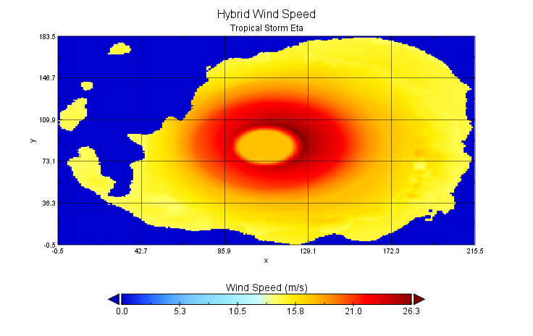
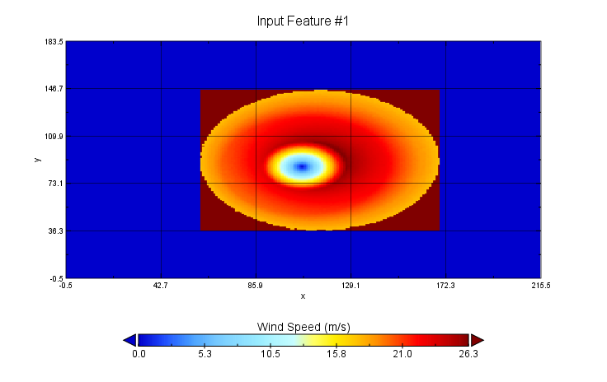
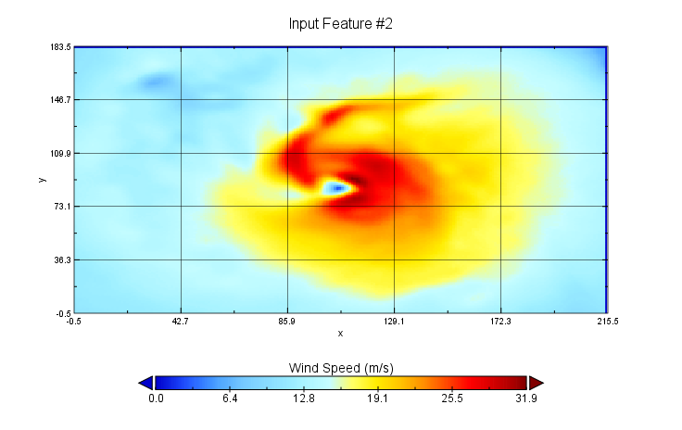
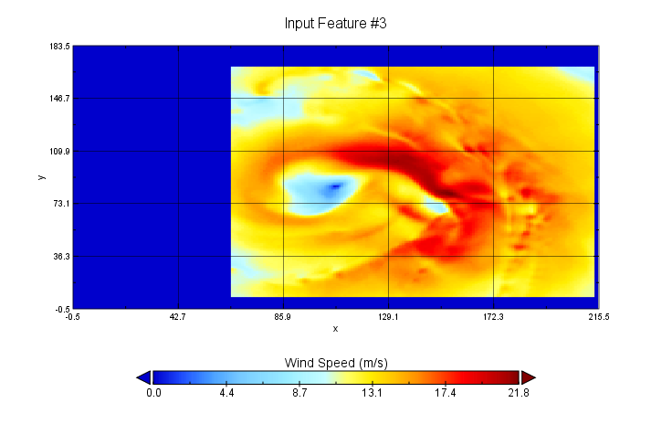
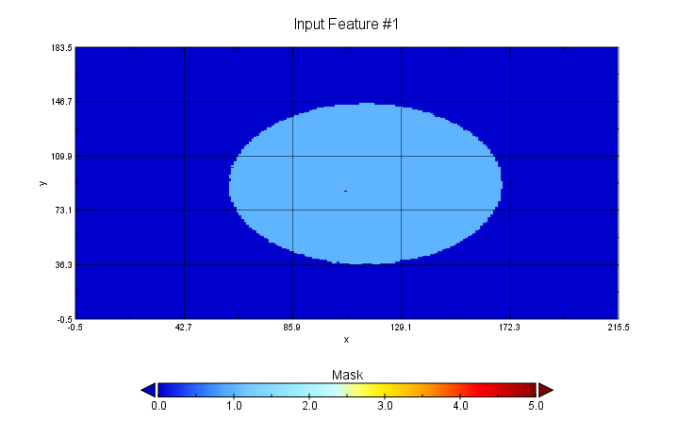
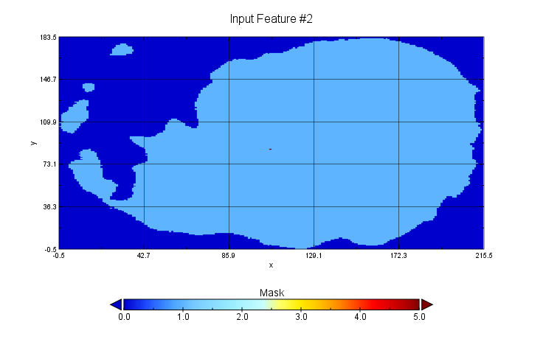
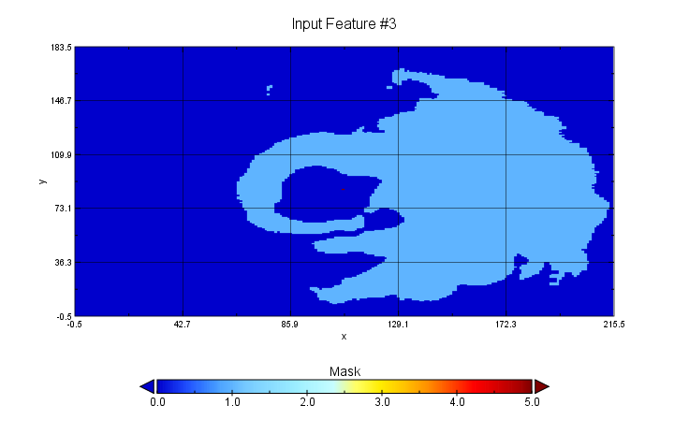
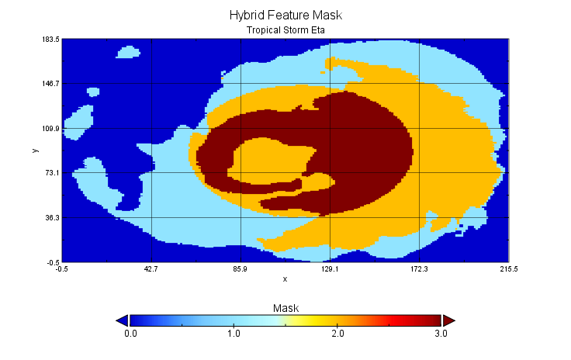
Build Hybrid Feature: TS Eta
Data
WTCM
HWRF
HMON
Hybrid Feature
Mask
Notes:
Input Wind Speed/Masks from TCM(L), HMON(C) and HWRF(R) and Hybrid Mask and Wind Speed (right) for Tropical Storm Eta, 2020-11-09 13z f068

Slide 34
Determining Feature Location
When wTCM is Present:
Hybrid Features placed at wTCM center location
When wTCM is Not Present:
Hybrid Features placed at mean center location of all inputs
Currently equal weight, but can be weighted if desired

Slide 35
Process Overview
1
Identify Features
2
Feature Adjustments
3
Match Features
4
Build Hybrid Features
5
Place Hybrids on Background

Slide 36
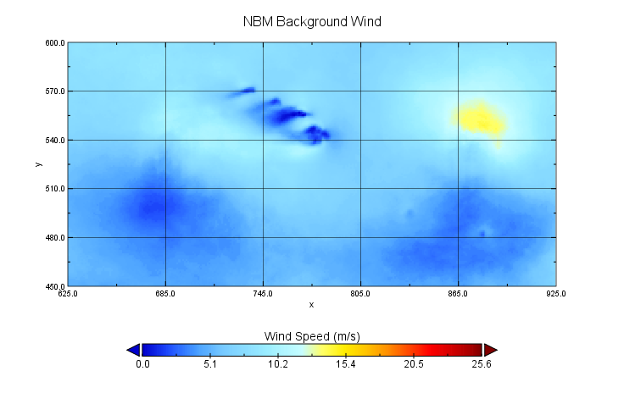
NBM 50% Probability Exceedance Wind
Notes:
NBM 50% Probability Exceedance WS

Slide 37
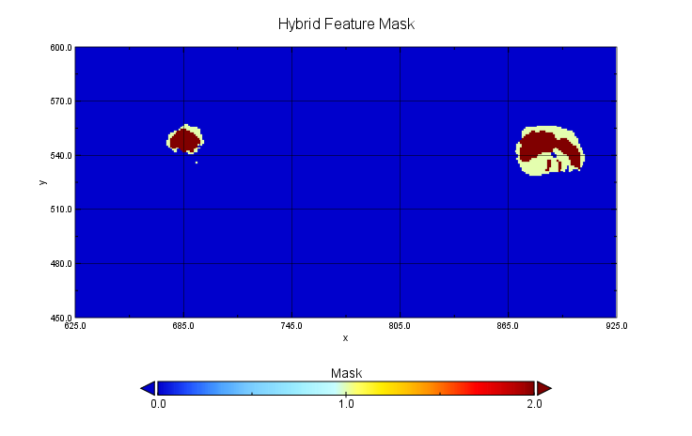
Hybrid Feature Mask
Notes:
NBM 50% Probability Exceedance WS

Slide 38
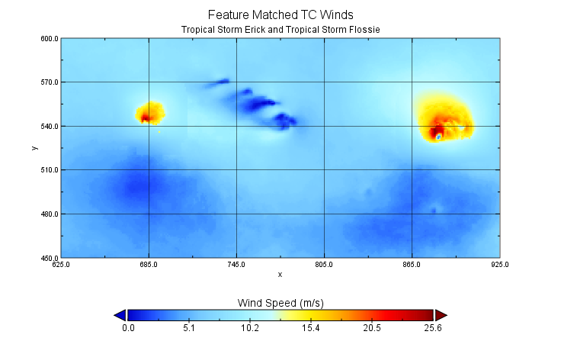
Combined Forecast
Notes:
NBM 50% Probability Exceedance WS

Slide 39
Combined WS Forecast (NBM + HMON + HWRF)
NBM 50% Probability Exceedance Values
HMON
HWRF
Notes:
Erick/Flossie NBM Oceanic Case
2019 08 03 00z f030

Slide 40
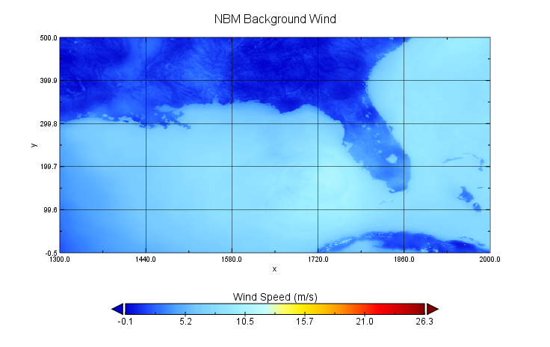
Oceanic Mean Wind Speed
Notes:
NBM 50% Probability Exceedence WS

Slide 41
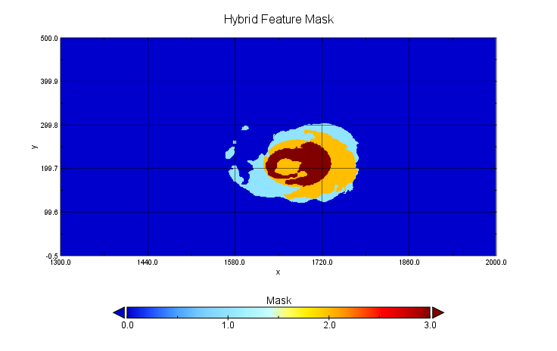
Hybrid Feature Mask
Notes:
Hybrid Feature Mask

Slide 42
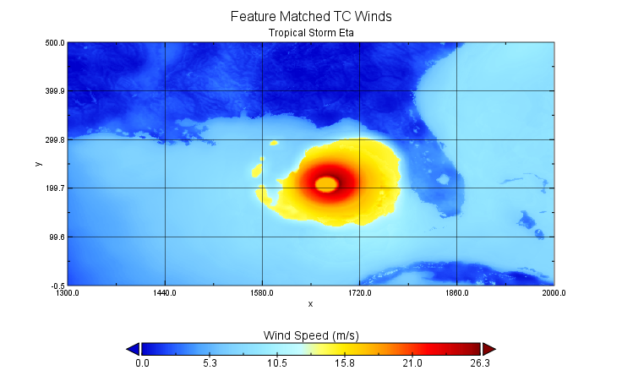
Combined Forecast

Slide 43
NBM Background
Hybrid Feature placed on NBM Background Winds
HMON
HWRF
WTCM
Notes:
TS Eta

Slide 44
How do we fare with diverging solutions between DMO and wTCM?
Notes:
NBM v4.0 - no feature matching, versus NBM Beta, with Feature Matching.

Slide 45
How do we fare with diverging solutions between DMO and wTCM?
Notes:
NBM v4.0 - no feature matching, versus NBM Beta, with Feature Matching.

Slide 46
How do we fare in a multiple TC environment?

Slide 48
How do we fare in a multiple TC environment?
Notes:
Features in the Atlantic basin from the 9/14/2020 13z run of Feature Matching (05 hour Forecast), compared with the NHC Two-Day Outlook from roughly the initialization time. This run incorporated 12z NBM Oceanic Mean Wind as the background, the 12z wTCM guidance, and the 06z HWRF and HMON guidance. As a note, TS Rene had largely dissipated at this point and did not have TS strength winds (see following hidden slide).

Slide 50
Conclusions
Results from the wide variety of scenarios presented during the 2020 Atlantic hurricane season have been encouraging so far.
Specifically, we’re pleased with the consistency of the matching algorithm and the visual presentation of the hybrid TCs.
Feedback from our collaborators at NHC and AFS has been positive.
We plan on evaluating more conclusively after the close of the season.
We’ve highlighted some of our positive results here, but oddities can and do pop up.

Slide 51
What can go wrong?

Slide 52
Feature Matching Forecasts can be found on WSUP:
http://wsup.mdl.nws.noaa.gov/ (NOAA Login Required)
Select ‘NBM Beta’ for Dataset
Tropical Speed (NBM Background + HWRF + HMON + wTCM)
Available for CONUS, Hawaii, Puerto Rico, and Oceanic domains
Run for 01z, 07z, 13z, and 19z
Guam domain is in the works!
10m Wind Speed (NBM Background + HWRF + HMON)
Available for CONUS, Hawaii, Puerto Rico, and Guam domains
Run hourly
Oceanic domain is in the works!

Slide 53
Future Plans
This is still a Work-In-Progress; we are making improvements as we evaluate over this (unprecedented) hurricane season.
Refinements to matching logic
Land interaction considerations
Time interpolation of DMO Inputs in early lead times
Working on speeding up runtime by spreading computational load and leveraging existing compiled libraries where we can
Matching/calculating U-, V-Wind and Wind Gust in Hybrid Features for consistency
We plan to implement with NBM v4.1 in Q2 of FY23.
Forecasts will continue to be viewable on WSUP.
We intend to also make GRIB2 data available for download next season.

Slide 54
Thank You
We want to thank all those who have helped support this work:
The MDL, CIRA and AceInfo Solutions teams,
Dave Rudack for his guidance,
John Crockett for his guidance and help making this VLab Forum talk happen,
Our colleagues at NHC and AFS for their invaluable collaboration,
Our colleagues in the Can-US-UK Statistical Post-Processing Forum for their advice,
The WSUP team for making it so much easier to evaluate and share our forecasts, and
Our MDL-SMD colleagues for their enthusiasm and the lively tropical discussions as we’ve shared our work.

Slide 55
Thank you for joining us!
Questions/Comments?
Please also feel free to email us: Geoff.Wagner@noaa.gov, Samantha.Camposano@noaa.gov

Slide 56
Matching Score Calculation
Overall Process
Model 1
Model 2
Model 1, Feature 1
Model 1, Feature 2
Model 1, Feature 3
Feature 1
Feature 1
Model 2, Feature 1
Model 2, Feature 2
Feature 2
Feature 2
Calculate differences:
Distance
Mean Magnitude
Total Area (“Size”)
Find greatest error across all Model 1 features for each category
Feature 3
Divide by greatest error between Model 1, Feature 1 and any Model 2 Feature to normalize scores
Take equal-weighted mean of Distance, Magnitude, and Size Scores for Total Match Score
Overall Match Score for Model 2, Feature 1
Overall Match Score for Model 2, Feature 2
Lowest Overall Match Score Indicates Best Match
Repeat across all Model 1 Features...
Notes:
This example considers Model 1, which contains 3 Wind Speed features (discrete continuous areas > 14 mps), and Model 2, which contains 2. We start with the first feature in Model 1, and calculate the difference (error) between it and each of the features in Model 2, for three categories: distance (location), size (area), and mean magnitude. These scores are then divided by the largest error between Model 1 Feature 1 and any of the Model 2 features, to normalize them down into the 0 to 1 range. The three scores are then combined by equal-weighted mean to an overall match score, which also ranges from 0 to 1. Scores near 0 indicate a better match, while a score of 1 would indicate the worst match in all categories. The lowest overall score is then selected as the best match.

Slide 57
Scoring Example
HMON Feature #1
Feature Value
Difference from HMON#1
Press. Center
(884, 532) | 5.099 gp
16.250 mps | 0.855 mps
614 gp | 44 gp
HWRF Feature #1
Mean Mag.
Total Area
Feature Value
Difference from HMON#1
Press. Center
(887, 534) | 5.0 gp
14.718 mps | 2.387 mps
11 gp | 559 gp
HWRF Feature #2
Mean Mag.
Total Area
Feature Value
Difference from HMON#1
Press. Center
(692, 535) | 191.010 gp
14.0 mps | 3.105 mps
1 gp | 569 gp
HWRF Feature #3
Mean Mag.
Total Area
Feature Value
Difference from HMON#1
HMON Feature #1
Press. Center
(682, 543) | 201.090 gp
16.792 mps | 0.313 mps
198 gp | 372 gp
HWRF Feature #4
Mean Mag.
Pressure Center
(883, 537)
17.105 mps
570 gridpoints
Total Area
Mean Magnitude
Feature Value
Difference from HMON#1
Press. Center
(697, 552) | 186.604 gp
14.0 mps | 3.105 mps
1 gp | 569 gp
Total Area
HWRF Feature #5
Mean Mag.
Total Area
Notes:
Greatest error scores highlighted in red. Note that the two largest errors for Magnitude and Size occurred between HMON#1 and two different HWRF features (3 and 5).

Slide 58
Scoring Example
HMON Feature #1
Normalized Score
Total Match Score
Press. Center
0.0254 | 0.082
0.2753
0.0773
Best Match
HWRF Feature #1
Mean Mag.
Total Area
Normalized Score
Total Match Score
Press. Center
0.0249 | 0.450
0.7687
0.9824
HWRF Feature #2
Mean Mag.
Total Area
Normalized Score
Total Match Score
Press. Center
0.9499 | 0.975
1.0
1.0
HWRF Feature #3
Mean Mag.
Total Area
Normalized Score
Total Match Score
HMON Feature #1
Press. Center
1.0 | 0.688
0.1007
0.6538
HWRF Feature #4
Mean Mag.
Pressure Center
(883, 537)
17.105 mps
570 gridpoints
Total Area
Mean Magnitude
Normalized Score
Total Match Score
Press. Center
0.9280 | 0.964
1.0
1.0
Total Area
HWRF Feature #5
Mean Mag.
Total Area
Notes:
Same as previous, but scores have been normalized by greatest error. Total Match Score is the sum of the normalized scores (with distance getting a double weight) divided by 4 (weighted mean). Since values closer to 0 indicate least error, HWRF Feature #1 is the best match to HMON Feature #1 with a total match score of 0.082.

Slide 59
Calculating Hybrid Feature Wind Speed
Using Masked Mean -- Step 1: Sum Input Features
Feature 1
Feature 2
Sum of Feature 1 and Feature 2
15
15
14
16
17
16
14
16
17
16
15
17
15
16
17
14
17
15
34
29
33
16
17
17
16
16
34
16
No Data
29 m/s
14 m/s
33 m/s
15 m/s
34 m/s
16 m/s
17 m/s

Slide 60
Calculating Hybrid Feature Wind Speed
Using Masked Mean -- Step 2: Divide by Hybrid Mask
Summed Values
Combined Mask
Hybrid Feature
15
1
15
14
16
17
16
1
1
1
1
14
16
17
16
15
34
29
33
1
2
2
2
15
17
14.5
16.5
16
34
16
1
2
1
16
17
16
No Data
14 m/s
15 m/s
16 m/s
17 m/s

Slide 61
Notes:
External smoothing mask used to transition between placed Hybrid Features and the background forecast when creating the final combined forecast.

Slide 62
Background Forecast
No Feature Removal
Combined Forecast
No Feature Removal
Background Forecast
Feature Removal
Combined Forecast
Feature Removal
Notes:
We have an additional process to identify features in the background forecast and remove the feature nearest to the Hybrid Features we are placing, however this is currently turned off due to extreme runtime variability when many (sometimes > 300) background features are identified. We anticipate adding this functionality back after we’ve had a chance to reduce the variability and computational expense.

