Slide 1
The Winter Storm Severity Index in 2020
Joshua Kastman
Jim Nelson

Slide 2
Acknowledgments
There is no WSSI without Andy Nash. He is the original creator and developer.
Thank you Andy for your hard work and continued support!
Thank you also to Dan Cobb, Mike Muccilli and the other original developers who laid the foundation for the WSSI.
Thank you to Ian Lee who set up the WSSI VLAB page

Slide 3
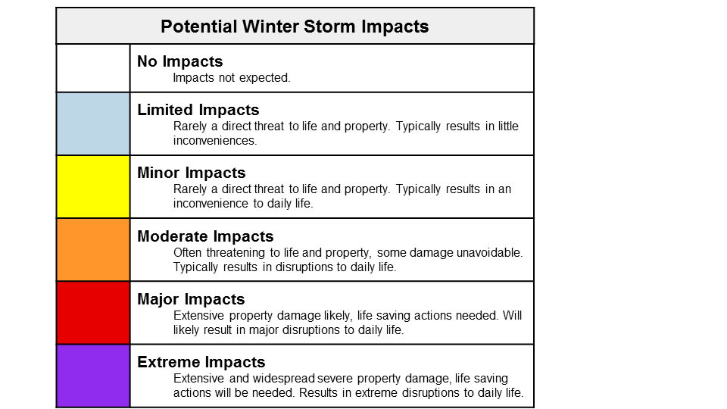
Overview
Goal of the Product
Summarize multiple winter weather impacts from a storm into an easily consumable graphic
72 Hour forecast
24 HR breakouts
Data comes from the NWS National Digital Forecast Database (NDFD)
Updates every 2 hours
Summary graphic is a composite of the maximum impact from any of the six components
Components:
Snow Amount - Snow Load - Ice Accumulation - Blowing Snow - Ground Blizzard - Flash Freeze

Slide 4
Overview - Components
Snow Amount Index:
PURPOSE: This component is designed to highlight areas in which impacts, especially transportation, could become overwhelmed due to either:
The total amount of snow.
2-Day climatology taken into account
The rate at which the snow is falling.
Because we are using 6-hour data impacts from snow amount are much more common
Snow Load Index:
PURPOSE: This component is to highlight areas where the weight of the snow could result in damage to trees and powerlines. In general, the lower the snow-liquid ratio (SLR) is and the greater the total snow accumulation, the higher the index.
Forest type is taken into account (more on that later)
Notes:
Snow Amount: Prior to making calculations based upon the amount or rate of snow, climatology based factors are determined. Climatology is an important aspect to the level of impacts a winter storm brings. Those areas of the country less accustomed to snowfall will be less prepared to deal with snow, resulting in higher level of impacts compared to the same amount of snow in a snowier part of the country.

Slide 5
Overview - Components
Blowing Snow Index:
PURPOSE: This component highlights areas where blowing/drifting snow is expected to occur and result in transportation related problems. In general, the blowing snow significance increases as the SLR and winds both increase. Prior blowing snow research indicates that in general it takes just under 20 mph of wind to start to move snow around.
Ground Blizzard Index:
PURPOSE: This component is to highlight areas where pre-existing snow combined with very strong winds results in ground blizzard conditions, which result in a significant impact to transportation.
Land use is taken into account for both of these parameters

Slide 6
Overview - Components
Flash Freeze Index:
PURPOSE: The component depicts severity primarily to transportation of situations where temperatures rapidly fall below freezing during or just after precipitation.
Ice Accumulation Index:
PURPOSE: This component was developed to account for the combined effects of ice accumulation and wind which can produce widespread tree damage, transportation shutdowns and other impacts.

Slide 7
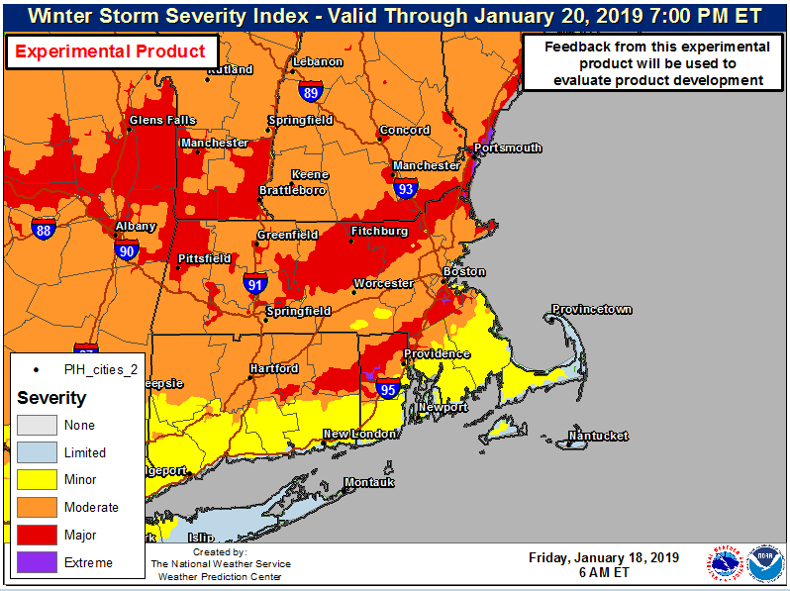
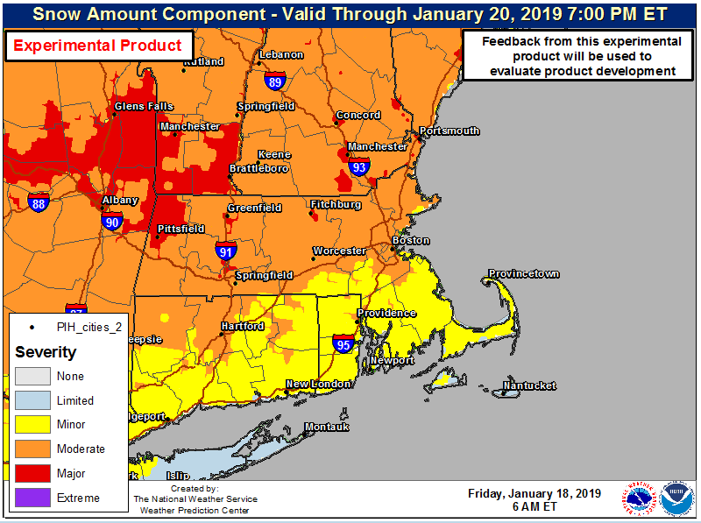
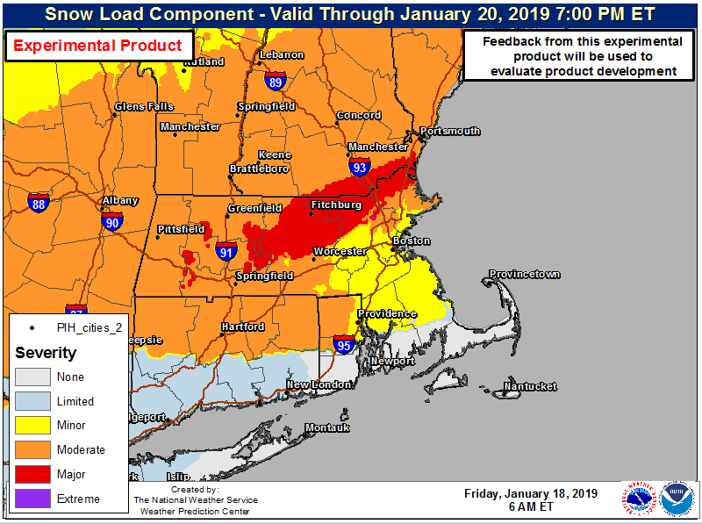
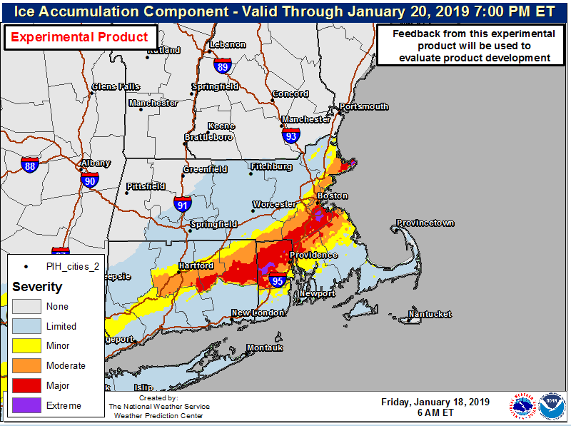
Overview - WSSI Interpretation
Final interpretation: Expect the primary impacts to come from ice accumulations across northern RI northeastward toward Boston, MA. Expect impacts to come from heavy snowfall for VT and NY. There is a major threat for impacts from snow load across central MA through southeast NH.
Notes:
Top Left: WSSI depiction of all threats.
Top Right: The snow amount component matches the total WSSI around southern VT, western MA and NY.
Bottom Right: The ice accumulation component matches the WSSI for southeastern MA and northern RI.
Bottom Left: The snow load component matches the WSSI for central MA and southeast NH.

Slide 8
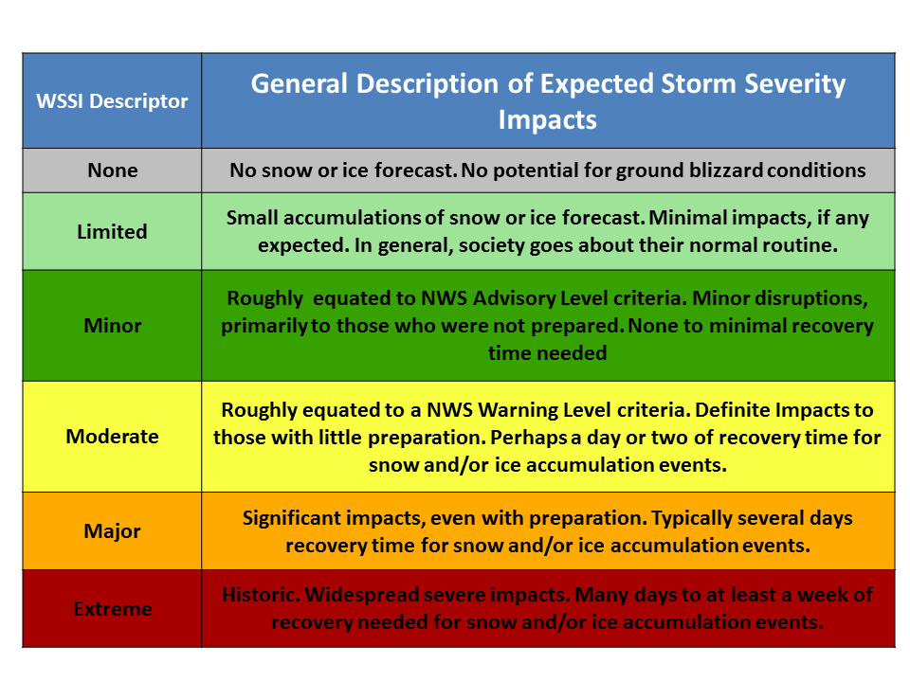
Colors and Definitions
FROM: → TO:

Slide 9
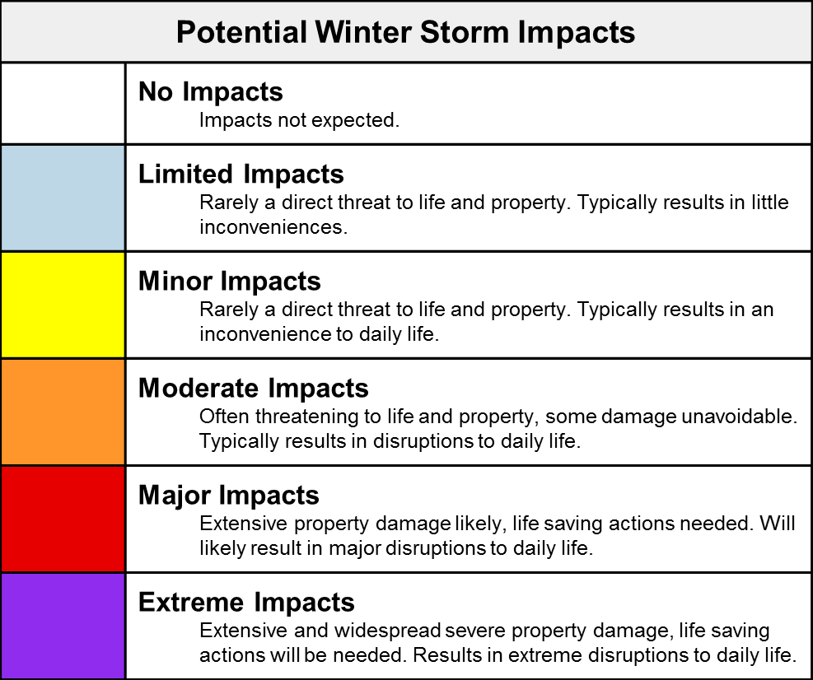
WSSI Changes for 2019 - Definitions and Colors
Improvements based upon input from Social Science engagements
Participants: Jennifer Sprague (NWS, OPPSD), Danielle Nagele (NWS, OPPSD), Greg Schoor (NWS, AFS), James Nelson (WPC), Joshua Kastman (WPC), Alyssa Cannistraci (WPC), Amanda Wagner (WPC)
Matched color curve to other NWS Hazards efforts
Reworked definitions of impacts
Removed mentions of watch/warning criteria; focused on impacts to daily life and threat to life and property

Slide 10
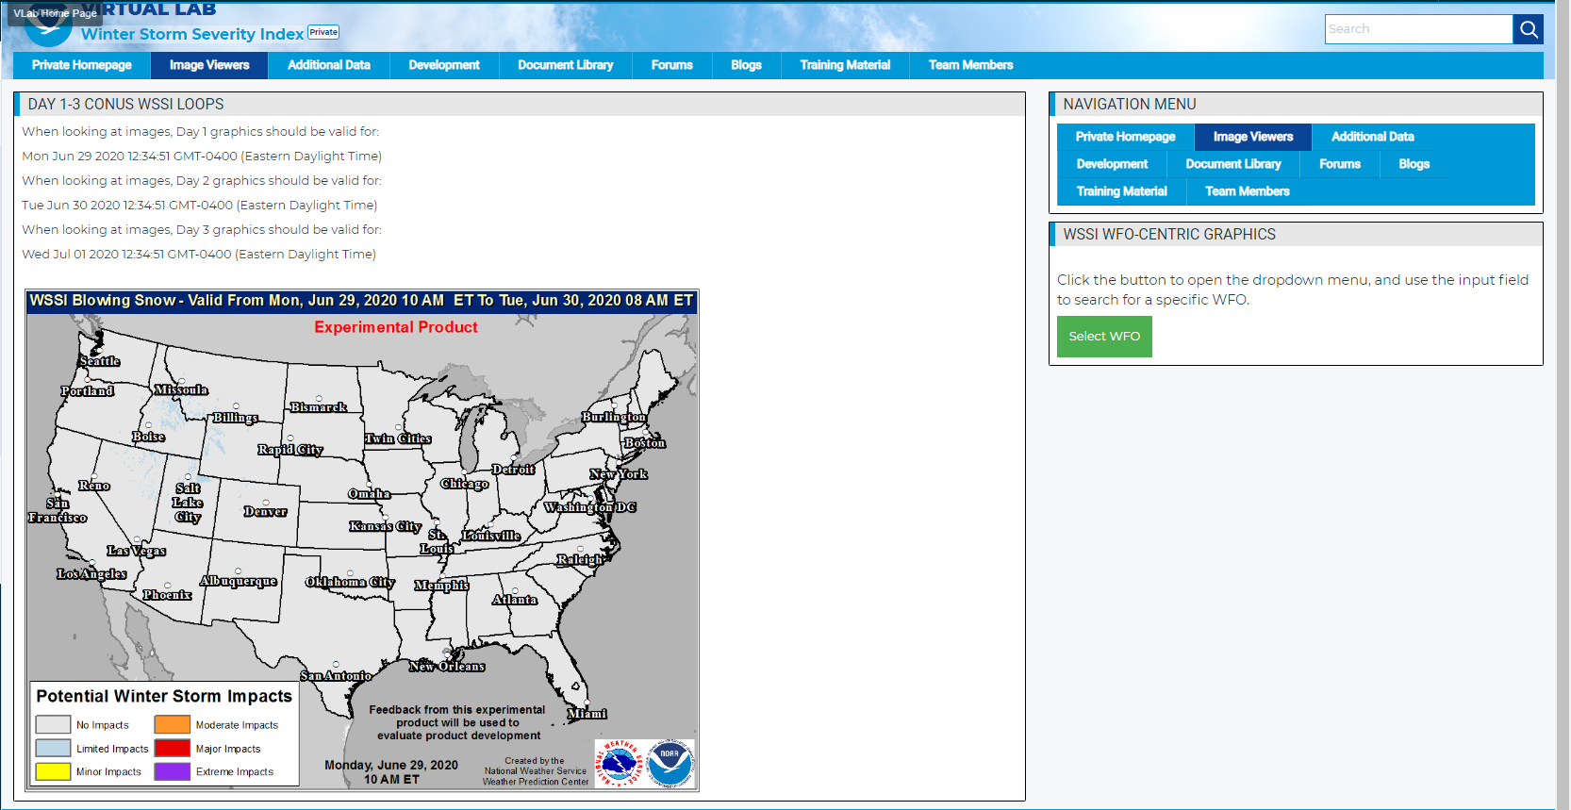
WSSI - VLAB Image Viewer Page
This button will take you to the WFO WSSI page

Slide 11
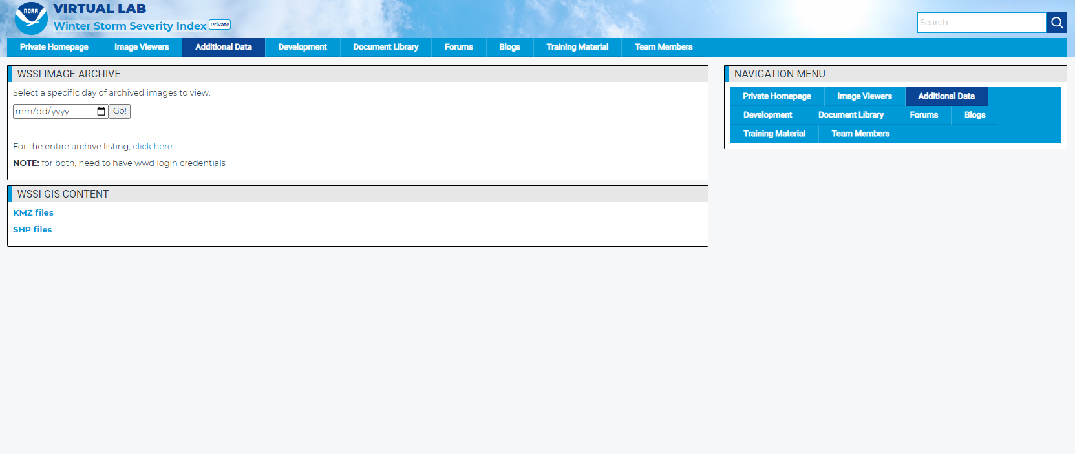
WSSI - VLAB Page
This page will lead you the WSSI archive and to the links for the current KMZ & SHP files

Slide 12
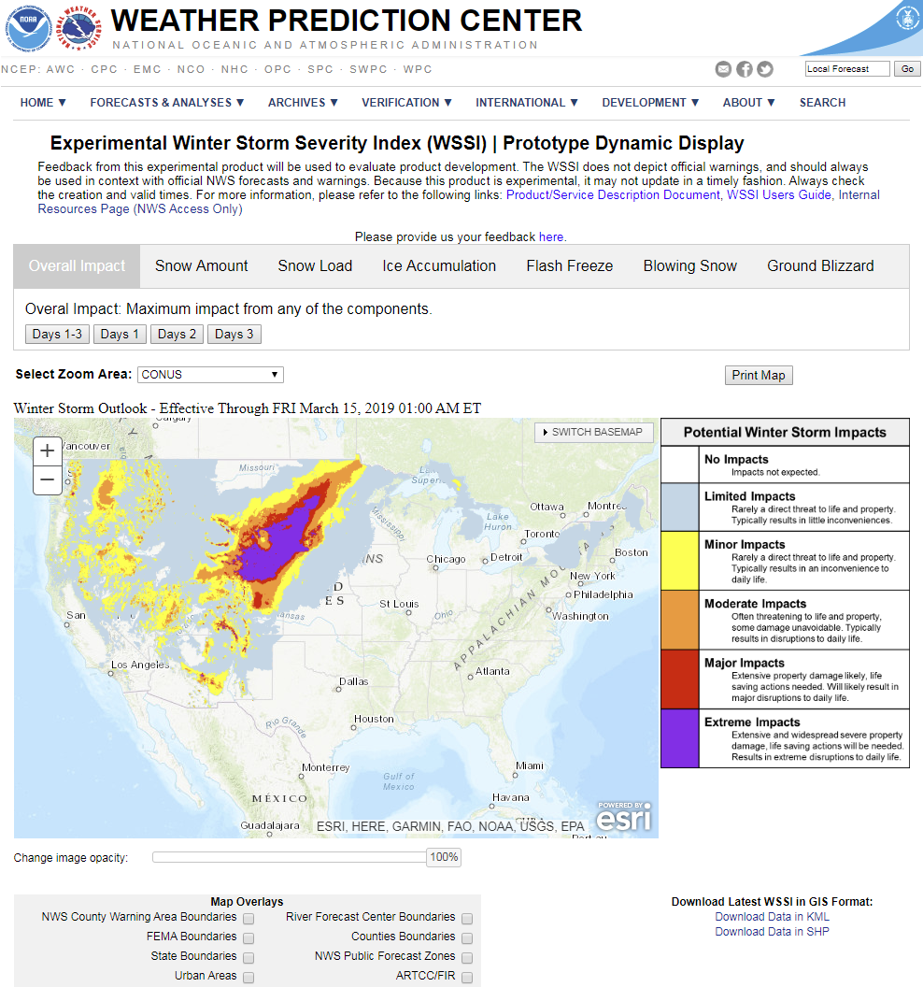
WSSI – Website
Clickable tabs
Loads WSSI components upon click
Day Period tabs
Revised definitions
Zoom to WFO
Dropdown Box
Print Image button
Creates a PDF of the map with your specifications
Variety of basemaps
Switch Basemap dropdown button
Links to GIS Data

Slide 13
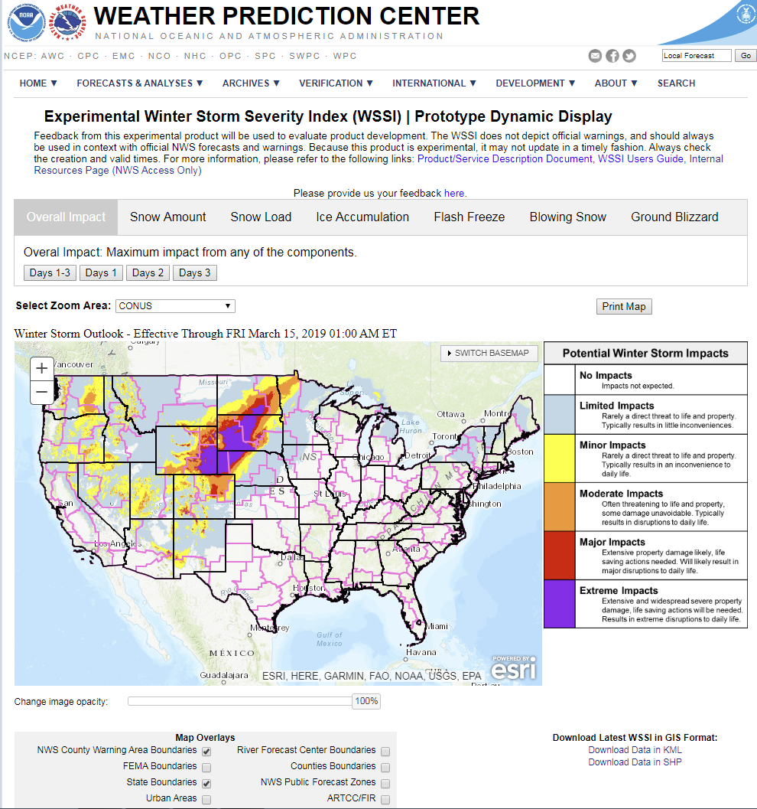
WSSI – Website
Map overlay options
Toggled via checkbox
CWA
FEMA
State
RFC
Counties
Public Forecast Zones
ARTCC
Metro Areas

Slide 14
WSSI Changes for 2019 - Snow Climatology Update
More quality control
Station must have at least 30 years of data
This reduced number of stations and increased influence of 1st order stations
~ 3900 Stations
Average of Max plus Mean 2-Day snowfall
Increased correlation to moderate and minor thresholds
Reduced minor threshold particularly in snowy regions
Response to feedback from NWS WFOs of minor being too hard to achieve
Empirical Bayesian Kriging Regression (EBKR) included River Forecast Center (RFC) boundaries
Same regression variables used (Annual Snow, Elevation & Latitude)
Improved EBKR results by grouping stations by RFC
Model weighted stations more within the same RFC
Improved results where different regions had similar statistics

Slide 15
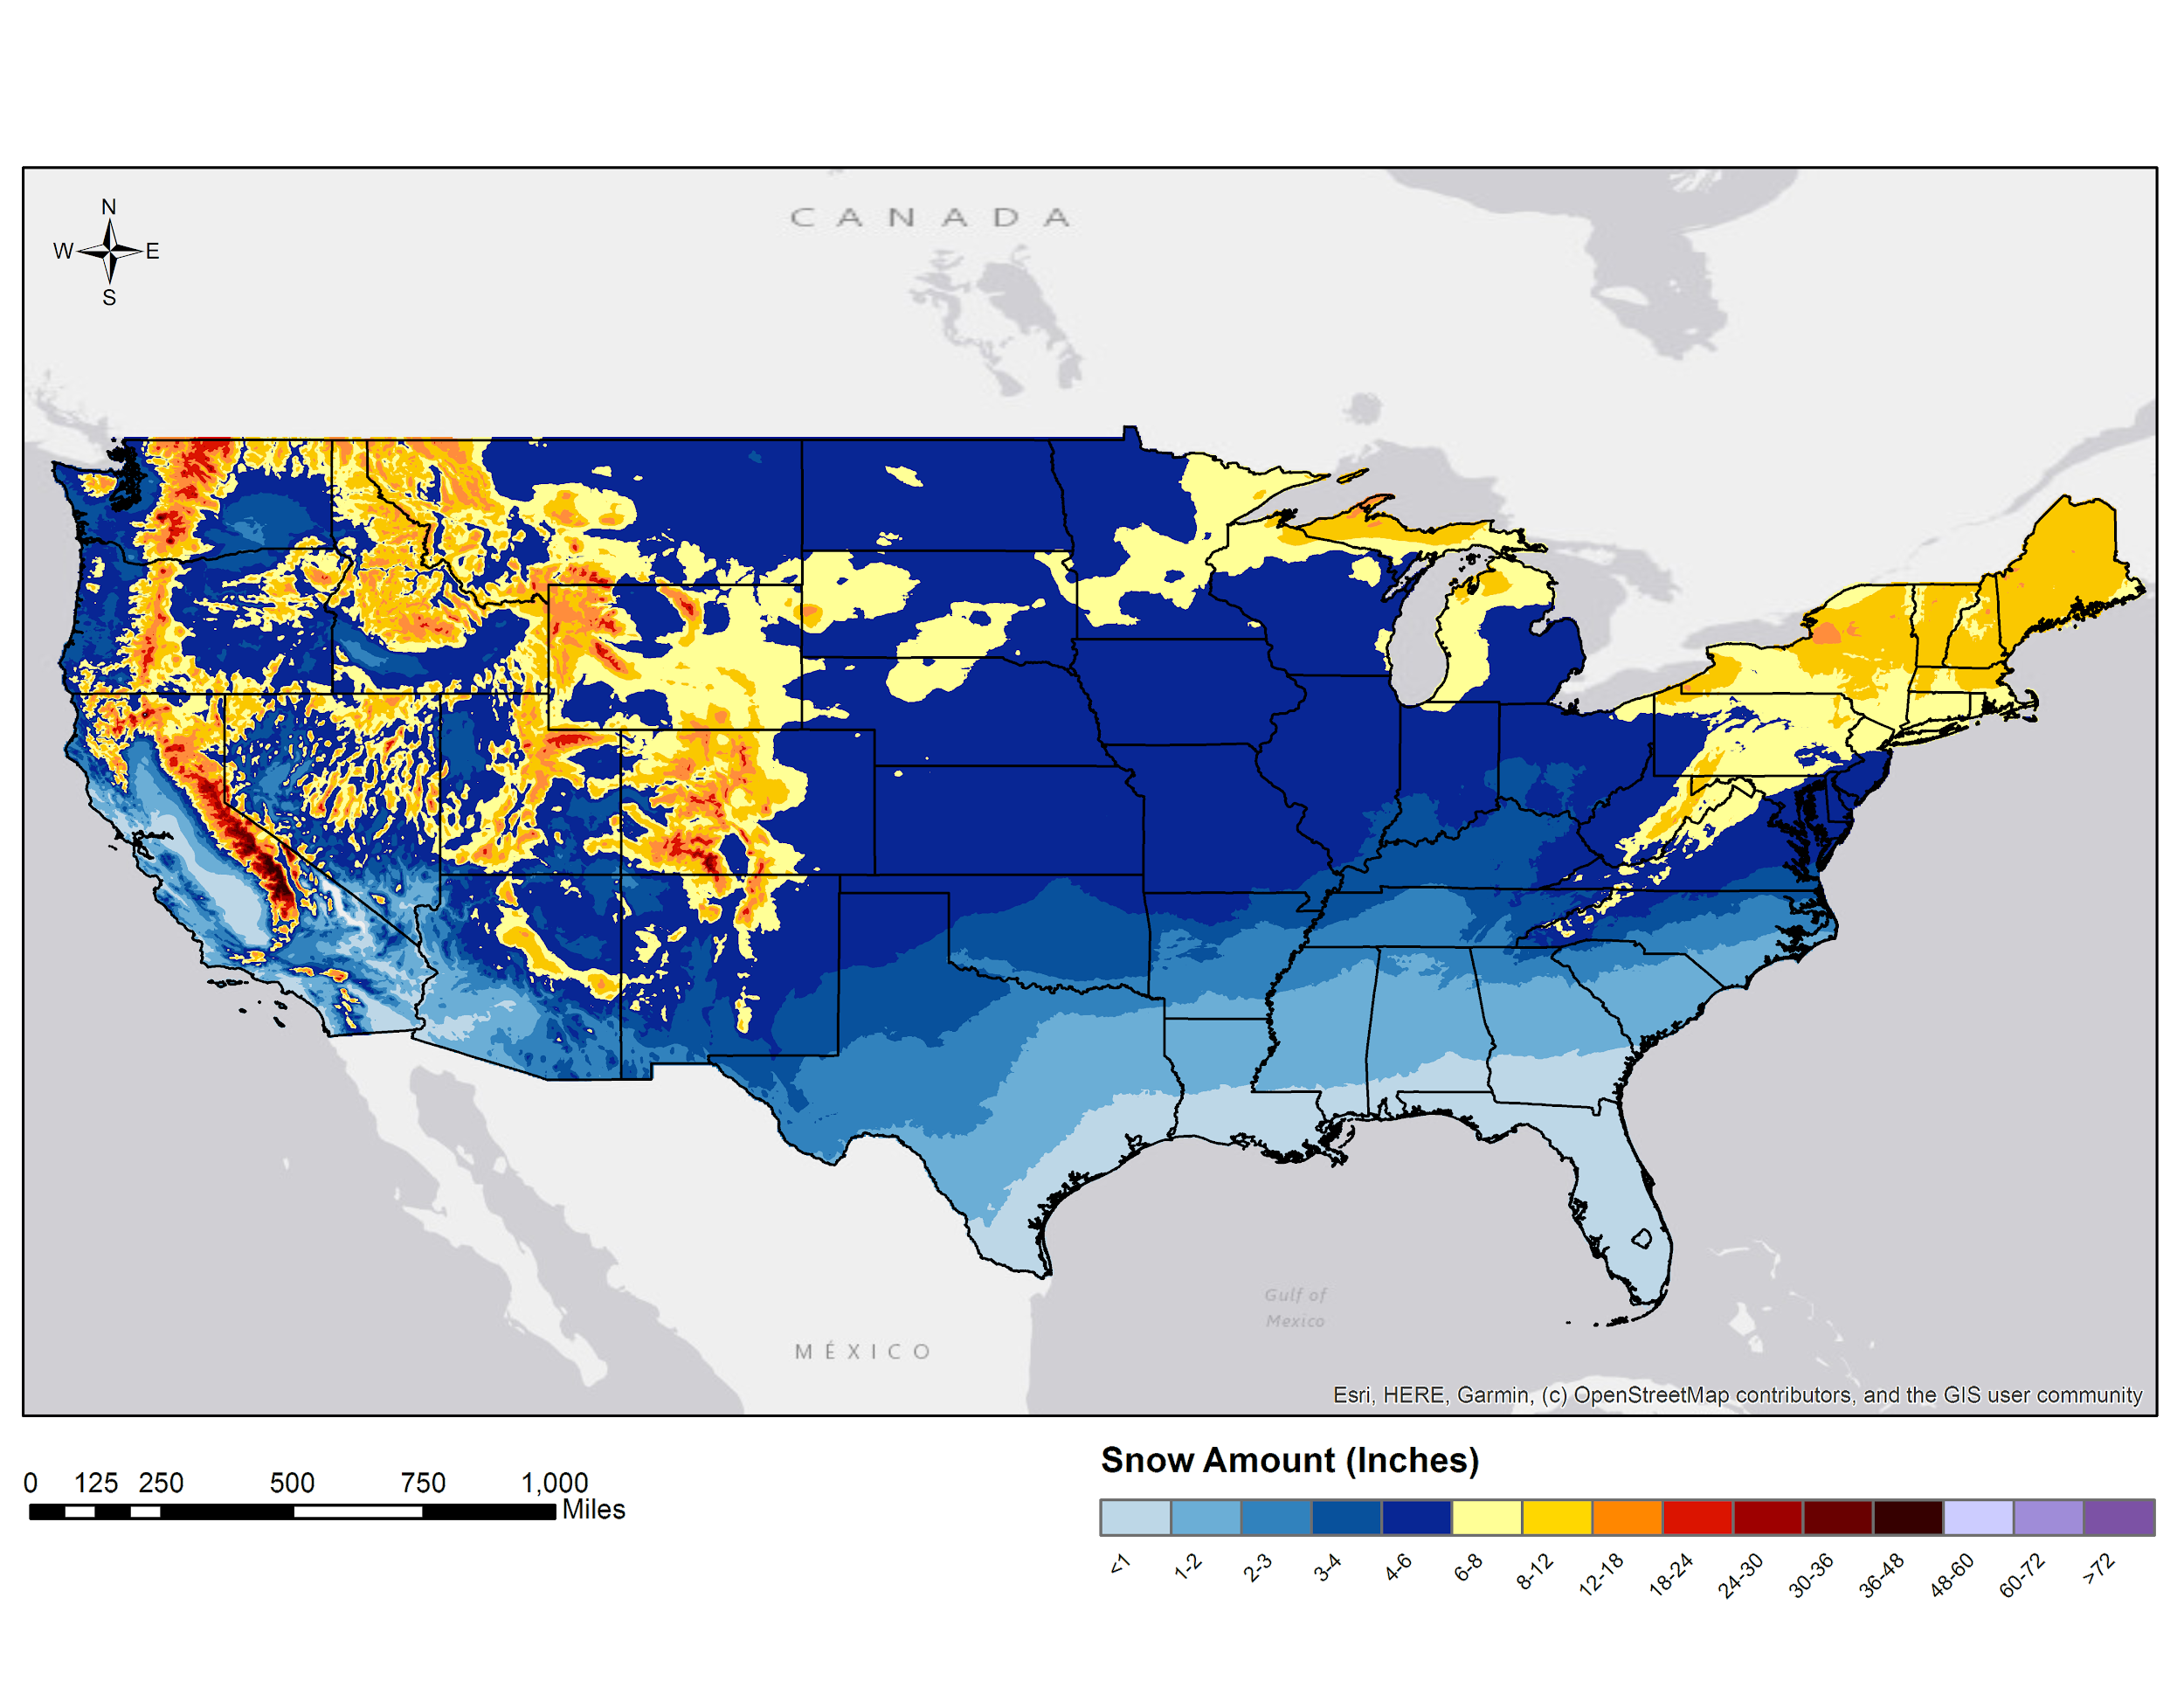
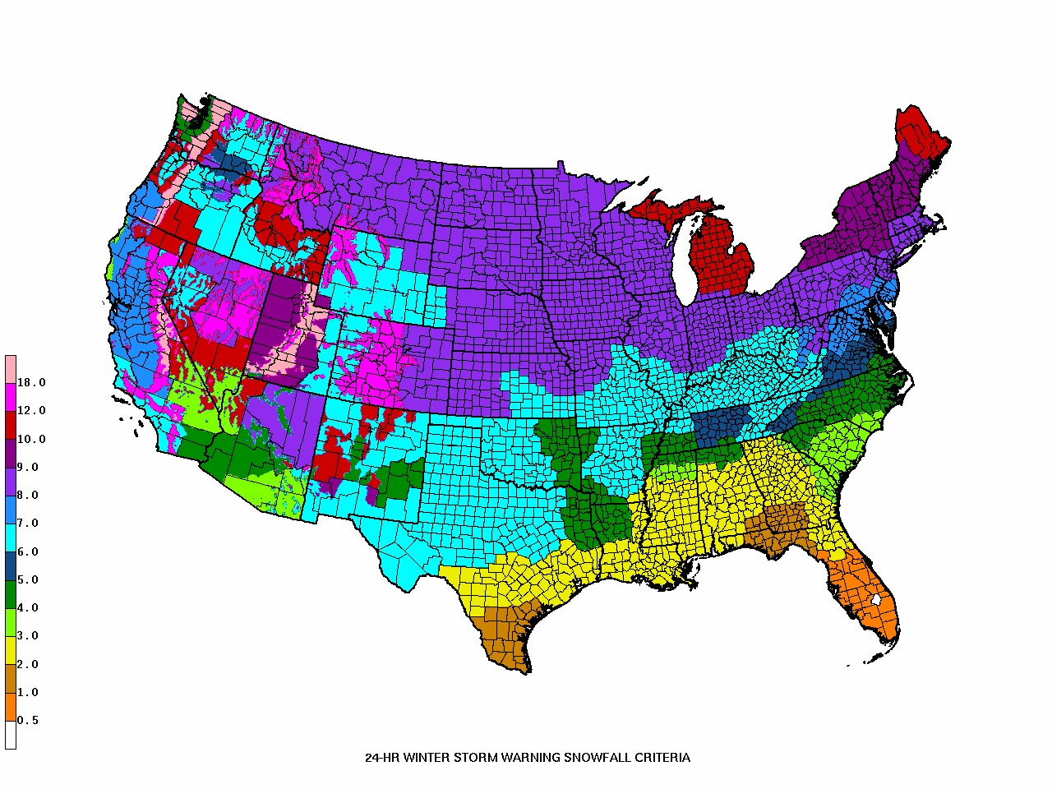
WSSI Moderate Criteria Vs 24 HR NWS Winter Warning Criteria

Slide 16
Modified WSSI Flash Freeze Component
A three hour average temperature change will be used this upcoming season as opposed to hourly temperature changes.
This will effectively cap the Flash Freeze impact. While extreme will be possible, it will take a highly unusual scenario to generate an extreme Flash Freeze.
This will mitigate problems when rapidly rising temperatures are followed by a quick, steep drop of temperatures within a six hour QPF block.
The proposed modification will not fix QPF temporal resolution issues.

Slide 17
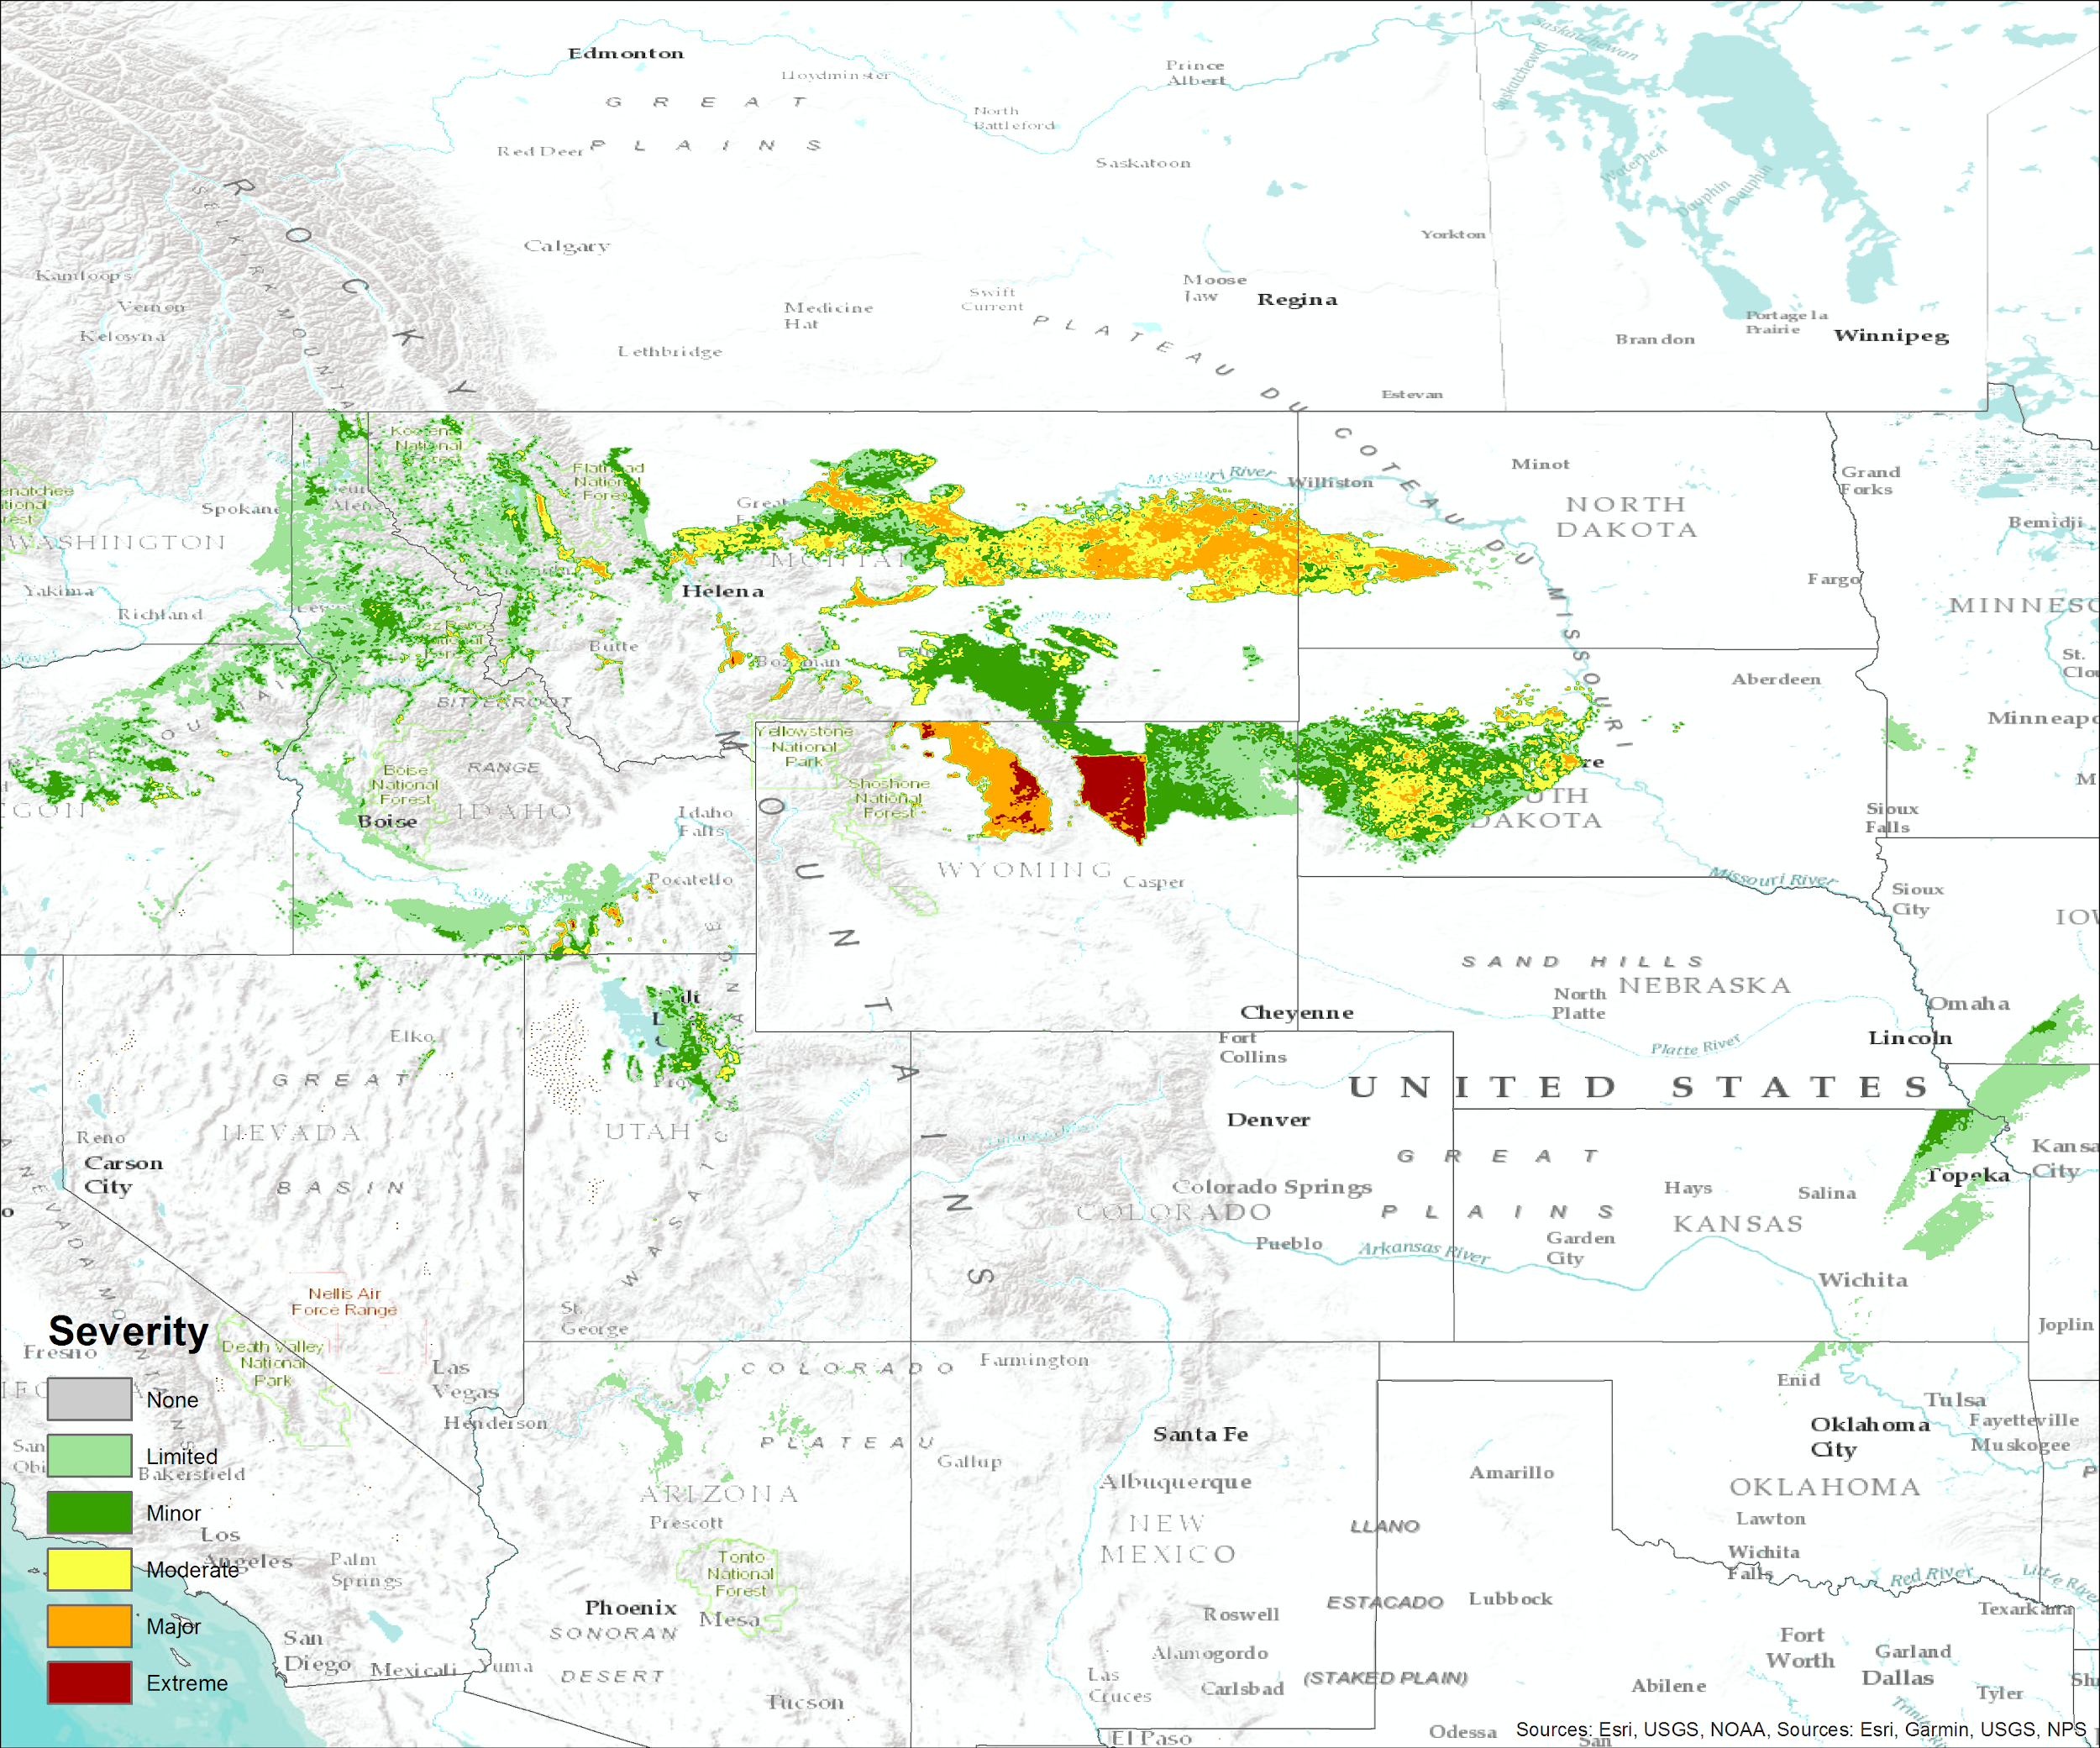
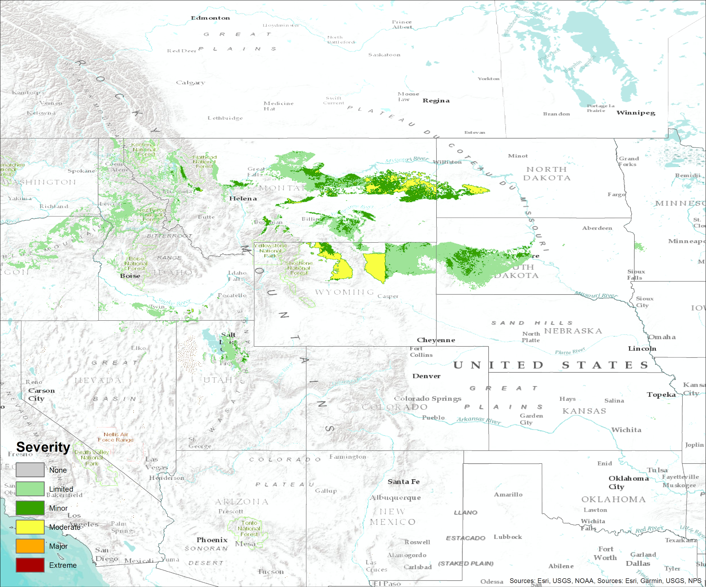
WSSI Changes for 2019 - Flash Freeze
30 December 2018 Original Method
30 December 2018 Proposed Method
Reduction in intensity
Reduction in coverage

Slide 18
2019-20 Survey Results
Public Survey 76 Responses
Less than last year (150)
Less snow in the east
Pandemic could have eaten into March/April responses
Generally very positive (81% favorable)
NWS Internal Survey 29 Responses
Event Specific
Focused on time of day / commutes
Lots of model discussion in responses

Slide 19
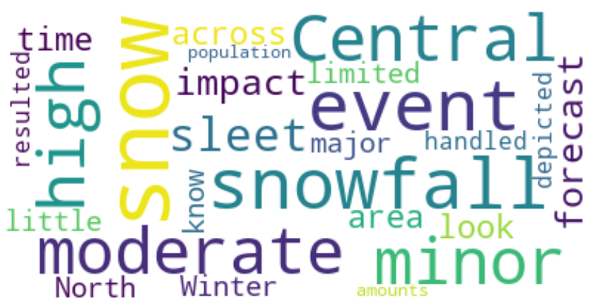
2019-20 Survey Results - NWS Survey Word Cloud

Slide 20
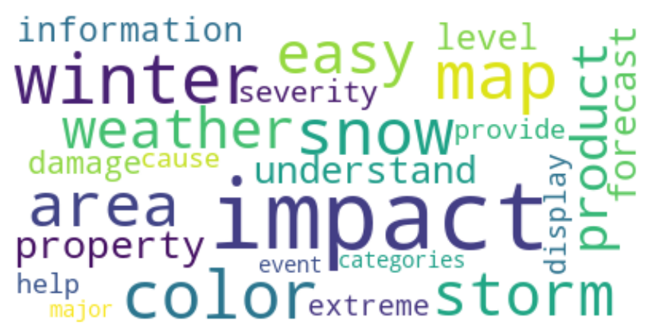
2019-20 Survey Results - Public Survey Word Cloud

Slide 21
2019-20 Use & Visibility
Amazon Use
Lead intelligence Analyst reached out for an explainer
Reported they use it daily for decision making at shipping and distributions centers
Washington Post’s Capital Weather Gang wrote a positive article on the WSSI
Weather Channel also wrote an article on the WSSI
Pivotal Weather now has the tool on its website
TV station use
KMLs are being use to create graphics

Slide 22
WSSI - Overview Version 2.0
Implemented October 4th, 2019
72hr Summary and Components Graphics
CONUS, FEMA, States, and CWA Basemaps
24hr Breakout Summary and Components Graphics
KML and Shapefiles (CONUS)
Flash Freeze Update
Updated Snow Climatology from WSSI Prototype
Average of Max plus Mean 2-Day snowfall
Increased correlation to moderate and minor thresholds
Reduced minor threshold particularly in snowy regions
Response to feedback from NWS WFOS of minor being too hard to achieve

Slide 23
WSSI - Collaboration
Active NWS WSSI Team
WFO and regional representation
Great Feedback from NWS Offices and Regions in the Last Year
Lead directly to improvements
Training Materials
Training development planned with WDTD this summer

Slide 24
WSSI Version 3.0
72hr Summary and Components Graphics
CONUS, FEMA, States, and CWA Basemaps
24hr Breakout Summary and Components Graphics
KML and Shapefiles (CONUS)
Updated Snow Climatology from WSSI Prototype
Flash Freeze Update
Rolling 24hr Summary and Components Graphics (6hr cadence)
In development
Extend WSSI to Day 5
In development using NBM deterministic forecast
ArcGIS Online Service
Internal services created by IDP in April (link)

Slide 25
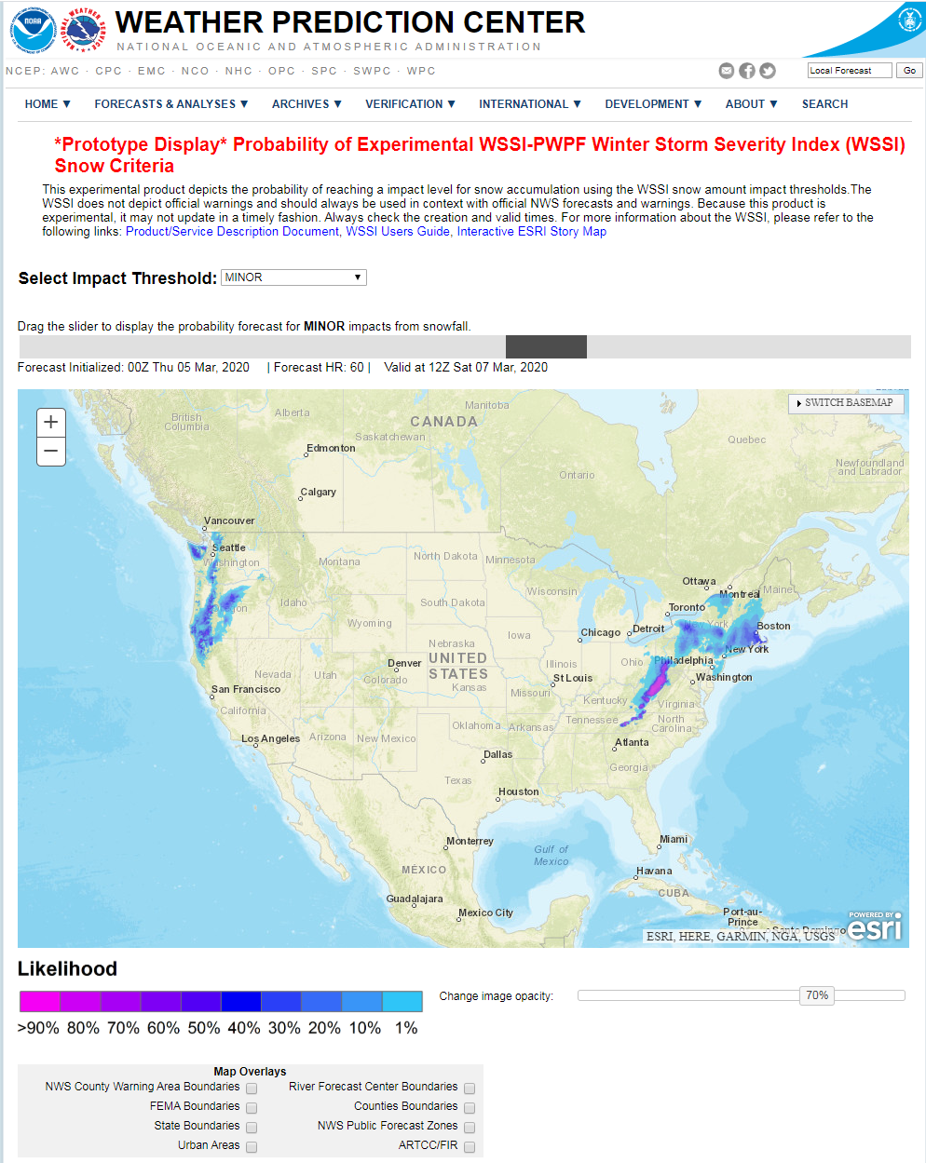
Probabilistic WSSI
Probability of Exceeding WSSI Snow Amount Criteria
Web page launched Feb. 2020.
Used WSSI Snow Climatology Thresholds & WPC PWPF
More Probabilistic Components will be developed

Slide 26
Probabilistic WSSI - All Component
Fully probabilistic WSSI using PWPF model members in development
Method 1:
Each member will have its own WSSI forecast
Probabilistic output for each component
Forecast out to day 3.5
Method 2:
Joint probability method
Probability of raw components calculated
Snow Amount, Ice amount, QPF amount, Wind Speed, Temperature
Currently Developing Method 1

Slide 27
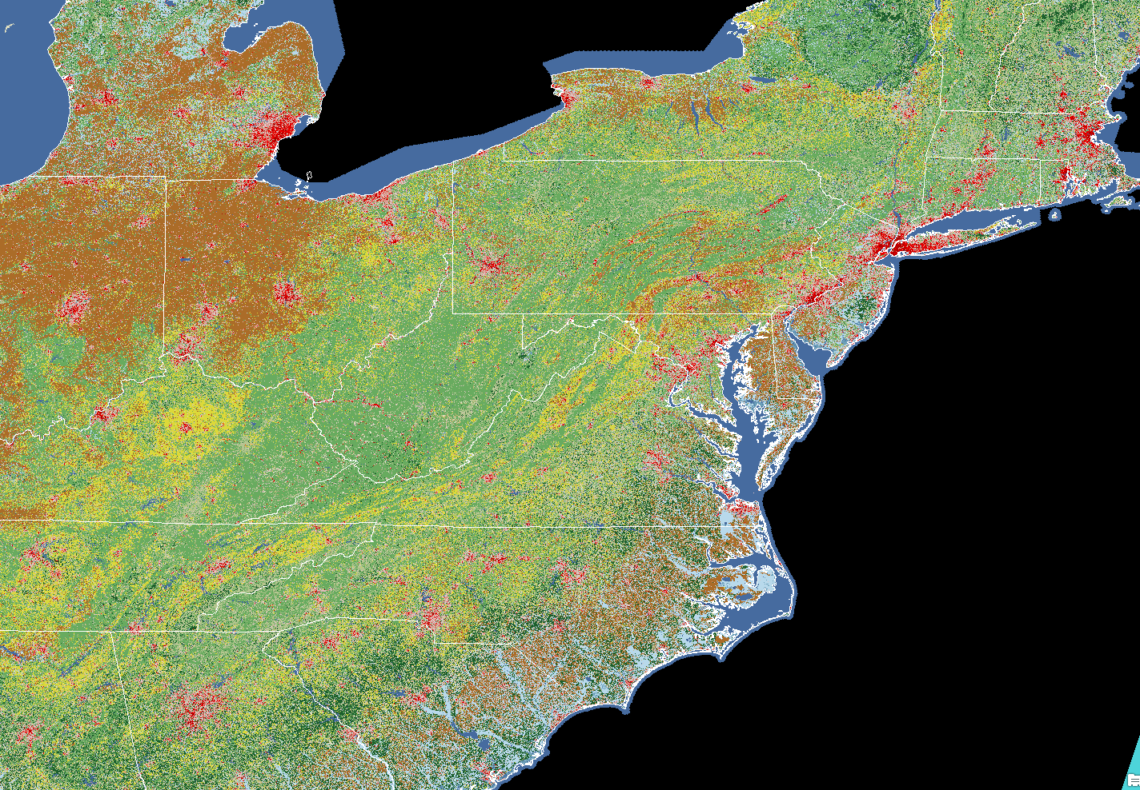
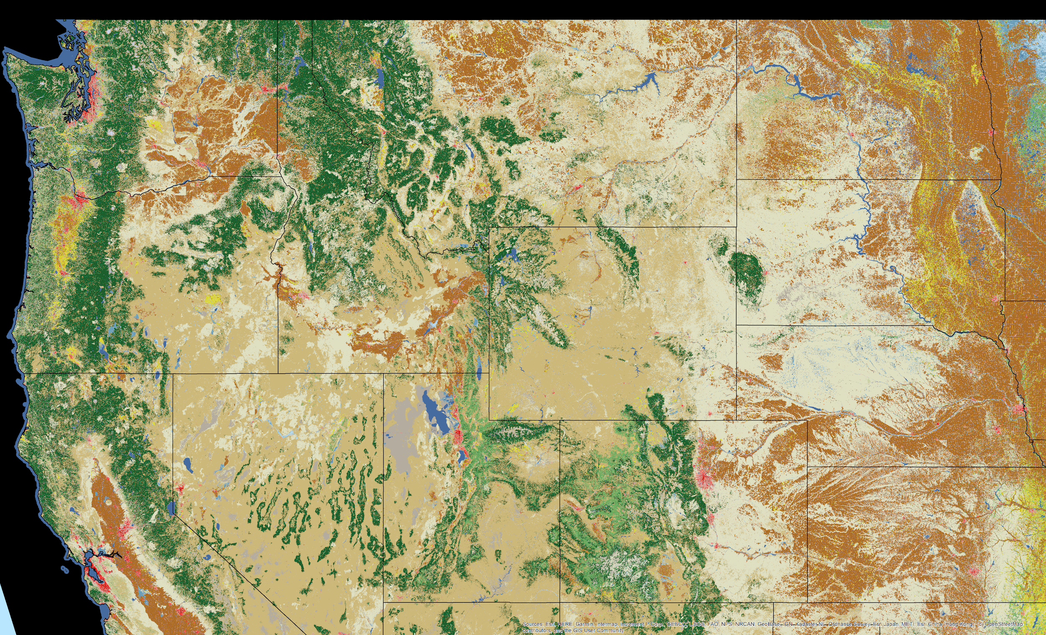
30 M Land Use
Classification
Areas above the treeline
Date Source: Multi-Resolution Land Characteristics (MRLC) Consortium

Slide 28
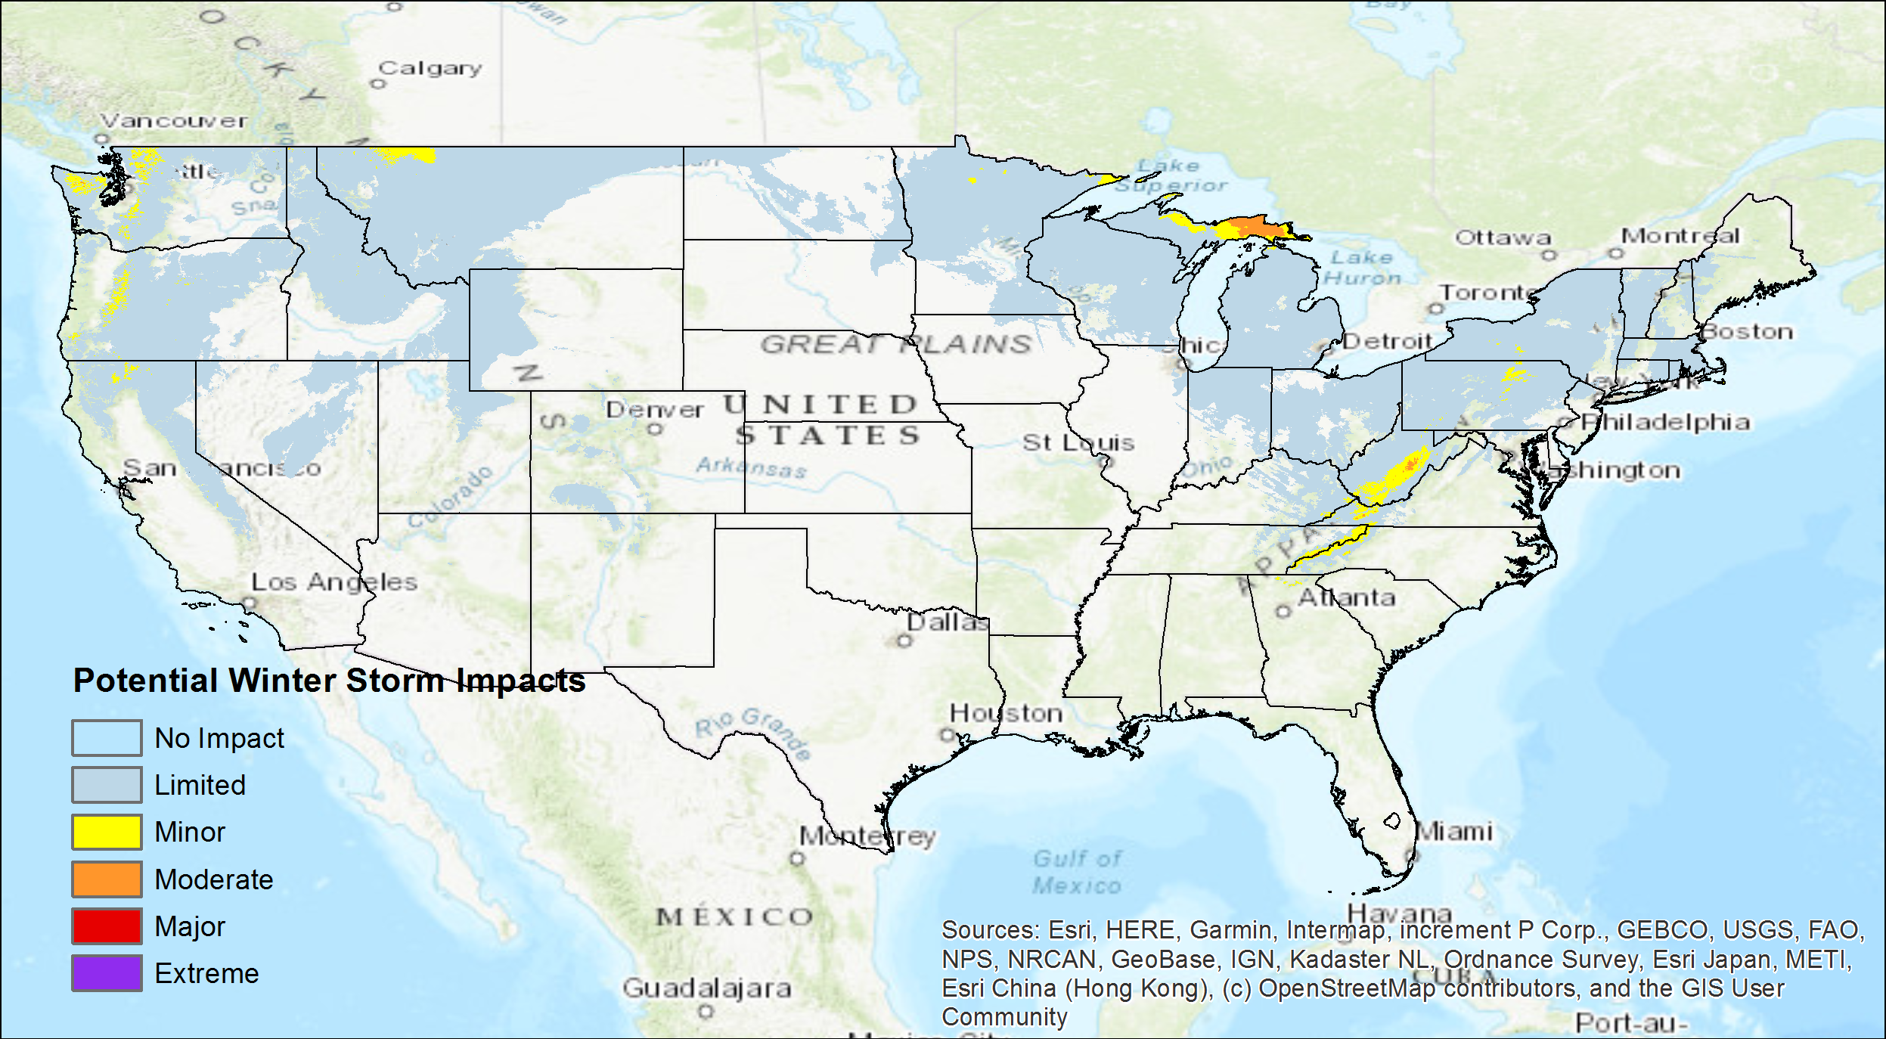
WSSI - Model Generated Output
Deterministic NBM WSSI
Proof of concept
Higher Temporal Resolution
Time of day impacts
Hourly Snow Rates
Collaboration Opportunities
Possible to expand out to day 7
Could pair with GWHO
WSSI - NBM Snow Amt 72 HR Forecast

Slide 29
NCEP Summer Intern and Summer Projects
One summer student (Chris Long of Penn State)
Projects
URMA/RTMA Reanalysis of key cases from last two seasons
Yearly Counting Stats
Improvements to WSSI website
Static Images
Improved Archive
CWA tracker (number of each component and severity)

Slide 30
Thank You!!!
Comments or Questions?

