Slide 1



Hydrologic Modeling at the National Water Center:
Operational Implementation of the WRF-Hydro Model
Brian Cosgrove NWS/NWC
David Gochis NCAR
Large integrated NWC and NCAR team

Slide 2
Outline
Growing need for actionable hydrologic information
WRF-Hydro overview
Model configuration and version control
Products and data dissemination
End users
Initial validation examples
Summary and future directions
2

Slide 3
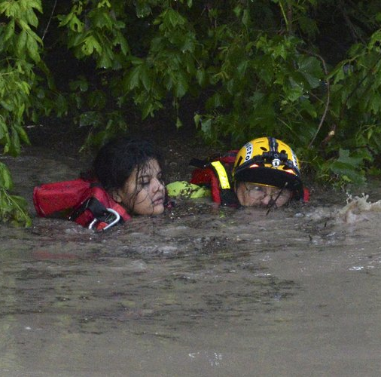
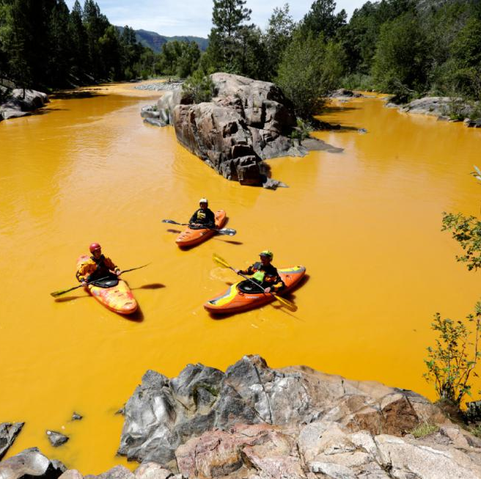
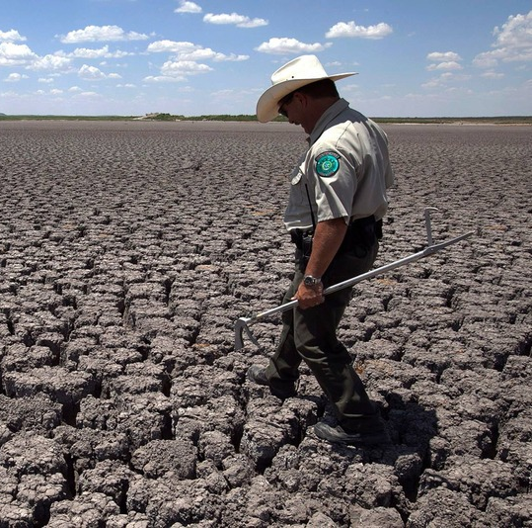
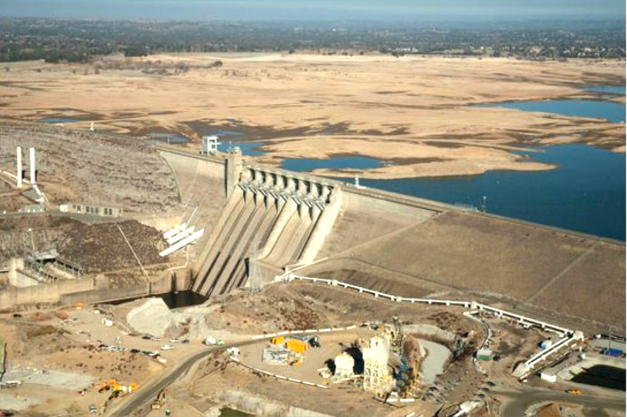

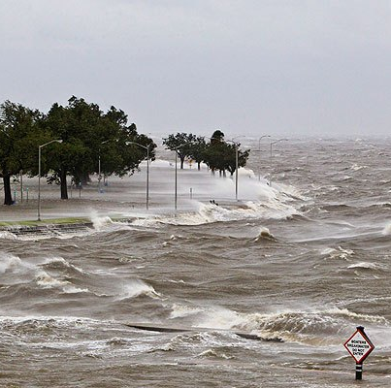
Hydro Analysis/Forecast Needs Extremely Broad
Floods
Water Quality
Drought/Soil Moisture
Water Supply, Low Flow Issues
Snowpack
Coastal Total Water Level
Notes:
NWC forecasting, analysis and research activities will focus on the full range of water related issues, coordinating with related research/operational efforts across NOAA

Slide 4



Produce Seamless CONUS-Scale Products
(NWS Field, Intergov. Activities, Stakeholder Assessments, Flash Flood Summit)
Produce Street Level Forecasts
(NWS Service Assessments, FEMA, EMs)
Support River-to-Ocean Modeling
(NWS Service Assessment, Flash Flood Summit, NOAA Strategic Goal)
Produce Extended Range Forecasts
(ACE, River Basin Commissions)
Capture Impacts of Regulation
(NWS Field, River Basin Commissions, Regional Stakeholders)
Feature Operational Reliability
(NWS Field, FEMA, ACE)
Support Flood Inundation Mapping
(FEMA, River Basin Commissions)
Produce Flash Flood Forecasts
(NWS Service Assessments, FEMA, Stakeholder Summits)
Utilize Data Assimilation
(IWRSS IDS Report, Flash Flood Summit)
A new national hydrologic modeling system, WRF-Hydro, will be implemented into NWS operations in June. This will begin to fill these hydrologic service gaps in a holistic fashion
Growing and Varied
End User Requirements
Capture a Vital Need for an
Operational Hydrologic Model
No Current NWS System
Satisfies All of These
Army Corps
4
Notes:
End users of hydrologic data are growing in number, and the need for such data is growing stronger. Hydrologic end user requirements were gathered through a variety of methods and are listed above. No current NWS system satisfies all of them, which is the driving force behind the implementation of WRF-Hydro. WRF-Hydro can provide a solid basis for beginning to address these operational gaps.

Slide 5
WRF-Hydro: Initial Operating Capability (IOC)
Initial efforts are focusing on implementing a capable and solid foundation that will support year-over-year growth in operational hydrologic forecasting capability
Goals for this WRF-Hydro Initial Operating Capability
  Provide forecast streamflow guidance for underserved locations
  Produce spatially continuous national estimates of hydrologic states (soil moisture, snow pack, etc.)
  Seamlessly interface real-time hydrologic products into an advanced geospatial intelligence framework
  Implement a modeling architecture that permits rapid infusion of new data, science and technology
5

Slide 6
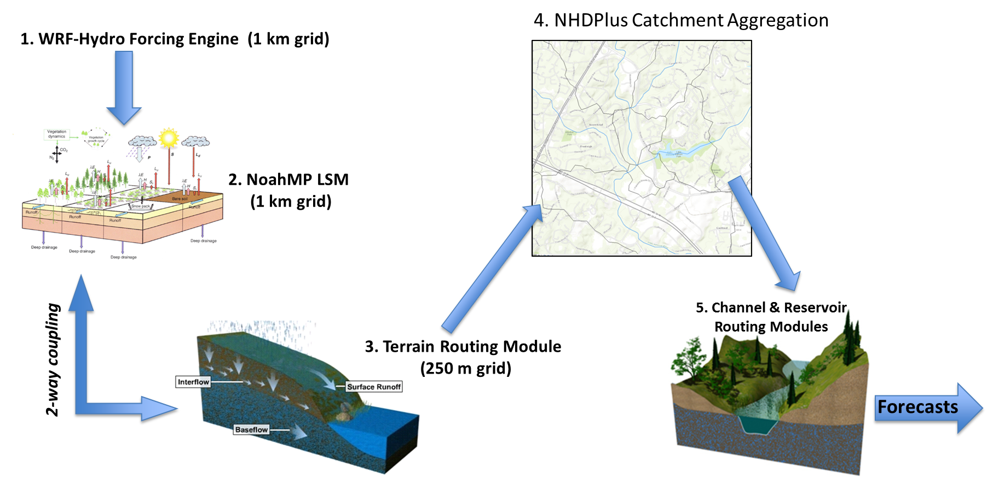
What is WRF-Hydro?
A community-based hydrologic modeling framework supported by NCAR
Not dependent on a particular forcing data source or choice of LSM
Able to operate over multiple scales and with multiple physics options
IOC System Flow (Uncoupled)
(avg. size ~3km²)
6

Slide 7
WRF-Hydro Operational Configuration
Analysis & Assimilation
Short-Range
Medium-Range
Long-Range
Cycling Frequency
Hourly
Hourly
Daily
Daily (16 mem)
Forecast Duration
- 3 hrs
0-18 hours
0-10 days
0-30 days
Meteorological Forcing
MRMS blend/ HRRR/RAP bkgnd.
Downscaled HRRR/RAP blend
Downscaled GFS
Downscaled & bias-corrected CFS
Spatial Discretization & Routing
1km/250m/NHDPlus Reach
1km/250m/NHDPlus Reach
1km/250m/NHDPlus Reach
1 km/NHDPlus Reach
Assimilation of USGS Obs
Reservoirs (1615 water bodies parameterized with level pool scheme)
7
Notes:
Planned WRF-Hydro operational configuration

Slide 8
NWC Repository
NCAR Repository
NWC VLAB git repo
(soon subversion)
master
branch
NCAR Developer
Dev Branch Updates
NCAR GitHub git repo
NCAR Developer
Master NWC Version
NWC Developer Ports to
WCOSS Coding Standards
branch
master
VLAB Usage
NWC is currently using VLAB for their git repository. NCAR has access to the repository and commits their changes from their own repository (on github) into the VLAB branch. VLAB also has a bug tracking system which can be implemented anytime in the future.
NCO
NWC Developer
NCEP/NCO Repository
Manual Code Flow
NCAR developer commits code into a VLAB branch
NWC developer implements WCOSS coding standards to the VLAB branch revision and merges it into the master
NCO pulls a copy from the VLAB master and places it into a branch in the NCO subversion server
NCO freezes the branch and runs a test evaluation
NCO updates code as needed to meet standards
NCO implements into production and commits the branch into the trunk
An NWC developer merges the NCO trunk version back into the VLAB repo (master branch)
NCO svnwcoss subversion repo
branch
trunk
8

Slide 9
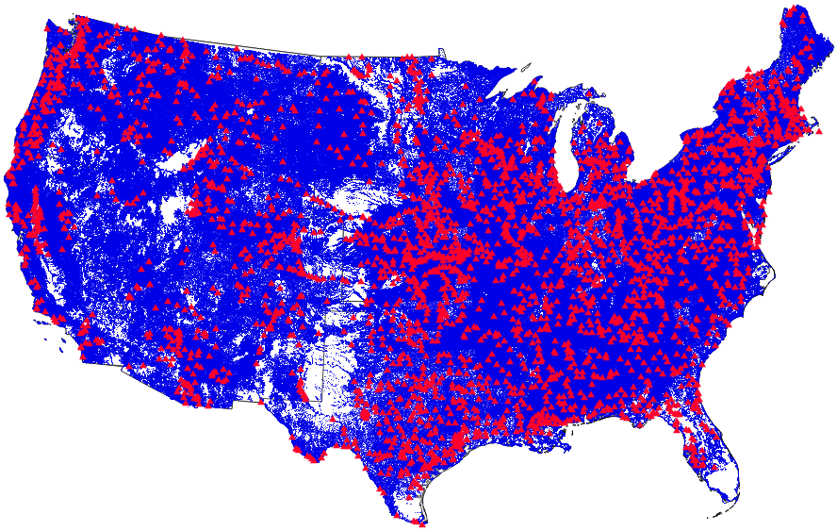
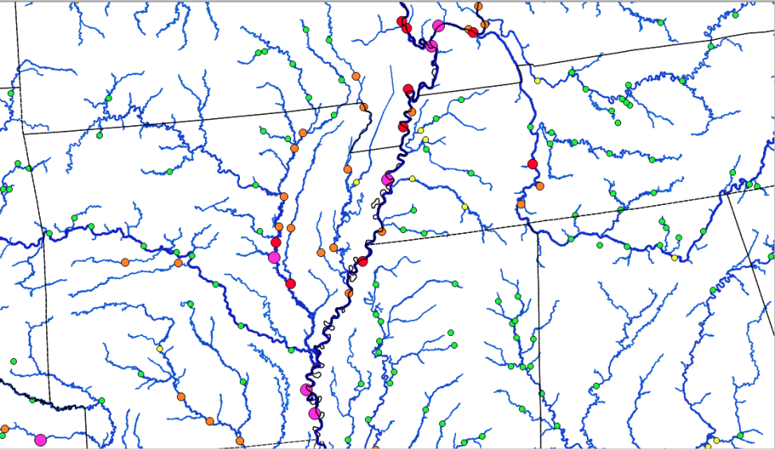
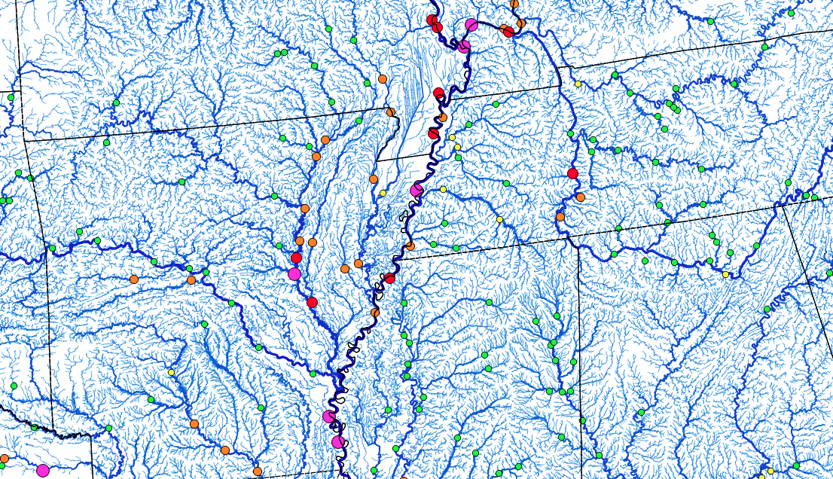
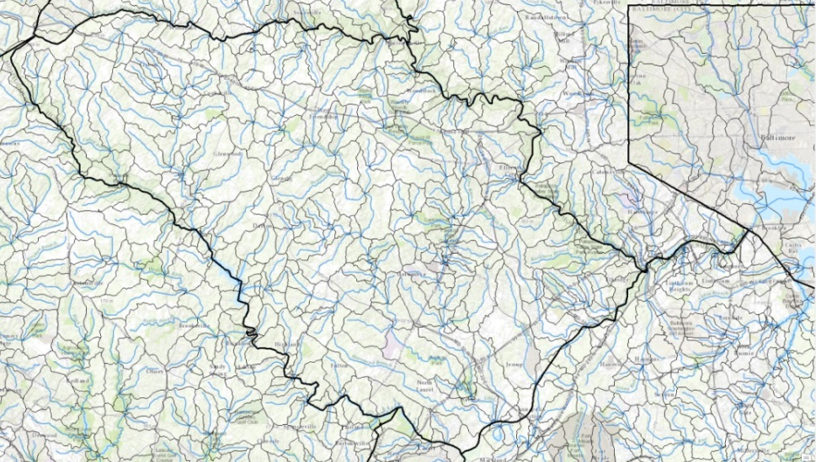
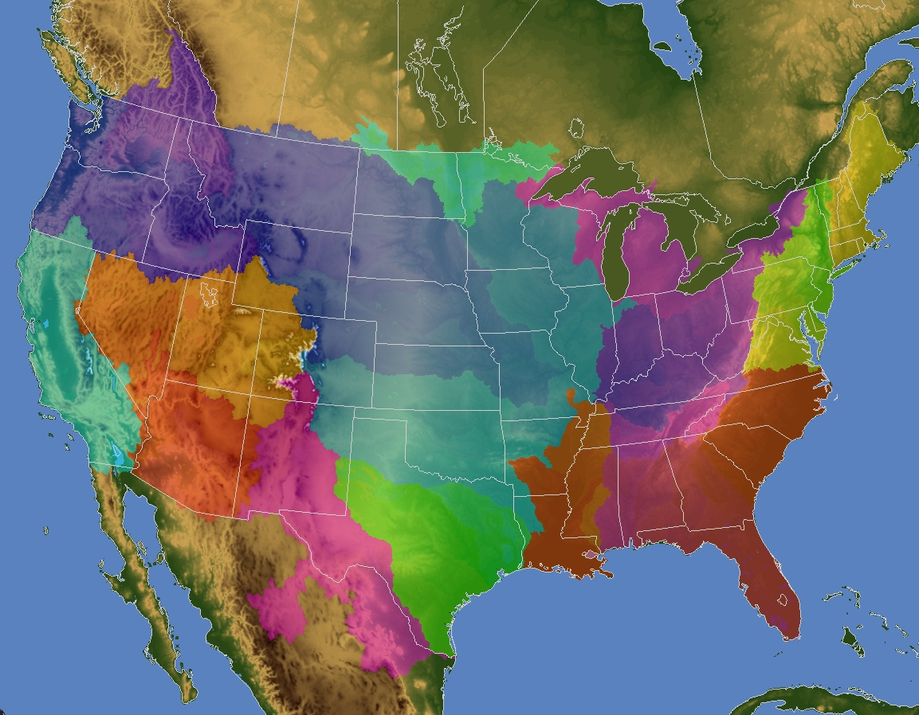
WRF-Hydro IOC Products
Hydrologic Output
  River channel discharge and velocity at 2.6 million river reaches
  Surface water depth and subsurface flow (250 m CONUS+ grid)
Land Surface Output
  1km CONUS+ grid
  Soil and snow pack states
  Energy and water fluxes
Direct-output and value-added geointelligence products
Current NWS river forecast points (red)
WRF-Hydro forecast points (blue)
9
WRF-Hydro DOMAIN
Current NWS River Forecast Points (circles)
Overlaid with WRF-Hydro Stream Reaches
9
Notes:
When implemented operationally, WRF-Hydro will produce a wide variety of hydrologic and land surface outputs. Output will take the form of raw unaltered model output along with value-added products such as anomalies, ensemble means, and GIS-enhanced geointelligence products. WRF-Hydro will provide greatly improved forecast coverage. Users will be in much closer proximity to forecasts than they are now.

Slide 10
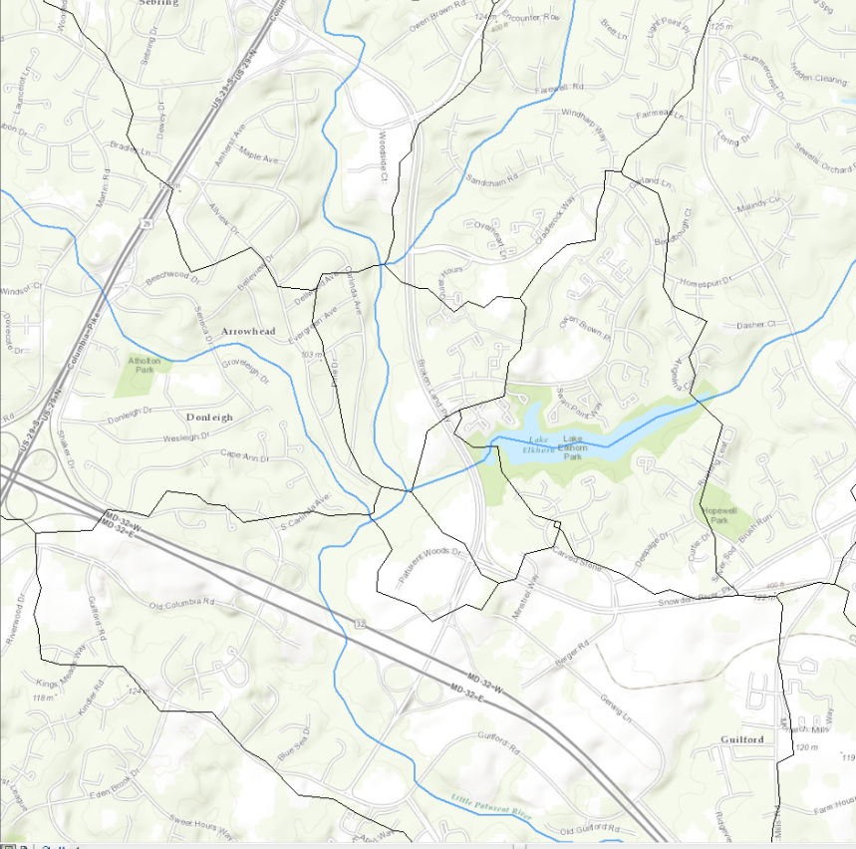
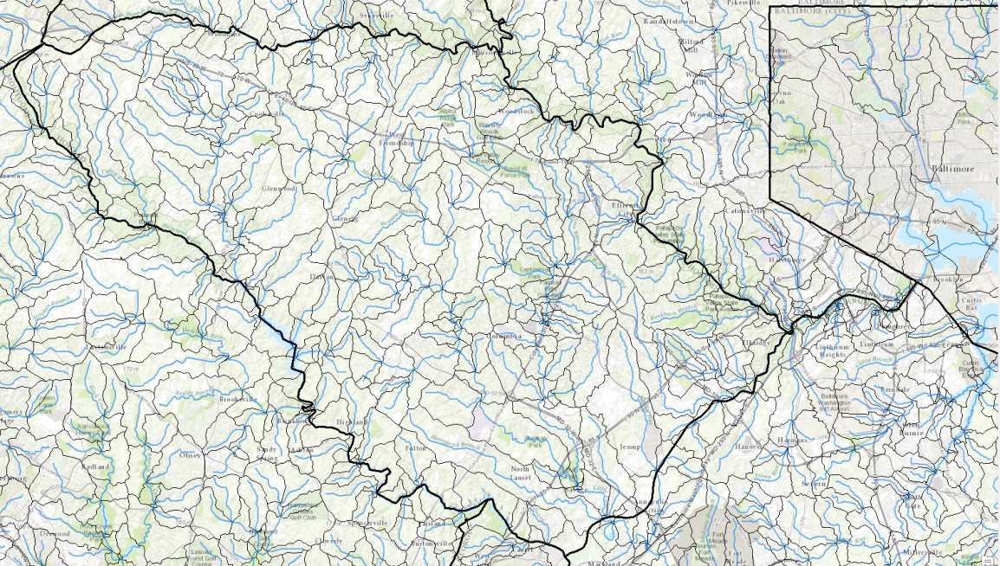
Increase in River Forecast Coverage
Neighborhood-Scale
Streamflow Guidance
Howard County, Maryland
(300k People with 2nd Largest Community in MD)
Blue=Output Flowline
Black=Catchment
Current River Forecast Points: Zero
WRF-Hydro Forecast Points: 300+
Notes:
WRF-Hydro will provide greatly improved forecast coverage. Users will be in much closer proximity to streamflow information than they are now. For example, there are currently no river forecast points in Howard County, Maryland (containing 300,000 people), but WRF-Hydro will provide streamflow guidance for 300+ stream segments within this area.

Slide 11
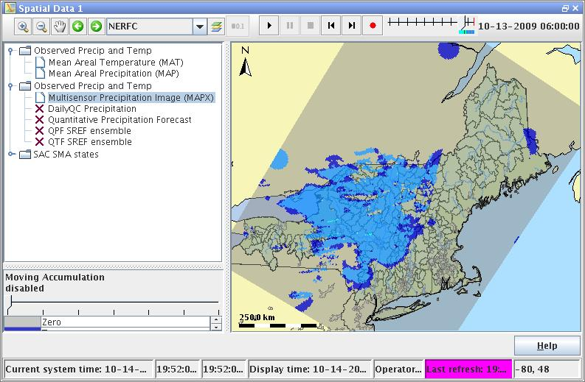
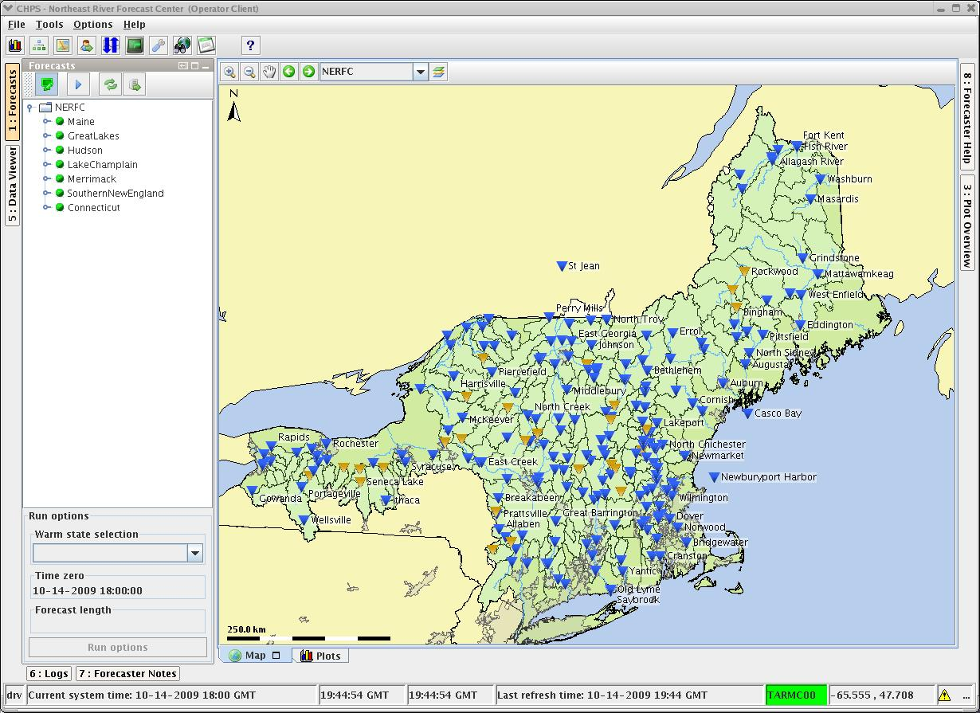
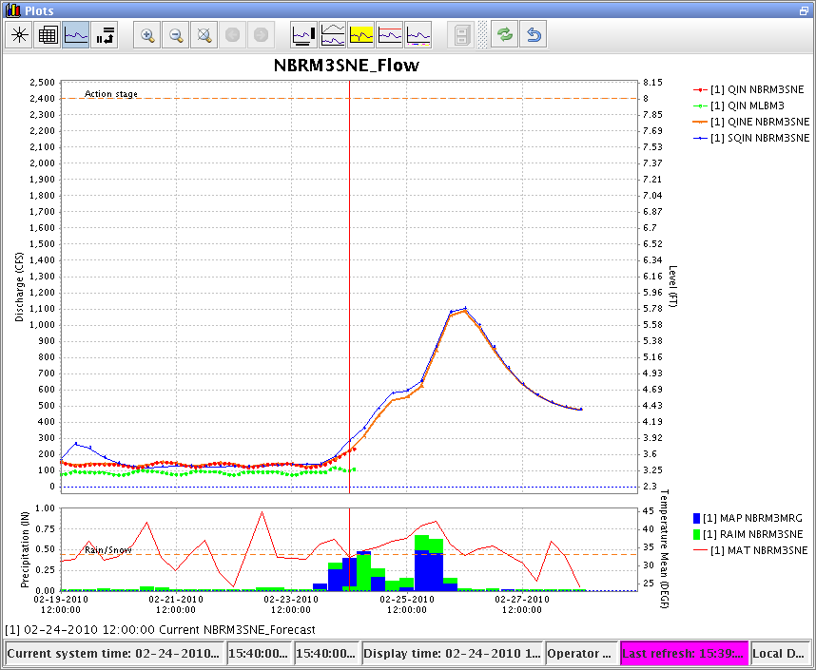
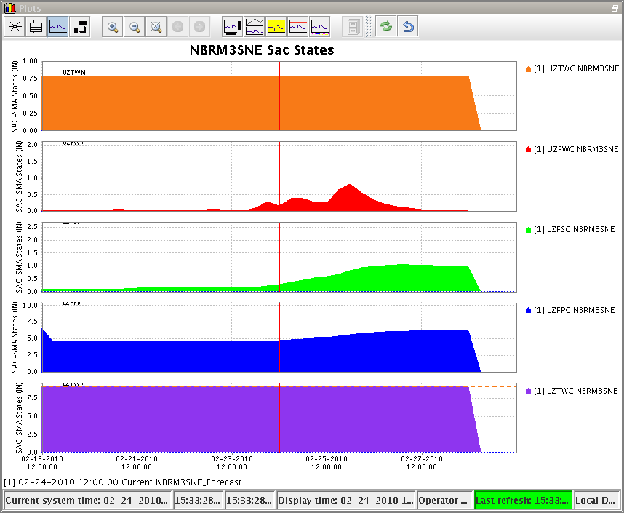
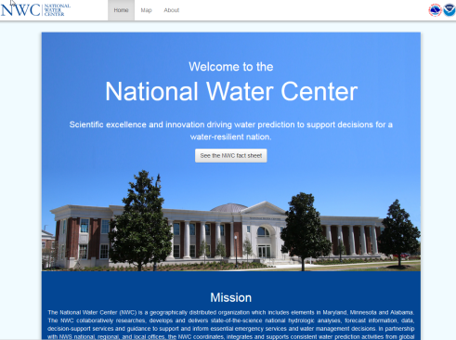
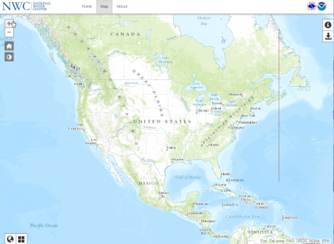
WRF-Hydro IOC Product Dissemination
Visualization key to success, area of active development
Three-pronged product dissemination strategy
  NWC website-based viewer
    Public-facing visualization option
    GIS-enabled dynamic visualization
  Community Hydrologic Prediction System
    Used operationally by RFCs
    WFO access via remote-login
    Geographically subsetted WRF-Hydro data
    Streamflow at river reaches
    Gridded land surface output
  File dissemination via NOAA NOMADS server
Post IOC Visualization Plans
    Potentially AWIPS in FY17
    GIS-based hosting of WRF-Hydro output
CHPS
NWC Website
Notes:
The success of a model is tied, in part, to having a efficient and effective way to disseminate and visualize output data. Recognizing this, WRF-Hydro data will be disseminated via the new NWC website, CHPS and NOMADS. Potential FY17 plans include dissemination via AWIPS.

Slide 12


WRF-Hydro End Users
National Weather Service
  River Forecast Centers—River flow analyses and forecasts
  National Water Center—Operational forecast and research support
  Weather Forecast Offices—Flash flood forecasts
  Environmental Modeling Center—Fluxes, land states for NLDAS, research
  Weather Prediction Center—Input to excessive rainfall forecasts
  Climate Prediction Center—Long range guidance for anomaly forecasts
External Users
  Federal Emergency Management Agency—Flood/drought forecasts
  Army Corps of Engineers—Reservoir inflow forecasts
  Local emergency managers, first responders—Hyper-local forecasts
  National Ocean Service—Total Water Prediction (coupled ocean/estuary)
  National Integrated Drought Information System—Drought forecasts
  Academia—Research and Development
  Private Sector—Development of value added products
12
Universities
Emergency Managers
Private Sector
Notes:
WRF-Hydro output will benefit a wide range of government, private and academic end users as listed above

Slide 13
WRF-Hydro Sample Data
Recognition that delivering sample data to initial group (RFCs) is vital
  Progress on implementation activities makes movement on task possible
  Complicating factors
    Size of output data (full data is 3 Tb per day) impacts transfer and viewing
    New data content and format impacts method of viewing on non-ops system
    Need to ensure proper data packaging and subsetting
Plan for sample data dissemination
  Initial data release targeted for early March (sooner if resources permit)
  Data contents
    Drawn from multi-year retrospective WRF-Hydro analysis forced with NLDAS2
    One year of full CONUS 1km netCDF gridded LSM data, point streamflow (1 TB)
    16 year timeseries of streamflow thinned to ~8000 USGS gauge locations
Multiple waves of future data releases, including sample forecast data and additional test groups
13

Slide 14
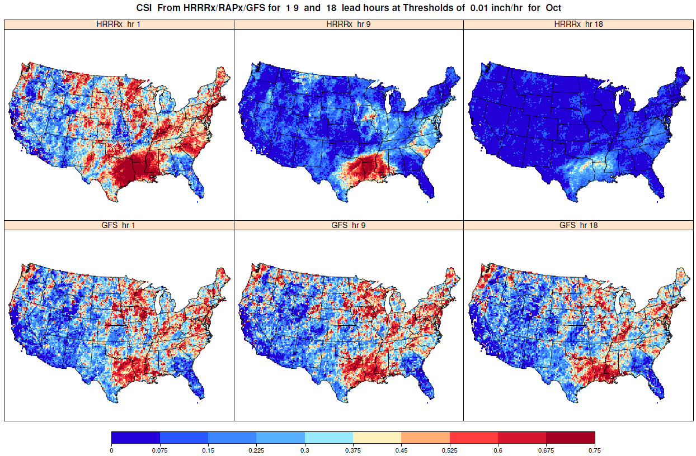
Initial WRF-Hydro Evaluation
Concerted push to build overall hydro evaluation into fabric of NWC
  Pre-implementation WRF-Hydro evaluation underway
    Multi-faceted assessment of HRRR-, RAP-, GFS- and CFS-based forcing data
    Retrospective and real-time WRF-Hydro test simulations
  Example types of forecast verification approaches follow
Critical Success Index (CSI) for 1, 9, and 18 hour HRRRx Forecast Lead Times
Threshold Applied=0.01 inch/hour Average for October 2015
14
(CSI ranges from 0 to 1, with a value of 1 indicating a perfect forecast. It takes into account false alarms and missed events.)
Notes:
The evaluation of the full range of hydrologic observations and model data will be a core mission built into the fabric of the NWC. Initial evaluation activities are now focusing on QPF evaluation and on an assessment of WRF-Hydro development runs. What follows are simply development examples of the types of assessments underway.

Slide 15
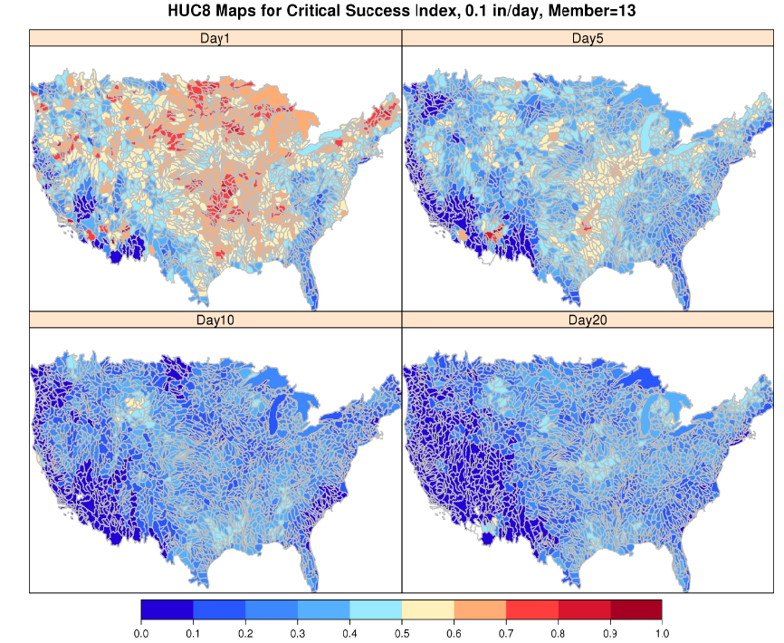
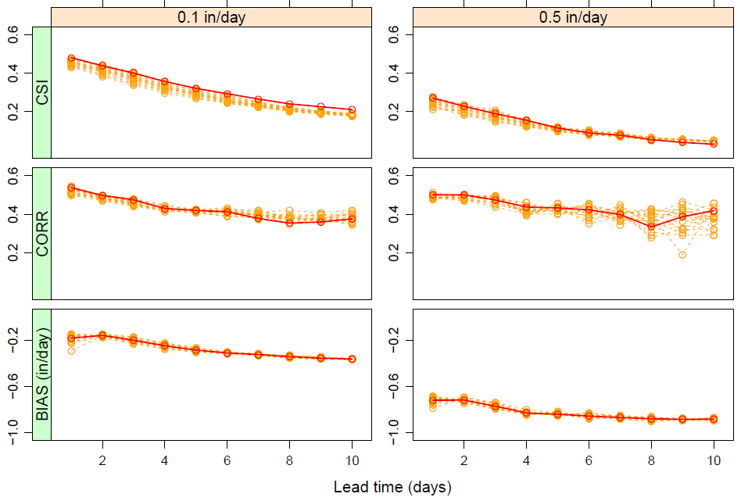
Example WRF-Hydro Precipitation Forcing Evaluations
Correlation for Hourly GFS Precipitation
May-Oct 2015, CONUS Avg, 0.1 inch/hr threshold
CSI for Single Member Daily CFS Precipitation May-Oct 2015, HUC 8 Regions, 0.1 in/dy threshold
Lead Time (hr)
-0.5 -0.4 -0.3 -0.2 -0.1 0 0.1 0.2 0.3 0.4 0.5
Assessment of Daily CONUS Avg CFS Precipitation, May-Oct 2015
CSI for Hourly GFS Precipitation
Averaged Over May-Oct 2015
15
Dashed=Ensemble Members
Solid = Ensemble Mean
Lead Time (hours)

Slide 16
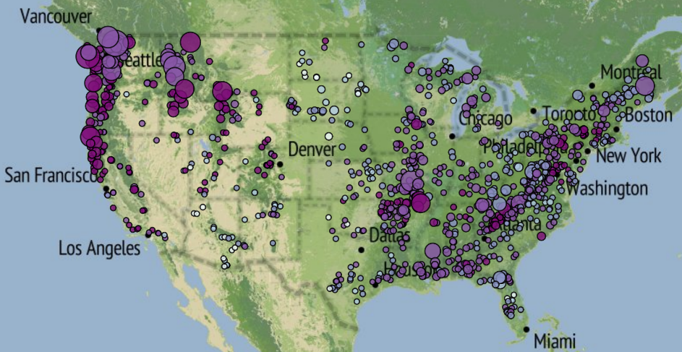
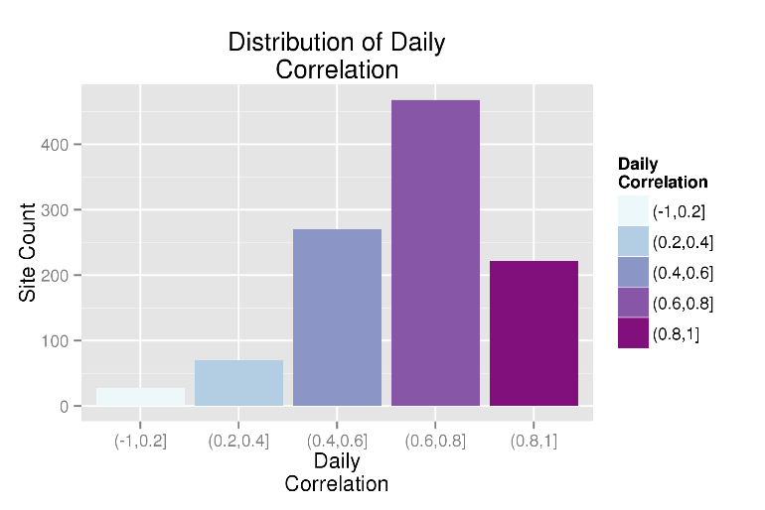

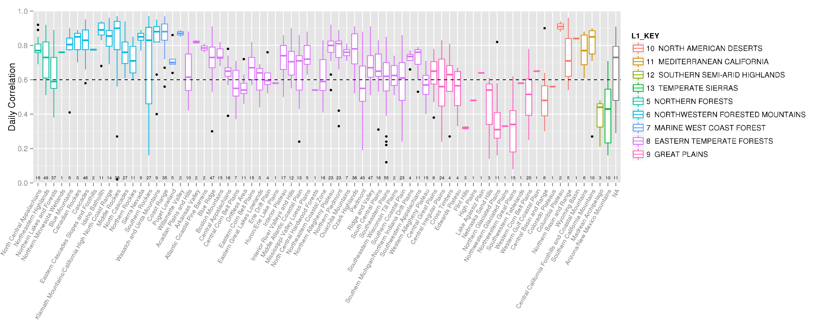
Initial WRF-Hydro Output Evaluations: Streamflow
Average Daily Streamflow Correlation Over Gages II Unregulated Basins 2011-2013
Simulation With NLDAS2 Forcing, Initial Parameters, No Data Assimilation or Reservoirs
Distributed CONUS Analysis
71% of basins had correlation > 0.6
Regional Box-and Whisker Type Analysis
16
Analysis courtesy Aubrey Dugger (NCAR)…talk given in AMS Benchmarking Session

Slide 17
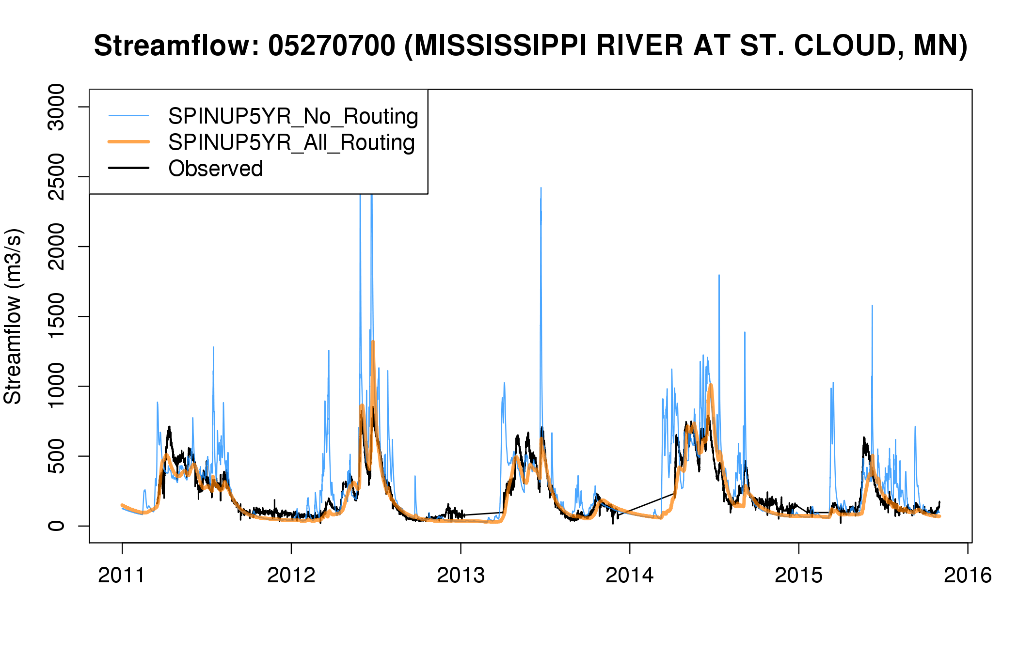
Sample WRF Hydro Output Hydrograph
*Note: Development version with no data assimilation, no reservoirs, initial parameters

Slide 18
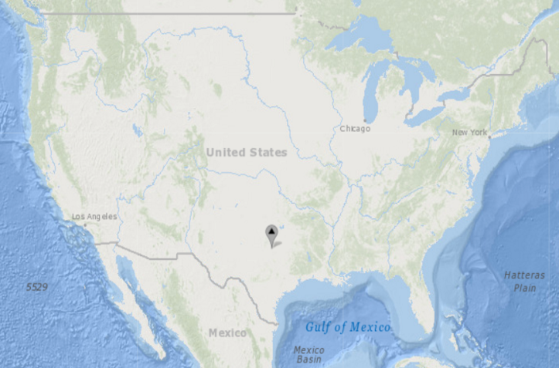
Initial WRF-Hydro Output Evaluations: Streamflow
Nudging-based streamflow data assimilation
~7000 USGS real-time stations across U.S.
Provides improved national streamflow analyses and forecasts
Assessment of WRF-Hydro Hourly Streamflow Analysis, With and Without DA
Simulation With NLDAS2 Forcing, Initial Parameters, May–Nov 2015
Obs
No DA
Full DA
Upstream
DA
18
Analysis courtesy James McCreight (NCAR)…talk given in AMS Data Assimilation Session

Slide 19
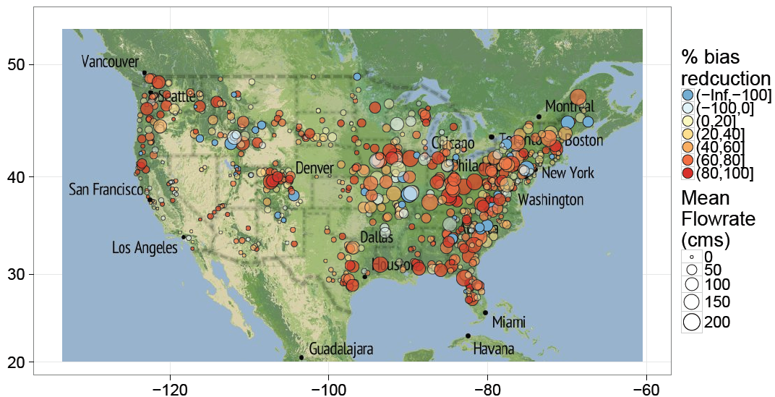
Initial WRF-Hydro Output Evaluations: Streamflow
Percent Reduction in Hourly Streamflow Bias Achieved Through
Assimilation of USGS Gauge Observations May–Oct 2015
% bias
reduction
19
Analysis courtesy James McCreight (NCAR)…talk given in AMS Data Assimilation Session

Slide 20
Summary and Future Activities
WRF-Hydro modeling system on track for a June implementation
  Effective NWC/NCAR/NCEP collaboration: “extremely well done for a first crack at getting to WCOSS production standards” (NCEP/NCO)
  Automated real-time tests this week on NOAA supercomputer
An important operational hydrologic modeling capability—but just version 1.0
  Improved data assimilation, hyper-resolution nested modeling windows
  Domain enlargements and linkages to ocean/estuary models
  Increased use of ensemble forcing and ensemble simulations
Integration into ongoing R2O efforts like NGGPS and NLDAS key
Strong partnerships with government agencies, academia and the private sector important to the system’s long term success
20
Notes:
WRF-Hydro will continue to develop and expand in capability year-over-year, providing revolutionary operational hydrologic capabilities. Strong links within NOAA and with external government, research, private industry, and academic partners will be essential to this enhancement.

Slide 21
Thanks!
Any Questions: Brian.Cosgrove@noaa.gov
21

