Slide 1
An Introduction to the National Blend of Global Models Project
Kathryn Gilbert, Project Manager
David Myrick, Deputy Project Manager
Wednesday, February 18, 2015
Co-Authors: Jeff Craven, Dave Novak, Tom Hamill, Jim Sieveking, and David Ruth
Many additional contributors

Slide 2
Overview
Introduction
Project Goals & Scope
Activities and Progress
Schedule
Summary of Issues and Challenges
How VLab is being used

Slide 3
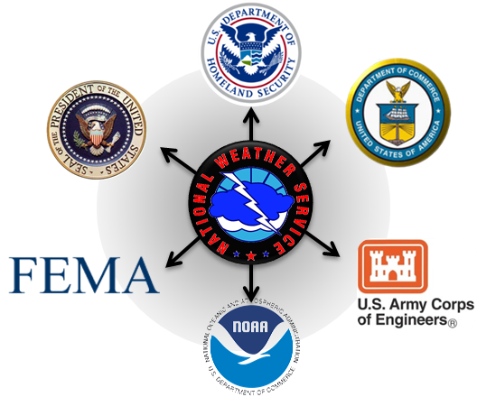
The Growing Challenge: Consistency
Issue: Local forecast offices work primarily to serve local user requirements.
How are state, regional, and national needs being addressed?
Consequence: Inconsistencies across CWA or Regional lines can lead to challenges for Impact-based Decision Support Services on the state, regional & national scale.
What do our partners think when they see sharp changes in our forecast grids?
It impacts their confidence in our forecasts
Need: To develop nationally consistent methodologies
Notes:
Our Transition to Impact-based Decision Support Services requires national consistency for both our private and our public partners
NOTE – Recognize that this sometimes occurs due to update times in grids, but we all know it happens legitimately when viewing our own ISC consistency. (~Crowe)
This issue has nothing to do with products & services WFOs provide our local users. That role is critical and keeps the NWS relevant. Consistency becomes an issue along CWA, state, and regional boundaries.

Slide 4
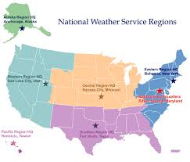
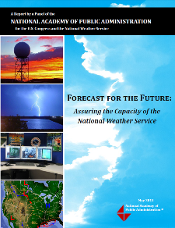
Origins of the National Blend
REASONING
Local / Regional
Model Blend Initiatives
NAPA Report
WRN Roadmap
FUNDING
Sandy Supplemental
JPSS Gap Mitigation:
projects that make better use of existing model data
Notes:
Local/Regional Initiatives:
Variety of regions and offices have been looking into ways to provide a better starting point, not efficient to run at all 122 WFOs
NAPA Report:
Recommended that we need to facilitate consistency and sharing of information, because the lack of consistency impedes the ability of our partners to use our data.
WRN Roadmap:
Highlighted plans to proactively adopt new science & technology developments and leverage field innovation to enhance services
Sandy Supplemental:
large chunk of money available for mitigating the potential gap in POES data in the Joint Polar Satellite System era
Variety of great projects were proposed and funded to mitigate the impacts of a potential gap, both at NWS and NESDIS
CR model blend was one such project -> "better use of existing model data" to mitigate a potential gap
funded as a way to explore expanding that tool across the country while ensuring it is a top performer

Slide 5
The National Blend Project Team
Former Technical Advisor – Stephen Lord (ret. as of Jan 3)
Project Manager – Kathryn Gilbert
Deputy Project Manager – David Myrick
Plenary Team: NWS HQ, NCEP, NWS Regions, NWSEO, OAR/ESRL
Project ‘Working Level’ Teams:
Analysis and Verification
Post Processing
Testing and Training
Dissemination
Outreach
Over 70 contributors on this one project!
Notes:
This project is a massive undertaking involving more than 70 contributors, and it continues to grow. Several sub-teams perform the underlying heavy lifting or work of the project.
The Post Processing Team is led by Tom Hamill.
The Analysis/Verification Team is led by David Ruth.
The Testing and Training Team is led by Dave Novak and Jeff Craven.
And the Dissemination Team is led by Jack Settelmaier and Kathy Gilbert.
I’ll go into more detail about the activities of the Post Processing and Analysis and Verification teams today
John Gagan and I are the team leads for Outreach group. We believe that it is very important that the project communicates effectively with the people that will actually be using this new guidance product.

Slide 6
The National Blend Project Team
Former Technical Advisor – Stephen Lord (ret. as of Jan 3)
Project Manager – Kathryn Gilbert
Deputy Project Manager – David Myrick
Plenary Team: NWS HQ, NCEP, NWS Regions, NWSEO, OAR/ESRL
Project ‘Working Level’ Teams:
Analysis and Verification
Post Processing
Testing and Training
Dissemination
Outreach
Over 70 contributors on this one project!
Notes:
This project is a massive undertaking involving more than 70 contributors, and it continues to grow. Several sub-teams perform the underlying heavy lifting or work of the project.
The Post Processing Team is led by Tom Hamill.
The Analysis/Verification Team is led by David Ruth.
The Testing and Training Team is led by Dave Novak and Jeff Craven.
And the Dissemination Team is led by Jack Settelmaier and Kathy Gilbert.
I’ll go into more detail about the activities of the Post Processing and Analysis and Verification teams today
John Gagan and I are the team leads for Outreach group. We believe that it is very important that the project communicates effectively with the people that will actually be using this new guidance product.

Slide 7
Project Goals & Requirements
Objective:
Improve quality and consistency of the NWS National Digital Forecast
Project Goals
Through an integrated and structured approach:
Develop a set of foundational gridded guidance products for National Digital Forecast Database (NDFD) weather elements based on NWS and non-NWS model information
Create a methodology for a national blend (“best”) product from multiple models, beginning with the Day 3 - 8 time frame and extensible to a full set of deterministic and probabilistic products covering days 1-10
Project Requirements:
NWS Enterprise Solution
Nationally uniform product, with spatial and temporal consistency
Extensible methodologies (models, elements, lead times…)
Meet R2O criteria
Implementable and Sustainable
No degradation of service

Slide 8
The National Blend Project
What this IS:
What this IS NOT:
Recognition of the need to get the most out of the data we have and use it to improve consistency in our products on a state, regional, and national scale
A scientifically sound approach to extract consistent weather information from all models, especially ensembles
A way to reduce NWS staff
A way to remove the human completely from grid editing

Slide 9
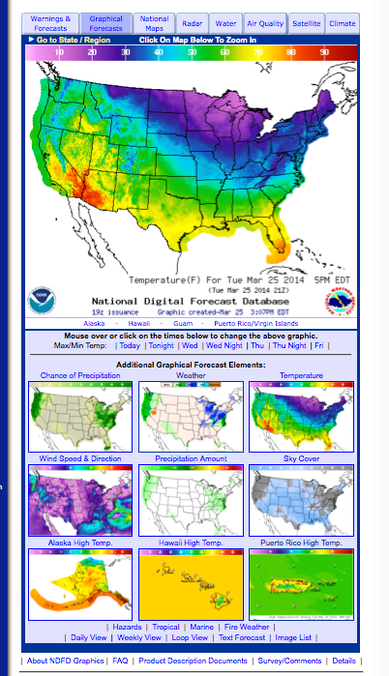
Project Development Scope
National Digital Forecast Database (NDFD) elements will be part of the National Blend package
Version 1, December 2015 weather elements:
2-m Temperature
2-m Dewpoint
Daytime Max T and Nighttime Min T
Sky Cover (%)
10-m Wind speed/direction
12-h Probability of Precipitation (%)
Version 2, FY16Q3, adds:
Snowfall Amount
QPF
Wind Gusts
Precipitation Type
Predominant Weather
Derive where it makes sense to ensure consistency, efficiency: i.e. Relative Humidity, Apparent Temperature

Slide 10
Project Development Scope (cont.)
Products will be generated on NOAA’s Weather and Climate Operational Supercomputer System (WCOSS)
Initial efforts focused on blending global models
Global Model inputs
ECMWF, ECMWF Ensembles
GFS, GFS Ensembles
CMC Ensembles
CMC, FNMOC - NAVGEM, UKMET

Slide 11
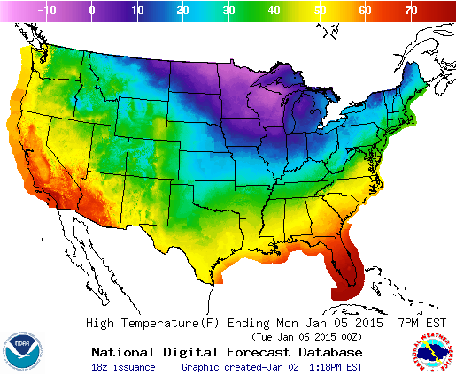
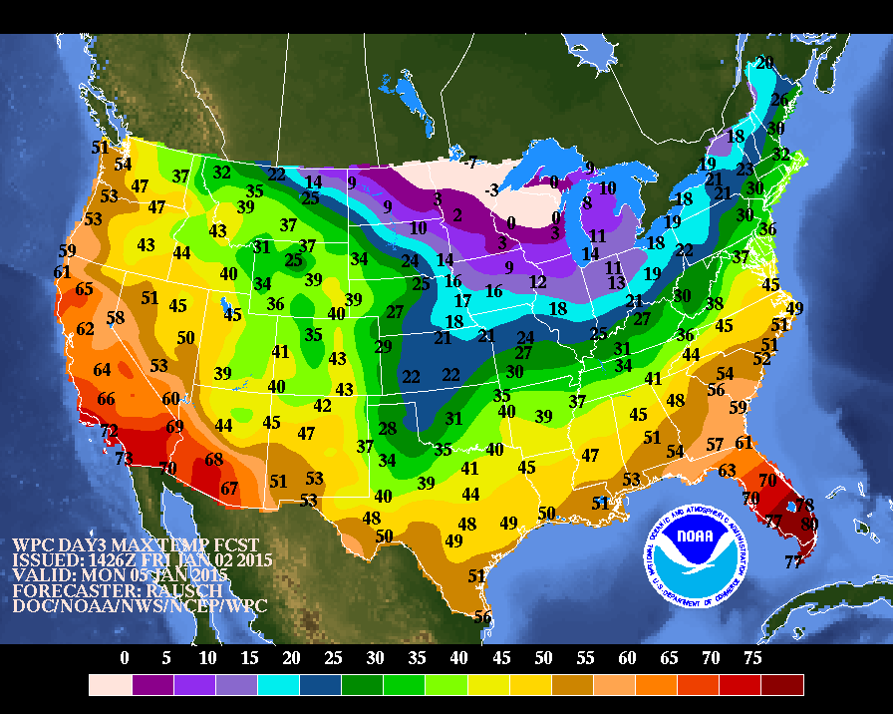
The National Blend Plan
Objective blended products will be generated on WCOSS from calibrated post-processed model output
Two cycles per day (0000 and 1200 UTC)
Initially limited to Deterministic and Ensemble Global models
Disseminated to NCEP Centers and WFOs
Weather Prediction Center (WPC) will provide oversight of the National Blend for Days 3-8 to ensure meteorological and spatial consistency
WFOs will receive both objective (WCOSS-generated) and WPC (edited) grids
WFOs retain the final gridded forecast responsibility for the full Day 1 – 8 period to populate NDFD.
Example:
WPC and NDFD
Day 3 Max T
Notes:
WCOSS output is restricted to NOAA-only
WPC grids have been edited by forecasters. This human touch eases the restrictions, the WPC grids and the WFO grids are available to the public.

Slide 12
Activities & Progress
Analysis and Verification – David Ruth, NWS/MDL
MDL developed a viewer to compare performance of candidate analyses and prototype blends in real-time with NDFD
The team reviewed candidate analysis packages, identifying strengths and weaknesses
Real-Time Mesoscale Analysis (RTMA)/UnRestricted Mesoscale Analysis (URMA) identified as the best candidate analysis for verification and post-processing:
Running centrally on WCOSS
Covering all NDFD domains
Validated products for most NDFD elements
Goal: Improve the RTMA/URMA to be the “Analysis of Record”
The viewer enabled enhanced NWS field participation in a recent parallel URMA evaluation (RTMA/URMA upgrade scheduled for March 2015)
Notes:
Developers at NCEP’s EMC working hard to improve the RTMA and URMA
Developers at MDL are providing tools to enable evaluation and conducing objective verifications.

Slide 13
Comparison Viewer URMA evaluation - wind, arctic front 11/11/2014
URMA Blend
blends HRRR and NAMNest as first guess
URMA HRRR
HRRR only as first guess
First Guess Field
Blend of HRRR and NAMNest
First Guess Field
HRRR
Notes:
A concerted effort is being made to improve the Real Time Mesoscale Analysis (RTMA) and the UnRestricted Mesoscale Analysis (URMA). These analyses will evolve to become the analyses of record and serve as the basis for verification. While there has been increased interaction between the field and the RTMA/URMA developers, it is imperative that the field remains highly engaged to ensure that the RTMA and URMA will be the best quality possible.
Note from Steve Levine: “After the conference call on December 10 and additional conversations we had with folks from the regions, we decided to use a blended NAM/HRRR background for all mass variables, but a HRRR-only background for winds and wind gust. “ Should go operational in late February

Slide 14
Activities & Progress (cont.)
Post-Processing – Tom Hamill, OAR/ESRL/PSD
NWS and OAR scientists conducted sample-size studies, results used for white paper recommendations on reforecasts and reanalyses (http://www.esrl.noaa.gov/psd/people/tom.hamill/White-paper-reforecast-configuration.pdf)
Team conducted comparisons of methods for post-processing (OAR, EMC, MDL)
OAR/PSD developing calibrated precipitation guidance (lead: Tom Hamill)
12-h PoP code handed over to MDL in September
CDF-based bias correction using past 60 days
Statistically downscale – find past coarse-resolution precipitation analyses most similar to today’s forecast, differences applied to each member to increase resolution
Compute probability from ensemble relative frequency
MDL developing non-precipitation guidance (lead: Bruce Veenhuis)
Temperature and Dewpoint now ready for limited evaluation
Statistically post-processed at observing sights
Downscaled to NDFD grids
Bias-corrected to the RTMA/URMA
Blended using MAE-based weights, trained on ~ 20 days
Notes:
A couple of papers will be presented later this afternoon by John Wagner and Phil Shafer on the sample size sensitivity tests
i.e. EMC’s bias correction techniques used for NAEFS vs MOS
OAR/PSD PoP: CDF-based bias correction using past 60 days
Statistically downscale – find past coarse-resolution precipitation analyses most similar to today’s forecast, differences applied to each member to increase resolution
Compute probability from ensemble relative frequency
2-m Temperature and Dewpoint:
Statistically postprocessed gridded guidance from the GFS, GEFS, CMCE, ECMWF, and ECMWF Ensemble
Guidance calibrated to 2.5 km RTMA analysis
Blended using MAE-based weights (Woodcock and Engel, 2005)
Training based on the previous ~20 days.
Track the MAE of each component using an exponentially weighted moving average (EWMA) algorithm
We use α = 0.05 thus training is based on ~20 days
Unique MAE (and thus weight) for each grid point

Slide 15
Comparison Viewer – National Blend
Dewpoint 78 hours in advance, from Jan 2, 2015 0000 UTC
9.5
-10.5
NDFD
WPC
10
8
Gridded MOS
National Blend

Slide 16
Early Verification of the National Blend
201410 Dewpoint MAE: NDFD, Gridded MOS, Blend, DNG, WPC
Verified against RTMA
Notes:
This is just one snap shot, the early look at the November statistics showed some problems with the colder than normal conditions, errors were larger in the medium-range – the objective guidance was worse than NDFD and WPC by 108 hour lead times. Investigating downscaling techniques and effectiveness of bias-correction in the extended time periods
Jeff Craven: We have found, even in the Mountains, that bias correction falls off in the extended. It is very important in the warm season everywhere and in the mountains even in cold season. But elsewhere the raw model output does better in the cold season in the extended.

Slide 17
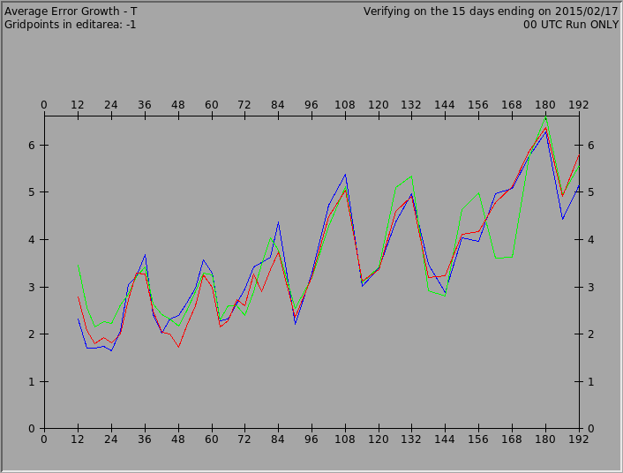
Temperature MAE – MKE CWA – Feb. 2-17, 2015
NBM
Official
SuperBlend
Verified against CONSOBS
Stats courtesy: Jerry Wiedenfeld, WFO MKE

Slide 18
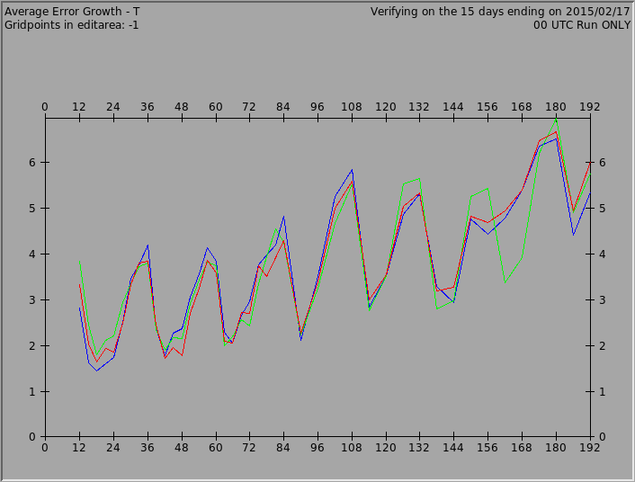
Temperature MAE – MKE CWA – Feb. 2-17, 2015
NBM
Official
SuperBlend
Verified against Operational RTMA
Stats courtesy: Jerry Wiedenfeld, WFO MKE

Slide 19
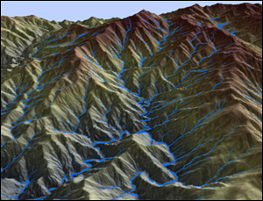
Consistency! NWS Standard Terrain
Identified and documented the need for a common NWS terrain – credit to Brian Miretzky, Eastern Region
NWS development groups such as those responsible for statistical post-processing and those responsible for the analysis will downscale to the same terrain in use by the WFOs.
Recommendation made to use GMTED2010
Expected to be in place at NWS by September 2015

Slide 20
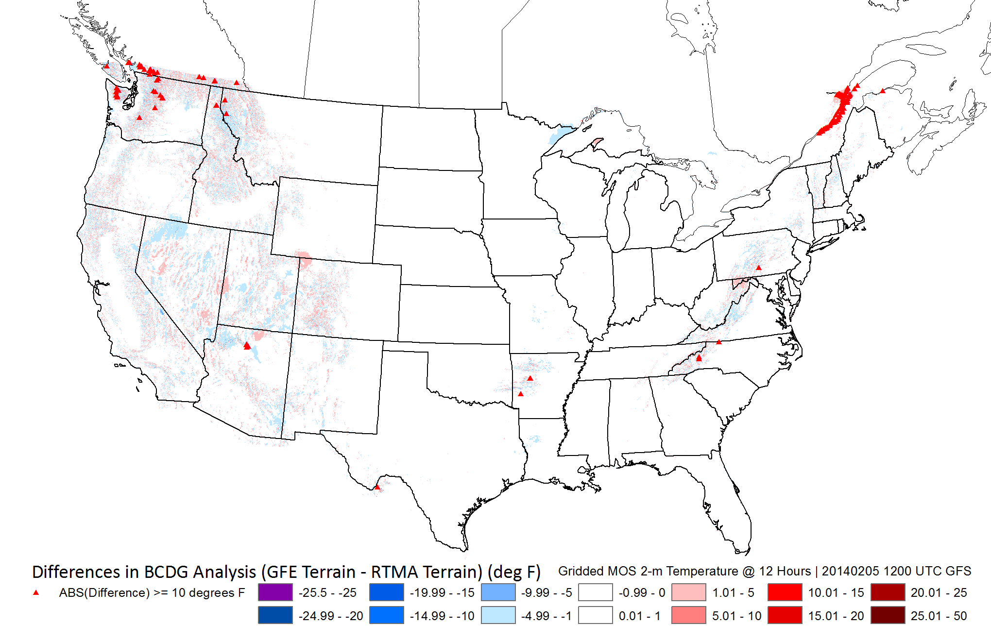
Example: Gridded MOS 2-m Temperature differences in analysis (WFO terrain – RTMA terrain) diff > 10°F noted by

Slide 21
Project Milestones and Timeline
Version 1 Elements implemented on WCOSS, Continued Development, Testing, Evaluation
Version 2,
More elements added
National Blend Project Scope
Finalized
Preliminary Blend Products Viewable
DEC 2013
SEPT 2014
DEC 2015
Spring 2016
Notes:
The scope of the project was finalized last December and MDL provided us the website to view the initial National Blend product and so much more just a few short months ago. There is an expectation to have the training and implementation plan finalized by March and to have the National Blend at your fingertips in GFE by December of 2015.

Slide 22
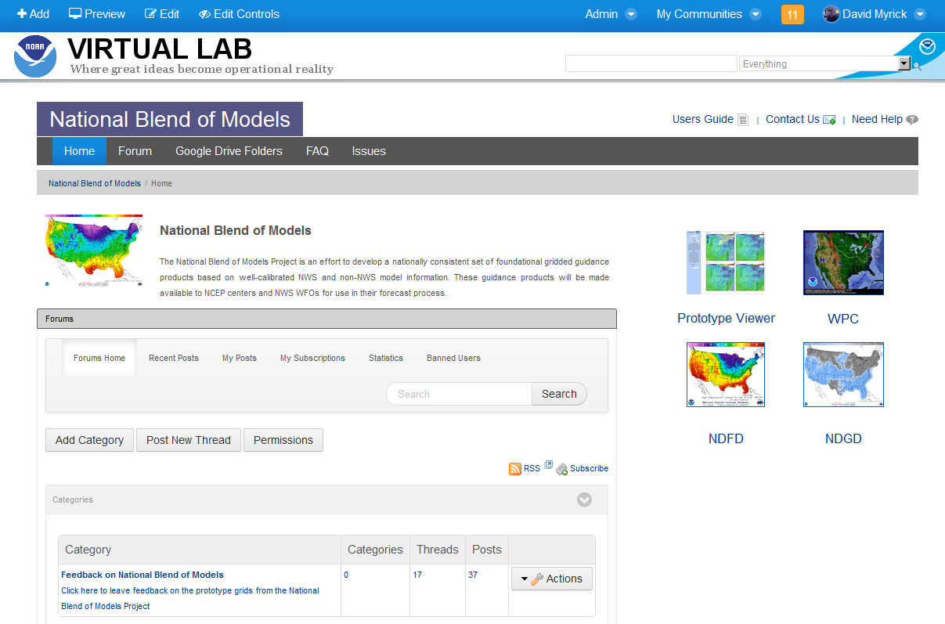
NBM – VLab Community
Open community
Links to project folders on Google Drive and Outreach Google Site
Forum created to share feedback with NBM development team (acts as a list-serve)
Feedback emails post directly to the Forum
national.blend.feedback@noaa.gov

Slide 23
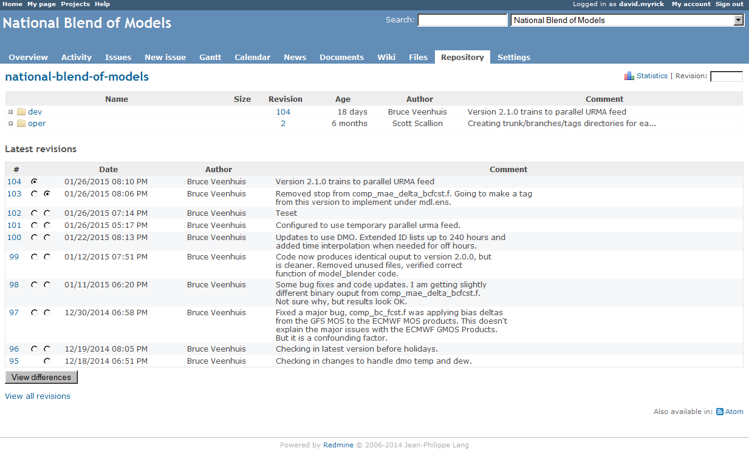
NBM – Use of VLab Development Services
Subversion repository used for code management
Issues tracking used by developers to track issues

Slide 24
Summary of Issues & Challenges
Issues
Clarify dissemination restrictions on products developed with ECMWF model data
NWS and ECMWF have approved a Cooperative Agreement
Implementing Arrangements need to be vetted.
Need nationally consistent foundational datasets: terrain, land/water masks, observation analyses
Analysis of Record is a work in progress
Challenges
Lack of High Performance Computing and human resources to generate sufficient reanalysis and reforecast samples from numerical models to provide representative samples for statistical calibration
Not fully known how to properly blend or bias correct all needed weather variables
High bar for success in place with blending capabilities already at WPC and WFOs
Thank You

