Slide 1
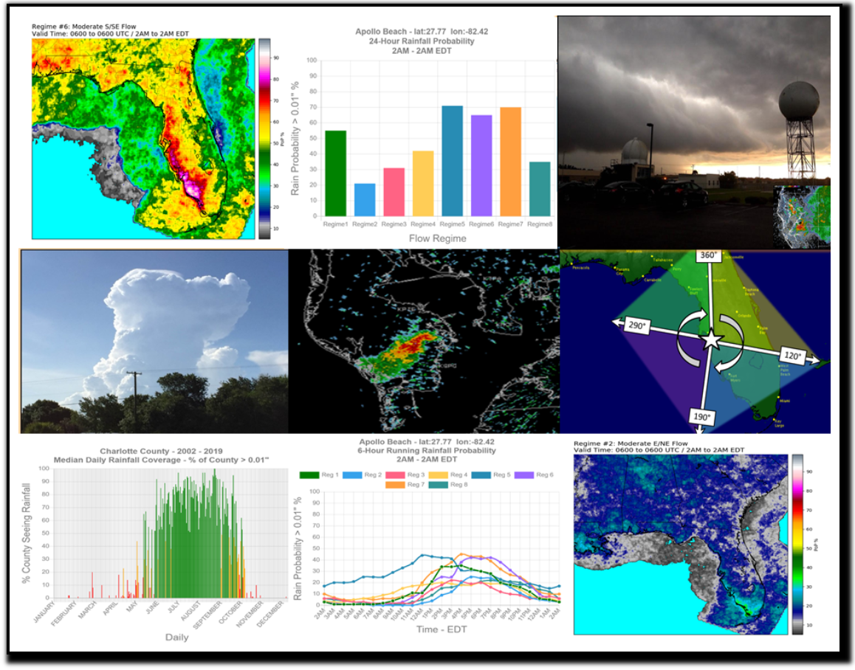
Utilizing Subtropical Ridge "Flow Regime" Convective Precipitation Climatologies within AWIPS to Enhance Warm Season Probability of Precipitation Forecasts and Related Decision Support Services Across the Southeastern United States
Bryan Mroczka
Science and Operations Officer
National Weather Service
Tampa Bay Area

Slide 2
Today’s VLAB Forum Talk
Why sea breeze convective forecasting & decision support is vitally important. Plus, a little history…
2. Flow regime climatology methodology
3. Integration into the Advanced Weather Interactive
Processing System (AWIPS)
4. Public/Media based website for accessing seabreeze
climatology content in various forms
Part 1: Research
Part 2: Operations

Slide 3
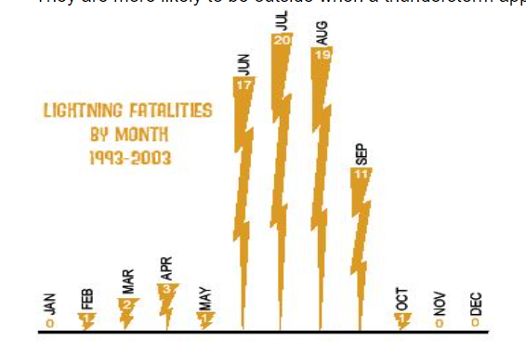
Why is this research important?
Florida’s unique geography and favorable conditions for both land and marine activities, combined with the daily pulse convection type of thunderstorms, annually puts it near (or at the top) of lightning fatalities & injuries

Slide 4
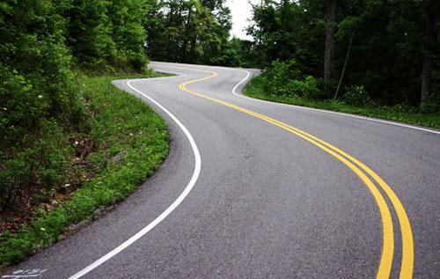
Standing on the Shoulders of Giants
A long road of research
1970’s
1980’s
1990’s
2000’s
2021

Slide 5
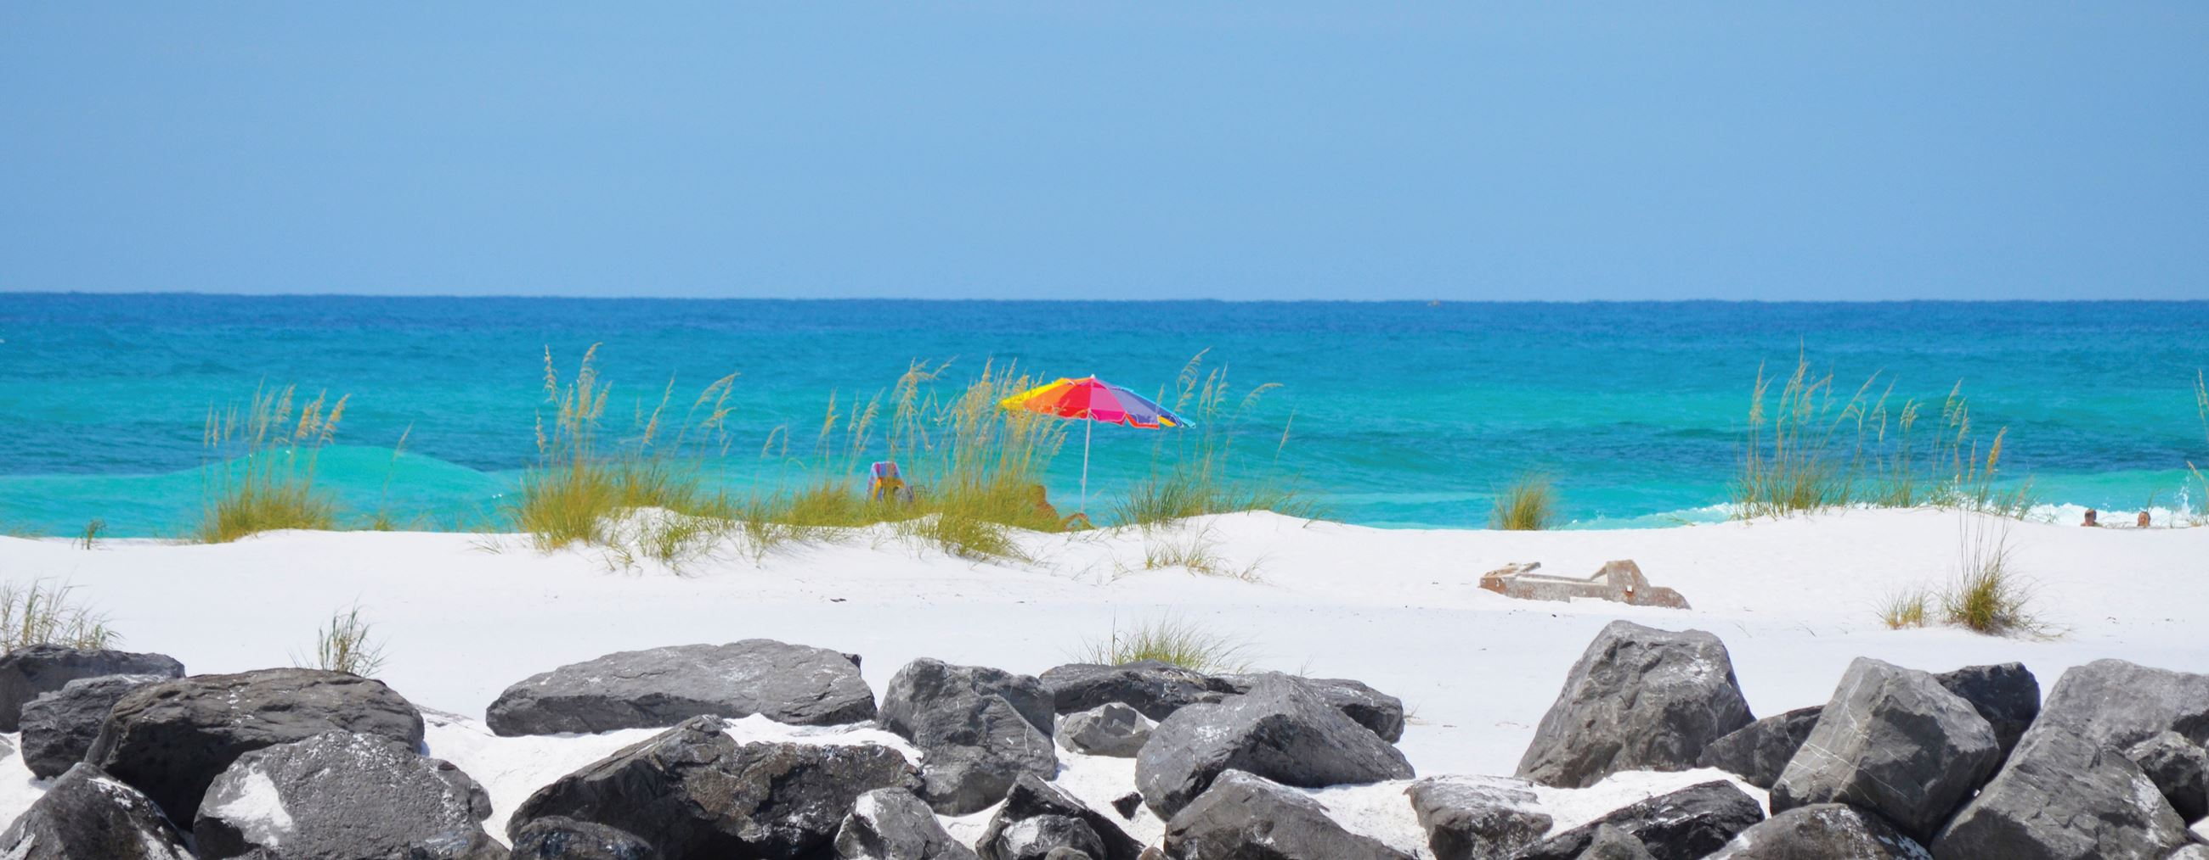
The Sea Breeze
The sea breeze is not just simply an onshore wind forecast, but often leads to a much more inclement and dangerous weather phenomenon.
A pleasant day at the beach or boating can change in a big hurry…
Refreshing Breezes…
Wind in the sails…

Slide 6
Sea Breeze Thunderstorms
The sea breeze is not just simply an onshore wind forecast, but often leads to a much more inclement and dangerous weather phenomenon.
A pleasant day at the beach or boating can change in a big hurry…

Slide 7
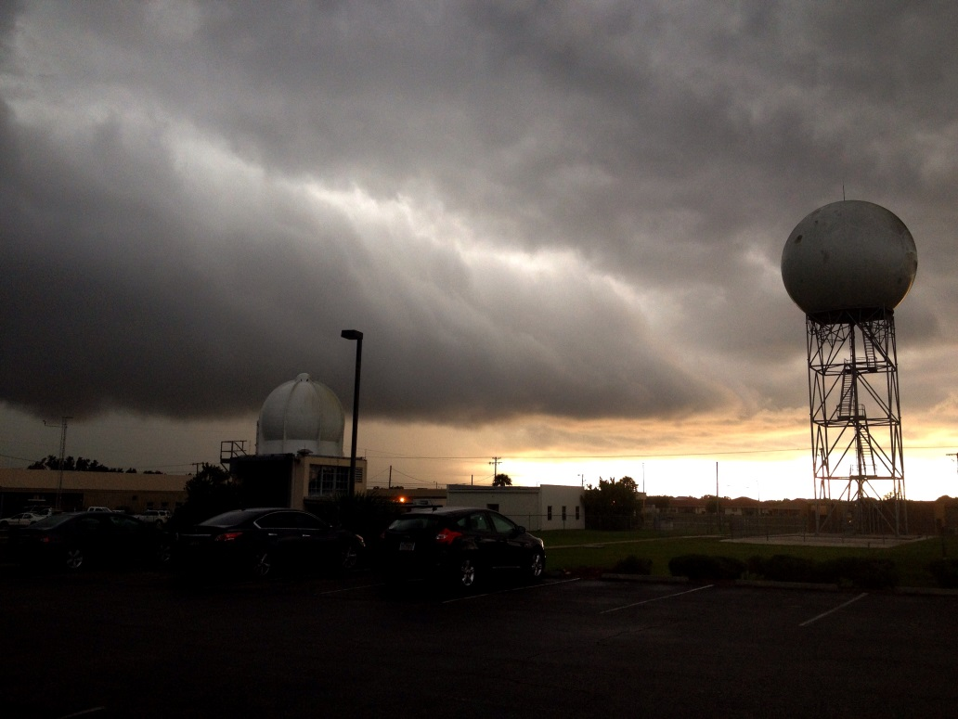
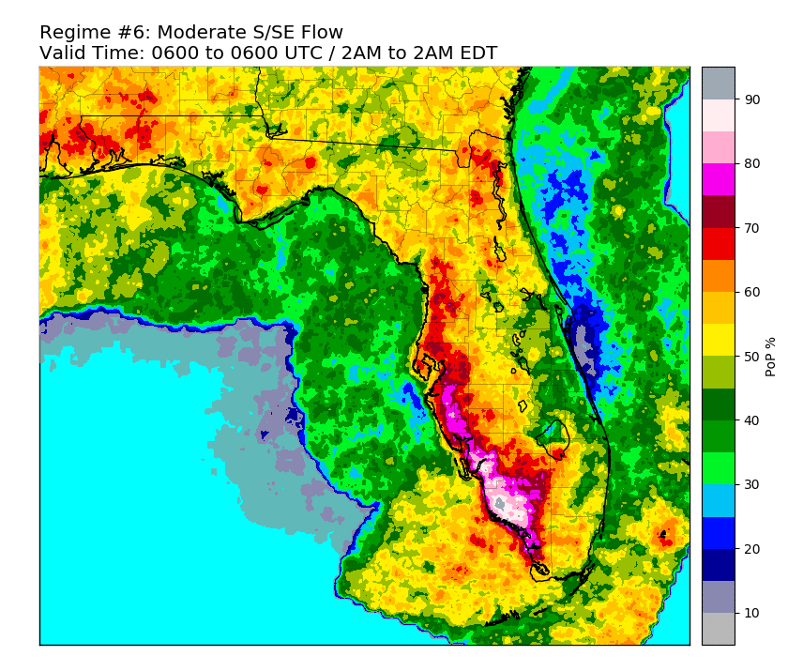
Tackling the Seabreeze Thunderstorm Threat: Forecasting & Decision Support
Sea Breeze Thunderstorms
Forecasting When and Where…
Using the “Flow Regime” Methodology

Slide 8
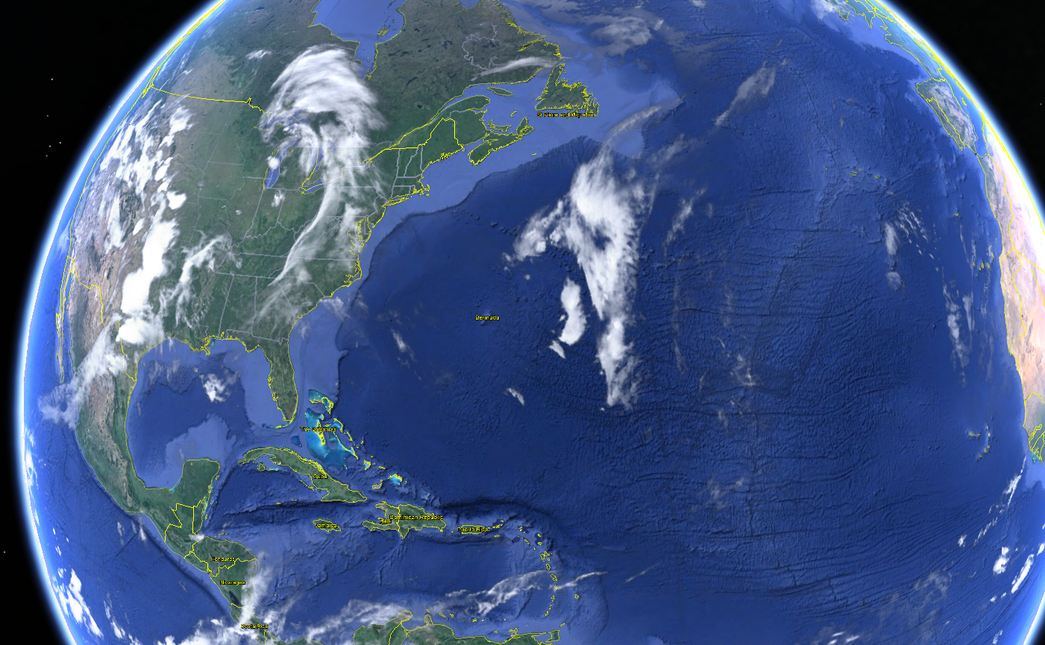
Flow Regimes & The Subtropical Ridge
A “Flow Regime” refers to the specific interaction between the large scale (synoptic) wind flow and the various sea breezes boundaries.
This synoptic flow is controlled by the position and strength of the “Atlantic Subtropical Ridge”.
A region of high pressure that often exists around 30° north latitude over the Atlantic Ocean.
H

Slide 9
The Subtropical Ridge
The ridge will shift to the north and south over time, and also become stronger or weaker
The ridge’s position and strength impacts on the weather across Florida and the eastern Gulf of Mexico.
These variations in the structure of the ridge play a large role in the “where and when” for thunderstorms on a particular day.
H

Slide 10
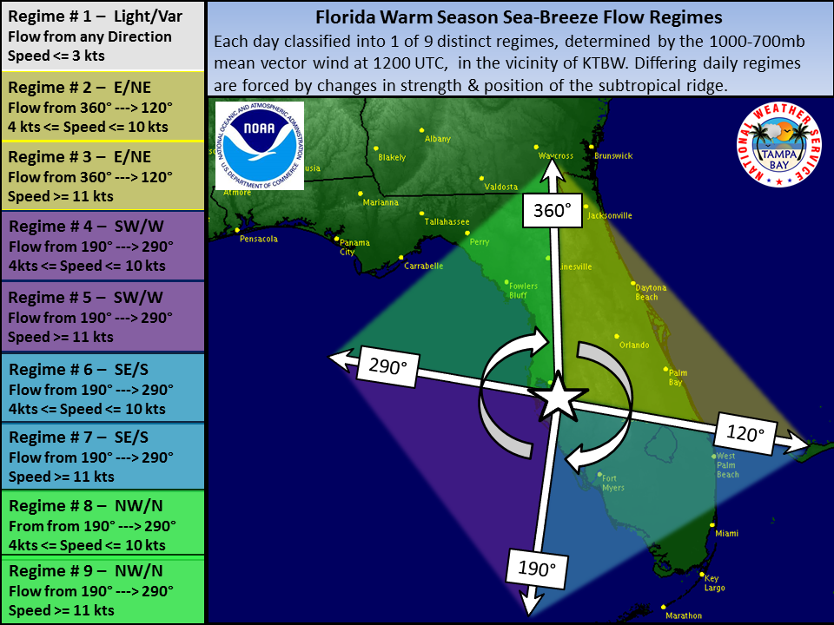
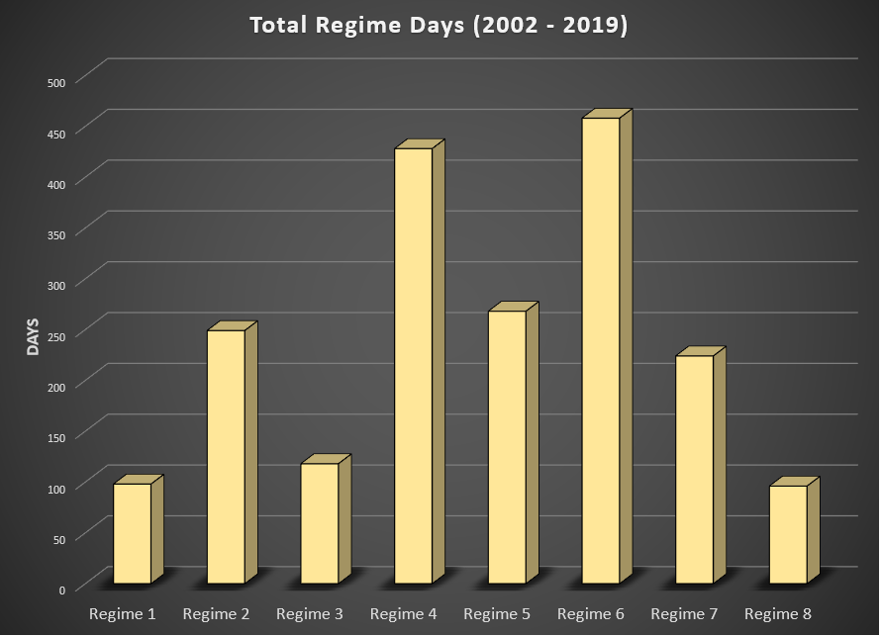
Study days classified as ones with a subtropical regime controlled weather pattern (June 1st- Sept 15th).
Regime was chosen by the mean 1000-700mb flow vector at 12UTC within a region around the Tampa Bay Area.
Regime # | Flow | # of Days
1 | Light/Variable | 98
2 | E/NE 5-10kts | 249
3 | E/NE > 10kts | 118
4 | W/SW 5-10kts | 428
5 | W/SW > 10kts | 268
6 | S/SE 5-10kts | 458
7 | S/SE > 10kts | 224
8 | N/NW 5-10kts | 96

Slide 11
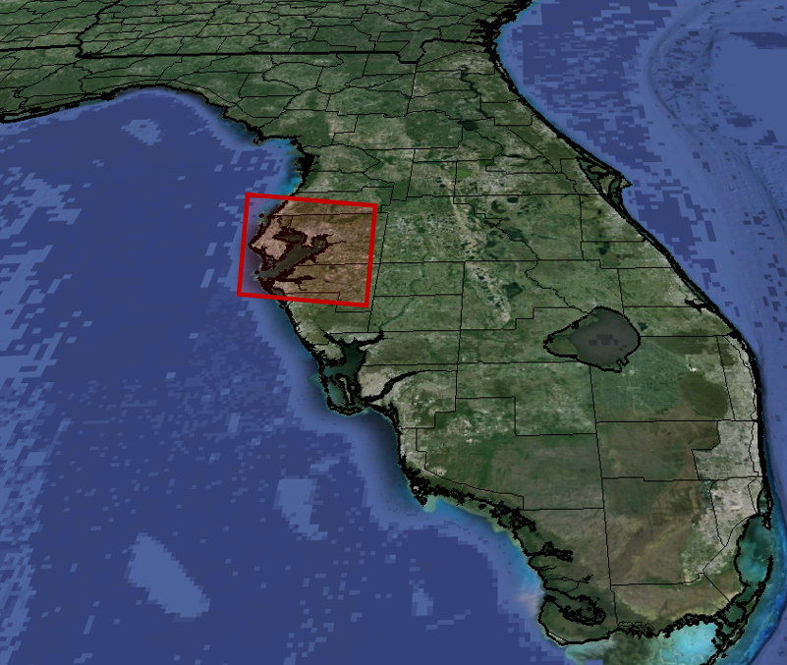
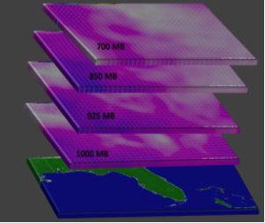
In order to classify a day into a particular flow regime, the 1000-700mb mean vector wind at 12 UTC was calculated within a defined zone over the Florida west coast.
Study Period was June 1st, - Sept 15th for the years 2002 - 2019
Wind Data
North American Regional Reanalysis (NARR) data:
U & V Wind Components
1000 mb , 925 mb, 850 mb, 700 mb
Precipitation Data
STAGE IV
Hourly rainfall
accumulation
Processing Engine
Graphical Forecast Editor (GFE):
Python Based
Precipitation & wind data combined into convective climatologies

Slide 12
Applying Flow Regime Research
to Forecast Operations – Part 2
View the 24 hour convective pattern results from each of the 8 distinct flow regimes. Probability of precipitation >= 0.01”
Identify the various temporal climatologies that are available through this research
Discover how this research is being incorporated into AWIPS for enhanced forecast and decision support
Introduce a new Decision Support / Public Website housing all the data

Slide 13
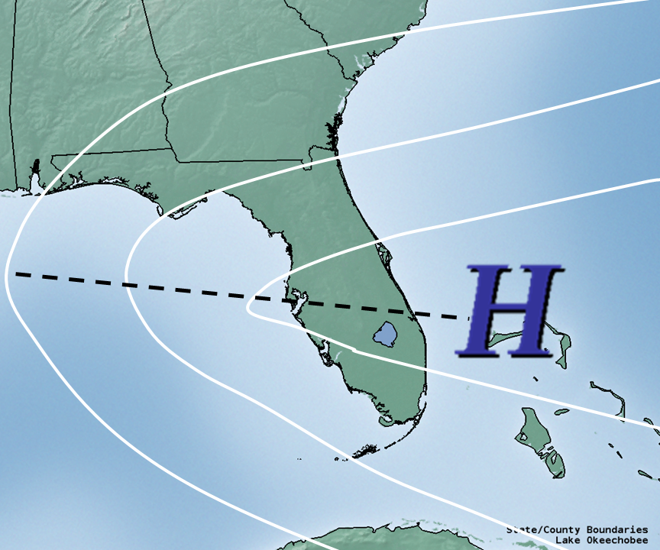
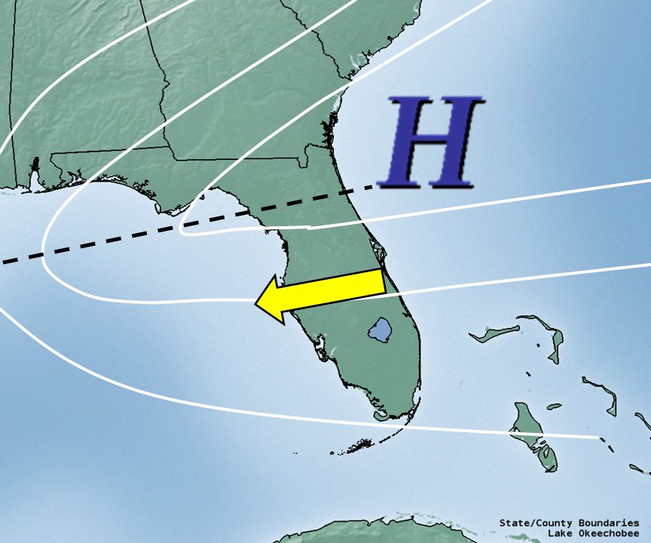
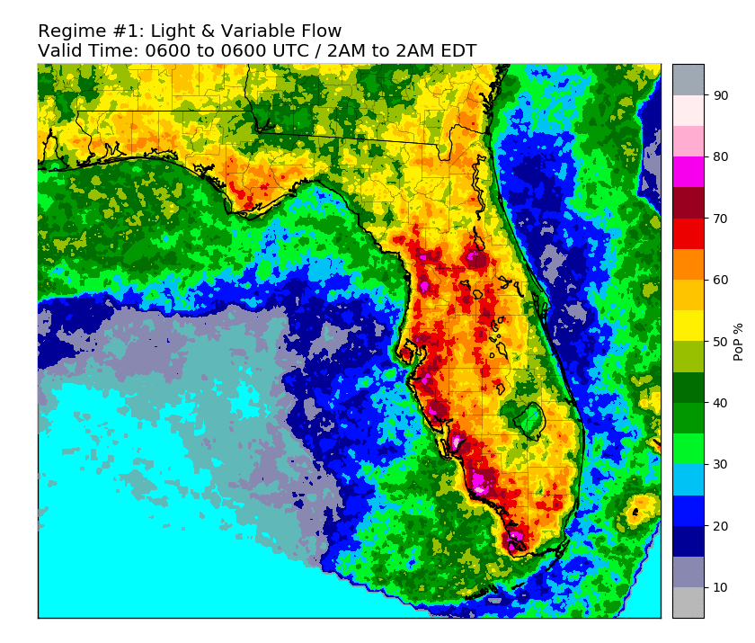
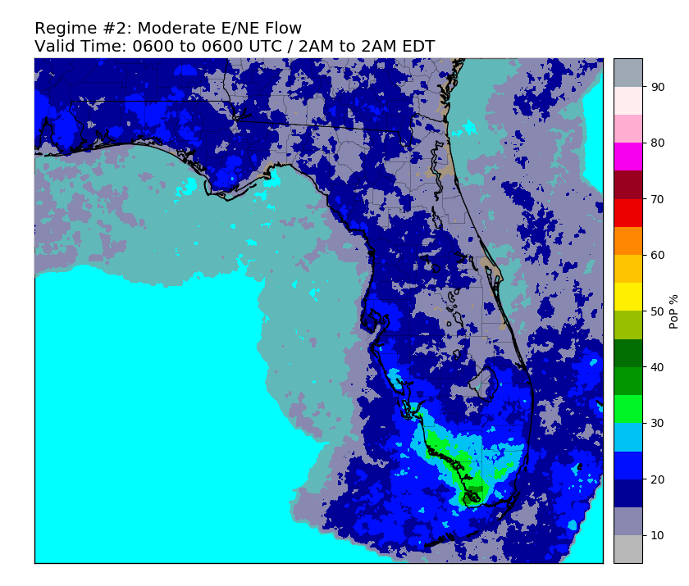
Regime #1: Light / Variable Flow
Regime #2: E/NE 5 - 10 knots

Slide 14
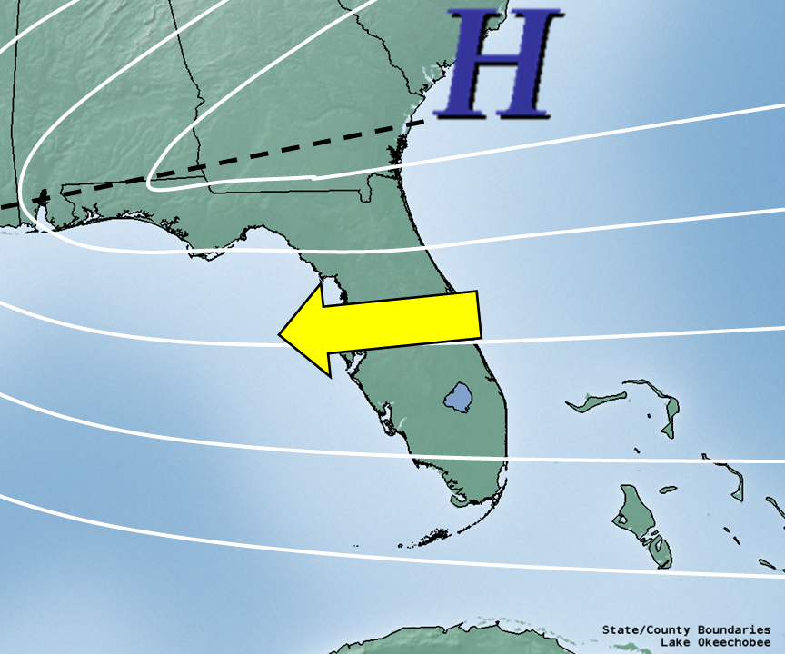
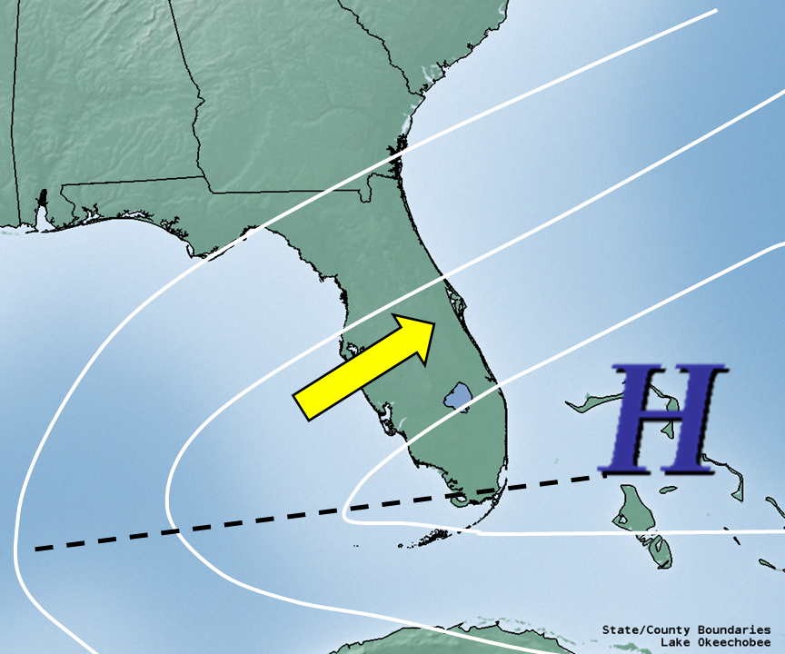
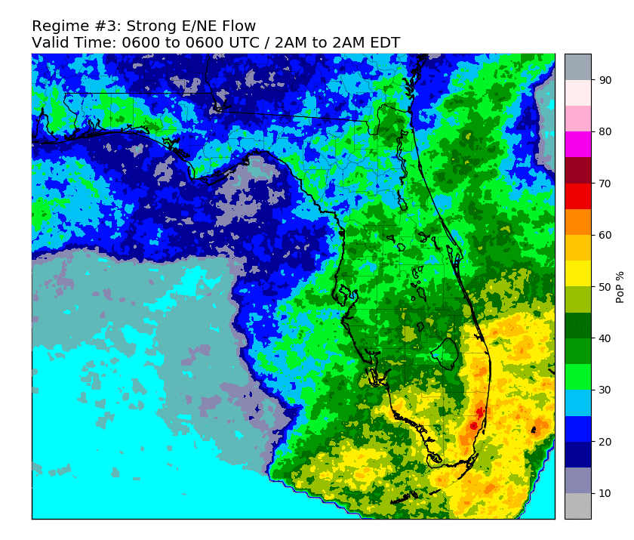
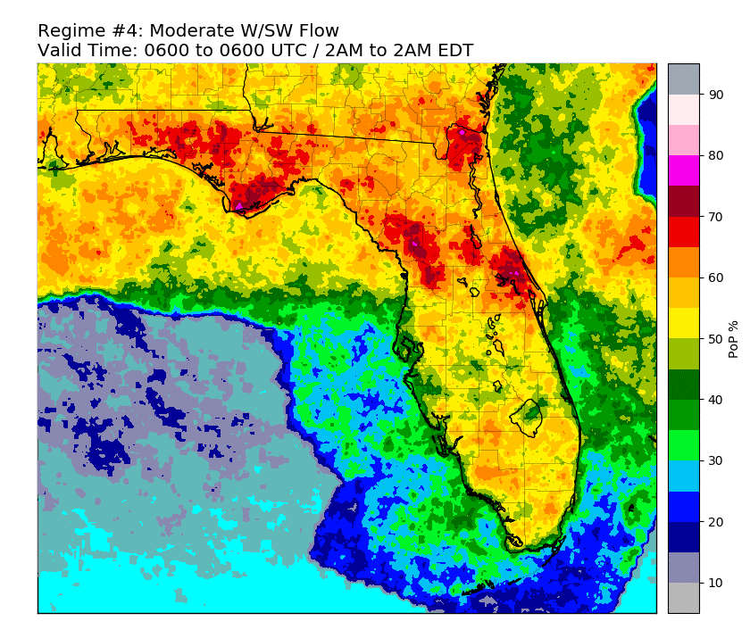
Regime #3: E/NE > 10 knots
Regime #4: SW/W 5 - 10 knots

Slide 15
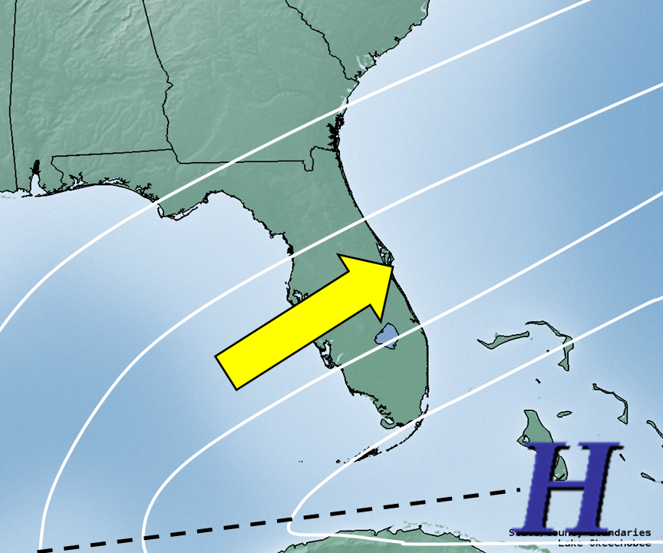
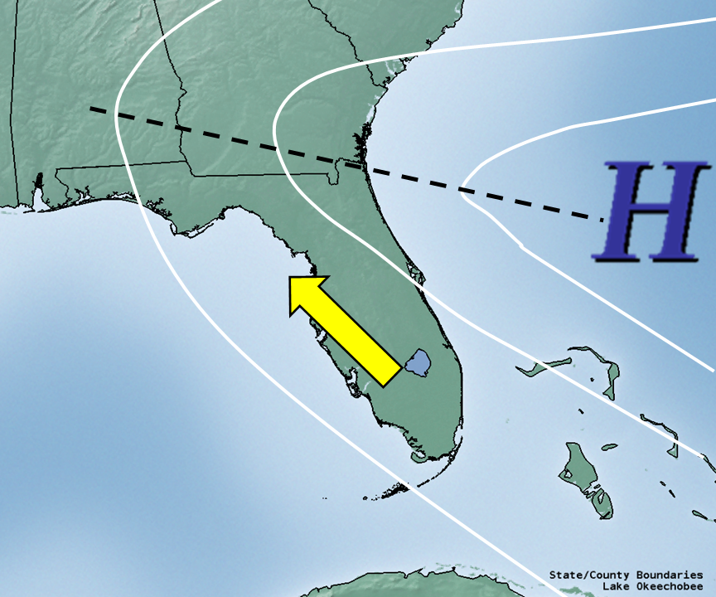
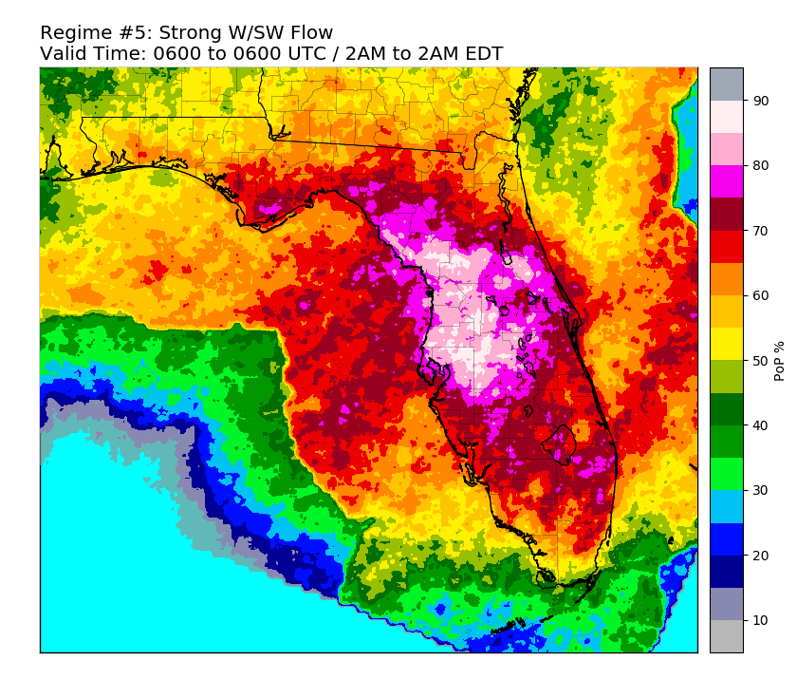
Regime #5: SW/W > 10 knots
Regime #6: S/SE 5 - 10 knots

Slide 16
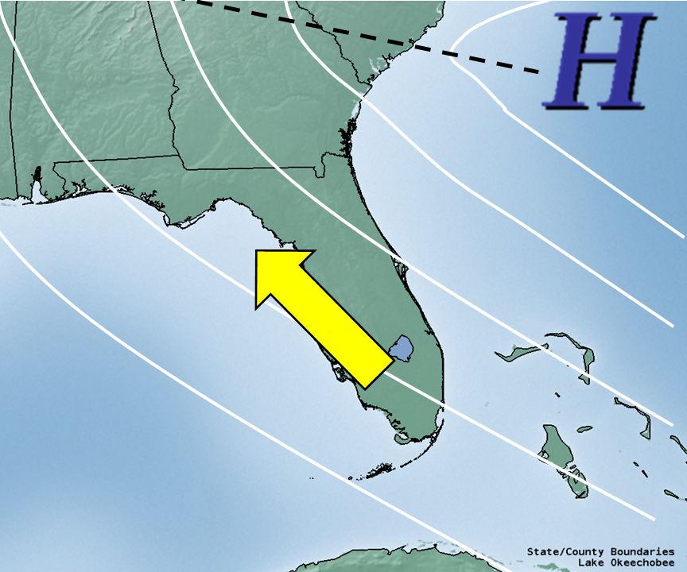
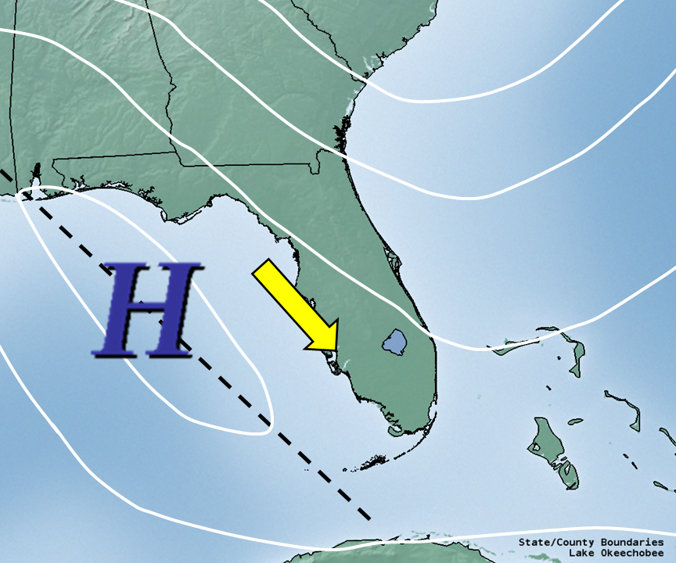
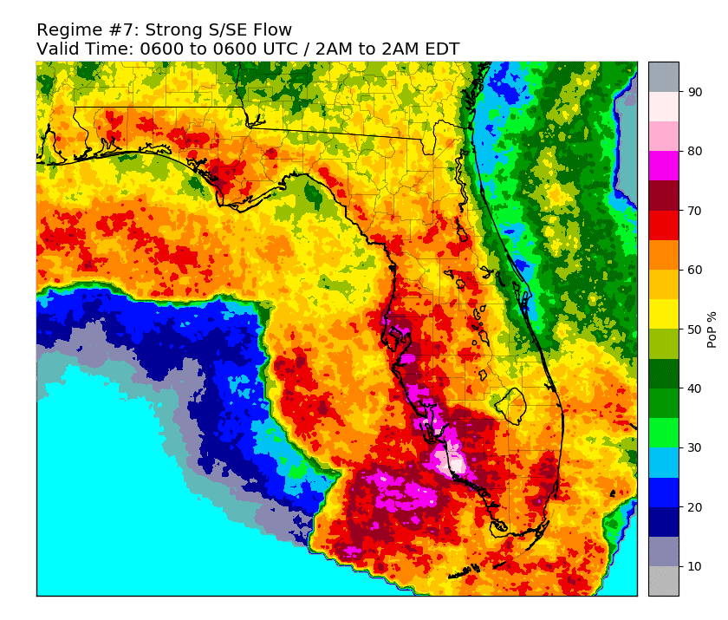
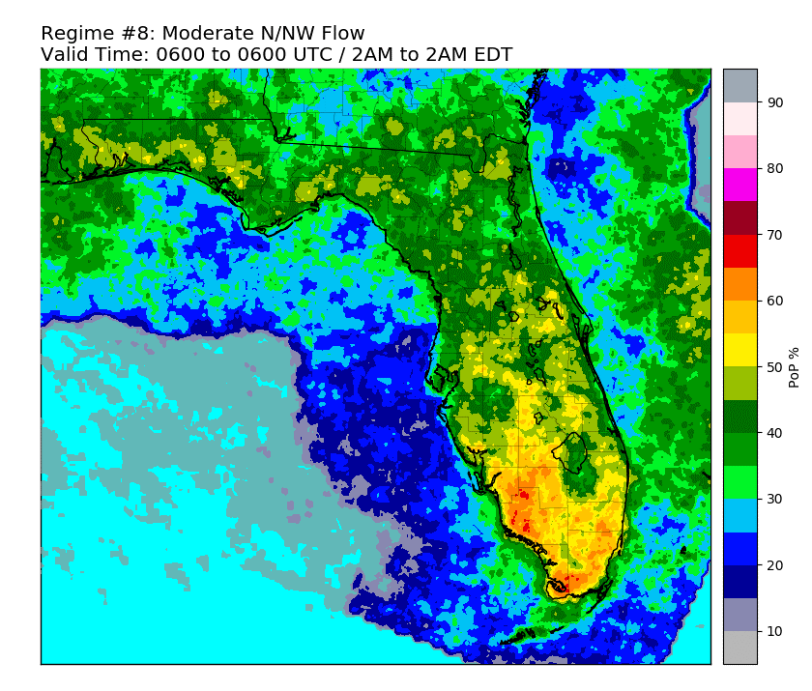
Regime #7: S/SE > 10 knots
Regime #8: N/NW 5 - 10 knots

Slide 17
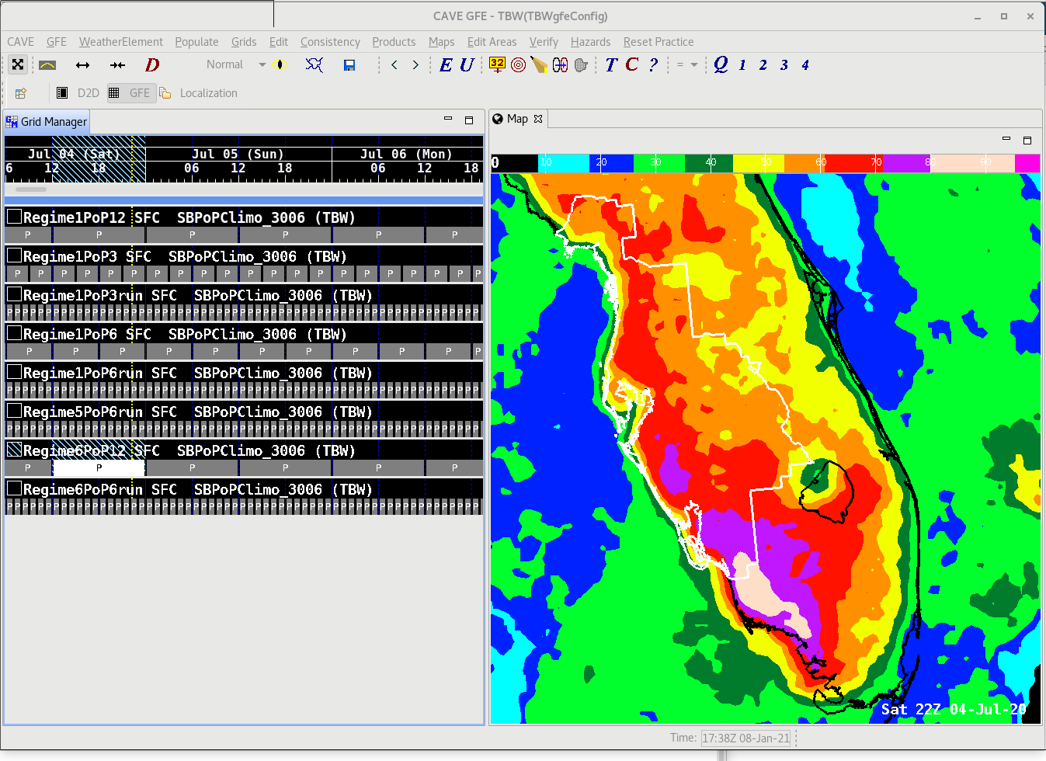
Fast Forward (2018-2020)
National Weather Service Tampa Bay Area, FL
18 years of data (2002-2019)
All climatologies stored via WMO/AWIPS friendly grib2
Allows datasets to be fully integrated into AWIPS as a processed “model”
AWIPS Data Access Framework (DAF) python system utilized to calculate the regime
Utility of the grib2 AWIPS ingest and DAF capability allows operational expansion to all NWS offices within Florida
Updating of datasets over time easier and more automated
Graphical Forecast Editor Example:
Regime #6 - SE/S Flow 5-10 kts
12-hour Rainfall Probability / 8AM-8PM EDT

Slide 18
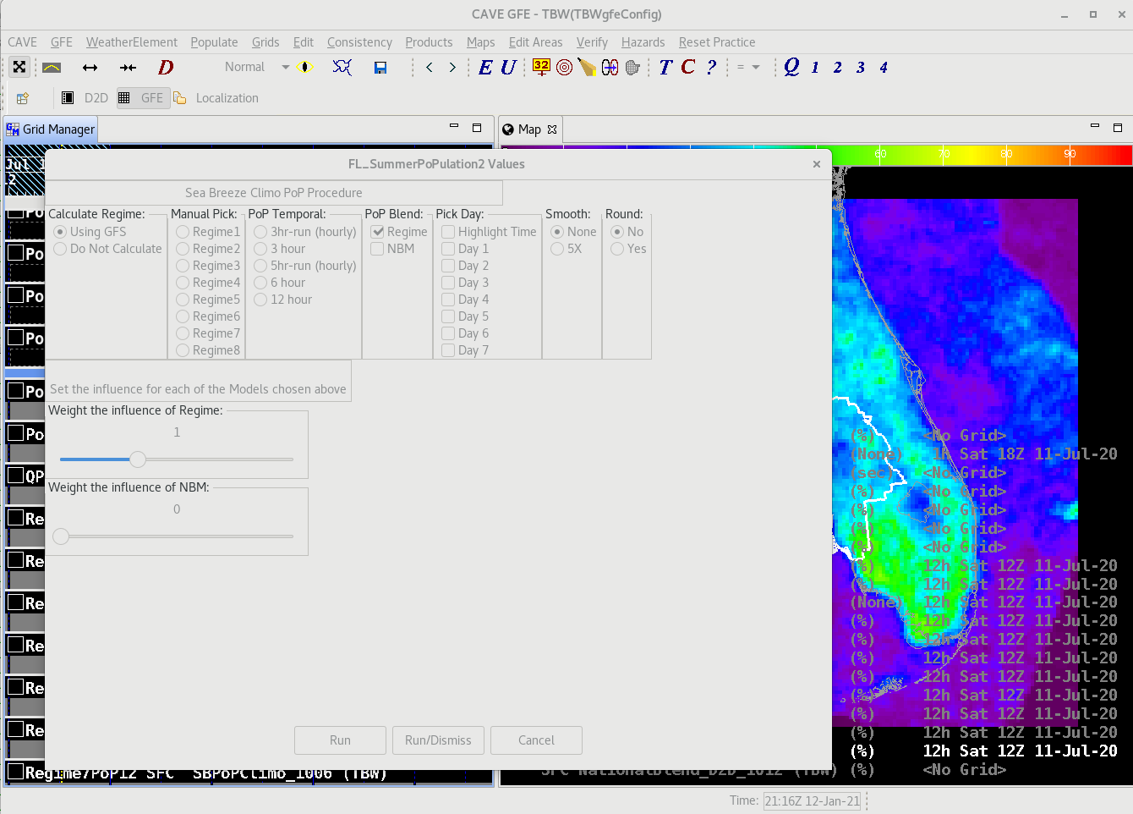
Today (2021)
AWIPS / Graphical Forecast Editor Interface Procedure
Automation to provide “first guess” at regime and population of forecast with resulting climatology
Forecasters may choose to manually input flow regime based on analysis.
Options include:
Automated or Manual
Temporal Period
Forecast Day (1 – 7)
Smoothing functions
Rounding functions
Combined through weighted blend with National Blend of Models

Slide 19
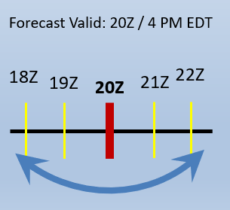
Temporal Period Climatologies Available to Forecasters in AWIPS:
Synoptic Period Time Based: 24-Hour:
0600 UTC - 0600 UTC
12-Hour:
1200 - 0000 UTC
0000 - 1200 UTC
6-Hour:
0600 - 1200 UTC
1200 - 1800 UTC
1800 - 0000 UTC
0000 - 0600 UTC
3-Hour:
0600 - 0900 UTC
0900 - 1200 UTC
1200 - 1500 UTC
1500 - 1800 UTC
1800 - 2100 UTC
2100 - 0000 UTC
0000 - 0300 UTC
0300 - 0600 UTC
“Running” Period Time Based: 5run-Hour:
Running probability during a 5 hour period centered on each specific hour (1200 UTC, 1300 UTC, ...2100 UTC…)
3run-Hour:
Running probability during a 3 hour period centered on each specific hour (1200 UTC, 1300 UTC, ...2100 UTC…)
Provides statistically significant and high resolution spatial/temporal hourly forecasts

Slide 20
5run-Hour : Regime # 1 – Light/Variable Flow
Detail Level:
Best Suited for Days 1- 2 Forecasts

Slide 21
5run-Hour : Regime # 6 – SE/S Flow 5-10 kts
Detail Level:
Best Suited for Days 1 - 2 Forecasts

Slide 22
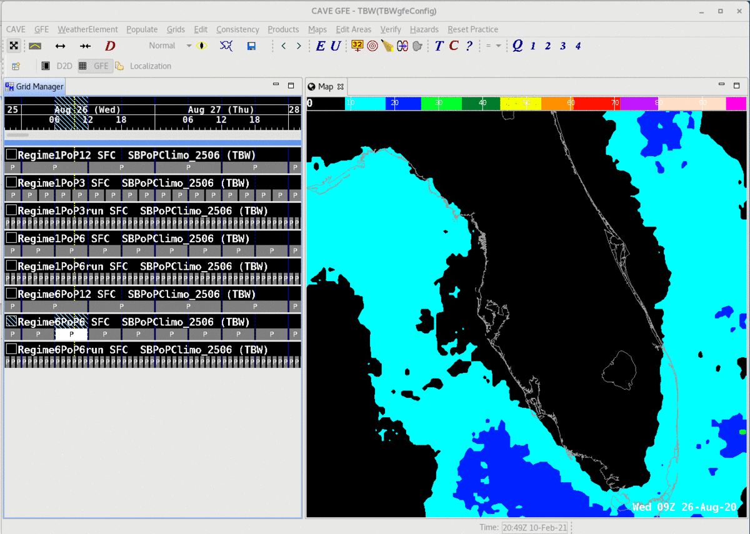
6-Hour (Synoptic) : Regime # 6 – SE/S Flow 5-10 kts
Detail Level:
Best Suited for Days 2 - 4 Forecasts

Slide 23
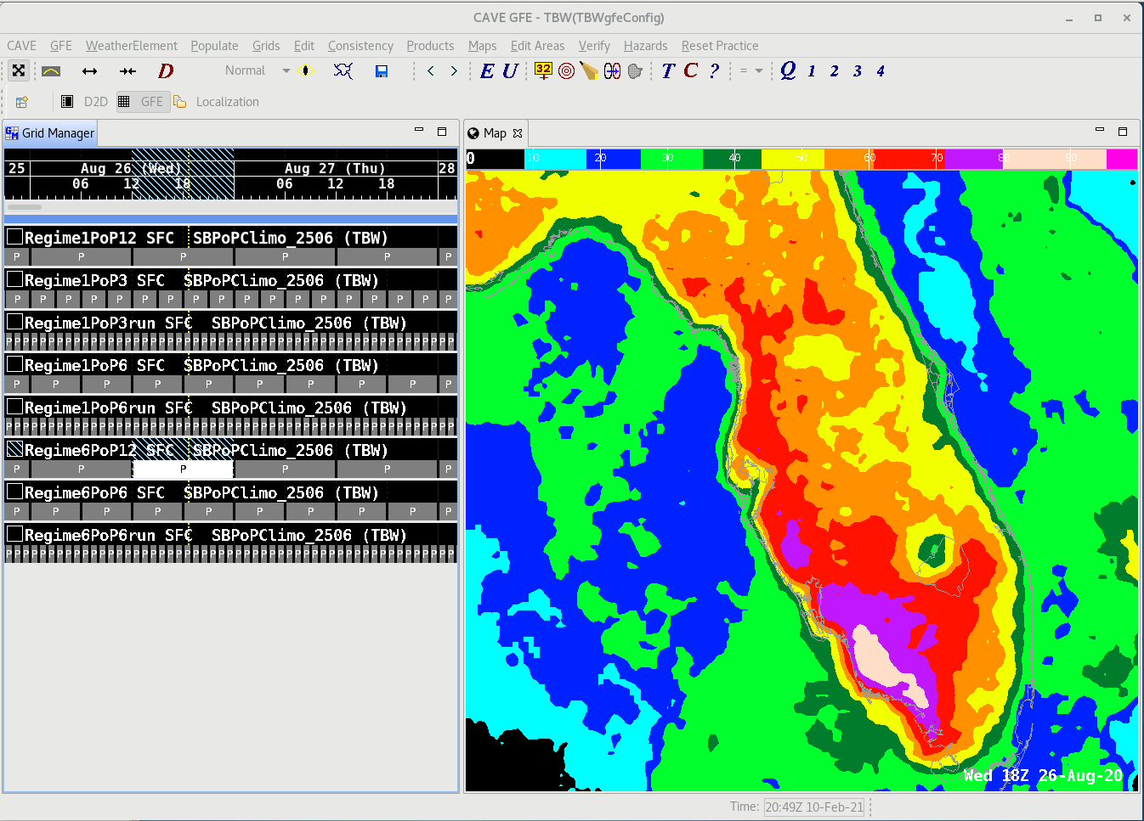
Regime # 6: 12UTC – 00UTC
800AM – 800PM
Regime # 6: 00UTC – 12UTC
800PM – 800AM
Detail Level:
Best Suited for Days 4 - 7 Forecasts

Slide 24
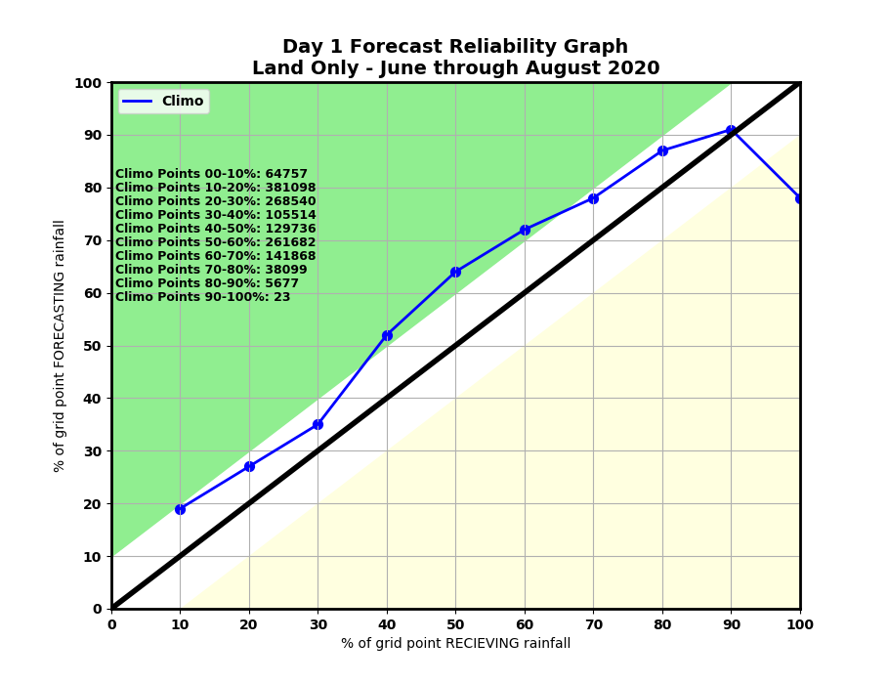
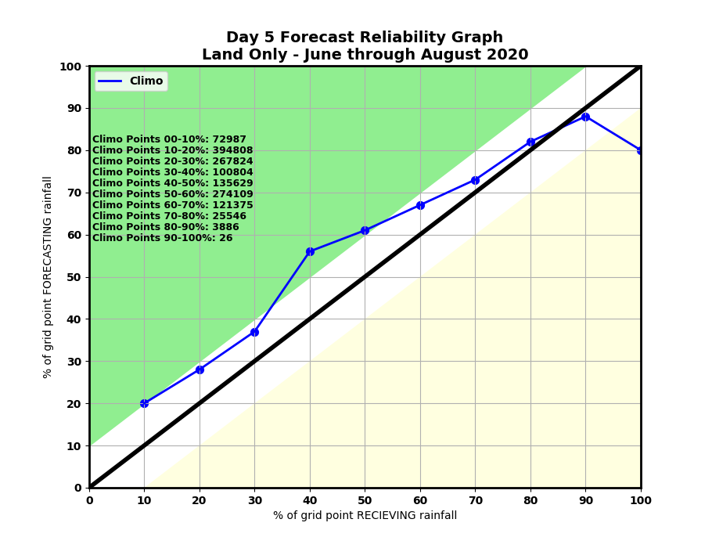
Gridded Verification – All of Florida Reliability Chart June – August 2020

Slide 25
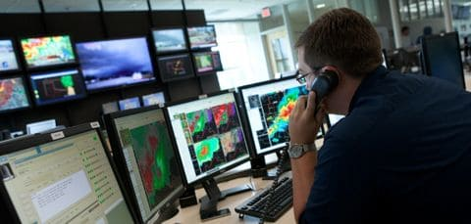
Decision Support Examples

Slide 26
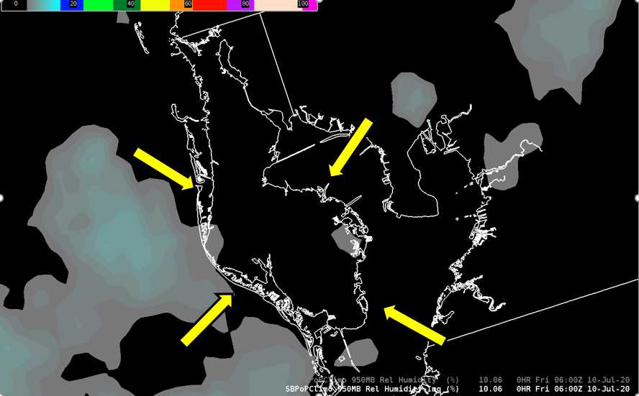
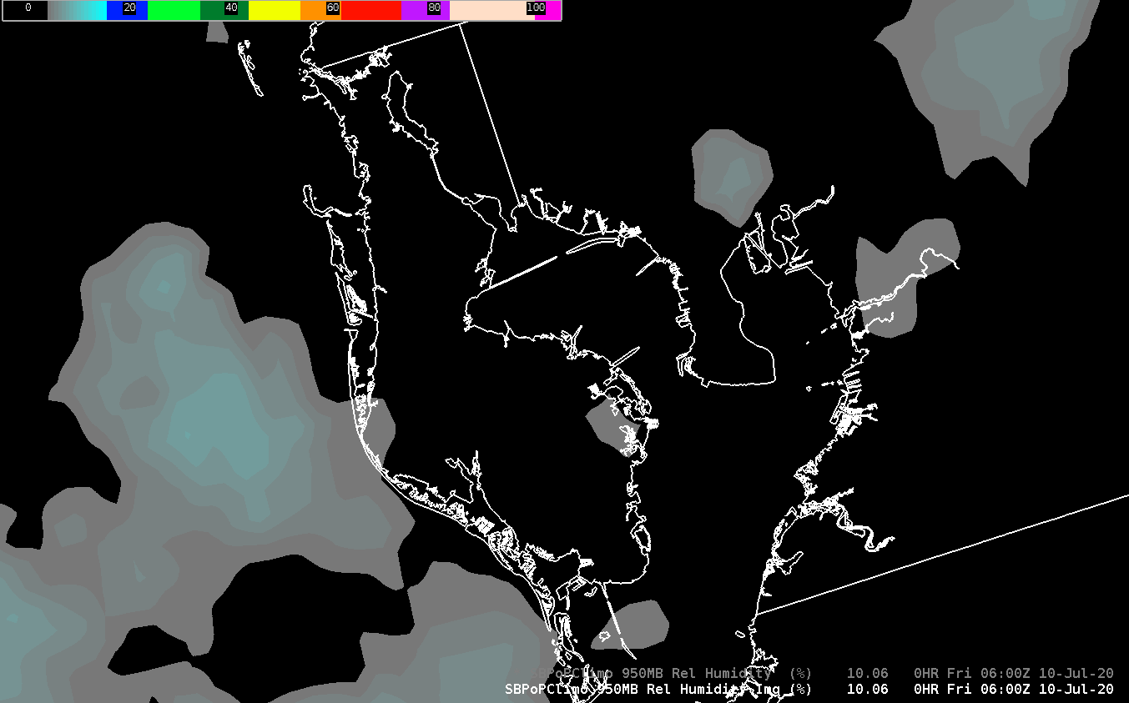
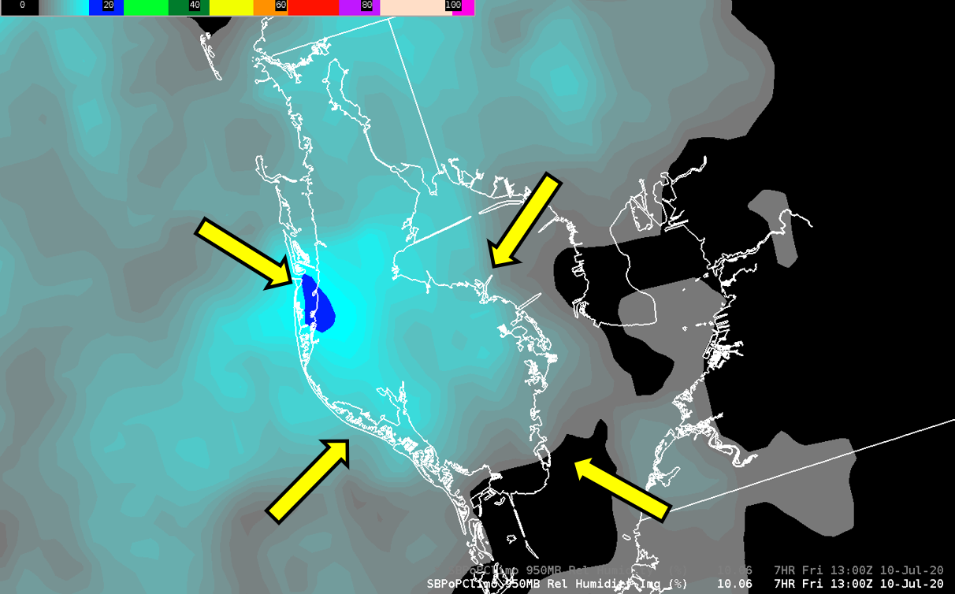
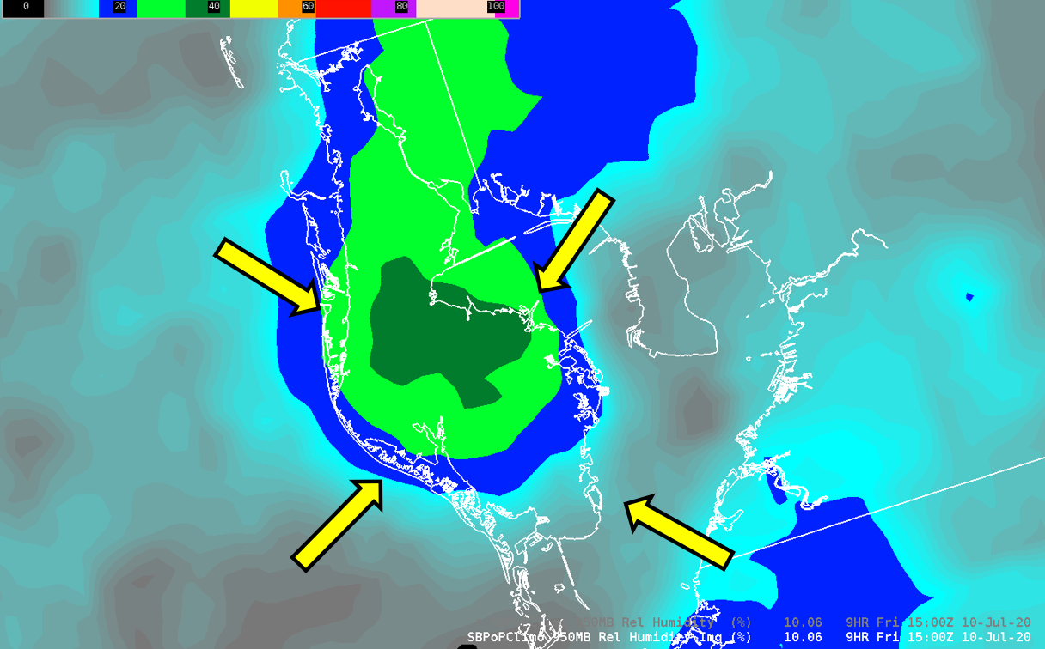
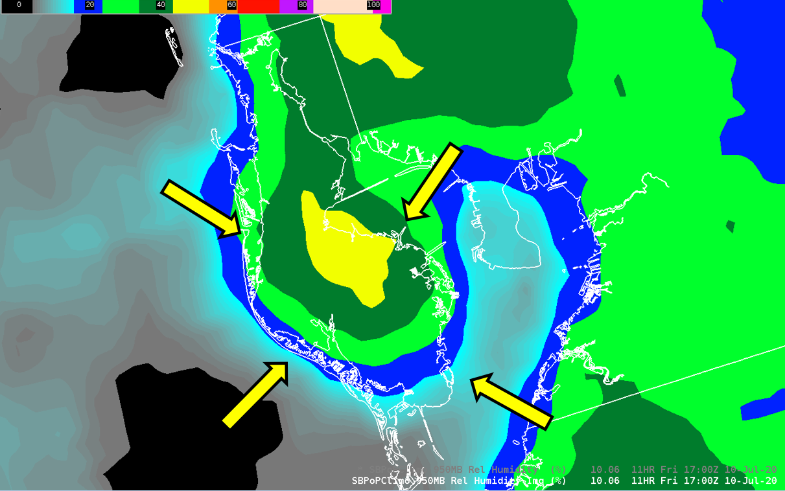
Pinellas County Florida: Regime # 1
The unique geography of Pinellas county under weak synoptic flow allows a collision of mesoscale versions of the Gulf of Mexico seabreeze and Tampa Bay (breezes).
The first storm of the day develops usually within 30 minutes of noon, with a high degree of forecast confidence.
These datasets instantly provide that spatial/temporal detail, normally requiring considerable time and effort to include in the forecast

Slide 27
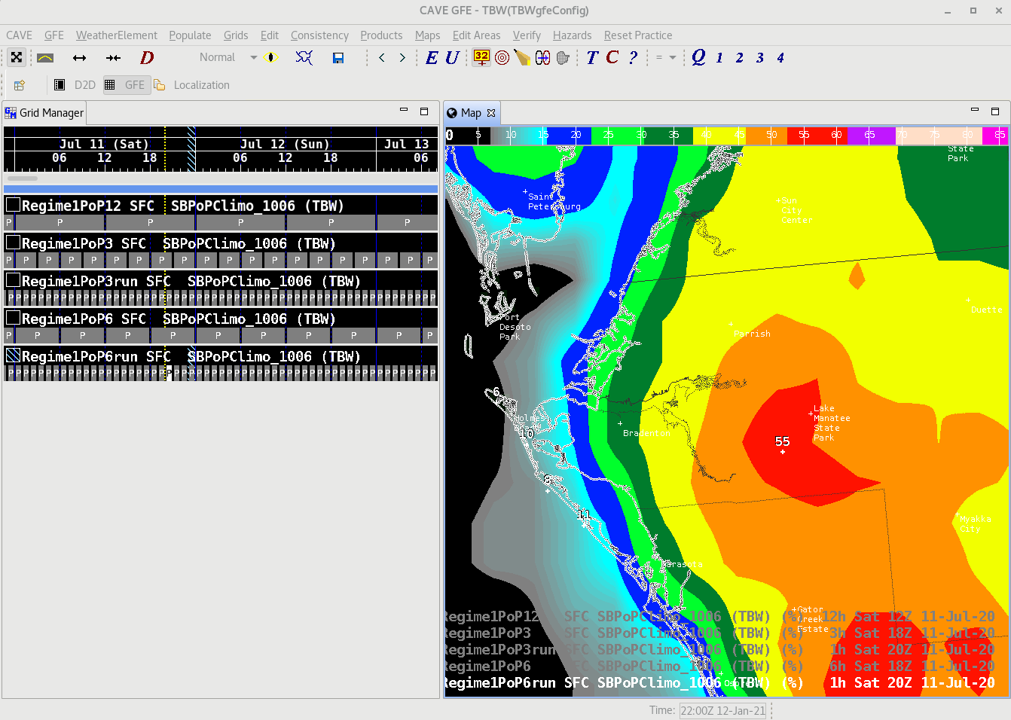
Manatee County Florida: Regime # 1 – 2000UTC / 400 PM EDT
Beaches of Manatee/Sarasota Cnty: Rainfall potential and resulting lighting threat less than 10%
Inland Manatee/Sarasota Cnty: Rainfall potential and corresponding lightning threat approaching 60%
The advantages for decision support and outdoor event planning (even for “Is it safe to go to the beach?”) can not be overstated.
20 miles
10%
60%

Slide 28
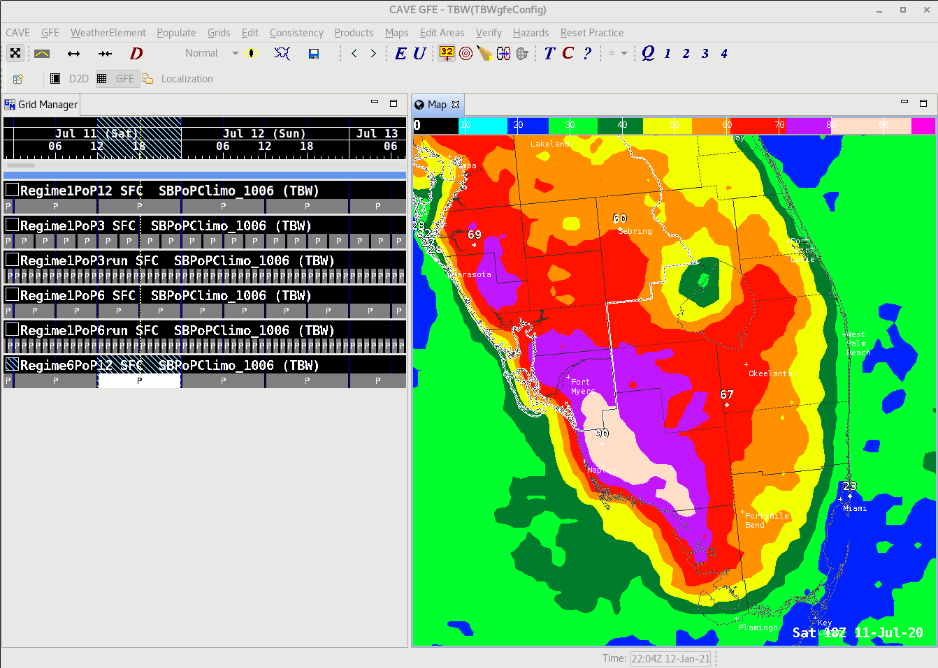
Example: Day 4 - 7 Forecast
12 hour 8AM – 8PM
Regime 6 day:
Notice Lake Okeechobee lee side rainfall shadow due to SE to NW flow
Beaches of southeast Florida have a daytime rainfall potential and corresponding lightning threat of 25% or less.
Inland sections of south Florida (Naples area) have a daytime rainfall potential and corresponding lightning threat of 80-90%

Slide 29
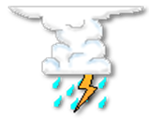
Charlotte Harbor Area
Charlotte & Lee Counties
Large volumes of boating and beach activities
6 hour 2PM – 8PM
Regime 6 day:
S/SE 5-10 kts
6 hour 2PM – 8PM
Regime 4 day:
SW/W 5-10 kts

Slide 30
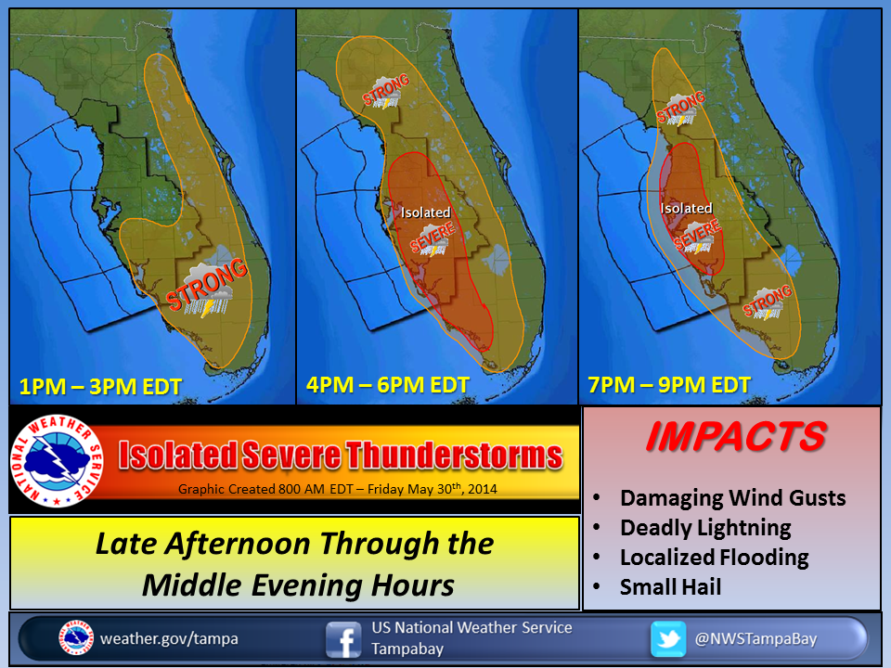
Decision Support Through Social Media
Utilizing Flow Regime Forecast Knowledge

Slide 31
https://www.weather.gov/tbw/ThunderstormClimatology#
Will be rolled out with summer decision support seminars
March/April 2021

Slide 32
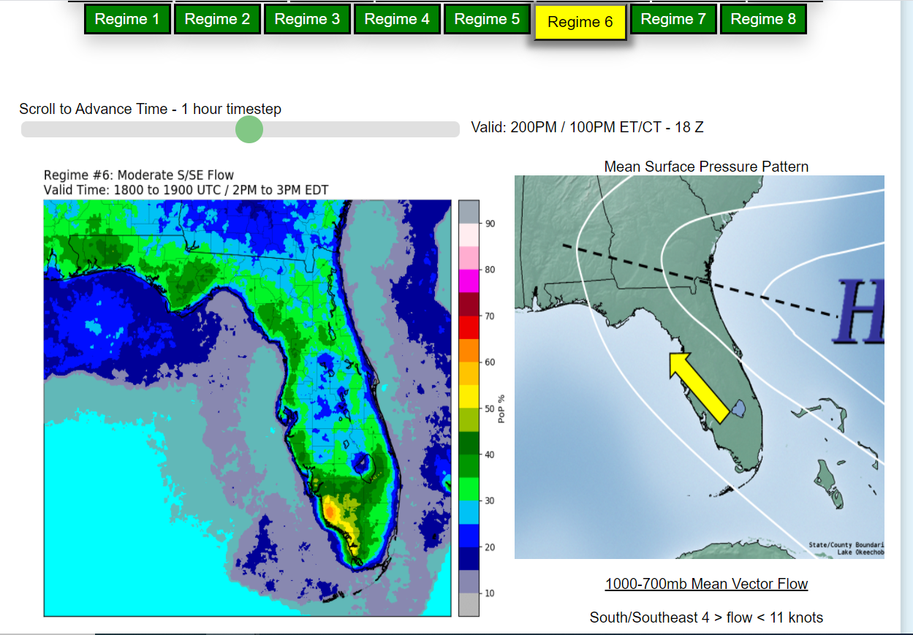
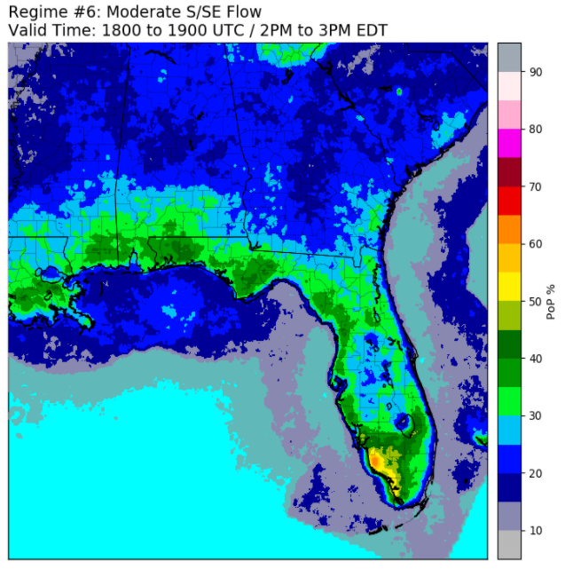
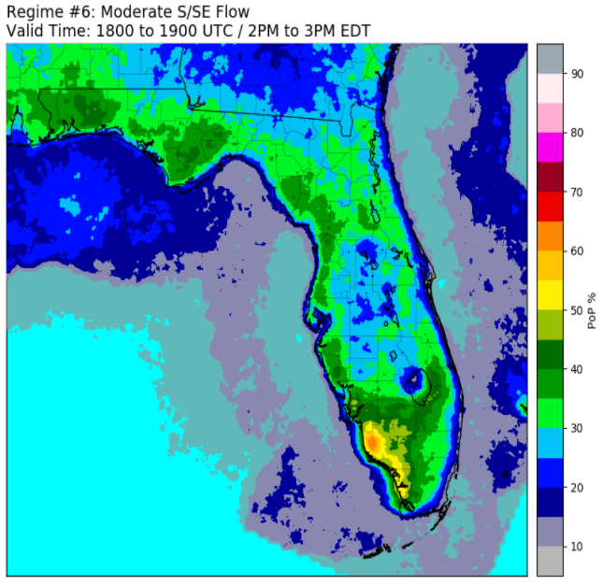
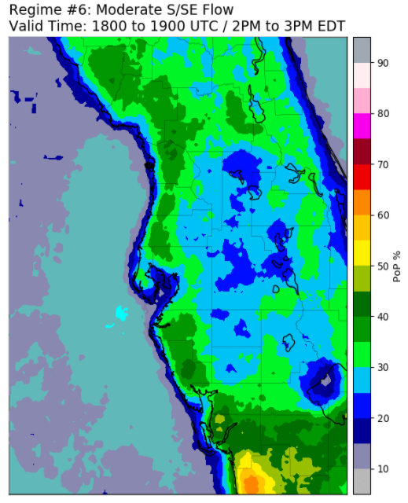
2-D Imagery
Choose any regimes
Choose one of 8 viewing options ranging from Southeast United States, to Florida, to 6 varying National Weather Service county warning areas (CWAs)
Choose any temporal period with scrolling animations available
Any Florida NWS County Warning Area (CWA)
Upscale Viewing Regional to State

Slide 33
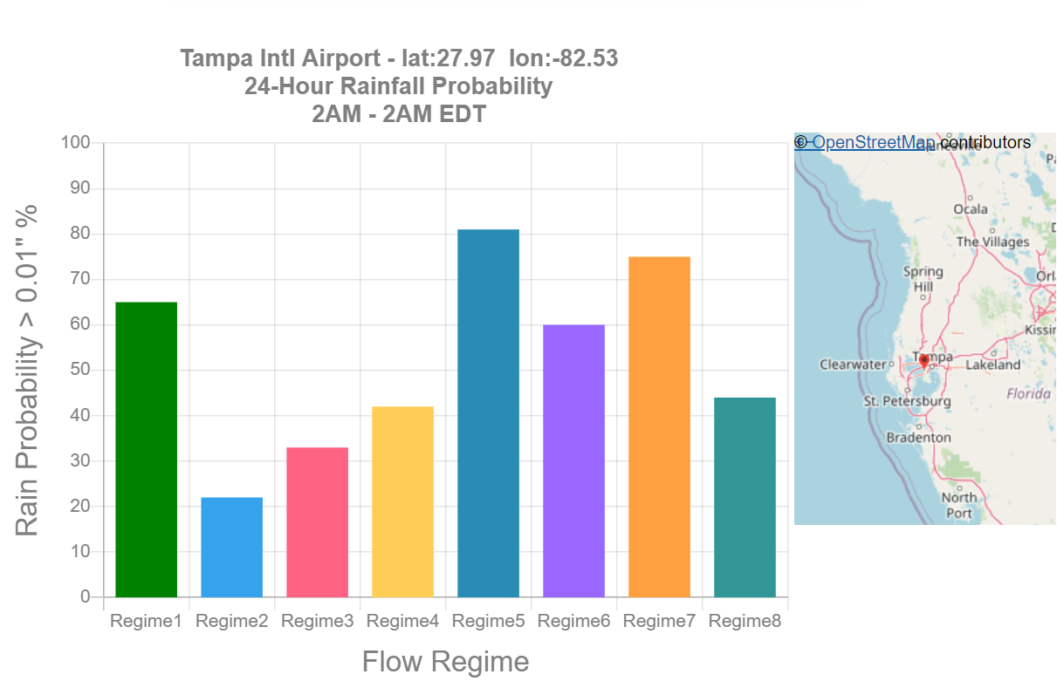
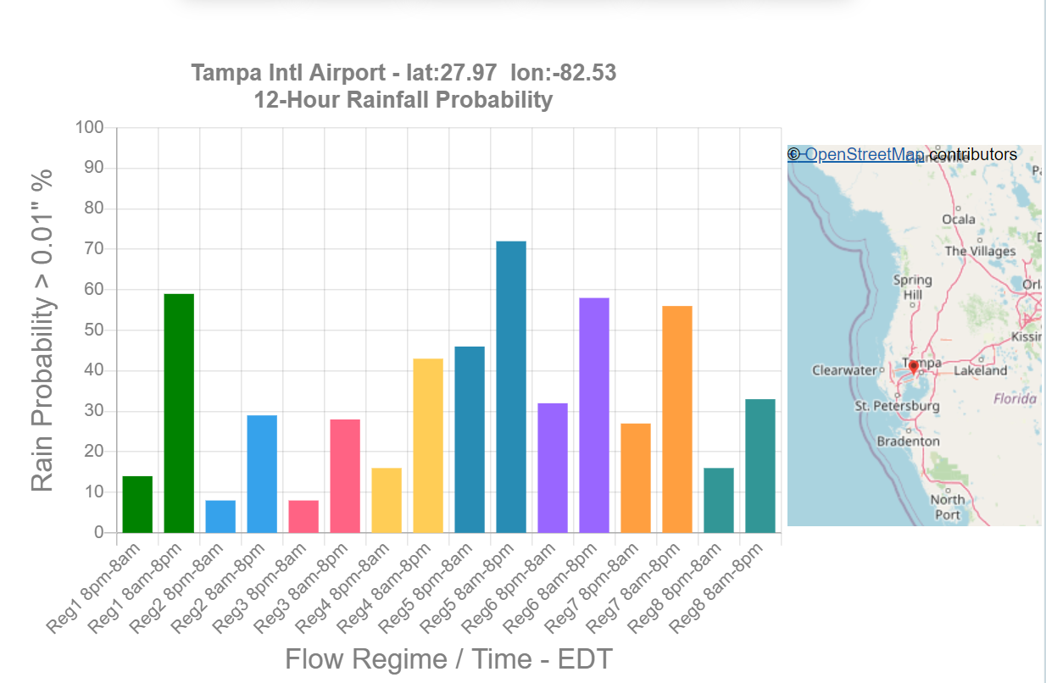
Point Data Plots
12-Hour
Point Data Plots
24-Hour
Two bars / One color: Represents the probability of precipitation for the regime, during the two synoptic 12 hour period of a given day, at the chosen location
One bar / One color: Represents the probability of precipitation for the regime, during a 24 hour period, at the chosen location
Users can choose between literally hundreds of cities, town, locations across the state of Florida
Graphs are created on the fly from pre-developed text files
All temporal possibilities are available, and graphed in the format that best visualizes the length of data.

Slide 34
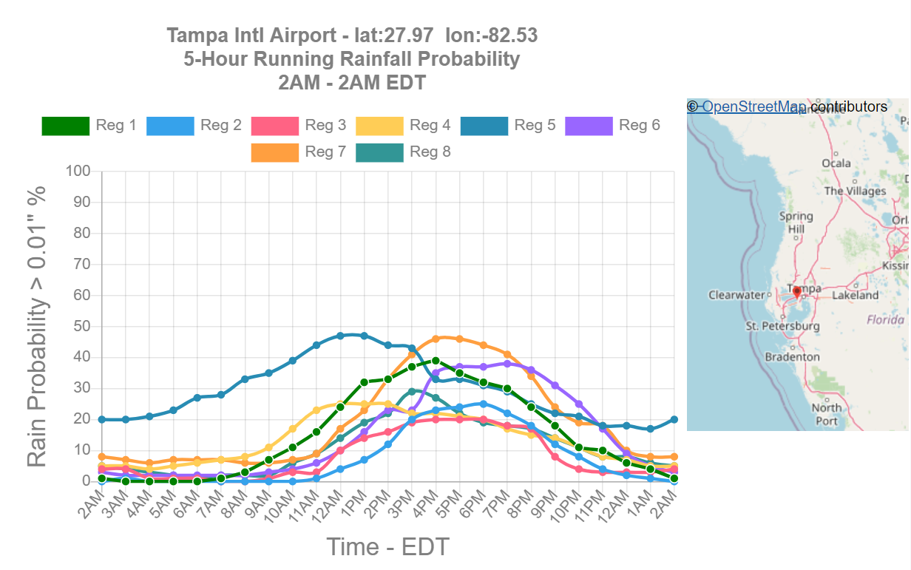
Point Data Plots
5run-Hour
Viewing time scales less than a temporal period of 12 hours, the graph will switch from bar to line format
The line format:
Useful for diagnosing preferred days and times for weather sensitive.
Florida Power & Light has requested data access for scheduling and positioning of field crews to deal with storm related issues.
SW Florida Water Management District (SWFWMD) requested for their decision support purposes.
One line color / One regime: Represents the running 5run-Hour hourly probability of precipitation for the regime, at the chosen location.

Slide 35
Wet Season Plots (Median) – County Based

Slide 36
Wet Season Plots (Mean) – County Based

Slide 37
The Florida Wet Season / Thunderstorm Season
Wet Season Plots – Media Market Based

Slide 38
Thank You For Your Time & Attention
Questions/Comments?

