Slide 1
VLab Update: What’s New and What’s on the Horizon
Steve Smith
Director, NOAA VLab
https://vlab.ncep.noaa.gov
VLab Forum – March 22, 2017

Slide 2
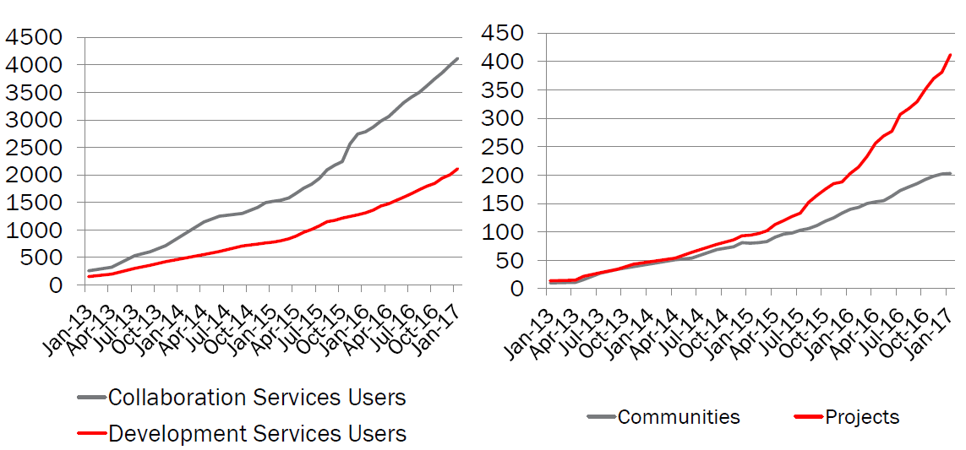
VLab Growth

Slide 3
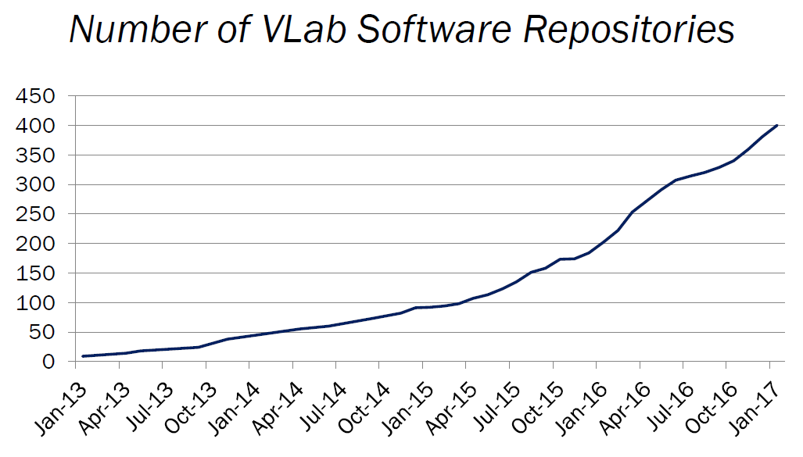
VLab Growth

Slide 4
Communities by Line Office

Slide 5
Projects by Line Office

Slide 6
NWS Projects by Organization

Slide 7
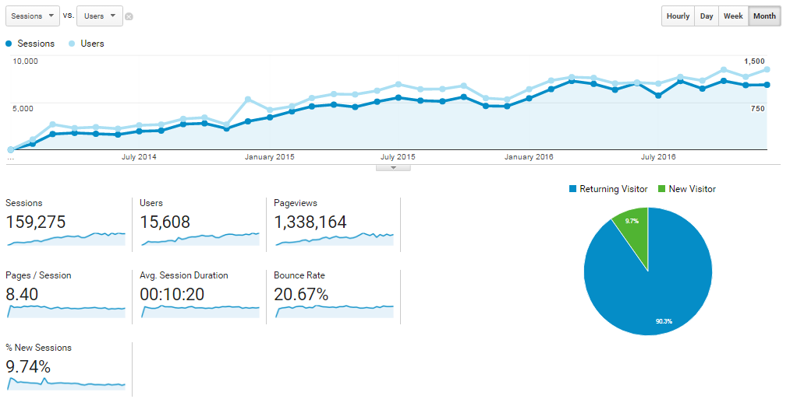
VLab Growth
~ 500 users/month (2014) → over 1,100 users/month (2016)
~ 2,500 sessions/month (2014) → over 7,000 sessions/month (2016)
27,000 staff-hours!

Slide 8
Community Highlights
OCLO Training Community
CSTAR Community
NCEP EMC Community Workspace
FACETS
Flash Flood Local Techniques Collaboration
GIS in NWS
Vortex-SE Field Experiment
RTMA/URMA Evaluation/Feedback Group
National Blend of Models
CR SOO Community
Near Storm Environment Awareness Project
NWS Spanish Translators
Probablistic Snow Experiment
National Water Model
NWS UAS
NCRFC Runoff Risk
Operations Proving Ground
Total Operational Weather Readiness Satellites (TOWR-S)
Google Analytics
MRMS
AWIPS Community
Impacts Catalog

Slide 9
Project Highlights
AWIPS
National Blend of Models
Impacts Catalog/iNWS/Iris/HCE
HIWPP
FIM
HRRR/RUC
IDP Onboarding
MRMS
MADIS
CHPS
National Water Model
NOMADS
P-Surge
NWSChat
Aviation Forecast Verification Tool
US Meteorological Information Exchange Model
NOS Forecast Modeling Systems for Lakes Michigan and Huron

Slide 10
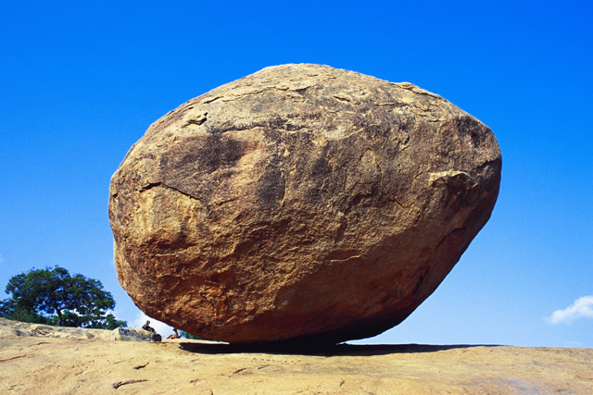
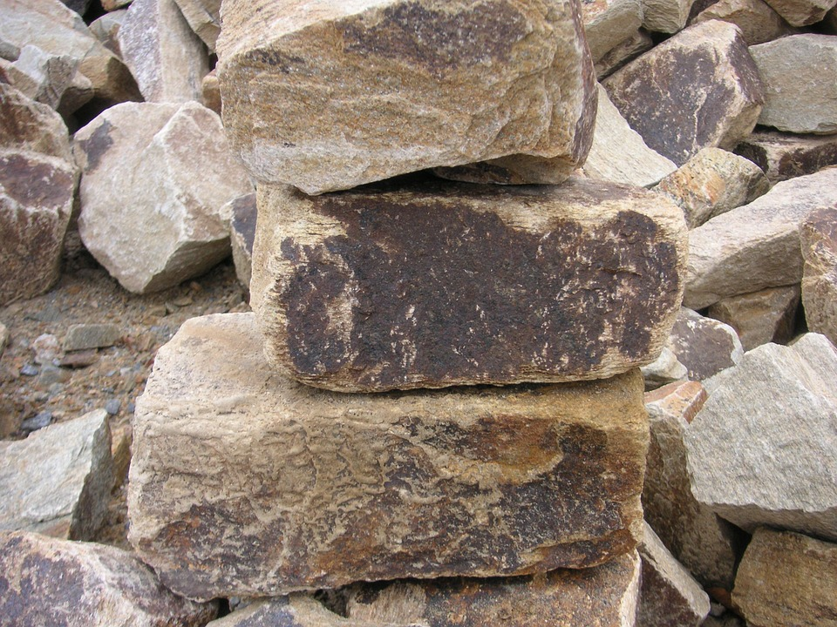
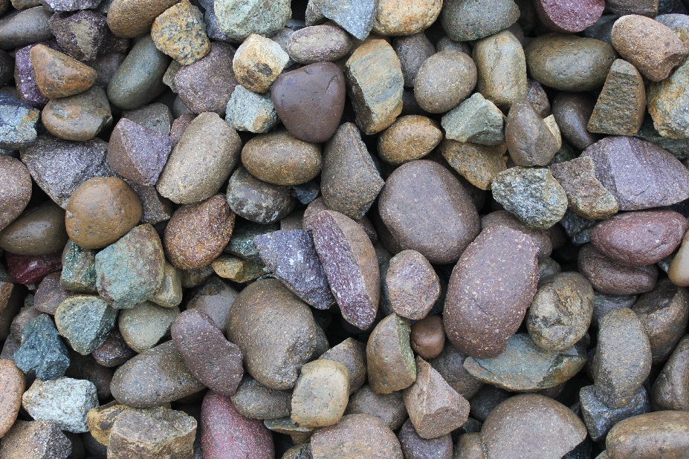
VLab Capability Enhancements
BOULDERS
ROCKS
PEBBLES

Slide 11
BOULDERS:
AWIPS SCP
Projects Registry
Single Sign On
Elasticsearch
AWIPS Integrated Ref
ROCKS:
Ideas Marketplace
SOO-DOH Dashboard
OSTI 1STOP
Requirements Mngt
VLab User Training
PEBBLES:
Blog enhancements
Forum enhancements
What’s New
NEW

Slide 12
AWIPS Integrated Reference (AIR)

Slide 13
OSTI 1STOP

Slide 14
Weather Archive and Visualization Environment (WAVE)

Slide 15
BOULDERS:
EMC/NGGPS Dev
Linkage to GitHub.com
Organizational Communities
ROCKS:
CaRDS
Liferay 7.0
Advanced Metrics
PEBBLES:
New VLab theme
My Landing page
Community Explorer
On the Horizon

Slide 16
QUESTIONS?

