Slide 1
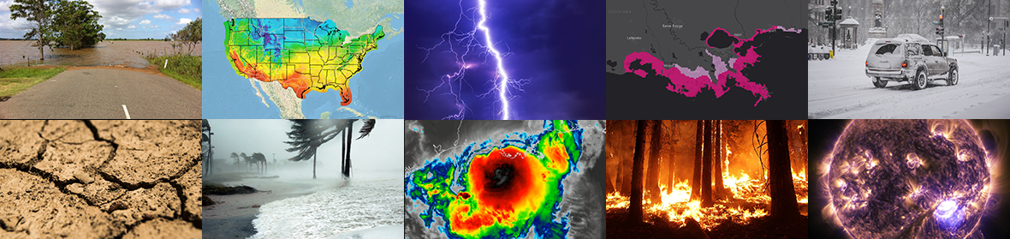
New guidance products of the
Nearshore Wave Prediction System v1.3
APRIL 29, 2021
Andre van der Westhuysen, Jian Kuang, Roberto Padilla; Michael Churma, Jung-Sun Im (MDL); Greg Dusek (NOS); Kara Doran, Margaret Palmsten (USGS); Pablo Santos (WFO MFL); Darren Wright, John F Kuhn (AFS).

Slide 2
Outline
Scope of changes in NWPS v1.3 (Feb 3, 2021)
Unstructured mesh transition
Wave system identification
Hazardous rip current
Wave runup guidance (erosion/overwash)
Conclusions and Outlook
  *Dataflow: No impact (Hosted on rzdm polar ftp)
  *Dataflow: No impact (Hosted on rzdm polar ftp)
  *Dataflow: No impact (Hosted on rzdm polar ftp)
  *Dataflow: No impact (Hosted on rzdm polar ftp)

Slide 3
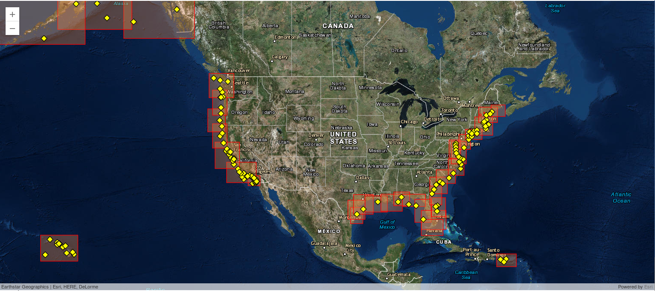
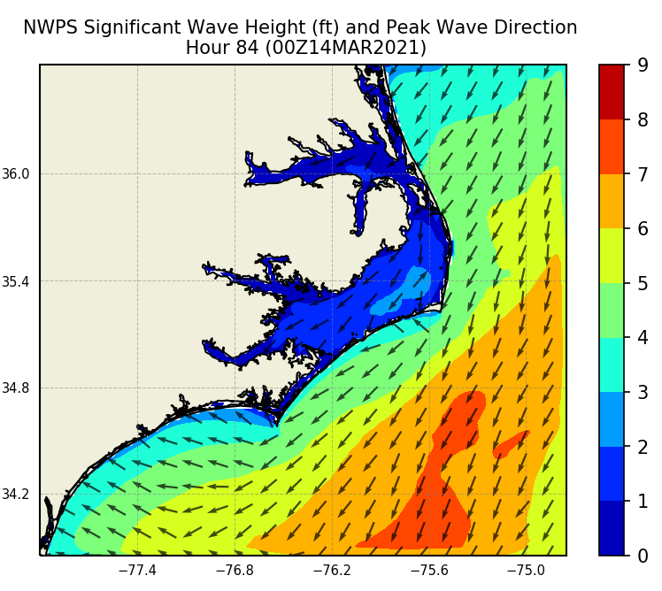
NWPS On-demand Domains (36 WFOs)

Slide 4
Scope of changes in NWPS v1.3
(NWS, 2021)
Transition 12 WFO domains from regular to unstructured grids.
Wave system identification using ML methods (K-means clustering). Resolved low-frequency limit lowered to 0.035 Hz.
Include hourly rip current guidance out to 6 days
Include hourly wave runup (erosion/overwash) guidance out to 6 days.
Improve blending of P-Surge and ESTOFS water level inputs.
Transect output graphics.

Slide 5
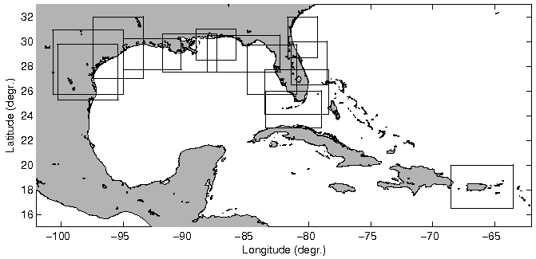
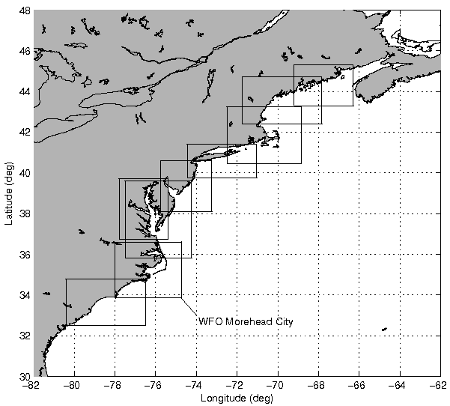
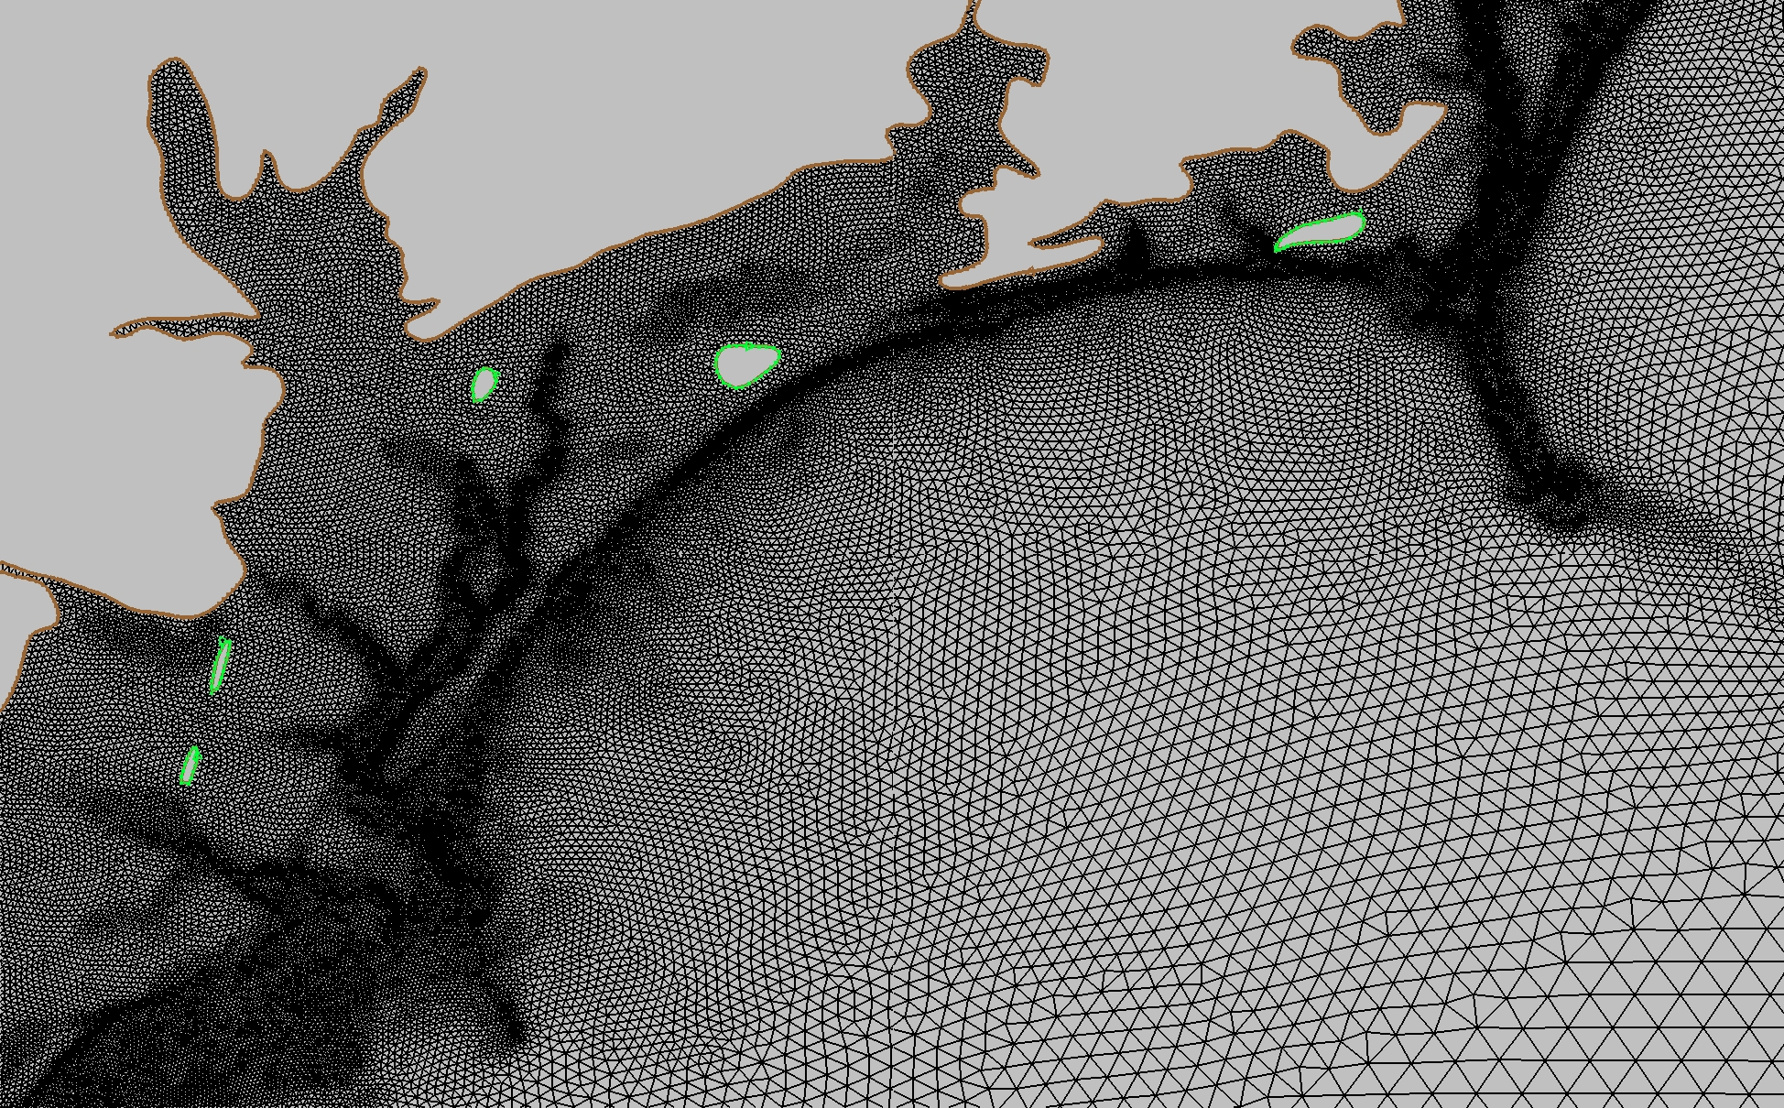
1. Unstructured Mesh Transition
12 WFO domains transitioned
(Shaded domains, plus ALU and GUM)
WFO Wilmington (detail)
6

Slide 6
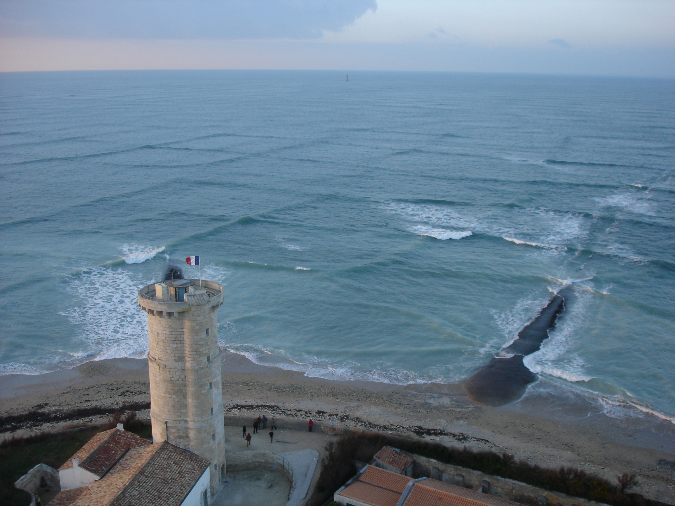
2. Wave system identification
Tracy et al. (2007)
Credit: Michel Griffon, Wikipedia (no edits)
Creative Commons
Attribution 3.0 Unported
license
2

Slide 7
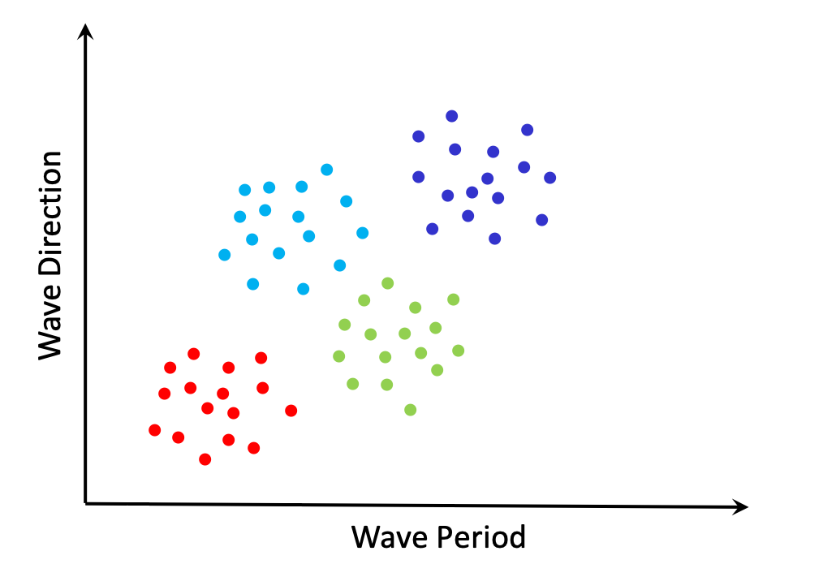
Cluster Analysis (k-means clustering)
+
+
Cluster Centers
(discovered from the data)
+
+
2

Slide 8
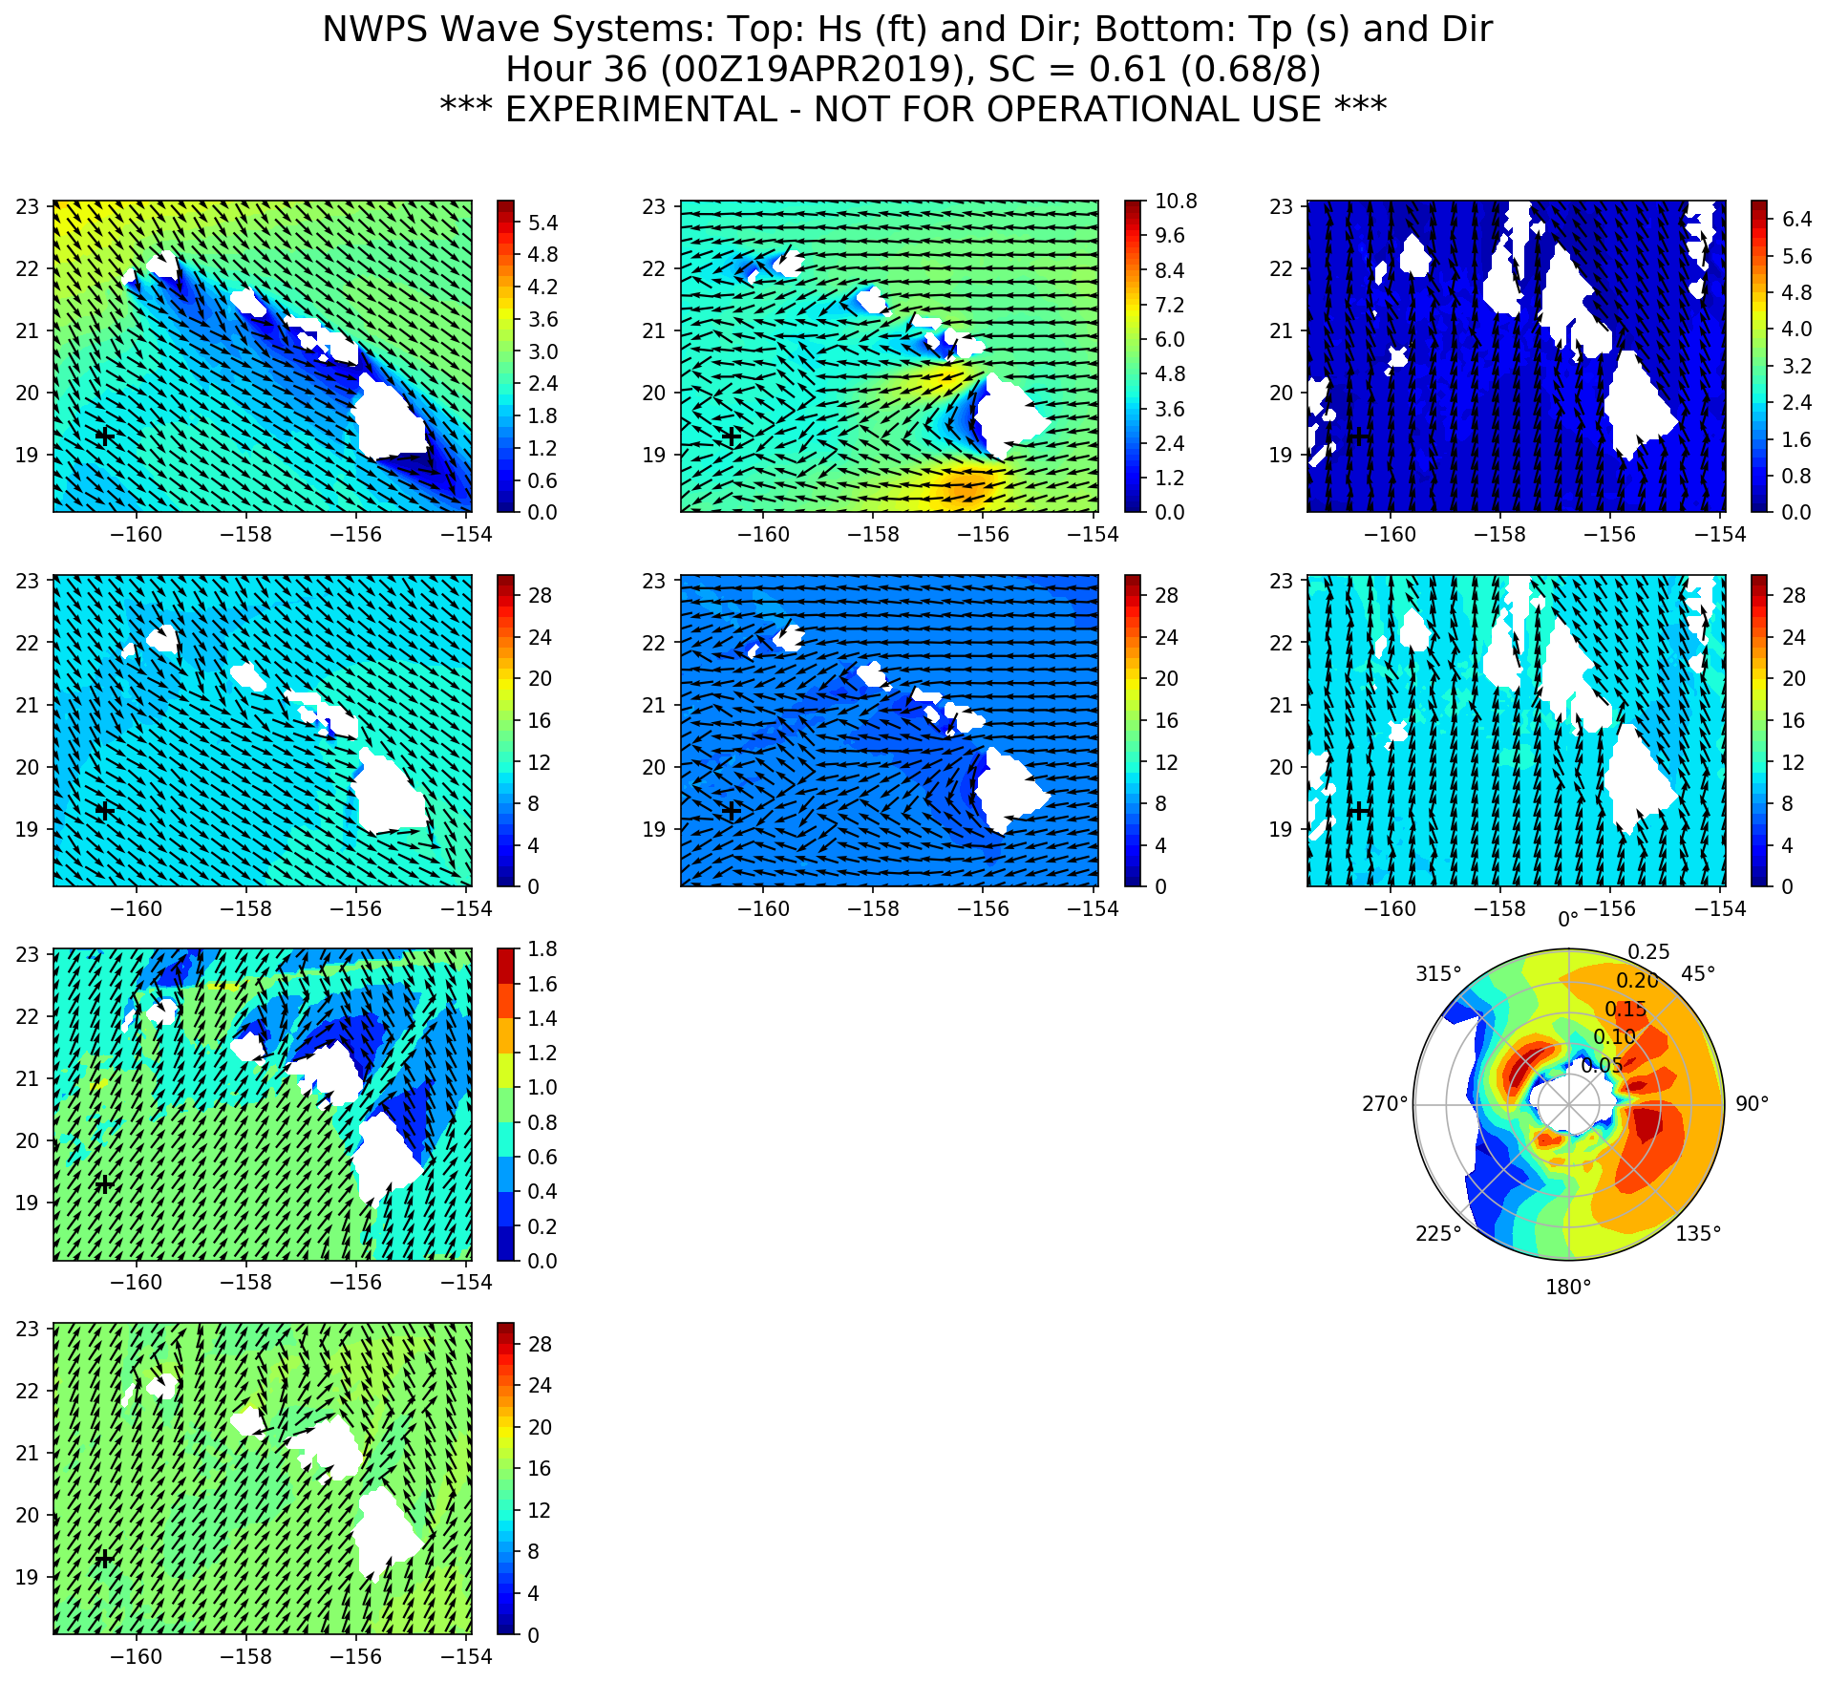
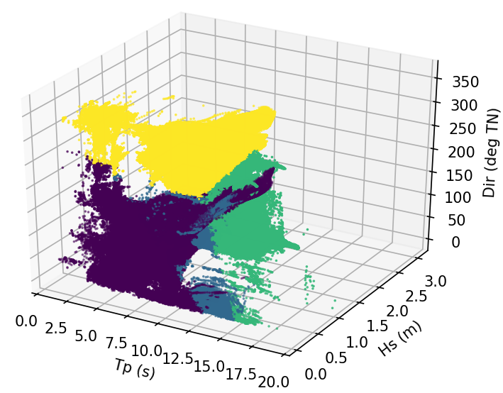
Wave systems: WFO Honolulu example
k-means clustering geographical space
k-means clustering in parameter space
Hs1
Hs2
Hs3
Tp1
Tp2
Tp3
Hs4
Tp4
(Van der Westhuysen, 2020)

Slide 9
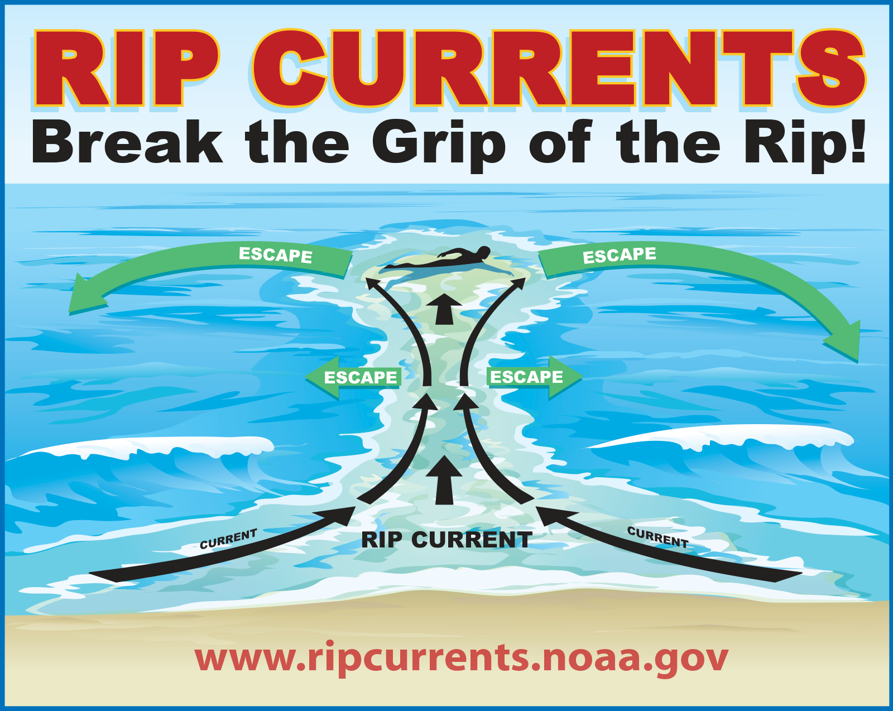
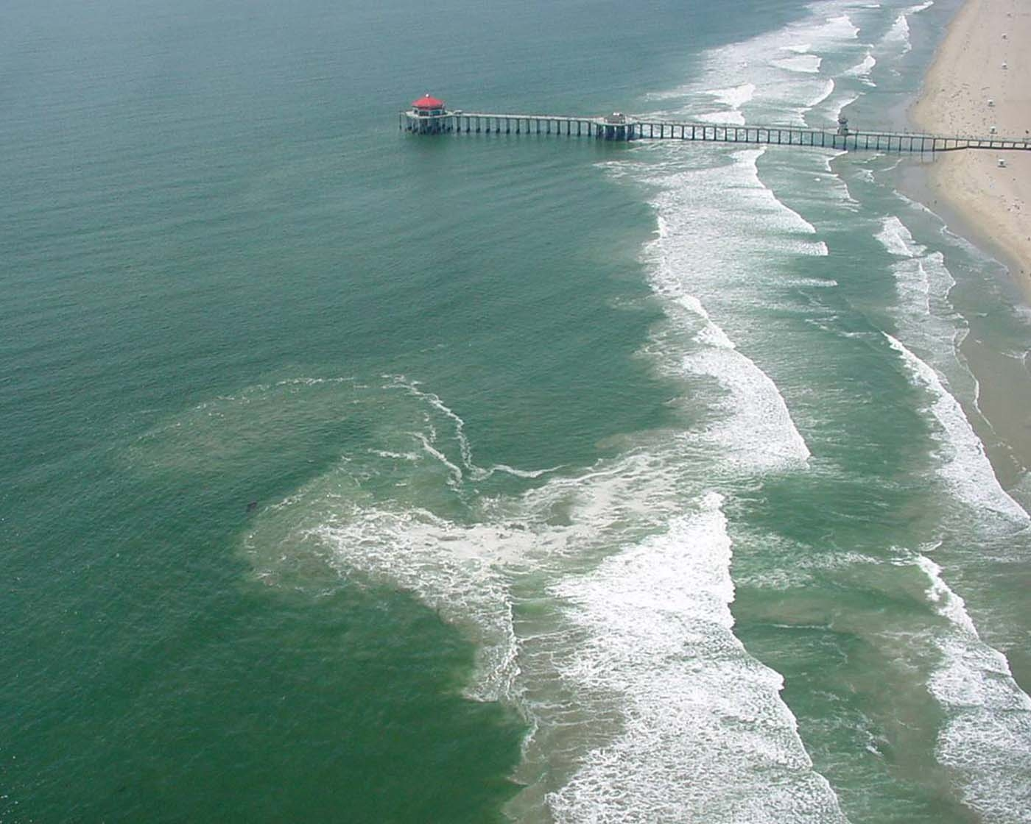
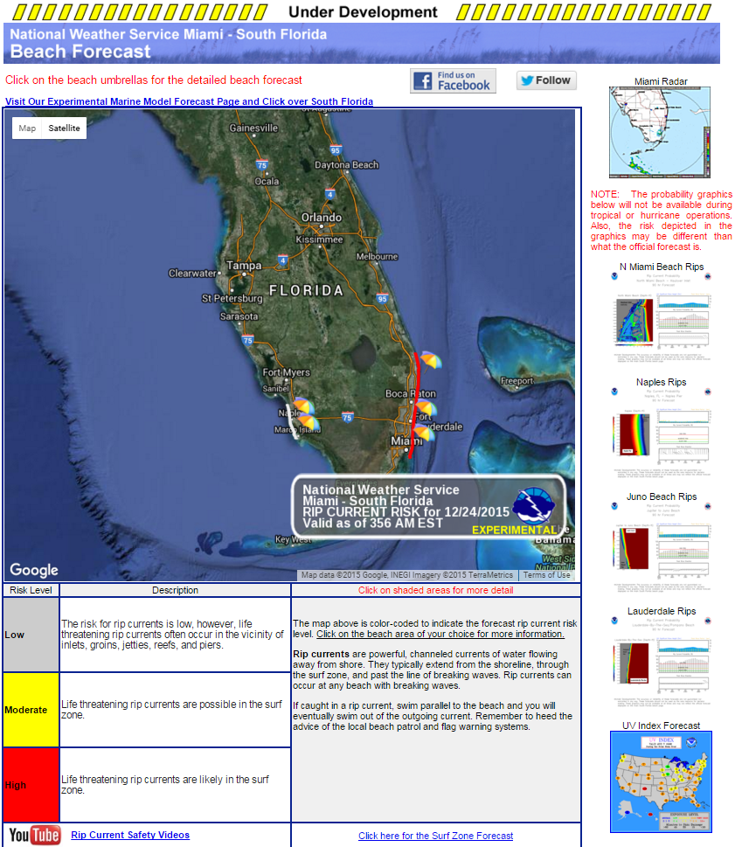
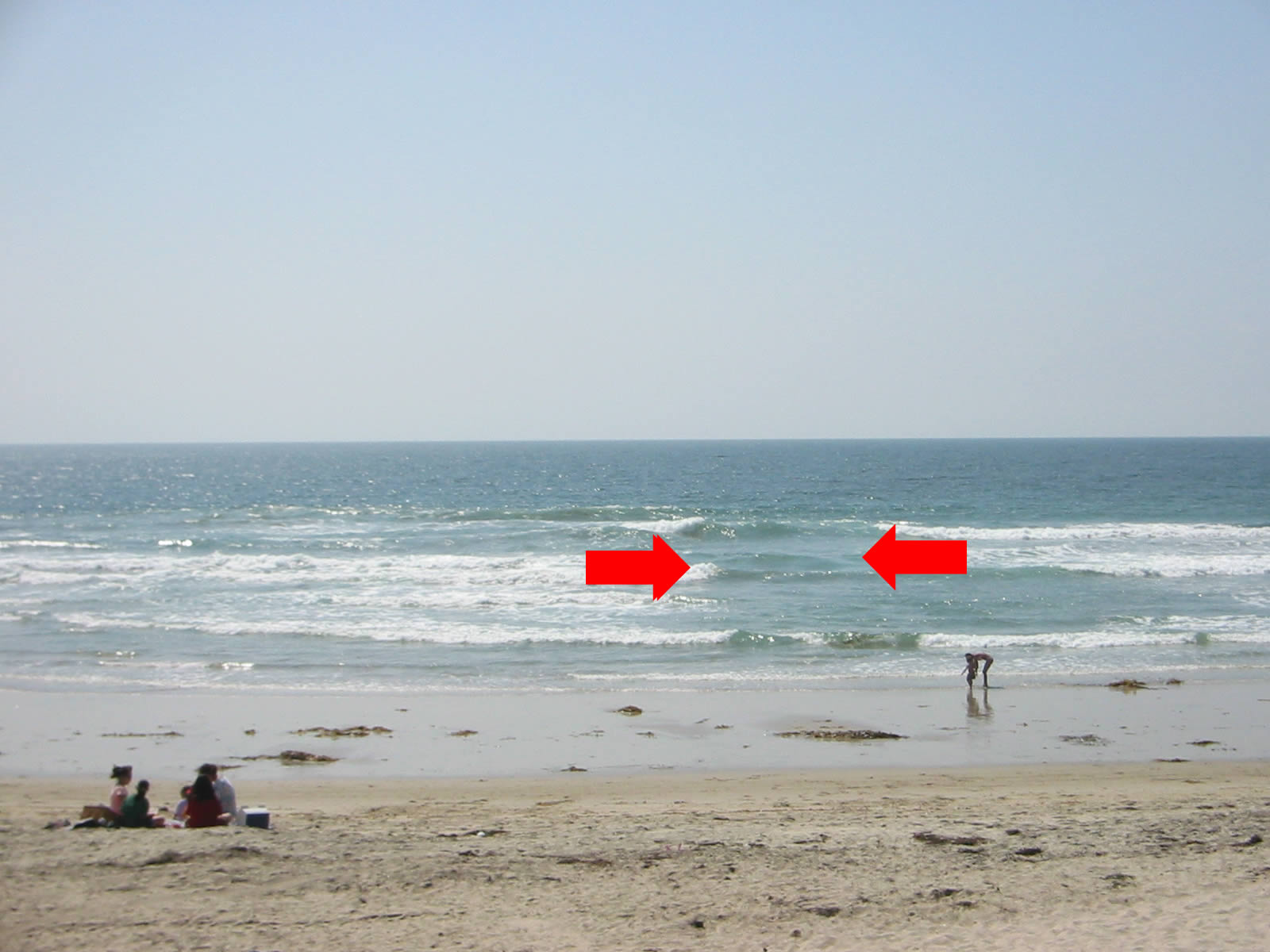
3. Hazardous Rip Current Forecasting

Slide 10
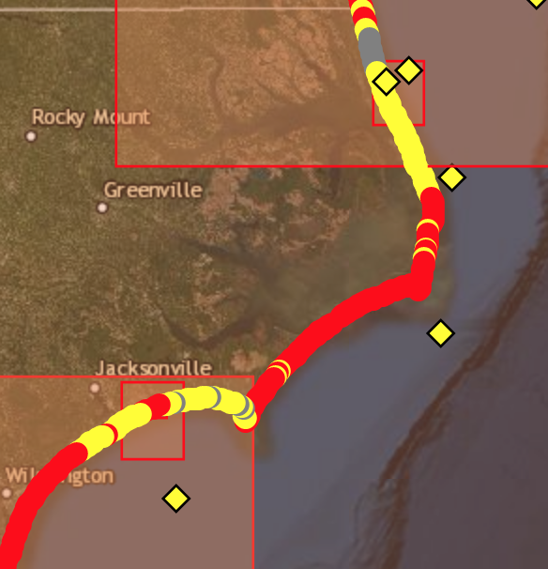
NWPS Probabilistic Rip Current guidance

Slide 11
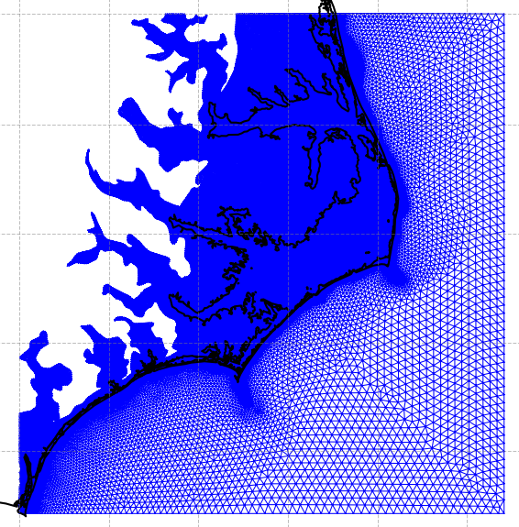
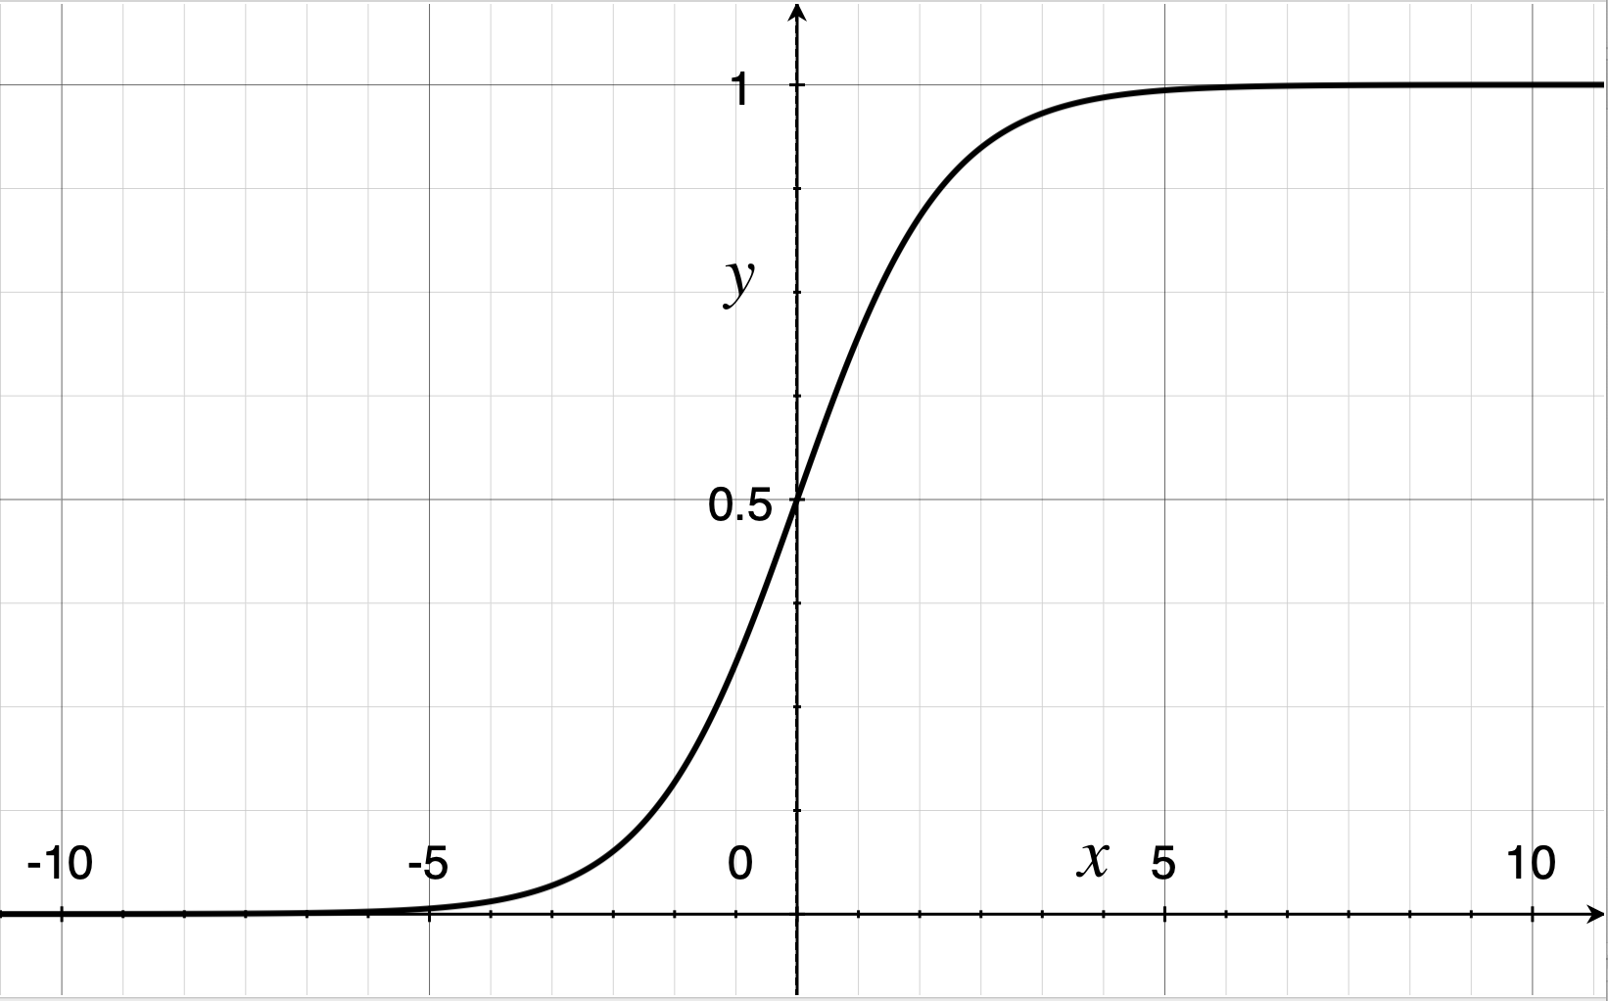
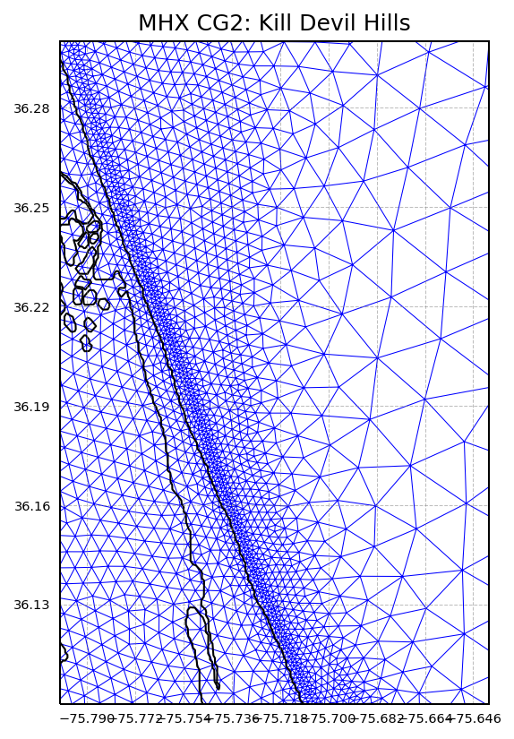

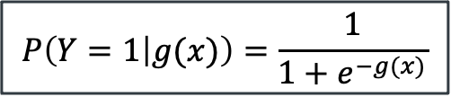

Rip Current Guidance with Logistic Regression
(Dusek & Seim, 2013)
WFO Morehead City model mesh
$$P\left(Y=1 | g(x)\right)=\frac{1}{1+e^{−g(x)}}$$
$$P(Y=1|g\left(x\right))$$
Nearshore resolution ~100 m
$$g(x)$$

Slide 12
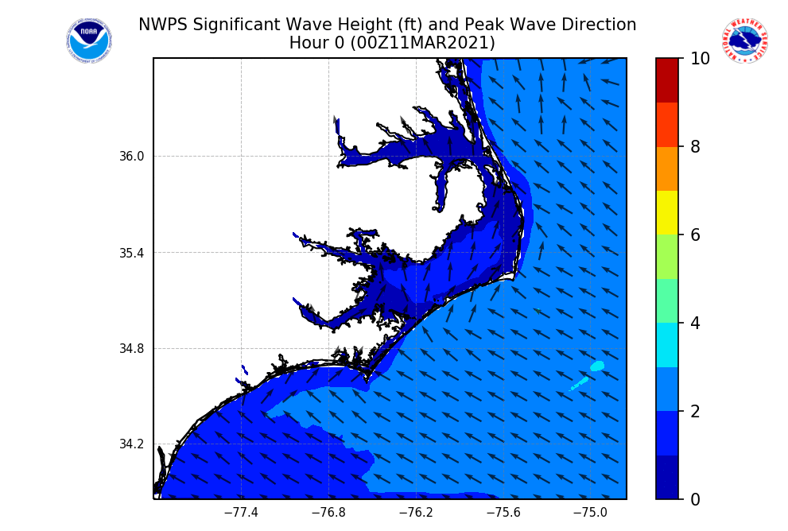
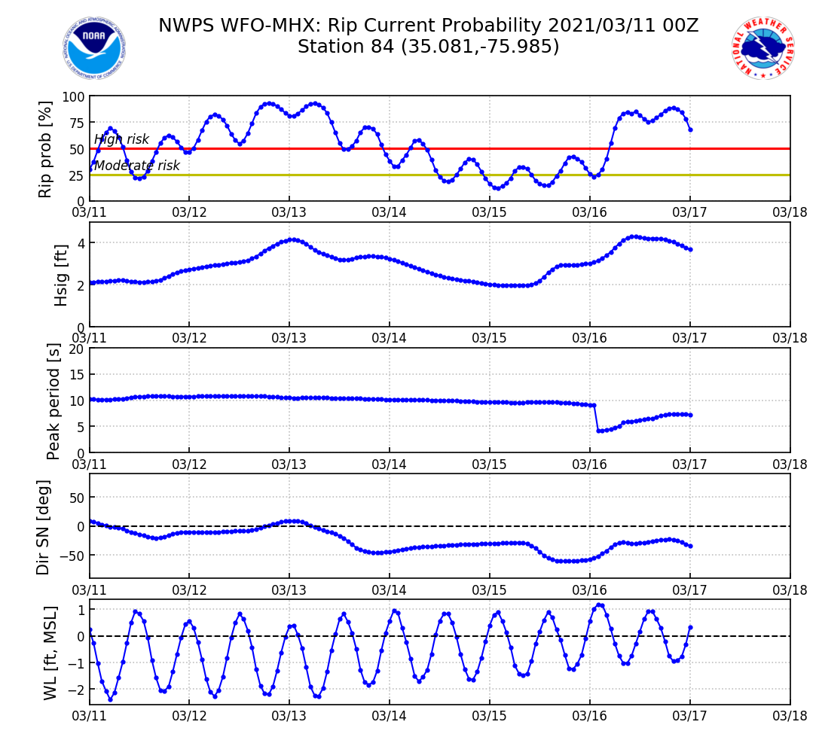
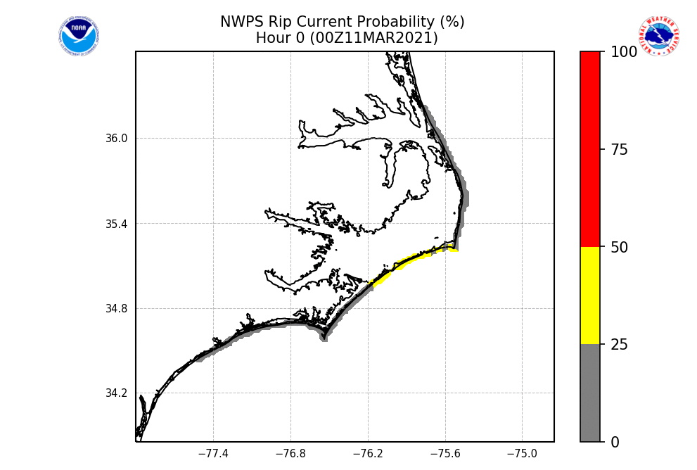
Rip Current Guidance in NWPS

Slide 13
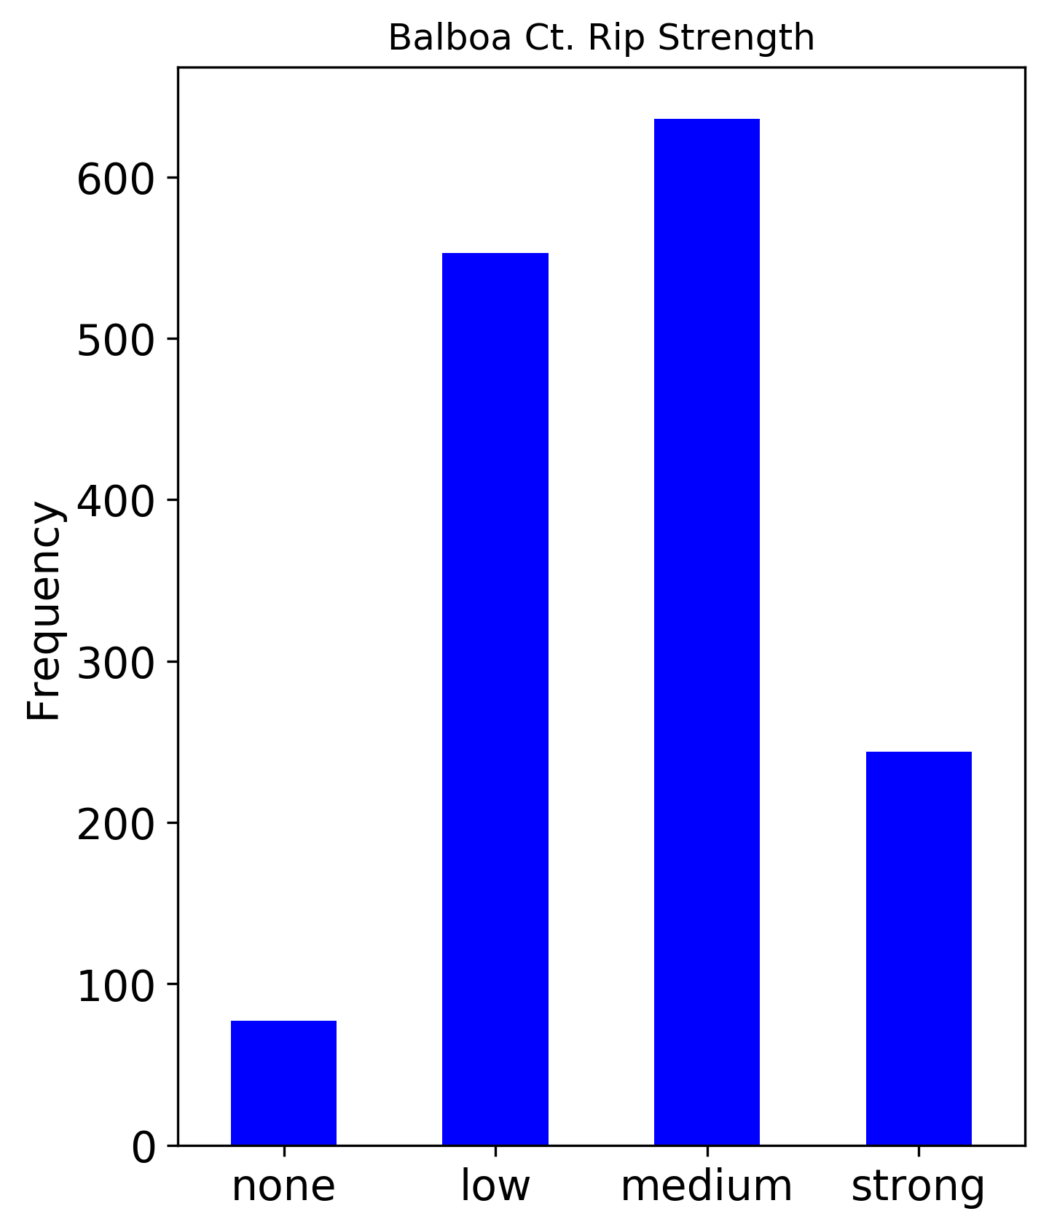
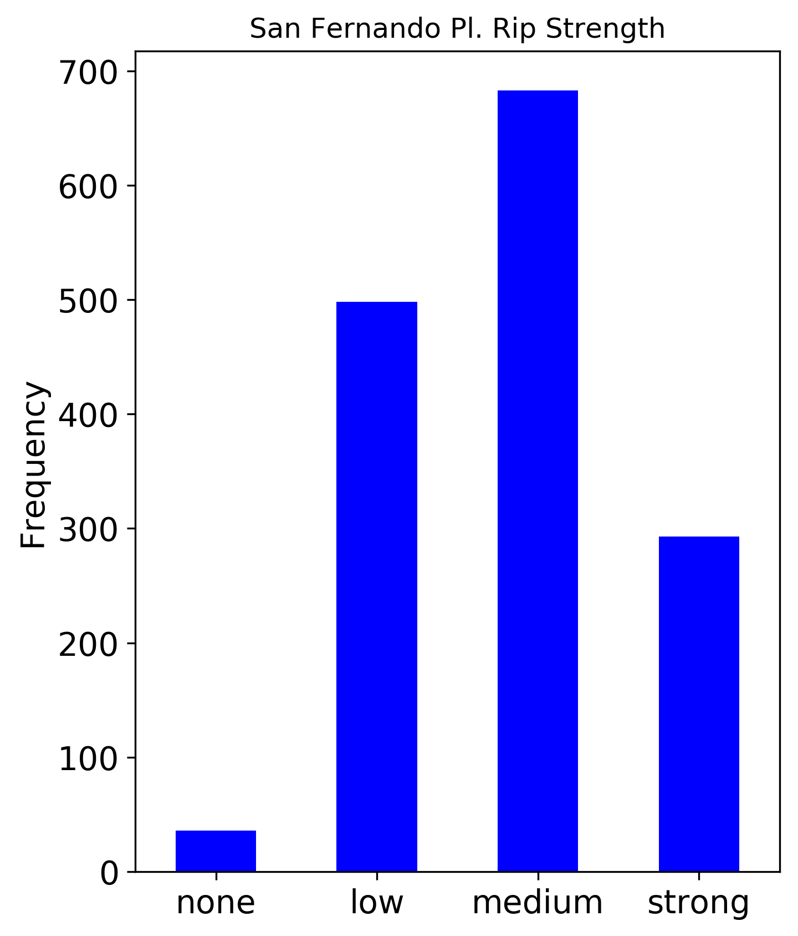
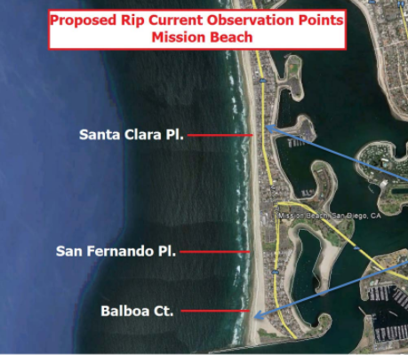
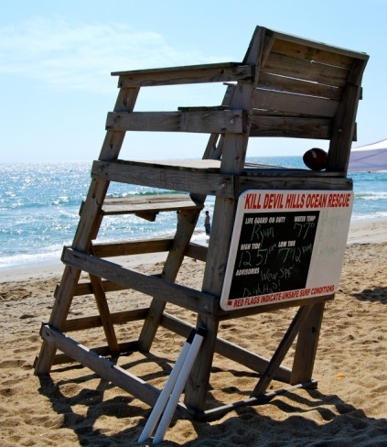
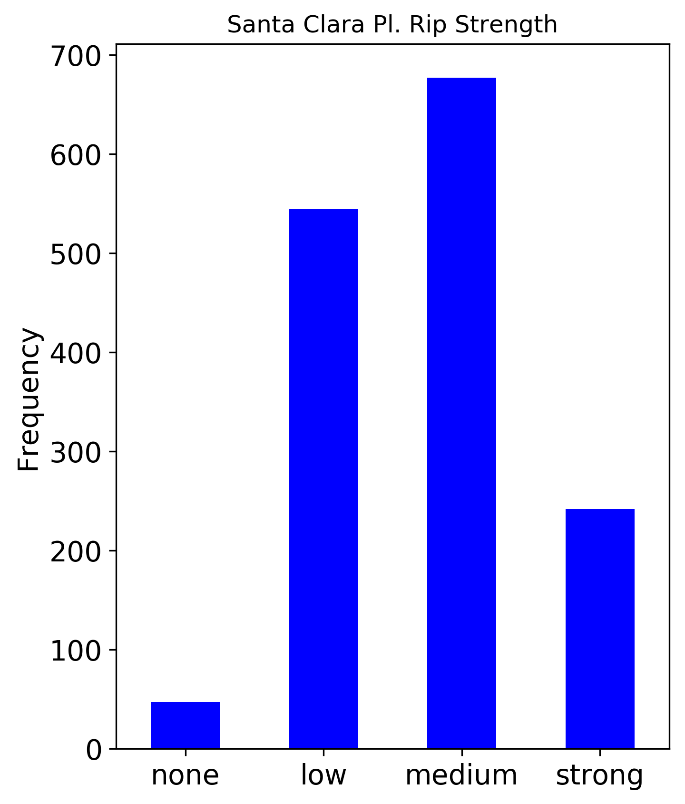
Rip Current Validation

Slide 14
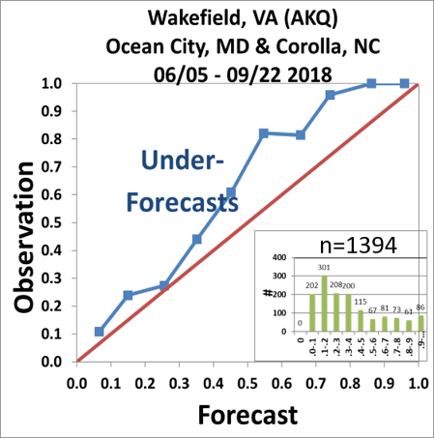
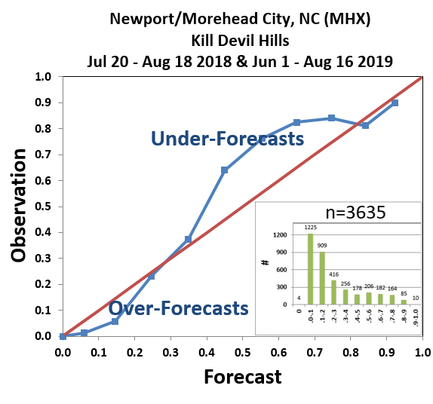
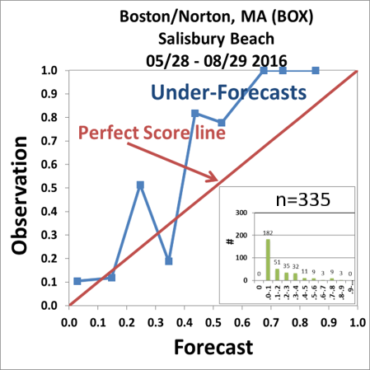
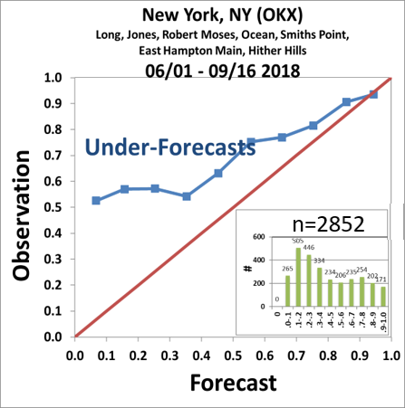
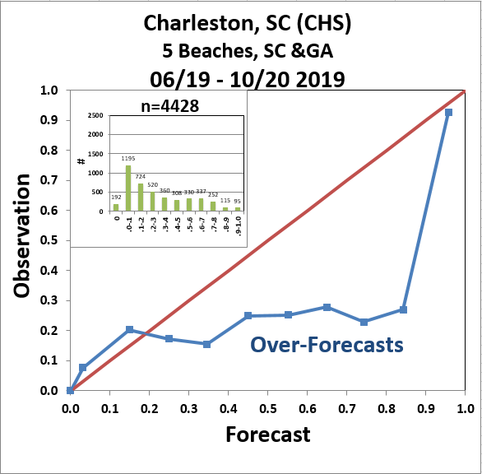
Rip Current Validation: ER example
Brier Skill Scores
Weather Forecast Office | Model vs Sample Climate | Model vs traditional Rip Index
Boston/Norton, MA (BOX) | +23.5% | NA
New York, NY (OKX) | -25.8% | NA
Wakefield, VA (AKQ) | +32.4% | NA
Morehead City, NC (MHX) | +45.3% | +35.8%
Charleston, SC (CHS) | -19.3% | NA
Reliability
Diagrams
Notes:
Reliability Diagram: Answers the question: How well do the predicted probabilities of an event correspond to their observed frequencies? Forecast probability in X axis, Observed relative frequency in Y axis. Blue line over the red Perfect Score line represents an underforecast. Blue line under the Perfect Score line represents an overforecas. The figures Inserted into the RD represent the number of forecast points and their distribution. A too small number of forecast points (< 30) at a given interval bin may lead to extreme results.
Brier Skill Score: Answers the question: What is the relative skill of the probabilistic forecast over that of climatology, in terms of predicting whether or not an event occurred? Measures the improvement of the probabilistic forecast relative to a reference forecast (usually the long-term or sample climatology), thus taking climatological frequency into account. Table columns are Brier Skill Scores against sample climate (observed relative frequency in the sample data) or, where available a WFO method (Traditional Lushine approach) or Surf Zone Forecasts. Positive numbers are an improvement %; negative are decline %.
Results:
Improvement against sample climate for BOX, AKQ, MHX and improvement over MHX Lushine approach.
Decline against sample climate in BSS for OKX (mosty underforecast in RD, especially at lower model probabilities) and CHS (mostly overforecast in RD)

Slide 15
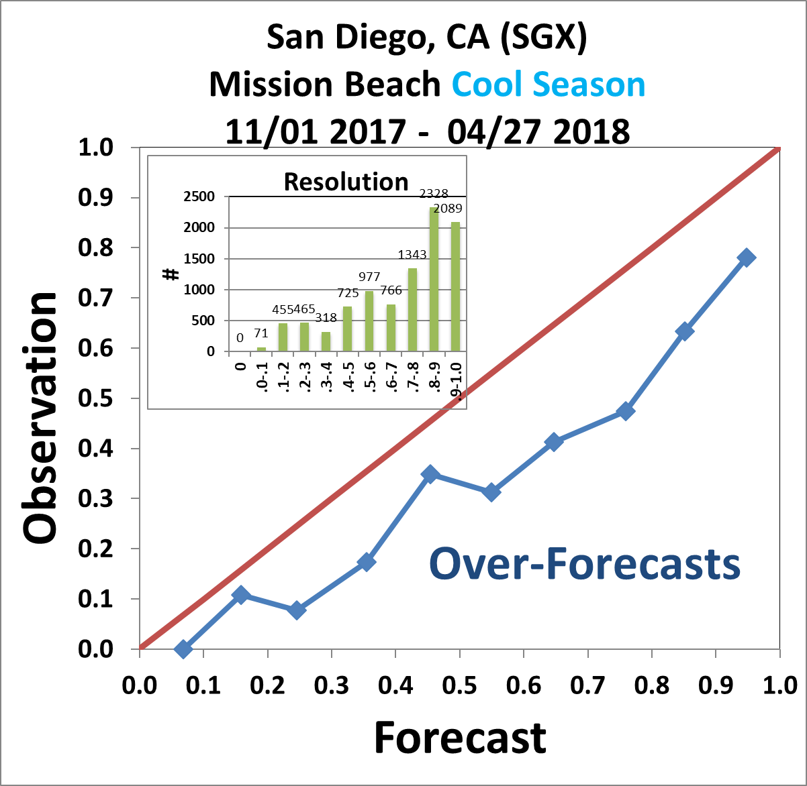
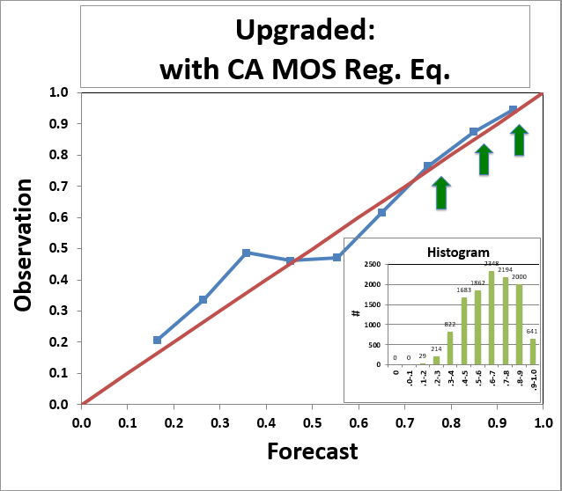
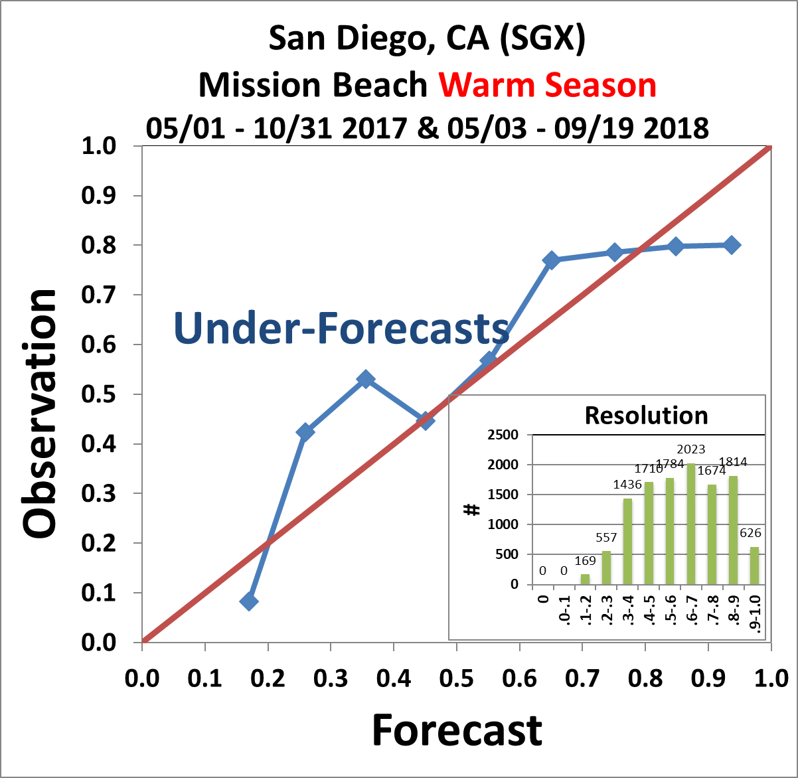
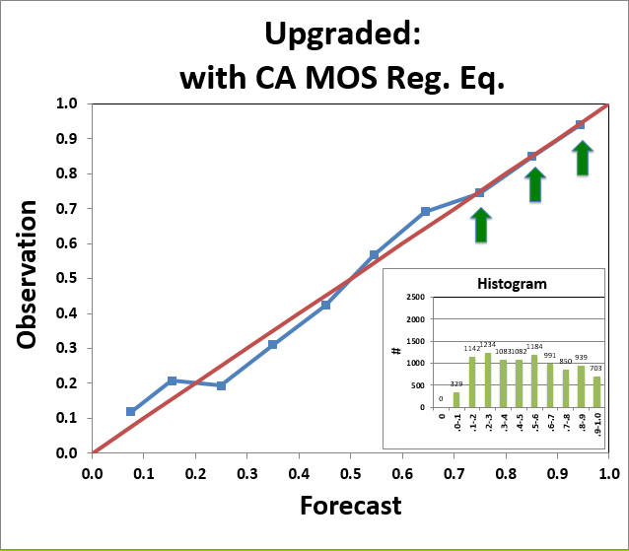
Future improvements with MDL RCMOS
The NWPS v1.3 rip current model is not calibrated with regard to either regional or seasonal variations.
The model is a “perfect prog” model, i.e., no corrections made for systematic biases of the NWPS model output (input to this model).
MDL has developed new regional and seasonal MOS logistic regression model using lifeguard obs and NWPS forecast data (Im et al., 2019, 2021).
Future versions of the NWPS rip model can be calibrated locally with RCMOS equations.
Future Model vs Sample Climate (current model) | Future Model vs traditional approach or SRF (current model)
Warm season: 12.2% (7.4%) Cool season: 26.8% (3.7%) | Warm season: 32.3% (27.1%) Cool season: 15.7% (-8.8%)
Current model
(Im et al., 2019)
Im et al. (2019)

Slide 16
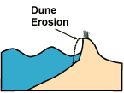
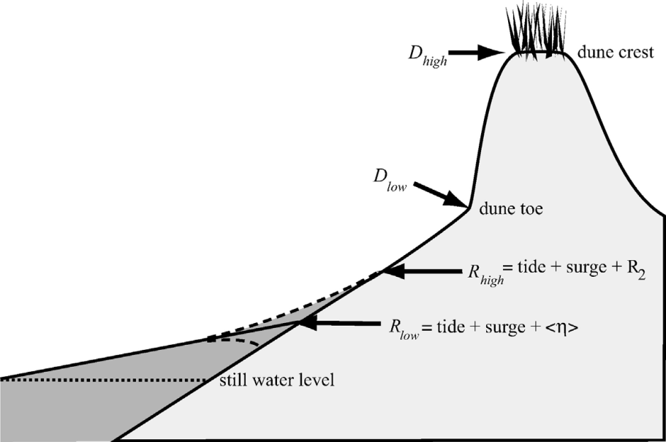
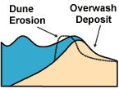

4. Wave runup guidance (Stockdon et al. 2006)
Erosion (collision)
Overwash
Inundation
12

Slide 17
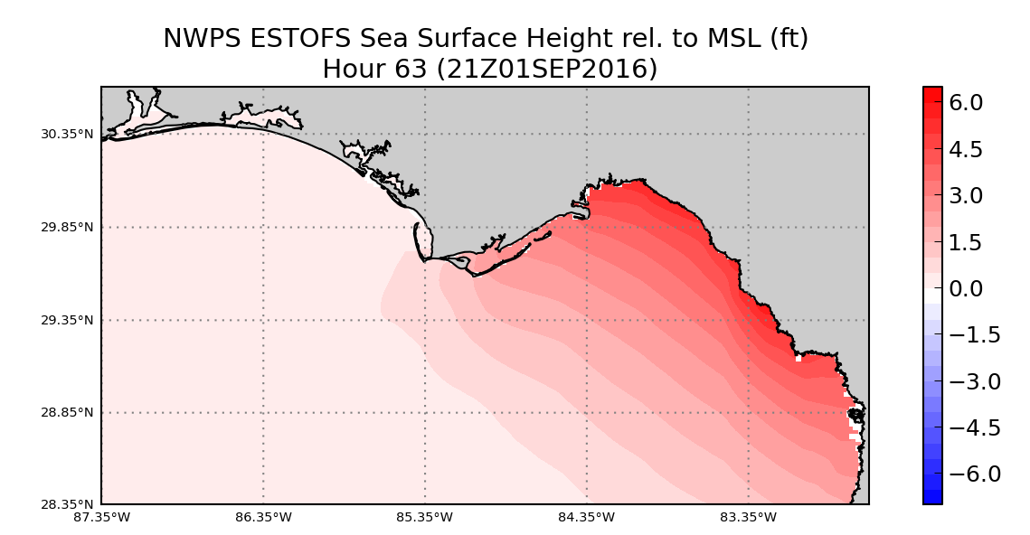
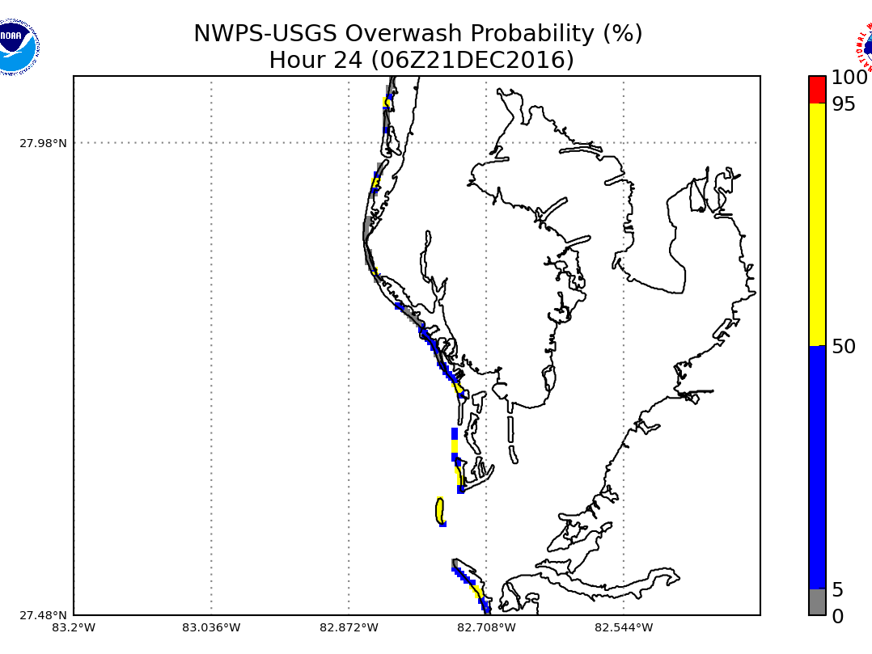
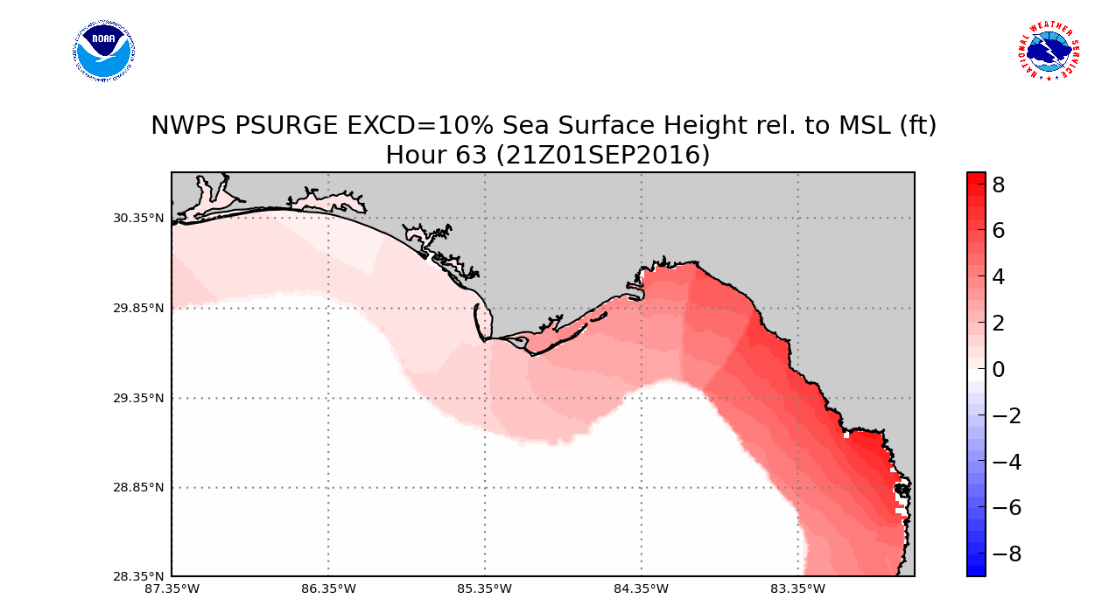
Gridded runup guidance (e.g. WFO Tampa)
ADCIRC-based
deterministic tides+wind surge
SLOSH-based
probabilistic tides+wind surge

Slide 18
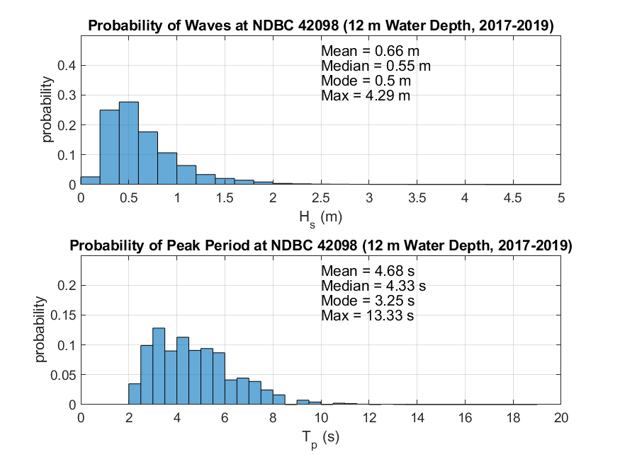
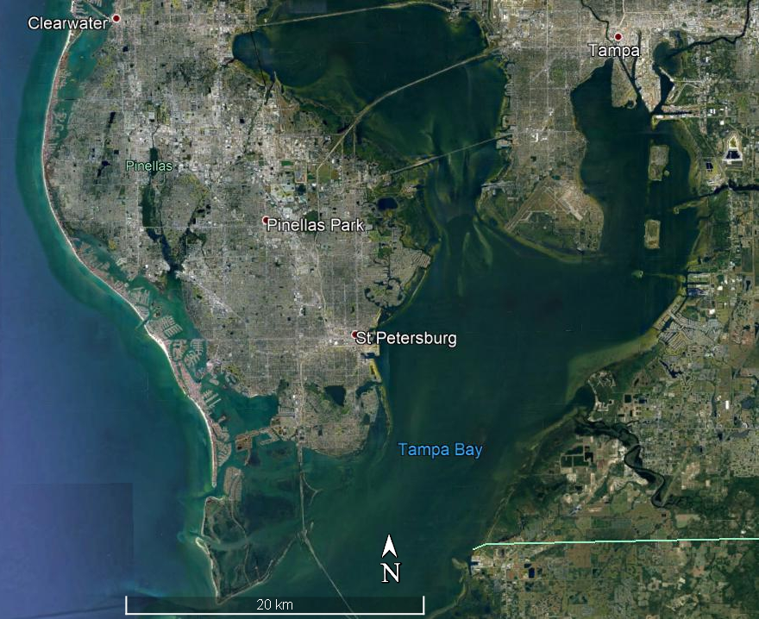
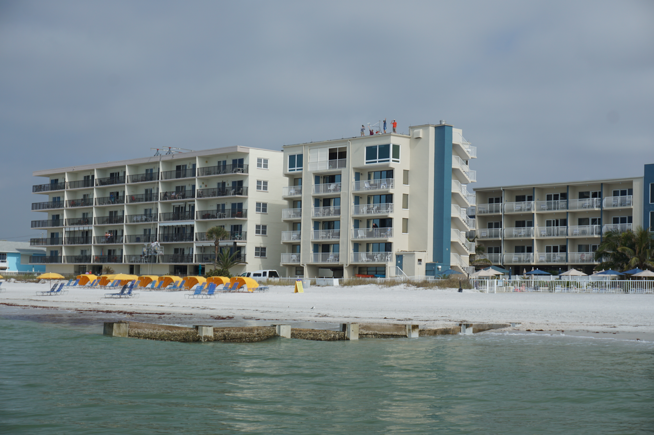
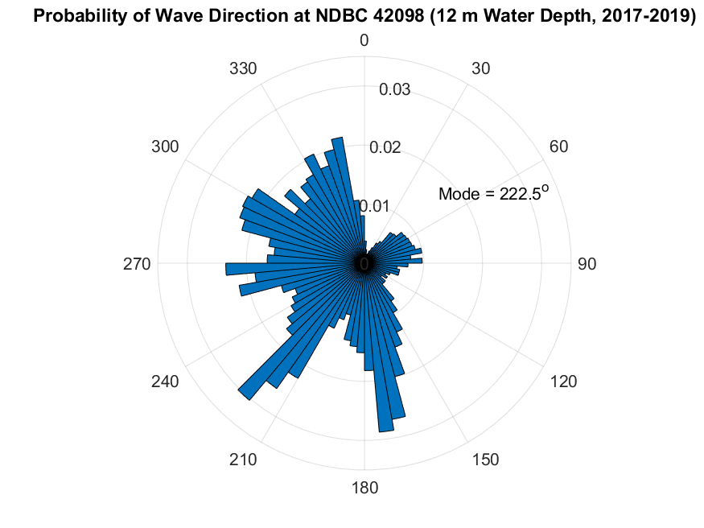
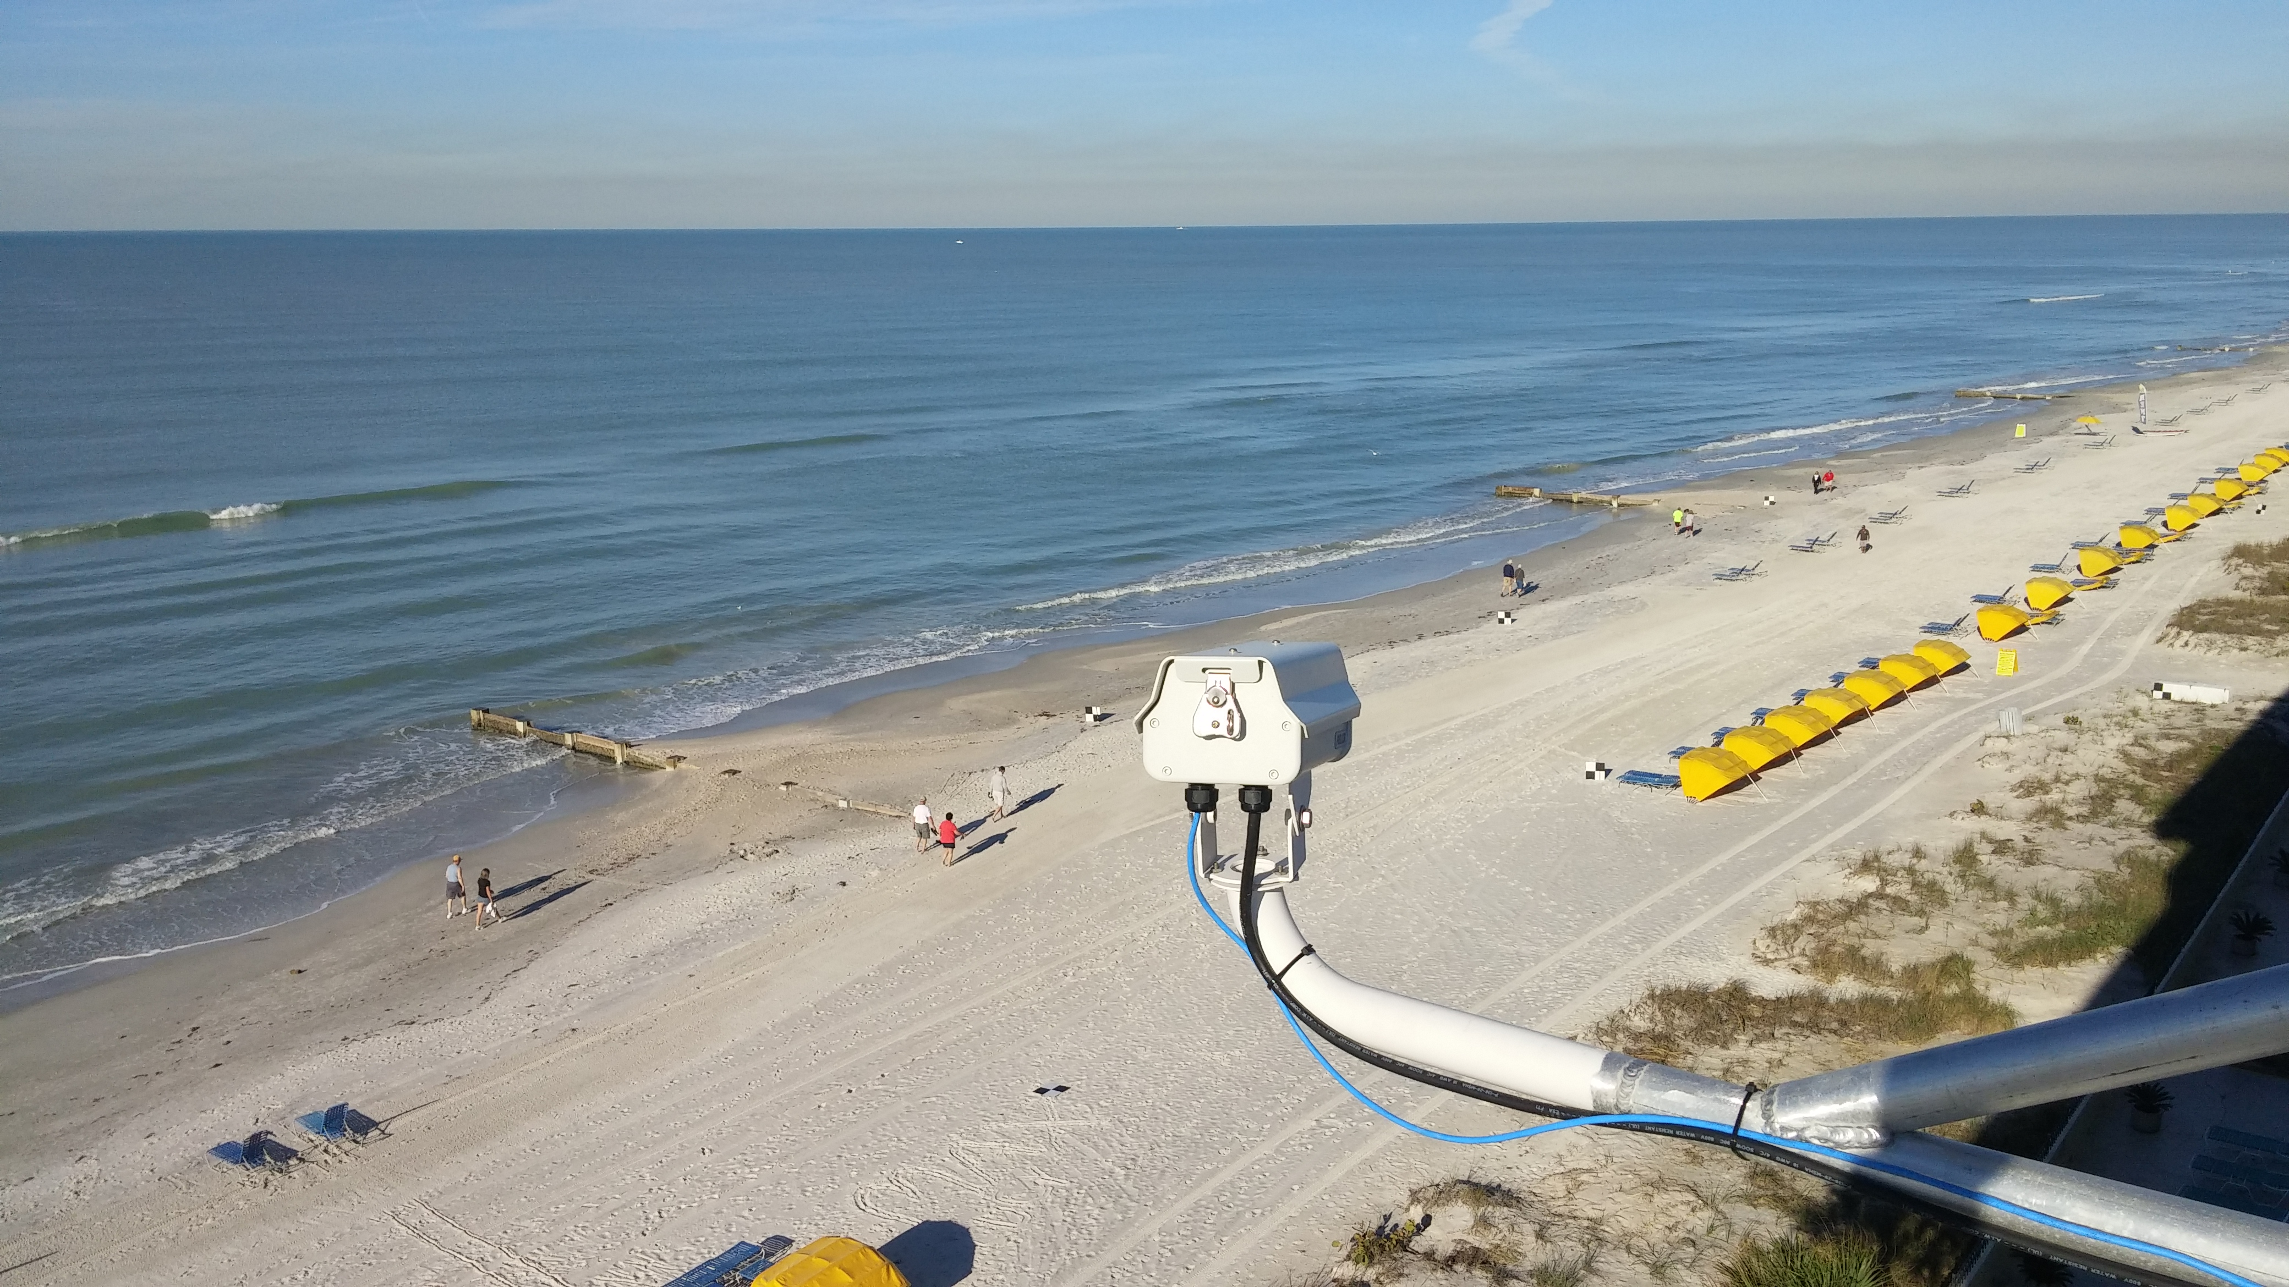
Wave Runup Validation: Experimental Site
USGS CoastCam; Madeira Beach, FL; Jan 2017-Present
Camera
Camera
Tidal range = 0.8 m

Slide 19
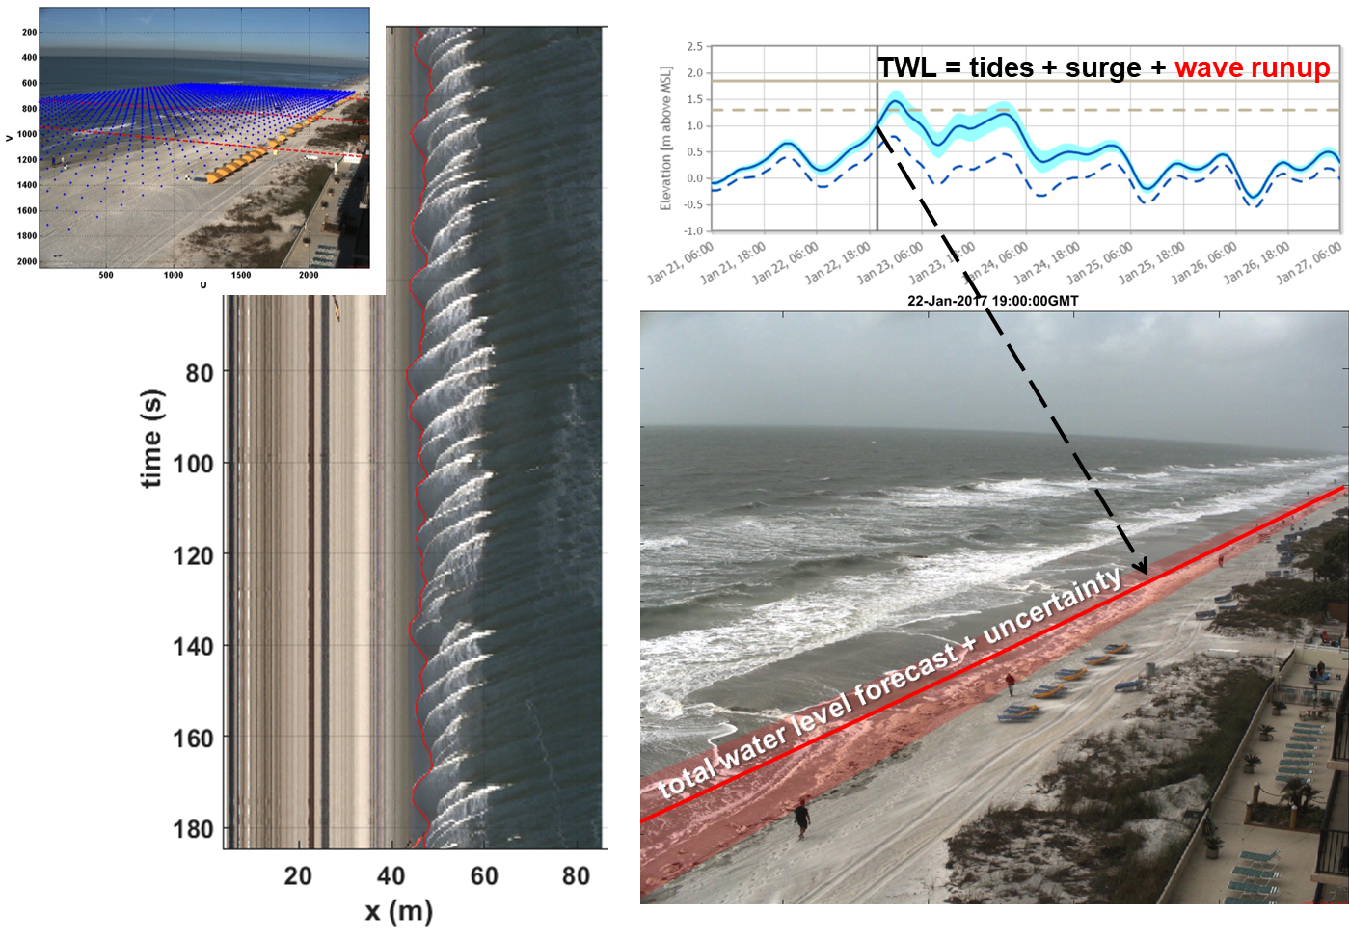
Wave Runup: Image processing and validation
Camera calibrated
Video down-sampled to a cross-shore transect
Wave swash edge is digitized and projected into real-world coordinates
Observed elevation of TWL compared to forecast

Slide 20
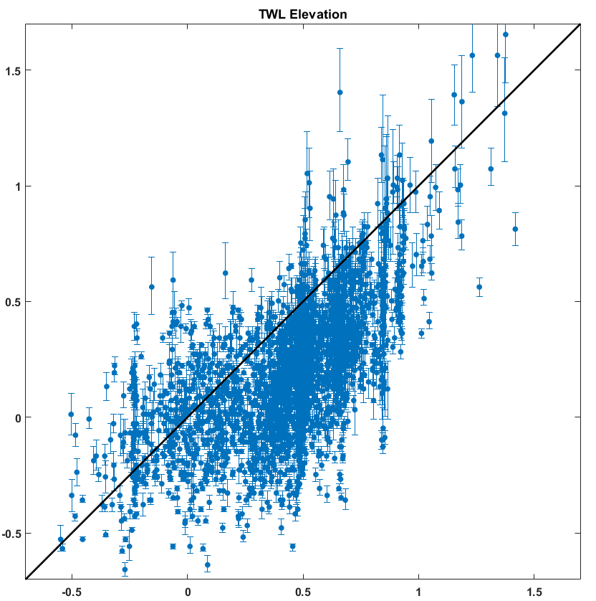
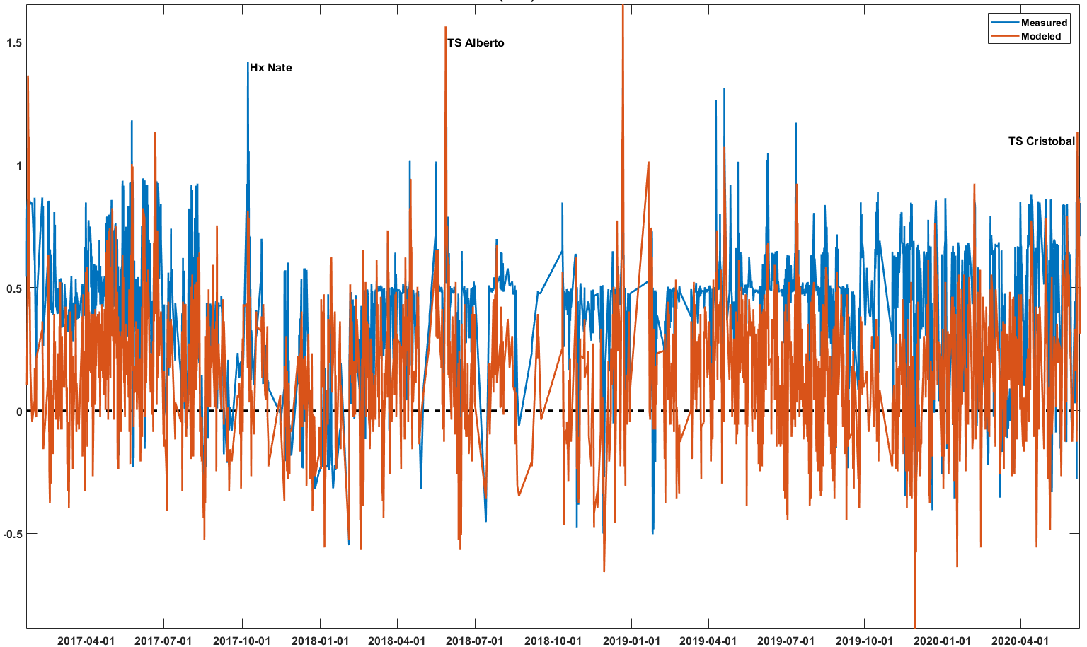
Wave Runup: Forecast validation (2017/01-2020/06)
Hx Nate
TS Alberto
TS Cristobal
Forecast (m, NAVD88)
Observed (m, NAVD88)
Date (YYYY-MM-DD)
Bias = -0.24 m, RMSE = 0.34 m, R² = 0.38

Slide 21
Conclusions and Outlook
NWPS v1.3 features new and improved guidance on wave systems, hazardous rip currents and erosion/overwash.
The rip current model performed well at most locations, but not all:
      - In NWPS v1.3, a single equation from the North Carolina “perfect prog
      model” has been applied to all WFOs, without local tuning.
      - No bias correction has been applied to inputs.
      - Model coefficients can be fit locally and seasonally (Im et al., 2019).
      - Different and additional sets of predictors to be investigated.
      - Quality of observations can be improved.
The wave runup model performed well at single long-term monitoring station. Future enhancements include:
- Expand validation by adding remote sensing stations to more locations.
- Introduce additional expressions for different shore types (e.g. rubble mound).

Slide 22
References
Dusek, G. and H. Seim, 2013. A probabilistic rip current forecast model. Journal of Coastal Research. 29(4). 909-925.
Im, J.-S., M. Churma, S. Smith, G. Dusek, P. Santos, J. Kuhn, A. J. van der Westhuysen, R. Padilla-Hernandez, D. Atkinson, 2019. NOAA Probabilistic Rip Current Forecast Model: Evaluation and Implementation. Poster presented at 2019 NWA Annual Meeting, Huntsville, AL.
Im, J.-S., S. Smith, M. Churma, J. Ghirardelli, G. Dusek, 2021. Rip Current Model Output Statistics (RCMOS) Modeling for Real-Time Probabilistic and Deterministic Forecasts, 19th Symposium on the Coastal Environment, 2021 AMS Annual Meeting, Boston, MA.
NWS, 2021. SCN20-116 Updated: The Nearshore Wave Prediction System (NWPS) Update v1.3 Effective on or about February 3, 2021. https://www.weather.gov/media/notification/pdf2/scn20-116nwps_v1_3aab.pdf.
Stockdon, H. F., R. A. Holman, P. A. Howd, A. H. Sallenger, 2006. Empirical parameterization of setup, swash, and runup. Coastal Engineering, Volume 53, Issue 7, 573-588.
Van der Westhuysen, A.J., 2020. Tracking of Wind-Wave Systems Using K-Means Clustering. AMS Annual Meeting, Boston, MA. https://ams.confex.com/ams/2020Annual/mediafile/Manuscript/Paper370887/VanDerWesthuysen_AMS2020_ext_abstr_paper10-4.pdf

