Slide 1
Making the Most out of Operational Ensembles with Clustering and Sensitivity Analysis
Austin Coleman¹, Jim Nelson², Brian Colle³, Travis Wilson⁴, and Samantha Lankowicz³
VLab Forum | Feb 28th 3 – 4pm ET
¹CIRES/WPC, ²NOAA WPC, ³Stony Brook University, ⁴NOAA GSL

Slide 2
Motivation
As technology improves and NWS responsibilities expand
Forecasters have access to more data with simultaneously less time to interrogate those data
The National Blend of Models (NBM) is frequently used as a first-guess for said forecasts
Blends a large amount of forecast data, but can be seen as a black box
Forecasters desire more information about what makes up the NBM
Ensemble mean of NBM’s sub-ensemble systems (CMCE, GEFS, and ECMWF) is one way to quickly summarize solutions
Problem: it often washes out important nuance amongst ensemble membership

Slide 3
Motivation
As technology improves and NWS responsibilities expand
Forecasters have access to more data with simultaneously less time to interrogate those data
The National Blend of Models (NBM) is frequently used as a first-guess for NWS forecasts
Blends a large amount of forecast data, but can be seen as a black box
Forecasters desire more information about what makes up the NBM
Ensemble mean of NBM’s sub-ensemble systems (CMCE, GEFS, and ECMWF) is one way to quickly summarize solutions
Problem: it often washes out important nuance amongst ensemble membership
Solution? Develop a clustering approach to break down an ensemble forecast into its most prevalent scenarios!
This isn’t a viable answer either!

Slide 4
Motivation
WPC runs an ensemble clustering tool that breaks down an ensemble forecast (composed of 100 CMCE/GEFS/ECMWF members) to its prevalent scenarios
Cluster scenarios prove more skillful than the ensemble mean (Lamberson et al. 2023)
NWS forecasters use these products often (either through WPC or the DESI – Dynamic Ensemble-based Scenarios for IDSS)
In 2021, clusters were referenced over 3,600x in Area Forecast Discussions
Forecasters often request additional context about what leads to the different cluster outcomes → cue ensemble sensitivity analysis!
Ensemble clusters tell you the “what” Ensemble sensitivity tells you the “why”

Slide 5
PART 1
Ensemble Clustering | “The What”

Slide 6
But first, how does clustering work? Relies heavily on Empirical Orthogonal Function (EOF) Analysis, traditionally known in statistics as Principal Component Analysis (PCA)
Empirical Orthogonal Function (EOF) Analysis decomposes a series of spatial fields into mathematically-independent (orthogonal) modes
Method most often used by climatologists to understand leading spatial modes of variability in a time series
For example, it could be used to answer the question: What wind patterns are typically associated with various phases of the North Atlantic Oscillation?
For ensemble clustering, we seek to identify the leading spatial modes of variability amongst the ensemble membership

Slide 7
We break down the forecast (super-ensemble of CMCE, GEFS, & ECMWF) into its leading modes of variability via EOF Analysis
Leading mode of uncertainty:
SW-NE position of trough
Secondary mode of uncertainty:
Amplitude of trough

Slide 8
Common source of confusion: What do the positives and negatives mean? - Sign doesn’t matter when looking at the EOFs themselves - Only becomes important once we start clustering or looking at members in PC phase space
Leading mode of uncertainty:
SW-NE position of trough
Secondary mode of uncertainty:
Amplitude of trough

Slide 9
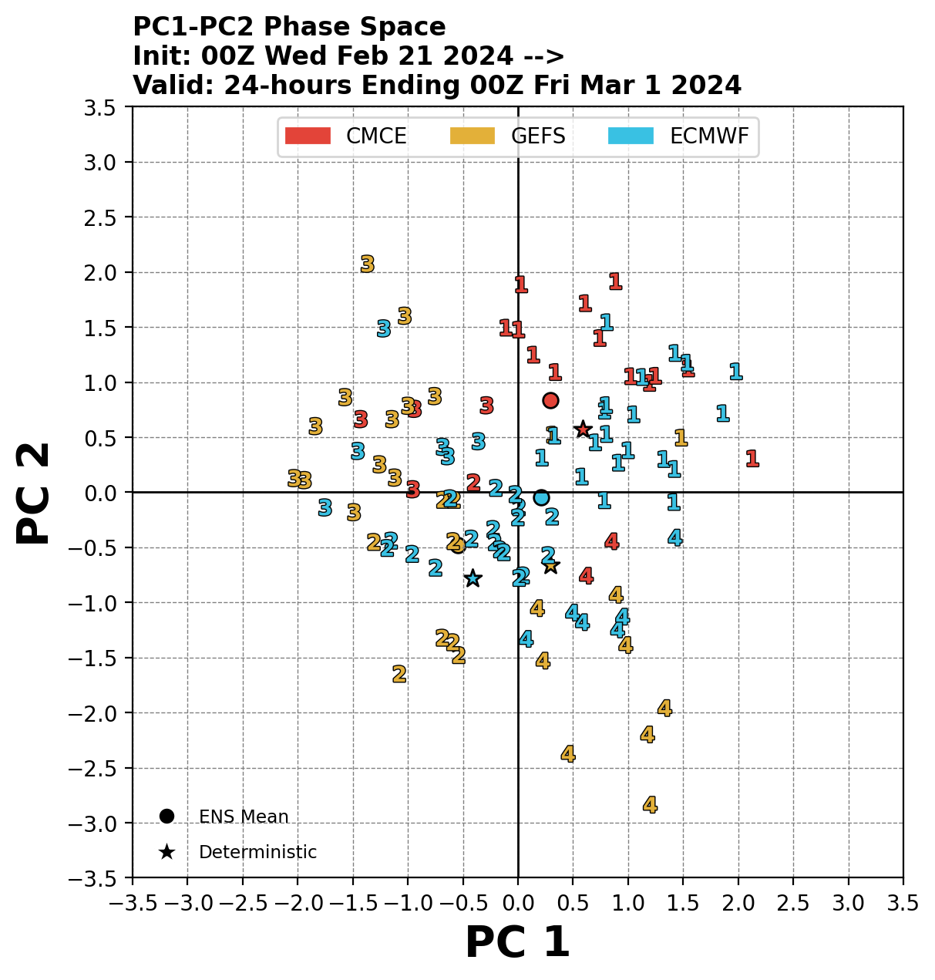
How does it work? Next, we group similar ensemble solutions together with clustering
Shallower Trough
Cluster 1
Shallower trough shifted NE
First two EOFs for reference
Projecting ensemble members into PC phase space shows us the forecast scenario for each member
EOF 1
Cluster 3
Shallower trough shifted SW
Members with positive PC1 will look more like EOF1 (trough shift NE)
whereas members with negative PC1 will look opposite EOF1 (trough shift SW)
Trough Shifted SW
Trough Shifted NE
Leading uncertainty mode:
SW-NE position of trough
EOF 2
Cluster 4
Deeper trough shifted NE
Cluster 2
Deeper trough shifted slightly SW
Secondary uncertainty mode:
Amplitude of trough
K-means Clustering groups members with similar solutions based on our leading modes of uncertainty
Deeper Trough
Notes:
Now that we know how the leading modes of ensemble forecast uncertainty look spatially, we can analyze each ensemble member in the context of those uncertainty modes by displaying them in principal component space. Basically, members with a positive PC1 will look more like EOF1 and members with a negative EOF1 will look opposite EOF1. The same goes for the secondary leading mode EOF2, and PC2. And the fact that we can summarize all of this information into 2 dimensions is pretty incredible! After plotting members in PC1-PC2 phase space, we see that some of them cluster together. To create the clusters, we use k-means clustering to assign each member to a group of similar forecasts. These are denoted by the number shown for each ensemble member.

Slide 10
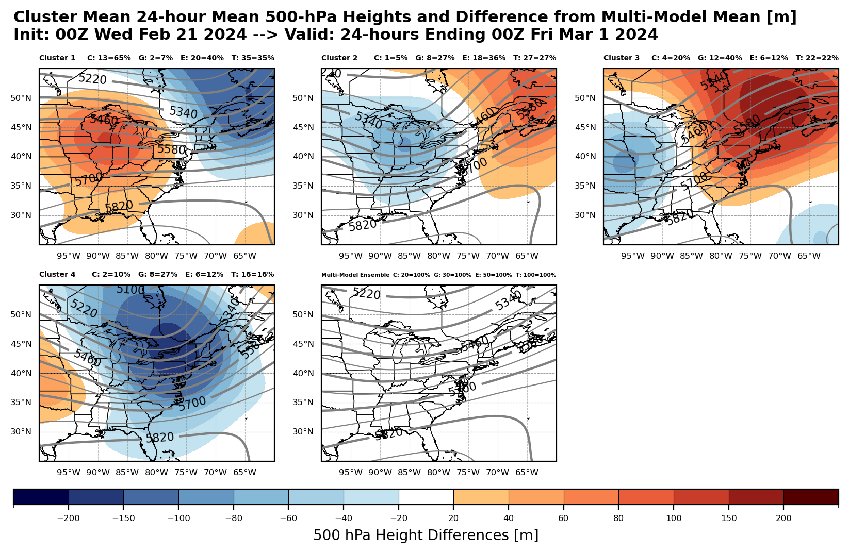
Don’t even need to look at EOFs or PCs to use! Can skip straight to the cluster forecasts (of 500-hPa heights in this case)
Cluster 1:
Shallower trough shifted NE
Cluster 2:
Deeper trough shifted slightly SW
Cluster 3:
Shallower trough shifted SW
Color-filled contours show differences from multi-model ensemble mean
Cluster 4:
Deeper trough shifted NE
Multi-model Mean

Slide 11
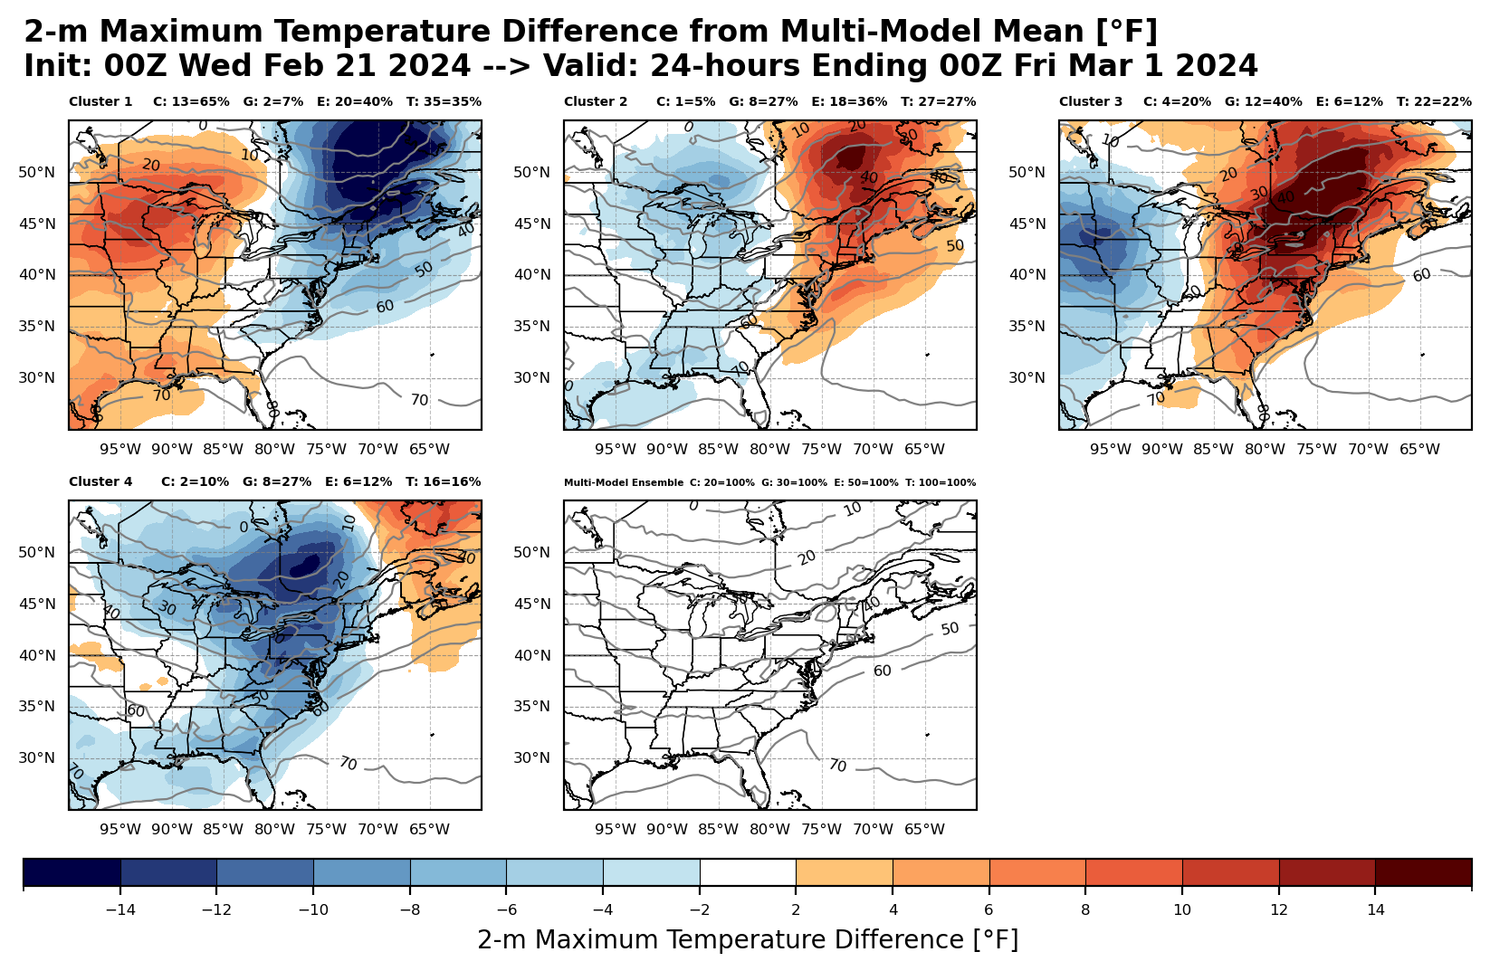
Can use 500-hPa height clusters to predict other fields Maximum Temperatures
Cluster 1:
Shallower trough shifted NE
Cluster 2:
Deeper trough shifted slightly SW
Cluster 3:
Shallower trough shifted SW
Color-filled contours show differences from multi-model ensemble mean
Cluster 4:
Deeper trough shifted NE
Multi-model Mean

Slide 12
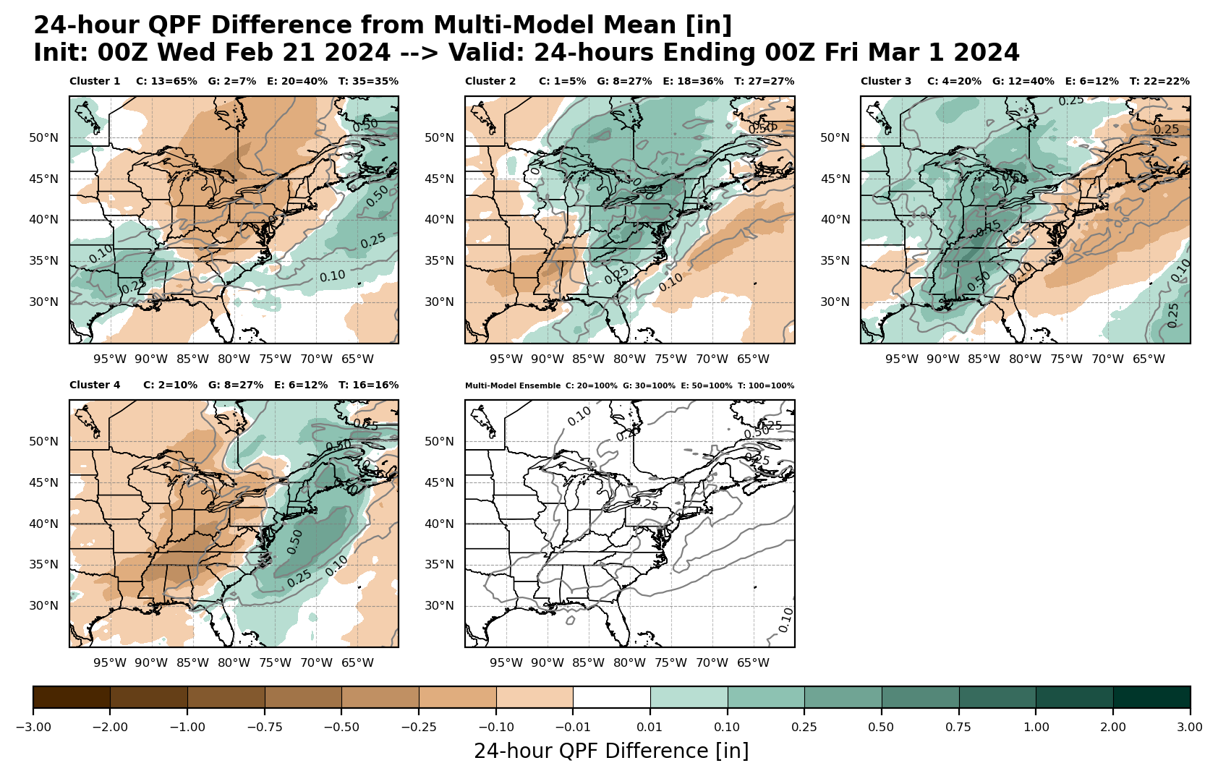
Can use 500-hPa height clusters to predict other fields 24-hr QPF
Cluster 1:
Shallower trough shifted NE
Cluster 2:
Deeper trough shifted slightly SW
Cluster 3:
Shallower trough shifted SW
Color-filled contours show differences from multi-model ensemble mean
Cluster 4:
Deeper trough shifted NE
Multi-model Mean

Slide 13
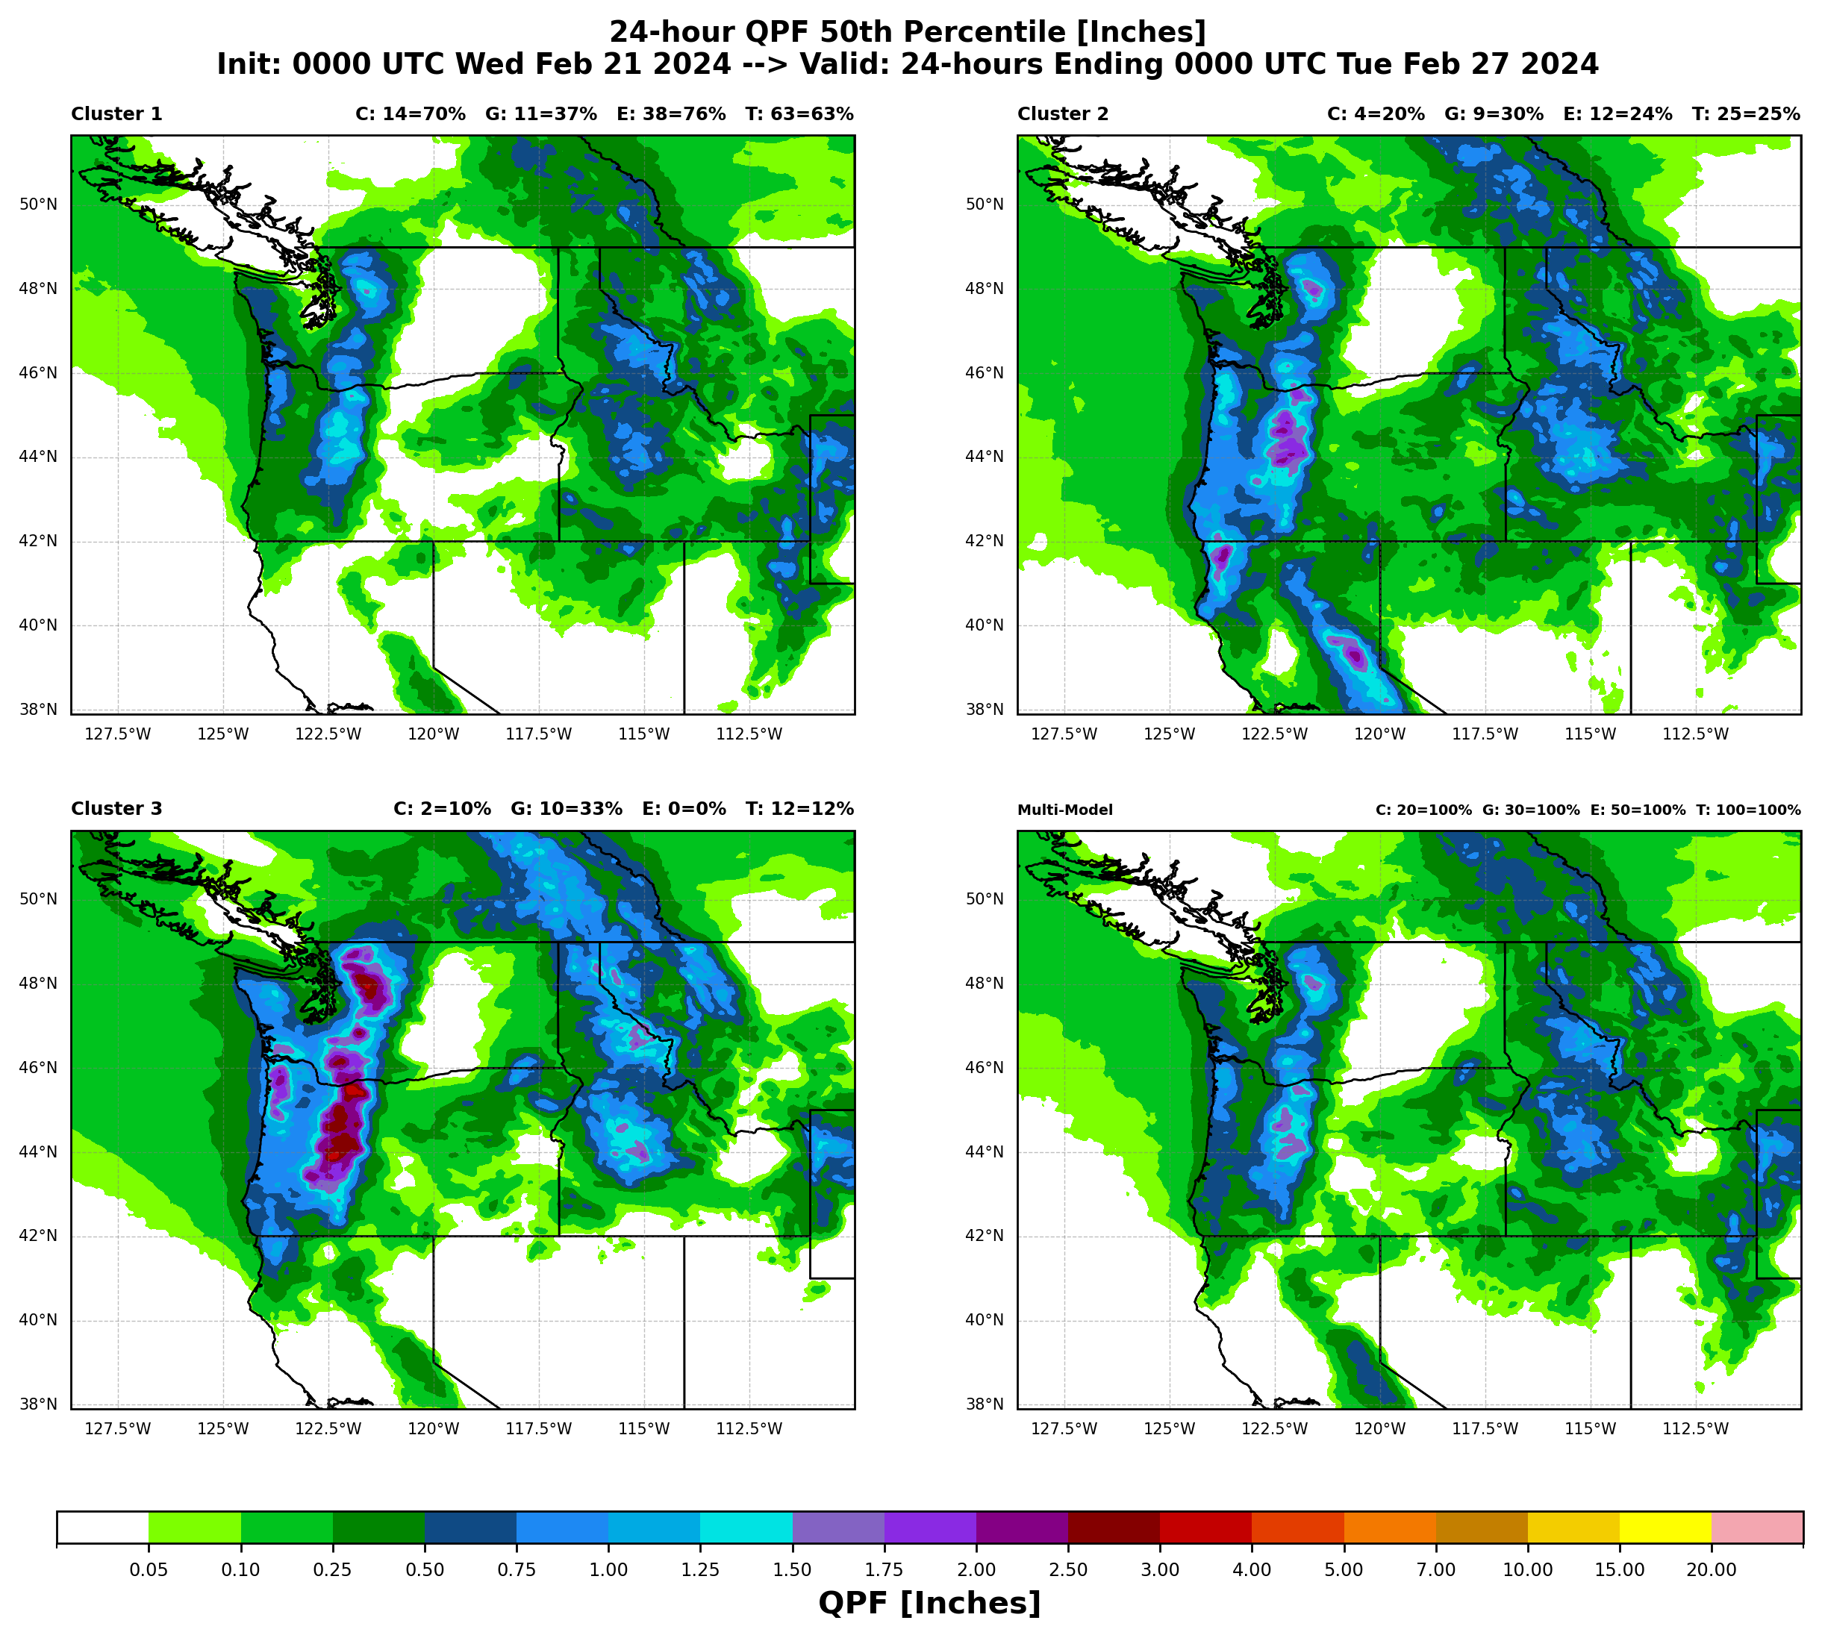
We additionally have a WPC page that clusters directly on QPF!
Algorithm
Identifies QPF objects (0.50” Day 5 QPF object shown here)
Picks a varying number of clusters based on the silhouette score (3 clusters picked here)
Provides more skillful QPF scenarios than using QPF derived from 500-hPa height clusters! (Colle, personal communication)

Slide 14
You can interrogate the clusters even more effectively with the Dynamic Ensemble-based Scenarios for IDSS (DESI)!
CAVEAT: WPC Clusters and DESI Clusters do not match exactly!
DESI uses a time-lagged ECWMF in order to plot QPF from the NBM QMDs. WPC does not use a time-lagged ECMWF ensemble.
Cluster Differences from Full Ensemble Mean

Slide 15
You can interrogate the clusters even more effectively with the Dynamic Ensemble-based Scenarios for IDSS (DESI)!
Can analyze the 500-hPa height cluster data any way you’d like!
Cluster mean MSLP & 95th percentile 24hr QPF shown here

Slide 16
You can interrogate the clusters even more effectively with the Dynamic Ensemble-based Scenarios for IDSS (DESI)!
What early forecast differences are responsible for all this forecast uncertainty?
There is a wide range of 500-hPa height scenarios here, and a wide range of potential impacts!

Slide 17
PART 2
Ensemble Sensitivity Analysis | “The Why”

Slide 18
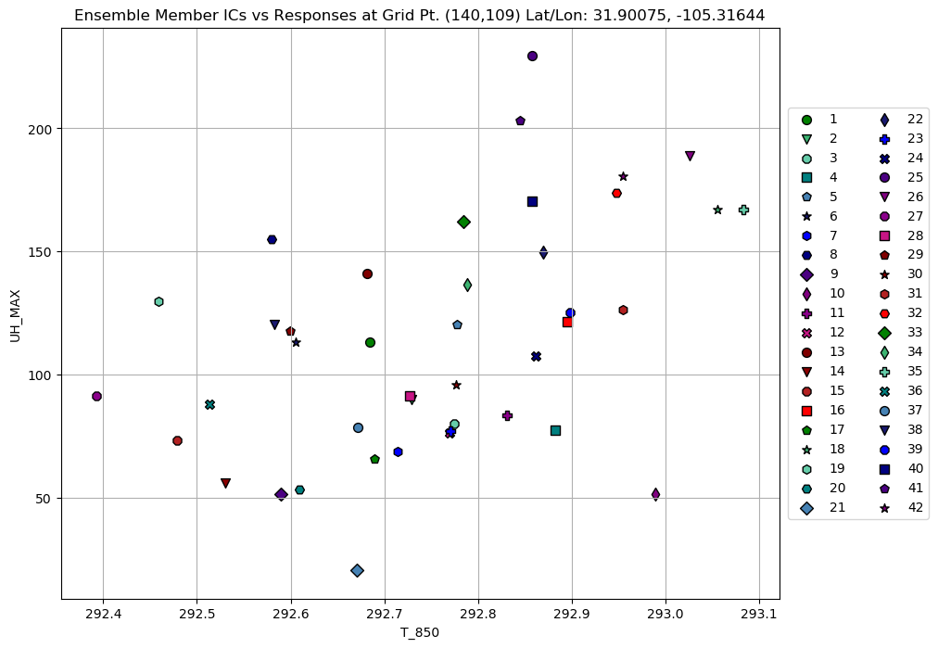
What is Ensemble Sensitivity Analysis?
Reveals how meteorological conditions early in the forecast (sensitivity variable) are linked to the evolution of a chosen high-impact forecast feature (response function)
(Hakim and Torn 2008, Ancell and Hakim 2007, Torn and Hakim 2008)
Simply the slope of a linear regression line:
$$\frac{∂J}{∂x_{0}}$$
$$J≡response function$$
$$x_{0}≡sensitivity variable$$
Ensemble Sensitivity $≡$ Slope of the Linear Regression
Member 1-hour UH Max at f25
(Response Function = J)
Member 850 hPa Temperature at f6
(Sensitivity Variable = x₀)

Slide 19
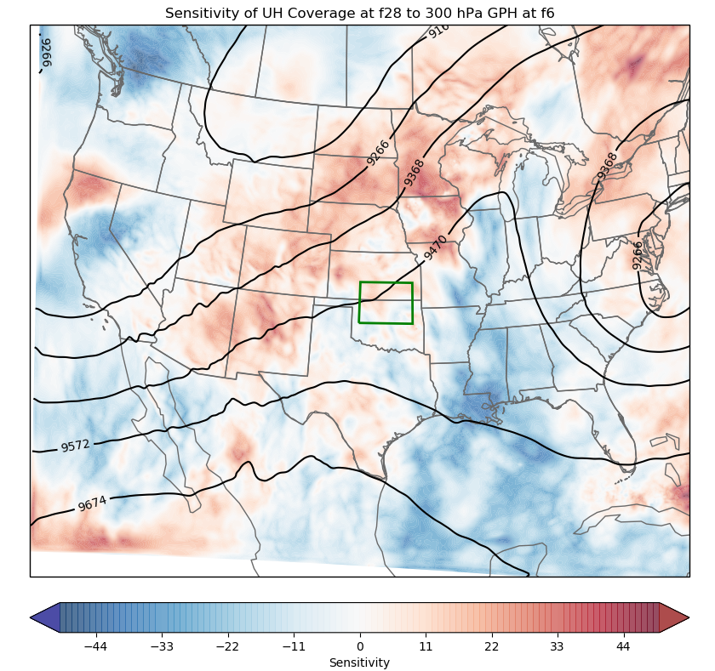
Ensemble Sensitivity Fields
Powerful tool: Sensitivity fields show us which early forecast features the ensemble “cares” most about in predicting high-impact weather!
More Examples of Sensitivity Variables and Response Functions:
Sensitivity Variables
(Predictors)
500 hPa GPH
2m Temperature
700 hPa Temperature
SLP
300 hPa U, V
850 hPa Temperature
850 hPa Moisture
High 10m Wind Speed (>40 mph) Coverage
High 24hr QPF (>2”) Coverage
High Reflectivity (>40 dBZ) Coverage
Coverage Responses
Max Precipitation Accumulation
Max Simulated Reflectivity
Magnitude Responses
Response Functions
(High-Impact Forecast Features)
Max 10m Wind Speed
Response Box
Sensitivity time (early)
Response time (later)
(# high UH points / meter geopotential height)

Slide 20
In our use case, ESA tells us how the atmosphere needs to evolve early on in order to look like a given EOF! Let’s regress the phase speed uncertainty of the pattern back onto the early 500-hPa height field
+ PC1 means trough shifted to the NE
- PC1 means trough shifted to the SW
Uncertainty:
Position of trough relative to full ensemble mean
(phase speed)
Notes:
Mention 4 pre-defined response domains corresponding with cluster domains, and 1 potential floater domain we’re trying to figure out how to implement

Slide 21
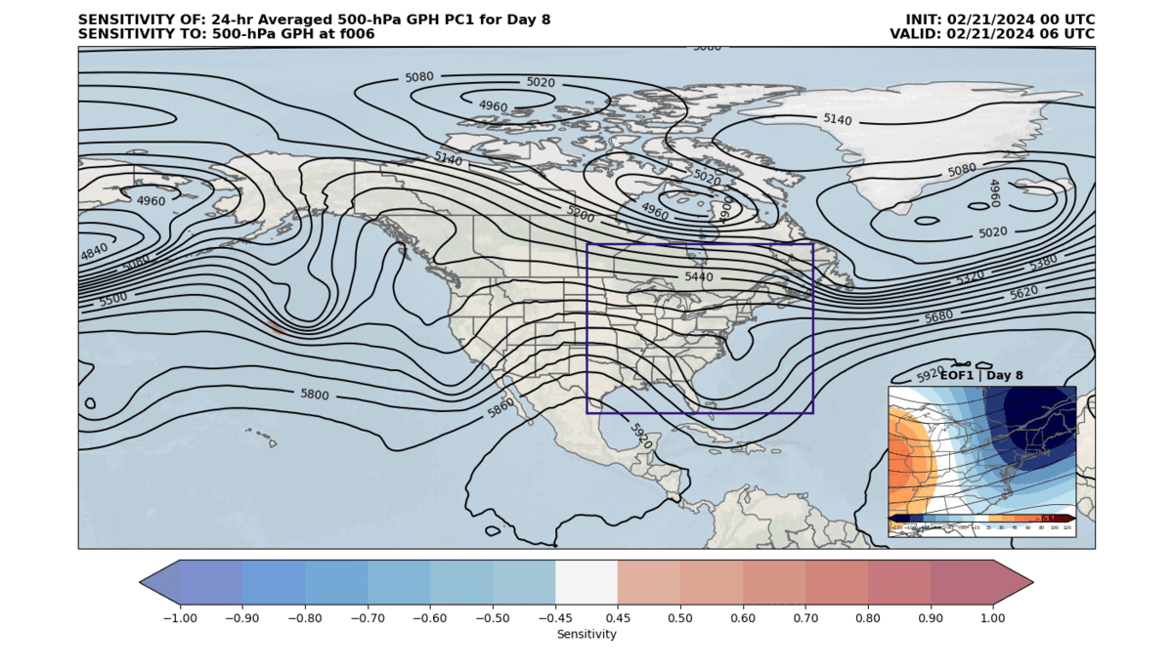
ESA shows us what the ensemble “cares about” most when predicting the position of the trough at Day 8
When we calculate the standardized sensitivity of PC values to the early forecast state, the slope of the linear regression line becomes a correlation!

Slide 22
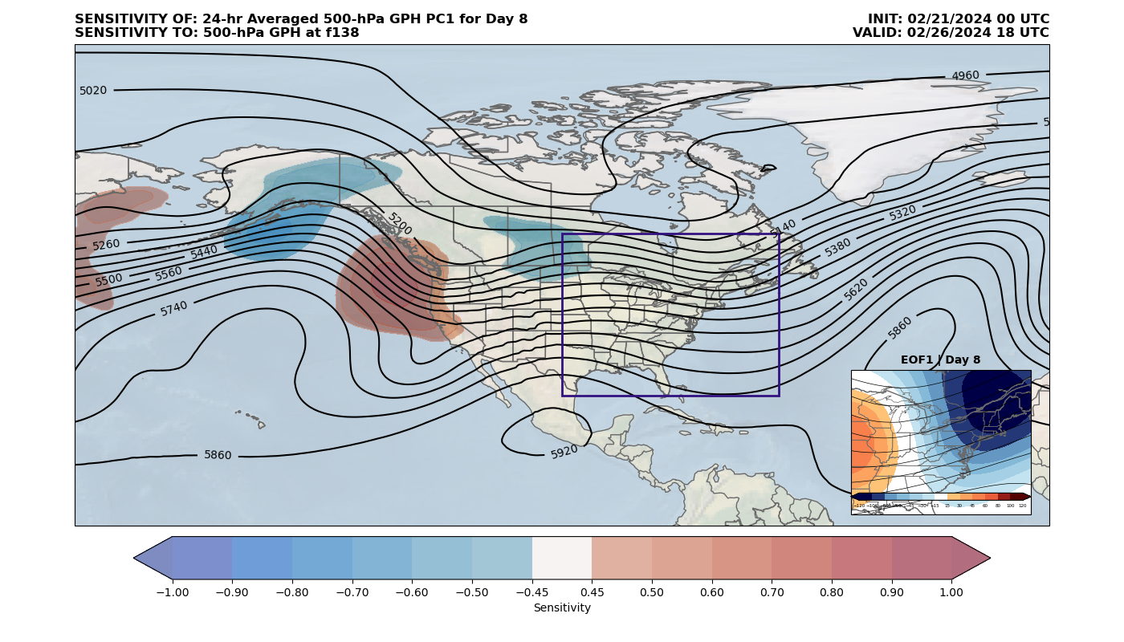
ESA shows us what the ensemble “cares about” most when predicting the position of the trough at Day 8
When we calculate the standardized sensitivity of PC values to the early forecast state, the slope of the linear regression line becomes a correlation!
Monopole in ESA Field along mean ridge axis
Members with shallower ridge here will have more progressive trough in East on Day 8
Members with amplified ridging here will have less progressive trough in East on Day 8
Dipole collocated with mean trough axis in ESA Field
Members with trough shifted NE of mean will have trough shifted to the NE on Day 8
Monopole collocated with shortwave ridge in ESA Field
Members with amplified shortwave ridge here more likely to have more progressive trough on Day 8

Slide 23
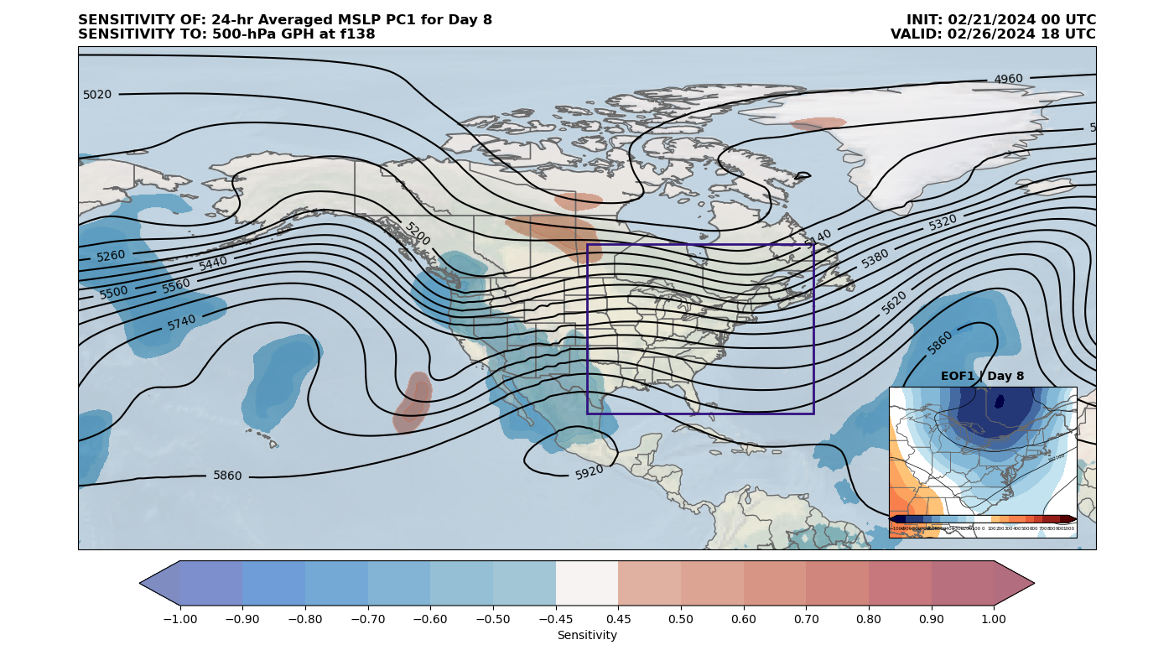
We can also conduct sensitivities of MSLP PCs back to the early forecast 500-hPa height field
This product could be particularly useful during the hurricane season for tropical cyclone sensitivity fields
Members with a deeper trough than average here more likely to have stronger and more progressive surface low on Day 8
Main Uncertainty:
Depth & Position of Surface Low
Members with a shallower trough than average here more likely to have a stronger and more progressive surface low on Day 8

Slide 24
Ongoing and Future Work | Clustering
- Recent Updates:
Hawaii QPF Cluster Page (based on NBM 4.2 QMDs)
Added Pacific 500Z Cluster Domain to WPC page for use in AR Forecasting and by Alaska region
Worked with the wonderful team at COMET to publish a cluster training module! ☺
Added ability for DESI clusters to handle missing members (requires >80% membership)
- Developing a medium-range WPC MSLP Cluster page for tropical cyclone and winter weather forecast applications (expected mid-March)
- Adopting a cluster consistency approach in DESI similar to that used by the Japan Meteorological Agency (expected with fall DESI release)
- Creating a verification dashboard with bulk long-term cluster statistics (expected late 2024)

Slide 25
Ongoing and Future Work | Ensemble Sensitivity
- Will replace WPC 500Z Cluster page with combined 500Z Cluster & ESA page once ECMWF section of ESA page is password-protected (expected soon)
For now, it’s linked here!
- Start soliciting feedback from forecasters and testing in the HMT testbeds (over the next few years)
- Work on a sensitivity-based ensemble subsetting application that objectively identifies most likely scenario to verify as event unfolds (long-term goal)
- Explore ESA & Clustering applications with RRFS-based convection-allowing ensemble systems (long-term goal)

Slide 26
Take-Home Points
Ensemble clustering is a quick way to distill an ensemble forecast down to its prevalent scenarios
Ensemble sensitivity analysis (ESA) provides context on how the atmosphere must evolve to lead to different cluster scenarios
Allows you to hedge your bets on a particular scenario as the event unfolds
Testament to the potential of data mining ensemble systems
As we continue to build techniques that extract information from these datasets, need to keep forecaster needs at the forefront
Lots of room for O2R/R2O in these spaces

Slide 27
BONUS SLIDES

Slide 28
Introduction
Forecasters often request additional context about what leads to the different cluster outcomes → cue ensemble sensitivity analysis!
Ensemble sensitivity analysis (ESA) offers a quick, efficient way to diagnose sources of high-impact forecast uncertainty

Slide 29
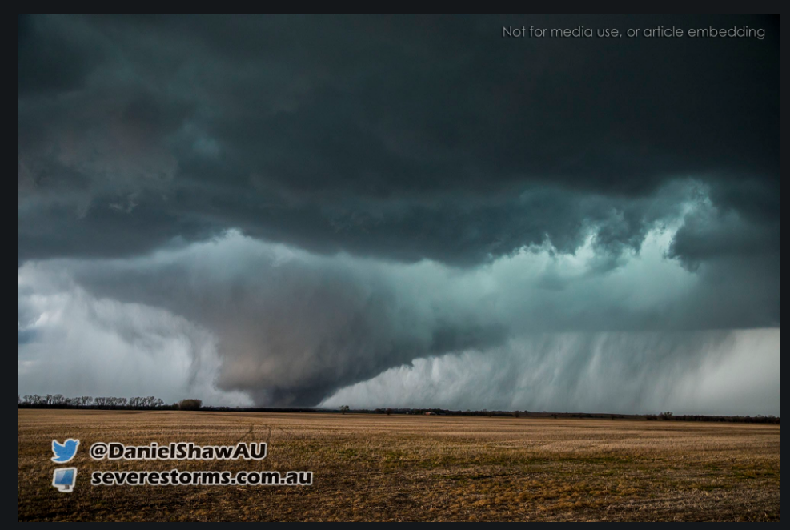
Sensitivity-based Ensemble Subsetting picks forecast solutions with best handle on early sensitive regions
Goal: Pick the ensemble members with the best forecast of a chosen high-impact event
Combine ESA and analyses (“truth”) at early forecast times to pick members with best representation of sensitive regions!
Proven beneficial to synoptic- and convective-scale forecasts in an idealized framework
(Ancell 2016; Coleman and Ancell 2020)

Slide 30
Subsetting Example with a Single Point
Subset Mean
Member 1-hour UH Max at f25
(Response Function)
Full Ensemble Mean
Member 850 hPa Temperature at f6
(Sensitivity Variable)
Truth at 06 UTC

Slide 31
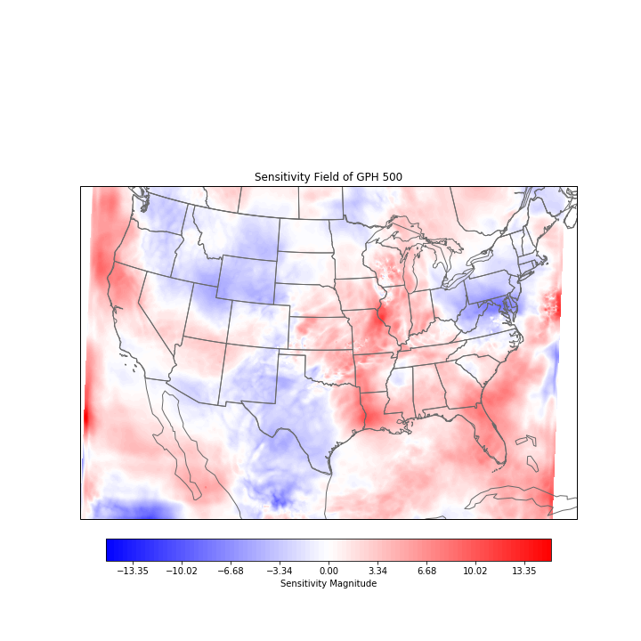
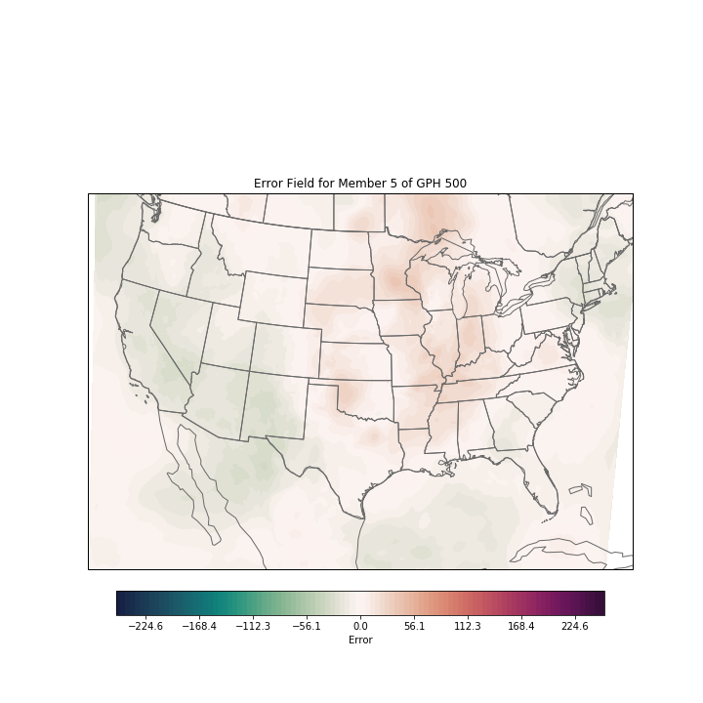
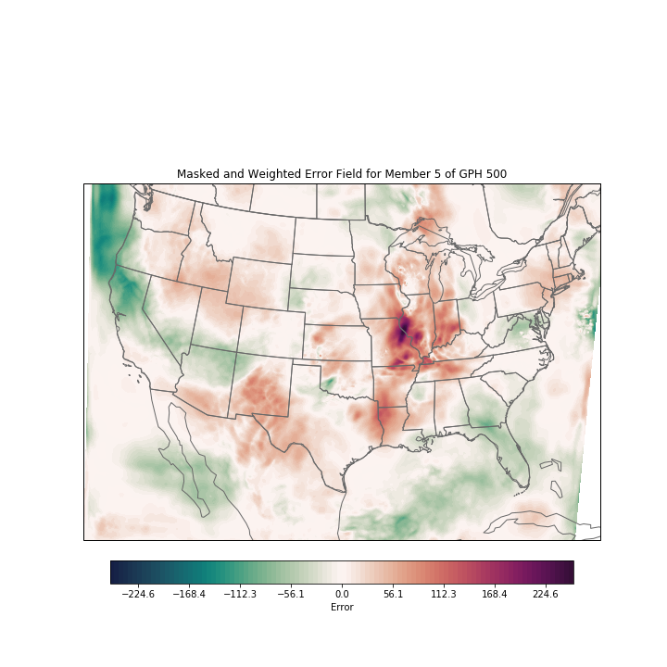
In practice, we use the Projection Technique
Sensitivity field is projected onto error field for each ensemble member to get an error field weighted by ensemble sensitivity.
$$×$$
$$=$$
Repeat for each sensitivity variable of interest and sum over all sensitivity variables and grid points! Then repeat for each ensemble member and rank by summed sensitivity-weighted errors.

Slide 32
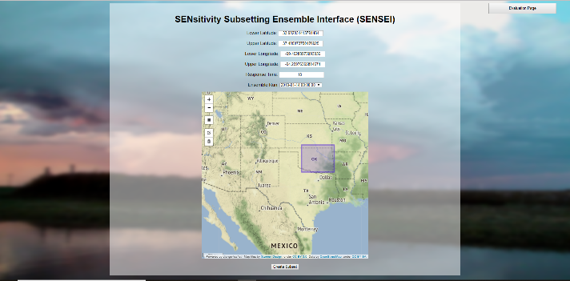
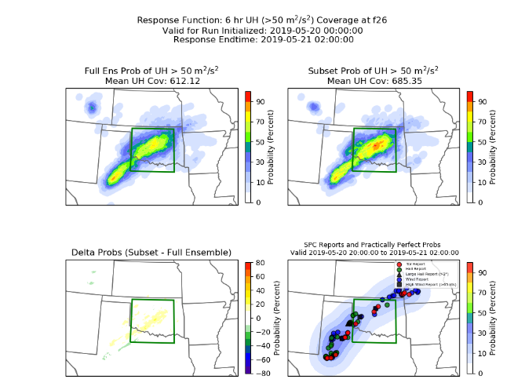
Hazardous Weather Testbed Spring Experiments
Variations of subsetting tool tested throughout its evolution at the 2018, 2019, 2020, and 2022 testbeds
Response box chosen by participants of HWT every day with a web GUI (SENSEI)
Next day, participants compare subsets to full ensemble to reports and evaluate
Testament to the importance of O2R in developing these tools! ☺

Slide 33
HWT SFE Overview of Results
Sensitivity-based subsetting improved ensemble forecast probabilities 53% of the time
Even if no improvement noted, technique rarely degraded forecast
Applying sensitivities
from TTU system to
external systems to
generate subsets
not as effective
Subsets subjectively outperformed their full ensemble counterparts over 50% of the time even when applied to multiphysics ensemble systems**
**Statistics only aggregated over 9 cases due to data flow issues throughout the 2022 HWT SFE

