Slide 1
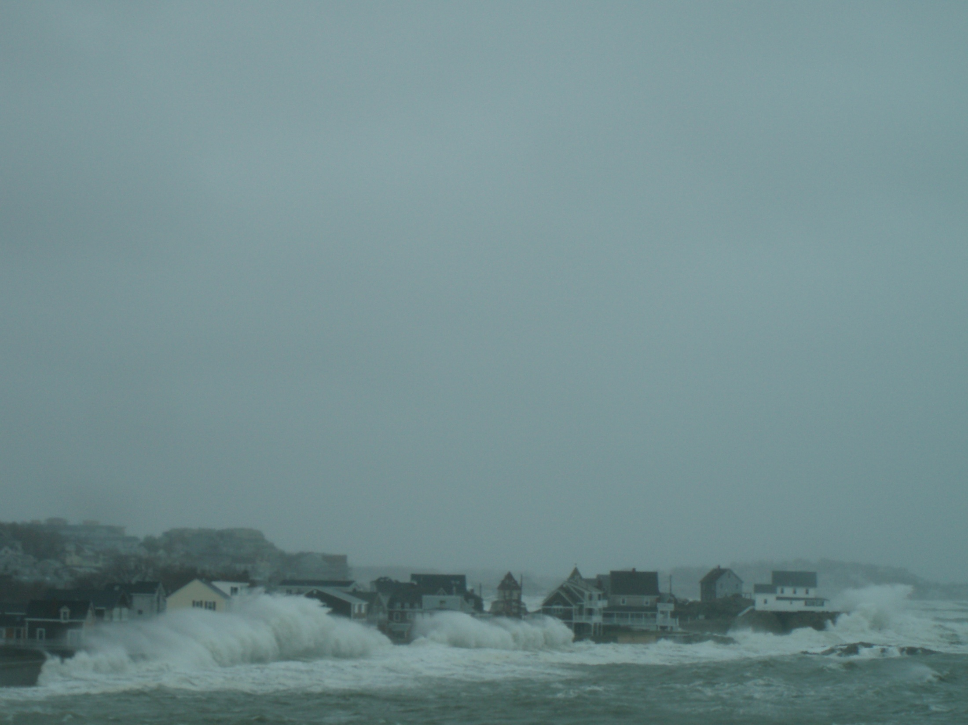
Forecasting Wave Runup & Overtopping
Tony Mignone National Weather Service Caribou Maine anthony.mignone@noaa.gov

Slide 2
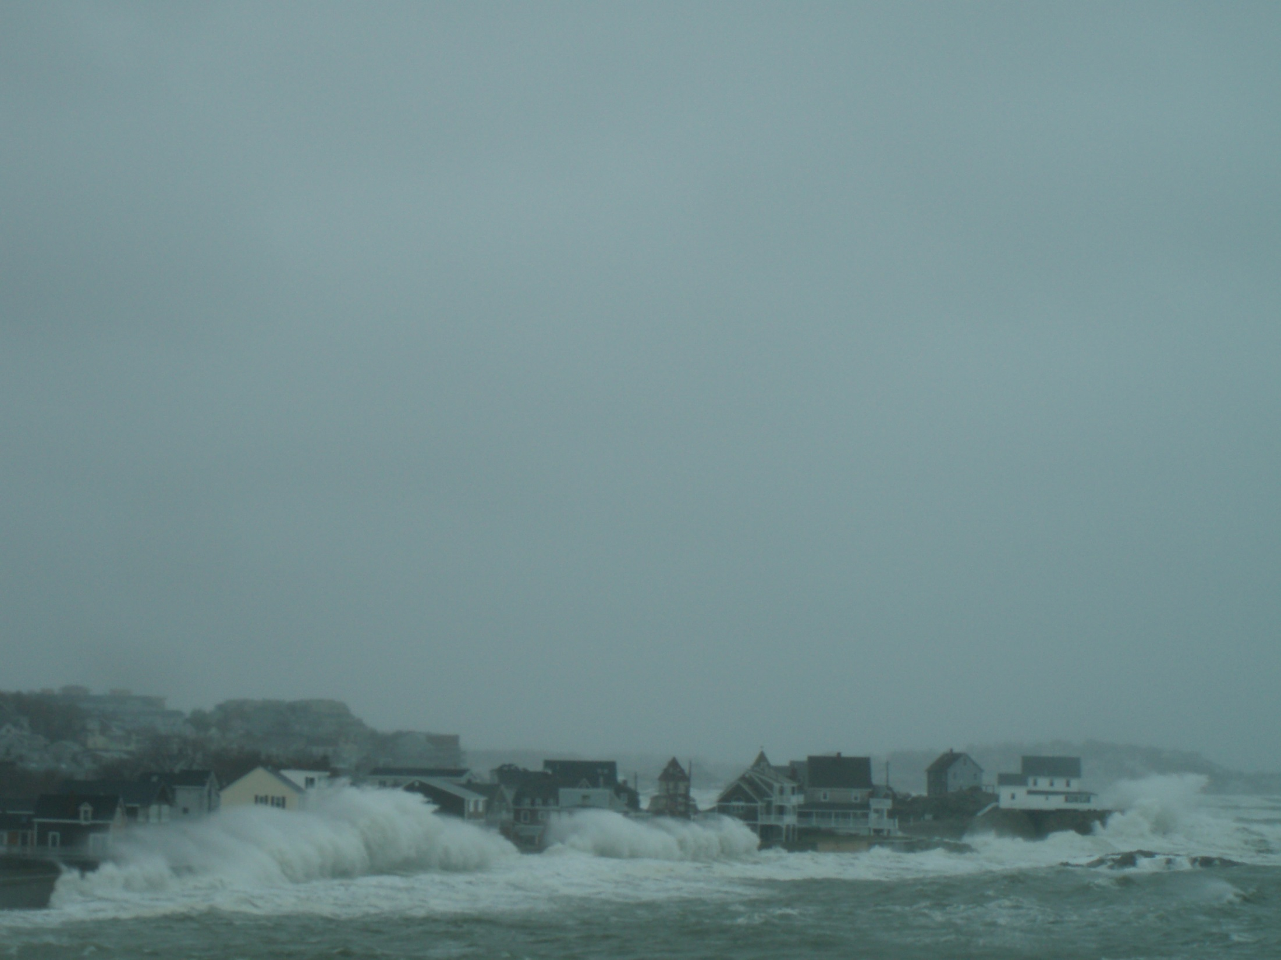
Service Assessment
Hurricane/Post-Tropical Cyclone Sandy
October 22-29, 2012
Finding 16:
NWS lacks sufficient forecast guidance on inundation associated with wave runup and coastal rivers making it difficult to forecast impacts from coastal storms.

Slide 3
Introduce Tools to forecast Wave runup and overtopping
Runup on Sandy Beaches
Dune Erosion
Overtopping of Seawalls
Overtopping of Stone Armored Revetments

Slide 4
Runup on a Sandy Beach

Slide 6
Parameterization for Runup Elevation
Dr. Hilary Stockdon
Ground truthed extensively
Tested in Hurricanes Bonnie, Floyd, Ike, and Ivan
Real time forecasts done every season since Hurricane Ivan

Slide 7
Input Parameters
Deepwater Wave Height
Wave Length
Foreshore Beach Slope

Slide 8
Computing Wave Setup
$$η$$
Wave Setup
Super Elevated water level due to wave action
Time averaged

Slide 9
Wave Setup + Wave Runup
Wave Setup
Swash
Time varying water level
Large waves making incursions up the beach

Slide 10
Infra-Gravity Waves
Infra-Gravity Waves
Long period waves of 3 to 30 minutes
Generated in areas of differential Radiation stress in swell groups in transit from the fetch area to the coast.

Slide 11
Dune Erosion

Slide 12
Dune Erosion
A. H. Sallenger Jr. Scaling Model “Collision Regime”
Dune Crest
Maximum Runup level
Above dune toe
Below dune crest
Dune
Toe
Erosion of seaward dune face
Swash
η
Still Water Level SWL

Slide 13
Dune Erosion
A. H. Sallenger Jr. Scaling Model “Overtopping Regime”
Infrastructure behind dune
Maximum Runup level
Above dune crest
Erosion of dune
Heavy
Erosion of dune
η
Swash
SWL

Slide 14
Dune Erosion
A. H. Sallenger Jr. Scaling Model “Inundation Regime”
Infrastructure behind dune
Maximum Setup Level
Wave Setup
η
Loss of dune
Wave Setup
Swash
SWL

Slide 15
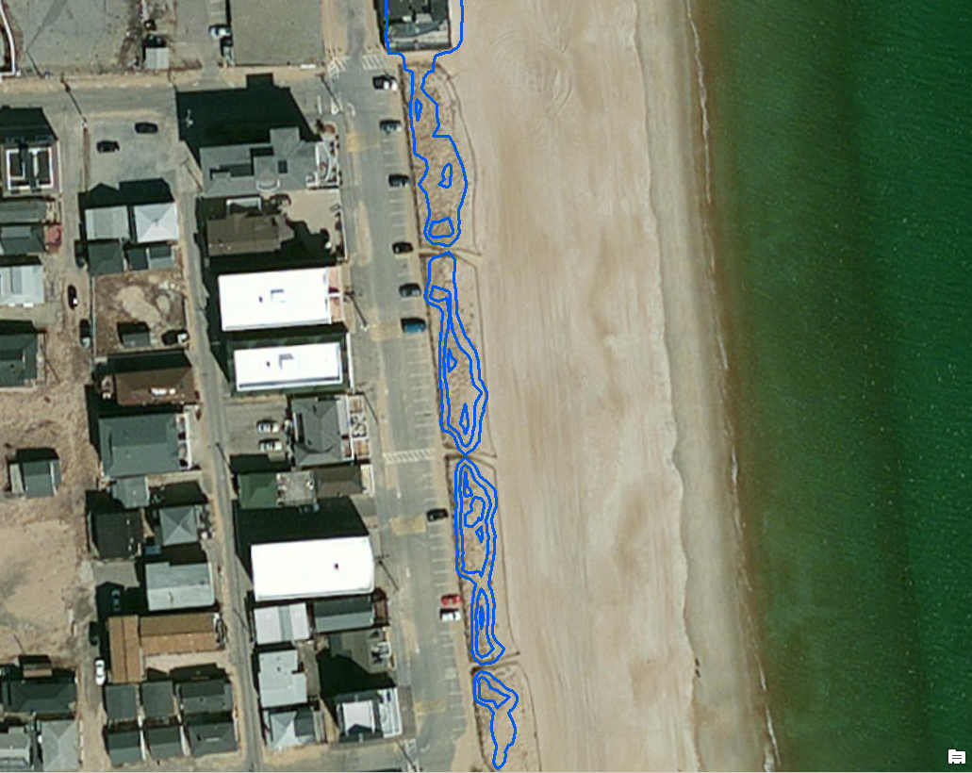
Infrastructure protected by a dune
Dune
Dune
Dune
Dune

Slide 16
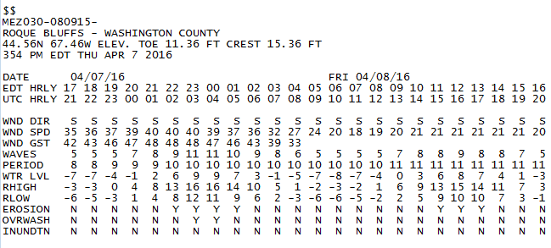
Runup Matrices
Using the Stockdon Parameterization
Roque Bluffs Test Site
Matrices for April 7-8, 2016 Storm
Sallenger Regime levels are Predicted in Matrices

Slide 17
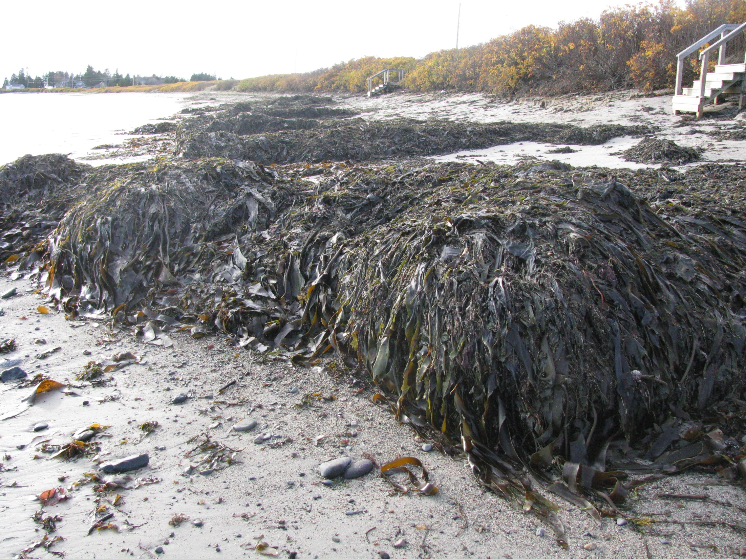
Dune
Roque Bluffs Beach

Slide 18
Roque Bluffs Verification Results
April 7-8, 2016 Storm
Lead Time Erosion Overwash Inundation
70 hours yes yes no
58 hours yes yes no
46 hours yes yes no
34 hours yes yes no
22 hours yes yes no
10 hours yes yes no
Occurred
Occurred
Did Not Occur

Slide 19
Overtopping A Vertical Seawall

Slide 20
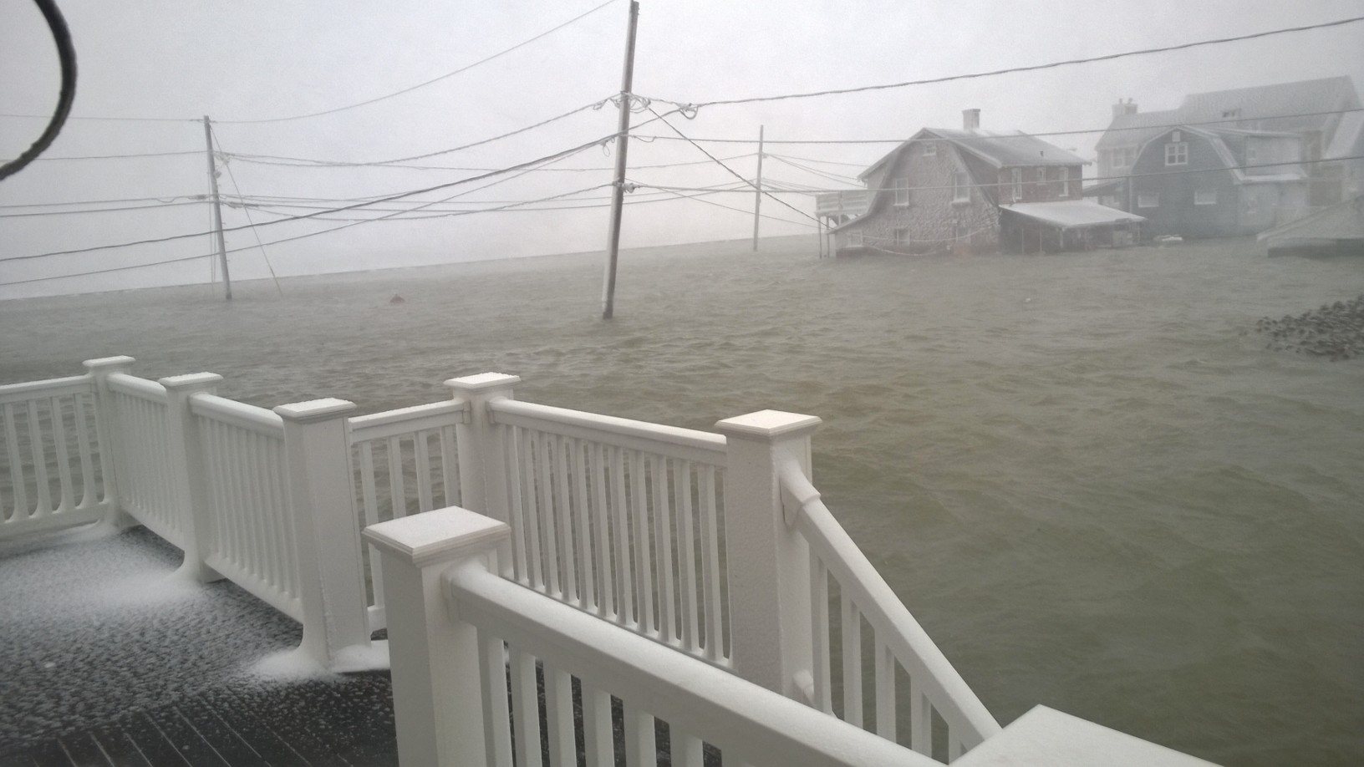
Overtopping of a Seawall
Time Stamp = 27th/0754 EST
Water Level = 15.476 feet
Seawall
Seawall
Seawall
Stop Sign 7th &
Ocean Side Dr.
Scituate, MA January 27, 2015

Slide 22
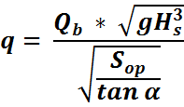
Overtopping Parameterization for Seawalls
Jansen and van der Meer
Mean overtopping discharge
m³/s per meter of structure length
Off shore wave steepness
Dimensionless Freeboard for slopes
Adjusted Dimensionless Freeboard for slopes (Bruce)
Plunging wave dimensionless discharge

Slide 23
Input Parameters
Freeboard & Slope
Seawall Crest
Freeboard
$tan$α
Seawall
toe
Slope measured from the +2.0 MLLW level to the seawall toe
Still Water Level (SWL)

Slide 24
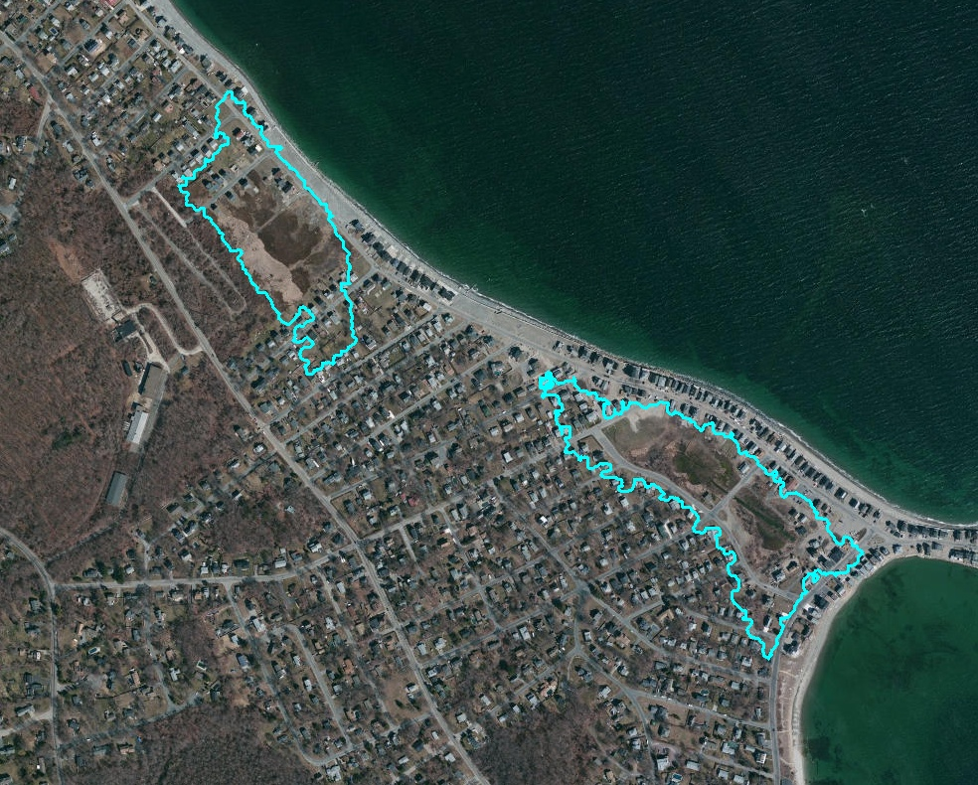
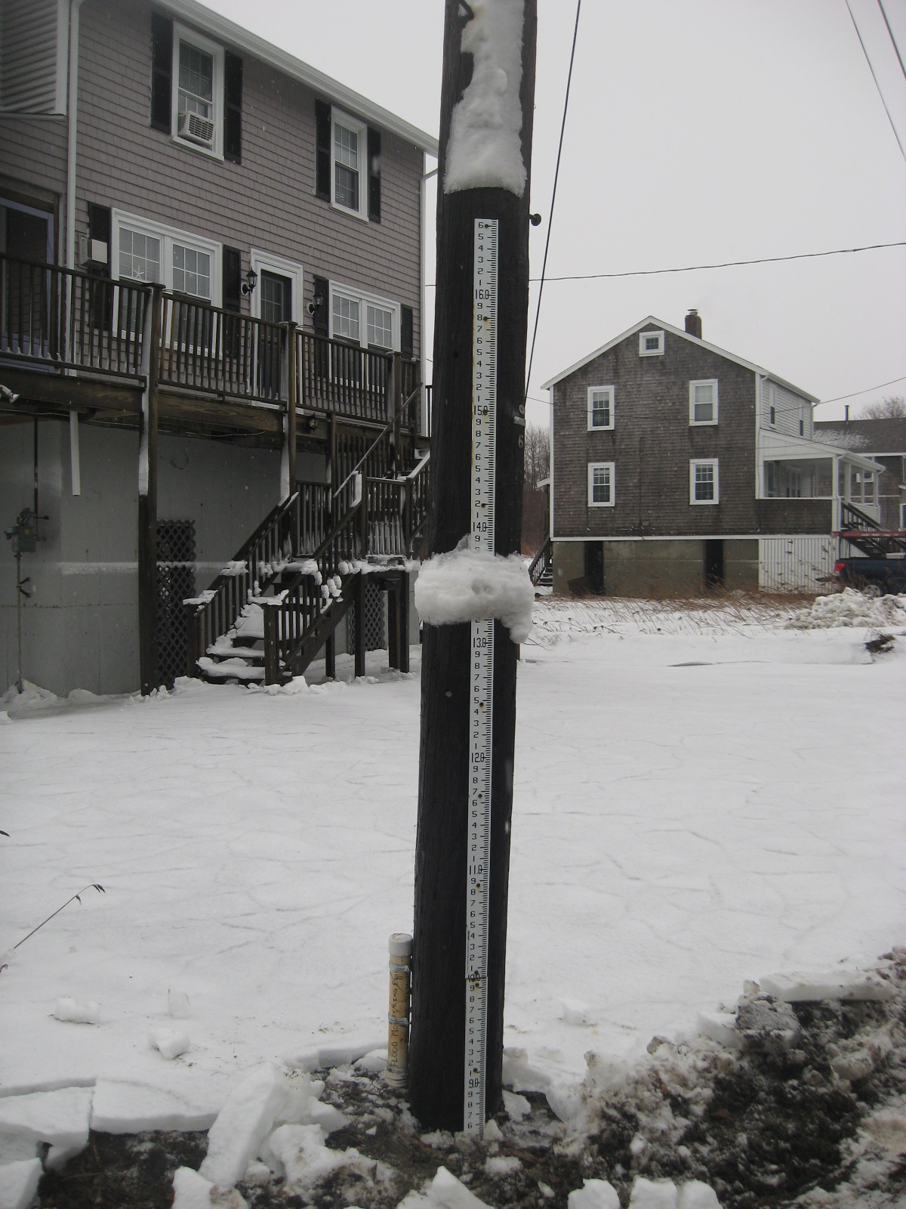
Validation of the parameterization
Length of seawall used for calculations
Seawall
Staff Gauge
7th Avenue Basin
Seawall
Data Logger
Seawall
Staff Gauge
Scituate Ave Basin

Slide 25
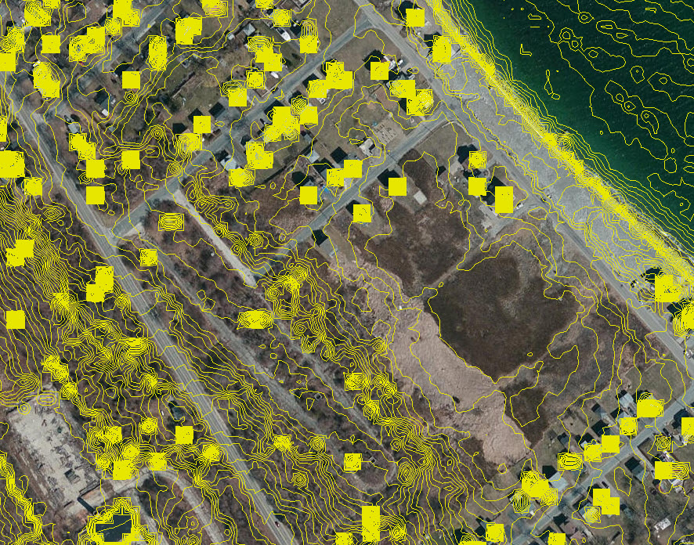
LiDAR Elevations plotted in 1 foot intervals
GIS used to compute volume of basin from LiDAR

Slide 26
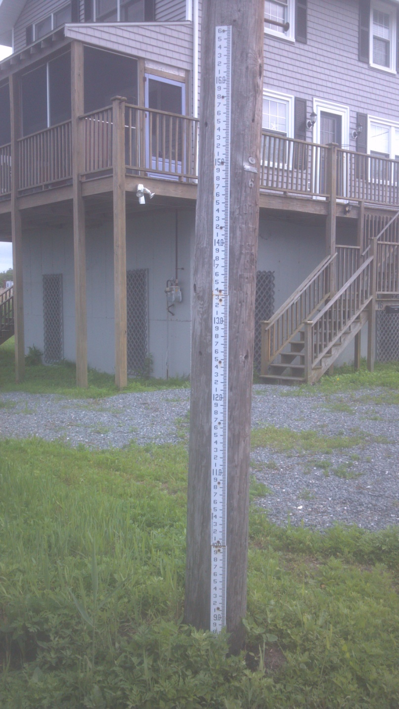
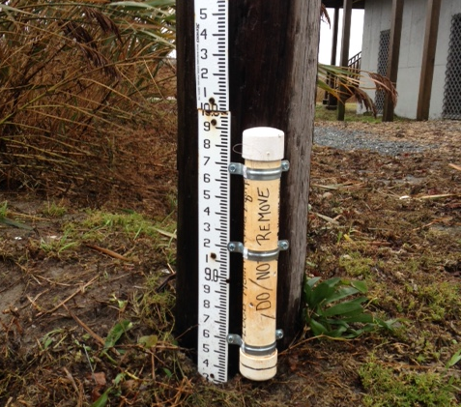
Test Events
Deploy Data Logger prior to event
Records water level every 6 min.
Volume determined from water level

Slide 27
Wave Height
Period
Water level
Volume of Basin can be determined every 6 minutes by comparing water going in to water going out

Slide 28
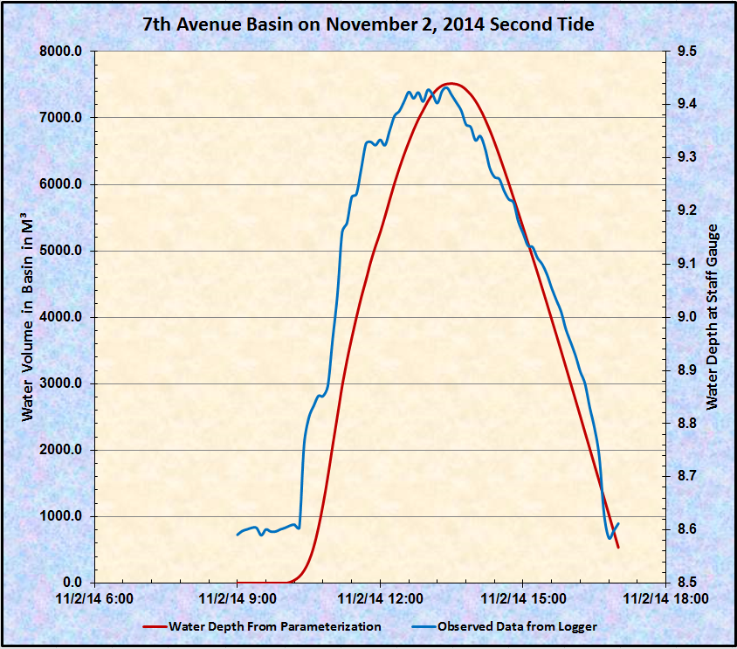

Slide 29
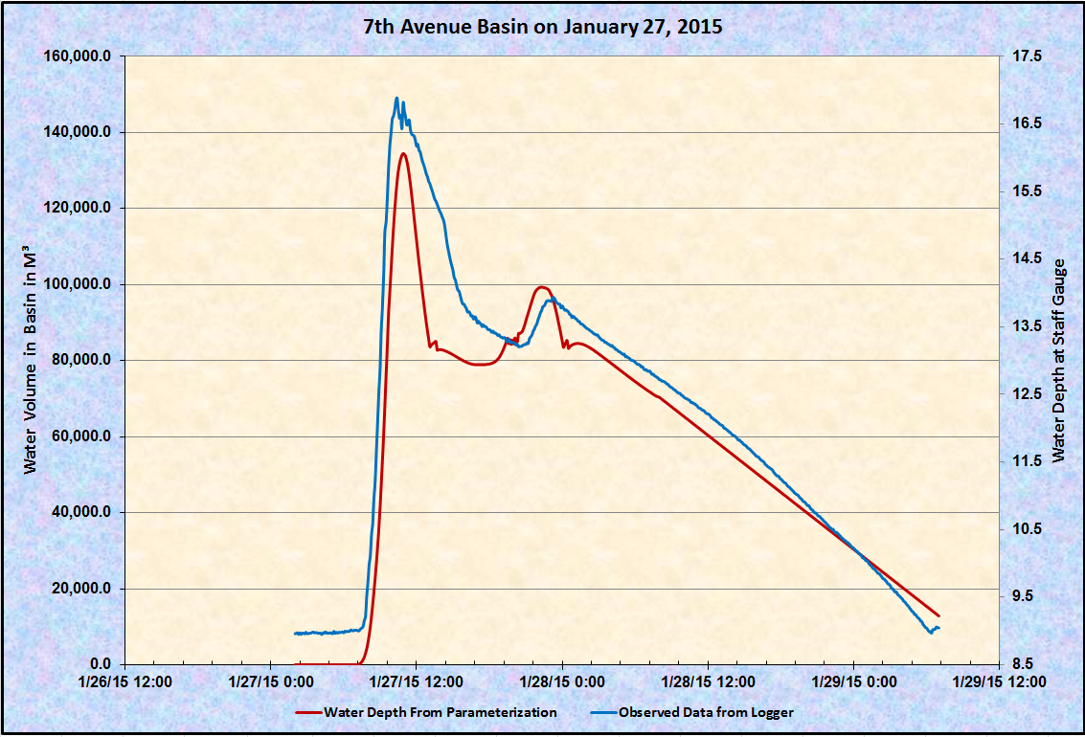

Slide 30
Overtopping A Stone Armored Revetment

Slide 31
Overtopping Parameterization for Stone Armored Revetments
Jansen and van der Meer
$Q_{b}$ = 0.06*$e^{−5.2R_{b}}$
Mean overtopping discharge
m³/s per meter of structure length
Off shore wave steepness
Dimensionless Freeboard for slopes
Plunging wave dimensionless discharge
$Q_{b}$ = 0.06*$e^{−5.2R_{b}}$

Slide 32
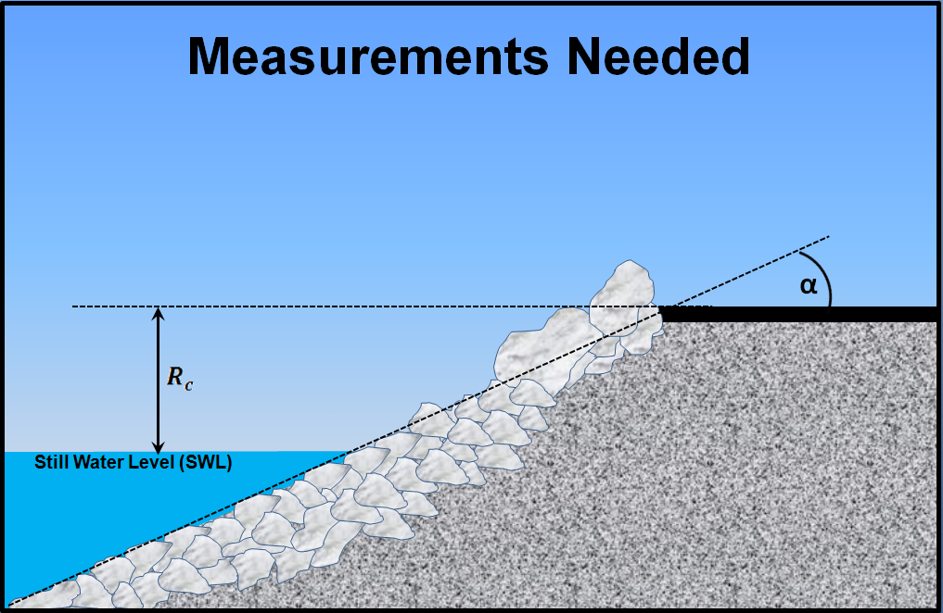
Input Parameters
Freeboard & Slope
$tan$α

Slide 33
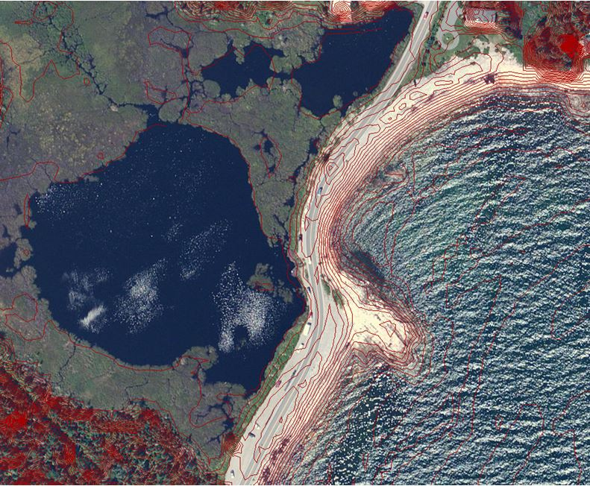
Seawall Road LiDAR Elevations

Slide 34
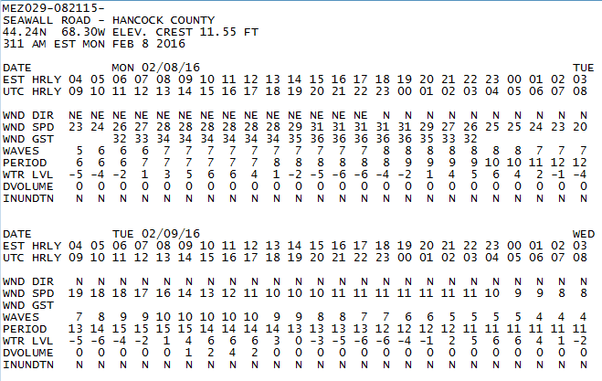
Forecast Matrices for Overtopping Discharge Volume
Seawall Road Test Site
Matrices for April 7-8, 2016 Storm

Slide 35
Impact Index Scale
Currently predicted volume is treated as an index with correlated impacts

Slide 36
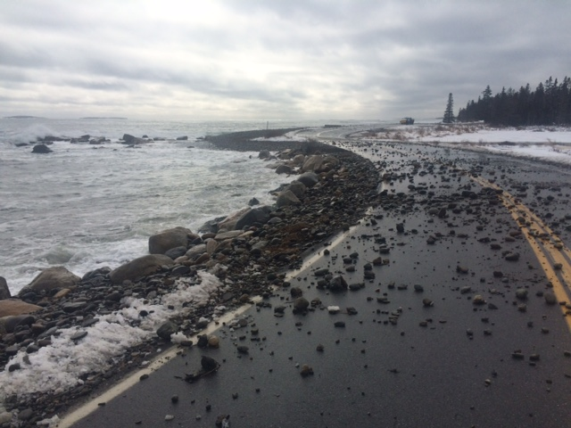
February 8, 2016

Slide 37
Attempt to Validate predicted volume

Slide 38
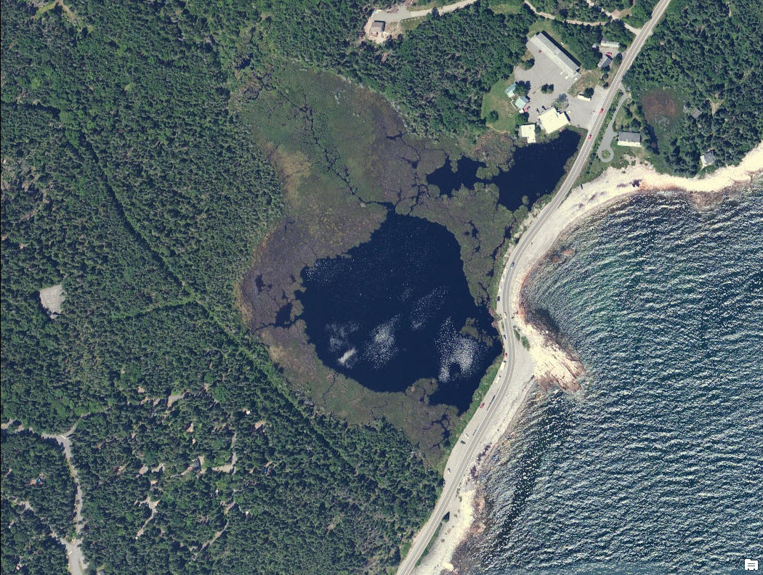
Pond and Marsh Area Behind Sea Road
Pond behind road sometimes floods from overtopping water and can be used as collection area to validate predictions

Slide 39
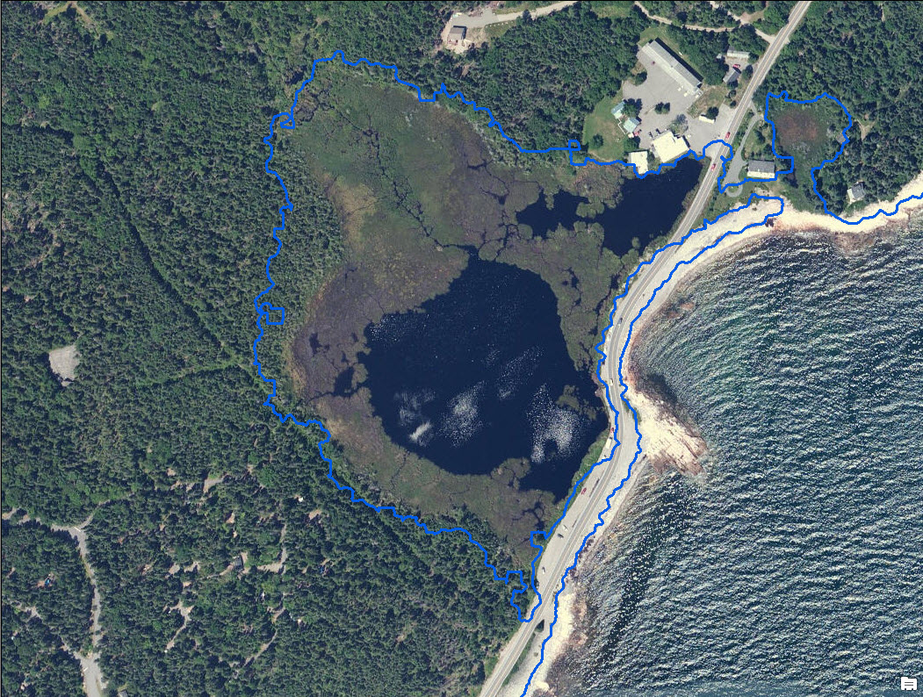
Pond and Marsh Area Behind Sea Road
Area at 11 Feet NAVD88 = 20.6 Acres
Culvert Outlet Pipe
Volume at 11 Feet NAVD88 = 50,000 Cubic Meters
(From GIS)

Slide 41
Manning Equation
Used to Compute volume flowing through pipe
h
$$r$$
$$θ$$
$$r$$
$$θ$$
h
More than half full
Less than half full
$r= D/2$ h = 2r - y
θ = 2 arc cos $\left(\frac{r −h}{r}\right)$
A = $πr^{2}$ - $\frac{r^{2}\left(θ−sinθ\right)}{2}$
P = 2𝝅r – rθ
$R_{h}$ = A/P
$r= D/2$ h = y
θ = 2 arc cos $\left(\frac{r −h}{r}\right)$
A = $\frac{r^{2}\left(θ−sinθ\right)}{2}$
P = rθ
$R_{h}$ = A/P
Q = $\left({1.49}/n\right)$A$\left({R_{h}}_{}^{2/3}\right)S^{1/2}$
Q =${{ ft.}^{3}}/{second}$
S = bottom slope of channel
n = Roughness Coefficient

Slide 42
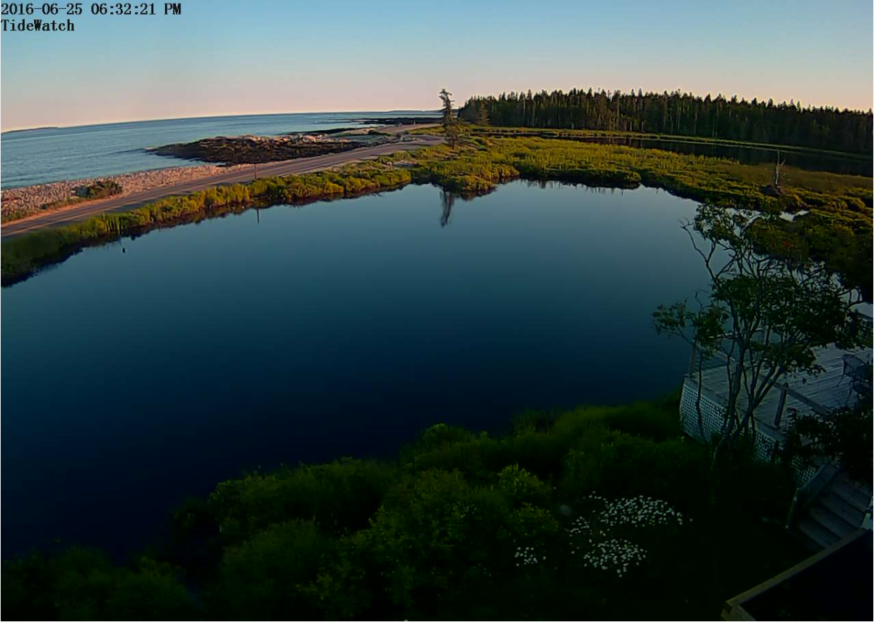
Seawall Road Webcam
Can deploy data logger or install staff rod that can be read from webcam

Slide 43
Modeling Seawall Road
Wave Height
Period
Water level
Flooded Pond
Will allow volume validation
Results can be compared with other sites

Slide 44
Questions ??

