Slide 1
Evaluation of NCAR’s AutoNowCaster for Operational Application within the National Weather Service Presenter: John Crockett, CIRA/CSU

Slide 2
The AutoNowCaster (ANC) Team
NOAA / NWS / MDL
Stephan Smith, Decision Support Branch Chief
Mamoudou (Ama) Ba, Project Manager
Lingyan Xin, Verification Analyst
CIRA / CSU
John Crockett, Technical Lead
Kenneth Sperow
NCAR / RAL
Rita Roberts, Principal Investigator
Daniel Megenhardt

Slide 3
ANC: MDL Timeline
WFO DFW
Domain
Florida
Domain
“Golden Triangle” Domain
CONUS
Domain
2008
2009
2010
2011
2012
2013
2014
2015
2016
2017
Auto-tuning Study
Operational at NCEP
Verification Data Collection
AWC begins to use ANC to help issue 2-hr Convective SIGMETs
AWT
Summer Experiment

Slide 4
ANC: Overview
ANC is designed to nowcast areas where storms are considered likely to form and/or be sustained, and vice-versa. How?
ANC ingests NWP model output, GOES satellite data, surface METAR data, and NWS radiosonde data in order to analyze characteristic features of the atmosphere. The results of the analyses are 60-minute predictors which are converted into dimensionless likelihood fields.
The likelihood fields have a dynamic range from -1 to 1, where increasing positive values correspond to an increasing likelihood of storm initiation and/or sustainment, and vice-versa.
The likelihood fields are weighted and summed to produce a 60-minute Convective Likelihood (CL) field.
In essence, ANC attempts to analyze, weight, and sum various data in a manner analogous to that of a forecaster.
Notes:
NCAR’s research and development led them to interpret values of CL ≥ 0.7 as indicating where storm initiation was likely to occur.

Slide 5
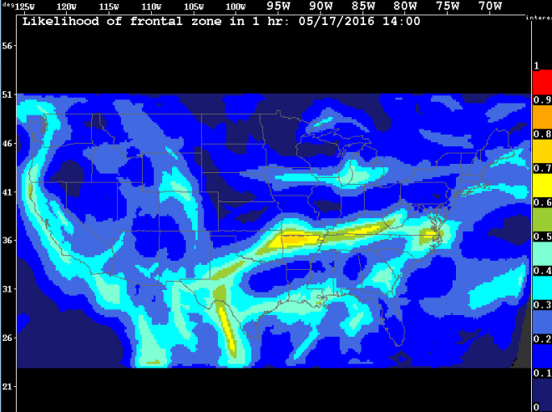
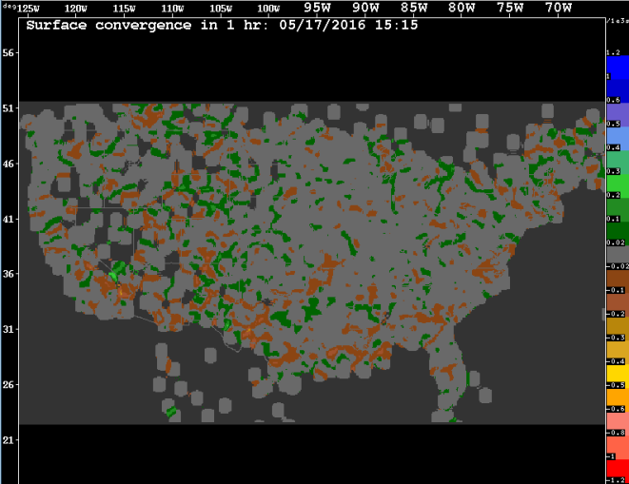
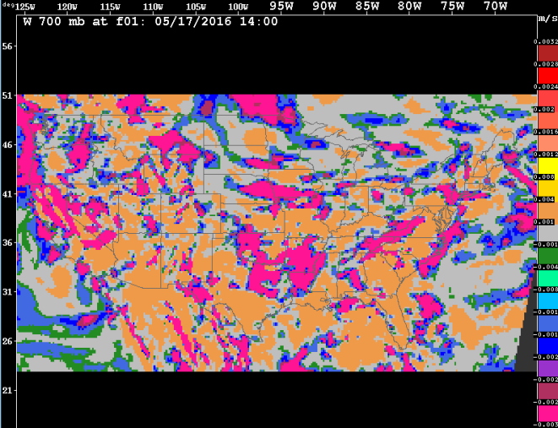
ANC Predictors: Dynamics
Likelihood of Frontal Zone in 1 hr
Surface Convergence in 1 hr
W 700 mb at f01
Notes:
In order to create the Likelihood of Frontal Zone in 1 hr predictor, the 1000 mb convergence, maximum gradient of θ_{e} (equivalent potential temperature), and vorticity fields are derived from the RAP f03 data. These fields are first “fuzzified,” and a normalized, weighted summation of those “fuzzy” fields is taken. This normalized, weighted summation is then input to an elliptical filter algorithm created by MIT Lincoln Labs. For more details, see Appendix A.
In order to create the Surface Convergence in 1 hr predictor, the 1000 mb convergence field is derived from the RAP f01 data. This field is augmented by surface METAR data.
The W 700 mb at f01 predictor is derived from the RAP f01 data.

Slide 6
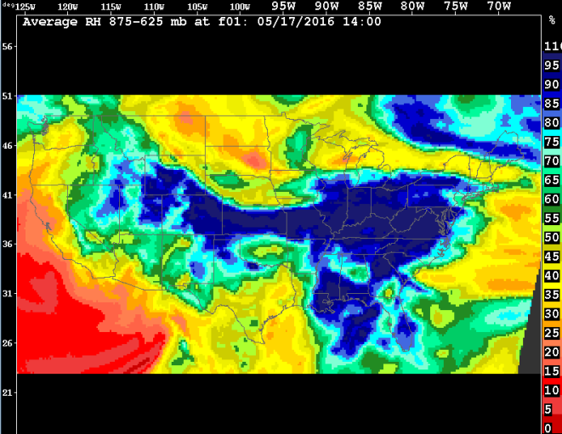
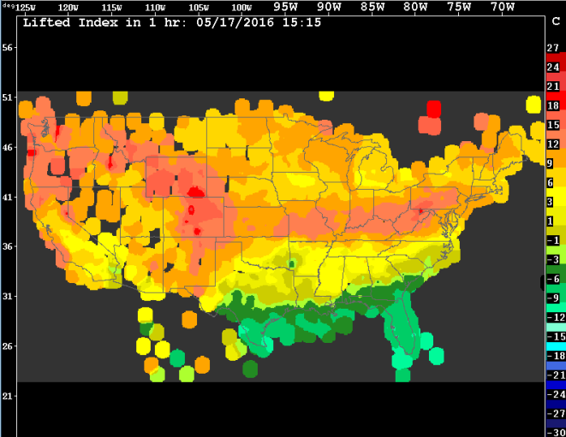
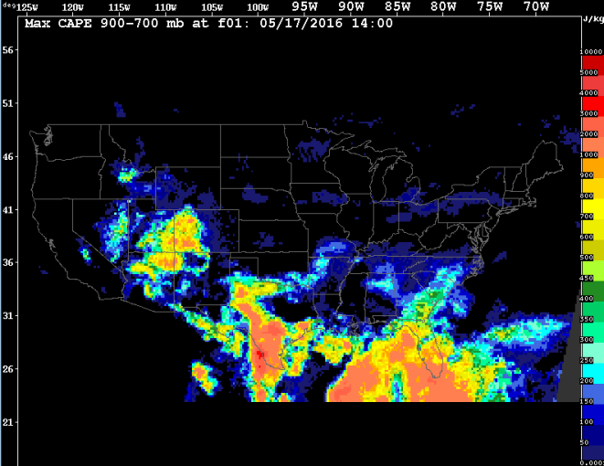
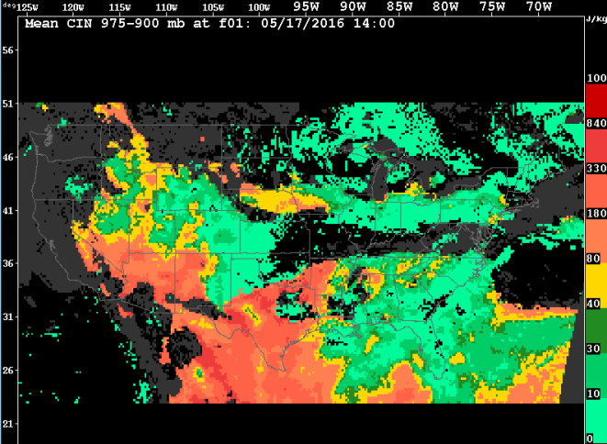
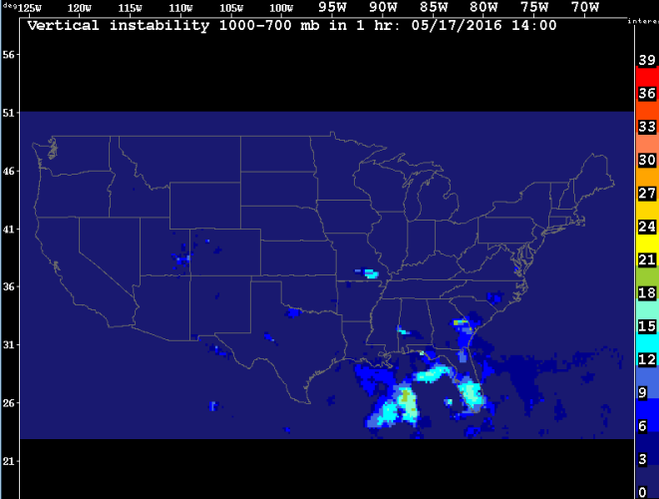
ANC Predictors: Thermodynamics
Average RH 875-625 mb at f01
Lifted Index in 1 hr
Max CAPE 900-700 mb at f01
Mean CIN 975-900 mb at f01
Vertical Instability 1000-700 mb in 1 hr
Notes:
The Average RH 875-625 mb at f01 predictor is derived from the RAP f01 data.
In order to create the Lifted Index in 1 hr predictor, 1000 to 100 mb artificial soundings are derived from the RAP f01 data. These soundings are augmented by NWS radiosonde data. The temperature at 500 mb is used in the calculation of the Lifted Index.
The Max CAPE 900-700 mb at f01 predictor is derived from the RAP f01 data.
The Mean CIN 975-900 mb at f01 predictor is derived from the RAP f01 data.
In order to create the Vertical Instability 1000-700 mb in 1 hr predictor, a series of interim fields are derived from the RAP f00 and f01 data. The interim fields include the first order trends of CAPE and CIN (RAP f00), the magnitude of vertical shear from 975-725 mb (RAP f01), the vertical derivative of horizontal θ_{e} advection from 875-675 mb (RAP f01), and the layer average relative humidity from 875-625 mb (RAP f01). At the end, the interim fields are “fuzzified,” weighted, and summed. For more details, see Appendix B.

Slide 7
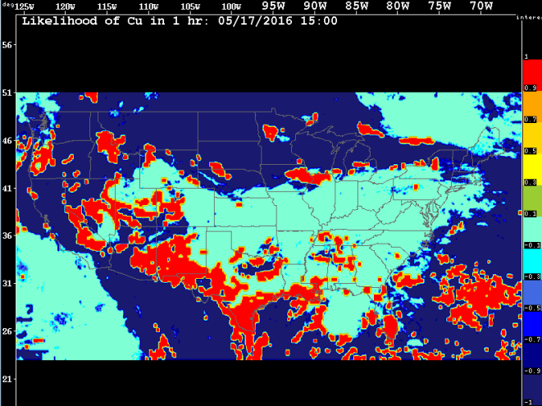
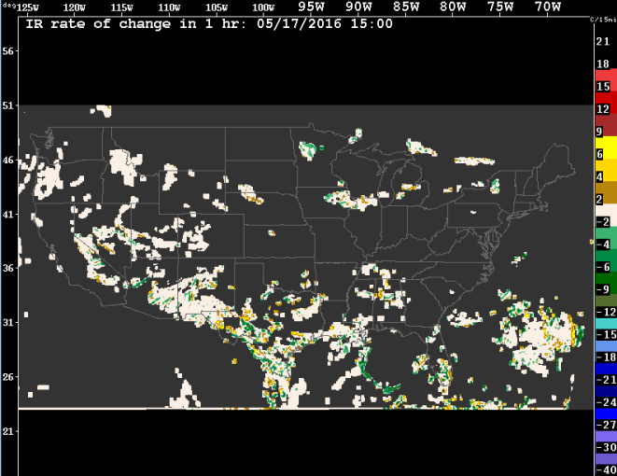
ANC Predictors: Clouds
Likelihood of Cu in 1 hr
IR Rate of Change in 1 hr
Notes:
In order to create the Likelihood of Cu in 1 hr predictor, both GOES East’s and GOES West’s visible, near infrared (3.9 microns), water vapor (6.5 microns), and infrared (10.7 microns) data are input to NRL Monterey’s cloud classification algorithm. The outputs are stitched together at 105°W to form a single field. This field is then passed through a fuzzy logic filter. The result of that is then expanded and smoothed, after which it is advected forward in time 60 minutes by the 750 mb wind vectors from the RAP f00 data. For more details, see Appendix C.
In order to create the IR Rate of Change in 1 hr predictor, both GOES East’s and GOES West’s infrared (10.7 microns) data are stitched together at 105°W to form a single field. Using that single field, the prior such single field, and the 750 mb wind vectors from the RAP f00 data, the rate of change between the two images is calculated. That rate of change is then masked in order to exclude those areas which, based upon the results of cloud classification, are unlikely to have convective clouds. That masked field is then advected forward in time 60 minutes by the 750 mb wind vectors from the RAP f00 data.

Slide 8
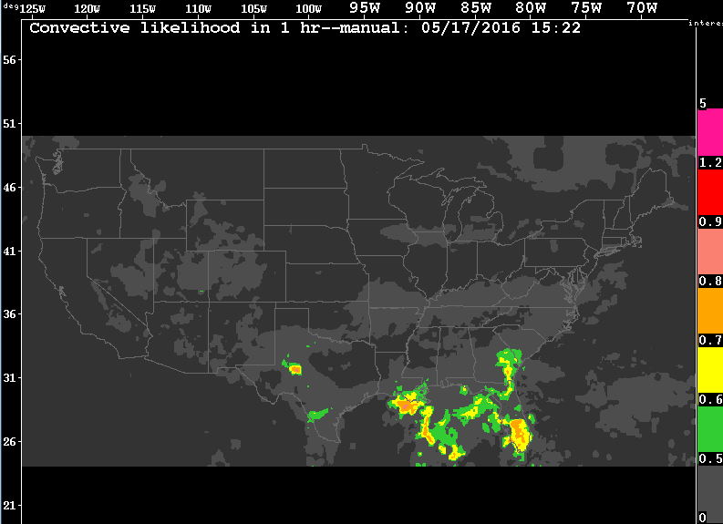
ANC Predictand:
Convective Likelihood (CL) in 1 hr
(0.22 * F₁ (Likelihood of Frontal Zone in 1 hr)) +
(0.08 * F₂ (W 700 mb at f01)) +
(0.10 * F₃ (Surface Convergence in 1 hr)) +
(0.18 * F₄ (Average RH 875-625 mb at f01)) +
(0.20 * F₅ (Lifted Index in 1 hr)) +
(0.20 * F₆ (Max CAPE 900-700 mb at f01)) +
(0.12 * F₇ (Mean CIN 975-900 mb at f01)) +
(0.12 * F₈ (Vertical Instability 1000-700 mb in 1 hr)) +
(0.12 * F₉ (Likelihood of Cu in 1 hr)) +
(0.40 * F₁₀ (Likelihood of Clear Sky in 1 hr)) +
(0.10 * F₁₁ (IR Rate of Change in 1 hr))
F# denotes a predictor-specific fuzzy function.
Convective Likelihood in 1 hr
Notes:
Performance depends on the accuracy of RAP, especially with respect to errors in the timing and location of where storms are likely to form and be sustained. Relevant convective forcing is not always adequately captured by RAP.

Slide 9
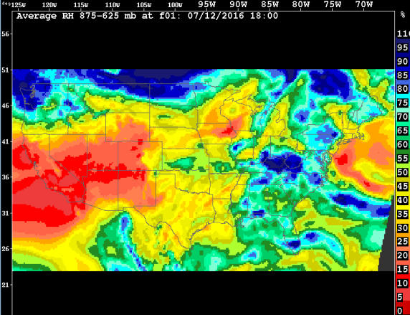
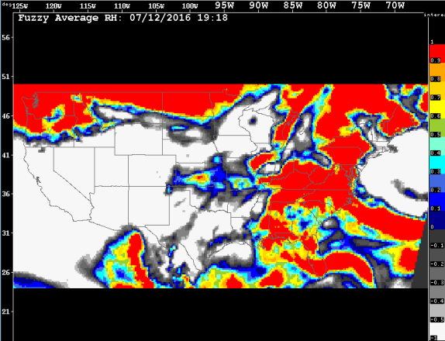
ANC: Predictor-Specific Fuzzy Functions
PREDICTOR
LIKELIHOOD FIELD
Average RH
875-625 mb at f01
Fuzzy Function for Average RH
875-625 mb at f01
“Fuzzy” Average RH
875-625 mb at f01
See Appendix D for the graphs of ANC’s predictor-specific fuzzy functions.
Notes:
Earlier in ANC’s development, the transformation of a predictor into its corresponding likelihood field was done using binary logic. However, this led ANC to be too sensitive to small changes in a predictor’s values. To make the system less sensitive and to reflect more accurately the inherently non-binary nature of the contribution of any single predictor to meteorological stability/instability, non-binary, fuzzy logic was introduced.
The fuzzy functions were developed by experts who have insight into the relevant physical processes.

Slide 10
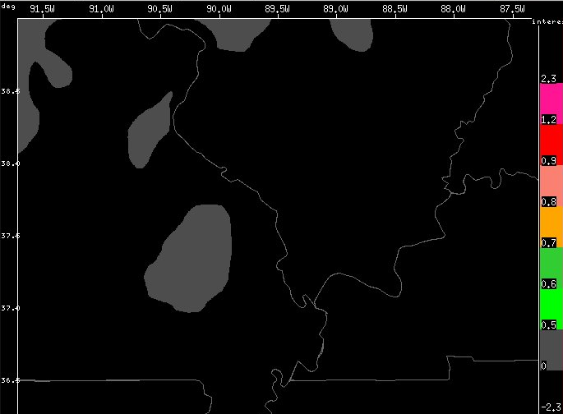
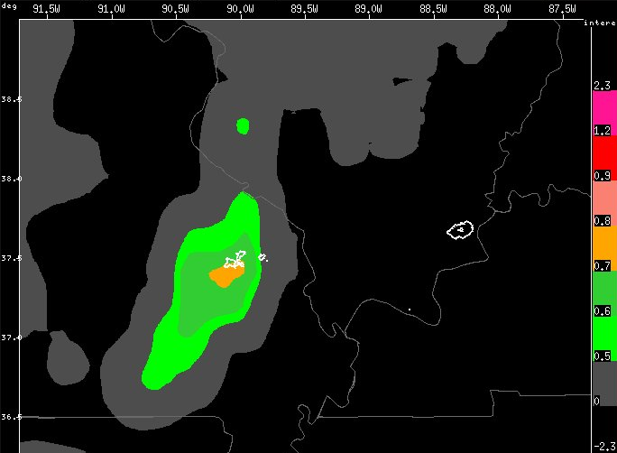
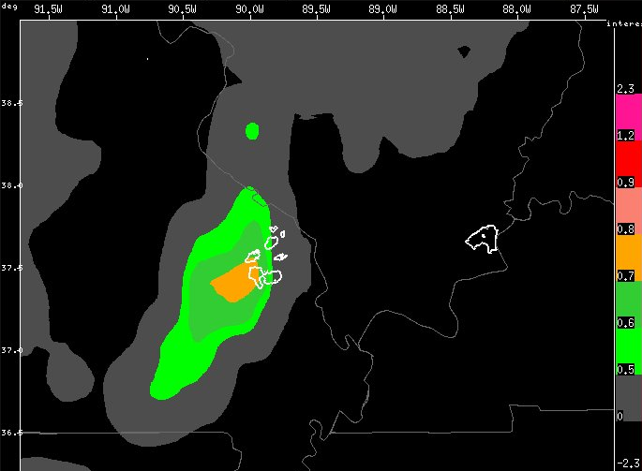
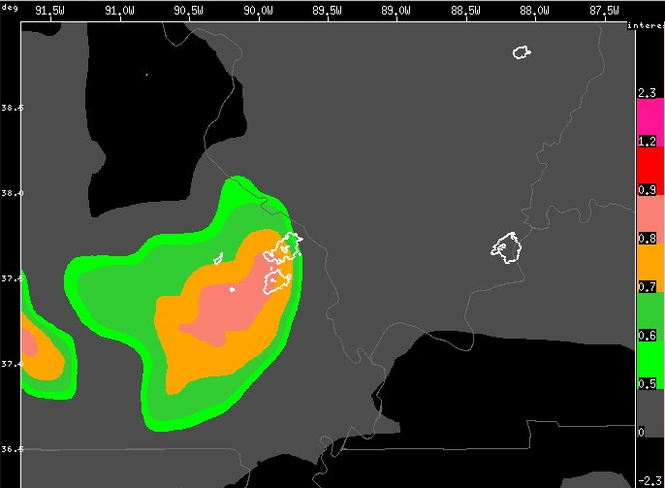
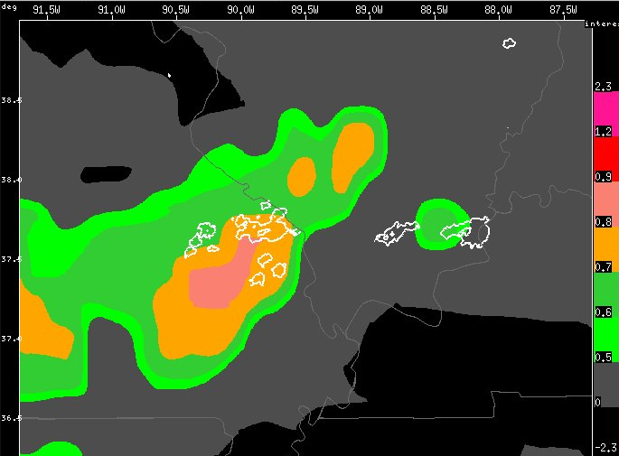
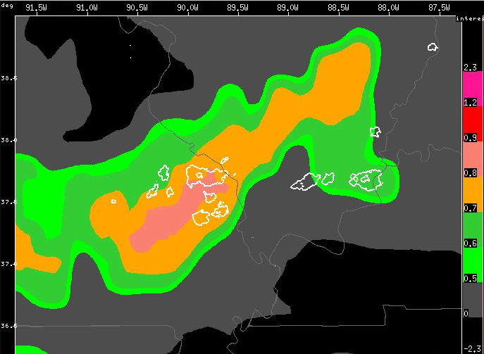
ANC: Example Time Series
Valid time: 1741Z
Valid time: 1838Z
Valid time: 1853Z
Valid time: 1908Z
Valid time: 1929Z
Valid time: 1944Z
60-min nowcasts of CL on July 1, 2012 overlaid with 35 dBZ contours at the valid time
Notes:
Question: How do we measure the performance of the nowcast of Convective Likelihood?

Slide 11
ANC Verification: Questions
What is the smallest spatial scale at which ANC’s 60-minute nowcasts of CL can skillfully nowcast the general areas where both new storms may initiate and existing storms should be sustained, and to what values of CL does this apply?
What is the smallest spatial scale at which ANC’s 60-minute nowcasts of CL can skillfully nowcast the general areas solely where new storms may initiate, and to what values of CL does this apply?
To what degree, if any, are ANC’s 60-minute nowcasts of CL subject to temporal ambiguity?

Slide 12
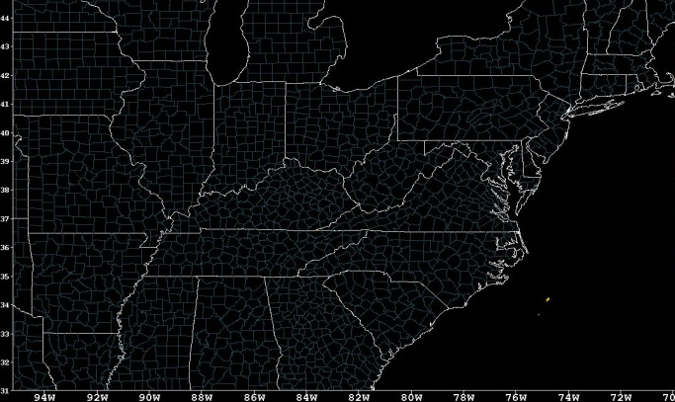
ANC Verification: Domain
x
The “Golden Triangle” Domain: 31° to 45° N; 94° to 71° W; 0.02° x 0.02°

Slide 13
ANC Verification: Data
Nowcast grids of ANC’s predictand: CL in 1 hr
55 days from June 11 to September 30, 2012; 1400Z to 2359Z;
~10 nowcasts per hour
“Ground truth” grids derived from 3-D Cartesian WSR-88D reflectivity volumes
Reflectivity volume
Filtered for bright band data
Filtered for stratiform data
Composited between 2.5 and 4.5 km, inclusive
Filtered radar composite at t_{nowcast}
ciClassifier
“Ground truth” grid at t_{valid}
Filtered radar composite at t_{valid}
Notes:
Radar data do not distinguish newly initiated storms from ongoing storms and so cannot be used directly as “ground truth” against which to compare ANC’s nowcasts of CL.
The ciClassifier application is a slightly modified version of the w2detectinitiation application which is part of the Warning Decision Support System—Integrated Information (WDSS-II) suite. The application's output is a grid in which each grid point is assigned a value which identifies the corresponding grid point in the second composite of each pair of composites as either a newly initiated element of a storm, an ongoing storm element, a decaying storm element, or none of the above, where a storm is defined to be any radar echo ≥ 35 dBZ.

Slide 14
ANC Verification: Statistics
1400Z
Verification 1
H₁ | M₁ | F₁ | N₁
+
H → a hit
Nowcast and “Ground truth” Grids 1 to m
Verification 2
H₂ | M₂ | F₂ | N₂
M → a miss
+
F → a false alarm
Verification 3 to (m – 1)
H# | M# | F# | N#
N → a non-event
+
Verification m
H_{m} | M_{m} | F_{m} | N_{m}
1500Z
=
H_{tot} | M_{tot} | F_{tot} | N_{tot}
Calculate POD, FAR, Bias, CSI and HSS for the hour
Notes:
ANC’s Validator application was used to calculate the verification grids.
The Heidke Skill Score (HSS) was calculated in order to accommodate the fact that non-events dominate when nowcasting storm initiation.

Slide 15
ANC Verification: Spatial Neighborhoods
N = the neighborhood size parameter
It yields a (2N + 1) by (2N + 1) neighborhood.
○ → an event was forecasted
+ → an event was observed
⊕ → an event was both forecasted and
observed
 |  |  |  |  |  |  |  | ＋
 |  |  |  |  | ○ | ○ | ⊕ | ＋
 |  |  |  | ○ | ⊕ | ⊕ | ⊕ | ○
 |  |  | ○ | ⊕ | ⊕ | ⊕ | ⊕ | ○
 |  |  | ○ | ⊕ | ⊕ | ⊕ | ⊕ | ○
 |  | ○ | ○ | ⊕ | ⊕ | ⊕ | ○
 |  | ○ | ○ | ⊕ | ⊕ | ⊕ | ○
 |  | ○ | ○ | ⊕ | ⊕ | ○
 |  |  | ○ | ○ | ○
→ a hit
→ a miss
→ a false alarm
→ a non-event
Example verification when N = 1, i.e., a 3 by 3 neighborhood
Notes:
Attempting to match exactly the forecast value at a grid point with the observed value at the same grid point often results in poor verification scores. To represent the skill of ANC’s nowcasts of CL in 1 hr better, ANC’s Validator application was configured to implement neighborhood verification, whereby forecasts and observations were compared using spatial neighborhoods around grid points.
Varying the neighborhood size parameter helps determine the scale at which a desired level of skill is attained by the nowcasts of CL in 1 hr. Such verification rewards closeness by not requiring exact matches spatially between the nowcasts and what was observed.

Slide 16
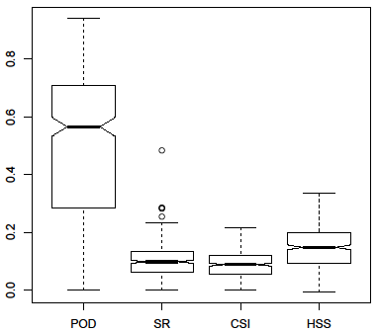
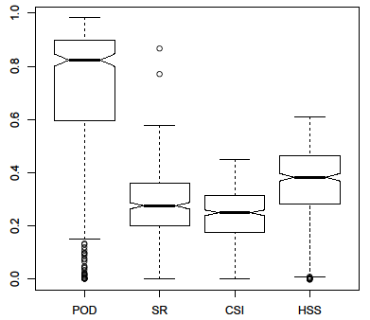
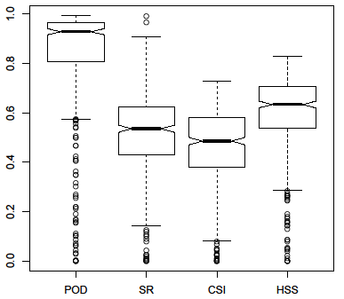
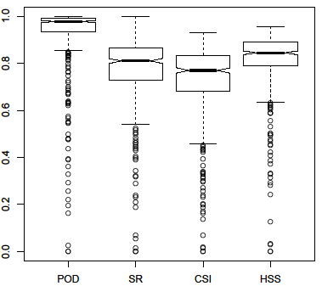
ANC Verification: Results (1)
N = 2 (~10 km²)
Median CSI ~0.1
N = 6 (~25 km²)
Median CSI ~0.3
N = 12 (~50 km²)
Median CSI ~0.5
N = 24 (~100 km²)
Median CSI ~0.8
Verification for N = 2 (~10 km²), 6 (~25 km²), 12 (~50 km²), and 24 (~100 km²); a forecast event consists of a nowcast grid point whose CL value ≥ 0.6; an observed event consists of a “ground truth” grid point classified either as storm initiation or as an ongoing storm
Notes:
A box-and-whisker plot represents a distribution of values. The box denotes the interquartile range, i.e., the 25th to the 75th percentiles, while the notches represent roughly a 95% confidence interval for differences between the medians of the two distributions. The whiskers extend 1.5 times the length of the box, with all data points further than this from the median drawn as circles.

Slide 17
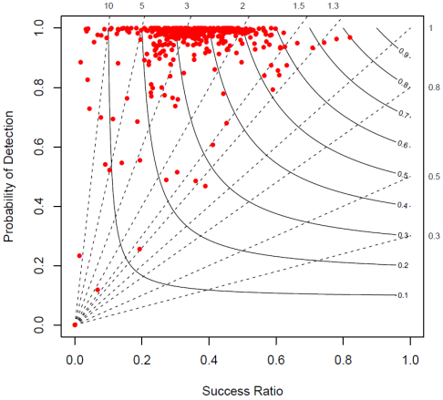
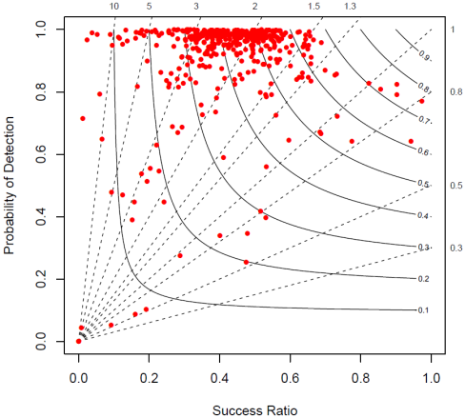
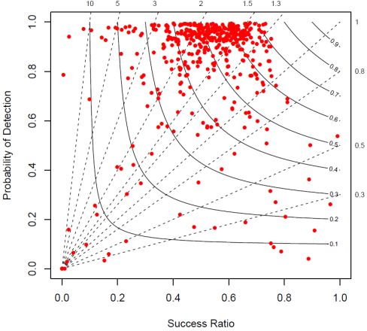
ANC Verification: Results (2)
CL ≥ 0.4
CL ≥ 0.5
CL ≥ 0.6
Verification for N = 12 (~50 km²); a forecast event consists of a nowcast grid point whose CL value ≥ 0.4, 0.5, and 0.6; an observed event consists of a “ground truth” grid point classified either as storm initiation or as an ongoing storm
Notes:
POD, FAR, bias and CSI are geometrically related and consequently can be plotted in a single performance diagram which summarizes multiple statistics of forecast quality, including the Success Ratio (SR [= 1 – FAR]). In such performance diagrams, the x-axis denotes SR, the y-axis denotes POD, curved lines correspond to CSI, and straight lines correspond to bias. For good forecasts, SR, POD, CSI and bias approach unity, such that a perfect forecast lies in the upper right of the diagram.
Values of CL ≥ 0.6 are optimal for nowcasting the general areas where convection will occur.

Slide 18
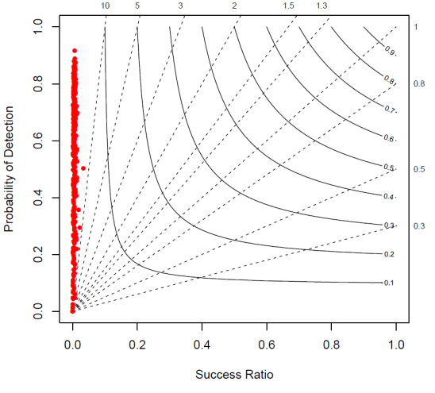
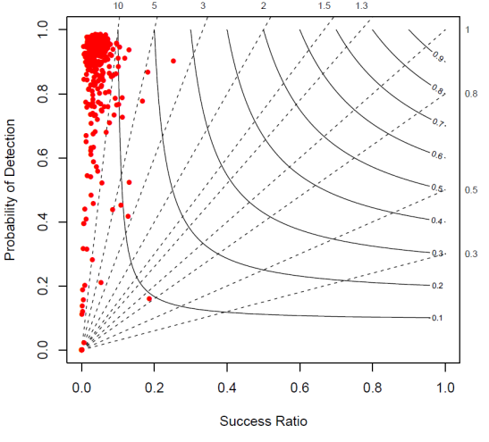
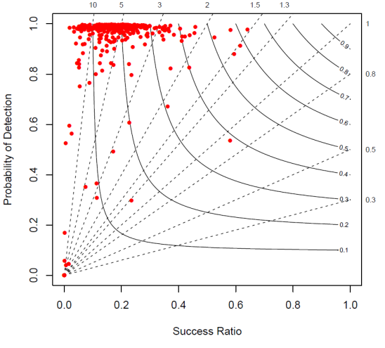
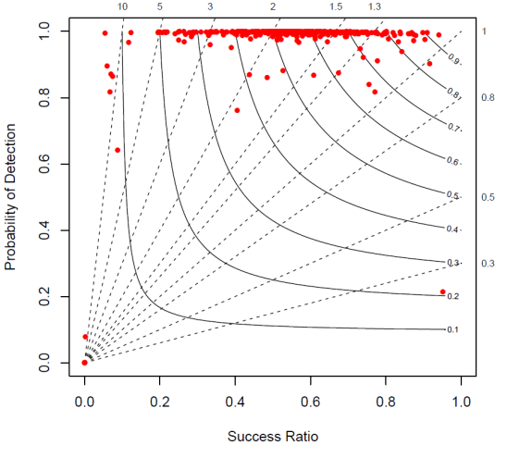
ANC Verification: Results (3)
N = 2 (~10 km²)
N = 6 (~25 km²)
N = 12 (~50 km²)
N = 24 (~100 km²)
Verification for N = 2 (~10 km²), 6 (~25 km²), 12 (~50 km²), and 24 (~100 km²); a forecast event consists of a nowcast grid point whose CL value ≥ 0.7; an observed event consists of a “ground truth” grid point classified solely as storm initiation
Notes:
There is some skill at the 100 km² scale, but that is a scale above where ANC can skillfully nowcast the general areas of convection. How can the scale for nowcasting solely storm initiation be made comparable?

Slide 19
ANC Verification: Temporal Relaxation
“Ground truth” grid at t_{valid} – t⁻
t_{valid} – t⁻
new
ongoing
“Ground truth” grid at t_{valid}
t_{valid}
ongoing
ongoing
decaying
decaying
“Ground truth” grid at t_{valid} + t⁺
t_{valid} + t⁺
Composite “ground truth” grid at t_{valid}
new
Notes:
When verifying storm initiation—an event which is not widespread—nowcasting it for one time but observing it at another time contributes to the double penalty of nowcasted-by-not-observed and observed-but-not-nowcasted. The penalty can be alleviated by using temporal relaxation during the verification process.

Slide 20
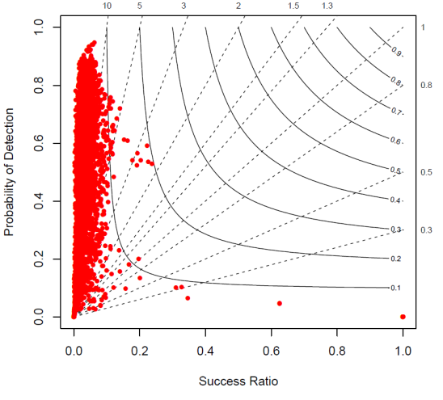
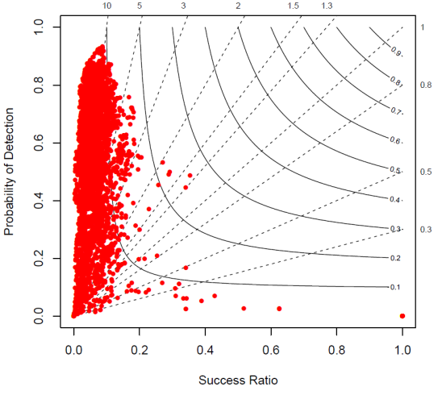
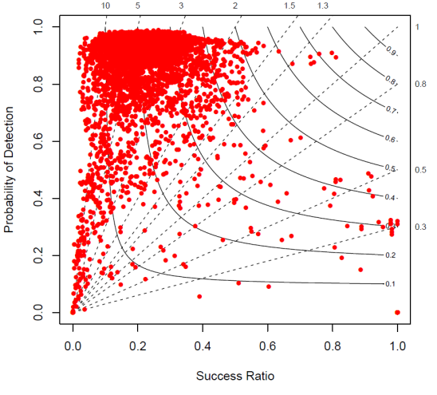
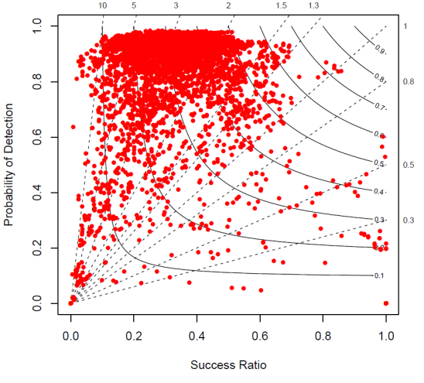
ANC Verification: Results (4)
N = 2 (~10 km²); t⁻ and t⁺ = 15 min
N = 2 (~10 km²); t⁻ and t⁺ = 30 min
N = 6 (~25 km²); t⁻ and t⁺ = 15 min
N = 6 (~25 km²); t⁻ and t⁺ = 30 min
Verification for N = 2 (~10 km²) and 6 (~25 km²); t⁻ and t⁺ = 15 and 30 min; a forecast event consists of a nowcast grid point whose CL value ≥ 0.7; an observed event consists of a “ground truth” grid point classified solely as storm initiation

Slide 21
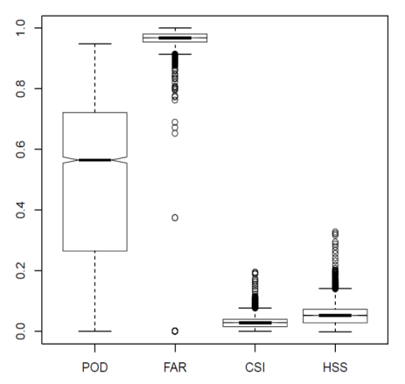
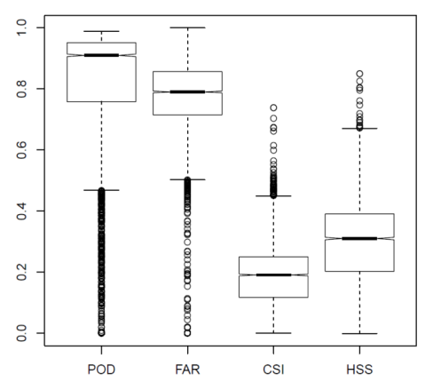
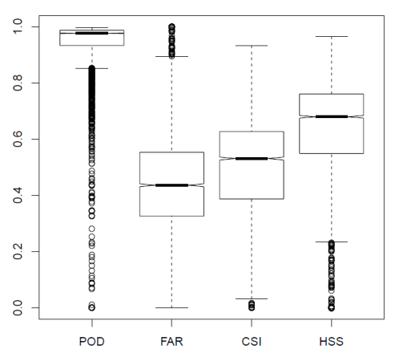
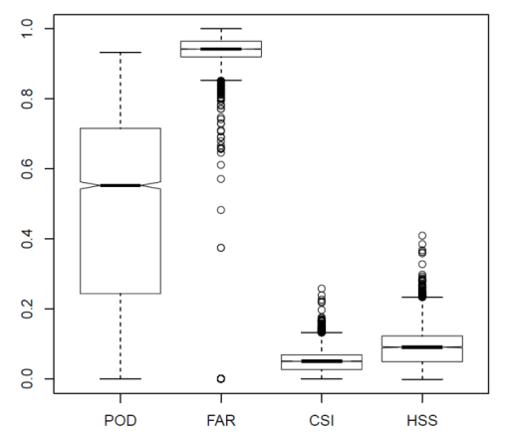
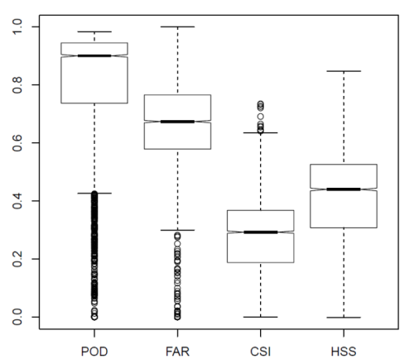
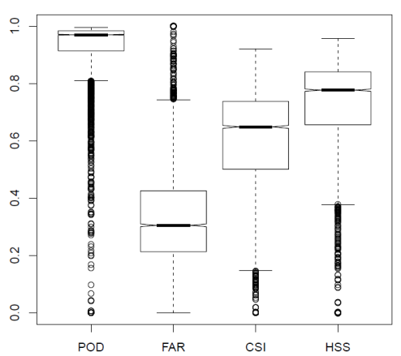
ANC Verification: Results (5)
N = 2 (~10 km²)
N = 6 (~25 km²)
N = 12 (~50 km²)
t⁻ and t⁺ = 15 min
t⁻ and t⁺ = 30 min
Verification for N = 2 (~10 km²), 6 (~25 km²), and 12 (~50 km²); t⁻ and t⁺ = 15 and 30 min; a forecast event consists of a nowcast grid point whose CL value ≥ 0.7; an observed event consists of a “ground truth” grid point classified solely as storm initiation

Slide 22
ANC Verification: Conclusions
At a spatial scale of ~50 km and with no temporal relaxation, grid points with values ≥ 0.6 in ANC’s 60-minute nowcasts of CL skillfully nowcast the general areas where both new storms may initiate and existing storms should be sustained.
At a spatial scale of ~50 km and within 45 to 90 minutes from the nowcast issuance time, grid points with values ≥ 0.7 in ANC’s 60-minute nowcasts of CL skillfully nowcast the general areas where new storms may initiate.
ANC's 60-minute nowcasts of CL can best improve situational awareness when interpreted as guidance at a spatial scale of ~50 km and within a time frame anywhere between 45 and 90 minutes of the issuance times.

Slide 23
ANC: MDL Points of Contact
To express an interest in collaborative research and development with ANC, contact Dr. Stephan (Steve) Smith.
Email: stephan.smith@noaa.gov
Telephone: (301) 427-9495
For scientific questions about ANC, contact Dr. Mamoudou (Ama) Ba.
Email: mamoudou.ba@noaa.gov
Telephone: (301) 427-9477
For questions about the verification analysis, contact Dr. Lingyan Xin.
Email: lingyan.xin@noaa.gov
Telephone: (301) 427-9092
For technical questions about the ANC system, its configuration, etc., contact John Crockett.
Email: john.crockett@noaa.gov
Telephone: (301) 427-9469

Slide 24
ANC: Select Bibliography (1)
Ba, M., L. Xin, J. Crockett, and S. Smith: Evaluation of NCAR’s AutoNowCaster for Operational Application within the National Weather Service.
Wea. Forecasting, 32, 1477-1490.
DOI: 10.1175/WAF-D-16-0173.1
Lakshmanan, V., J. Crockett, K. Sperow, M. Ba, and L. Xin, 2012: Tuning AutoNowCaster Automatically. Wea. Forecasting, 27, 1568–1579.
DOI: 10.1175/WAF-D-11-00141.1
Megenhardt, D., C. Mueller, S. Trier, D. Ahijevych, and N. Rehak, 2004: NCWF-2 Probabilistic Nowcasts. Preprints, 11th Conf. on Aviation, Range, and Aerospace Meteorology, Hyannis, MA, Amer. Meteor. Soc., 5.2. https://ams.confex.com/ams/pdfpapers/81993.pdf
Mueller, C., T. Saxen, R. Roberts, J. Wilson, T. Betancourt, S. Dettling, N. Oien, and J. Yee, 2003: NCAR Auto-Nowcast System. Wea. Forecasting, 18, 545–561.
DOI: 10.1175/1520-0434(2003)018<0545:NAS>2.0.CO;2

Slide 25
ANC: Select Bibliography (2)
Roberts, R. D., and S. Rutledge, 2003: Nowcasting storm initiation and growth using GOES-8 and WSR-88D data. Wea. Forecasting, 18, 562–584.
DOI: 10.1175/1520-0434(2003)018<0562:NSIAGU>2.0.CO;2
Steiner, M., R. A. Houze Jr., and S. E. Yuter, 1995: Climatological characterization of three-dimensional storm structure from operational radar and rain gauge data. J. Appl. Meteorol., 34, 1978–2007.
DOI: 10.1175/1520-0450(1995)034<1978:CCOTDS>2.0.CO;2
Tag, P. M., R. L. Bankert, and L. R. Brody, 2000: An AVHRR Multiple Cloud-Type Classification Package. J. Appl. Meteorol., 39, 125–134.
DOI: 10.1175/1520-0450(2000)039<0125:AAMCTC>2.0.CO;2
Wolfson, M. M., B. E. Forman, R. G. Hallowell, and M. P. Moore, 1999: The growth and decay storm tracker. Preprints, 8th Conf. on Aviation, Range, and Aerospace Meteorology, Dallas, TX, Amer. Meteor. Soc., 4.3. https://www.ll.mit.edu/mission/aviation/publications/publication-files/ms-papers/Wolfson_1999_ARAM_MS-13335_WW-10100.pdf

Slide 26
Appendix A: Creating the Likelihood
of Frontal Zone in 1 hr
This field “is used to determine the orientation of large-scale frontal forcing.” (Megenhardt et al., 2004) It “is designed to identify meso-synoptic (L = 100-1000 km) frontal structures based on . . . vorticity, horizontal divergence and horizontal gradients of θ_{e}. By itself, this field tends to identify horizontal scales that are significantly greater than those over which the organized convection occurs. However, it does provide important information on large-scale forcing that helps support the mesoscale organization of convection.” (Megenhardt et al., 2004)
At each grid point, calculate the following:
((0.5 * F₁ (Convergence 1000 mb at f03)) +
(1.0 * F₂ (Maximum gradient of θ_{e} 1000 mb at f03)) +
(0.5 * F₃ (Vorticity 1000 mb at f03))) / 2.0
where F# denotes the appropriate field-specific fuzzy function from the next two slides.
The above normalized, weighted summation is then input to an elliptical filter algorithm created by MIT Lincoln Labs. See Wolfson et al., 1999.

Slide 27
$$y=1: x ≤−0.06 {/10}^{3}s$$
$y=−22.\overline{2}x−0.\overline{3}: −0.06 /{10}^{3}s<x<−0.015 /{10}^{3}$s
$$y=0: −0.015 /{10}^{3}s≤x$$
$$y=0: x≤0\text{K}$$
$$y=0.0\overline{5}x: 0\text{K} <x<18\text{K}$$
$$y=1: 18\text{K} ≤x$$

Slide 28
$$y=0: x≤0 {/10}^{3}s$$
$y=25x: 0 /{10}^{3}s<x<0.04 /{10}^{3}$s
$$y=1: 0.04 /{10}^{3}s≤x$$

Slide 29
Appendix B: Creating the Vertical
Instability 1000-700 mb in 1 hr
This field “is a two-dimensional . . . field that approximates the ‘depth’ of thermodynamic instability.” It is based on the idea that “a single deep layer of instability, in most instances, is more conducive to deep convection than several shallow layers of instability that are separated by some distance in the vertical.” (Megenhardt et al., 2004)
Step 1 of 7
For each level between 1000 and 700 mb, inclusive, estimate the next CAPE and CIN analysis fields.
Step 2 of 7
Calculate the f01 layer average relative humidity between 875 and 625 mb, inclusive.
Step 3 of 7
Calculate the f01 vertical derivative of horizontal θ_{e} advection from 875 to 675 mb.
Step 4 of 7
Calculate the f01 magnitude of vertical shear between 975 and 725 mb, inclusive.

Slide 30
Step 5 of 7
For each level between 1000 and 700 mb, inclusive, correct the estimate of the next CAPE analysis field using the following equation:
((1.0 * F₁ (Estimate of CAPE_{f00} at t + 1)) +
(0.357 * F₂ (δ_{CAPE} Average RH 875-625 mb at f01)) +
(0.357 * F₃ (δ_{CAPE} dθ_{e}/dz 875-675 mb at f01)))
where F# denotes the appropriate field-specific fuzzy function from the next three slides.
Step 6 of 7
For each level between 1000 and 700 mb, inclusive, correct the estimate of the next CIN analysis field using the following equation:
((1.0 * F₁ (Estimate of CIN_{f00} at t + 1)) +
(0.1053 * F₂ (δ_{CIN} |Vertical Shear| 975-725 mb at f01)) +
(0.357 * F₃ (δ_{CIN} dθ_{e}/dz 875-675 mb at f01)))
where F# denotes the appropriate field-specific fuzzy function from the next three slides.
Step 7 of 7
For each level between 1000 and 700 mb, inclusive, threshold the corrected estimates of the next CAPE and CIN analysis fields, and assign grid point values based on whether a thresholded estimate is isolated or is vertically juxtaposed to a similar point. Then, sum the grid point values in each vertical column.

Slide 31
$$y=0: x≤100 J/kg$$
$$y=0.000\overline{714285}x−0.0\overline{714285}: 100 J/kg<x<1500 J/kg$$
$$y=1: 1500 J/kg≤x$$
$$y=1: x ≤5 J/kg$$
$$y=−0.00525x+1.02625: 5 J/kg<x≤25 J/kg$$
$$y≈−0.00526x+1. 02662: 25 J/kg<x<195 J/kg$$
$$y=0: 195 J/kg ≤x$$

Slide 32
$$y=−1: 0\%≤x≤30\%$$
$$y=0.0\overline{3}x−2: 30\%<x≤60\%$$
$$y=0.00\overline{6}x−0.4: 60\%<x<90\%$$
$$y=0.2: 90\%≤x≤100\%$$
$$y=−1: x ≤−6e^{−6}K/{s/{mb}}$$
$$y=2x+0.2: −6e^{−6}K/{s/{mb}}<x≤−2e^{−6}K/{s/{mb}}$$
$$y=x: −2e^{−6}K/{s/{mb}}<x<6e^{−6}K/{s/{mb}}$$
$$y=0.6: 6e^{−6}K/{s/{mb}}≤x$$

Slide 33
$$y=0.16x−1: 0 m/{s/{mb}}≤x≤6e^{−2}m/{s/{mb}}$$
$$y=−0.125x+0.75: 6e^{−2}m/{s/{mb}}<x<8e^{−2}m/{s/{mb}}$$
$$y=−0.25: 8e^{−2}m/{s/{mb}}≤x$$
$$y=−0.789: x ≤−6e^{−6}K/{s/{mb}}$$
$$y=0.1315x: −6e^{−6}K/{s/{mb}}<x≤0K/{s/{mb}}$$
$$y=0.05265x: 0K/{s/{mb}}<x≤2e^{−6}K/{s/{mb}}$$
$$y=0.1315\overline{6}x−0.1578\overline{3}: 2e^{−6}K/{s/{mb}}<x<8e^{−6}K/{s/{mb}}$$
$$y=0.8947: 8e^{−6}K/{s/{mb}}≤x$$

Slide 34
Appendix C: Creating the Likelihood
of Cu in 1 hr
Step 1 of 5: Classify
Input both GOES East’s and GOES West’s visible, near infrared (3.9 microns), water vapor (6.5 microns), and infrared (10.7 microns) data to NRL Monterey’s cloud classification algorithm (Bankert et al., 2009). The outputs are stitched together at 105°W to form a single cloud classification grid.
Step 2 of 5: Filter
For each grid point in the cloud classification grid, determine how the cloud classification algorithm classified that point. For points classified as either Cu or CuC, place a +1 in output grid #1. For points classified as clear sky, place a -1 in output grid #1. For all other points, place a 0 in output grid #1.
Step 3 of 5: Expand
For each grid point in output grid #1, search a 17 x 17 (i.e., a 0.34° x 0.34°) grid box centered at that grid point for the maximum value in that grid box, and place that maximum value at that same grid point in output grid #2.
Such expansion is done because ANC “tries to define areas of cloud that work for both day and night (no VIS data at night) but tends to fragment the data.” So, it “expands these areas [with Cu and CuC] so it doesn't overestimate the clear areas. Clear areas are weighted heavily in the forecasts. That is, ANC gives a negative weight in areas where there are no clouds, so it [shouldn’t be] too aggressive with defining clear areas.” (Megenhardt, personal email, 2011)

Slide 35
Step 4 of 5: Smooth
For each grid point in output grid #2, and using a 9 x 9 (i.e., a 0.18° x 0.18°) grid box centered at that grid point, calculate the mean value in that grid box, and place that mean value at that same grid point in output grid #3.
Step 5 of 5: Advect
Using the RAP f00 750 mb wind vectors, advect output grid #3 forward in time 60 minutes.

Slide 36
Appendix D: ANC’s Predictor-Specific
Fuzzy Functions
$$y=−0.5: 0\%≤x≤40\%$$
$$y=0.05x−2.5: 40\%<x<70\%$$
$$y=1: 70\%≤x≤100\%$$
$$y=1: x≤−6\text{°}\text{C}\text{/15 }\text{min}$$
$$y=−0.25x−0.5: −6\text{°}\text{C}\text{/15 }\text{min} <x<−2\text{°}\text{C}\text{/15 }\text{min}$$
$$y=0: −2\text{°}\text{C}\text{/15 }\text{min} ≤x$$

Slide 37
$y=0.3: x≤−2$°C
$$y=−0.15x: −2 °C<x<0 °C$$
$$y=−0.2x: 0 °C≤x≤1 °C$$
$$y=−0.4x+0.2: 1 °C<x<3 °C$$
$$y=−1: 3 °C≤x$$
$$y=−1: x≤−1$$
$$y=x: −1<x<0$$
$$y=0: 0≤x$$

Slide 38
$$y=0: x≤0$$
$$y=x: 0<x<1$$
$$y=1: x≥1$$
$$y=−0.2: x≤0.1$$
$$y=2.4x−0.44: 0.1<x<0.6$$
$$y=1: 0.6≤x$$

Slide 39
$$y=−0.5: x≤−200 J/kg$$
$$y=0.001\overline{36}x−0.2\overline{27}: −200 J/kg<x<900 J/kg$$
$$y=1: 900 J/kg≤x$$
$$y=0: x≤30 J/kg$$
$$y=−0.0\overline{142857}x+0.\overline{428571}: 30 J/kg<x<100 J/kg$$
$$y=−1: 100 J/kg≤x$$

Slide 40
$$y=1: x≤−0.05 {/10}^{3}s$$
$$y=−12.5x+0.375: −0.05 /{10}^{3}s<x<−0.03 /{10}^{3}\text{s}$$
$y=−25x: −0.03 /{10}^{3}s≤x≤0 /{10}^{3}$s
$y=−8.\overline{3}x: 0 /{10}^{3}s<x<0.03 /{10}^{3}$s
$$y=−0.25: 0.03 /{10}^{3}s≤x$$
$$y=0: x≤0$$
$$y=0.1x: 0<x<10$$
$$y=1: x≥10$$

Slide 41
$$y=−1: x≤−0.03 m/s$$
$$y=100x+2: −0.03 m/s<x<−0.02 m/s$$
$$y=0: x≥−0.02 m/s$$

