Slide 1
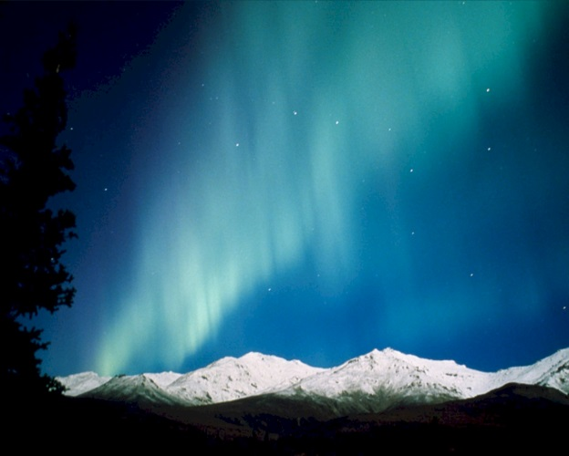
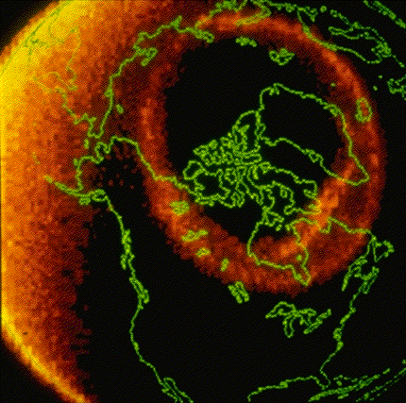

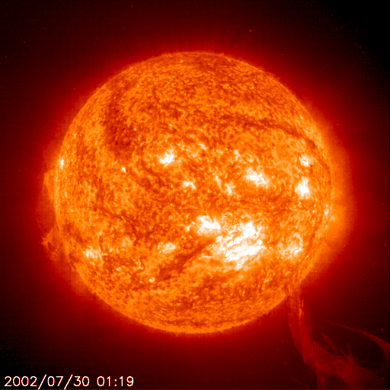
The NOAA/USGS Geoelectric Field Modeling Project:
Mitigating the Impacts of Space Weather on the Nation’s Electrical Power Grid
Outline
The Sun-Earth Connection – Space Weather
Geomagnetically Induced Currents & the Power Grid
The NOAA/USGS Geoelectric Field Model
Christopher Balch
NOAA Space Weather Prediction Center
NOAA VLab forum
23 March 2021

Slide 2
Collaborators - Acknowledgements
The near real-time E-field mapping project is a joint effort between
  NOAA/SWPC
    Geospace-geoelectric team: Balch, Singer, Camporeale, Millward, Adamson
    SWPC development & transition team: Hill, Carpenter, Husler, Dodani, England, Gray
    SWPC system admin & maintenance team
  USGS Geomagnetism group (Anna Kelbert, Josh Rigler)
  NASA/CCMC (Antti Pulkkinen)
  University of Colorado – LASP (Greg Lucas)
Technical advice from David Boteler – NRCan – is gratefully acknowledged
Key data provider agencies are gratefully acknowledged:
  U.S. observatories operated and maintained by USGS
  Near U.S. observatories operated and maintained by NRCAN
Magnetic field time-series interpolation algorithm developed and made available courtesy of the Finnish Meteorological Institute
  Spherical Elementary Currents (SECS)
  Amm & Viljanen, 1999; Pulkkien et al., 2003
Results from NSF’s Earthscope USArray project are being used as the source for improved Earth-conductivity specification

Slide 3

Space Weather & the Power Grid
A severe space weather event will impact the electrical power grid
Reliable electrical power is a prime example of ‘critical infrastructure’
Known impacts from March 13, 1989
  9 hour power outage in Hydro-Quebec
  Transformer failure in PSE&G system
  Widespread operating anomalies (211 documented)*
What happens when the next severe storm hits?
Developing understanding of the physical processes is interdisciplinary
Many research, modeling, and observational projects derive inspiration from the societal impact of this issue
*See NERC March 13, 1989 Geomagnetic Disturbance Report (1990)
Notes:
Inspiration and also justification, both from the proposer side and from the funding resource allocator side
Additional critical infrastructure depend on reliable electrical power (water, pumping gasoline, communications) so electrical power is a foundational part of the critical infrastructure
The physical processes involved connect to space weather, but also go beyond it, because one needs to account for solid earth geophysics, and one also needs to address the electrical power engineering aspects of the problem - Obviously it is an issue where we have to draw on the expertise from different areas and bring them together to get a coherent picture.

Slide 4
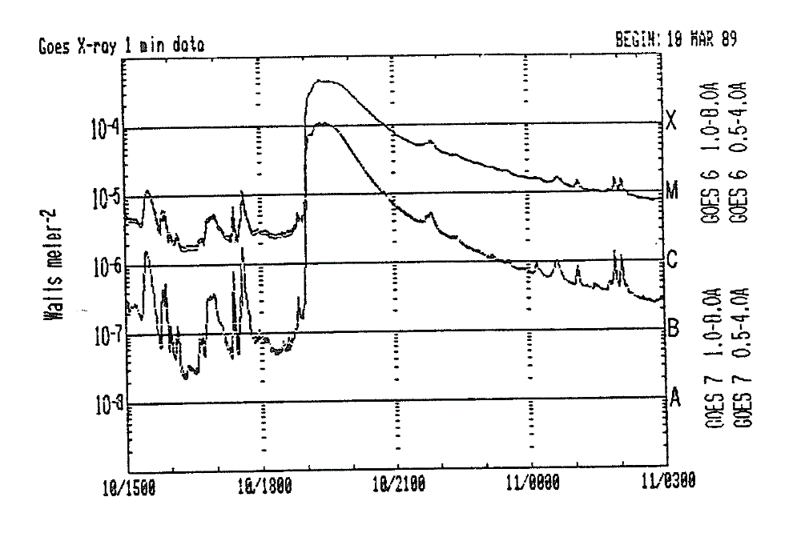

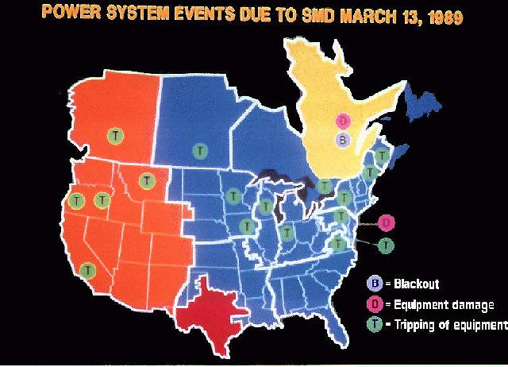
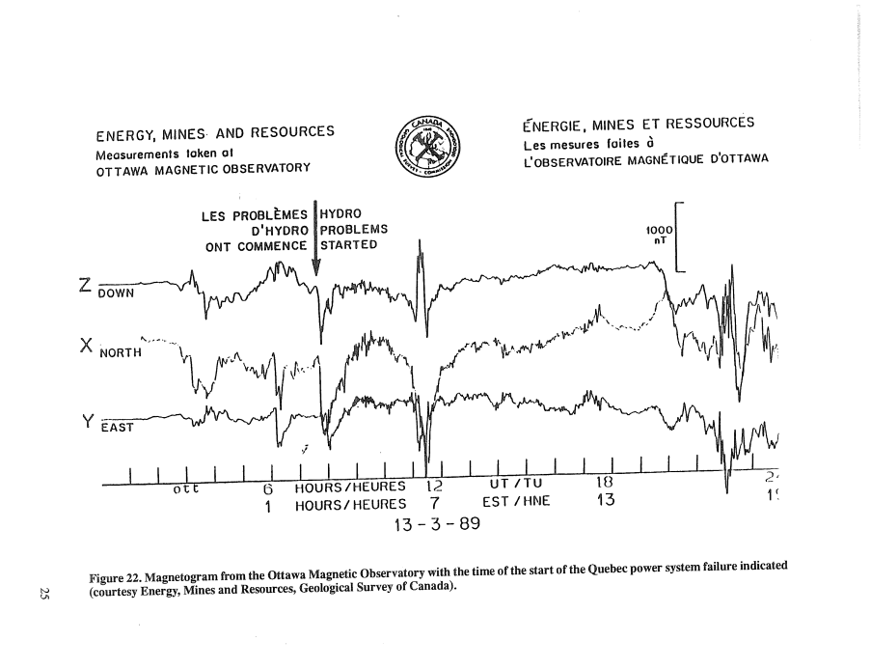
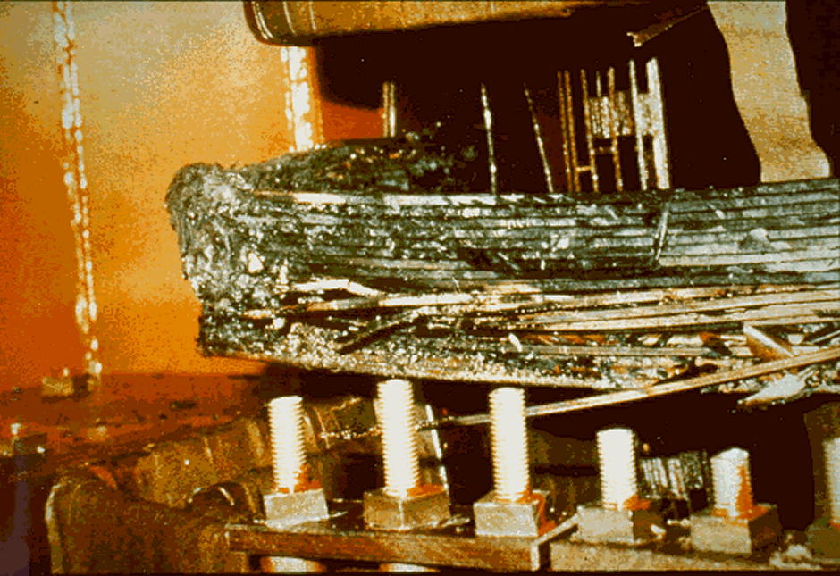
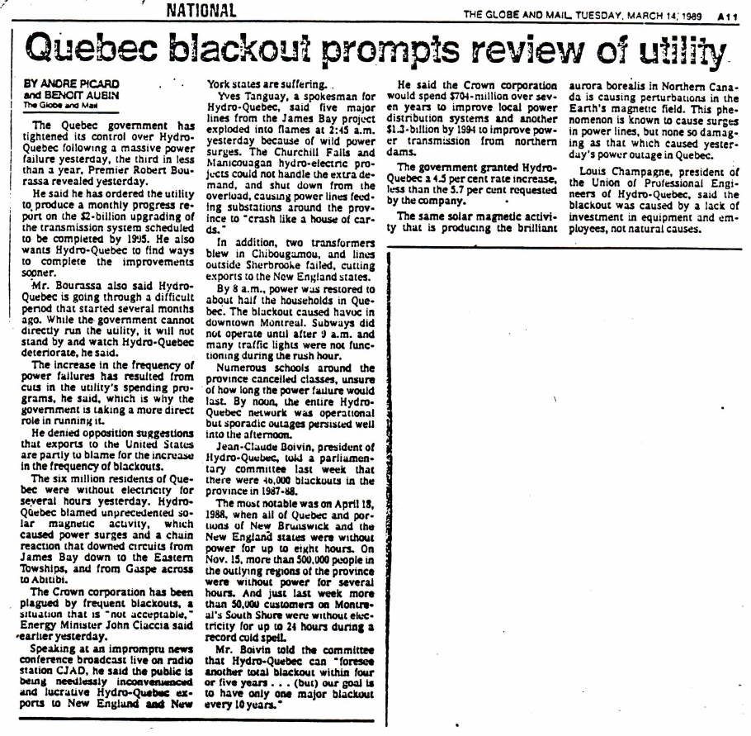
March 13, 1989 – Wake Up Call

Slide 5
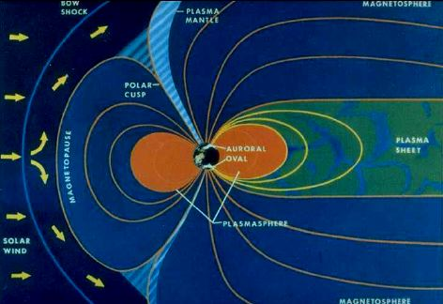
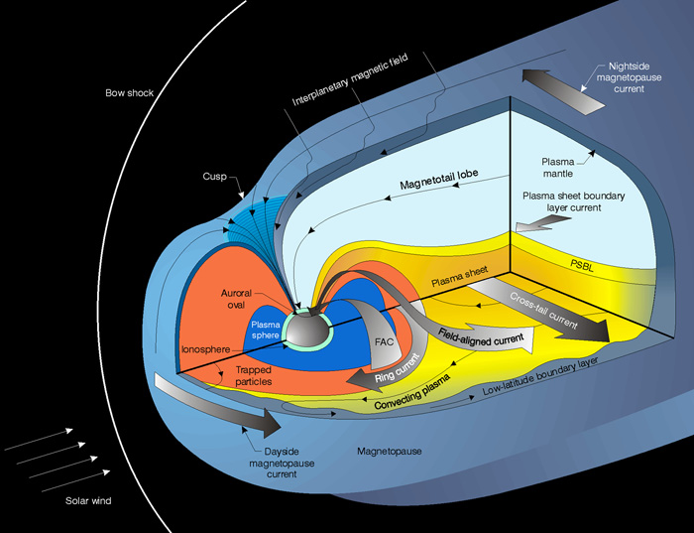
What Happened?
Geomagnetic Storms
Earth has a natural magnetic field
Processes in space near Earth produce magnetic variations which are superposed on the background field

Slide 6
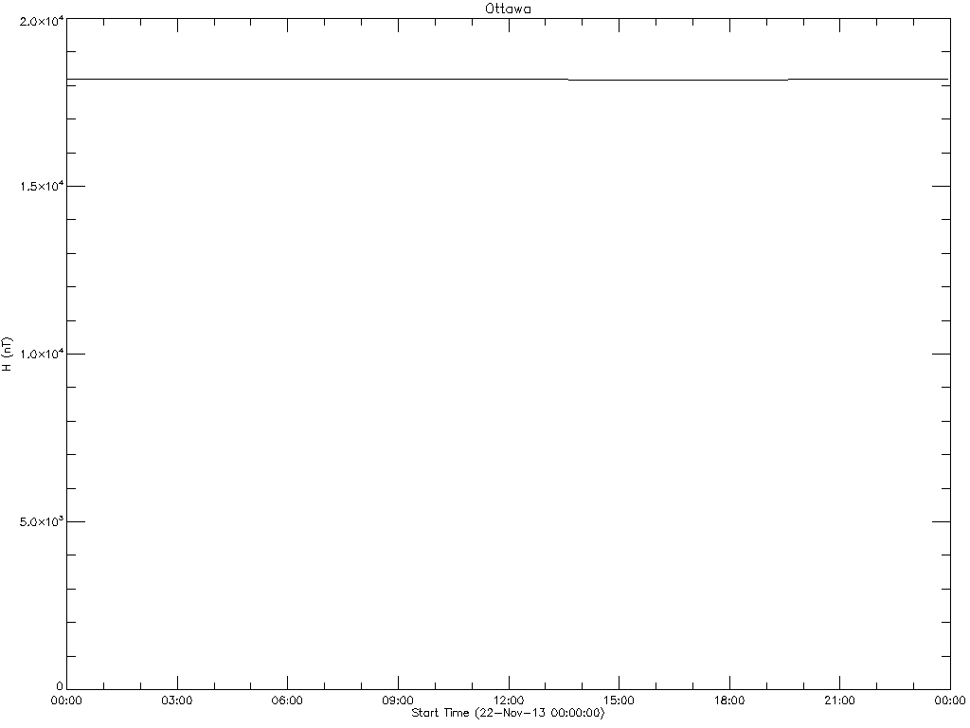
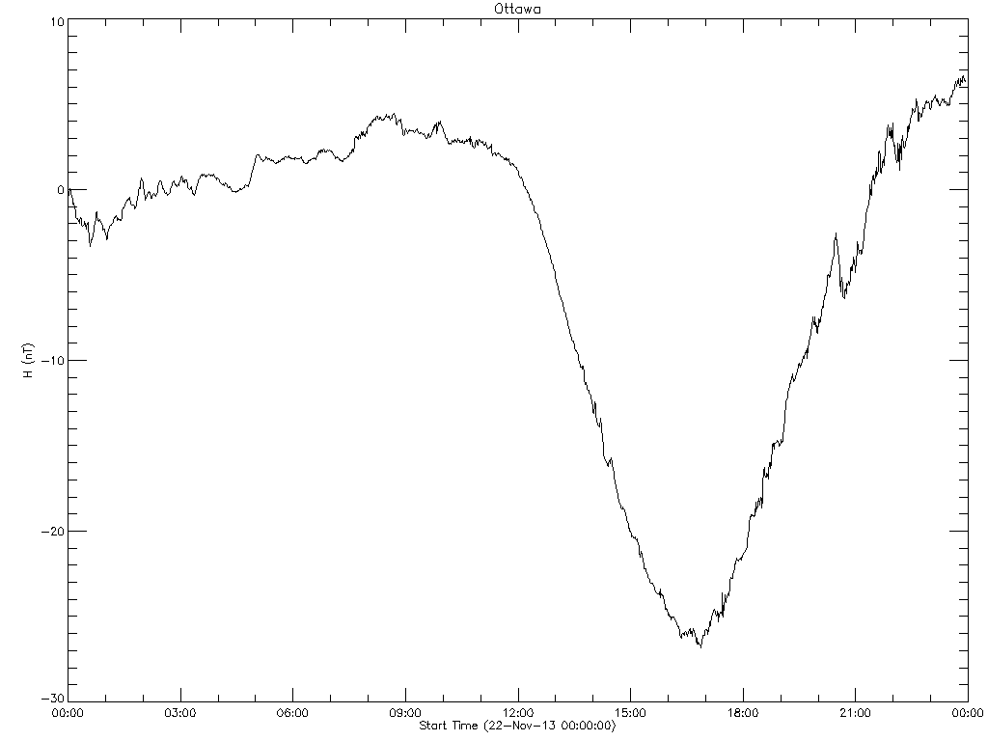
A Quiet Day
Total Horizontal Field ~18,188 nT
Quiet fluctuations about the mean ~25 nT (about 0.1%)
Even on a quiet day there are small daily fluctuations of the geomagnetic field

Slide 7
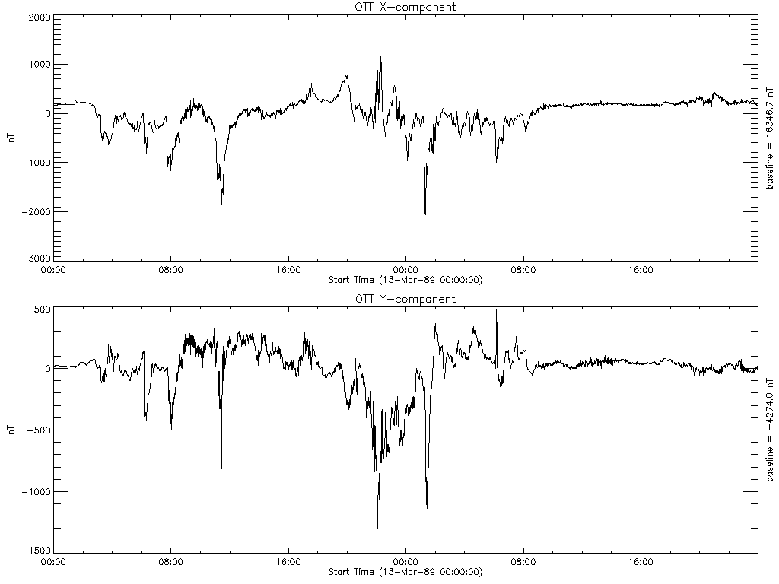
March 13, 1989
Storm fluctuations ~2000 nT (~10%)
Disturbances from the Sun travel through space and cause geomagnetic storms!

Slide 8
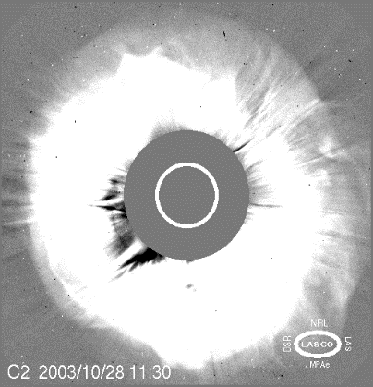
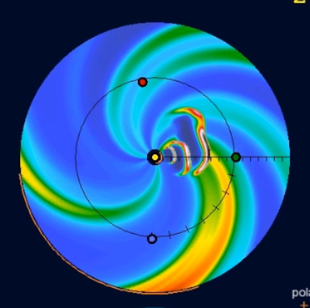
Cause & Effect - Sun to Mantle - I
SOHO C2 data courtesy of the NASA/ESA
Output from WSA-Enlil-Cone model for series of three CME’s observed in August 2011
Conceptual model for solar-wind-magnetosphere interaction
Image of the auroral oval from the Dynamics Explorer 1 Satellite (Louis Frank)
Conceptual model of the Magnetosphere. (Source - C Russell, IEEE Trans. on Plasma Science, 2000).

Slide 9
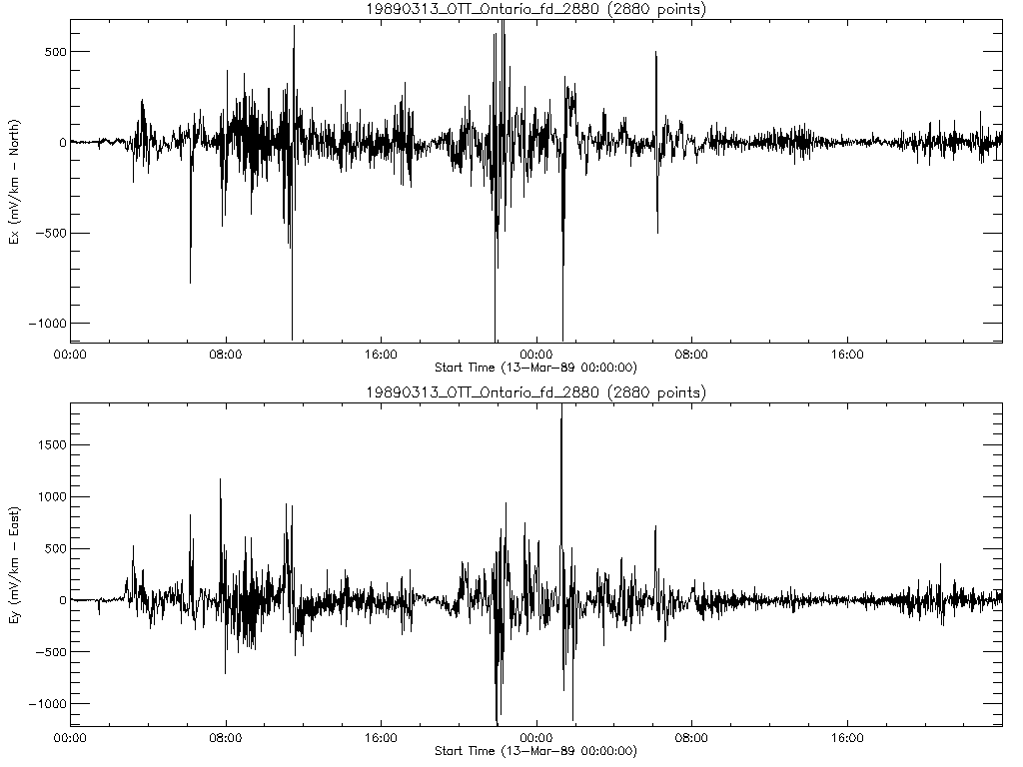
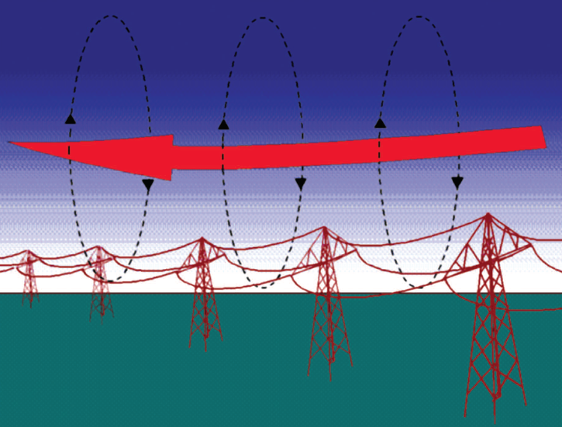
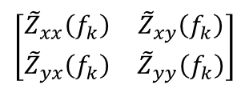
Cause & Effect - Sun to Mantle - II
$$\left[\begin{matrix}{\tilde{Z}}_{xx}\left(f_{k}\right) & {\tilde{Z}}_{xy}\left(f_{k}\right) \\ {\tilde{Z}}_{yx}\left(f_{k}\right) & {\tilde{Z}}_{yy}\left(f_{k}\right)\end{matrix}\right]$$
Earth Conductivity:
-frequency dependent filter
-varies with location
-depends on structure
below the mud
Input: Geomagnetic Field Time Series
March 13-14, 1989 Geomagnetic storm observed at Ottawa (NRCAN)
Output: Geoelectric Field Time Series
Calculated Geoelectric Field with a simple conductivity model
The induced electric field drives current in conductors on and below the surface of the Earth
Time varying currents in space induce currents in the Earth and in artificial conductors at the surface - Boteler (2015)

Slide 10
GIC and the Power Grid
Geomagnetically induced electric current flows along natural and artificial conductors
Currents flow to and from ground through windings of power transformers
½ cycle saturation in transformers is the root of the problem
  Transformer exciting current exceeds normal levels
  Magnetic material saturates
  Loss of back EMF with high voltage leads to excess currents, stray magnetic flux, abnormal heating from eddy current
  Transformer adds a large inductive-reactive load to the system, requiring high levels of capacitive reactive loading to maintain system stability
  Saturating transformers add significant harmonics to currents and voltages, often causing equipment to trip

Slide 11
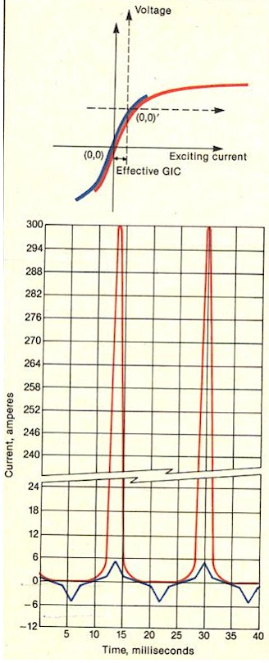
Half-Cycle Saturation
Results from GIC test
(Kappenman & Albertson ,1990)
Blue curve – normal exciting current
Red curve – exciting current with 75 Amps of DC current introduced in the neutral
Blue curve peaks ~ 5 Amps
Red curve peaks ~300 Amps
Highly distorted waveform with even & odd harmonics
High inductive reactive loss: e.g. 50 MVARs vs ~ 1 MVAR normally

Slide 12
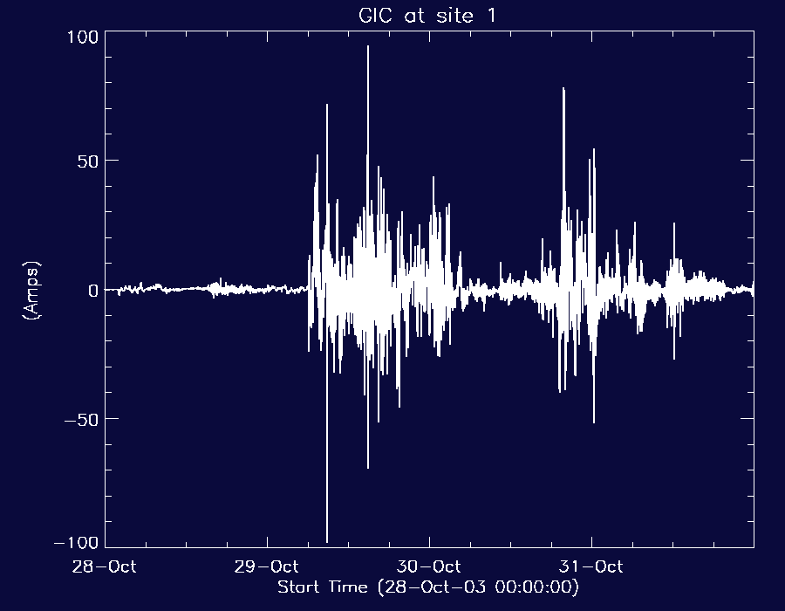
GIC measurement during a geomagnetic storm
Data courtesy of the EPRI SUNBURST project

Slide 13
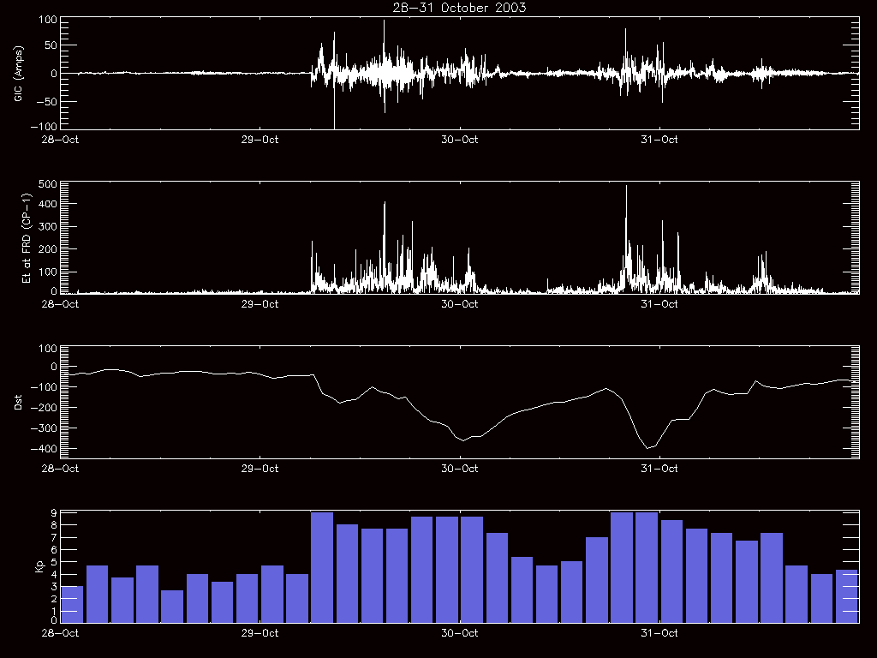
GIC compared with other Storm Measures

Slide 14
Geoelectric Field Modeling
The Electric Power Industry requires a better indicator than the Kp index/G-scale or local K-indices to specify geomagnetic activity levels
The Geoelectric Field – has been identified as the key space weather parameter that is needed (not G, Kp, Dst, dB/dt, etc):
  Space Weather Workshop 2011:
  ’…the best, most useful environment parameter…’
  Referenced by industry standards groups (NERC/FERC)
  Used to describe the ‘benchmark geomagnetic storm event’ and vulnerability assessment requirements
  National Space Weather Action Plan (SWAP) (OSTP 2015) highlights the Geoelectric field in Goal 1.1 (Benchmarks) & Goal 5.5 (Enhance Understanding)
Key Advantages for using the Geoelectric Field:
  Local-regional activity is characterized: there can be significant differences in comparison to globally averaged quantities
  The geoelectric field directly indicates the induction hazard; whereas the indices do not

Slide 15
How will the information will be used?
The geoelectric field enables calculation geomagnetically induced currents
The GIC calculation requires realistic system modeling
  Users are developing realistic models of their systems (a standards requirement)
Calculated GIC can be compared to measured GIC for validation
Assessment of GIC impacts on the system:
  System stability when GIC is present (i.e. voltage stability)
  Transformer behavior under GIC-caused saturation conditions
  Impact of GIC-caused harmonics on other system components
System planning or after-the-fact analysis:
  Simulations can locate problem spots and focus mitigation efforts
    Could consider installing a less vulnerable transformer
    Possible to modernize relays as newer devices are less susceptible
    Possible to implement GIC ‘blockers’ – but requires full system analysis
  Analysis can inform real-time response procedures to E-field nowcast/forecast

Slide 16
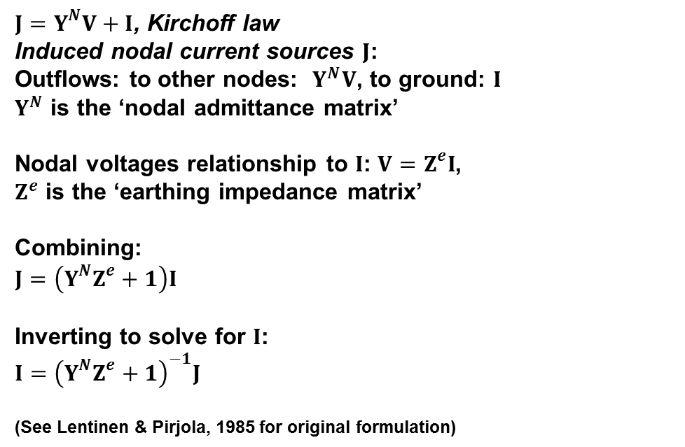
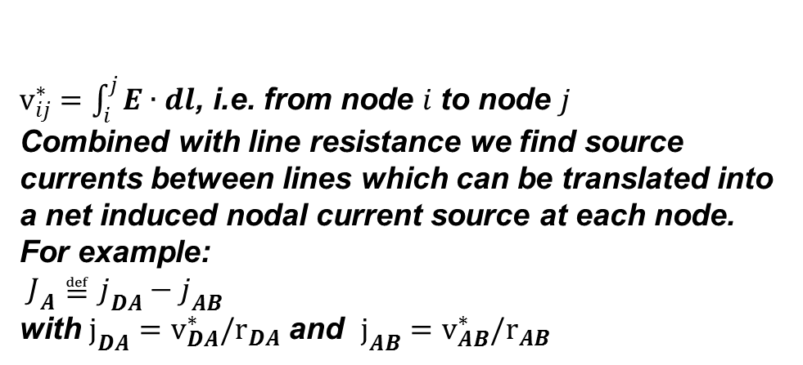
A Brief Overview of Calculating GIC
$v_{ij}^{∗}=\int_{i}^{j}{E∙dl}$, i.e. from node $i$ to node $j$
Combined with line resistance we find source currents between lines which can be translated into a net induced nodal current source at each node.
For example:
$J_{A}≝j_{DA}−j_{AB}$
with $j_{DA}=v_{DA}^{∗}/r_{DA}$ and $j_{AB}=v_{AB}^{∗}/r_{AB}$
$J=Y^{N}V+I$, Kirchoff law
Induced nodal current sources $J$:
Outflows: to other nodes: $Y^{N}V$, to ground: $I$
$Y^{N}$ is the ‘nodal admittance matrix’
Nodal voltages relationship to $I$: $V=Z^{e}I$,
$Z^{e}$ is the ‘earthing impedance matrix’
Combining:
$$J=\left(Y^{N}Z^{e}+1\right)I$$
Inverting to solve for $I$:
$$I={\left(Y^{N}Z^{e}+1\right)}^{−1}J$$
(See Lentinen & Pirjola, 1985 for original formulation)
Credit – Boteler & Pirjola, 2017

Slide 17
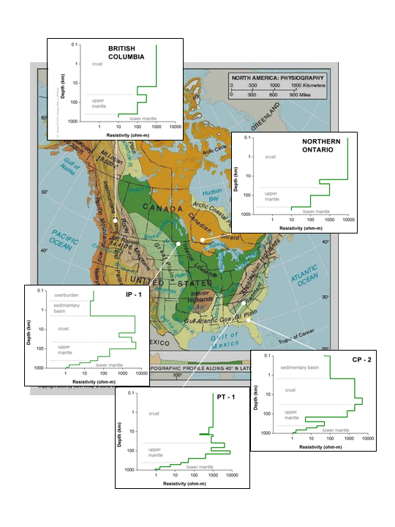
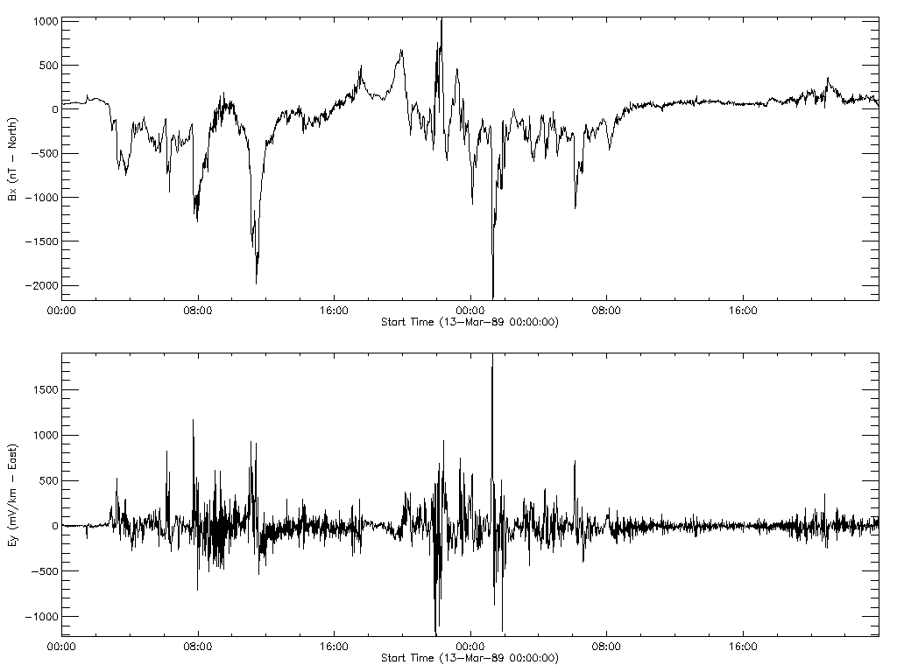
Geoelectric Field
The Geoelectric Field is calculated by convolving the Geomagnetic Field variation with a frequency dependent Earth-response function
The Earth response function depends on conductivity below the surface
March 13-14, 1989 – Ottawa geomagnetic and geoelectric fields using a 1D conductivity model

Slide 18
Geoelectric Field Calculation
Input – Observed Geomagnetic Field (B-field) time series
Earth conductivity acts like a frequency dependent filter:
  Earth conductivity affects the input signal amplitude and phase differently, depending on the input signal frequency
    High frequency fields have relatively shallow penetration (top-most layers)
    Lower frequency fields have relatively deeper penetration (lower layers with different conductivity properties)
Methods to determine the filter:
  One-dimensional multi-layer models (conductivity varies with depth) allow the filter to be calculated numerically (but typically will have limited accuracy)
  (EPRI-Fernberg models - 2012)
  A magnetotelluric site survey (measures B-field and E-field together) allows the filter to be constructed empirically which incorporates all the effects of the 3D Earth conductivity (not available in all locations) (Earthscope-based models)
  Earthscope MT data used with ModEM MT inversion code (Kelbert et al 2014) to generate high resolution 3D electrical conductivity model. (Enables interpolation between survey sites and also filters out near surface ‘noise’)

Slide 19
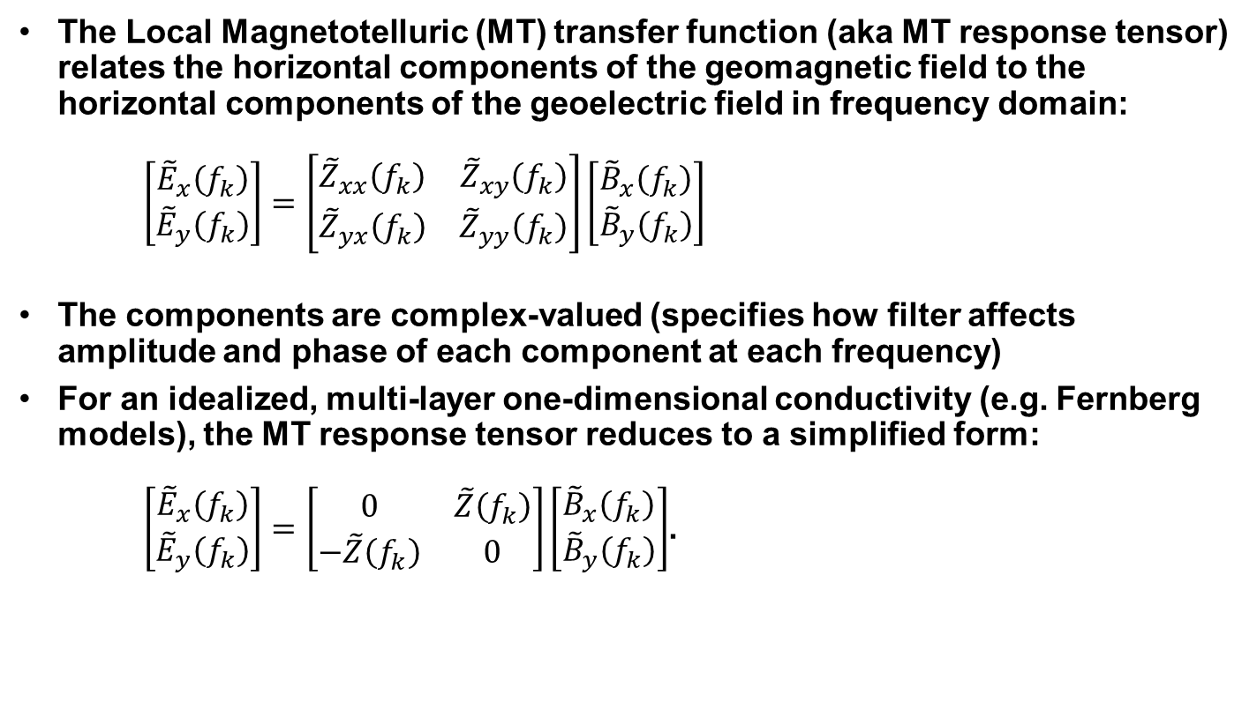
Geoelectric Field Calculation: Frequency Domain
The Local Magnetotelluric (MT) transfer function (aka MT response tensor) relates the horizontal components of the geomagnetic field to the horizontal components of the geoelectric field in frequency domain:
$\left[\begin{matrix}{\tilde{E}}_{x}\left(f_{k}\right) \\ {\tilde{E}}_{y}\left(f_{k}\right)\end{matrix}\right]=\left[\begin{matrix}{\tilde{Z}}_{xx}\left(f_{k}\right) & {\tilde{Z}}_{xy}\left(f_{k}\right) \\ {\tilde{Z}}_{yx}\left(f_{k}\right) & {\tilde{Z}}_{yy}\left(f_{k}\right)\end{matrix}\right]\left[\begin{matrix}{\tilde{B}}_{x}\left(f_{k}\right) \\ {\tilde{B}}_{y}\left(f_{k}\right)\end{matrix}\right]$
The components are complex-valued (specifies how filter affects amplitude and phase of each component at each frequency)
For an idealized, multi-layer one-dimensional conductivity (e.g. Fernberg models), the MT response tensor reduces to a simplified form:
$\left[\begin{matrix}{\tilde{E}}_{x}\left(f_{k}\right) \\ {\tilde{E}}_{y}\left(f_{k}\right)\end{matrix}\right]=\left[\begin{matrix}0 & \tilde{Z}\left(f_{k}\right) \\ −\tilde{Z}\left(f_{k}\right) & 0\end{matrix}\right]\left[\begin{matrix}{\tilde{B}}_{x}\left(f_{k}\right) \\ {\tilde{B}}_{y}\left(f_{k}\right)\end{matrix}\right]$.

Slide 20
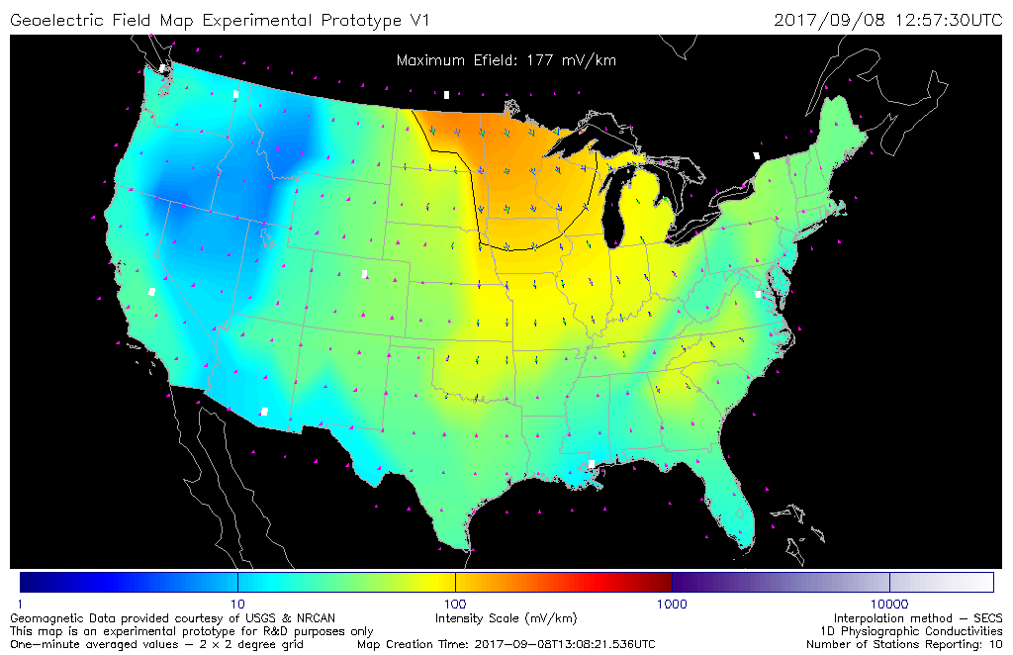

E-field maps data pipeline – 1D model
USGS observatories (8)
B-field time series
Detrending Algorithm
Interpolation Algorithm†
B-field on 0.5°x0.5° grid
(daily netcdf archive)
NRCAN observatories (5)
B-field time series
E-field calculation: 2°x2° grid, Fernberg 1D conductivities
E-field products:
-results in database
-graphical maps
-daily netcdf (for archive)
-gridded data files (available on request)
-GeoJSON format for dissemination
Operational deployment completed in September 2019
  † SECS - Amm & Viljanen, 1999; Pulkkinen et al., 2003
URLs
https://swpc.noaa.gov/products/geoelectric-field-1-minute
https://services.swpc.noaa.gov/json/lists/rgeojson/InterMagFB1DLP/ (geojson files)
Notes:
Operational deployment means the end-to-end process is running on SWPC’s operational systems and has high availability. End users are advised to run validation tests for their operating regions before using the information operationally, as the accuracy of the conductivity model may be limited in some locations.
The end-to-end data flow is designed to allow conductivity information to be updated relatively easily as new information is forthcoming from the research community.
The system can easily accept the addition of more input magnetometer data, provided the data meets the basic requirements for timeliness, minimal noise, and knowledge of sensor orientation.

Slide 21
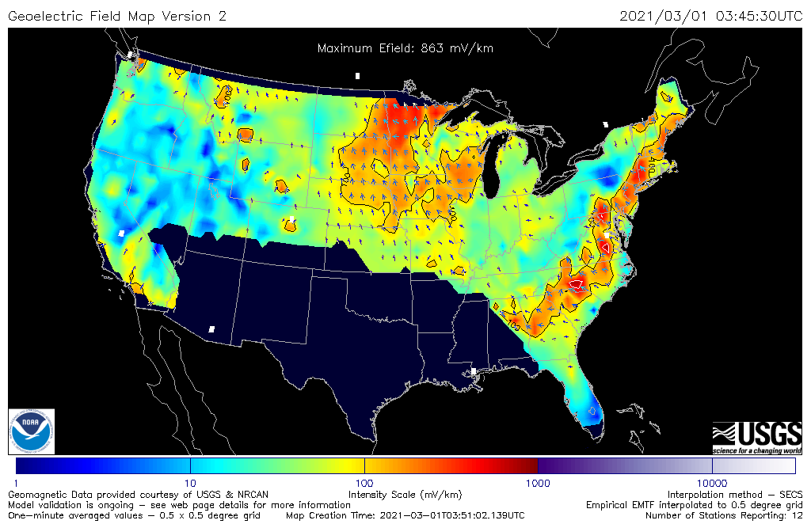
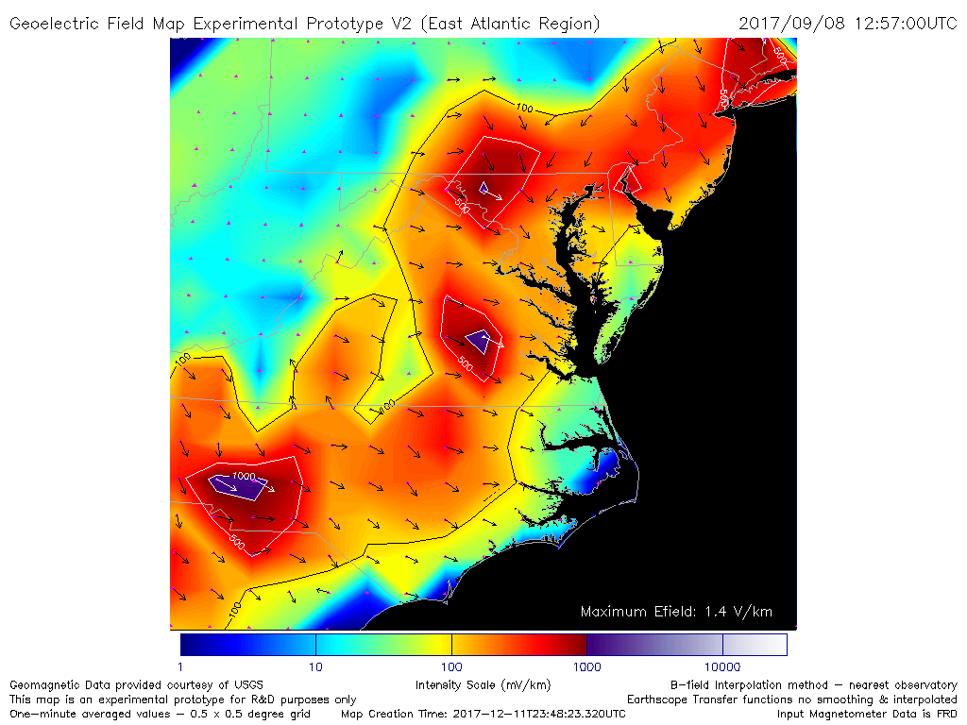
E-field maps data pipeline – 3D model
USGS observatories (8)
B-field time series
Detrending Algorithm
Interpolation Algorithm
B-field on 0.5°x0.5° grid
daily netcdf for archive
NRCAN observatories (5)
B-field time series
E-field calculation:
-Earthscope Transfer Functions & (USGS for FL)
-Interpolate to 0.5°x 0.5° grid
-Gaps in coverage
E-field products:
-results in database
-graphical maps
-gridded data files
-daily netcdf for archive/repository
-GeoJSON format for dissemination
Operational in September 2020
https://swpc.noaa.gov/products/geoelectric-field-1-minute-empirical-emtf-3d-model/
https://services.swpc.noaa.gov/json/lists/rgeojson/InterMagEarthScope/

Slide 22
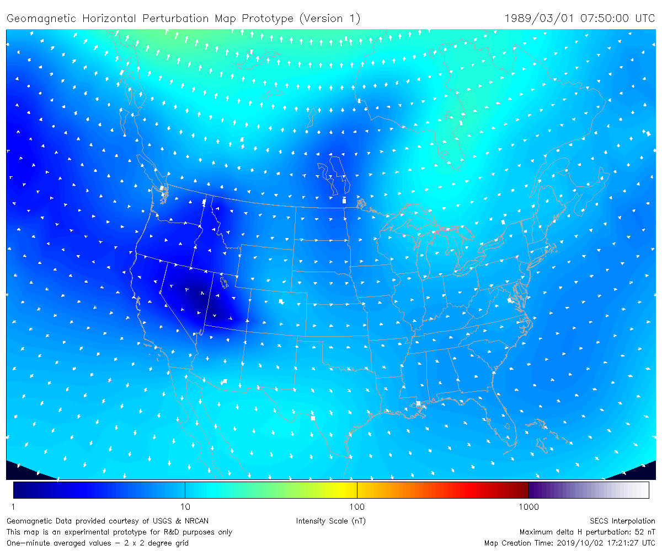
Sample B-field interpolation map – Quiet Time
CMO
BLC
YKC
FCC
SIT
SNK
STJ
MEA
VIC
BRD
NEW
OTT
BOU
FRN
FRD
TUC
BSL
DLR
SJG
The high latitude stations: CMO, YKC, BLC, FCC, SNK are planned to be added to the network in FY 2021

Slide 23
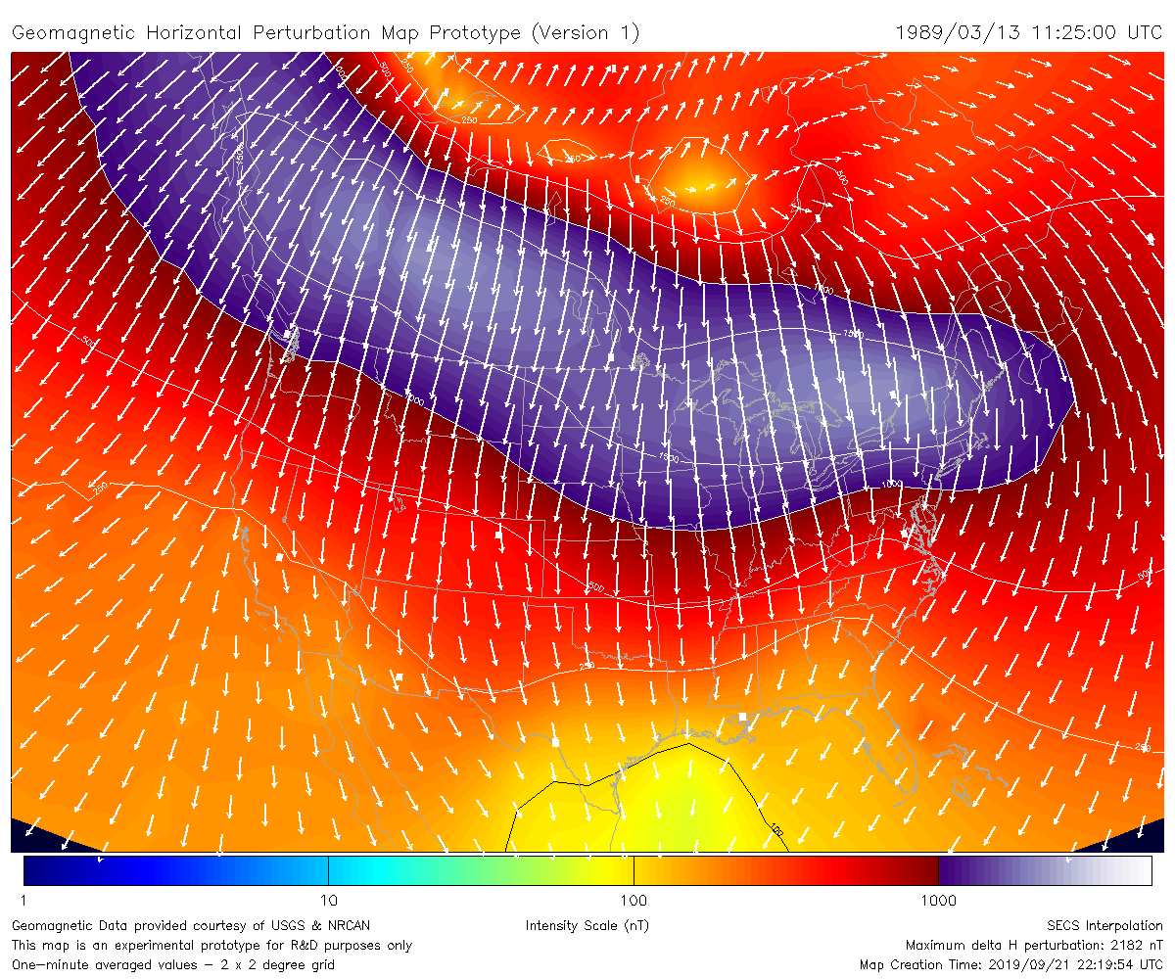
B-field interpolation map – March 13, 1989
CMO
BLC
YKC
FCC
SIT
PBQ
STJ
MEA
VIC
GLN
NEW
OTT
BOU
FRN
FRD
TUC
BSL
DLR
SJG

Slide 24
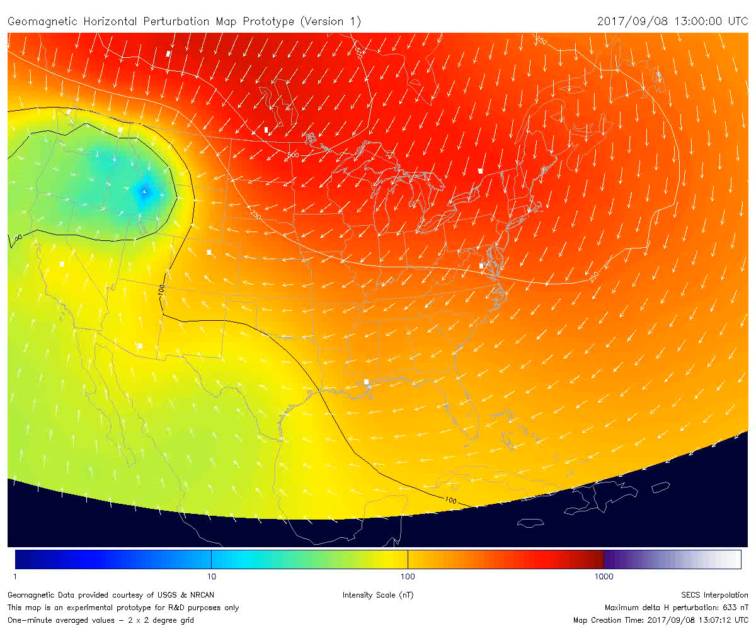
Notes:
September 08, 2017 from 1300-1400 UTC, 2 frames per second (30 second video)

Slide 25
E-field map generation – 1D model
Defined a set of geographic gridpoints
  Two degree resolution over CONUS
For each gridpoint:
  Use interpolated B-field time series as input
  Determined the conductivity model for the grid point
  The initial release uses 1D conductivity models
  (Fernberg 2012)
  The maps have been running at SWPC experimentally in October 2017 and operationally since September 2019
E-field for each grid point is calculated in near real-time (283 grid points for each time step)
Notes:
physiographic regions (Fenneman & Johnson, 1946)
First 1D conductivity models: EPRI report 1026430 (December 2012): (the Fernberg 1D models)

Slide 26
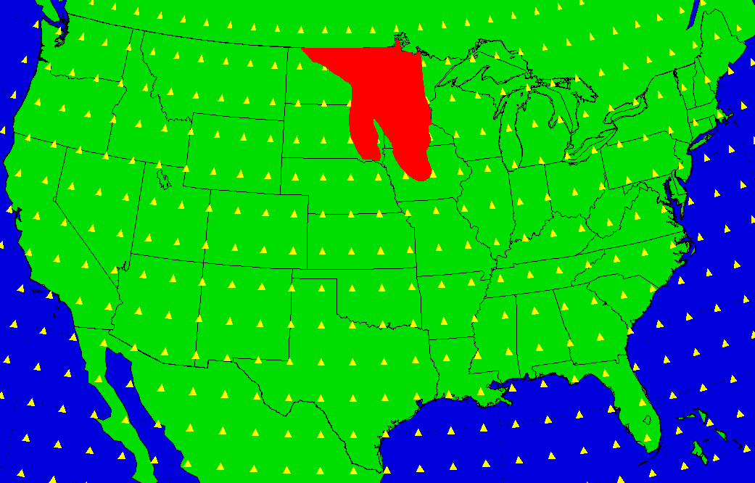
Physiographic Region 1D model
2 degree x 2 degree grid
Region 12b, interior plains, central lowland, western lake
All grid points in the region are assigned conductivity model IP-1

Slide 27
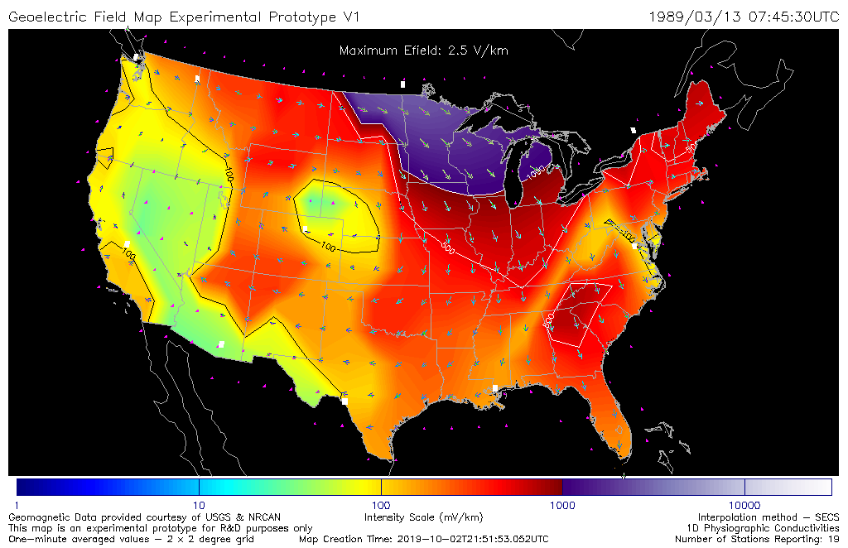
2 x 2 degree Fernberg 1D Map

Slide 28
E-field map generation – 3D model
Produce interpolated B-field time series over CONUS using a 0.5 degree resolution grid in longitude and latitude.
For each magnetotelluric survey site over CONUS
  Find the nearest interpolated B-field time series and use as input
  Calculate the E-field time series at each survey location using the published transfer function (1084 surveys available as of June 2020)
  Resample the E-field map (irregular grid) to a regularly spaced ½ degree resolution grid, omitting all points that are more than 100 km from an MT survey site (2800 grid pts)
The 3D maps have been running experimentally at SWPC since June 2020 and operationally since September 2020

Slide 29
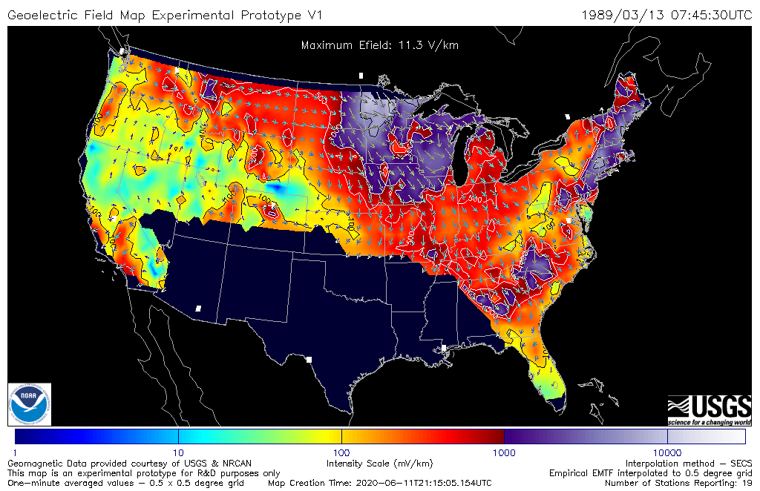
0.5 x 0.5 degree Empirical 3D Map

Slide 30
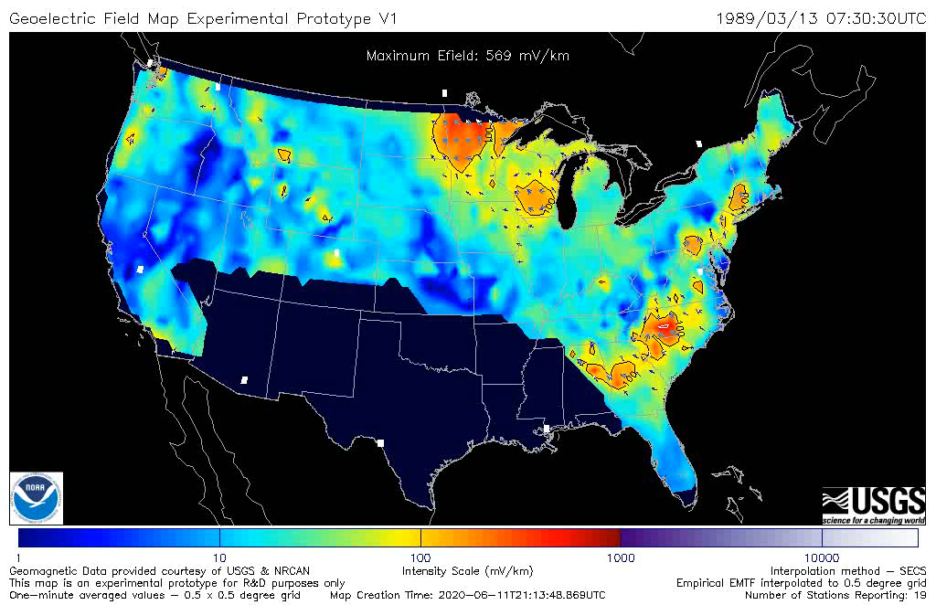

Slide 31
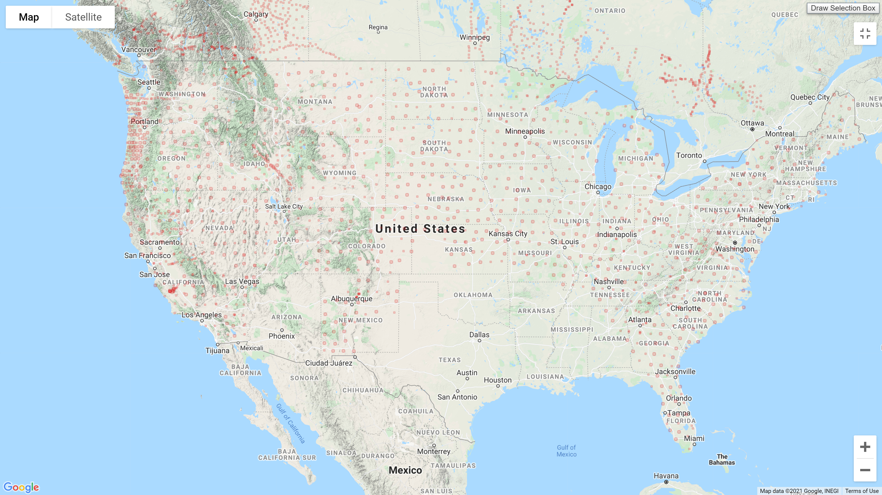
MT Survey locations – 3/21/2021
Graphic from IRIS website:
ds.iris.edu/spud/emtf

Slide 32
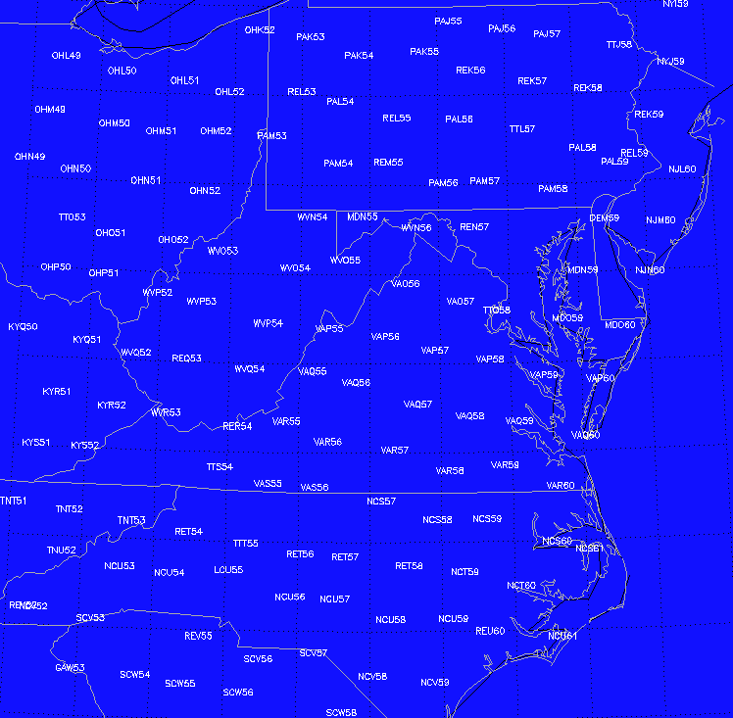
Survey Sites the mid-Atlantic Region

Slide 33
Model Comparisons with Historical Data
Goal: Compare the two different conductivity models by running side-by-side calculations using historical data – to help characterize the ‘error bars’ in the 1D maps
We choose full months with Kp = 9o (G5) occurrence:
March 1989, July 2000, October 2003 (93 days)
Historical data from 10 USGS stations and 8 Canadian stations (9 for March 1989)
The data are detrended & interpolated to a 0.5 x 0.5 degree grid
The Fernberg 1D maps are calculated for each time step on the same 2 x 2 degree grid as the operational version
The empirical 3D maps are calculated on a 0.5 x 0.5 degree grid as described on the previous slide
To compare models, for each point in the 1D map, we average together all the 3D empirical map grid points that are within one degree (158/209 available locations)
Notes:
Statistical comparison between the Fernberg 1D and the EMTF-based model to better characterize the ‘error bars’ in the former
Magnetic observatories used: CMO, BLC, YKC, FCC, SIT, PBQ, MEA, GLN (3/89 only), VIC, NEW, STJ, OTT, BOU, FRD, FRN, TUC, BSL, DLR, SJG

Slide 34
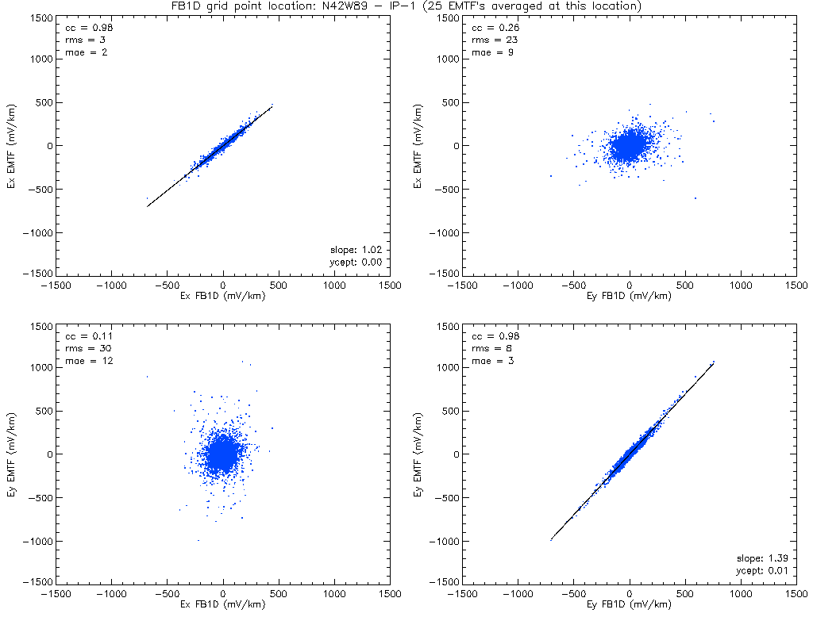
Scatterplots
North-Central Illinois
Notes:
North-Central Illinois

Slide 35

Correlation Table

Slide 36
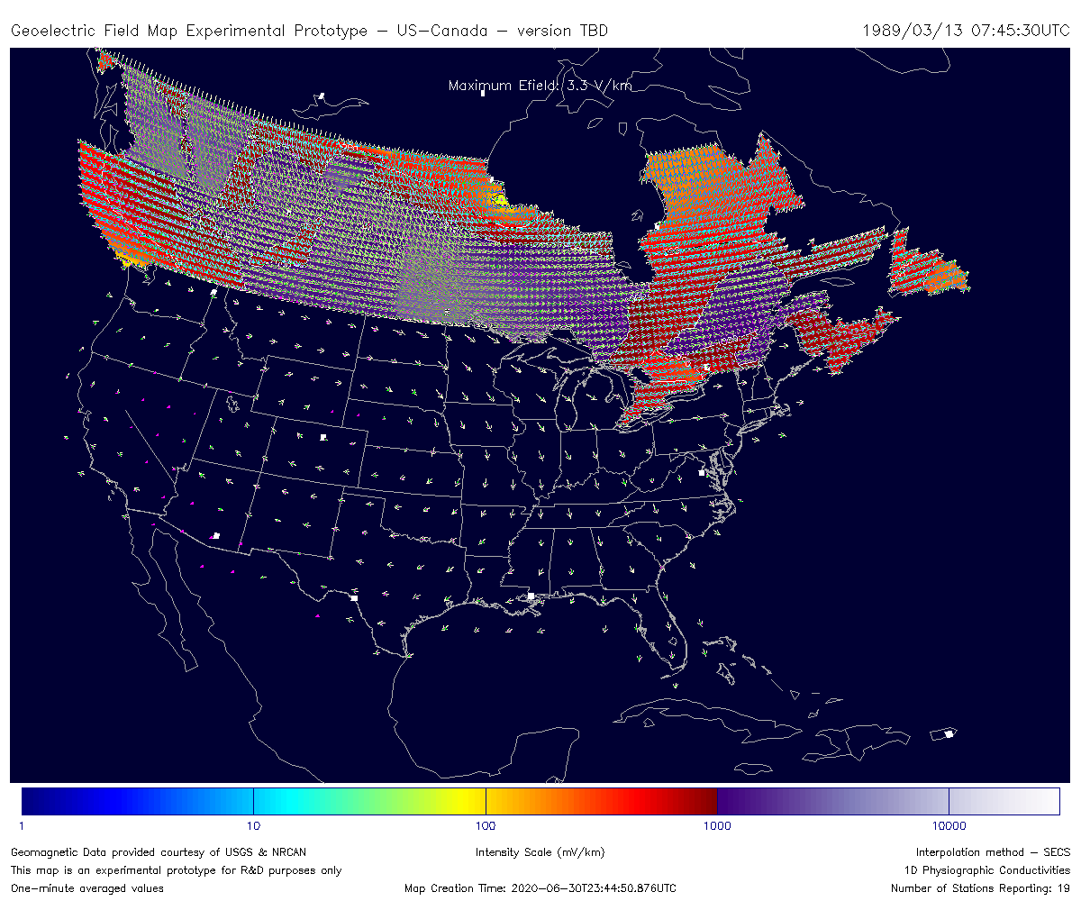
E-field maps – in development
Joint US-Canada E-field map
Partnership with NRCAN to develop US-Canada E-field map
Northern boundary will extend up to 60 degrees latitude
NRCAN space weather specifies conductivities for Canada
Four high latitude magnetometers to be added:
YKC, BLC, FCC, SNK

Slide 37
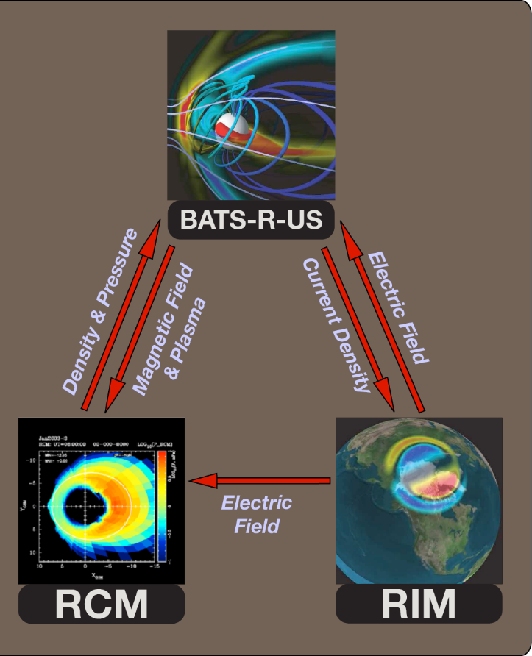
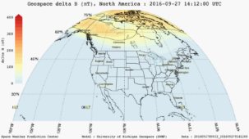
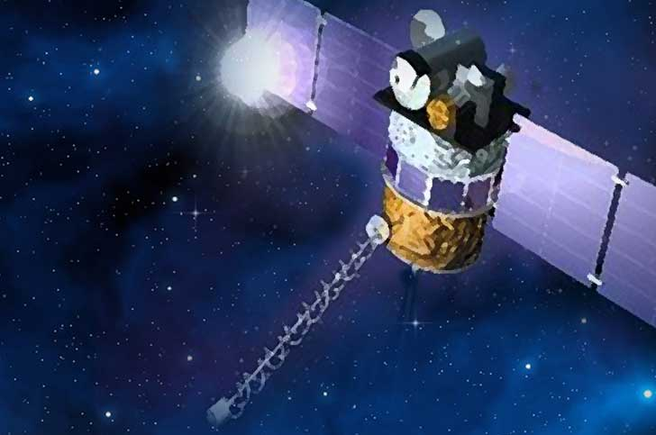
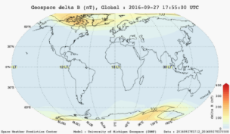
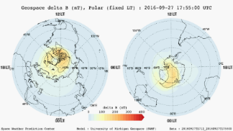
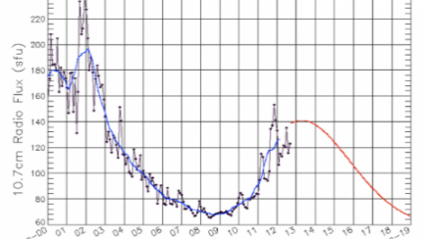
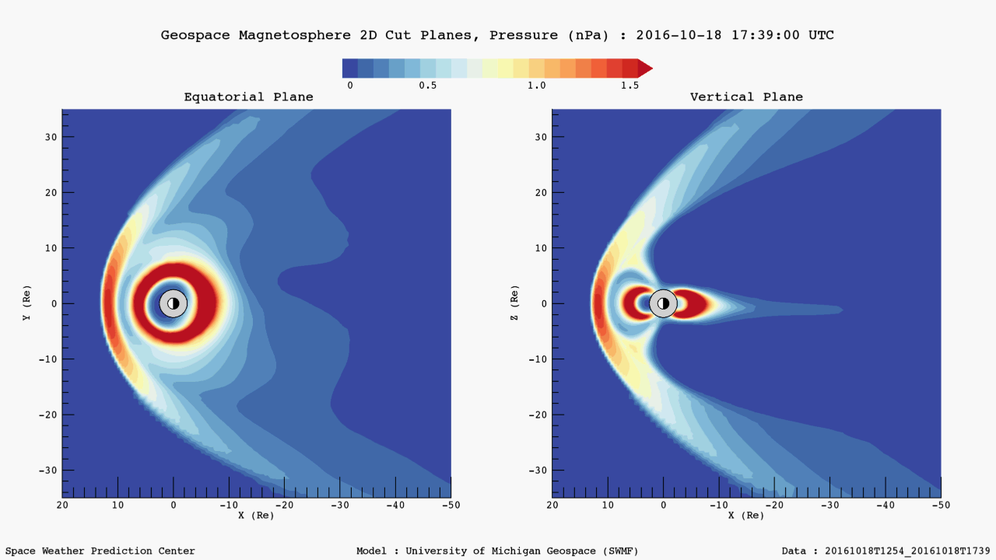
Forecasting:
Operational Geospace Model
Implementation at NWS
DSCOVR
Solar Wind Data:
V, n, T, B
http://www.swpc.noaa.gov/products
Solar F10.7 Radio Flux
Operational SWMF
Predicts Geomagnetic Variations on a 2°x2° grid over lower 48 states
SWPC is looking at using the model output for the E-field predictions
Notes:
This is what the Geospace model looks like as we currently have it implemented at the National Weather Service.
In the center, you can see the three components of the SWMF that we have coupled together to form the Geospace model.
We drive the Geospace model using real-time solar wind data, which we get from the DSCOVR satellite located at the L1 Lagrange Point, and F10.7 Solar Radio Flux which is a proxy for solar UV radiation.
The output from the Geospace model is then used to generate Geospace products such as the 1) the Geospace Ground Magnetic Perturbation Maps–and 2) Magnetospheric Views. These products are all available in real-time on the SWPC webpage. .
--------------
--------------

Slide 38
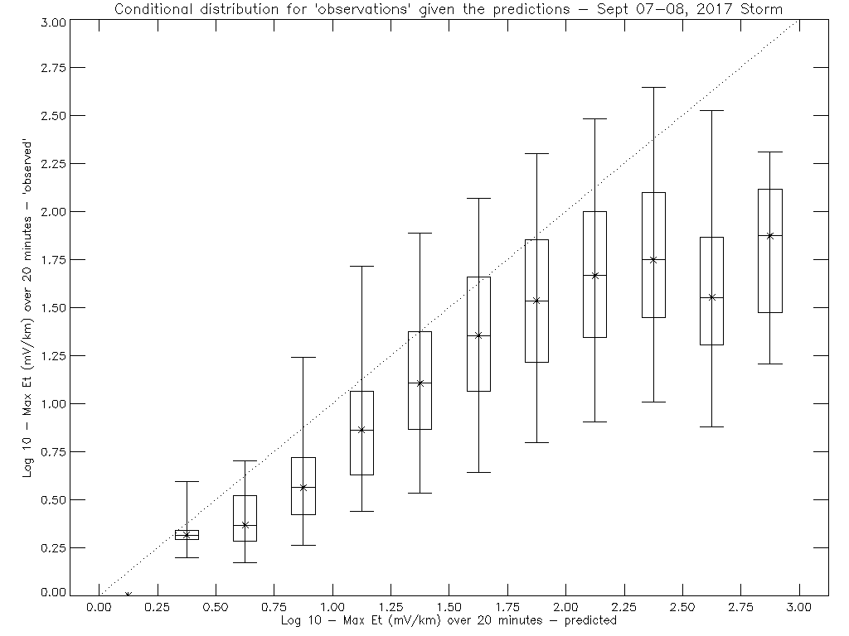
E-Fields: nowcast vs forecast
07-08 September 2017 storm
Notes:
September 8, 2017: 1326-1335

Slide 39
E-Fields: nowcast vs forecast
07-08 September 2017 storm
Define an ‘event’ as |E| exceeding 100 mV/km over a 20 minute interval (for the September 07-08, 2017 storm)
We compare predictions from Geospace with ‘observations’ from the ground-based mag calculation
The 2x2 contingency table is shown below.
There are more false alarms than hits, and there are a lot of misses
The hit rate = 0.55 (hits over total events) is higher than the false alarm rate =0.14 (false alarms over total non-events) so at least the True Skill Statistic = 0.41 is positive
Given that the forecast=yes, the probability of an event is ~27%
Given that the forecast=no, the probability of an event is ~5%
These results are limited to just one storm only – so further analysis is required to gain more confidence in this assessment
There is likely sensitivity to choice of threshold
Fcst\Obs | Yes | No
Yes | 748 | 2062
No | 601 | 12720
Notes:
September 8, 2017: 1326-1335

Slide 40
Future Plans
Geospace-Geoelectric coupling end-to-end demonstrations and comparisons with nowcast maps – milestone for FY 2021
Joint US-Canada E-field maps (1D)
  Experimental for FY 2021
  Demonstration for operational use in FY 2022 (proposed)
Ongoing validation studies with industry, comparing modeled and measured GIC
Ongoing need to improve the number of input magnetic observatories – (interpolation model inaccurate when you are too far from an observatory)
Look to USGS & other subject matter experts to improve the modeling effort in the future
  For example, may need to go to higher spatial and time resolution for better results

Slide 41
Summary
Geoelectric modeling is a major improvement in specifying space weather for impacts on the electric power gird
The geoelectric field accounts for variation of the induction effect by region and is directly related to the current induced in these systems
Accomplishments to date include:
  1D model operational in 2019
  3D empirical model operational in 2020

Slide 42
Summary
Work in progress – key elements:
  Testing coupled geospace-geoelectric results to find a way to forecast power grid impacts
  Developing joint US-Canada E-field map product
  Validation Studies with end users
  Developing better magnetometer network (to improve spatial coverage of the input data)
Future tasks
  Consider more advanced models developed by USGS and other Earth-model experts
  Consider regions where higher spatial resolution is needed
  Increase cadence (e.g. 10 second sample period)

Slide 43

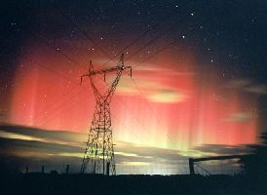
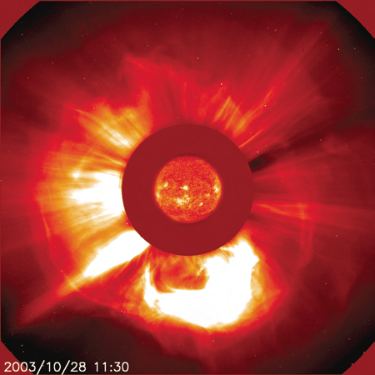


Questions?

Slide 44

Transformer Damage
22-500 kV GSU transformer at PSEG’s Salem Nuclear Plant in New Jersey was damaged by the March 13, 1989 geomagnetic storm
ESKOM’s Station 4 Transformer 6 damage was consistent with severe geomagnetic storm of October-November 2003

Slide 45

Sample Gridded Data Product

Slide 46
Data Dissemination via GeoJSON
About GeoJSON
    Adheres to a standard (RFC 7946): https://tools.ietf.org/html/rfc7946
    Can be read by web and desktop GIS clients
    Can be parsed as json, or by geojson libraries in a variety of languages
    Could be returned by a geospatial data service (e.g. ESRI ArcGIS Online)
    ASCII for human readability, compresses well when served with gzip enabled
Sample data available from the September 2017 storm
{
"type":"FeatureCollection",
"features":[
{
"type":"Feature",
"properties":{
"Ex":-0.48,
"distance_nearest_station":1107.47,
"Ey":-0.68,
"quality_flag":5
},
"geometry":{
"type":"Point",
"coordinates":[
-81.0,
24.0
]
},
…
Each “feature” has properties (data) and geometry (coordinates)
Can contain points, lines, multi-point lines, and polygons
Human and machine readable ASCII - compresses well with gzip
< 5 Kilobytes compressed for each minute

Slide 47

Station Distances (km)

Slide 48

Histograms for 3D empirical model
Histograms for each 0.5 x 0.5 degree 3D empirical grid point
2633 grid points (this sample is for Eastern Maine)
Shown is distribution of log 10 E-field magnitude in mV/km
Sample period: March 1989, July 2000, October 2003
Notes:
Eastern Maine – Based on the 0.5 x 0.5 degree empirical 3D model

Slide 49


Peak Value Map for Et (3D empirical)

Slide 50

Interplanetary Space:
Simulation

