Slide 1
VLab at 2 years
Stephan Smith
Director, VLab
NWS/OST/MDL
https://vlab.ncep.noaa.gov/

Slide 2
The Goal of VLab
The Goal of VLab is to manage innovation, streamline Operations to Research (O2R), and accelerate Research to Operations (R2O) in NOAA.

Slide 3
Virtual lab components
Virtual Lab (VLab)
Collaboration Services
Development Services
Communities
Workflow
Project Mgmt/Issue Tracking (Redmine)
Blogs
Forums
Document Libraries
Wikis
svn
Git
Code Review - Gerrit
Continuous Integration
Jenkins
Web Content

Slide 4
Growth of VLab

Slide 5
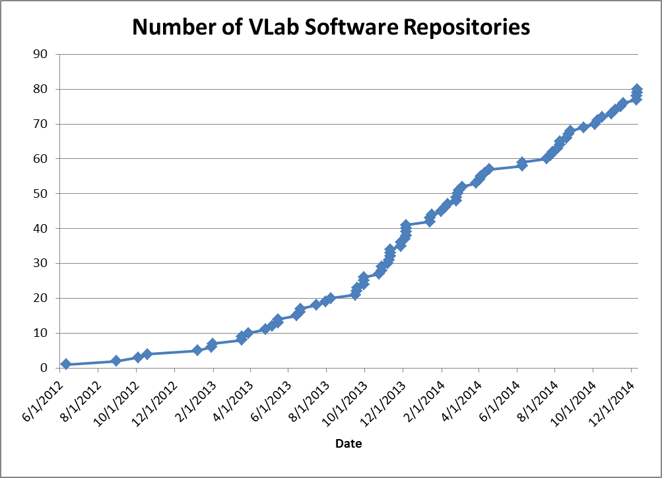
Growth of VLab

Slide 6
VLab Development Services (Redmine): Actual Usage*
VLDS | April 2014 | December 2014
Sessions | 1,784 | 3,005
Users | 344 | 802
12.3% New Users
87.7% Returning Users
Average Session Duration: 10:30 min
526 Man-hours in December
* Google Analytics

Slide 7
VLab Collaboration Services (LIFERAY): Actual Usage*
VLCS | April 2014 | December 2014
Sessions | 1,090 | 2,313
Users | 398 | 1,031
28.7% New Users
71.3% Returning Users
Average Session Duration: 5:08 min
196 Man-hours in December
* Google Analytics

Slide 8
Achievements
AWIPS VLab is now an essential and required component in the transition of research to operations (R2O) for the National Weather Service (NWS) Advanced Weather Interactive Processing System (AWIPS) II system
The VLab AWIPS Community is now the official source of AWIPS documentation
VLab has been successfully rehosted on NOAA IDP web farm
Many important NOAA projects rely on VLab for R2O: e.g., National Blend of Models, GOES-R, Hazards Services, Extra-Tropical Storm Surge, MRMS, MPAR, Impacts Catalog, NOAA Weather Wire, NDFD Verification, Aviation Forecast Verification Tool, and FACETS PHI Tool

Slide 9
Achievements
VLab Adjunct Program allows field staff to contribute to national R2O projects
VLab Support Team provides comprehensive user support M-F during business hours
Monthly VLab Focal Point meetings allows users to ask in-depth questions of VLab staff, share best practices and learn of upcoming changes

Slide 10
Lessons Learned
Easily accessible software code repositories are key to most transition projects.
Using the software management (e.g., Gerrit, Jenkins) tools in VLab improves the quality of the code developed.
Using VLab reduces direct (e.g., purchasing like COTS tools) as well as indirect (system administration) project transition costs. Applied to hundreds or thousands of projects across NOAA, this represents a significant cost reduction.
VLab allows for customized transition solutions which is essential in light of the diversity of NOAA R&D projects and operational systems.

Slide 11
Lessons Learned (cont.)
There is a significant learning curve for users to become proficient in using the VLab collaboration tools.
There is an ongoing need for marketing to potential user groups in NOAA.
There is a high demand to open up VLab more to non-NOAA users.
Sharing information enhances collaboration and raises all boats. VLab has benefitted from VLab!

Slide 12
Lessons Learned (cont.)
Establishing a local development environment for AWIPS is still far too problematic.
We must improve our expertise in user interface design.
There is an ongoing need for user training on VLab.
The Google suite of collaboration tools can be effectively integrated/leveraged within VLab.
We need to work on building a greater sense of community among VLab users.

Slide 13
Upcoming Enhancements
Single Sign-on (Google Pass-through)*
Closer integration of VLab components (e.g., My Development Projects Portlet, My Issues Portlet, Dynamic Development Projects Portlet)
Projects Repository portlet and Ideas Marketplace
VLab Trouble-Shooting Forum
* Investigating use of OpenID Connect – Google is shutting down support for OpenID 2.0 on April 20, 2015

Slide 14
On the Horizon
Open VLab
Enabling HIWPP/NGGFS development
Central Development and Testing Environment
Migration of AWIPS Software Collaboration Portal to Vlab
Customizable VLab Landing pages
VLab Subject Matter Experts portlet

Slide 15
Questions? Comments?

