Slide 1
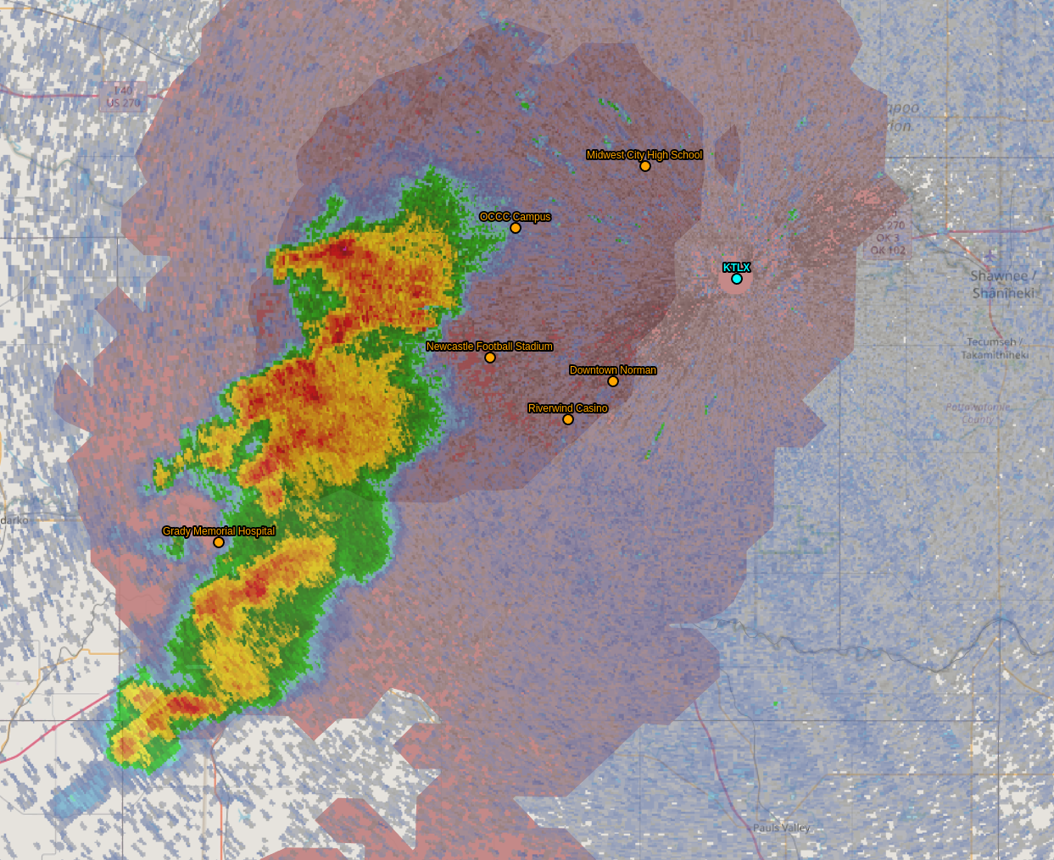
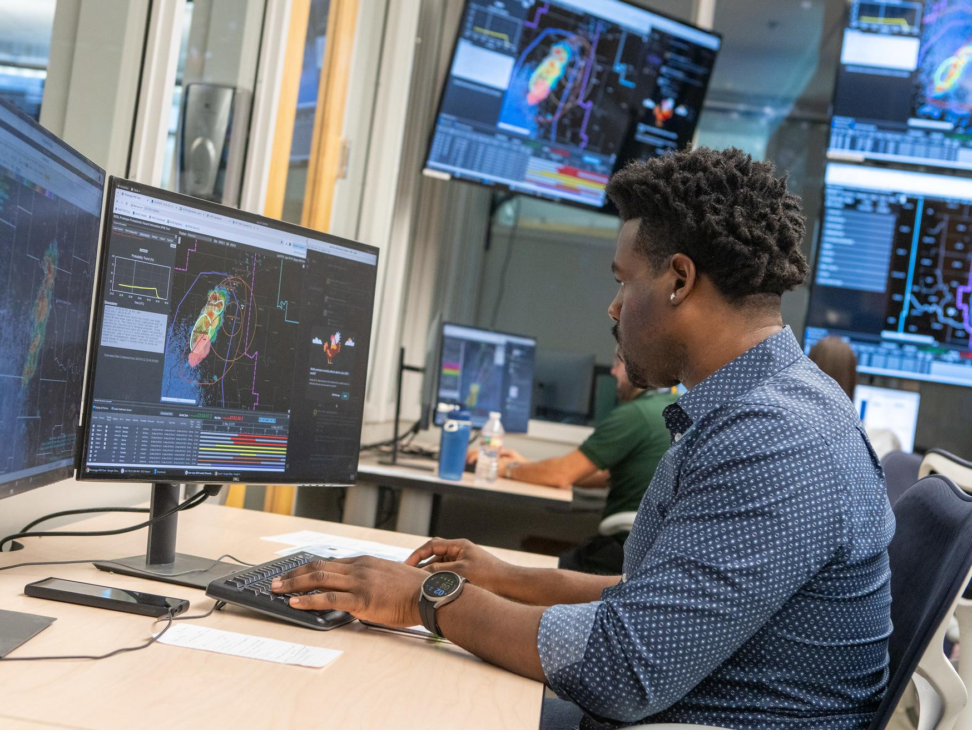
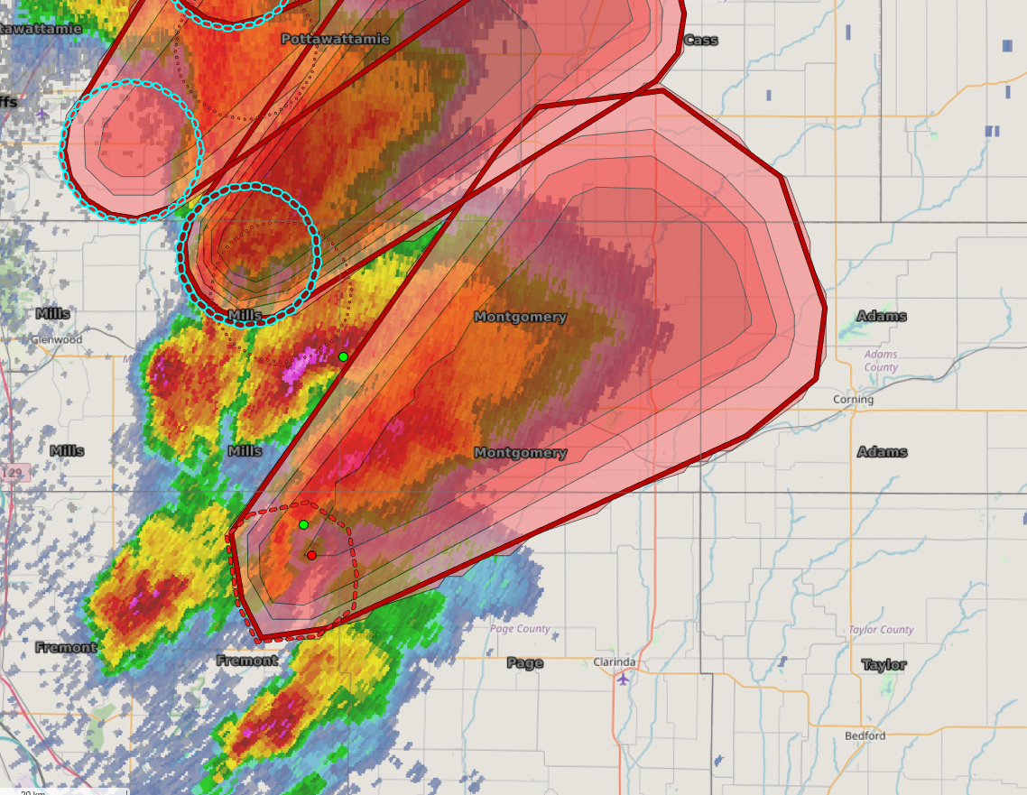
Improving the watch-to-warning space with Probabilistic Hazard Information and the Warn-on-Forecast System
Presenting: Drs. Eric Loken and Kristin Calhoun
With contributions from: Miranda Silcott, Thea Sandmael, Adrian Campbell, Rebecca Steeves, Claire Satrio, Ryan Martz, David Hogg, T. Galarneau, P. Skinner, J. Monroe, J. Madden, P. Burke, K. Berry, T. Lyza
NOAA/National Severe Storms Laboratory & University of Oklahoma/CIWRO

Slide 2
How to best handle the watch-to-warning space is not well understood

Slide 3
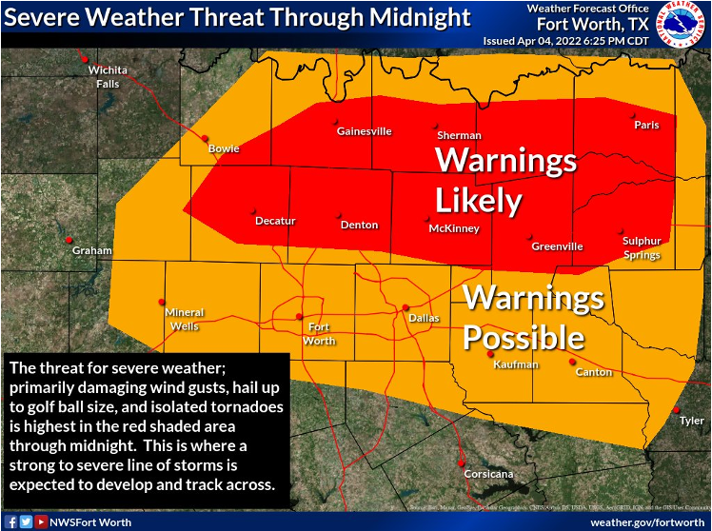
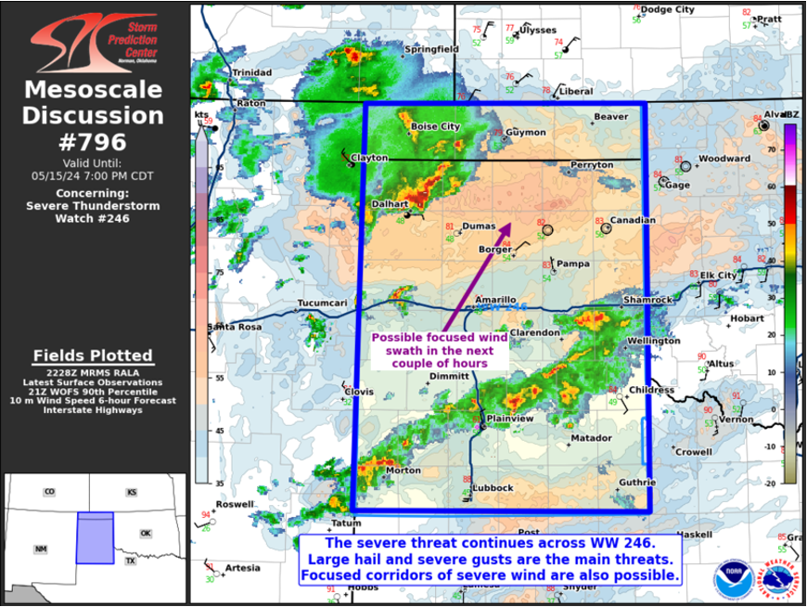
How to best handle the watch-to-warning space is not well understood
How to best message the threat?

Slide 4
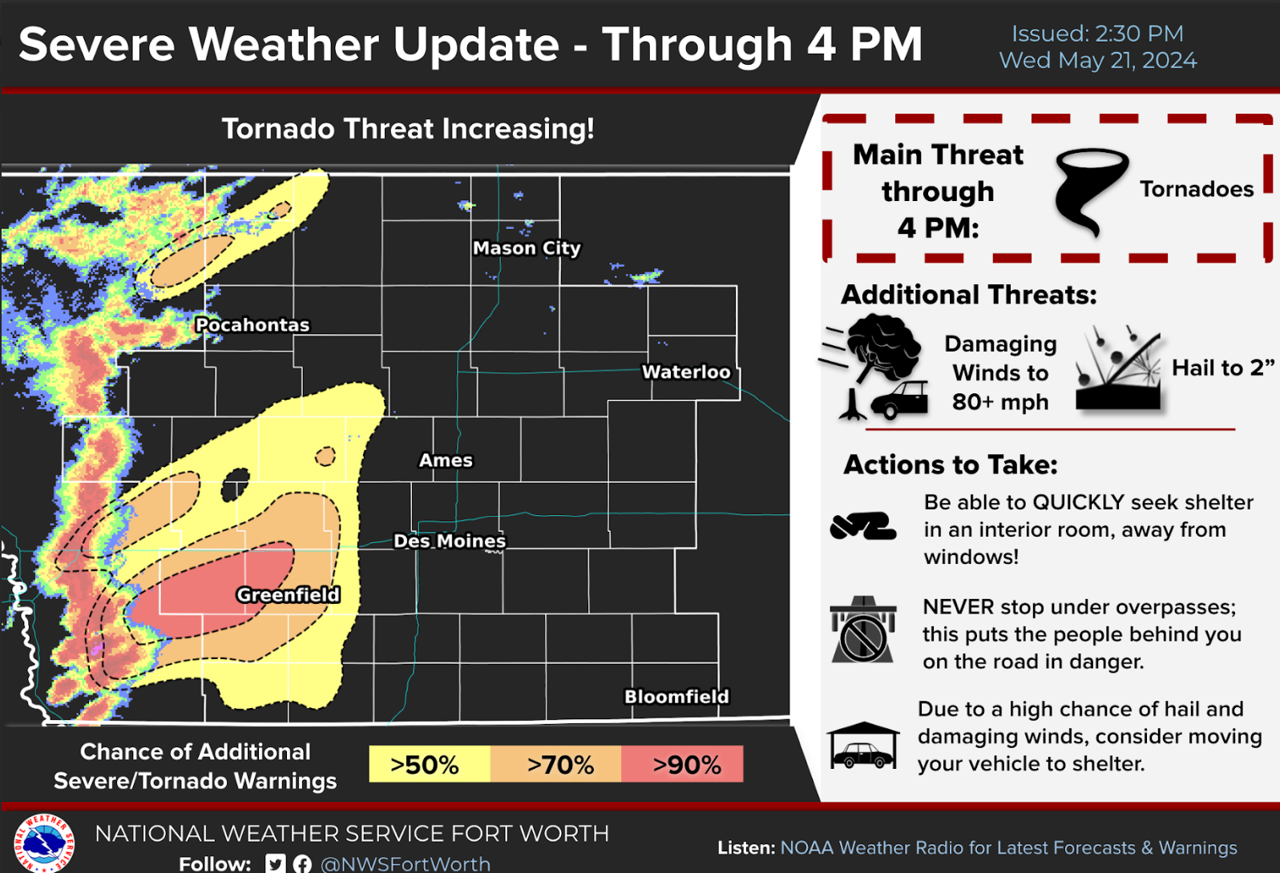
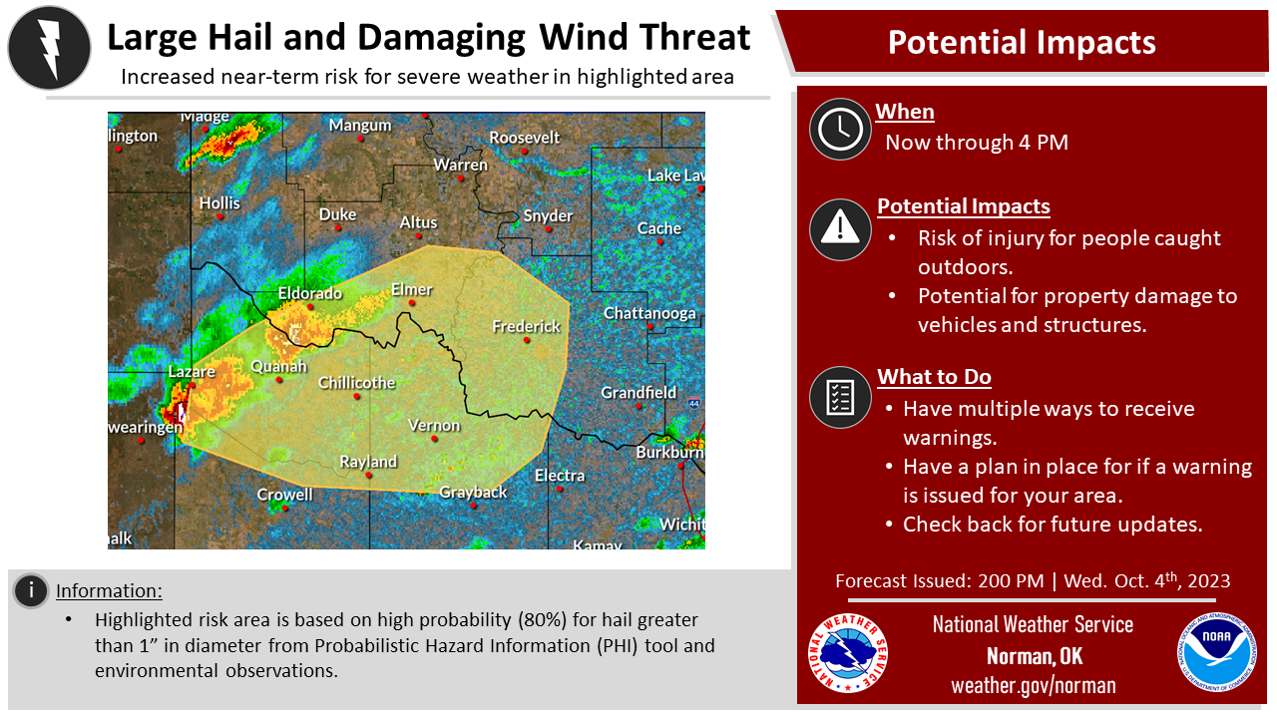
How to best handle the watch-to-warning space is not well understood
Can/should we incorporate probabilities? How?

Slide 5
How to best handle the watch-to-warning space is not well understood
How to account for uncertainty in both observation and model data?

Slide 6
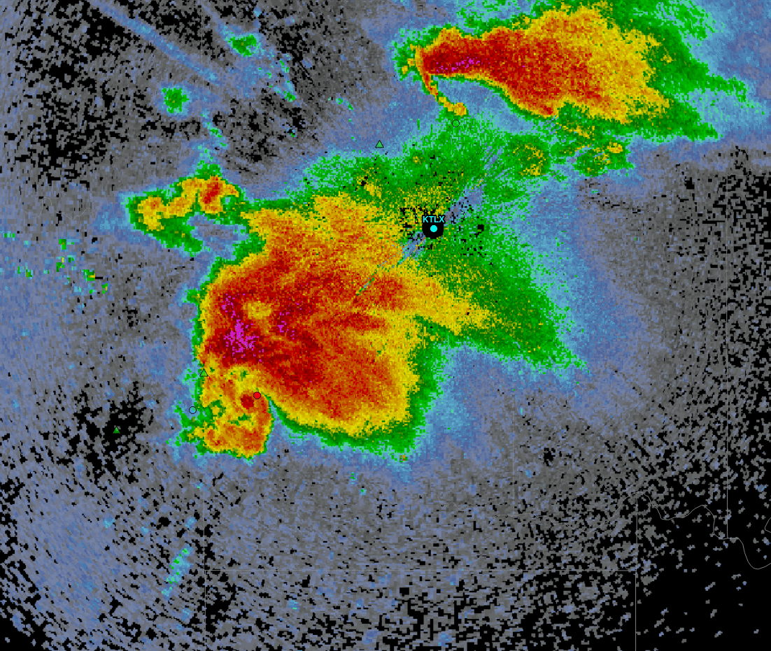
Probabilistic Hazard Information (PHI)
Storm-based product that conveys motion, timing, and likelihood of severe weather hazards
Defines the temporal, spatial, and intensity uncertainties of threats.
More specific regarding time (when storm will affect location, when it will end);
More specific regarding space (smaller aerial coverage moves with storm);
Allows for longer lead-times, though with higher uncertainty;
Updates continuously in real-time to reflect changes in storm motion and evolution.
Does not replace the warning!

Slide 7
Observational machine learning guidance provides:
Storm object -> size, location
Storm motion -> speed, direction
Hazard-based Probability
Severe (ProbSevere V3, hail/wind)
Tornado (TORP – Sandmæl et al 2023)
Lightning (MRMS CG ProbLightning)
Speeds up object creation & issuance
Calibrates the probabilities across forecasters

Slide 8
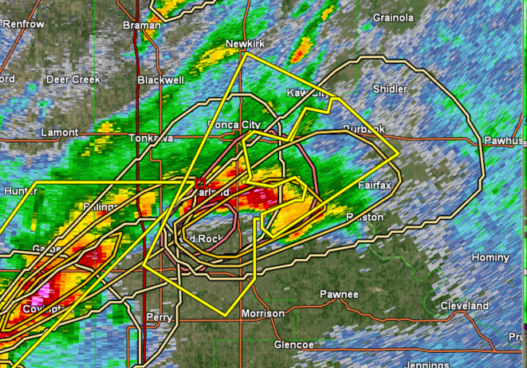
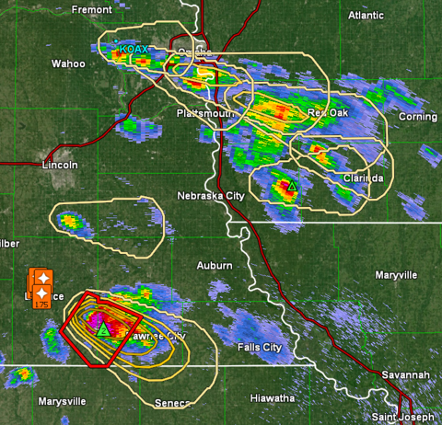

Slide 9
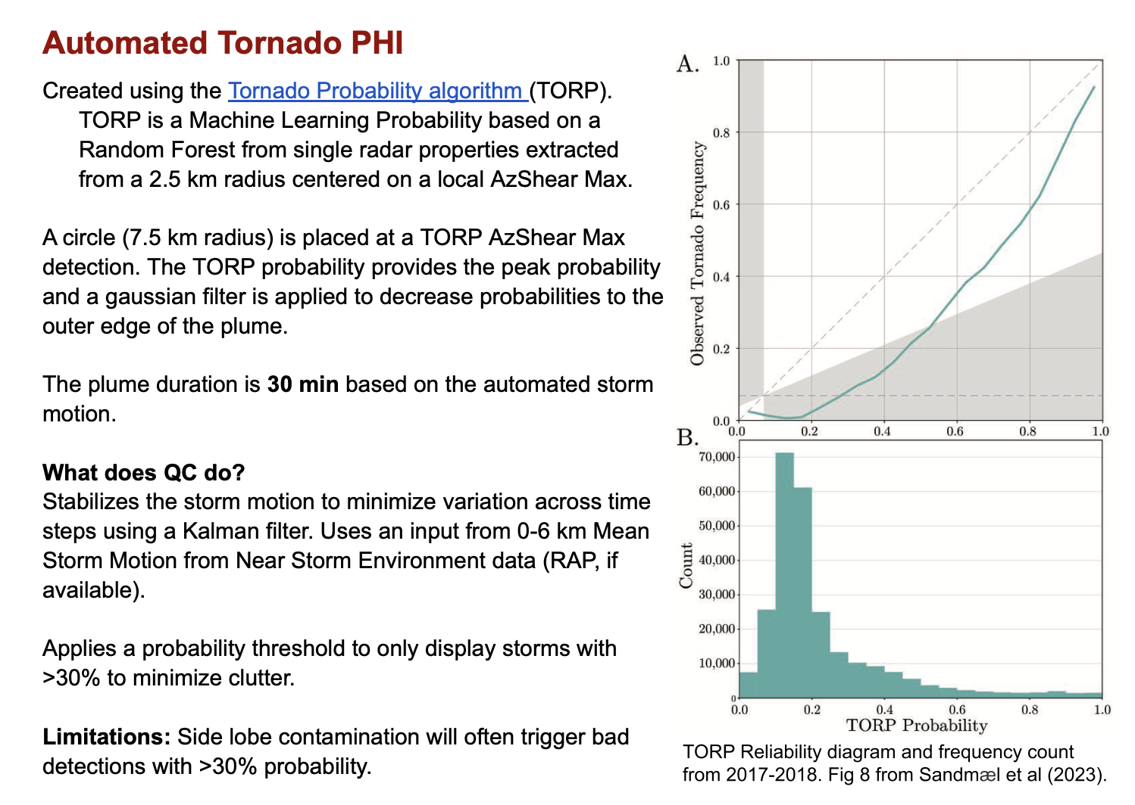

Slide 10
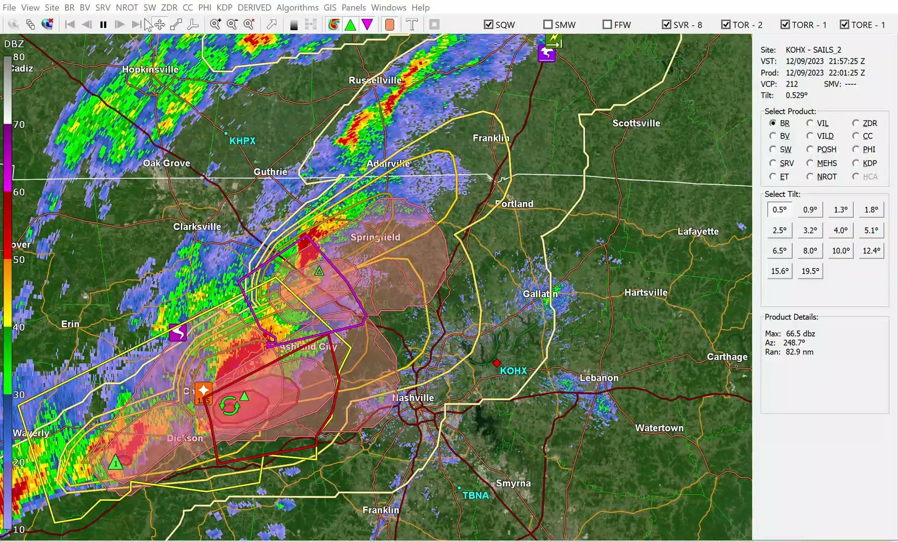
Probabilistic Hazard Information (PHI)
Fully automated system now available in GR. With archive capabilities and on-demand verification coming this spring.
https://phi.nssl.noaa.gov/
OHX, 9 Dec 2023

Slide 11
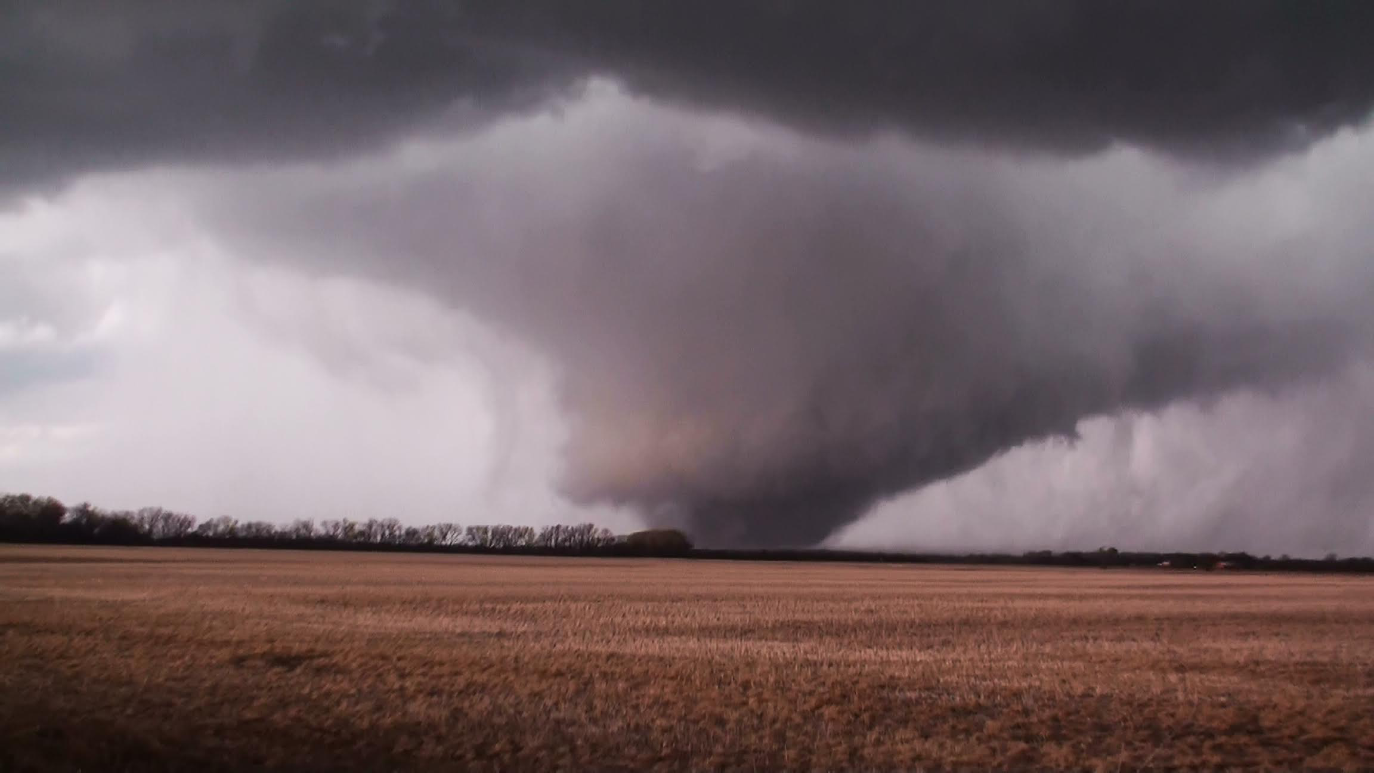
WoFS is designed to predict individual thunderstorms between watch and warning scales
WATCH
WARNING
6 hr Lead Time
3 hr Lead Time
1 hr Lead Time
Pre-CI
Post-CI
- EF3 Tornado

Slide 12
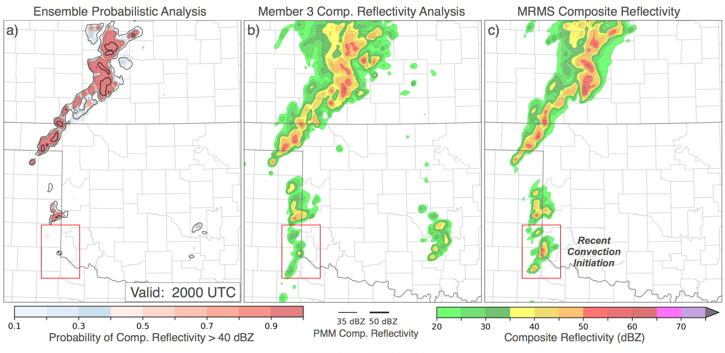
Rapid (15-min) data assimilation allows WoFS to analyze ongoing storms:
Ensemble Analysis
Member 3 Composite Reflectivity
Truth: MRMS Composite Reflectivity
Location, size, and intensity of ongoing storms accurately analyzed in ensemble members
Newly initiated storms are not accurately analyzed

Slide 13
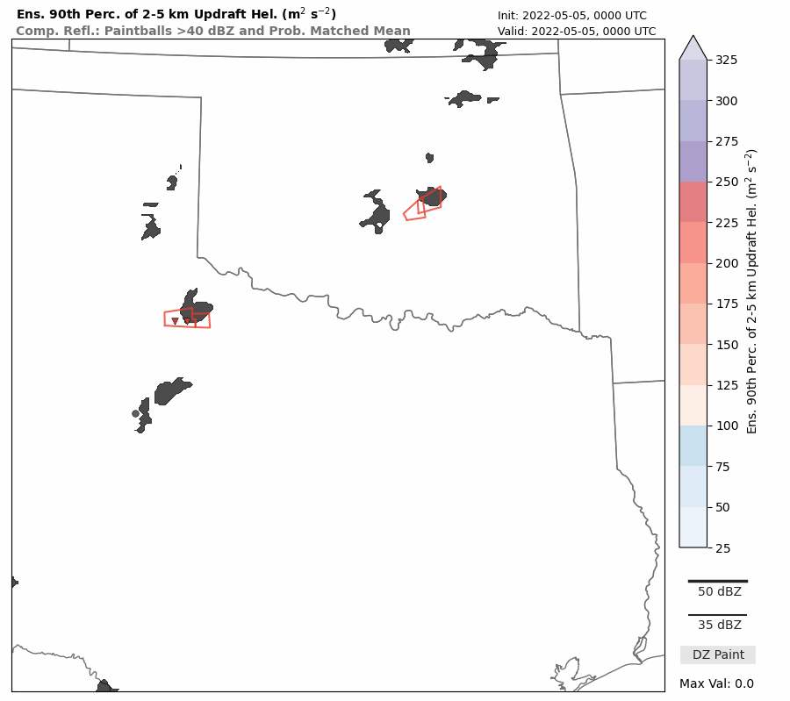
WoFS accuracy will vary from storm to storm
Good:
WoFS accurately predicts intense 2-5 km updraft helicity along tracks of three tornadic supercells
Accurately predicts potential for extreme precipitation with training supercells in central OK
Bad:
Large amounts of spurious convection predicted, particularly along warm front in southwest OK
WoFS fails to maintain tornado warned supercell moving into western OK
4 May 2022, 00 - 03 UTC: 90th %tile of 2-5 km UH
Gray shading: MRMS reflectivity > 40 dBZ
Red boxes/triangles: Tornado warnings/reports

Slide 14
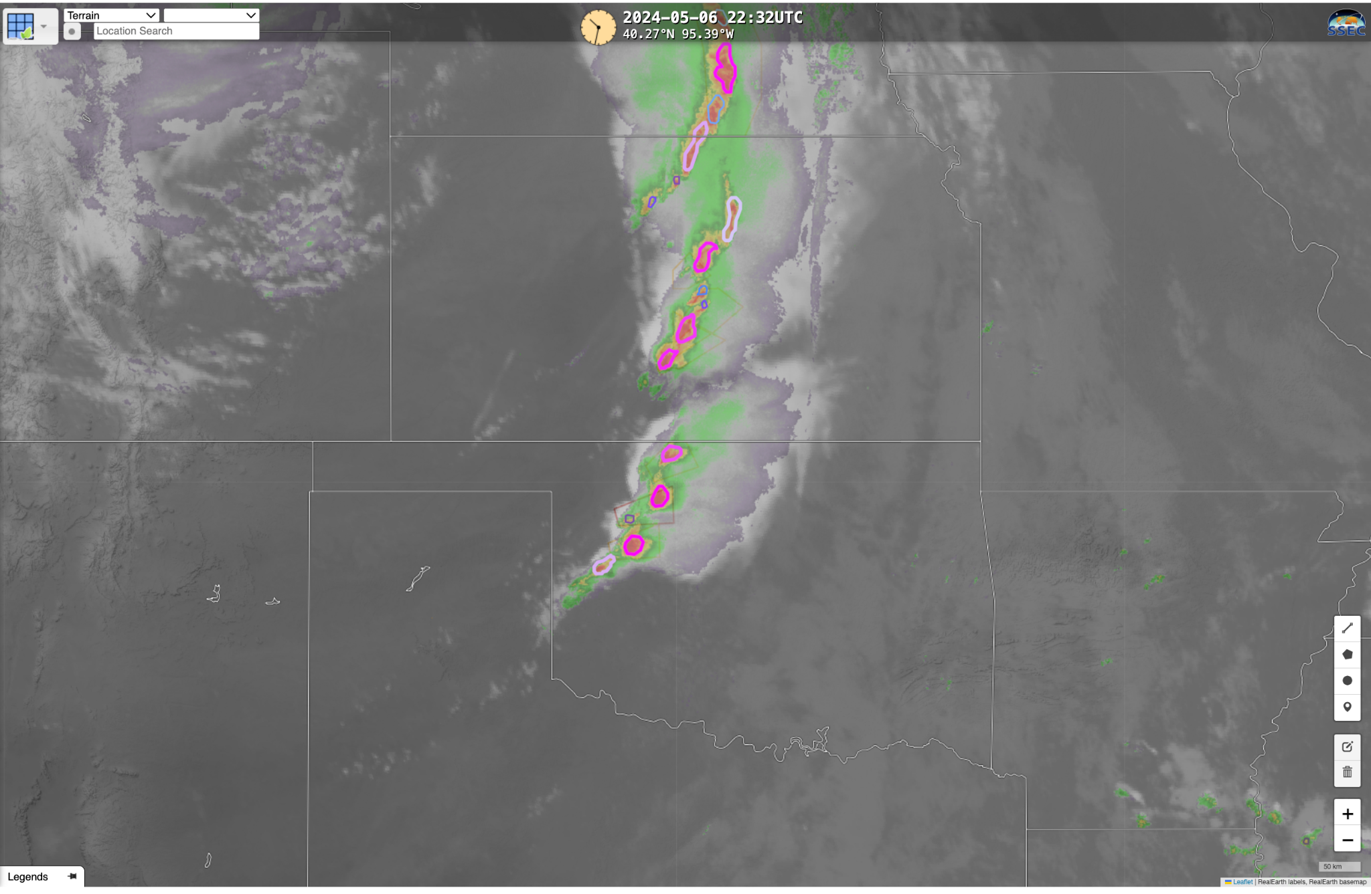
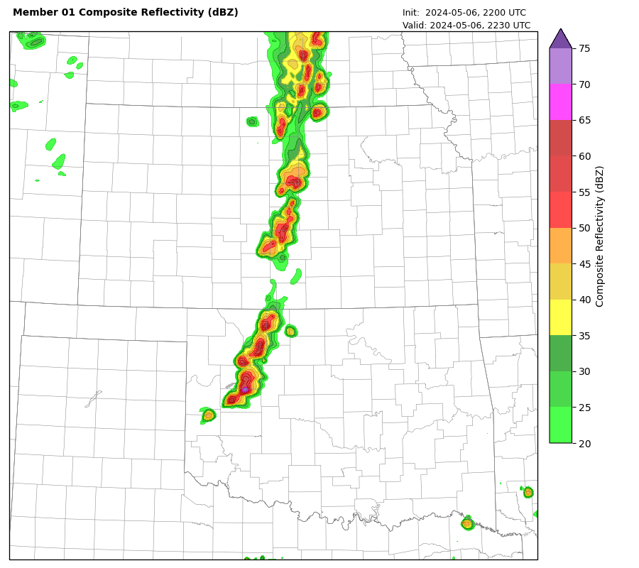
WoFS-PHI: Blending WoFS and ProbSevere
ProbSevere (PS)
Warn-on-Forecast System (WoFS)
Valid 2230 UTC 6 May 2024
PS objects
Simulated reflectivity (gridded)
Valid 2232 UTC 6 May 2024
https://cimss.ssec.wisc.edu/severe_conv/
https://cbwofs.nssl.noaa.gov/
Strengths: Current storm location; update frequency
Weaknesses: Future storm development; no spatial forecast information
Strengths: Future storm evolution, spatial forecasts
Weaknesses: Storm location (during spin-up), update frequency
Notes:
https://cimss.ssec.wisc.edu/severe_conv/psv3.html

Slide 15
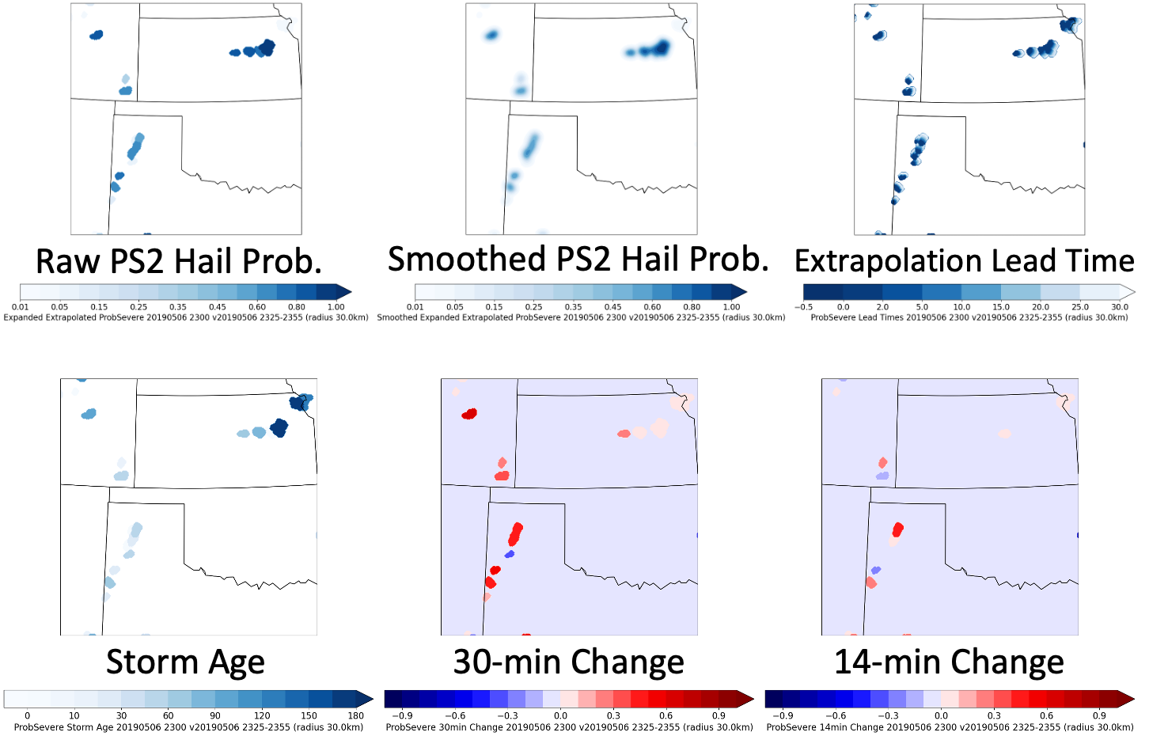
ProbSevere objects extrapolated, gridded to WoFS

Slide 16
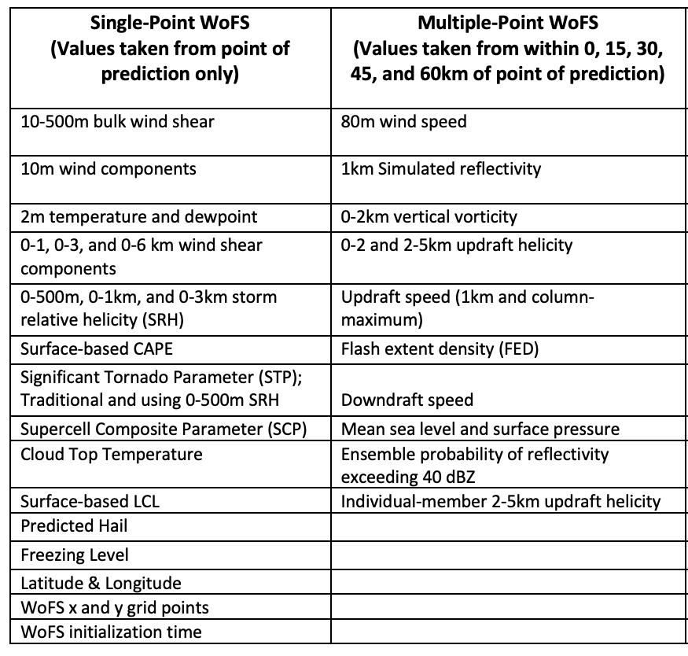
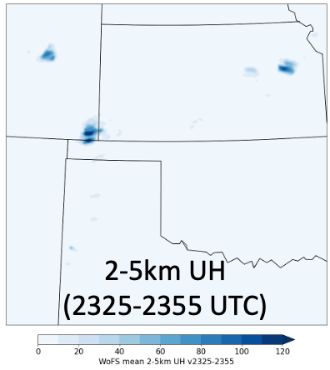
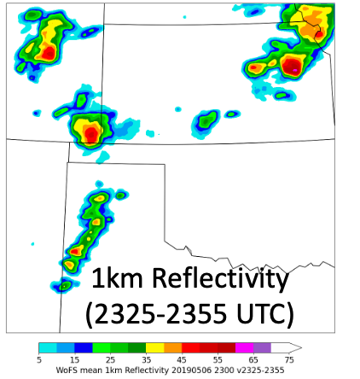
WoFS: Temporal aggregation -> ensemble mean ->
predictors from multiple points
Ensemble mean of temporal maximum UH, reflectivity

Slide 17
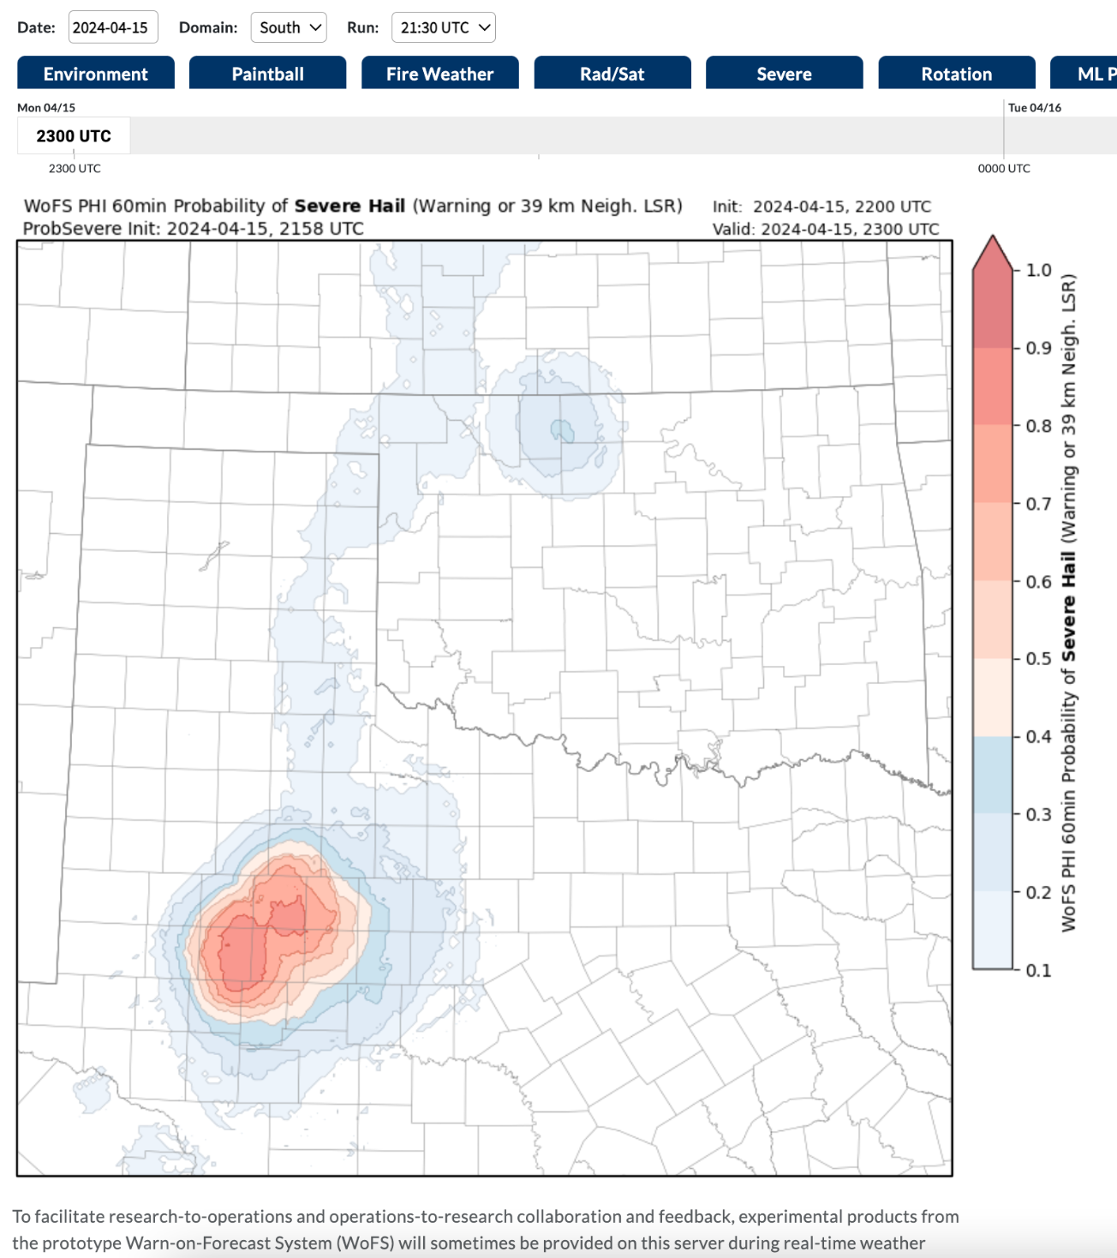
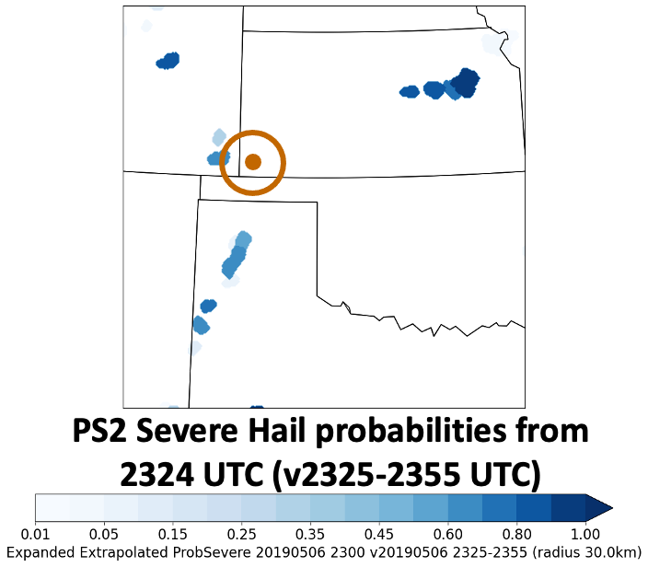
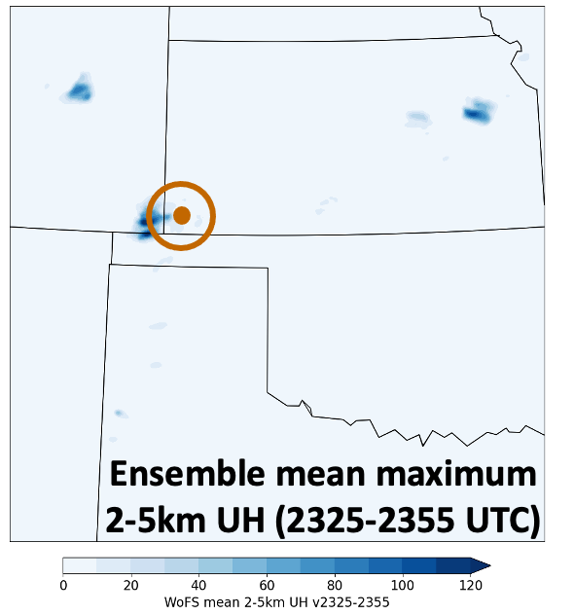
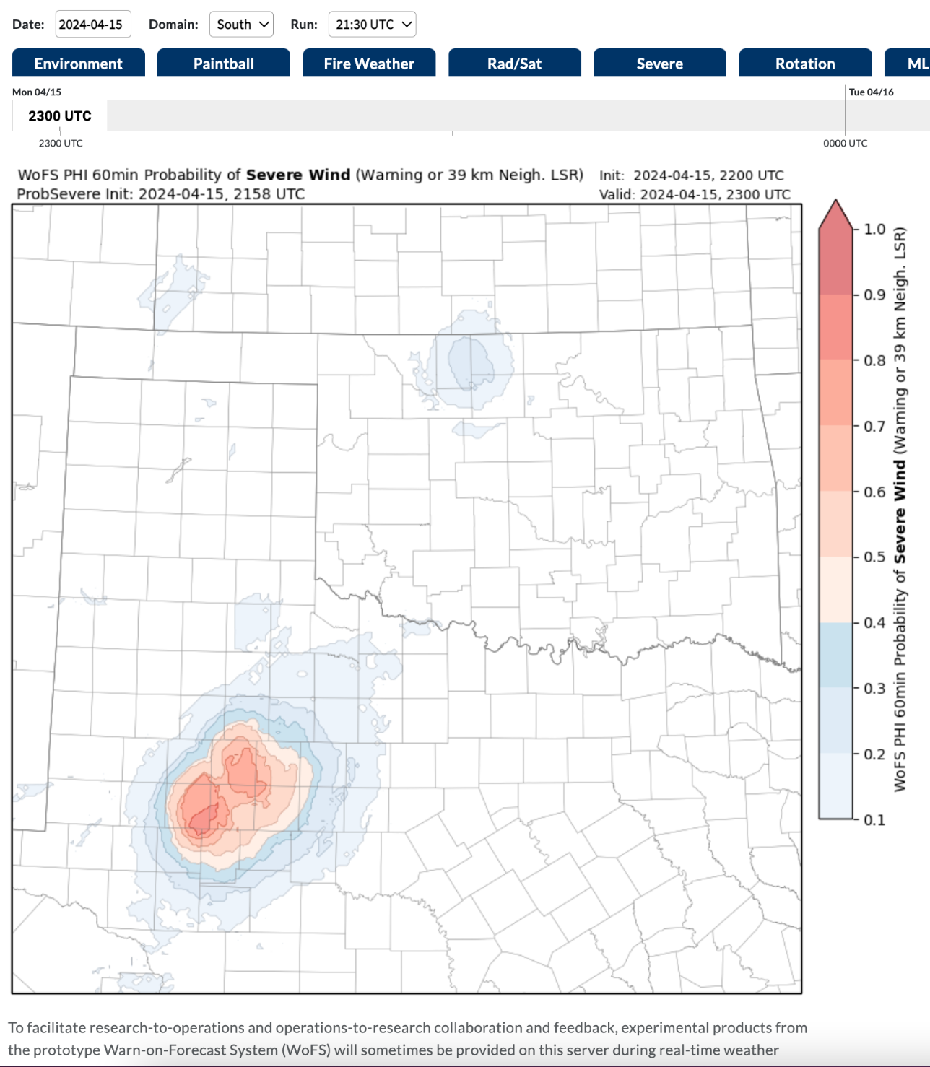
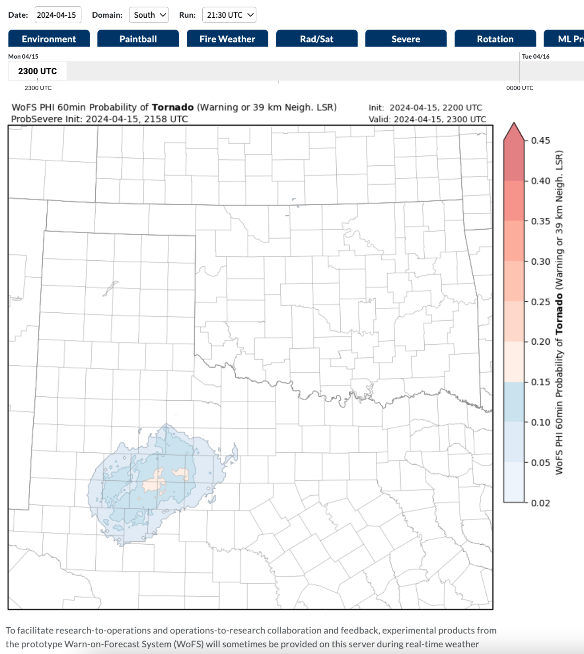
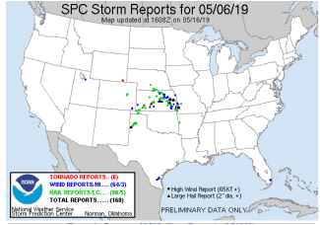
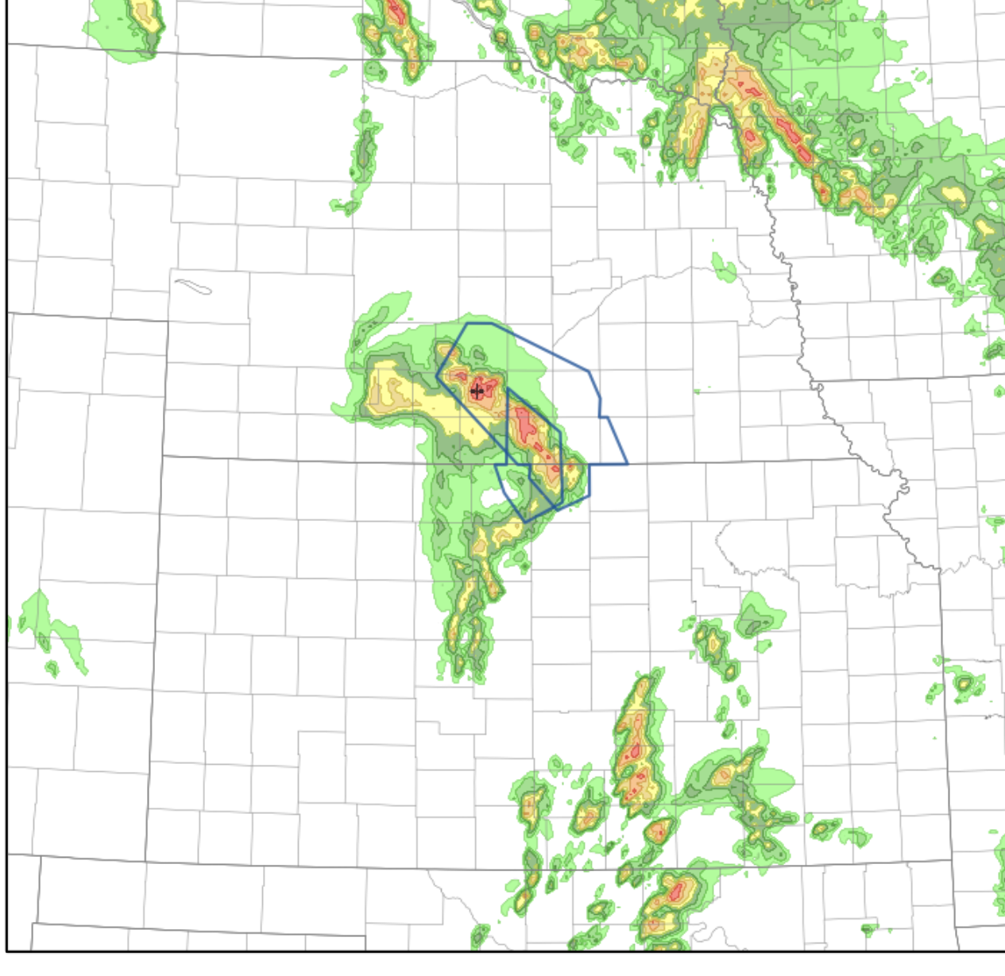
Random forests (RFs) are trained on spatial data using observed storm reports/warnings as targets
Hail
Map prob to Success Ratio
Hail RF
Map prob to Success Ratio
Spatial predictors from PSv2 and WoFS are input into hail-, wind-, and tornado-predicting RFs
Wind RF
Wind
Map prob to Success Ratio
Tornado RF
Tornado
RFs trained on observed storm reports and/or hazard-specific severe warnings
WoFS-PHI probabilities

Slide 18
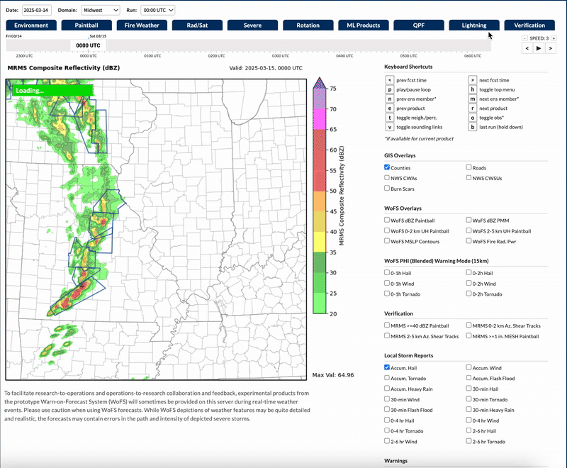
WoFS-PHI Forecast Mode:
Updates once per WoFS initialization
Predicts for up to 4 h of lead time
Located under “ML Products” tab
Severe hail, based on WoFS run from
0000 UTC on 15 Mar. 2025

Slide 19
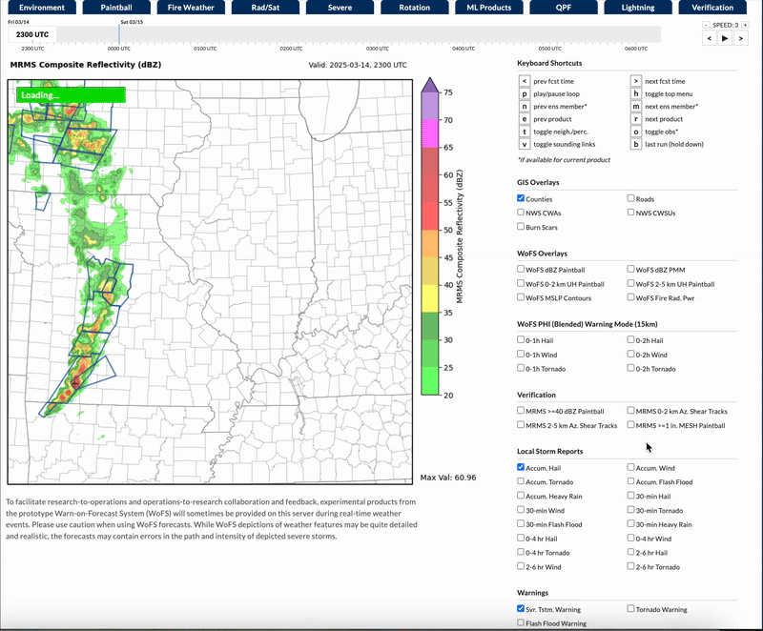
WoFS-PHI Warning Mode:
Updates every 5 min.
Always predicts for next 1h or 2h
Contour overlay (right side of viewer)
0-2h severe hail,
Loop starts 2300 UTC on 14 Mar. 2025

Slide 20
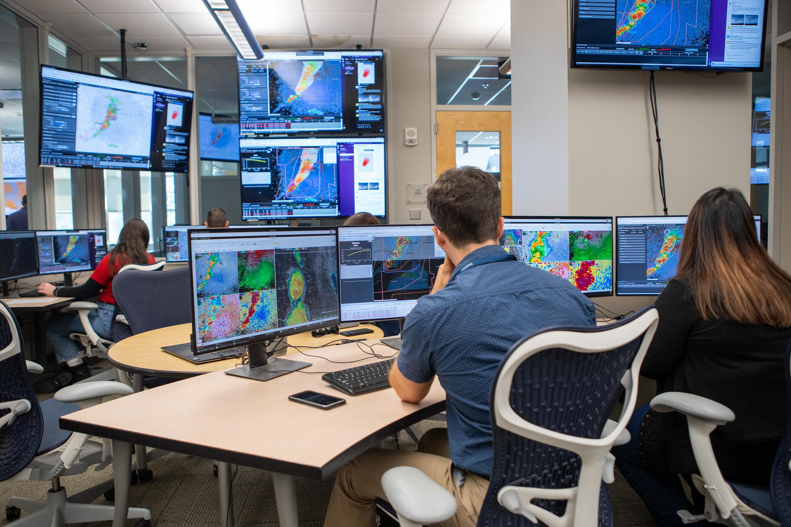
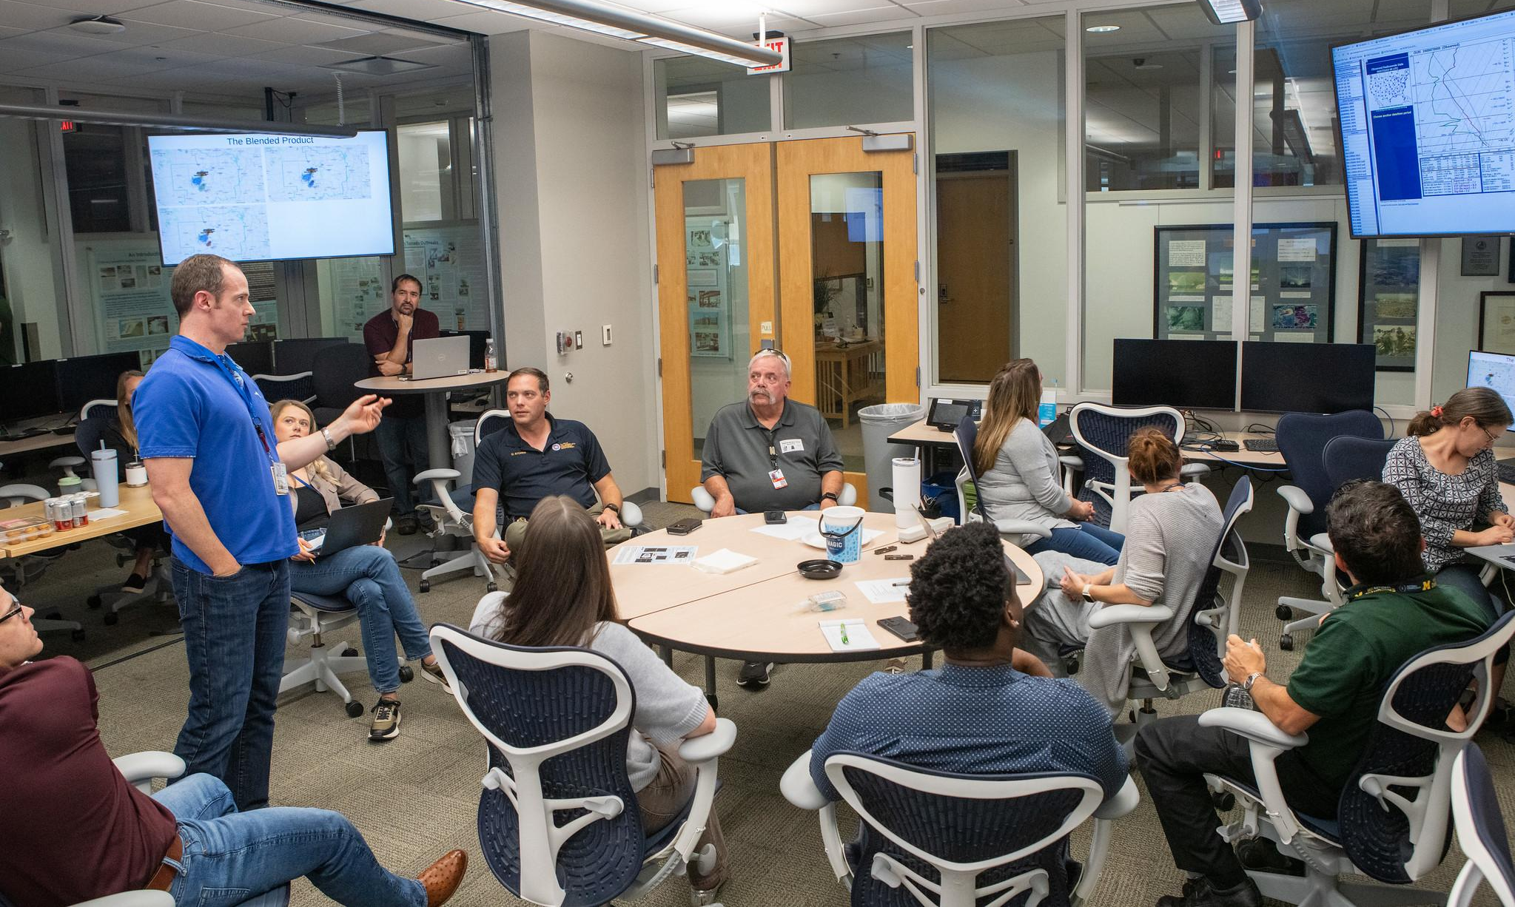
NOAA’s Hazardous Weather Testbed (HWT)
Joint project of the National Weather Service (Storm Prediction Center & Norman Weather Forecast Office) & National Severe Storms Laboratory
Conceptual framework & physical space to foster collaboration between research & operations to test & evaluate emerging technologies & science for NWS operations.

Slide 21
2023-2024 HWT Watch-to-Warning Experiment
Archive Case Selection
2024 - Added Emergency Managers (Oklahoma) on final case
3 weeks annually, archive only,
both SPC and WFO forecasters
Goals:
Examine how to expand communication / products in the watch-to-warning gap working with both the SPC and Local WFOs
Test multiple machine learning models blending obs and ensemble models (WoFS)
4 cases with increasing progression of difficulty across the week → from single supercell storm, to mixed mode, high risk tornado outbreak, QLCS with warm sector supercells

Slide 22
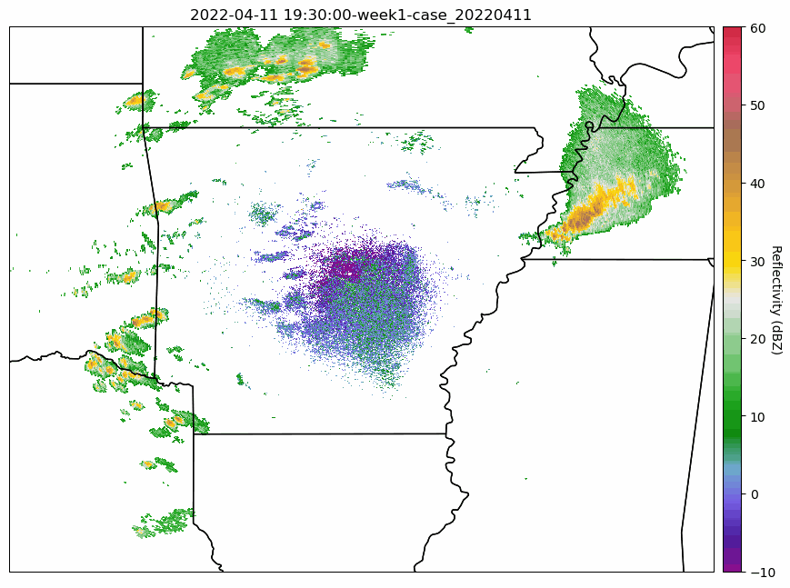
Watches from the Storm Prediction Center
Specifically meant to provide 2 hours of lead time to the first report
Smaller spatial coverage
Counties added/removed by SPC forecasters at any time
In 2024: Added potential to color watch by probabilities associated with tornado / significant tornadoes

Slide 23
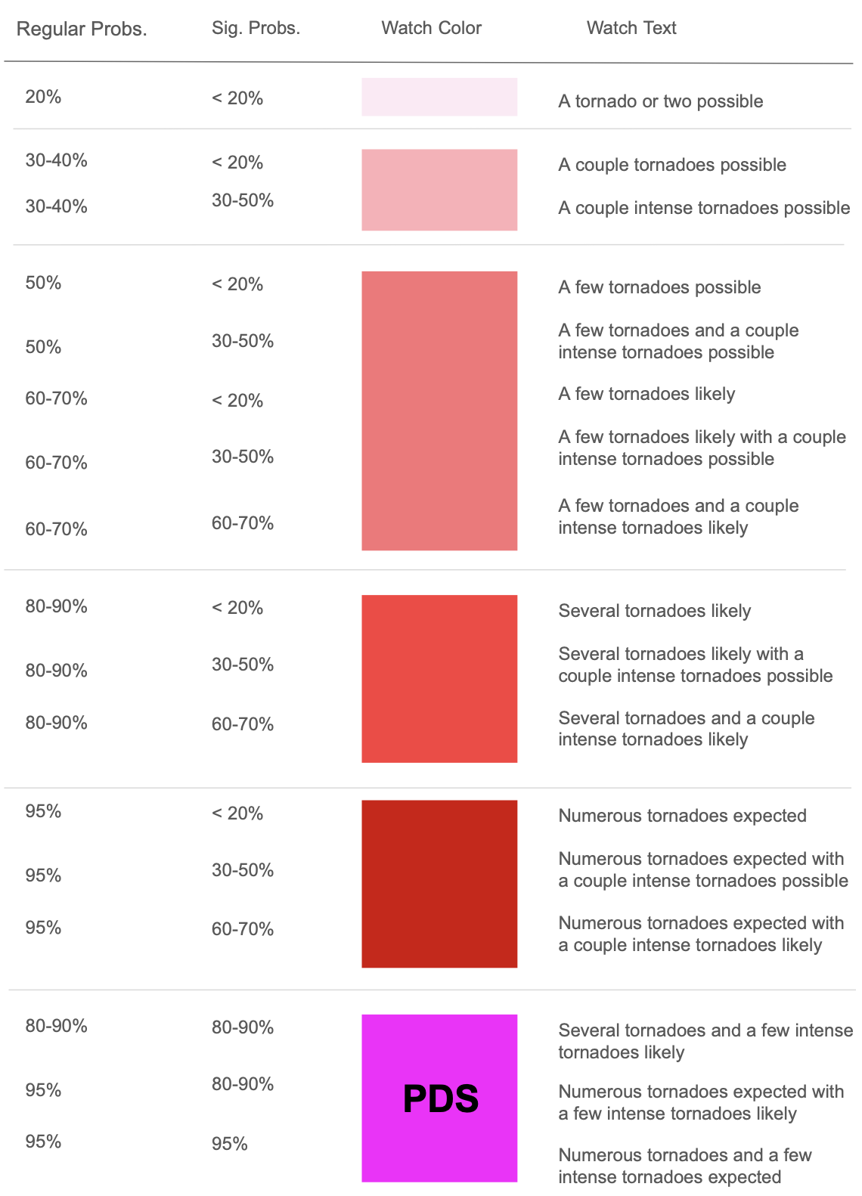
Watches from the SPC
Specifically meant to provide 2 hours of lead time to the first report
Smaller spatial coverage
Counties added/removed by SPC forecasters at any time
In 2024: Added potential to color watch by probabilities associated with tornado / significant tornadoes

Slide 24
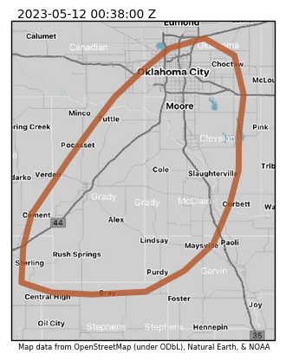
Mesoscale Discussions
Mesoscale Discussion -
(similar to today)
Precedes watches and updates
Added probabilities of hazard over time
Focused more often on meso-beta and meso-gamma discussions
Thunderstorms within the cluster over Grady County OK have shown signs of better organization over the past hour or so. This trend will likely continue, with supercellular characteristics becoming prevalent. Strong buoyancy and moderate bulk shear will support the potential for very large hail up to 2.5. Storm proximity will result in interactions, some of which could disrupt the processes needed for tornadogenesis. However, low-level shear is still strong enough to support a tornado threat if storms can remain discrete.

Slide 25
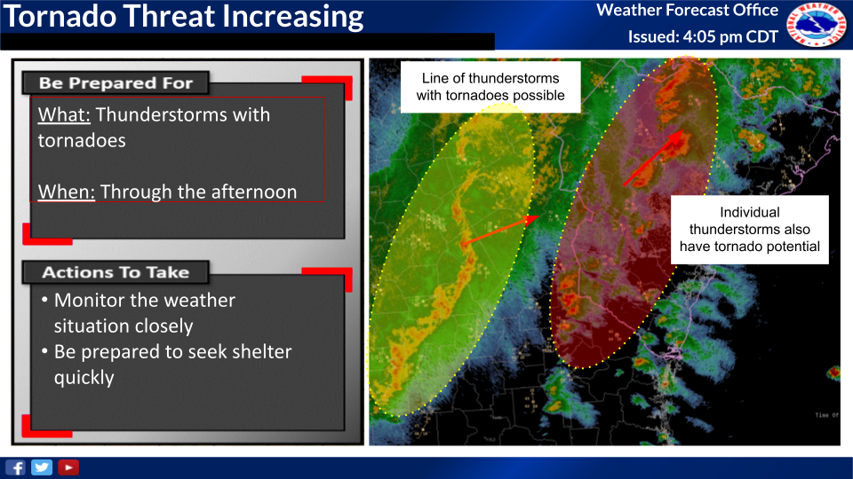
Local Discussions (NWS Forecast Offices)
Local Discussion -
issued by local forecast office
Focus is timing, location, hazard
Creates a well-defined geospatial domain (geojson – can move to other apps, systems)
Social media/NWS chat text: Two corridors of thunderstorms that will be capable of producing tornadoes continue across the area. Round one is ongoing now, and round two will arrive after 6pm and move west-to-east across the area into early evening.

Slide 26
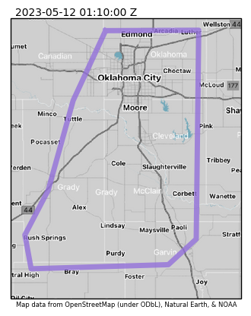
Local Discussion
NWS CHAT / SLACK:
Current Severe Probability: 60%
Discussion: Scattered strong to occasionally severe thunderstorms continue to affect areas of the OKC metro. This activity will continue for the next few hours within an environment conducive to hail and tornado development. Storms have struggled to distance themselves from one another, which has resulted in a lack of overall organization. Still, with favorable wind fields and remnant instability, these storms have produced brief tornadoes along with hail and gusty winds. These cells will continue to move east/northeast and pose a risk of severe weather. In addition, frequent lighting and torrential rainfall will be impactful to any outdoor events. The risk of severe weather looks to gradually decrease after 9-10pm as storms move east of I-35.

Slide 27
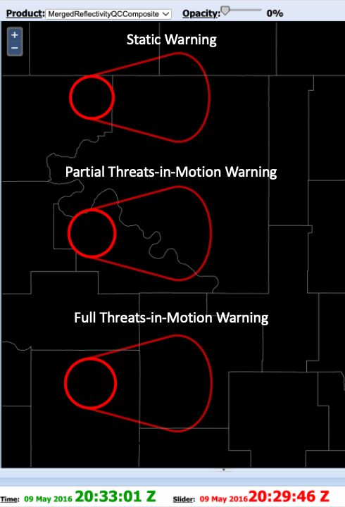
Threats-in-Motion Warnings:
1) Static Warnings (current paradigm).
2) Partial Threats-in-Motion (warning is tied to the object. Area behind storm removed each update).
3) Full Threats-in-Motion (warning is tied to the object. Both area behind removed and area ahead added to warning)

Slide 28
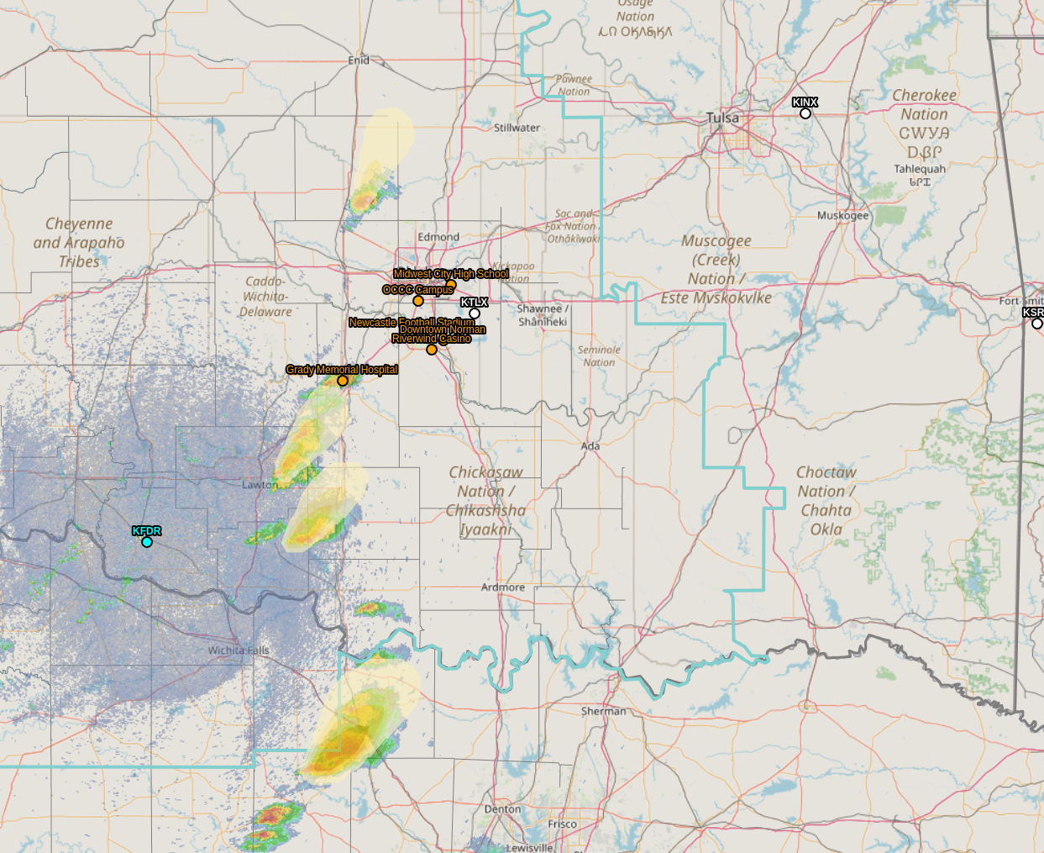
Severe Weather Threat Continues
Weather Forecast Office
Norman, OK
Severe Weather Probabilities Pictured Valid Through 7 pm
Issued: May 11, 2023 - 6:07 PM
Weather Details
Thunderstorm Coverage Increasing
Medium to High Chance for Severe Weather
Very large hail the main concern
Damaging wind gusts up to 60 mph
Tornado threat expected to increase through the evening as the environment becomes more supportive.
Notes:
Social Media Post] A Severe Thunderstorm Warning is in effect for parts of southwest Oklahoma. A high chance of quarter size hail exists, along with a low chance of a tornado. The tornado threat is expected to increase with time.

Slide 29
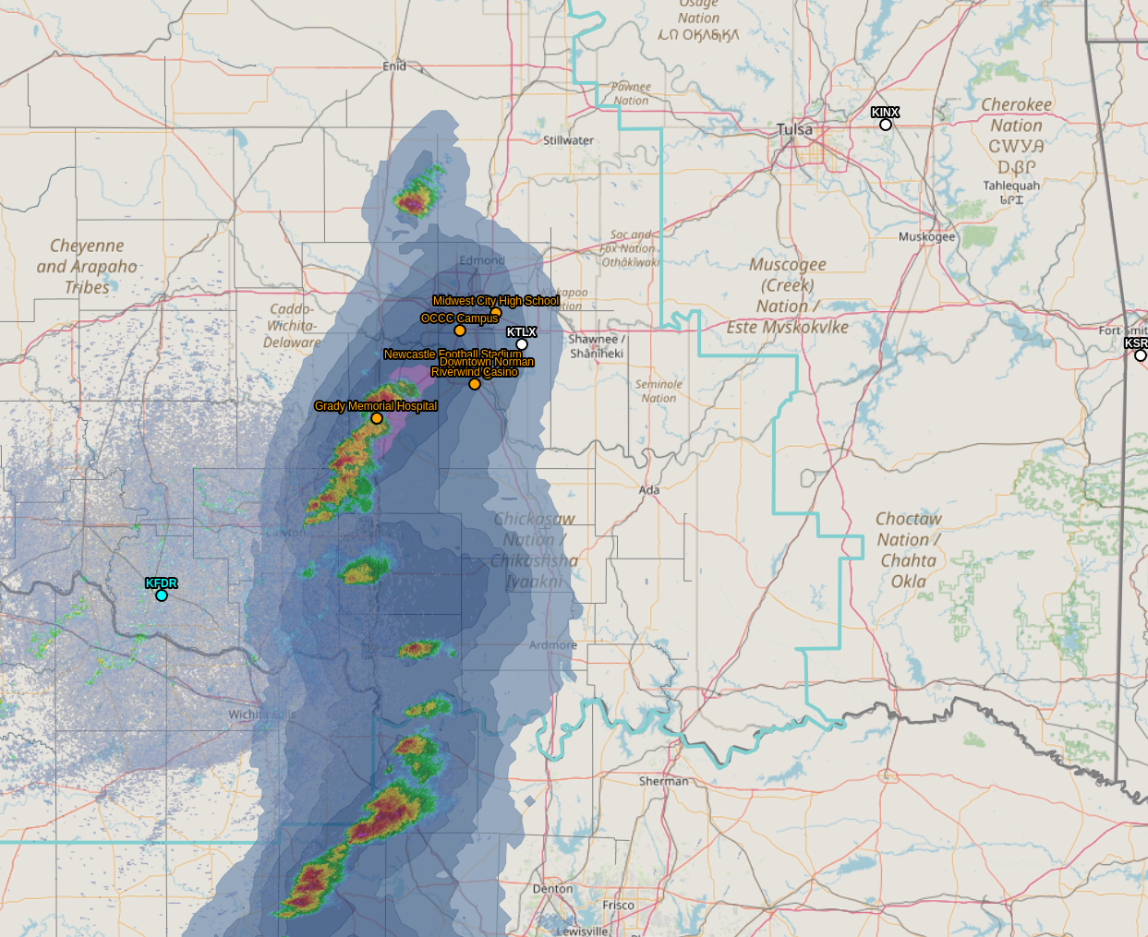
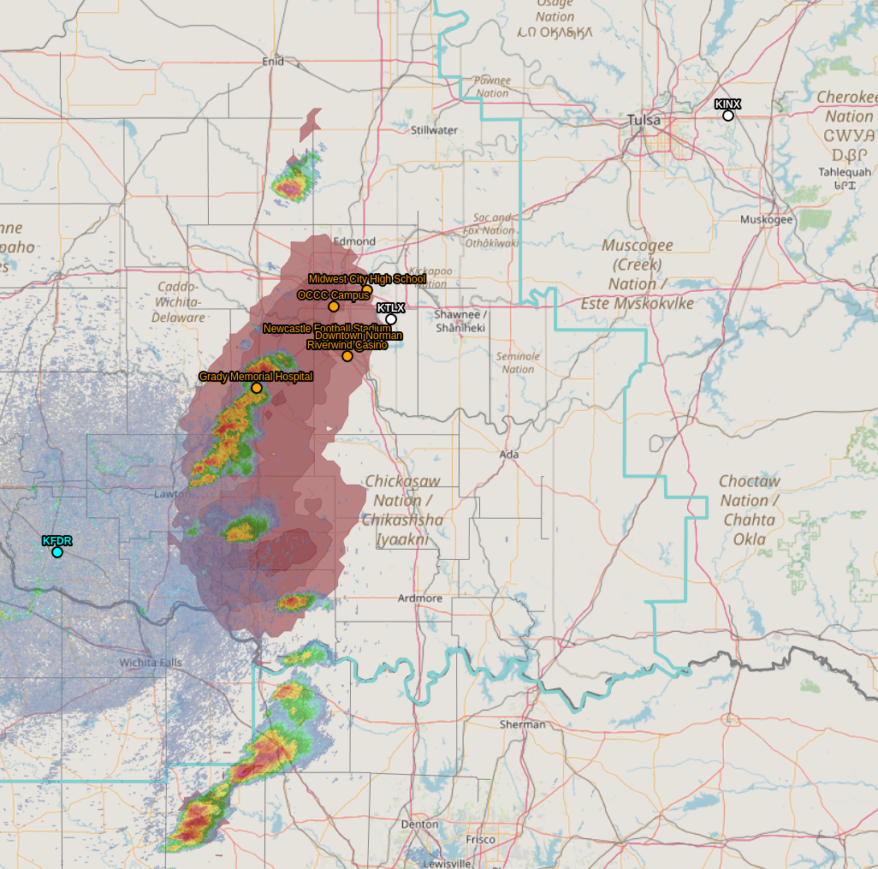
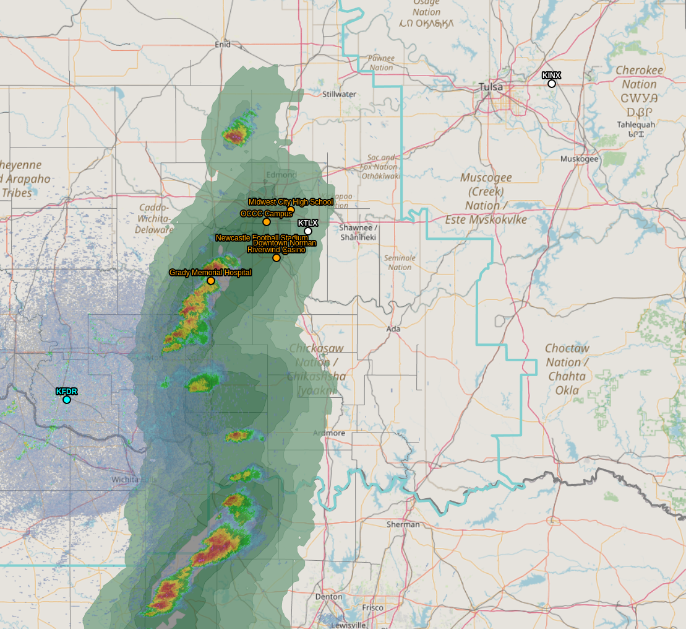
Severe Weather Chance Through 8:15 PM
Weather Forecast Office
Norman, OK
Issued: May 11, 2023 - 6:20 PM
Through 8:15 pm - Severe Wind, Hail and Tornado Threats to Increase Along and West of I-35, Including the OKC Metro
What: Text goes here.
When: Text goes here.
Notes:
[Social media post] The severe weather chance continues to increase through 8:15 pm to the east of the ongoing storms near I-44. Expect damaging wind, hail and tornado chances into the I-35 corridor.

Slide 30
Low Tornado Threat Into OKC Metro
Weather Forecast Office
Norman, OK
NO Tornado Warning in Effect At This Time
Issued: May 11, 2023 - 6:53 PM
Hazard Information
10-20% chance of tornadoes in the next 30 minutes into most of the OKC metro
Storms have exhibited weak low level rotation at times
Notes:
[Social media post] NO tornado warnings are currently in effect, but a 10-20% chance of tornadoes in the next 30 minutes will exist across much of the OKC metro area. These storms have shown weak low level rotation at times and the environment is supportive of tornadoes. Remain alert for warnings and be prepared to seek shelter quickly if a warning is issued.

Slide 31
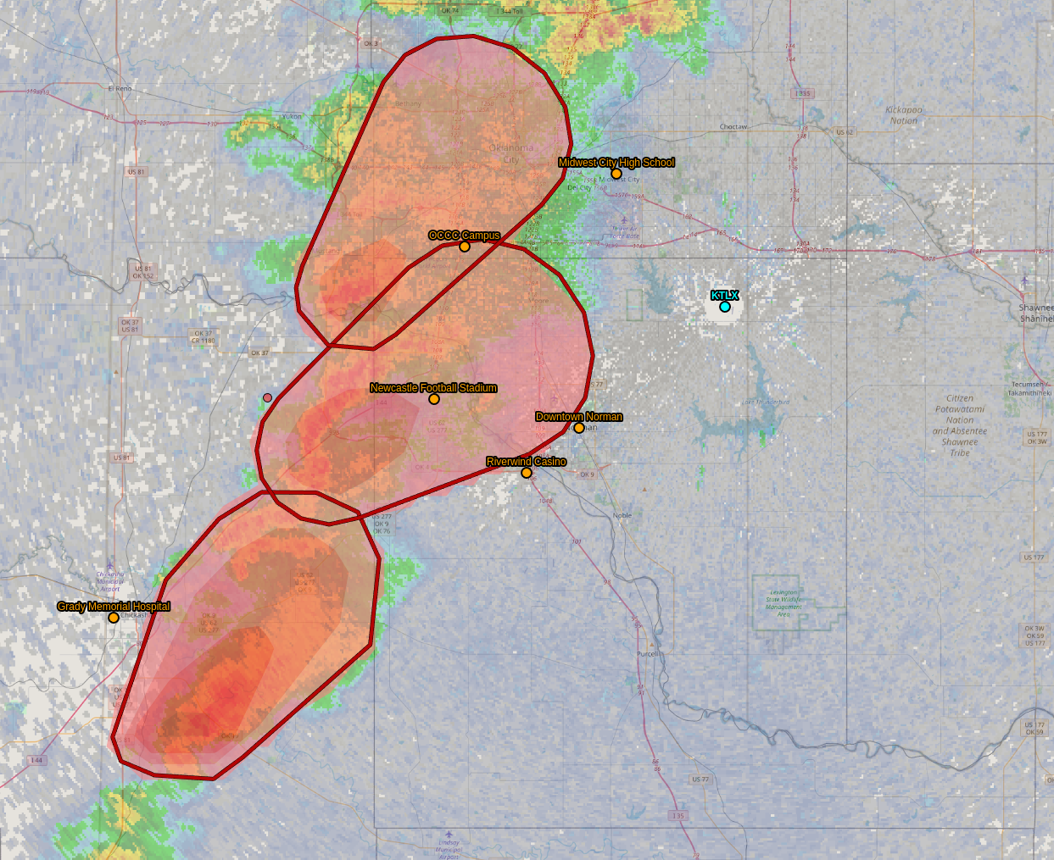
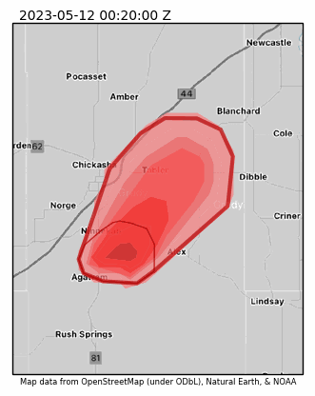
Emergency managers were particularly interested in seeing storms in motion with trends associated with hazards and likelihood.
[NWSChat] Update: this is in a difficult spot to interrogate radar-wise but the environment and history support at least hanging on to the tornado warning a bit longer until the threat has decreased significantly (Updated: 00:34 UTC)

Slide 32
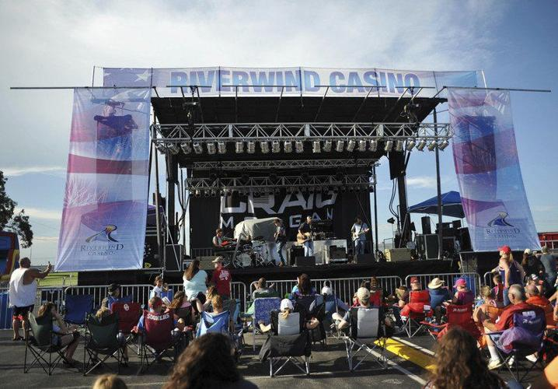
EM Scenario Introduction (Example)
Chickasaw Nation
The Chickasaw Nation Riverwind Casino in Goldsby (I-35 and Hwy. 9) is hosting a summer kickoff concert and food truck festival. The headlining act is Journey, which will likely skew the attendee crowd to be slightly older. The concert organizers are anticipating between 7,500 and 10,000 attendees for this outdoor concert. The event is scheduled to start at 7 pm, with the headliners coming onstage sometime around 9 pm.
Chickasaw Nation Emergency Management has been asked to support on-site operations, acting as a liaison for weather communication for the event. Due to the economic impact of the event, and the fear of reputational damage, organizers are loathe to cancel or postpone unless absolutely necessary. That said, festival organizers will suspend activities due to lightning within an 8-mile radius of Goldsby for 30 minutes after the last strike. Non-severe wind gusts over 40 mph are also a concern, particularly due to tents and stage construction.
There is an option to to move the entire event indoors into the casino’s permanent concert venue. This decision would need to be made no later than 5:30 pm, but is not considered ideal due to the food truck portion of the event. Organizers have requested frequent updates, with briefings being expected at a minimum of every 30 minutes if inclement weather is a possibility. It should be noted that traffic flow is a significant concern due to ongoing construction at the I-35/Hwy. 9 interchange, thus impacting egress for folks trying to drive north toward Norman/OKC.

Slide 33
EM Scenario

Slide 34
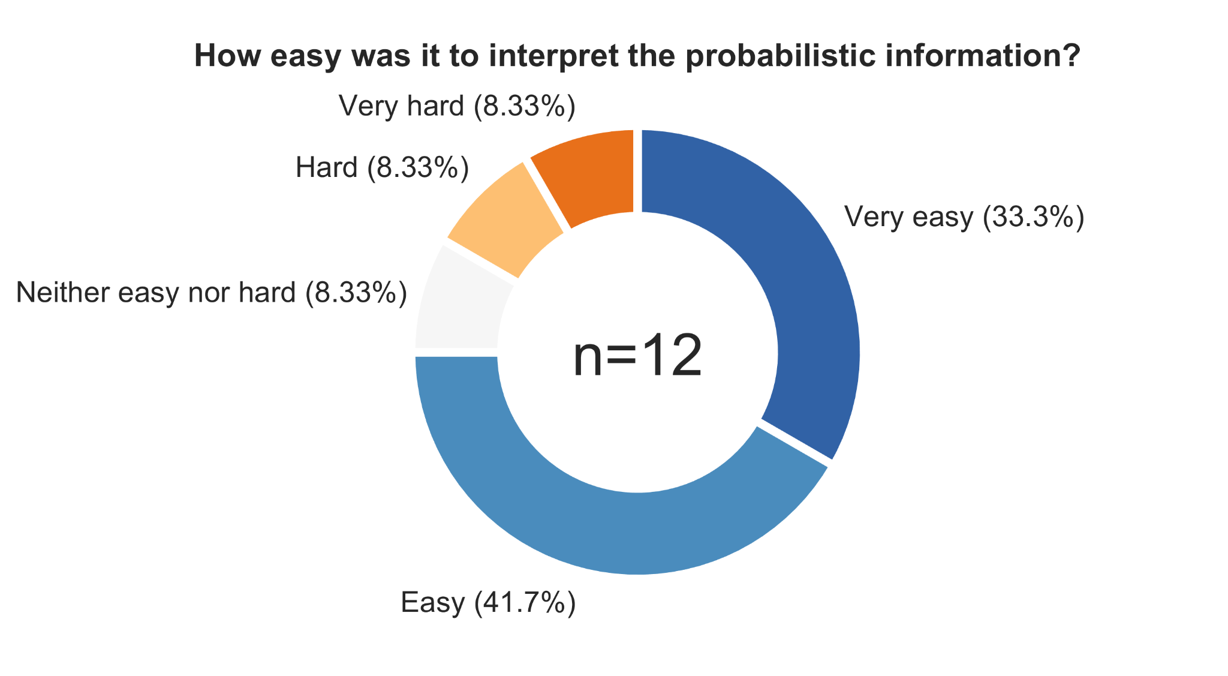
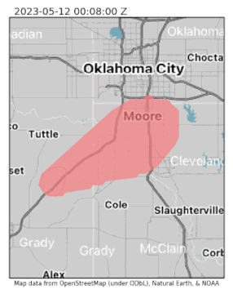
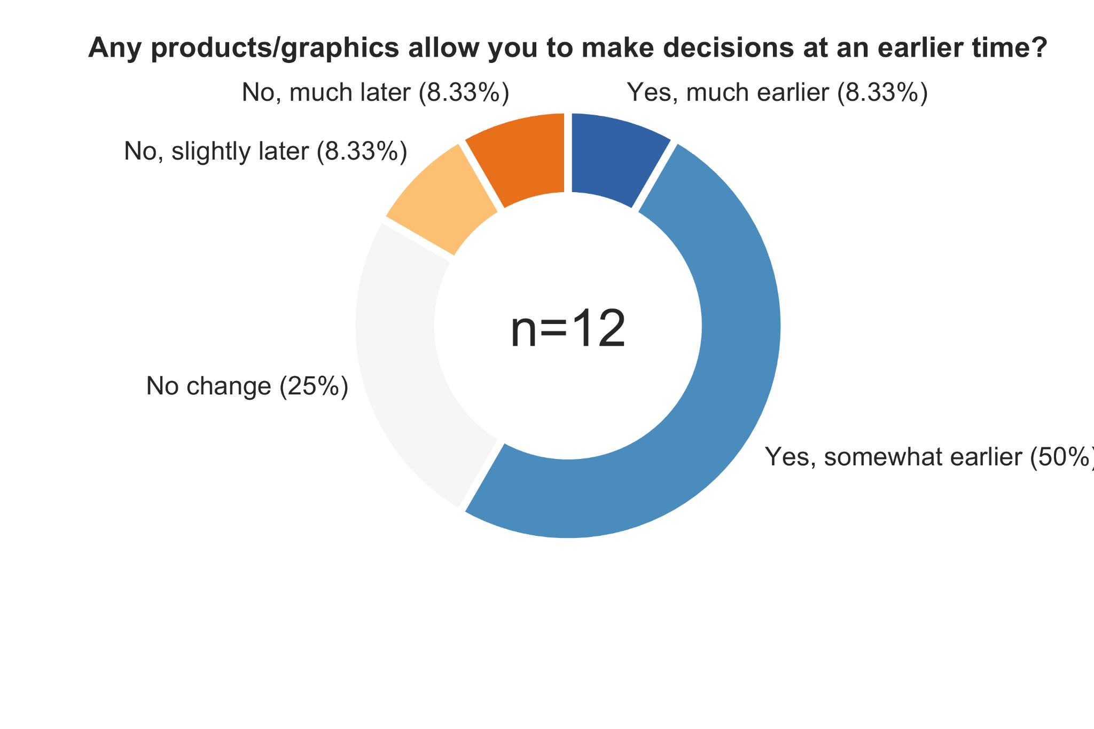
EMs: Probabilistic products were easy to interpret and helped with decision making
PHI plumes show storm motion,
threat location

Slide 35
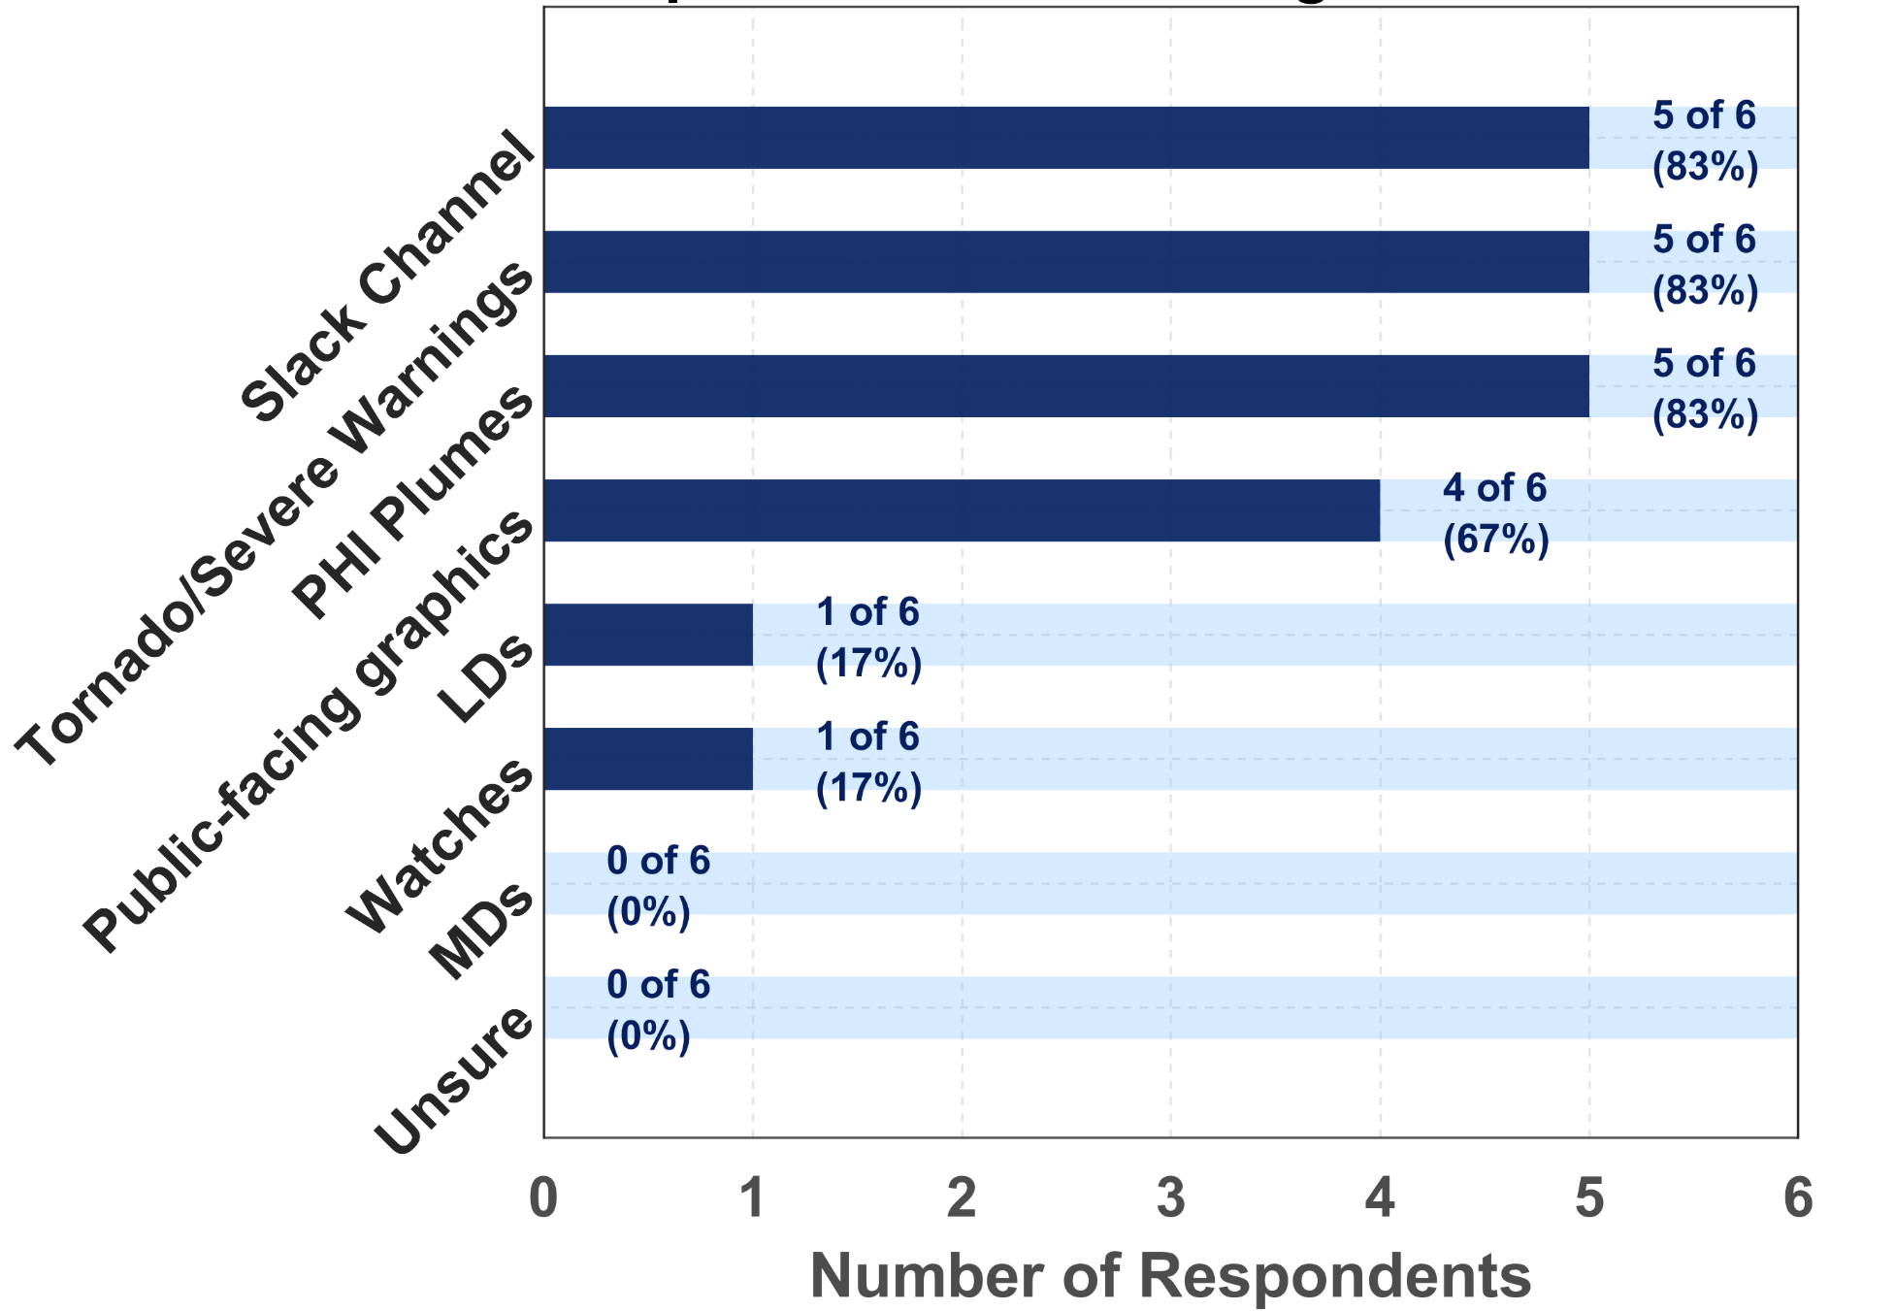
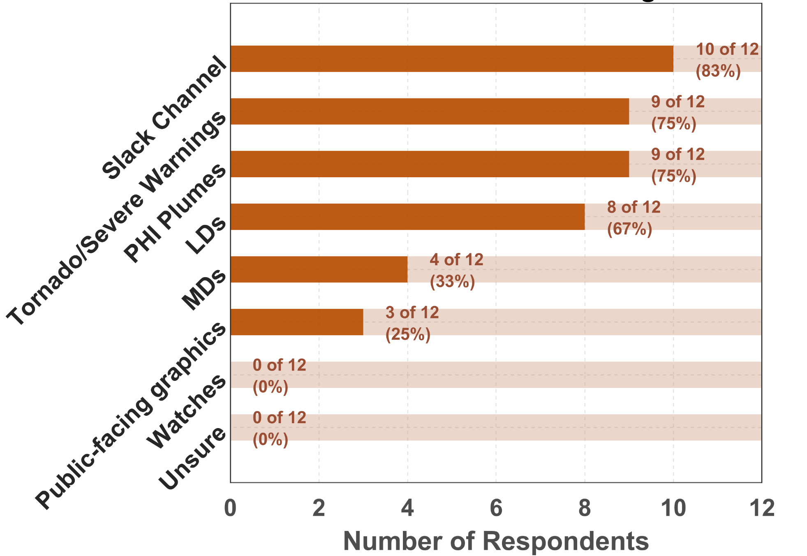
Forecasters: Which service did you prioritize/find most useful for communication with the EMs?
EMs: Which service did you find the most useful for decision making?

Slide 36
WoFS-PHI was especially helpful for Local Discussions and public graphics

Slide 37
PHI Verification

Slide 38
Forecaster changes to machine learning guidance
Blue/red/green lines represent forecaster added value to automation during HWT experiments.

Slide 39
Choosing a probability to issue first PHI vs Warning for a storm:
Severe
Tornado
Severe
Tornado

Slide 40
How can forecasters apply this information?
Use PHI and WoFS-PHI for messaging/situational awareness
Will highlight corridors of greatest risk before warnings
Create “Local Discussion” graphics for EMs/public
Highlight an area and discuss in lay terms

Slide 41
Example: WoFS-PHI Warning Mode for situational awareness/messaging
30% areas without a warning might deserve a 2nd look for warning or messaging
<30% areas might warrant extra attention/messaging as storms develop
Created 0010 UTC on 15 March 2025;
Valid until 0210 UTC

Slide 42
How does this play out?
2h WoFS-PHI Tornado Probabilities
(Warning Mode)
00-06 UTC
15 March 2025

Slide 43
Use bigger radii/time windows at longer lead times
WoFS-PHI spatial probabilities will naturally decrease with lead time (as uncertainty increases)
Hail probs from 00 UTC WoFS run
(shown earlier)

Slide 44
We can take advantage of these tools and messaging strategies now!
Fully automated PHI plumes on 28 March 2025. Tornado PHI derived from TORP and warnings (red polygons) at 2046 and 2100 UTC are shown.
1h, 15km WoFS-PHI tornado probs, valid 0230-0330 on 15 March 2025. Tornado LSRs (red dots) and warnings (red polygons) at 0330 UTC are shown.

Slide 45
WFO-SPC communication was helpful, especially about mesoanalysis and before warning mode

