Slide 1



The Urban Rain Rate Dashboard (URRD)
James Nelson¹, David Novak¹
David Bright², Erica Bower², Austin King²,
Rachel A.H. Carr³, Kathryn Semmens³, Burrell Montz³, Keri Maxfield³, Patrick Painter³
¹NOAA/Weather Prediction Center (WPC)
²Cooperative Institute for Research in Environmental Sciences (CIRES)
³Nurture Nature Center (NNC)
NWS VLab Forum
August 27, 2025

Slide 2
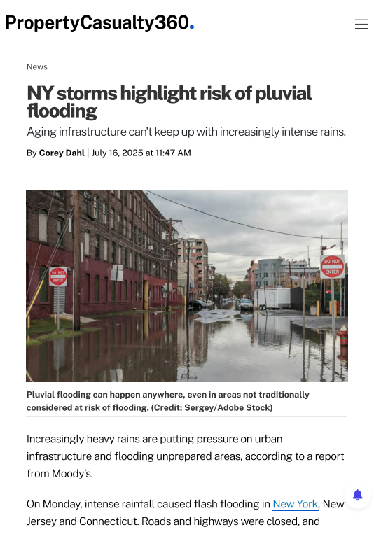
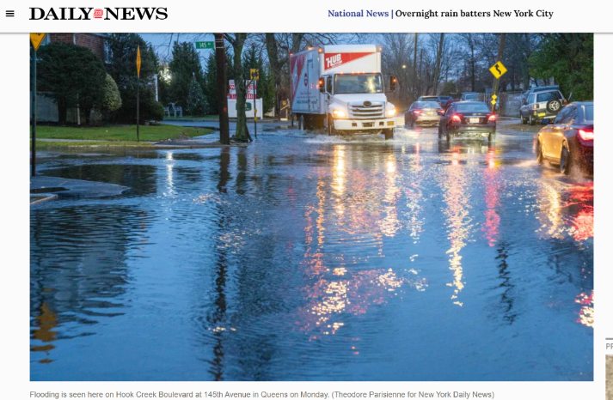
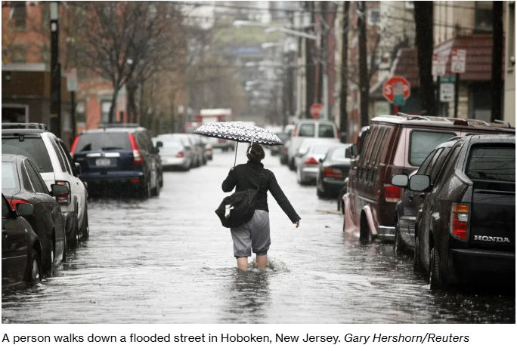
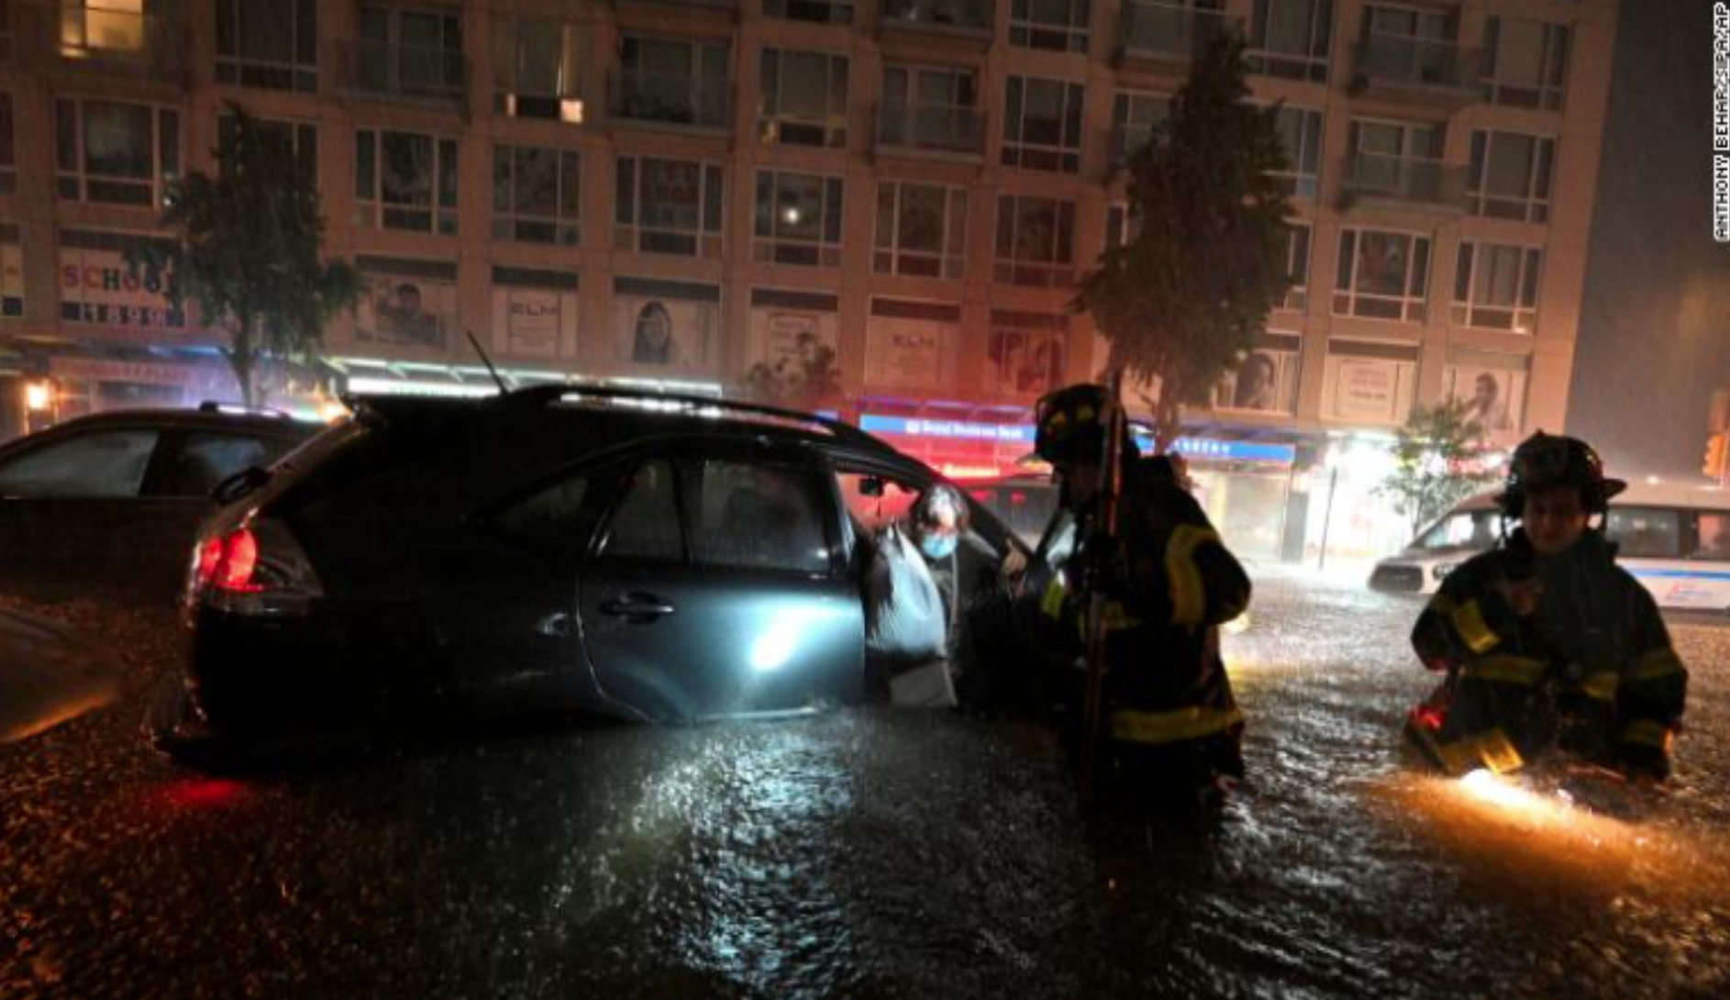
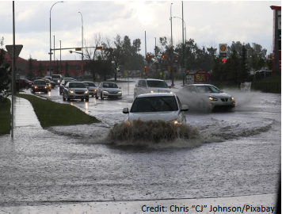
Motivation for the URRD
Flooding is the most common, costly, and deadly weather-related disaster in the U.S. (Alliance 2020)
The number of people affected by urban flooding is increasing annually (National Academies 2019)
Urban flooding typically occurs when short-term, intense precipitation exceeds its capacity to infiltrate or be removed by the drainage system (Galloway et al. 2018)
The increase is mainly attributed to population growth, expansion of impervious surfaces, outgrown stormwater infrastructure, local policies, and climate change (National Academies 2019; Galloway et al. 2018)
Ida Service Assessment (NOAA 2023) Finding 3/Rec. 3: NWS should develop forecast tools…to communicate…the expected hourly rate of rainfall, and a reasonable “worst case scenario”
Notes:
Among other reports, in IDA Assessment: Finding 3: Multiple interviews indicated that some partners did not know how to find rainfall rate forecasts; rainfall rates were a big driver of the impacts and would have helped decision makers. They expressed that rainfall rate information would be a helpful tool for making decisions regarding related impacts. Recommendation 3: NWS should develop forecast tools, IDSS, and messaging capabilities to communicate not only the expected rainfall, but also the expected hourly rate of rainfall, and a reasonable “worst case scenario” for each of these elements. NWS should also strengthen education and outreach efforts to highlight products which already contain this information.

Slide 3
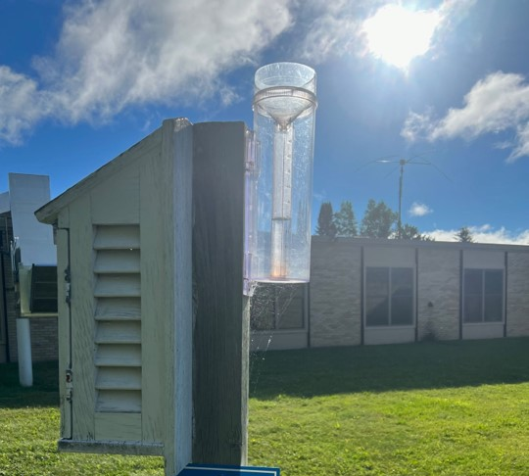
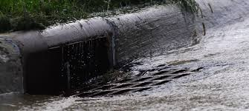
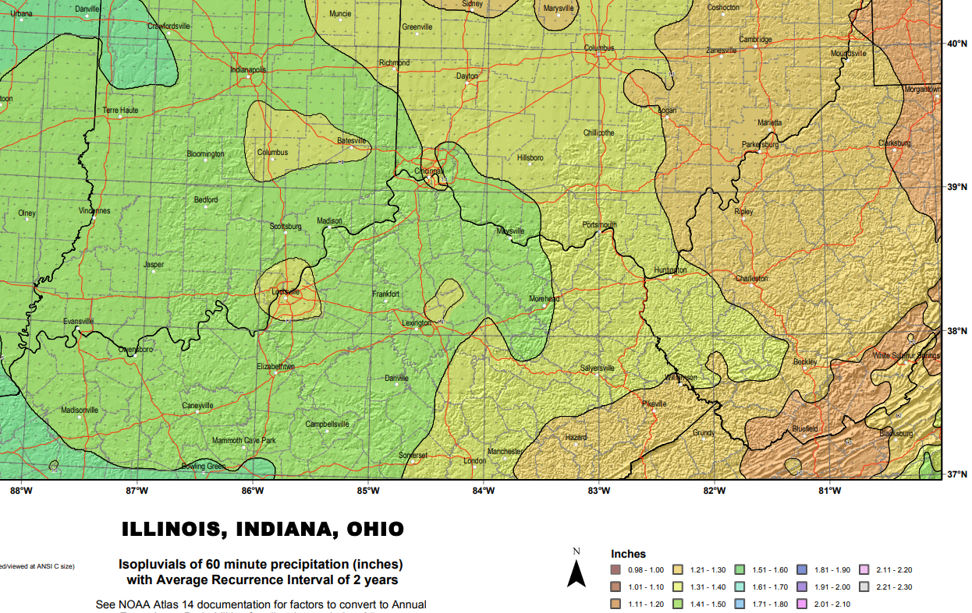
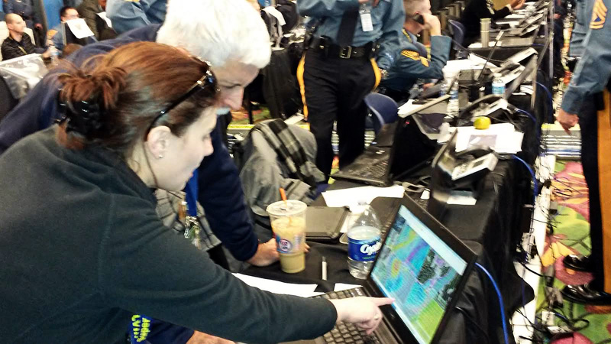
Ensemble QPF to Support Urban DSS
Inform users of the likelihood that your city’s critical rainfall threshold will be exceeded using the terms and criteria most meaningful to them
We typically see issues when rainfall exceeds 1” in an hour
We typically see issues when rainfall exceeds the 10 year storm
We can translate between rainfall and its statistical average recurrence interval (ARI)
We can provide real-time hourly probabilities of rainfall or ARI exceedance
Meteorologists
Stormwater, Utility, & EM Officials
Hydrologists
IDSS Meteorologists

Slide 4
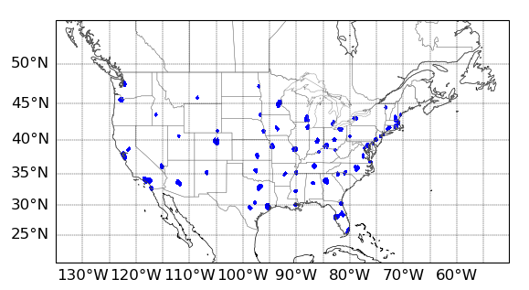
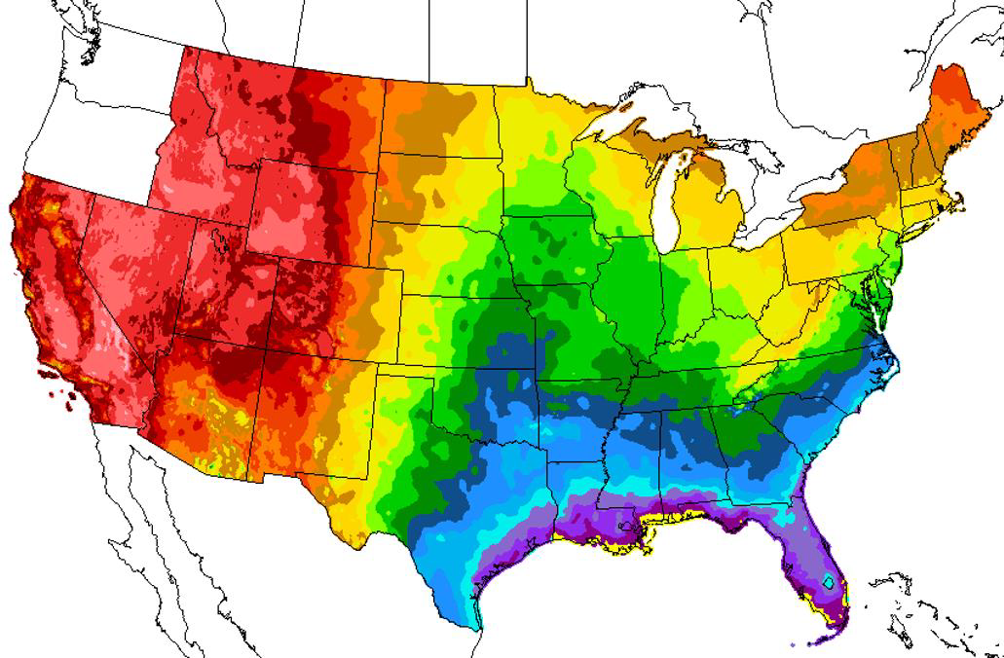

Components of the URRD
Current ensemble systems in the developmental/experimental URRD: HREF, REFS, GEFS
The REFS will be the only storm-scale ensemble system when operational and the HREF is retired (planned for early 2026)
A Neighborhood Maximum Ensemble Probability (NMEP) is used to define precipitation probabilities around each city
  The neighborhood is uniquely defined by the metro’s population density
The QPF from each member of the ensemble is compared to NOAA Atlas 14 Average Recurrence Intervals (ARIs). The URRD shows the probability of exceeding a 1 to 12 hour ARI or the probability of exceeding 1 to 12 hour accumulated precipitation
  All probabilities are uncalibrated in this version of the URRD
  Meteorologists preferred precipitation amounts while stormwater managers preferred ARIs
Eagerly awaiting the Atlas 15 updates for consistent, full coverage
  Until Atlas 15 in early 2026, Portland and Seattle ARIs derived from 30-years of airport precipitation data
The metro neighborhoods included in the URRD
An example of NOAA’s Atlas 14 for a 1-year recurrence interval and a 1-hour duration period. Units are in inches of precipitation.
Atlas 15
Notes:
Current - Static Values for Portland and Seattle - Based upon 30yr climo = Awaiting Atlas 15

Slide 5

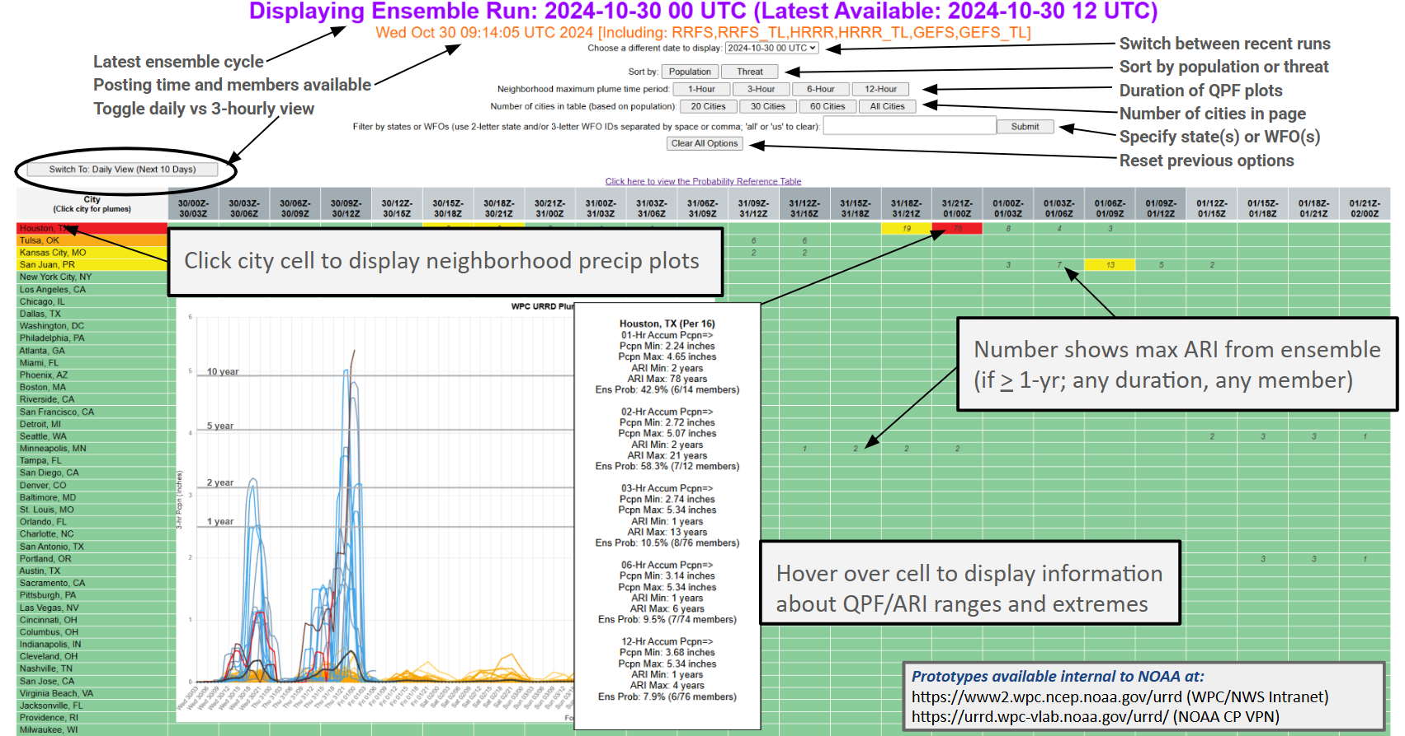
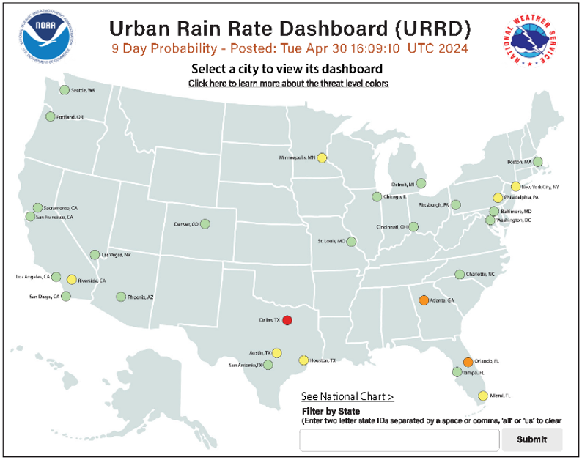
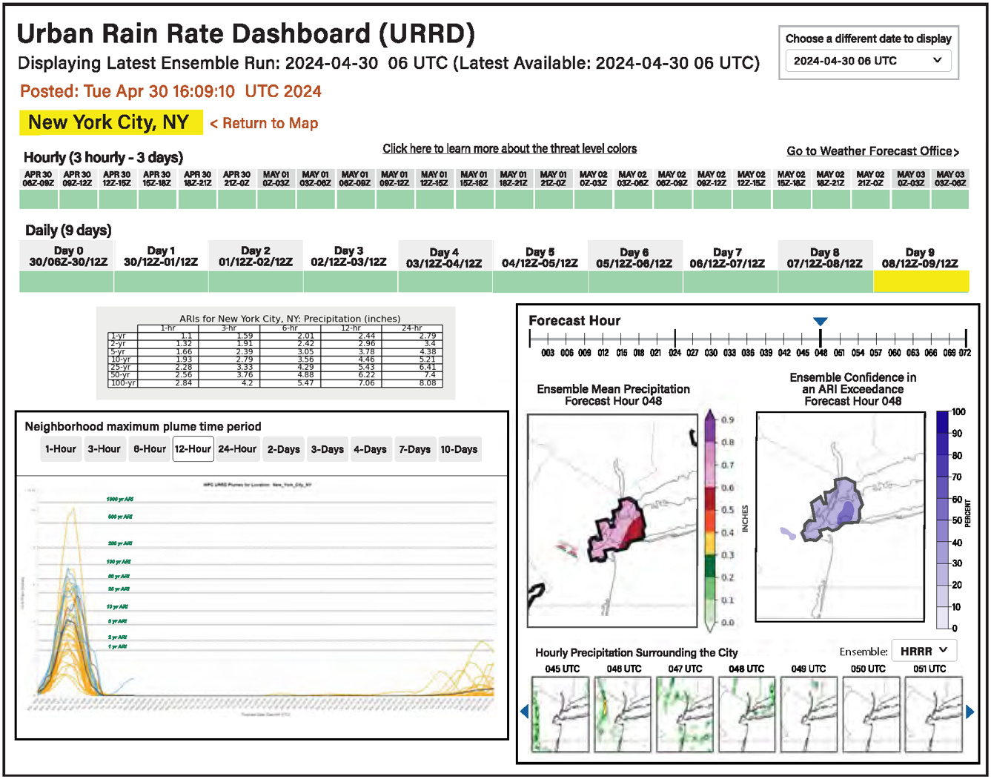
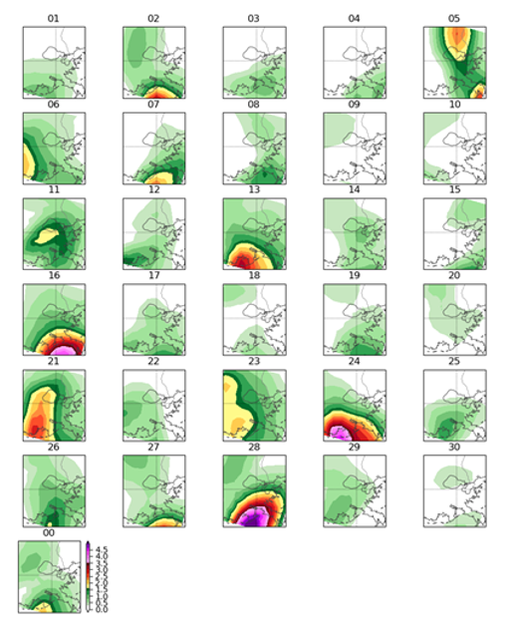
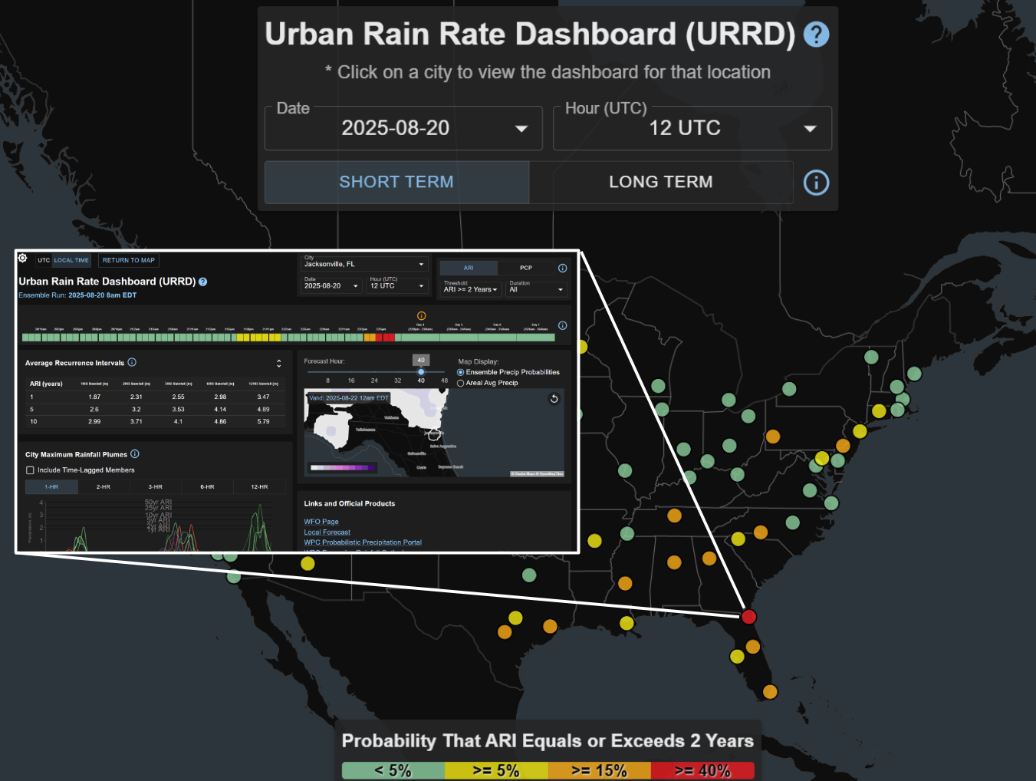
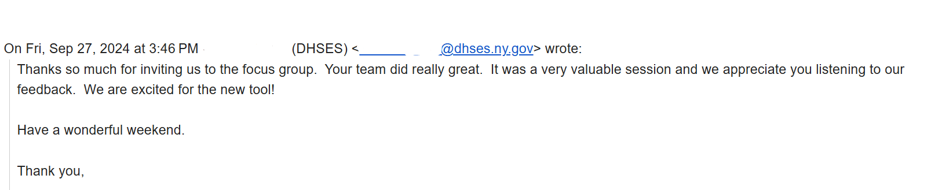
Social Science and User Engagement
Specialized community engagement led by social scientists from the Nurture Nature Center (NNC)
Six focus groups in 2024 (included seven WFOs: Atlanta, NYC, New Orleans, LA/San Diego, Denver, and Houston)
  Initial prototype, several mock-ups, and supplemental data presented to emergency managers, city managers, engineers, stormwater managers, meteorologists from partner WFOs
  Follow-up survey distributed in early 2025
URRD development shaped by the focus group feedback
Example of NNC pre-decision content for focus group discussion

Slide 6
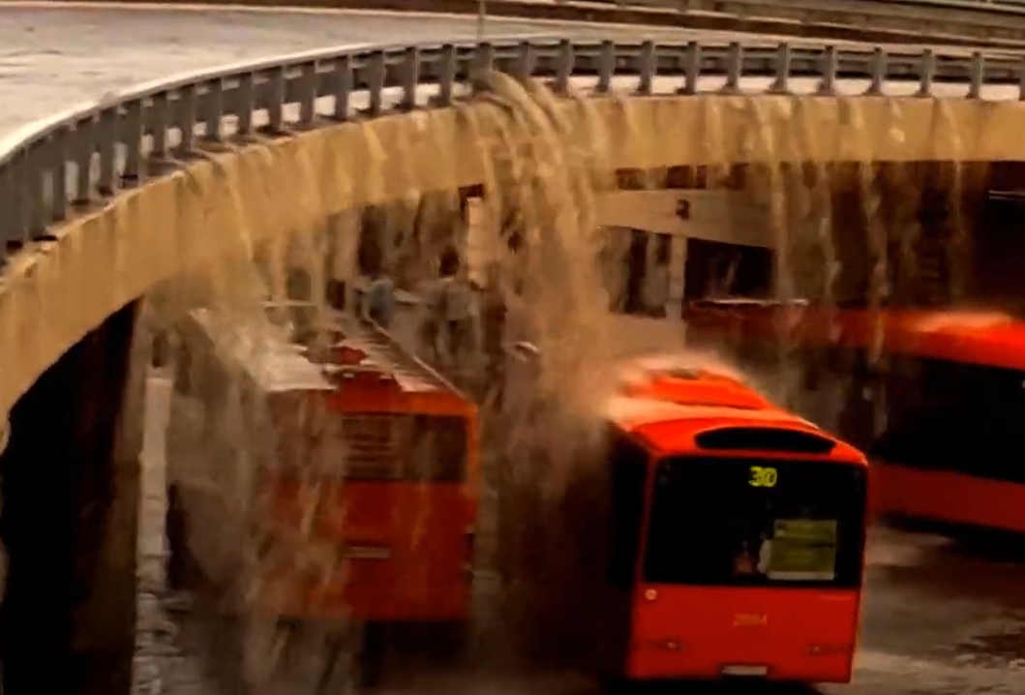
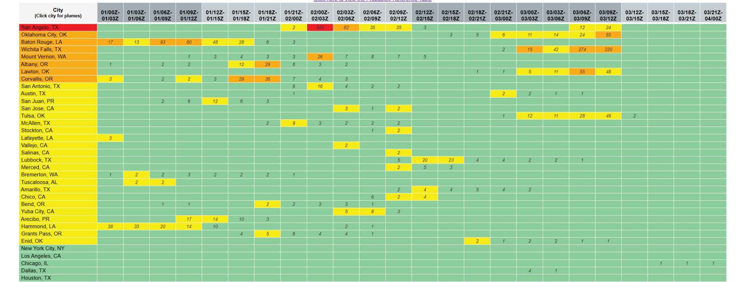
The Iterative Development Process
Engagement
City, Emergency, & Stormwater Managers
NWS WFOs
Language of urban flooding (ARI vs QPF)
Data visualization and interpretation
Decision making and decision support
Specifications
Community feedback
Verification
Determine optimal metric(s)
Limited archive for verification
Recent verification (real-time)
Long-term verification (skill)
URRD
Development
Defining urban areas
Ensemble system(s)
Post-processing QPF and ARI
Defining the threat
Probabilistic modeling/calibration
Prototyping

Slide 7
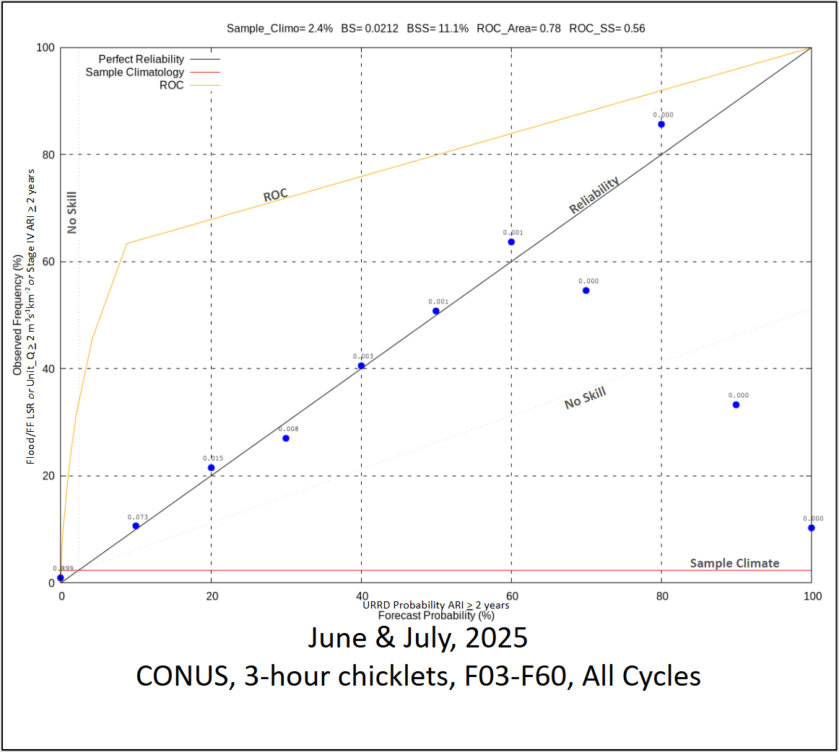
Performance Verification
Will use multiple verification methods to assess accuracy, discrimination, and skill of the probabilistic forecast. Initial metrics include:
Attributes Diagram
  Reliability: Agreement between forecast probability and occurrence frequency
  Sharpness: Deviation from climatology
  Resolution: Distinguish different occurrence frequencies
Relative Operating Characteristic (ROC) Curve and Area Under Curve (AOC)
  ROC: Hit Rate vs. False Alarm Rate across the probabilistic spectrum
  AUC: Single score summarizing separation ability (1 = Perfect; 0 = No Skill)
Brier Score and Brier Skill Score
  Brier Score: Mean squared error of forecast probabilities vs observations (0 = Perfect)
  Brier Skill Score: Improvement relative to a climatological forecast
  Sample climatology provides the event frequency for comparison
Verification can be used to guide further development and forecast calibration
A verification database and archive is now established
  Truth is a flood/flash flood LSR or MRMS CREST Unit-Q > 2 m³s⁻¹km⁻² (Gourley et al. 2017; Gerard et al. 2021) or Stage IV ARI > 2 years (Lincoln and Thomason 2018; Herman and Schumacher 2018)
  To keep it manageable, initial verification is based on probabilistic forecasts of ARI > 2 years
  We are assessing the preliminary results while building a longer-term verification archive
  Expect the performance to change in the coming months as REFS replaces the HREF
Example of initial verification for all the URRD cities
Notes:
Lincoln and Thomason (2018) said the 2-yr ARI derived from 3-hour rainfall amounts would capture approximately 90% of flash flood reports. This was across the eastern US.

Slide 8

Important URRD Caveats
Only as good as the accuracy of weather model inputs and
Atlas-14 recurrence intervals
  At its core, the first version of the dashboard is a detector of short-term, high-intensity rainfall events evaluated in rainfall or ARI exceedances
  Models may be biased, or the ensembles may not capture the PDF correctly
  ARI applications assume a stationary climate, representative historical record, etc.
Application depends on accurately linking impacts to the proper rain rate or recurrence interval
  Most cities have unique infrastructure, unique problem areas, and local issues that may complicate urban flooding prediction and impacts
Entirely automated model guidance with limited human oversight
The URRD is a Situational Awareness Tool - Does not replace official NWS watches, warnings, advisories, DSS
Notes:
It is an automated concept using models. Models are "capable" but:
1. not always location or timing precise (thus we use probability)
2. not fit for the tiny areas of flooding seen in individual thunderstorms
We will use the new Atlas 15 dataset

Slide 9
URRD Real-time Demonstration
https://www.wpc.ncep.noaa.gov/urrd/demo/

Slide 10
URRD Next Steps and Future Work
Verification - Continue collecting data for robust statistical analysis of the URRD
  URRD and its verification will also provide insights into model performance for model developers
Work with WFOs on unique city criteria
Gather feedback from meteorological, stormwater, and EM community during experimental period (NOAA Experimental Milestone - Q4 2025)
Expand to additional cities (have had multiple requests to do so already)
Continue website refinements and efficiency improvements
Incorporate Atlas 15 data once available (expected 2026)
Transition to entirely REFS when operational and HREF is retired (expected 2026)

Slide 11
References
Alliance, U. W. (2020). Water rising: equitable approaches to urban flooding. US Water Alliance.
Available online at: https://cityparksalliance.org/wp-content/uploads/2020/09/Final_USWA_Water-Rising_0.pdf
Galloway, G.E., A. Reilly, S. Ryoo, A. Riley, M. Haslam, S. Brody, …, S. Parker (2018). University of Maryland, Center for Disaster Resilience, and Texas A&M University, Galveston Campus, Center for Texas Beaches and Shores, The Growing Threat of Urban Flooding: A National Challenge (College Park, MD: University of Maryland, 2018). Available online at: https://cdr.umd.edu/sites/cdr.umd.edu/files/urban-flooding-report-online-revised.pdf.
Gerard, A., S. M. Martinaitis, J. J. Gourley, K. W. Howard, and J. Zhang, 2021: An Overview of the Performance and Operational Applications of the MRMS and FLASH Systems in Recent Significant Urban Flash Flood Events. Bull. Amer. Meteor. Soc., 102, E2165–E2176, https://doi.org/10.1175/BAMS-D-19-0273.1.
Gourley, J. J., and Coauthors, 2017: The FLASH Project: Improving the Tools for Flash Flood Monitoring and Prediction across the United States. Bull. Amer. Meteor. Soc., 98, 361–372, https://doi.org/10.1175/BAMS-D-15-00247.1.
Herman, G. R., and R. S. Schumacher, 2018: Flash Flood Verification: Pondering Precipitation Proxies. J. Hydrometeor., 19, 1753–1776, https://doi.org/10.1175/JHM-D-18-0092.1.
Lincoln, W. S., R. F. L. Thomason, 2018: A preliminary look at using rainfall average recurrence interval to characterize flash flood events for real-time warning forecasting. J. Operational Meteor., 6 (2), 13-22, doi: https://doi.org/10.15191/nwajom.2018.0602
National Academies of Sciences, Division on Earth, Life Studies, Water Science, Technology Board, Policy, ... & Committee on Urban Flooding in the United States (2019). Framing the challenge of urban flooding in the United States. National Academies Press.
Available online at: https://nap.nationalacademies.org/download/25381
NOAA Service Assessment: August-September 2021 Hurricane Ida (2023). Available online at: https://www.weather.gov/media/publications/assessments/Hurricane_Ida_Service_Assessment.pdf

