Slide 1
Enabling Decision Support Services in Health
A NOAA Initiative on Climate and Health for Africa
Wassila M. Thiaw
Climate Prediction Center
National Centers for Environmental Predictions

Slide 2
Outline
Background CPC International Desks
Climate and Health for Africa
    Heat – Health Project
      Strategy for Heat – Health Early Warning
      Heat Wave Forecast Strategy and Verifications
      Experimental Heat – Health Early Warning
      Gaps, Next Steps, and Discussion

Slide 3
Background CPC International Desks
Provide access to real time global and regionalized weather and climate forecasts for the world
To Support the USG humanitarian mission oversea, primarily USAID, DOS, DOD, USDA
  Food security
  Natural disasters
Collaborate with U.N FAO and WFP to provide information tailored to reducing hunger
Work with WMO to develop the capacity of NMHSs and to enable early warning

Slide 4
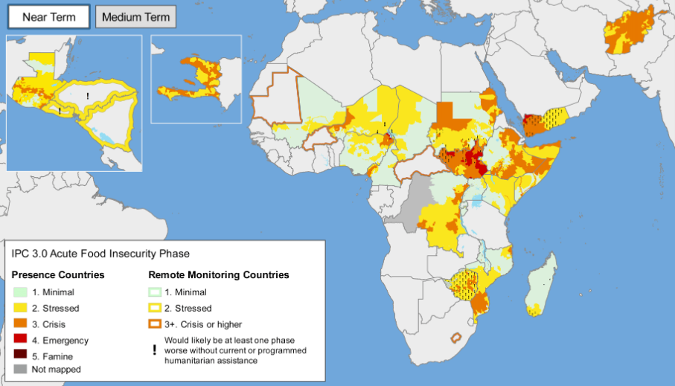
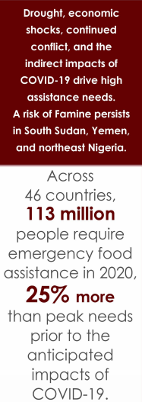
Background CPC International Desks
Decision Support Services – Food Security
USAID monitors food security in the developing world very closely
Need for timely weather information to mount a response to food insecurity
Requirement for food assistance in 2019: 28 Billion dollars. USAID spent 6 Billion dollars
Hazards outlooks are primary input to FEWS NET food security outlooks
COVID-19 | EXTREMES | CONFLICT | LOCUST
52millions
Source: FEWS NET
USAID funds CPC about $1M/year in support of famine early warning, to prevent hunger, malnutrition, and to reduce disaster.

Slide 5
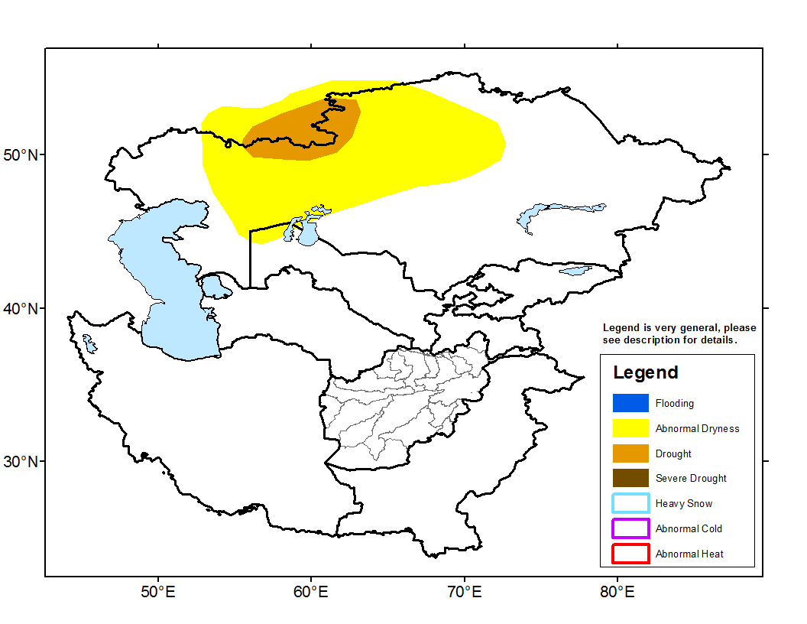
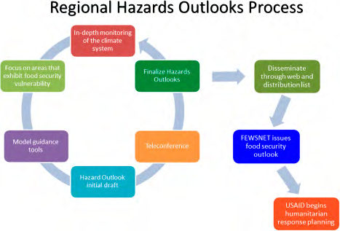
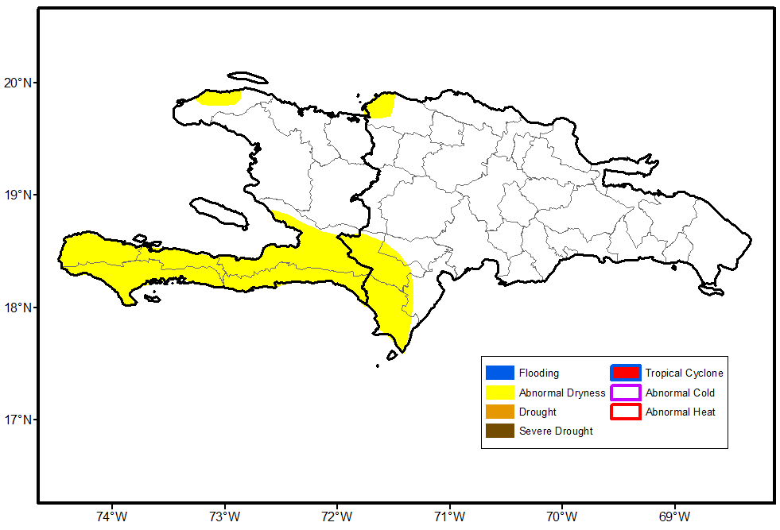
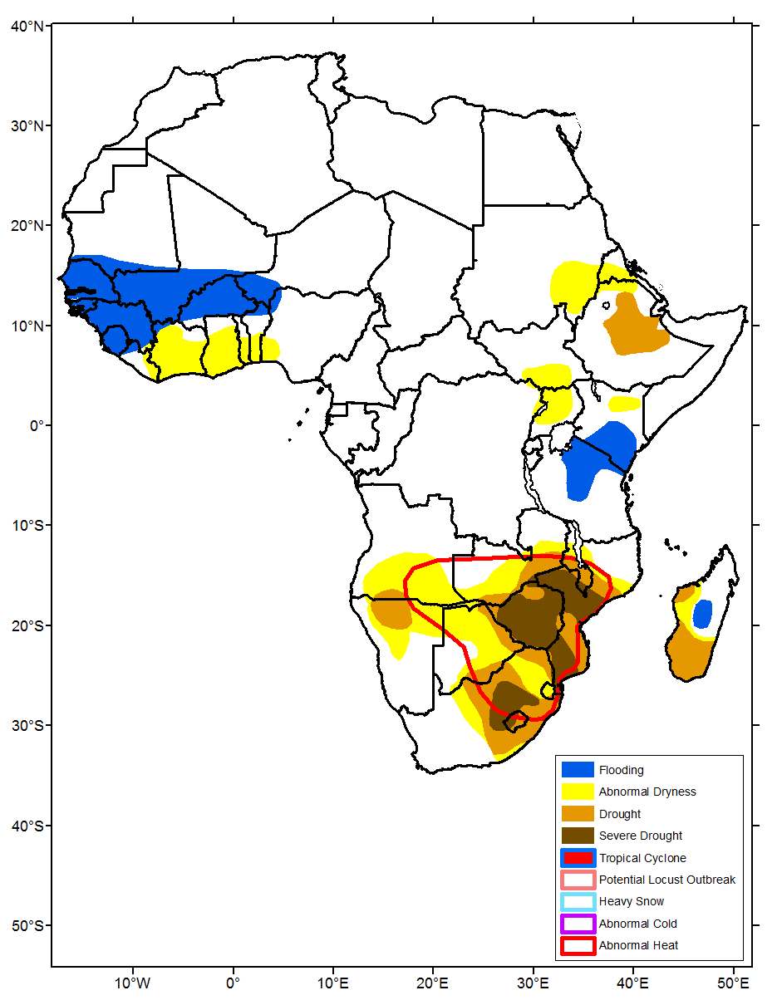
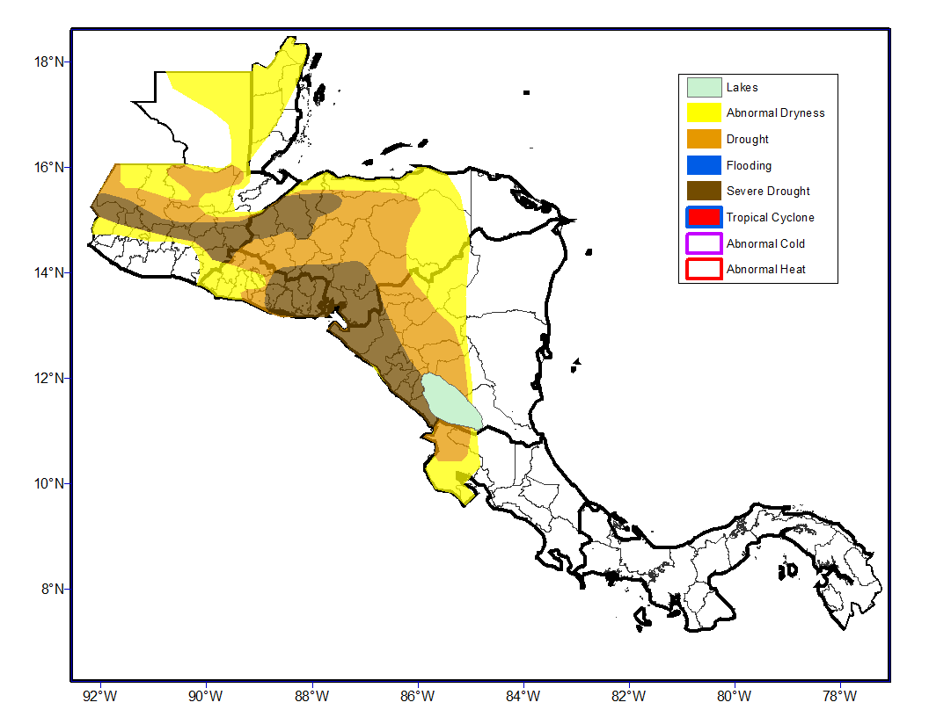
Background CPC International Desks
Hazards Outlooks for Food Security
Integrating weather, climate, and land information to inform humanitarian response planning.
Hispaniola
Central Asia
Hazards outlooks are based on the long term monitoring of the climate system and forecasts to gain knowledge of the current state of the climate and evolution in the near future from one week to a month or season
Central
America
Africa

Slide 6
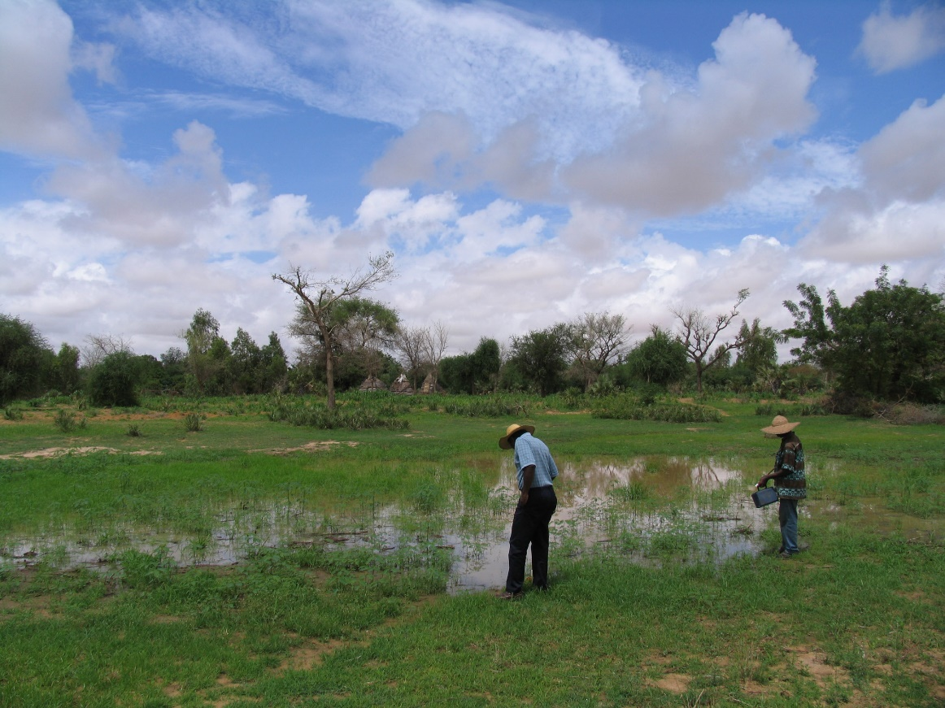
Climate and Health for Africa
Background
CPC work on climate and health started in 2004 – NOAA OHHI, Congress Appropriation, $18M
CPC effort extended in 2010: climate and cholera
WHO established ClimHealth Africa with NOAA one of the founding institutions
NWS funded CPC to conduct two scoping workshops in Africa and to initiate a climate and health activity
  Goal: To contribute to climate-based early warning systems for public health
  Recommendations
    Deliver training for the health sector
    Provide real time weather and climate information to enable decision making in health
    Focus Areas: heat-health and infectious disease
Observing mosquito larvae in a pond in Niger
Malaria ranks 3rd among major infectious disease threats in Africa
About 90% of all malaria deaths in the world occur in Africa
300-500 million cases: 1-3 million deaths each year (90% children under 5 years old)

Slide 7
NWS – OLR SLA Climate and Health Milestone for Africa
Heat-Health
Infectious Diseases
Sarah Diouf
Endalkachew Bekele
Murali Malasala
Ibrahima Diouf
Peitao Peng
Met Service Senegal
Ministry of Health of Senegal
Other international institutions
Ibrahima Diouf
Pierre-Honore Kamsu-Tamo
Assaf Anyamba, NASA (IRAP)
Met Service of Senegal
Ministry of Health of Senegal
University of Liverpool
International Center for Theoretical Physics and other institutions

Slide 8
Heat Waves Facts
Heat waves frequency and intensity have been increasing globally. Over the past decade, the world’s attention has focused on record breaking heat and associated health outcomes
The five warmest years on record occurred over the past five years (2015 – 2019), with the record set in 2016, and 2019 ranked a close 2nd according to NOAA and NASA
Africa is one of the regions most affected by heat waves due to population increase and poor infrastructure. More than 500 people died of heat waves in Niger (Central Sahel) in 2010 due to heat waves

Slide 9
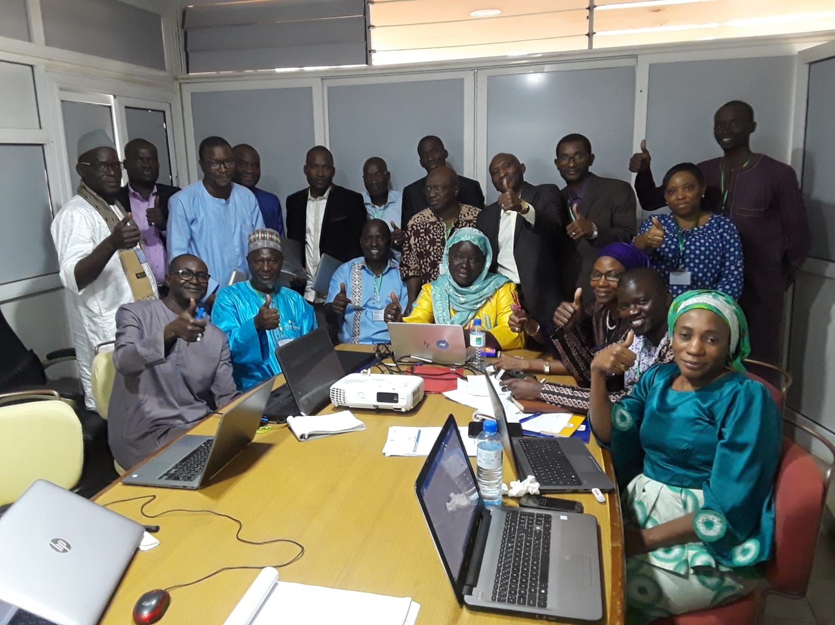
Enabling Heat Health Early Warning
NOAA – Ministry of Health and ANACIM Senegal Workshop on Heat Waves and Impact on Health, Dakar, Senegal, Dec 2019
At AMS 100, PR of Senegal with WMO briefed PR of the U.S. with WMO on workshop outcomes and recommendations
Further discussions with PR of Tanzania followed to work the same effort in Tanzania
Participants from the health community in the Sahel: Burkina Faso, Mali, Niger, and Senegal, during a break out group, working on a strategy for preparing a health impact risk map and a bulletin for heat – health early warning.

Slide 10
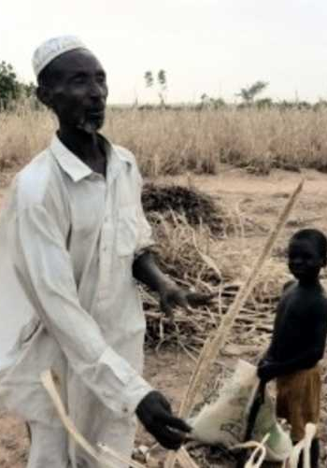
Aggravating Factors
Enabling Heat Health Early Warning
Access to information
Access to water and power
Access to health centers
Type of activity
Population density
Habitat
Health conditions

Slide 11
Enabling Heat Health Early Warning
Heat Alert Code
Alert Code | Alert | Health Risks
 | Extremely dangerous: Heat Strokes | Aggravation of cardiovascular diseases
 | Dangerous: Heat Strokes | Fatigue, severe dehydration, fainting, cramps
 | Very Uncomfortable: Care Required | Dehydration, confusion, headache, dizziness
 | Watch | Negligible

Slide 12
Strategy for enabling Heat – Health Early Warning
Enabling Heat Health Early Warning
Tools
meteorological forecasts
1
Heat Wave Risk Maps
meteorologists
4
Public Health Intervention
action to be taken by local authorities
Other Factors
urbanism
air pollution
livelihood
…
3
Heat Early
Warning Bulletins
Health Impacts Risk Maps
meteorologists and
the health professionals
2
Workshop recommendation: Pair a meteorologist and a health professional in the African Desk to begin experimental heat – health early warning

Slide 13
Heat Wave Forecasts Strategy
Heat Wave Definition:
  Heat index values exceeding X_{t}°C for at least 3 consecutive days
  Tmax or Tmax and Tmin > n^{th} percentile for 3 consecutive days
Models: NCEP GEFS, CFSv2, NAEFS
Verification Data and Period:
  GDAS for Heat Index
  GHCN-CAMS for Tmax and Tmin
  Verification Period: 2017-2019

Slide 14
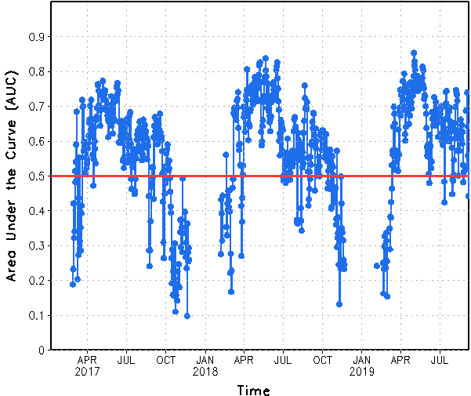
NCEP GEFS Performance – Week-2 Heat Index
Area Under the ROC Curve
NOAA Heat Index, Sahel
Scores above the 0.5 red horizontal line indicates good performance of the NCEP GFS to predict heat waves at week-2

Slide 15
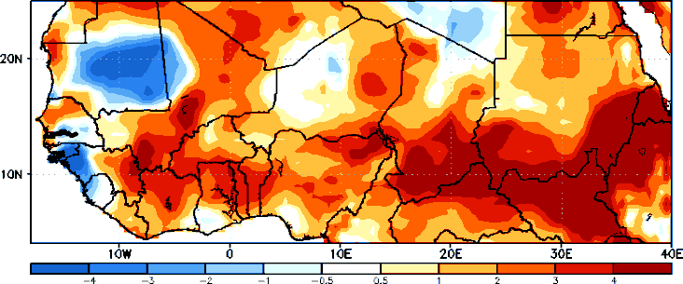
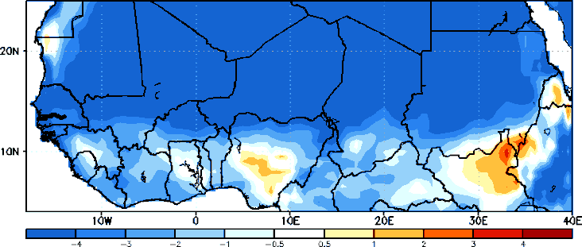
Differences between observations and GEFS week-2 Tmin and Tmax forecasts
Biases in GEFS week-2 Tmin and Tmax forecasts
Tmin
Tmax
Positive bias in Tmin forecasts and negative bias in Tmax forecasts

Slide 16
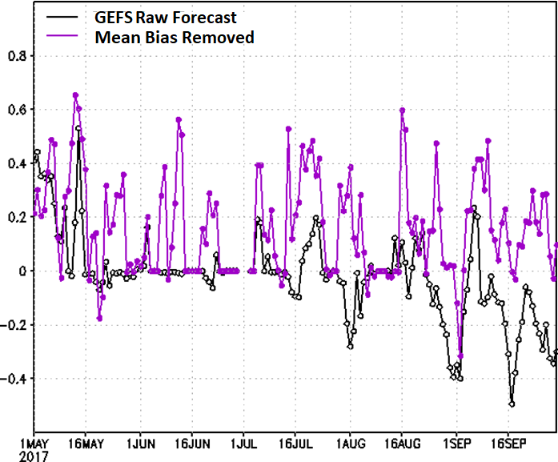
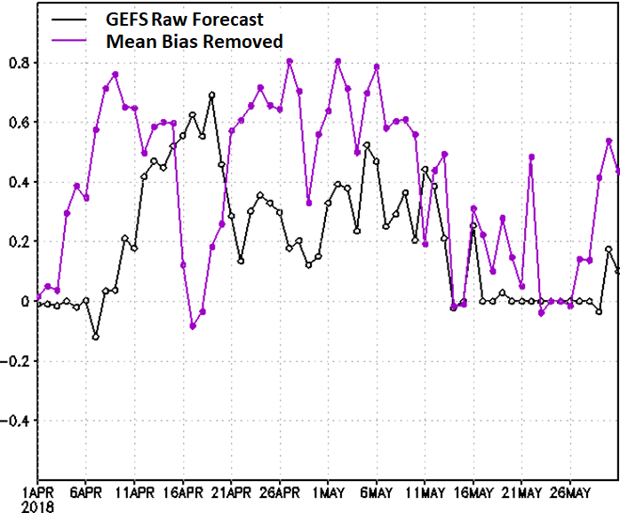
T_{max} ≥ 90th percentile
GEFS Forecast Performance – Week-2 Tmax
HSS Tmax > 90th Percentile
2017
2018

Slide 17
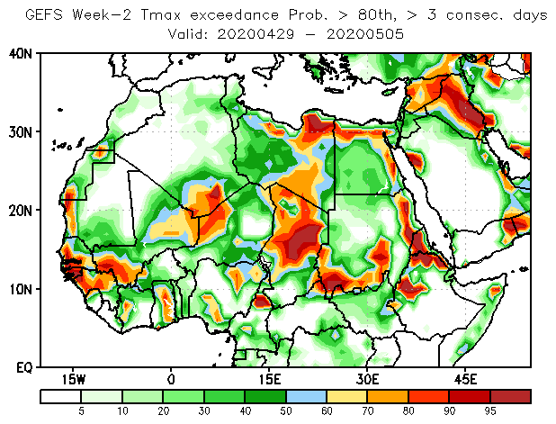
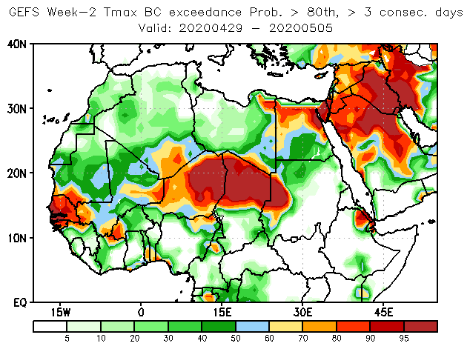
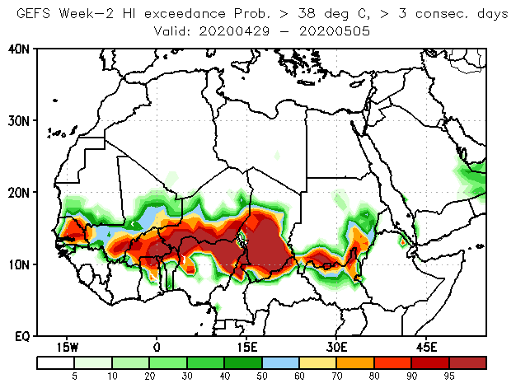
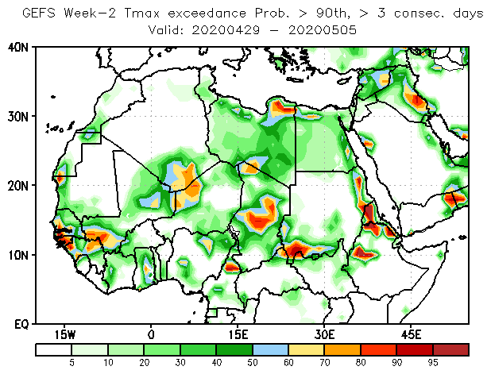
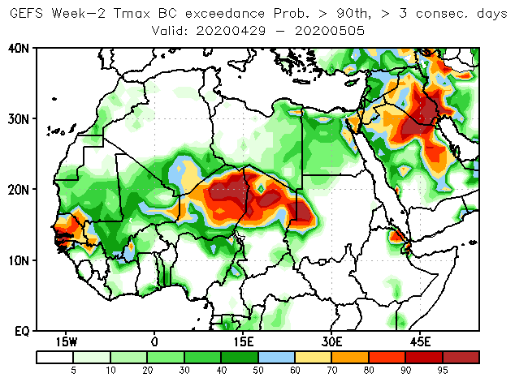
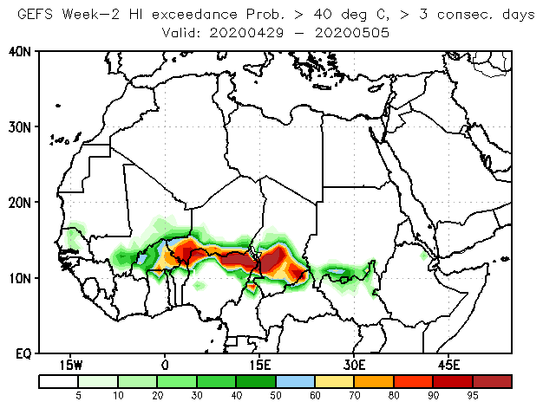
GEFS Heatwave Forecast Tools for Week 2, Valid 29 April – 5 May 2020
GEFS Raw and BC Tmax Probability Forecasts
GEFS HI Probability Forecasts
Raw Forecast
Bias Corrected Forecast
>38⁰C, > 3 C. Days
>80th Pctl,
> 3 C. Days
>40⁰C, > 3 C. Days
>90th Pctl,
> 3 C. Days

Slide 18
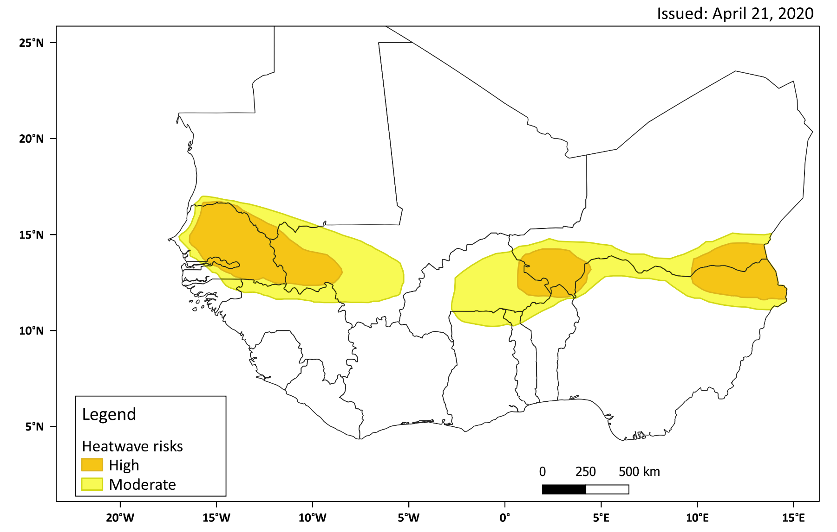
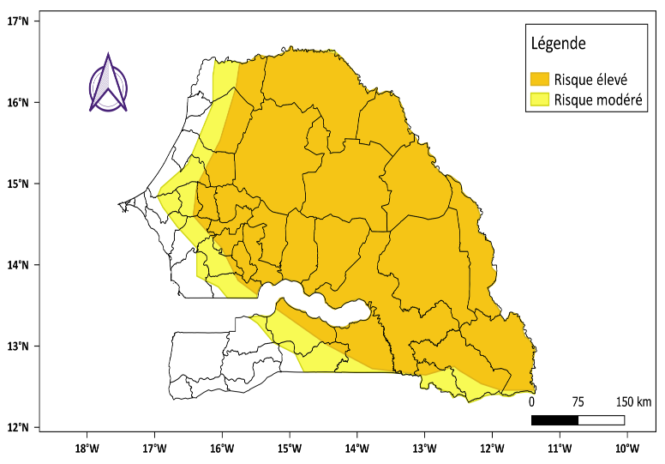
Week-2 HW Forecasts, 29 April – 5 May 2020
Zoom into Senegal

Slide 19
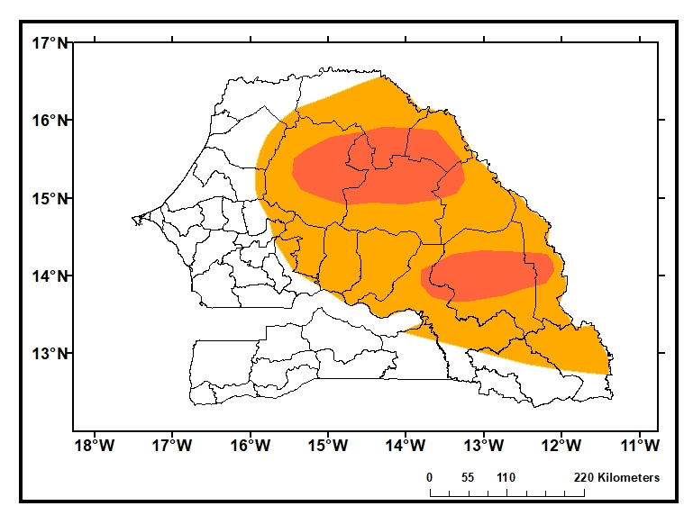
Experimental Heat – Early Warning
Elevated risk for HRI in areas shaded in red
Produced by trainees Met and health
Updated twice a week Tuesdays and Fridays
Heat health risk out to two weeks
Description of potential illnesses
Actions to take to mitigate impacts of heat
Alert Code | Alert | Health Risks
Extremely dangerous: Heat Strokes | Aggravation of cardiovascular diseases
Dangerous: Heat Strokes | Fatigue, severe dehydration, fainting, cramps
Very Uncomfortable: Care Required | Dehydration, confusion, headache, dizziness
Watch | Negligible

Slide 20
Summary Heat Waves Forecasts
Week-2 heat waves over the Sahel are quite predictable.
Predictability higher for the HI than Tmax and Tmin.
The mean bias correction method improves skill better than the EMC hybrid method
The CMCE improves skill over the GEFS raw and bias corrected forecasts. Gives advantage to the use of NAEFS

Slide 21
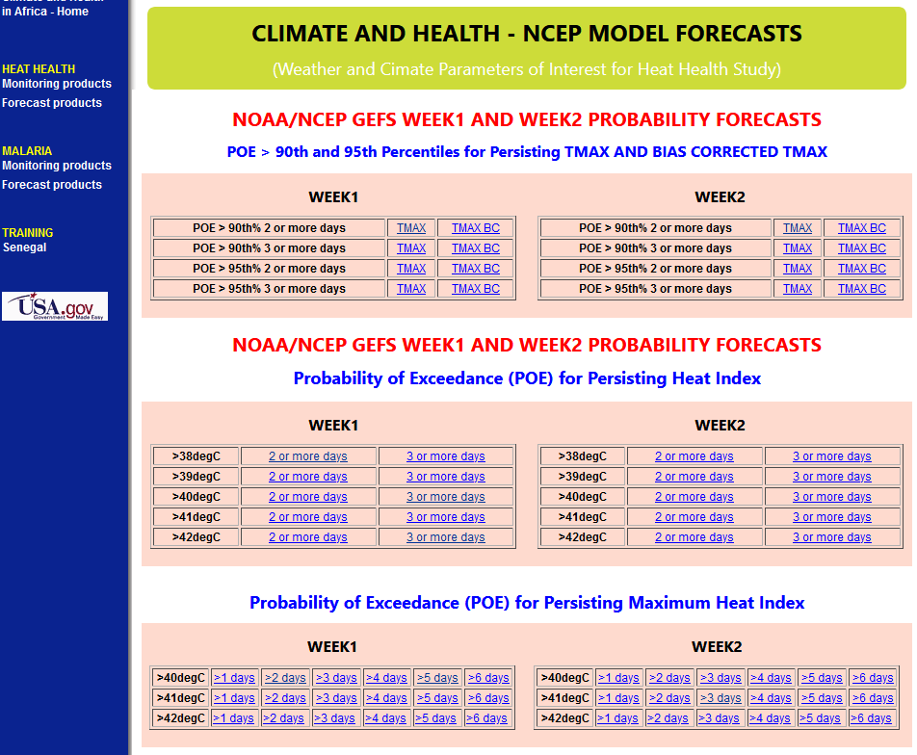

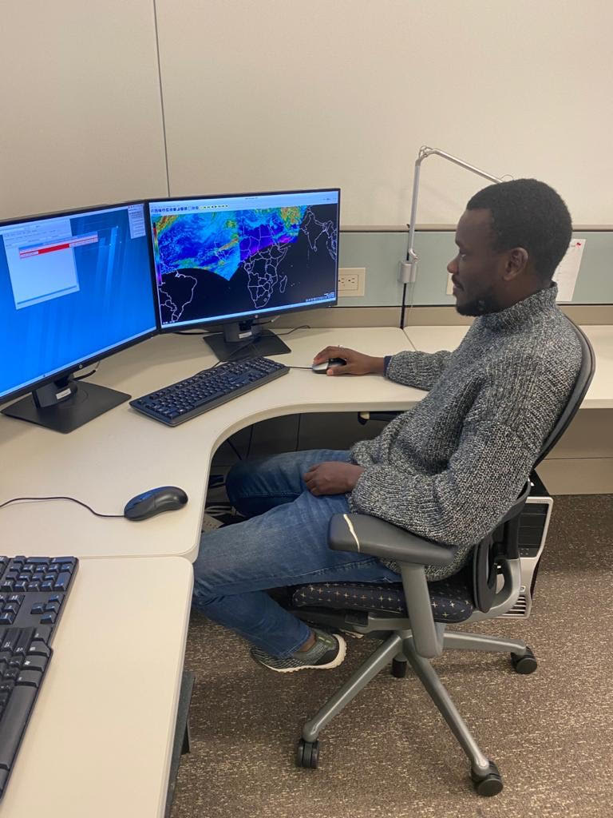
Heat Forecasting – R2O
Website designed to provide met Services with tools for week-1 and week-2 forecasts of heat waves
Fostering collaboration between meteorologists and health professionals to assess health impacts and enable heat – health early warning
https://www.cpc.ncep.noaa.gov/products/international/climatehealth/heat-health_forecasts.shtml
Health environmentalist and meteorologist working at the International Desks, March 2020

Slide 22
Heat – Health Next Steps
Follow up with the Senegal Met Service and Ministry of Health
MoH, ANACIM, and CPCID to meet for a debrief on heat – health training
Trainees to present their work and accomplishments while in training
Meteorologist trainee to train forecasters at the Senegal Met Service on heat wave forecasting tools
Health Environmentalist trainee to work with health districts in Senegal to validate the heat – health impacts forecasts
Resume heat wave forecasts in the fall and involve the health sector early on to prepare for the heat season of 2021
Organize a workshop to evaluate the heat – health project

Slide 23
Heat – Health Next Steps
Continue to engage the health sector – Resume work with Tanzania
Interest in expanding the heat wave project to other regions
  North Africa (Egyptian Meteorological Authority)
  Caribbean (Caribbean Institute of Meteorology and Hydrology)
  Latin America (Pan American Health Organization) – Also COVID-19
  South Asia (Indian Institute of Tropical Meteorology)
Need to test other definitions of heat waves:
  Heat duration: Tmax and Tmin above a threshold T
  Heat severity
Challenges
  Human resource
  Keeping the health sector engaged

Slide 24
Heat – Health Next Steps
Continue to improve heat waves forecasts and sharing with institutions in Africa
Work on model post processing week3-4 and monthly forecasts
  Apply consistency approach to improve forecast skill
  Neural Networks
  Knowledge of S2S phenomena
Evaluate the new FV3-GEFS for timescales for week2, week3-4 HW forecasts
Create an inventory of heat wave events 1999-present
Classify and create composites of heat wave events
Use hybrid statistical – dynamic approach to improve forecasts

Slide 25
Thank you
wassila.thiaw@noaa.gov

