Slide 1

Build Community Before the Storm:
Social Media Engagement for Crisis Communication
Jeannette Sutton
Risk and Disaster Communication Center
Notes:
Recent study by Sherman-Morris, published in WCAS (Oct ‘18) on Perceptions about Social Science among NWS Warning Coordination Meteorologists.
how to communicate a message effectively
why individuals do not take action during a warning
Bottom line: how to persuade people to take action when they are at risk.

Slide 2
Plan for this talk
The strategic use of social media is a “best practice” for crisis communication
Engagement pre, during, and post crisis has the potential to affect behavioral change
We investigate the use of social media by 12 NWS offices
We find that social media use differs by time of engagement
I’ll offer some thoughts about what this means for engagement efforts over time

Slide 3
Goal
Tactic
Strategy
What do you want to accomplish
What mechanism will you use
What can you do or say to accomplish the goal

Slide 4
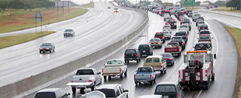
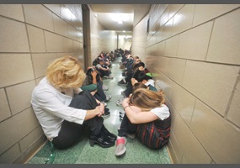
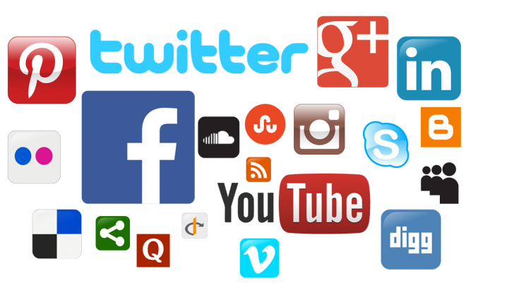

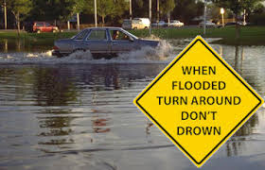

Goal: change behavior
Strategy: what I can do or say to affect goal
Tactic: channel
Notes:
Social media is less about “stickability” and more about “spreadability”

Slide 5
Strategy: engagement on social media
Engagement is about shaping beliefs through communication efforts/strategies.
What can I do or say to get you to believe that …
I am caring and honest?
I listen? I am open?
We are similar?
I am competent?
Why accomplish this goal:
So that when it comes time to take action message receivers are more likely to act.
** this is not a talk about messaging, it’s a talk about strategy
Some best practices for crisis communication

Slide 6
HEROIC Research to address these questions:
What are the engagement strategies used by NWS Offices on Twitter?
How do these strategies differ between non-threat and threat periods?

Slide 7

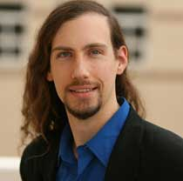
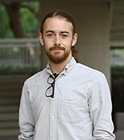
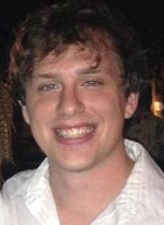

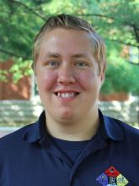

HEROIC Team
Jeannette Sutton
Carter Butts
Scott Renshaw
Ben Gibson
Micki Olson
Robert Prestley
Sarah Vos
This work was supported by grants from the National Science Foundation (CMMI-1536347, CMMi-1536319); with supplemental funding from the National Oceanic and Atmospheric Administration. The opinions expressed in this talk are those of the authors and do not necessarily represent those of the NSF or NOAA.

Slide 8
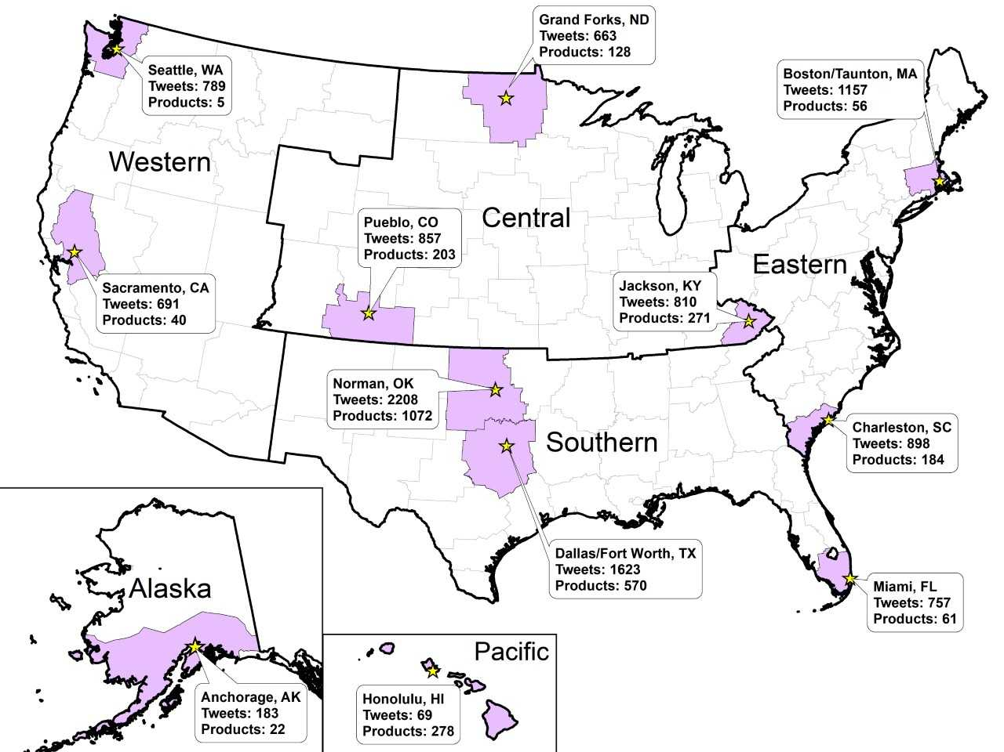
We selected 12 NWS WFOs and collected all of their tweets and products for 3 months (Apr-Jun) in 2016.
N = 10,705 tweets
N = 2,948 products
Notes:
Note the differences in location, number of tweets, number of products.
Note the potential types of weather events they may face in April – June 2016.

Slide 9
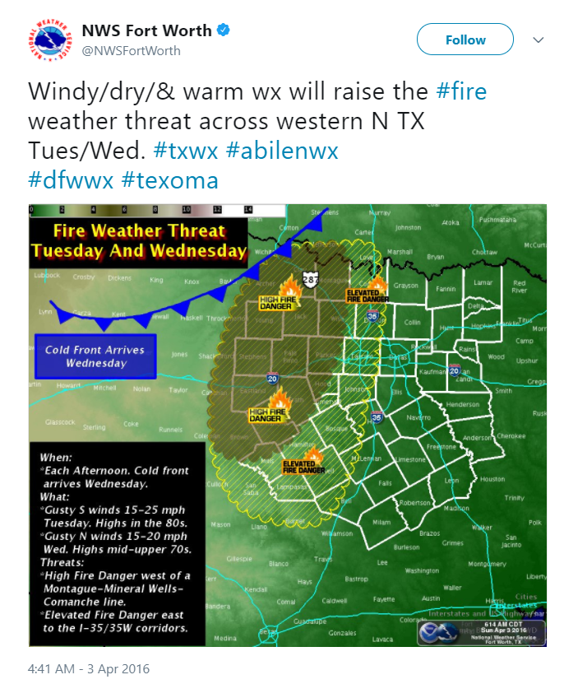
Engagement
By creating and sharing content
(These fall into three categories: information, community, and action. We’ll talk about these in just a moment…)

Slide 10
Engagement
1. By creating and sharing content
2. By using technological features that are part of the social channel.
We call these “microstructures”.

Slide 11
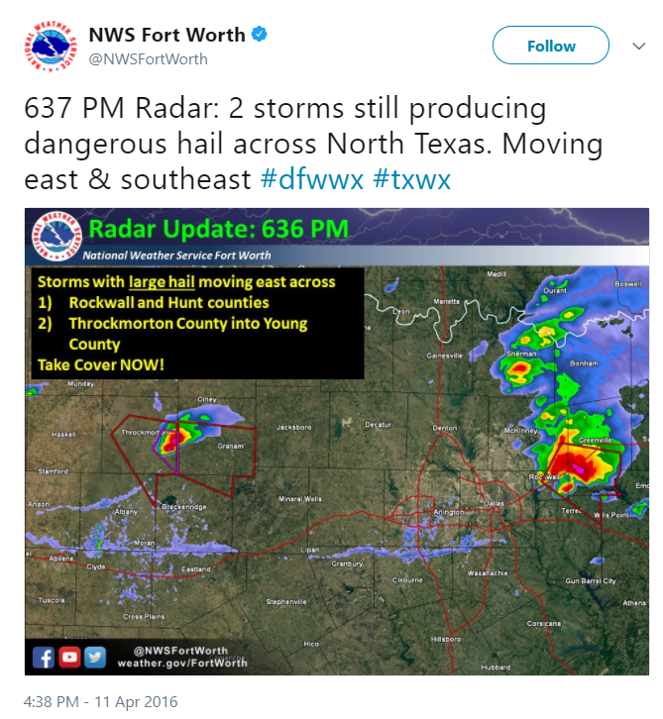
Engagement Content Categories: information
Forecast: (α = 0.94)
Weather in the future
Nowcast: (α = 0.84)
Current and ongoing weather

Slide 12
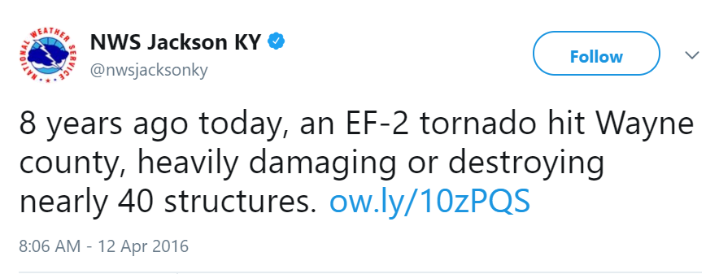
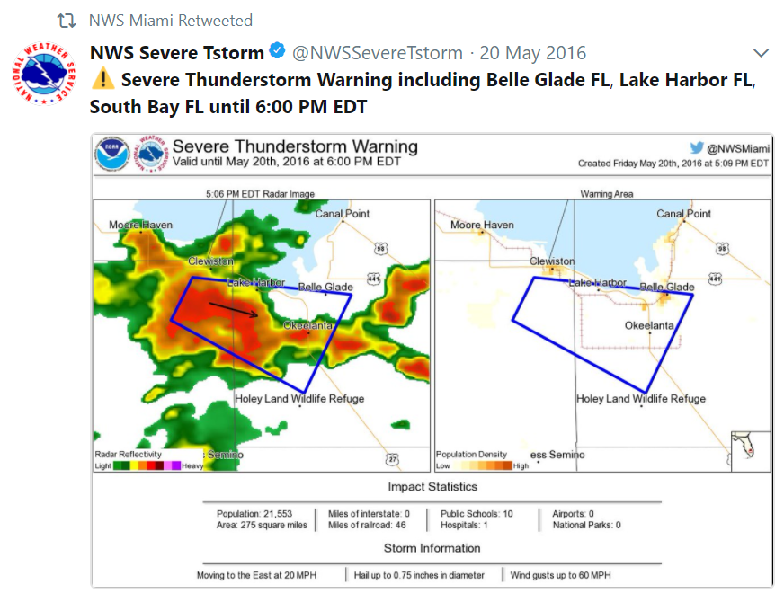
Engagement Content Categories: information
Weather facts: (α = 0.91)
Historical weather data and fun facts
Weather products: (α = 0.94)
Issued, continued, renewed, or cancelled products

Slide 13
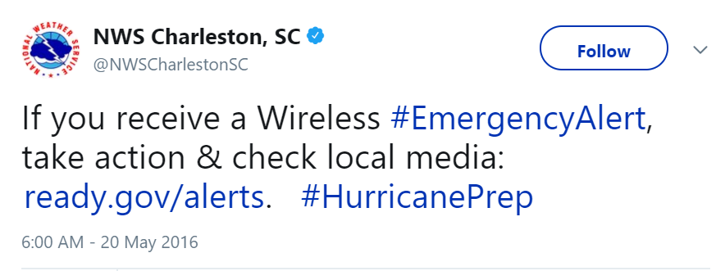
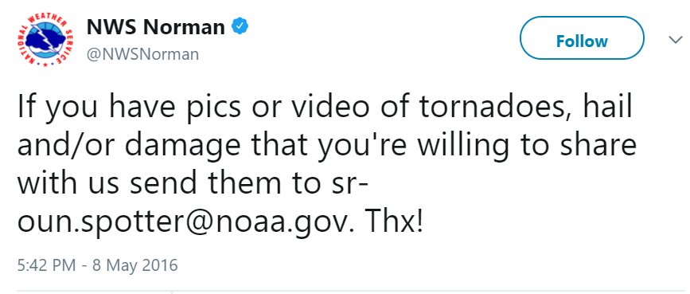
Engagement Content Categories: community and action
Action: (α = 0.94)
Messages that tell people to do something
Community: (α = 0.84)
Messages about classes, volunteering, local office info.

Slide 14
Engagement microstructure features in social media
Directed messages (@username)
Weblink (URL)
Mentioning other accounts (@username)
Retweeting other accounts (RT)
Hashtags (#wx)
Media attachment (photo, graph, map, video, audio)
Sentence style (!, ?)

Slide 15
We matched NWS products to the timing of Tweets from each NWS office
Non-Threat: no active watch, warning, or emergency products in the WFO CWA. There could be a statement or an advisory.
Threat: active watch or warning issued in the area for any hazard type.

Slide 16
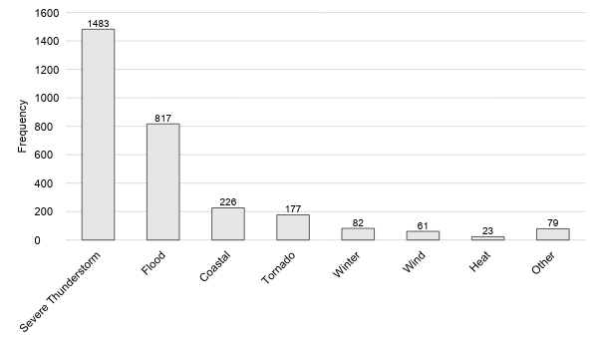
Thunderstorm was the most frequent hazard for which products were issued.
Notes:
This represents ALL products, not just watch and warning.

Slide 17
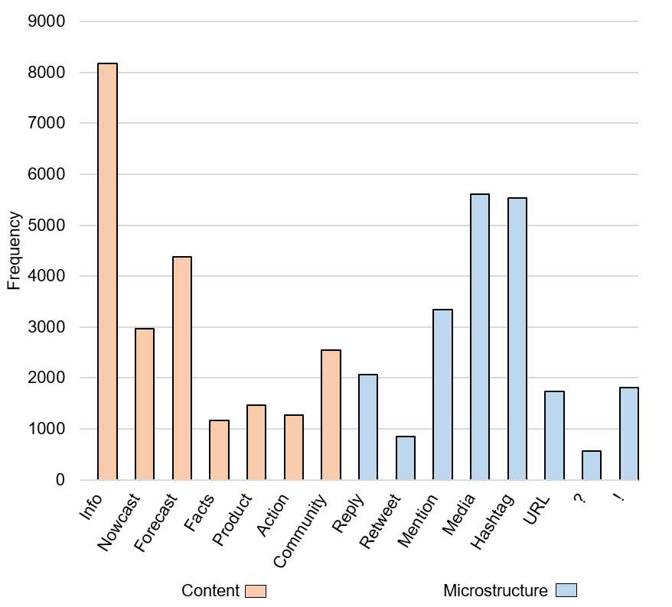
Weather information, which includes forecast, was most frequently posted content.
Media and hashtags were frequently employed microstructures.
Notes:
What are offices tweeting about?
Mainly providing information. Lots of forecast info.
Followed by building community.
Product content – lots of automated posts.
How are they tweeting?
Inclusion of media and use of hashtags – great!
We know that the inclusion of a media does XYZ. When you have limited space to convey something in writing, this is a good strategy!
The use of a hashtag does XYZ.
Mentions and replies – there’s a lot of dialogue going on here and it shows that NWS is monitoring the twittersphere and mentioning other accounts.

Slide 18
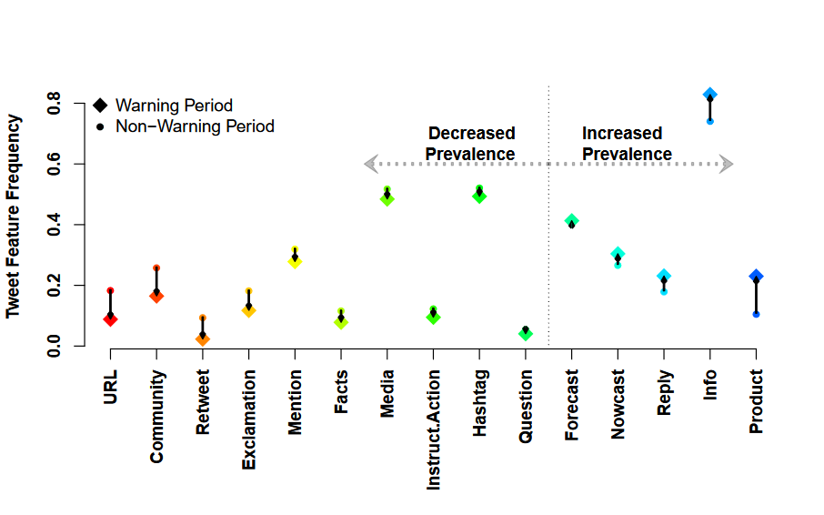
How do engagement strategies differ by time?

Slide 19
Community engagement content differs by time

Slide 20
Instruction/action engagement content differs by time

Slide 21
Weather Information engagement content differs by time

Slide 22
Microstructure use differs by time

Slide 23
Sentence structures differ by time

Slide 24
Putting it into practice
Engagement is a longitudinal strategy
When no threat – offices focus on fostering community. In addition to sharing forecasts, this is the time to talk about historical events, provide science education, personalize perceptions of the office, encourage preparedness action through education.
Threat – offices provide relevant info. And reply to questions if possible.

Slide 25
Is sharing info an engagement strategy?
“engagement as interaction” – fails to see that information can play a role in building community and inciting action.
Engagement is a hierarchy of messages
  The public expects info from NWS. Providing it in a time of need increases trust, future interaction.
  This builds a community of followers.

Slide 26



Social media microstructures
Use of hashtags – important because it puts your tweets into a channel of information
    The right hashtag matters – if you are speaking to people who know you versus if you are trying to participate in a breaking event
Inclusion of media – important because it provides additional information that cannot be communicated in 140 (or 360) characters
Mentions & Directed messages – evidence shows that offices are actively monitoring and responding to people during threat periods.

Slide 27
Back to the goal…
Strategy: what I can do or say to affect goal
Goal: change behavior
Tactic: channel
Notes:
I am caring and honest?
I listen? I am open?
We are similar?
I am competent?

Slide 28
Back to the goal
What if persuading people to take action isn’t the only outcome?
There are other things that matter too:
  Reach of messages
  Increased exposure and awareness
  Increased information seeking and sharing
  Reduced uncertainty
  Increased knowledge and understanding
  Maintaining or increasing source credibility
  Aligning risk perception with actual risk
  Increased self efficacy
  Behavior change
These can be accomplished through ongoing communication and are precursors to persuasion.
Notes:
See Seeger et al. A conceptual model for evaluating emergency risk communication in public health.

Slide 29
Questions/Comments?
Jeannette Sutton
Jeannette.sutton@uky.edu
Carter Butts
buttsc@uci.edu

