Slide 1
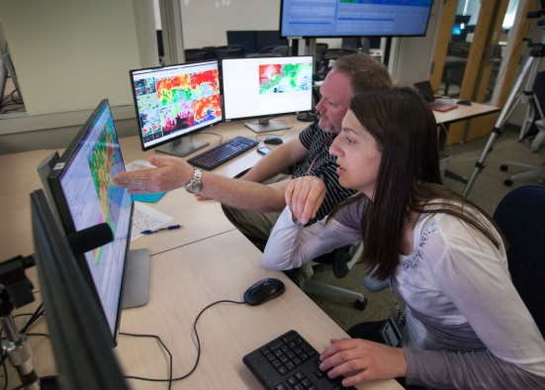
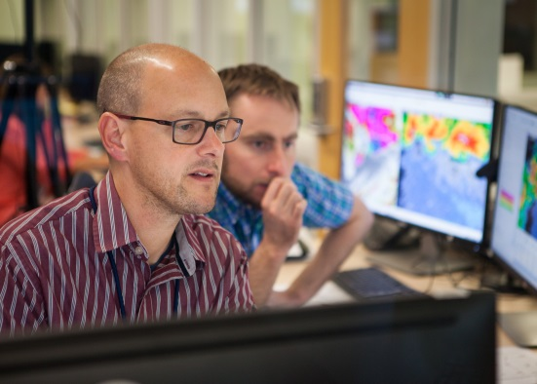
Hazard Services- Probabilistic Hazard Information (HS-PHI) THREE YEARS OF EXPERIMENTS IN THE HWT
Greg Stumpf
CIMMS / NWS-MDL, Norman, OK
Tracy L. Hansen
ESRL / GSD, Boulder, CO
With: Alyssa Bates, Chris Golden, Yujun Guo,
Joe James, Darrel Kingfield, Jim LaDue, Chen Ling, Kevin Manross, Tiffany Meyer
Notes:
‹#›

Slide 2
BACKGROUND: FACETs and PHI
Forecasting A Continuum of Environmental Threats (FACETs)
A next-generation severe weather watch and warning framework that is modern, flexible, and designed to communicate clear and simple hazardous weather information to serve the public.
Probabilistic Hazard Information (PHI)
Rapidly-updating probabilistic hazard grids.
PHI can be used to provide custom user-specific products that can be tailored to adapt to a variety of needs – for example, providing longer lead times, at lower confidence, for more vulnerable populations with a lower tolerance for risk.

Slide 3
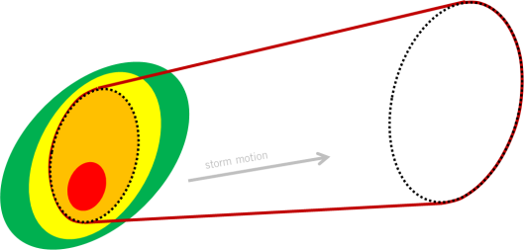
Warnings versus PHI
Track areas, not points or lines.
Uses motion uncertainty (swath width)
Addition of probabilistic trend, with limit of predictability (0% or background prob)
Durations can exceed typical warning durations for long-tracked events.
Define and edit object attributes - WE DON’T EDIT GRIDS
Threat area location at time=0, motion vector, motion uncertainty, duration, forecast probability trend
Nudging objects
Replaces SVS process
Threats-In-Motion (TIM)

Slide 4
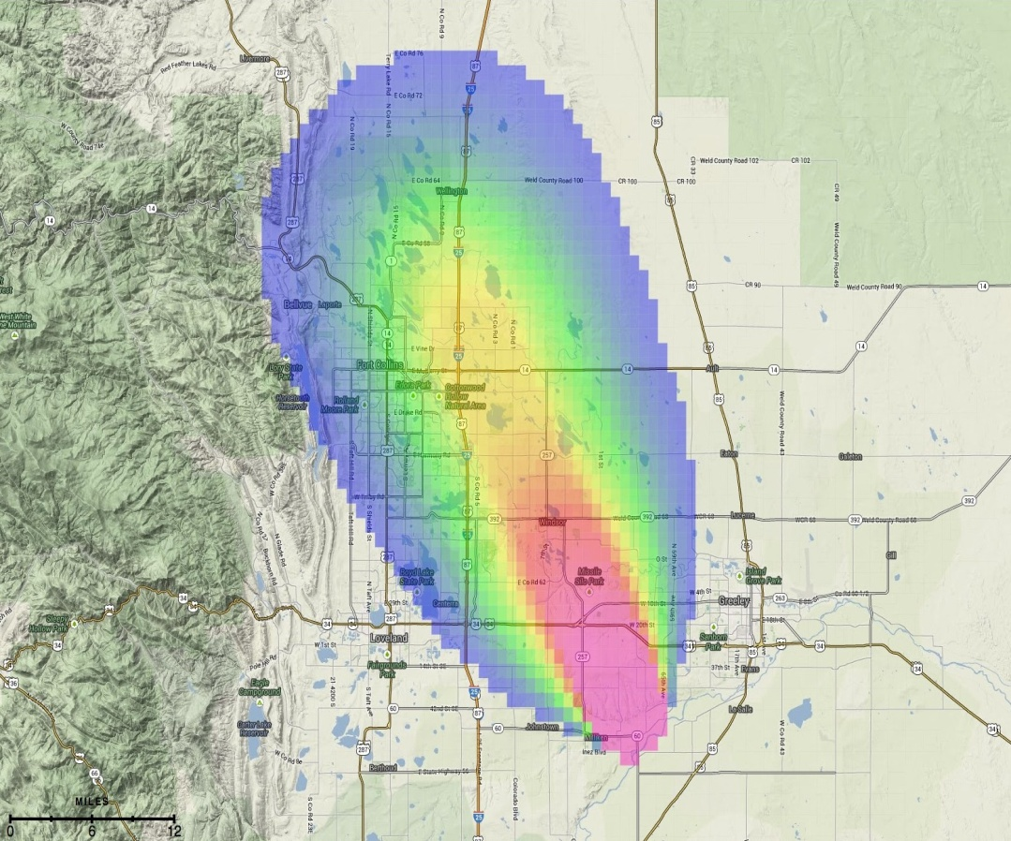
Adaptive warnings from PHI
30-Minute Threat: Tornado Probability
Valid 11:00 a.m. - 11:30 a.m. MDT
_{Last updated: 6 minutes ago}
Evolution from product-centric to information-centric paradigm:
Probabilistic Hazard Information (PHI): forecasters convey threat probability on grids using a new threat management tool.
_{Proximity Alert}
Legacy products (warnings/watches) result from pre-determined thresholds (probability and/or time of arrival) applied to binary decision-making.
Opens the door for new products and services – such as low-probability longer lead time warnings for high risk users who have greater tolerance to high false alarm ratios.
_{Legacy Warning}

Slide 5
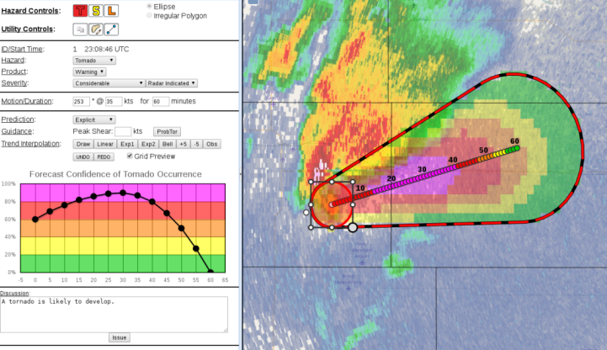
PHI Evaluation History in the Hazardous Weather Testbed (HWT)
PHI Tool Evolution:
First NSSL PHI prototype tests using Warning Decision Support System II (WDSSII), tested in 2007, 2008.
Second modern NSSL PHI Prototype using a web browser-based design, tested in 2014, 2015, 2016, 2017.
Look and feel based on AWIPS2 Hazard Services
Integrated user component with Emergency Managers and TV broadcasters using the Enhanced Data Display (EDD) to display custom products derived from PHI.
USWRP Grant: Developed initial capability in AWIPS2 experimental Hazard Services – PHI (HS-PHI) using PHI Prototype as a guide, tested in 2016-2018.

Slide 6
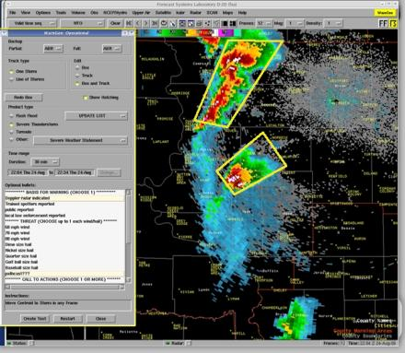
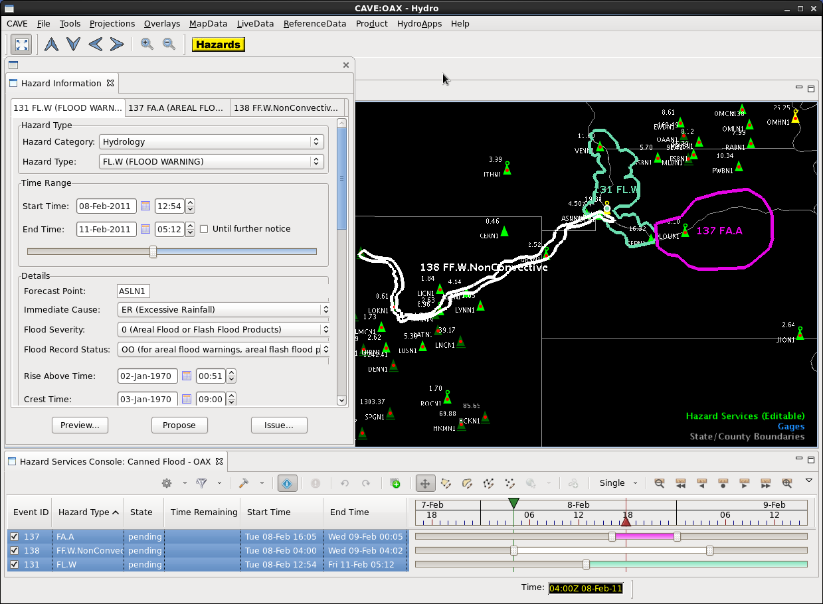
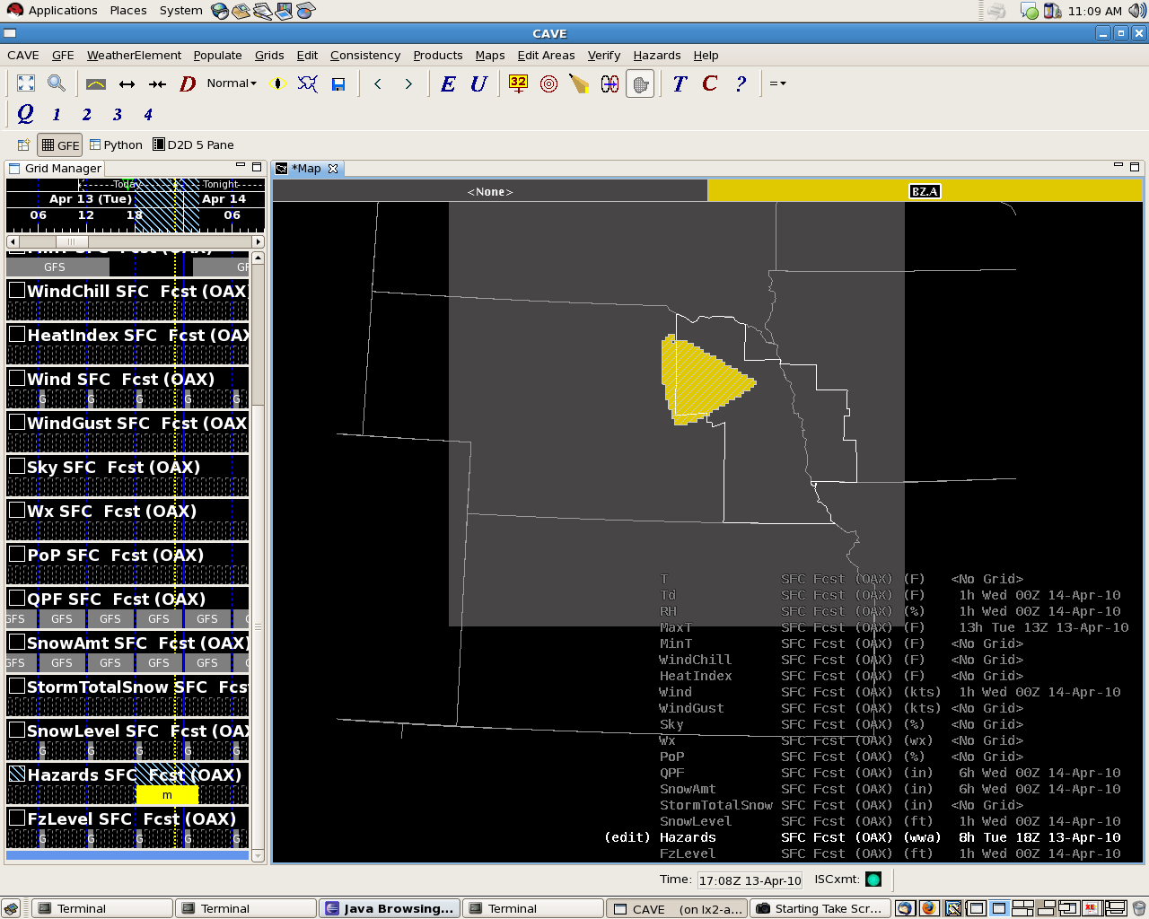
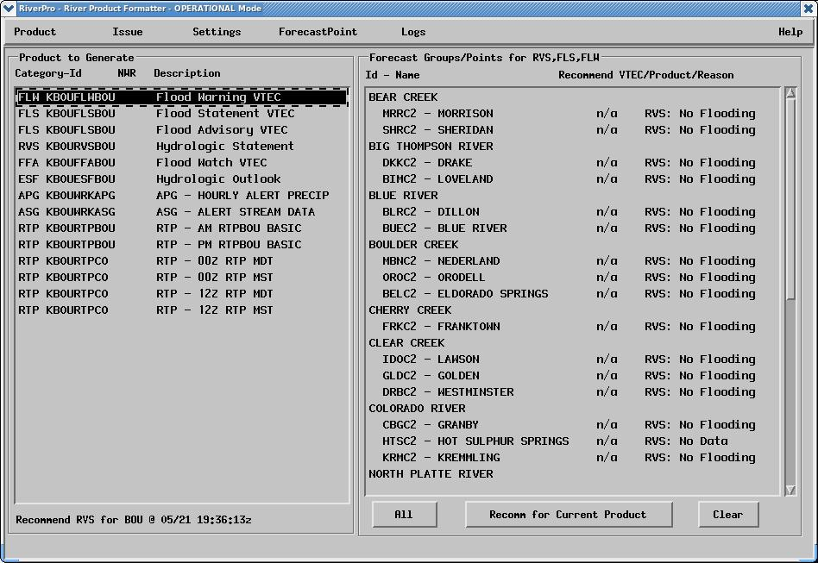
Hazard Services: Unifying Legacy Applications
_{WarnGen}
_{(<1 hour)}
_{Graphical Hazard} _{Generator}
_{(Hours, Days)}
_{RiverPro}
_{(Days)}

Slide 7
PHI in Hazard Services (HS-PHI)
Spatial Display
Hazard Information Dialog (HID)
Console

Slide 8
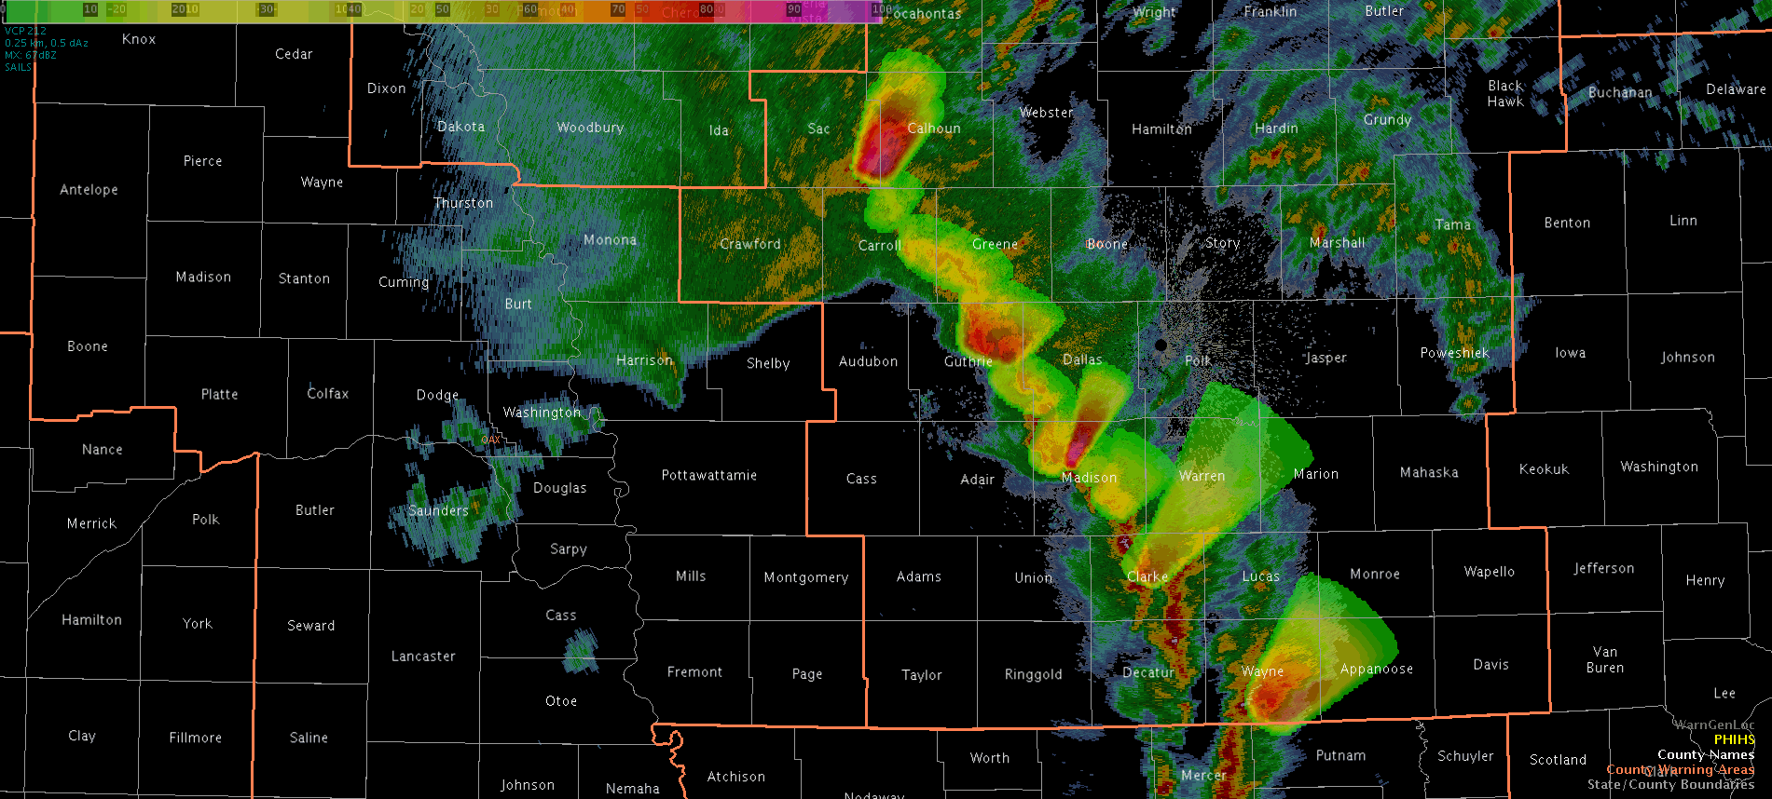
PHI Output Grids in AWIPS2

Slide 9
Cross-Organizational Team
MDL -- Experimental Design coordinator, Product Owner writing Functional Tests and prioritizing tasks. Conduit between PHI Prototype and PHI into Hazard Services / AWIPS / Operations. PHI visionary.
GSD -- Software design and development, integration with AWIPS, Hazard Services concepts, and VLab.
Forecasters -- Trying new paradigm, input from operation perspective, feedback on improving software, concepts, and process, O2R
NSSL -- FACETs concept and collaborations, IT support, Hazardous Weather Testbed facility, overall management of the grant / funding, future funding
WDTD -- Development of the Training including future operational use and best practices
University of Akron -- Human Factors

Slide 10
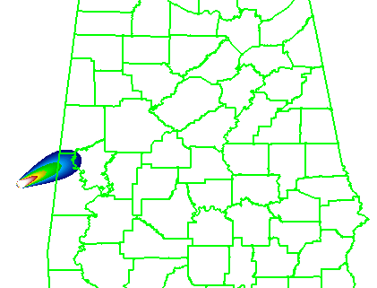
HS-PHI HWT Experiment Objectives
Technology: Evaluate HS-PHI components and performance so that the software can be improved before operational implementation.
Human Factors: Measure forecaster workload using HS-PHI, including ease of use and graphical design.
Methodology: Assess how forecasters adopt and evolve their current warning methodology into the HS-PHI environment, including evaluating the human-machine mix with automated ProbSevere guidance.
Conceptology: Collect and analyze data on forecasters’ thoughts on the paradigm change from deterministic warning products to probabilistic hazard information.
_{“Threats-In-Motion (TIM)”}

Slide 11
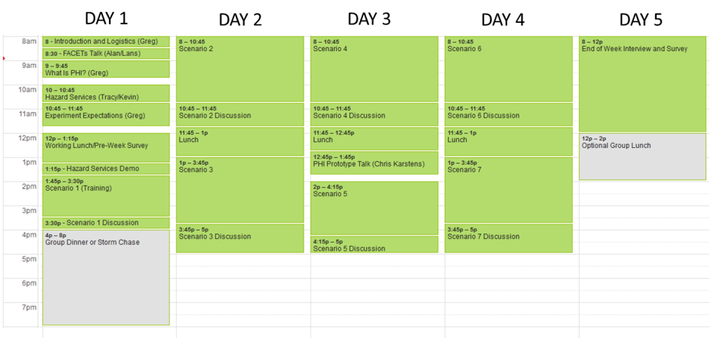
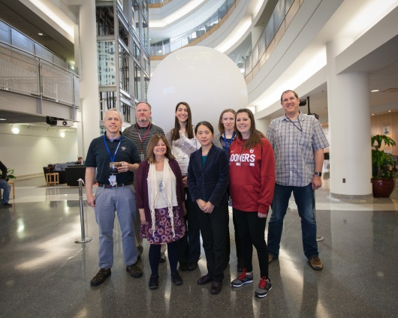
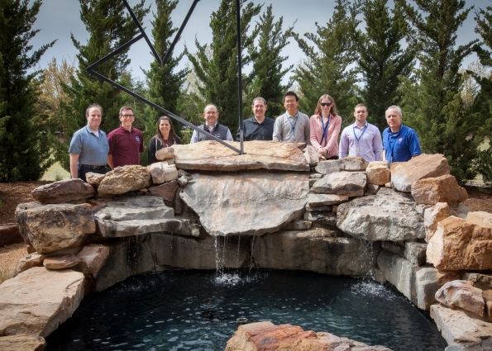
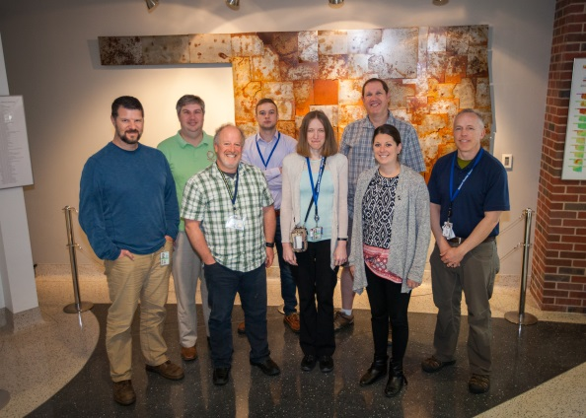
HS-PHI 2016-2018 HWT Experiments
2016-2018 Operations Weeks:
Three weeks per year (Mar-Apr).
2 forecasters per week.
18 WFO forecasters have participated from 5 of the 6 NWS regions.
Training materials hosted by Virtual Lab Collaboration Services

Slide 12
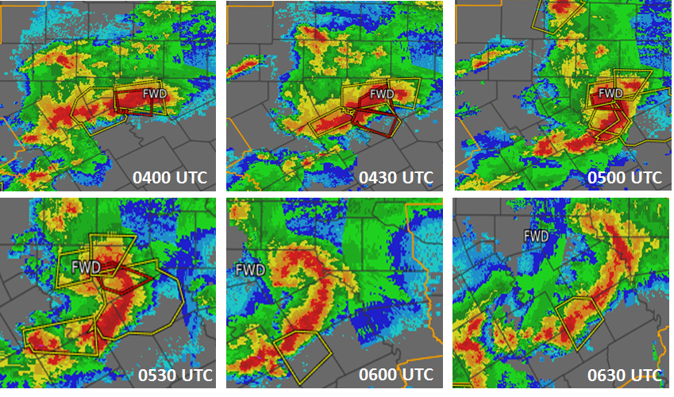
Displaced Real-Time Scenarios
Isolated marginally severe storm
Provide forecasters with basic concepts of PHI
Developing supercell
For continued practice with PHI and object nudging.
Merging/splitting supercells
Dealing with many events in very close proximity
Quasi-Linear Convective System Tornadoes
Multiple-scale PHI
Low-Shear Summer Southeast Microbursts
Random slow motion
Upscale growth to squall line
Merging objects to larger objects
Mature supercells
To study issues with cross-forecast area collaboration
_{CWA 1}
_{CWA 2}

Slide 13
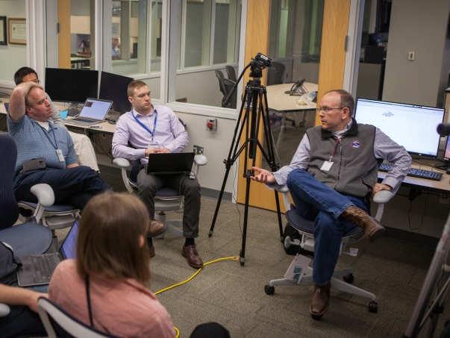
Human Factors Data Collection
Pre-operations survey
Internal probability thresholds, ProbSevere use, WFO warning team composition, forecasters’ ideas for warning improvement
Live video of forecasters, desktops, and group discussions
Discussions during events with meteorologists, developers, trainers, and human factors scientists
Post-event survey/discussion (60 minutes each)
NASA Task Load Index (TLX) Mental Workload Survey
Mental Demand, Physical Demand, Temporal Demand, Performance, Effort, Frustration
Confidence Survey
End-of-Week Discussion (Friday)
Post-Study Usability Survey
Long Interview touching on the four main objectives
Technology, Human Factors, Methodology, Conceptology

Slide 14
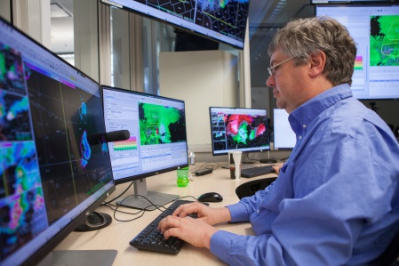
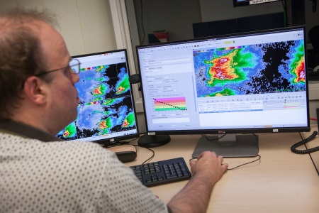
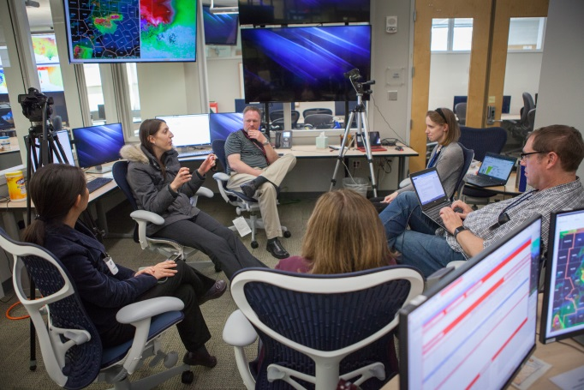
Forecaster contributions
Visiting forecasters provided suggestions to improve the software.
These suggestions are triaged to determine if they can be:
Incorporated into HS-PHI directly
Incorporated into both the PHI Prototype and HS-PHI
Require proof-of-concept testing in the PHI Prototype first.
Forecasters helping to formulate operational best practices – WDTD integration.

Slide 15
Recent Development Progress
The 2015 version of NSSL PHI Prototype is our current benchmark.
New systematic software releases and virtual functional testing resulted in better progress and improved stability each subsequent year.
Recent new functionality added:
Convective Recommender
Processes ProbSevere detections into Hazard Services – PHI objects.
Levels of Automation
Forecasters can create manual objects.
Forecasters can assume partial or full control of automated objects, and relinquish control back to automation one attribute at a time.
New object drawing tools: ellipses, rotation, resizing
Buffering of commands for quicker responsiveness
Ownership of hazard objects and locking (first step in collaboration tools)
Better drawing colors to enhance visibility of objects on radar data

Slide 16
Findings
How will we effectively extract legacy warnings from a continuously-updating probabilistic grid?
Probability thresholds?
Time-of-arrival thresholds?
Forecaster decision points?
It will be a challenge to blend probabilities at the storm scale with those from the SPC outlook scale, since they exist from different reference classes.
Cross-WFO collaboration and object handoff will require significant analysis of inter- and intra-office culture.

Slide 17
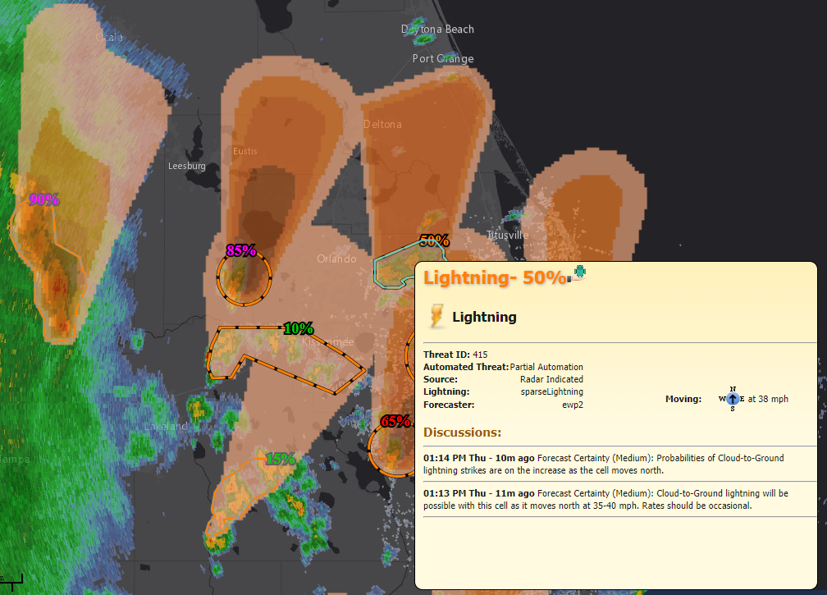
Joint Technology Transfer Initiative Funding: Year 1
We have been granted additional funds via JTTI to begin the incorporation of new functionality:
Intermediate “Threats-In-Motion” warnings (without PHI)
Warning product generation
Lightning PHI
Another JTTI grant for Cross-WFO Collaboration funded for 2019-2020:
Field surveys.
Additional collaboration tools.
HWT experiment.
_{Threats-In-Motion (TIM)}

Slide 18
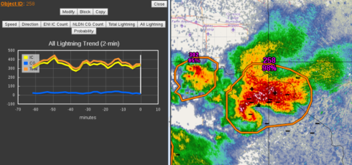
JTTI Years 2 and 3: Path to operations
Addition of new functionality informed by PHI Prototype during 2016-2017 tests)
Addition of new science as developed in companion JTTI proposals:
New probabilistic plume model
New storm object ID and tracking model
Improved probabilistic guidance
HWT spring experiments to include users (EMs, etc.)
Testing at Operations Proving Ground and some WFOs
Policy and paradigm shift to make FACETs operational

