Slide 1
What’s Up with WSUP
David Ruth, Dana Strom, David Miller,
Kevin McGrath, Tim Kempisty
1/21/2021

Slide 2
What WSUP Has Now
NBM forecast products from version 4.0 for CONUS, Alaska, Puerto Rico, Hawaii, and Oceanic domains
GEFS Bias Corrected forecast products for CONUS, Alaska, and Tropical Pacific domains
NBM component visualization for temperature, winds, sky cover, and precipitation at predefined points
GEFS point visualization for temperatures (surface and some upper levels), RH, and precipitation
Second slider for dProg/dt mode and categories in plan view
dProg/dt mode in point visualization
Optional wind barbs and contours with flexible zoom reveals available for NBM and GEFS
Notes:
Double click the second slider to load all hours of categorical elements
If there is time, may want to show how the zoom reveals work for wind barbs and contours.

Slide 3
A More Detailed Look at Point Visualization
Inspecting and interpreting data
Hovering techniques
Utilization of the wind rose and violin plots
dProg/dt mode allows users to inspect components, members, and quantiles for a specific valid time. This allows users to see how the range of possible solutions is evolving.
NBM quantiles are now available for maxT, minT, QPF at 00z, 06z, 12z, 18z

Slide 4
WSUP Next?
More GEFS elements in WSUP point visualization and plan view
“Likelihood to achieve” graphs (Greg Mann)
NDFD for comparative purposes
Weather-in-context (WPC)

Slide 5
What We’re Working On
NBM 1D at any grid point
Coordinated with NBM 1D Team (Travis Wilson, Ryan Walsh, William Rasch, Jebb Stewart, Rob Howlett, Dan Nietfeld, Drew Peterson) to obtain and interpret the NBM 1D visualization code.
Worked with internal MDL/WIAD developers Shane Mill, Jason Burks, and Steve Olson to utilize NWS instance of the Environmental Data Retrieval-Application programming interface (EDR-API) and backend datastore they developed that allows quick access to all the data in an n-dimensional array at a single geographical location
Developed by a partnership with MDL/WIAD and UKMET
The backend storage are Zarr datastores packed with the raw GRIB2 data organized by xarray and chunked to optimize a query that will return all weather elements from one lat/lon
GRIB2 data is processed such that the resulting datastore contains all the weather elements and valid times are organized into 128x128 pixel chunks. This is to reduce the amount of data needed to be read when querying for a single point.
Needed to balance processing time and query read speed
Will be available for all grid points in all NBM domains
Notes:
EDR API:
Purpose to make web coverage service more easily implemented and flexible
WCS is only for polygons - EDR-API can request point, multipoint, polygon, and return the data in many different output formats including JSON, XML, etc.
Open API specification - EDR-API service with open api specification
Metocean community
UKMET / MDL partnership to develop the EDR-API

Slide 6
What We’re Working On (cont.)
NBM 1D at any grid point
Space necessities:
Approximately 415 GB/NBM version/day for our datastores as compared to 575 GB/NBM version/day for the raw GRIB data
Data is saved on a Lustre instance mounted to the EDR-API instance
Data returned to user per click is <~1 MB for all weather elements (low bandwidth-friendly)
All-element data query returns in ~5 seconds

Slide 7
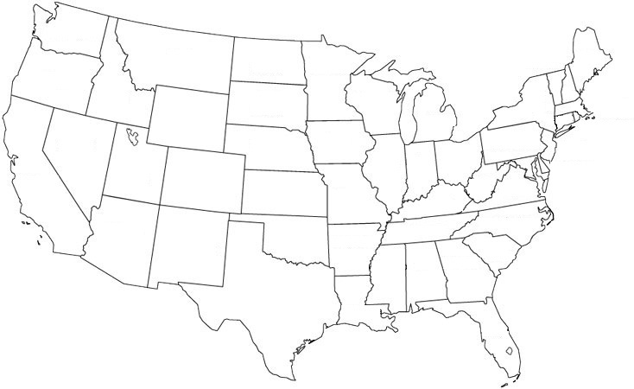
1D Query Optimization

Slide 8
Organize data into 128x128 pixel chunks

Slide 10
Zarr Datastore Details
API returns JSON used for plotting
temp
dew
wspd
wdir

Slide 11
1D Demo

Slide 12
Backup

Slide 13
Wind Rose and Violin Plots

Slide 14
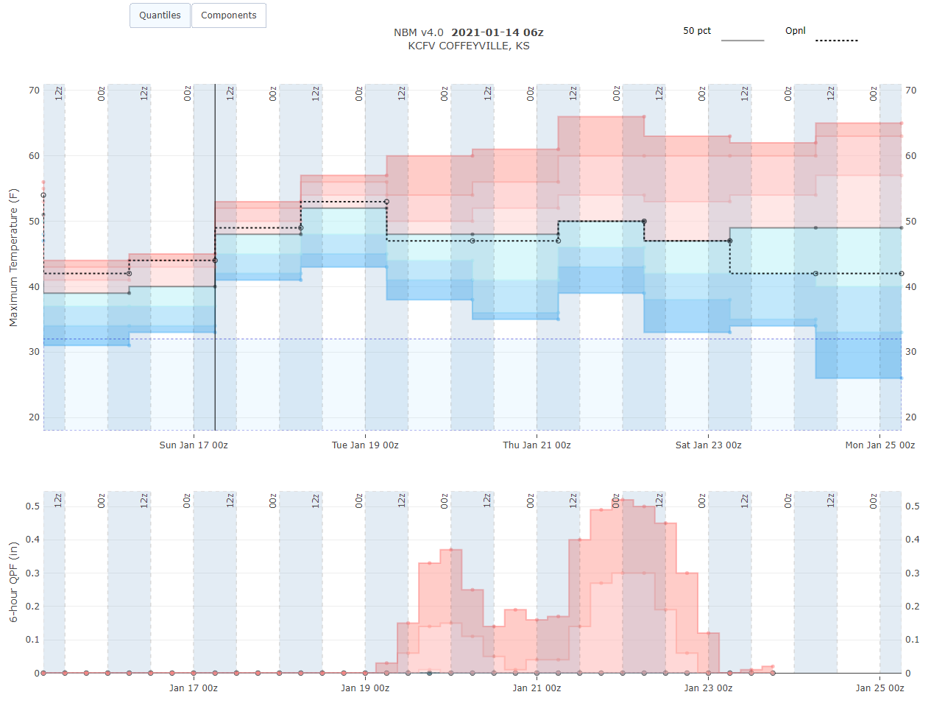
QMD Quantiles for Max T, Min T, and Precip

Slide 15
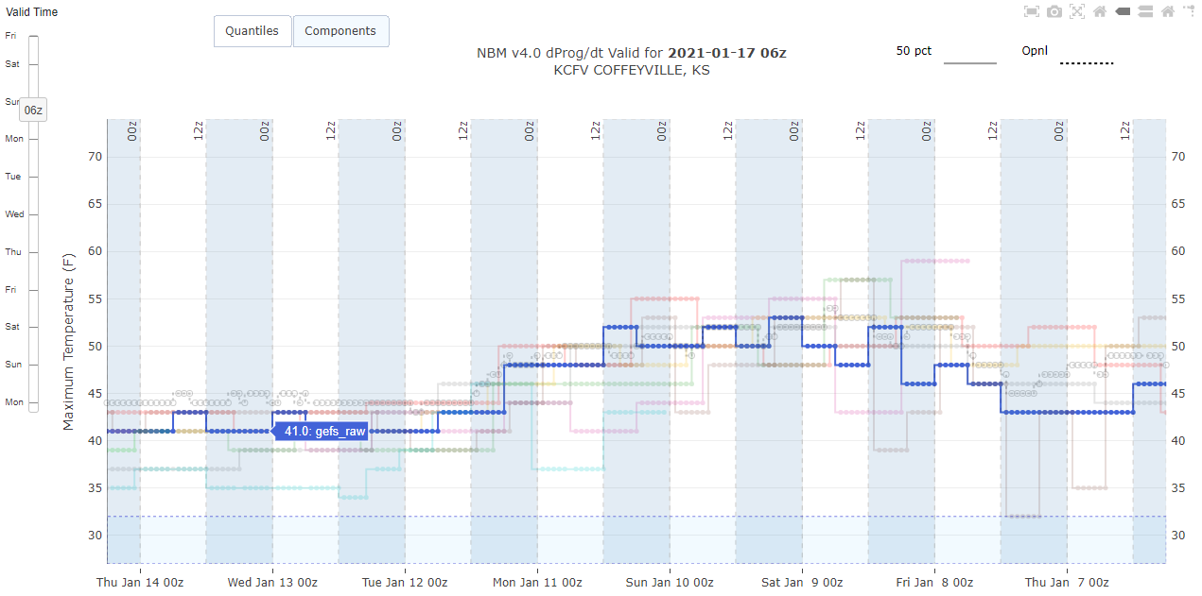
dProg/dt

Slide 16
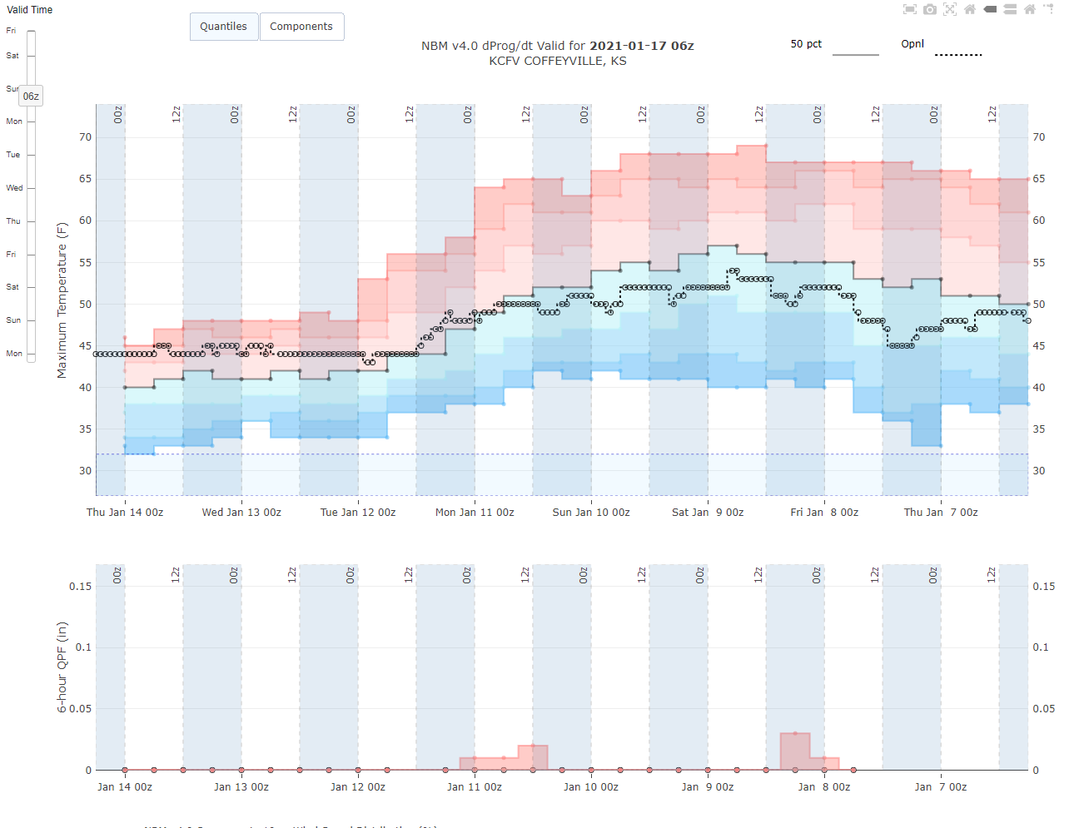
dProg/dt of Quantiles

