Slide 1

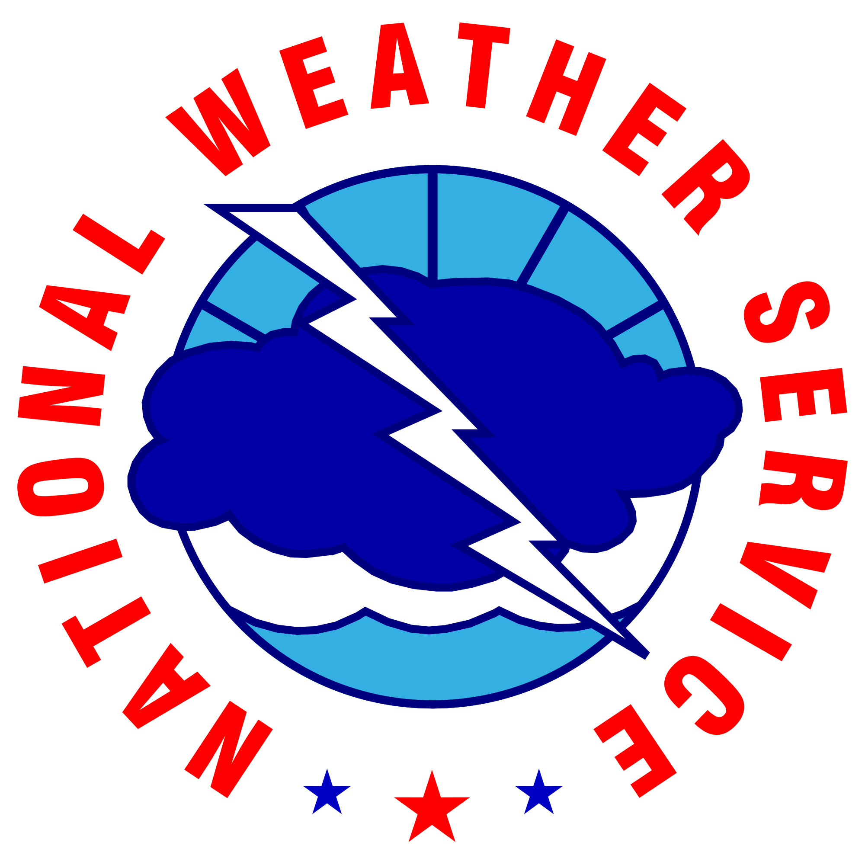
Status Update of the
Extreme Precipitation Forecast Improvement Project
Diana Stovern Ph. D.
CIRES/WPC/NWS
Notes:
Welcome everyone! I’m here on behalf of the project team to present our updates on an STI funded program call the Extreme Precipitation Forecast Improvement Project.

Slide 2
Introduction
What is the Extreme Precipitation Forecast Improvement Project?
A national team consisting of WPC-leadership, NWS Science and Operation Officers (SOOs), and RFC representatives tasked by the Office of Science and Technology Integration (STI) to work projects that help improve predictions and Impact-based Decisions Support Services (IDSS) associated with extreme precipitation events.
Primary Goal: Improve IDSS by increasing forecaster situational awareness leading up to an event.
Notes:
I’m Diana Stovern, and I’m a research meteorologist contracted by WPC to take the team’s project ideas and integrate them into a set of operational tools.
The primary goal these tools are to improve SA and IDSS of extreme precip events.
That means leveraging current software and datasets available to forecasters to help them identify when extreme rainfall is a threat, and help convey the extent of risk to their partners and the public. .

Slide 3
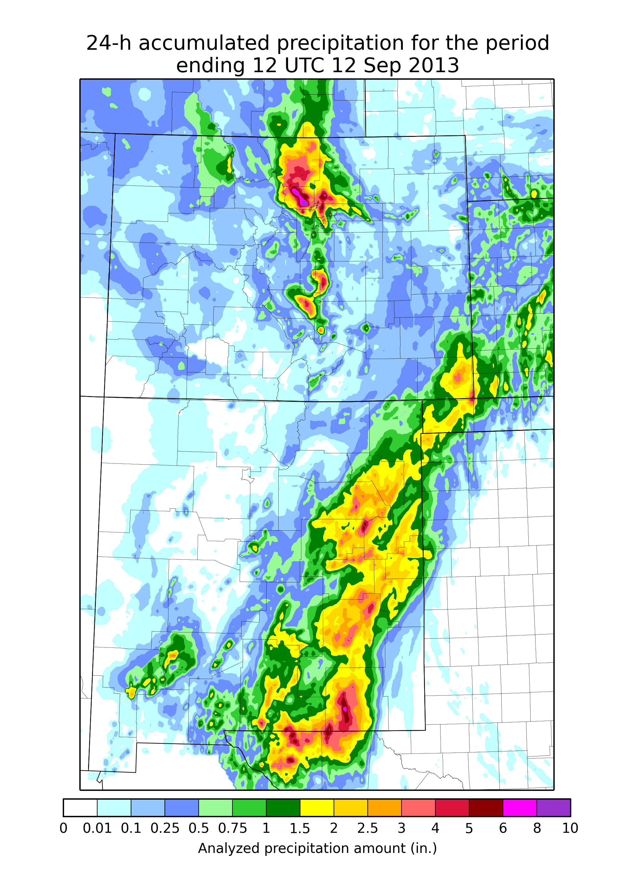
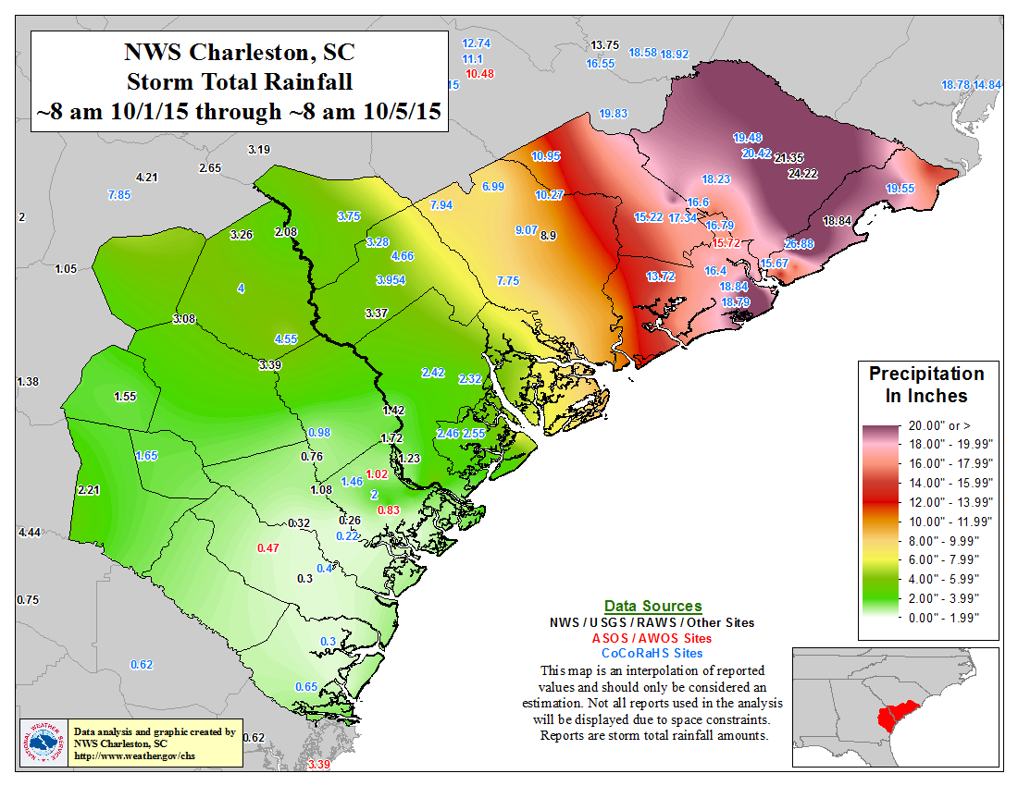
Motivation
NWS Service Assessments conducted after high-impact precipitation events consistently highlight weaknesses in situational awareness, IDSS, collaboration and communication.
Southeast 2009 assessment:
“FFG was eventually exceed by 900%, but forecasters had limited historical context or tools to utilize to help put this information into impact perspective.”
Front Range 2013 assessment:
“There was limited direct coordination regarding rainfall potential and flash flooding potential between WPC and the impacted WFOs and RFCs prior to this event.”
South Carolina 2015 assessment:
“Information shared from WFOs directly to the public did not convey the full extent of risk”
Notes:
This motivation behind this project comes from numerous NWS service assessment that have highlighted deficiencies in how WFOs and WPC have communicated the full extent of risk of a high-impact rain event with their partners and the public.

Slide 4
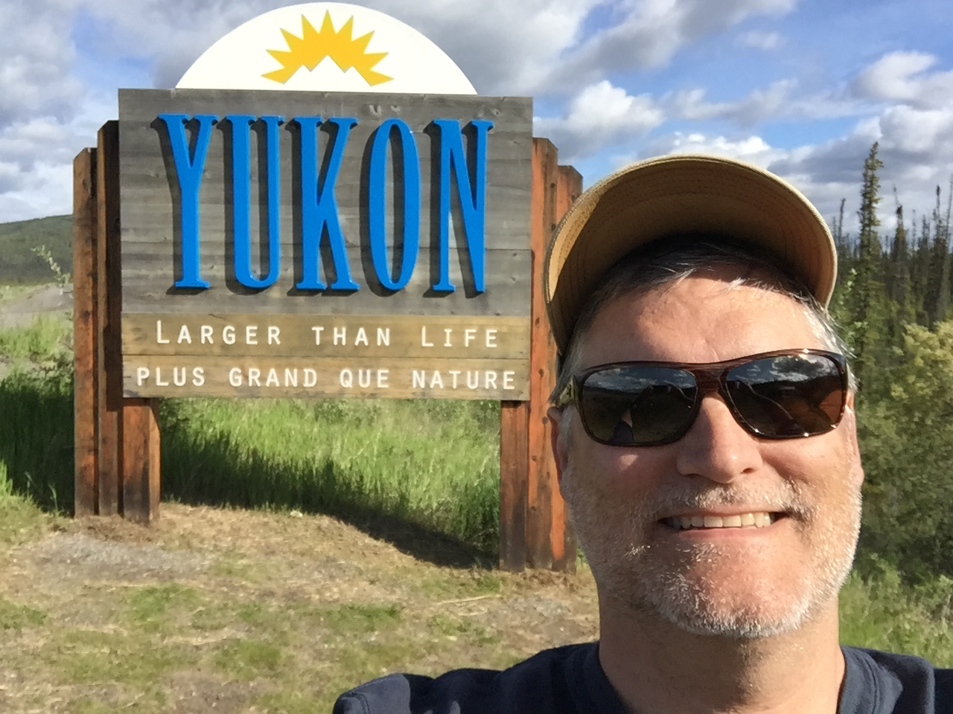
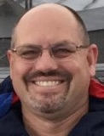
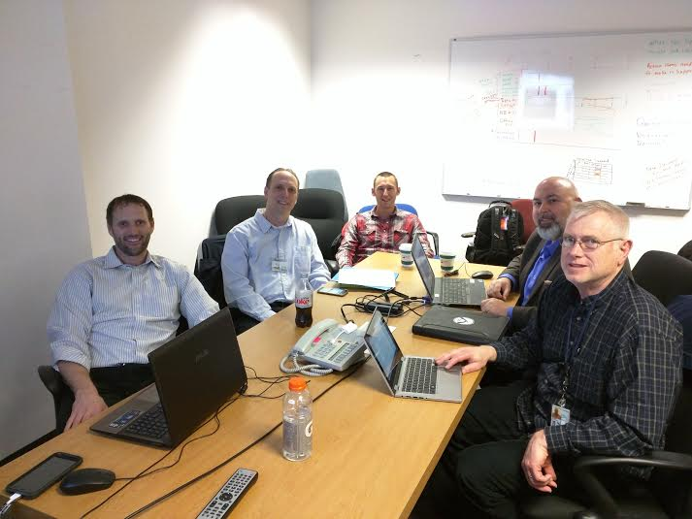
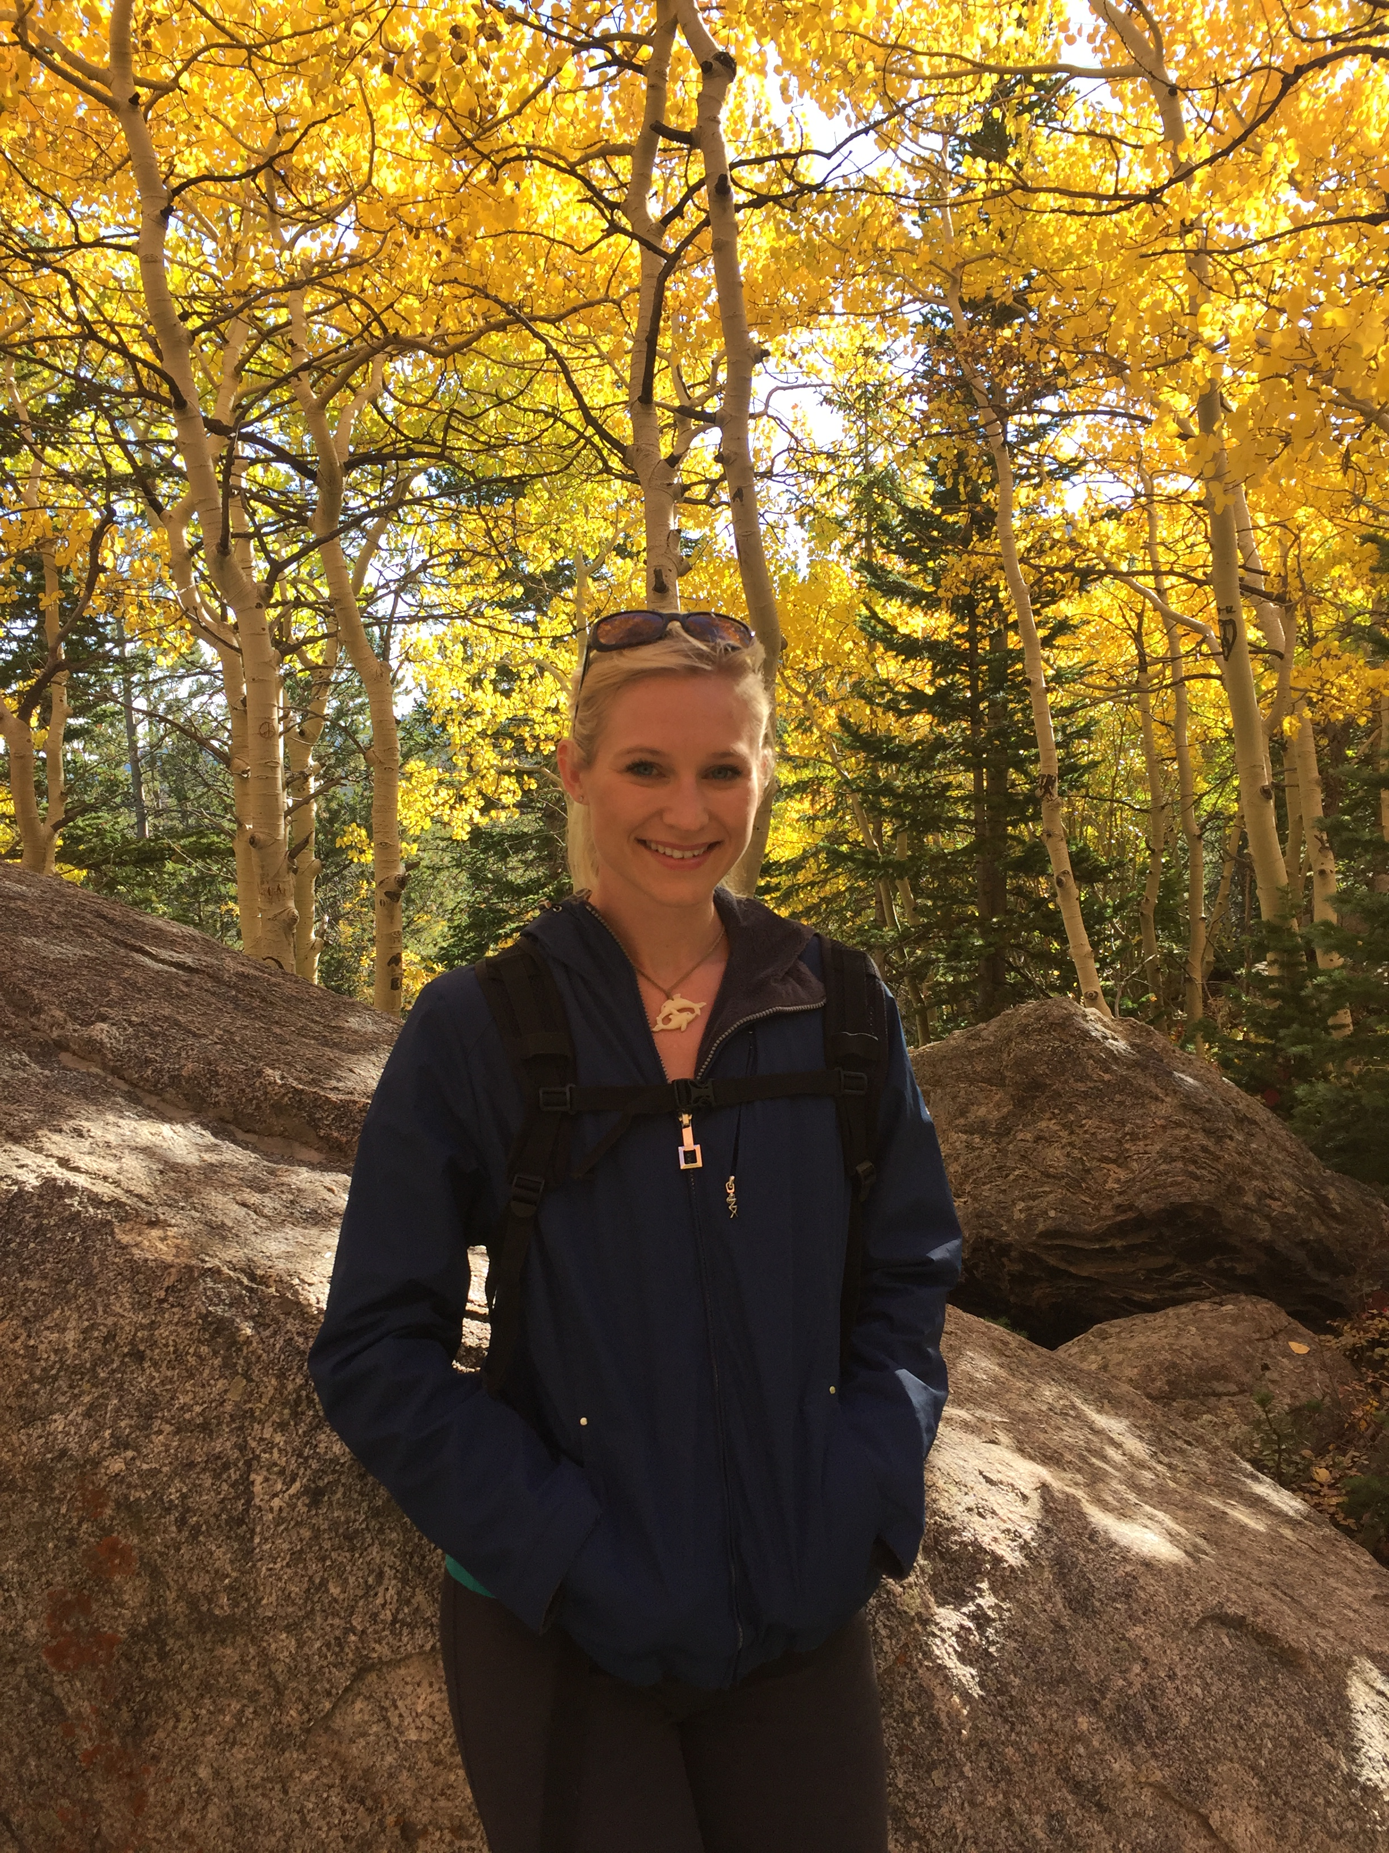

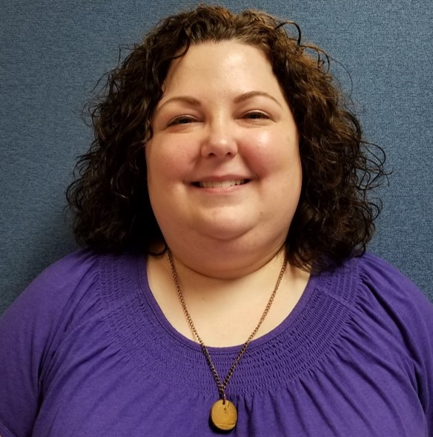
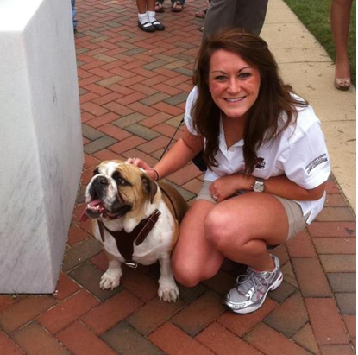
Meet the Extreme QPF Collaboration Team!
Aka the “Extreme” Team
Team Leader
James Nelson – DTB Chief
WPC Rep
Mark Klein - SOO
RFC Rep (LMRFC)
Emilie Nipper
Southern Region Reps
Jon Zeitler (SOO-EWX)
Katie Landry (SH – HOU)
Western Region Rep
Stan Czyzyck (SOO-VEF)
Eastern Region Rep
Rich Grumm (SOO-CTP)
Central Region Rep
Dan Miller (SOO-DLH)
Alaska Region Rep
Sam Shea (SOO-AFC)
Stan Czyzyck
(SOO-VEF)
Dr. Trevor Alcott
(alumni ESRL/GSD)
James Nelson
Chief of WPC’s Developmental Testbed (DTB)
Daniel Nietfeld
(alumni SOO-OAX)
Dr. Joshua Scheck
(alumni SOO-BIS)
Jon Zeitler
(SOO-EWX)
Rich Grumm
Alumbni (SOO-CTP)
Dr. Diana Stovern
(CIRES/WPC)
Mark Klein
(SOO-WPC)
Dan Miller
(SOO-DLH)
Katie Landry
(Service Hydrologist
WFO-HOU)
Emilie Nipper
(HAS - LMRFC)
Sam Shea
(SOO-AFC)
Notes:
Our team includes meteorologists and hydrologists from all facets of NOAA directly impacted by this problem; WPC, RFCs, and each SOO-rep from every region.

Slide 5
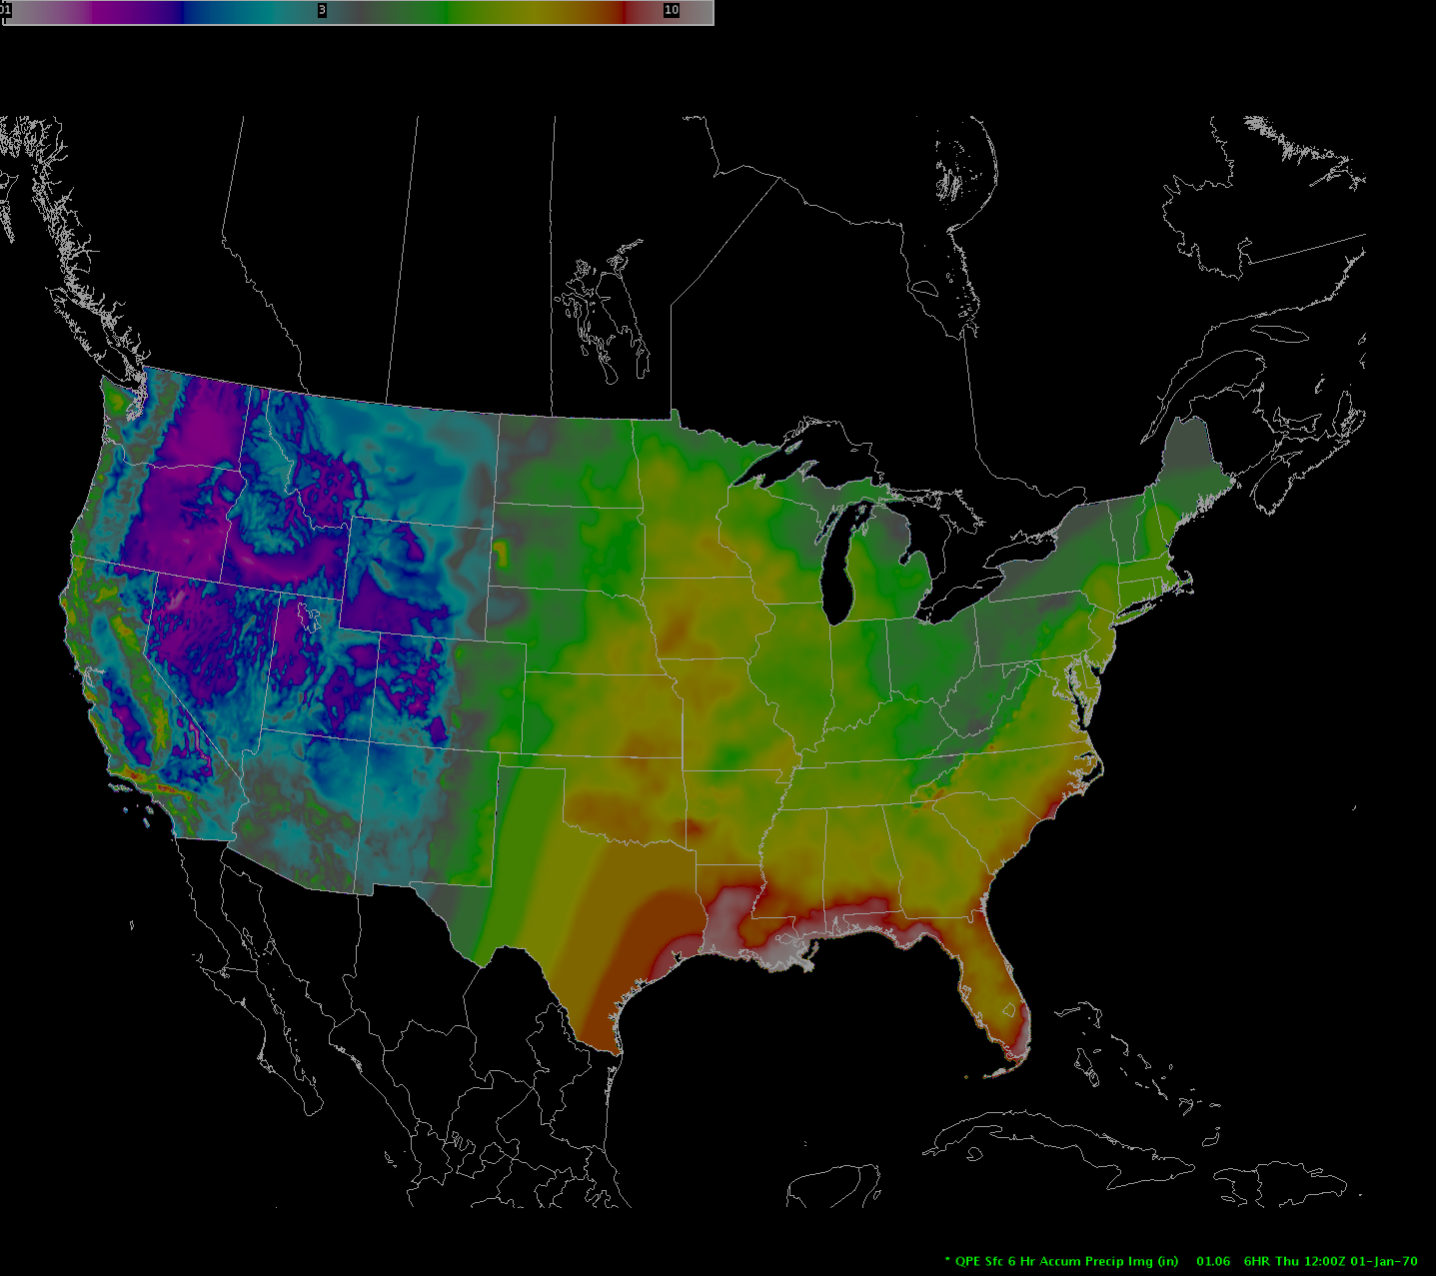
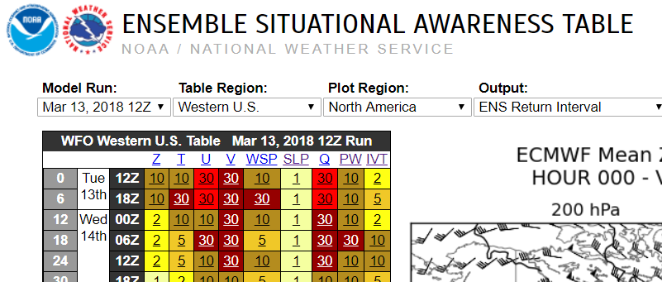
From Collaboration to Operation!
The “R2O” path
Research → Test → Implement → Improve
1. Explore the factors associated with severe flooding from precipitation
100-yr ARI, 6 hr duration
  Climatologically significant rainfall
  Antecedent conditions
Consult experts on extreme precipitation
3. Consider design concept and data sources leveraged
Data sources: NOAA Atlas 14, Atlas 2, Tech Paper 40
Notes:
The team started out the “Research to operations” path by first exploring the factors….
Which can be simplified in terms of climo signific. Rainfall and antecedent conditions…
They consulted with experts on extreme precip both in academia and within NOAA labs…
…and designed a tool concept based off of an SA table that uses climate date to highlight anomalous signals associated with high-impact weather
ESAT showed proof of concept that highlighting anomalies effectively raises awareness to forecasters
Our team wanted to employ a similar concept (based off of Trevor A’s work), using NOAA 14 to highlight anomalous rainfall in forecast

Slide 6
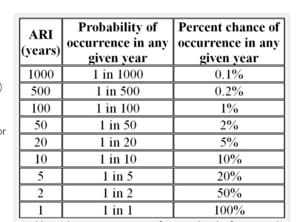
ARI Review
Average Recurrence Interval (ARI)
→ The average or expected value of the periods (years) between exceedances of a given rainfall total accumulated over a given duration.
  Rainfall ARIs ≠ Flooding ARIs
NOAA Atlas-14
→ Most recent, comprehensive dataset providing point-based, precipitation frequency estimates (inches) associated with a given ARI
“AEP”
ARI data can be used to:
  Compare to observations (QPE) and forecasted rainfall (QPF) → measures the rarity or extreme nature of a rainfall event → Ideal for IDSS
Notes:
Before we continue, I want to familiarize the audience with some important concepts I’ll be using throughout this presentation. I’m showing you a situational awareness tool that uses Average Recurrence Interval data to highlight when any piece of forecast guidance is highlighting a potential extreme event in the forecast.

Slide 7
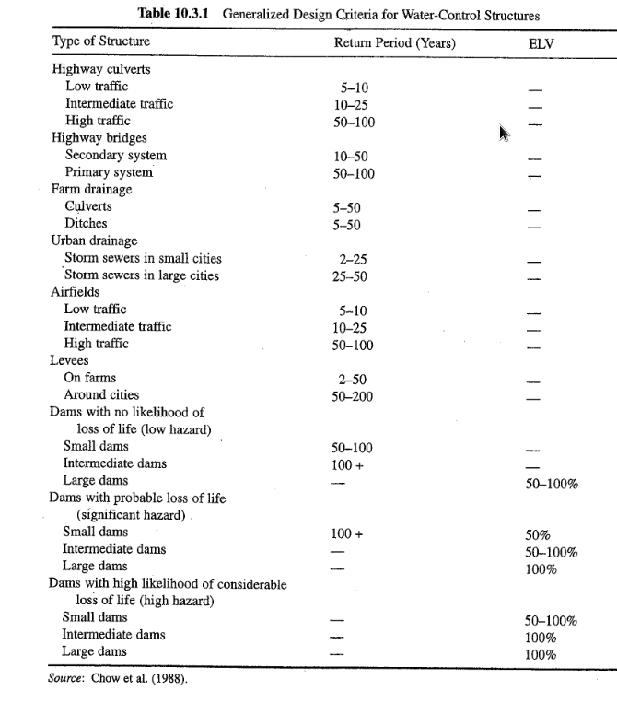
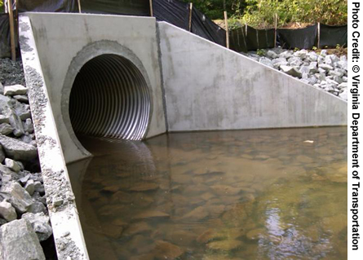
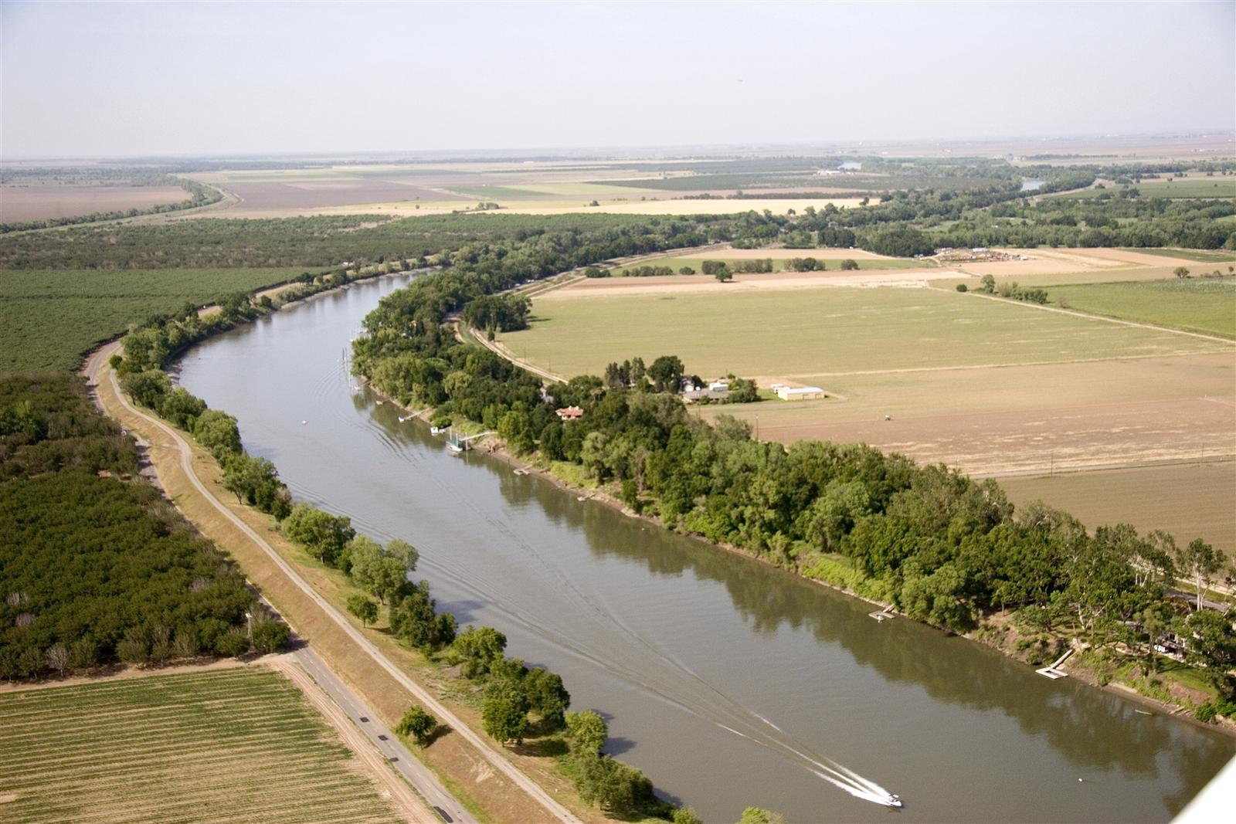
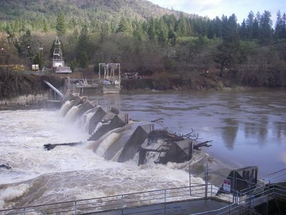
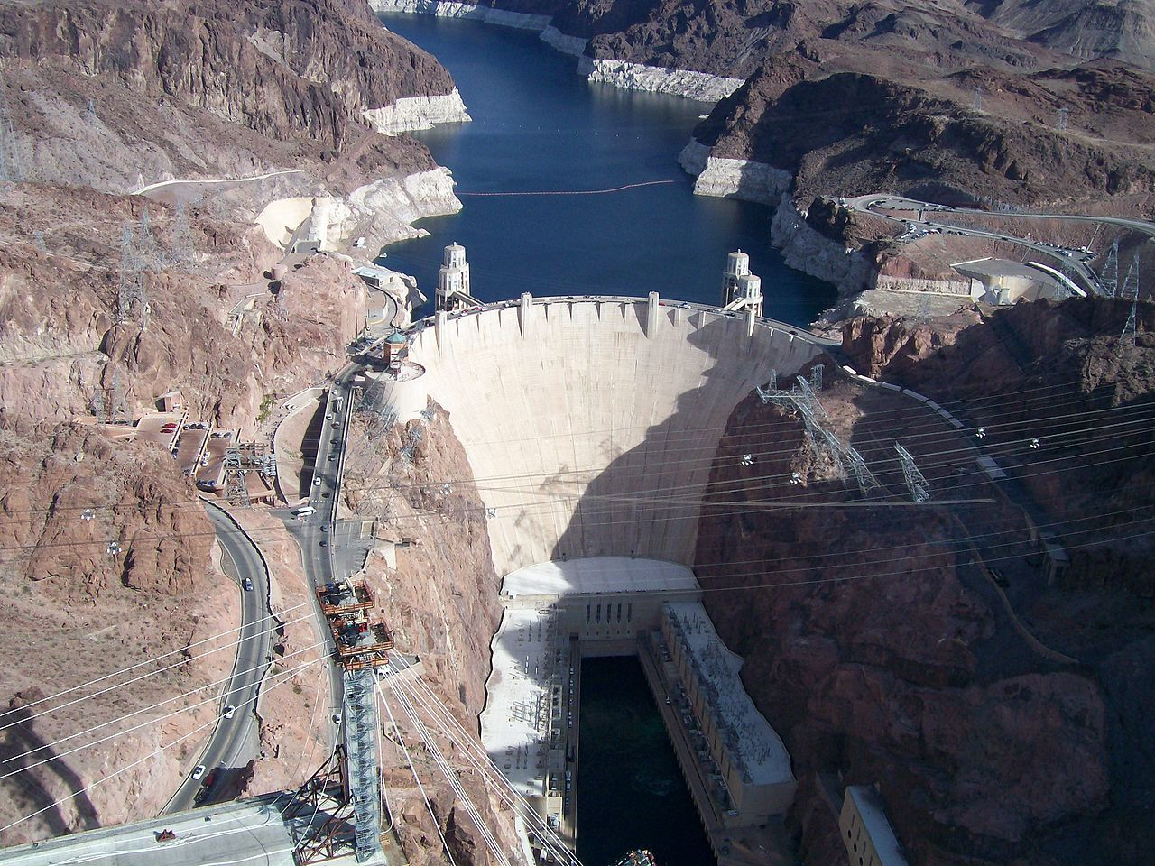
Why use ARIs?
Research → Test → Implement → Improve
Culverts → 5-50+ ARI
Rural levees → 2-50 yr ARI
Small Dams → 50-100 ARI
Large Dams → 100+ ARI
Notes:
So why else use ARIs? Besides for the fact that they convey “rarity”, they are also directly used in the design of hydrologic structures and flood retention systems. Thus, the impacts can be better assessed by NWS forecasters and their core partners when rainfall is expected to exceeds these ARIs.

Slide 8
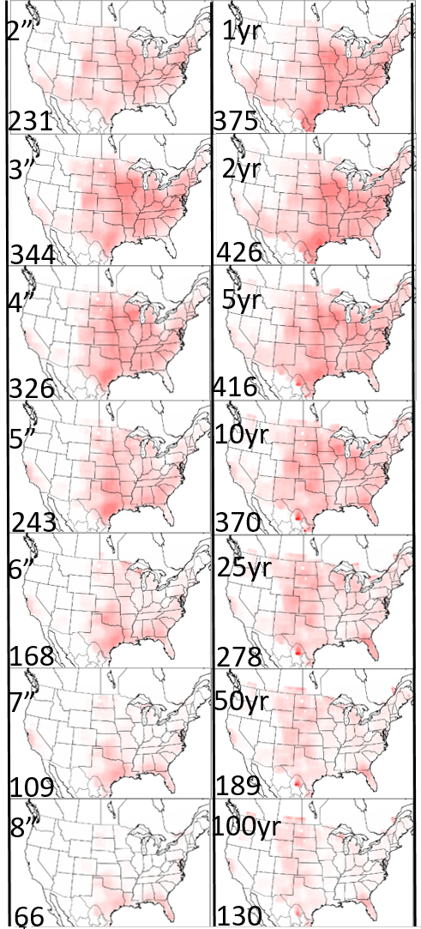
ARI Research
Research → Test → Implement → Improve
Dr. Russ Schumacher and Greg Herman (Colorado State University)
  ARIs are generally better correlated with FF reports compared to a fixed QPF threshold.
  Results are regionally dependent; some regions like the Northern Great Plains show that a fixed exceedance threshold of 2.5 in/24 hrs correspond best to FF reports.
Scott Lincoln at (Sr. Hydro.-LMRFC) and Rachelle Thomason (intern-LMRFC)
  2-yr ARI could be used for warning threshold
  25-yr ARI could indicate major flooding
Rich Grumm (SOO-CTP)
  GFS tends to under forecast 6-hour QPF amounts for top 1% events → QPF/100-yr ARI ratios over 70% are difficult to achieve
  Forecasters should be mindful of extreme rainfall potential when the 6-hour QPF/100-yr ARI ratios are over 50%
  Forecasters should be concerned about an extreme event as the values approach and exceed 70%.
  Values near 100% are rare and often indicate extreme rainfall and higher end flooding.
Notes:
When consulting with experts who’ve studied and/or worked with ARIs in operations, they found that…
Russ and Greg’s Work
Through Russ’s research predicting ARI exceedance from the GEFS using Machine Learning techniques, he related ARIs to report of flash flooding and found that were a better predictor than a fixed QPF threshold.
Scott Lincoln at LMRFC and a summer intern, Michelle Thompson, related ARIs to flood impacts.
Research based on 25 cases of FF reports suggested 2-yr ARI could be used for warning threshold.
25-yr ARI could be used for major flooding
Rich Grumm’s Preliminary work on model verification of extreme precipitation
The data imply that the GFS tends to under forecast 6-hour QPF amounts and thus QPF/ARI ratios over 70% are difficult to achieve
Thus forecasters should be mindful of extreme rainfall potential when the 6-hour QPF/ARI ratios are over 50% and concerned about an extreme event as the values approach and exceed 70%. Values near 100% though rare can occur and often indicated extreme rainfall and higher end flooding.

Slide 9
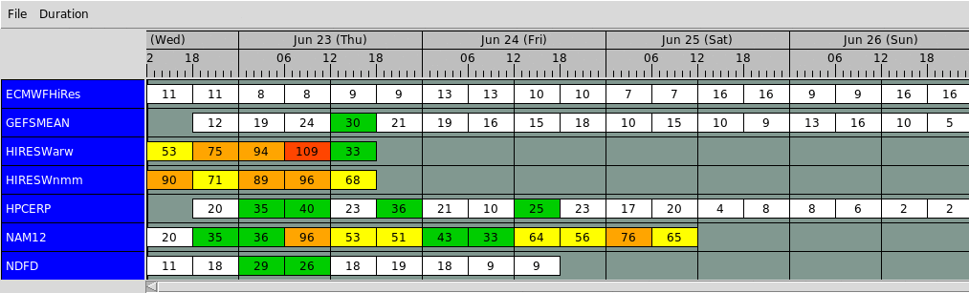
Design, Data, and Platform
Research → Test → Implement → Improve
Extreme Precipitation Forecast Table (EPFT)
  Design → Situational Awareness Table → Highlight climatologically significant rainfall
  Data → NOAA Atlas 14 Average Recurrence Intervals
  Platform → AWIPS→ Large source of QPF guidance → Can be utilized by WFOs, RFCs, and WPC, and Regions
(max[QPF/ARI] *100)
Notes:
- Preliminary research led up to the design of the Extreme Precipitation Forecast Table
- A situational awareness table that highlights extreme or climatologically significant rainfall in the forecast.
- This table was initially designed for AWIPS, due to it being a common platform between WPC, WFOs, RFCs, that could be utilized to better coordinate messaging during an extreme or high-impact rain event.

Slide 10
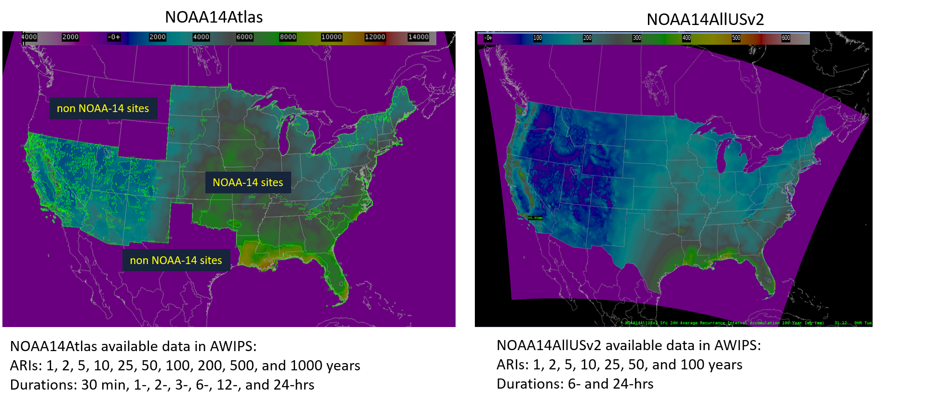
ARIs in AWIPS
Research → Test → Implement → Improve
Texas and Pac NW filled in with data from the DOC Tech Paper 40 (1961) and the NOAA Atlas-2 (1973)
Notes:
In addition, the NOAA 14 was baselined in AWIPS (D2D, FFMP) around the time the EPFT was released, allowing our team to develop an installation package to utilize the data in GFE.
Note that the data does not exist yet for the entire US. Texas is expected to be completed in 2018, but the Pac NW does not have a start or end date.
However, WPC has worked with some folks at CSU to get a limited dataset of ARIs for the Pac NW and Texas until those datasets get completed. This has allowed us to build a suite of forecast tools for identifying high-impact precip events, that can be used by any WFO, RFC, or national center that utilizes GFE.

Slide 11
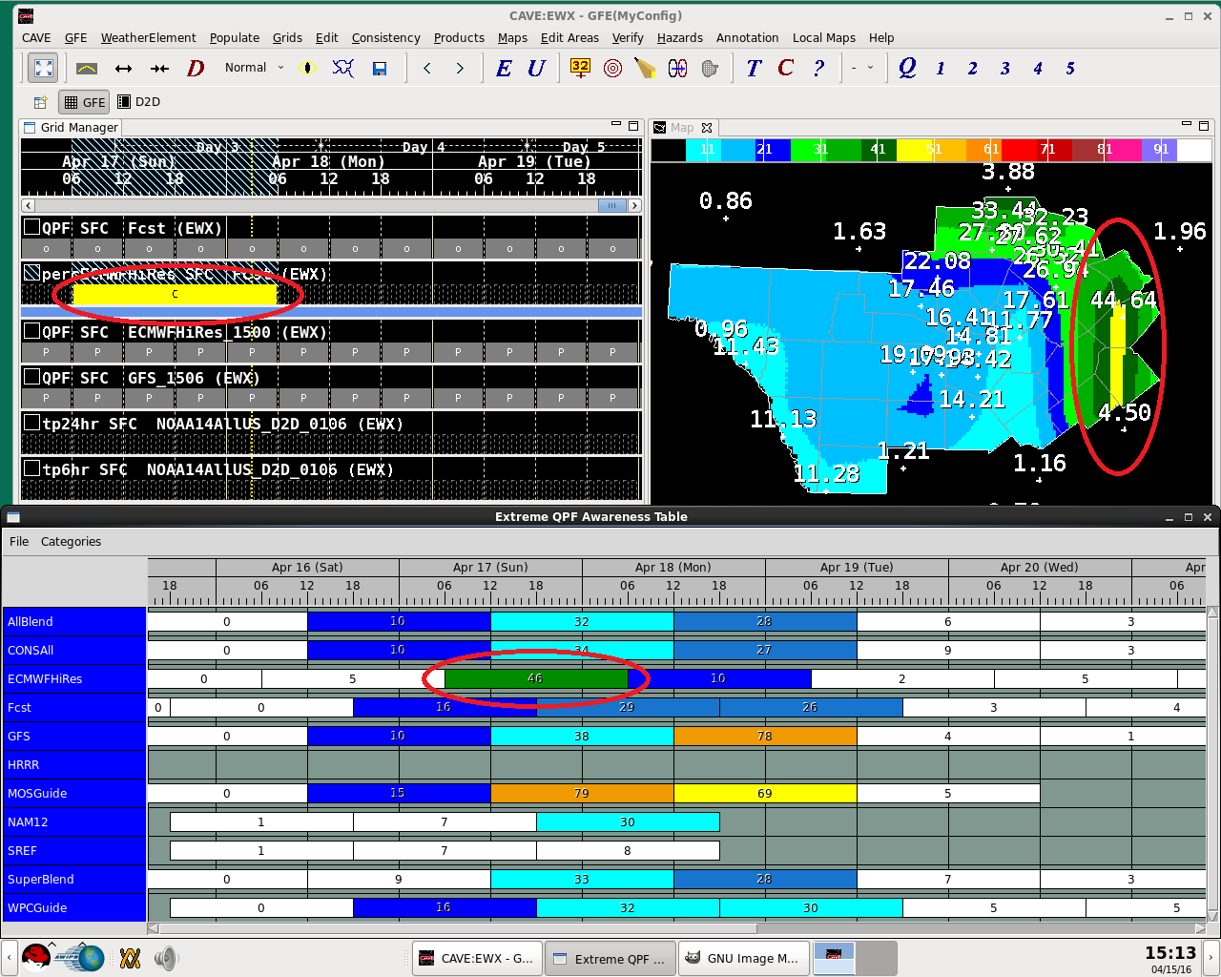
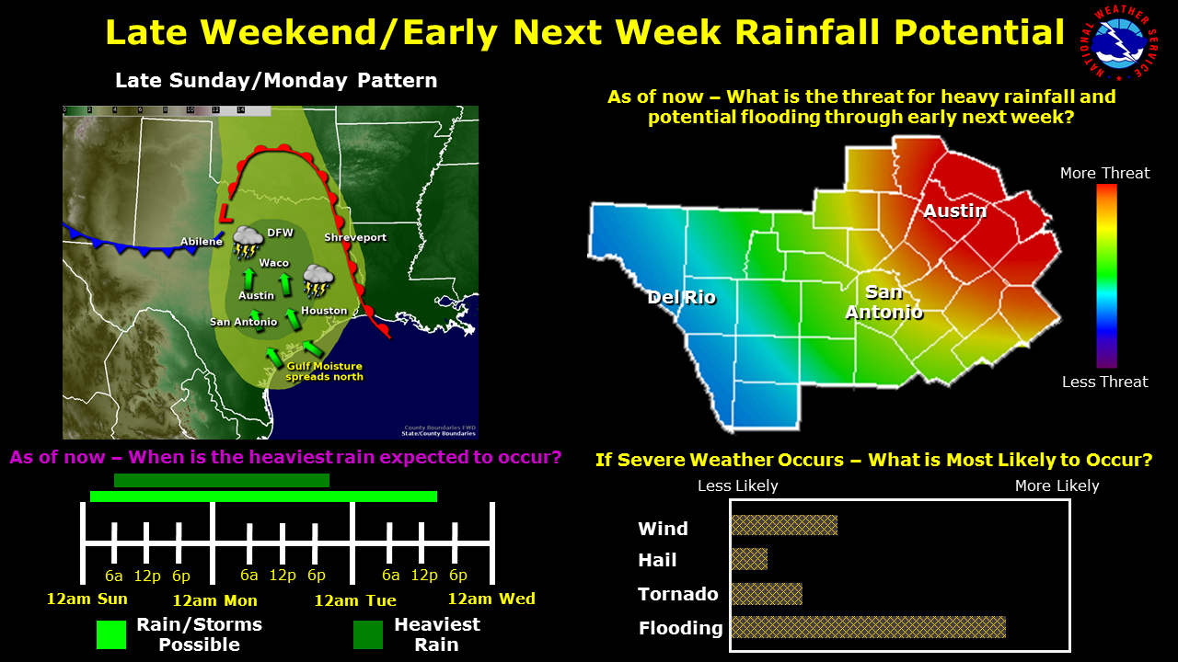
Test Case - EWX
Research → Test → Implement → Improve
Use and Calibration
Jon Zeitler (SOO-EWX)
Use the EPFT as a “one stop shop” tool to check for rarity and consistency
Antecedent conditions are not considered → Overlay low water crossings, burns scars, areas of high streamflow, etc. to highlight potential trouble areas
Create IDSS graphics that highlight extreme nature of event and confidence
QPF/ARI* | Potential for Damaging Impacts to Life and Property**
< 25% | Minimal
25-50% | Low
50-75% | Moderate
75-100% | High
100-125% | Very High
125-150% | Emergency
150-175% | Catastrophic
*Compared to the 100-year ARI rainfall estimates for durations of 6- and 24-hours **Impacts from flooding also depend on soil moisture and type, terrain, areal coverage of rainfall, and geography (urban vs. rural).
Notes:
When the team starting testing the tool…..
Here is what Jon came up with for a case in San Antonio CWA TX.
In general, we came up with this key that forecasters could use to assess the table. Note that our research is still ongoing in terms of associating specific ARIs with specific impacts.

Slide 12
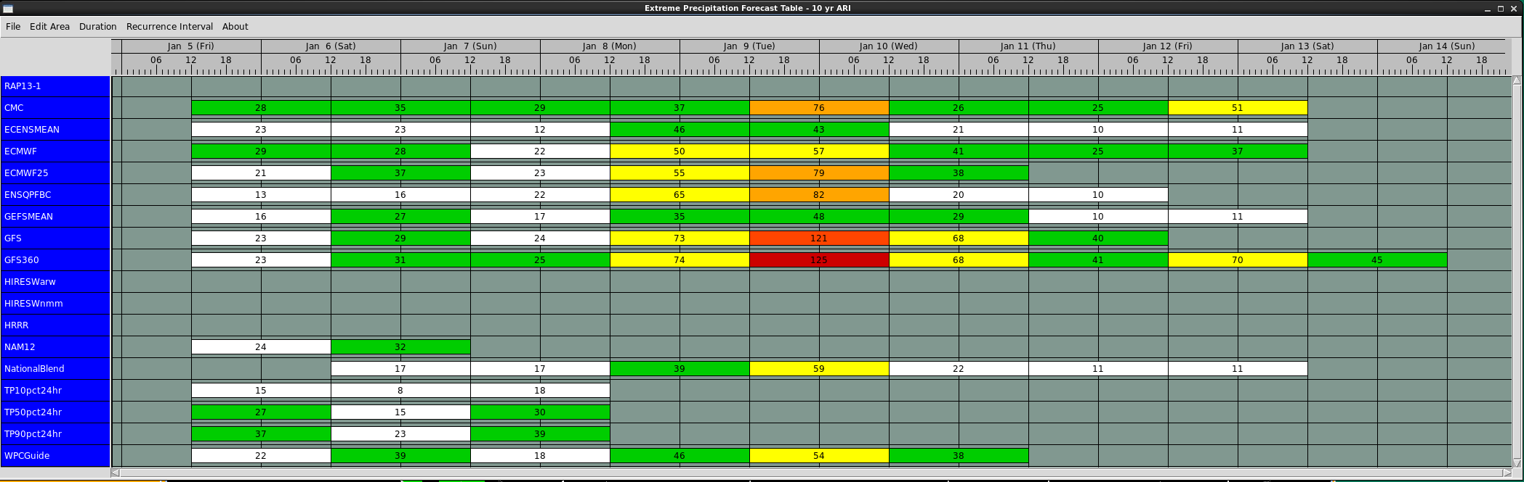
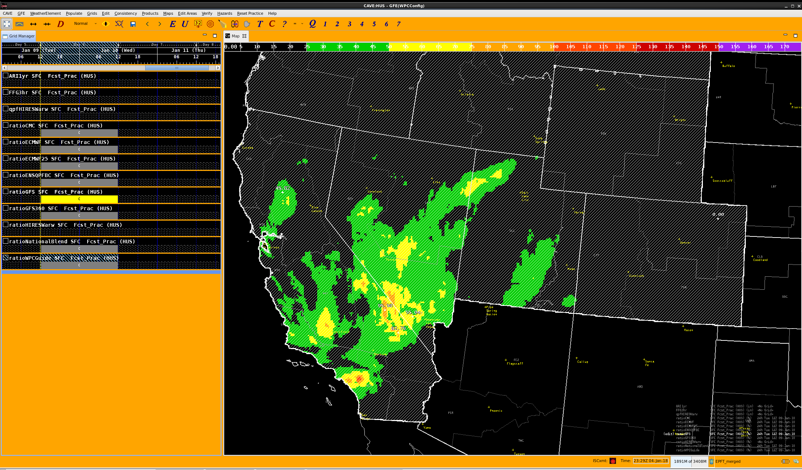
Operational Implementation
Research → Test → Implement → Improve
The EPFT and NOAA-14 data for GFE was uploaded to the Vlab/SCP on July 2016
https://vlab.ncep.noaa.gov/redmine/projects/nwsscp/wiki/AriInstallPackage
https://vlab.ncep.noaa.gov/redmine/projects/nwsscp/wiki/ExtremePrecipForecastTable
Notes:
So in July 2016, the EPFT was operational released on the SCP, which is now the Vlab-SCP.
It takes any piece of QPF guidance available in GFE, finds the maximum ratio of QPF to ARI (not that this is not necessarily where the maximum QPF is), and displays the value in the table.
Just like the ESAT, it’s designed so the user can click on a cell, bring the grid of percentages up in GFE, and locate the area where the pixel is located.

Slide 13
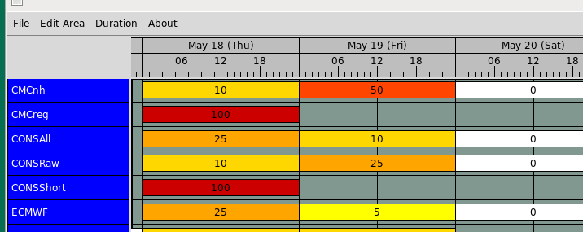
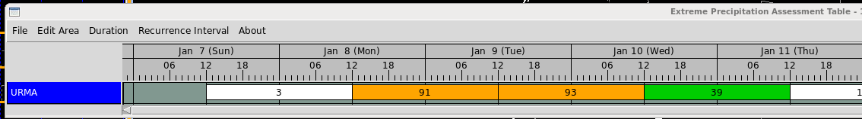
Operational Implementation
Research → Test → Implement → Improve
Extreme Precipitation Forecast Table (EPFT)
  Introduced to operations July 2016
  Table displays → max[QPF/ARI] *100
  Used by WFOs, RFCs, and WPC
Average Recurrence Interval Table (ARIT)
  Introduced February 2017
  Table displays → max[ARI]
Extreme Precipitation Assessment Table (EPAT)
  Introduced February 2017
  Table displays → max[QPE/ARI] *100
ARIT
EPAT
Notes:
We also released the EPAT and ARIT based on comments and feedback from the field.
The ARIT is a very similar concept to the EPFT, but shows the max recurrence interval in the table rather than the showing how close the guidance is to a specific ARI threshold.
Drawback - The procedure that produces this table takes longer to run because it has to compare every single grid with (sometimes) 10 ARI grids rather than 1, and increased I/O time because of this.

Slide 14
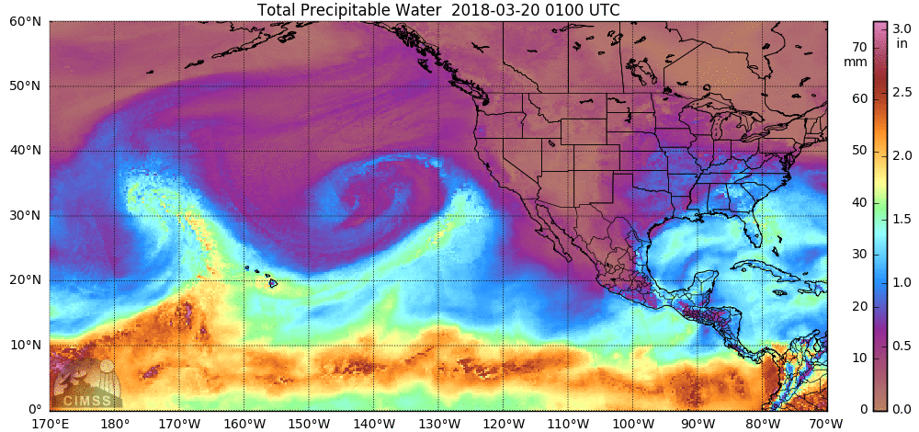
March 21-22 AR Event
Notes:
Here I will demonstrate the latest version of the EPFT (v2.0) from a March AR event this year.
What was particularly concerning about this event is that there was potential for heavy rain to fall on the burn scars from the fires the previous season. It doesn’t take much rain on a burn scar to produce flooding, but the more climatologically significant rainfall, the more potential there is for catastrophic damage.

Slide 15
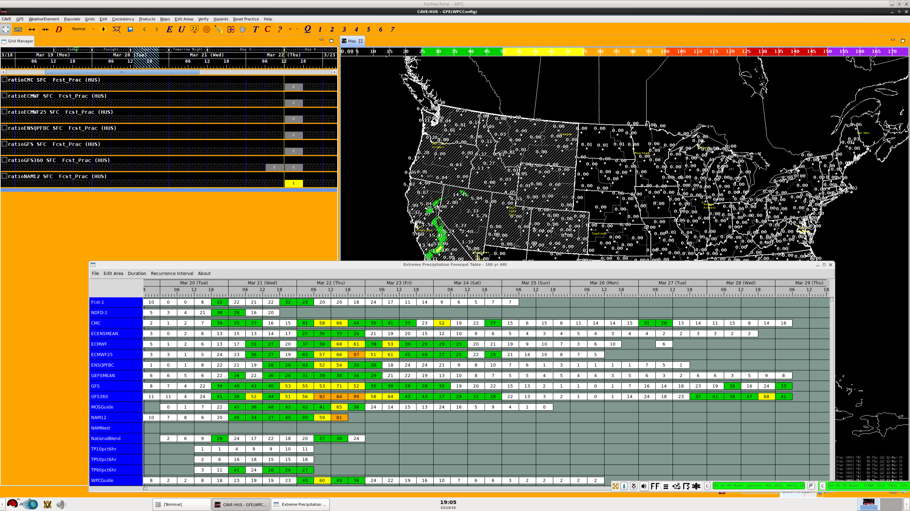
January 10th, 2017 AR event
QPF/10-yr ARI
Notes:
As I go through this demonstration, I’m going to use a top-down approach to analyzing or “mining” the guidance as if I were a forecaster at WPC trying to assess the situation for the West.
Running the EPFT on Monday, March 19th with the default configuration (6-hr, 100-yr) over the western US shows the agreement of the models indicating a rain event, with some potential to produce significant rainfall. You can see where some of global guidance and even the NAM are starting to produce QPF nearing a 100-yr event.

Slide 16
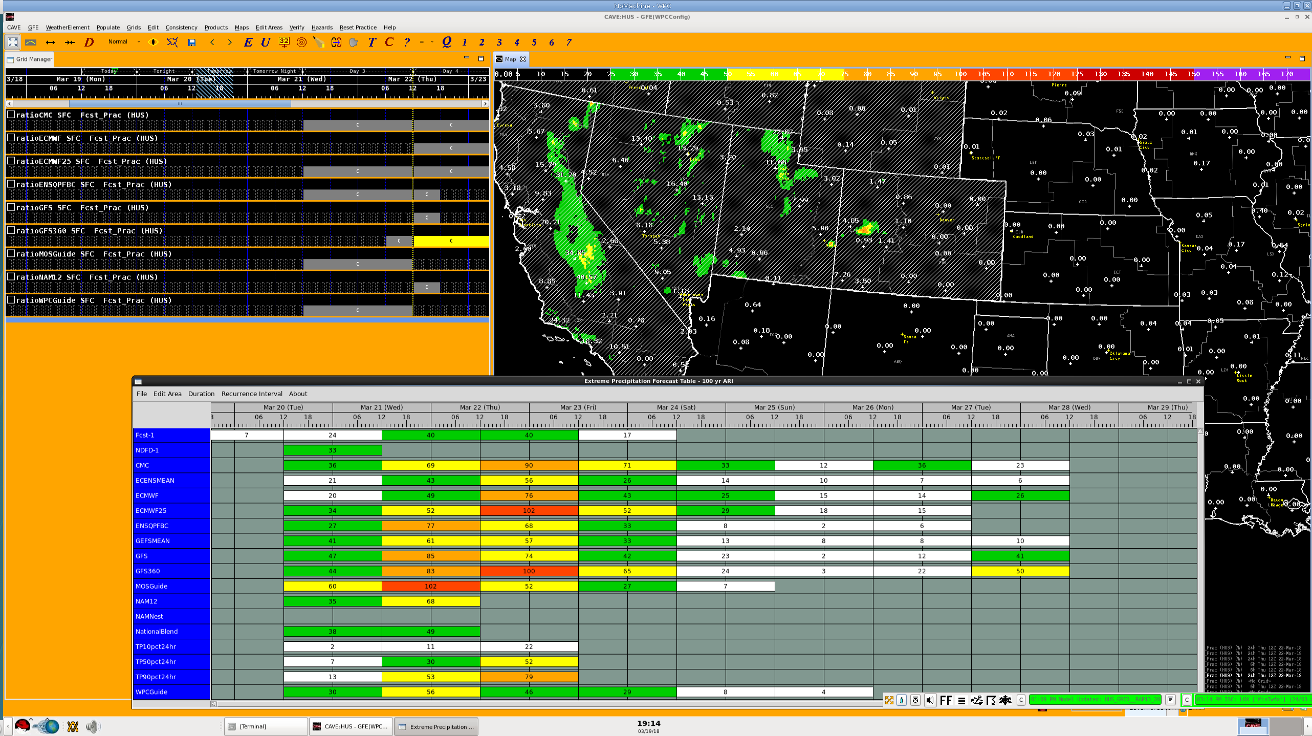
Notes:
Being that AR’s are usually larger-scale multi-day events, longer duration rainfall tends to be more significant, so switching to the 24-hr duration will cause the table to “light up” more as opposed to shorter durations.
So in this image you can see that there are ore models exceeding or nearing a 100-yr event. With the higher-duration, it’s easier to identify which models and how many models are producing extreme or near-extreme rainfall. Clicking on a cell in the table will bring up the grid of percentages in the spatial editor, and from here you can look to see where the significant rainfall is occurring, and refine the table by a specific edit area. WPC and RFCs can look at specific CWAs, and CWA’s can create edit areas of burn scars or low water crossings.

Slide 17
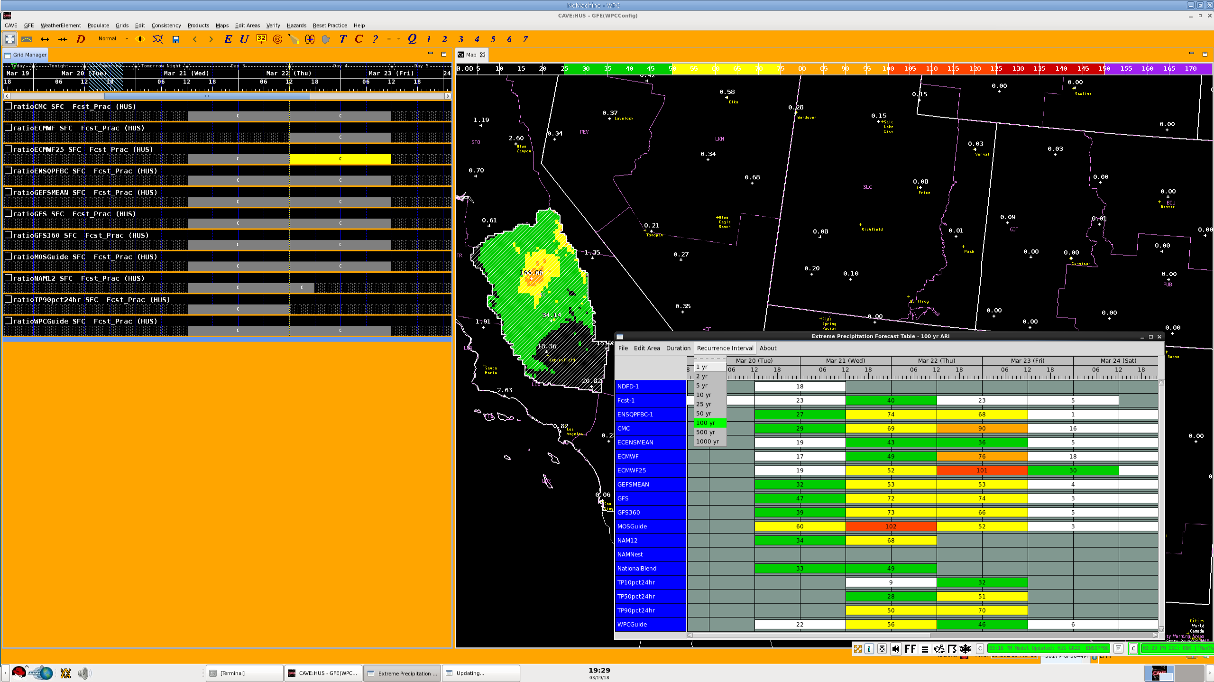
Notes:
So here is of the EPFT over HNX (San Joaquin Valley/Hanford) comparing QPF to the 100-yr ARI. The area is pretty large over which significant rainfall, and near extreme rainfall is being forecasted. At this point the forecaster could change the ARI to 25 year…

Slide 18
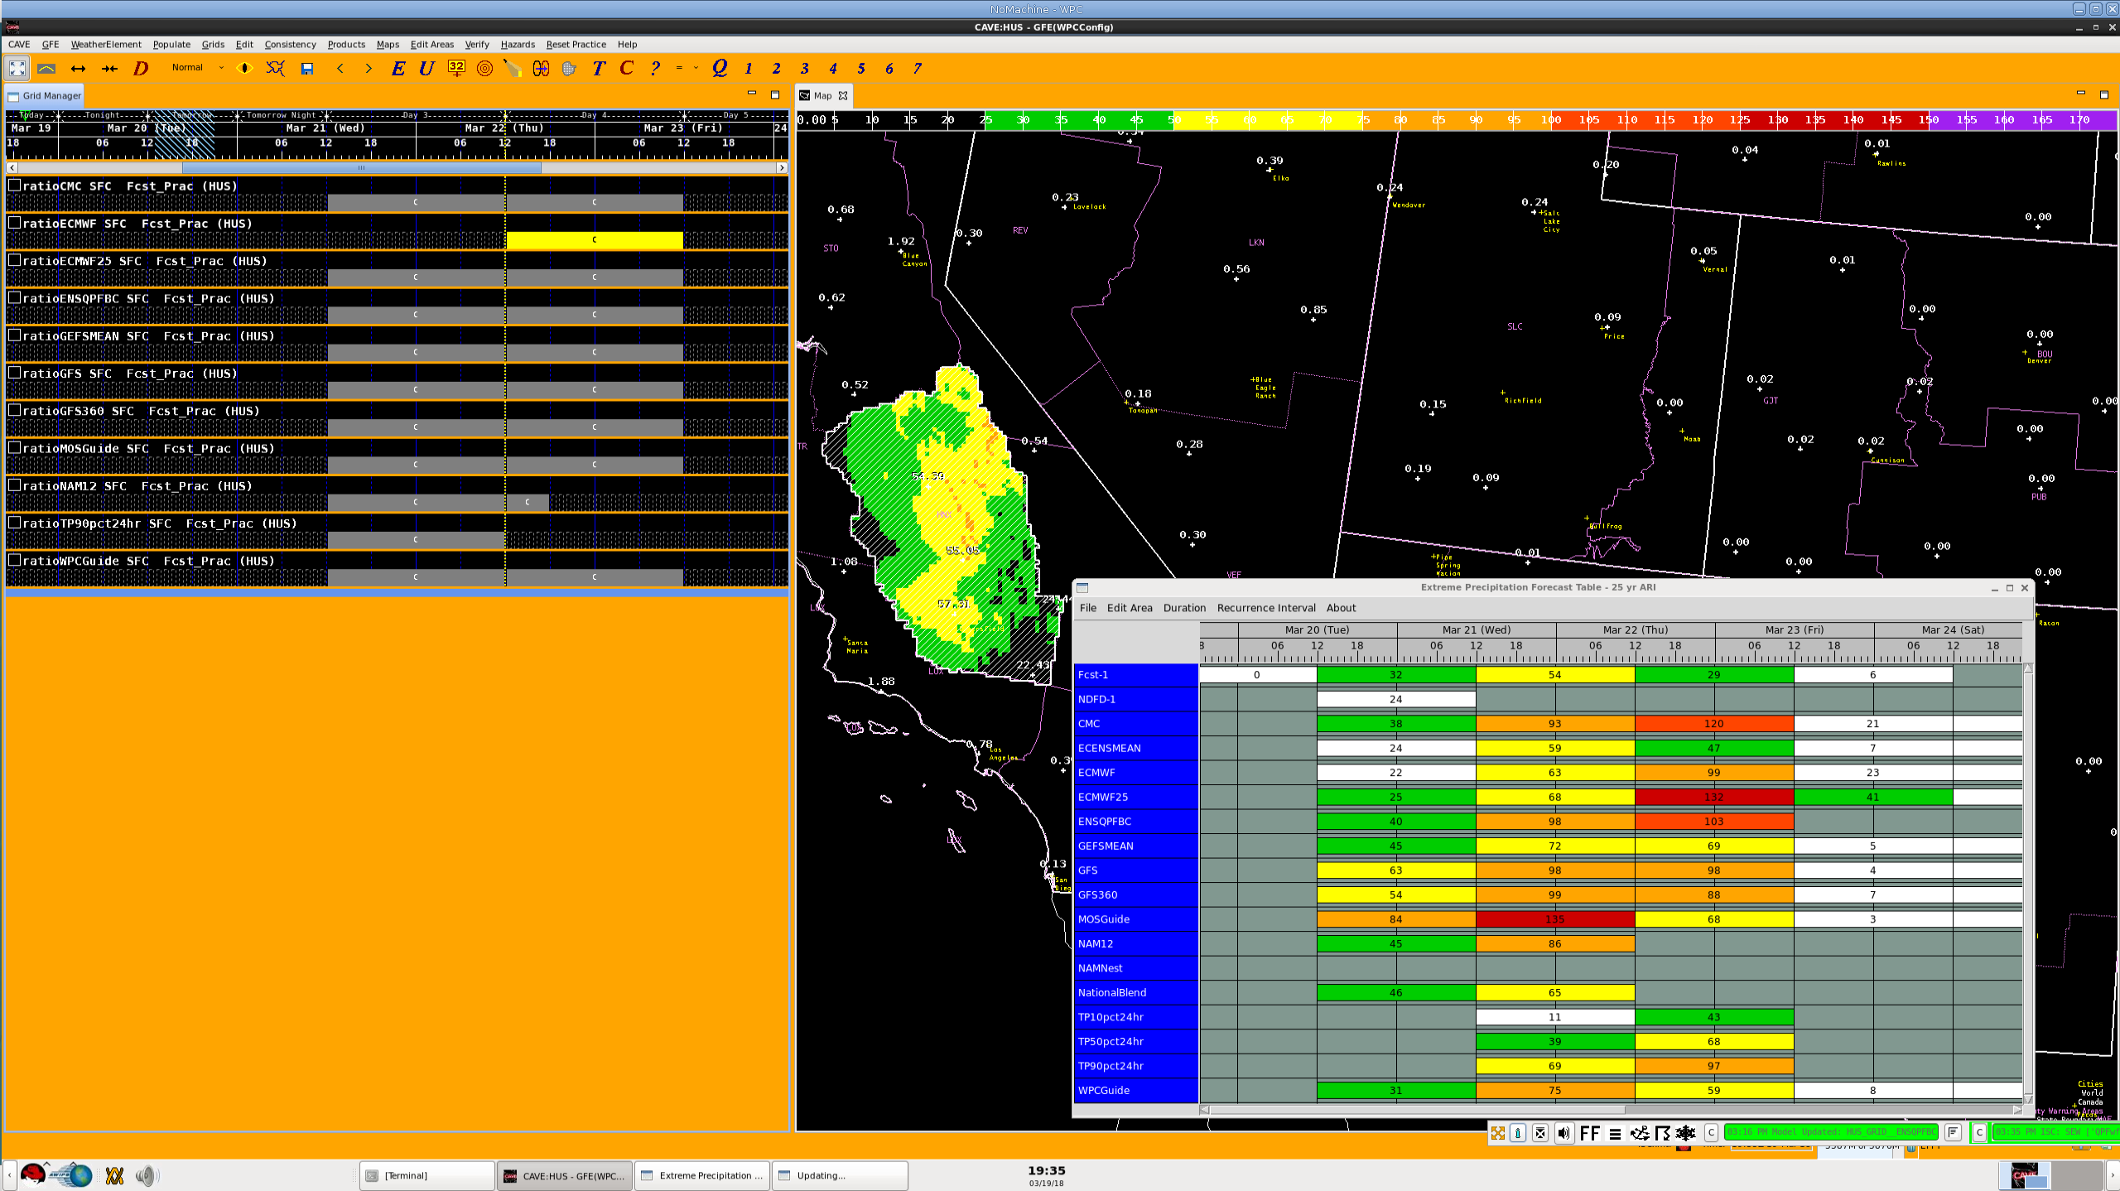
Notes:
..And they will see more models agreeing on that exceedance threshold, for that CWA.

Slide 19
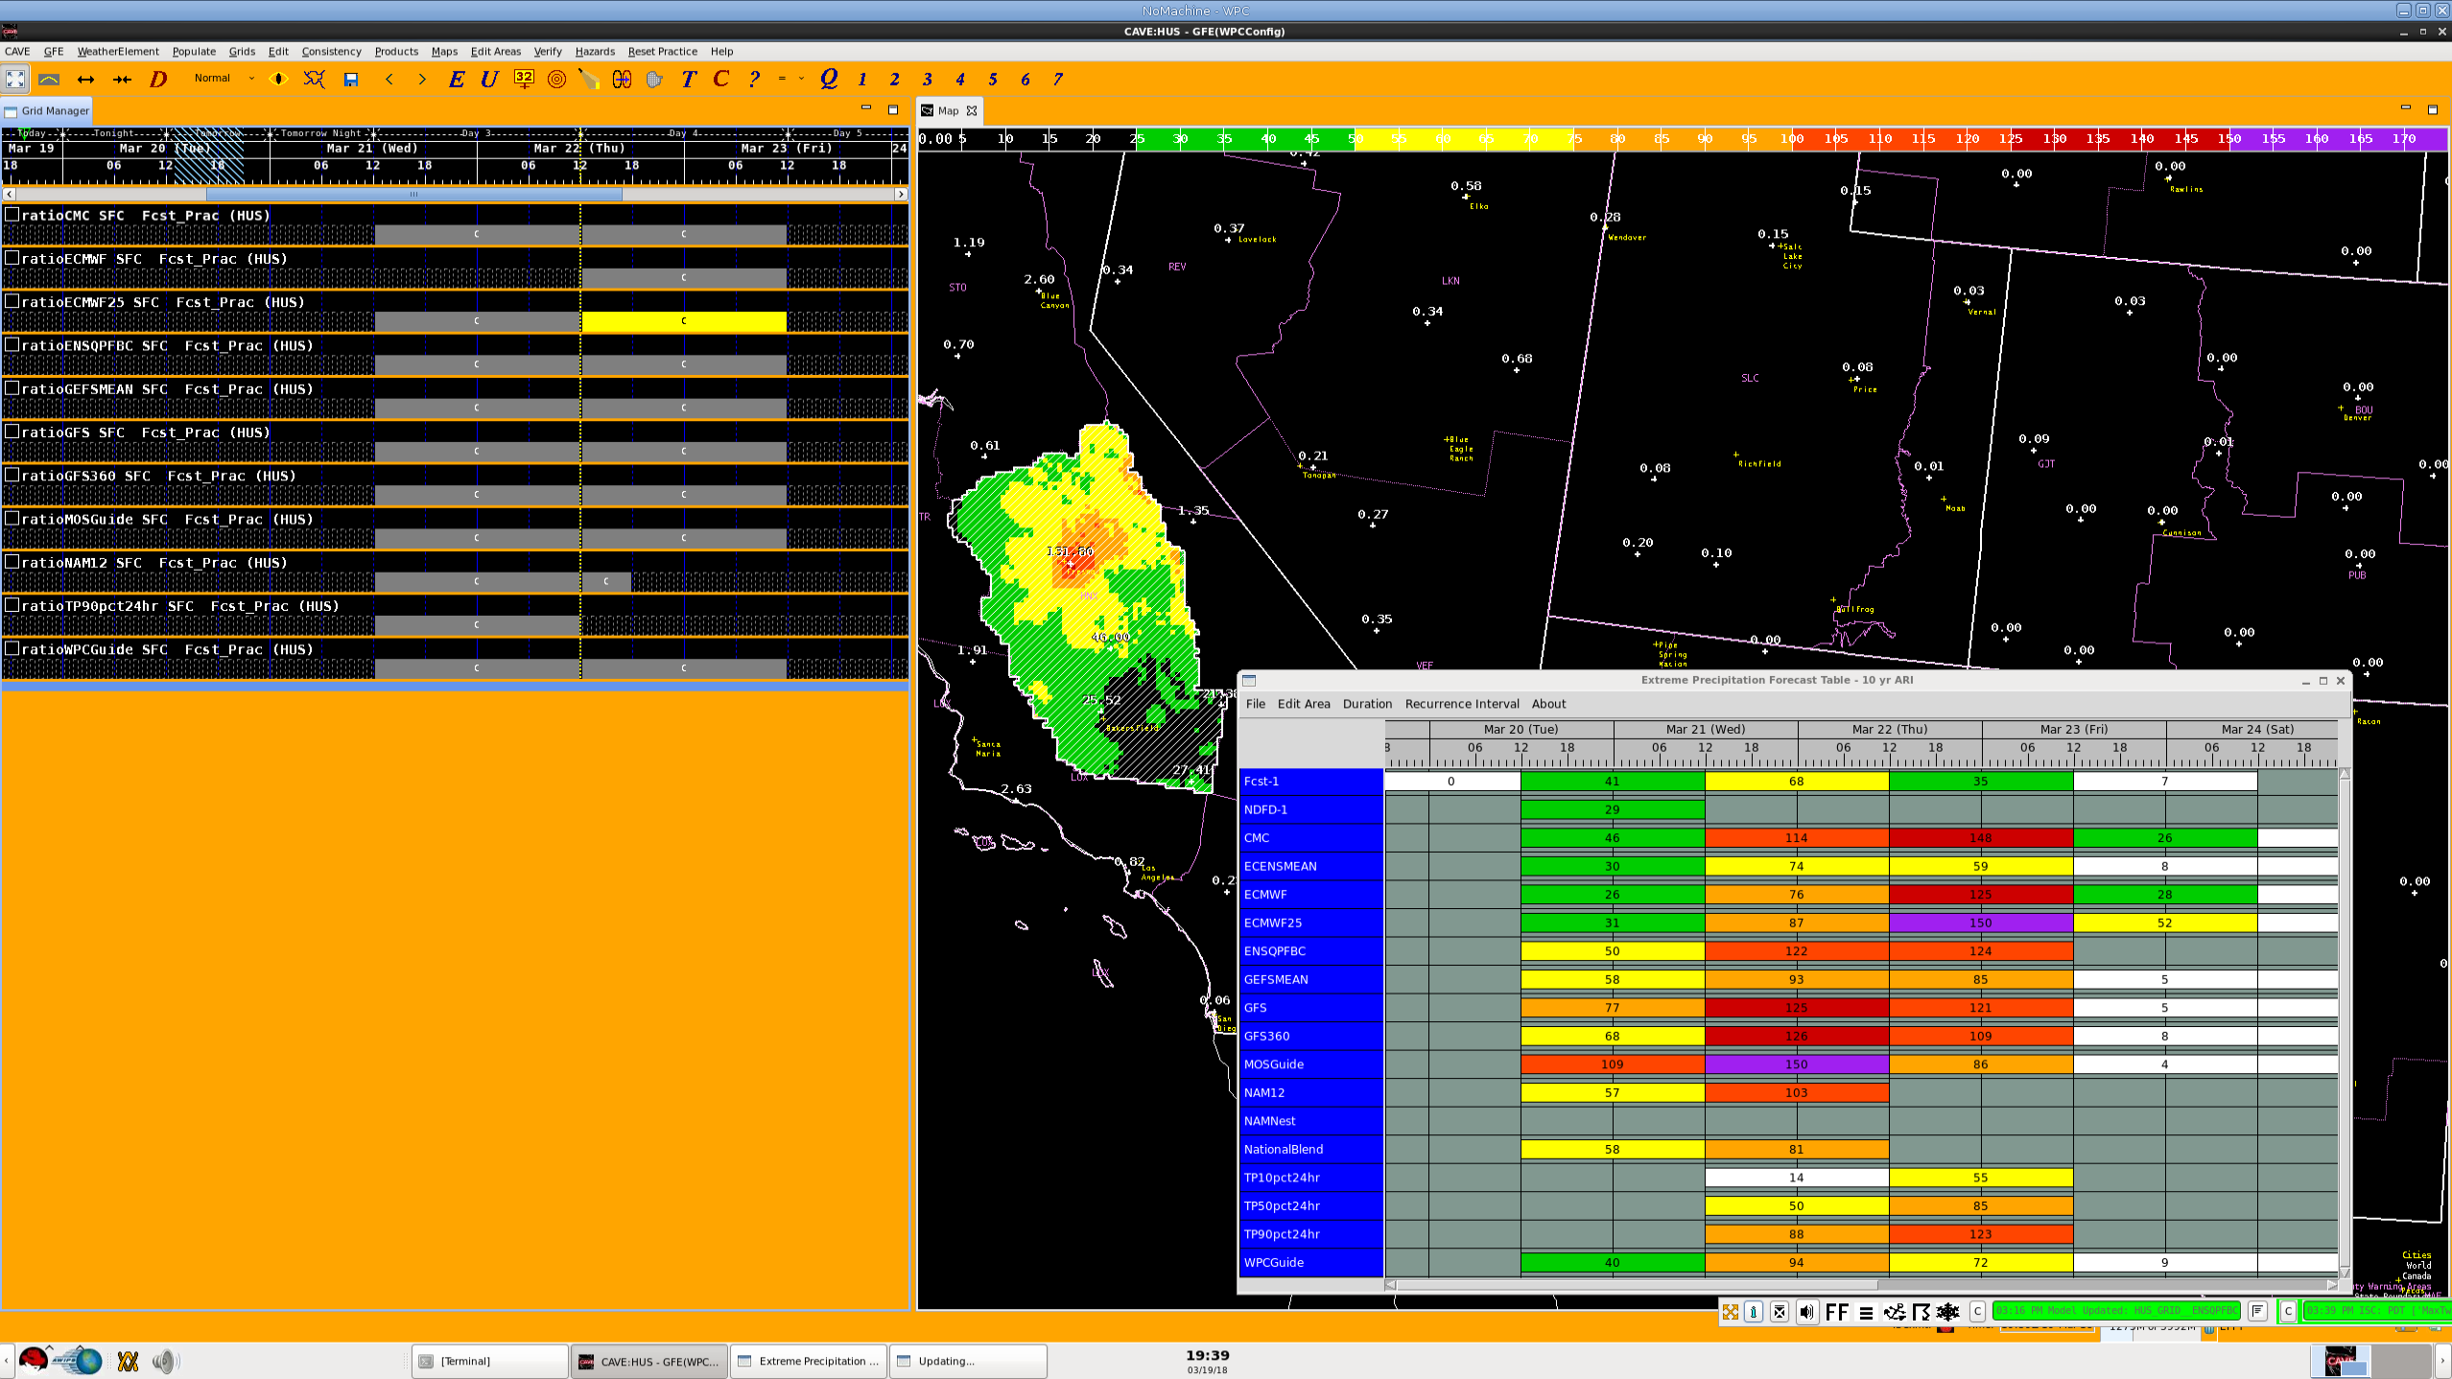
Notes:
Here we can start to see the majority of guidance starting to exceed the 10-yr ARI in this CWA.

Slide 20
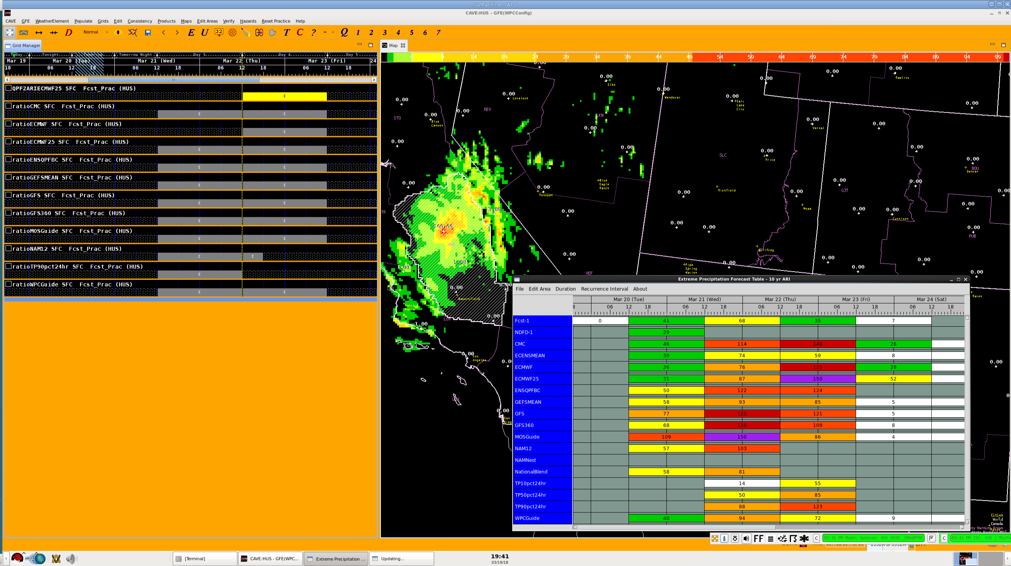
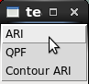
Notes:
Further mining the data, I (or a forecasters) could look at the ARI, QPF, and run a function that plots the QPF in the context of each ARI get a sense of how widespread the significant rainfall is.
In this example, I have run the function Contour ARI on the ECMWF.

Slide 21
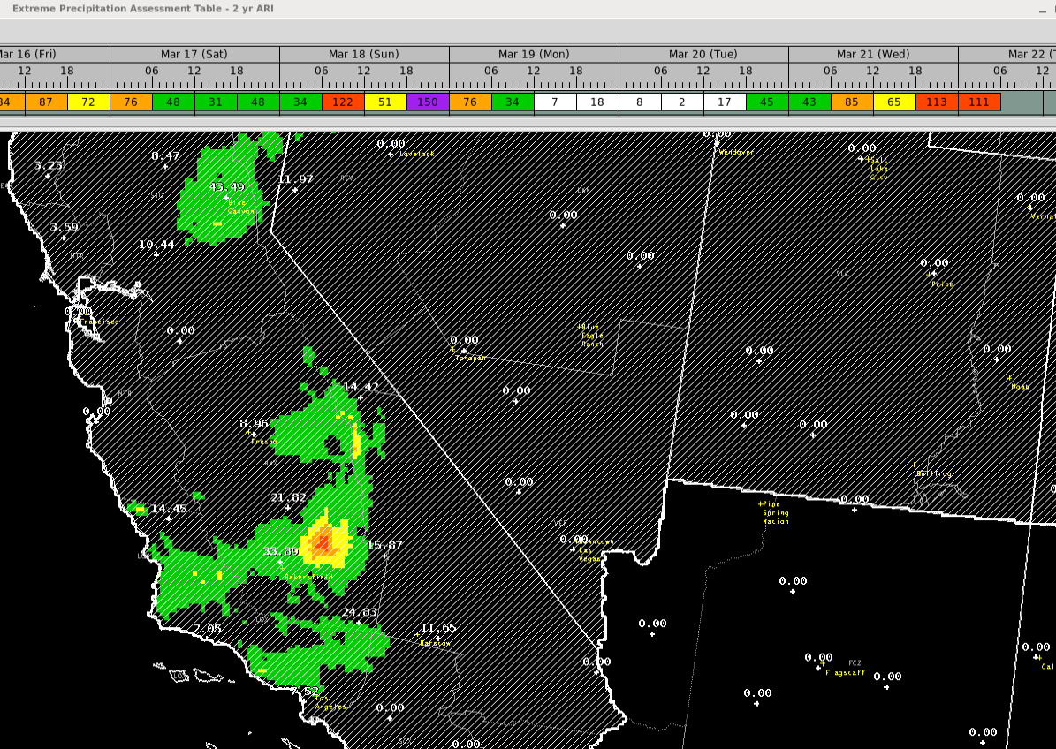
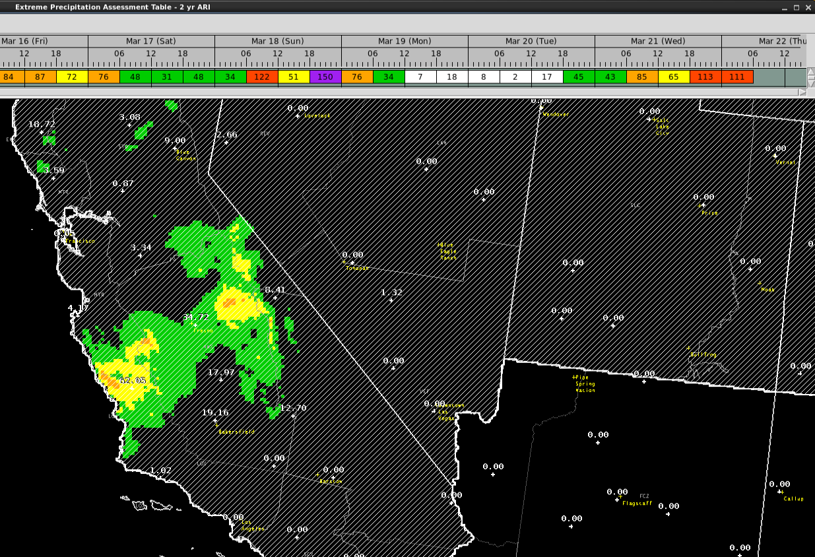
Extreme Precipitation Assessment Table
6-hr, 2 yr ARI
18-00Z March 21
00-06Z March 22
Notes:
After the event and associated impacts have taken place, the forecaster can view the observed rainfall (QPE) in the context of the ARIs.
Here I had to reduce the ARI down to 2-years to see a clear signal in the EPAT.
Continued use of the EPAT after a high-impact rain event can help the forecaster garner a sense of the ARIs associated with actual impacts, which will help them with decision support for future events.

Slide 22
Recent Improvements
Research → Test → Implement → Improve
Addition of:
WPC’s probabilistic quantitative precipitation forecast (PQPF) → QPF associated with the 10th, 50th, and 90th percentiles from an ensemble of 46-members (SREF, GEFS, ECMWF, NAM, GFS, WRF-ARW/NMM)
  WPC guidance is the mode, variance comes from the ensemble
  6- and 24-hr forecasts available
Can be used by forecasters and hydrologists to determine the probability of climatologically significant or extreme rainfall at a given location.
Can be used to identify where model guidance exists in the spread of probabilities assessed by WPC.

Slide 23
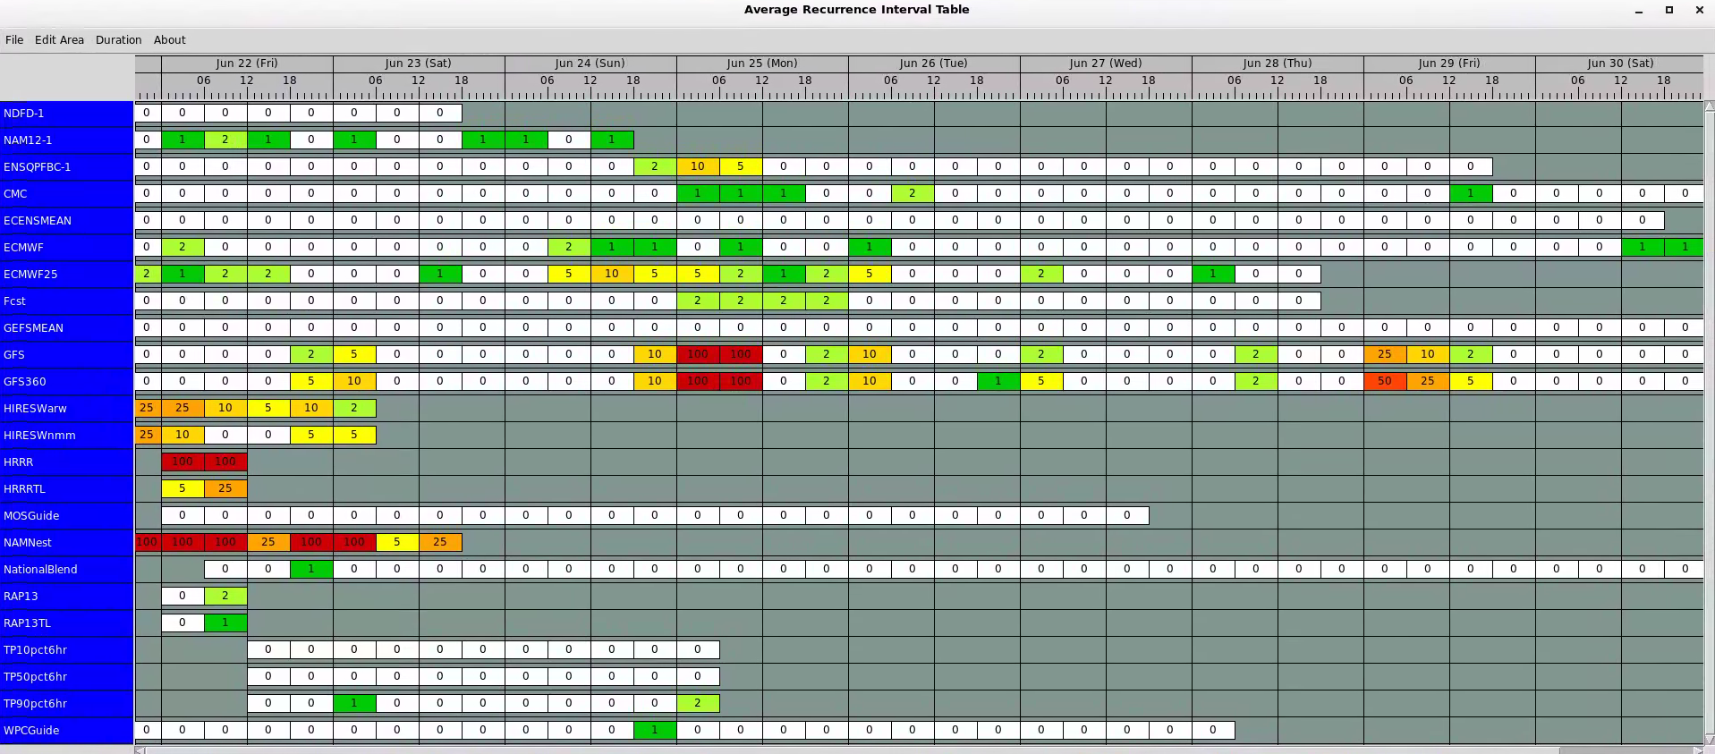
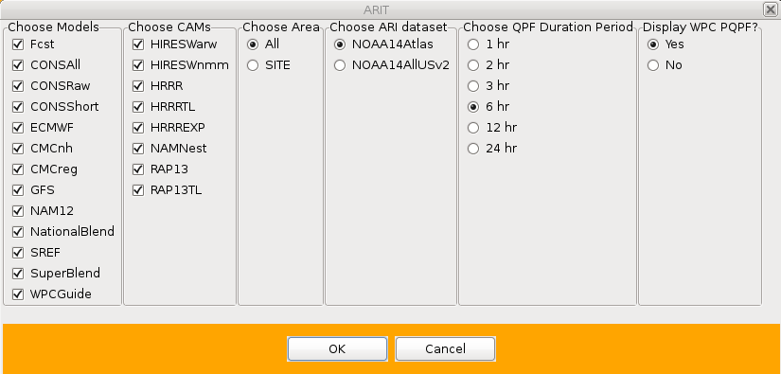
Recent Improvements
The new and improved ARIT…
Notes:
We will be adding a new version of the Average Recurrence Interval Table later this week. This version is now designed to work with any site that has downloaded the NOAA14Atlas or NOAA14AllUSv2.

Slide 24
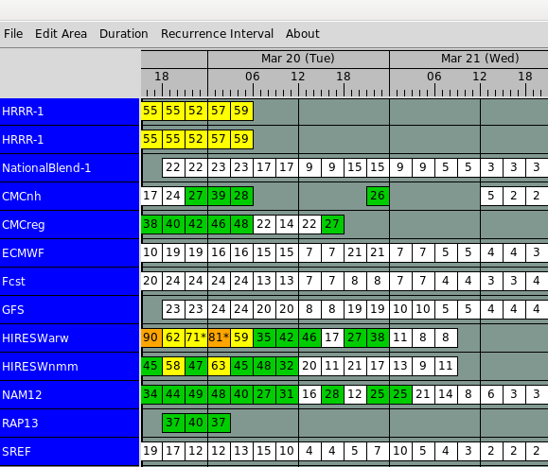
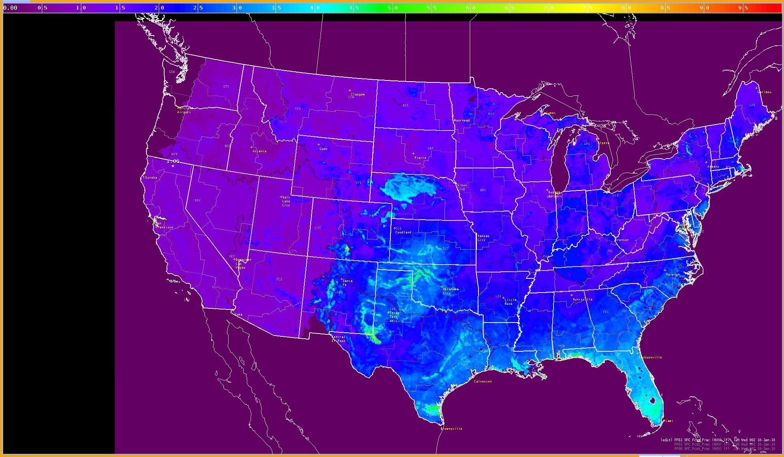
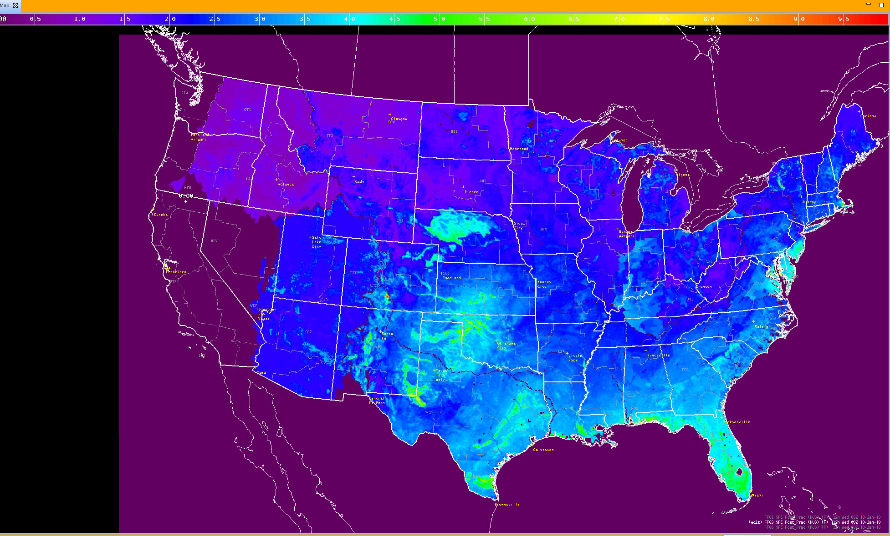
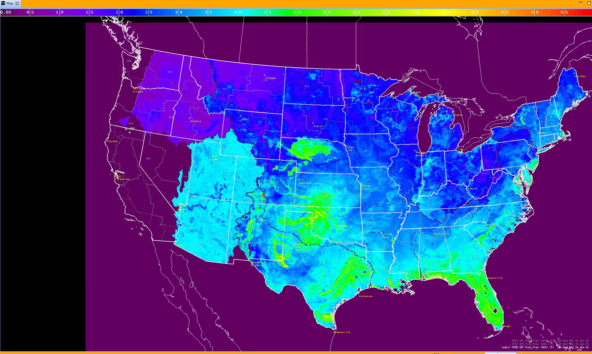

Future Improvements and Enhancements
Research → Test → Implement → Improve
Improvements
Flash Flood Guidance for improved situational awareness in the short term
1-hr
3-hr
6-hr
Enhancements/Additions
Longer duration ARIs (2-day, 3-day, 5-day)
Probability of ARI Exceedance (non-bias corrected → model relative frequency)
Anomalous meteorological ingredients analysis
Improved design for short-term precip, flash-flood producing situations
Notes:
The addition of FFG improves upon the lack of antecedent conditions in the EPFT, since antecedent conditions are usually included in the methodology RFCs use to create FFG.

Slide 25
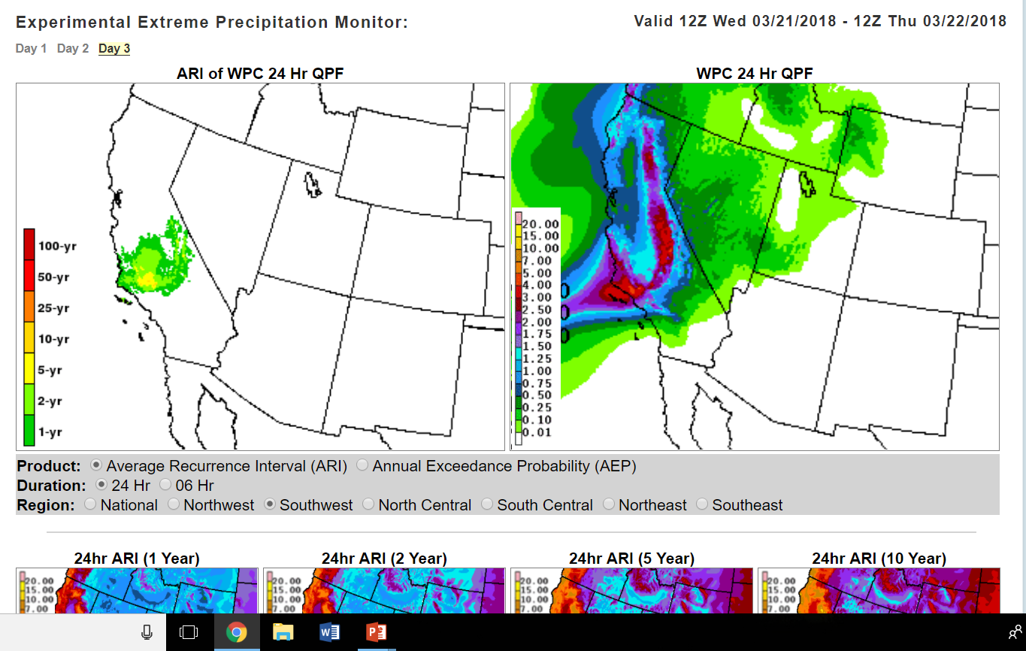
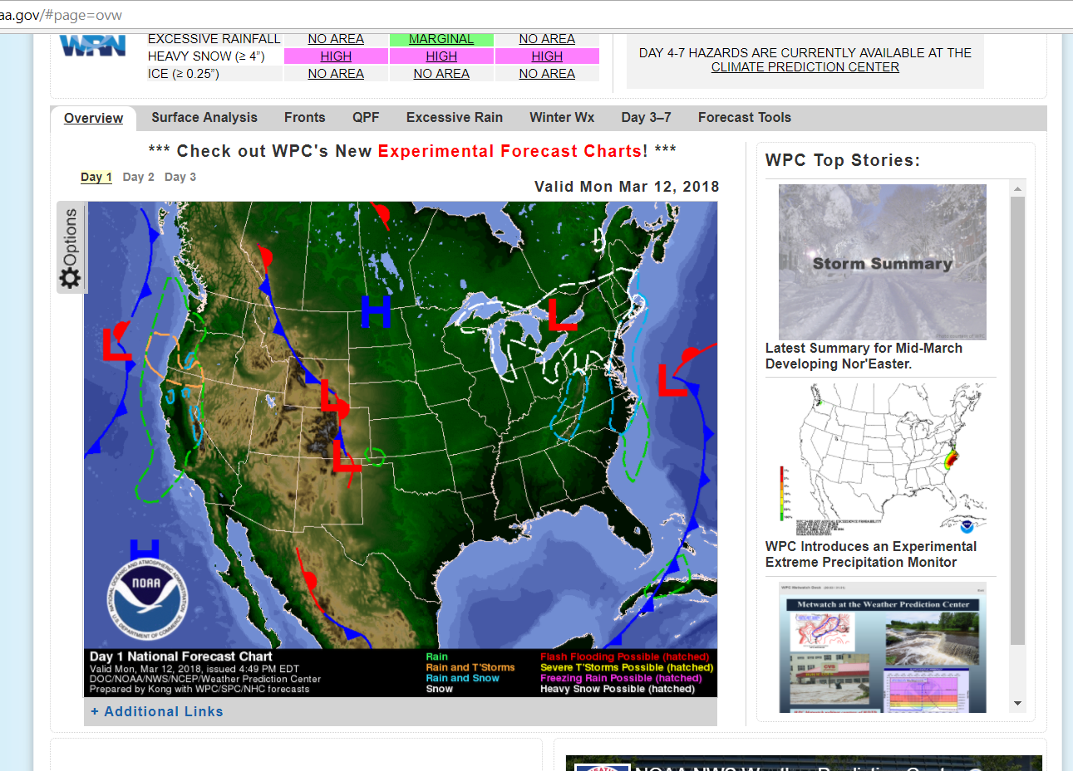
Extreme Precipitation Monitor
http://www.wpc.ncep.noaa.gov/qpf/epm/extreme_precip_monitor.php
Displays climatological significance of rainfall forecasted by the Weather Prediction Center
Generated with WPC’s Day 1-3 QPF for each 6- and 24-hour period and precipitation estimates from the NOAA Atlas-14
Each contour level represents the ARI/AEP equivalent of QPF expected to be equaled or exceeded during the specified time period.

Slide 26
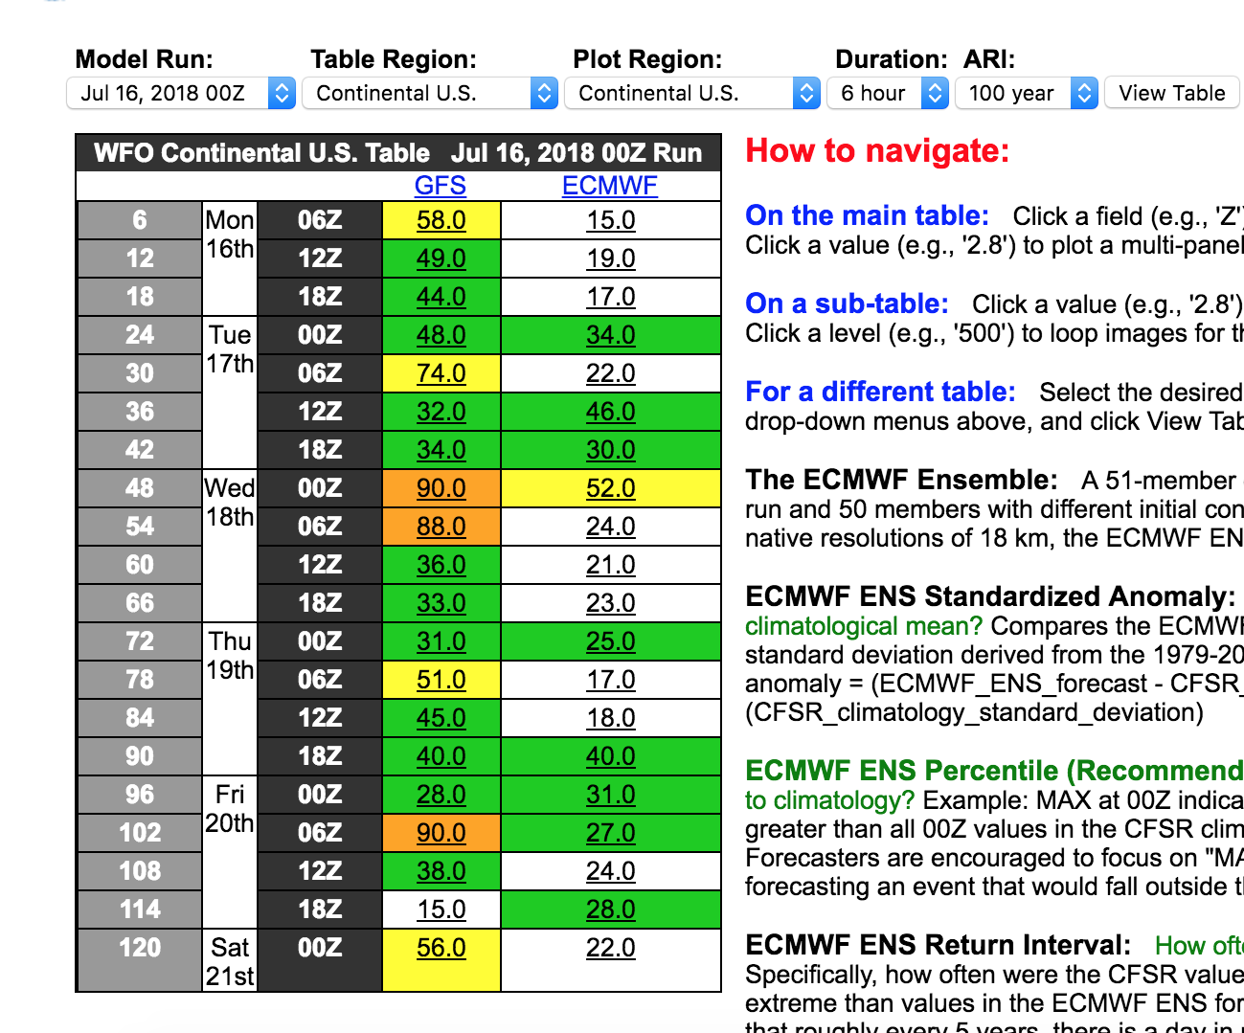
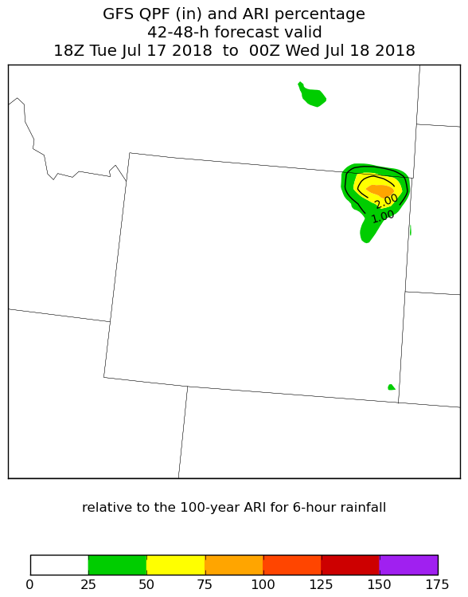
Web-based EPFT
(In Progress)
*In collaboration with Bill Lamberson (WPC)

Slide 27
Challenges moving forward…
ARIs are still widely misunderstood by the Public.
Hurricane Matthew 2017 NWS Service Assessment
“Difficulty in communicating the inland flooding threat is not a new issue and has appeared repeatedly in previous service assessments.”
“Partners indicated that despite the excellent service and information provided by the NWS they were surprised at the magnitude of flooding they experienced and did not feel that the threat was communicated adequately.”
More research needed to link ARIs to impacts.
The NOAA Atlas 14 is a relatively new dataset just starting to gain traction in the NWS. Continued use, training, and research linking specific ARIs to impacts is needed to optimize ARIs as a situational awareness tool.

Slide 28
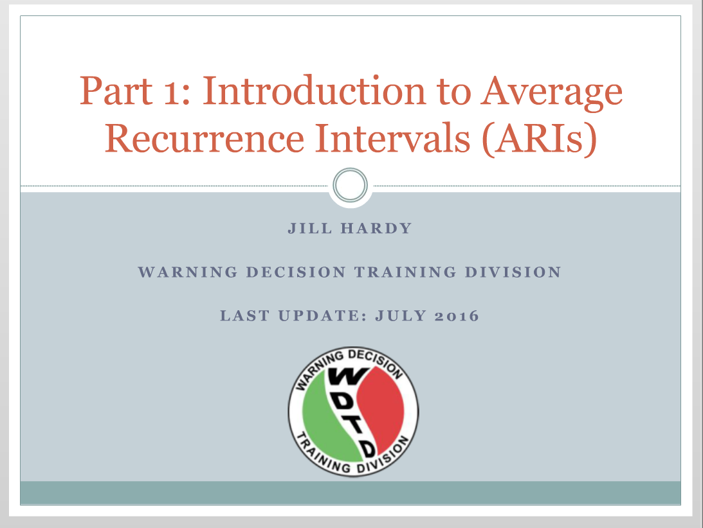
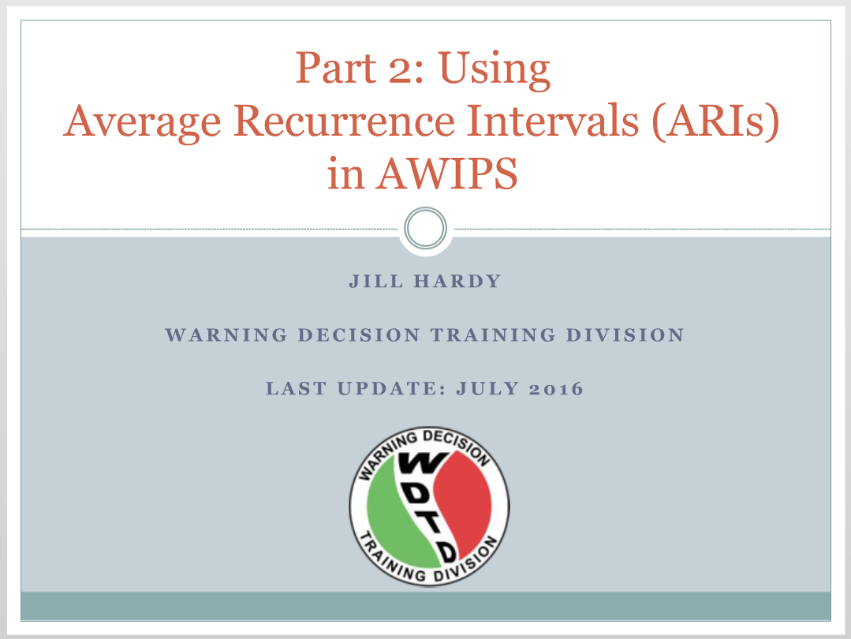
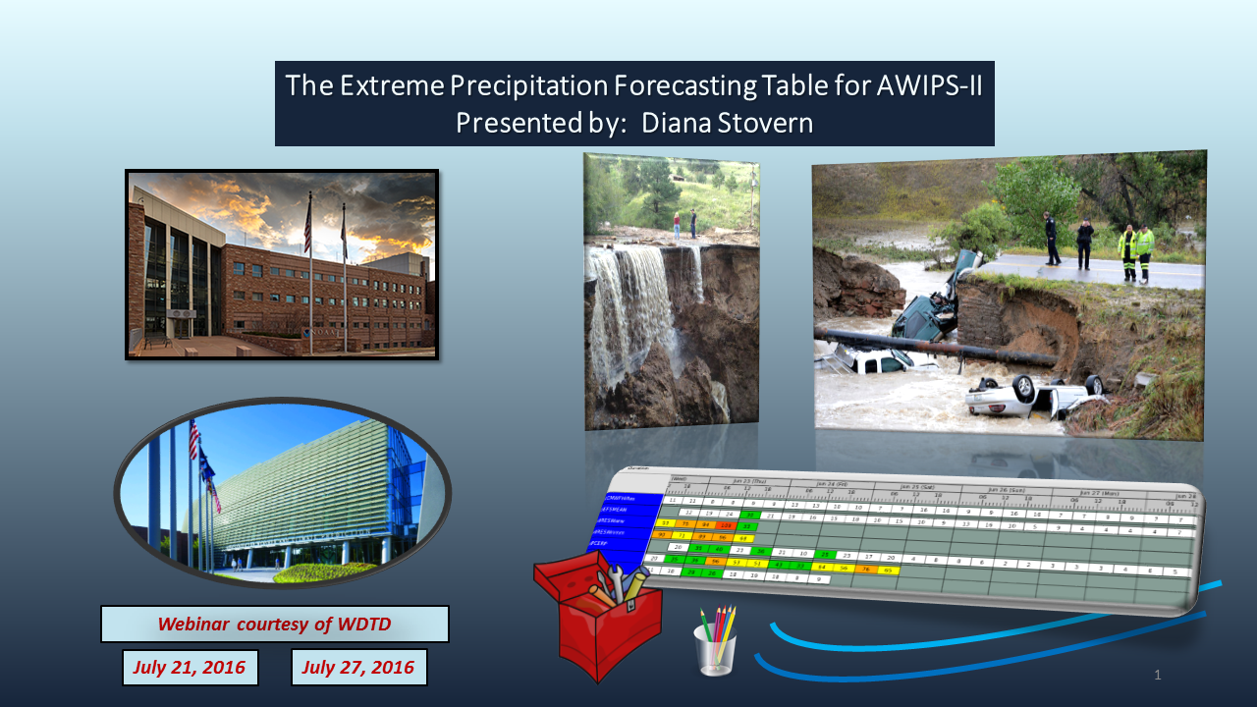
Training
Available on the Commerce Learning Center (CLC)

Slide 29
Thank you!
Dr. Diana Stovern (diana.stovern@noaa.gov)
ARI data → https://vlab.ncep.noaa.gov/redmine/projects/nwsscp/wiki/AriInstallPackage
EPFT → https://vlab.ncep.noaa.gov/redmine/projects/nwsscp/wiki/ExtremePrecipForecastTable
ARIT → https://vlab.ncep.noaa.gov/redmine/projects/nwsscp/wiki/AverageRecurrenceIntervalTable
EPAT → https://vlab.ncep.noaa.gov/redmine/projects/nwsscp/wiki/ExtremePrecipAssessmentTable
WPC Rep
Mark Klein (SOO-WPC)
mark.klein@noaa.gov
RFC Rep
Emilie Nipper (LMRFC)
emilie.nipper@noaa.gov
SR Reps
Jon Zeitler (SOO-EWX), Katie Landry (SH – HOU)
jon.zeitler@noaa.gov
katie.landry@noaa.gov
CR Rep
Dan Miller (SOO-DLH)
Dan.j.Miller@noaa.gov
WR Rep
Stan Czyzyck (SOO-VEF)
stanley.czyzyk@noaa.gov
ER Rep
Rich Grumm (retired)
Vacant
Notes:
Thank you for joining this presentation today.
Here are the Vlab links to download the ARI data and AWIPs Procedures…
And your reps to contact for your questions, comments, and feedback.

