Slide 1
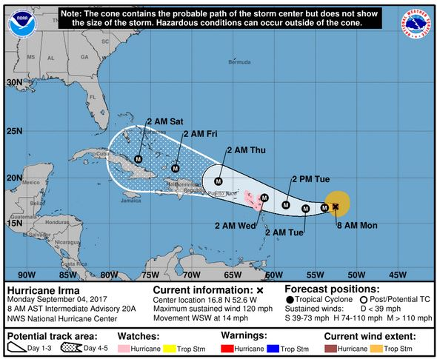
Cone of Uncertainty Social and Behavioral Research NOAA Virtual Lab Presentation March 18, 2020
Jennifer Sprague-Hilderbrand, NOAA NWS
Linda Girardi, ERG
Robbie Berg, NOAA NWS/NHC
Notes:
Hello, I am happy to be here today representing a team of researchers working under contract with NOAA to examine the National Hurricane Center’s Track Forecast Cone, also known as the Cone of Uncertainty.

Slide 2
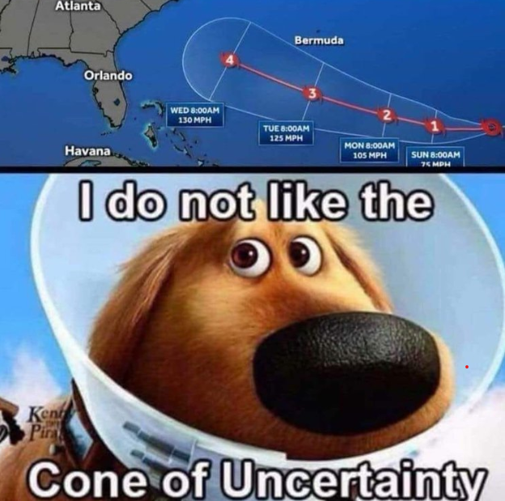
Operational Challenge to Be Addressed
Over the years, I have seen quite a few misinterpretations of the cone by the public, media, and stakeholders. … If articles have to be written to explain the intent to the public, is it too complicated for its intended purpose?
Marshall Shepherd, “The Hurricane Forecast 'Cone of Uncertainty' May Not Mean What You Think,” Forbes, April 2017
Notes:
Going into this work, we knew anecdotally that the Cone may be both the most public-facing and most misunderstood NOAA forecast product.
Our research is therefore focused on better understanding the interpretation, use, and decision-making around this graphic by key National Weather Service stakeholders, with a goal of providing NOAA with information to help it determine if changes should be made to the graphic—and whether those be around its visualization, its content, its dissemination, all of the above, or something else.

Slide 3
Research Objectives
How is the cone interpreted and used?
How embedded is the cone in stakeholder decision-making?
What decisions are made based on the cone and what are the implications of those decisions?
Notes:
Specifically, our research addresses three main questions: 1) How is the cone interpreted and used? 2) How embedded is the cone in stakeholder decision-making? And 3)
What decisions are made based on the cone and what are the implications of those decisions?

Slide 4
Timeline
Literature Review
Completed in April 2019
Looked at nearly 60 studies and NWS service assessments
Survey
Tentatively looking at deployment in the summer of 2020 with analysis in fall of 2020
Interviews
Initial set of seven interviews completed 3/13/20
Notes:
To address these objectives, we are taking a three-pronged research approach. We began with a literature review of nearly 60 research studies and NWS service assessments to get a baseline understanding of how the Cone Graphic is being interpreted and used for decision-making, primarily by members of the public. We have also designed a survey, which will be distributed to less-studied, but critical sectors of NHC’s user base: the transportation, marine, energy, and tourism sectors. Finally, because the Cone Graphic is used internationally, we are conducting in-depth interviews with meteorologists in Canada, Mexico, and several Caribbean nations and dependent territories.

Slide 5
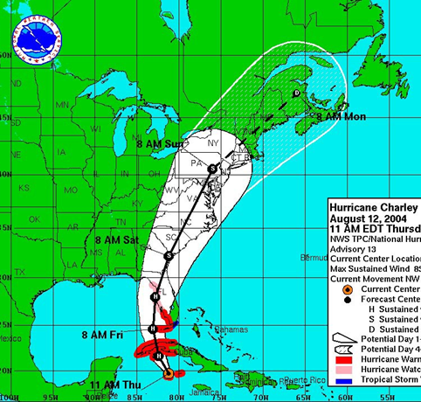
Background From NHC website: The cone represents the probable track of the center of a tropical cyclone, and is formed by enclosing the area swept out by a set of circles (not shown) along the forecast track (at 12, 24, 36 hours, etc.). The size of each circle is set so that two-thirds of historical official forecast errors over a 5-year sample fall within the circle. https://www.nhc.noaa.gov/aboutcone.shtml
Notes:
Just a little background about the cone before we get into the findings. The cone represents the probable track of the center of a tropical cyclone (exact definition on this slide). The visualization has changed over the years. For example, as forecast track errors have decreased over time, the size of the cone has also decreased. The NHC has also added a statement that the cone contains the probable path of the center of the storm and does not represent the size of the storm, and that hazardous conditions can occur outside of the cone.

Slide 6
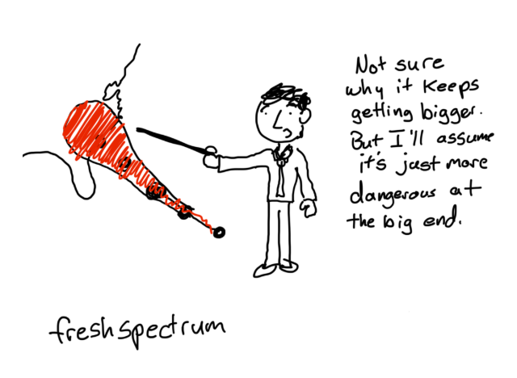
Literature Review Findings Members of the Public
Problem | Implication
Misinterpreting the cone as the swath of damage from the storm (i.e., an impact visualization). | Believing a person is “safe” if located outside of the cone or having an exaggerated sense of not being safe if located inside the cone.
Misinterpreting the cone as the actual size and or intensity of the hurricane. | Believing the hurricane is increasing or decreasing in size or strength as it approaches land.
Notes:
Most of this presentation will focus on the results of the literature review, since we have just completed the interviews and the survey has not yet been distributed.
Our literature review found a number of documented misinterpretations about the Cone Graphic. This statement addresses two important misconceptions about the cone documented in the literature: 1) People often view the graphic as an impact visualization (they feel safe if they are located outside of the cone and doomed if they are inside of it and 2) many people misinterpret the cone as the actual size (or intensity) of the storm.

Slide 7
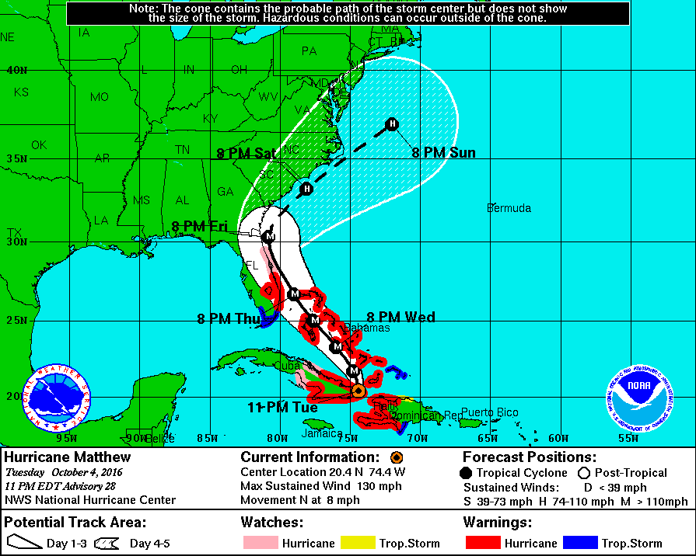
Line or No Line? The NWS service assessment of Hurricane Matthew found that: Significant confusion continues regarding the official NHC tropical cyclone track forecast. NWS partners and the public alike continue to focus on the “skinny black line.”
NOAA. (2017). Service Assessment: October 2016 Hurricane Matthew. National Oceanic and Atmospheric Administration, National Weather Service. Silver Spring, MD. https://www.weather.gov/media/publications/assessments/HurricaneMatthew8-17.pdf
Notes:
Additional misconceptions focus on the track itself with implications on preparedness and risk perception. A key issue is the tendency for people to focus on the center track line and not recognize impacts could occur beyond this center path. To help address this concern, the NHC changed its website so that the cone can be viewed with or without the track line (the no track line is the default view). Confusion seems to remain as evidenced by the 2016 NWS Service Assessment for Matthew.

Slide 8
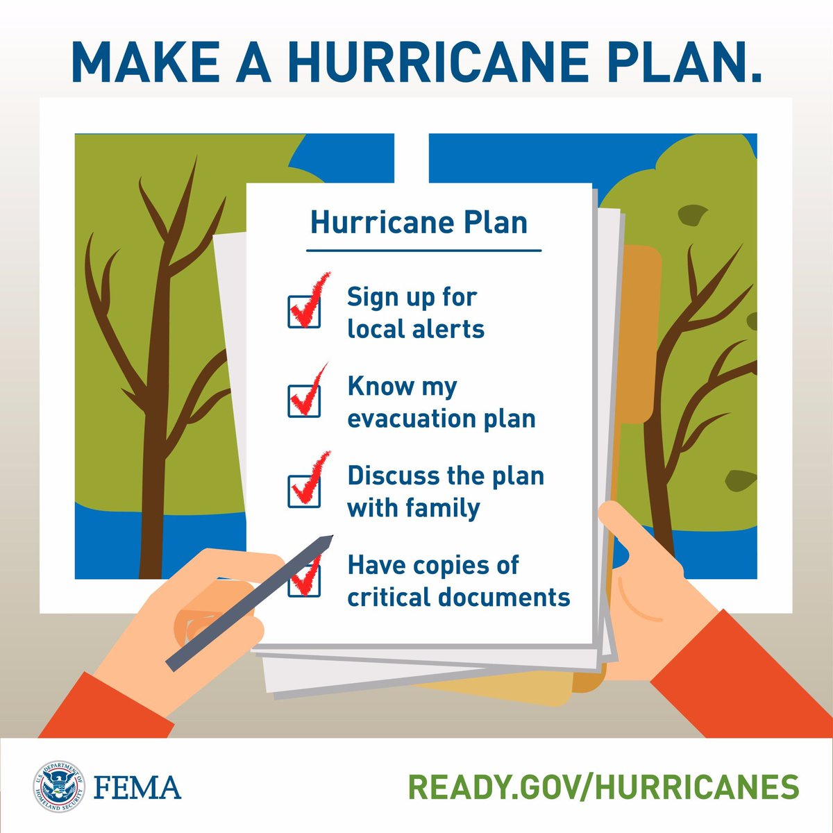
Some realization that hurricanes do not follow the track or stay within cone
Notes:
However, the literature also indicates that people do realize that hurricanes might not always follow the forecast track or even fall within the cone. In fact, one study, participants who viewed forecast graphics containing the track line had higher levels of preparation than those who saw only the cone, and this was true even for people living far from the predicted center path.

Slide 9
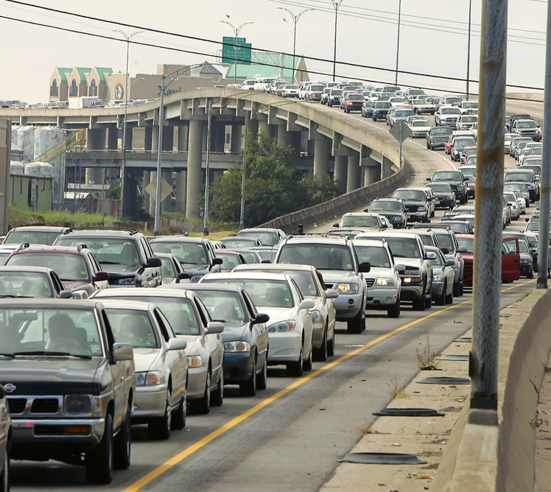
Literature Review Findings: Members of the Public
Decisions
Notes:
We also looked at the types of decisions that people make in preparing for a storm. For an imminent storm, these include protecting homes, buying emergency supplies, securing pets and loose objects, making evacuation plans, and actually evacuating.

Slide 10
Literature Review Findings: Members of the Public
Information Sources
Notes:
The literature shows that the public’s risk perception and decision framework for taking these actions is holistic, comprising information from many sources, including NOAA forecast products, private weather products, public officials, television and radio broadcasts, and the internet and social media. In addition to these information sources, many other factors influence decision making, including past experience with hurricanes, friends and family, people’s risk perceptions and risk tolerance thresholds, and their worldviews.

Slide 11
Literature Review Findings: Members of the Public
Other Factors
Notes:
In addition to these information sources, many other factors influence decision making, including past experience with hurricanes, friends and family, people’s risk perceptions and risk tolerance thresholds, and their worldviews.

Slide 12
Literature Review Findings Members of the Public
Influences on Decision-Making
Probability and uncertainty concepts are confusing.
Does not provide information likely to influence decision-making.
Notes:
While the cone is the most well-known and sometimes the only NOAA product that members of the public access, the graphic does not necessarily influence people’s preparations in a positive way. The literature provides two prevailing reasons for this. First, the underlying concepts of probability and uncertainty depicted in the cone can easily confuse people and cause them to misinterpret messaging, as discussed earlier. Second, the cone does not provide the types of information (such as storm surge, storm size, impacts, calls-to-action) that are more likely to influence the public’s decision-making, particularly in regard to evacuation.

Slide 13
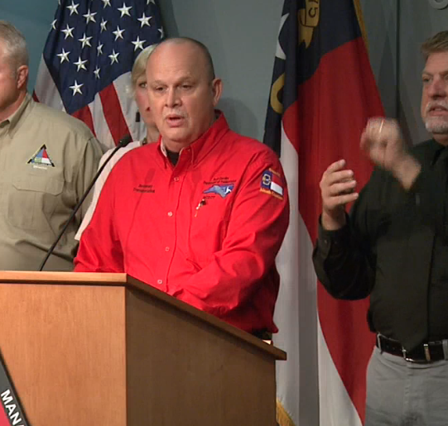
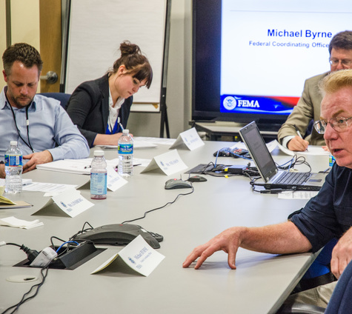
Literature Review Findings: Emergency Managers
Cone is the most well-known product, but use many other products and information sources
Notes:
We also looked at research related to the use and interpretation of the cone by emergency managers. As with members of the public, the cone is widely viewed and used by emergency managers, but it is just one piece of information among many that they use. Emergency managers rely heavily on discussions and briefings with trusted forecasters at NHC and their local WFO; many also use decision-support tools, such as HURREVAC, to help in their planning and decision-making.

Slide 14
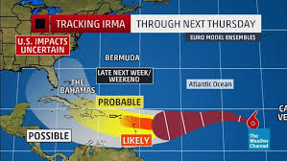
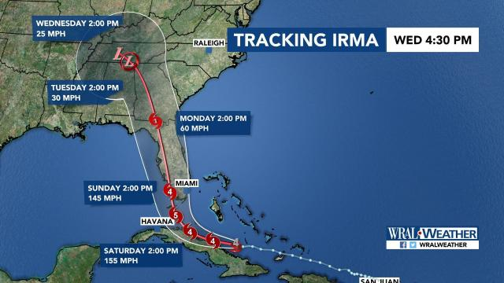
Literature Review Findings: Broadcast Meteorologists
Broadcasters create their own but also use verbal messaging and body language
Notes:
Like emergency managers, broadcasters use the NHC Cone Graphic along with many other resources, and they often create their own versions of the graphic. Because they know the Cone can be confusing to the public, they also rely on their body language and verbal messaging to talk about the Cone on air and in their social media posts.

Slide 15
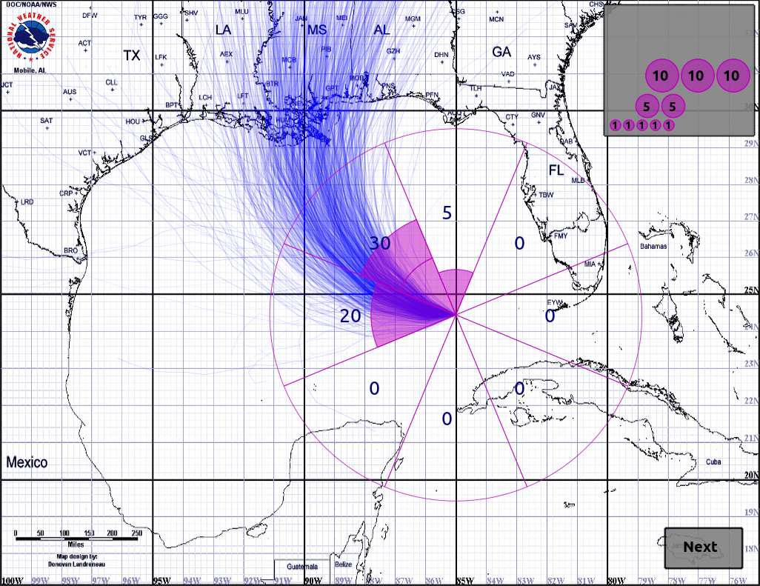
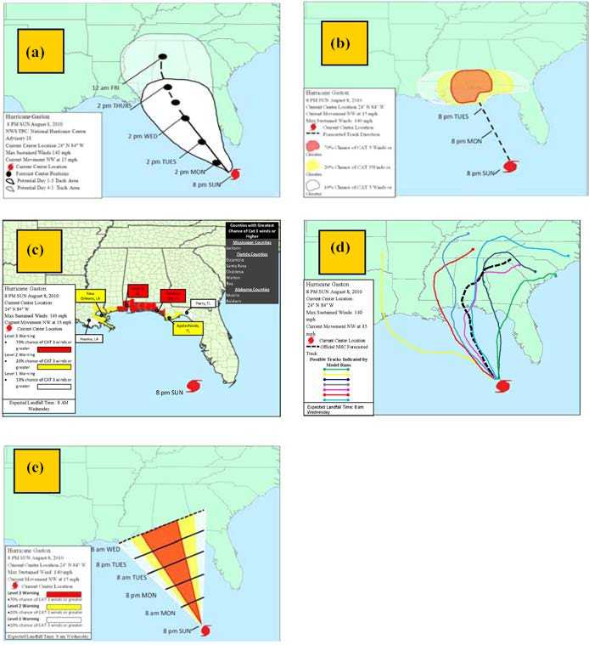
Alternative Visualizations
Notes:
Much research is under way exploring alternative visualizations of the cone. These include summary displays, such as the cone, and ensemble displays. Both types have pros and cons.

Slide 16
Summary Displays
Notes:
Summary displays are created by plotting statistical parameters (e.g., mean, median, standard deviations) instead of plotting actual data points. Compared to other methods, summary displays are often used for public presentations of data because they are simple to understand and enable viewers to recognize patterns. However, researchers have also documented drawbacks to summary displays. For example, they require an explanation and legend, placing additional cognitive load on the viewer.

Slide 17
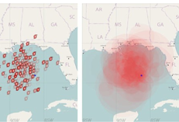
Ensemble Displays
Notes:
Ensemble displays are another method of visualizing uncertainty. Over the last decade, a wealth of ensemble visualization techniques have been introduced in many scientific domains and encouraging results have been reported. Ensemble displays are created by generating or collecting multiple data values or “ensemble members” and then, plotting all, or a subset of, the ensemble members on a plane.

Slide 18
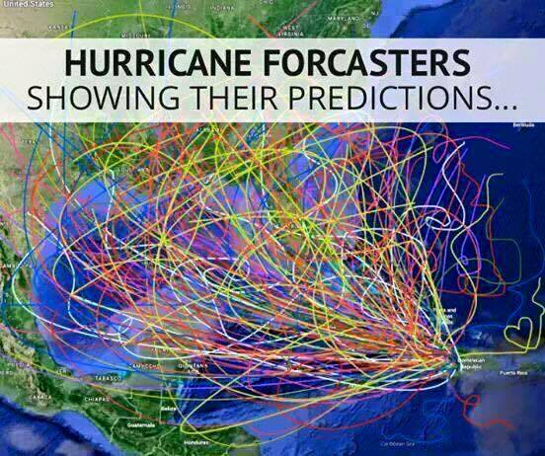
Downsides to Ensemble Displays
Notes:
However, there are also some drawbacks to ensemble displays. The primary issue is visual crowding, which happens when ensemble members are plotted too closely together and cannot be easily differentiated. Viewers may also overweight individual ensemble members when they overlap with a point of interest This could lead to situations where individuals may be more likely to evacuate or take precautionary actions if a hurricane forecast track overlaps with their own town but feel less concerned or do not take action if the track does not.

Slide 19
Dynamic Visualizations
Notes:
Researchers are also investigating animated approaches for ensemble visualizations. One study looked at four different displays (two static and two dynamic). Of the four displays, an animated icon visualization (second from right) that continuously added new ensemble members while fading out others was most effective in reducing the tendency to confound uncertainty with storm size. However, the study revealed other misconceptions with these visuals; for example, many viewers mistakenly saw the animated displays as indicating the passage of time.

Slide 20
Simple and Communicative
Notes:
Another study that tested five alternative graphics found participants preferred the “e” graphic, which they praised for being simple and communicative. Most respondents said they wanted to be able to glance at the graphic in 20 seconds or less and be able to glean everything they need to understand the map. The study also found that some segments of the population desire to see additional storm attributes, such as hurricane size, color threat levels, and post-landfall hazards.

Slide 21
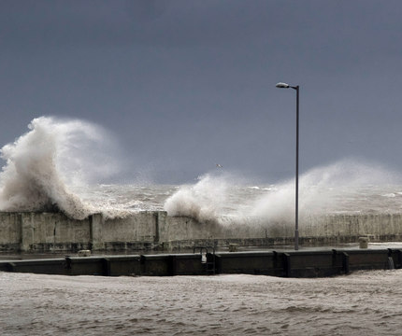
Information on Hazards
Notes:
While we just finished our interviews with international meteorologists and haven’t formally analyzed the results, several did echo this same desire to see information about the other hurricane hazards (such as rainfall and storm surge) depicted on or as a complement to the Cone Graphic, noting that in their countries, and depending on the particular storm, these other hazards can be of more concern than the wind. Some suggested including layers on the web that could be turned on or off to view other hazard information.

Slide 22
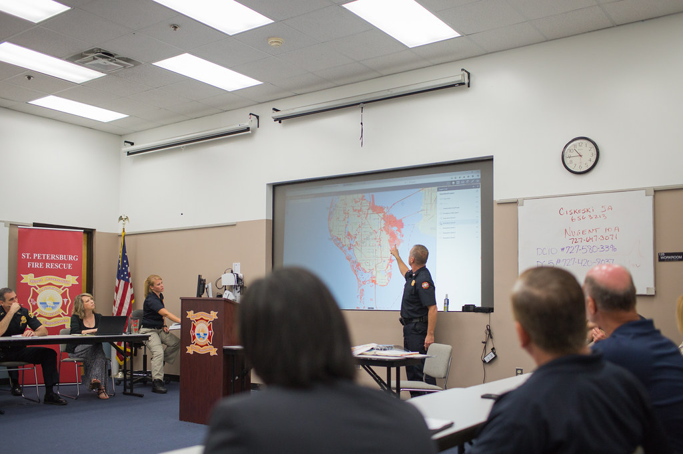
Looking Ahead
Notes:
While the literature review is just one phase of this work, it has spurred some observations that NOAA may consider as it contemplates potential changes to the cone. The cone is seen and used by many different audiences. Not only do these groups have different levels of sophistication and expertise, they also have different purposes for using the cone. For example, while members of the public may be simply monitoring a situation, emergency managers are using the cone (with other information) to make localized planning and preparedness decisions. A key concern is whether a single graphic can address the needs and tasks of different users.

Slide 23
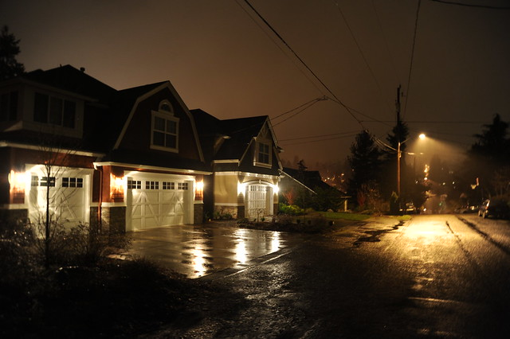
Localized Information Impacts
Notes:
Another consideration is whether to add (or subtract) certain information to the graphic. For example, Adding localized messaging about potential impacts may help the public more easily relate the forecast to their personal risk and increase their protective decision-making. However, trying to visually present all this information in one static graphic could be overwhelming. An interactive or dynamic visualization could open up the possibility to customize the cone so that users could obtain localized impacts.

Slide 24
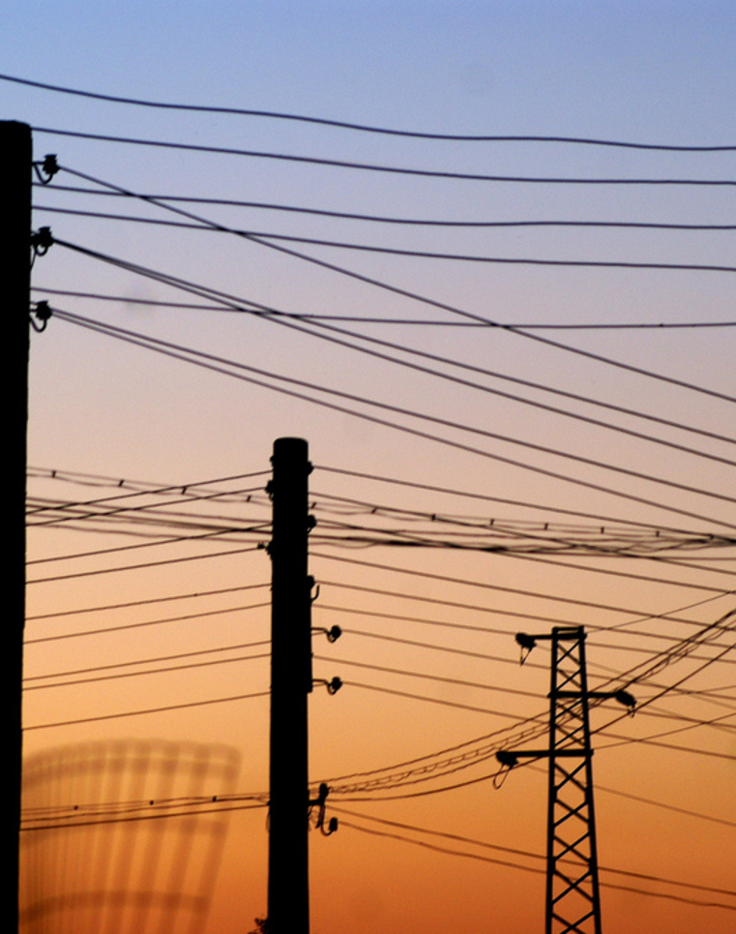
Survey: Energy/utilities, transportation, marine, and tourism sectors
Notes:
We are also in the process of developing a survey to learn more about the Cone’s wider user base, which is not represented in the literature. The survey will be directed to four key sectors that have an important role in protecting public safety, serving populations vulnerable to hurricanes, and/or ensuring national security and economic welfare. These are the transportation, marine, energy/utilities, and tourism sectors. The survey will assess how these sectors interpret the graphic, what decisions they make based on the graphic, and whether the graphic is helping to inform these decisions.

Slide 25
Survey Objectives
How do they interpret the Cone Graphic?
What decisions to they make based on the Graphic?
What other information do they need/access to inform decision-making?
What are the strengths and weaknesses of the graphic?
Notes:
The survey will assess how these sectors interpret the graphic, what decisions they make based on the graphic, what other information they need and access to make hurricane preparedness decisions, and what they perceive to be the strengths and weaknesses of the graphic, along with their suggestions for enhancing the graphic. We hope to gather at least 1,400 responses, as evenly split as possible, across the four sectors.

Slide 26
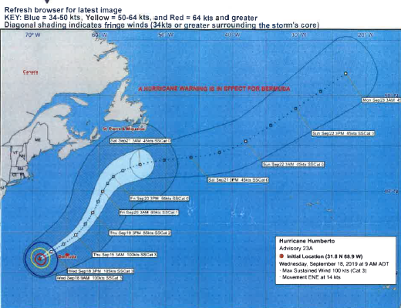
Interviews with International Meteorologists
Notes:
Also, as mentioned earlier, we have just finished seven in-depth interviews with International meteorologists to learn how they use the Cone Graphic to inform decision-making. We are also gathering examples of how they may “repackage” the graphic or provide additional messaging when they distribute the graphic, as well as their insights into strengths, weaknesses, and alternative or enhanced visualizations.

Slide 27
Questions?
Notes:
We look forward to continuing to work on the next phases of this research and gathering more information on this important forecast tool.

