Slide 1
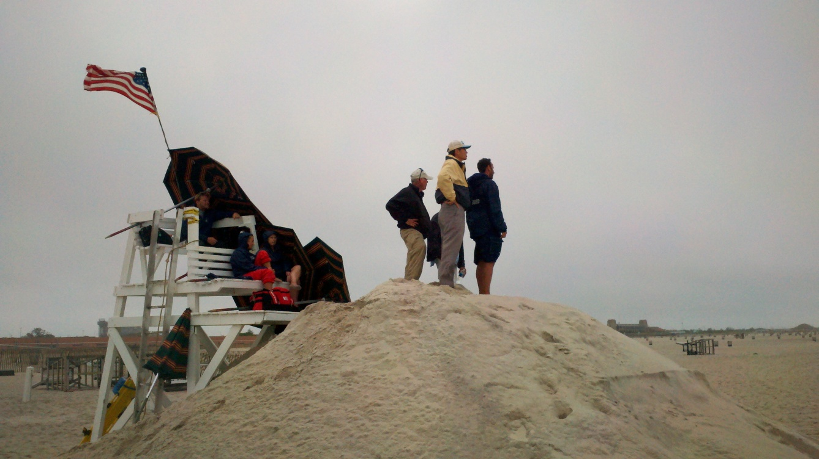
Rip Current Local Collaboration Project
Observation, Analysis, and Forecasting
Mike Churma, John Schattel, Chung-Sheng Wu
NWS Meteorological Development Laboratory
Notes:
Collaboration is especially important in times of scares resources (even lifeguard agencies have funding problems).

Slide 2
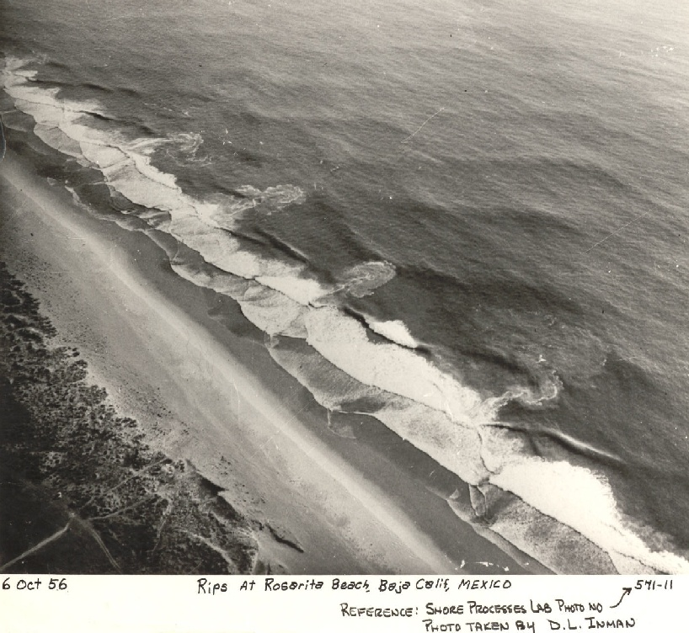
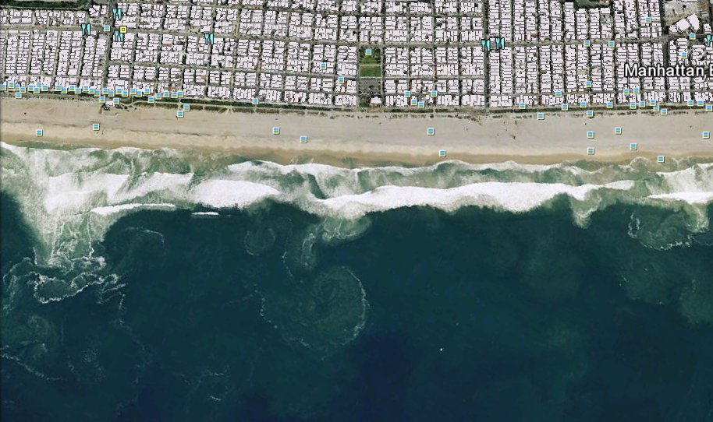
Rip Currents -- A jet-like seaward flow across the surf zone of a beach.
Notes:
Introduce basic rip current concepts.

Slide 3
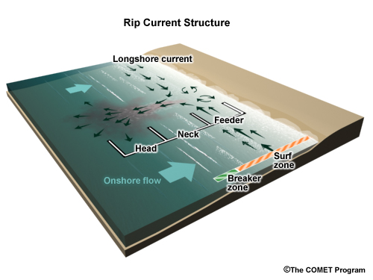
In 2011 , 30,981 out of 60,635 total rescues by lifeguards involved rip currents
(Source – usla.org)
Notes:
Give reference to COMET module. Describe process – onshore flow leads to wave breaks and tumbling “bores” water mass transport. Longshore current flows to low spots, can concentrate into rip currents that jet out tu return water mass outside breaker zone.

Slide 4
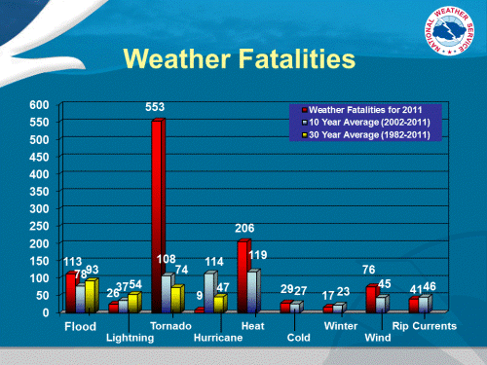
http://www.nws.noaa.gov/os/hazstats/resources/hazstat-chart12.gif

Slide 5
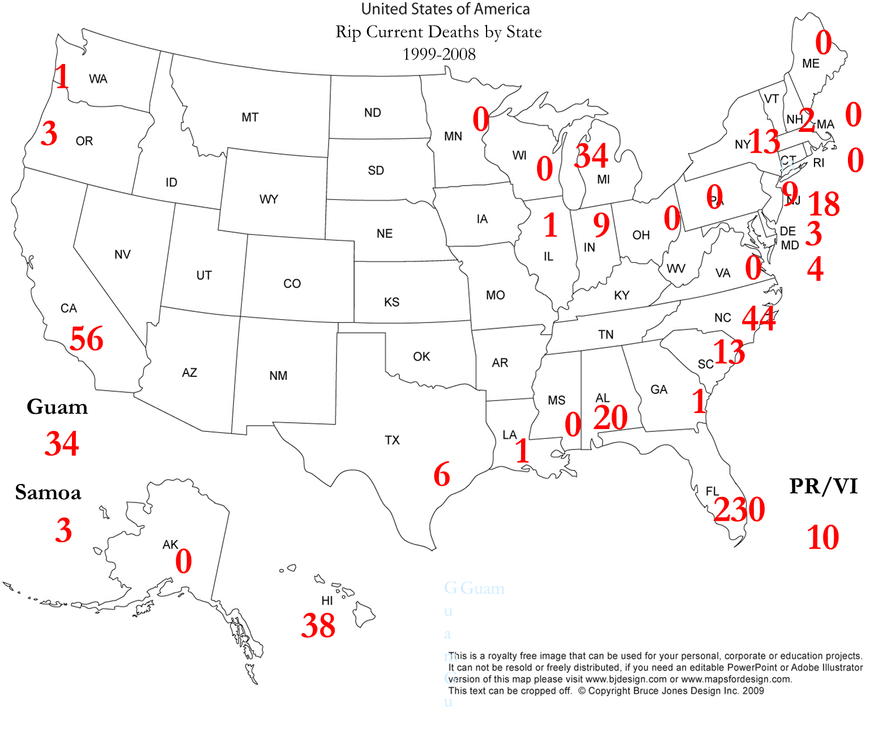

Slide 6
Without observations of rip currents we can not verify rip current forecasts for beach safety.
2004 NWS-Sea Grant Rip Current Technical Workshop:
“A pilot program should be implemented to monitor rip currents so as to reduce the hazard they pose to the public.”

Slide 7
Stakeholders: A Team Approach
MDL OST
-Science
-Development
OCWWS
-Policy
-Coordination
Regions/WFOs
- Forecasting
- IDSS
Local Lifeguards
-Beach Safety
-Observations

Slide 8
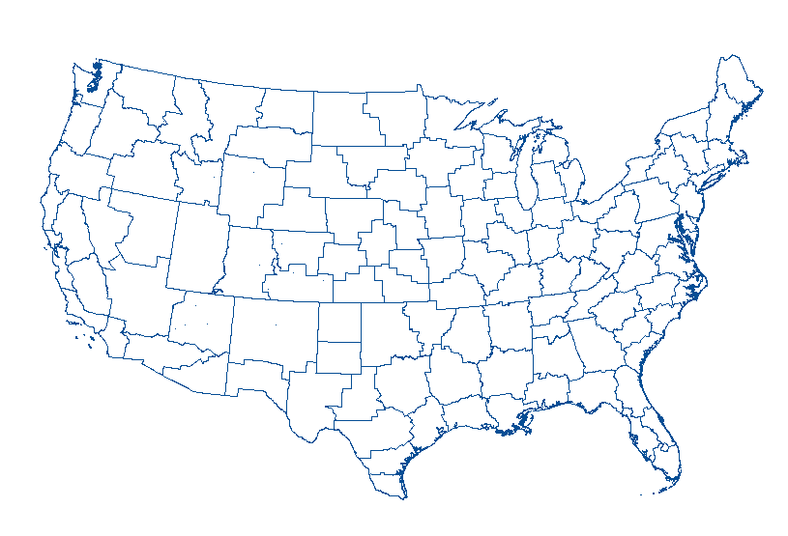
IWX
OKX
LOT
ILM
SGX
JAX:
MLB
Participating Beaches
Notes:
Current participating WFO’s and beaches.

Slide 9
Observation Stored
In Rip Current
Database
3
NWS
Web
Farm
1
Lifeguard
Observes
(2/day)
4
Supplemental
Data
Added
Internet
MDL
H
Q
WFO
5
2
Observation entered into web form
Analyze
Observations

Slide 10
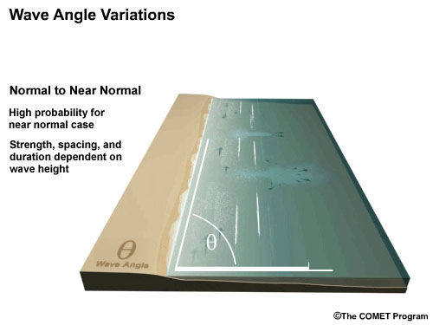
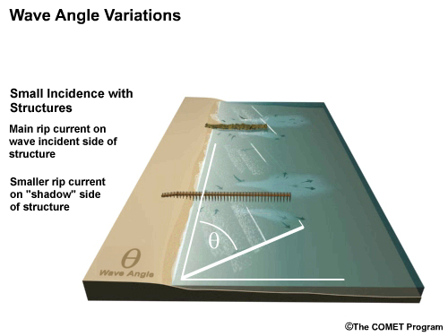
Near-normal incoming waves will most likely cause rip currents at beaches with no permanent outcroppings.
Permanent outcroppings along the shoreline, such as jetties or piers, can cause rip currents, especially with oblique wave angles.

Slide 11
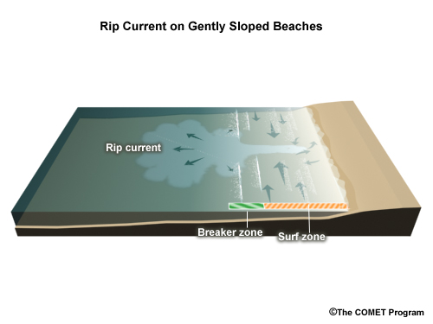
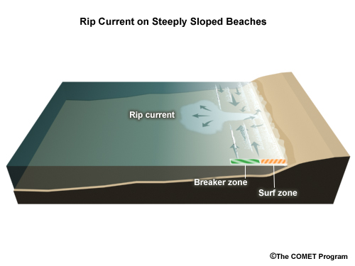
Wave breaks when wave height is > ~0.8 times the water depth.
Rip currents are more often seen at beaches with mild slopes instead of steep slopes, because this affects the surf zone width and therefore the amount of water transport.

Slide 12
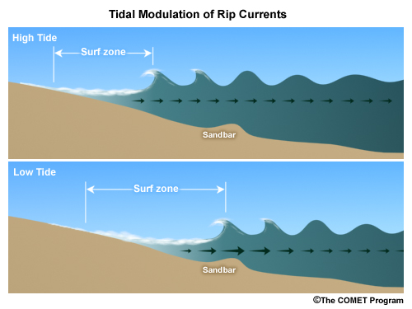
Changes in water level via tides or (in the Great Lakes) seiches or seasonal water level variations can provoke rip currents through surf zone with changes and increase channeling through sandbars.

Slide 13
Observation Stored
In Rip Current
Database
3
NWS
Web
Farm
1
Lifeguard
Observes
(2/day)
4
Supplemental
Data
Added
Internet
MDL
H
Q
WFO
5
2
Observation entered into web form
Analyze
Observations

Slide 14
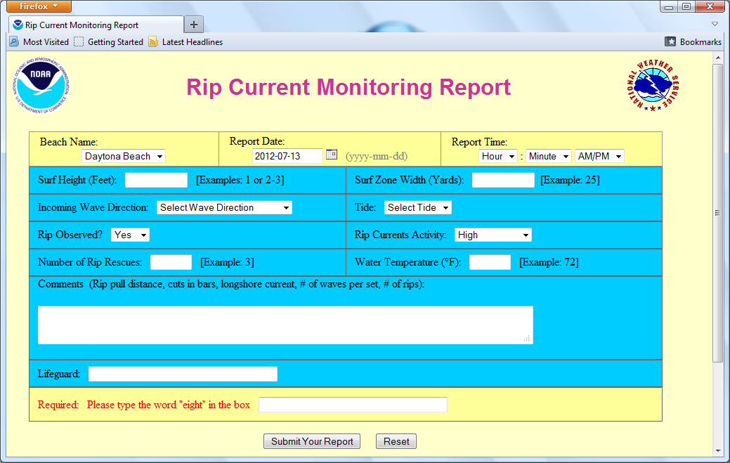
MDL Rip Current Report Form (WFO-MLB)
Notes:
Web Form for WFO MLB. Note the references to some of the important features in rip formation, and also the water temperature (MDL tried to incorporate previous parameter reporting into the form).

Slide 15
3
Observation Stored
In Rip Current
Database
NWS
Web
Farm
1
Lifeguard
Observes
(2/day)
4
Supplemental
Data
Added
Internet
MDL
H
Q
WFO
5
2
Observation entered into web form
Analyze
Observations

Slide 16
Jacksonville Beach Rip Current Report
LOCATION: Jacksonville Beach
OBSERVATION TIME (L): 2012-07-17 12:05 PM
SURF HEIGHT (FT): 2-3
SURF ZONE WIDTH (YDS): 80
WAVE DIRECTION: E
WATER LEVEL CATEGORY: Falling
RIP CURRENT OBSERVED (Y/N): Yes
RIP CURRENTS ACTIVITY: High
RIP RESCUES: 5
WATER ATTENDANCE: High
COMMENTS: Extremely hazardous conditions persist throughout area. Deep sloughs and powerful feeder currents are creating unusually strong rip current conditions.
LIFEGUARD: Taylor Anderson
Notes:
E-mail output from the web forms (now manually input into NIDS, but will be automated in the future).

Slide 17
Rip Current Activity Level
-- A subjective assessment of activity of rip currents that could impact swimmers at a particular beach. It encompasses aspects of both the strength and number of rip currents
High Activity: Many, strong rip currents
Medium Activity: Many, weak rip currents
Low Activity: A few weak rip currents
No Activity: No rip currents

Slide 18
3
Observation Stored
In Rip Current
Database
NWS
Web
Farm
1
Lifeguard
Observes
(2/day)
4
Supplemental
Data
Added
Internet
MDL
H
Q
WFO
5
2
Observation entered into web form
Analyze
Observations

Slide 19
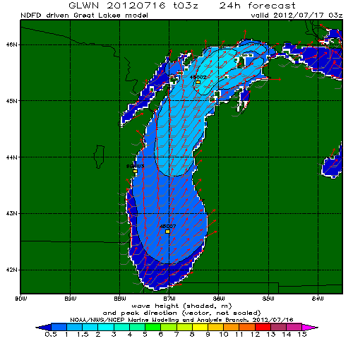
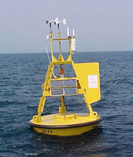
Stored Obs/Forecast Parameters (when available):
Wave Ht/Pd/Dir
Swell Ht/Pd/Dir
Tide Level
Water Temperature
http://polar.ncep.noaa.gov/waves/viewer.shtml
Models:
WaveWatch III
Coastal Data Information Program (CDIP)
Great Lakes Coastal Forecasting System (GLCFS)
http://www.ndbc.noaa.gov
Corresponding model data and station observations are paired with the lifeguards reports for later analysis
Notes:
At SGX, a tangible “lesson learned” from the observations was that the surf height did not need to be high to provoke rip currents.

Slide 20
3
Observation Stored
In Rip Current
Database
NWS
Web
Farm
1
Lifeguard
Observes
(2/day)
4
Supplemental
Data
Added
Internet
MDL
H
Q
WFO
5
2
Observation entered into web form
Analyze
Observations

Slide 21
Surf (ft) | 1.5 - 2.0 | 2.0 – 3.0 | 3.0 - 5.0 | Preventive warnings
Tide level
Low | 2 | 5 | 3 | 1270
Mid | 3 | 9 | 0 | 456
High | 0 | 4 | 1 | 49
Sub-total | 5 | 18 | 4 | 1775
Encinitas Lifeguards safety service record (7/1-8/30/2008)
Many beach rescues occur in 2-3 ft waves (WFO-SGX).
Notes:
At SGX, a tangible “lesson learned” from the observations was that the surf height did not need to be high to provoke rip currents.

Slide 22
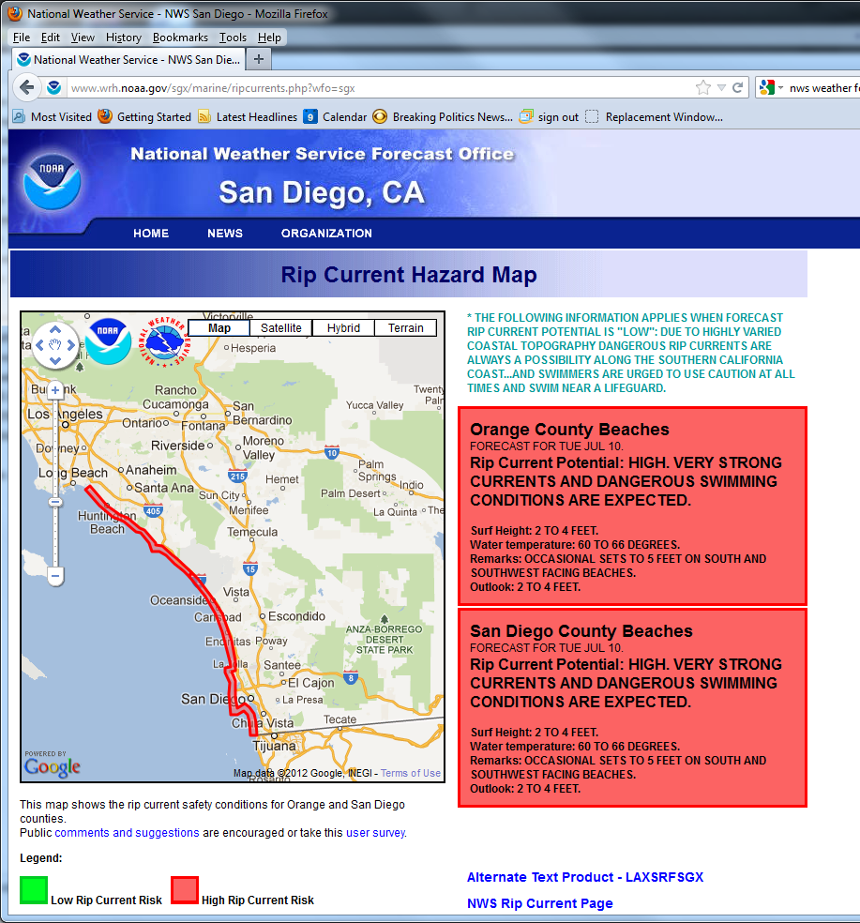
“This ongoing project is a good example of how a clear goal and good communications between HQ,
WFO, emergency partners, and media can work and be successful for a common cause.”
Noel Isla, WFO-SGX
Notes:
Improved situational awareness has resulted from lifeguards’ reports.

Slide 23
3
Observation Stored
In Rip Current
Database
NWS
Web
Farm
1
Lifeguard
Observes
(2/day)
4
Supplemental
Data
Added
Internet
MDL
H
Q
WFO
5
2
Observation entered into web form
Analyze
Observations

Slide 24
Rip Current Forecasting Tools (Wu)
Incorporating input from key rip current forcing factors:
  Significant Wave Heights
  Coastal Winds
  Peak Wave Periods
  Total Water Levels
Other factors to take into account:
beach orientation
hot weather
beach sand characteristics
Model types tested:
Check List Tables
Parametric Models
Regression Models

Slide 25
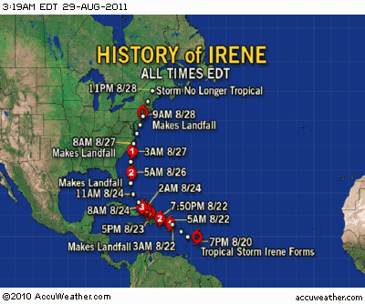
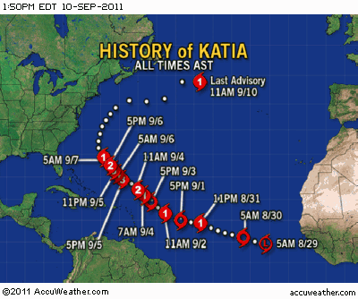
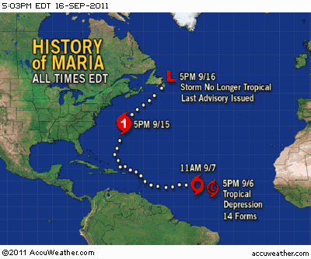

Slide 26
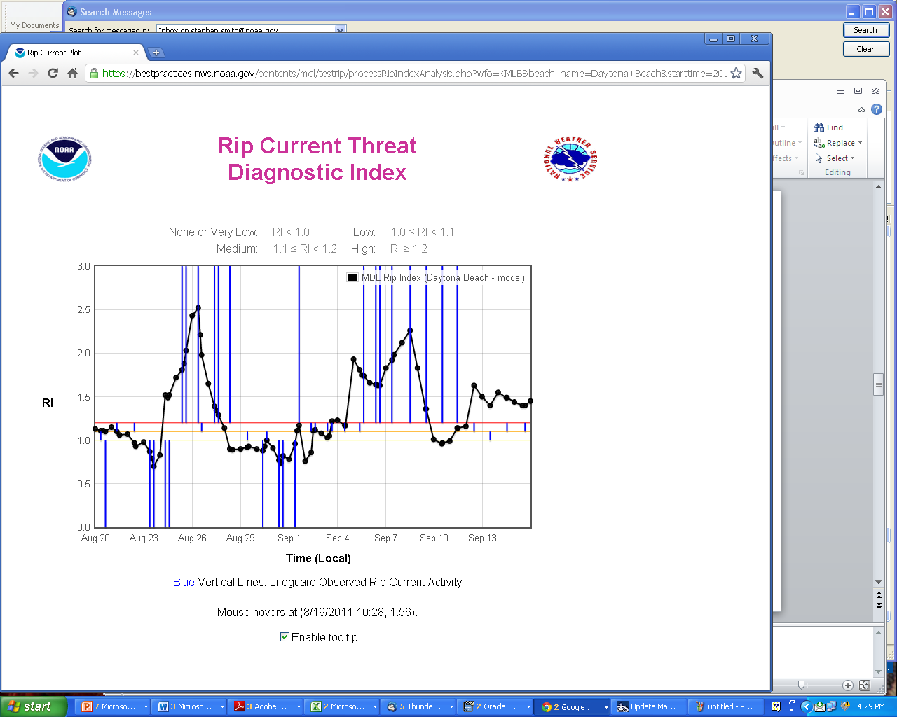
Automated Local Rip Current Guidance
RI = A*H + B*T – C*h
H=Surf Zone wave ht; T=Surf Zone Wave Pd.; H = Water Level
A, B, C = empirically-derived coefficients (e.g., beach slope and orientation)
Rip Episode - Katia
Rip Episode - Irene
Maria
# Rescues
5
3
2
3
2
2
25
1
9
34
23
1
1
Daytona Beach, Florida
Rip Current Episode -- An extended period of medium to high rip current activity at a beach lasting from a few hours to several days

Slide 27
MDL Automated Local Rip Current Guidance Skill Scores
Summer 2011 at Daytona Beach, FL
 | POD (Probability of Detection) | FAR (False Alarm Rate) | CSI (Critical Success Index)
Hurricanes Irene & Katia 08/24 – 09/15 | 0.71 | 0.26 | 0.67
Summer 2011 05/20-09/25 | 0.65 | 0.27 | 0.63

Slide 28
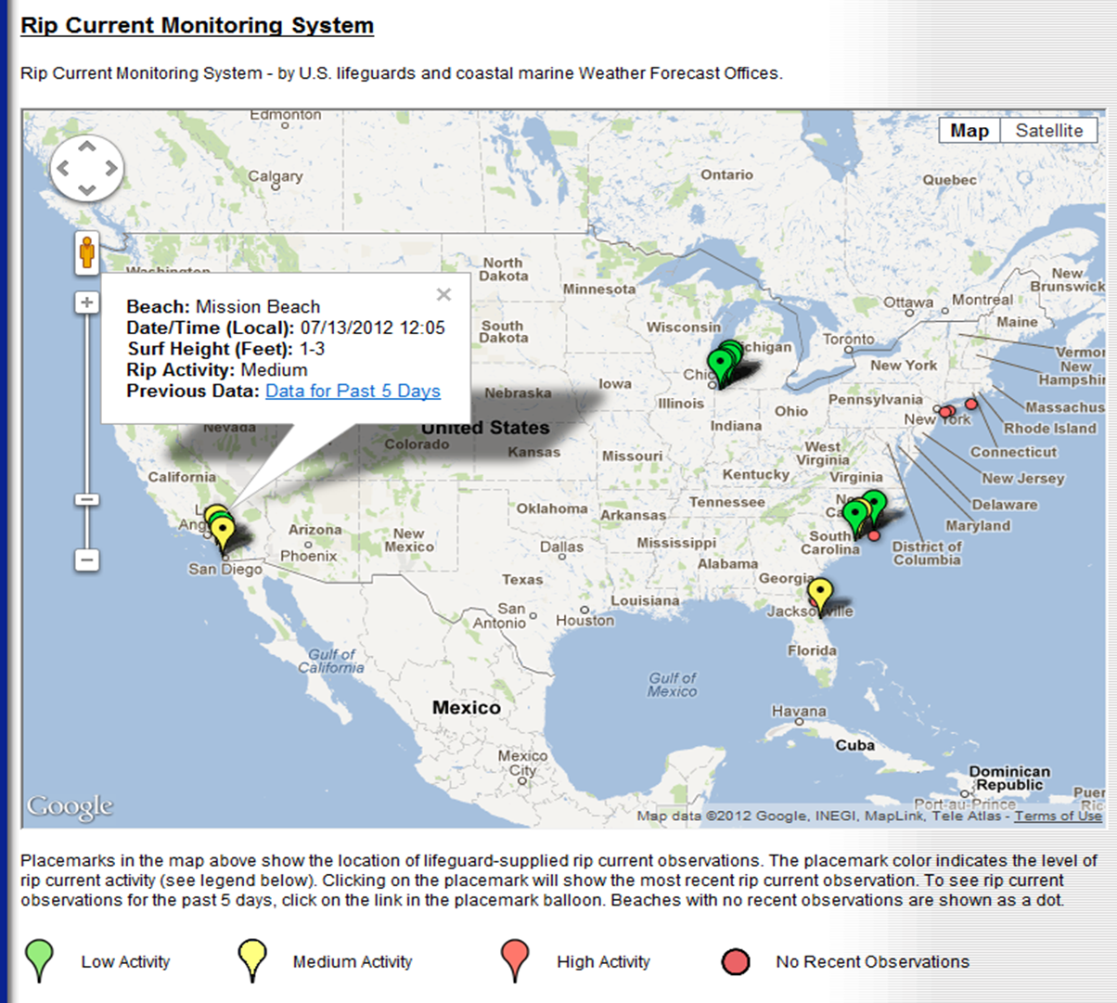
Experimental MDL Rip Current Activity Level page – Lifeguard Rip Activity reports mapped to beaches.
http://www.nws.noaa.gov/mdl/survey/pgb_survey/dev/rip_current/index.php?L=259

Slide 29
Short-Term Goals
Provide WFO’s and partners with instant access to past lifeguard reports, supplemental data, and automated local rip current guidance.
Assist WFO’s with setting up rip current collaboration with local lifeguard agencies.
Send rip current reports/alerts to WFO’s via AWIPS.

Slide 30
Long-Term Goals
Develop beach-specific rip current forecasts and diagnostics.
Create methodology that can be shared with WFO’s to develop their own formulas.
Share lifeguard reports and rip current diagnostics/forecasts with the public.
-- Working towards an Impacted-Based Decision Support Services approach for rip current hazards.

Slide 31
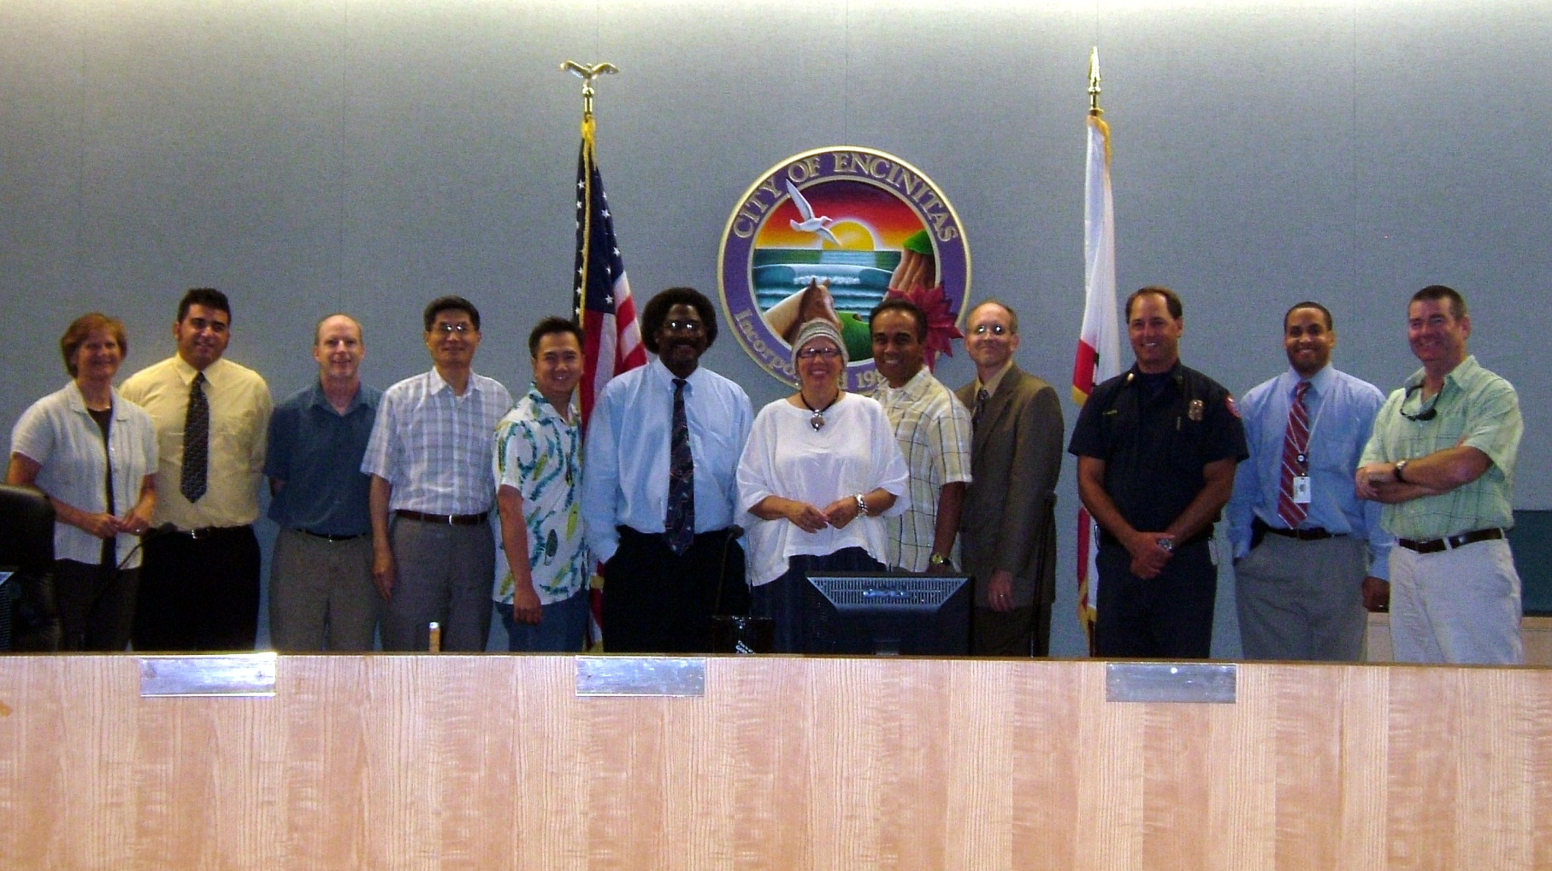
(Listed from left to right):
Julie Thomas, Andrew MacAuthor, Dr. William O’Reilly, Dr. C-S Wu, Michael Khuat, Ivory Small, Mayor Maggie Houlihan, Noel Isla, Dr. Stephan Smith, Capt. Larry Giles, Jason Taylor, and Sgt. David Rains
Notes:
Collaboration is especially important in times of scares resources (even lifeguard agencies have funding problems).

