Slide 1
RTMA/URMA v2.8 Improvements and Plans for the Future
Jacob R. Carley¹, Manuel Pondeca¹², Steve Levine^{13*}, Ying Lin¹, Yan Luo¹² Annette Gibbs¹², Jim Purser¹², Stylianos Flampouris¹², Xiaoyan Zhang¹², Matthew Morris¹³, Edward Colon¹², Runhua Yang¹², Gang Zhao¹², Jeff Whiting¹², and Daryl Kleist¹
And many other excellent folks from ESRL/GSD, NWS WFOs and Regions, MDL + the NBM team, and NCEP Centers
¹NCEP/EMC/Modeling and Data Assimilation Branch
²IM Systems Group
³Systems Research Group
*Now at MDL

Slide 2
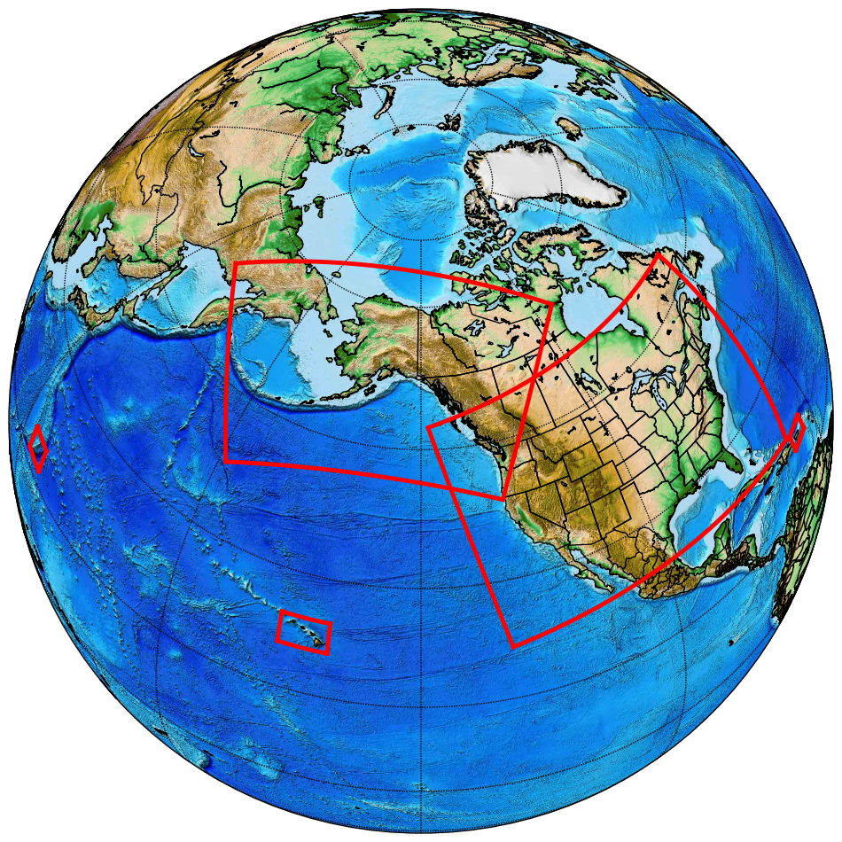
RTMA/URMA/RTMA-RU
2D, 2.5km* analysis of sensible wx elements
2DVar system
2m T and moisture, 10m wind and gust, ceiling, visibility, sky cover, wave height, etc.
Real Time Mesoscale Analysis (RTMA)
Hourly
Real time system for nowcasting and situational awareness
UnRestricted Mesoscale Analysis (URMA)
Runs 6 hours after RTMA to capture late arriving obs
Verification, calibration, analysis of record
Calibration in National Blend of Models
RTMA-Rapid Update
15-min updates, low-latency
Nowcasting, aviation, + situational awareness
RTMA-Rapid Update
RTMA
RTMA + URMA
*AK domains are currently at 3 km
*PR now at 1.25 km

Slide 3
v2.8 RTMA/URMA Upgrade: Highlights
Downscaling/background field improvements [All stakeholders]
2.5 km → 1.25 km for PR, consistent with NDFD [NBM, Puerto Rico]
Improved wind analysis with reduced low bias [All stakeholders]
Significant wave height for Guam and Great Lakes [NBM, Guam, Great Lakes]
Moisture/dew point analysis enhancements [NBM, W. Region, WFO Missoula]
Re-tuned sky cover analysis with enhanced QC [NBM, CONUS, AWC]
Consistent ceiling and sky analysis [All stakeholders, esp. AWC]
Precipitation enhancements [CONUS and coastal CONUS, WPC]
NOHRSC snow analysis [CONUS, WPC]
Expansion of upgrade for better fit to observations for OCONUS (already in CONUS) [NBM, OCONUS]
Many improvements continue to be motivated via collaboration with highly engaged stakeholder community

Slide 4
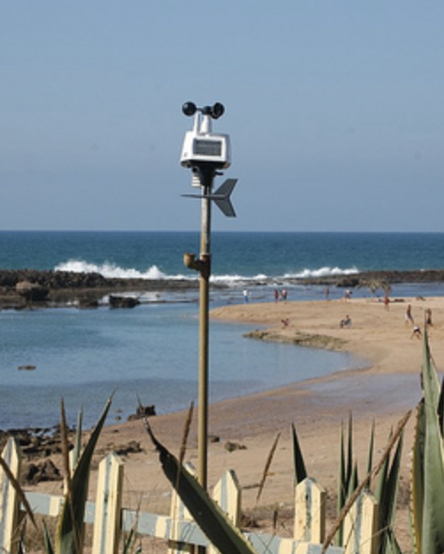
Wind Changes: Similarity Theory Adjustment
Has been assumed that all wind obs are taken at 10 m AGL
We know from looking at station photos that this is not true
For mesonets: wind sensor height will now be a function of provider/network
Background wind is adjusted via similarity theory to the same height as the observed wind
Observation is be compared against this adjusted background wind value
Similar adjustments made to gust analysis
Station photo from weather.gladstonefamily.net

Slide 5
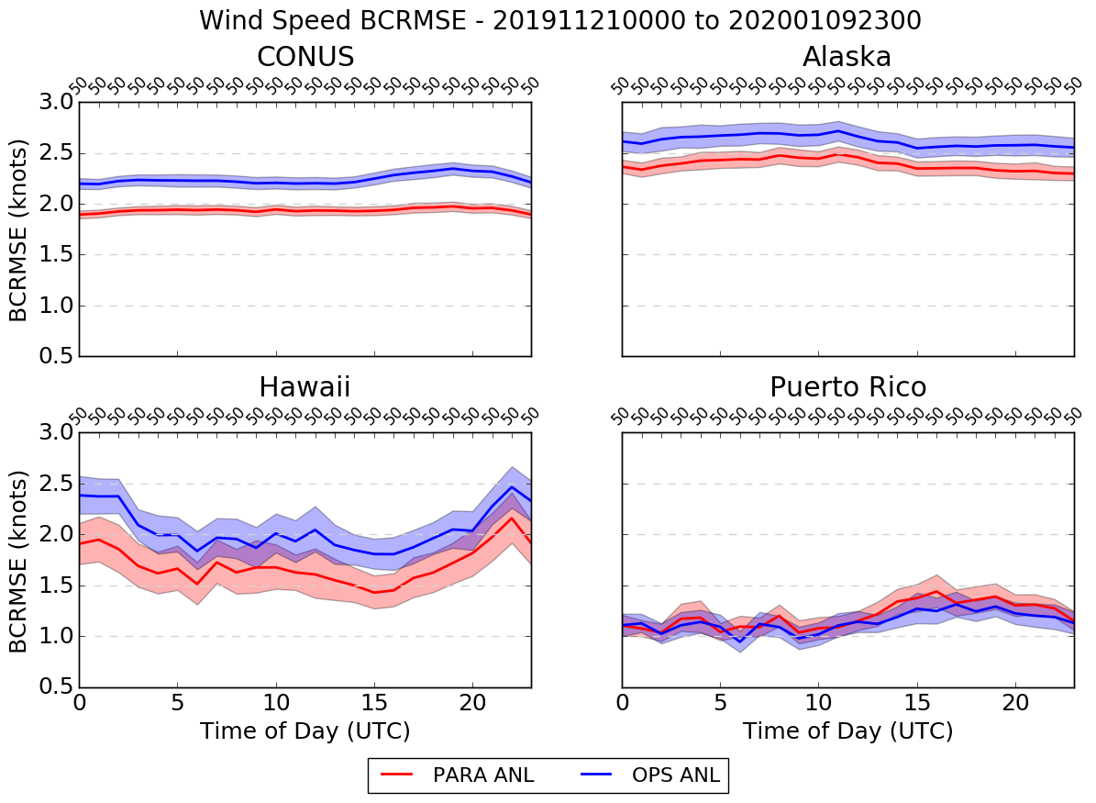
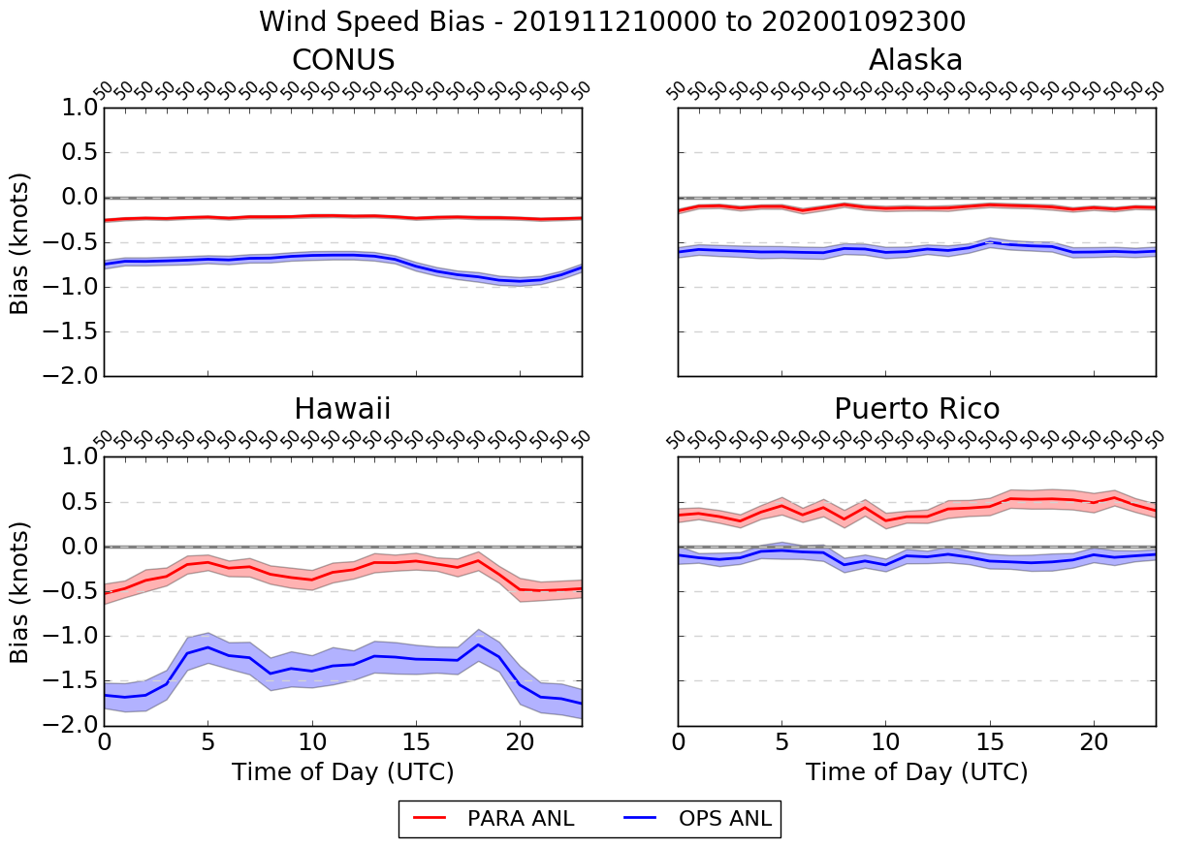
Wind Speed Time Series - Analysis
BCRMSE
Bias
NEW SYSTEM OLD SYSTEM
NEW SYSTEM OLD SYSTEM
*stats are relative to METARs, buoys, and ships*

Slide 6
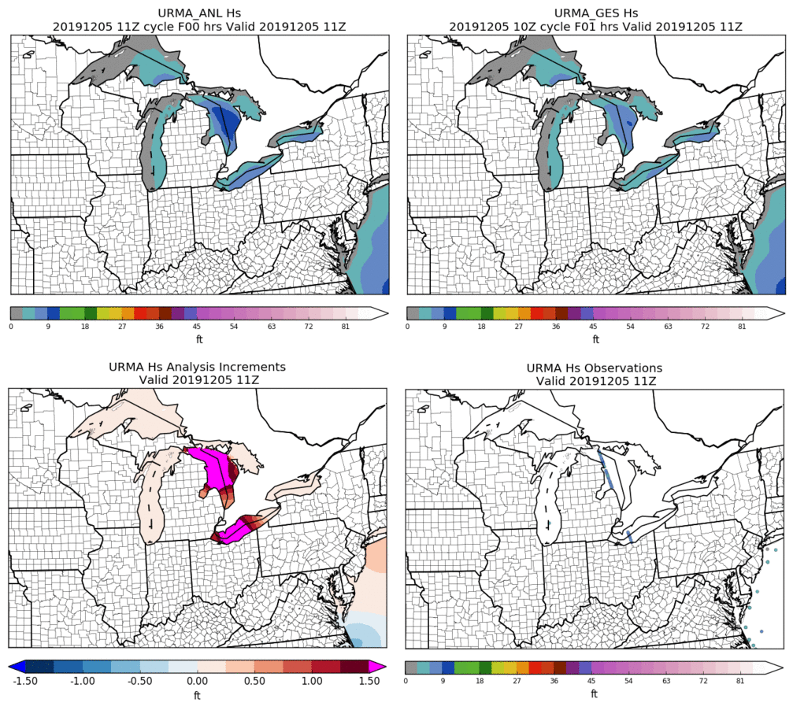
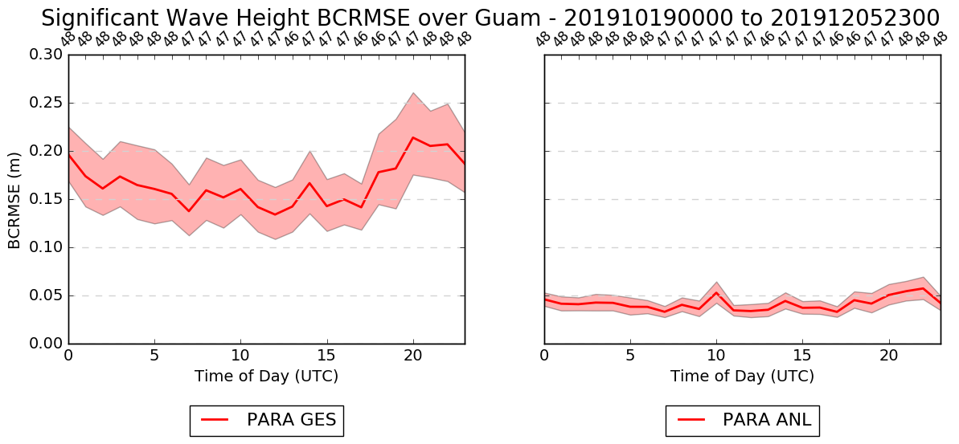
Wave Height v2.8
Great Lakes
Guam
*stats are relative to METARs, buoys, and ships*
Notes:
At the bottom right panel, satellite observations at two lakes

Slide 7
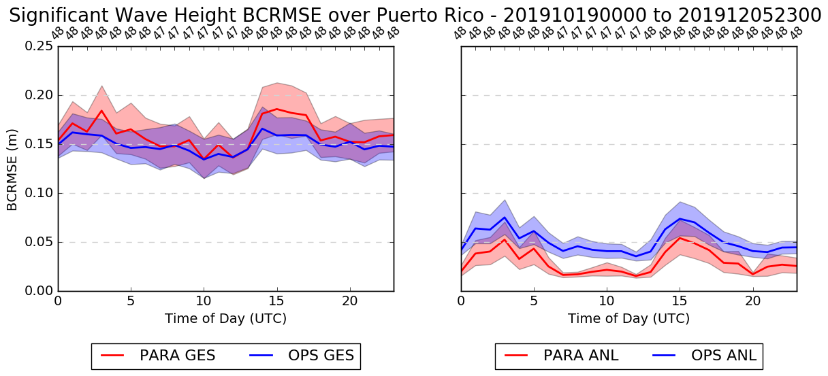
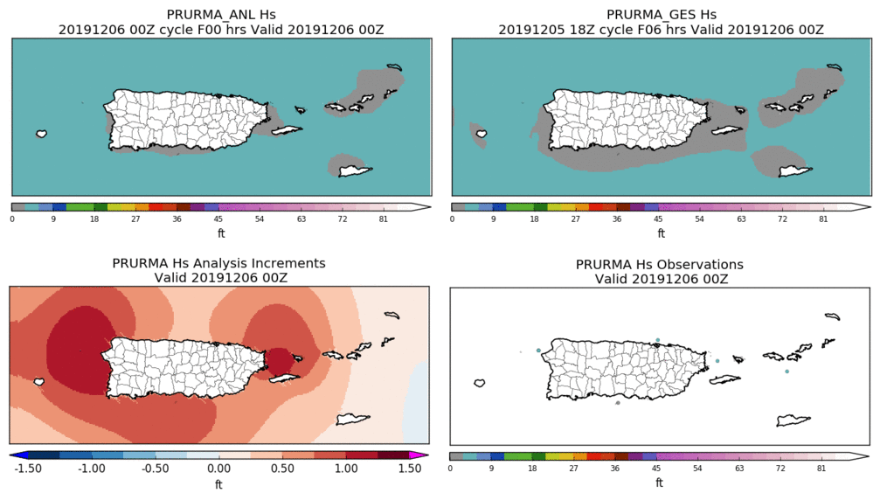
Puerto Rico Wave Height Stats
The spatial resolution of PR was doubled (from 2.5km to 1.25km):
The system’s parameters were recalibrated
PR URMA now has the highest spatial resolution of any wave analysis
PR
New grid and higher resolution + new background error = closer fit to obs
*stats are relative to METARs, buoys, and ships*

Slide 8
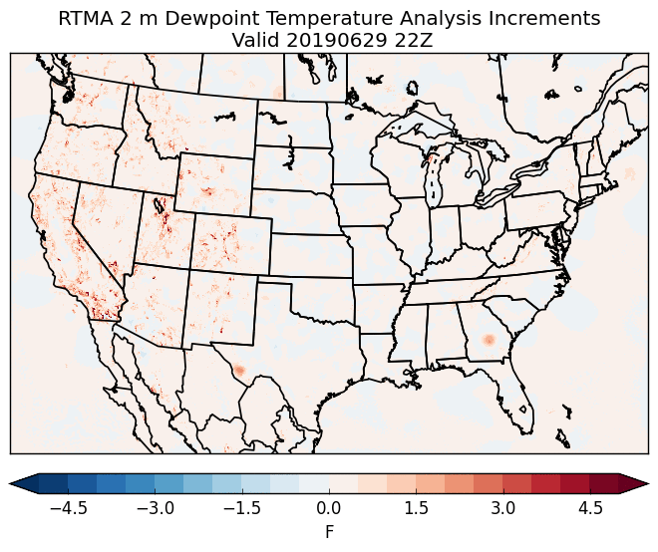
Dew Point Analysis Updates
Moist bias causing issues with FireWx
First noticed by WFO Missoula, MT
Operational Dew Point Product:
Q and surface press. analysis is used to derive Td
Analysis increments between the computed Td fields is smoothed via a “1-2-1” filter and added to the downscaled Td to generate the final analysis
The “1-2-1” smoothing filter has been switched off**
Impacts closely tied to steep terrain
Coordinated and approved with Western Region and WFO Missoula
22Z on 29 June 2019
Operational - Retrospective
**Very early RTMA (>10yrs ago) had serious issues with localized areas of unrealistically low dew points

Slide 9
Ceiling and Sky Cover Updates for v2.8
Ceiling is cleared (i.e., set to maximum ceiling value) when the analyzed sky cover is < 50%
Ensuring product consistency
Reject GOES Imager sky cover observations when:
The observation is < 30%; and
Solar zenith angle is > 80° (i.e., late evening, overnight, or early morning)
Based upon feedback and consultation with GOES product developer and stakeholders
Reduced thinning of GOES sky cover observations (by half) and tripled the decorrelation length to address feedback of a “splotchy” sky cover analysis
Add sky cover analysis to RTMA-RU
Updates every 15 minutes

Slide 10
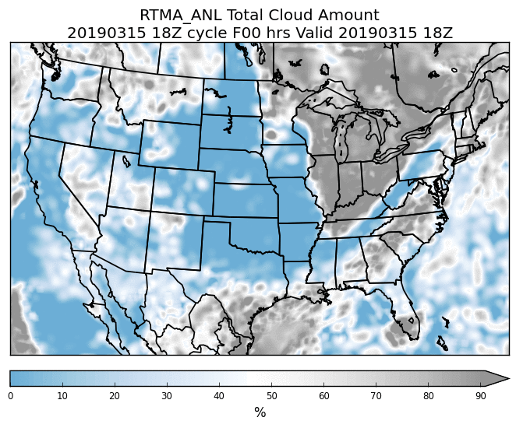
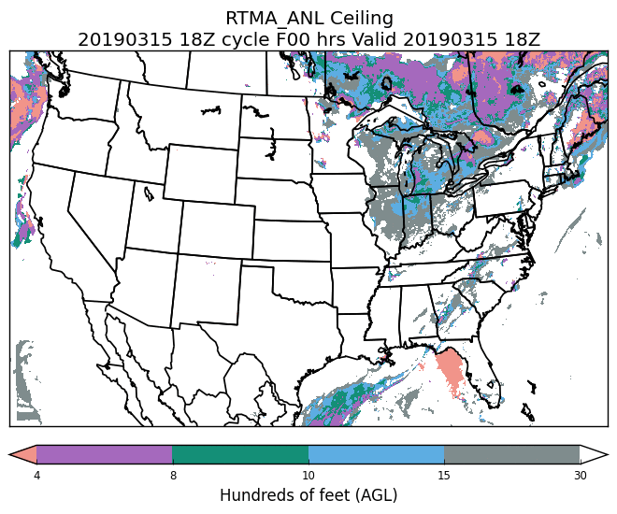
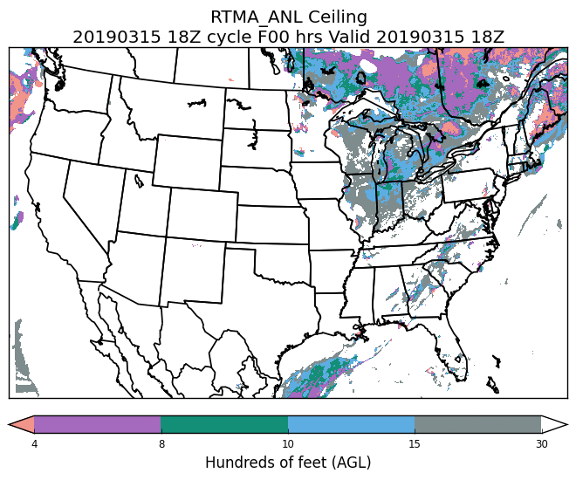
Example: Ceiling clearing
Sky Cover
Original Ceiling
Modified Ceiling
18Z on 15 March 2019

Slide 11
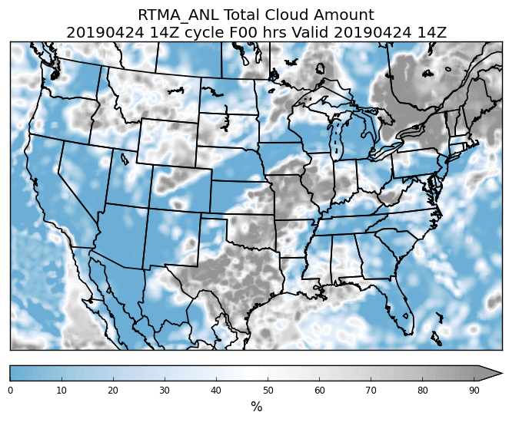
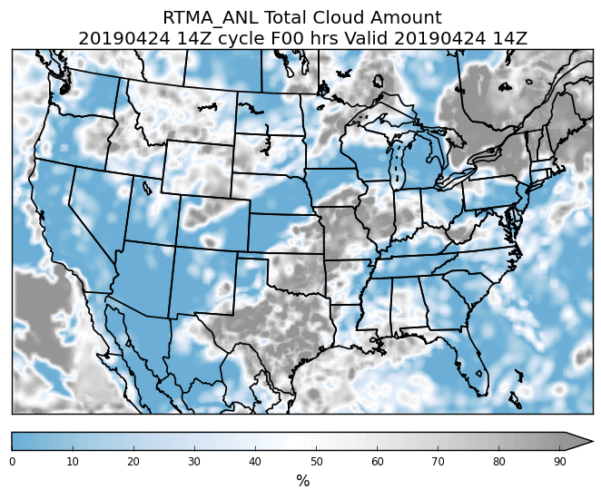
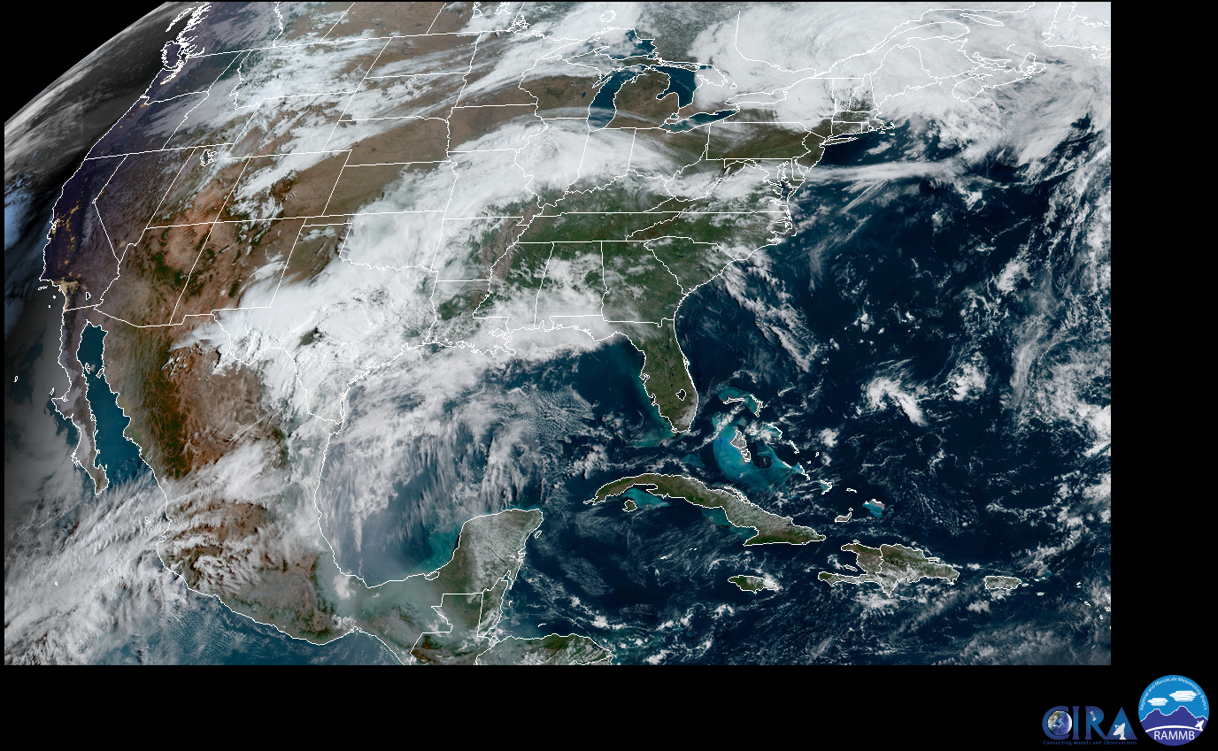
Example: Sky Cover QC
Original Sky Cover
Modified Sky Cover (QC)
VIS
14Z on 24 April 2019

Slide 12
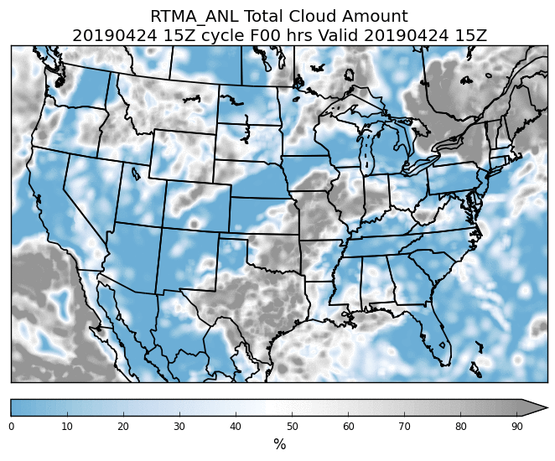
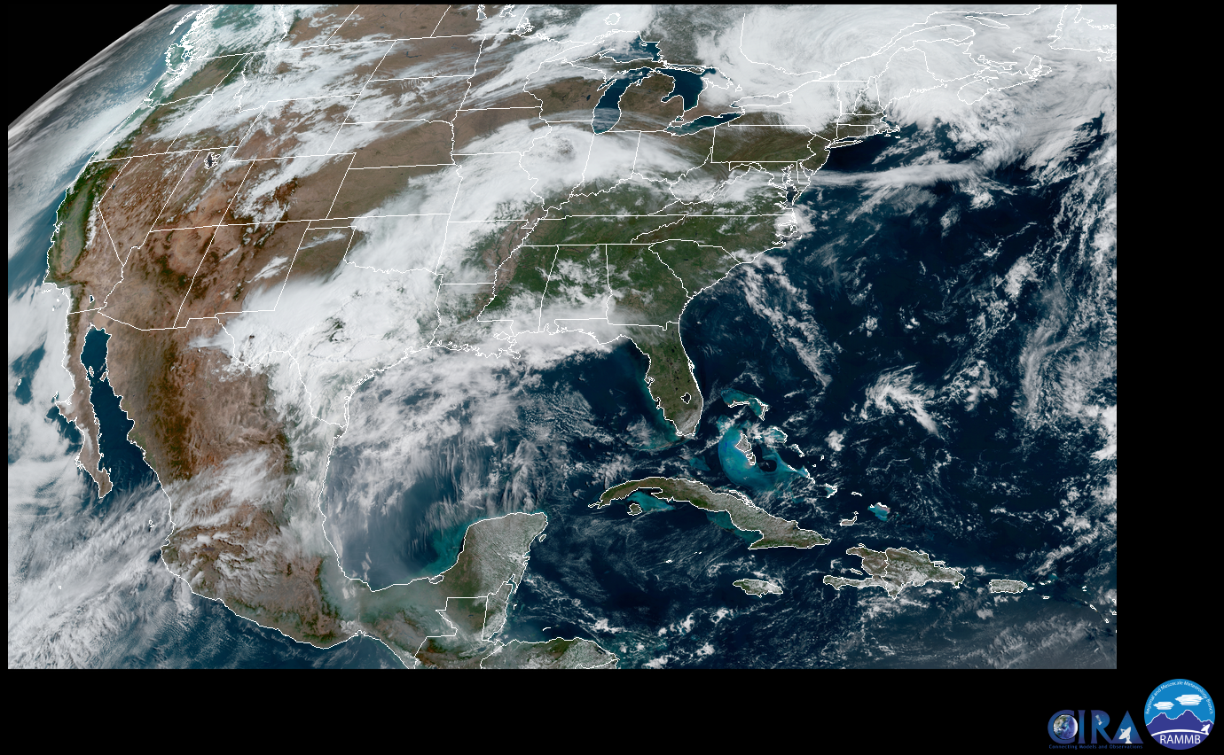
Example: Sky Cover QC
Original Sky Cover
Modified Sky Cover (QC)
VIS
15Z on 24 April 2019

Slide 13
Ceiling and Sky Cover Stats
*stats are relative to METARs, buoys, and ships*

Slide 14
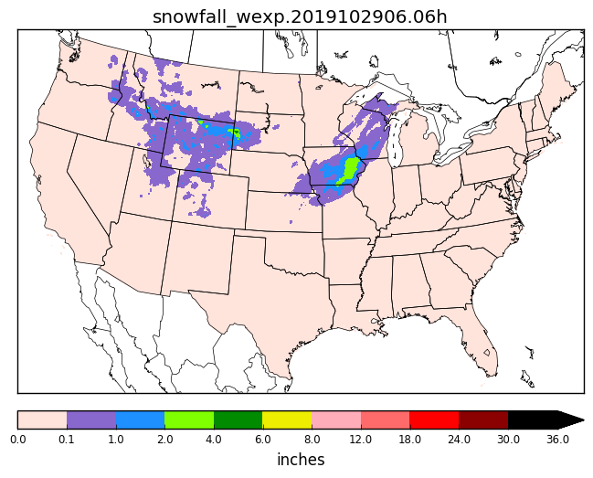
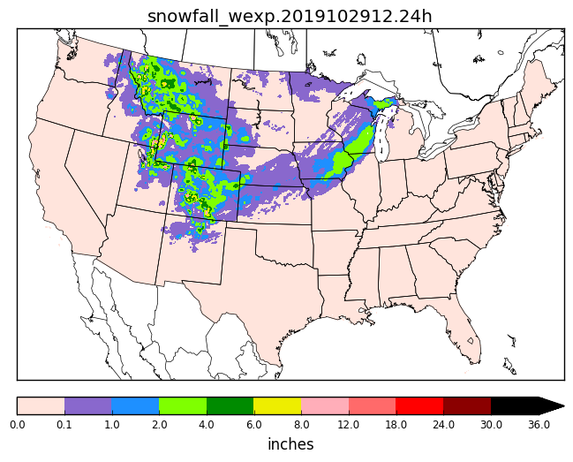
NOHRSC Snowfall Analysis for URMA
Add NOHRSC 6h/24h snowfall analysis to the precipitation URMA suite
At the 18Z cycle, process NOHRSC data for current day AND the past 7 days to continually refine snow product
Data mapped from NOHRSC’s g184 to the expanded ConUS grid (WEXP) for NBM
g184 data sent out to AWIPS
6h Snowfall Accumulation
24h Snowfall Accumulation

Slide 15
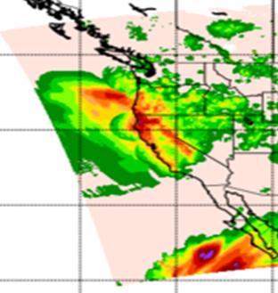
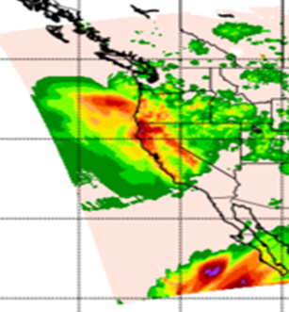
Improved Offshore Filling of pcpURMA
The primary source of ConUS pcpURMA is the NCEP Stage IV
mosaicked RFC QPEs → which is limited to RFC domains
V2.7 introduced offshore filling of ConUS PCPURMA with
Gauge-corrected MRMS (where RQI ≥ 0.1)
CMORPH
Sharp discontinuities can exist between these products
Solution → apply Whittaker blending function for a smoother pcpURMA offshore filling
Approach already used in RTMA/URMA to fill edges around domain
Prod
v2.8
24h ending 12Z 27 Nov

Slide 16
V2.8 RTMA/URMA/RTMA-RU Timeline
NCO begins 30 day IT test
Science Briefings
12/10
04/16/2020
11/22
12/20
05/25
2020
Science evaluation ended
Hand off to NCO
Implementation
[latest estimate from NCO]
The last upgrade of the 2D RTMA/URMA system!

Slide 17
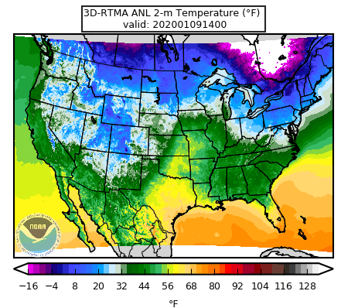
2D → 3D-RTMA
Joint development effort between EMC + ESRL/GSD
Real time, rapid updated analysis of 3D atmospheric fields
Severe and aviation weather parameters
Analysis of hydrometeor and cloud fields
Assimilation of radar observations
Heavy rainfall, etc.
15 min updates
Low latency
FY23

Slide 18
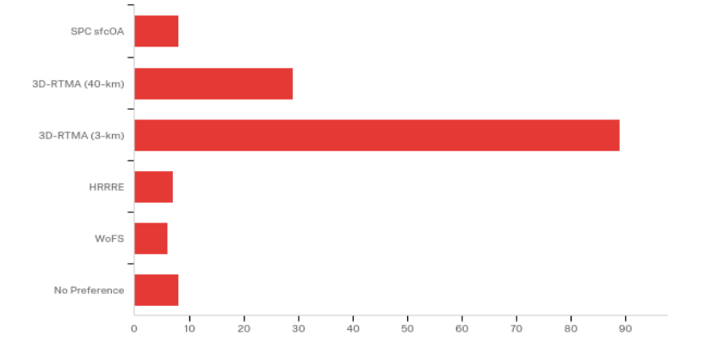
3DRTMA in the Testbeds
Aviation Weather Testbed
Better received over the 2D RTMA
Ability to interrogate the data in 3D increased confidence in the data owing to apparent vertical consistency
*Thanks to AWC and the AWT team for this material*
SPC sfcOA
Hazardous Weather Testbed
High resolution 3D RTMA was rated highest quality of all available analyses during the HWT (~90 ratings)
3D-RTMA (40 km)
3D-RTMA (3 km)
HRRRE
WoFS
No Preference
*Thanks to the HWT team for this material*

Slide 19
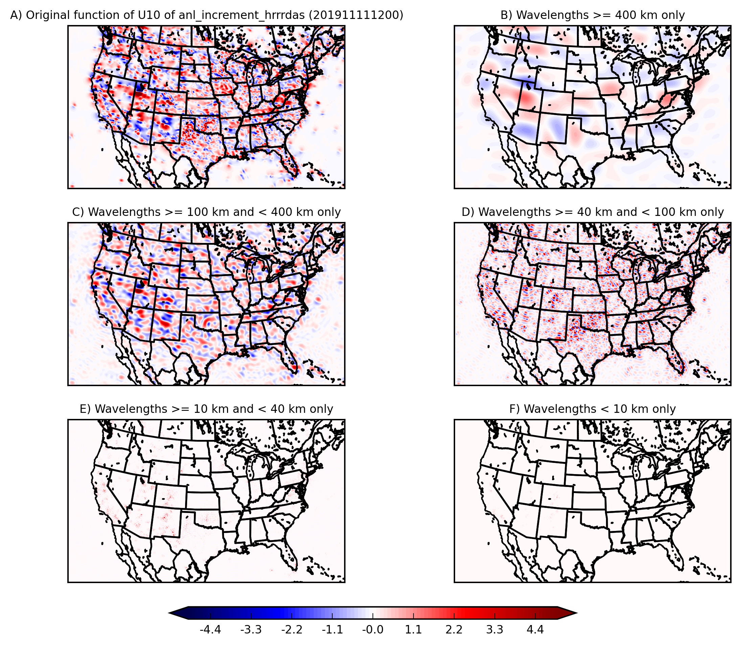
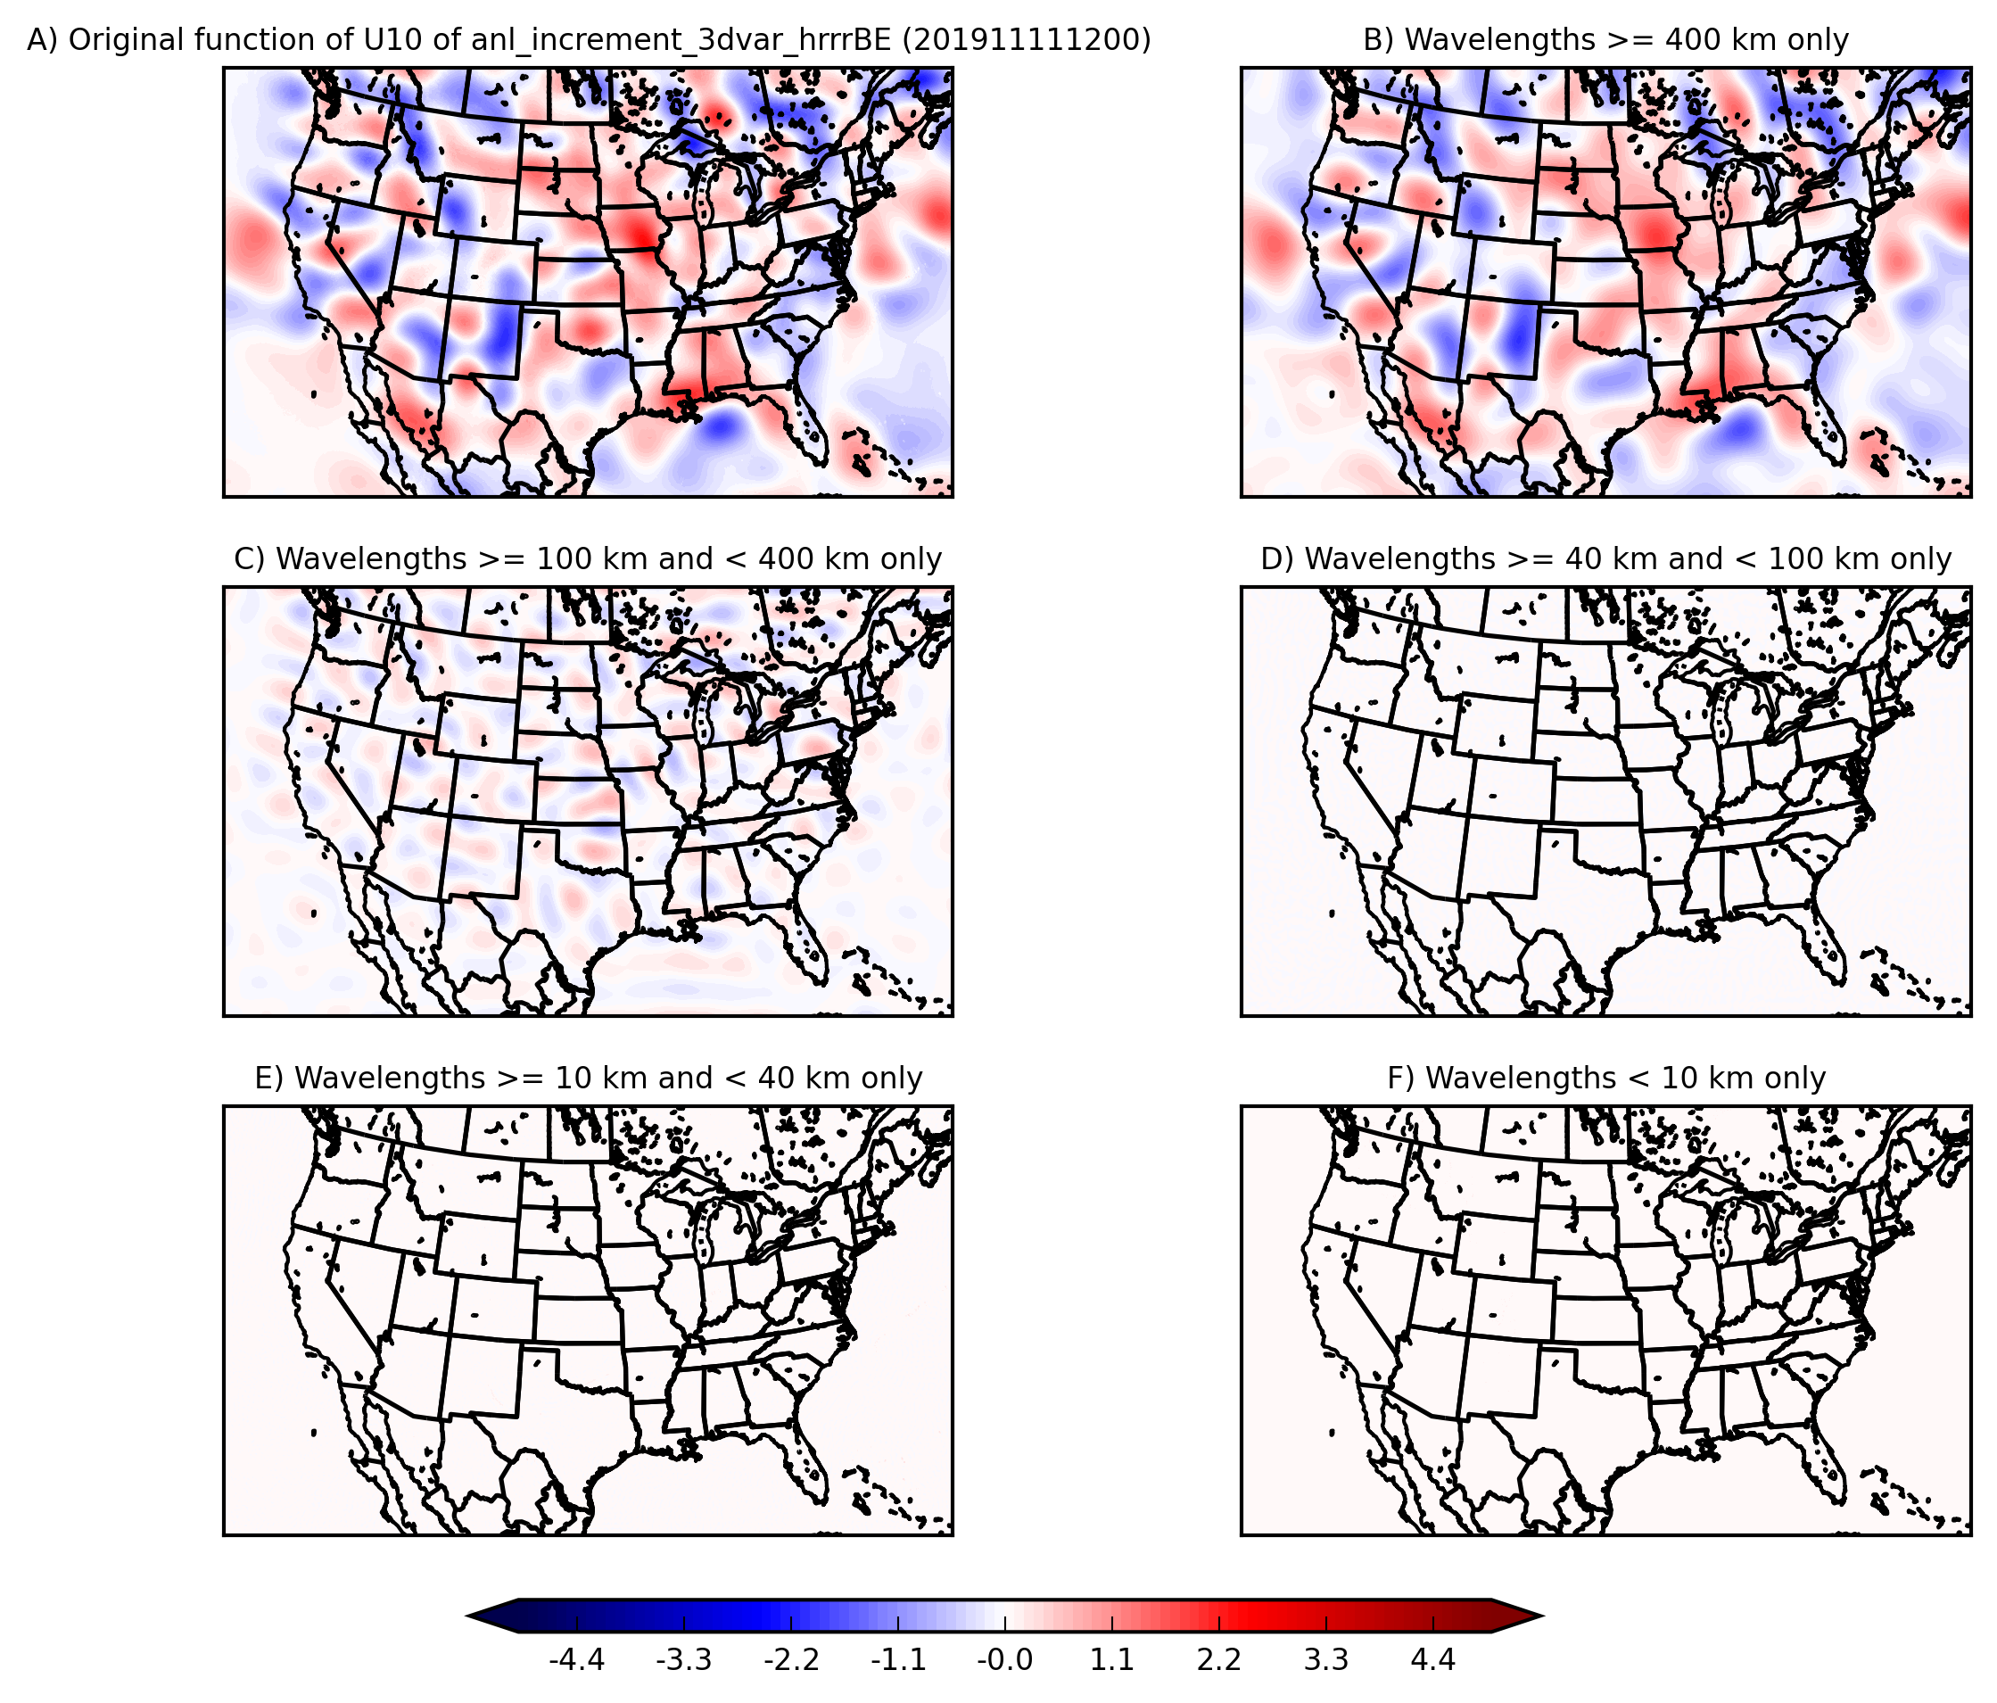
3D-RTMA: Scale Analysis of Wind Increments
Using HRRR Ensemble Error Covariances
Using Static Background Error Covariance
*Thanks to G. Zhao for this material and A. Johnson (OU/MAP) for the code*

Slide 20
Summary
V2.8 Upgrade
Improved wind analysis through advanced forward operator
Expanded support for waves to Great Lakes and Guam
Improved sky cover analysis and consistent with ceiling
Improvements/updates for precipitation analysis
Implementation date: May 2020
This is the final 2D RTMA/URMA/RTMA-RU upgrade
3D-RTMA is coming in the FY23 timeframe
The RTMA project benefits tremendously from an active user community.
Thank you!

Slide 21
Supplemental Slides

Slide 22
Ceiling and Sky Cover Stats
*stats are relative to METARs, buoys, and ships*

Slide 23
QPE RTMA/URMA Changes for v2.8
Precip RTMA
Real time, low-latency QPE → currently from Stage II/IV (+33 min)
v2.8: Replace with radar-only MRMS; change hourly run schedule from hh:33 to hh:15
Improve latency
Situational awareness
Precip URMA
Backbone is Stage IV and is rerun regularly ~1 week after valid time to refine/enhance as RFCs transmit revised data (what the NBM uses)
v2.8: Add NOHRSC snowfall analysis
v2.8: Add a blending for a smoother offshore filling with MRMS and CMORPH QPE
v2.8: Change hourly run schedule for PCPANL/pcpURMA from hh:33 to hh:55
Request by OWP, RFCs for RIDGE II, so more RFC QPEs can be included for current hour
More complete coverage, earlier
PCPANL v4.0 (upstream job of RTMA/URMA):
Discontinue Stage II analysis - prod suite simplification
Add another 30h rerun of Stage IV 24h mosaic (for water.weather.gov/precip)
Supplements the current ~daily rerun schedule and gives chance for updated RFC QPE’s to get out to public (e.g. water.weather.gov/precip)

Slide 24
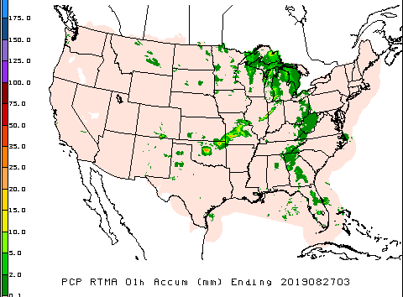
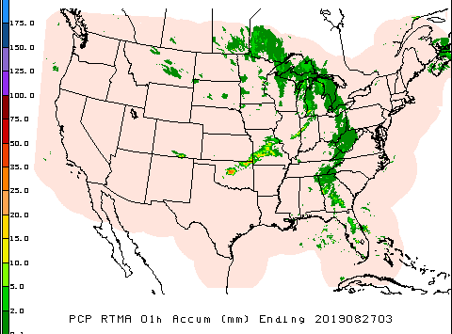
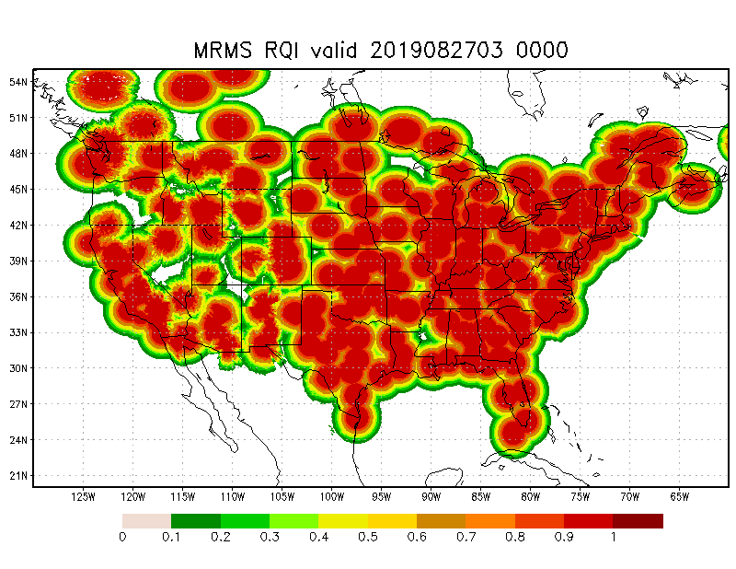
pcpRTMA using MRMS
Use radar-only MRMS QPE
Lower latency
Less affected by data outages than gauge-corrected MRMS QPE
Radar quality index (RQI) added as companion to each hour’s pcpRTMA array
Provide users with info about quality of the QPE
RQI arrays will be available on NOMADS (not AWIPS)
Prod
v2.8

Slide 25
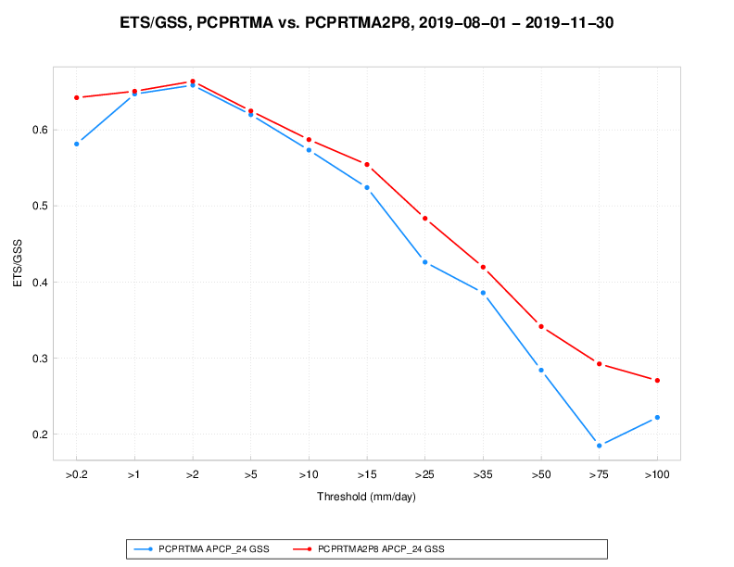
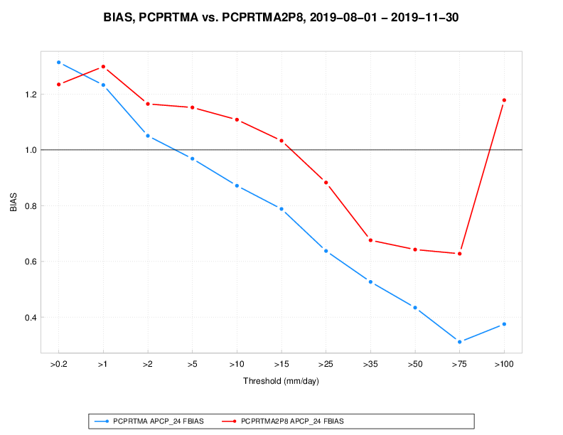
pcpRTMA using MRMS: validation
Prod vs. v2.8 pcpRTMA: 24 QPE validation vs. daily gauges (1 Aug - 30 Nov 2019)
ETS vs. threshold Bias vs. threshold

