Slide 1


Understanding Tropical Climate to Advance Sub-seasonal to Seasonal Prediction
Michelle L’Heureux,
NOAA/NWS Climate Prediction Center (CPC)
RITT Forum, April 2013

Slide 2
I. The El Niño- Southern Oscillation (ENSO): Is it Solved?
Later on…
II. Madden-Julian Oscillation (MJO) Attribution and Prediction

Slide 3
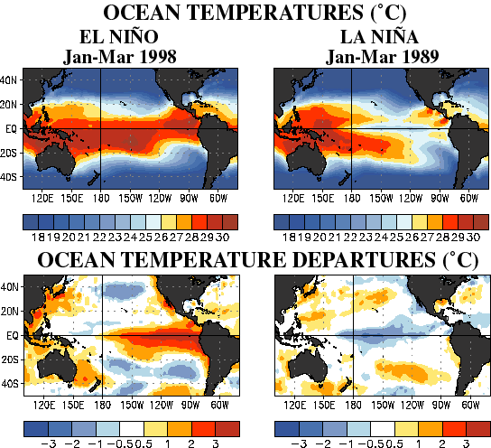
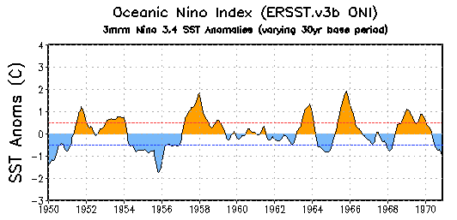
What is ENSO?
Irregular cycle (every 2-7 years) of warm (El Niño) or cold (La Niña) conditions in the tropical Pacific Ocean.
Ocean changes occur alongside changes in the tropical atmosphere circulation & rainfall
On average, events last 9-12 months (La Niñas can persist longer) and peak in strength during N. Hemisphere winter
Red colors: above average sea surface temps
Blue colors: below average sea surface temps
Niño 3.4 sea surface temperatures (SST): Primary ENSO index or time series

Slide 4
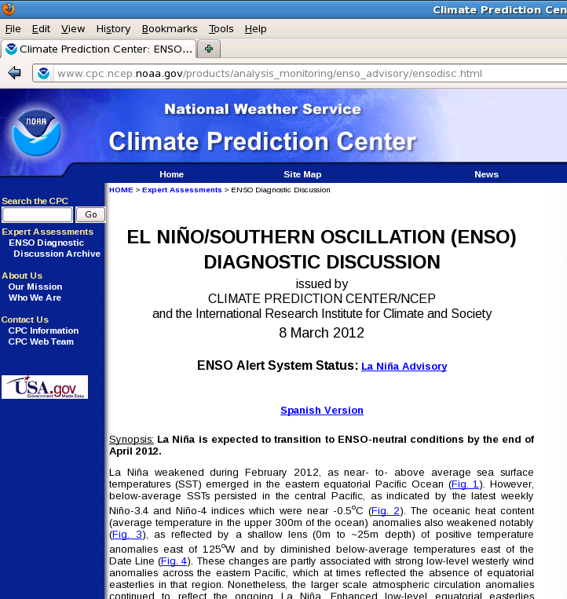
Creation of the NOAA ENSO Outlook
CPC provides weekly (every Monday) + monthly monitoring and prediction products for ENSO, which are available on our website:
http://www.cpc.ncep.noaa.gov/products/precip/CWlink/MJO/enso.shtml
Indices: http://www.cpc.ncep.noaa.gov/data/indices/
The ENSO Diagnostics Discussion is released on the Thursday between the 4-10th of each month. Concurrent with that release, the “ENSO Alert System” and the official outlook is updated.
El Niño or La Niña Watch:
Favorable for development of ENSO within the next six (6) months.
El Niño or La Niña Advisory: conditions are observed and expected to continue.
Final El Niño or La Niña Advisory: conditions have ended.
NA: Not Active
To receive monthly notification: ncep.list.enso-update@noaa.gov

Slide 5
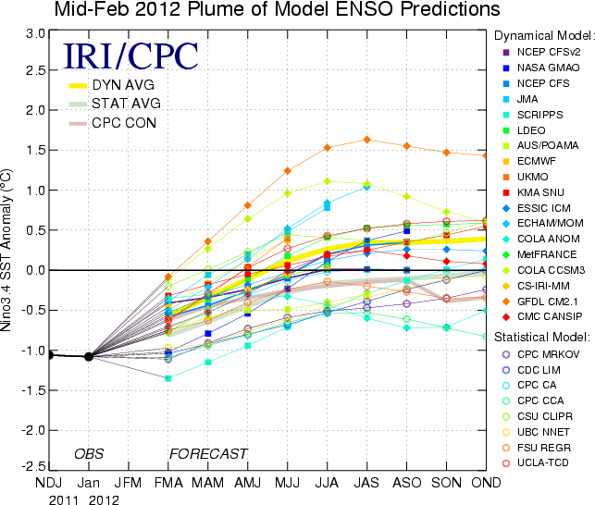
Creation of the NOAA ENSO Outlook
The ENSO team (7 CPC forecasters + Tony Barnston at the IRI) determines the probabilities for each ENSO category, which provides the ENSO prediction for the upcoming ~8 seasons.
Forecasters consider:
The observed state of the tropical Pacific
Dynamical and statistical model output and multi-model (“MME”) combinations
Knowledge and experience of previous ENSO episodes

Slide 6
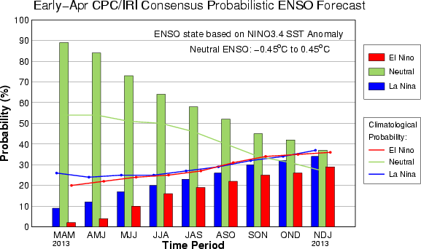
How Is the probability of ENSO determined?
Each forecaster individually provides probabilities of three categories (El Niño – Neutral – La Niña). Individual forecasts are averaged to create the “Consensus” probabilities and form the basis for the diagnostics discussion.
Notes:
6

Slide 7
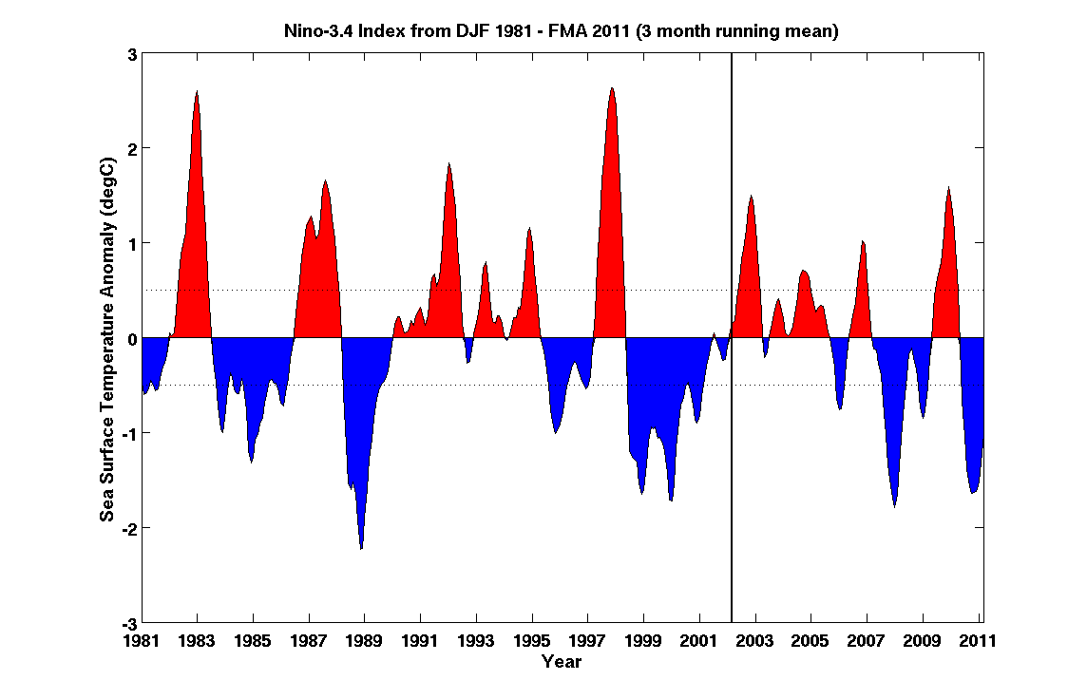
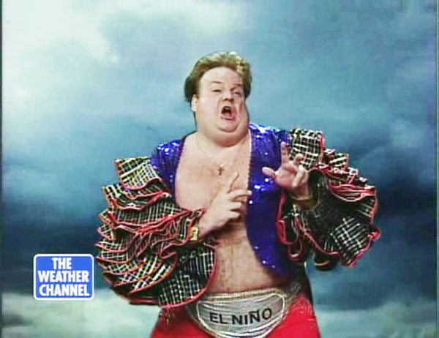
So, how well do these ENSO predictions work?
Pretty well when you see the strong 1997-98 El Niño, six months in advance:

Slide 8
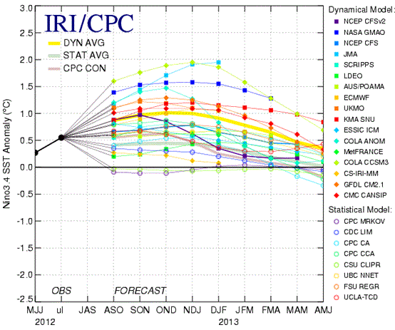
So, how well do these ENSO predictions work?
Not so well when this happens….
Early September 2012 Model Predictions
Black Line: Observed Niño-3.4 Index through December 2012
Most models predicted El Niño (> +0.5°C) for the 2012-13 winter
DJF Niño-3.4 index value was -0.6°C

Slide 9
Primary features of ENSO model performance
Recently, dynamical models have slightly edged statistical models in forecast skill (see Barnston et al. BAMS, 2012)
Models have trouble with transition timing and predicting amplitude of ENSO events.
The transition to stronger ENSO events tends to be better predicted than transitions to weaker ones.
“Spring prediction barrier:” historically, forecasts before the Northern Hemisphere Spring have low skill.
Notes:
9

Slide 10
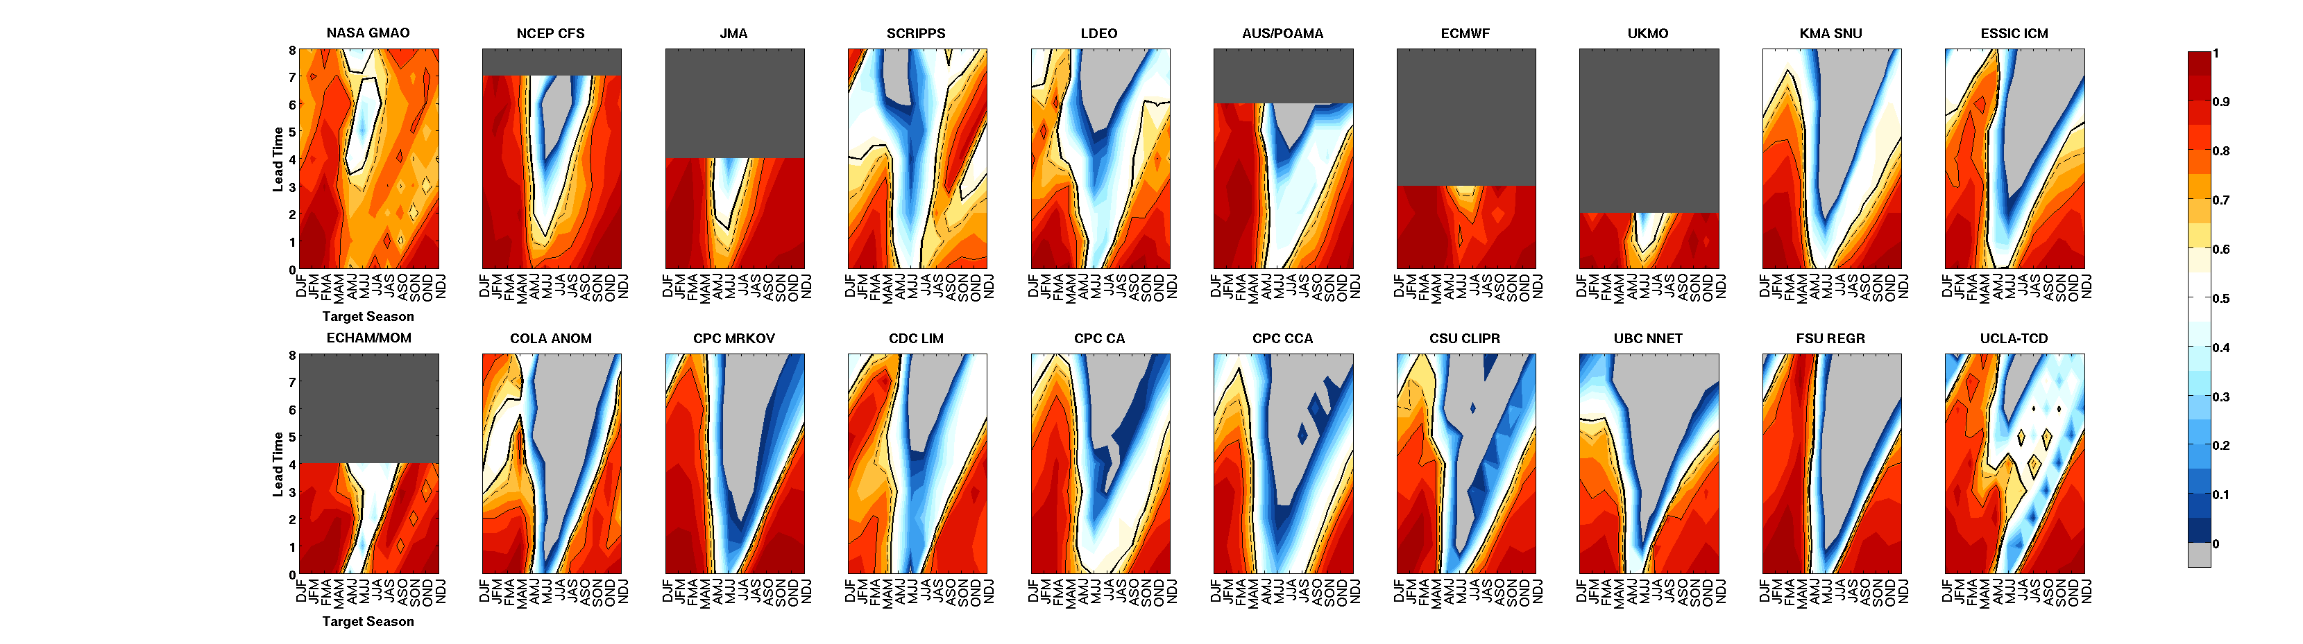
Prediction of Niño-3.4 Index by NCEP CFS from 2002-2011 (Note: statistical corrections were applied after 2009)
Orange/Red Shading: Higher correlations (more skill)
White/Blue: Lower correlations ( 0 < r < 0.5)
Light Grey: Negative correlations (very poor skill!)
8
Lead Time (mths)
4
Model skill is reduced during the N. Hemisphere spring when ENSO often emerges or decays
CFS prediction improves to ~0.8 to 0.9 correlation for prediction of the N. Hemisphere winter (after ~June)
RMSE (amount of error in amplitude) is ~0.5°C to 1.0°C in Niño-3.4
0
Target (season you are predicting)
From Barnston et al. (BAMS, 2012)
Notes:
10

Slide 11
Anomaly Correlations of ENSO models from 2002-2011 (from the IRI/CPC ENSO Prediction Plume)
The orange box designates the statistical models (the rest are dynamical)
Skill for mid-year targets: Dynamical Models > Statistical models
-- Dynamical models have better initial conditions and ability to detect changes on shorter timescales than statistical models (often trained on monthly or seasonal data)
For NH winter target, statistical and dynamical models are more comparable.
From Barnston et al. (BAMS, 2012)
Notes:
11

Slide 12
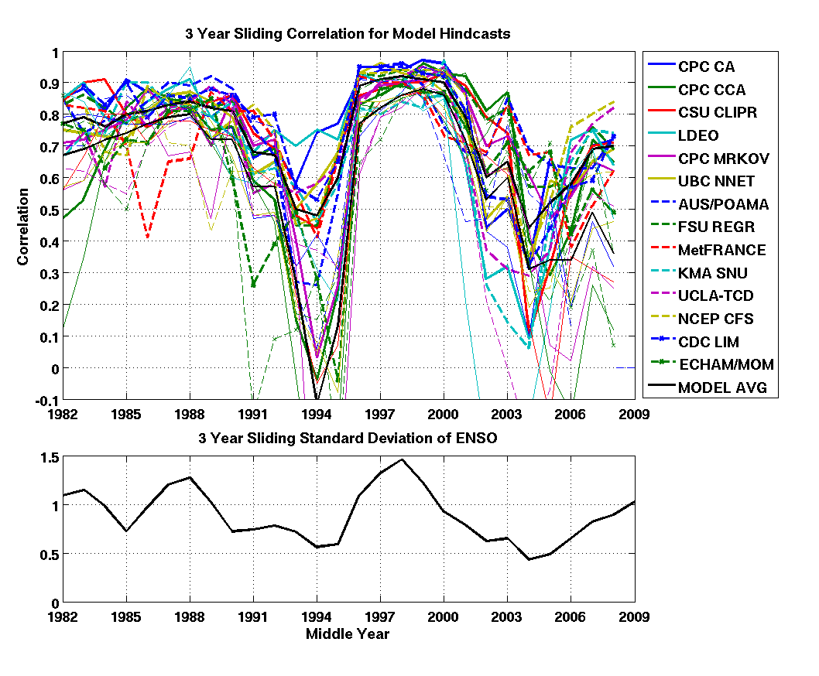
Top Panel: 3-year sliding Correlation based on Hindcasts (1981-2010) Bottom Panel: 3-year sliding variability of Niño-3.4
Periods of smaller Niño-3.4 variability → Lower Model Skill
(and vice versa)
ENSO model skill decreased during 2002-10 in part due to the observed ENSO variability.
Model predictions can fluctuate due to natural, multi-year/decade variability of ENSO
(and overwhelm attempts to detect forecast model improvements)
From Barnston et al. (BAMS, 2012)

Slide 13
Currently Popular Areas of ENSO Investigation
Understanding different types, or “flavors,” of ENSO
Potential Operational linkage: better understanding of ENSO intensity and impacts over the United States
(2) Exploring the role of mid-latitude variability on ENSO
Potential Operational linkage: extending ENSO forecast skill out to a year?
Notes:
13

Slide 14
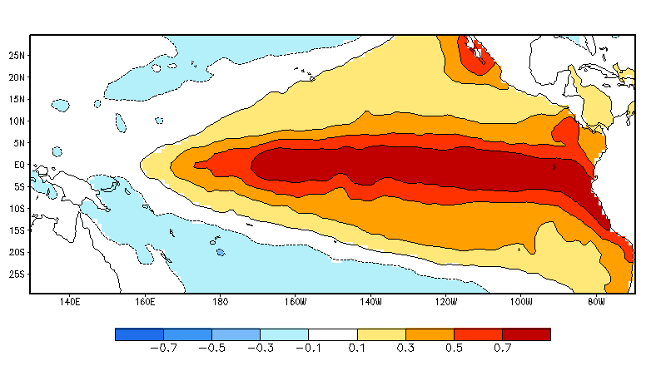
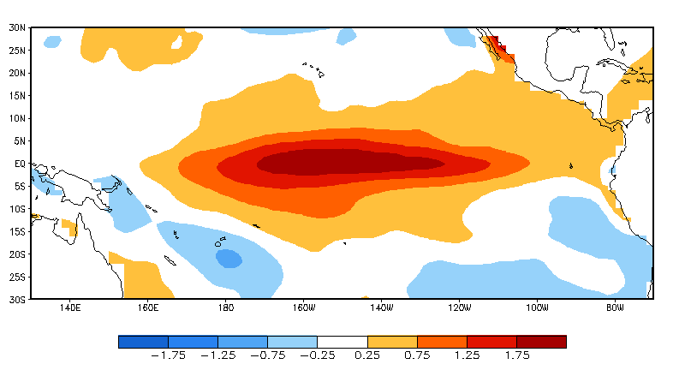
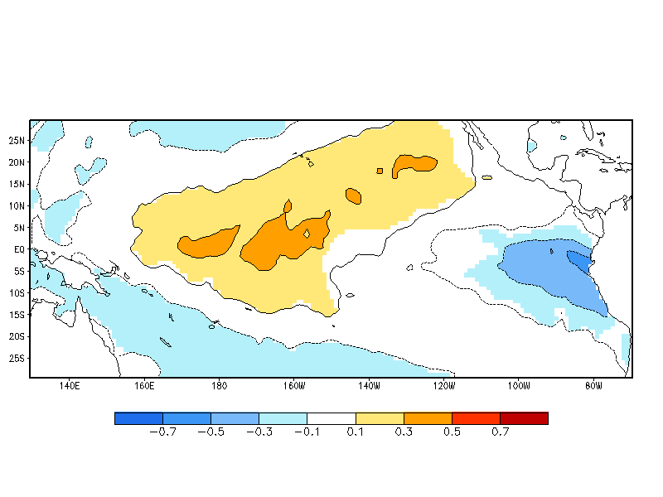
Considerable Variety in the Structure and Amplitude of El Niños
The stronger El Niño events in the 80s and 90s resembled EP El Niño
Since ~2000, El Niño has often resembled CP El Niño
2009-2010
Eastern Pacific (EP) El Niño = Cold Tongue El Niño = Conventional or Canonical El Niño
Central Pacific (CP) El Niño = Warm Pool El Niño = El Niño Modoki = Date Line El Niño

Slide 15
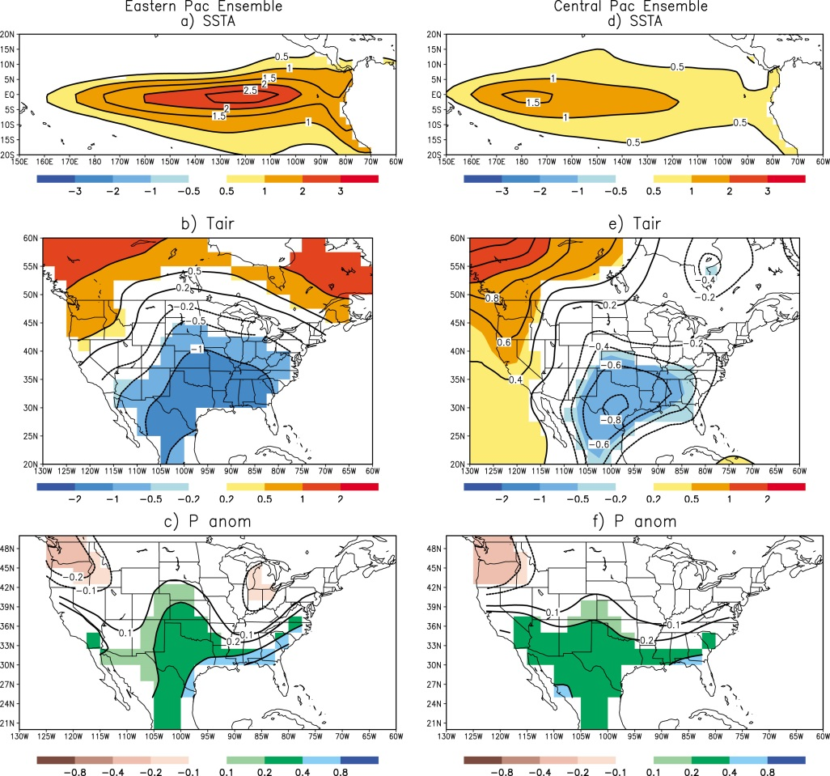
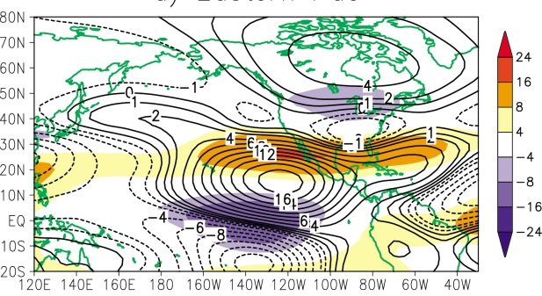

Eastern Pacific vs. Central Pacific Impacts
PRO: Data from CMIP3 model runs, which increase the number of cases and significance (# of cases too small in the observational record). CON: is susceptible to model errors.
EASTERN
CENTRAL
From Mo (2010)
SSTA
Central Pacific (CP) El Niño:
Pacific jet does not extend as far eastward and flow is less zonal over the U.S.
Eastern Pacific (EP) El Niño has a stronger zonal configuration
Temp
Precip
200mb winds & streamfunction
Notes:
15

Slide 16
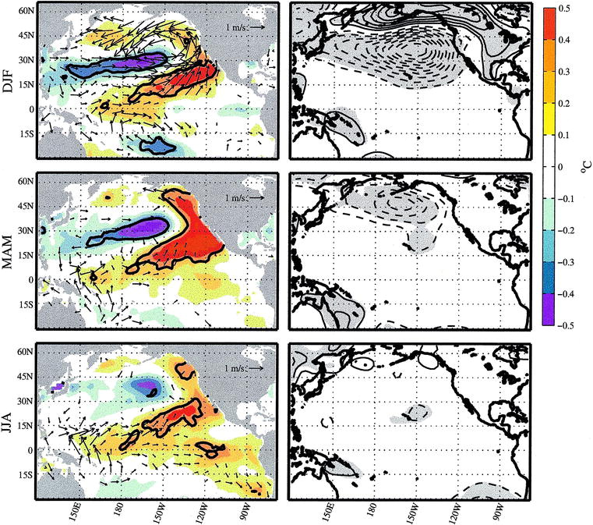
Role of Mid-latitude variability on ENSO
SST + wind anomalies
Sea Level Pressure anomalies
Chiang and Vimont (2004)
December-February
“Seasonal Footprinting Mechanism (SFM)”
March-May
June-August
(1) “North Pacific Oscillation”- NPO (upper right panel) during winter → subtropical SST “footprint” that persists for several seasons
(2) Subtropical SSTs → winds that extend to the equator and eventually can influence equatorial SSTs
Notes:
16

Slide 17
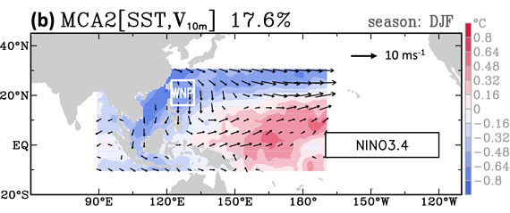
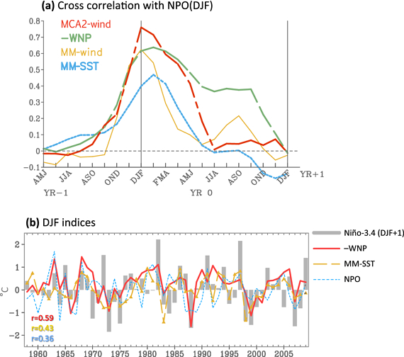
Role of Mid-latitude variability on ENSO
SST + low-level wind anomalies in the western N. Pacific (WNP)
WNP index
(red line) against Niño-3.4 one year later (grey bars)
S.-Y. Wang et al. (2012, GRL) identify “Western North Pacific (WNP)” index that correlates well with Niño-3.4 index one year in advance (~36% of variance using dependent data).
The WNP is likely a part of the broader SFM idea, but may more directly influence generation of ocean waves (Kelvin waves) on the equator.
Notes:
17

Slide 18
Q: Has ENSO been solved? A: No.
How do we move forward?
(1) Better understand mechanisms and evaluate models to distinguish and predict ENSO flavors and their impacts
-- EP El Niño are generally stronger El Niños (forecasted better) and CP El Niños are weaker (and not forecasted as well)
(2) In tandem with observations, evaluate how well models simulate different aspects of the Seasonal Footprinting Mechanism (SFM) → ENSO linkage
(3) Improve model physics (especially clouds/convection): “Cold tongue” and double ITCZ biases affect ENSO frequency and flavor.
(4) Produce ensembles + long reforecasts + develop statistical procedures to correct for systematic model biases and generate probabilities.
(5) Improved ocean observations for the best initial conditions possible- includes the subsurface ocean! [note: over the last year, reduction in data from the TAO/TRITON buoys in the eastern half of the Pacific]
(6) Developing and improving historical SST datasets will be helpful to put ENSO events (and flavors) in better context and strengthen confidence in associated impacts.

Slide 19
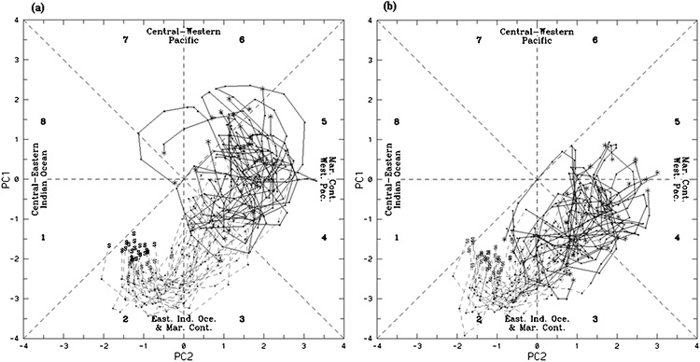
1997-98 El Niño amplitude/strength was not well predicted by deterministic models (Barnston, BAMS 1999).
Ensemble members with a more progressive MJO shift did better with the strong 97-98 event than those without (Shi et al. 2009).
90 member POAMA model initialized in Dec 1996 out to 9 mths
MJO index for WARMER members
MJO index for COLDER members
WARMER members: MJO propagating further east than in COLDER case
Ensemble prediction enables a percent chance (%) of a high intensity event that a deterministic/ensemble mean does not provide (Federov et al., BAMS 2003).

Slide 20
II. Madden-Julian Oscillation (MJO) Attribution and Prediction

Slide 21
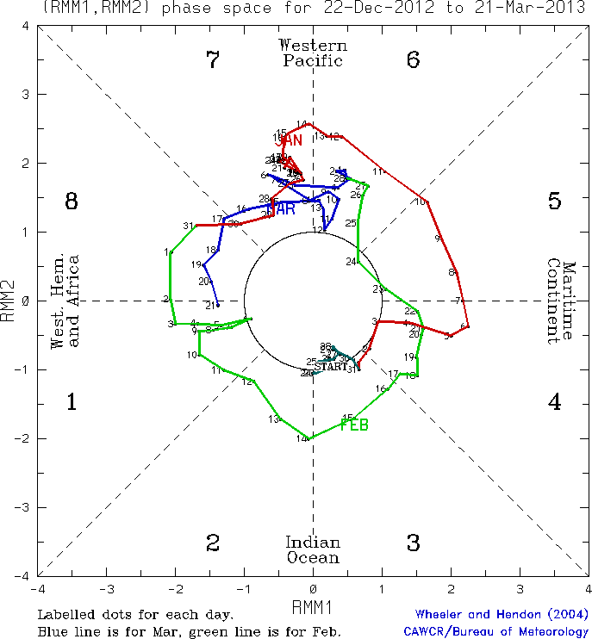
What is the MJO?
Sub-seasonal (varies within a month/season) climate pattern that moves eastward around the global tropics in ~30-60 days.
Has its strongest tropical impacts (winds, rainfall) over the Indian and Pacific Oceans when it moves slower (5 m/s). But still affects the Western Hemisphere even though moving faster.
Exists ~40-50% of the time, but can go many seasons without an MJO.
CPC monitors the MJO with the Wheeler and Hendon MJO index
MJO exists when there is counterclockwise movement on diagram
Each dot/number represents a single day and location of the MJO enhanced rainfall.

Slide 22
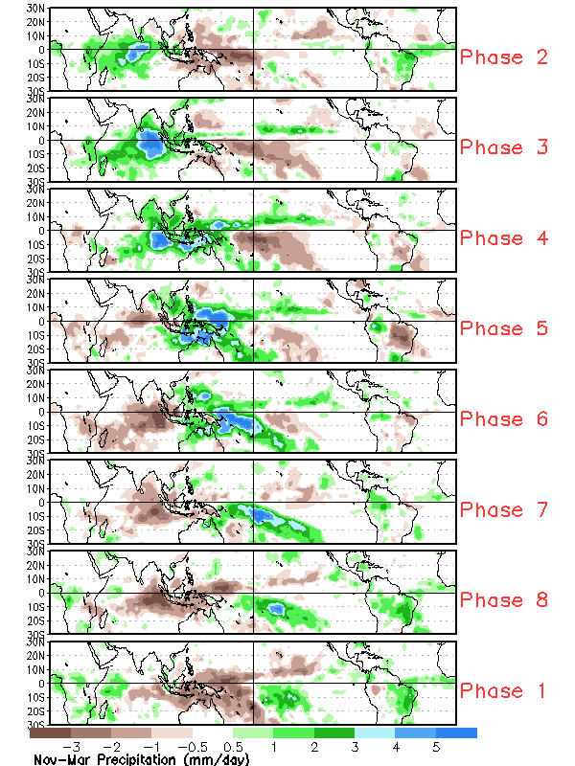
Madden Julian Oscillation
Tropical Rainfall Patterns linked to MJO phases
Wheeler and Hendon MJO index shows the position of the MJO in real time.
For example on February 12-14th, 2013, MJO in Phase 2 so expected tropical rainfall pattern is shown on the upper left.

Slide 23
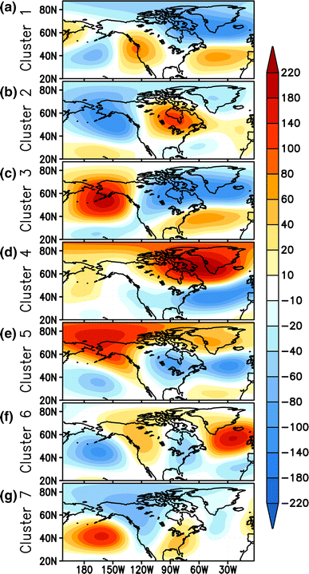
Certain Wintertime 500-hPa Geopotential Height Patterns occur more frequently with MJO
Negative AO/NAO-ish pattern
Bars = Frequency of occurrence over climatology
(100 means twice as frequent as the full record).
POSTIVE/RED BARS: pattern more frequent
NEGATIVE/BLUE BARS: pattern less frequent
Colored bars are statistically significant at 95% level
MJO PHASE 6: Central Pacific
Ocean
SLANT IS EVIDENCE OF EASTWARD MOVING MJO SIGNAL
MJO PHASE 7: East Pacific Ocean
MJO PHASE 8: Western
Hemisphere
From Riddle et al. (2013, Climate Dynamics)
Days after MJO

Slide 24
Influence of the MJO on the Extratropical Circulation
Cluster A/ Negative AO
Cluster B/ Positive PNA
Cluster C/ Negative PNA
From Riddle et al. (2013, Climate Dynamics)
MJO
PHASE 1
PHASE 2
PHASE 3
PHASE 4
PHASE 5
PHASE 6
PHASE 7
PHASE 8
West Indian
Ocean
East Indian
Ocean
West Maritime Continent
East Maritime Continent
West Pacific
Ocean
Central Pacific
Ocean
East Pacific
Ocean
Western
Hemisphere
Days after MJO

Slide 25
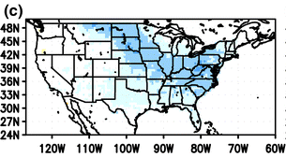
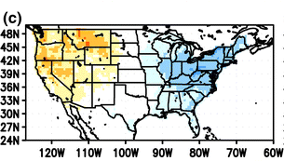
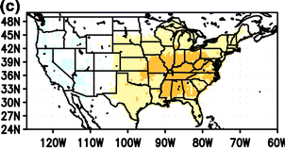
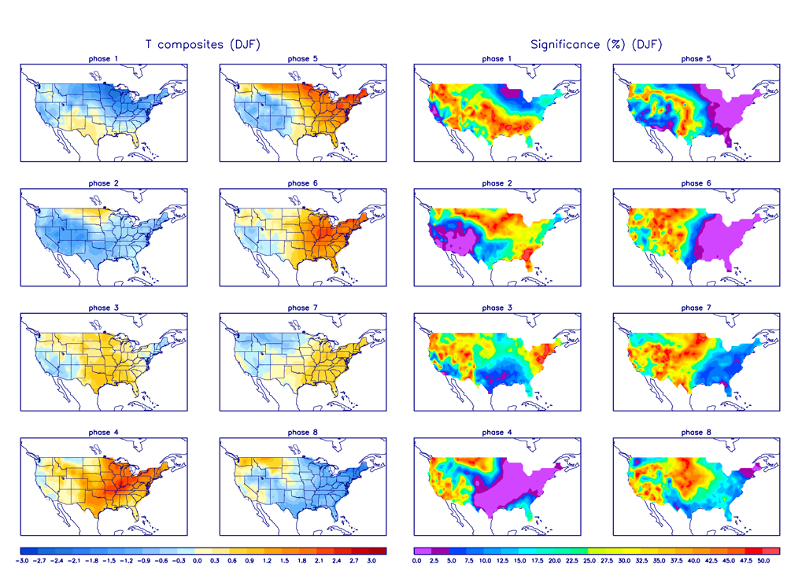
Connection with Wintertime U.S. Surface Temperature
Surface Temperature associated with MJO circulation patterns:
Cluster A/ Negative AO
Cluster B/ Positive PNA
Cluster C/ Negative PNA
Composites of Surface Temperature based on MJO Phase:
From Riddle et al. (2013, Climate Dynamics)
From Zhou et al. (2012, Climate Dynamics)

Slide 26
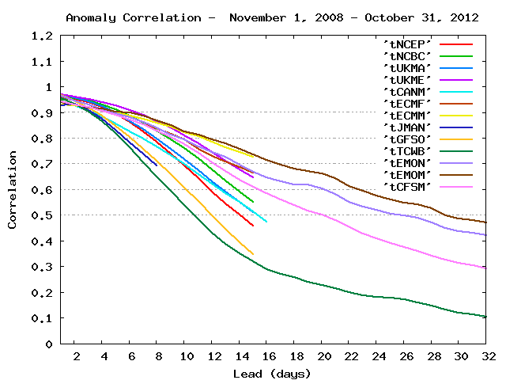
How good is the prediction skill of the MJO?
Not terrible ☺. For prediction of the MJO index (Wheeler&Hendon), reasonable skill is found out to 2 weeks for nearly all models.
ECMWF (out to ~ 1 mth)
CFSv2
GEFS
Analysis by Jon Gottschalck and Augustin Vintzileos

Slide 27
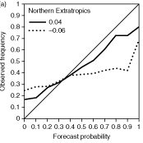
How good is the prediction skill of the MJO?
Do models capture the influence of MJO on the temperature in N.H. (north of 30°N)?
-- ECMWF show considerable improvement with MJO occurring (thick black line) VS. *no* MJO occurring (dotted black line)
For upper tercile of 850-hPa temperature for Days 19-25
A reliable probabilistic prediction would lie perfectly on this diagonal line
(an unreliable one would be a nearly horizontal or flat line)
Using 20 year reforecasts in ECMWF system
(from Vitart and Molteni, 2010)

Slide 28
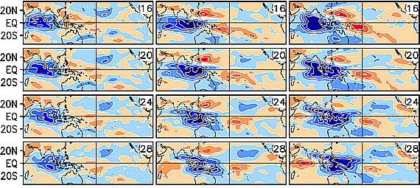
Where do we have room to improve?
Better initializations and model physics to resolve the MJO (i.e. better clouds/moisture/convective processes– Stan et al. 2010; Thayer-Calder & Randall, 2009)
“Super-parameterized” CCSM model
Standard CCSM
Observations
OLR anomalies during an MJO
(blue: more rainfall
orange: less rainfall)
From Stan et al. (2010)
Continued studies on how the MJO influences the United States.
-- extracting “signal” (MJO) from the “noise” (synoptic detail) is more difficult on sub-monthly timescales.
---requires rigorous statistical testing on both observational and model (reforecast) data.

Slide 29
What does improved representation of the MJO give us?
More skillful prediction over the globe:
-- Temperature (cold air outbreaks)
-- ENSO onset and decay
-- Severe weather (hurricanes–Maloney and Hartmann, 2000/2001, potentially tornadoes– Thompson and Roundy, 2012)
-- Etc.
A better MJO would lead to better probabilistic outlooks (##) for Weeks 1 through 4.
Better understanding of the MJO and its impacts leads to increased attribution capability (i.e. what is driving this cold air outbreak?)
## This requires ensemble prediction (many members) and statistical calibration methods (requires reforecasts belonging to the current forecast model).

Slide 30
A Recent Case Study: January-March 2013
CLIMATE INGREDIENTS:
ENSO-neutral (neither El Niño or La Niña)
Sudden Stratospheric Warming (SSW)
Active Madden Julian Oscillation (MJO)
MJO in phases 7/8/1 during last half of January and March
MJO in phases 3-6 during last half of February

Slide 31
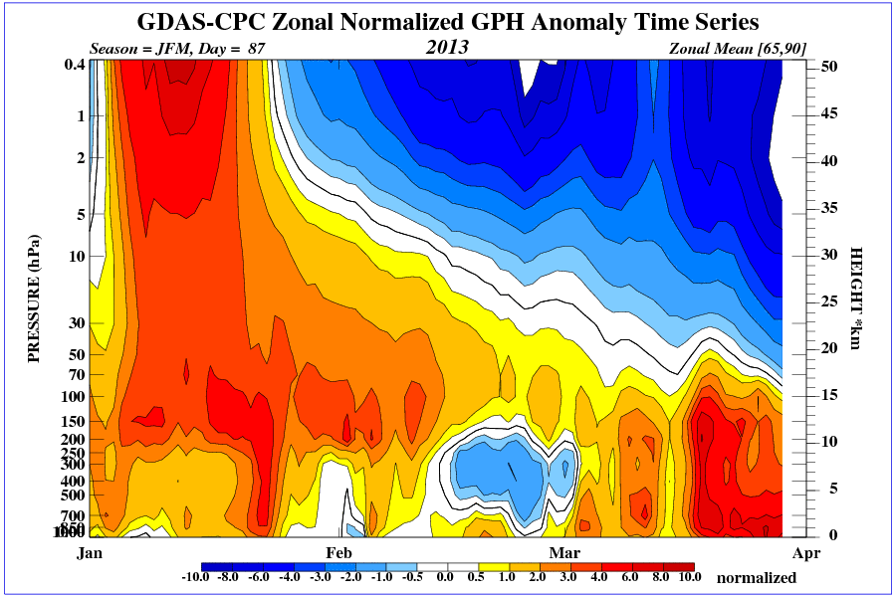
Vertical cross section of zonally averaged Geopotential Height (GPH) over the N. Hemisphere Polar Cap
Cluster A/ Negative AO = positive heights over polar cap
Real-time monitoring by CPC’s stratosphere team
Tropopause
January through March 2013
Solid green: Surface GPH was most positive when MJO-related convection followed phases 7/8 (coincided with cold air outbreaks/ below avg. surface temps in the northern and eastern United States)
Dashed green: Polar cap GPH was weakest when MJO-related convection followed phases 3/4

Slide 32
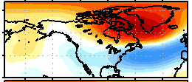
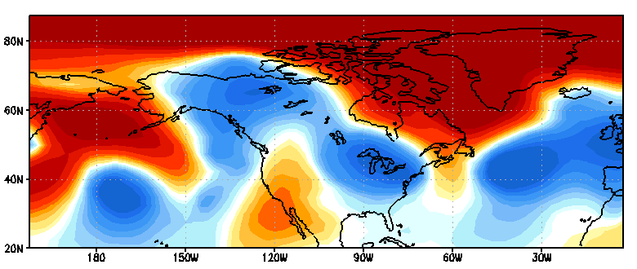
A snapshot from March 20th, 2013: The MJO was in Phase 8. The observed 500-hPa height pattern strongly matched the expected negative AO/NAO-ish pattern shown below.
Cluster 4
Large positive values = good projection/ matching to the pattern shown at top.
Recent history
Ensemble
GFS
forecast
Observed March 20th anomalies
Courtesy of Emily Riddle

Slide 33
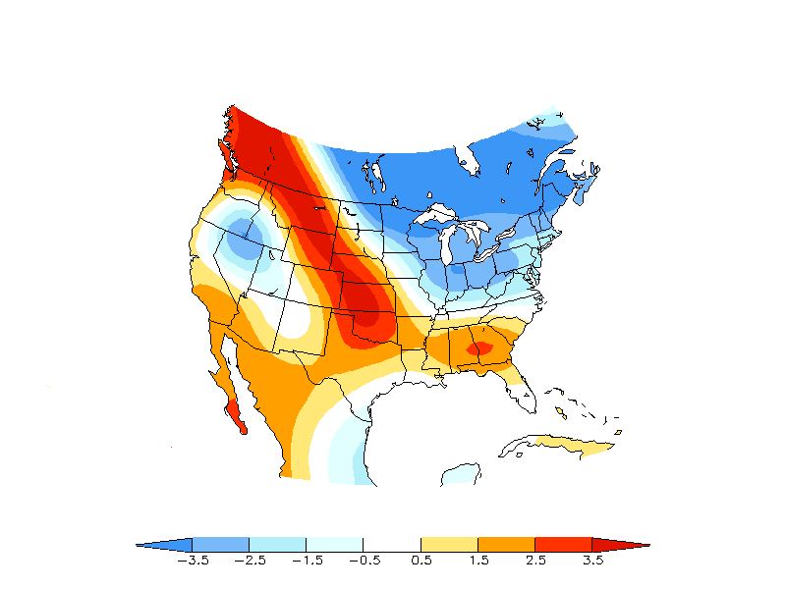
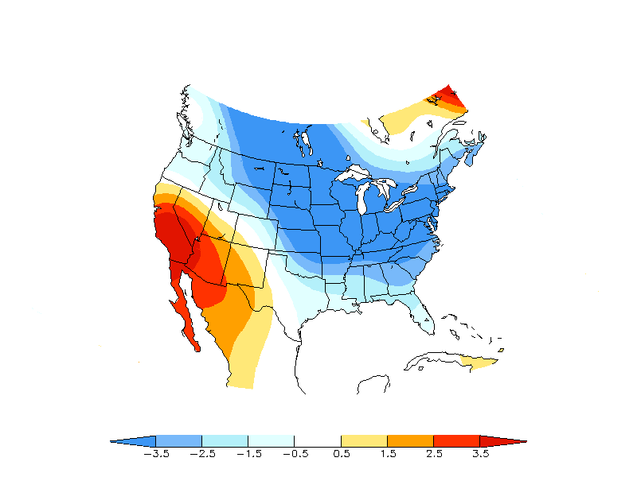
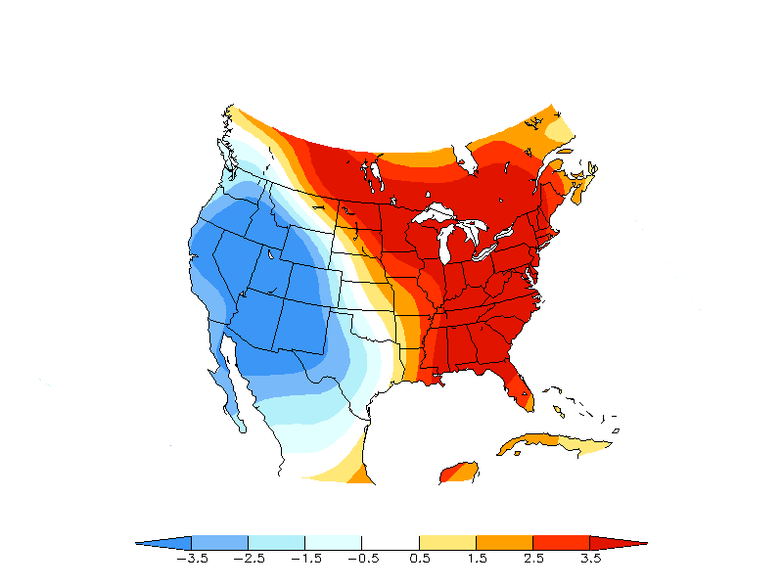
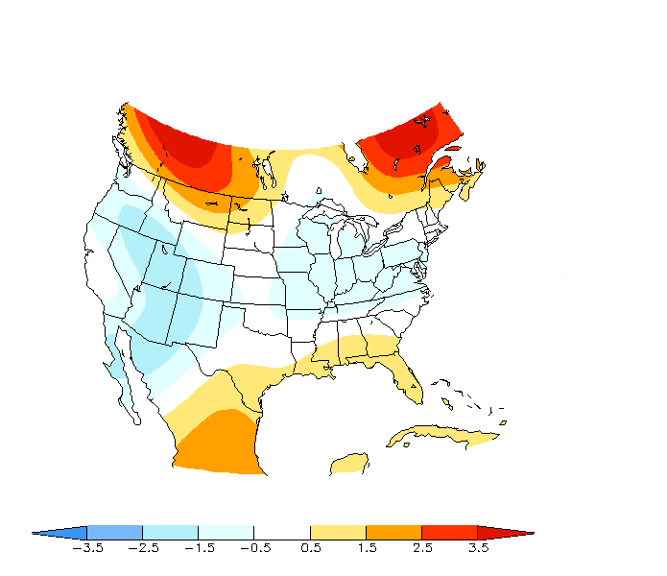
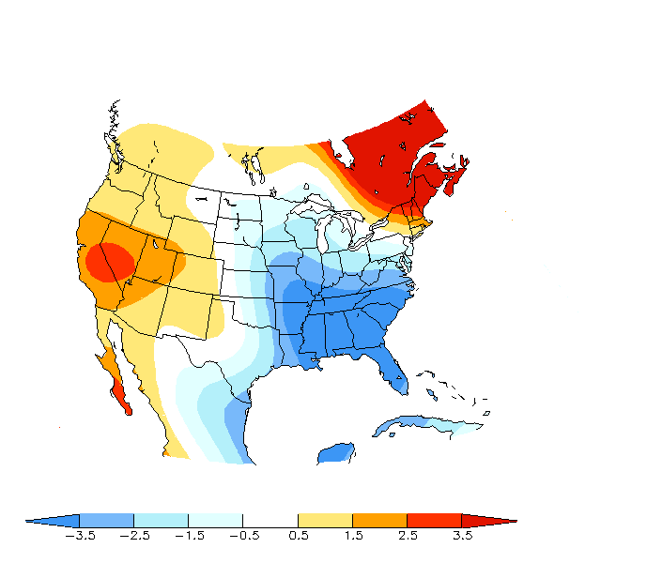
Averaging daily data January-March 2013
Expected MJO forced Surface Temperature pattern after Phase 7/8
Jan 15-27th
Mar 15-27th
~ 2 week period following MJO into Phase 7.
925hPa Temperature from GDAS
Jan 1-14th
Feb 1-28th
Mar 1-14th
Averages for the remainder of the JFM period

Slide 34
Where can I get information on the MJO?
CPC MJO webpage (links to MJO Composites/Impacts): http://www.cpc.ncep.noaa.gov/products/precip/CWlink/MJO/mjo.shtml
Real-time MJO forecasts from various dynamical models (sponsored by CLIVAR):
http://www.cpc.ncep.noaa.gov/products/precip/CWlink/MJO/CLIVAR/clivar_wh.shtml
Weekly Update on the current status & prediction of the MJO (every Monday):
http://www.cpc.ncep.noaa.gov/products/precip/CWlink/MJO/mjo.shtml#discussion
Week-1 and Week-2 outlook for rainfall and tropical cyclones over the global tropics (every Tuesday):
http://www.cpc.ncep.noaa.gov/products/precip/CWlink/ghazards/index.php
Email Jon.Gottschalck@noaa.gov and Matthew.Rosencrans@noaa.gov (CPC MJO Forecast Team)

Slide 35
Thanks for listening.
Any Questions?
You can also contact me at:
Michelle.LHeureux@noaa.gov

