Slide 1
NOAA’s National Weather Service
Office of Science and Technology
Damage Assessment Toolkit
Status Report
Dario Leonardo/OSIP IWT Lead
Ira Graffman/GIS Lead
Storm Damage Assessment
OST/SEC/Support Branch
May , 2012
NOAA’s National Weather Service

Slide 2








Project Team
Paul Kirkwood – SRH – Prototype IT Administration
Parks Camp – SR (TLH) – DAT Developer
Keith Stellman – SR DAT Developer
  Kris Lander – CR Developer
Jay Laseman – CR developer
Ira Graffman – NWSHQ GIS specialist
John Ferree – OCWWS – OSIP / Field Liaison
Dario Leonardo – NWSHQ OSIP IWT

Slide 3
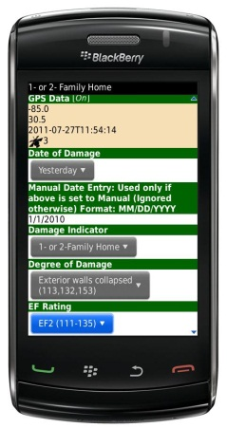
Background Information
Project Origin
2005 Storm Damage Survey on GPS device
2009 Project enters OSIP (SON – PP)
2011 IWT formed to transition project
  Goals
  Reduce preparation time for site deployment
  Reduce perishable damage data collection time
  Improve damage survey data collection consistency
  Improve delivery of geospatially-accurate data to core partners and the public

Slide 4
Role in NOAA Enterprise

Slide 5
DAT contributes to a
Weather Ready Nation
Enhancing IDSS: Partners want to know what we know
  Combining DAT collected and quality controlled data with other NWS storm data results in comprehensive situational awareness
  Help to better prepare our communities for extraordinary events
  Provides a time saving collaborative tool for pilot project Emergency Response Specialists
Next Generation Dissemination Requirements
  Deploying DAT via the Cloud as an NWS wide IT tool is the realization of NWS delivering knowledge “anytime anywhere via a scalable, agile, and cost-effective infrastructure”
  Technologically relevant customer/partner support to deliver cutting-edge science

Slide 6
Field Testing
Over the course of the last 2 years, the following focal points have led the Beta testing of DAT at their WFOs
GLD: David Floyd
LSX: Ron Przybylinski
OAX: Jay Laseman
JKL: Buddy Whorrall
LOT: Stephen Rodriquez
FGF: Rick Hozak
GID: Michael Moritz
LBF: Teresa Keck
ILX: Darrin Hansing
ABR: David Hintz
TOP: Chad Omitt
FWD: Mark Fox
SHV: Keith Stellman
TLH: Parks Camp
AMA: Krissy Scotten
LUB: Jody James
LZK: John Robinson
OUN: Richard Smith
TSA: Ed Calianese
LCH: Roger Erickson
LIX: Frank Revitte
BHM: John Deblock
MOB: Jeff Garmon
ALY: Steve DiRienzo
CAE: Steve Naglic
CAR: Noelle Runyan
CLE: Gary Garnet
ILM: Steve Pfaff
ILN: Mary Jo Parker
RLX: Jamie Bielinski

Slide 7
Damage Collection Comparison
Shreveport CWA
October 29, 2009 22 Tornados
April 27, 2011 27 Tornados

Slide 8
Time Savings
    1551 = Average Annual Number of Tornados (2007-2010)
    Approximately ½ of tornado events require overtime to complete storm reports = 775 annual average
    Data Collection Team
  2 people per team, avg 1 team per event
  Annual savings ~ $58,162 (Low estimate…)
    Report Generation
  8 hours per event for Warning Coordination Meteorologist
  Annual saving ~ $654,646

Slide 9
Alternatives Analysis
    Two Alternatives Analyses were completed for OSIP
Analysis # 1 for the overall Damage Assessment Process (OSIP Stage 3)
  DAT was selected as best option
Analysis # 2 Most Recent for transitioning the field prototype to national operations (OSIP Stage 4)
  Government Systems
    Alternative A = NWS Internet Dissemination System (NIDS)
    Alternative B = NOAA Web Operations Center (WOC)
  Commercial Cloud Options
    Alternative C = Esri Cloud
    Alternative D = USGS facilitated GeoCloud

Slide 10
Alternatives Analysis
Government Systems
    Alternative A = NWS Internet Dissemination System
Implementation Costs = $142K - $197K
O&M Costs = $135K- $189K/yr + 3% annual increase
Operating Systems = Linux or Windows
Could not guarantee implementation schedule requested by DAT
    Alternative B = NOAA Web Operations Center (WOC)
Implementation Costs = $300K (estimated)
O&M Costs = $190K (estimated)
Operating Systems = Linux or Windows
Could not guarantee implementation schedule requested by DAT

Slide 11
Alternatives Analysis
Commercial Cloud Solutions
    Esri Cloud
Implementation Costs = $325K or more
O&M Costs = $130K/yr + additional development services
Operating Systems = Windows on Amazon Cloud
Assured compatibility with other Esri software in DAT solution
    USGS facilitated GeoCloud
Implementation Costs = $119K
  14K year 1 and 30K year 2 for USGS
  75K for C&A
O&M Costs = $54K + 3% annual increase
Operating Systems = Windows on Amazon Cloud
Requires NWS AA signing an Memorandum of Understanding with USGS

Slide 12
Cost Comparison
    Analysis: (more details available in backup slides)
  Total costs for FY12 -13 are as follows:
  Total estimated costs for FY14-18:
  Initial 2 yr cost saving over NIDS of $127,838
NIDS / Linux | NIDS Windows | USGS GeoCloud
$247,447 | $355,127 | $119,609
NIDS / Linux | NIDS Windows | USGS GeoCloud
$735,886 | $1,025,931 | $307,428

Slide 13
Benefits of DAT
Complies with NWS’ implementation of an enterprise approach to information technology (IT) solutions as a method for identifying and implementing efficiencies directed by the President
The US Chief Information Officer has directed a shift to a “Cloud First” policy, shift to consolidated IT frameworks and develop a strategy of shared services
  Leveraging the USGS GeoCloud enables the NWS to comply with this direction
Promotes sharing of resources and costs between agencies maximizing tax payer investment
Notes:
Vivek Kundra

Slide 14
Project Timeline
June 2005
Initial Development with handheld GPS
April 2007
Application for laptops added to toolkit
August 2008
Application for Blackberry Mobile Phones Developed
June 2009
OSIP Gate 1 Approval
July 2009
Field Testing for Laptop Prototype
October 2009
Field Testing for Mobile Phone Prototype
June 2011
Business Case
Project Plan Updated
OSIP Gate 2 Approval

Slide 15
Project Timeline continued
NSTEP Requirements Document
Technical Requirements Document
September
2011
Operational Transition Plan
TOC/NiDS/DAT MOU
TRD and ODP Posted
Project Plan Update
October 2011
OSIP Gate 3 Review
NWSEO Review
November 2011
USGS Cloud
March 2012
NWS/USGS MOU drafted
August 2011
December 2012
GeoCoud IOC
January 2014
GeoCloud FOC

Slide 16
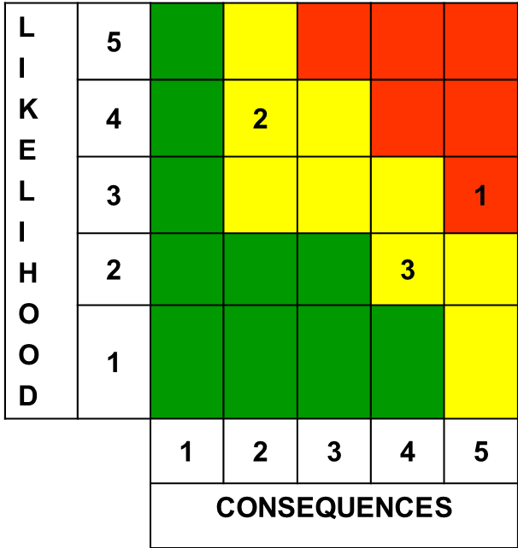

Risk Management
Criticality
Trend
Approach
Critical
Improving
M - Mitigate
Moderate
Worsening
W - Watch
Low
Unchanged
A - Accept
☼
New
R - Research

Slide 17
Milestones in Danger
    Milestones
C&A of DAT application in the Cloud – 6/15
Transition to operational hosting environment – 12/1
    Mitigation Strategy
Engage management to assist with funding project
Task security assessment
Open communication by USGS/NWS with ESRI

Slide 18
Issues
    Budget and Policy
Shrinking budget environment
Security Policy for Cloud and Mobile Devices is NOT complete
Engineering
Multiple platforms (problem for personal devices only)
    Cultural Challenges
“My app is best”
Non-development region buy-in

Slide 19
Future
DAT application to run on multiple Mobile Operating Systems
Damage Assessment Teams ability to use their personal devices to conduct surveys
DAT and AWIPS run from the same Tablet Device
Notes:
19

Slide 20
Back-up

Slide 21
Partner Benefits
    FEMA/DHS
  Utilizes storm damage assessment reports to prepare for disaster assistance. Information of damage impact made available the same day shortens the time before FEMA can deploy with assistance (food, clothing, shelter, etc)
    American Red Cross
  Advanced notification of the level of damage and casualties can help to estimate the amount of blood to deploy to Triage locations
    EPA
  Utilizes storm damage assessment reports to better assess ecological damage and the funding decisions required for environmental cleanup
    DOD
  Army Corp of Engineers, US Marine Corps use web services for warnings and situational awareness (require OGC web map services)

Slide 22
Societal Benefits
    Internal NWS
  Greater efficiencies - decrease forecaster time / improve quality storm damage data
  Ability to compare Tornado touchdowns to warning areas (via shapefiles) to apply verifications
    External NWS
  Provide public and partner agencies with NWS collected information to use in disaster response and communication.
  Standardization of the data sets and data collection methodology allow WCMs to train Emergency Managers in advance of how to interpret the data.

Slide 23
References
  National Weather Service, cited 2012 - April 3rd Severe Weather Outbreak. Available online at http://www.srh.noaa.gov/fwd/?n=april32012sum
  National Weather Service, cited 2012 - Tornado Outbreak and Severe Weather. Available online at http://www.erh.noaa.gov/iln/events/20120302
  National Weather Service, cited 2012 - Information for the Tornado Outbreak of May 24, 2011. Available online at http://www.srh.noaa.gov/oun/?n=events-20110524
  National Weather Service, cited 2012 - Pertinent Geographic Information Systems (GIS) Data from the March 2, 2012 Tornado and Severe Weather Event. Available online at http://www.srh.noaa.gov/bmx/?n=event_03022012gis

Slide 24
References
  Obama, Barack, 2011 - Promoting Efficient Spending, Executive Order 13589, of November 9, 2011, Federal Register, Vol. 76, No. 220, 2 pp. Available online at http://www.gpo.gov/fdsys/pkg/FR-2011-11-15/pdf/2011-29683.pdf
  Kindra, Vivek, 2010 - 25 Point Implementation Plan to Reform Federal Information Technology Management, 35 pp. Available online at at http://www.cio.gov/documents/25-Point-Implementation-Plan-to-Reform-Federal%20IT.pdf
  Maier, C, 2011 - Post Storm Data Acquisition, National Weather Service Office of Climate, Water and Weather. NWS Instruction 1604. Available online at http://www.nws.noaa.gov/directives/sym/pd01016004curr.pdf

Slide 25
References
  Blackberry, cited 2012 - Government Agency Uses Blackberry Solution, with Freeance Mobile App and GPS, to Streamline Strom Survey Work. Blackberry Customer Success Story, 2 pp. Available online at http://us.blackberry.com/newsroom/success/USNWS_final.pdf
  Leonardo, Dario, 2011 – Damage Assessment Toolkit Business Case Analysis. NWS OSIP Project 08-024, 16pp. Available online at https://osip.nws.noaa.gov/osip/projectDetail.php?projectid=07-012

Slide 26
Supporting Documents
FEMA request for NOAA GIS Data

Slide 27
Field Reports
    Comments & Quotes
  During a visit to the Birmingham WFO on Saturday, April 30, both NOAA Administrator Jane Dr. Lubchenco and U.S. Representative Bachus were impressed by a demonstration of the DAT prototype
  Experienced SRH damage assessor used application and spent 4-5 hours doing what normally would have taken 3-4 days to accomplish
  Damage area surveyed as the assessor walked through the impact area. The tornado path was updated at the WFO as the assessor walked the impact area
  Quote from the GIS focal point for the City of Lancaster TX: "At the risk of sounding like a total GIS dork, this is awesome!!! Thank you so much for sharing your data & expertise."
  Mass media outlets had access to the data within hours rather than days

Slide 28
Field Reports
    Comments & Quotes
  Quotes from DAT Users include: "With any luck, this tool will become the standard" from Jim LaDue (OCWWS WDTB) and "We need this tool yesterday" from Jim Stefkovich (WFO BHM MIC)"
  Greg Carbin – SPC: Following the March 2, 2012 Kentucky tornado event - “We do not have shapefiles of the tracks. Part of the problem resides with the way the offices are providing survey information”
  “If anything, this most recent event is more difficult to track because it covers three NWS Regions with somewhat disparate ways of compiling and disseminating the track, damage, and fatality information”
  “Until the regions and WFOs use a common format in providing the geographic information, we may have to wait for the Storm Data deadline (60 days after the end of the month) to acquire this data and then have it made into a shapefile”

Slide 29
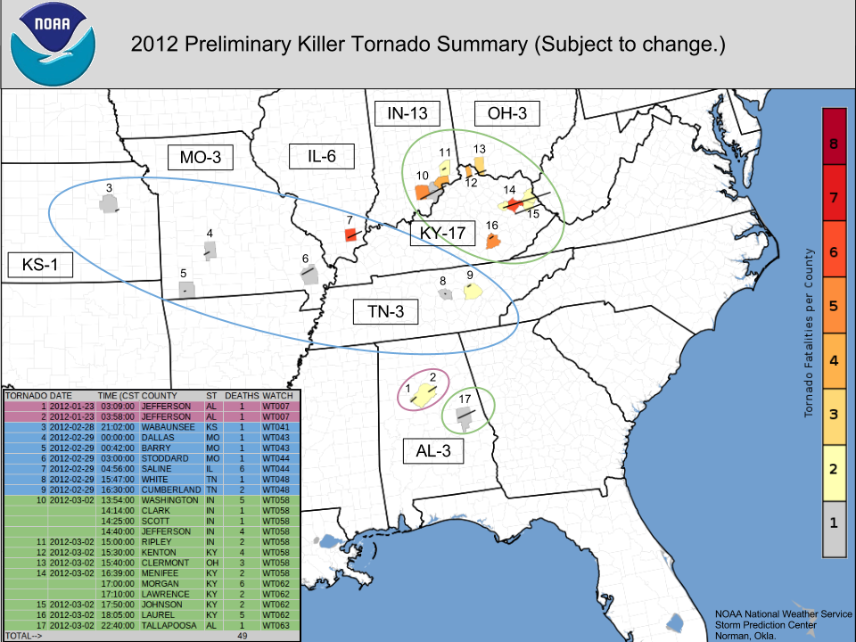
DAT DATA
    March 2nd Tornado report

Slide 30
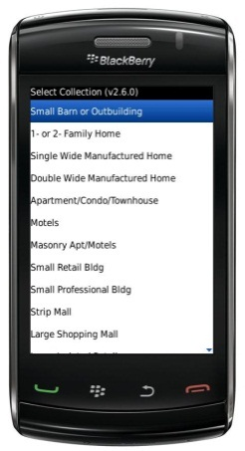
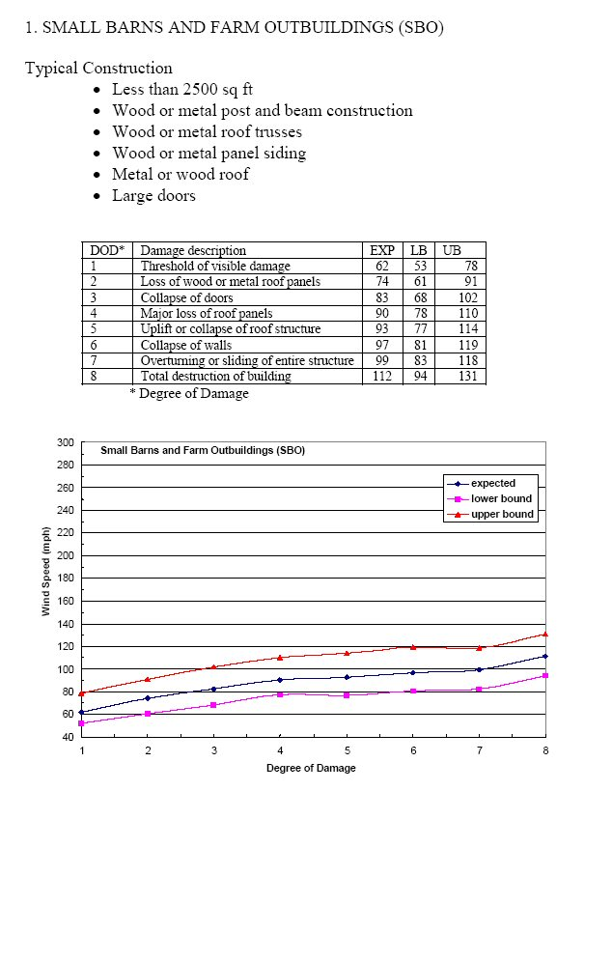
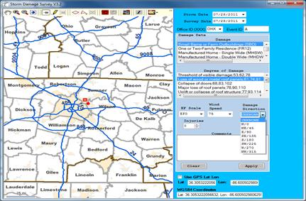
PDA Interface

Slide 31
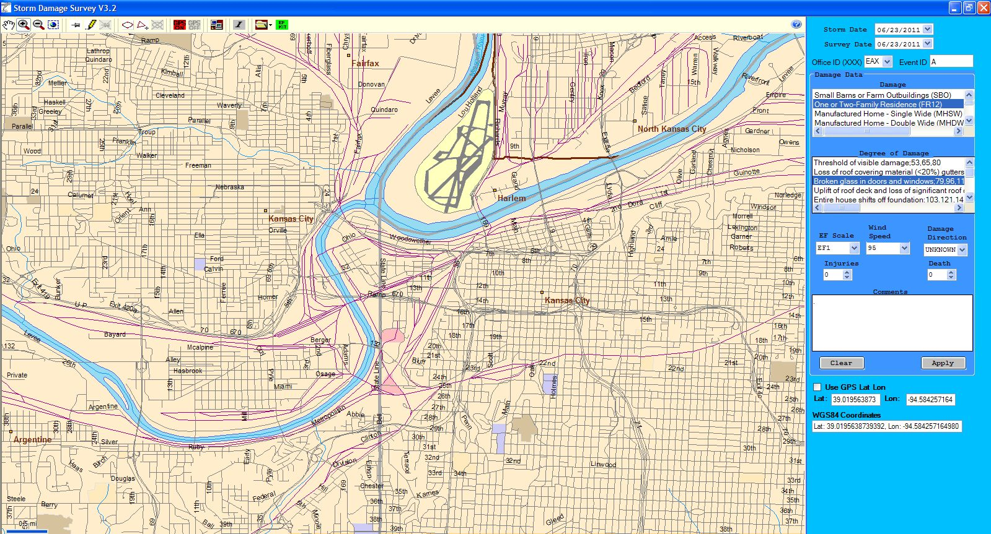
Laptop Interface

Slide 32
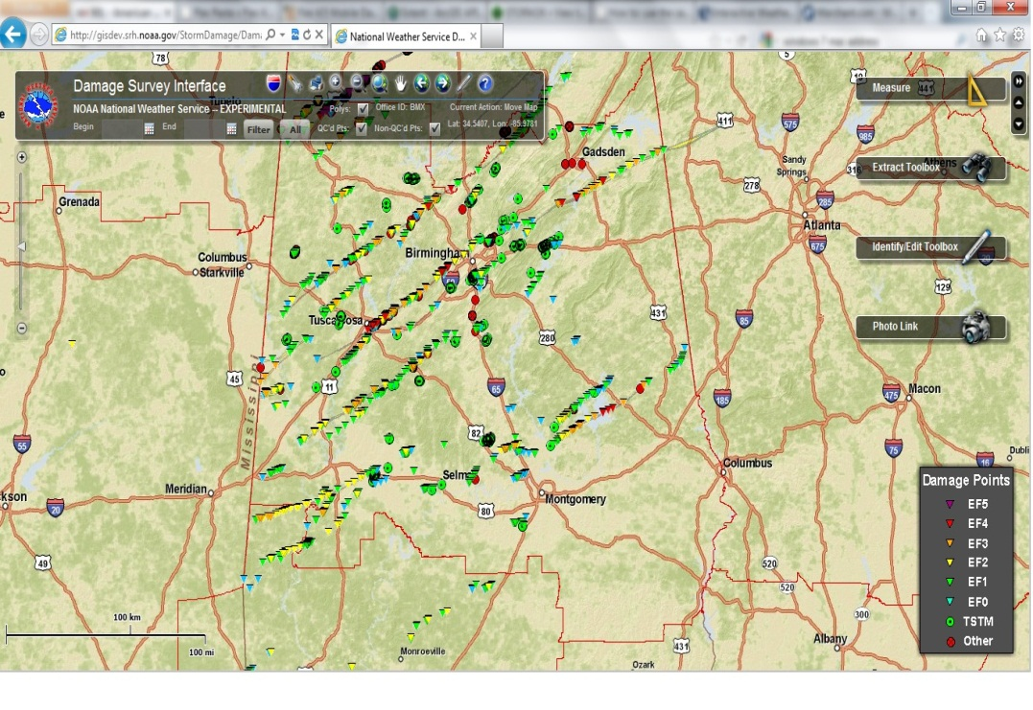
Quality Control (QC) Interface

Slide 33
Training
    Web based training module
      4 training sessions provided since Jan 2011
  20 or more WFOs from various regions attend each training session with attendance of approximately 40-60 participants

