Slide 1
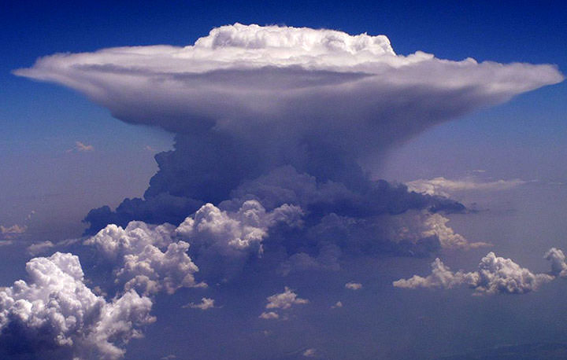
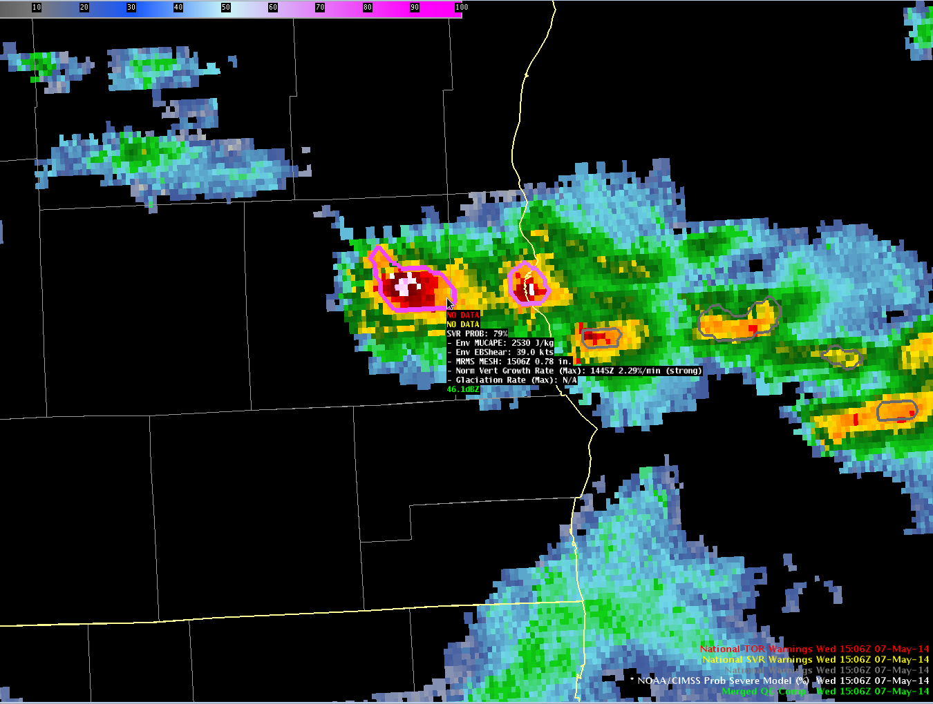
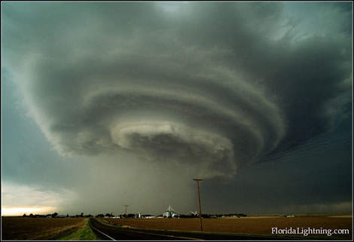
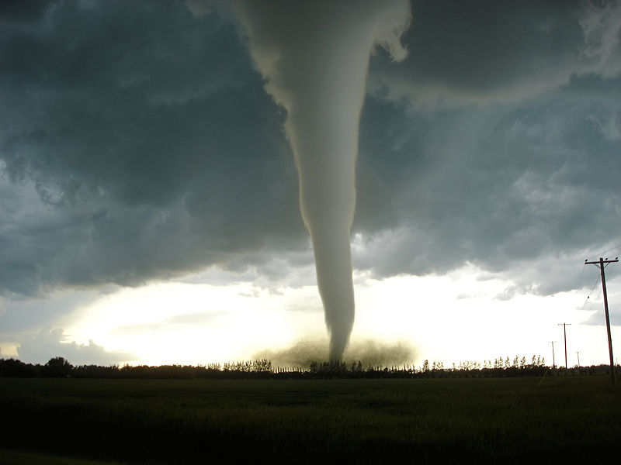



ProbSevere – A New Tool for NWS Severe Weather Warning Operations
Michael J. Pavolonis (NOAA/NESDIS)
John Cintineo (UW-CIMSS)
Justin Sieglaff (UW-CIMSS)
Dan Lindsey (NOAA/NESDIS)
Chad Gravelle (UW-CIMSS)

Slide 2
Research is critical for transforming “Big Data” to information
Notes:
200 vs 2 GB

Slide 3
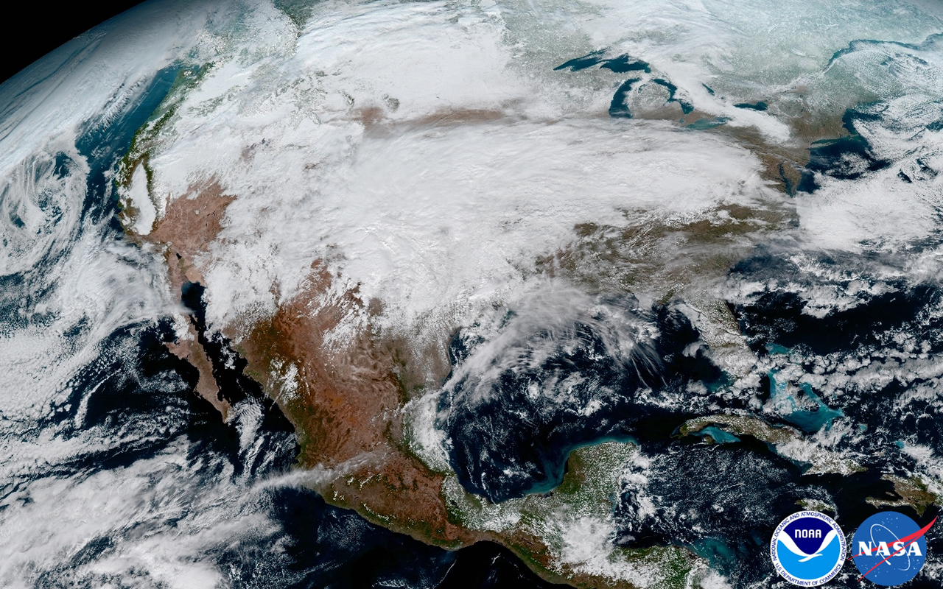
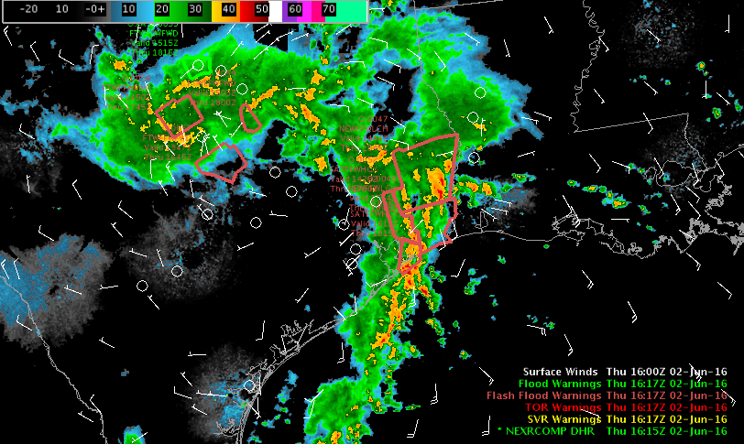
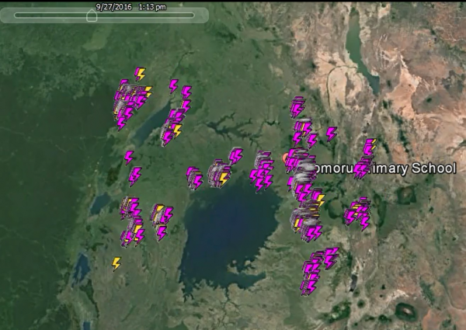
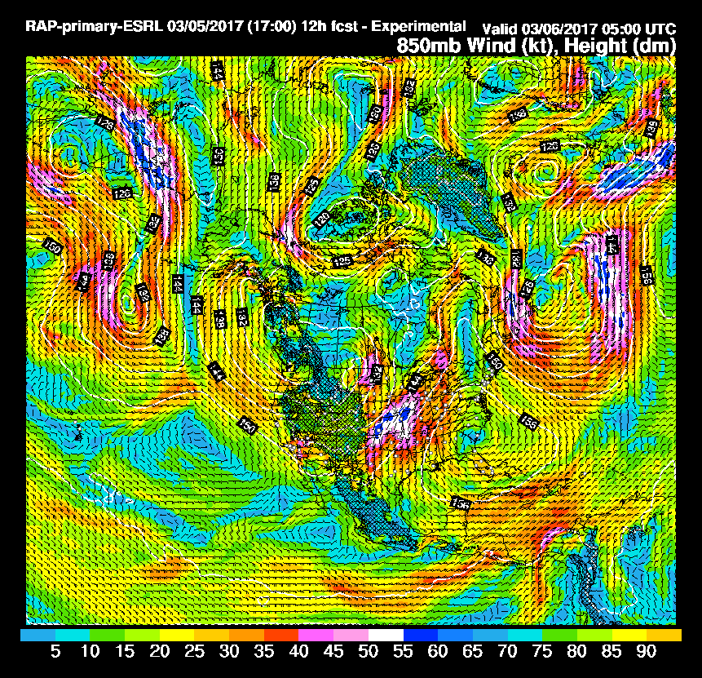

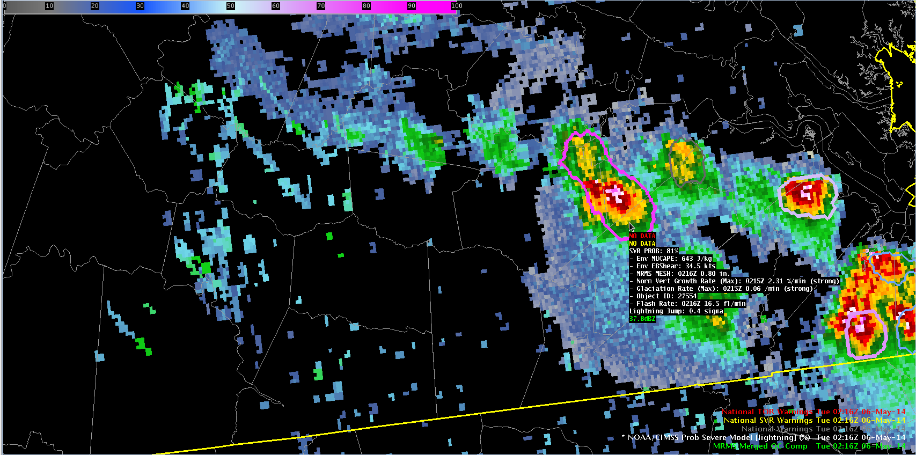
Operational applications require “Big Data” to be automatically transformed into information and insight for decision making
Volcanic Eruption Detected!
Severe Weather Likely
Notes:
-The value of satellite data can be increased through fusion with non-satellite data sources
-In the era of big data, manual extraction of information from L1 and L2 satellite and non-satellite data is not sufficient.
-Need to build upon the traditional L1 and L2 paradigm to realize true value

Slide 4
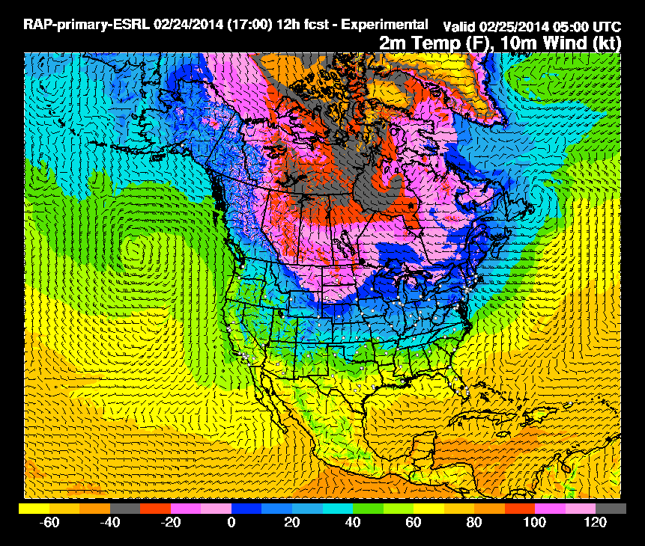
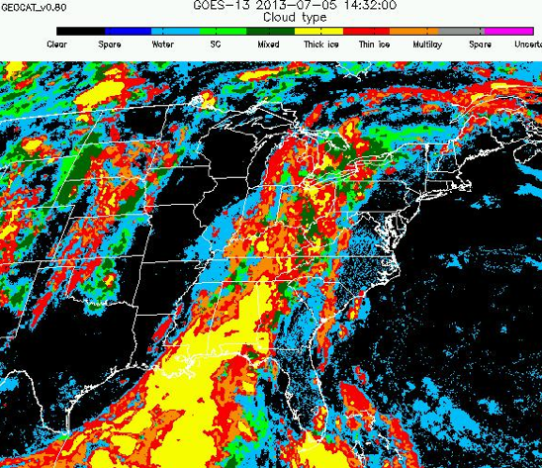
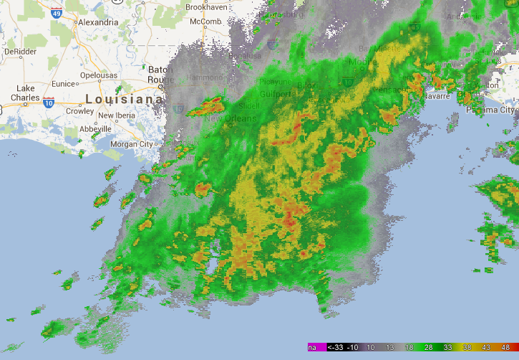
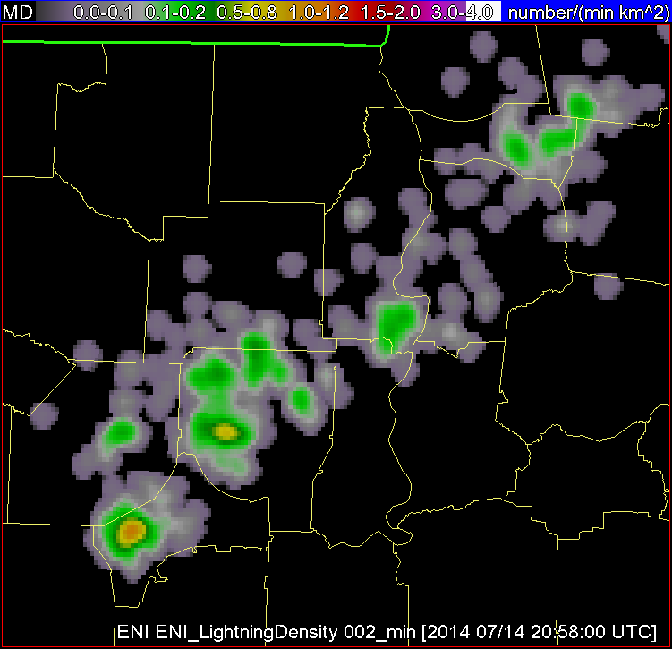
“Big Data” to Environmental Intelligence
High-resolution NWP Data
Satellite Imagery and Derived Products
Radar Imagery and Derived Products
Total Lightning
Storm Environment
Evolution of Cumulus to Cumulonimbus
Storm Tracking and Hydrometeor Properties
Storm Electrification
Probability a thunderstorm will produce severe weather in the future (up to 60 minutes)
Notes:
A few more details about the input data into the statistical model are beneficial. The high-resolution NWP data are used to characterize the instability and shear of the environment a storm develops.
The satellite imagery is used in two ways; to track clouds across space and time—in the same way a human views satellite imagery loops and to quantify the cloud growth rates, which are used as predictors in the model.
The radar data are used in a similar manner as the satellite data. The radar data are used to track storm cells in reflectivity imagery—again like how a meteorologist looks at a loop of radar imagery. And to quantify the intensity of the precipitation core of a developing thunderstorm, which is used as a predictor in the model.
The total lightning data are used to quantify the number of lightning flashes per minute within a radar tracked storm cell.
Before discussing a few more details about the input datasets, a schematic of how the statistical model works is presented in the following slide.

Slide 5
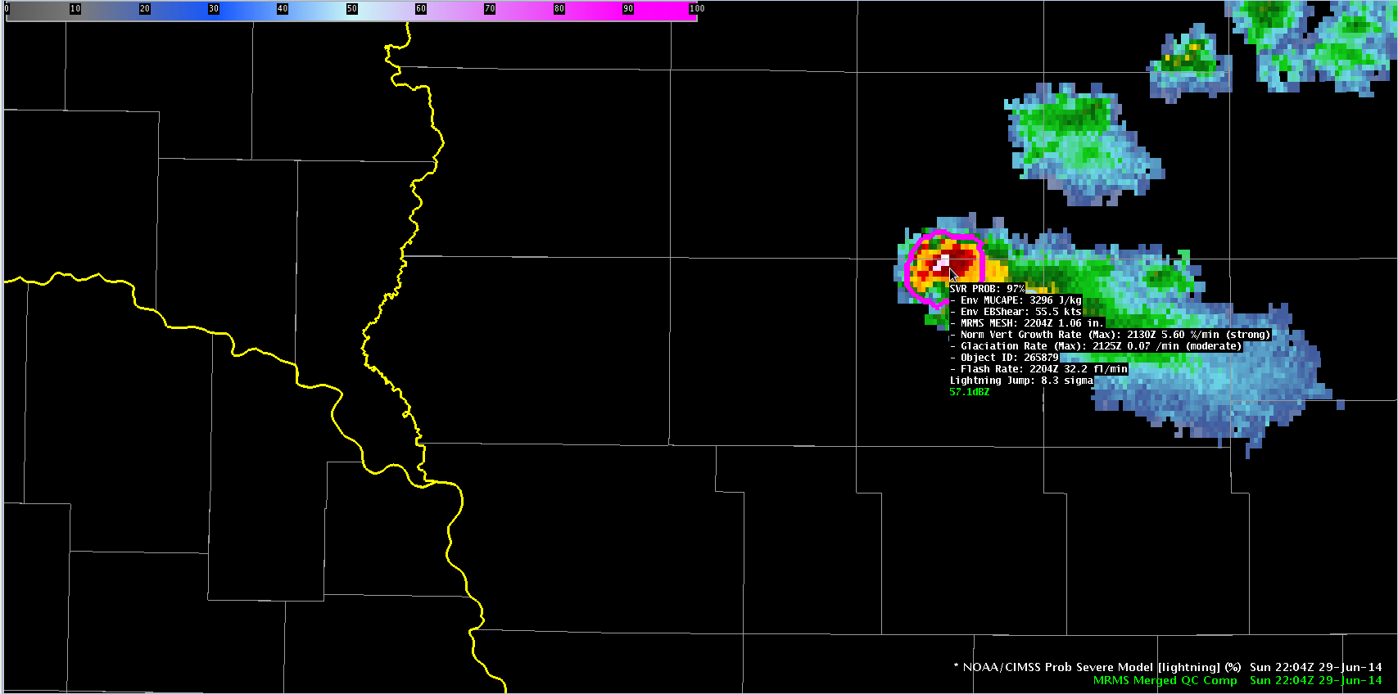
ProbSevere Model AWIPS-II Display
Model output are shapefiles contoured around radar storm cells.
Enhancement designed for overlay on radar reflectivity—but can be overlaid on any field (satellite, radar velocity, etc.).
Sampling offers readout of model probability as well as each model input.
Notes:
We will now transition from discussing how the statistical model works and learning about the input datasets to showing examples of how the model performed in some severe weather events.
The model output is displayed in two ways. One is a probability contour with a color enhancement designed for overlay on top of typical radar reflectivity color tables (e.g. greens, yellows, and reds are avoided in the ProbSevere colortable). The shapefile nature of the output makes the display very flexible—the contours can be overlaid on any field within AWIPS-II (e.g., radar velocity). Additionally, the model probability and each model predictor is displayed as text when sampling is turned on. The following bullets briefly describe the text read-out.
This field is the ProbSevere probability and ranges between 0 and 100% for a given storm cell.
This field is the most unstable CAPE from our RAP composite for the storm cell.
This field is the effective bulk shear from our RAP composite for the storm cell.
This field is the MRMS MESH value—the time and value are provided. Note the MRMS may not match a single radar site MESH algorithm—both time and value.
This field is the normalized vertical growth rate of the storm. It is the maximum value attained during the growth stage of the storm and the time that maximum value occurred. The units are percentage of the troposphere depth the cloud grew per minute. The exact values are not terribly important—we append a statistical measure of intensity with the terms “weak”, “moderate”, or “strong”.
This field is the glaciation rate or the rate at which the storm-top transitioned from liquid water droplets to ice crystals. It is the maximum value attained during the growth stage of the storm and the time that maximum value occurred. The units are a percentage of water to ice conversion per minute. Again we append a statistical measure of intensity with the terms “weak”, “moderate”, or “strong”.
This field is the flash rate--the time and value are provided. Recall the total lightning is part of a 2-D predictor in the ProbSevere model—combining effective bulk shear and total lightning flash rate.
While each model predictor is provided in the text read-out, it is important to emphasize—the sum of the information--the probability--is more valuable than any individual piece of information.

Slide 6
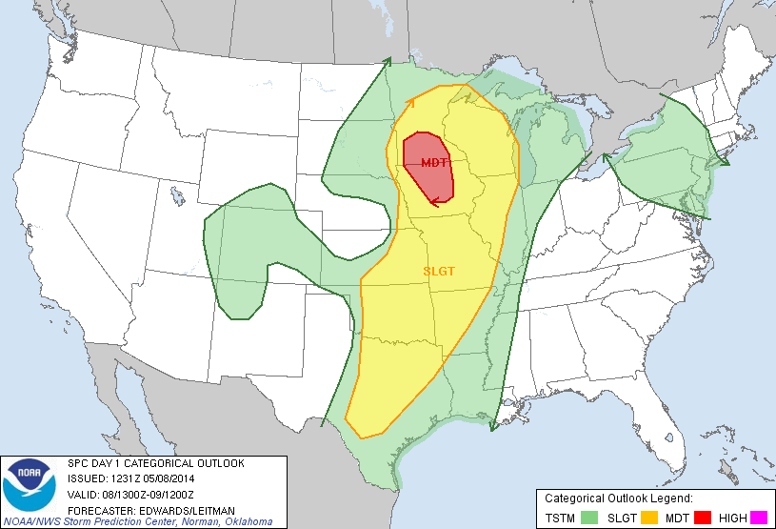
08 May 2014
Notes:
Now getting to examples, the first example is over southeastern South Dakota on the western edge of a slight risk region as depicted by the Storm Prediction Center outlook.

Slide 7
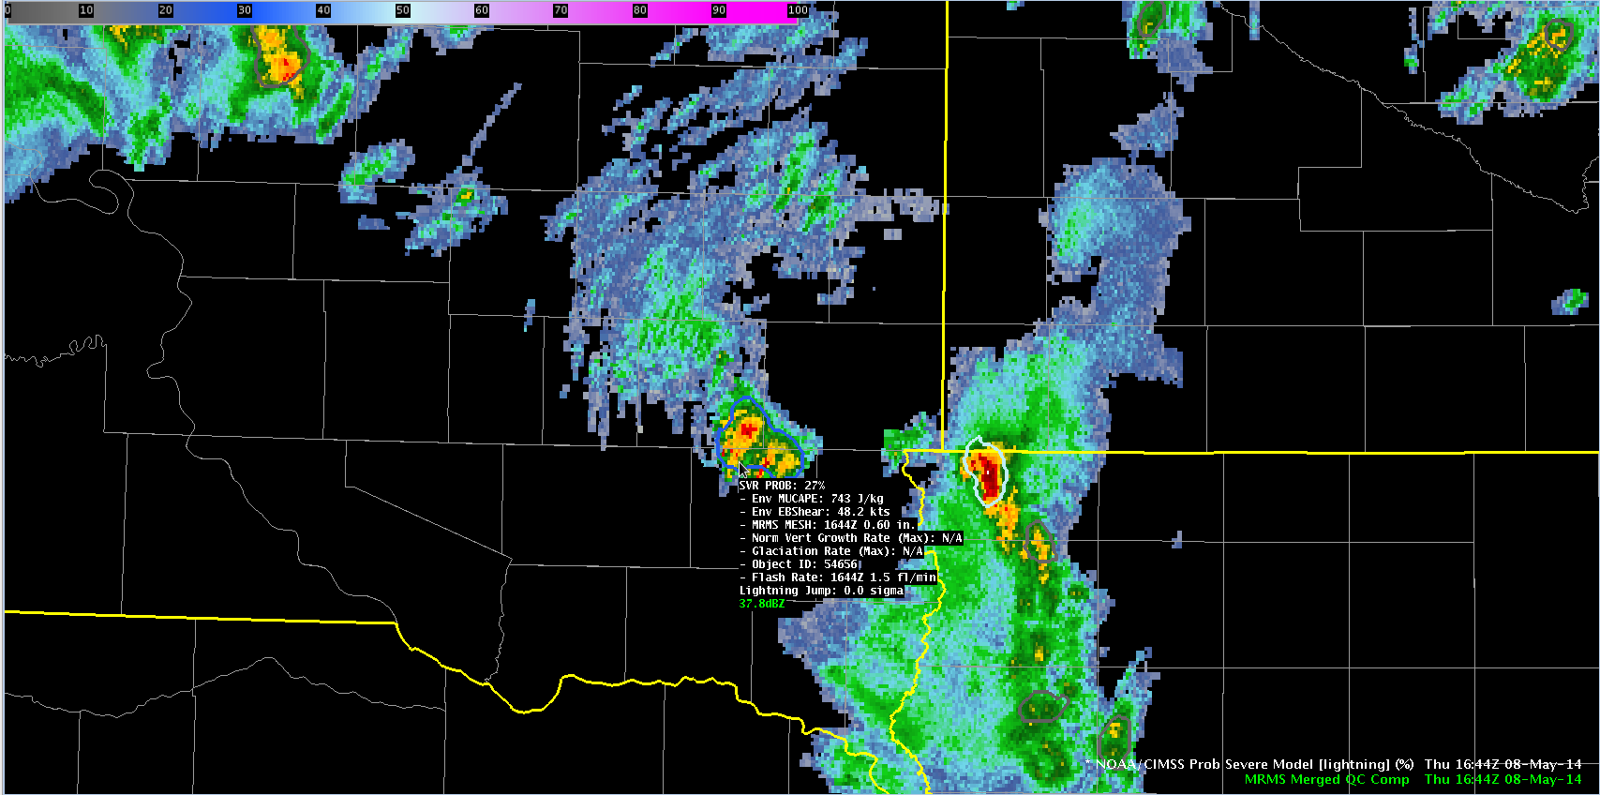
1644 UTC May-08-2014
MUCAPE ~ 750 J kg⁻¹
Eff. shear ~ 48 kts
Prob = 27%
Highly sheared environment
Low MESH
Low lightning
MN
SD
IA
Notes:
In these examples, MRMS composite reflectivity is shaded and the ProbSevere contours are overlaid on the reflectivity data with the text read-out provided for the storm of interest. At 1644UTC a developing storm had marginal instability but significant shear. The probability at this time was low—only 27% as the MRMS MESH and total lightning were fairly low.

Slide 8
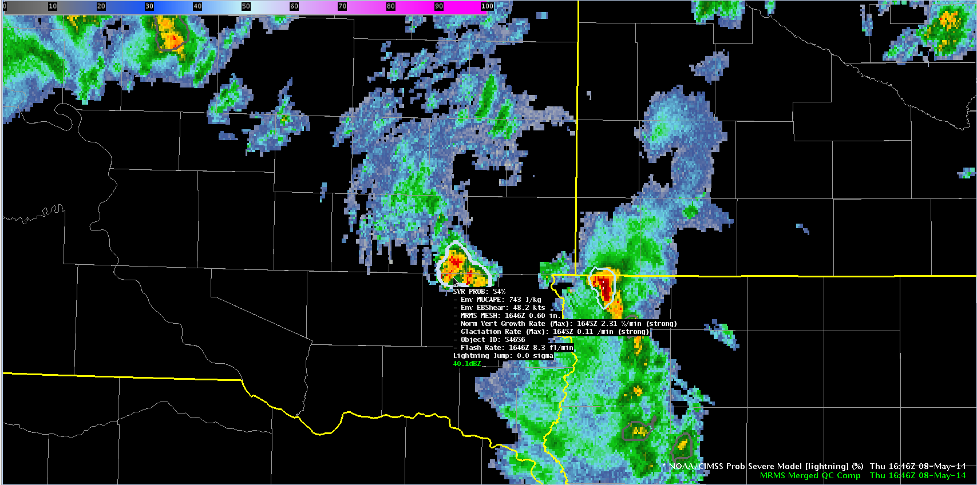
1646 UTC May-08-2014
MUCAPE ~ 750 J kg⁻¹
Eff. shear ~ 48 kts
Prob = 54%
Strong satellite growth and glaciation rates.
Small increase in lightning.
MN
SD
IA
Notes:
At 1646 UTC, satellite growth rates were diagnosed and included into the ProbSevere calculation. Both the vertical growth rate and glaciation rate were in the ‘strong’ category, which drove the probability up to 54%.

Slide 9
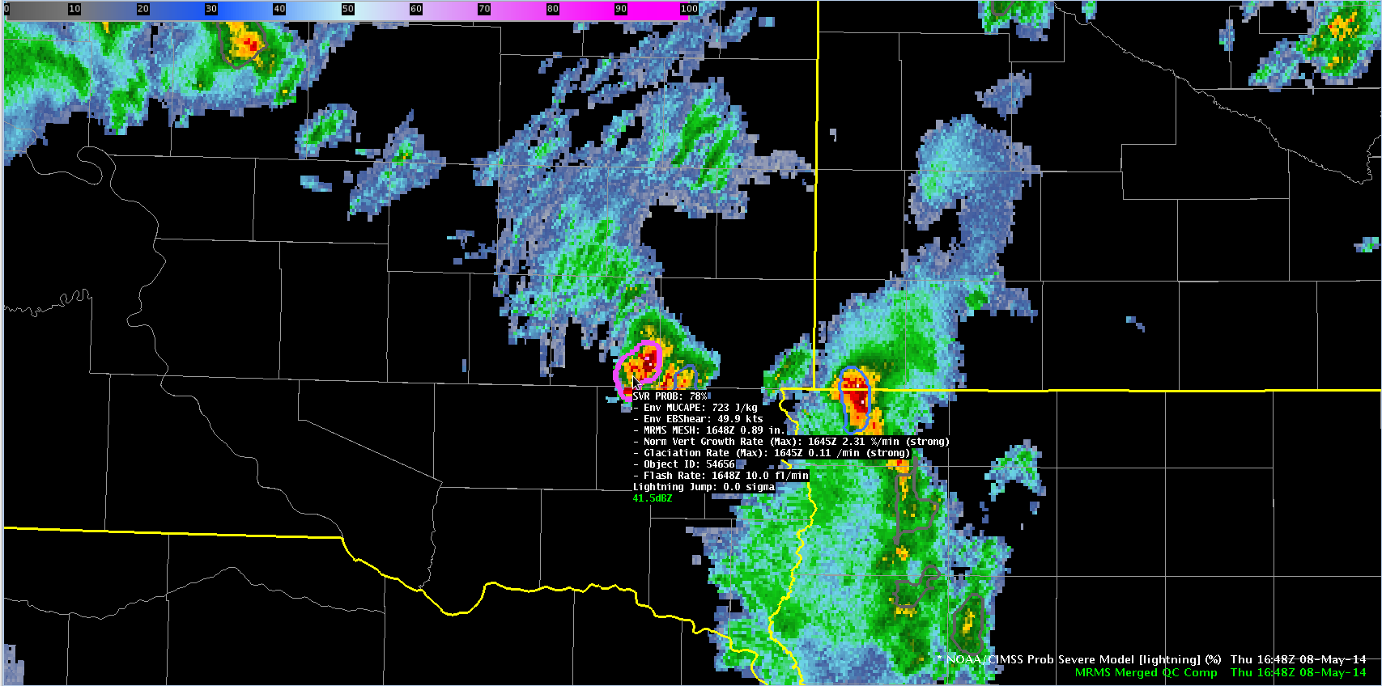
1648 UTC May-08-2014
MUCAPE ~ 750 J kg⁻¹
Eff. shear ~ 48 kts
Prob = 78%
Strong satellite growth and glaciation rates.
MESH increases to 0.89”.
Lightning continues to increase.
MN
SD
IA
Notes:
Two minutes later, the storm continued to intensify as indicated by the MESH and total lightning read-outs. The probably again jumped, now to 78%.

Slide 10
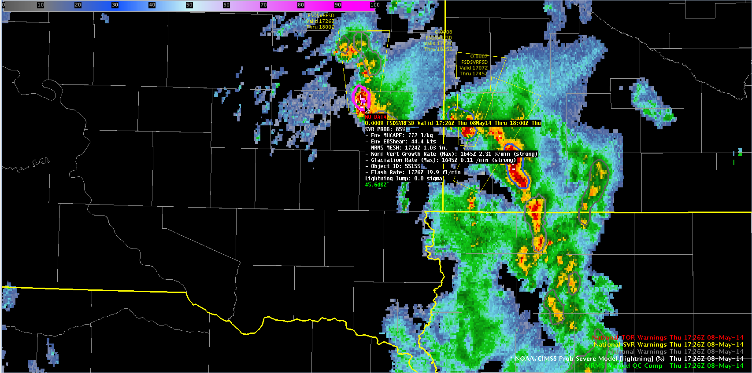
1726 UTC May-08-2014
MUCAPE ~ 750 J kg⁻¹
Eff. shear ~ 48 kts
Prob = 85%
KFSD issues SVR warning @ 1726 UTC (40 minutes)
Golf ball sized hail report @ 1732 UTC (46 minutes)
MN
SD
IA
Notes:
The storm continued to exhibit high probabilities and at 1726 UTC a severe thunderstorm warning was issued by the Sioux Falls WFO. 6 minutes later the first severe report of golf ball sized hail was received. This example demonstrates how ProbSevere can be used to identify a storm that is likely to produce severe weather and potentially be used to increase lead-time. [For those interested, the storms over extreme northwestern Iowa/southwestern MN had lower probabilities and did not produce severe reports.]

Slide 11
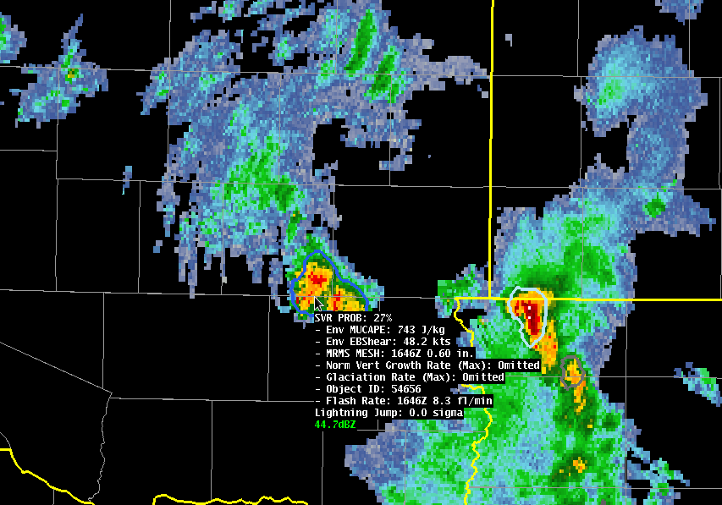
Impact of GOES Data
1646 UTC May-08-2014
Prob = 54%
Prob = 27%
NWP + Satellite + Radar + Lightning
NWP + Satellite + Radar + Lightning
Time (UTC) | With GOES | Without GOES
1644 | 27% (no sat. growth yet) | 27%
1646 | 54% | 27%
1648 | 78% | 54%
1728 | 85% | 65%
Notes:
We are often asked, what value do the satellite growth rates provide? Using this example, you can see at 1646 UTC, by removing the satellite observations, the ProbSevere probability is reduced by HALF! Additionally, removing the satellite growth rates reduces the amount of lead-time gained.

Slide 12

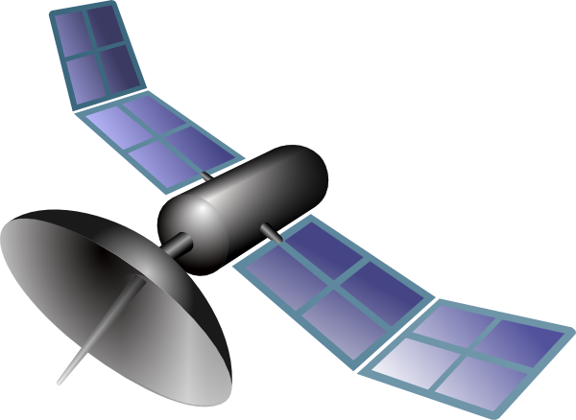
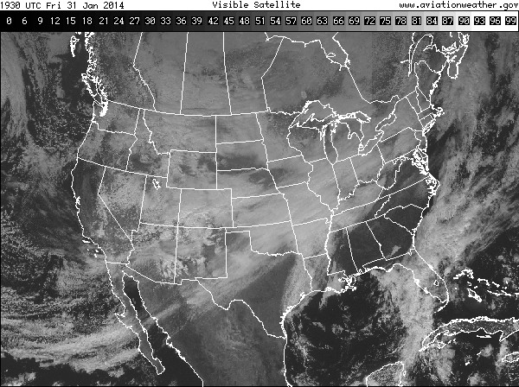
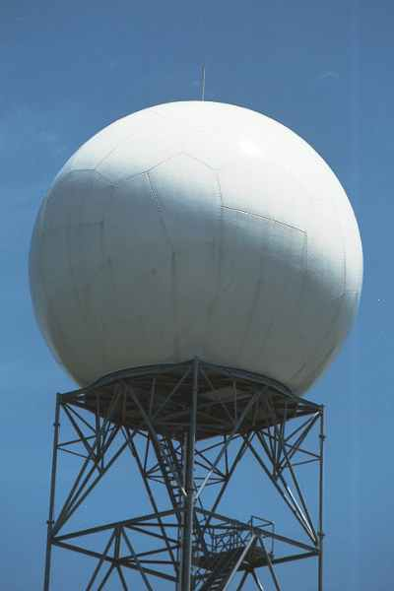
“Big Data” to Information: ProbSevere
EMC
In one hour…
1 set of RAP grids
8 CONUS satellite scans (in rapid scan)
ProbSevere
30 lightning files
OUTPUT
Input: 1.3 GB
Output: 6 MB
30 CONUS radar scans
File size: 0.2 MB
30 output files
Notes:
Reduces data volume by a factor of 1000

Slide 13
“Big Data” to Information: ProbSevere
EMC
In one hour…
With 1 GOES-R Series
1 set of RAP grids
12 CONUS satellite scans (in rapid scan)
ProbSevere
30 lightning files
OUTPUT
Input: 10 GB
Output: 6 MB
30 CONUS radar scans
File size: 0.2 MB
30 output files
Notes:
Reduces data volume by a factor of 10000

Slide 14
“Big Data” to Information: ProbSevere
EMC
In one hour…
With 2 GOES-R Series
1 set of RAP grids
12 CONUS satellite scans (in rapid scan)
ProbSevere
30 lightning files
OUTPUT
Input: 19 GB
Output: 6 MB
30 CONUS radar scans
File size: 0.2 MB
30 output files
Notes:
Reduces data volume by a factor of 10000

Slide 15
“Big Data” to Information: ProbSevere
EMC
In one hour…
With 2 GOES-R Series + HRRR
1 set of RAP grids
12 CONUS satellite scans (in rapid scan)
ProbSevere
30 lightning files
OUTPUT
Input: 22.5 GB
Output: 6 MB
30 CONUS radar scans
File size: 0.2 MB
30 output files
Notes:
Reduces data volume by a factor of 10000

Slide 16
ProbSevere Verification
33 min
19 min
Notes:
A validation for about 5000 storms on 18 convectively active days during 2014 was performed. (Using manual analysis from Eric)

Slide 17
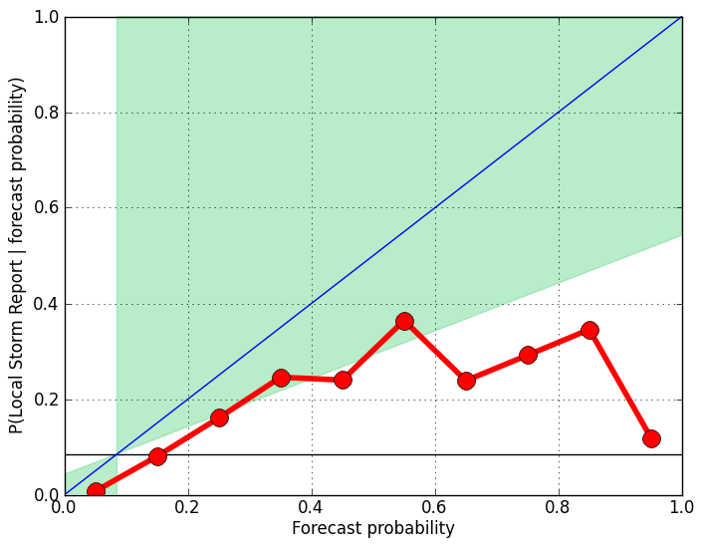
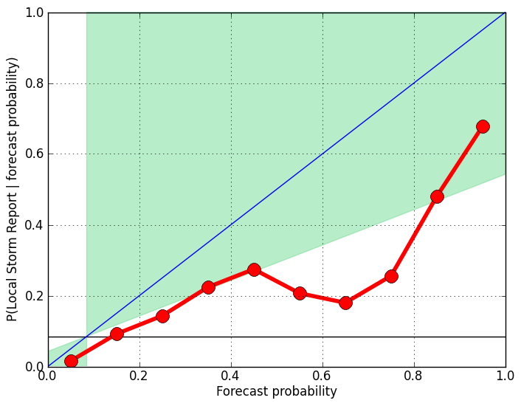
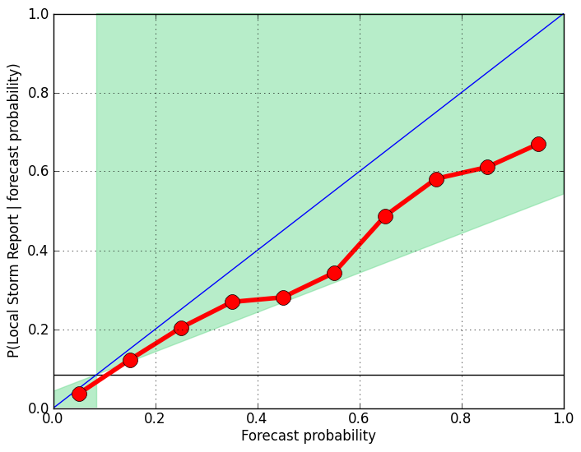
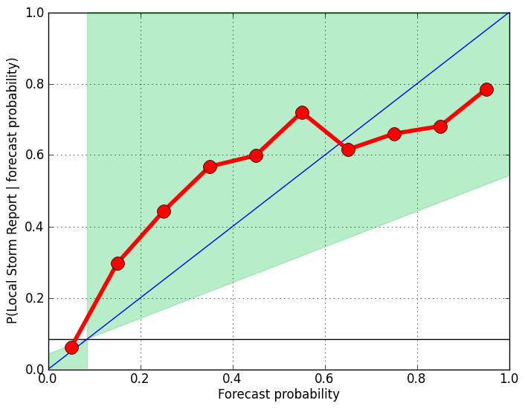
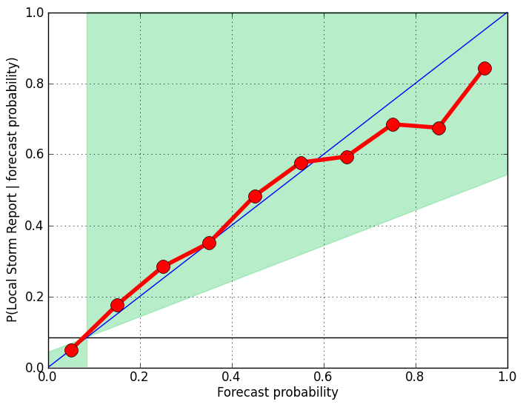
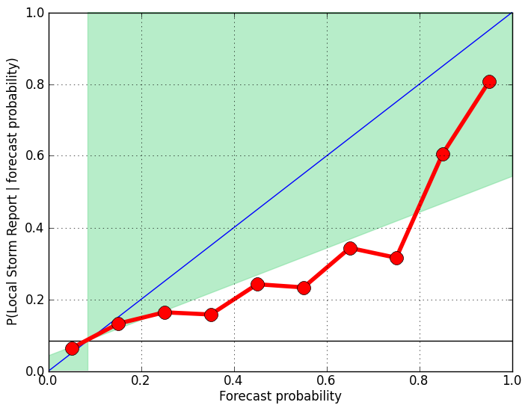
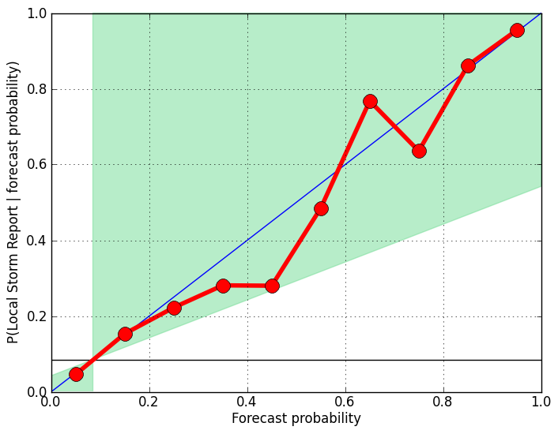
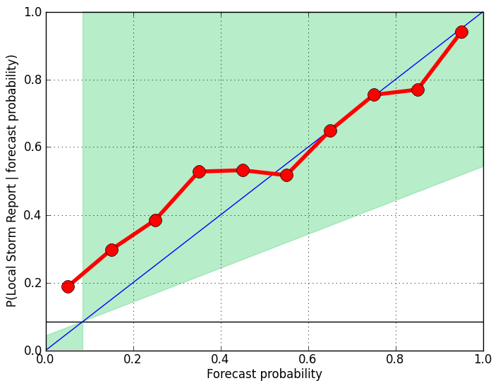
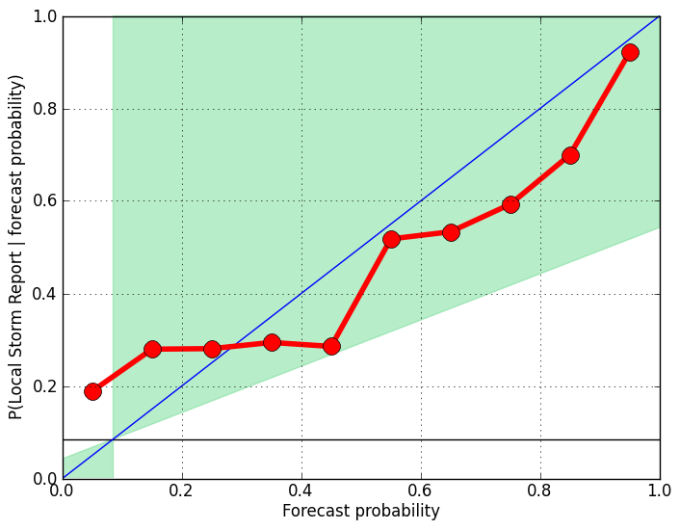
ProbSevere Calibration
CAPE 0-1500 J/Kg
CAPE 1500-2500 J/Kg
CAPE 2500+ J/Kg
Small Sample Size
EBS 0-10 m/s
Small Sample Size
EBS 10-15 m/s
EBS 15+ m/s
Notes:
Validation using ALL storm reports (not just the first)
total_sev_storms= 71 156 181
85 132 69
85 200 110
total_ns_storms= 8328 6667 6124
2090 1381 589
855 773 329

Slide 18
ProbSevere Verification by WFO
http://cimss.ssec.wisc.edu/severe_conv/training/validation.html

Slide 19
ProbSevere Verification - Daily Storm Tracks

Slide 20
ProbSevere Verification - Daily Storm Tracks

Slide 21
ProbSevere Verification - Daily Storm Tracks

Slide 22
Hazardous Weather Testbed (HWT)
http://goesrhwt.blogspot.com
Notes:
HWT: NSSL, SPC, and the Norman WFO
-During multiple experiments that take place in the HWT throughout the year, researchers and forecasters work side-by-side to evaluate emerging research concepts and tools in simulated operational settings, including experimental forecast and warning generation exercises.

Slide 23
HWT (2014)
“Would you use NOAA/CIMSS ProbSevere model output during warning operations at your WFO if available?”
HWT (2015)
HWT (2016)

Slide 24
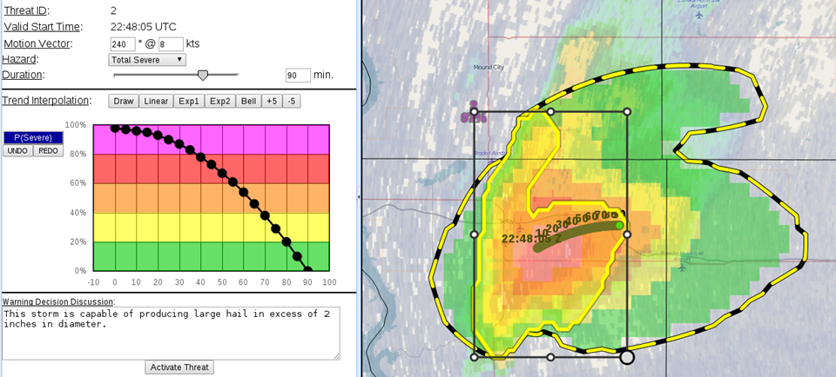
ProbSevere is one of the guidance options available in the PHI tool

Slide 25
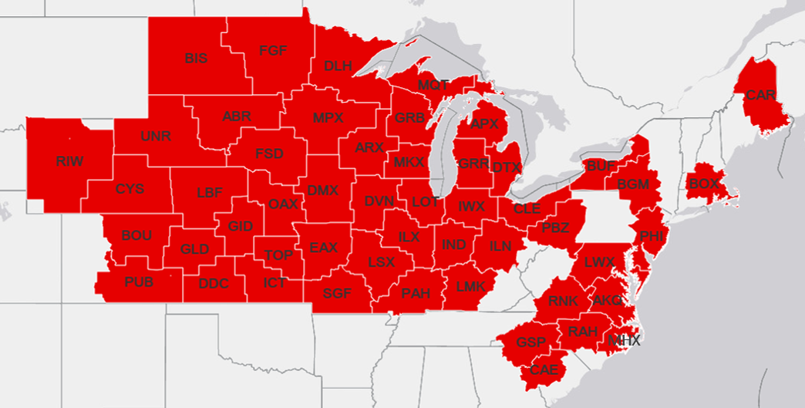
Spring/Summer 2016 Central and Eastern Region Evaluation
1 April – 1 October 2016
Participating Forecast Offices…
Eastern Region: 15
Central Region: 37
Credit: Chad Gravelle
52 offices…18 forecasters (assumptions)…potentially 936 sets of eyes

Slide 26
Spring/Summer 2016 Central and Eastern Region Evaluation
Overall, during the CR and ER ProbSevere Model evaluation, how useful did your office find ProbSevere for providing confidence in issuing or not issuing convective warnings on thunderstorms?
10 (Extremely Useful)
9
8
7
6
5
4
3
2
1 (Not Useful)
10 (Extremely Useful)
9
8
7
6
5
4
3
2
1 (Not Useful)
Mode (8)
Median and Mode (7)
Range
Median (7)
Range
62 forecasters
25 SOO’s

Slide 27
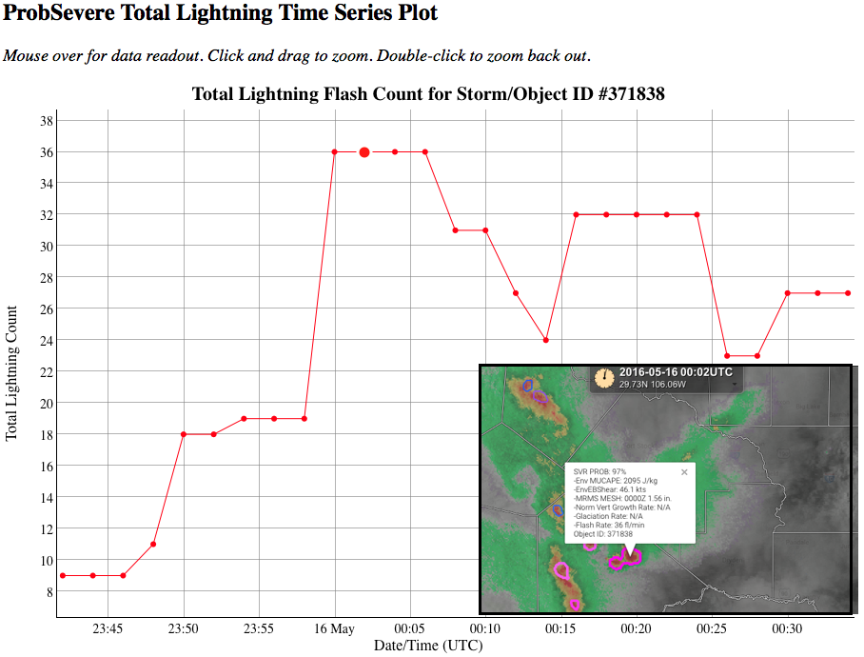
Realtime ProbSevere Time Series Analysis
http://hopwrf.info/ProbSevere/PlotLightning.html
Notes:
Tom Hultquist (SOO at Twin Cities)

Slide 28
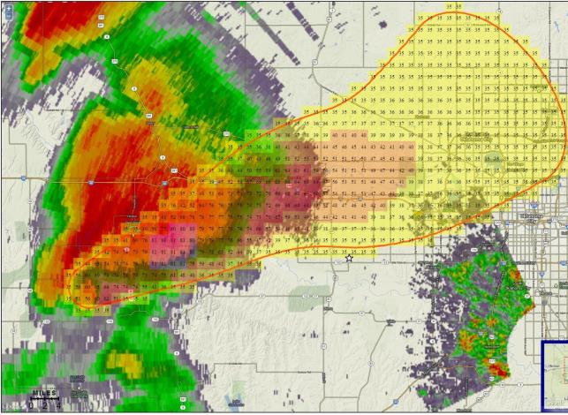
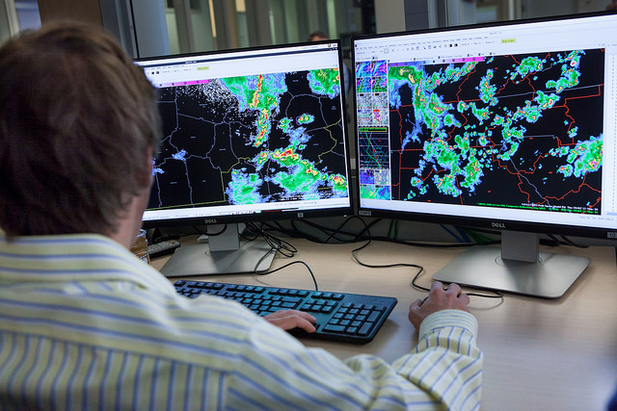
ProbSevere – Multi NOAA Line Office Research and R2O Effort
National
Weather
Service
(NWS)
NOAA Satellites
(NESDIS)
NOAA Research
(OAR)
Project lead, satellites,
data fusion
MRMS, lightning, PHI
End user, O2R

Slide 29
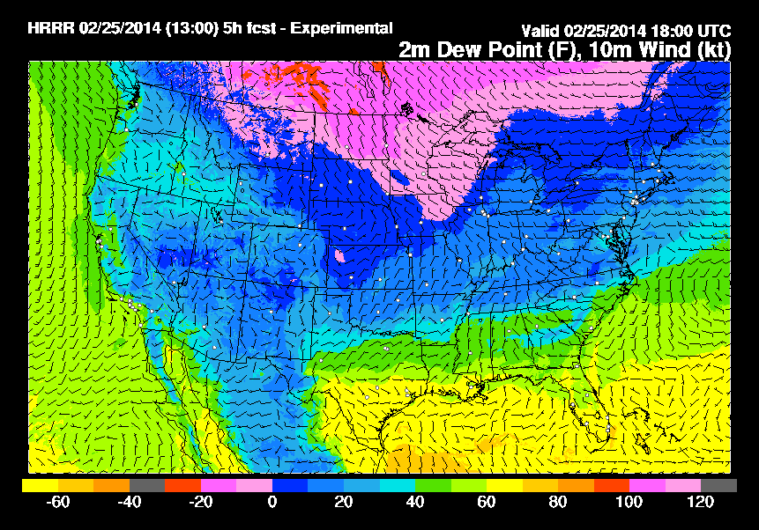
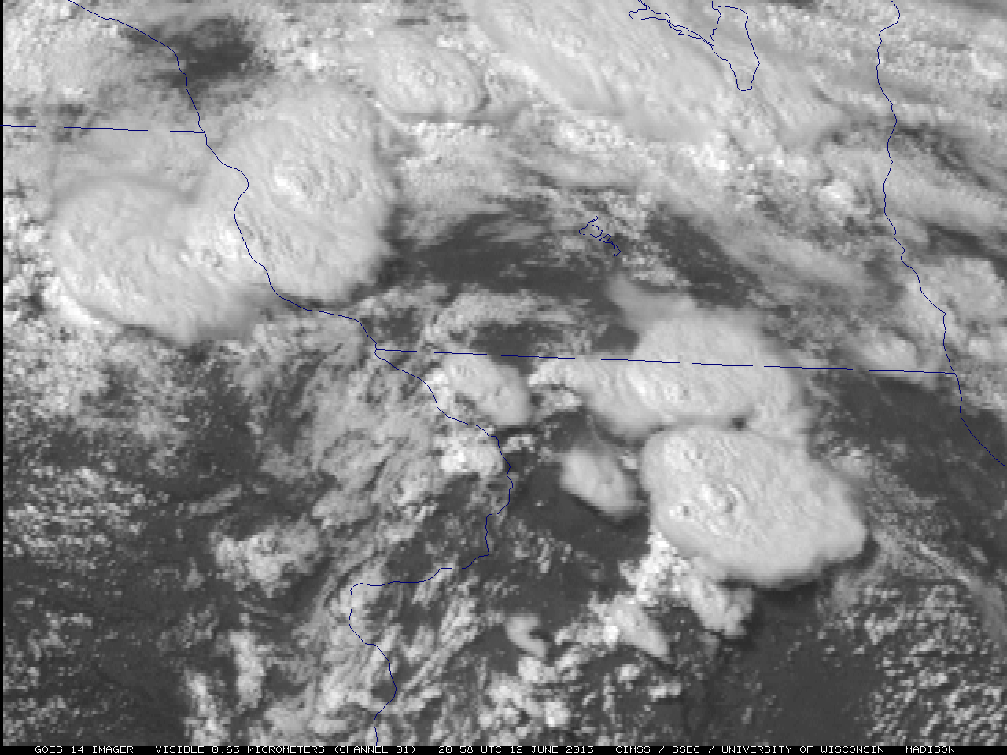
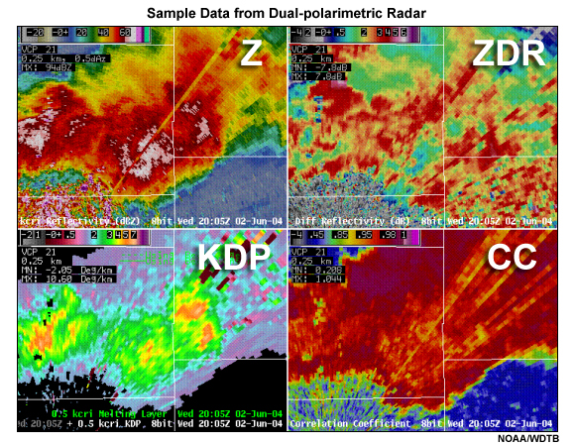
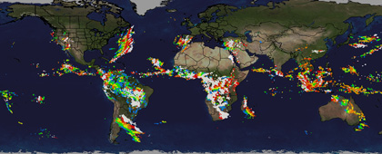
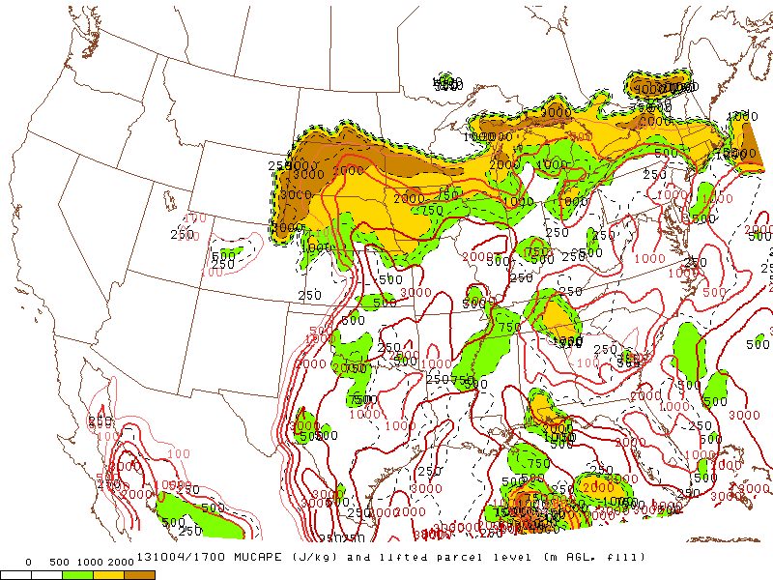
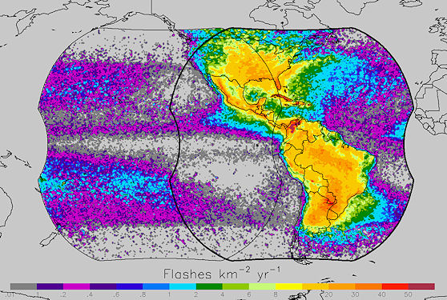
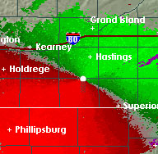
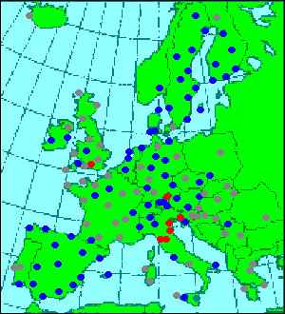
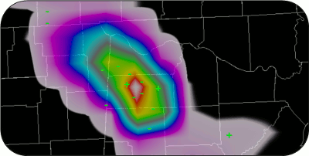
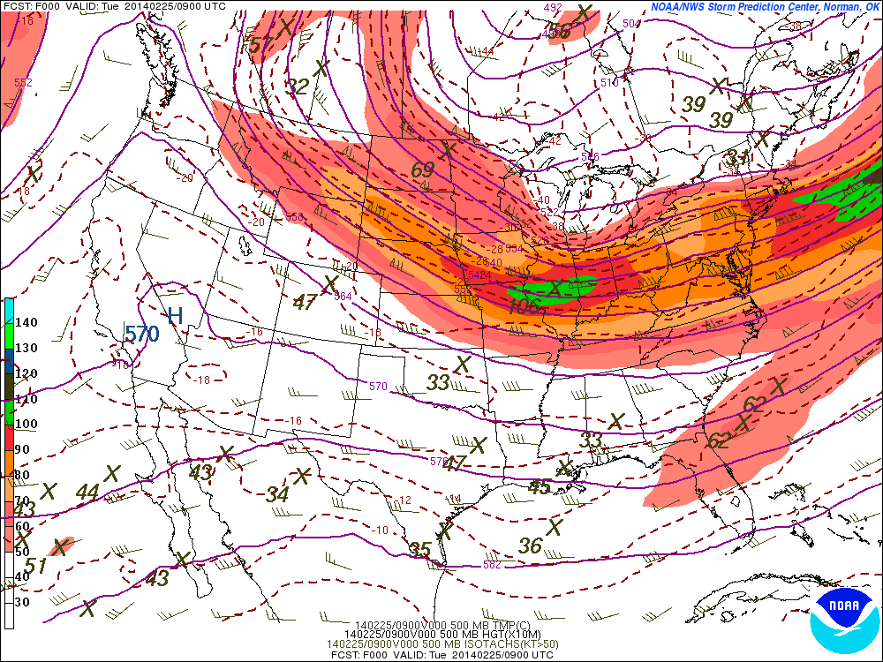
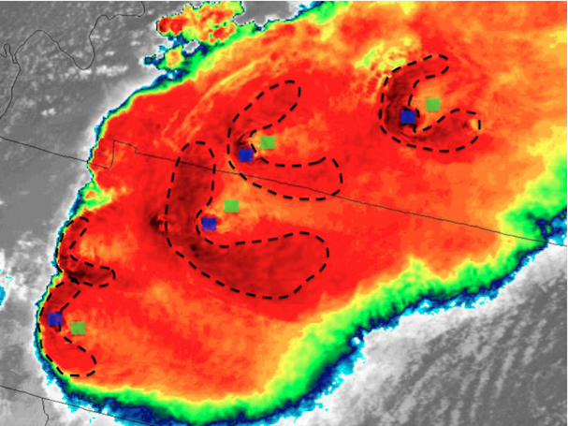
ProbSevere is Expandable
NWP
GOES-R
NEXRAD
Other
HRRR
Super-rapid scan
Dual-pol products
Global lightning
SPC-OA
GLM
Doppler velocities
Additional radars
Hazard specific probabilities (tornado, hail, wind) are being evaluated in the 2017 HWT
SREF
Cb properties
Images are from NOAA, NASA, UW-CIMSS, and OU-CIMMS
Notes:
-Working on training several versions of the model to account for differing physical mechanisms that produce severe wind.
-Create several models to account for different physical mechanisms for producing different types of severe weather

Slide 30
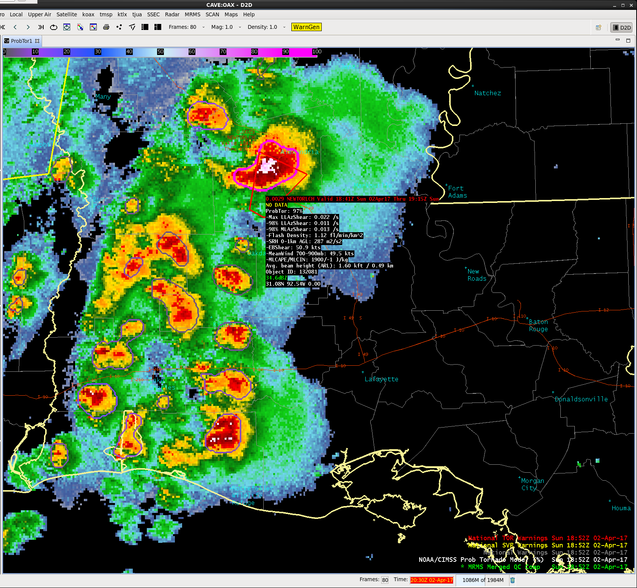
Probability of Tornado (ProbTor)
MRMS low level az. shear
MRMS mid level az. shear
ENTL flash density
0-1 km SRH (RAP)
EBS (RAP)
Mean wind 700-900 mb (RAP)
MLCAPE (RAP)
MLCIN (RAP)
ProbTor = 97%
April 2, 2017 (18:52Z)
Louisiana

Slide 31
Probability of Tornado (ProbTor)
NE Pennsylvania – February 25, 2017
Tornado Path
19:35 – 19:50 UTC
Storm had a probability of tornado of 91% 10 minutes prior to tornado warning and 23 minutes prior to formation of an EF2 tornado

Slide 32
Storm Centric ProbTor Verification
ProbTor shows promise, but there are some known issues that are being worked:
Radar artifacts
RAP limitations
Human experts will always add value!
Notes:
POD/FAR/CSI/reliability statistics are for ALL tornadoes in validation database. (60 days in 2016; 325 tornadic storms; 45,586 non-tornadic storms)
The lead-time statistics are measured to the FIRST tornado report associated with tornadic storms.

Slide 33
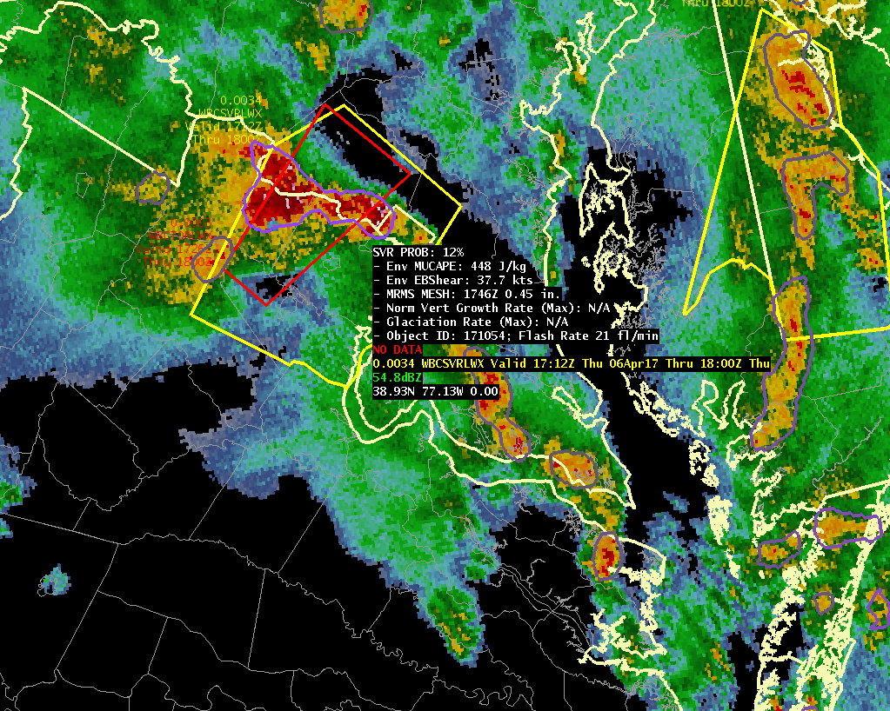

“All Hazards” ProbSevere
April 6, 2017 (17:48Z) – Washington D.C. Area
Legacy ProbSevere
“All Hazards” ProbSevere
ProbSevere = 12%
ProbHail = 13%
ProbWind = 80%
ProbTor = 14%

Slide 34
Legacy ProbSevere wrt First LSR
Notes:
The ProbSevere preliminary verification shown on this slide includes 2,250 severe storms and 42,000 non-severe storms during 2016.

Slide 35
“All Hazards” ProbSevere wrt First LSR
Notes:
The ProbSevere preliminary verification shown on this slide includes 2,250 severe storms and 42,000 non-severe storms during 2016.

Slide 36
Summary
Goal: ProbSevere is designed to directly support NWS severe weather warning operations through data fusion
R2O: Optimistic that ProbSevere will be added to MRMS product generation suite at NCO in coming years
User Readiness: Most NWS forecasters have taken the ProbSevere training and have experience using it at WFO’s or the HWT
Development: An “all hazards: version of ProbSevere will be evaluated in the 2017 HWT EWP and PHI experiment (future availability in baseline AWIPS depends on HWT results and AWIPS development schedule)
GOES-16 Status: Work is underway to re-train ProbSevere with on-orbit GOES-16 data by the Fall 2017 (improvements in lead-time and accuracy are expected)

Slide 37
Additional Resources
Mike Pavolonis – NOAA/NESDIS/STAR (michael.pavolonis@noaa.gov)
John Cintineo – UW/CIMSS (john.cintineo@ssec.wisc.edu)
Justin Sieglaff – UW/CIMSS (justin.sieglaff@ssec.wisc.edu)
Dan Lindsey – NOAA/NESDIS/STAR (dan.lindsey@noaa.gov)
ProbSevere training modules and supplemental training material:
http://cimss.ssec.wisc.edu/severe_conv/training/training.html
ProbSevere blog posts:
http://goesrhwt.blogspot.com/search/label/ProbSevere
Realtime ProbSevere on the web:
http://cimss.ssec.wisc.edu/severe_conv/probsev.html
Realtime “All Hazards” ProbSevere on the web:
http://cimss.ssec.wisc.edu/severe_conv/probsevtest.html
Realtime ProbTor on the web:
http://cimss.ssec.wisc.edu/severe_conv/probtor.html
Realtime ProbSevere time series:
http://hopwrf.info/ProbSevere/PlotLightning.html

Slide 38
References
Pavolonis, M. J., 2010: Advances in Extracting Cloud Composition Information from Spaceborne Infrared Radiances-A Robust Alternative to Brightness Temperatures. Part I: Theory. Journal of Applied Meteorology and Climatology, 49, 1992-2012, doi:10.1175/2010JAMC2433.1 ER.
Cintineo, John L.; Pavolonis, Michael J.; Sieglaff, Justin M. and Heidinger, Andrew K. Evolution of severe and nonsevere convection inferred from GOES-derived cloud properties. Journal of Applied Meteorology and Climatology, 52 (9), 2013, 2009–2023.
Cintineo, John L.; Pavolonis, Michael J.; Sieglaff, Justin M. and Lindsey, Daniel T. An empirical model for assessing the severe weather potential of developing convection. Weather and Forecasting, 29 (3), 2014, 639–653.

Slide 39
Questions?

Slide 40
Backup Slides

Slide 41


“Big Data” to Environmental Intelligence
1). Mesoscale NWP
Short-term forecasts from the Rapid Refresh NWP model are used to characterize the dynamic and thermodynamic environment.
Effective Bulk Shear
Most Unstable CAPE
Notes:
The bulk vector difference from the effective inflow base upward to 50% of the equilibrium level height for the most unstable parcel in the lowest 300 mb. This parameter is similar to the 0-6 km bulk shear, though it accounts for storm depth (effective inflow base to EL) and is designed to identify both surface-based and "elevated" supercell environments. Supercells become more probable as the effective bulk shear vector increases in magnitude through the range of 25-40 kt and greater.

Slide 42


“Big Data” to Environmental Intelligence
2). Geostationary Satellite Data
Top of Troposphere Emissivity
(Pavolonis, 2010)
False Color Image
Developing Convection
Developing Convection
Texas
Texas
Object are extracted from ε_{tot}(11μm) and are tracked in time (Lakshmanan et al. 2003). Time trends in the maximum value of ε_{tot}(11μm) are utilized.
Notes:
Tracking algorithm: Lakshmanan et al. 2003

Slide 43

“Big Data” to Environmental Intelligence
2). Geostationary Satellite Data
IR-derived Cloud Top Phase
(Pavolonis, 2010)
False Color Image
Developing Convection
Developing Convection
Texas
Texas
The time trend in the fraction of glaciated pixels within each object is also utilized.

Slide 44


“Big Data” to Environmental Intelligence
3). Precipitation RADAR Data
The MESH is taken from the Multi-sensor/Multi-radar System (MRMS) (Witt el al., 1998; Lakhmanan et al., 2006). The composite MRMS reflectivity is used to identify and track radar objects.
MESH
Notes:
Thermally weighted integration of reflectivity

Slide 45
“Big Data” to Environmental Intelligence
4). Lightning Data
Total lightning (per minute) within each radar object is utilized. The total lightning data are from Earth Networks.
Total Lightning
Liu and Heckman, 2012
Notes:
Same concept can be applied to GEO lightning sensor data

Slide 46


Automated integration of information
A meteorologist sees developing storms and cloud clusters—not satellite pixels or radiances.
The same concepts apply to radar data.
Meteorologists view cells or storms—so the computer needs to identify and track radar cells and their evolution over time.
Notes:
-Extract storm-scale objects and track them in time
-Instantaneous satellite-derived cloud fields are not well-suited to the short-term severe weather forecasting, but temporal trends in those cloud properties are.
-Calculating temporal trends in satellite-derived cloud properties is not a trivial task.
-In order to capture temporal trends in cloud properties, object tracking is needed
-Collaboration with OU-CIMMS and NSSL was essential
-Model output is updated after every radar and satellite scan

Slide 47
ProbSevere Verification
Once a 60% probability is achieved, any gain in CSI at higher probabilities is negligible
Overall, the ProbSevere probabilities are well calibrated
Under-forecast
Over-forecast

Slide 48
Spring/Summer 2016 Central and Eastern Region Evaluation
“It seems that ProbSevere has become a standard display to load up on several of the forecaster's routine procedures during convection, a sign that many of our forecasters have enough experience with the model that they have at least some confidence in the product.”
“As people got comfortable using the data it became very useful, especially in marginal cases and when the warning met wanted to issue a warning early in a storms life. We had a supercell event where a storm was quickly building and warnings were issued before a robust core aloft. ProbSevere gave us another piece of data to support the warning decision to our customers before it was apparent on legacy radar techniques.”
“I think we all found the best use of ProbSevere to be what storms to NOT focus on as much. In that way, ProbSevere improved radar efficiency on a scope full of storms...guiding us to more detailed interrogation on the higher probability storms.”
“ProbSevere was most valuable on days with numerous cells with just one person on radar, helping to quickly determine which cells to focus on and which not to.”
“I think those who used the model as a guide to determine what storms to focus a more detailed assessment on generally were pleased. With 4 RPGs in our CWA (3 TDWRs and an 88D) we need all the time/awareness efficiency we can get.”

Slide 49
http://cimss.ssec.wisc.edu/severe_conv/probsev.html

Slide 50
ProbSevere History
2007: Small exploratory project to utilize GOES Imager derived cloud properties for quantitatively diagnosing and forecasting severe storms begins under NESDIS GIMPAP
2011: First version of ProbSevere (GOES + NWP)
2012: NEXRAD added to ProbSevere
2013: ProbSevere project continues under GOES-R Risk Reduction Program
2013: Internal NRT evaluation of ProbSevere at UW-CIMSS
2014: ProbSevere successfully demonstrated at HWT EWP
2014: ProbSevere evaluated at WFO MKX
2015: ProbSevere becomes part of AWIPS II baseline (V14.4)
2015: ProbSevere, with improvements, successfully demonstrated in HWT EWP
2016: Earth Networks lightning integrated into ProbSevere
2016: ProbSevere, with lightning, successfully demonstrated at HWT EWP and PHI experiments
2016: Successful completion of NWS Eastern, Central, Southern, and Western Region demonstrations
2017: Began testing ProbSevere upgrades for improved forecasting of severe straight-line winds across spectrum of storm type
2017: ProbTor model is evaluated in HWT EWP and PHI experiments
2017: ProbSevere is assessed in Operations Proving Ground

Slide 51

The Weather Channel

Slide 52
Local Media Coverage: Peoria, IL
https://www.youtube.com/watch?v=493mk5K1pO8

