Slide 1
Context Aware Weather Warning Systems
Brenda J. Philips
CASA Co-Director
Univ. of Massachusetts, Amherst
VLAB Forum
May 30, 2018

Slide 2
Collaborators & Funding Sources
ACADEMIC
PRACITIONERS
FUNDING
V. Chandrasekar, CSU, Radar Engineering
J. Trainor, UDEL, Sociology
Q. Yu, UMass, Geosciences
D. Westbrook, UMass, CS
A. Bajaj, UMass, ECE
C. League, W & S Consulting, sociology, geography
E. Lyons, UMass, Systems Engineering
M. Zink, UMass, Computer Networking
Molly Thoerner (North Central Texas Council of Governments)
Amanda Everly (City of Fort Worth Emergency Management)
Joe Frizzell (Mayor Pro Tem, City of Midlothian)
Ranjan Mutttiah, Ft. Worth Storm Water
National Weather Service Weather Forecast Office (KFWD)
T. Bradshaw
T. Ryan
M. Fox
NSF: “Hazards SEES Type 2: Next Generation, Resilient Warning Systems for Tornados and Flash Floods” NSF-AGS
NSF: “PFI:BIC: CityWarn A Smart, Hyperlocal, Context-Aware Hazard Notification Service System” NSF-PFI
North Central Texas Council of Governments
National Weather Service

Slide 3
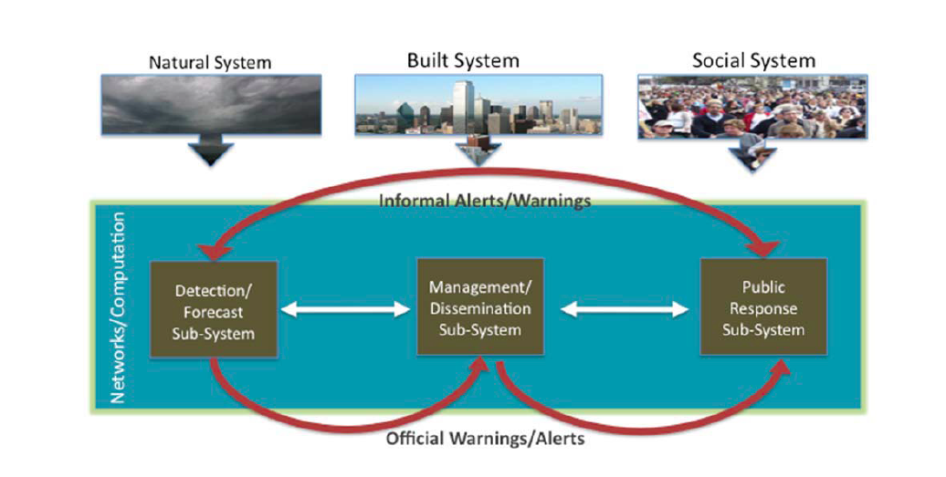
Severe Weather Warning Systems Are Complex
Modified from Mileti, D. S., & Sorensen, J. H. (1990).

Slide 4
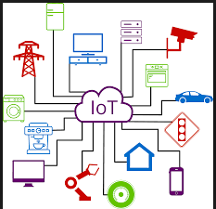
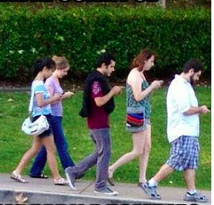
Technology Trends & Severe Weather Warning
Mobile phone penetration & usage
Attitudes towards privacy & sharing
Social media
Internet of Things (IoT)/Cloud Computing
Mobility-optimized Information & Communications Technology (ICT)

Slide 5
What are the opportunities for Severe Weather Warning Systems?
How should we integrate the current broadcast paradigm and the potential for dynamic, personalized warnings?
Can IoT help us better understand the linkages among warning system components?
Human interpretation, perception and response
New types of weather information: high resolution radar data, ensemble forecasts, etc.
New warning policies
What are innovative ways to research these types of questions given the complexity of warning systems?

Slide 6
Today’s Talk
Background: CASA and the CASA DFW Living Lab
Context-aware warning systems
Current Research Projects (Three of many!)
Publics’ perception of rain intensity & radar data
Mobility patterns & warning
Flash flood case study
Broader implications and next steps

Slide 7
Background

Slide 8
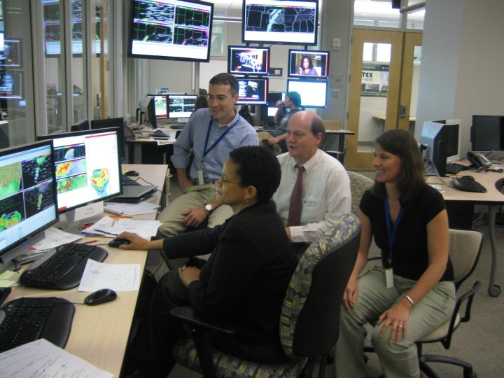
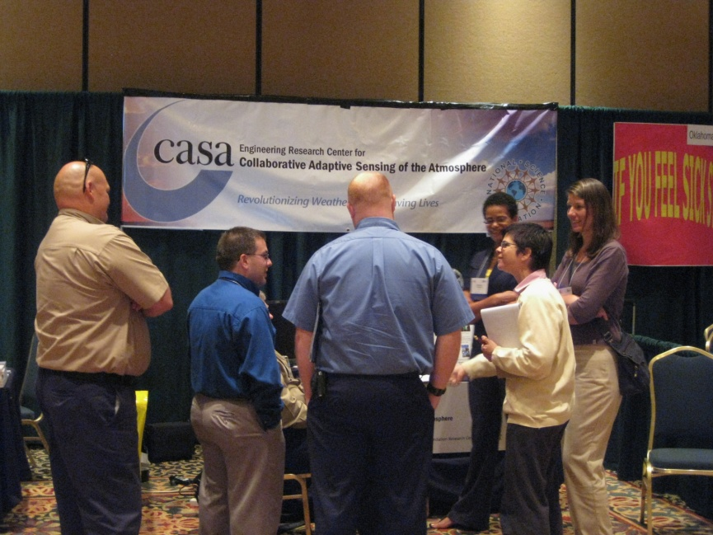
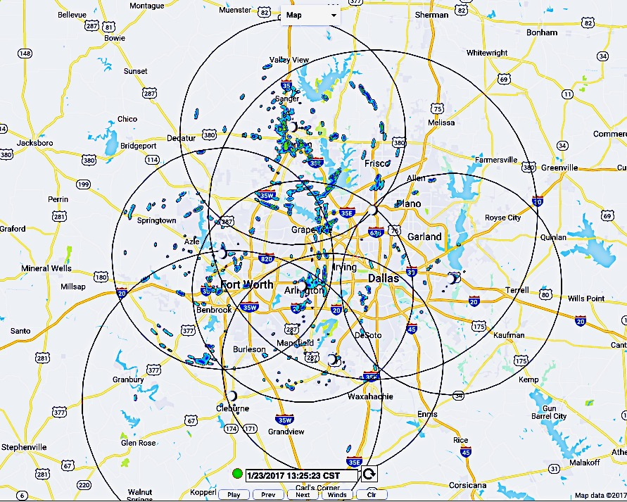
My Background
Co-director, CASA: severe weather warning system innovations
Sociotechnical systems research: integrating natural/technical/behavioral parts of warning systems
Research in real-world contexts: living labs, test beds
Multidisciplinary research, “spanner”
Notes:
CASA operated as NSF engineering research center with an $40 million grant, plus other contributions from the participating Universities: CSU, OU, UPRM, UVA, UDEL, UCCS. Our research was conducted through rearach andimplementation of test beds and with user input from the befginneing Test bed in Ok;ahoma, operated in the Hazardous weather test bed for many years forecasters looked at live data as it came in to talk about how it could impact warning decisions. We also worked closelu with EM within the test bed region who also received data in real time. A key moment was the chickasha EF4 tornado.

Slide 9
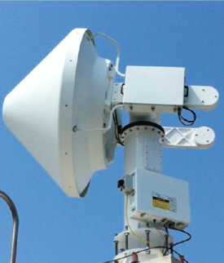
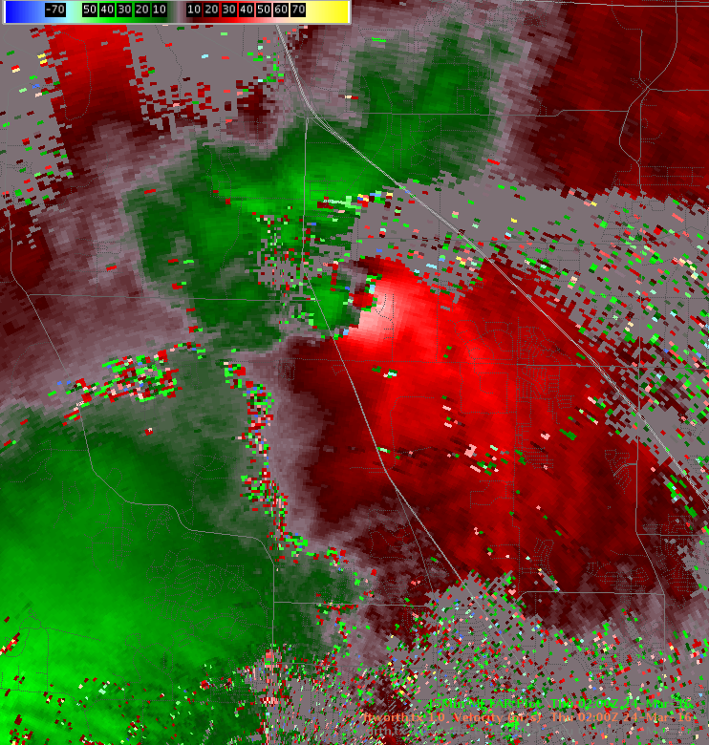
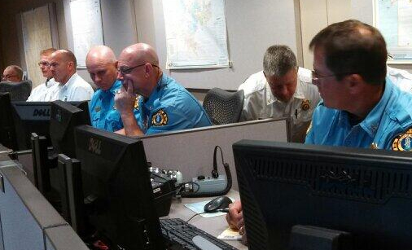
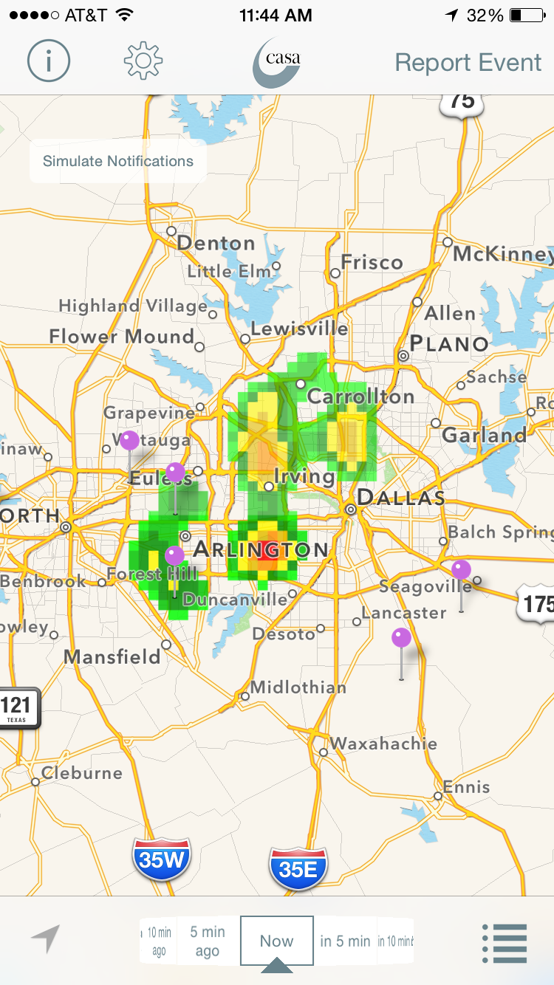
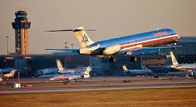
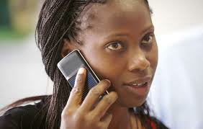
CASA DFW Living Lab: Technology, People, Real-world, Real-time Contexts & Urban Scales (since 2011)
Sensors-to-People Severe Weather Warning System centered around X-band CASA radars & other sensors
Demonstrates benefits of high resolution, lower atmosphere sensing: Urban, gaps, users
Multidisciplinary research in live environment (physical, technical, social sciences)
Flexible infrastructure for technology development & R2O
Co-Creation with users through a public private partnership
Sensors & Software
WX Info
CASA Alerts App
Stakeholders
Publics
Notes:
Next move for the project. Emphazsis on co-creation.

Slide 10
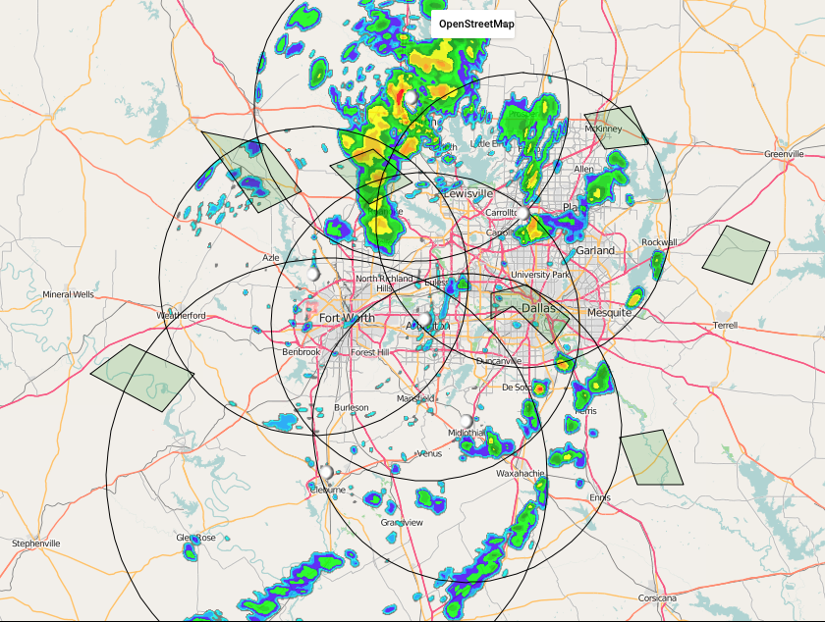
CASA DFW Living Lab: Concept of Operations
7 node network, doppler, dual polarization radar + other sensors
Operates year round when there is precipitation
Real-time single & merged radar data, + derived products (QPE, hail, winds, nowcasts, forecasts)
CASA radar data available on AWIPS2 to NWS-FWD, SRH
CASA products available on CASA WX website for real-time operational use with low latency
1500+ users: ~750 local public safety users from 50 NTX cities and counties, ~600 App holders
CASA network covers approximately 32,000 sq. km. radar range is 40 – 60km. Overlapping coverage helps to address X-band attenuation

Slide 11
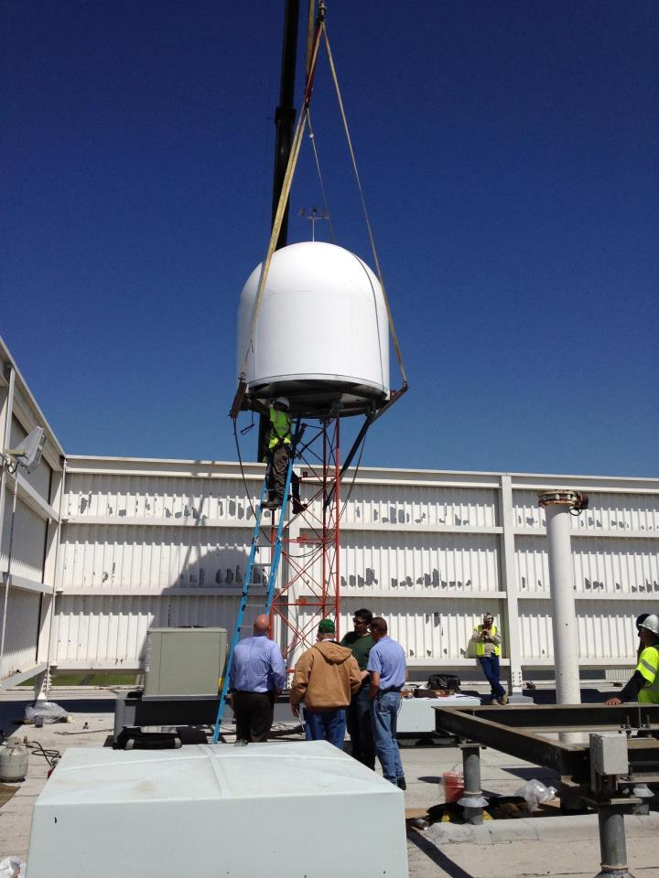
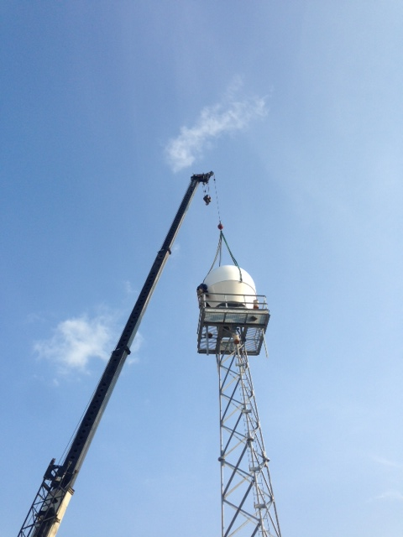
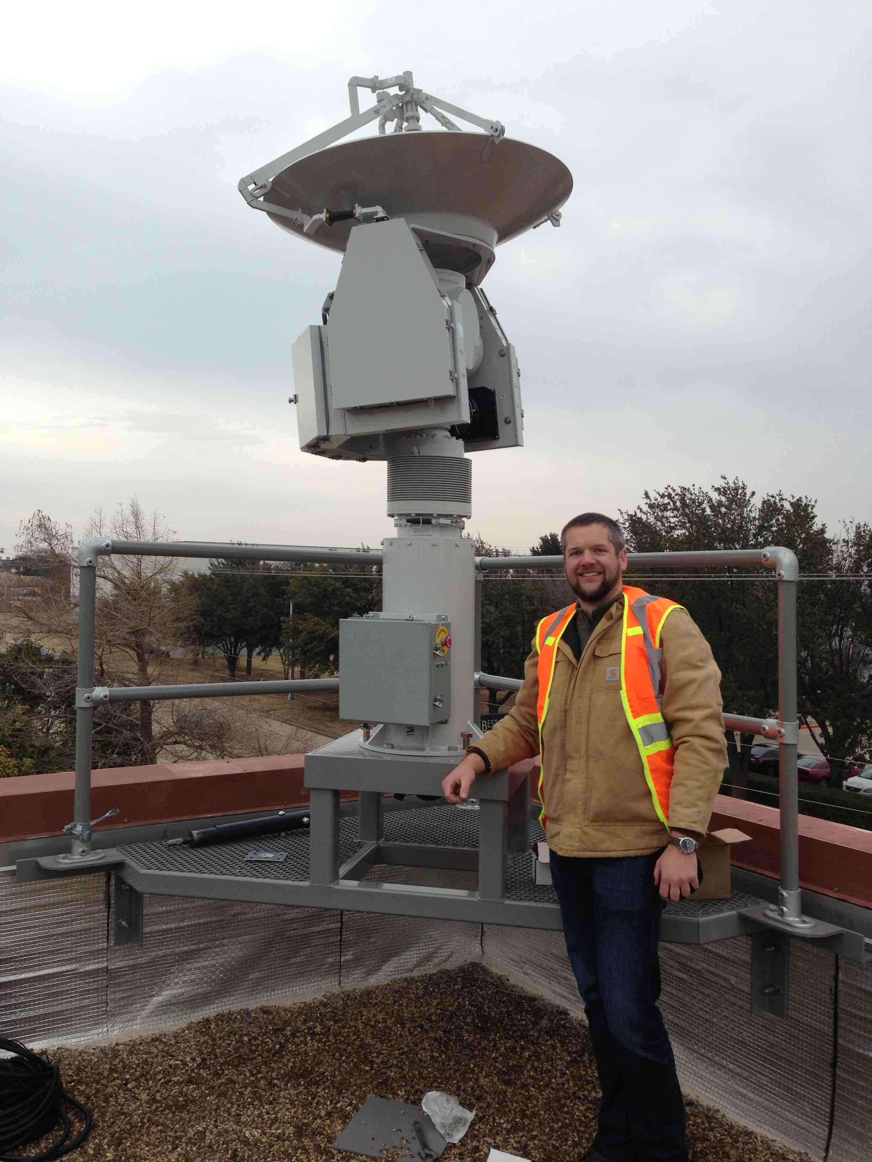
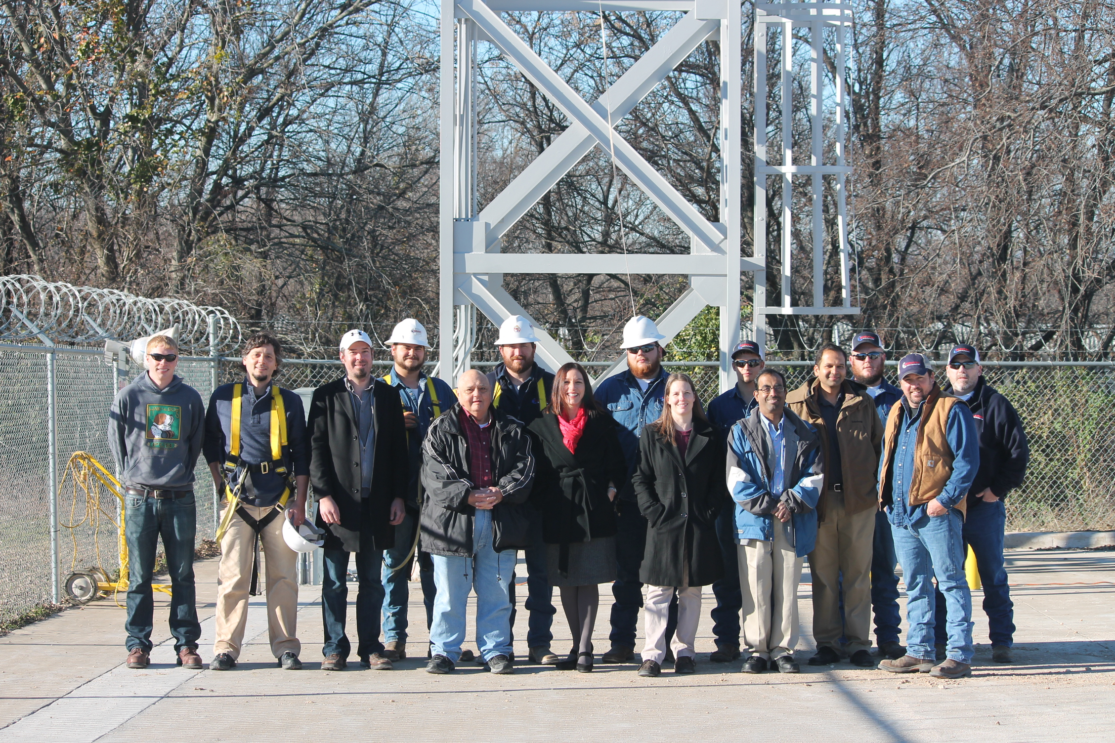
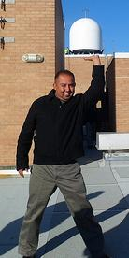
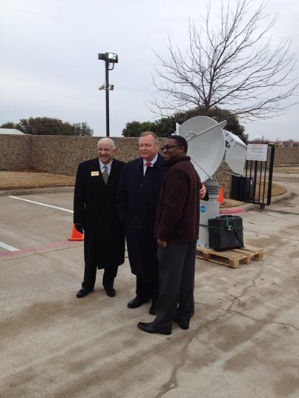
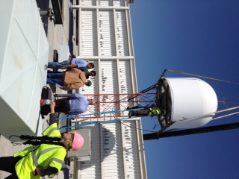
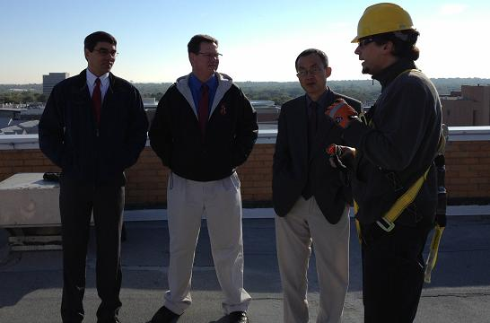
North Central Texas community contributes resources for installation and operation of radar network
University of North Texas
Johnson County
City of Addison
North Central Texas Council of Governments coordinates local efforts through 5-year agreement with CASA. In second renewal period.
Local Exec Committee of EMs, media, NWS sets local policy
A membership fee to local towns and cities supports radar operations. ~$1 million in fees to date.
Community sponsored installations
UT Arlington, UNT, Cities of Addison and Midlothian

Slide 12
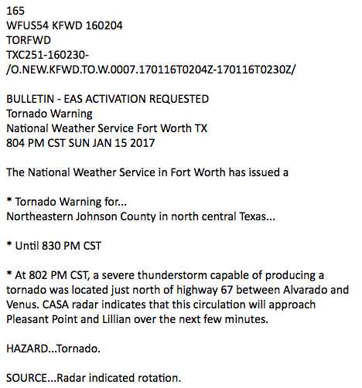
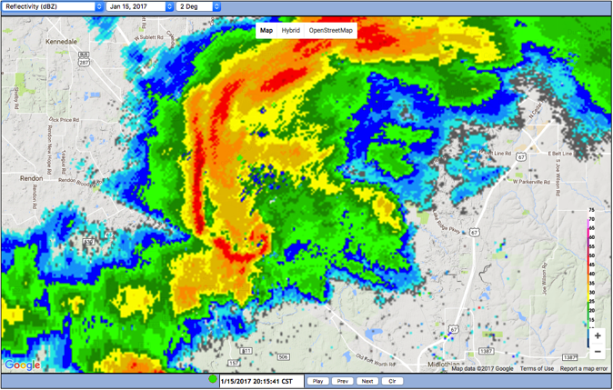
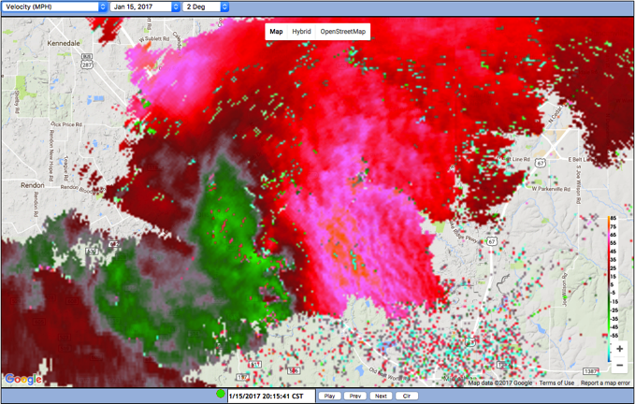
KFWD issues tornado warning based on CASA data on 01/15/17
EF0 tornado near Mansfield, TX captured by CASA radar

Slide 13
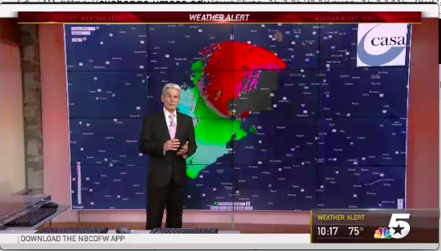
Media Pilot: NBCDFW Using CASA Radar Data 5/3/18

Slide 14
Context Aware Warning Systems

Slide 15
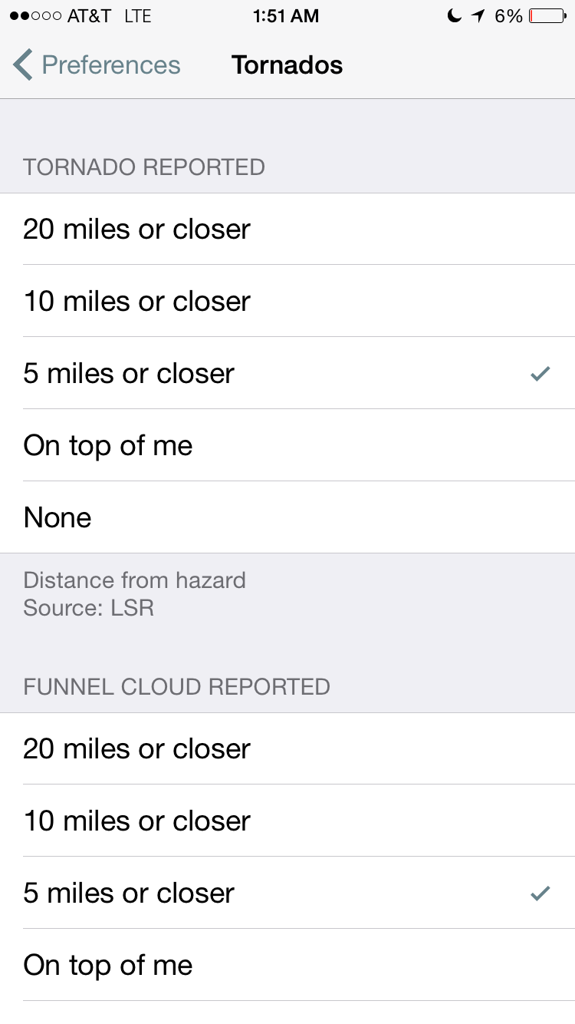
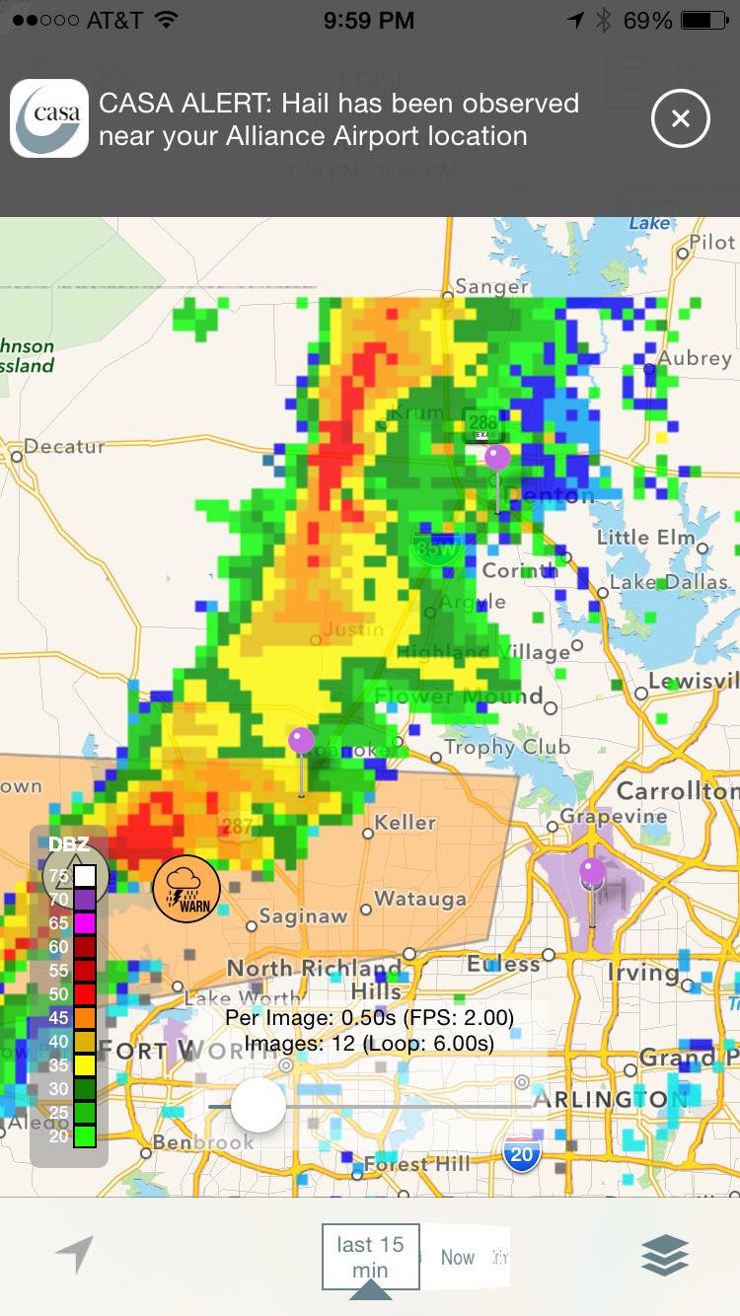
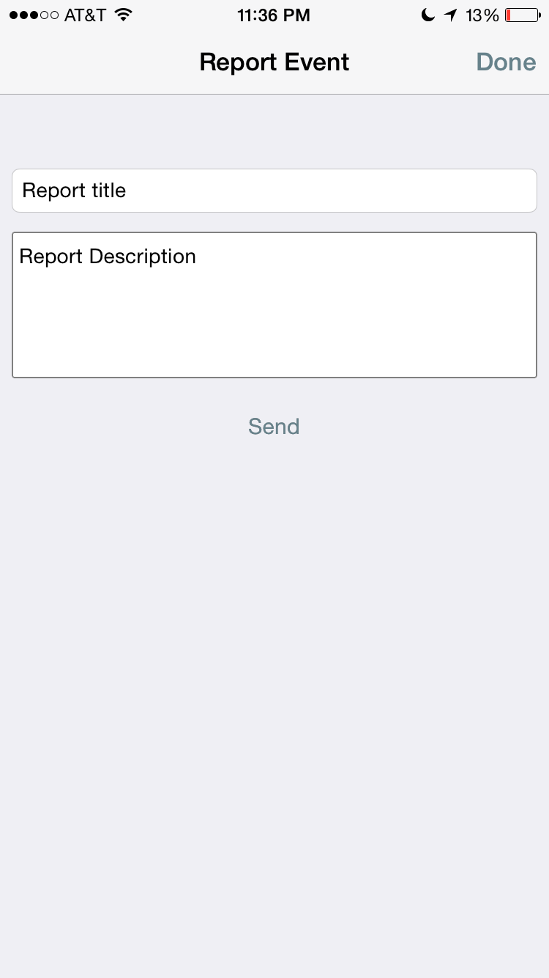
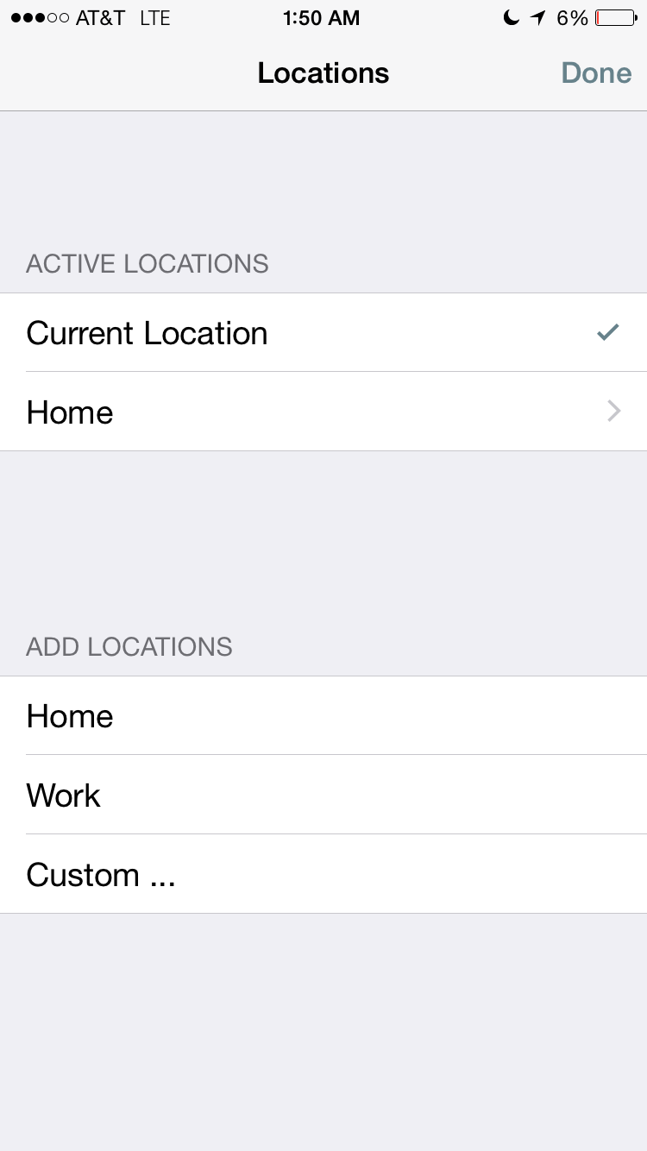
CASA Alerts App Enables Research on User Perception & Response to Weather Infomration
Alerting/
Preferences
Text & Visual WX Info
Surveys
/Reports
Locations
600+ app users
Random sample
Convenience sample
Location tracking
Pre-experiment surveys
Event-based mobile phone surveys
Link location, surveys responses, weather, environment via archive data base

Slide 16
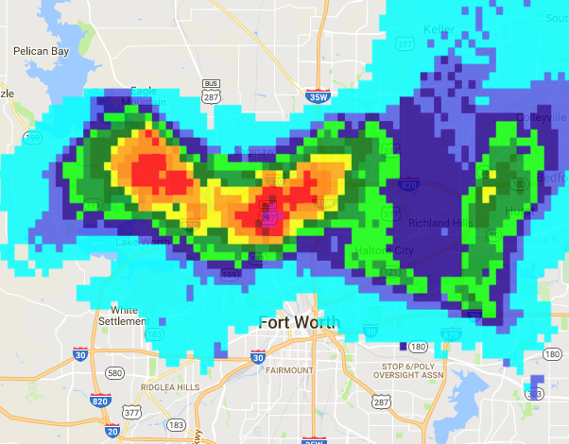
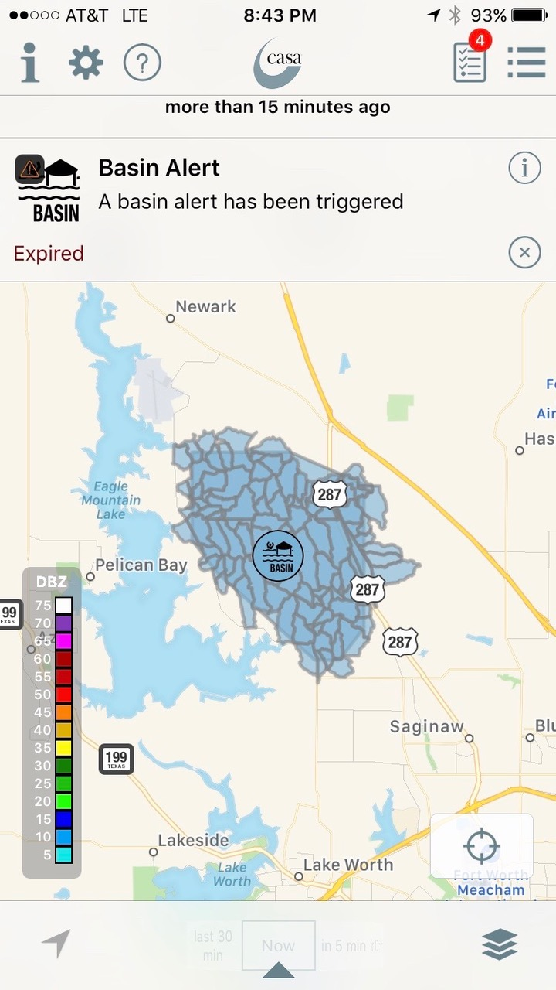
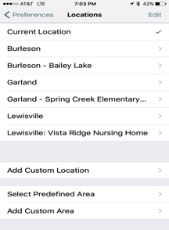
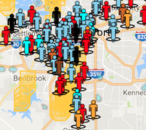
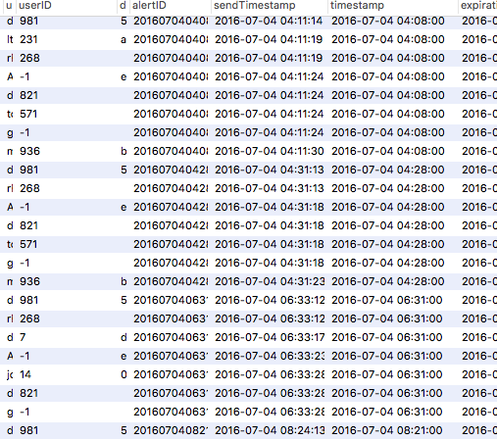
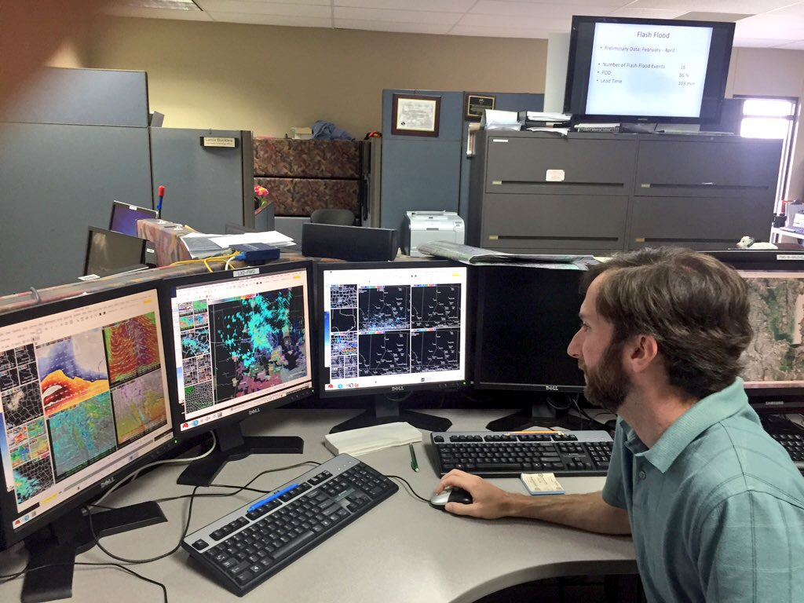
Context-Aware Warning System: Links Hazards Infrastructure, Policy, People Contexts Dynamically in Time & Space
Environmental Risk
Infrastructure Risk
Mobile App
Alerts
(Automated, Manual)
Surveys
Rainfall rate
Thresholds for flood risk
Management Policy
People
Data Archive
Spatio-Temporal Data
Survey Results
Alert when15 min. Rain Accumulation exceeds .5” within 5 miles radius
Preferences, Surveys, Location, Demographics

Slide 17
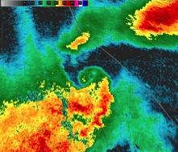
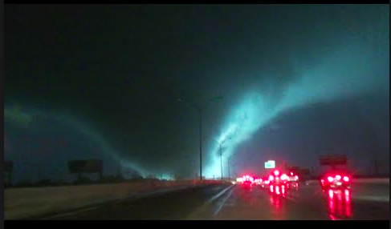
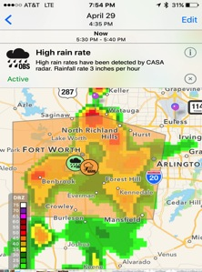
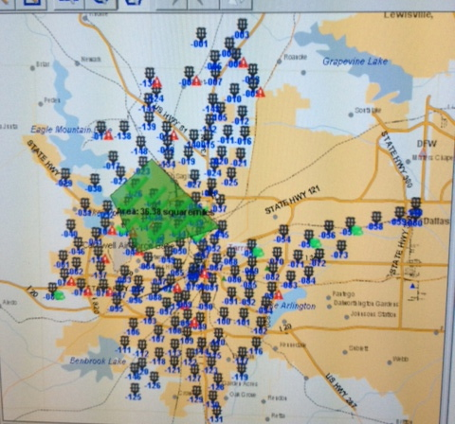
Environmental Risk
Infrastructure Risk
Mobile App
Management/Policy
People
Infrastructure
Data Archive

Slide 18
Research Projects

Slide 19
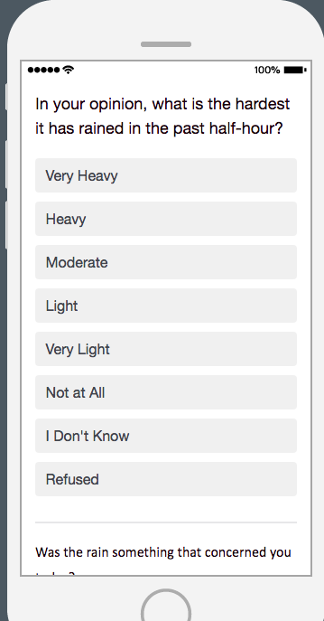
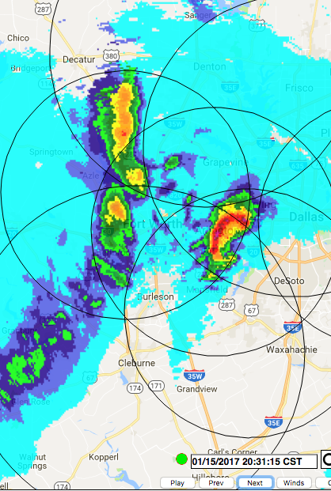
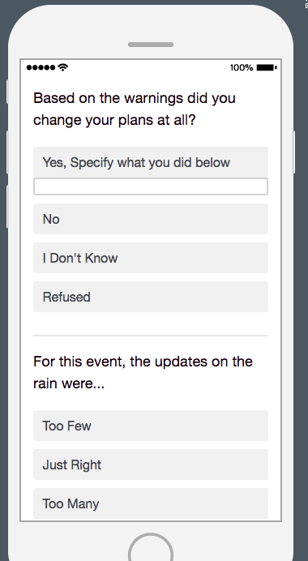
Linking the publics’ perception of rain intensity & radar data pilot study
Pilot study
Survey automatically sent to all app users when more than 8 people are in heavy rain (.75” rain in 15 mins)
Convenience sample
437 responses

Slide 21
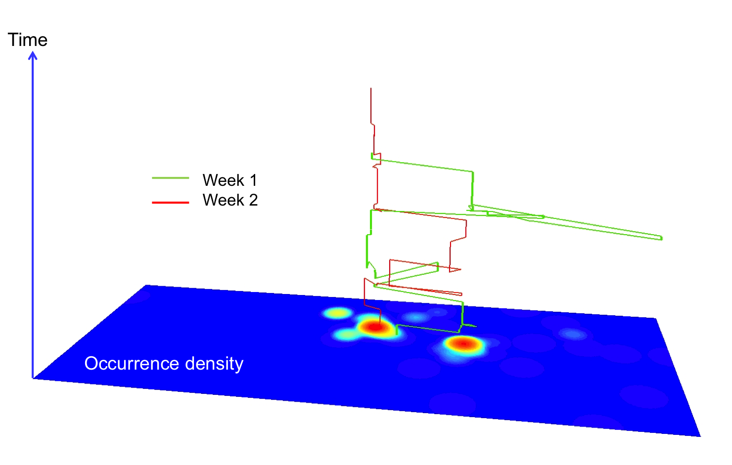
Human Mobility Research: Individual Foot Prints
Individual mobility patterns are largely predictable in time and in space
240 app holders’ location sampled every 5 mins for 6 months
Convenience Sample
Kernal Density Function used to determine time-weighted location density & activity weighted locations
“Hot Spots” represent home, work, places of daily activity
Sunday
Monday
Individual Time Space Path over 2 weeks

Slide 22
Individual Footprint: Time-Weighted Density
Footprint at all times
Footprint During Commute Time

Slide 23
People spent 80% of their time in 23% of their footprint
% Density | Median % of Area | Median # of Nodes | Median Sq. Miles
100 | 100 | 3 | 221
90 | 36 | 3 | 71
80 | 23 | 2 | 45
70 | 16 | 2 | 28
60 | 11 | 2 | 19
50 | 8 | 2 | 13
30 | 5 | 2 | 10
20 | 3 | 1 | 9
10 | 2 | 1 | 6

Slide 24
Why are individual footprints important?
Personalization is crucial in the warning perception and response process
Footprints contain the important locations that help with personalization: home, work, school, commuting
Footprints are spatio-temporal artifacts that can represent people in warning system technology.
Personalization: “People’s expectations of the personal impacts from an extreme environmental event” including “death, injury, property damage, and disruption to daily activities such as work.” (Lindell and Perry 2012)

Slide 25
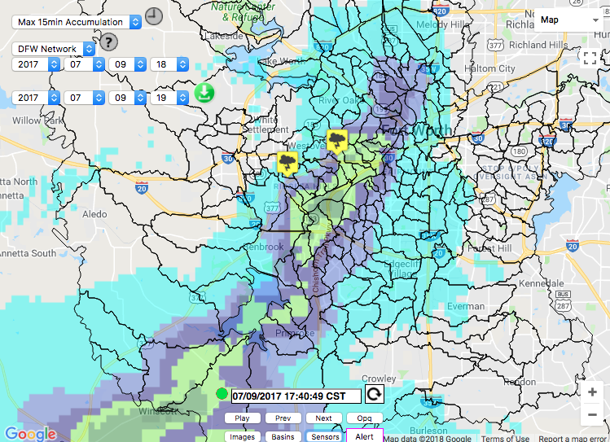
7/9/17 Flash Flood Case Study
Flooded Car Rescues
Environment and Infrastructure Risk
Policy and Rules: NWS Flash Flood Advisory & CASA Targeted Alerts

Slide 26
Individual footprints can represent people’s spatial, temporal and perceptual contexts
Person #1 Potential Risk dependent on time of day
Person #2: High potential
risk of floods
Person #3: Low potential risk of floods

Slide 27
Broader Implications and Next Steps

Slide 28
Footprints Can Be a Spatial/Temporal Representation of People in Time and in Space in Operational Warning Systems
Mobile App
Environmental Risk
Infrastructure Risk
Alerts
(Automated, Manual)
Surveys
Warning Policy
People
Data Archive
Spatio-Temporal Data
Survey Results
Context-Aware Systems can incorporate and operationalize individual perception and preferences

Slide 29
Next Steps
If we can link user perception (about rain) and radar data, can we create better warning communications?
Do footprints make a difference? Communicate hazards and warnings to people based on their footprints, anticipated locations, preferences
Use data analytics (survey responses, app preferences, location data) to refine personalized alerting approaches
Evaluate how current warning policy and individualized warnings can complement one another
Address issues of convenience sampling, generalizeability, confounding variables in field experimentation

Slide 30
Thank you
Questions and comments:
Brenda Philips: bphilips@ecs.umass.edu
Look for upcoming papers on this topic

