Slide 1
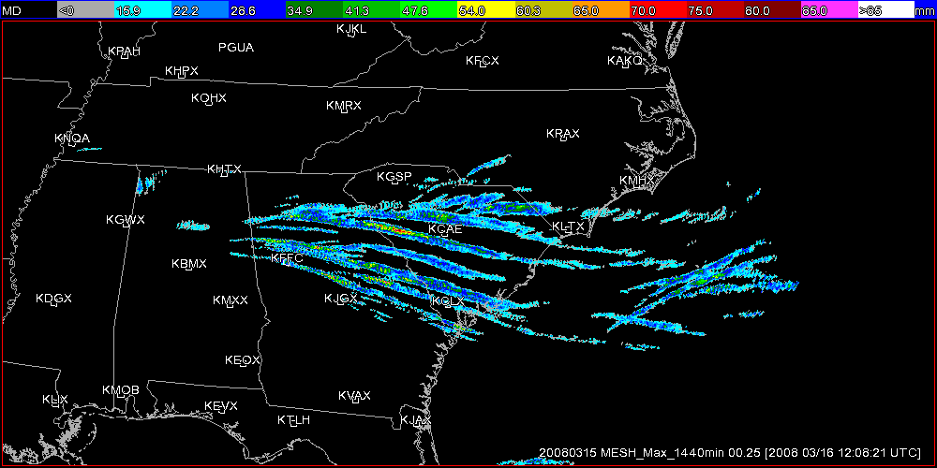
The Multi-Year Reanalysis of Remotely Sensed Storms (MYRORSS)
Kiel Ortega and Travis Smith
U. of Oklahoma/CIMMS
&
NOAA/OAR/NSSL

Slide 2
Important People
Sam Degelia
Rachel Gaal
Paul Goree
Wolfgang Hanft
Corey Howard
Ken Howard
Dave King
Carrie Langston
Garrett Layne
Brian Nelson
Brittany Newman
Youcun Qi
Scott Stevens
Jennifer Tate
Skylar Williams
Jian Zhang

Slide 3
Why MYRORSS?
Provide a consistent radar data set across the CONUS
Support research in the development of probabilistic information for warnings
Support implementation of MRMS to operations

Slide 4
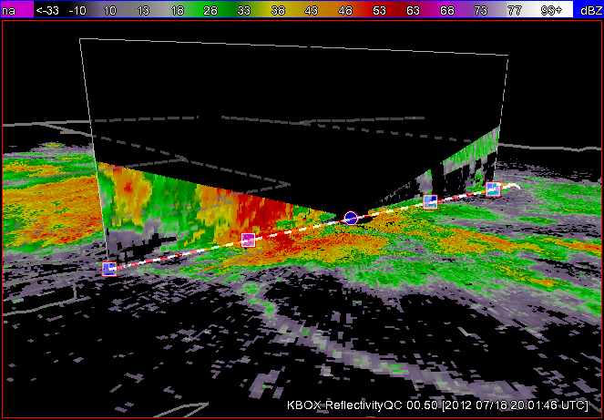
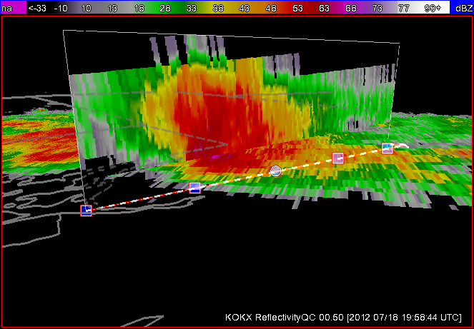
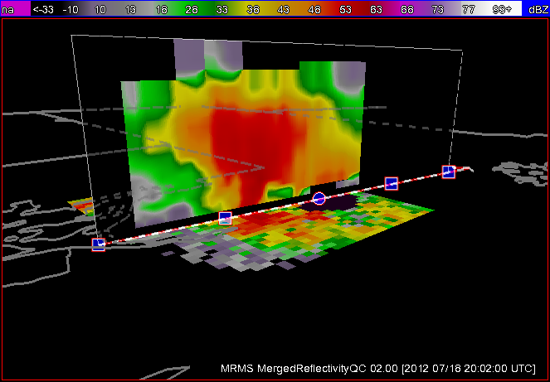
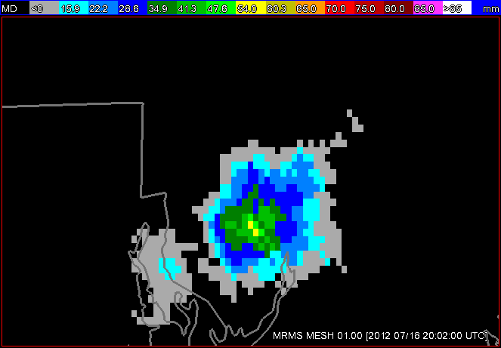
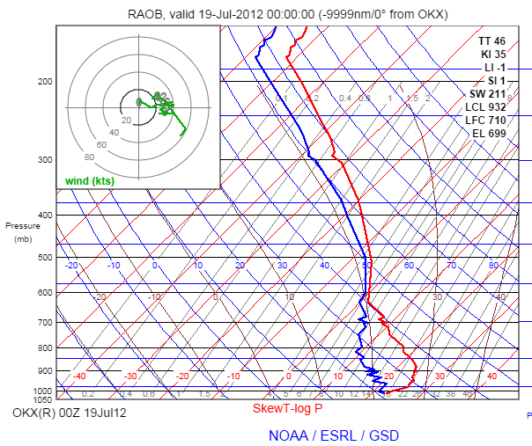
Multi-Radar Multi-Sensor System
+
other neighboring radars
KBOX
KOKX
MRMS Maximum Hail Size
MRMS

Slide 5
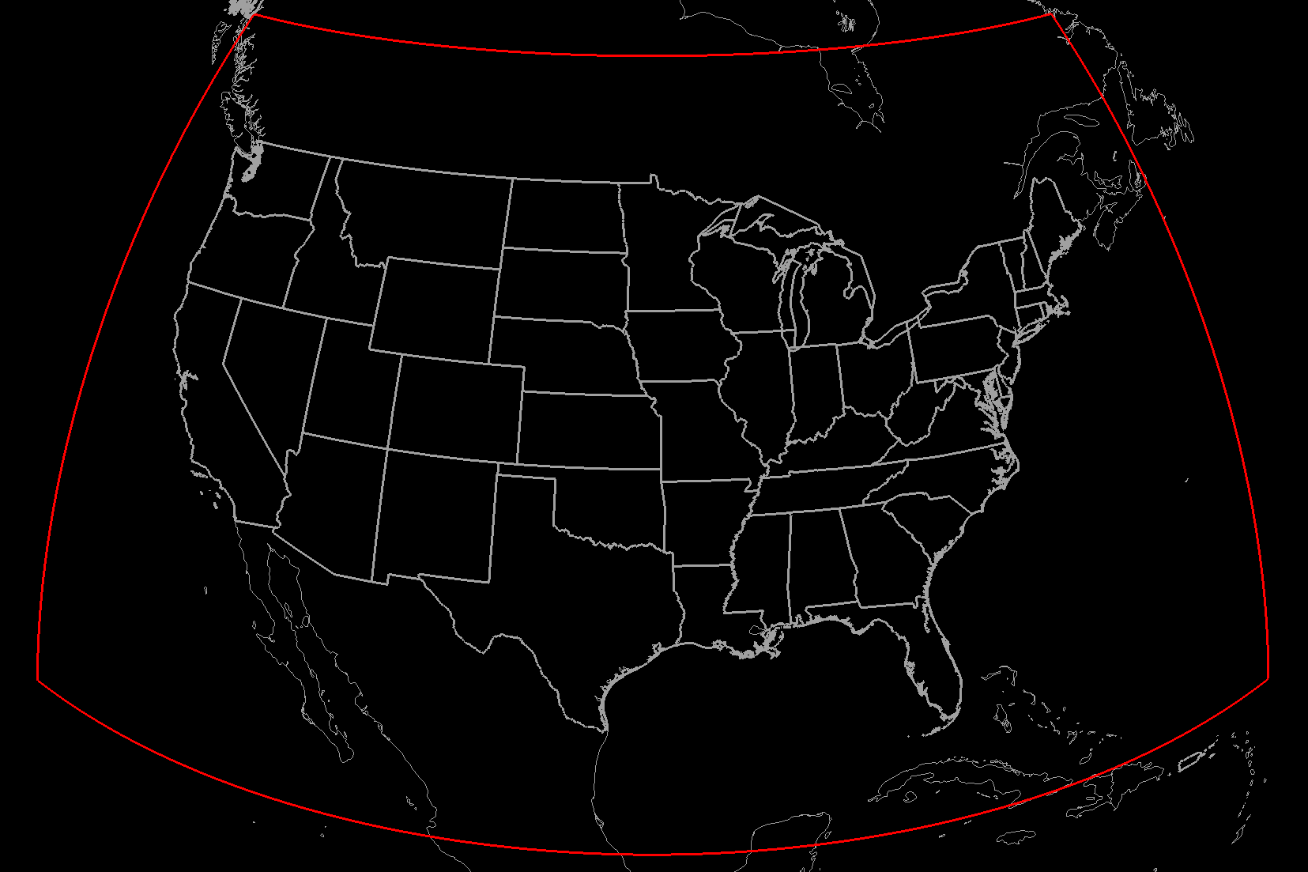
MYRORSS Domain
5-minute, 0.01x0.01 degree resolution, 35 vertical levels

Slide 6
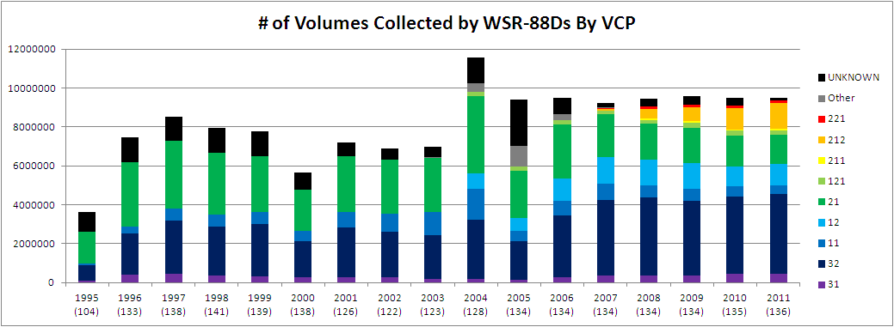
MYRORSS Data
- complete
- needs QC
Σ ~ 105 million volume scans

Slide 7
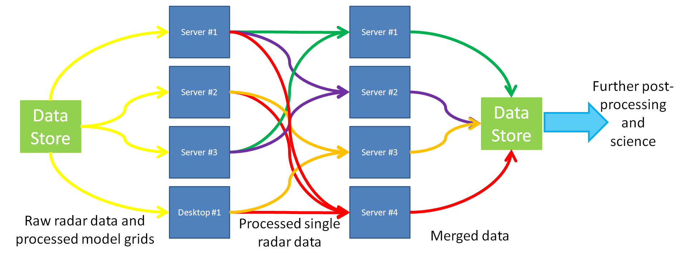
MYRORSS Processing

Slide 8
MYRORSS post processing
Severe Wx Products
Merged 3D reflectivity
Aviation Products
Hydro Products

Slide 9
MYRORSS Processing (single radar)
Conversion into netCDF
Radar QC
QCNN – Lakshmanan et al. 2007 & 2010
Further bloom QC for biological scatterers—Tang et al. 2011
Dealiasing
2D dealiasing—Jing & Weiner 1993
Azimuthal Shear Calculations
LLSD—Smith and Elmore 2004
Range correction—Newman et al. 2013
Composite layers (0-3 km AGL and 3-6 km AGL)

Slide 10
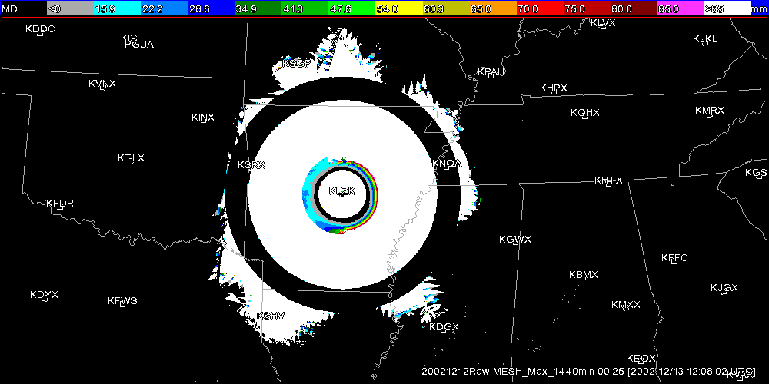
MYRORSS QC

Slide 11
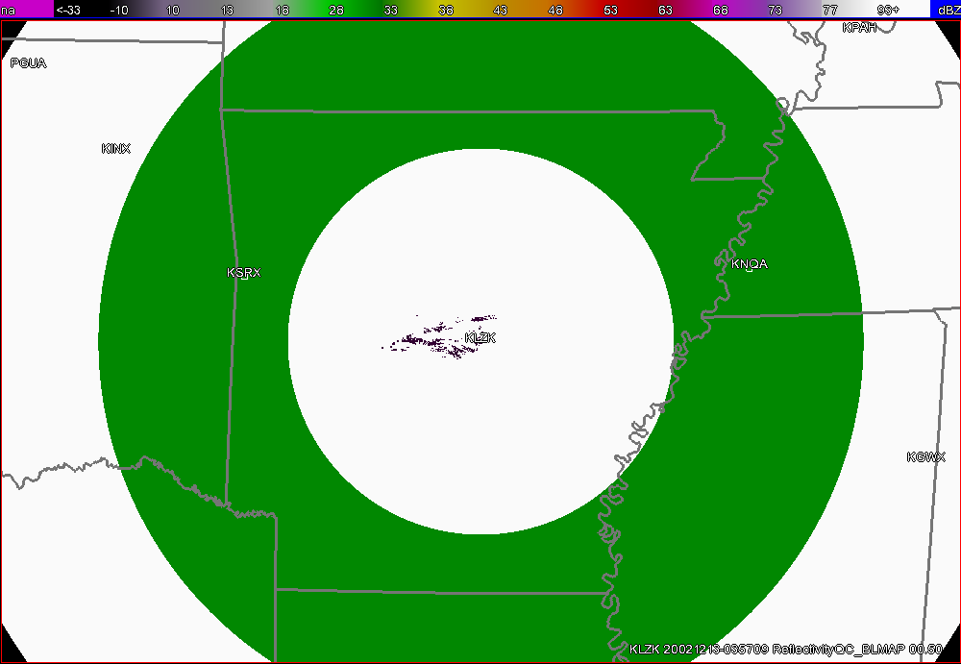
MYRORSS QC

Slide 12
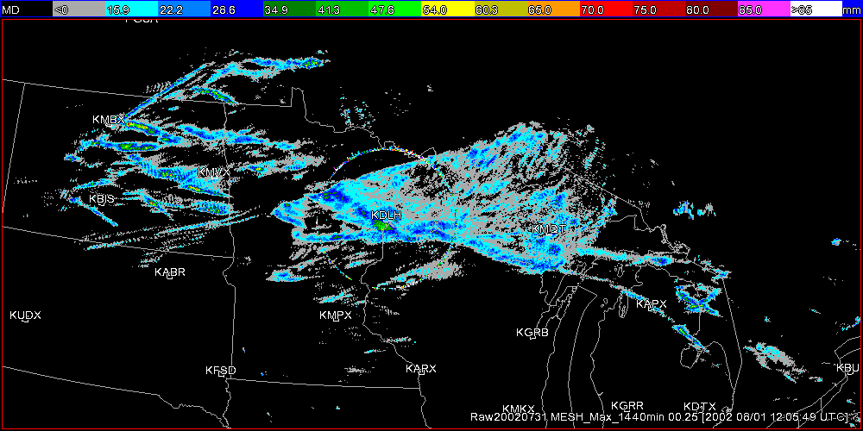
MYRORSS QC

Slide 13
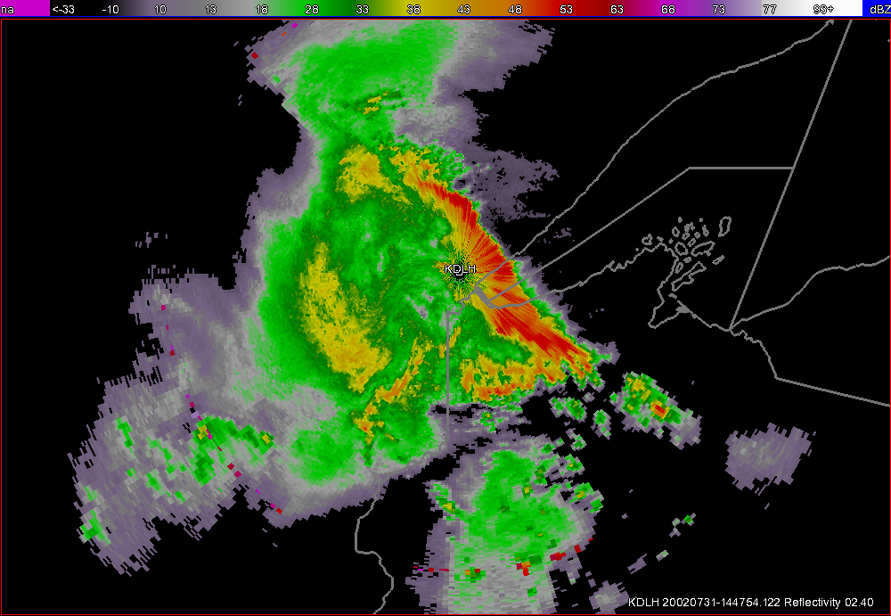
MYRORSS QC

Slide 14
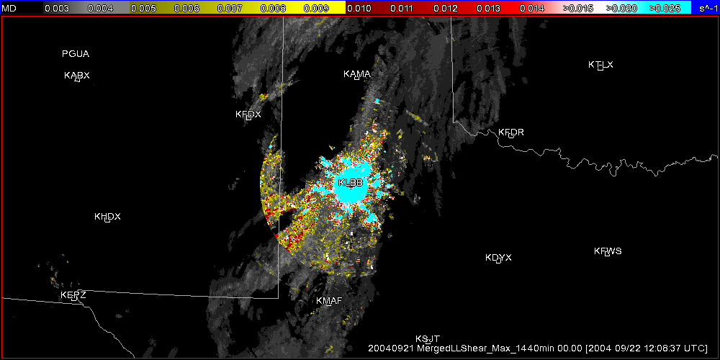
MYRORSS QC

Slide 15
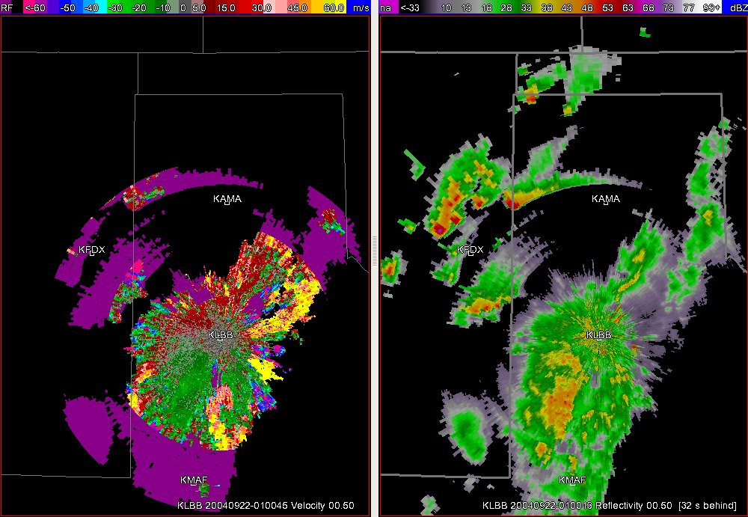
MYRORSS QC

Slide 16
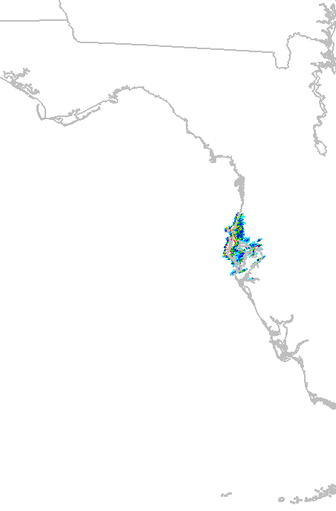
MYRORSS QC
Erroneous MESH detections—large areas and large values—due to radar ducting and coastline interactions. The most common QC problem.

Slide 17
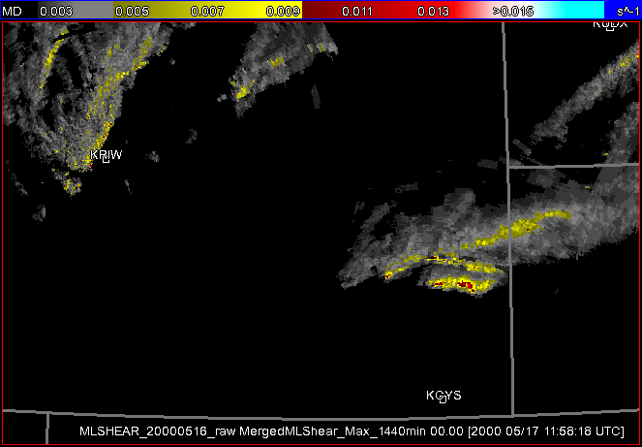
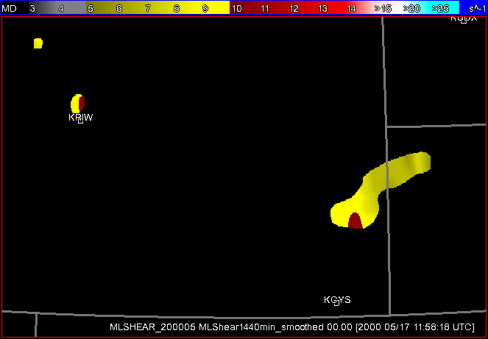
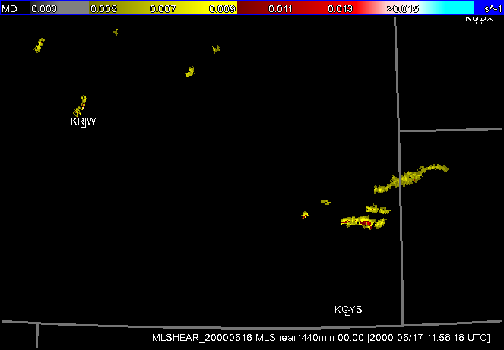
Using the Data: Radar-based Climatologies
Raw
Smoothed
Individual timesteps are cleaned up using a threshold, minimum size of clusters and temporally using a multiple-hypothesis tracking method
MHT accumulations are then run through a series of smoothers to futher clean up the field and make the size of the fields appropriate for climatology generation
MHT

Slide 18
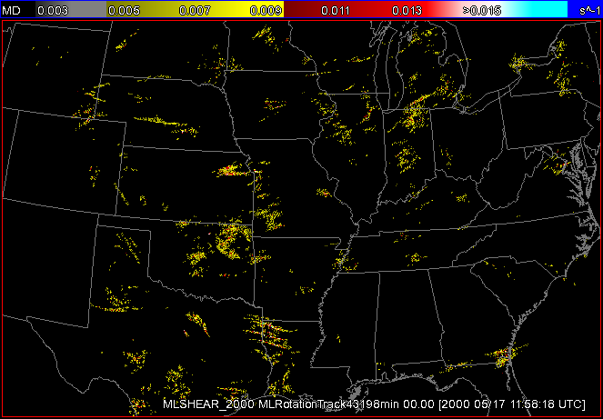
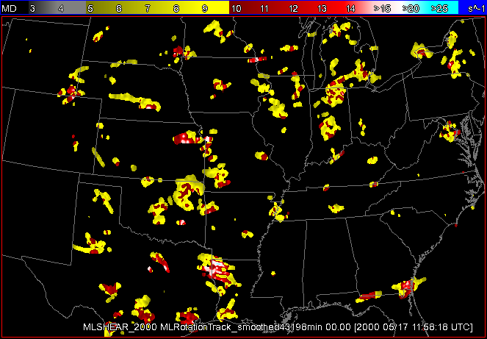
Using the Data: Radar-based Climatologies
Yearly Accumulation (MHT)—2000
Yearly Accumulation (MHT & Smoothed)—2000

Slide 19
Future Fixes
Make timing of products smooth (right now ~5 minutes, need exactly 5 minutes)
Fix LLSD corrected shear calculations
Produce un-QC’d composite
Identify and correct reflectivity issues affecting QPE estimates

Slide 20
What’s Next?

Slide 21


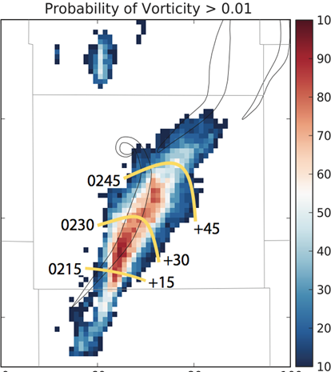

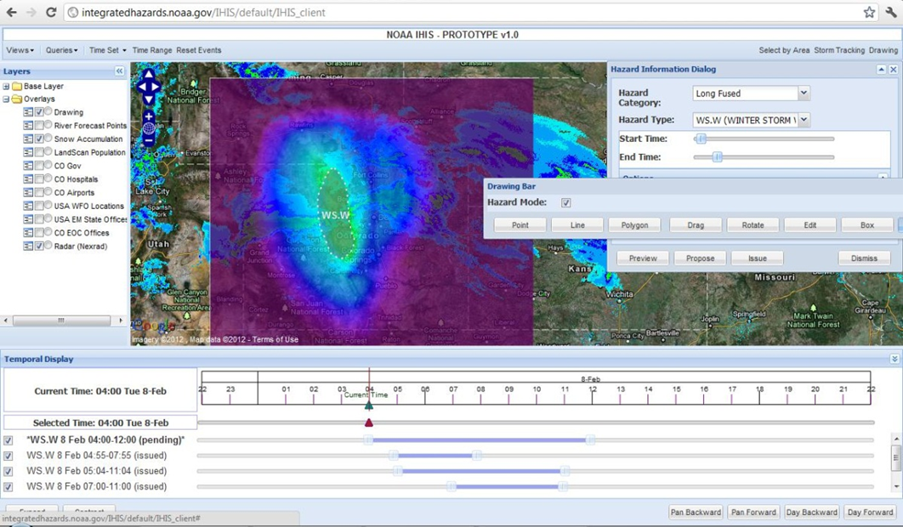
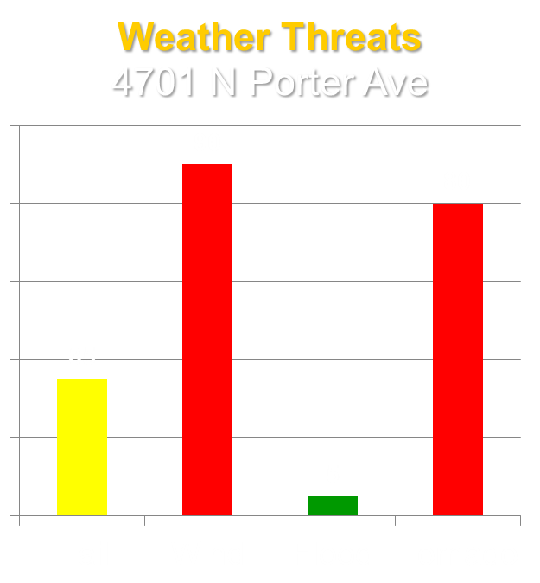

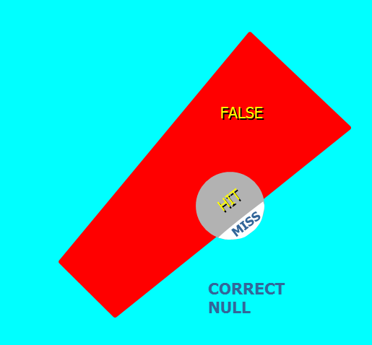
Forecasting a Continuum of Environmental Threats
Grid-Based Probabilistic Threats
Observations & Guidance
The Forecaster
Threat Grid Tools
Useful Output
Effective Response
Verification Methods
Follows the flow of “The Warning Process”

Slide 22
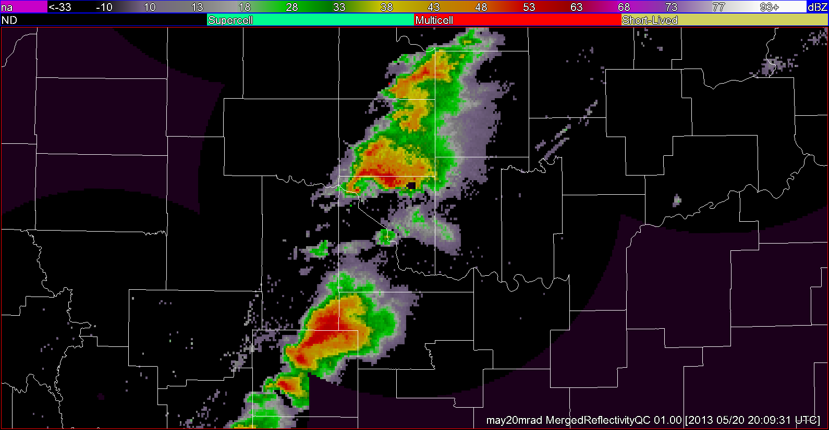
Multi-scale storm “cluster” identification

Slide 23
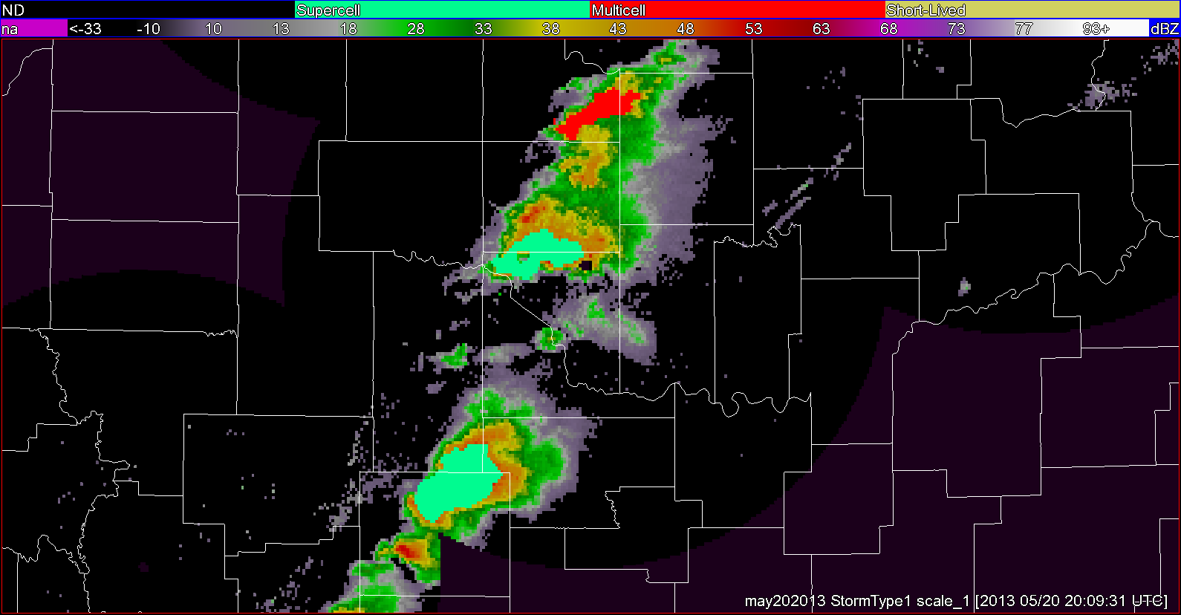
Multi-scale storm “cluster” identification
200 km²

Slide 24
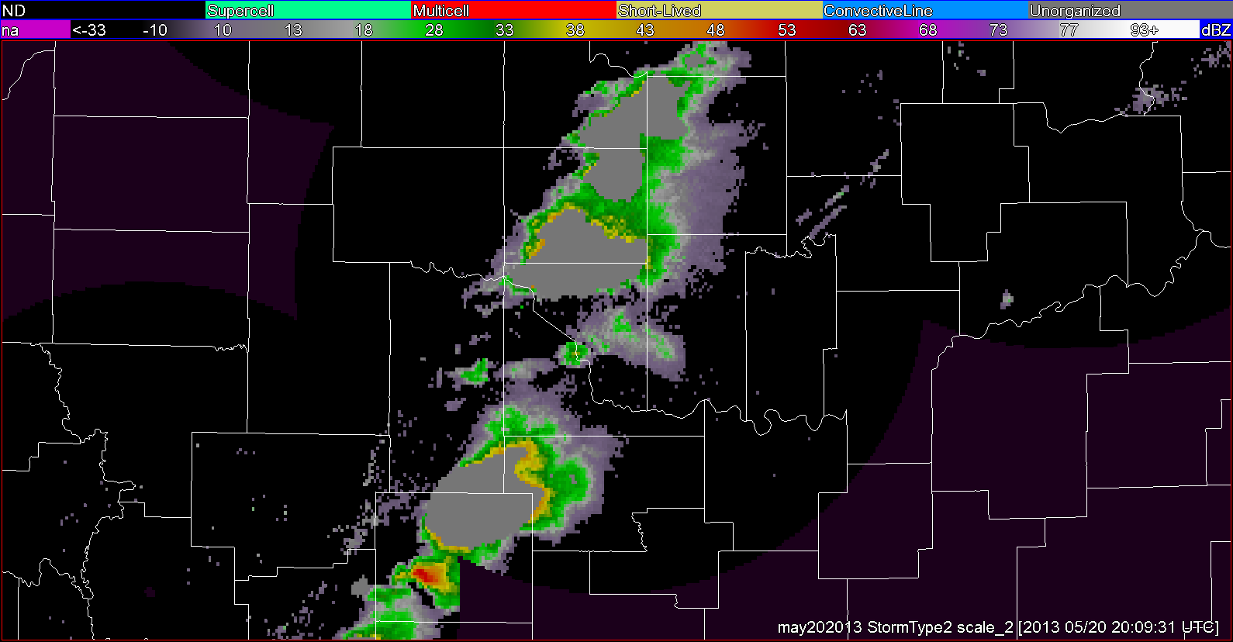
Multi-scale storm “cluster” identification
2000 km²

Slide 25
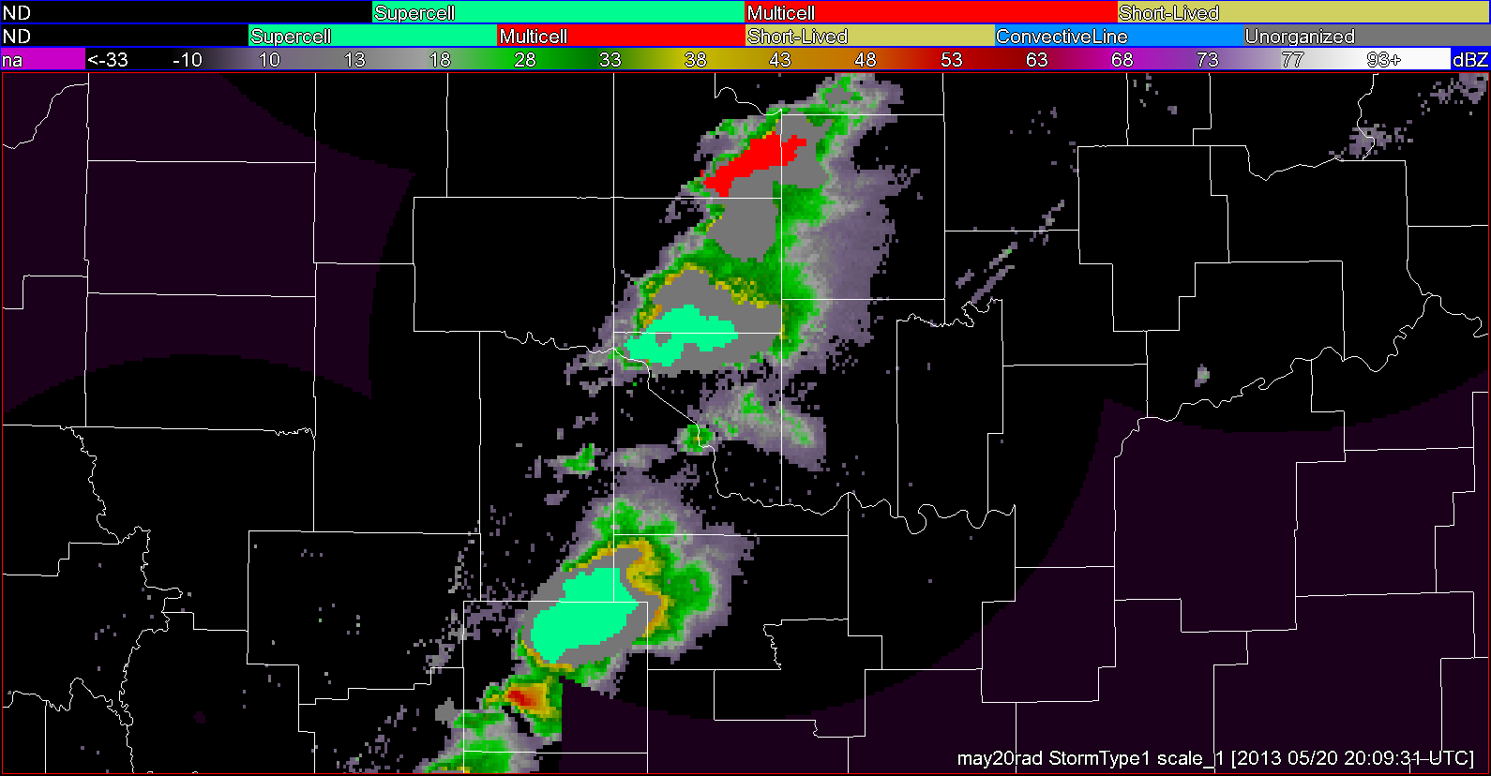
Multi-scale storm “cluster” identification

Slide 26
Storm classification inputs from MYRORSS / MRMS
Storm Attribute
-20 C Merged Reflectivity
0 C Merged Reflectivity
Aspect Ratio
0-2 km Merged Azimuthal Shear
3-6 km Merged Azimuthal Shear
0-6 km Shear Magnitude
0-1 km Storm Relative Helicity
0-3 km Storm Relative Helicity
Longevity
Maximum Expected Size of Hail (MESH)
Max 30 Minute MESH
Most Unstable CAPE
Most Unstable LCL Height
Probability of Severe Hail (POSH)
Quality Controled Merged Reflectivity Composite
Severe Hail Index (SHI)
Storm Size
Surface CAPE
Surface Dewpoint
Surface Temperature
Vertically Integrated Liquid (VIL)

Slide 27
Storm classification
Disorganized
Bow Echo
Discrete
Supercell Right Mover
Discrete
In Line
QLCS
In Cluster
In Line
In Cluster
Supercell Left Mover
Discrete
In Cluster
In Line
Based on:
Smith, B. T., R. L. Thompson, J. S. Grams, C. Broyles, and H. E. Brooks, 2012: Convective modes for significant severe thunderstorms in the contiguous United States. Part I: Storm classification and climatology. Wea. Forecasting, 27, 1114–1135.

Slide 28
Storm classification: Example Decision Tree

Slide 30
Data mining & Nowcasting
Generate probability (P) of:
[tornado/wind/hail/heavy precip/lightning/mesocyclone/etc.]
For each storm cluster.
P(event is ongoing)
P(event will occur in X minutes)
Probabilistic 0-60 minute Nowcast

Slide 31
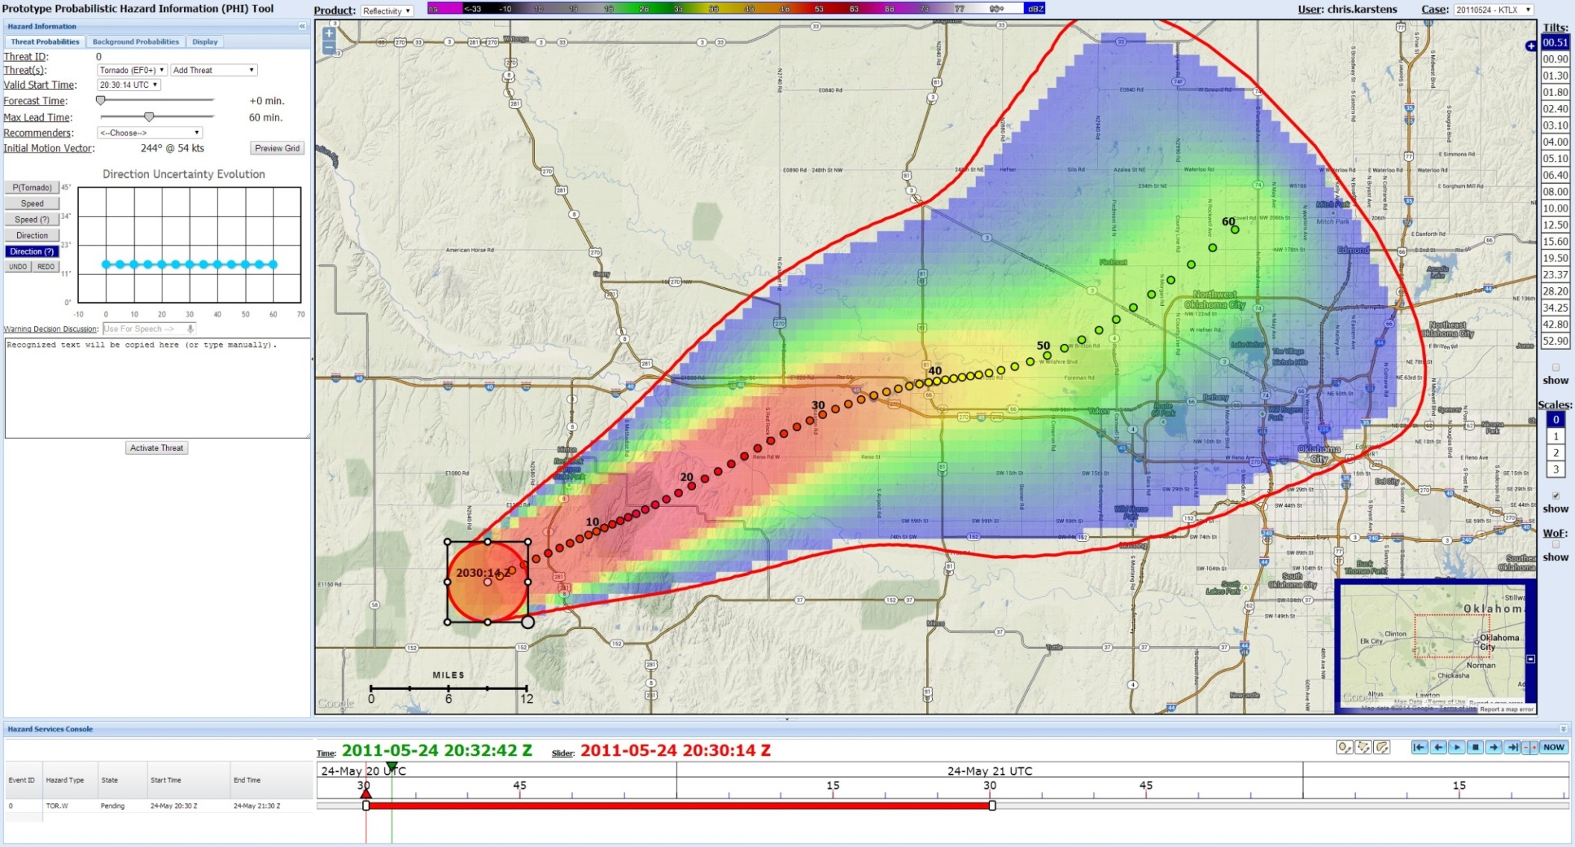
Informed Probabilistic Hazard Information (PHI)

Slide 32
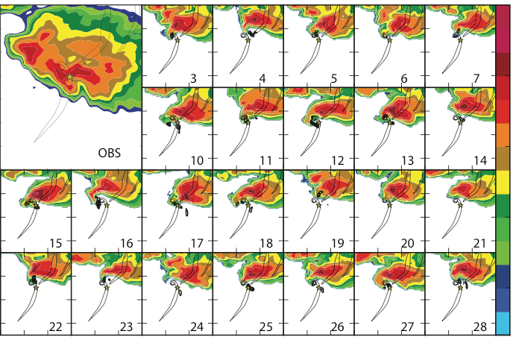
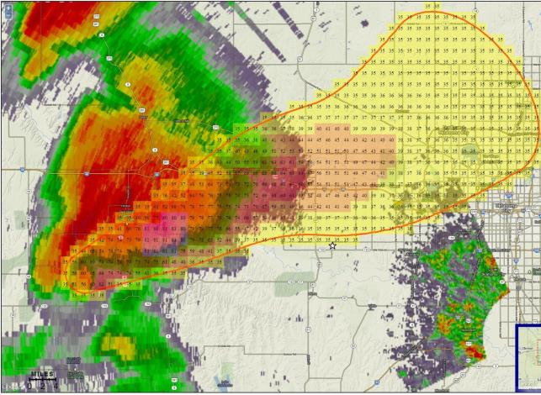
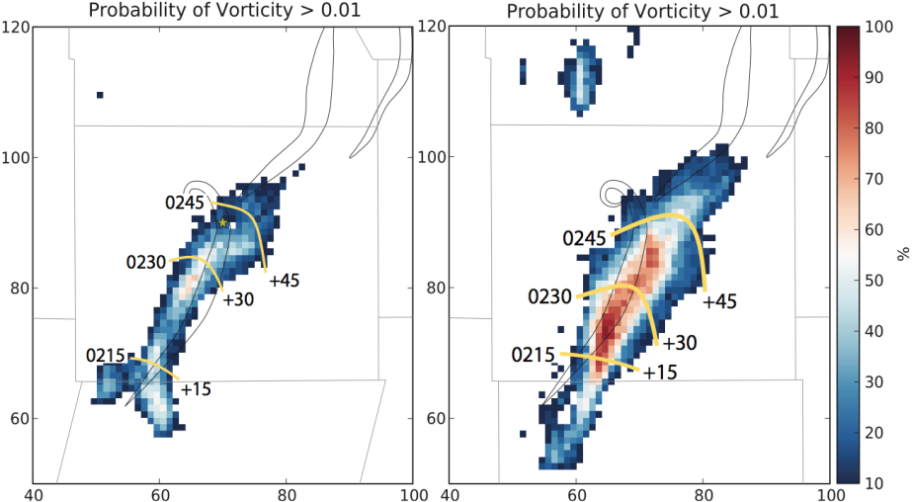
MYRORSS and NWP
Blending with 0-2 hour storm-scale ensembles
Validation of storm mode in convection-allow models
Baseline for evaluation of Warn-on-Forecast: beating climatology

Slide 33
High resolution verification & Synthetic verification
e.g. Severe Hazards Analysis and Verification Experiment; mPING; radar proxies for severe wx…
Days of operation: 554 Total data points: 63353 Hail data points: 45406 Wind data points: 6456 Flood data points: 9313 Winter data points: 2178 Questionable time: 33371 'No wind' reports: 4117 'No flood' reports: 6821 'No hail' reports: 20226 Non-svr hail reports: 15196 Svr hail reports: 8848 Sig hail reports: 1021 Measured hail reports: 380 Measure avg reports: 89

Slide 34
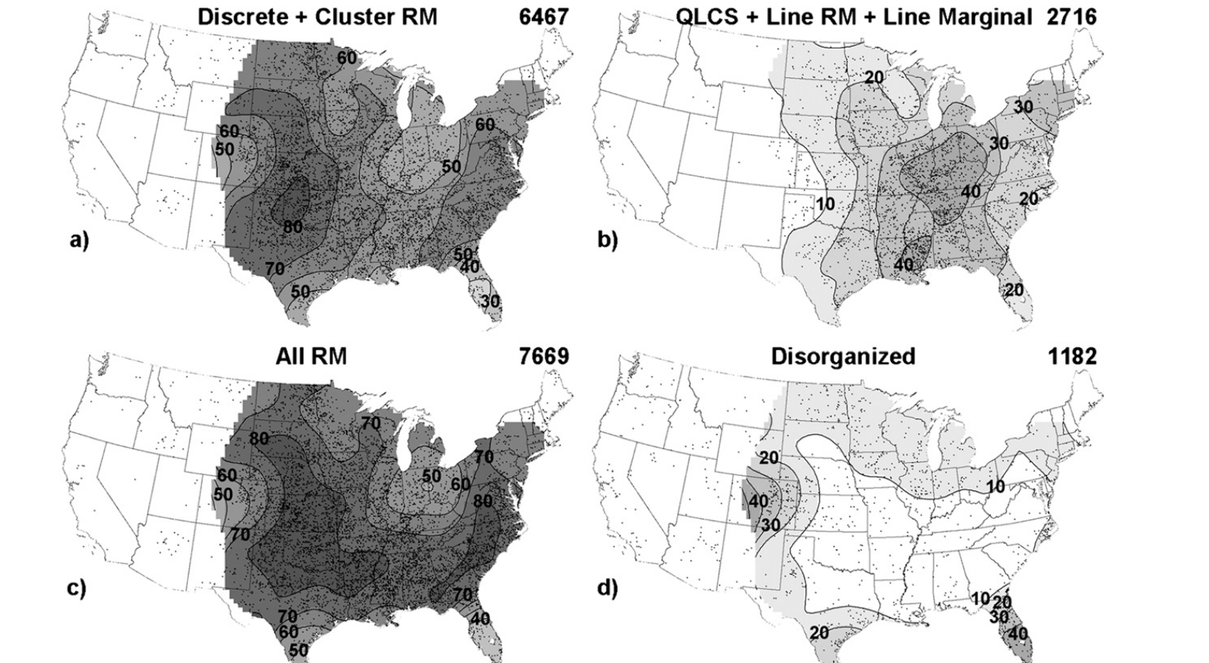
Relational database: storm type / severity by environment
Supplement to Smith et al. 2012,
including weak severe, non-severe,
and synthetic verification measures

Slide 35
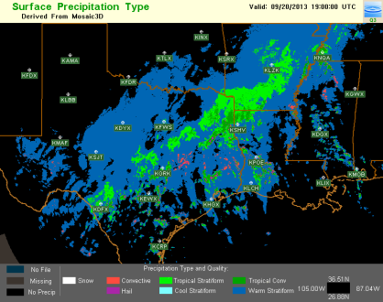
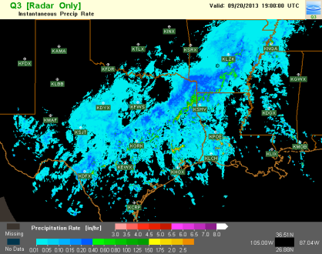
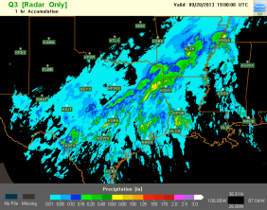
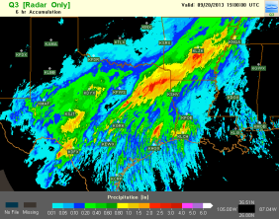
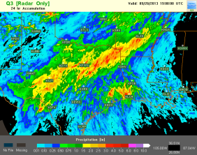
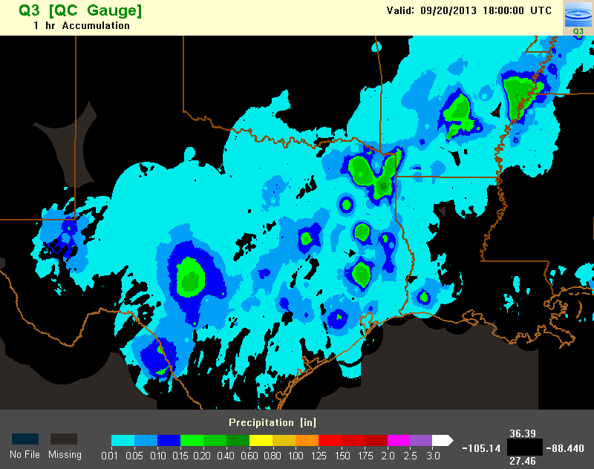
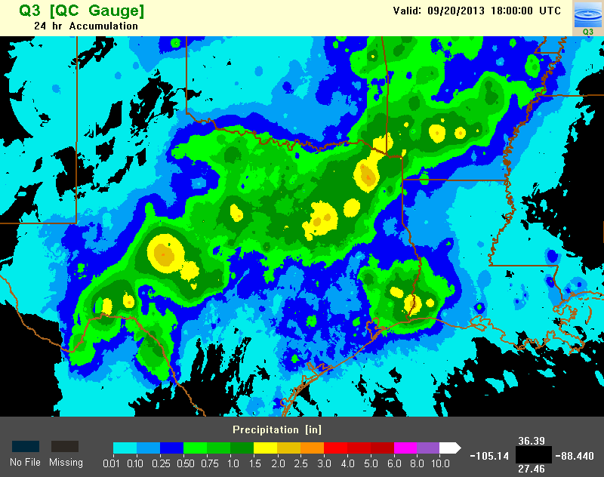
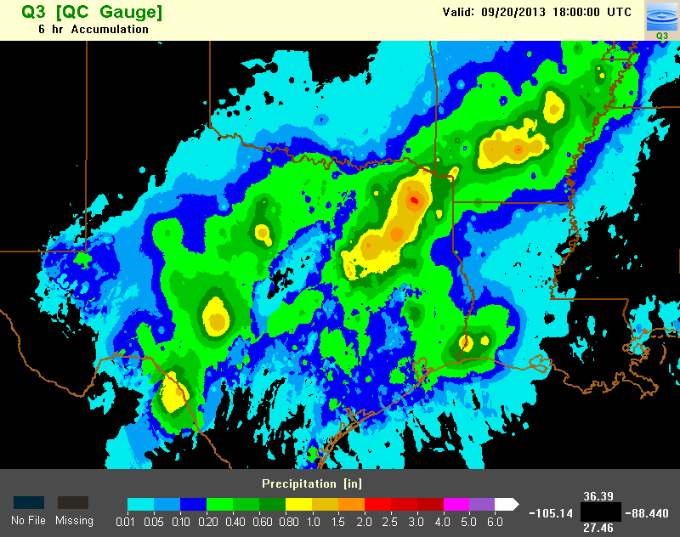
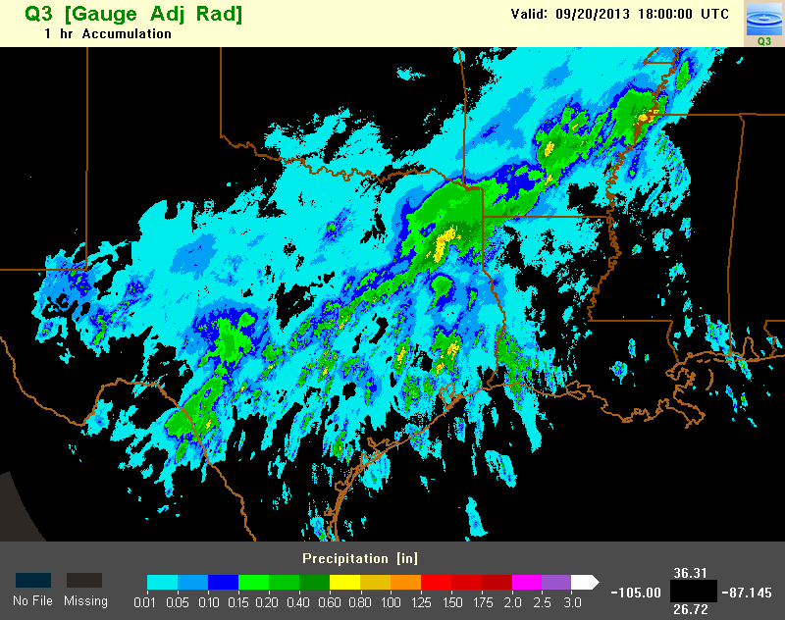
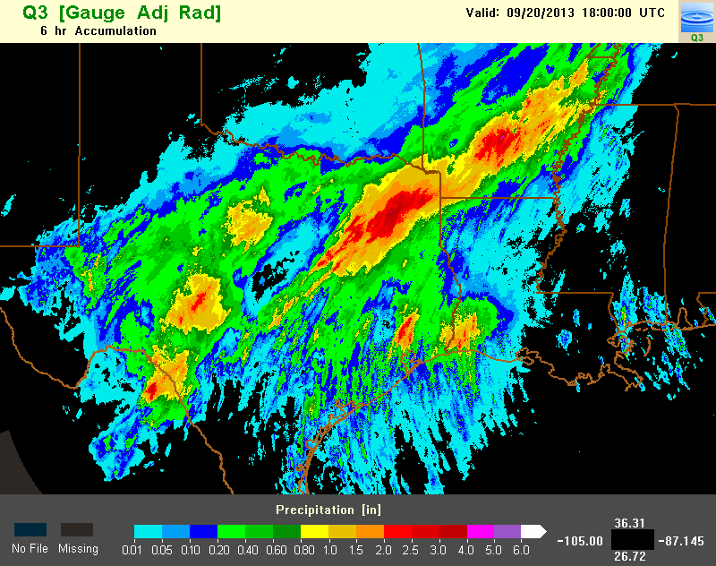
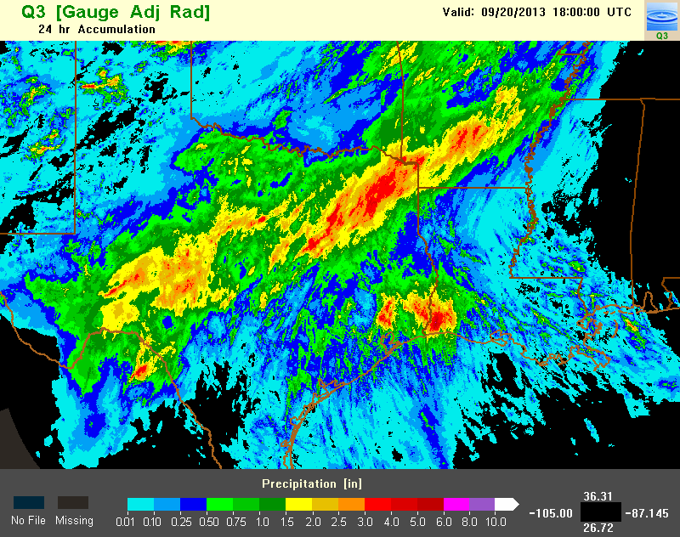
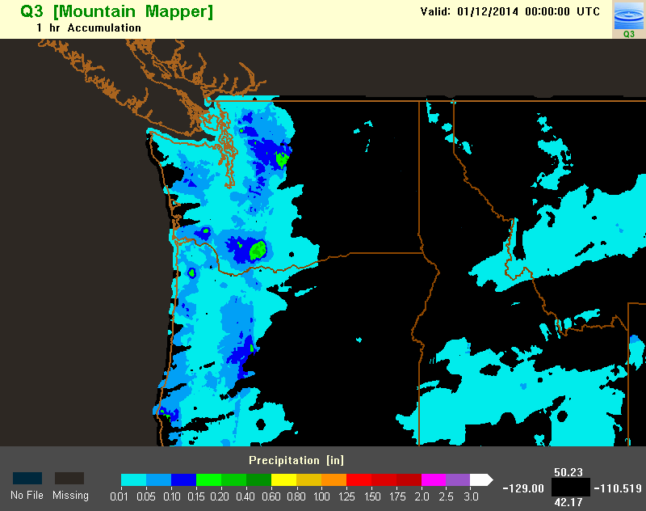
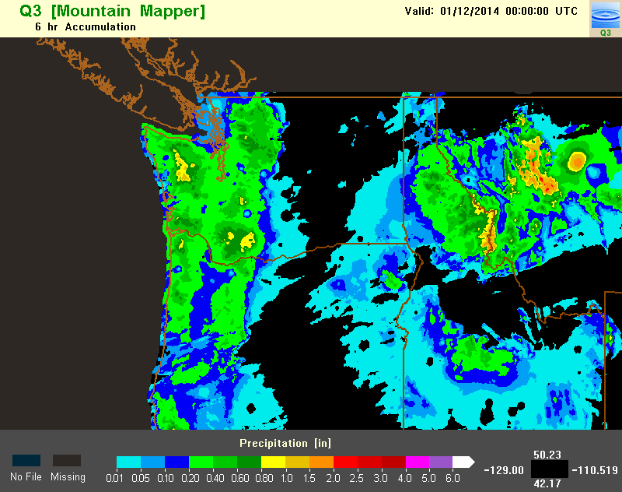
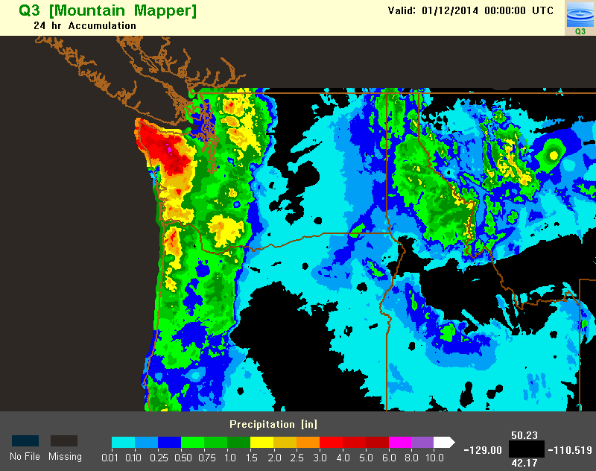
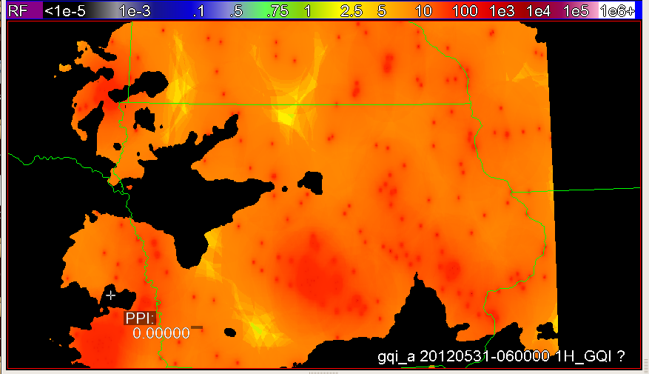
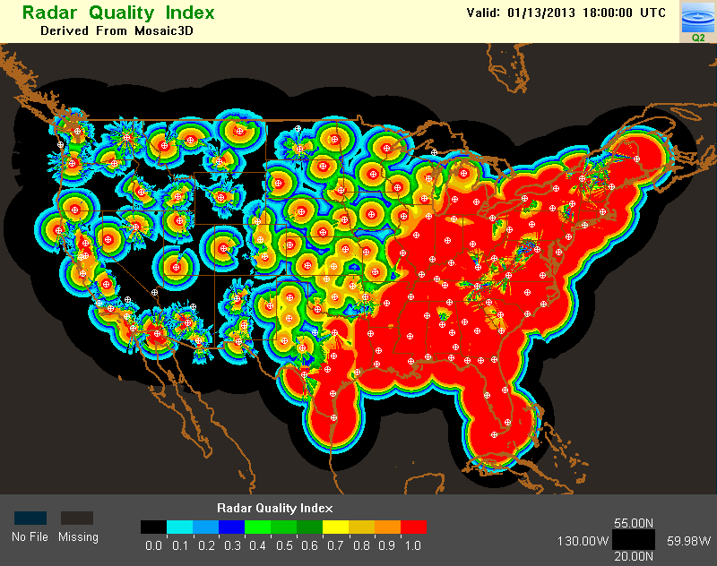

Quantitative Precipitation Estimation
Key MRMS QPE Products
Surface Precip Type
Surface Precip Rate
Radar QPE (1, 6, 24, 48, 72h, 10day acc)
Gauge QPE
Local gauge bias corrected radar QPE
Gauge + orographic pcp climatology QPE
Radar QPE Quality Index (RQI)
Gauge Influence Index (GII)
GII 06Z 5/31/2012 Iowa
RQI 18Z 1/13/2013
RQI 18Z 6/13/2013
The radar QPE quality is better in warm season than in cool season, and is better in the east than in the west.
Notes:
This slide shows key QPE products in the MRMS system, which include:

Slide 36
Other Opportunities & Plans
Fix issues, re-run! (and again, and again…)
Near real time addition of new data
Web front end for data mining / case studies by collaborators
Aviation
Insurance / Reinsurance
Climate
Agriculture
And more!

Slide 37
Summary
MYRORSS processing is ongoing
Many QC issues identified
Next: post processing
QPE radar retrospective is another talk
Many science opportunities at many time/space scales
Kiel.Ortega@noaa.gov; Travis.Smith@noaa.gov

