Slide 1
Storm Prediction Center Post-Processing: HREF Calibrated Thunder and Severe Guidance
Israel Jirak, David Harrison, Matt Elliott, and Chris Karstens
NOAA/NWS/NCEP/Storm Prediction Center
VLab Forum
October 2021

Slide 2
Post-Processing at the Storm Prediction Center
The Storm Prediction Center (SPC) has been involved with ensemble post-processing since the initial implementation of the Short-Range Ensemble Forecast system (SREF) and experimentally with convection-allowing models (CAMs) for over a decade
In fact, the first operational CAM ensemble, the High-Resolution Ensemble Forecast system (HREF) originated from the SPC Storm-Scale Ensemble of Opportunity, which was developed and tested beginning in 2011
On May 11, 2021, the initial version of SPCPOST was implemented on WCOSS.
SPCPOSTv1.0.6 includes two calibrated, probabilistic guidance datasets:
HREF/SREF calibrated tornado, hail, and wind (4-h & 24-h Day 1)
HREF calibrated thunder (1-h, 4-h, full period through f48)
Not only can this guidance be used directly for high-impact weather forecasting, but it also serves as input to the NBM and SPC Severe Timing Guidance

Slide 3
HREF/SREF Calibrated Severe
SPC has been generating probabilistic forecasts of severe weather hazards (i.e., tornado, wind, and hail) on Day 1 for over two decades
While raw neighborhood probabilities from CAM ensembles are useful in forecasting severe weather, calibrated probabilistic hazard guidance can be more directly used and applied by a forecaster
CAM ensembles provide the necessary information on convective mode and storm intensity to generate calibrated hazard guidance
0600Z Day 1 Convective Outlook (4/28/2014)
Tornado
Wind
Hail

Slide 4
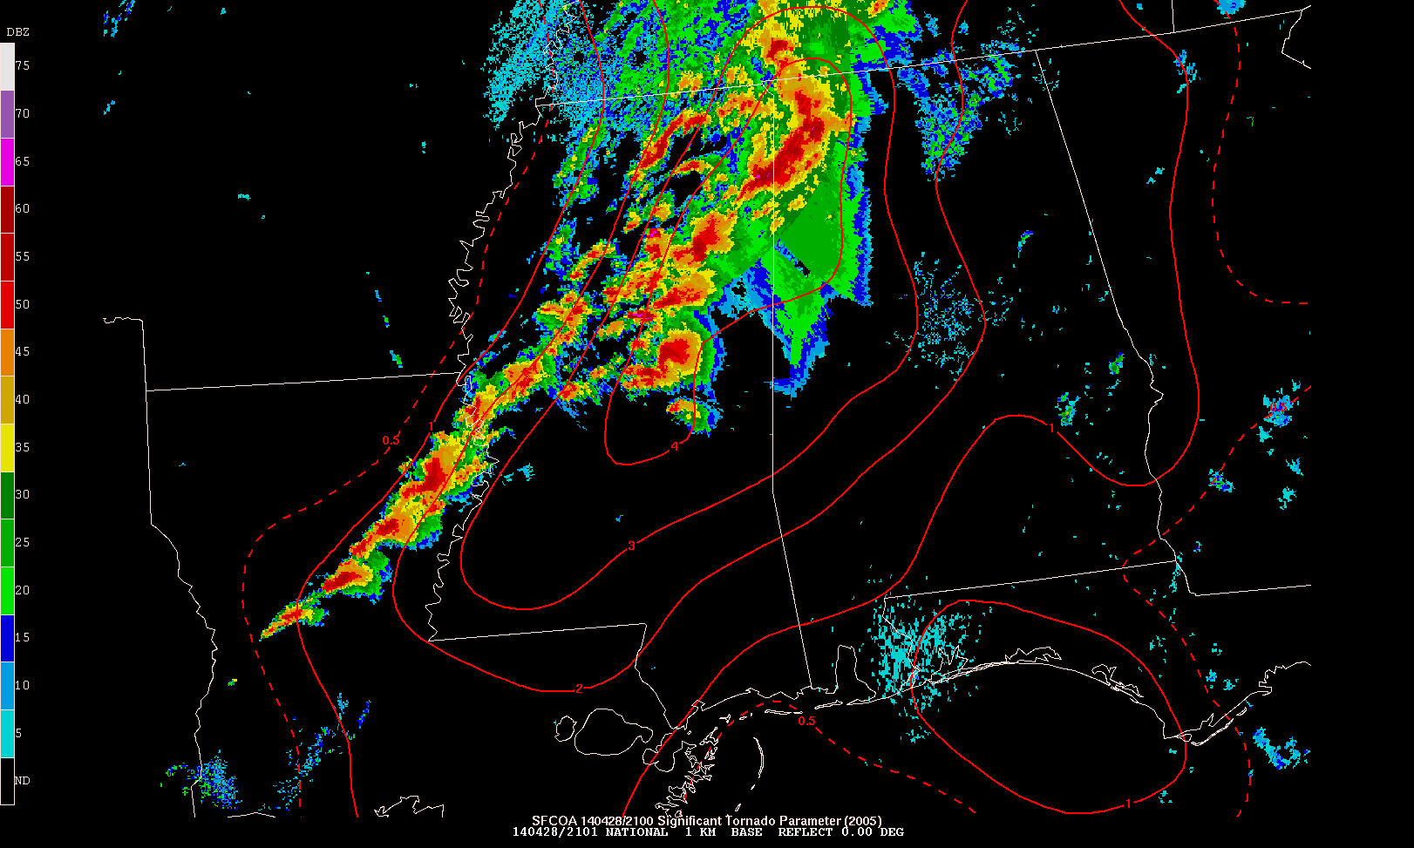
HREF/SREF Calibrated Severe
Methodology: Use probabilistic forecasts of the environment from the SREF and simulated storm attributes from the HREF to create calibrated probabilities for severe weather hazards:
SREF – 26 members @ 16 km, multi-model, multi-initial cond., multi-physics
HREF – 10 members @ ~3 km, multi-model, multi-initial cond., multi-physics
Combining information in this way is similar to forecaster thinking: Given a storm of certain mode/intensity in this environment, what is the likelihood of severe weather, and what are the possible hazards?
4/28/14
Radar @ 21Z
STP of 4 from RAP-based sfcOA

Slide 5
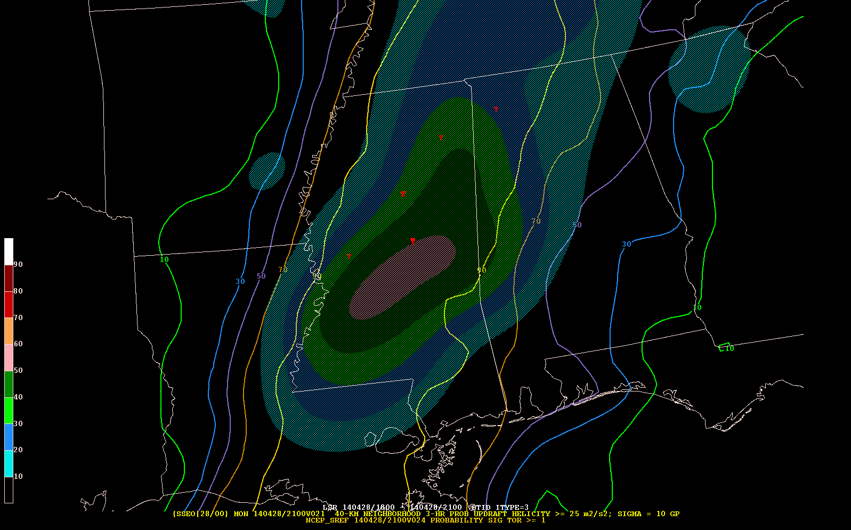
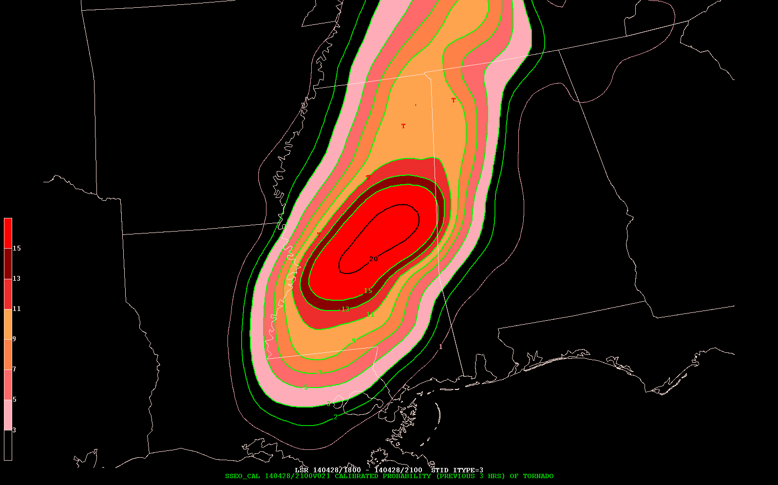
HREF/SREF Calibrated Severe
A frequency-adjustment approach is applied to probabilistic information from the SREF and HREF based on historical storm reports to arrive at calibrated probabilities for each hazard:
Hazard | HREF Variable | SREF Variables
Tornado | NProb UH ≥75 m²s⁻² | Prob STP ≥1
Hail |  | Prob MUCAPE >1000 J/kg x Prob Eff Shear >20 kts
Wind |  | Prob MUCAPE >250 J/kg x Prob Eff Shear >20 kts
HREF NProb UH ≥75 m²/s²
SREF Prob STP ≥1
Valid 21Z 4/28
Calibrated
Prob of Tornado
Valid 21Z 4/28
50% Prob UH ≥75
>90% Prob STP
50-60% NProb UH →
~20% Occurrence of Tornado w/in 25 mi. during 18-21Z
90% Prob STP ≥1

Slide 6
HREF/SREF Calibrated Severe
There are a number of challenges in developing this type of calibrated probabilistic guidance:
Imperfect, underdispersive, and changing ensemble systems
Limited calibration sample for rare events (reforecasts are needed)
Issues with the calibration dataset (i.e., observed storm reports)
Raw UH NProb
Calibrated Tornado Prob

Slide 7
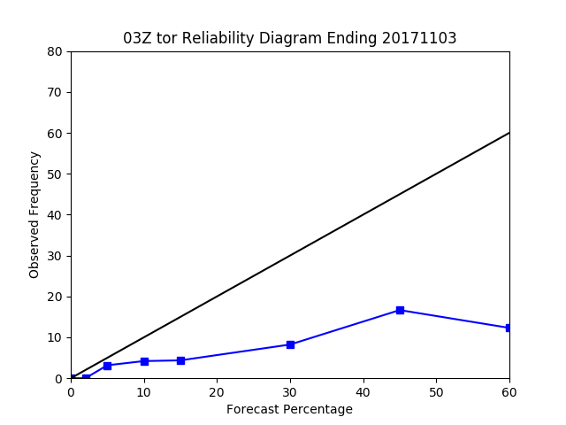
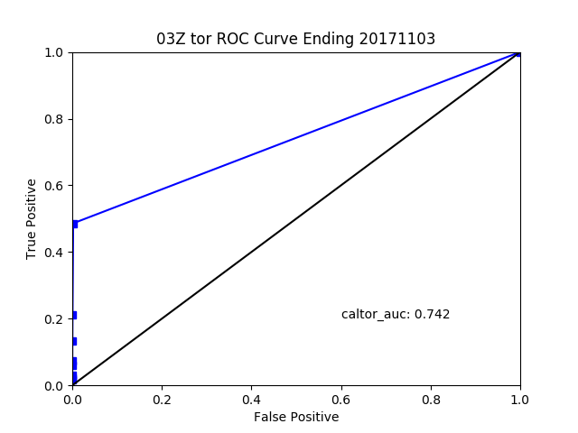
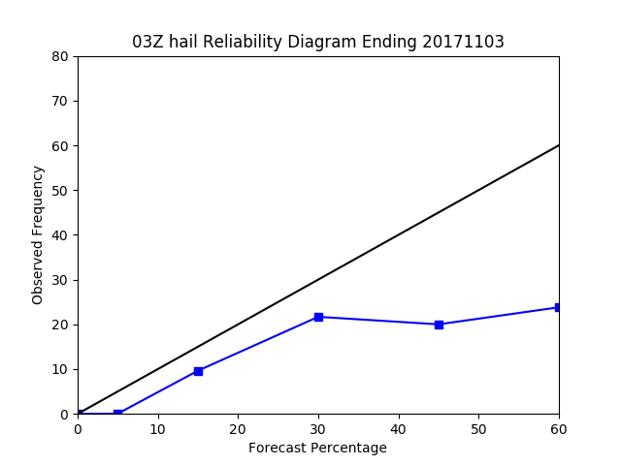
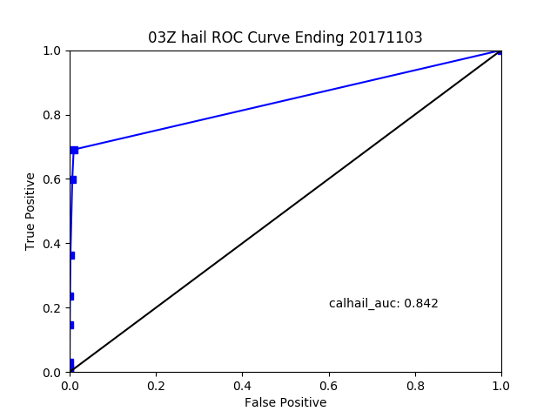
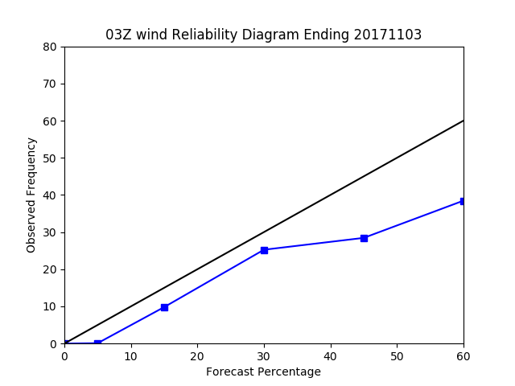
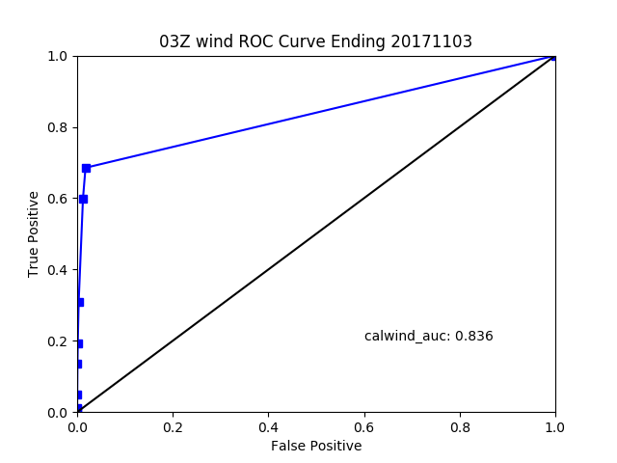
HREF/SREF Calibrated Severe
Despite these obstacles, reasonably skillful and reliable probabilistic guidance can be generated for severe weather hazards
Reliability
ROC
Reliability
ROC
Reliability
ROC
AUC=0.742
AUC=0.842
AUC=0.836
Tornado
Hail
Wind
Verification of 24-h calibrated probabilistic forecasts for periods valid 12-12 UTC
Verification period from 20170403 to 20171103

Slide 8
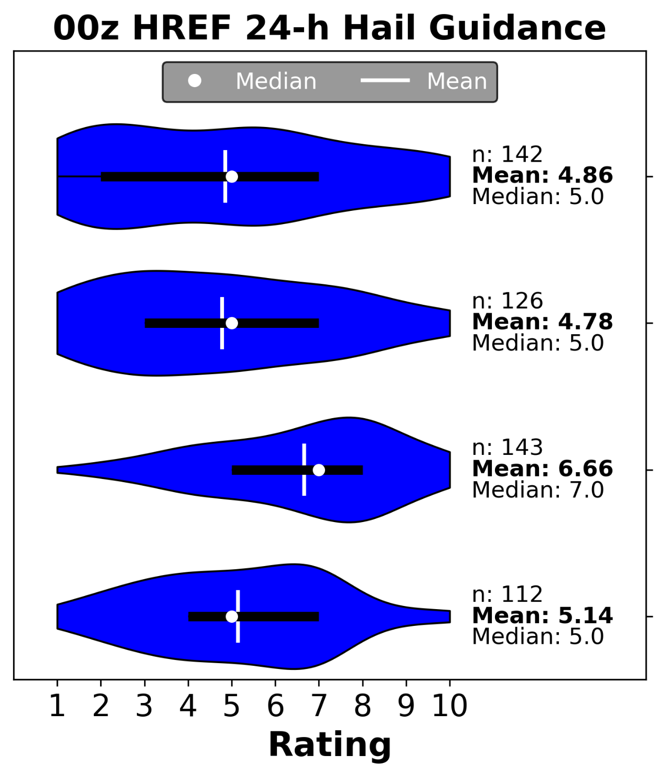
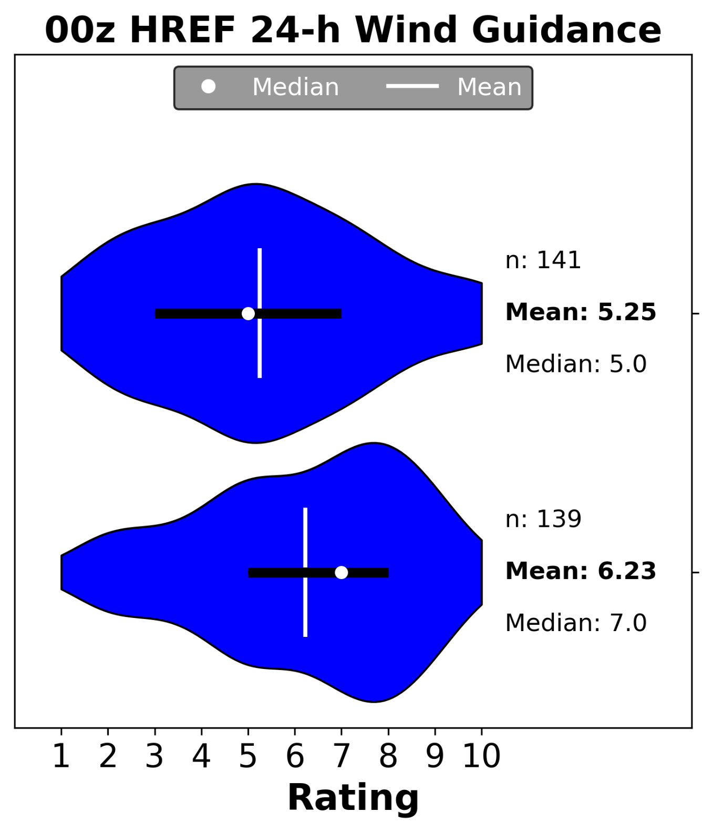
HREF/SREF Calibrated Severe
When compared to other calibrated hazard guidance in the HWT Spring Forecasting Experiments, the HREF/SREF guidance is typically the most conservative (magnitude and coverage) and often an underforecast
HREF/SREF
HREF/SREF

Slide 9
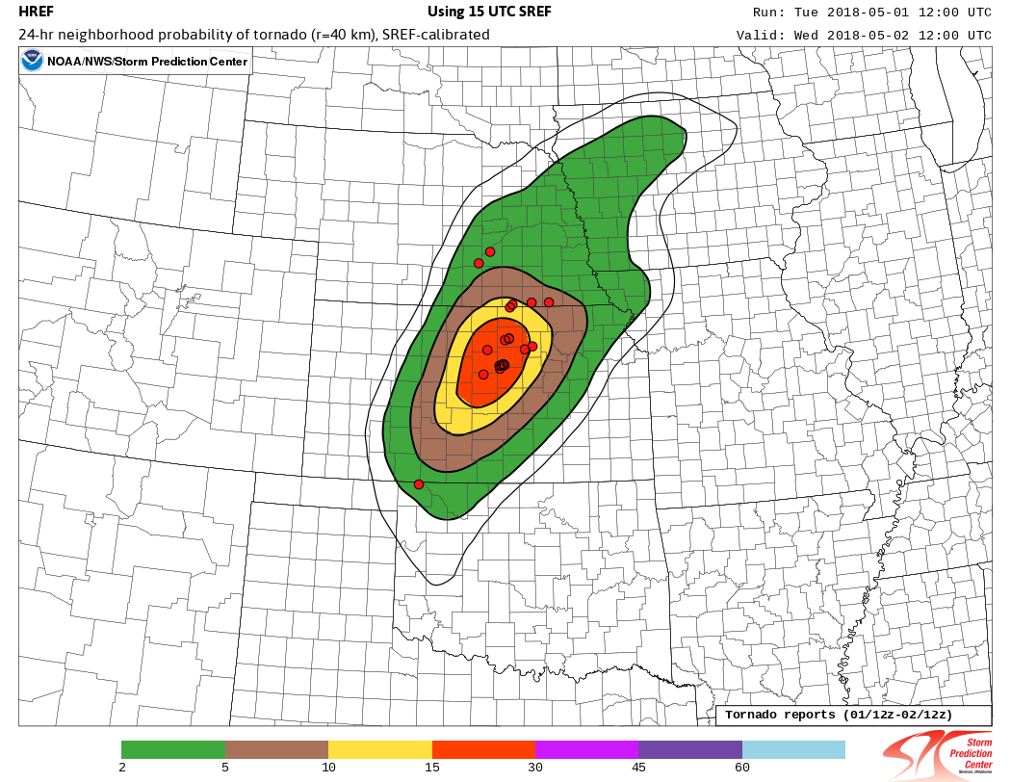
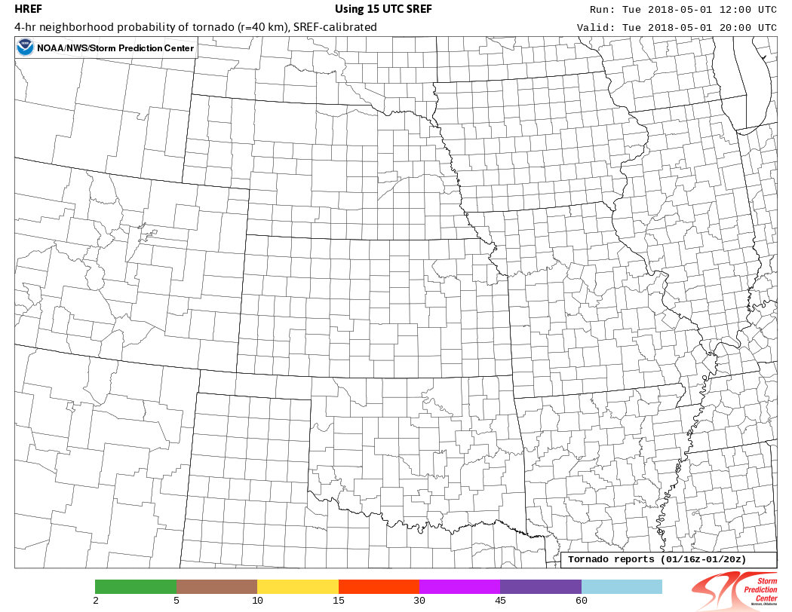
HREF/SREF Calibrated Severe
Perhaps one of the most useful aspects of incorporating HREF data into the calibrated severe guidance is the accurate timing information
24-h Calibrated Tornado
Valid 1 May 2018
Hourly 4-h Calibrated Tornado
Valid 1 May 2018

Slide 10
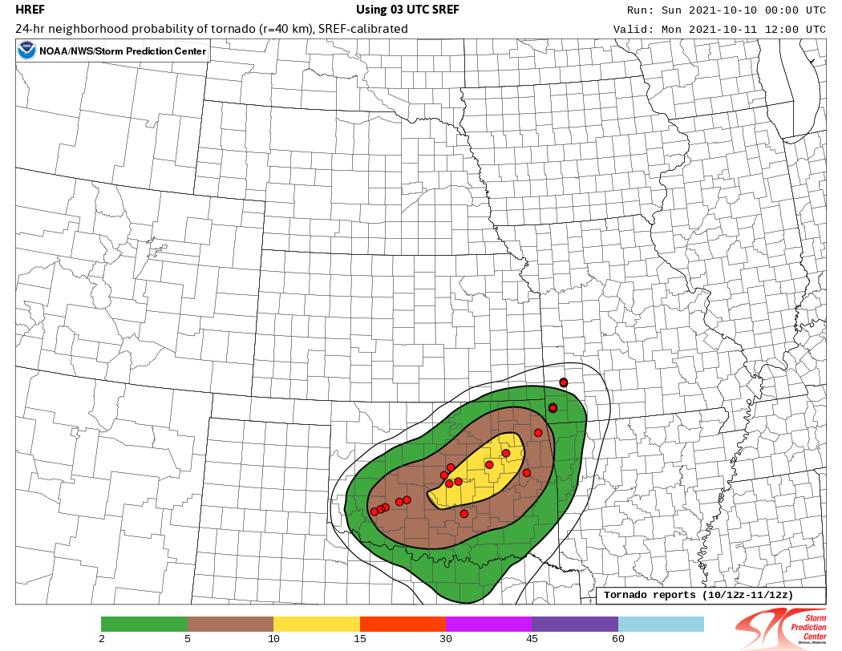
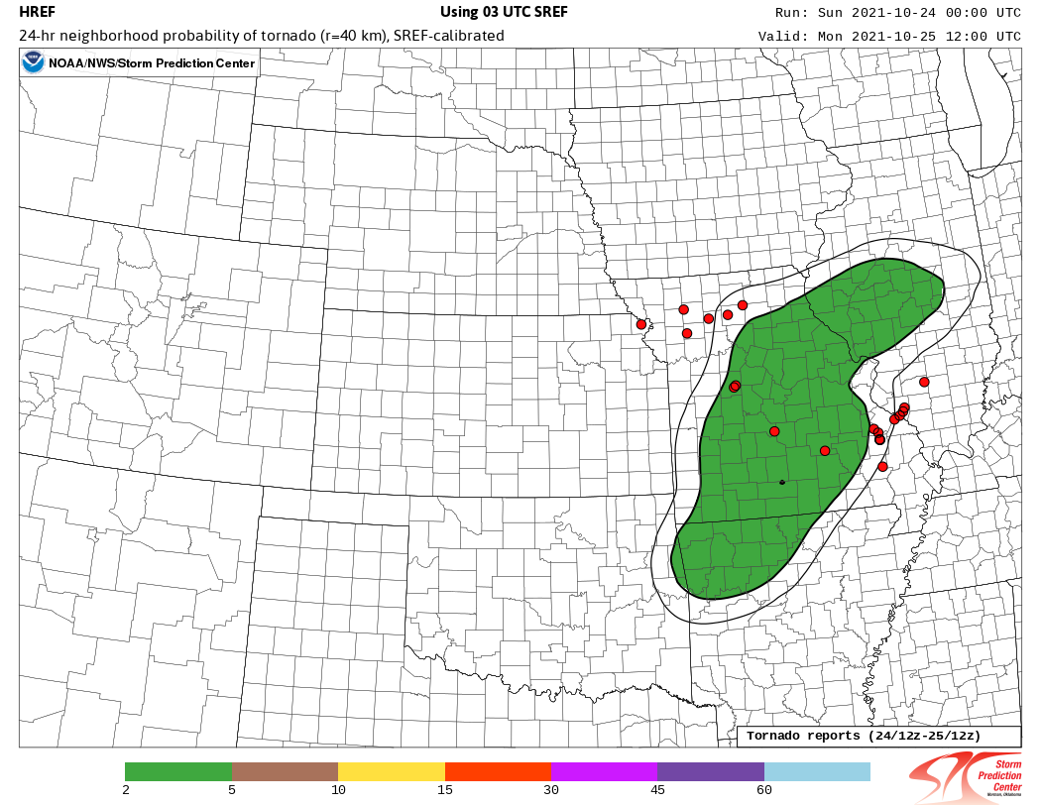
HREF/SREF Calibrated Severe
Recent forecast examples (both good and bad) can provide additional insight to the performance of the calibrated probabilistic guidance
October 10
24-h Tornado Guidance
October 24
Good Forecast
Poor Forecast

Slide 11
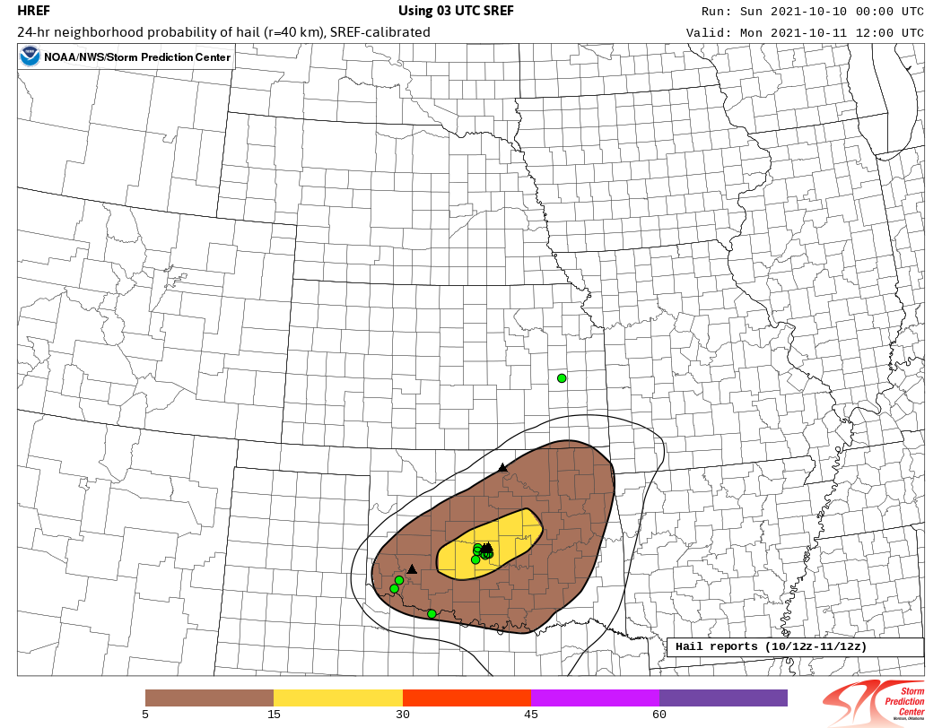
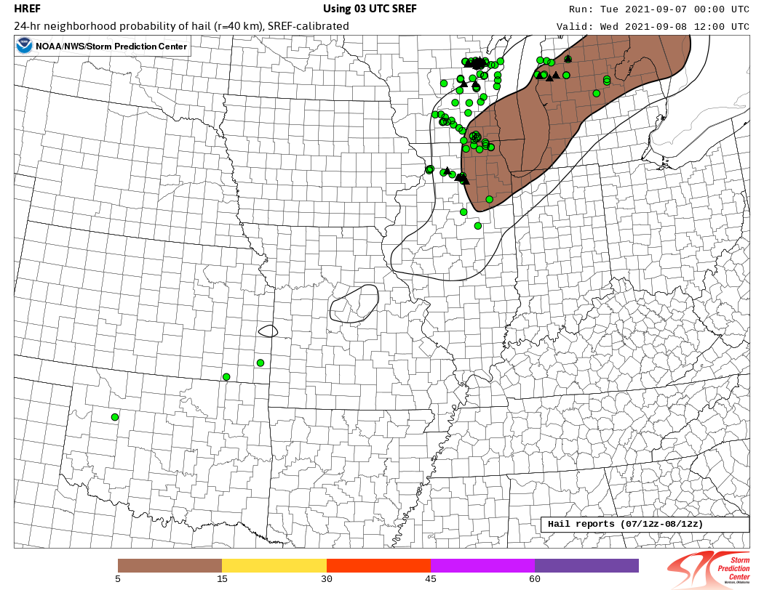
HREF/SREF Calibrated Severe
Recent forecast examples (both good and bad) can provide additional insight to the performance of the calibrated probabilistic guidance
October 10
24-h Hail Guidance
September 7
Good Forecast
Poor Forecast

Slide 12
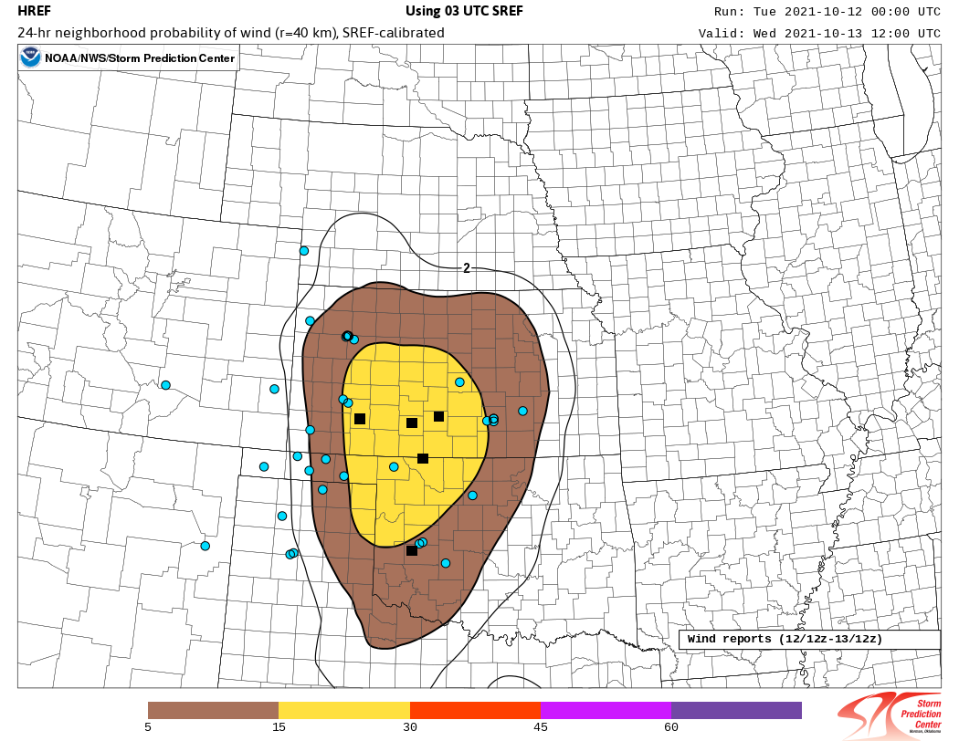
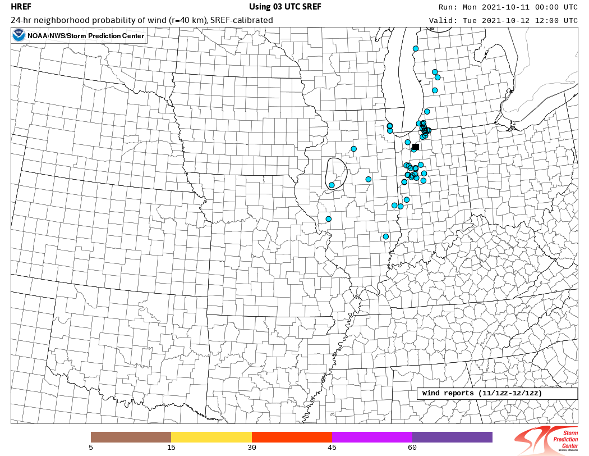
HREF/SREF Calibrated Severe
Recent forecast examples (both good and bad) can provide additional insight to the performance of the calibrated probabilistic guidance
October 12
24-h Wind Guidance
October 11
Good Forecast
Poor Forecast

Slide 13
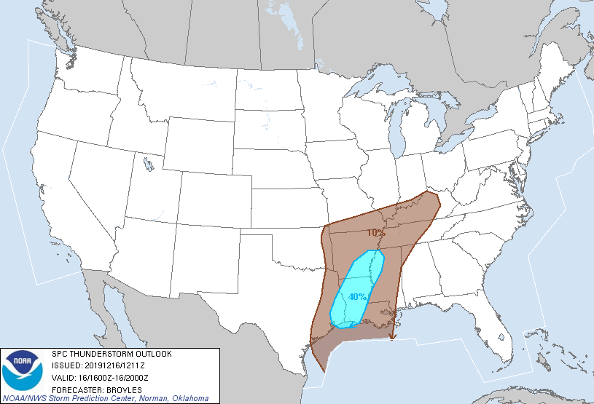
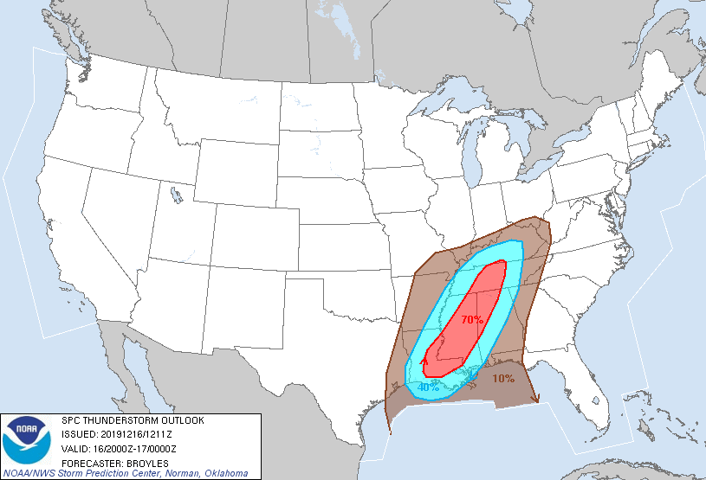
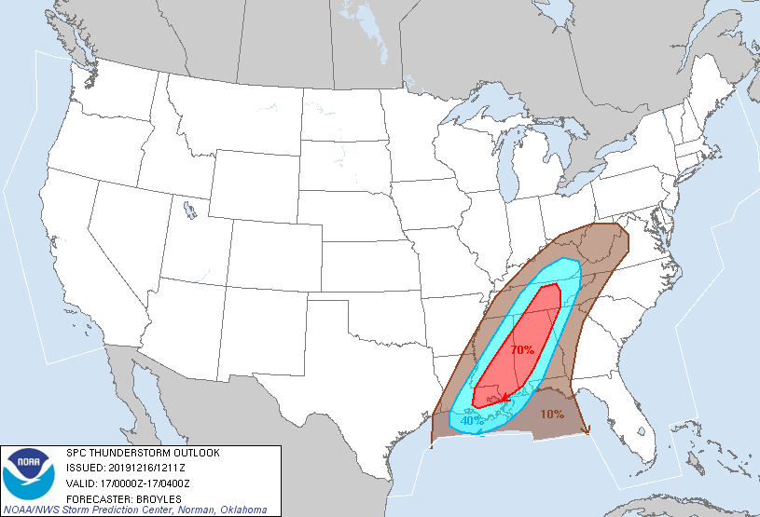
HREF Calibrated Thunder
SPC has been generating 4-h probabilistic thunderstorm outlooks (≥1 CG flash within 12.5 miles of a point) on Day 1 (12-16Z, 16-20Z, 20-00Z, 00-04Z, and 04-12Z) for over a decade.
SREF calibrated thunderstorm guidance has been essential for these outlooks; however, the convection-allowing nature of HREF was expected to result in improved thunderstorm guidance

Slide 14
HREF Calibrated Thunder
Fields from the HREF, including simulated reflectivity and environmental parameters, were utilized to develop, test, and implement a skillful and reliable probabilistic lightning prediction model
The HREF data were extrapolated from the 3-km grid to a 40-km grid using the nearest neighbor maximum/minimum approach
The probability that at least 1 CG flash within 20 km (~12.5 mi) is defined by:
P(CG≥1) = [w₁P(X≥t₁) + w₂P(Y≥t₂) + w₃P(Z≥t₃)]
where w₁,w₂,w₃ are weights summing to one
X,Y,Z are simulated reflectivity at -10C, accumulated precipitation, and most-unstable lifted index, respectively
P() is the ensemble probability defined by the fraction of members exceeding a given threshold (t₁,t₂,t₃)
For example, if 5 of 10 members have Z_{-10C} ≥40 dBZ, then P(Z_{-10C})=5/10=50%

Slide 15
HREF Calibrated Thunder
A comprehensive grid search was used to tune the weights and thresholds for each variable and forecast interval.
 | X: Refl @ -10C | Y: Tot Precip | Z: MU Lifted Index
1-hour forecast | t₁ = 40 dBZ; w₁ = 0.6 | t₂ = 1 mm; w₂ = 0.3 | t₃ = -1; w₃ = 0.1
4-hour forecast | t₁ = 40 dBZ; w₁ = 0.6 | t₂ = 2 mm; w₂ = 0.3 | t₃ = -1; w₃ = 0.1
24-hour forecast | t₁= 40 dBZ; w₁ = 0.6 | t₂ = 1 mm; w₂ = 0.4

Slide 16
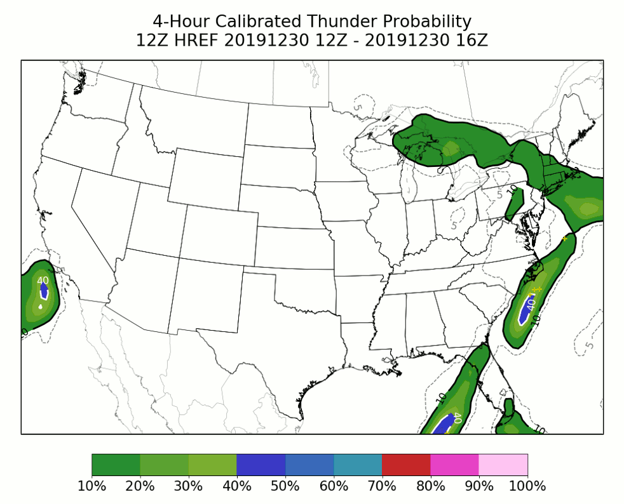
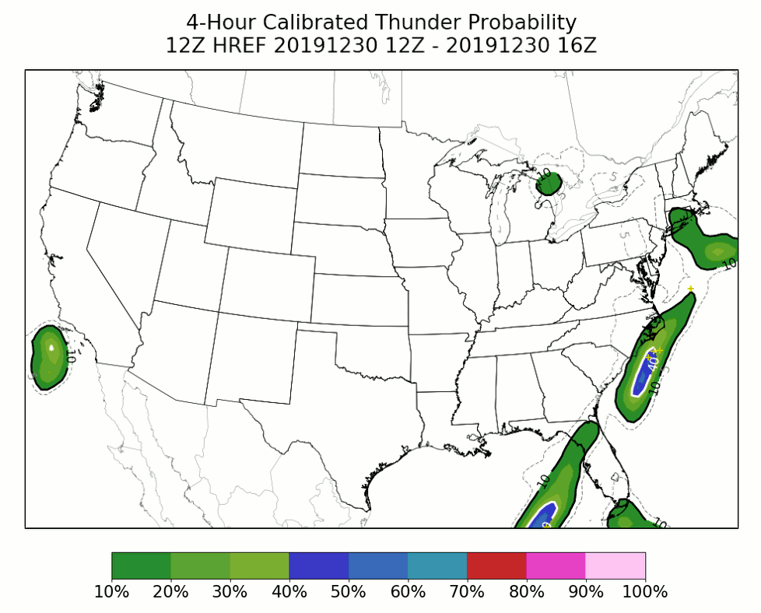
HREF Calibrated Thunder
After some initial forecaster feedback about probabilities being too high in stable, precipitating environments an instability mask was implemented to filter out these scenarios
HREF members with MULI ≥0 and Z_{-10C} <35 dBZ are set to 0%
Without Instability Mask
With Instability Mask

Slide 17
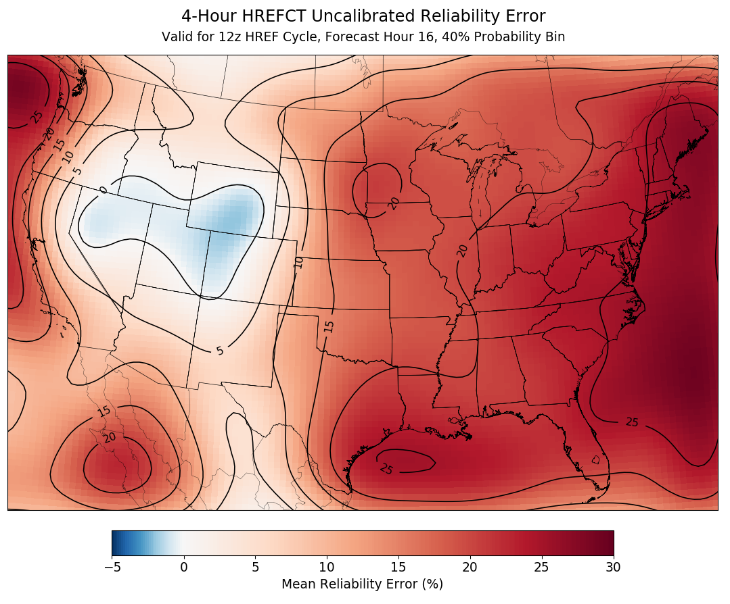
HREF Calibrated Thunder: Calibration
Data from 20190613– 20200613 were used to calibrate the 1-, 4-, & 24-h thunder probabilities
A Gaussian filter (𝜎=2) used to spatially smooth forecasts prior to calibration
Calibration performed by:
Calculate mean reliability error at each grid point for each 10% bin at each hour of the day
Add error back to the forecast probabilities
Gaussian filter (𝜎=2) applied to smooth calibrations spatially and temporally

Slide 18
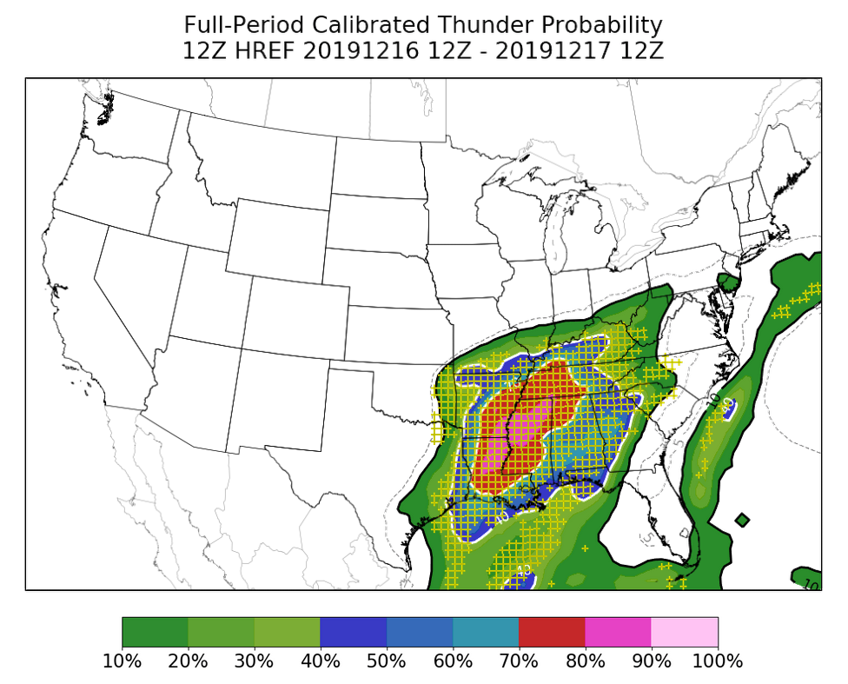
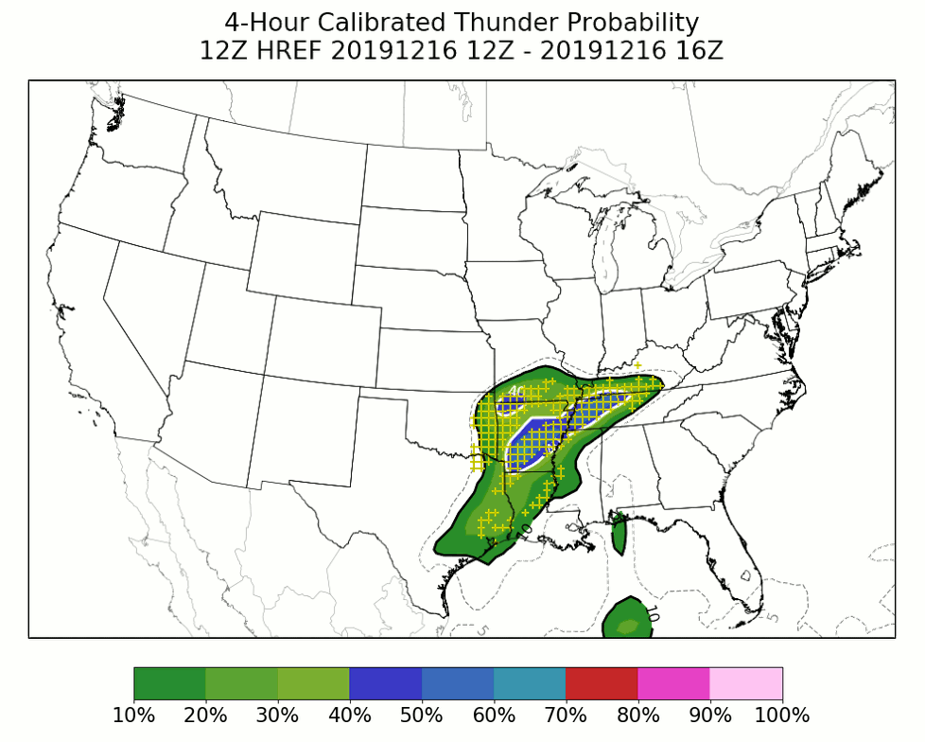
HREF Calibrated Thunder: Example Forecasts
Probability of at least 1 CG flash within 12 miles (20 km) of a point
Probability of at least 1 CG flash within 12 miles (20 km) of a point

Slide 19
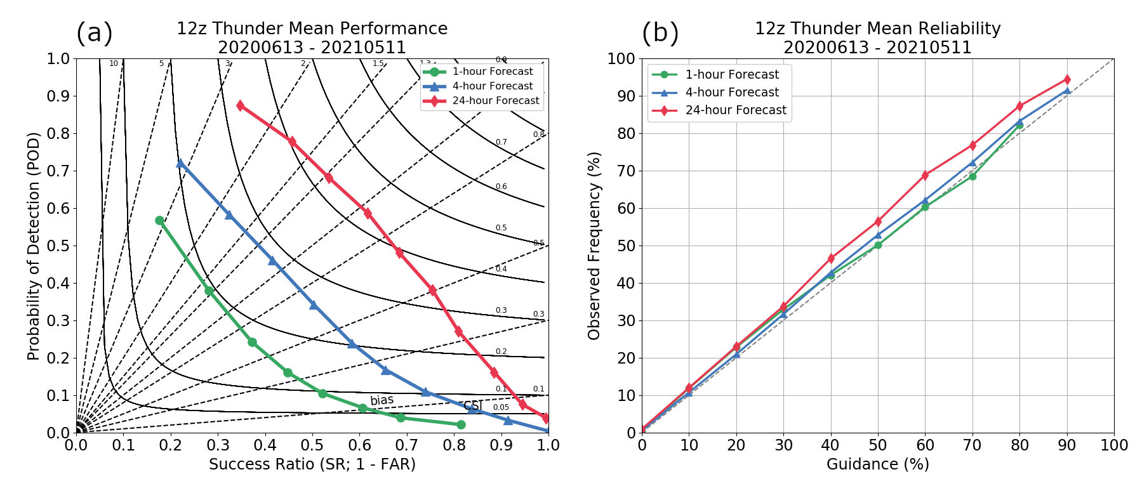
HREF Calibrated Thunder: Verification

Slide 20
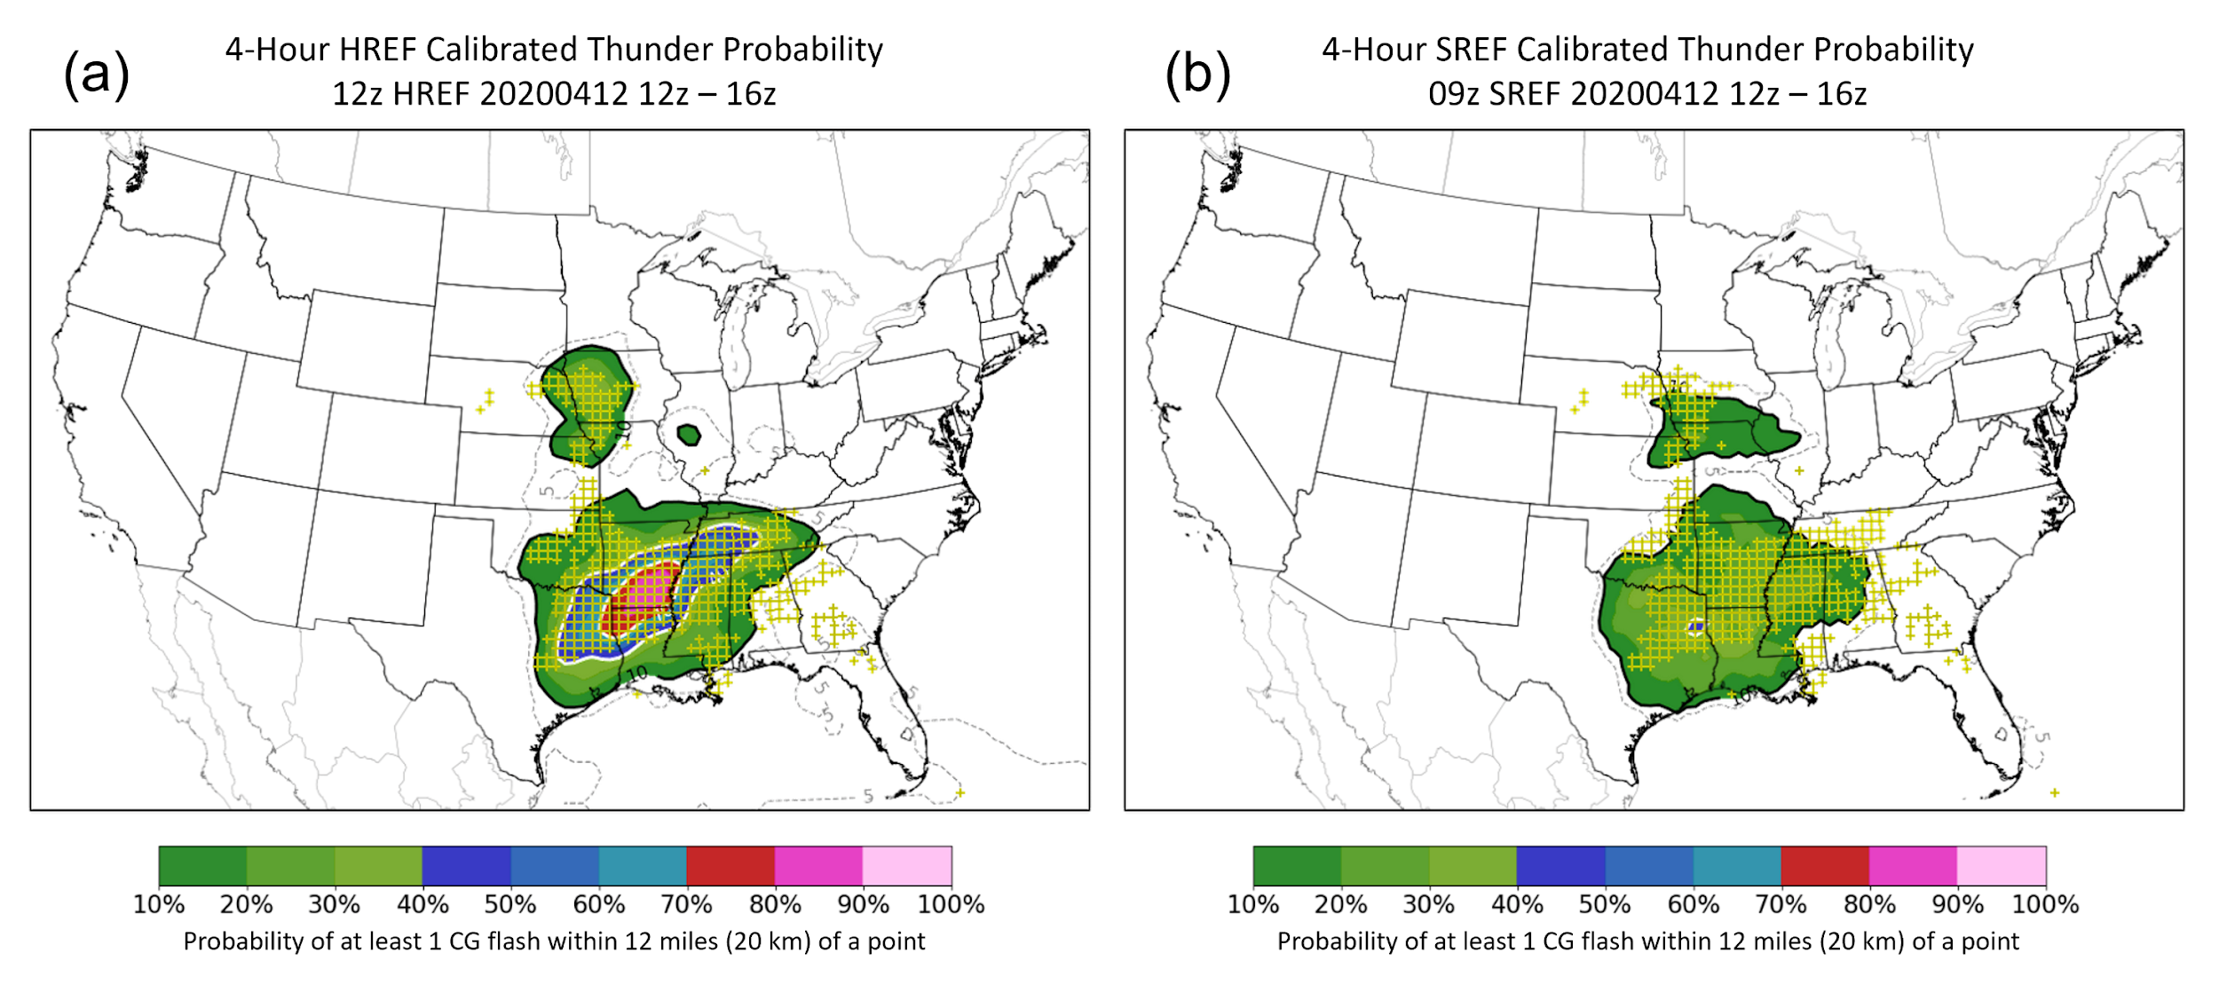
HREF Calibrated Thunder: SREF Comparison

Slide 21
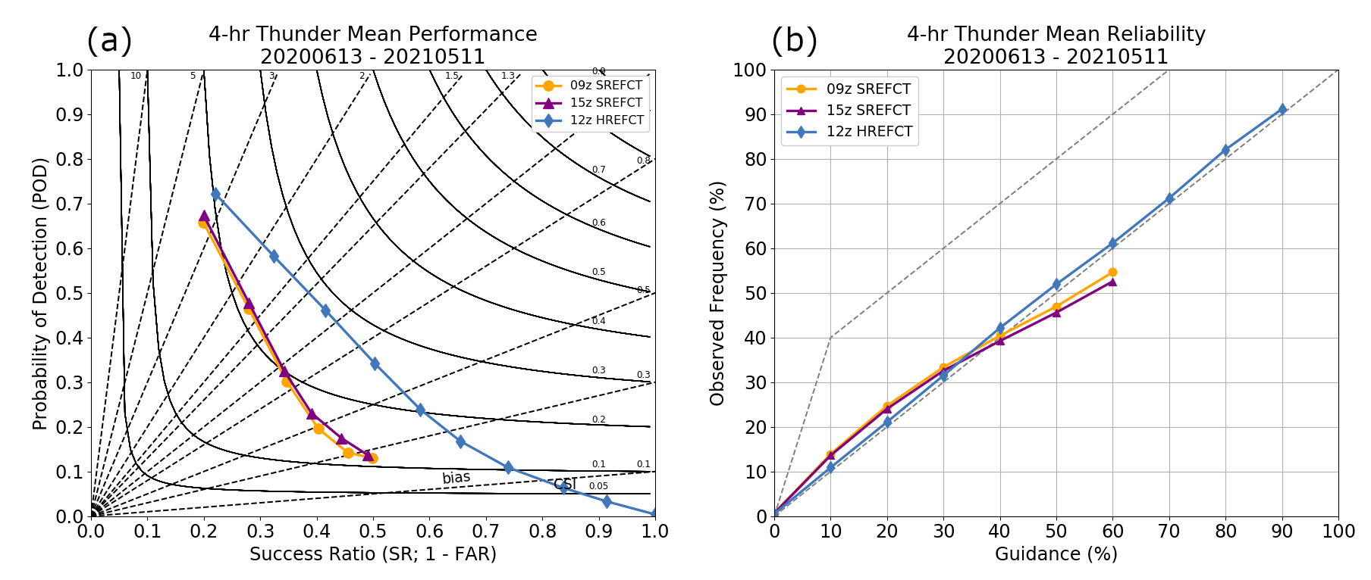
HREF Calibrated Thunder: SREF Comparison

Slide 22
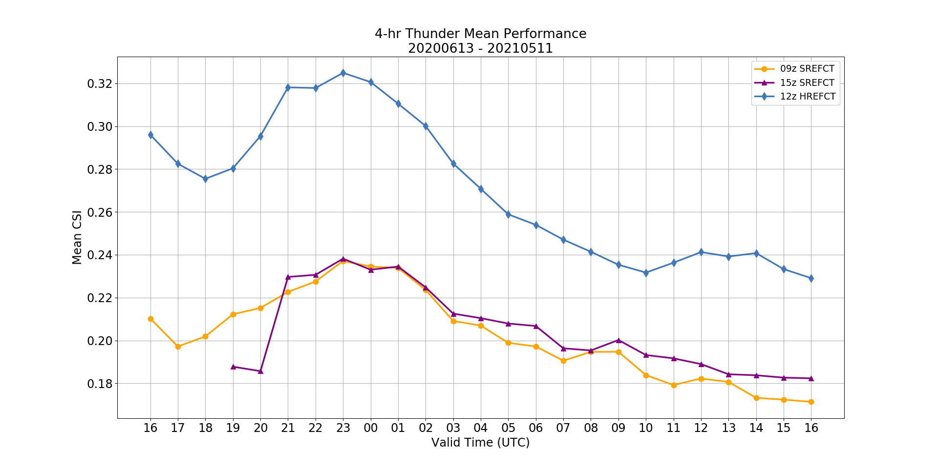
HREF Calibrated Thunder: SREF Comparison

Slide 23
Summary
SPCPOST was implemented on WCOSS in May with two calibrated, probabilistic datasets updated at 0000 and 1200 UTC:
HREF/SREF calibrated tornado, hail, and wind (4-h & 24-h Day 1)
HREF calibrated thunder (1-h, 4-h, full period through f48)
The HREF/SREF calibrated severe guidance is strongly dependent on the high neighborhood probabilities of UH, so performs well for higher-end supercell events, but commonly an underforecast for other severe events
The HREF calibrated thunder guidances produces very skillful and reliable CG lightning forecasts, far exceeding the skill of the SREF
These products are publicly available:
NCEP NOMADS: https://nomads.ncep.noaa.gov/pub/data/nccf/com/spc_post/prod/
SPC HREF Web Viewer: https://www.spc.noaa.gov/exper/href/

Slide 24
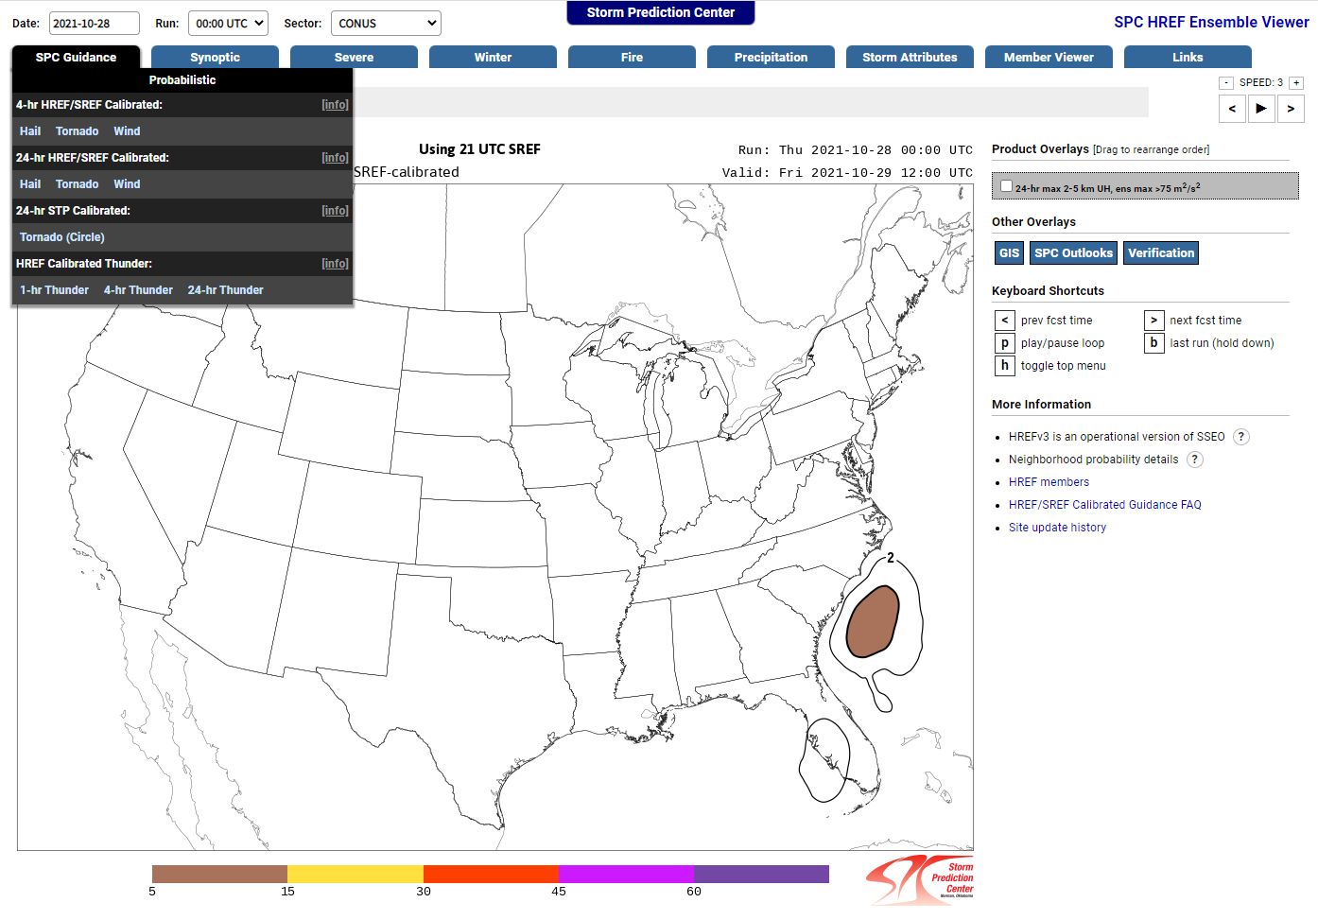
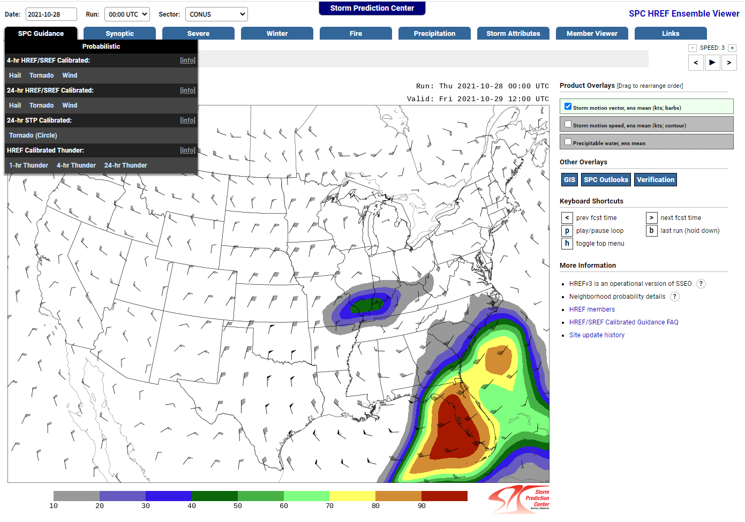
Summary
https://www.spc.noaa.gov/exper/href/
Brett Roberts
Comments/Questions: Israel.Jirak@noaa.gov

