Slide 1

The science behind multi-model precipitation probability in the “National Blend of Models”
Tom Hamill and Michael Scheuerer
ESRL, Physical Sciences Division
tom.hamill@noaa.gov; michael.scheuerer@noaa.gov
(303) 497-3060; (303) 497-4281

Slide 2
“National Blend of Models” project
Improve NWS National Digital Forecast Database (NDFD) fields using multi-model ensemble and multiple deterministic forecasts.
  Reduce need for forecaster manual intervention, free up forecasters for more decision support.
Eventually “Blend” will cover:
  all NDFD variables (e.g., T_{max}, T_{min}, T, T_{d}, wind speed, direction, gust, sky cover, precip amount, snow amount, wave height) on 2.5-km grid.
  all US regions (CONUS, AK, HI, PR, Guam)
May expand to PQPF in the future
PSD’s role: improve multi-model precipitation, and more specifically here, POP. Asked to focus on +3 to +8 day period initially.

Slide 3
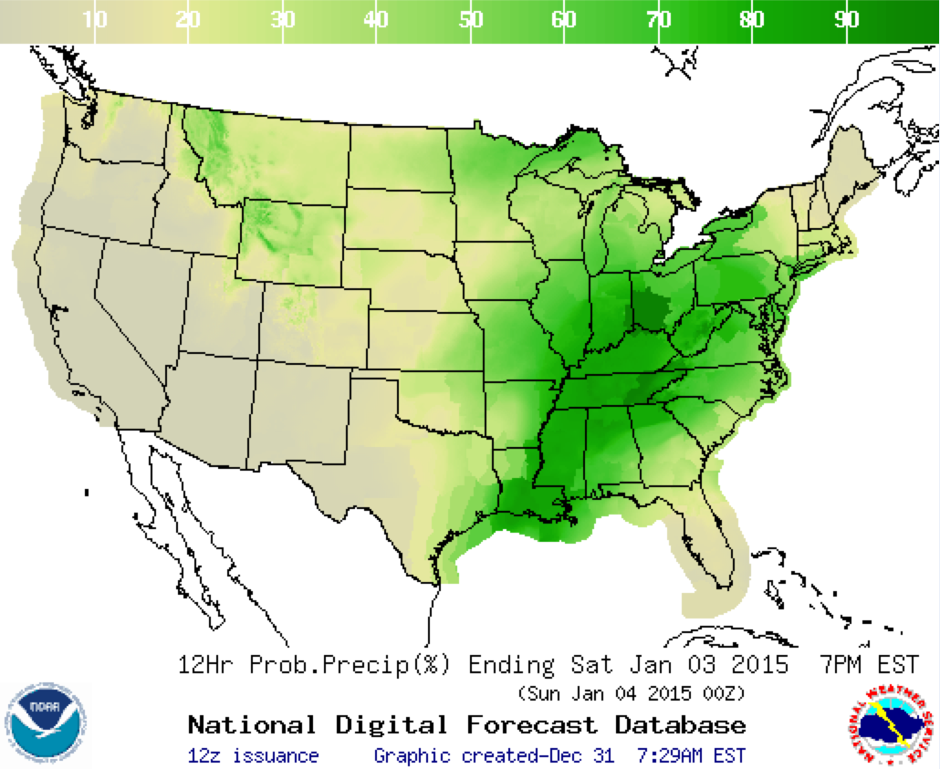
NDFD POP product example
One’s eye is
drawn to
major changes
in POP at WFO
boundaries.
Can we make
POP so skillful
and reliable that
forecasters will
need to modify
centralized
guidance less
frequently?

Slide 4
Challenge: for NWS “National Blend” project, little training data exists, or it’s hard to get (and archive).
GEFS: will change soon to new version, obviating the existing 00Z cycle reforecasts.
ECMWF: ~20-year, 1x weekly reforecasts, but have not been made available to us (yet).
CMC: ~ 5 years of reforecasts based on ERA-Interim with near-surface adjustment; not available for this project (yet).
No reforecasts for control/deterministic of various centers.
This limits the range of post-processing methodologies we feel comfortable trying.

Slide 5
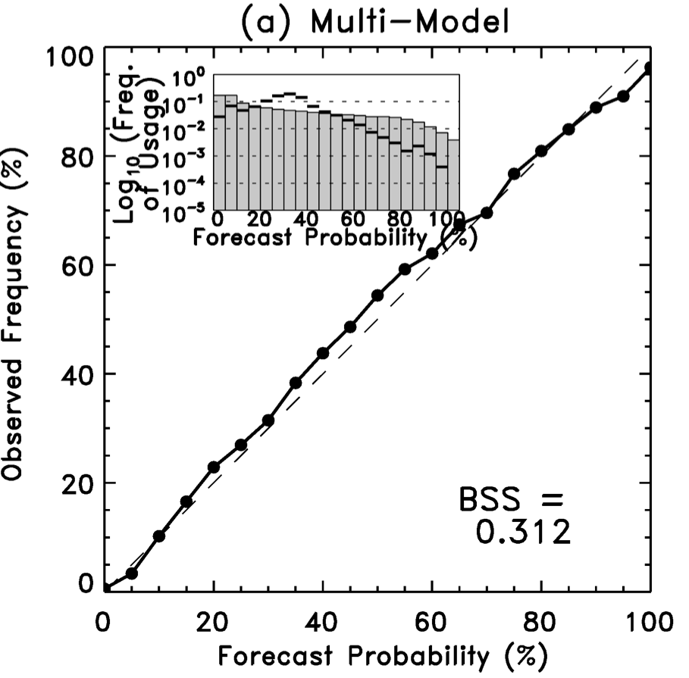
What might we reasonably do to post-process multi-model ensemble guidance?
Multi-model reliability, Day +5, > 1 mm
Previously (Hamill, July 2012 MWR) multi-model ensembles for POP (July-Oct 2010) averaged to 1 degree grid verified against 1-degree CCPA.
This procedure produced reliable and skillful POP forecasts.
Models were ECMWF, UK Met Office, CMC, and NCEP.
1-degree forecasts are not high-enough resolution for Nat’l Blend; desire on 2.5-km grid.

Slide 6
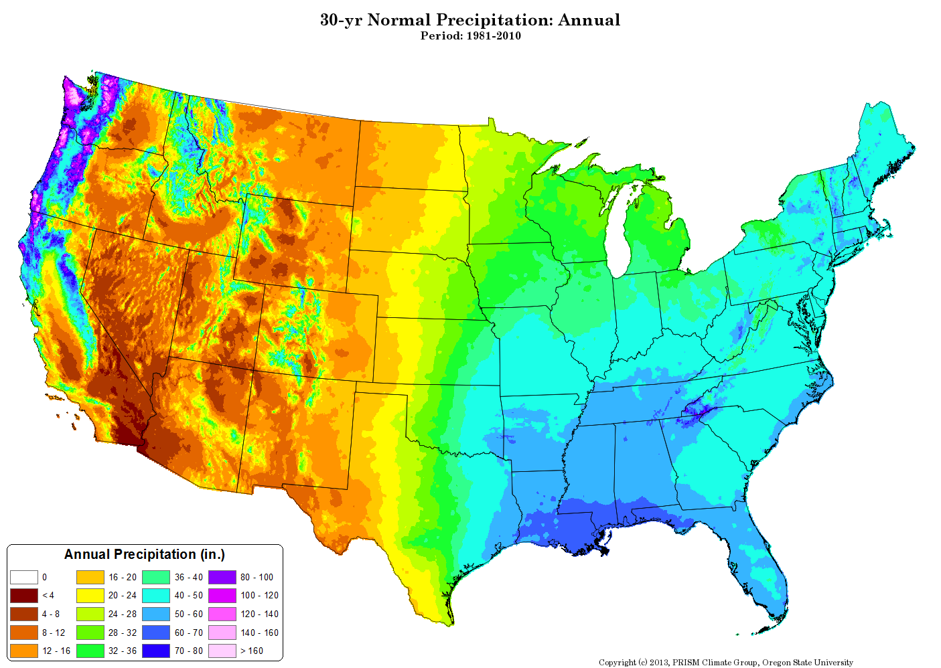
Why we don’t expect >10-km global ensemble forecasts to be reliable when verified against < 10-km analyses.
Problem 1: there is coherent climatological detail, especially in the western US at scales < 10 km, below the model-resolvable scales.

Slide 7
Problem 2: sub-grid variability
large scale
precip
amount
1
2
3
4
5
east-west grid box #
Here we have a precipitation forecast along a segment of a latitude circle.

Slide 8
Problem 2: sub-grid variability
large scale
precip
amount
fine scale
1
2
3
4
5
east-west grid box #
Here’s one possible fine-scale analysis that is consistent with the large scale.

Slide 9
Problem 2: sub-grid variability
large scale
precip
amount
fine scale
1
2
3
4
5
east-west grid box #
But here’s yet another. There are infinitely many fine-scale vectors that
will spatially average to the correct large-scale vector.
So, when simulating a high-resolution ensemble, one should account
for sub-gridscale variability in a realistic manner.

Slide 10
Proposed downscaling methodology
Ensemble member’s
forecast
Precipitation amount
1 model
grid point
Repeat this process for every member at every grid point:
Consider coarse resolution ensemble member forecast at a given grid point.

Slide 11
Proposed downscaling methodology
Matching coarse-
resolution
precip. analysis
Ensemble member’s
forecast
Precipitation amount
Precipitation amount
1 model
grid point
1 model
grid point
Repeat this process for every member at every grid point:
Consider coarse resolution ensemble member forecast at a given grid point.
Find a past coarse-resolution analysis close in value to this forecast.

Slide 12
Proposed downscaling methodology
Matching coarse-
and fine-resolution
precip. analyses
Ensemble member’s
forecast
Precipitation amount
Precipitation amount
1 model
grid point
1 model
grid point
Repeat this process for every member at every grid point:
Consider coarse resolution ensemble member forecast at a given grid point.
Find a past coarse-resolution analysis close in value to this forecast.
Extract the fine-resolution analysis at the same day and location.

Slide 13
Proposed downscaling methodology
Matching coarse-
and fine-resolution
precip. analyses
Ensemble member’s
forecast
Precipitation amount
Precipitation amount
1 model
grid point
1 model
grid point
Repeat this process for every member at every grid point:
Consider coarse resolution ensemble member forecast at a given grid point.
Find a past coarse-resolution analysis close in value to this forecast.
Extract the fine-resolution analysis at the same day and location.
Define the downscaling vector.

Slide 14
Proposed downscaling methodology
Matching coarse-
and fine-resolution
precip. analyses
Downscaling vector
+ coarse-resolution
forecast.
Ensemble member’s
forecast
Precipitation amount
Precipitation amount
Precipitation amount
1 model
grid point
1 model
grid point
1 model
grid point
Repeat this process for every member at every grid point:
Consider coarse resolution ensemble member forecast at a given grid point.
Find a past coarse-resolution analysis close in value to this forecast.
Extract the fine-resolution analysis at the same day and location.
Define the downscaling vector.
Add vector to the coarse-res. forecast to define the downscaled forecast.

Slide 15
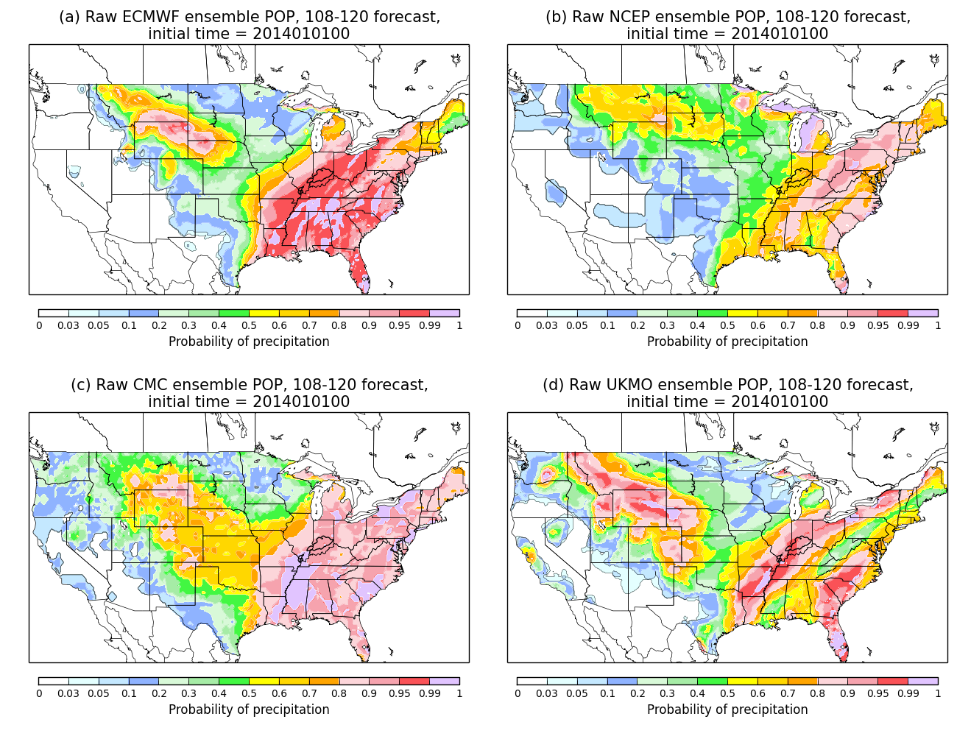
A different problem: systematic biases such as over-forecasting of drizzle.
Some regions,
such as in N
Nevada, models
tend to produce
precipitation
unrealistically,
day after day.
Such systematic
errors may
affect POP
reliability.

Slide 16
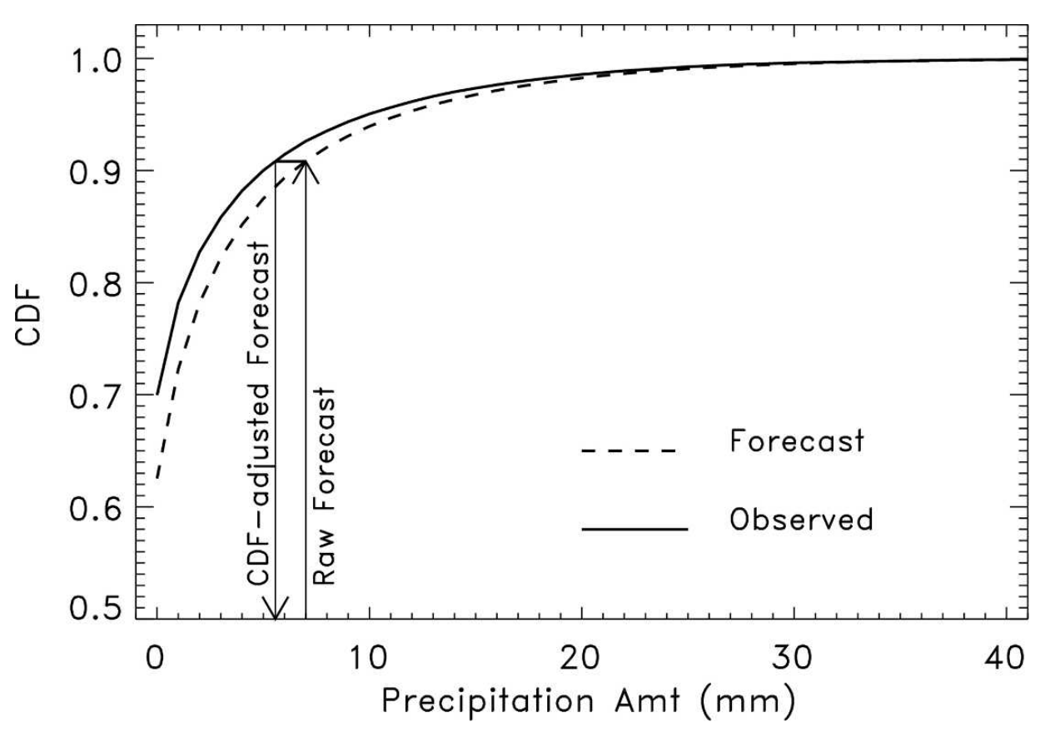
CDF-based bias correction, or
“quantile mapping”
A challenge is that if the CDFs are generated from small samples (with CDFs computed
separately for each grid point) may be noisy if computed using a small training sample size.

Slide 17
Potential remedy for small sample size: use supplemental data locations
Idea is to supplement
training data at
each grid point using
n extra grid points
that have similar
observed climatology
and similar
forecast-observed
relationships, as
determined from
GEFS reforecasts.
In this plot, big symbol
is where we’re training,
smaller symbol where
we’re supplementing
training data.

Slide 18
Smoothing the POP forecasts
Savitzky-Golay (S-G) filter used. For more details, see:
  http://research.microsoft.com/en-us/um/people/jckrumm/SavGol/SavGol.htm
  http://www.wire.tu-bs.de/OLDWEB/mameyer/cmr/savgol.pdf (good tutorial)
  Numerical Recipes text.
I coded up the S-G filter with a window size of 9 and using 3rd-order polynomial fitting.

Slide 19
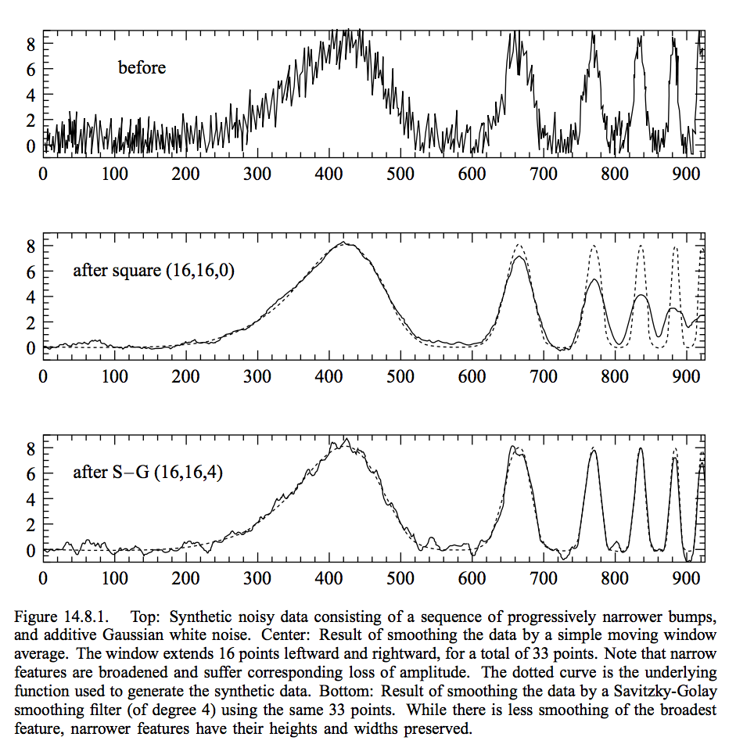
Savitzky-Golay filter
designed to preserve amplitudes, unlike more common nxn block smoothers
from Press et al. Numerical Recipes text

Slide 20
Multi-model POP with statistical downscaling
(but w/o
Savitzky-Golay)

Slide 21
Multi-model POP with statistical downscaling
(but WITH
Savitzky-Golay)
In this implementation, more
smoothing is applied in less
varied terrain of eastern US than
in more varied terrain of western
US.

Slide 22
Strategy for POP forecasting implemented here.
POPs via multi-model ensemble, but with two modifications:
  Adjust each member with a CDF-based bias correction.
  Apply statistical downscaling as described previously.
Data used in subsequent demo:
  108-120 h coarse res. precip. forecasts, ensembles and deterministic for Jan 2014 from ECMWF, NCEP GEFS, UK Met, CMC.
  CDF bias correction trained using Nov-Dec 2013 108-120 h forecasts
  Long time series of both hi-res. and coarse-res. CCPA precip. analyses (2002-2013) for statistical downscaling.
Technique:
(1) CDF bias correct the forecasts using the past 60 days of forecasts and observations.
(2) Statistically downscale each member.
  (3) Compute probability from ensemble relative frequency.
  (4) Apply Savitzky-Golay smoothing to mimimize noise from sampling error.

Slide 23
POP Reliability and skill, before & after
The BSS numbers look
rather high, even for the
raw ensembles (next slide).
I think this is because:
no big “dropouts” this
month?
(b) forecasts were very
different than the long-term
climatology, so skill relative
to climatology was larger
(the month was abnormally
dry in many locations).

Slide 24
Reliability and skill of raw ensembles
Over this sample, the
multi-model raw
ensemble skill wasn’t
better than that of
the best forecast,
from ECMWF.
ECMWF
NCEP
CMC
UK Met Office

Slide 25
Case study

Slide 28
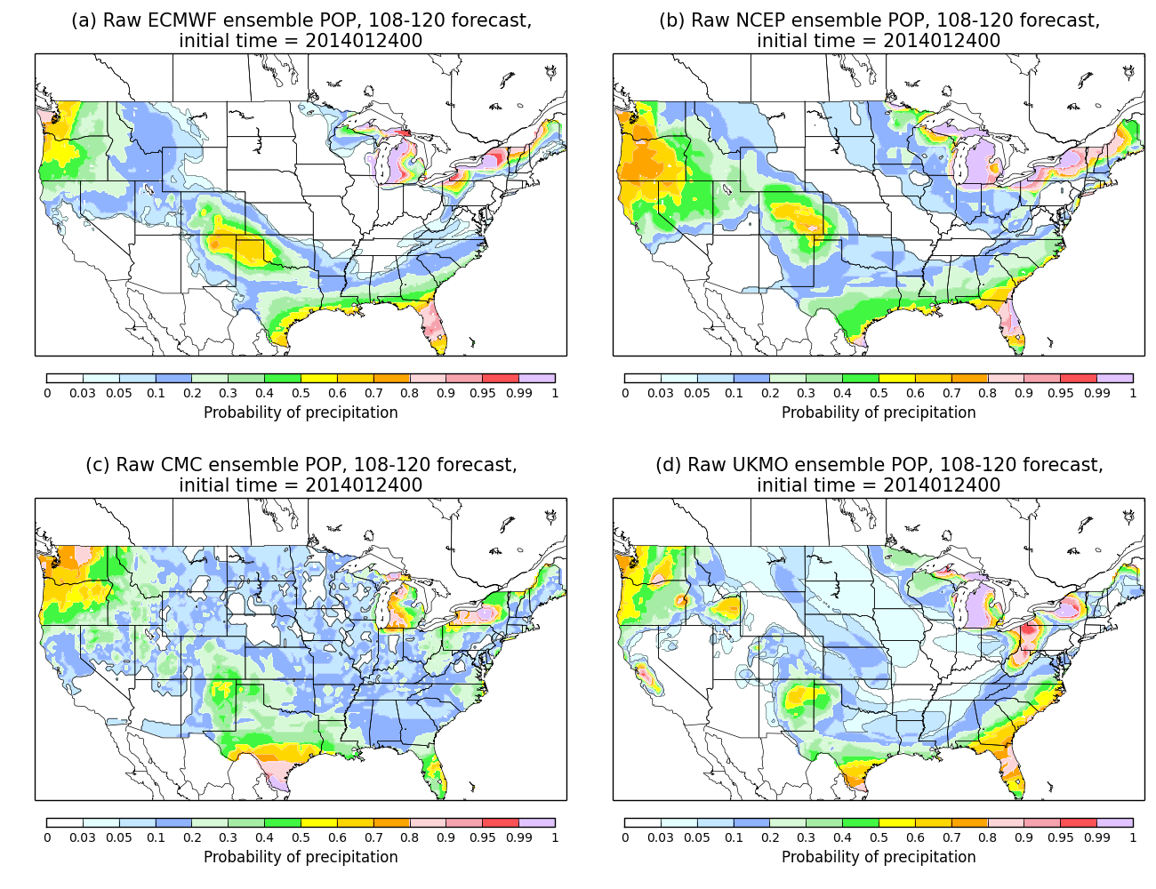

Slide 29
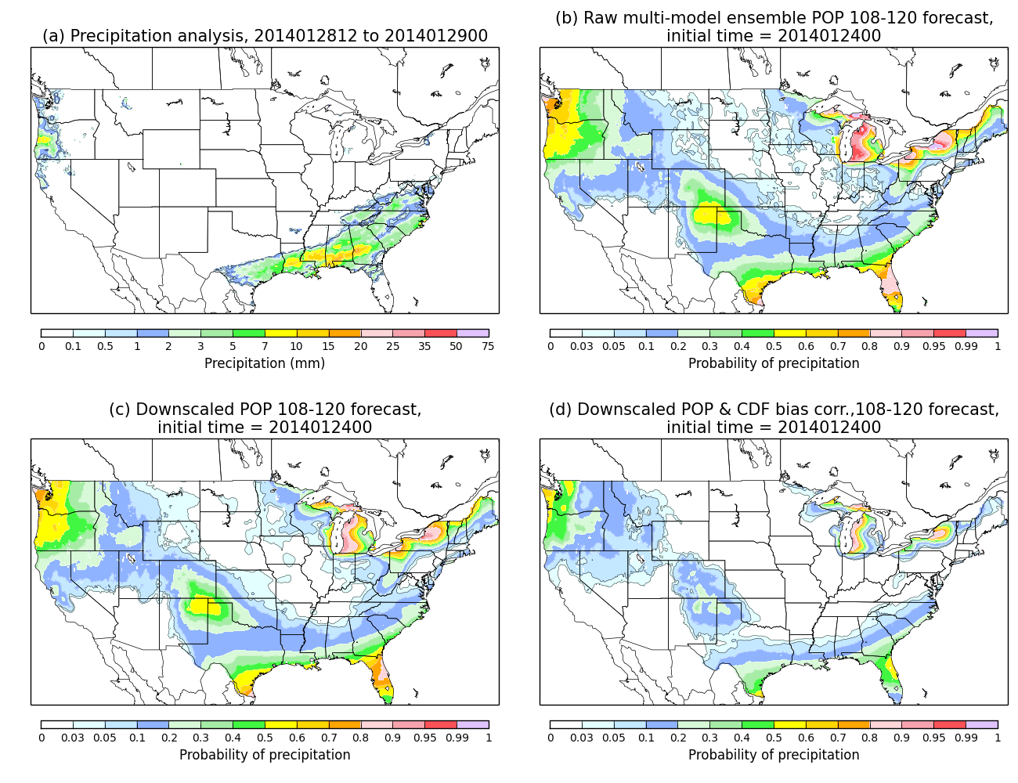

Slide 30
Benefits of CDF correction may not generalize to higher precipitation amounts
Applying the same methodology
to > 10 mm 12 h⁻¹ forecasts, we
see little improvement as a
result of statistical downscaling
or CDF-based bias corrections.
It’s likely that 60 days, even with
supplemental locations, is not
enough samples to properly
adjust > 10 mm forecasts
(reforecasts and/or other
post-processing approach
needed)

Slide 31
Thinking ahead:
How to improve PQPF for rare events
Next-Generation Global Prediction System priorities include:
  Development of reanalysis/reforecast data sets to provide large training samples needed to improve probabilistic forecasts of rare events like heavy precipitation.
  Development and deployment of advanced post-processing methods.
Where are we with these developments?

Slide 32
Reanalysis / reforecast: where are we?
What’s important is to have reforecasts be statistically consistent with real-time forecasts.
To do this, probably need reanalysis using same model, same data assimilation procedure as used for real-time GFS analysis.
Existing reanalysis is now ~ 7 years old, T382 3D-Var; new analyses soon to be T1534 4D-En-Var. So we need new reanalysis.
ESRL/PSD funded to begin reanalysis work, expect funding to continue it in FY2016 with EMC, CPC.
Reforecast generation is straightforward (if computationally expensive) once reanalysis is generated.

Slide 33
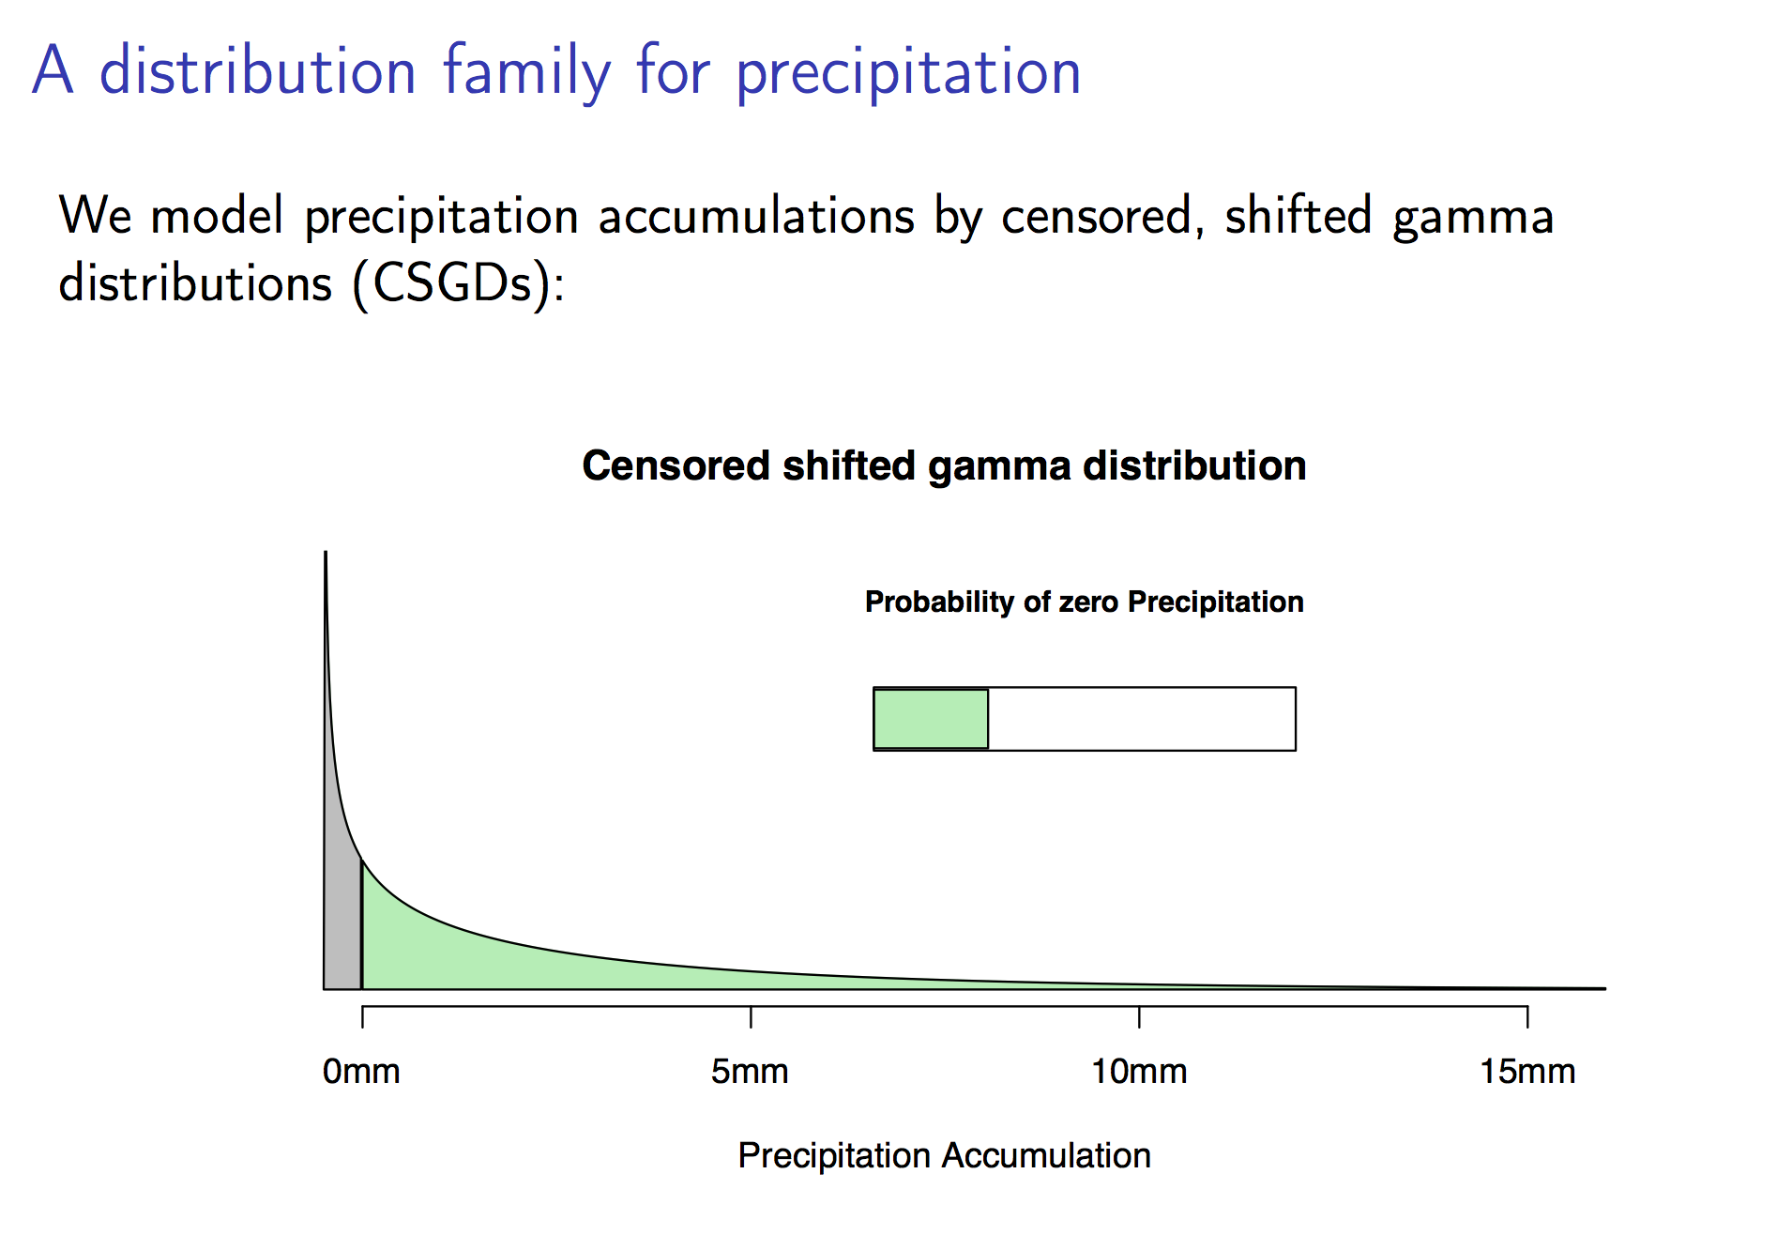
Advanced post-processing methods: where are we?
My PSD colleague Michael Scheuerer has
Scheuerer and Hamill, 2015 MWR, conditionally accepted.

Slide 34
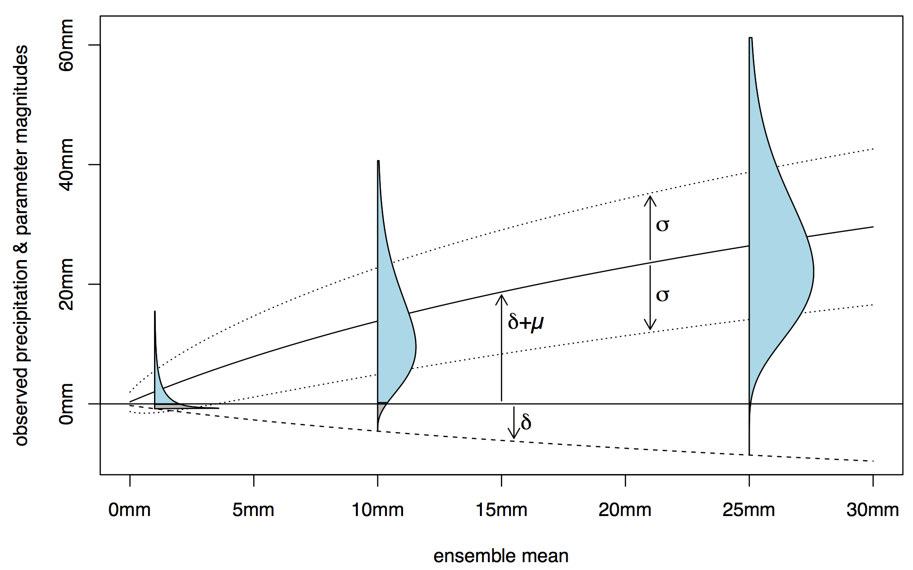
Gamma distribution’s shift, location, and scale parameters set with ensemble data
This produces predictive distributions with a variety of shapes
depending on the ensemble mean, spread, and other predictors
Ref: ibid.

Slide 35
Brier
Skill
Scores
Rank analog (no supplemental locations)
At the higher
thresholds,
the CSGD
forecasts
significantly
outperform
the rank analog.
No data from
supplemental
training locations
used in either
method here.
Censored, shifted gamma distributions

Slide 36
Reliability diagrams, +108 to +120 h
Rank analog, no supplemental locations
Censored, shifted gamma distribution fitting

Slide 37
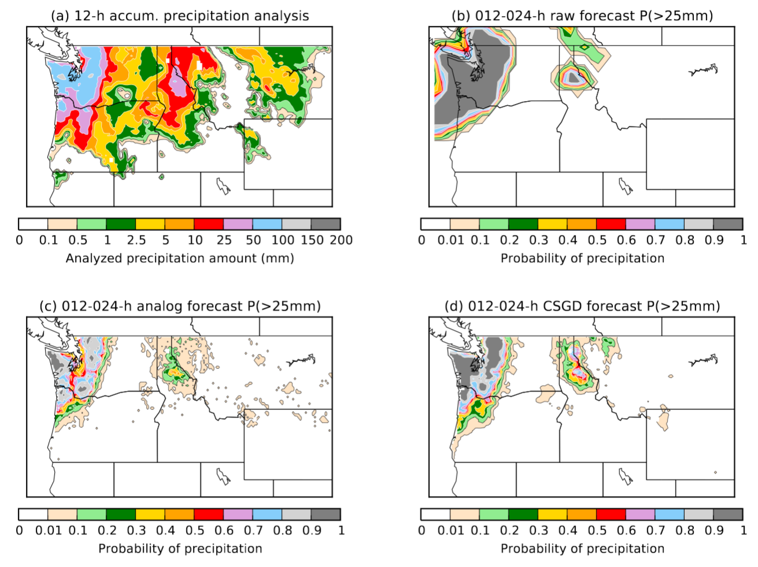
Improved high-end sharpness
In this case (one
where the raw
ensemble guidance
was quite good), one
can see that the
CGSD approach
produced much
higher probabilities
of heavy precipitation
than the analog.

Slide 38
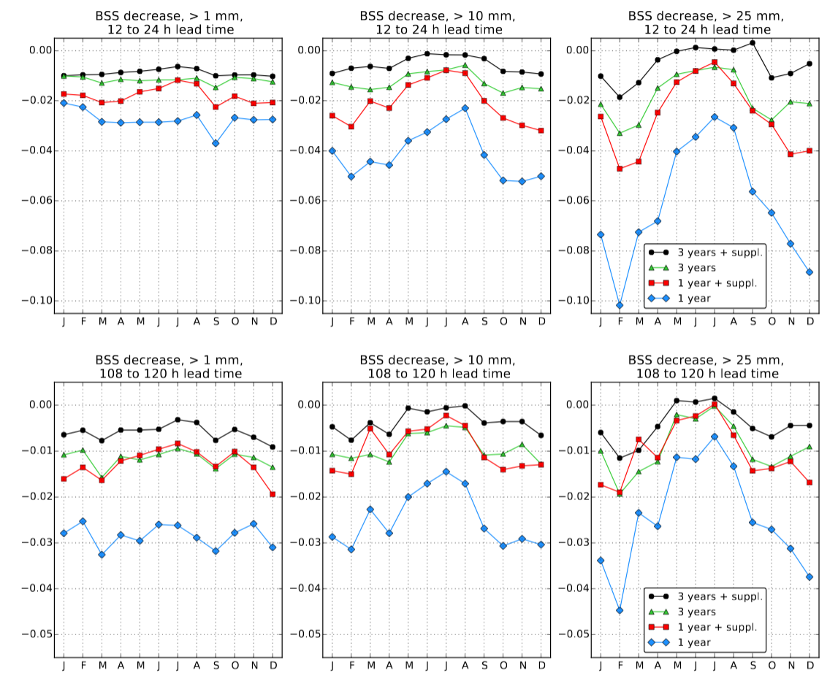
How skillful is CSGD when using smaller training sample sizes?
There is some
drop-off in skill,
shown here, and
reliability (not shown)
when decreasing
samples to 3- or 1 year
of training data
from the original
2002-2014 training
data. Use of
supplemental locations
to increase the sample
size does have a
positive benefit.
Further tests and
comparisons underway.

Slide 39
Conclusion / next steps
It appears to be possible to add skill, improve reliability of multi-model ensemble POP with statistical downscaling,CDF quantile mapping, and judicious smoothing.
Improvements to probabilities for higher event thresholds more marginal with this method, probably because CDFs used in bias correction are noisy with small sample size at higher quantiles.
Our group is working on more advanced methods, including censored, shifted Gamma distributions, which show promise for post-processing an individual model.
This method is being evaluated in real time by forecasters.
  Pending evaluation, will migrate this technology to downscale using high-resolution Stage-IV precipitation analyses.

Slide 40
Supplementary slides

Slide 41
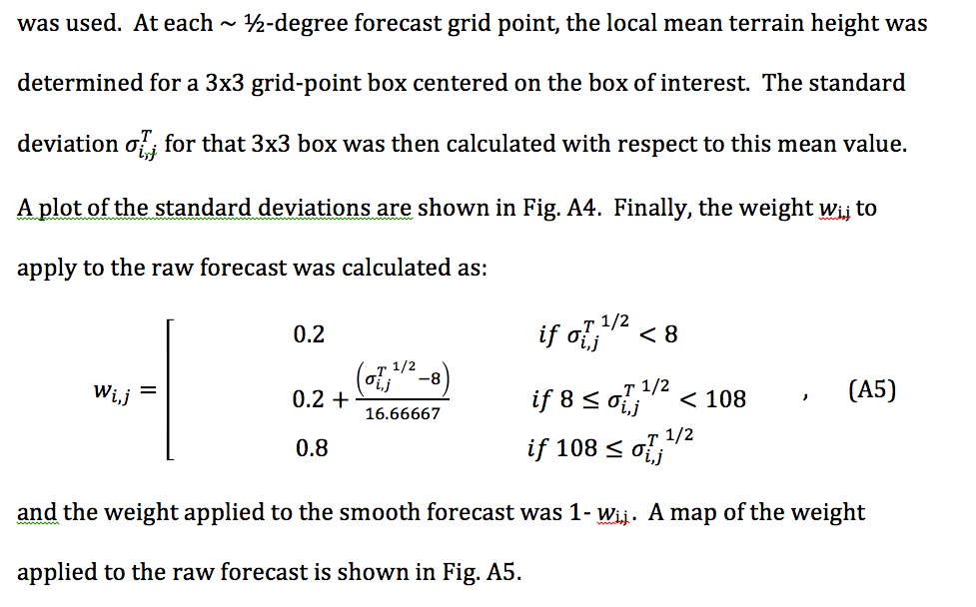
Methodology for weighting smoothed vs. original ensemble probabilities.

Slide 42
Terrain-height variations

Slide 43
Weight applied adjusted ensemble probabilities
Weight applied to CDF bias-corrected and downscaled multi-model ensemble probabilities

