Slide 1
NWS Connect:
NWS Connect - Moving beyond Initial Operating Capabilities (IOC)
VLab Forum
August 2024
Notes:
Give you a brief overview of the project, What the features are that we’re including in our first release,
Some info on next steps for offices / rollout.

Slide 2
What is NWS Connect?
NWS Connect is a system to provide an evolving set of tools that can be utilized by NWS field offices, regional centers, and national centers in order to foster internal coordination and communication that supports the provision of IDSS to Partners and Community Engagement.
Notes:
Formerly known as the IDSS Management System (IMS)
NWS Connect is a system designed to provide an evolving set of tools that can be utilized by NWS field offices, regional centers, and national centers in order to foster internal coordination and communication that supports the provision of IDSS to our partners. So what does that mean? Think of tools such as Google Workspace (Sheets, Slides, Docs, etc) -> this is a suite of tools that work together, and look and feel the same, and are loosely connected to allow you to do your job easier.
NWS Connect is designed to be that common, nationally supported, suite of tools for IDSS delivery. Leverage field innovation and ideas

Slide 3
NWS Connect’s First Release
Initial Operating Capability
Store Partner Information
Support Profiles
Communications
A universal database which allows for the NWS to store, display, filter and organize partner contact and role information.
NWS Connect IOC will contains the first operational capability for IDSS Support Profiles focused on Event Support. This will allow us to identify partner IDSS concerns and environmental thresholds.
NWS Connect implements a way to send email messages to individuals and groups of core and general partners, while avoiding Gmail limitations.

Slide 4
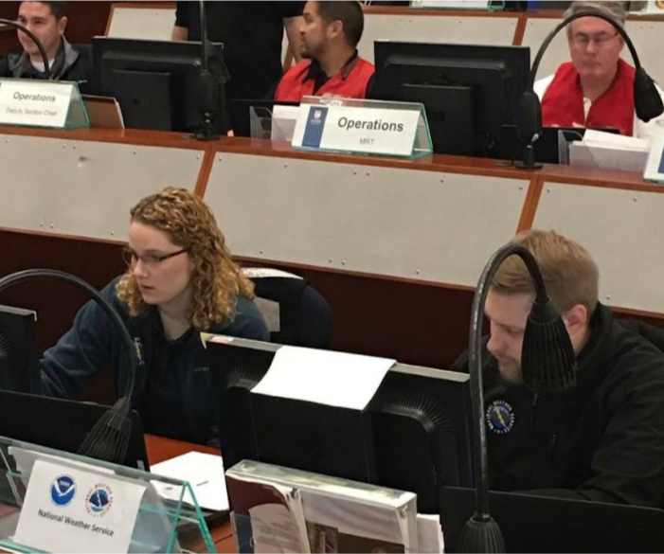
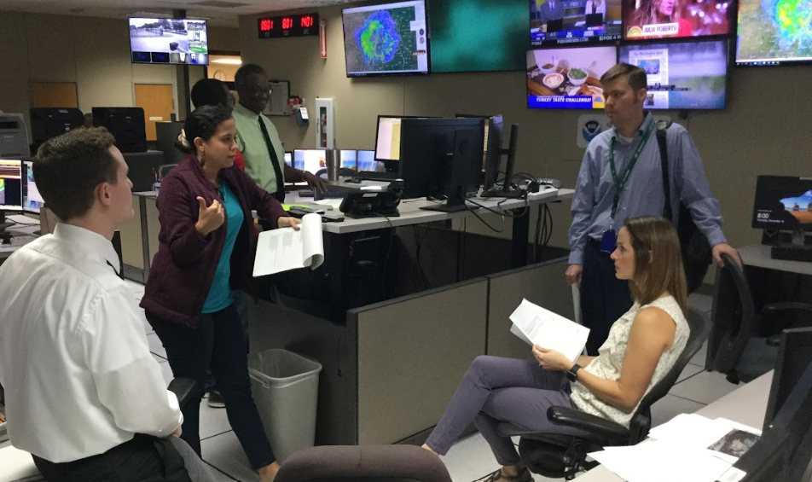
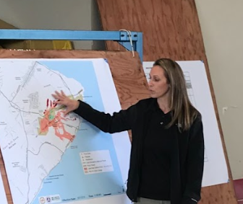
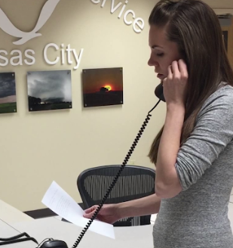
IDSS Cycle and NWS Connect
Relationships
Readiness
Continuous Engagement
w/ Core Partners
Delivery
Evaluation
First meet and greet
Build out partner profile
Document thresholds
Table top exercises,
Preparedness engagement.
Seasonal preparation and planning
Partner and NWS needs & resources assessments
IDSS Planning Guide development
NWS IDSS training activities.
IDSS Action Plan based tactical IDSS
Emergency incident-driven event Operations
Scheduled special event Operations
Alerting for hazards and Partner impacts
Includes post-event performance reviews
Local, regional or national service assessments
Core Partner surveys.
Notes:
IDSS is such a core part of what we do, but there are very few national tools available to forecasters to aid them in providing IDSS more effectively
The IDSS Cycle is primarily composed of 4 parts, and NWS Connect goal is to connect these four parts together for an office.
RELATIONSHIPS: This is where WCMs are on the front lines. They’re focused on building relationships withing their community and continuous engagement with with Core Partners.
Includes documenting needs of the core partner
Document things like partner thresholds
Engage in their preparedness exercises, have partners engaged in ours.
READINESS: Internal activities to NWS offices to prepare and ensure office readiness to effectively respond to the unique needs of their Core Partners.
Includes evaluating what those internal needs
Resources assessments
Creation of IDSS Planning Guides
Office IDSS training activities.
DELIVERY: The actual service of IDSS products and services to Core Partners.
Includes support for a specific weather, water or climate event,
Routine high value IDSS,
Supporting an emergency or incident driven event
Supporting a scheduled special event.
EVALUATION: Post event - NWS needs to gather feedback, and refine our services.
Includes post-event performance reviews
Core Partner surveys.

Slide 5
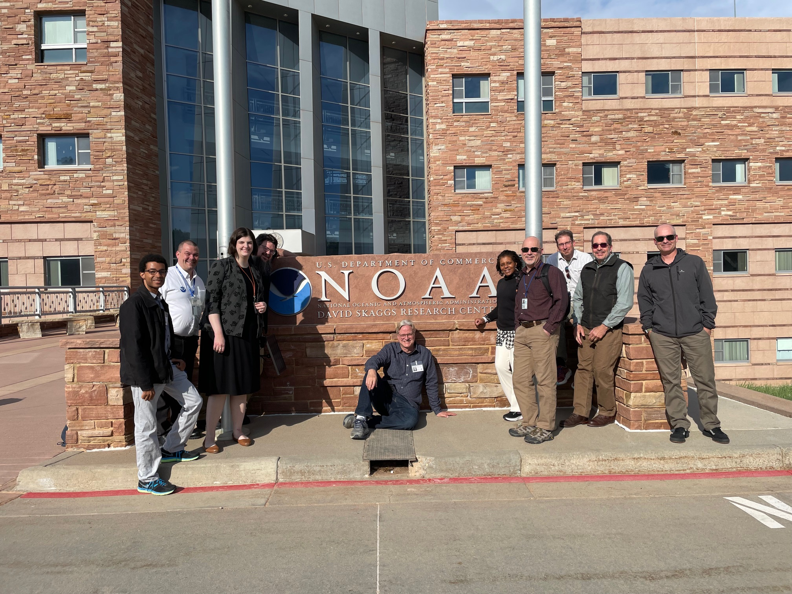
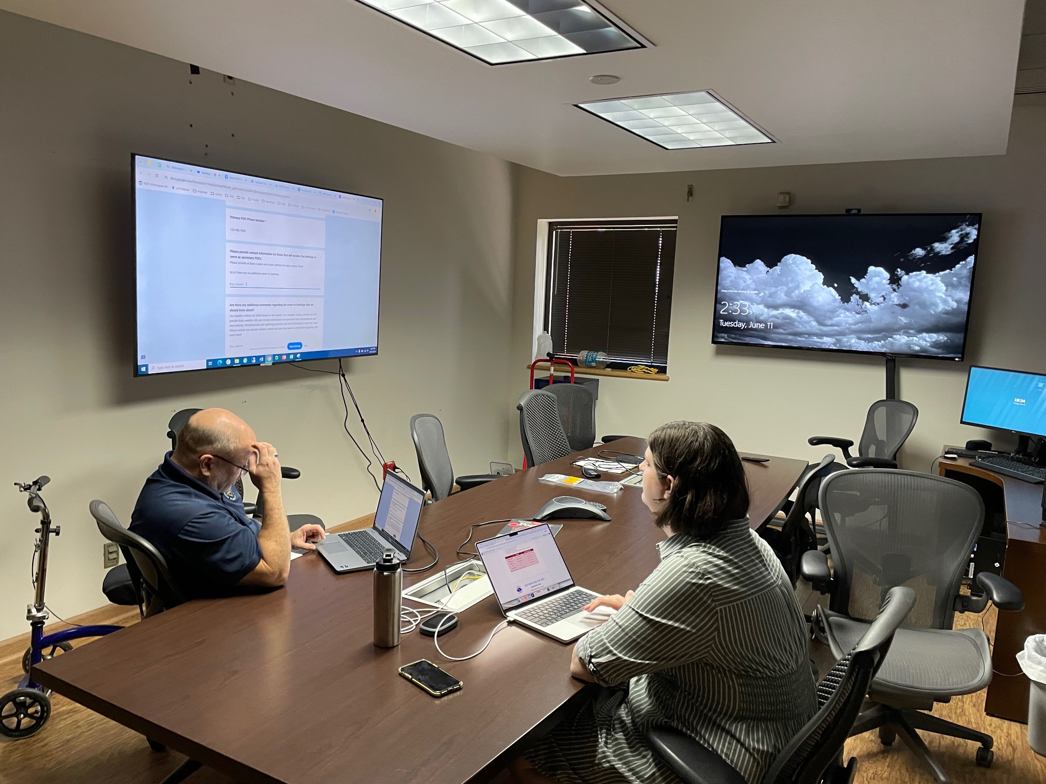
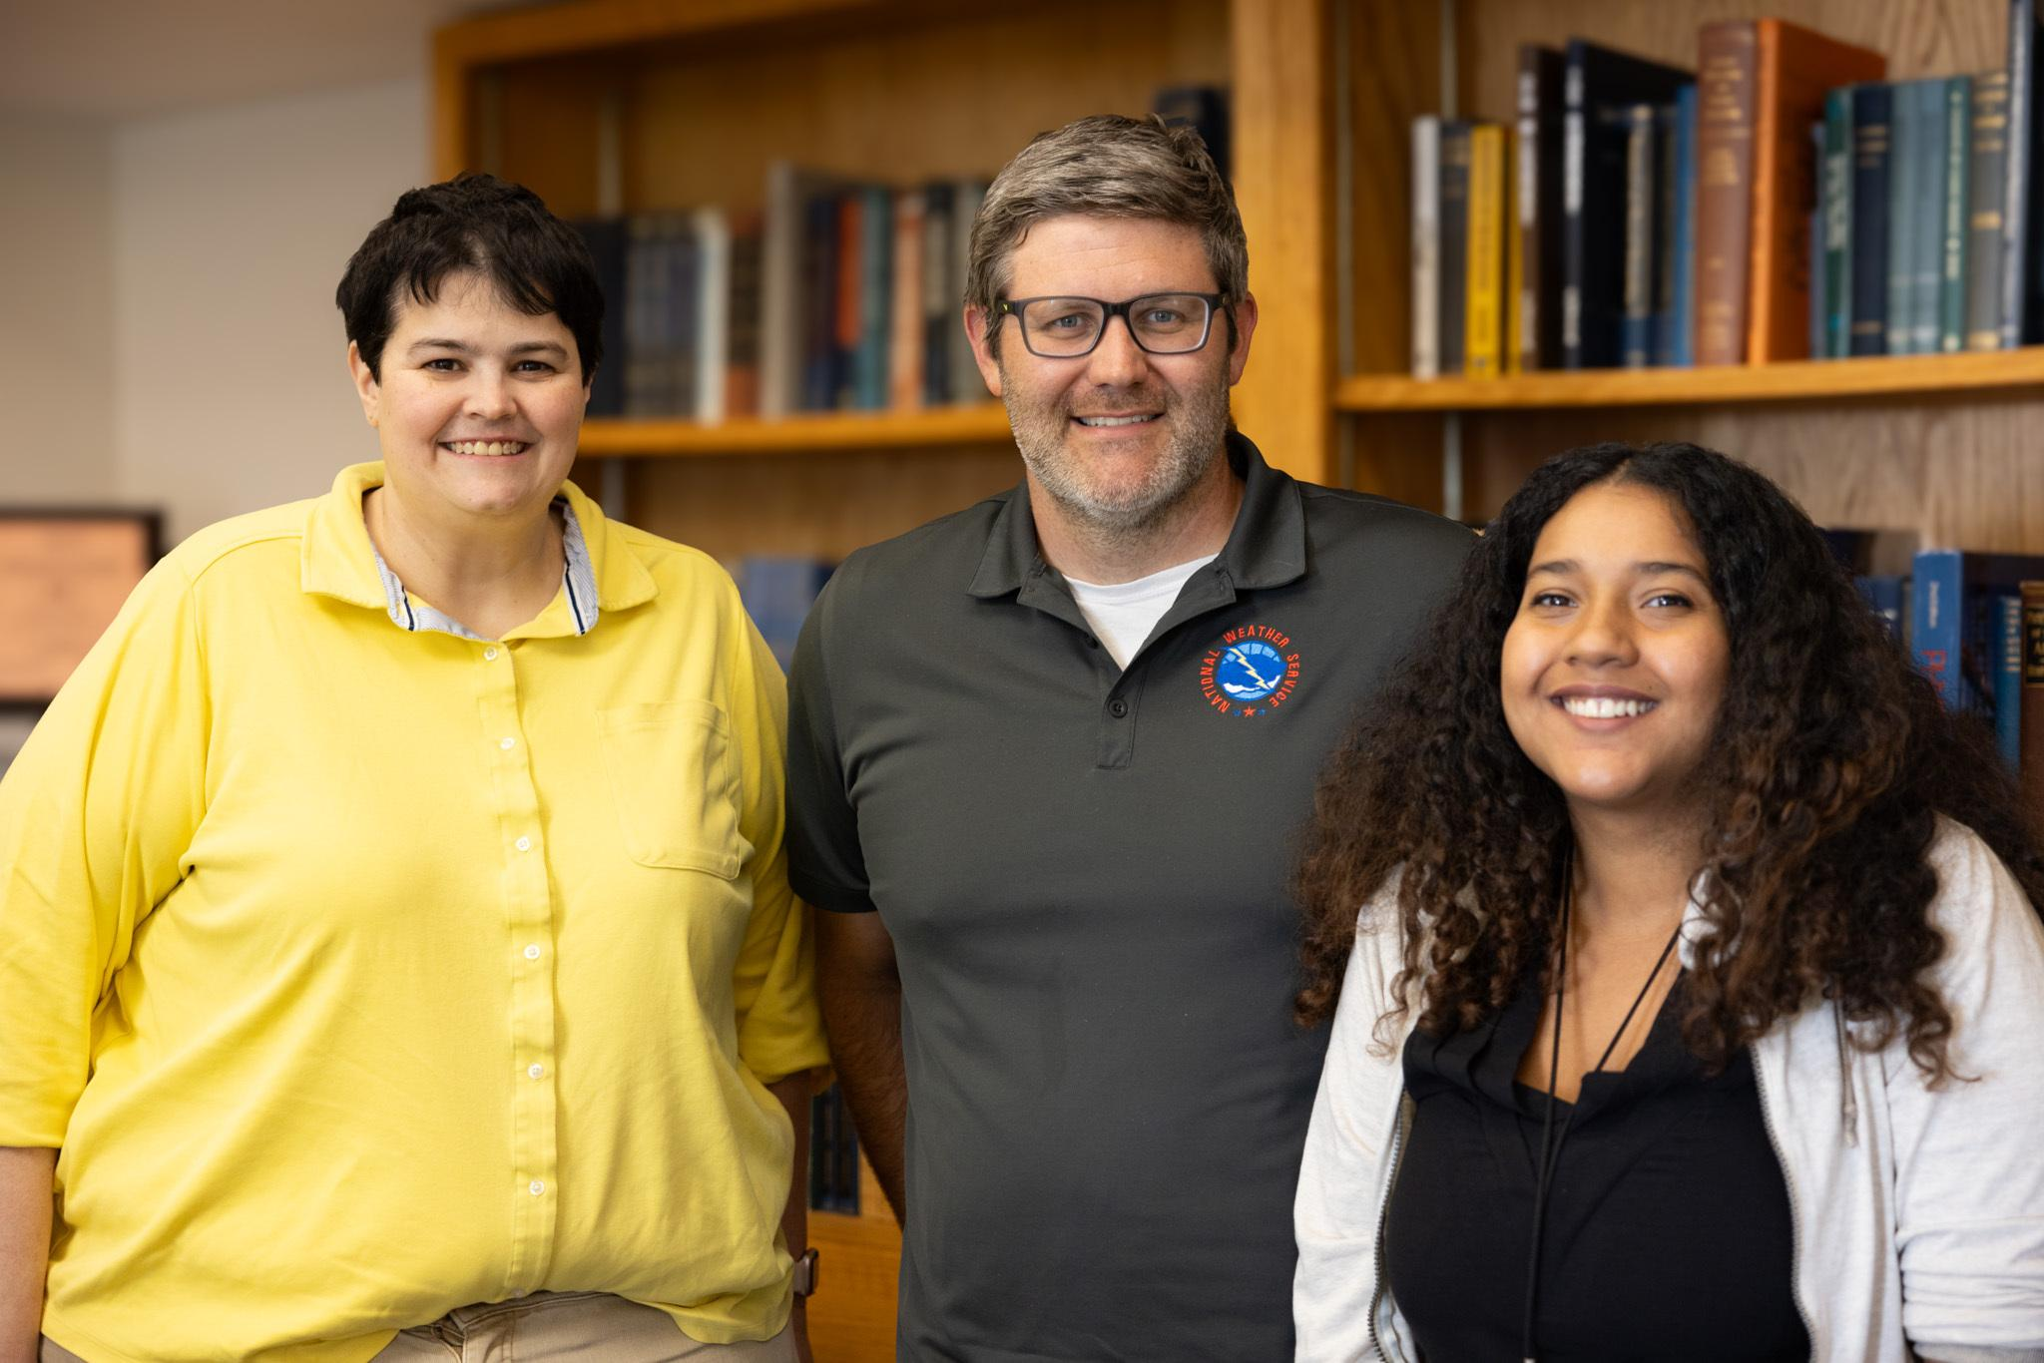
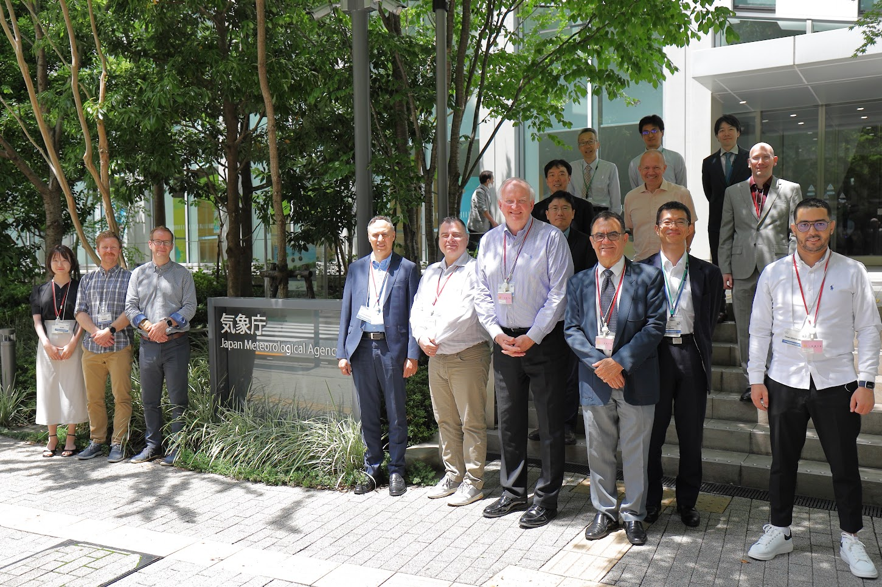
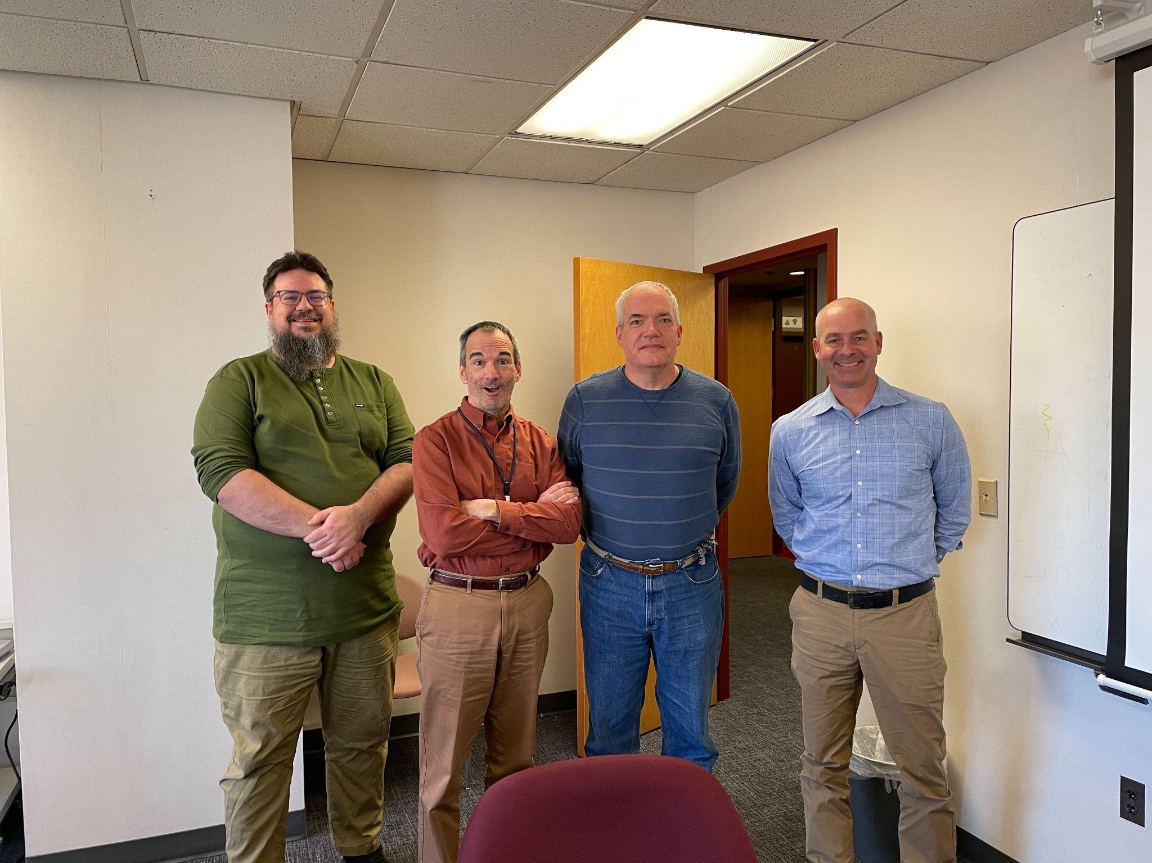
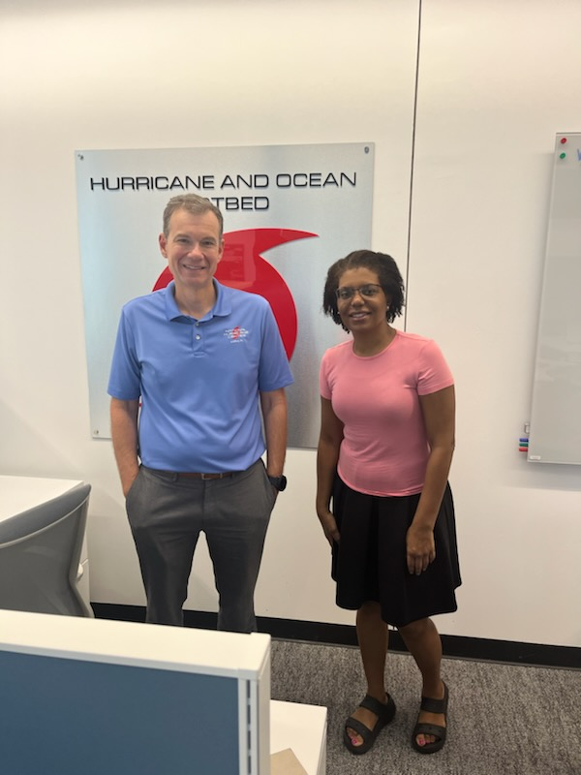
Project Staffing
Federal Employees (8), Guidehouse Contractors (3), CIRA Associates (8), GSL/WIDS (8) - A true collaboration across MDL divisions and between MDL and GSL!

Slide 6
NWS Connect Background
Funded by BIL Provision 3 and STI
A Ken’s 10 Initiative supporting Probabilistic IDSS
Enables mutual aid and service backup
Will host an increasing number of Prob IDSS and community engagement tools
Will enable field innovation
Will permit termination of 2 legacy systems: iNWS and IRIS. Will also play a role in future of NOEES.
Being built in an iterative fashion as field feedback flows in

Slide 7
NWS Connect Milestones for FY2025
Notes:
Speak to what IOC is - Initial Operating Capability - Fancy term for our first release.
This is just the first step in the marathon. We just went through a 6 month Field Test and Evaluation to test out and get an initial round of feedback on the application itself. The feedback we got indicated there we needed to simplify and focus on just a few core features instead of trying to do too much off the bat.
So we pulled things back to the skids a bit, and focused on providing an initial set of MVPs. I’ll get into what those focus areas are for IOC.

Slide 8
DSS Builder Integration - A BIL Provision 3 Milestone
Consistent Templates & Content

Slide 9
NWS Connect Partner Portal
STI milestone
NWS Partners
- Self Manage Their Information - - Subscriptions To Product Alerts -
- Request Support For Event - - View Latest Briefings - - Set Communication Preferences -
NWS Personnel
- Create & Deliver IDSS -
- Partner Info Management - - Manage Partner Support Levels -
- Consistent Customer Service - - Visualize Partner Insights -
NWS Connect

Slide 10
React Refactor (Project Milestone)
In order to unlock the capability of having DESI/WSUP, IDSS Engine, and NWS Connect be interoperability, NWS Connect must be refactored into React. All new development going forward will be built with this frontend.
Notes:
IDSS Engine is a toolkit developed by GSL to analyze partner thresholds and create forecaster guidance on the probability of, timeline of, and scale of their occurrence. This toolkit is designed to work hand in hand with NWS Conn

Slide 11
NWS Connect Milestones for FY2026
Notes:
Speak to what IOC is - Initial Operating Capability - Fancy term for our first release.
This is just the first step in the marathon. We just went through a 6 month Field Test and Evaluation to test out and get an initial round of feedback on the application itself. The feedback we got indicated there we needed to simplify and focus on just a few core features instead of trying to do too much off the bat.
So we pulled things back to the skids a bit, and focused on providing an initial set of MVPs. I’ll get into what those focus areas are for IOC.

Slide 12
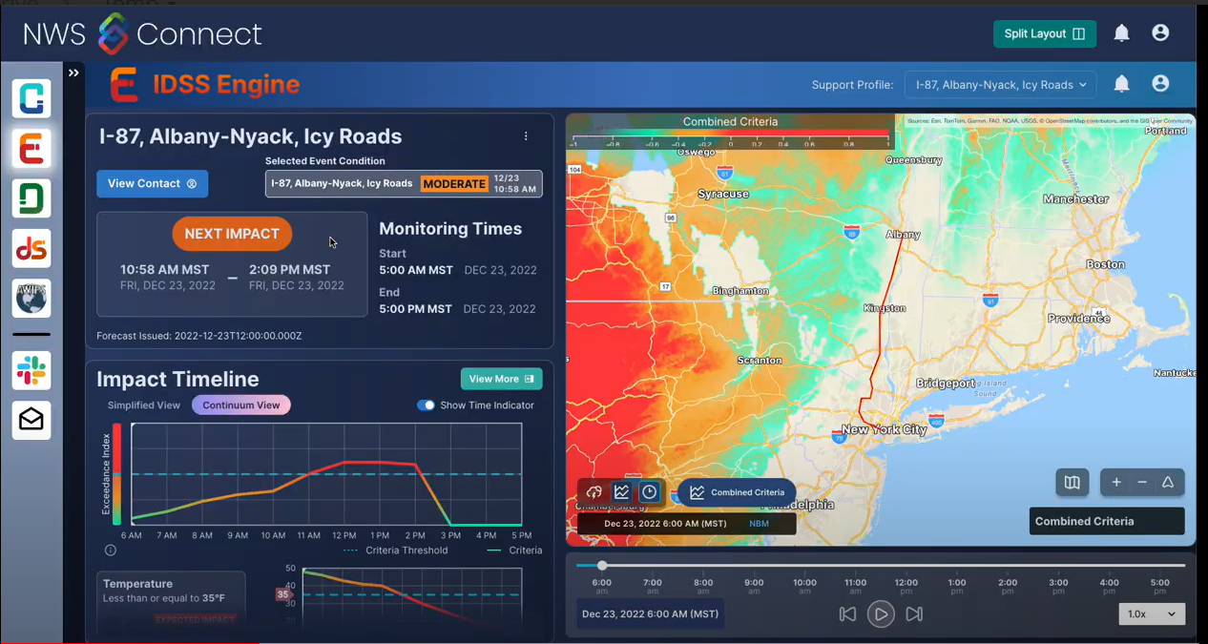
IDSS Engine Integration
Probabilistic impact analysis based on partner thresholds
Guidance & SA tools for forecast staff to monitor and adapt to constantly evolving partner needs
App Interoperability
Notes:
IDSS Engine is a toolkit developed by GSL to analyze partner thresholds and create forecaster guidance on the probability of, timeline of, and scale of their occurrence. This toolkit is designed to work hand in hand with NWS Conn

Slide 13
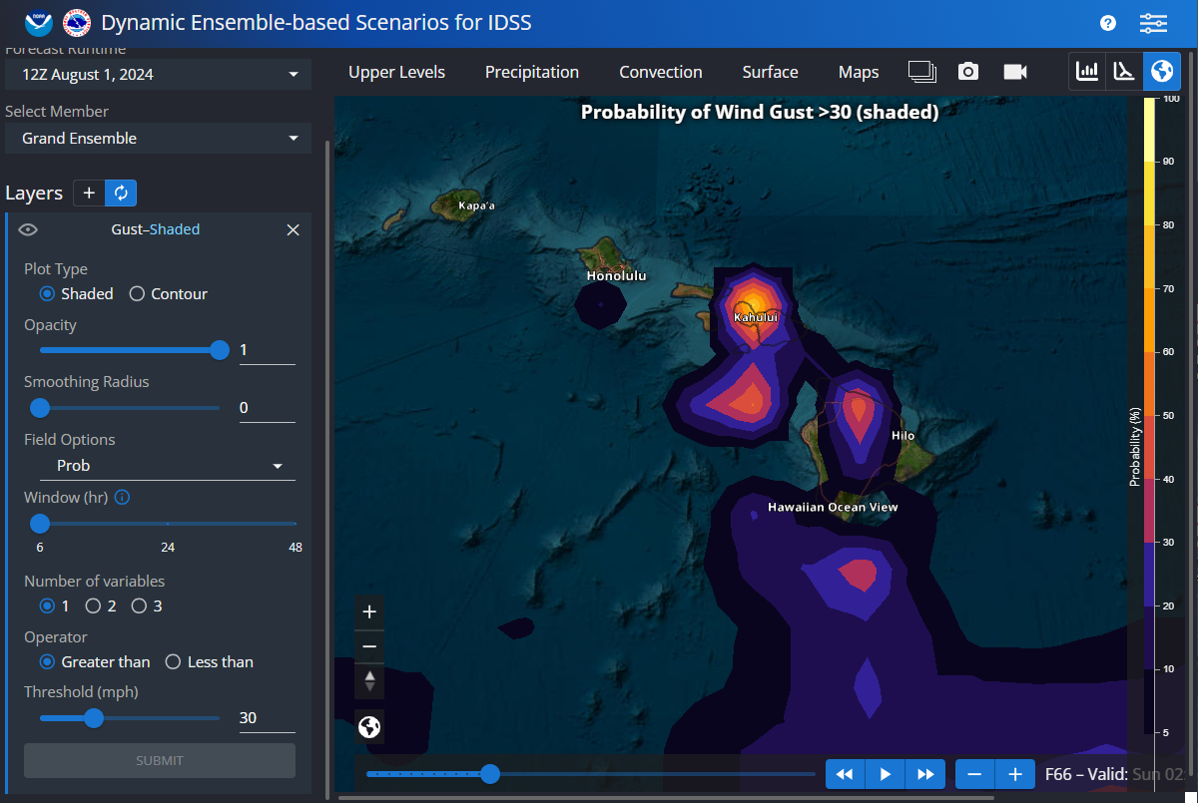
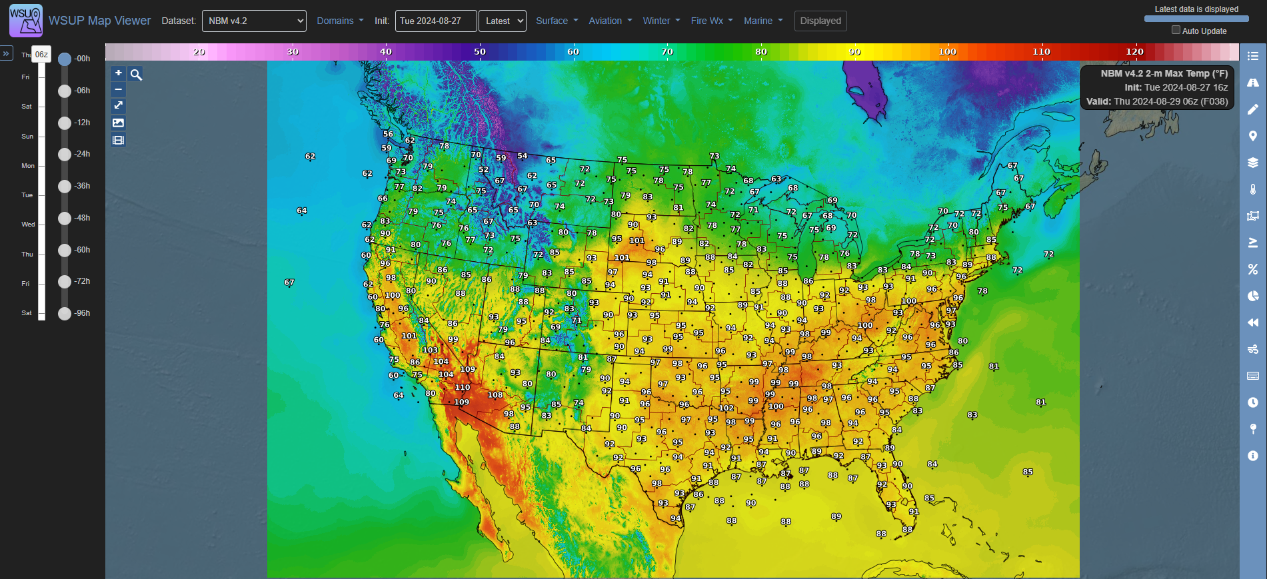
Combined WSUP/DESI Integration
Impact identification and forecasting
Probabilistic messaging content - maps and infographics
Allows forecasters to hone focus & aid highly sensitive support
Forecasters using the same tool when eye to eye with partners

Slide 14
Thank you!

Slide 15
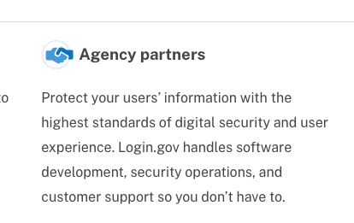
Partner Portal including Modernized iNWS
Partner
Partner Portal
NWS Connect DB
NWS Connect Core UI
Forecaster
Initial Registration
Service Permission & Approval Control
Partner Service Subscriptions (Core Partner)
Partner Service Permission Management
Alert Management
Access Validation
Chat Access
NOAA SSO Access Validation
Partner IDSS Requests (Core)
Office Approval of Support Request
Partner Self Information Management (C + Gen)
Office Management of Partner Info
Office Management of Partner Access

Slide 16
Collaborative Co-development
Before anything else, we need to all be on a level playing field of knowledge across the applications. We need a series of demonstrations for all applications.
We will need to organize ourselves, including Project Management, technologies, and team structure and roles.
It will at times be hard to break down the barriers to effective co-development. We take pride in our work, and it shows. I will be leading the effort to build a cohesive MDL/GSL team.

