Slide 1
Near Storm Environmental Awareness (NSEA) Project
David Hotz – Lead
Aaron Anderson (SR), Joseph DelliCarpini (ER), Chad Entremont (SR),
Stephen Keighton (ER), Patrick Marsh (SPC), Jason Schaumann (CR),
Mike Sutton (CR), Thomas Turnage (CR) and Jerry Wiedenfeld (CR)

Slide 2
NSEA (SOO-DOH) Project Team
Aaron Anderson, ITO, WFO OUN
Joseph DelliCarpini, SOO, WFO BOX
Chad Entremont, SOO, WFO JAN
Stephen Keighton, SOO, WFO RNK
Patrick Marsh, WCM, SPC
Jason Schaumann, Senior Forecaster, WFO SGF
Mike Sutton, ITO, WFO GRR
Thomas Turnage, SOO, WFO GRR
Jerry Wiedenfeld, ITO, WFO MKX

Slide 3
Presentation Objectives
Overview of the Near-Storm Environmental Awareness (NSEA) Project
Background and History of the NSEA Project
NSEA Applications
NSEA/OPG Demonstration
Temporal Resolution - Future

Slide 4
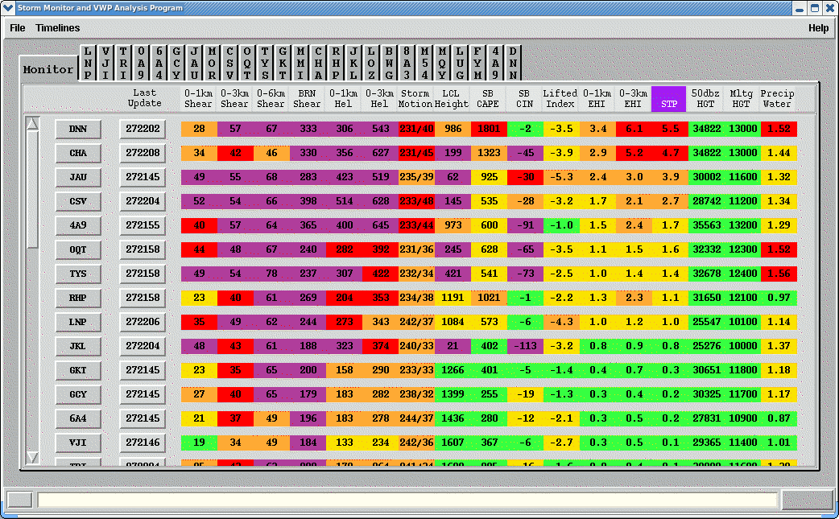
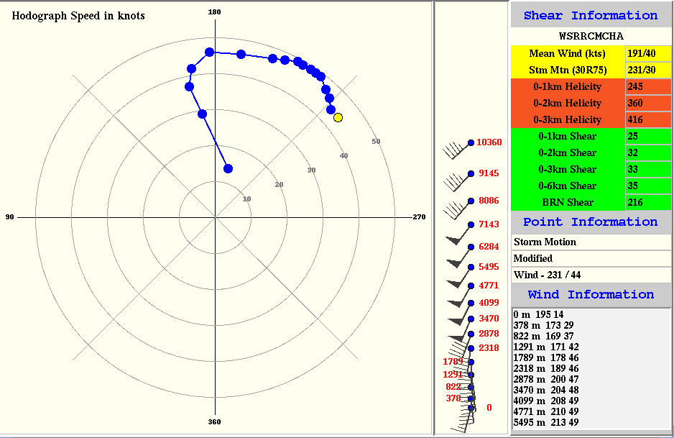
Background and History of NSEA
2010-2015:
Began as an AWIPS I Application called the
Storm Monitor and Analysis Program
Jason Schaumann, Senior Forecaster, WFO SGF and David Hotz, WFO MRX

Slide 5
Background and History of NSEA
2015: NSEA Project began by forming a multi-regional team to develop, test, and provide training for WFO applications to improve monitoring of the Near Storm Environment.
2016: NSEA Project selected as a national STI Project.

Slide 6
Project Goal
Best Practice:
Situational Awareness of the Near Storm Environment
Two AWIPS applications
NSEA Application
NSEA Digital Cursor Readout
Purpose: Increase situational awareness of environment to improve warning performance and IDSS support to our customers.
Intended Users: Warning Team, Mesoanalyst, (Enhanced) Short Term Forecaster
The Vlab page for the NSEA Project:
https://vlab.ncep.noaa.gov/group/near-storm-environment-awareness-project/home
The Vlab Redmine page for the NSEA Project:
https://vlab.ncep.noaa.gov/redmine/projects/nsea-project

Slide 7
NSEA Application
Near Storm Environment (NSE) Application within the Tools Menu

Slide 8
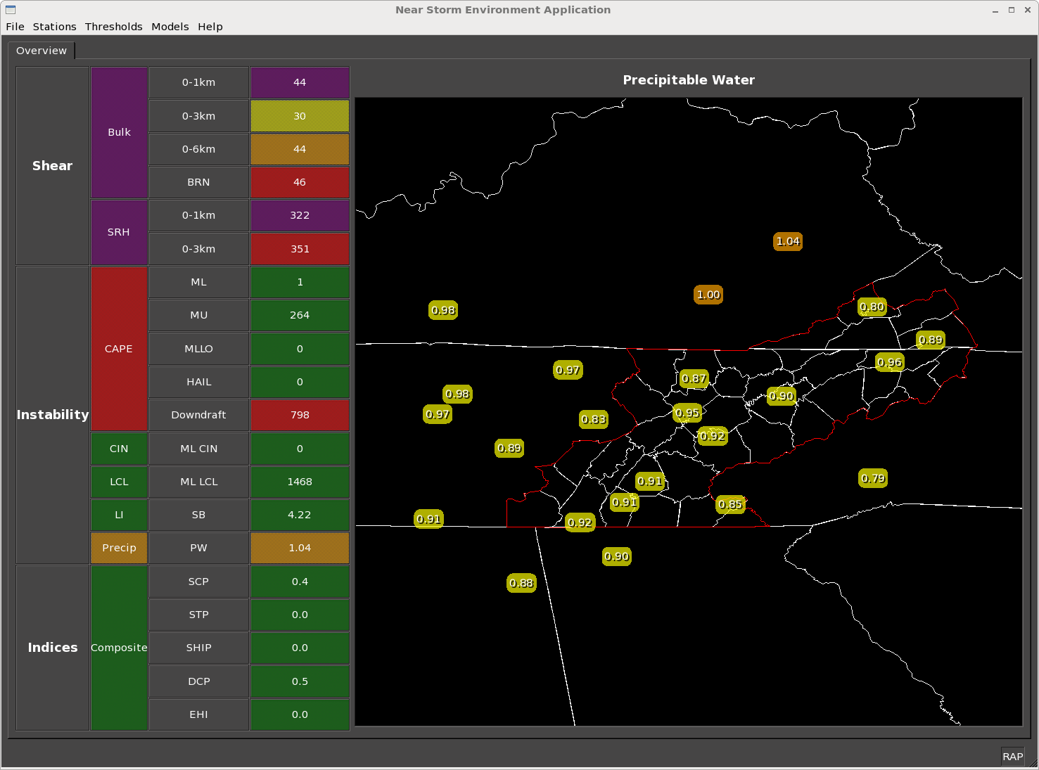
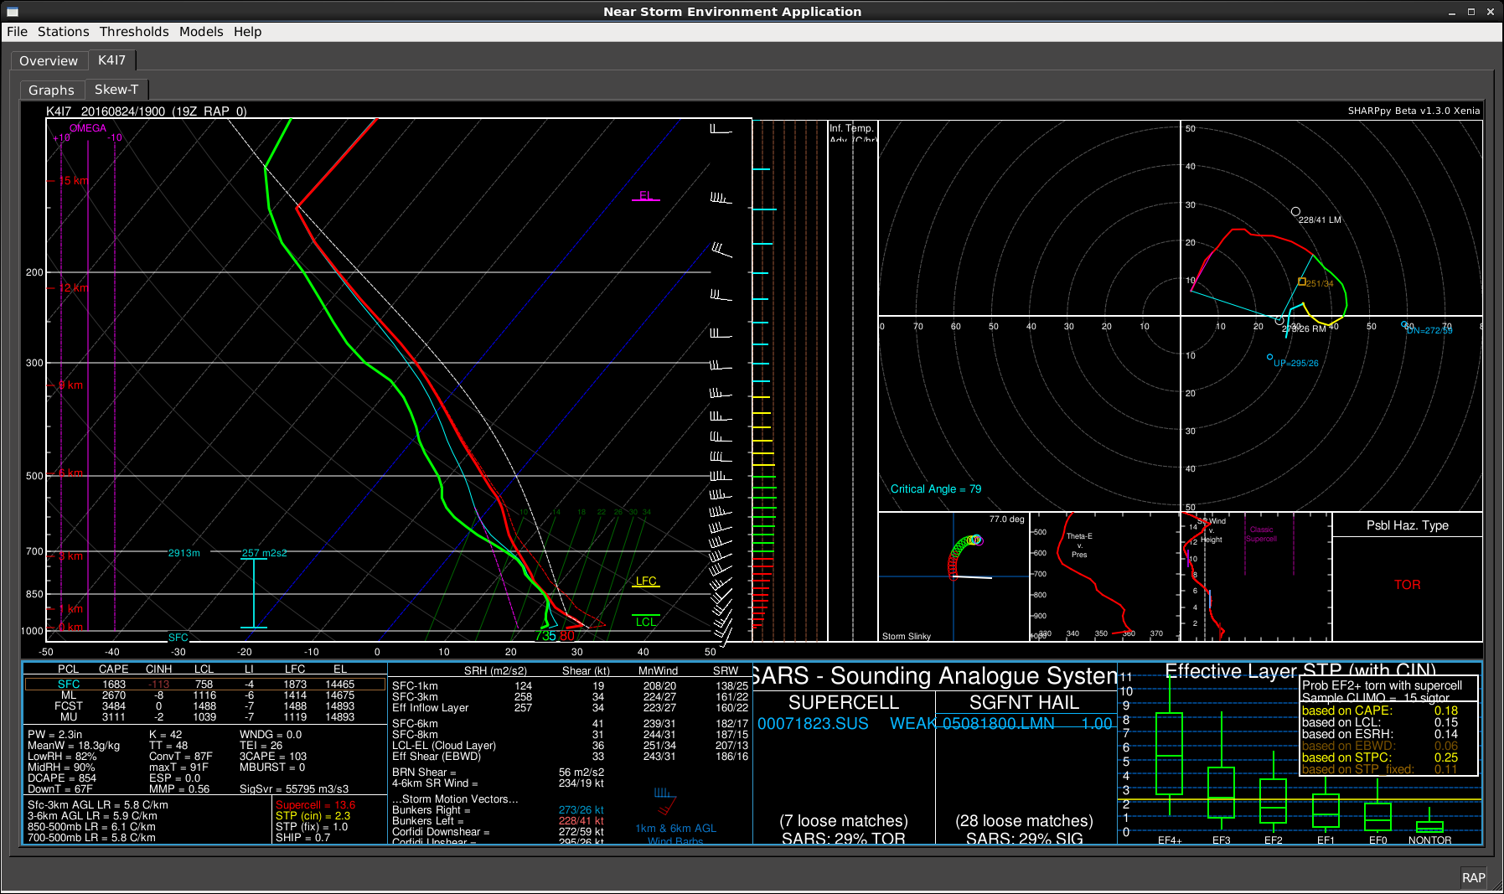
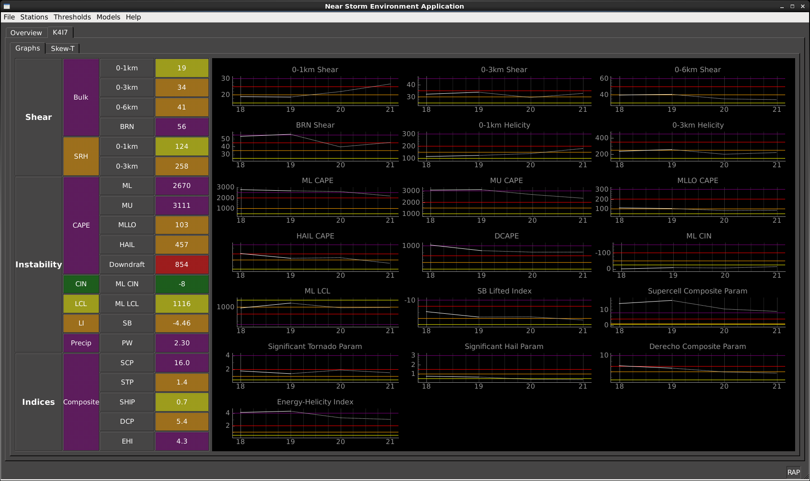
Project Accomplishments (NSEA Application)
Utilizes SHARPpy code for the SKEWT and SOUNDING Interface
Map of parameter selected by dashboard
Time series of all values
SHARPpy (SkewT/Hodograph) editable

Slide 9
Project Accomplishments (NSEA Application Dashboard) Developed by Aaron Anderson
The parameters are color-coded based on thresholds set by the office. The color coded thresholds allow the forecaster to maintain awareness of the environment in/near the CWA. The color displayed is the “highest” value found in all stations.
Hovering over the parameter in the table triggers that parameter to be displayed in the map. Each parameter within the table will also display within the County Warning Area (CWA) map. Each station will be plotted by the color-coded thresholds.
Forecasters will be able to zoom in/out of the map. Stations just outside of the CWA can also be plotted.

Slide 10
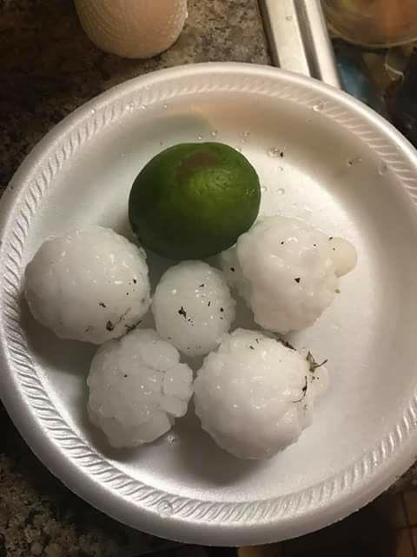
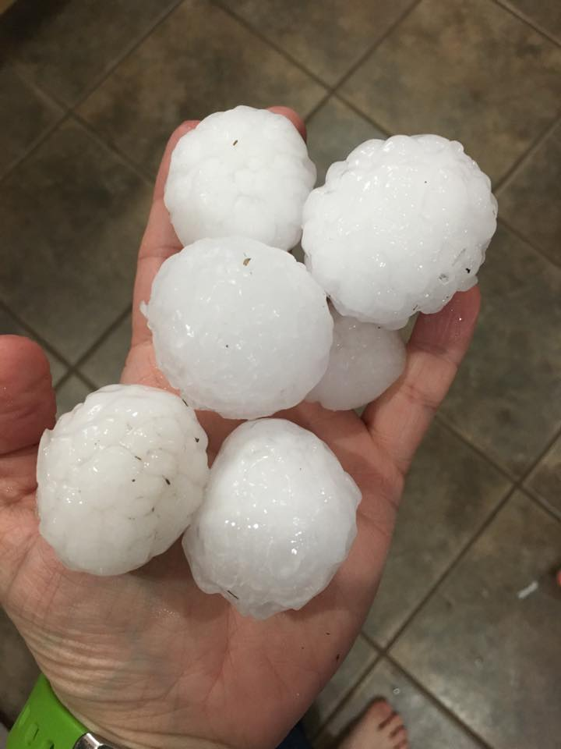
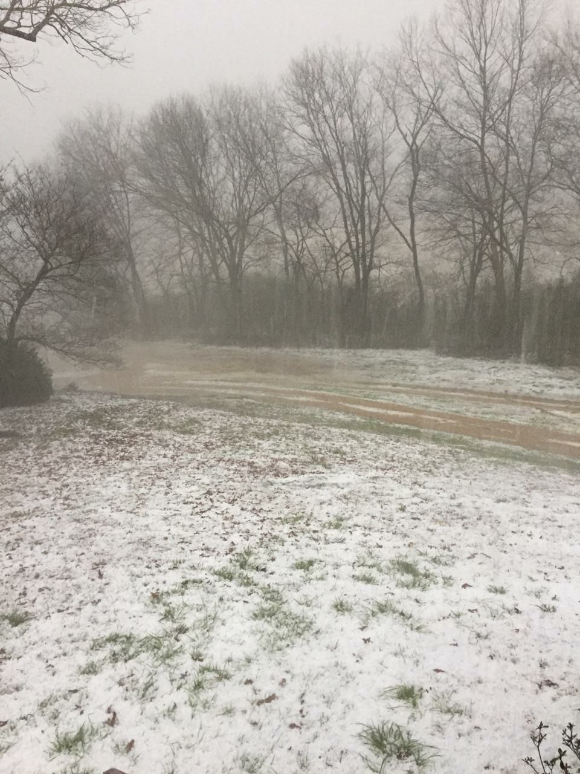
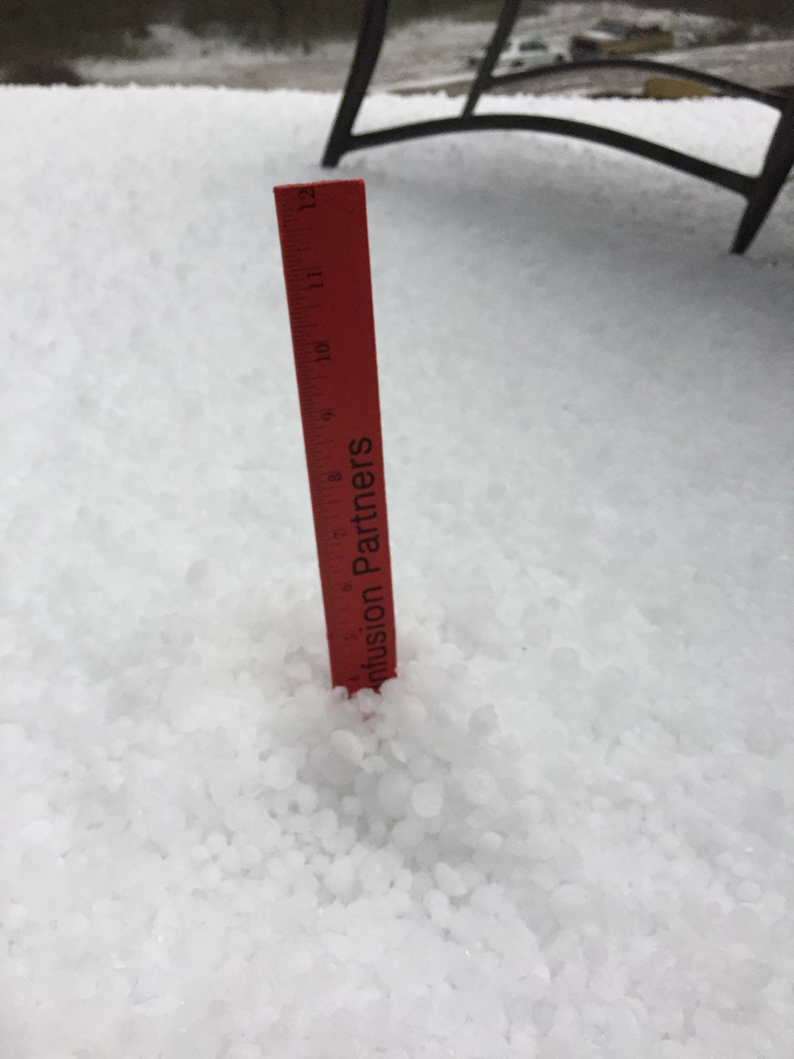
NSEA Application During A Large Hail/Wind Event

Slide 11
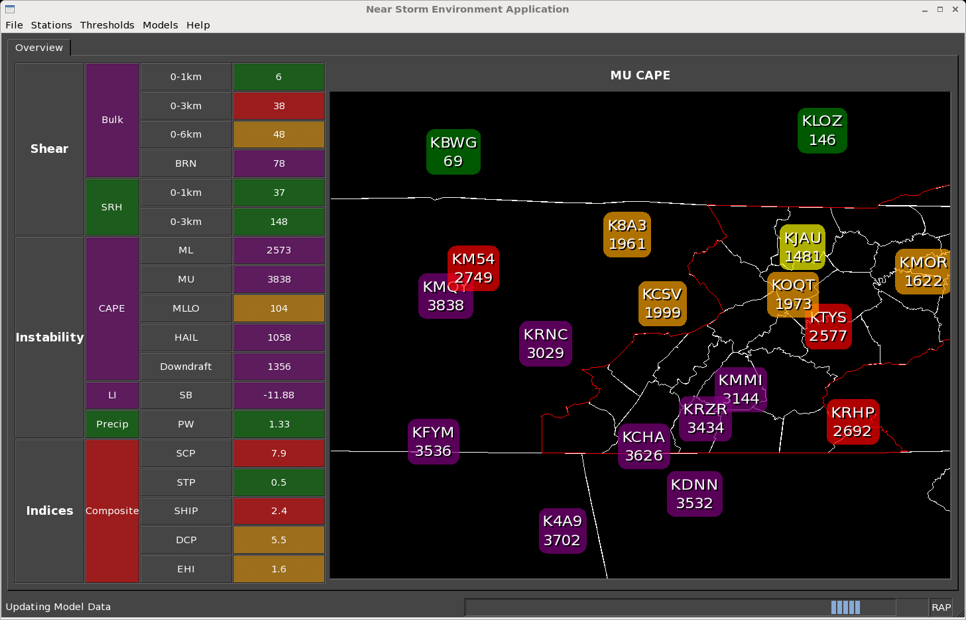
NSEA Application During A Large Hail/Wind Event
The high ML/MU CAPES, Downdraft CAPE, Derecho Composite Parameter (DCP) also noted the environment conducive to damaging winds.
The high HAIL CAPE, ML/MU CAPES, 0-6km Shear, and SHIP Comp parameters suggested an environment for large hail.
The color code thresholds help differentiate the areas and magnitude.

Slide 12
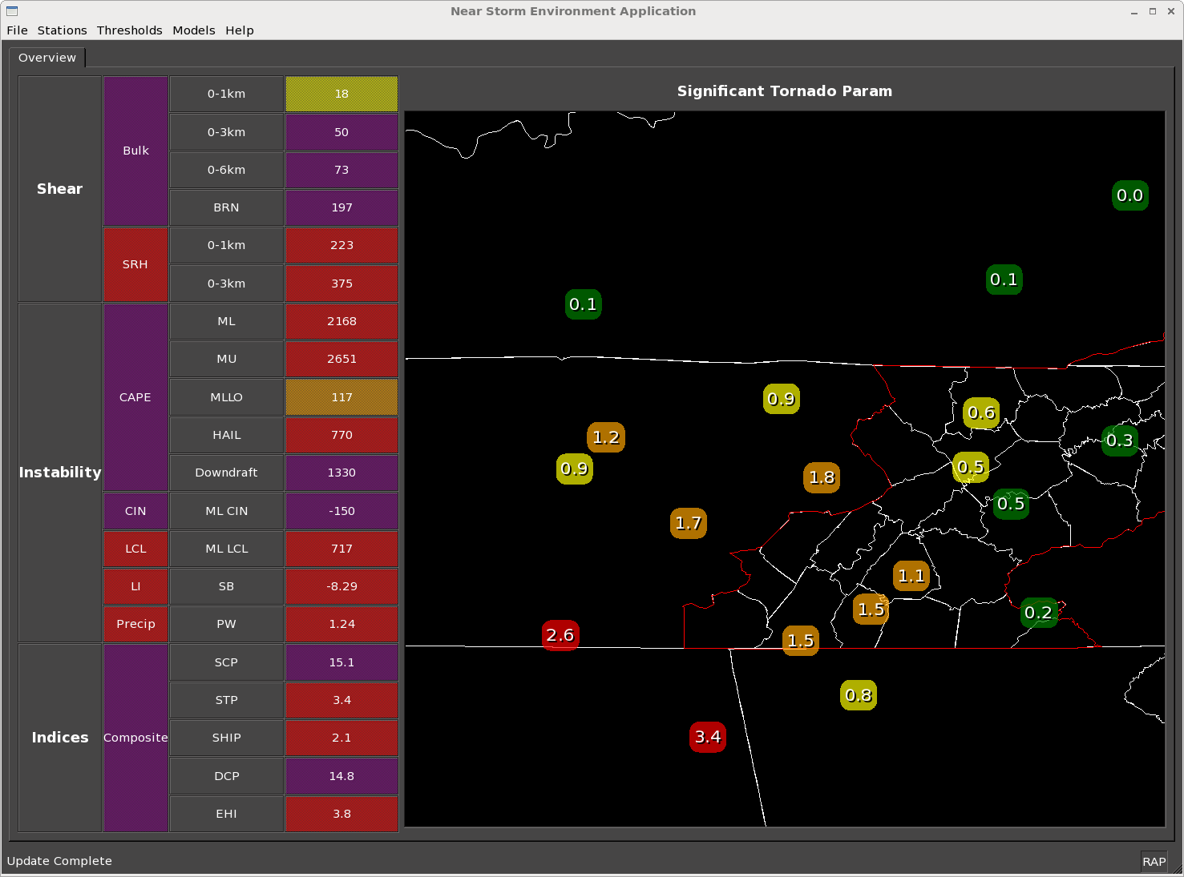
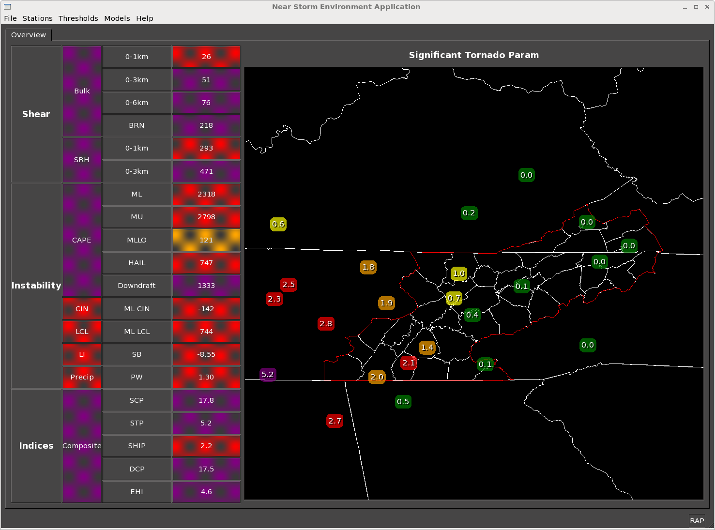
NSEA Application During A Potential Tornado Event
The Significant Tornado Parameter (STP) showed relatively high values across southern middle Tennessee into southeast Tennessee.
A tornado was reported across southern middle Tennessee.
The color code thresholds help differentiate the areas and magnitude. The display of multiple parameters allows the forecaster to quickly monitor the NSE.

Slide 13
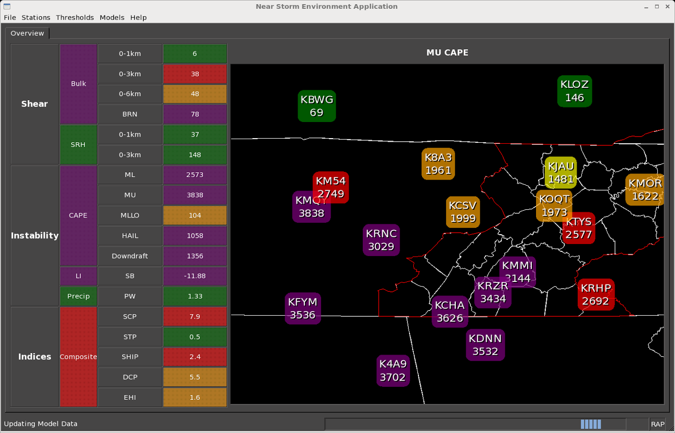
Project Accomplishments (NSEA Application Time Series) Developed by Aaron Anderson

Slide 14
NSEA Time Series – Closer Look
The time series graphs go back 1 hour and ahead 2 hours based off the RAP13 model for each parameter. The lines are color-coded based off the thresholds set for each parameter.

Slide 15
NSEA SkewT/Hodograph utilizes SHARPpy
Credits of the developers of SHARRPpy: http://sharppy.github.io/SHARPpy/contributors.html

Slide 16
Project Accomplishments (NSEA Digital Cursor Readout) Developed by Jason Schaumman, Mike Sutton and Aaron Anderson
Pre-Defined Parameter Bundles
Elevated CAPE
Pulse Severe
Hail
Supercell
Heavy Rain/Flooding
QLCS
RAP, LAPS, and HRRR-based “families” for different scenarios (convection and heavy rain)

Slide 17
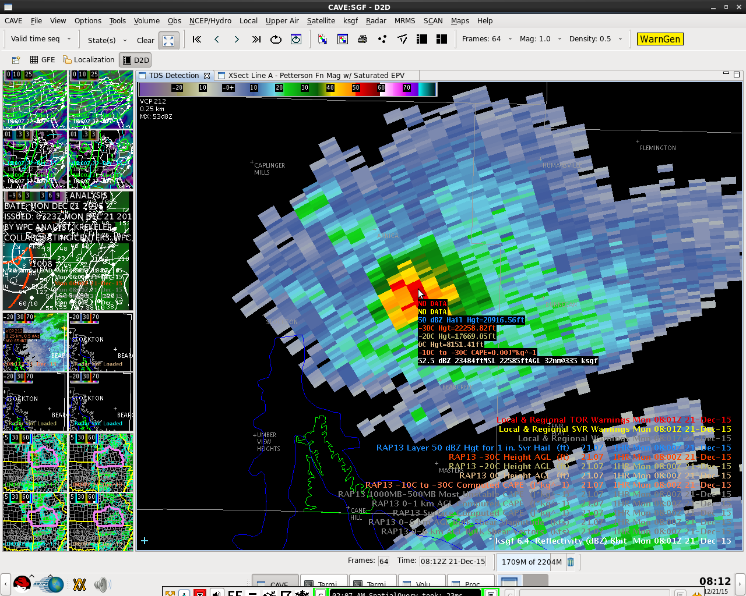
Project Accomplishments (NSEA Digital Cursor Readout) Hail Bundle

Slide 18
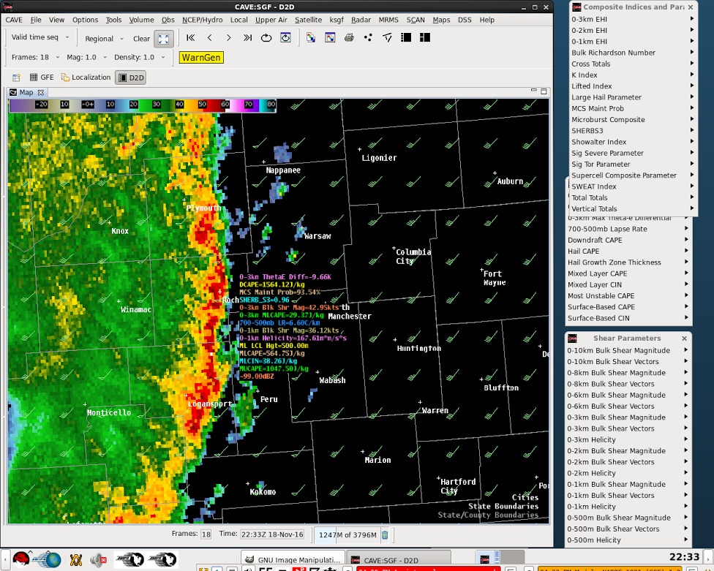
“QLCS Environment” NSEA Bundle
Project Accomplishments

Slide 19
Project Accomplishments
Supercell Tornado Environment Bundle

Slide 20
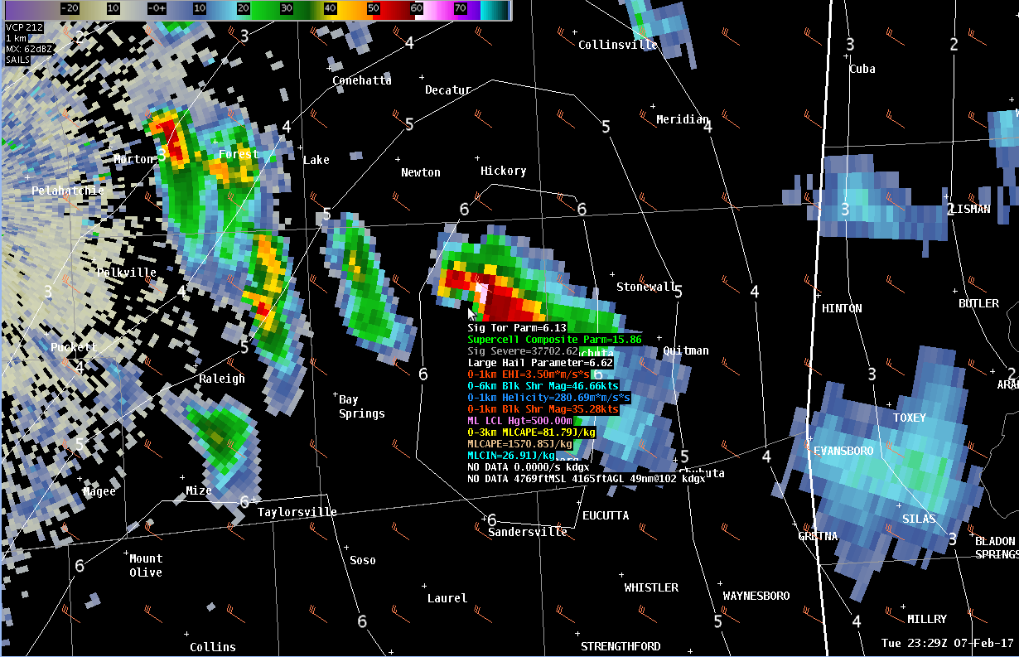
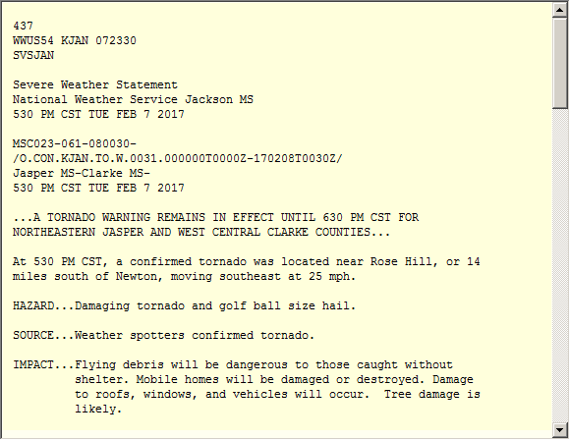
“Supercell Tornadic Environment” NSEA Bundle

Slide 21
“Supercell Tornadic Environment” NSEA Bundle Utilized During the New Orleans Tornado Outbreak
I did manage to get a sneak peak at a tornado super cell with the "NSEA Cursor Readout". It was an eye opener to see "Supercell Tornadic Environment" indices in real time next to the threatening storm! It is an awesome application. (SOO LIX)

Slide 22
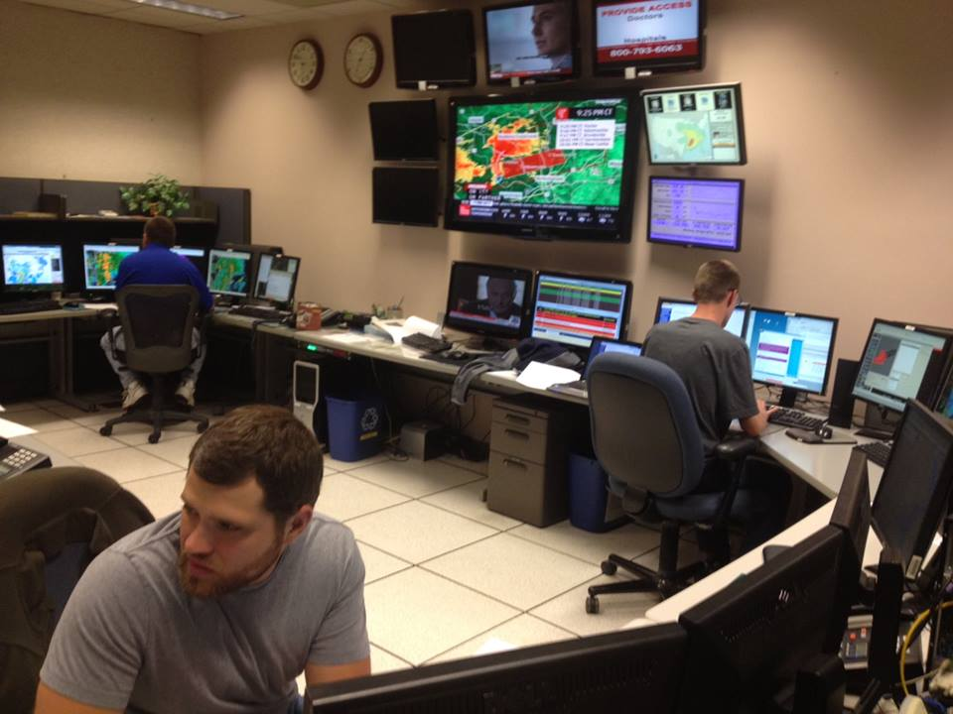
WFO Scenario – Using NSEA Applications
Short-Term Forecaster/ mesoanalyst (multiple duties) (NSE Application)
NSE Tool will highlight areas in/near the CWA that are most prone to severe weather.
Able to monitor numerous parameters.
Tool will help forecasters quickly diagnose the environments potential severity and severity type.
He/she needs to be able to display thermodynamic, wind shear, composite, etc. fields on-top of radar.
This allow the radar operator have a better situational awareness of the severity potential and severity type.
Best Practice:
Increased Situational Awareness
Radar Operator (NSE Cursor Readout Bundles)
Radar operator will able to display thermodynamic, wind shear, composite, etc. fields on-top of radar data.
Allows the radar operator to have better situational awareness of the severity potential and severity type.

Slide 23
What’s Happening Now
Bi-weekly coordination calls with OPG until evaluation.
3 members from the NSEA Project team traveled to the OPG during the last week of March. The purpose is to work with OPG to make sure the NSEA/OPG Evaluation is ready.
A Subject Matter Expert (SME) from the NSEA project team will be available during the OPG evaluations.

Slide 24
Future Plans
Evaluation of NSEA Applications at OPG May-June, 2017 (4 weeks)
Purpose is to demonstrate, evaluate, and gather feedback from incoming forecasters on the two NSE applications. Use of the applications at different office positions/functions and with other NSE Applications, such as ProbSevere.
Final goal is to gain approval to have the NSEA Digital Cursor Readout baselined. The NSEA Application will remain a VLAB local application project for continued development after OPG.

Slide 25
Higher Temporal Resolution is Critical for Improved NSE Analysis
Possible ways to improve temporal resolution:
Higher temporal model resolution (Example: RUA)
Utilizing higher resolution observation platforms, such as 5-mintue METARs, GOES-R wind information, aircraft observations, etc.
Recommend further research/projects focusing on the best ways to combine these platforms.

Slide 26
NSEA Project..Questions
Thanks for your interest in the NSEA Project
The Vlab page for the NSEA Project:
https://vlab.ncep.noaa.gov/group/near-storm-environment-awareness-project/home
The Vlab Redmine page for the NSEA Project:
https://vlab.ncep.noaa.gov/redmine/projects/nsea-project
Notes:
The blue http text does not show up well with the dark background. Recommend changing to white text.
Be prepared for these questions:
I’m in Western Region, and our bread and butter is fire weather as opposed to severe convection. There is a corresponding need for rapidly updating weather information that is geared specifically for fire weather forecasters (e.g. wind speeds, gusts, prob of dry lightning, RH, etc). Could this application be easily modified to support an entirely different forecast problem?
Do you envision using or expanding the use of ensemble data (e.g. means or spread or ‘worst case’) in this program? In other words, would it be better to at least utilize a time-lagged-ensemble technique, say from hourly HRRR runs, to provide environmental SA information to the forecaster that would also give a sense of model trends and uncertainty information?

