Slide 1





NOMADS and the National Climate Model Portal
M. Sutton 1995
NCMP
NOAMDS
NWS RITT Forum
May 18, 2011
Glenn K. Rutledge
NCMP/NOMADS Project Manager
NOAA’s National Climatic Data Center
Asheville, NC 28801

Slide 2
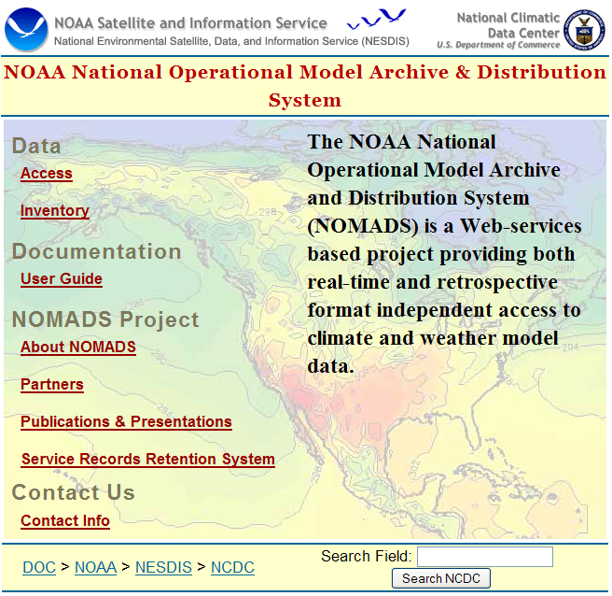
NOMADS - NCMP
Outline
Project Staff
Background: NOMADS
Mission, Goals, and Objectives
User Statistics and Data Availability
Spin-up Plan and System Design
User Requirements and Science Tools
Program Support and Next Steps

Slide 3
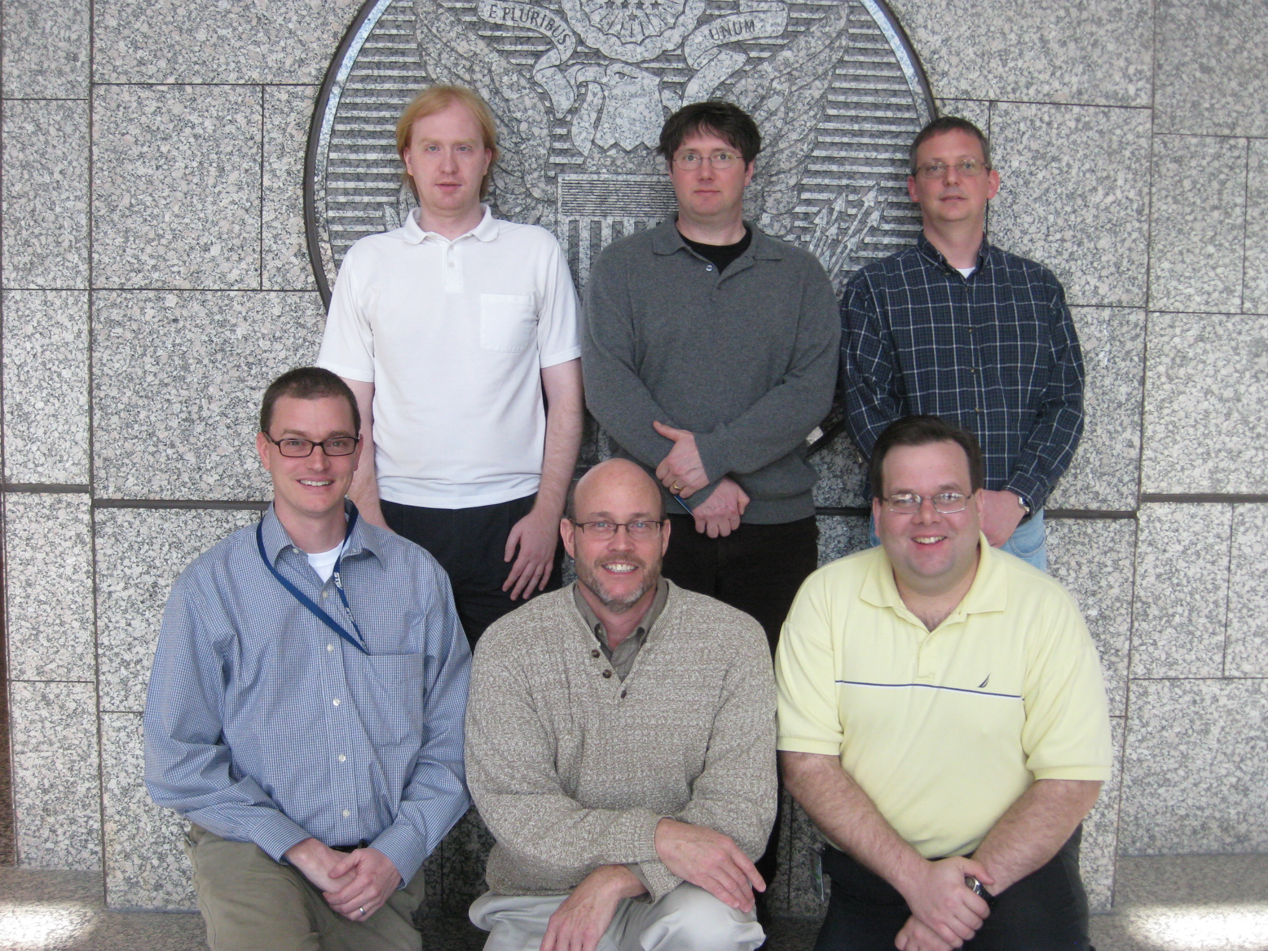
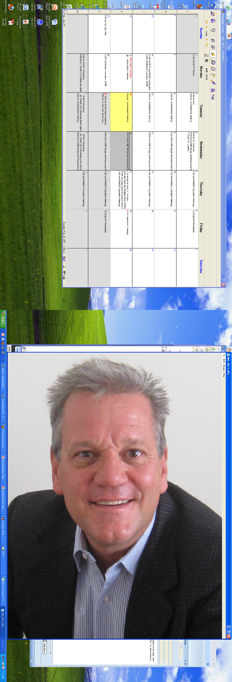
NOMADS Operations
NCMP Development Staff
Jay Hnilo CICS
Boulder, CO.
Rear (L-R):
Dan Swank
Jeff Budai
Danny Brinegar
Front (L-R):
Phil Cogbil
Glenn Rutledge
Mike Grogan
Not shown: NOMADS Extended Team members: Scott Stephens and Jeff Robel
Web Admin & App Dev: Georgi Petov

Slide 4
NOMADS - NCMP
Mission Statement
Supporting NOAA’s Science, Service, and Stewardship mission, the mission of the National Climate Model Portal (NCMP) is to aid in the understanding, sharing, and improvement of climate and weather models and associated information via innovative applications of web-based technology

Slide 5
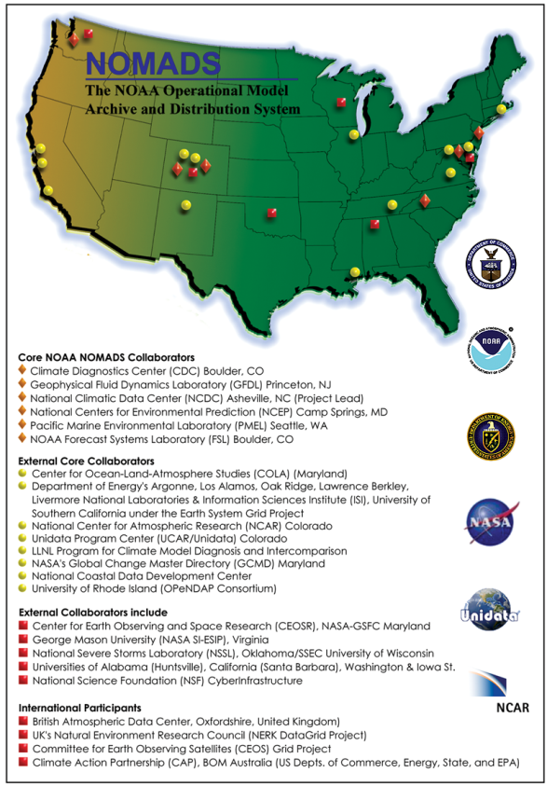
Background: NOMADS
NOMADS is a distributed data access project for access to real-time and
retrospective high volume numerical weather prediction and climate
models. Conceived in 1999- operational in 2002.
NOAA’s NCDC initiated NOMADS with NCEP and
GFDL. The collaboration grew quickly.
Founding member of GO-ESSP. Focus has been on
weather models. NCMP will address reanalysis and
climate models and associated observational data.
Users can have access to data as input to their decision
making processes this information is useful on time scales
from days (weather) to months (El Nino) to decades
(global climate change).
Original Collaborator’s
10 Years OLD !

Slide 6
NOMADS Benefits
In 2009 NWS systems engineers informally studied the bandwidth “cost savings” obtained via the NOMADS vs. traditional “gateway” servers.
In a nutshell, they found an overall savings of 80% of the volume by using NOMADS for the same services.
“NOMADS” services (OPeNDAP, GDS, LAS, TDS, ftp4u) being considered for “NOAA NexGen”.

Slide 7
NOMADS - NCMP
OCIO Recommendation
NCMP
NOAA Office of the CIO
  Strategic Information Technology Plan 2010‐2017, March 2010
  IT Strategic Objectives (one of nine):
“Continue development/implementation and maintenance of operational archive and user access capabilities for the National Climate Services Portal and National Climate Model Portal (NCMP) to provide access to the next generation of NOAA climate and weather models and analyses products.”

Slide 8

NOMADS - NCMP
NAS Recommendation
NCMP
National Academies of Sciences, National Research Council, Board of Atmospheric Sciences and Climate:
“Completing the Forecast: Characterizing and Communicating Uncertainty for Better Decisions Using Weather and Climate Forecasts”
The NOAA National Operational Model Archive and Distribution System (NOMADS) should be maintained and extended to include (a) long-term archives of global and regional ensemble forecasting systems and their native resolution, and (b) re-forecast datasets to facilitate post-processing”¹
  NCMP will be built on top of NOMADS as a suite of Services and Tools. It is an extension and an expansion of NOMADS

Slide 9
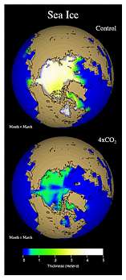
NOMADS Goals
Establish a unified climate and weather model archive providing format independent access to retrospective models
promote model evaluation and community feedback
foster research within the geo-science communities (ocean, weather, and climate) to study multiple earth systems using collections of distributed data
develop institutional partnerships and access via distributed open standard technologies

Slide 10
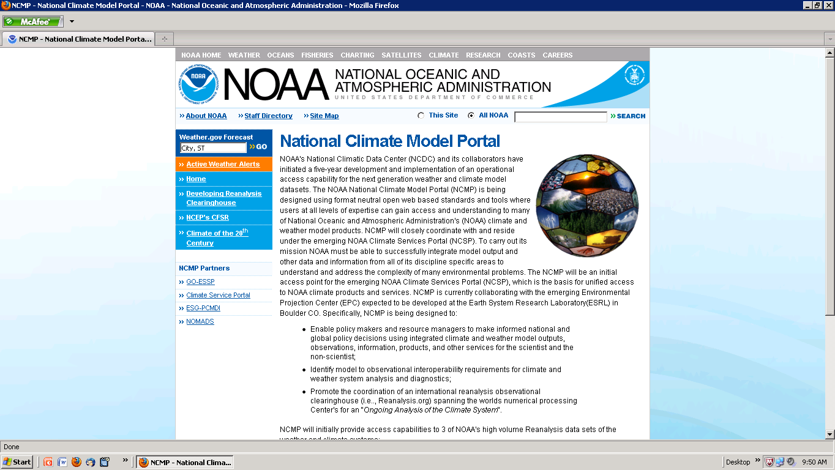
NCMP
Objectives
Objective: Reliable, Consistent, Long-Term Public Access and Interoperability and Inter-comparison of Models and Observational Data sets for all levels of expertise.
  NCMP will be an Initial access point for models and associated data under the NOAA Climate Services Portal (NCSP).
  Access capability to NOAA’s next suite of Climate reanalysis products: “Explaining Climate to Improve Predictions” (ECIP) approaching 1.2 Petabytes:
    CFS-RR (reanalysis and reforecast) (Saha, et al.)
    Twentieth Century Reanalysis Project (20CR, Compo)
    CFSR- ‘Lite’ (CPC, tbd)
  In support of IPCC Assessment Report (AR5) activities NCMP will advance CMIP with a suite of both derived products and data and on-line diagnostic tools designed to support Stakeholders and improve access to climate information.
  Regional & Local Modeling support; Downscaling
  Engage and support stakeholders from functional requirements of their needs; Societal Benefit Areas; and NCDC “Sectorial” Teams. Initial requirements based on need of Water and Energy.

Slide 11
NCMP
Deliverables
While NCMP has a number of goals and objectives, it will ultimately be judged by it success in meeting the Deliverables and Performance Measures outlined in NOAA’s FY 2012 Presidential Budget Request. NCMP’s activities will be prioritized toward meeting those success factors.
Deliverables
  NOAA Reanalysis Web Page for collection of User requirements
  Access to the next generation reanalysis datasets; & derived CMIP
  Model-to-Observational inter-comparison capability
  Prototype Customer Service support capability and a research quality help desk supporting NCMP users
  A reanalysis clearinghouse to host consensus datasets for the next series of NOAA reanalysis. (Reanalysis.Org)

Slide 12
GO-ESSP
A Primary Collaborator
Global Organization for Earth Systems Science Portals
British Atmospheric Data Centre
  Bryan Lawrence – Director, British Atmospheric Data Centre
Geophysical Fluid Dynamics Laboratory
  V. Balaji, Head, Modeling Group, Princeton/GFDL
The German Climate Computing Centre
  Michael Lautenschlager (NeRC Grid)
Lawrence Livermore National Laboratory
  Dean Williams, PCMDI, Chief Archive Services/CMIP5 , ESGF
National Center for Atmospheric Research
  Don Middleton, Senior Manager, Enabling Technologies, ESGF
Pacific Marine Environmental Laboratory
  Steve Hankin (Unified Access Framework, DMIT)
NOAA/Earth Systems Research Laboratory
  Cecelia Deluca (ESMF, National Climate Projection and Prediction NCPP prototype)
NOAA/National Climatic Data Center
  Glenn Rutledge, NOMADS/NCMP, DMIT
NOMADS hosted the
2011 GO-ESSP Workshop
May 9-10, Asheville NC
>90 participants !
http://go-essp.gfdl.noaa.gov/

Slide 13
Primary Collaborators (cont.)
NCMP
Programs, Agencies, Academia
  Lawrence Livermore National Laboratory
    Program for Climate Model Diagnostics and Intercomparison (PCMDI)
    CMIP and AR International partners via the Earth System Grid (ESG): ORNL, PCMDI, NCAR, BADC, etc,
  Earth System research Laboratory (ESRL)
    Environmental Projection Center
    CIRES Climate Diagnostics Center NOAA PSD
  Pacific Marine Environmental Research Laboratory (PMEL)
    Unified Access Framework UAF
  NOAA Climate Services Portal (NCSP)
  National Weather Service
    Operational R/T NOMADS; WOC
  Geophysical Fluid Dynamics Laboratory via NOMADS
  Open Geospatial Consortium (OGC)
  Group on Earth Observations (GEO)
    AIP-4
  U.S. Integrated Drought Information System (NIDIS)
  U.S. National Assessment Program (NCDC/NCS)
  UCAR / Unidata
  Center for Ocean-Land-Atmosphere (COLA)
  CEOS WGISS

Slide 14
NOAA National
Climate Model
Portal
NOMADS Archive
NCMP
NWP Model and Climate Reanalysis
Global Forecast System (GFS), 1 and ½ degree March 2004 – Present, October 2006 - Present
NCEP Climate Forecast System Reanalysis (CFSRR) Global 32km January 1979-Present
NCEP Climate Forecast System Reforecast (CFSRR) Global 32km January 1979 – Present
NCEP North American Regional Reanalysis (NARR) 30 years 32km January 1979 - Present
NCEP/NCAR/DOE R1 & R2 Global Reanalysis Jan 1948 – Present, Jan 1979 - Present
NCEP Global Ensembles (GENS) / TIGGE (w/ NCAR) December 2007 - Present
ESRL Twentieth Century Reanalysis Project (20CR) (2011) January 1850-Present
NCEP Spectral Statistical Interpolation (SSI) Global Data January 2001 - Present
Assimilation System (GDAS) w/ model restart February 2002-Present
North American Mesoscale (NAM, formally Eta) 12km February 2005 - Present
Rapid Update Cycle (RUC) 20km and 13km January 2006 – Present, March 2007 - Present
Climate Data / Coupled AOGCM
Limited GFDL CM2.0 and CM2.1 Climate Experiments Limited AR4/5
Paleoclimate Model Intercomparison Project (PMIP) POR
CMIP3/5 multi-model suite via ESGF (2011) AR4/5
In-situ
NCDC Global Historical Climate Network (GHCN) Temp/Precip Jan 1880 – Present, Jan 1900 - Present
NCDC Integrated Global Radiosonde Archive (IGRA) upper air Varies by station
NCDC Smith-Reynolds Extended Reconstructed and OI ¼ SST’s Jan 1854 – Present, Jan 1985 – Present
Service Records Retention System (SRRS) April 2001 - Present
Notes:
CLIVAR Hurricane model data requested. (GFDL)

Slide 15
NCDC NOMADS
User Statistics FY2010 (1/3)
NCMP
Users by domain (%)

Slide 16
NCDC NOMADS
User Statistics FY2010 (2/3)
Education (.edu)
Commercial (.com)
User | % Tot. Vol.
ucar.edu | 32.55%
fsu.edu | 5.33%
iastate.edu | 1.97%
princeton.edu | 1.30%
psu.edu | 1.30%
User | % Tot. Vol.
wunderground.com | 3.30%
ceinetworks.com | 1.09%
windlogics.com | 1.01%
vestas.com | 0.82%
boeing.com | 0.69%
Government (.gov)
Networks (.net)
User | % Tot. Vol.
nasa.gov | 4.75%
noaa.gov | 2.33%
aftac.gov | 0.66%
pnl.gov | 0.64%
nersc.gov | 0.46%
User | % Tot. Vol.
comcastbusiness.net | 2.35%
comcast.net | 0.63%
verizon.net | 0.58%
optonline.net | 0.50%
windstream.net | 0.38%
% of total volume

Slide 17
NCDC NOMADS
User Statistics FY2010 (3/3)
FY10
Data Type | Volume (TB)
CFSR -Reanalysis | 218.89
NARR | 64.11
GFS | 56.64
NAM | 15.16
RUC | 10.46
NDFD / NDGD | 1.38
GDAS | 0.79
GENS | 0.49
Tape Orders | 97.27
Total | 465.19 TB
Distinct hosts served: 83,370
Successful requests: ~125 million
1 day record: 4.9TB
user requests will exceed 2010
significantly due to the addition of:
- CFS Reforecast
- CFSv2 Operational runs
- 20th Century Reanalysis Project
How best to scale to meet ever
increasing data volumes and user demand
With NOMADS/NCMP sub-setting capabilities performance metrics based solely on data volume downloaded…
misses the point entirely!
FY11
Notes:
With NOMADS/NCMP sub-setting capabilities as a core feature, metrics based solely on
data volume downloaded misses the point entirely!

Slide 18
Model Archive Growth Exebyte (EB)
Since 1966, model output volume closely mirrors “Moore’s Law”:
  - a doubling of volume (CPU processing speed) approximately every two years*.
Derived estimates below show existing archive storage requirements without data reduction practices. Volumes approach 1 Exabyte (1 Billion Gigabytes).
Simple data reduction policies to remove forecast products, and outdated reanalysis
reforecasts, and Atmospheric-Ocean General Circulation Models (AOGCM’s) at the Archive level greatly reduces archive and stewardship requirements.
* unpublished results (Rutledge, Alpert 2004)

Slide 19
Model Data Volume by Type
Data Type | Volume Growth Rate | Data Reduction | Compression | Total Volume * (PB) FY10 FY30
NWP and Ensembles¹ | Doubling /2yr** | Yes: Del. Fcst fields | GRIB/NetCDF | 1.3 | ~49
AOGCM’s Climate² | Step function | Yes: Maintain Two IPCC AR cycles | NetCDF (4) | 0.1 | ~40
Reanalysis³ | Step function | Yes: 2 Reanal cycles | GRIB/NetCDF (4) | .3 | ~36
Regional Downscaled⁴ | Linear | Yes 10 years | NetCDF (4) | 0.002 | 5
Reanalysis Clearinghouse Observations⁵ | Linear | No WCRP/ WOAP/other | various | 0.005 | 1
Totals |  |  |  | 1.7 PB | 131 PB
Notes:
NWP forecasts removed after 5 years. Only Analysis and Initial conditions retained.
Climate Models increasing as stewardship and user access requirements increase under NOAA.
NOAA reanalysis once performed only every 10 years. New IT resources and NOAA “Clearinghouse” will allow on-going reanalysis of the climate system.
Only critical Regional and Local scale downscaled analysis retained at NCDC. Regional offices can maintain as req’ed.
NOAA recommendation to create a database of in-situ obs avbl for on-going reanalysis of the climate system. Multi-Agency involvement: NOAA, NASA, ESCMF, EPA, NCAR, USGS, et al., : “Reanalysis.org”.
* Volumes in Peta bytes (1,000TB).
* * NWP Estimates based on verified linear to log exponential growth using empirical data since 1966 (J. Alpert 2004).

Slide 20
NOMADS
Data Management Philosophy
Different combinations of community assets will solve different problems
Can be tailored to current near-term solutions
Effective use of existing portals for data access and distribution, and for existing transport technologies will increase chances of success.
NOMADS participates in a broader NOAA-wide and Agency-wide framework for a comprehensive suite of modeling services (e.g., GO-ESSP, ESGF, NCPP, etc.)

Slide 21
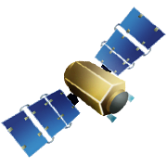
U.S. GEO Modeling Infrastructure Vision of the Future
Reanalysis and Climate Clearing-house
Community vetted observational database
Public and
private
catalogue
Search
tools
NOAA
Climate
Services
Portal
Middleware, access protocols, secure data transport
User authentication, access control logic
Metadata vocabularies, ontology standards
Education and training, user support
Private
virtual
workspaces
NOMADS &
National Climate Model Portal
Metadata
Ontologies
Shared
virtual
workspaces
Workflow
generation
tools
Users
Monitoring
& control
services
Event
detection
Observing System
Simulation Experiments
Pre / Post Processing
Adaptive
Real-time
data streams
Datasets
Modeling
Systems
Analyses
Other (e.g.
Unique
Instrumentation)
Task
D
D
D
Earth Systems Modeling Framework
Observing Systems
Private or
published
results
Workflow
orchestration
engine
Q
A
DOE Earth
System
Grid &
iRODS
D
data
Q
Q/A
M
M
model
GEO
US-GEO
A
analysis
CLASS and NCDC
Long-term archives
Compute servers
Digital
libraries
Rutledge/Meacham/Fontaine 2006

Slide 22
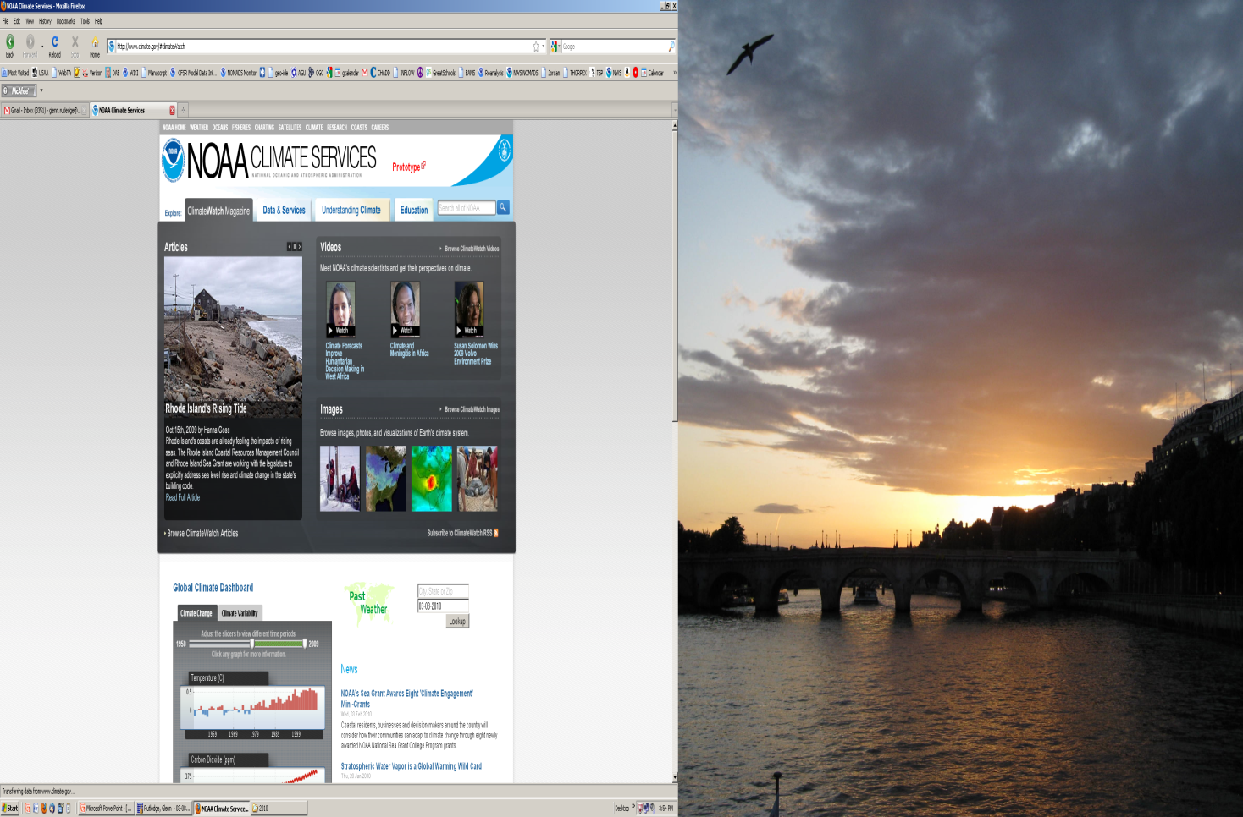
NCMP Model Infrastructure
NWS
NODC
GFDL
Reanalysis.Org
Climate Clearing-house
Community vetted observational database
NCDC
…
NOAA
NOMADS
GDS
Search
tools
LAS
ESG
iRODS
CDAT
TDS
Global Interoperability Framework
- National Climate Predictions and Projections Center
NOAA Cooperative Institute Climate and Satellites
CICS-NC Asheville
Users
NOAA Climate Assessment Services
Private or
Unpublished
results
LLNL / ORNL
Collaborations
NCDC
Earth System Grid Framework
NOAA Archive Services / CLASS
Rutledge/ 2011

Slide 23
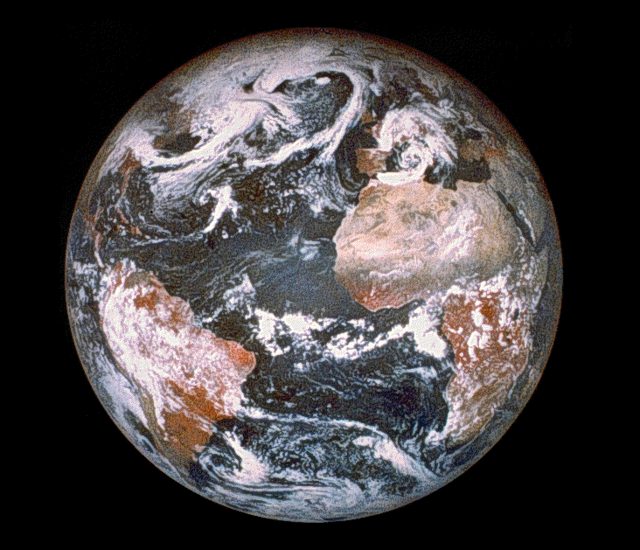


Multiple paths to format independent data access
NCMP
The NOMADS/NCMP System
NCDC
Archive
NOMADS
TDS GDS
LAS
NOMADS
Archive
Interface
Data Management
Applications
Priority Collaborations
- National Climate Service Portal (NCSP)
- National Climate Prediction and
Projections Center (NCPP) prototype
OPeNDAP.org
Open GeoSpatial Consortium (OGC)
- GO-ESSP
- Earth System Grid Federation (ESGF)
& PCMDI / IPCC Archive
- UNC iRODS / RENCI
Data Ingest &
Stewardship
NCMP
Community
National
Climate
Model
Portal
Reanalysis.Org
Climate Diagnostics
Earth System Grid
NCMP
ERRDAP
OpenDAP
Reanalysis
CMIP
Reforecast
On-Line Holdings
NWP
20CR
Ensembles

Slide 24
NCMP
The NOMADS/NCMP System
NCMP
National
Climate
Model
Portal
NCMP

Slide 25
Current NOMADS Architecture

Slide 26
Existing NOMADS-NCMP Servers
Archive services supported by NCDC is available at http://nomads.ncdc.noaa.gov/. This server provides
  access to most of NCEP's operational data sets
  a long-term archive for all data sets
  many other data sets (see http://nomads.ncdc.noaa.gov/data.php?name=inventory)
  A non-operational research and development server (and developing ESG node) managed by NCDC is available at http://nomads6.ncdc.noaa.gov/ncep_data/index.html
Near real-time services supported 24x7 by NWS is available at http://nomads.ncep.noaa.gov/. This server provides
  access to NCEP's operational data sets as they are being generated
  a short-term archive of up to a month for most data sets
  24x7 operational monitoring by NCEP staff
  a geographically-diverse backup server to insure operational availability
Four non-operational research and development servers used for customer testing of new products and services prior to operational implementation
  These servers are not guaranteed to have current data and their content are supported only during business hours and on the basis of staff availability. Three non-operational research and development servers managed by NCEP are available at
    http://nomad1.ncep.noaa.gov/ncep_data/index.html
    http://nomad3.ncep.noaa.gov/ncep_data/index.html
    http://nomad5.ncep.noaa.gov/ncep_data/index.html
Ocean-NOMADS at http://edac-dap2.northerngulfinstitute.org/ocean_nomads/. This server provides most NCEP and some Navy Ocean Models.

Slide 27
Existing NOMADS Services
NCMP
Data Access Services
  THREDDS Data Server
    OPeNDAP access form
    NetCDF Subset service
    GIS/WCS and WMS capabilities
    Raw data file server
    Limited aggregation capabilities
  Grads Data Server
    OPeNDAP access for GrADS compatible data
    Full aggregations to ease access
  Web applications
    Ensemble probability tool: Easy interpretation of GFS ensembles
    SRRS archive / NCEP charts access application
Raw/Scriptable data access
  Partial-HTTP subsetting
  Anonymous FTP for select datasets
  Bulk access through wget scripts
Archive Access
  N-HAS offline data request system within NOMADS web interface
  Bulk FTP access through N-HAS
  OPeNDAP enabled offline cache.
  CLASS bulk and OPeNDAP access proxy
Requirements and Outreach
  User requirements
  “Sectoral” engagement (energy, water, transportation, Ag, etc.)
  NCMP Charter & Program Plan

Slide 28
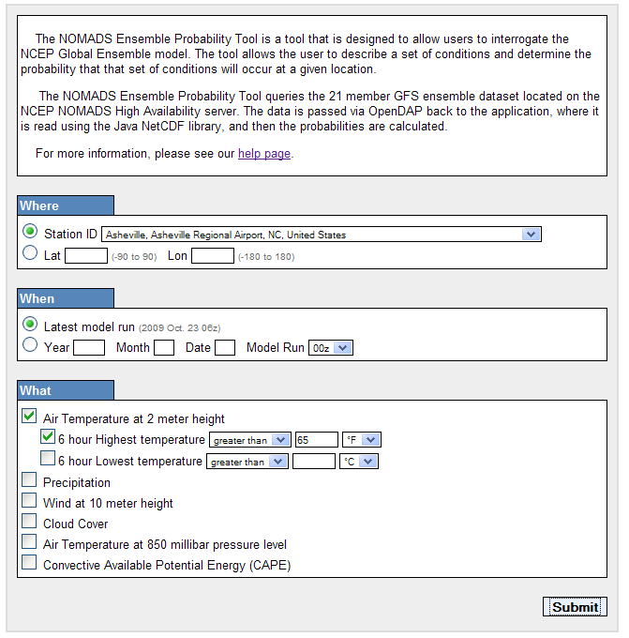
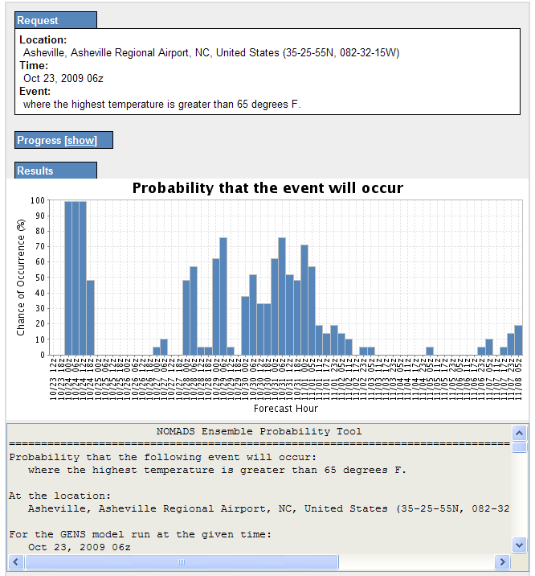
NOMADS Ensemble Probability Tool
PDF’s on the fly
NOMADS Ensemble Probabilities on the fly:
20 model runs
30 fcst projections
10 days of forecast
http://nomads.ncdc.noaa.gov/EnsProb/

Slide 29
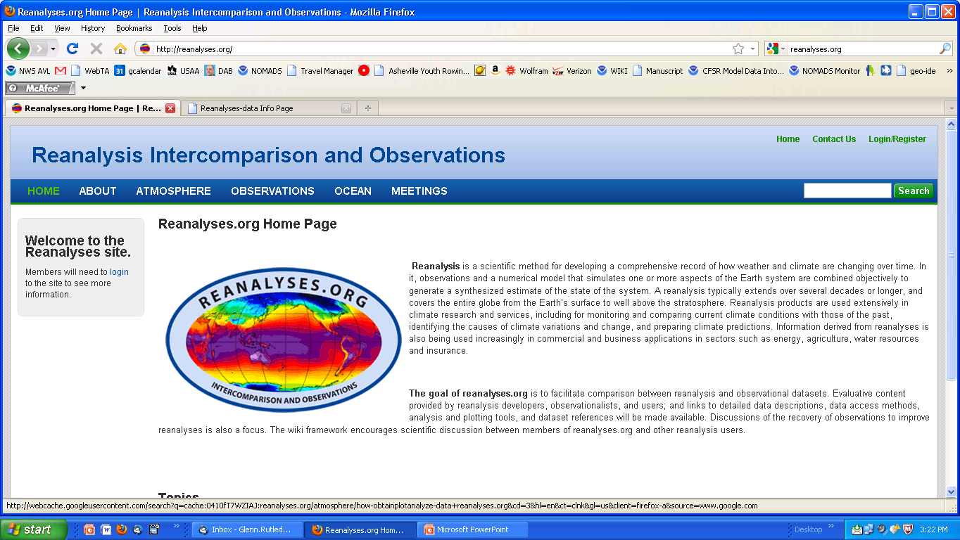
NOMADS - NCMP
Reanalysis.Org
Reanalyses.org collaboration to:
Facilitate comparison between
reanalysis and obs datasets
Evaluative content provided by
reanalysis developers
Provide links to detailed data
descriptions;
Describe and provide data access
Wiki format to promote
discussions of the recovery of observations to improve
reanalysis
NOAA, NASA, ECMWF, UKMET, JMA…

Slide 30
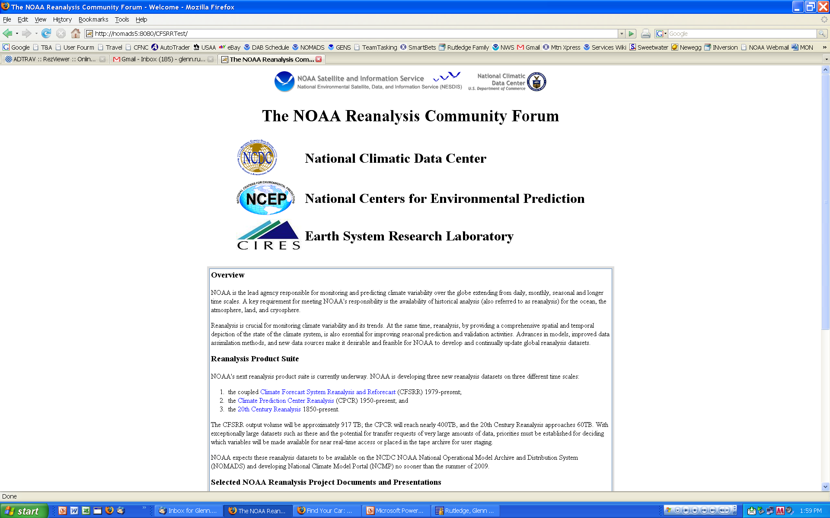
NCMP
NOAA’s Reanalysis Community Forum
NCMP hosts a community feed- back and information page. Used for requirements. Provides info for:
1) Climate of the 20th Century (Compo et al.,)
  1850 to present.
  2) Climate Forecast System Reanalysis and Reforecast (CFSRR) Project (Saha et al.) 1978-2009 modern era Reanalysis and Seasonal Reforecast
  3) tbd: CFSR ‘Lite” reanalysis (NCEP/CPC)
http://nomads.ncdc.noaa.gov/NOAAReanalysis/

Slide 31
NCMP Architectural
Design by Functional Areas
Project Management
Planning & Engineering
Climate Science Applications
Application Development
Sector Engagement
Systems Technology
Dataset Management
Model Data Dissemination Support

Slide 32
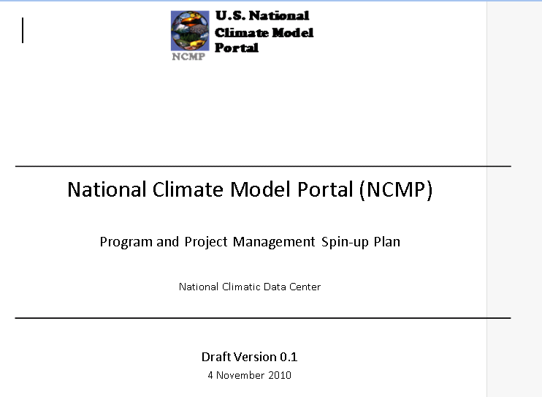
NCMP
Spin-up Plan and Charter
NCMP Project Management Spin-up Plan, Charter and Program Plans in development gathering stakeholder requirements, and leveraging and community efforts.
To reach its broad goals, NCMP
will focus its work on five key
functional areas:
1) dataset availability
2) scientific tool development
3) sector engagement
4) general tool development
5) climate data dissemination and support

Slide 33
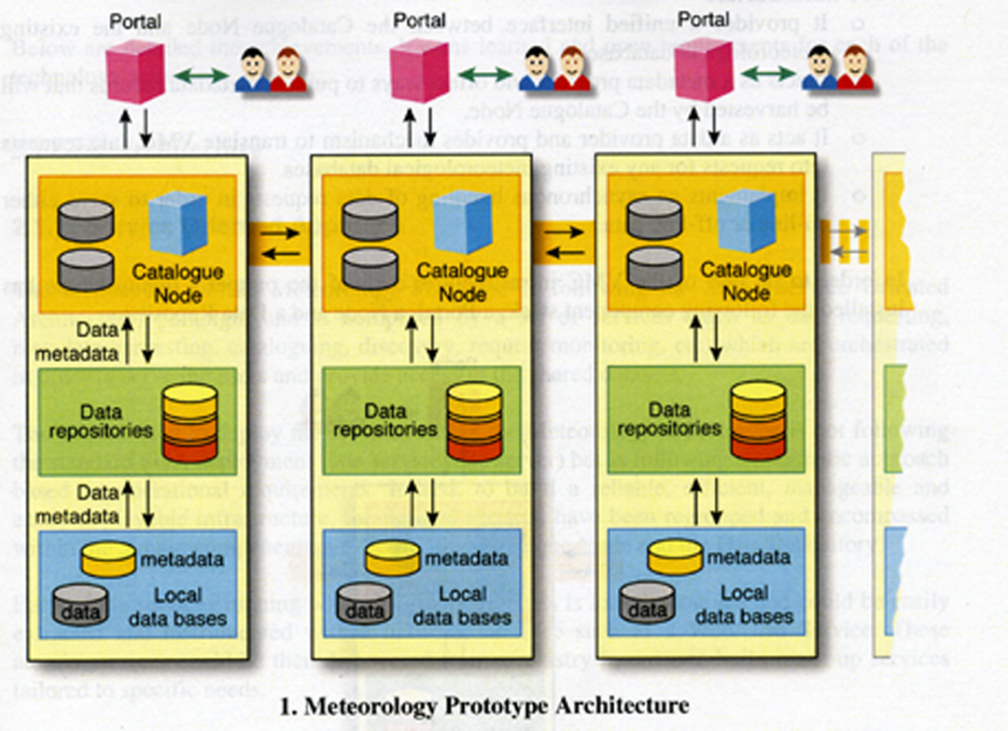
NCMP Initial Capabilities
U.S. National
Climate Model
Portal
NCMP
Architectural Fit: An Earth System Grid Federation Node
The initial NCMP architecture is based on NOMADS and on the DOE ESG: a (advanced) Portal, the ESG/TDS Catalog Node, and the (local) Data Repository.
The Portal is the user’s real-time interface to the system, manage requests, download data, receive user input and catalog browsing.
The Catalog Node advance and leverage ESG/ TDS. Heart of collaboration and concentrates on connecting partners, metadata, search and discovery and secure peer-to-peer connectivity.
the Data Repository will be based on advanced real-time access components, advancements to CLASS and will also use the NOAA Data Center IT infrastructure for long term storage and access
Generalized Schematic
NCDC
NCAR
GFDL
NCEP?
Archive
Data Sources
…*
Pilot w/ RENCI / DICE iRODS underway
Notes:
OAIS (Open Archive); THREDDS (NSF); OASIS; GOS; OPeNDAP; Common Data Model,

Slide 34
U.S. National
Climate Model
Portal
NCMP
Science Tools for Users (1/3)
NCMP
Support for assessments, downscaling, diagnostics, calibration of NWP ensembles and model-to-obs inter-comparisons, and aggregations of commonly used variables of NOAA reanalysis datasets.
Regridding: Preserving the monthly mean, from high res to low
res and back and forth.
Format Conversions, Transformations & Geo-rectification:
Grib1,Grib2 to CF complaint NetCDF; and from NetCDF3 to NetCDF4.
More general simpler tools for dumping data (of all formats) to
CF compliant NetCDF
Extraction of a pseudo-station location (ARM site for example)
from gridded model data using a Cressman analysis

Slide 35
NOAA National
Climate Model
Portal
NCMP
Science Tools for Users (2/3)
NCMP
NCMP ADVANCED / INTERMEDIATE USERS
Incorporate first look diagnostic capabilities. These could be both a thumbnail plot, brief description, resultant data in NetCDF form and (initially) python source code and OGC compliant (ESRI) plots.
Average Annual cycles, diurnal cycles, annual averages, examination of anomalies, measures of extreme events, climate sensitivity, decadal trends, ratio of variances, Empirical Orthogonal Functions and where applicable comparisons to observations.
Examination of tropical variability, calculation of ENSO indices, simulation of satellite measures from both models and observations

Slide 36
NOAA National
Climate Model
Portal
NCMP
Science Tools for Users (3/3)
NCMP
PROFESSIONAL USERS- Diagnostics & Model-to-Obs Inter-comparisons
On-line access to Climate Model Analytical Egines
  Climate model Data Analysis Tool (CDAT) for advanced model diagnostics and model-to-obs intercomparisons.
  other tools such as NCDC’s SPEC (Ansari et al) will be leveraged to a help develop thumbnail plots generated from CDAT python code as to be extensible with CDAT to accurately geo-locate non-discrete points to grids.
Variability (identification of regions of climate sensitivity)
  Tools will be developed to find a simple ratio of variances for (projected model results) / (observations)
  e.g., Twentieth Century Reanalysis Project, or Climate of the 20th Century run or, 2x or 4xCO2 GFDL IPCC CM.x runs
Decadal Temperature Trends and Average Annual Cycles
Anomalies can be pre-staged. Average annual cycle differences between a control run and a doubled CO2 would infer that presently precip maximums are in June – but in a 2xCO2 run precip maximizes in January. These are important direct measures appropriate for an advanced audience.

Slide 37
Simple Measures of sensitivity/indices:
- Ratio of variances of (surface temperature)/(skin temperature)
- Radiative flux measures: TOA and surface SW and LW
- Examination of vertical structure of simulated Cloud fraction
- Investigate quantification of surface albedo and change
- Quantification of extreme events from models compared to observations (frequency and magnitude)
- Derived ENSO, NAO, indices compared to observations, emphasize timing of reoccurrence and magnitude.
- Simulation of satellite measures from model data
ratio of variance of skin temp and simulated measure
Notes:
Will be on-line for easy access. Will be pre-computed!

Slide 38
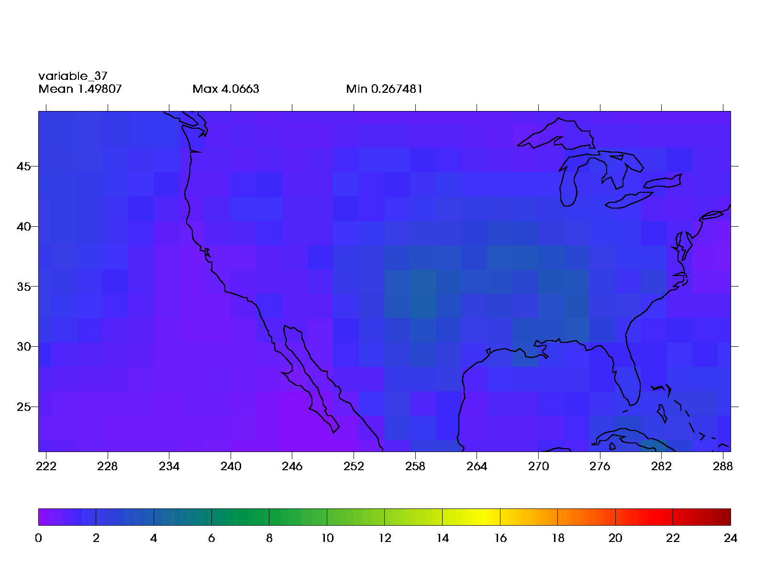
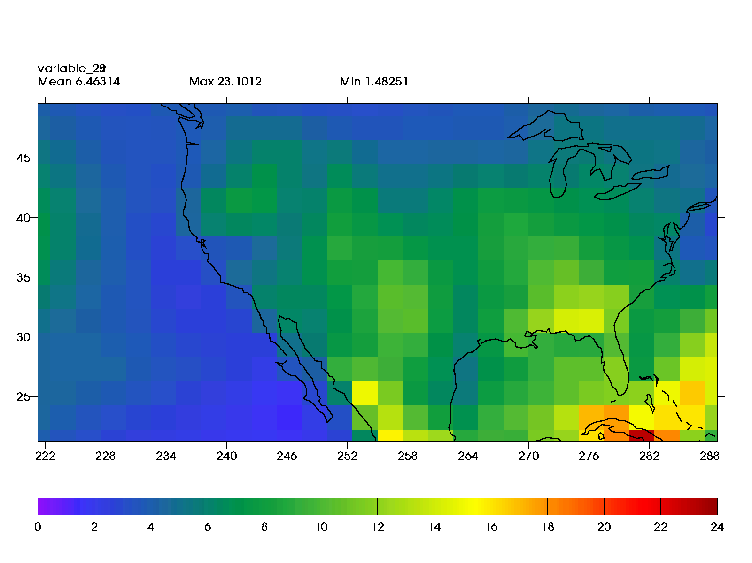
NOMADS - NCMP
Eg. Science Tools for Users
20C3M
Climate of the 20th century runs (Annual averages):
Global variance of surface temperature (C).
NCEP/NCAR R2 reanalysis (1948-2000) = 0.064
GFDL 2.1 (1948-2000) = 0.071
GFDL 2.1 (2000-2099) A2 = 0.841
GFDL 2.1 (2000-2099) A1B = 0.553
GFDL 2.1 (2000-2099) B1 = 0.193
SRESA2
A ratio of variance of annually
averaged surface temperature
(same scale)

Slide 39
NOAA National
Climate Model
Portal
National Climate Model Portal
Downscaling
NCMP
NCMP CICS DOWNSCALING
Close Coordination with U.S. National Assessment Program at USGCRP
Dynamical:
Initially use NCAR WRF for downscaling of global reanalysis, climate of the 20th century runs and 2xCO2 model runs. Output initially will emphasize state variables and those appropriate for study of the hydrological cycle and alternative energy production (e.g., wind, solar isolation).
Statistical:
NCMP will advance existing NCDC Sector Teams and work with mitigation, economic, and private sector researchers to formulate appropriate methods for application of this approach. We will emphasize tools to perform the calculations on the server side or give access to monthly-mean model output for data generation by the researchers themselves. It is thought ASCII text output would be sufficient for this method in the short term. (Heyhoe and Boyle guidance)

Slide 40
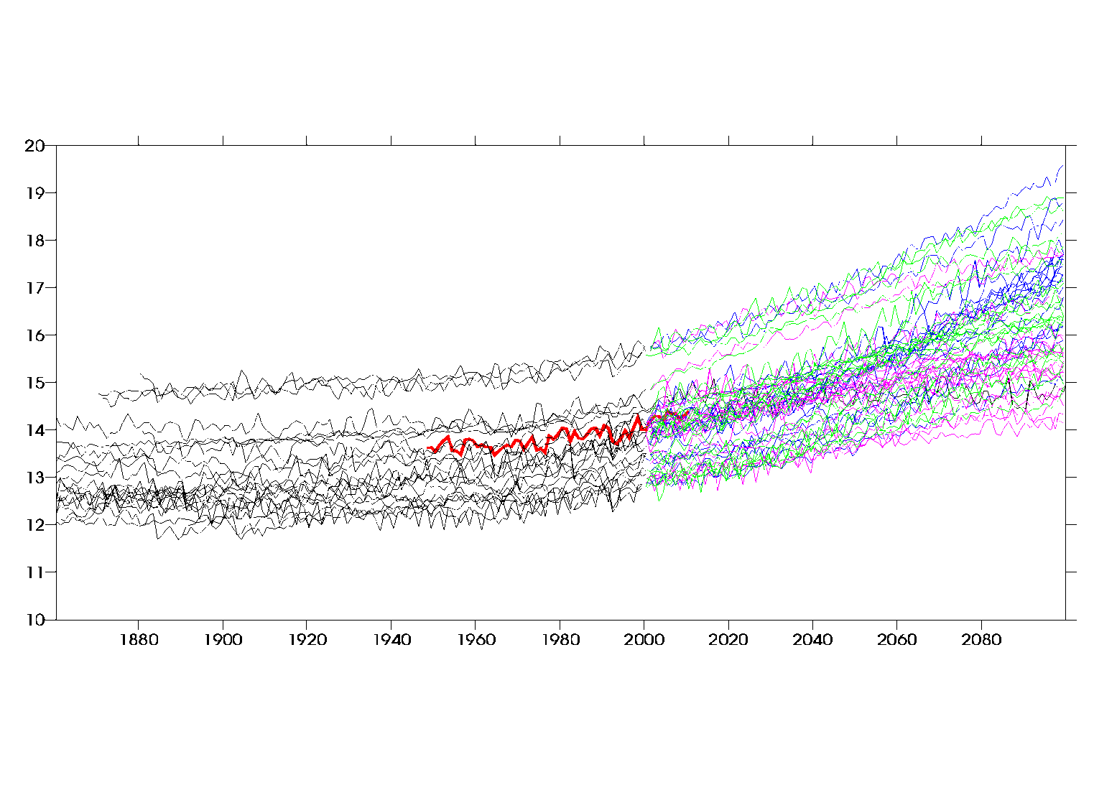
Modeling, NWP, and Intercomparison Projects
Global Surface
Temperature ⁰C
Climate of the 20th century
INGV_ECHAM4
CSIRO3.5
GISS_E_H
Climate Scenarios
R2 reanalysis
This plot is dynamically
generated from CMIP3 and
requested by NCSP
A2 Scenario:: Average of 19 different models and
average of last ten annual values = 17.00 ⁰C
A1B Scenario:: Average of 24 different models and
average of last ten annual values = 16.45 ⁰C
B1 Scenario:: Average of 20 different models and
average of last ten annual values = 15.51 ⁰C

Slide 41

Improved Data Management
NCDC Spinning Disc
NOMADS’ holdings continue to grow, especially with additions of new data as part of NCMP
Holdings now spread across 4 different NOAA/NCDC media
NCMP will leverage/create and/or select a data management system to abstract the handling of these media
NOMADS/NCMP users will gain a more consistent user experience across all datasets
NCDC Tape
CLASS Tape
ESG
iRODS
~ ½ PB
CLASS Spinning Disc
Both?
Consolidated Data Management System
Home-grown?

Slide 42

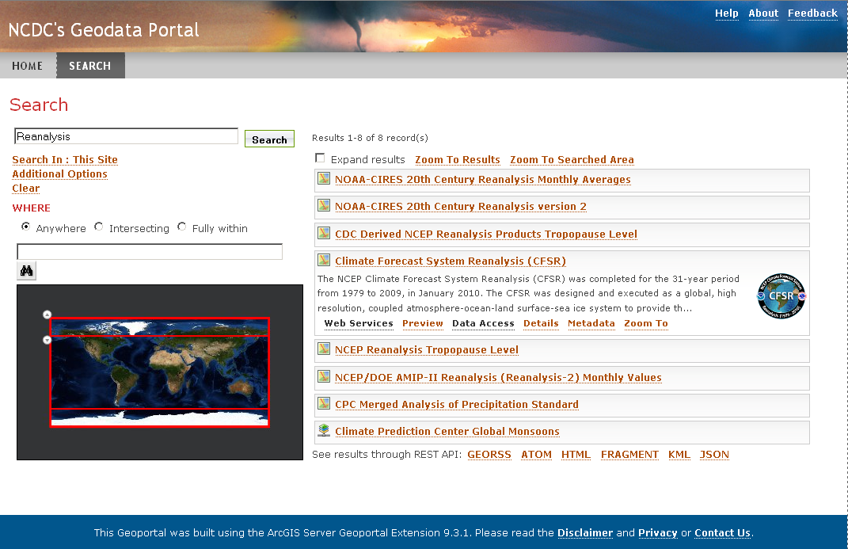





NOMADS as data store →
NCMP as data discovery
Metadata-based search and discovery
Extending distributed access mechanisms
Technology & tools such as
  ncISO
  ESGF
  ERDDAP / GI-cat / GI-go
  UAF
  esri GeoPortal

Slide 43
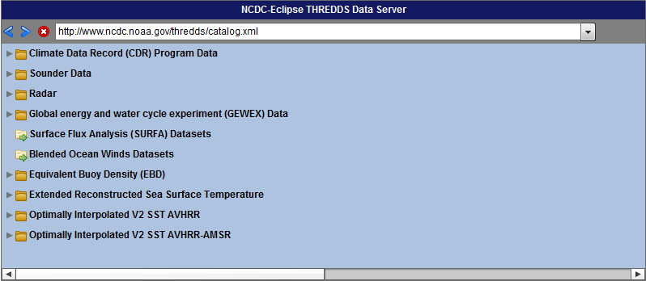
NCMP / NOMADS
Technology Enhancements
Extending NOMADS into interactive and sector-utilized formats and technologies
Example: THREDDS Catalog Navigation in Adobe® Flash®

Slide 44
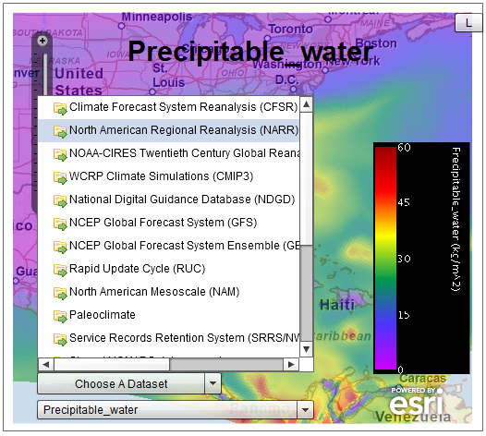
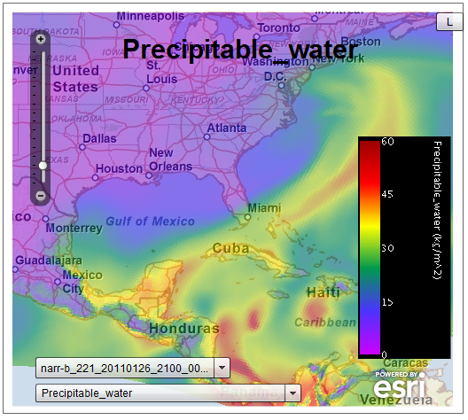
NCMP / NOMADS
Technology Enhancements (cont.)
Incorporating THREDDS-based data into interactive mapping applications
Utilizing OGC components from THREDDS (WMS, WCS, etc.)

Slide 45
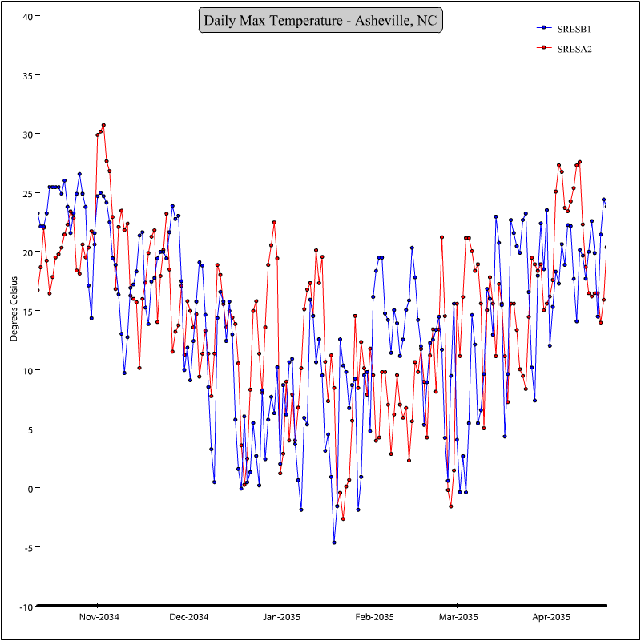
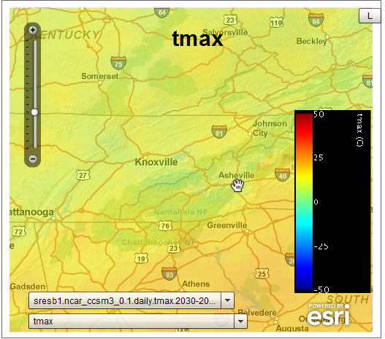

NCMP / NOMADS
Technology Enhancements (cont.)
Interactive experiences: CMIP3 data in a web-based mapping application with multi-scenario timeseries comparisons via Multigraph

Slide 46

NOMADS - NCMP
Support for GIS Users
NCMP
Oblate spheroid (aka, Earth) to sphere
Shapefile defined region to gridded data
CV
CV
At present there are no commonly
used transformations when going
from one to the other
EARTH
MODEL
No Datums included
in datasets
Shapefiles: Bound Regions
Grids defined by
Lat & Lon Bounds
?

Slide 47
Advanced Tasks: GIS to NetCDF
NCMP
1000m
Increasing Depth
100m
Tiles, GIS format
10m
Increasing Elevation
Gridding high/deep topography to netCDF
+
=
?
GIS geometries
Tiles at different scales
Notes:
Geoid issues

Slide 48
NOMADS – NCMP
Next Steps
Finalize Charter & Program Plans.
Codebase re-write (java/python). Improved tape access.
Implement requirements process: evolving Climate Service coordination; sector engagement: Water and Energy themes
NOAA Climate Model Portal Governance and Science Teams being established
Fill gaps in existing architecture identified in NOMADS
Capabilities nearing completion:
  ESGF; Model Reanalysis Observational Clearinghouse: (Reanalysis.Org); pre-aggregations of most requested data
Initiate Data Reduction processes
Prototype downscaling and diagnostics capabilities
2011 GO-ESSP Workshop; Climate Service Workshops

Slide 49
Select Bibliography
Rutledge, G.K., J. Alpert, and W. Ebisuzaki, 2006: NOMADS, a climate and weather model archive at the National Oceanic and Atmospheric Administration. Bulletin of the American Meteorological Society, 87 (3), 327-341.
Saha, Suranjana, and Coauthors, 2010: The NCEP Climate Forecast System Reanalysis. Bull. Amer. Meteor. Soc., 91, 1015–1057.
Compo GP, et al., 2011. The Twentieth Century Reanalysis Project. Q. J. R. Meteorol. Soc. 137.
2010 BAMS Global State of the Climate Report, 2011:
(in press)

Slide 50
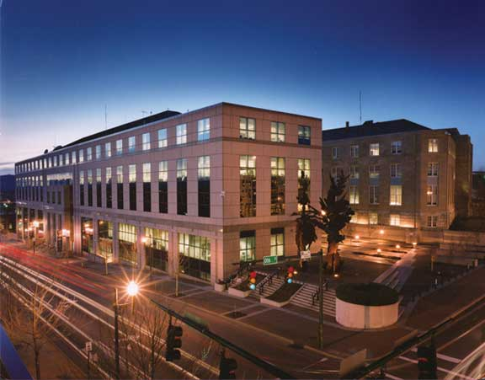
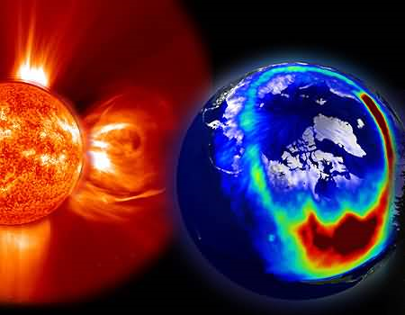
Questions?
Glenn.Rutledge@noaa.gov
NCDC Asheville, NC
M. Sutton 1995
NOAA National
Climate Model
Portal
NCMP
http://nomads.ncdc.noaa.gov

