Slide 1




NextGen Weather:
Network-Enabled Verification Service
Jamie Vavra
Office of Science and Technology
National Weather Service
Jennifer Mahoney and Melissa A. Petty
Forecast Impact and Quality Assessment Section
Aviation, Computing and Evaluation Branch/Global Systems Division
Office of Oceanic and Atmospheric Research

Slide 2
Overview
Motivation for NEVS
NWS Plans and Requirements for NEVS
NEVS OSIP and Implementation Schedules
Evolution of Verification
Current RTVS Capabilities
NEVS Solution
NEVS Techniques
NEVS Prototype 2010
Summary

Slide 3
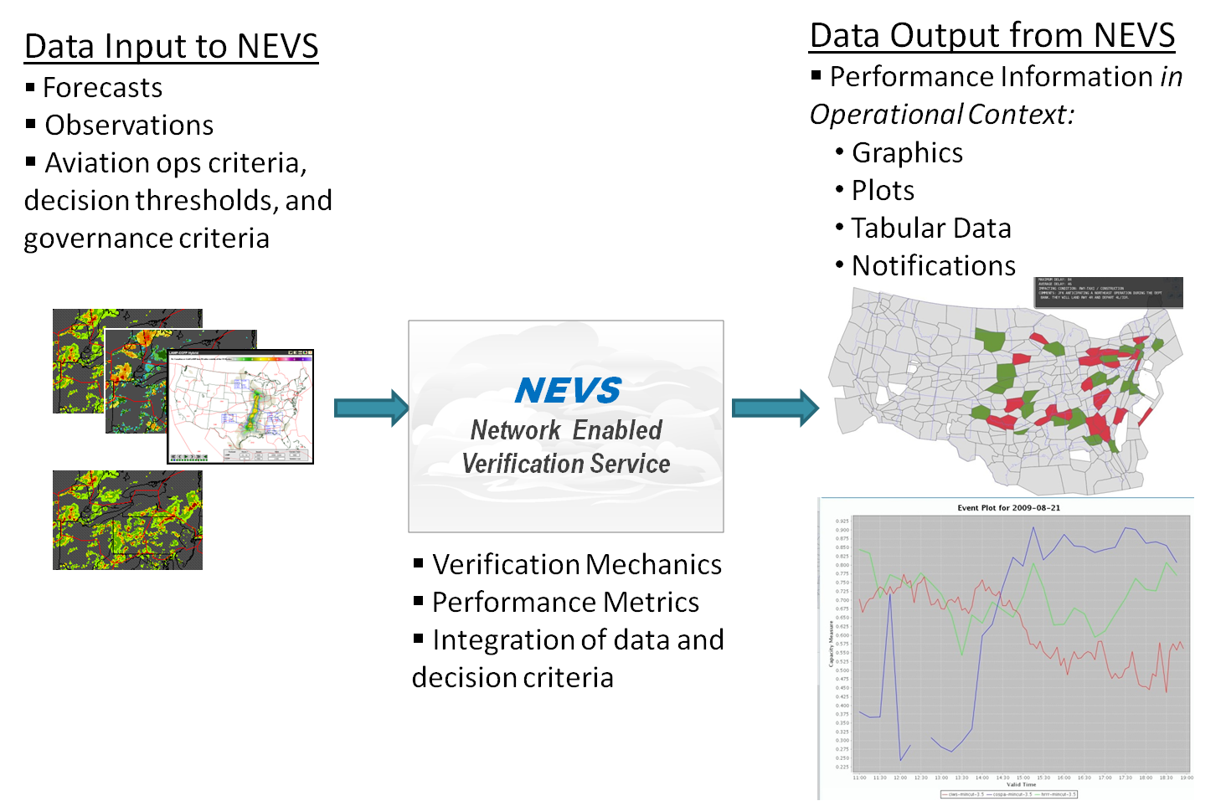
Network-Enabled Verification Service (NEVS) Overview

Slide 4
Motivation for NEVS
Support the Federal Aviation Administration (FAA) goals for the Next Generation Air Transportation System (NextGen)
Provide NWS forecasters real-time feedback on the quality of their official products
Provide users of the NextGen 4-Dimensional Weather Data Cube (Cube) information about quality and uncertainty of the data and products they access
Need to establish quality baselines for NextGen Program Performance Management

Slide 5
Key NWS NEVS Requirements
Forecaster Perspective
  Real-time feedback to forecasters
  User relevant verification metrics and displays
  Web-based graphical interfaces
  Augment existing NWS capabilities in Stats on Demand (SOD) and National Digital Forecast Database (NDFD) verification systems
System Perspective
  NextGen Net-centric Standards
  Service Oriented Architecture (SOA)
  Open Geospatial Consortium (OGC) Web Services
  Inter-operability among all Cube system components
User Perspective
  NEVS will be a consumer of and publisher of verification results to NextGen Cube
  Objective data to use for Single Authoritative Source for FAA

Slide 6
NEVS Notional Architecture
4-D Wx Data Cube
CIES= Cube Input Edge Services
COES = Cube Output Edge Services
SOD = Stats on Demand Verification System
NDFD = National Digital Forecast Database Verification System
SAS= Single Authoritative Source
SAS
Net-enabled Observations + Analyses + Forecasts
Net-enabled Verification Results for FAA and SAS
CIES
COES
NEVS
NDFD
SOD
Users and Partners
FAA’s Quality Management System
Federal Government
NWS Forecasters

Slide 7
NOAA NextGen Plans for NEVS
NWS plans to transition NEVS to operations to replace Real-Time Verification System (RTVS) by 2013
NEVS capabilities will continue to evolve incrementally until NextGen Final Operational Capability (FOC) in 2022
NEVS at NWS will have five primary roles:
  Verification of Aviation Services products
  Verification of 4-D Weather Data Cube elements
  Support development of performance measures
  Support FAA’s Quality Management System (QMS) verification reporting requirements
  Provide objective information for NextGen Single Authoritative Source (SAS) contents decision-making

Slide 8
NEVS OSIP Milestones
Gate 1 - Completed June 2009
Gate 2 - Completed April 2010
Gate 3A - Completed September 2010
Gate 3B - April 2011
Gate 4 - April 2012
NEVS Deployment at NWS - Fall 2013

Slide 9
Schedule for NEVS Implementation at NWS
NOAA NextGen Weather Program planned funding:
  2010-13
    Prototype NEVS verification web services capabilities as a consumer of NextGen Cube
    Develop NEVS Architecture
    Implement RTVS functionality in NEVS
  2011-13
    Prototype NEVS verification results as web services provider to AWIPS II via Data Delivery and to the NextGen Cube
  2013
    Integrate NEVS with NextGen Cube infrastructure
    Deploy NEVS in NWS operations

Slide 10
Evolution of Verification
 | 1990’s | ~2003 | 2013
Verification Drivers | Meteorological quality assessment feedback to algorithm developers | Support for the Aviation Weather Technology Transition (AWTT) process Historical aviation forecast performance record for FAA Managers Meteorological quality assessment feedback to forecast producers Meteorological feedback to algorithm developers | NextGen: Forecast performance in the context of FAA operations and decision criteria Support for Research Transition process (formerly AWTT) Historical aviation forecast performance record for FAA and NWS Managers Meteorological quality assessment feedback to forecast producers Meteorological feedback to algorithm developers
Performance Metric and Verification Techniques | Standard meteorological skill scores for State of the Atmosphere variables | Modified verification techniques and scores for aviation weather products, historical performance | User-specific verification techniques and new performance metrics to provide performance in the context of how the forecast is used
Engineering Requirements | Tools for users | Database storage and web access to results | Real-time feedback for operational decision support, and real-time machine to machine delivery of data

Slide 11
Demands of a NextGen Verification Service
Network-enabled communication for data access and distribution
Forecast quality in the context of its use
Agility and adaptability to add new datasets and methodologies
Meets security and safety requirements of the NextGen architecture

Slide 12
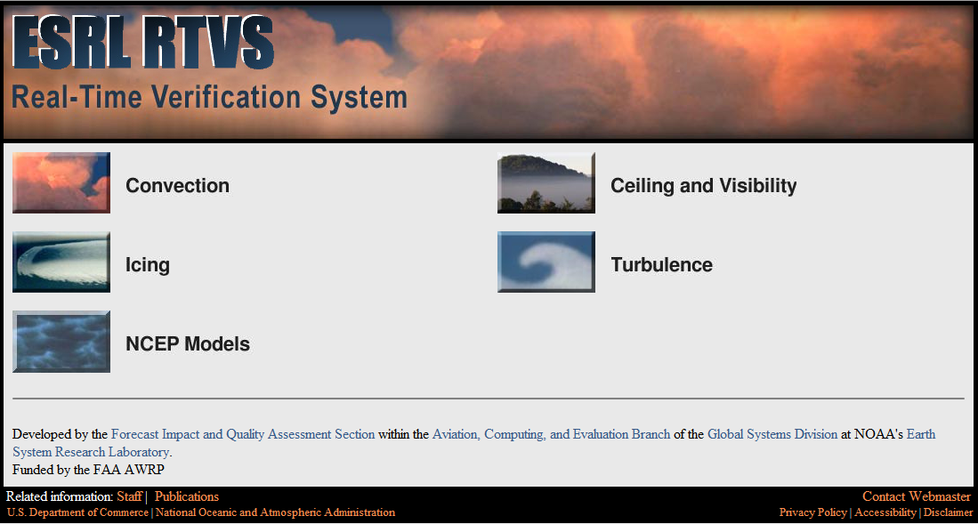
Current Verification - RTVS

Slide 13
RTVS Has Served Us Well, but…
Lack of modularity
  Invasive changes needed to add new products
  Requires duplication across verification domains to incorporate new methodologies
Data ingest and output lack ability to support NNEW protocols
Security and maintenance do not meet operational requirements
More cost-effective to re-engineer … resulting in NEVS

Slide 14
The NEVS Solution
New infrastructure
  Modular decomposition allows for the efficient addition of new data products and verification methods
  “Integration” layer supports the joining of verification data with air traffic information
  Support of NNEW communication protocols
New verification techniques
  Incorporate user-based criteria
  Methodologies represent the use of the forecast in aviation decisions

Slide 15
NEVS Infrastructure
Production
Integration
Presentation
Data ingest and management
Import of verification results from other systems
Verification modules
Storage of verification information
Storage of air traffic information
Strategies to allow joining of air traffic and verification information
Web user interface providing variety of graphical results
Web services for machine-to-machine communication

Slide 16
Verification Techniques
Traditional
  Pixel-to-pixel
  POD, FAR, CSI
  Stratifications such as forecast issuance, lead, altitudes
Future
  User-based
  Object-oriented
  Operational stratifications such as telecon time, planning period

Slide 17
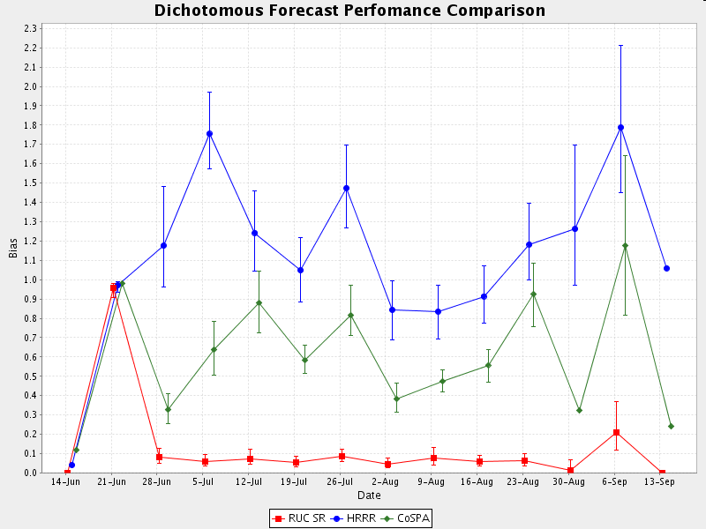
Traditional Metrics
Can provide a first-order indicator of skill
User-agnostic
May even be misleading, particularly for high-resolution models
Notes:
While we want to mention traditional/standard verification approaches, they are only one way of evaluating a forecast, so it’s important to emphasize other, newer, approaches (see next slides)

Slide 18
Future – Incorporation of the User’s Perspective
Methodologies incorporate use of the forecast in a decision-making context
Example: Context of operational ATM planning:
  Strategic decision points are incorporated into statistical measures
  Operational spatial domains are included in assessment mechanics
    ARTCC boundaries
    High altitude sectors
  Metrics link forecast quality to operational constraints such as air space capacity
Notes:
Example of strategic decision points are the standard 4 telecon times each day that ATM planners develop strategic plans

Slide 19
User-based Techniques
Forecasts and observations are translated into estimates of sector capacity (or capacity reduction), due to presence of convective weather
  Techniques such as Mincut Bottleneck
Resulting output is at the spatial granularity of high altitude sectors
Verification skill scores are applied to translated forecast and observations, thus measuring performance in context operational parameters (such as airspace capacity)

Slide 20
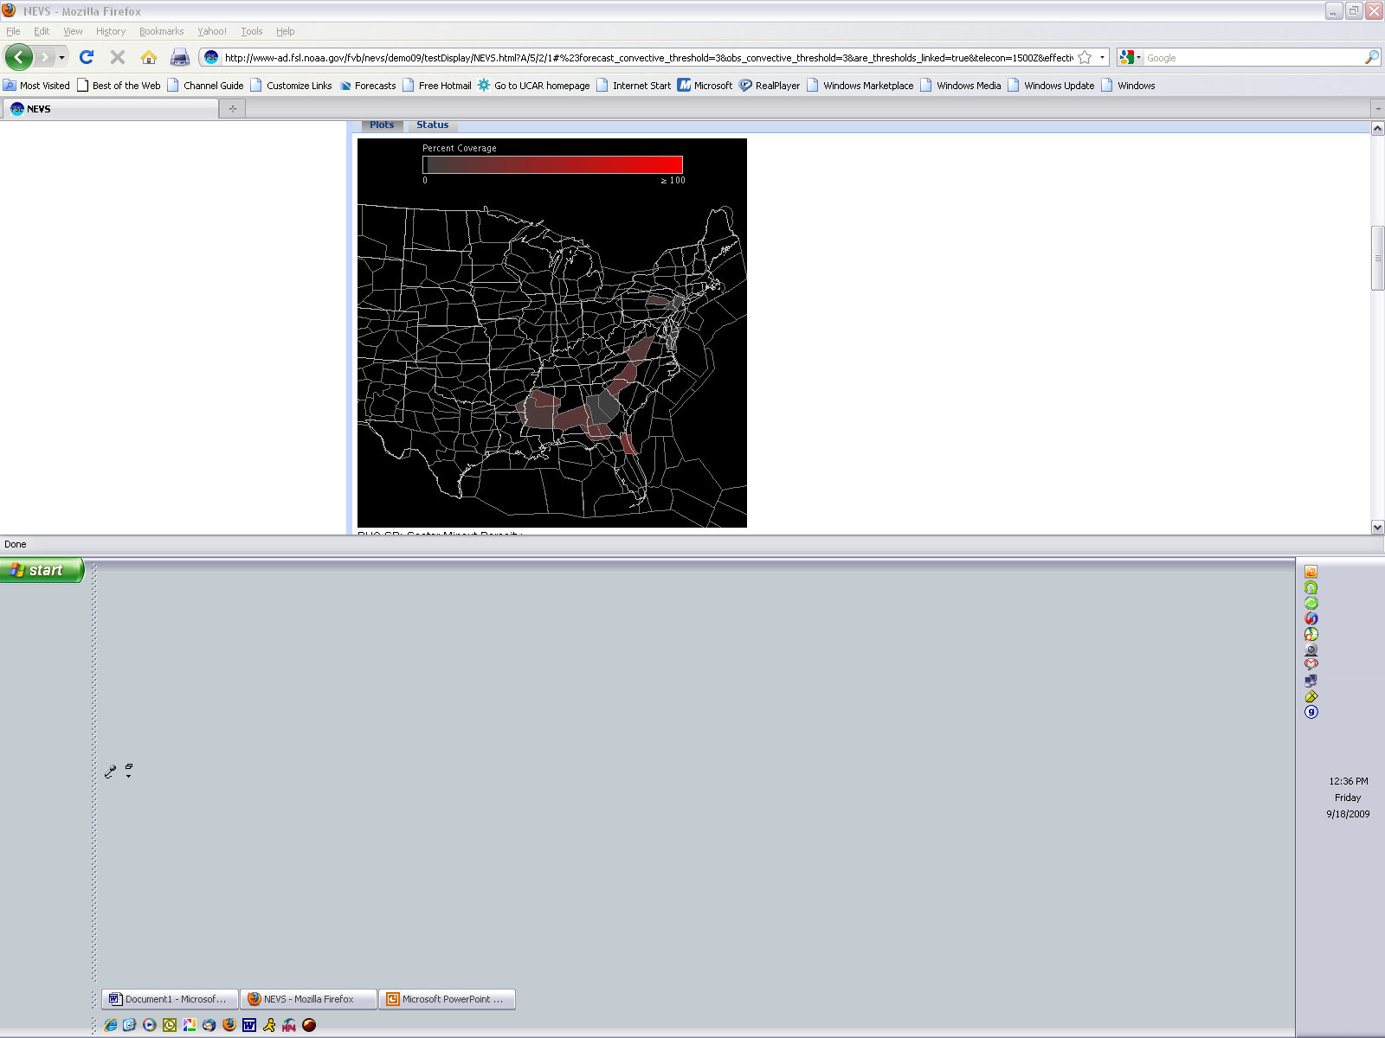
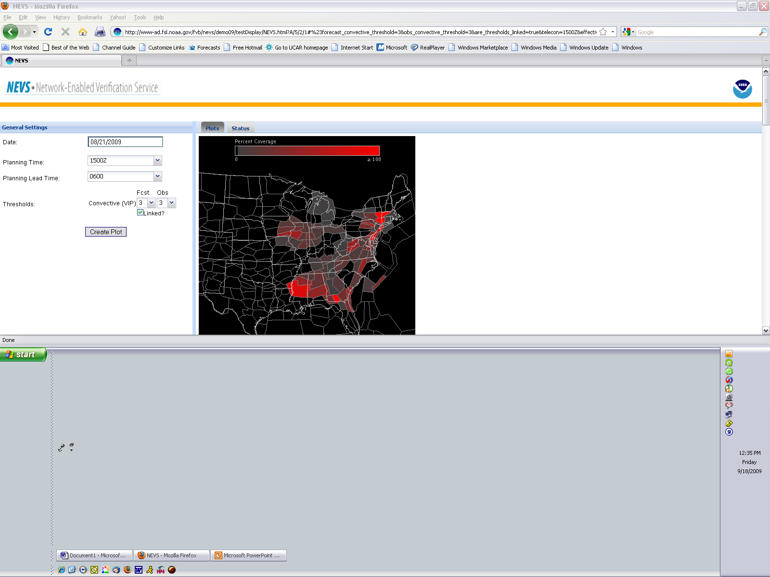
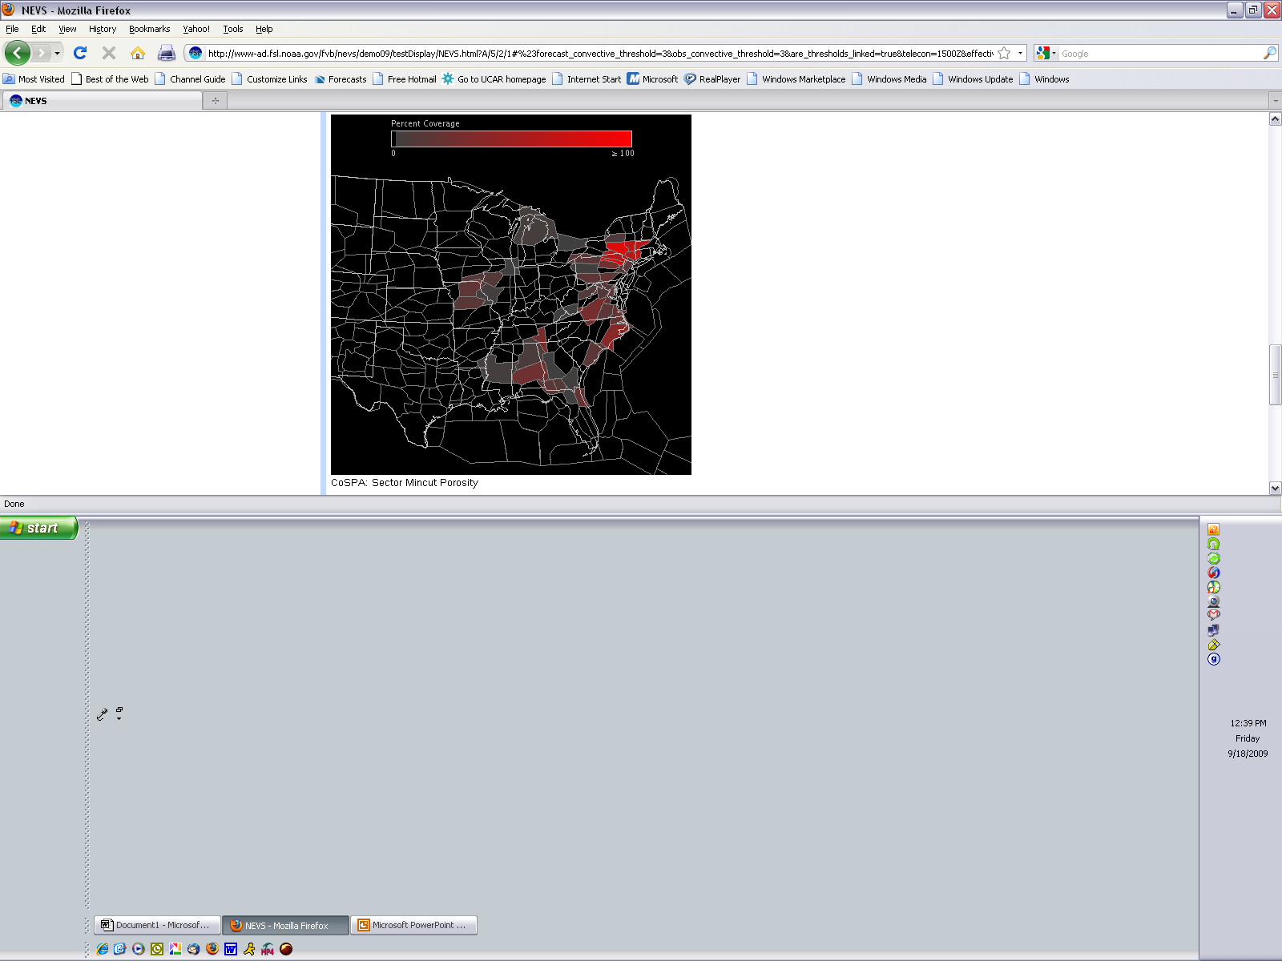
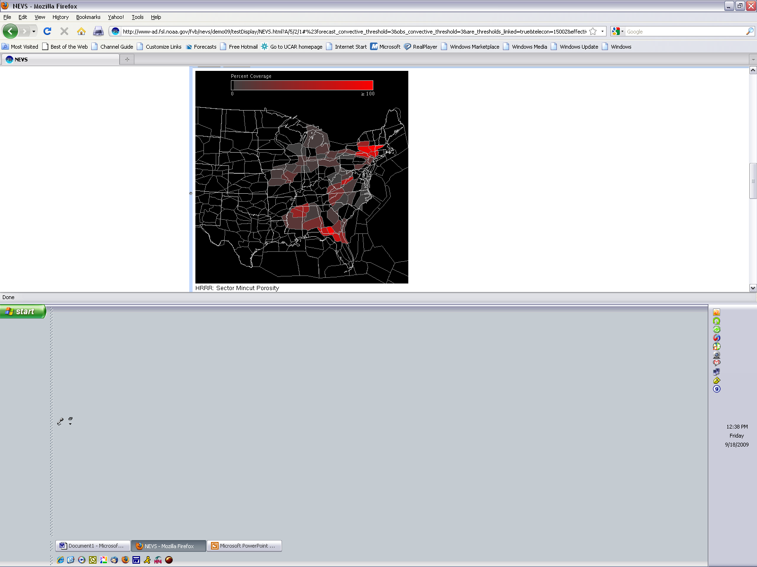
NEVS Graphical Mincut Bottleneck Output
Forecast 1
Obss
Forecast 2
Forecast 3
20
Notes:
Sectors become pixels

Slide 21
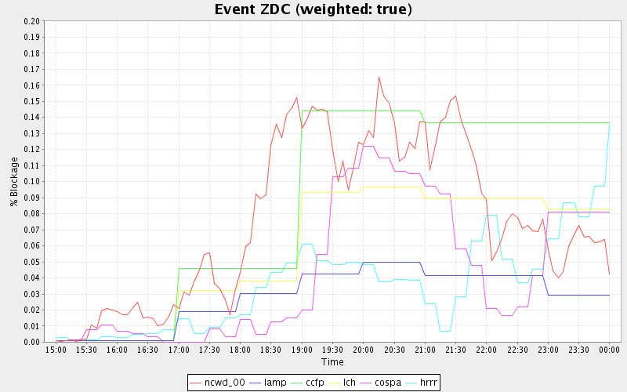
Planning Point Capacity Plot
% Blockage as derived from
Mincut Bottleneck Technique
Cessation
Onset

Slide 22
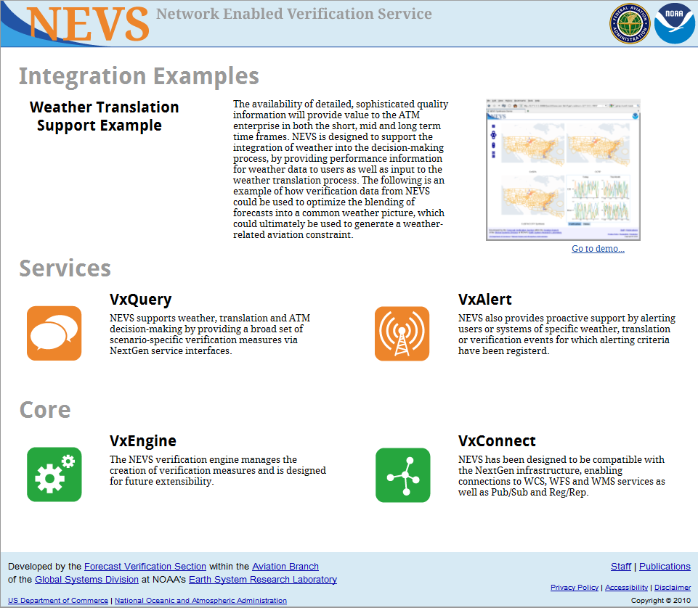
NEVS Prototype 2010

Slide 23
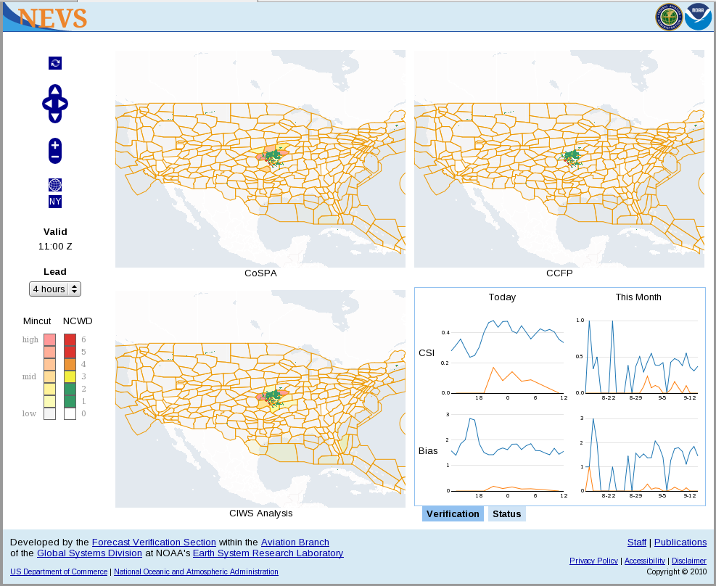
NEVS Prototype 2010

Slide 24
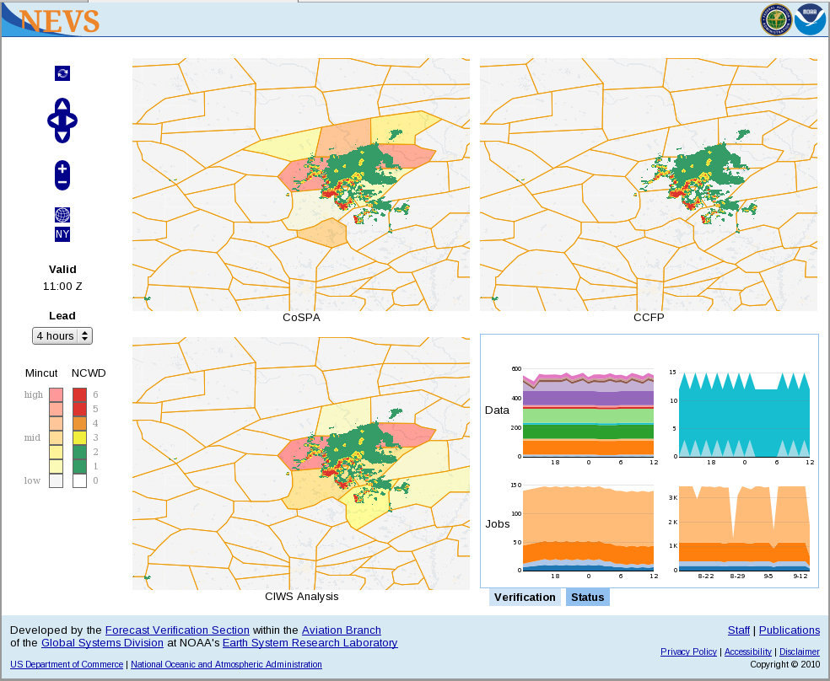
NEVS Prototype 2010

Slide 25
Summary
NEVS verification capabilities will enable NWS, FAA and users to understand quality of Aviation Products and data provided in NextGen Cube

Slide 26
Backup Slides

Slide 27
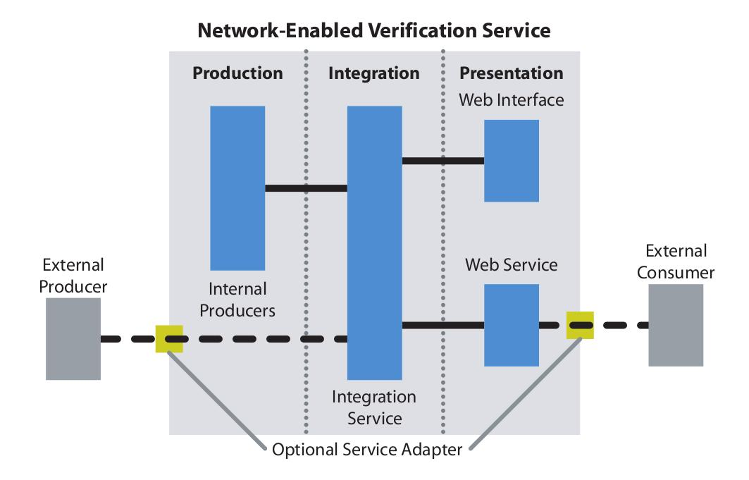
NEVS Architecture

Slide 28
Mincut Bottleneck
Technique
Jetway
Sector
Hazard
Corridor
Bottleneck
Blockage Potential 0.5

Slide 29
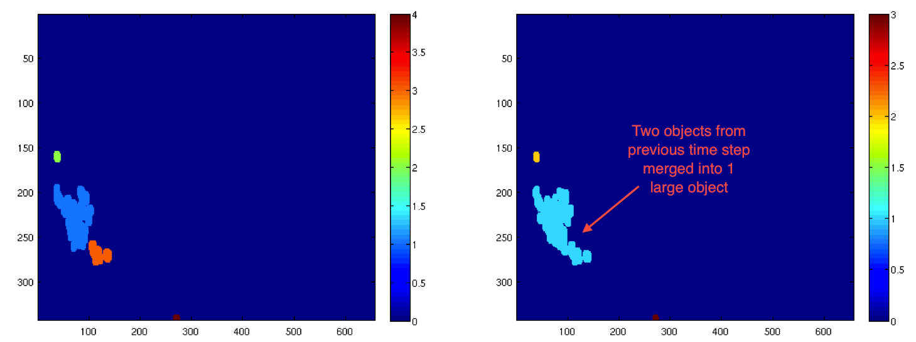
Object-oriented Techniques
Attempt to capture how the user perceives the matching of objects in the forecast field to the observed field
Differentiators between techniques are
  What defines an object
  How objects (between forecast and obs) are matched

Slide 30
Procrustes Methodology
Identify forecast and observation objects (cells)
Fit forecast cells to truth cells by shifting location, resizing the object, and rotating them if necessary
If there is not a perfect fit, there will be a resultant residual error term
Works with gridded data of any dimensions for spatial objects
References
  Micheas et al. 2007, Cell identification and verification of QPF ensembles using shape analysis techniques. J. of Hydro., 363, 105-116.
  Lack et al., 2010: An Object-Oriented Multiscale Verification Scheme. Weather and Forecasting, 25, 79-92
30

