Slide 1
NDFD Statistics Viewer
John Wagner & Dana Strom

Slide 2
Planned Updates to Viewer on AWS
Current NDFD Sample Matching
NDFD | Blend/Blendx |  | GMOS |  | WPC (day 4-7)
IssuanceTime | Model Cycle | Available Time | Model Cycle | Available Time | Model Cycle | Available Time
00z | 19z | 20z | 12z | 18z | 12z | 16z
06z | 01z | 02z | 12z | 18z | 00z | 04z
12z | 07z | 08z | 00z | 06z | 00z | 04z
18z | 13z | 14z | 00z | 06z | 12z | 16z

Slide 3
Planned Updates to Viewer on AWS
New NDFD Sample Matching - CONUS/Puerto Rico
NDFD | Blend/Blendx Early |  | Blend/Blendx |  | GMOS |  | WPC (day 4-7)
Issuance Time | Model Cycle | Available Time | Model Cycle | Available Time | Model Cycle | Available Time | Model Cycle | Available Time
00z | 13z | 14z | 19z | 20z | 12z | 18z | 12z | 16z
12z | 01z | 02z | 07z | 08z | 00z | 06z | 00z | 04z

Slide 4
Planned Updates to Viewer on AWS
New NDFD Sample Matching - Alaska/Hawaii
NDFD | Blend/Blendx Early |  | Blend/Blendx |  | GMOS
Issuance Time | Model Cycle | Available Time | Model Cycle | Available Time | Model Cycle | Available Time
06z | 19z | 20z | 01z | 02z | 12z | 18z
18z | 07z | 08z | 13z | 14z | 00z | 06z

Slide 5
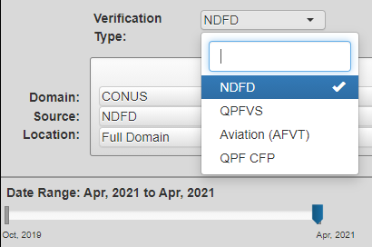
Planned Updates to Viewer on AWS
Four selectable Verification Types to support unique sample matching
NDFD - NDFD/NBM/GMOS/WPC verification through 7 days
QPFVS - QPF Verification Service
Aviation (AFVT) - near-term hourly NDFD verification through 36 hours
QPF CFP - Special QPF verification for Collaborated Forecast Process demo

Slide 6
Planned Updates to Viewer on AWS
Entire period of record (April 2005-present) for NDFD
Query by Blend version number (in addition to Blend, Blendx)
Gridded scores for just land areas, just water areas, or both
High Impact Verification for NDFD
Scores specific to valid times when selected WWAs (e.g., winter weather) were in effect
Additional elements
QPF24 and Snow24 in QPF CFP
RH/Apparent Temperature in NDFD
NDFD, Blend, and GLMP wind speed/gust/direction, temp, dewp, sky cover to 36 hours in Aviation (AFVT)
QPF01 - Blend, GFS, and HRRR to 36 hours in Aviation (AFVT)
PoP01 - Blend and GLMP to 36 hours in Aviation (AFVT)
12-hr Max Wind Gust in NDFD
Gridded Verification for the Guam and Oceanic domains

Slide 7
Known Issues
Station PoP12
Probabilistic verification takes significantly longer to run in MET
Solution that works for the 134 gridded masks (WFOs/regions/RFCs) does not work for 2600+ stations
Gridded Monthly PoP12
Daily PoP12 brier scores are available
Currently missing from Mar-Present due to an offset problem with WPC data
We rely on unreliable sftp to move data from WCOSS to MDLnet
Will no longer be an issue when viewer/db is in the cloud

Slide 8
Data Usage
Sufficient Data for Contingency Table Scores (Heidke Skill Score, Critical Success Index, Probability of Detection, False Alarm Ratio, etc)
Looking at small samples of data for these scores can produce unexpected results. If thresholds are not exceeded, no results will be displayed.
We recommend selecting at least 30 days of data when looking at these scores
Blendx
Blend V4.1 started on May 20, 2021
Blend V4.0 spans February through September 2020
Blend V3.2 spans October 2019 through January 2020
Quality Control
QC for gridded data currently using “common sense” thresholds and known issues that we have encountered.
If you encounter data that you believe incorrectly got through our QC process, please let us know via VLab/slack.

Slide 9
More information about MET
DTC Homepage
MET V9.1 Users Guide
Existing builds on NOAA Machines

Slide 10
NDFD Statistics Viewer
NDFD Statistics Viewer
https://veritas.mdl.nws.noaa.gov/ndfd-stats/comparative/verification.php
VLab Community
https://vlab.ncep.noaa.gov/group/mdl-forecast-evaluation
Slack
https://noaa-mdl.slack.com/archives/C01AC41QVFC
QPFVS
https://veritas.mdl.nws.noaa.gov/qpfvs/verification.php

Slide 11
Backup Slides

Slide 12
NDFD Statistics Using MOS-2000
Gridded and station verification for months only
Relied on monthly station obs file from the Statistical Modeling Division
Run after the 15th of the following month
63-step process to run the verification
Plots and tables available to users limited to monthly averages
Station data limited to WFO averages

Slide 13
NDFD Statistics Using Model Evaluation Tools (MET)
Hourly verification
7 day delay for QPF and PoP - to get final URMA grid with RFC updates
1 day delay for other elements
Quality control station data using the Community Atmospheric Modeling Post-processing System (CAMPS)
Data is ingested nightly into the database
Currently automated using crons. Upgrade to rocoto as job scheduler coming soon.
New viewer allows users to verify custom ranges for grids
Monthly station verification can be plotted for an individual station
Monthly station and gridded verification still runs around the 15th of the following month, when all necessary obs are available

Slide 14
How MET Differs From MOS-2000
Grib2/netCDF files instead of TDLPack
Run for a single model/element/projection
Case and Gridpoint matching done externally
Data must be preprocessed for thresholds
MET is not optimized to run on a supercomputer
Using MET ensures consistency of scores among users

Slide 15
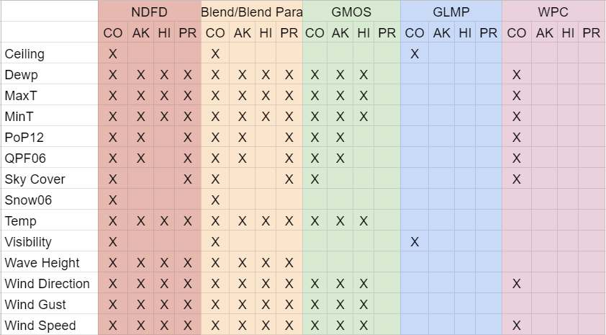
What is Verified Currently

Slide 16
Known Issues
Station PoP12
Probabilistic verification takes significantly longer to run in MET
Solution that works for the 134 gridded masks (WFOs/regions/RFCs) does not work for 2600+ stations
Gridded Monthly PoP12
Daily PoP12 brier scores are available
Currently missing from Mar-Present due to an offset problem with WPC data
Station MaxT/MinT
Working through issue with CAMPS QC process

Slide 17
Known Issues
Station Verification for Guam
Currently working through issues with data for Guam
Station Sky Cover Obs Require Satellite Data
SCE/SCW data was down for Feb-Oct 2020
Offsets off for WPC cl/dp/mx/mn/po/ws/wd for Feb 26-May 10
We rely on unreliable sftp to move data from WCOSS to MDLnet
This is no longer expected to be an issue after the db/viewer is in the cloud

Slide 18
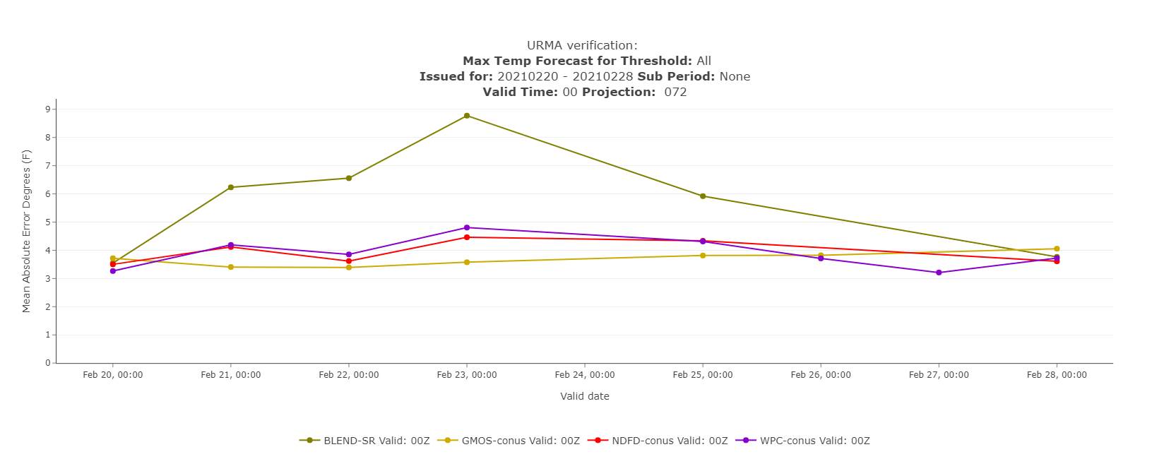
Feb 24 - Data missing for all dates means missing data or data failed QC check
Feb 26-27 - Missing Blend data means that we likely had an sftp issue. Please let us know when you see this.

Slide 19
Score Groups - CNT
Continuous Scores (CNT)
Mean Absolute Error (MAE) - measures accuracy of a forecast
Perfect Score: 0
Bias - indicates whether a forecast is too high or too low in predicting a certain parameter. Also known as Mean Error (ME).
Perfect Score: 0
Root Mean Square Error (RMSE) - measures the accuracy of a forecast. Since the mean is computed of the square error, more emphasis is placed on larger errors.
Perfect Score: 0

Slide 20
Score Group - CTS/CTC
Contingency Table Scores (CTS) and Contingency Table Counts (CTC)
Critical Success Index (CSI) - ratio of the number of times the event was correctly forecasted to occur to the number of times it was either forecasted or occurred. Also known as the Threat Score.
Perfect Score: 1
Probability of Detection (POD) - the fraction of events that were correctly forecasted to occur. Also known as the hit rate.
Perfect Score: 1
False Alarm Ratio (FAR) - the proportion of forecasts of the event occurring for which the event did not occur.
Perfect Score: 0
Gilbert Skill Score (GSS) - the CSI, corrected for the number of hits that would be expected by chance. Also known as the Equitable Threat Score.
Perfect Score: 1

Slide 21
Score Group - CTS/CTC
Contingency Table Scores (CTS) and Contingency Table Counts (CTC)
Heidke Skill Score (HSS) - skill score based on Accuracy, where the Accuracy is corrected by the number of correct forecasts that would be expected by chance.
Perfect Score: 1
Frequency Bias - the ratio of the total number of forecasts of an event to the total number of observations of the event. A “good” value of Frequency Bias is close to 1; a value greater than 1 indicates the event was forecasted too frequently and a value less than 1 indicates the event was not forecasted frequently enough.
Perfect Score: 1
Percent Correct - Ratio of forecasted events to the total number of events.
Perfect Score: 100

Slide 22
Score Group - PSTD/PCT
Probabilistic Statistics for Dichotomous Outcome (PSTD) and Probabilistic Contingency Table (PCT)
Brier Score (BS) - Mean squared probability error
Perfect Score: 0
Reliability Plot - Ratio of times an event was forecast to occur versus how often it occurred.
Perfect Score: Diagonal line

