Slide 1
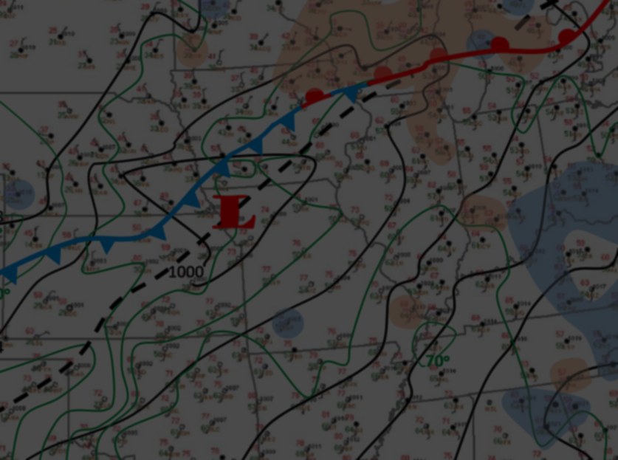
Impressions and Lessons Learned From Mesoanalyst Boot Camp
Jesse Lundquist WFO Goodland
Notes:
Once upon a time there was a forecaster who wanted to learn how to properly use his meteorological knowledge to better anticipate storm development and behavior instead of being held at the mercy of the performance of the models. So he applied and was accepted to the mesoscale boot camp in KC. Good day everyone, my name is Jesse Lundquist, one of the lead forecasters at the Goodland, KS office. Today I will be sharing with you my impressions and lessons learned from the mesoanalyst bootcamp I attended in July.

Slide 2
Topics
Structure of Boot Camp
Key takeaways
Helpful displays
Duties of mesoanalyst
Conclusions
Notes:
Here are the topics we will cover. The presentation will start off with an overview of the structure of the boot camp. Following that, most of the presentation will be about the key takeaways of my experience at the boot camp. After that I will show some examples of the helpful satellite displays that were used. As we approach the conclusion of the presentation I will outline the general duties of the mesoanalyst then wrap up the presentation with some concluding points.

Slide 3
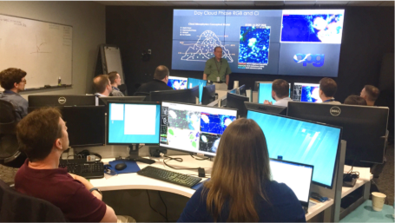
Structure of Boot Camp
Instruction Days 1-2
Case work Days 3-4
Wrap-up/Assessment Day 5
Goal: Accurately anticipate what the radar will look like in 2-3 hours and communicate specifically what/when/where to the public.
Notes:
During the boot camp we received Instruction from Areil Cohen, Rich Thompson, and Matt Foster
The first two days were instruction and review of concepts we were already familiar with.
The bulk of the workload occurred on days 3 and 4, when we had 2 cases each of these days. After we concluded each case there was a review of what actually happened and discussion about our interpretation of mesoanalysis and the conclusions drawn from it. We also discussed the messaging in AFDs or graphics based on what the mesoanalysis information revealed.
The cases chosen were from different parts of the country. Each case had different subtle mesoscale features that could easily be missed if the forecaster was not paying attention to the mesoscale.
The term tactical IDSS was coined referring to being as specific as we can be regarding what the threats are, where the storms will be and when the threats will be.
The boot camp wrapped up on the morning of day 5 with some key takeaways. The goal of the entire week was to accurately anticipate what the radar will look like in 2-3 hours, and communicate specifically what/when/where to the public.

Slide 4
Key Takeaways
Being a mesoanalyst involves having a different mindset
Equal in importance to the radar operator
Weather safety net for the office
Helps the office remain weather ready not weather reactive
Notes:
Let’s move to the key takeaways. Being a proficient mesoanalyis does not involve using a different type of meteorology; it does involves a different mindset. This position is overlooked in importance because it is labor intensive with no tangible benefits to operations. You’re not creating anything as the mesoanalyst.
In my opinion the mesoanalyist is of equal imporance to the radar operator. Without a mesoanalyist the radar operator can easily become too focused on how the storms are currently behaving to anticipate what sort of environment the thunderstorms are moving into, or how the environment is changing and how that will effect storm mode and threats. Without a mesoanalyst how can the office specifically message where the greatest threat for thunderstorms will be and what the specific threats will be? Without the aid of the mesoanalyst how can the forecaster have a good idea of what the storm coverage will be in the next hour or two, aside from what the CAMS may show?
I’m sure you can think of times in the past when the thunderstorms did something that surprised you, like suddenly becoming tornadic when there was no indication that would be the case. In situations like that, having someone watching the mesoscale would have helped the office be ready for a change in storm behavior instead of reacting to it. If we are to build a weather ready nation, the best way to help reach that goal is by having a mesoanalyst monitoring the observations and feeding that information to the office so the office stays ahead of what the weather is doing instead of playing catchup.

Slide 5
Key Takeaways
Maintain mesoscale awareness through an event
Don’t assume the weather will behave linearly
Stay in tune with trends in observations
intensity
time
Notes:
Another key takeaway from the camp is to not assume the weather will behave linearly, meaning that what the weather is doing now will continue to be the same trend in the next couple of hours. This kind of assumption is easy to fall into, especially if there is not an awareness of changes in the mesoscale. I learned this in each of the four cases we went through. (click) When we take our eyes off the mesoscale we are trusting the weather will continue to behave as it has in the past, which is a dangerous assumption.
Maintaining mesoscale awareness requires work, and is more than browsing through SPC mesoanalyist page. There can be subtle wind shifts or mixing gradients that setup that may not be caught by the SPC mesoanalysis but could have an effect on storm formation or intensity.
Along with that, knowing how the environment is changing is very important. For instance a non tornadic supercell can turn into a tornadic one by ingesting the outflow of a nearby storm.
Just noticing minor gradients or discontinuities in the observations can greatly help being aware of how the mesoscale pattern is changing. Minor convergence along a weak mixing gradient may be enough to form thunderstorms that would have been missed otherwise, forcing the office to react to storm development instead of being ready for it.

Slide 6
Key Takeaways
Environment matters
Able to increase lead time for warnings
Subtle boundaries can drastically change the expected storm behavior if overlooked
Differential mixing boundaries
Hot vs. warm
Moist vs. dry
Notes:
Environment matters. This is so simple, how could we not keep that in mind right? Not necessarily. Consider a day that you know is going to be a big hail day. SPC has the CWA in a hatched area for larger than 2” hail. A storm forms in this environment and you know this storm will continue to grow uninhibited. Do you wait for the storm to reach your thresholds for severe hail before issuing the warning or do you go ahead and issue the warning before the storm reaches your threshold? If you are in tune with the mesoanalysis you would have enough confidence to know the storm will continue to intensify so why wait for it to reach severe thresholds; issue the warning to get as much leadtime as possible for the people who will be affected.
(click) Along with paying attention to how the environment is changing or will change, the mesoanalyst needs to be aware of the subtle boundaries that can exist. These boundaries can drastically change the storm behavior from what is expected if these boundaries are overlooked. The one problem with being able to see these subtle boundaries is we need a fairly dense observation network, which can be a problem in the High Plains. However, further east the observation network becomes more dense, allowing forecasters to better see subtle boundaries. Personal weather stations can help fill in these gaps if you have them plotted in AWIPS. For areas that don’t have a dense observation network, watching visible satellite is a great way to help identify where boundaries are setting up based on cloud development.

Slide 7
Key Takeaways
Pattern recognition
Not just in the upper air or surface pattern
Recognizing patterns in the sounding or hodographs
Help anticipate storm behavior
Aid in communicating the threats to partners
Side note on hodographs
Disservice to yourself to not use them
Notes:
With weather models continuing to become better at forecasting the weather, synoptic pattern recognition is starting to go by the wayside. However we can still add value by recognizing patterns in the soundings and hodographs. Learning what these patterns are for your forecast area can help to better anticipate storm behavior and aid in communicating the threats to partners.
(click) Speaking of using hodographs, if you do not use them you are handicapping yourself in the words of Rich Thompson. Speaking from personal experience I had not used them much at all aside from using them to determine whether right, left or spitting storms would be favored for a given weather event. After attending this camp I realized how much I was handicapping myself by not using the hodograph. There is a great deal of information you can gain from a hodograph including: whether there will be streamwise or crosswise vorticity, calculating vertical wind shear for a given layer, what type of storms will be favored, and where the vertical shear is weakest/strongest.

Slide 8
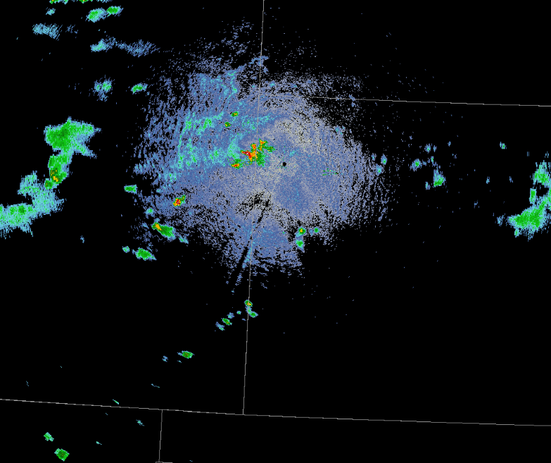
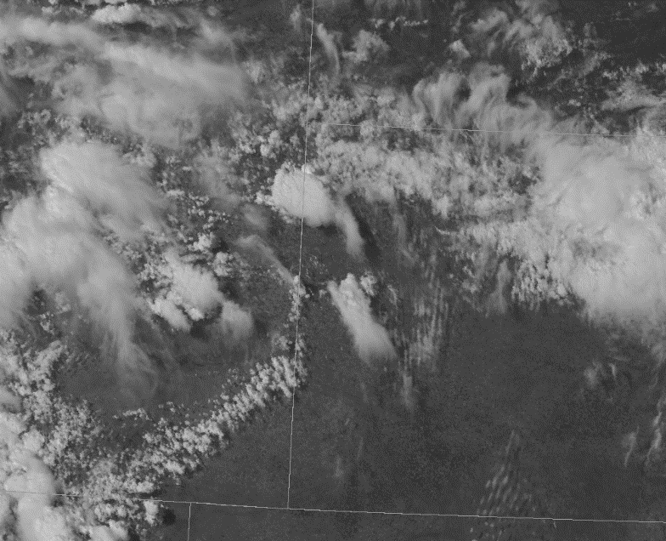
Key Takeaways
Which do you have more displays of, radar or satellite data?
Indicative of what you are paying more attention to
Plethora of information you can glean from satellite data
Radar
Focused on the present
Satellite
Able to anticipate storm behavior
Shifts mindset from reacting to storms to being ready
Would your mesoanalysis be crippled without it?
Notes:
During a typical severe weather event what do you have more displays of radar or satellite data? For myself I tend to have more radar than satellite data displayed. I am still working on the mindset of using satellite data like I do radar data, to interrogate in real time what is going on, which we couldn’t do until the GOES R generation. Have you every spent a minute or two just looking at a visible satellite loop? If you haven’t I encourage you to. There is so much information you can glean from it. You can see where different air masses are, where the stable environment is, where subtle boundaries are, if the environment is becoming more unstable, where broad lift is occurring just to name a few.
(click) If the majority of the data we take in is from our radar that means we are focusing mostly on the present. If we are doing that how can we anticipate what the storms will do in the next few minutes to hour timeframe? As mentioned earlier, we cannot assume the weather will behave linearly. To do so would cause us to be more reactive the proactive.
(click) A proficient mesoanalyst should be mindful of what is happening on radar, but also need to focus on what the satellite data is showing. Focusing more on satellite imagery and less on the radar will help the mesoanalyst keep the office prepared for what the storms could do instead of reacting to a change in the storm behavior. Rich Thompson said that if you wanted to cripple SPC take away visible satellite. I challenge you to put that much emphasis on satellite data that you would feel crippled without it. If you would not be severely limited with a lack of satellite data, consider placing more emphasis on using it for your mesoanalysis.
(click) To give you an idea of how much you can miss by only looking at radar data, take a look at the two images. Both these images were taken at the same time. With the radar image you can see there are scattered storms developing. If I had a loop you could likely tell where the next storms may form and the trend in storm intensity, but not much more. Looking at the satellite imagery you can see where towering cumulus clouds are, indicating where storms are more likely to form. You can also see where the environment is more stable and which storms may be on the downward trend in intensity. The biggest difference with the satellite image is it allows you to be able to see how the environment is affecting storm development and behavior before similar trends are seen on radar. Information like this can help add valuable lead time to a warning.

Slide 9
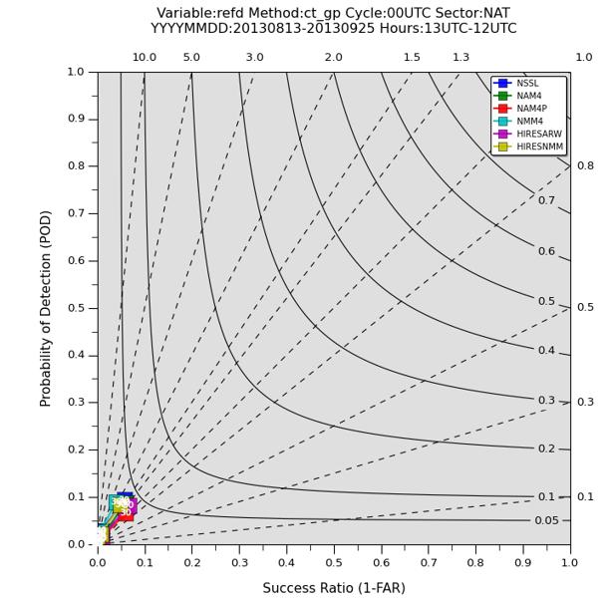
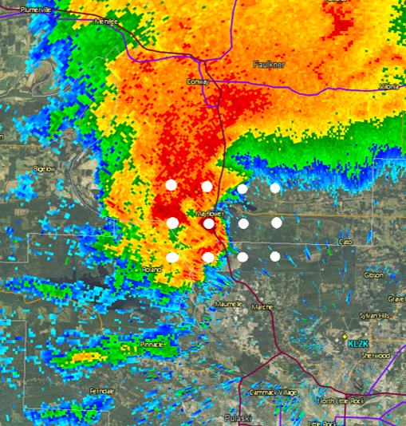
Key Takeaways
Keeping CAM output in perspective
National Stats at Grid Point
For 30 dBz or higher 8/13/13 – 9/25/13
Adapted from Jirak and Thompson
Adapted from Jirak and Thompson
Notes:
What is the one CAM field we all look at? Reflectivity. It gives us a first guess as to what the storms could due for the near term. However we can too easily go from seeing CAM reflectivity as a possible scenario to a forecast of what will happen.
So how well do the CAMs perform at each point with their reflectivity? Not all that good, as shown in this verification plot on the left which shows the verification at each grid point for 30 dBz or higher reflectivity. The plot has the probability of detection on the left and success ratio along the bottom. If a model has a perfect score it would have points in the upper right corner. However, keep in mind that accurately capturing a typical supercell, even at a 4km resolution, is difficult as shown with the gridded white dots over the radar image. Even with a fine resolution of 4 km, there is still quite a bit of supercell features the model will miss due to those features falling between the gridded points in the model. In general reflectivity is the worst performing model field of the CAMS. Wind is actually one of the best performing fields.

Slide 10
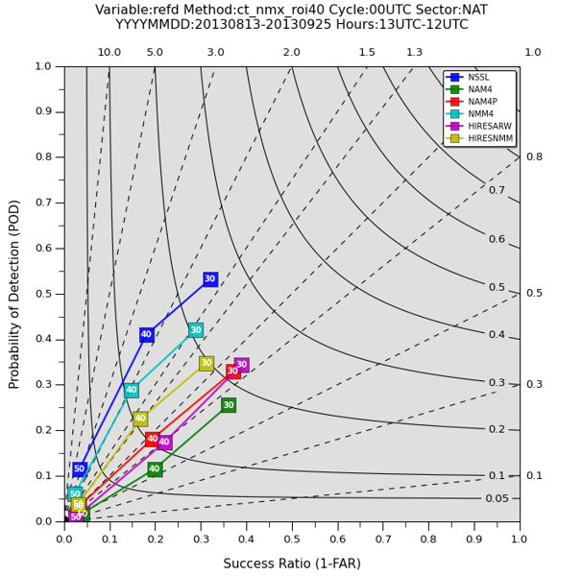
Key Takeaways
Keeping CAM output in perspective
Using a neighborhood approach for verification showed increased improvement in CAM verification
National Stats 40 KM Neighborhood
For 30 dBz or higher 8/13/13 – 9/25/13
Adapted from Jirak and Thompson
Notes:
What if a neighborhood approach were used to validate model output of reflectivity, would this change anything? As you can see from the plot for the same time frame, using the same data, the verification does improve when looking for reflectivity in a 40 km ring as apposed to an exact point. This highlights the proper perspective that all forecasters should have regarding CAM reflectivity; that is to not view it as an exact forecast, but rather one possible scenario of what could happen.
For example, when viewing HRRR radar data, don’t expect supercells to move over the exact location that the latest run has. If the track of the supercell changes with the next model run, will you adjust your forecast based on that single run? This is a dangerous trap to fall in, as it makes us dependent on what the model is forecasting instead of relying on our own skill set. However if several runs through the shift have the same supercells following a similar track, then that is something to take into consideration. Using an ensemble approach to the HRRR, or any other CAM, is the best way to use these data sources, as indicated by the better verification using the neighborhood approach.

Slide 11
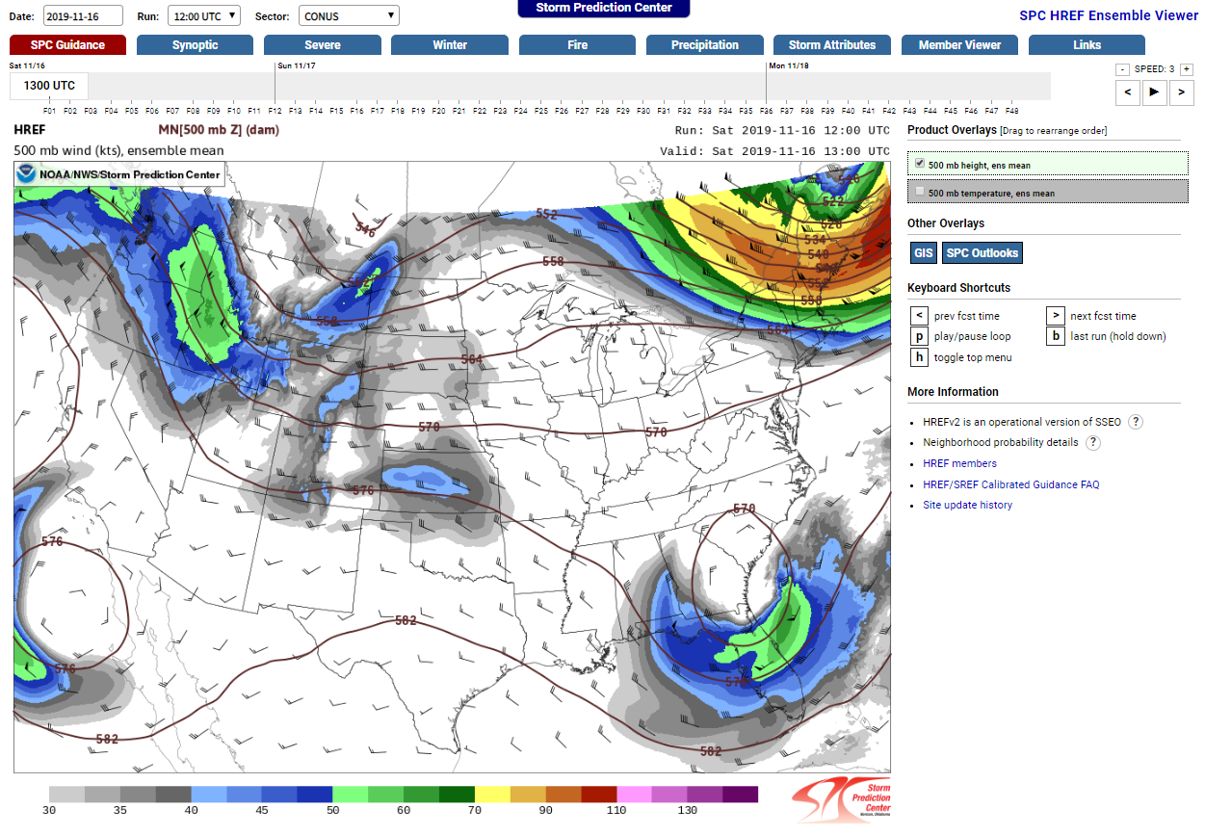
Side Note on HREF
One of the best ways to view CAM output.
The SPC site has probabilities for:
QPF
Snowfall
Blizzard conditions
Updraft helicity
CAPE
Fosberg Index (fire weather)
Notes:
Speaking of ensembles for CAMs, the best ensemble for this kind of data is the HREF from SPC. The HREF gives a better overall view of these models instead of relying on the deterministic nature of individual CAMs. It also has probabilities for some of its data, including qpf, snowfall, blizzard conditions, updraft helicity, CAPE, and Fosberg Index (for fires). There are many parameters, including some of the probability fields, that are shown in hourly resolution. The one downfall is the HREF is only updated twice a day.

Slide 12
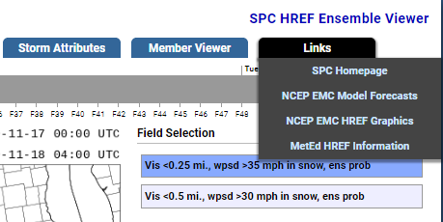
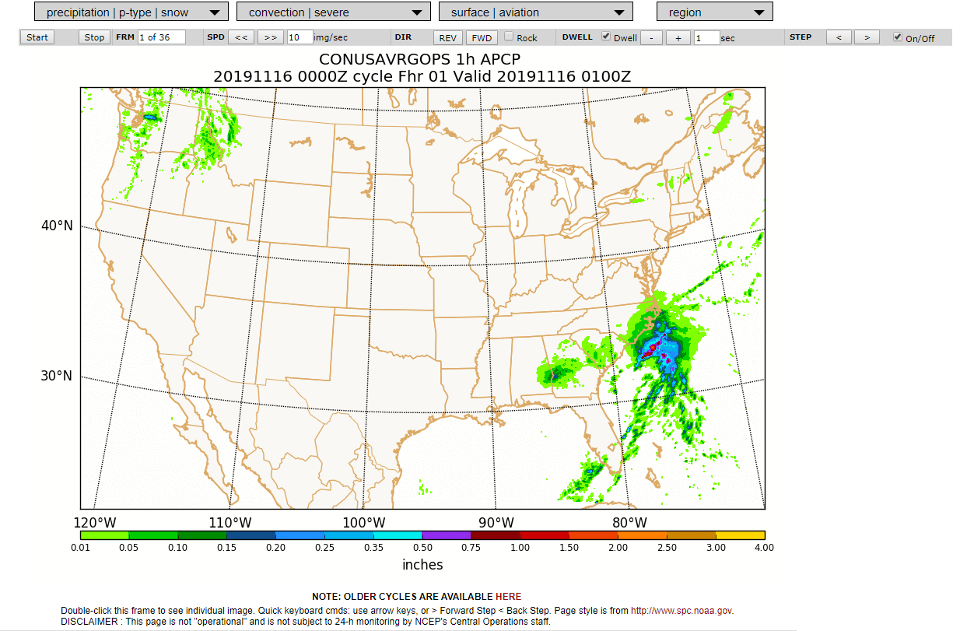
Side Note on HREF
The NCEP website has probabilities for:
Aviation
Severe weather
Precipitation type
Snow amount
Notes:
If you want to see more probability fields for aviation, severe weather, precipitation type, or snow amounts, go to the links menu on the far right side of the HREF page and click on the NCEP HREF graphics option. You can zoom into a particular region. This is also available for Alaska, Hawaii, and Puerto Rico. This page offers a wealth of probability information at your disposal. However this page is not operationally supported.

Slide 13
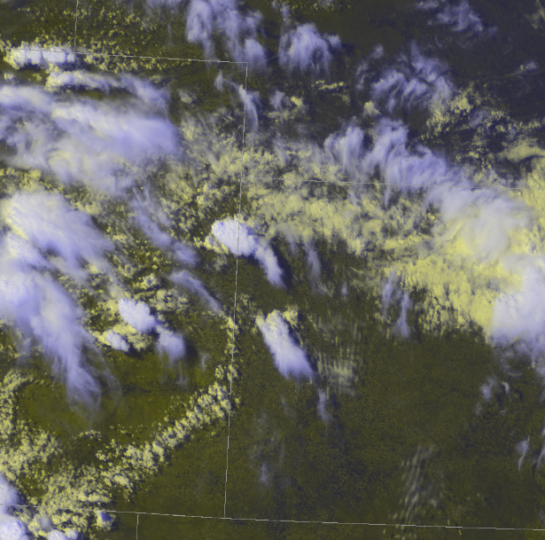
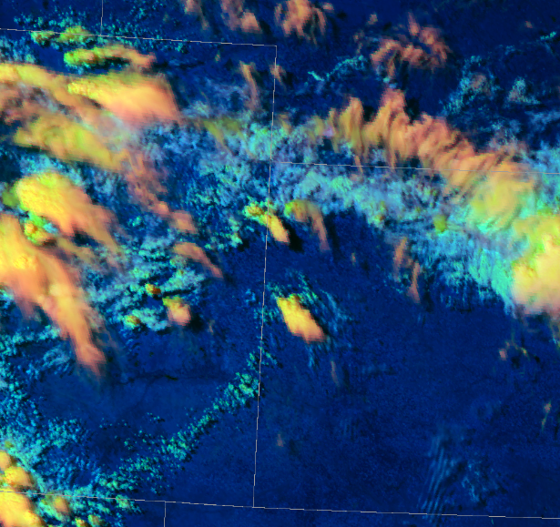
Helpful Displays
ice
Day cloud phase
Distinguish liquid water from ice
Under RGB composites
Liquid water
Daytime cloud phase distinction
Evaluate phase of cooling cloud tops
Determine growth, decay, glaciation
Under RGB composites
Low clouds, liquid water
glaciating
High clouds, ice
Notes:
Back to the mesoanalysis. Here are some displays that were used at the boot camp that I found helpful. The day cloud phase is useful to distinguish liquid water (the yellow) from ice (the purple). This can be used to distinguish lower clouds from higher ones, when cloud tops begin to transition to ice they are more likely to produce lightning. It can also help determine precipitation type by differentiating clouds with super cooled water droplets from clouds with ice crystals. The drawback is this can only be used in the day time.
(click) My favorite satellite image is the daytime cloud phase distinction. The bolder greens and yellows indicate vertical development and increasing cloud ice. The lime green shading indicates glaciating clouds. Having this display has helped me have a better idea of how the storm will trend on radar in the near term as far as strengthening or weakening. Being able to see the clouds starting to glaciate has given me lead time in alerting DDS events about lightning danger before lightning was detected by the satellite. In the winter time this image can also help determine precipitation type, giving you a bit more information than the day cloud phase that just distinguished liquid from ice. This display has the same limitation of only being available during the day.
In addition, when the sun angle gets too low the color scale becomes skewed. If your forecast area is covered by both east and west satellites, you could use the west satellite to get some more time before the sun angle becomes too low again.

Slide 14
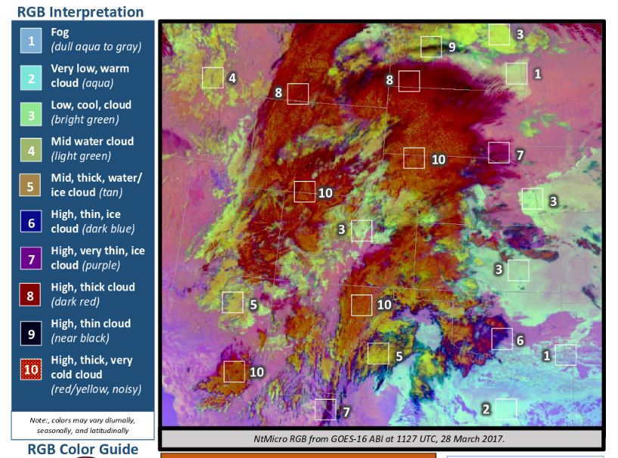
Helpful Displays
Nighttime Microphysics
Distinguish fog from low, mid, or high clouds
Help determine if ice is present in the clouds
Under RGB composites
Notes:
There is atleast one satellite display that can help with cloud phase during the night. The one that I found is called the nighttime microphysics under the RGB composites option. There are a variety of cloud features you can see with this. In general the more blue a color is, the closer to the ground it is and the more likely the cloud will have liquid water in it. In contrast, the more red or orange a cloud has, the higher it is and the more likely the cloud has ice in it.
One downside with this display is it is sensitive to the colder ground temperatures radiating through thin fog or low clouds, thus making the low clouds/fog appear cooler than they really are.

Slide 15
Helpful Displays
Meso sectors
One minute data is crucial
Provides a more complete picture
Notes:
Mesoscale sectors are an extremely important tool for the mesoanalyst to have. Being able to see cloud development every minute is crucial to anticipate what is going on, and provides a more complete picture. The 5 minute data is far better than what we had before GOES R, however subtle trends in the cloud development can easily be lost or muted with the 5 minute data. If your forecast area is not in a meso sector and you believe it needs to be, contact the Detroit Office and ask to have a meso sector moved to your area. The worst they can say is no.

Slide 16
What does a mesoanalyst do?
Monitors the mesoscale for subtle features
Surface observations
Satellite data
Radar data
SPC mesoanalysis data
Based on data, anticipates what will happen in the next 2-3 hours
Communicates with radar operator and forecaster
Notes:
With all the displays, takeaways, and comments on how to properly apply CAM data, you may be wondering, so what does a mesoanalyst actually do? That’s a great question. The main point to remember about the mesoanalyst position is having a mindset of anticipating storm behavior, and not reacting to the storms. In order to anticipate storm behavior and communicate what the storms will do, the mesoanalyst needs to monitor trends in surface observations, specifically where the subtle boundaries are, watch satellite data for trends in the clouds that will help to determine where the subtle boundaries will be, monitor trends in radar data to help see in real time any surface boundaries, and of course view mesoanalysis fields on SPC’s meso analysis page.
Based on all these different data sources the job of the mesoanalyst is to anticipate what the storms will generally be doing in the next 2-3 hours, and communicate that to the radar operator and forecaster. Don’t forget that this type of information is great to share on NWS Chat and on weather graphics.

Slide 17
Conclusions
Weather forecasting is not dead!
Goal of the mesoanalyst: anticipate what the radar will be showing in 2-3 hours
Mesoanalyst is the weather safety net
Be proactive not reactive
Leverage satellite data
Hand analysis helps
Notes:
Let’s wrap up with some concluding points. Models continue to become more accurate. However we can still add to the forecast by applying the meteorological knowledge we have learned to the first few hours of the forecast. I have been amazed how much information I can provide someone by relying on what I know and applying it to what the mesoscale environment is showing me. Weather forecasting is not dead! We can still add value in the near term through maintaining mesoscale awareness.
(click) The goal of the mesoanalyst is to anticipate what the storm mode, coverage, and threats will be in the next few hours based on what the surface observations, satellite and other data show. If the assumptions turn out to be wrong, adjust them. I have found out that I learn more by trying to anticipate what will happen instead of just assuming the models are correct and completely relying on them. This takes work, but it is worth it because we can become more effective forecasters by applying what we know instead of being confined to what the model says.
(click) The mesoanalyst is the weather safety net of the office. Without a mesoanalyst the office can only react to what the weather is doing. If we are going to continue moving forward in becoming a WRN, we need to encorporate more mesoanalysis into operations to be more proactive and less reactive.
(click) I encourage you to use satellite data more in your analysis. There is so much you can infer about the atmosphere by just watching visible satellite. Be as dependent on it as SPC, so if you do not have access to it you would be crippled without it.
(click) Lastly hand analysis is also helpful to get an idea of what the mesoscale environment is doing. During the boot camp, I started out each of the scenarios by doing a simple hand analysis to help situate myself with the weather pattern for that scenario. AWIPS actually has a tool called P-Gen in the tools menu that allows you to draw all sorts of different hand analysis symbols on the screen, so you don’t have to print out a surface map and use color pencils to create a surface analysis any more. Another option would be to export a surface map from AWIPS to you PC and then use power point to draw in your surface analysis. The analysis I used for a slide background was done using power point.
This course was very beneficial to go through. It opened my eyes up to how useful the forecaster still is despite all the hourly model data we have access to. In my opinion this boot camp was on the same level as the RAC training new forecasters go through. I wish we could have forecasters go through this training before they go to RAC. I think it would help them better understand how to use radar and satellite information in the warning process. If you are interested in learning how to better anticipate what the weather will do without relying heavily on hourly model data, this course is for you.

Slide 18
Where to go from here
Practice mesoscale analysis wherever there is hazardous weather.
Show fellow staff how important mesoscale analysis is.
Offer mesoscale analysis assistance to offices affected by hazardous weather.
Notes:
So where do we go from here? That’s a great question, I’m glad you asked.
Like any skill, if you don’t practice mesoscale analysis you will lose it. If hazardous weather is not occurring in your forecast area, look for places else where that are having active weather that you can use to improve your mesoanalysis skills.
(click) Show fellow staff how important these skills are and why they can benefit the entire office. The more people you have onboard the better equipped your office will be to effectively communicate and stay ahead of the weather on busy weather days.
(click) Lastly, offer mesoanalysis to other offices that are dealing with hazardous weather. They may be too busy to perform routine meosanalysis, or may not think it beneficial enough to devote a staff member to. So offer your expertise, and that may open their eyes to how valuable these skills are.

Slide 19
Any Questions?
Notes:
Thank you for your time today, that is all I have, are there any questions?

