Slide 1
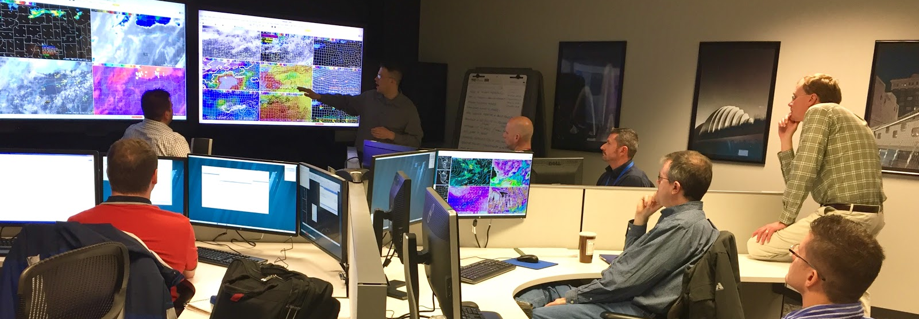
The Role of Expert Mesoanalyst in Collaborative Severe Weather IDSS
Vlab Forum - Wednesday, October 16, 2019
Kim Runk, Director
Operations Proving Ground

Slide 2
Background: A Growing Problem
Difficulty managing increasing volume of high-res data sets
Mesoanalyst role is often underutilized in high impact Events *
* - Recurring feedback from 35 forecasters in 12 OREs & 100+ SOOs at GOES-R Prep Course
Notes:
Dozens of forecasters and SOOs say Mesoanalyst role underutilized.
GOES-R era allows us to reinvigorate the role

Slide 3
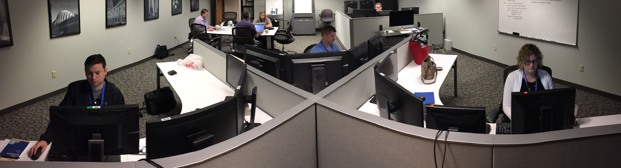
Background: A Potential Solution
Champion the potential value of expert mesoanalysis
Improve targeted IDSS in watch/warning gap
Promote more effective SPC-WFO collaboration
Conduct Collaborative Proof-of-Concept Evaluations
Notes:
“Mesoanalyst Boot Camp”

Slide 4
The 2018 Mesoanalysis Think Tank
Gathered expert convective mesoanalysts in Kansas City for 3 days
Identified science/services gaps & best practices for convective IDSS
Documented 5 findings & recommendations; forwarded to NWSH

Slide 5
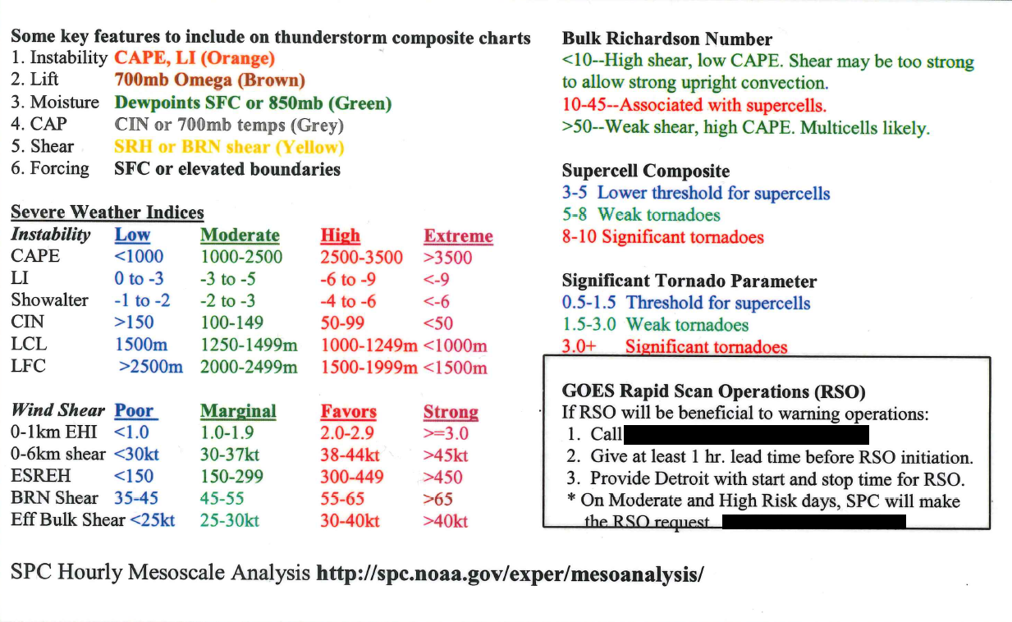
Mesoanalysis Today
Mesoanalyst/Radar Support
Conduct analysis of synoptic, mesoscale, and near-storm environment; communicate key insights and observations to radar operator.
Issue Mesoscale AFD(s) to describe expectations regarding initiation, timing, location, severity, coverage, storm mode, and threats.
Provide updates on NWSChat when significant changes in storm mode or warning thresholds are anticipated.
Participate in any SPC watch coordination discussions.
Provide radar briefings and updates over MERS and to SkyWarn hams, if present.
Assist the Warning Forecaster(s) in any mission critical aid needed (e.g., monitor web cams, serve as second pair of eyes on radar, etc.)
Notes:
Mesoanalyst of today and delta
Notion of roles
Laminated cards – duties on front checklist parms on back

Slide 6
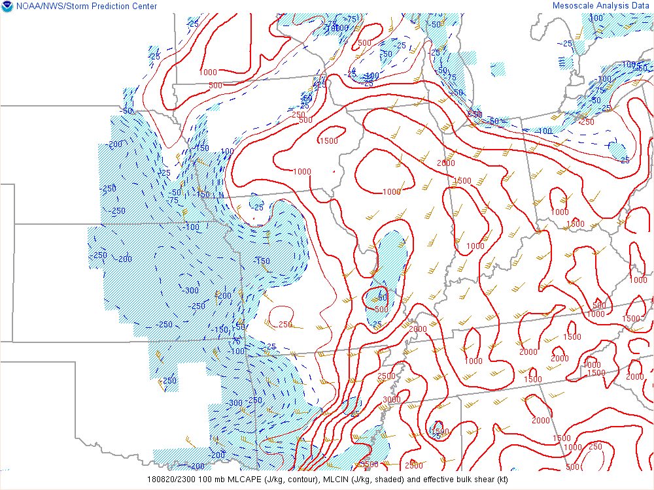
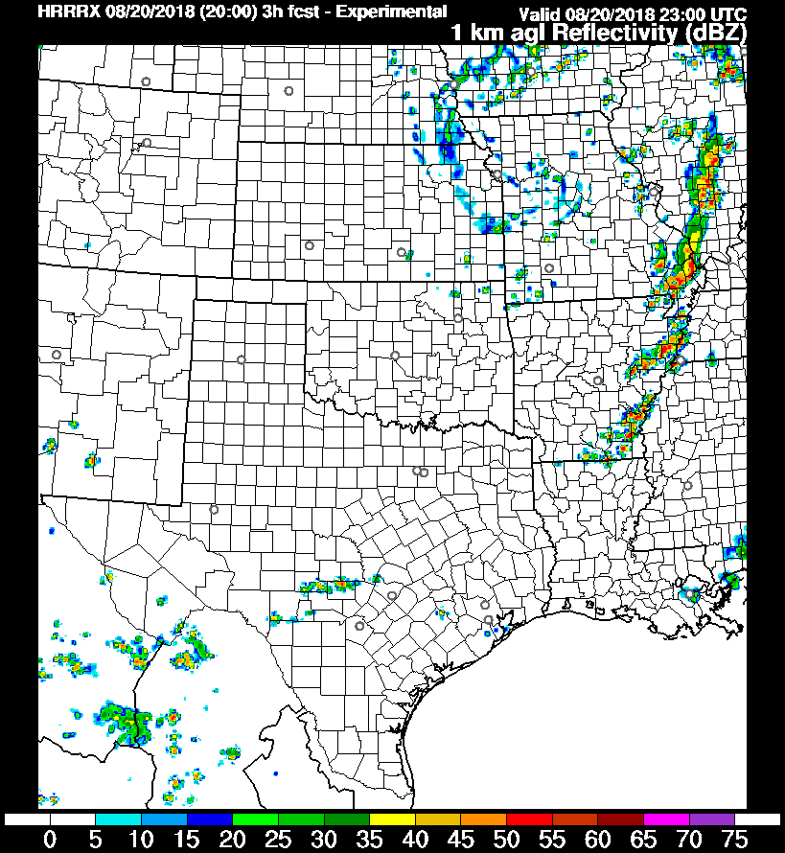
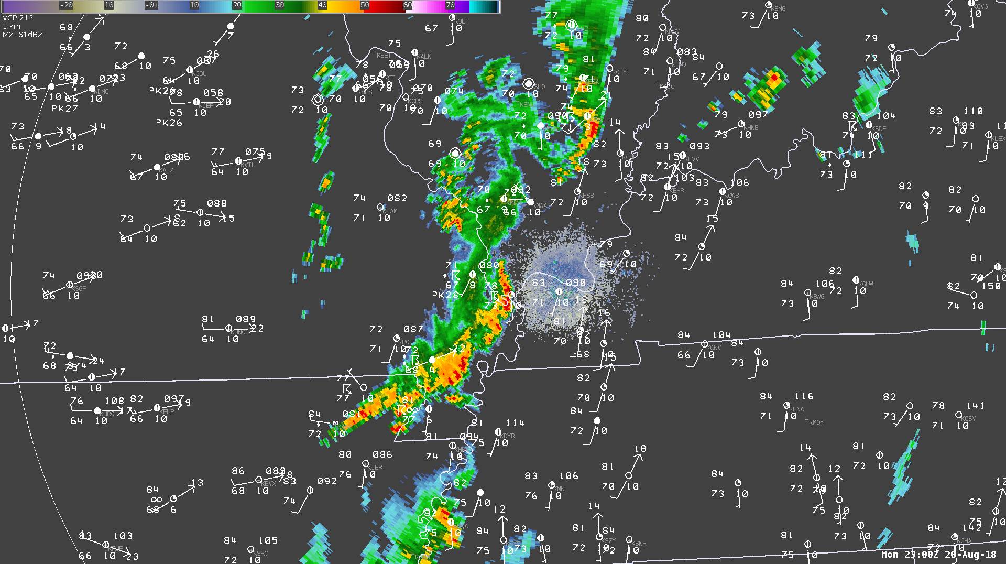
Mesoanalysis Today
Notes:
Typical approach: SPC meso, radar and obs, model output
Effective for many years
Near RT availability of hi-res data, esp. G16… potential to glean additional detail about the NSE is vastly improved.

Slide 7
Effective Mesoanalysis Techniques
Notes:
Insight from one 20-min G16 scene
Armed with this knowledge … envision radar in 1-2 hrs.
Provide precise tactical info to EMs who need our expertise to make timely, effective risk mgmt. decisions
These are skills/practices we hope to infuse in experiential workshops next year

Slide 8
Dedicated Mesoanalyst
Aviation Forecaster
DSS Forecaster
Ensure all TAFs are updated and representative of ongoing critical weather developments.
Coordinate directly with Tower when changes that may affect runway configurations or airfield operations become imminent.
Monitor satellite, radar, and surface observations in close coordination with Event Coordinator and Mesoanalyst to ensure situational awareness.
Conduct coordination calls with CWSU and AWC when needed.
Prepare and disseminate tactical messaging via appropriate communication channels, with guidance from Event Coordinator, Mesoanalyst, and Warning Forecaster.
Initiate and respond to NWSChat; proactively solicit and provide relevant information related to radar trends, reports, expiring warnings, etc.
Disseminate watch/warning information via MERS/NAWAS.
Disseminate important updates to Core Partner IDSS email list.
Monitor social media for storm reports, impact information, etc.
Monitor eSpotter and Chaser Networks via GR2Analyst.
Relay storm reports to SRS and Warning Forecaster(s).
Assist as needed with composing and transmitting LSRs.
Warning Forecaster
Event Coordinator
Primary person responsible for issuing all convective warnings and update statements, unless decision is made to sectorize warning roles, either by geography or phenomenon. May decide to assign update statements to someone else on the internal warning team.
Maintain clear and frequent communication with other members of the warning team, especially the Mesoanalyst and Event Coordinator.
Solicit input, as time permits, from others monitoring the situation, as to evolution of the near-storm environment, types of warnings and threats that are warranted, etc.
Be mindful of fatigue levels, and willing to admit need for assistance or relief.
Mesoanalyst
Oversee office operations; assign staff positions, including sectorizing warning operations, if necessary. Monitor for signs of fatigue.
Ensure coordination between warning forecaster, mesoanalyst, DSS forecaster; and between warning teams during sectorized operations
Serve as back-up to disseminate watches/warnings via MERS/NAWAS.
Monitor SVS issuance and warnings nearing expiration.
Verify dissemination of warnings and track incoming storm reports.
Log problems with equipment and spearhead troubleshooting efforts.
Lead coordination efforts with Regional Operations Center.
Lead collection of data to be included in post-event folder.
Conduct analysis of synoptic, mesoscale, and near-storm environment; communicate key insights and observations to radar operator.
Issue Mesoscale AFD(s) to describe expectations regarding initiation, timing, location, severity, coverage, storm mode, and threats.
Provide updates on NWSChat when significant changes in storm mode or warning thresholds are anticipated.
Participate in any SPC watch coordination discussions.
Provide radar briefings and updates over MERS and to SkyWarn hams, if present.
Assist the Warning Forecaster(s) in any mission critical aid needed (e.g., monitor web cams, serve as second pair of eyes on radar, etc.)
Notes:
This level of IDSS req. integrating all avbl data + core concepts of primary importance to diagnose CI, mode, evolution and hazards
One person can not fill multiple roles and maintain SA

Slide 9
Dedicated Mesoanalyst
Aviation Forecaster
DSS Forecaster
Ensure all TAFs are updated and representative of ongoing critical weather developments.
Coordinate directly with Tower when changes that may affect runway configurations or airfield operations become imminent.
Monitor satellite, radar, and surface observations in close coordination with Event Coordinator and Mesoanalyst to ensure situational awareness.
Conduct coordination calls with CWSU and AWC when needed.
Prepare and disseminate tactical messaging via appropriate communication channels, with guidance from Event Coordinator, Mesoanalyst, and Warning Forecaster.
Initiate and respond to NWSChat; proactively solicit and provide relevant information related to radar trends, reports, expiring warnings, etc.
Disseminate watch/warning information via MERS/NAWAS.
Disseminate important updates to Core Partner IDSS email list.
Monitor social media for storm reports, impact information, etc.
Monitor eSpotter and Chaser Networks via GR2Analyst.
Relay storm reports to SRS and Warning Forecaster(s).
Assist as needed with composing and transmitting LSRs.
Warning Forecaster
Event Coordinator
Primary person responsible for issuing all convective warnings and update statements, unless decision is made to sectorize warning roles, either by geography or phenomenon. May decide to assign update statements to someone else on the internal warning team.
Maintain clear and frequent communication with other members of the warning team, especially the Mesoanalyst and Event Coordinator.
Solicit input, as time permits, from others monitoring the situation, as to evolution of the near-storm environment, types of warnings and threats that are warranted, etc.
Be mindful of fatigue levels, and willing to admit need for assistance or relief.
Mesoanalyst
Oversee office operations; assign staff positions, including sectorizing warning operations, if necessary. Monitor for signs of fatigue.
Ensure coordination between warning forecaster, mesoanalyst, DSS forecaster; and between warning teams during sectorized operations
Serve as back-up to disseminate watches/warnings via MERS/NAWAS.
Monitor SVS issuance and warnings nearing expiration.
Verify dissemination of warnings and track incoming storm reports.
Log problems with equipment and spearhead troubleshooting efforts.
Lead coordination efforts with Regional Operations Center.
Lead collection of data to be included in post-event folder.
Conduct analysis of synoptic, mesoscale, and near-storm environment; communicate key insights and observations to radar operator.
Issue Mesoscale AFD(s) to describe expectations regarding initiation, timing, location, severity, coverage, storm mode, and threats.
Provide updates on NWSChat when significant changes in storm mode or warning thresholds are anticipated.
Participate in any SPC watch coordination discussions.
Provide radar briefings and updates over MERS and to SkyWarn hams, if present.
Assist the Warning Forecaster(s) in any mission critical aid needed (e.g., monitor web cams, serve as second pair of eyes on radar, etc.)
Notes:
Think Tank determined that 100% focus is req. on current and next 2-3 hrs
Initial reaction may be… insufficient staffing… Culture change… Resource Mgmt issue… a prioritization issue…
If it’s important enough, you find a way to make it happen.

Slide 10
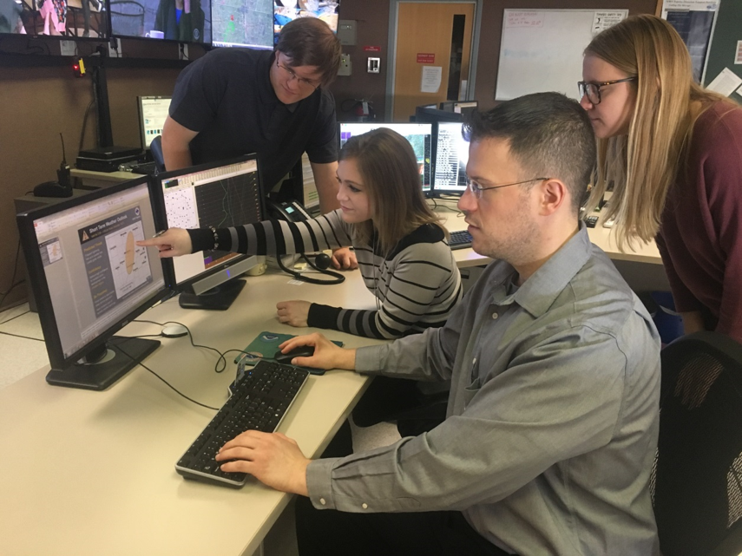
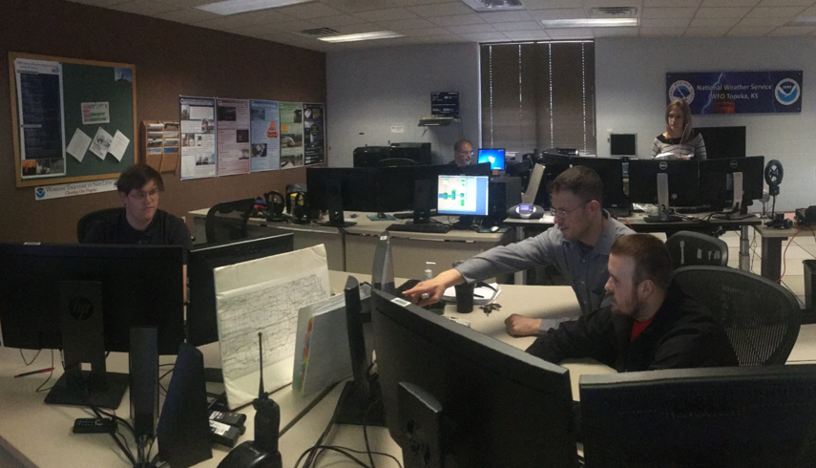
Multiple Benefits
Enhance situational awareness of NSE
Continuous flow of tactical information
Clear, precise, actionable intelligence
Notes:
Applying expertise can lead to clear, concise…
Segue – The value & importance of these techniques is evident…

Slide 11
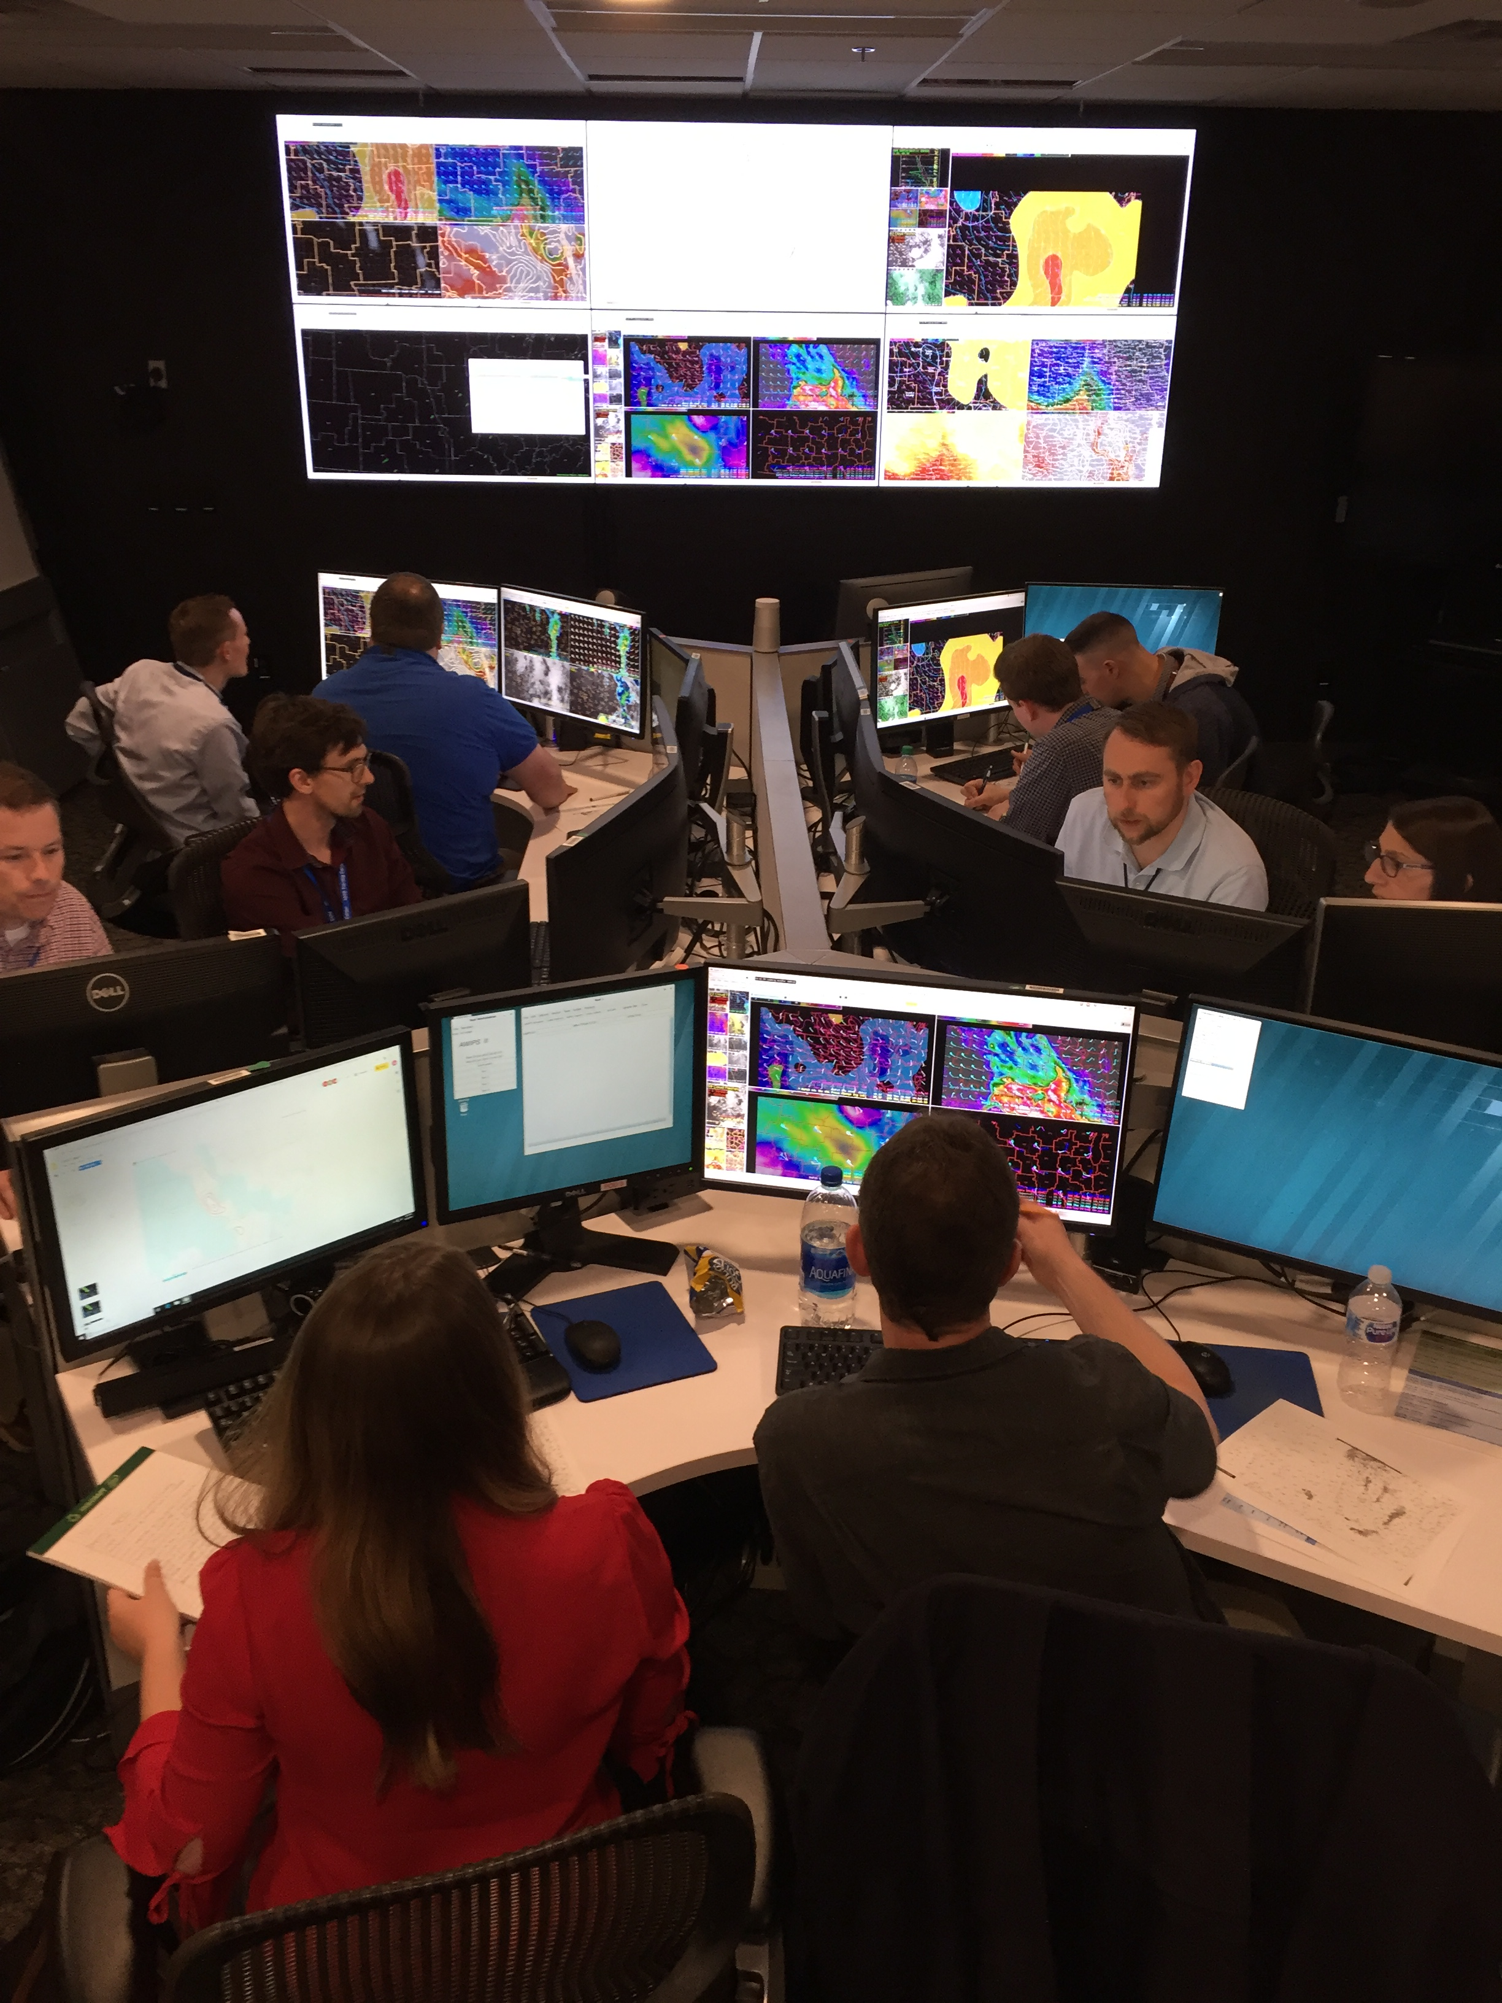
FACETs Challenge
Transition NWS operating model from product-centric, schedule-driven to information-centric, service-driven.
Key characteristic: continuous flow of information with special emphasis on existing gaps (e.g., watch/warning).
Also lends itself to exploring the use of probabilistic space to drive intelligent risk management decisions.

Slide 12
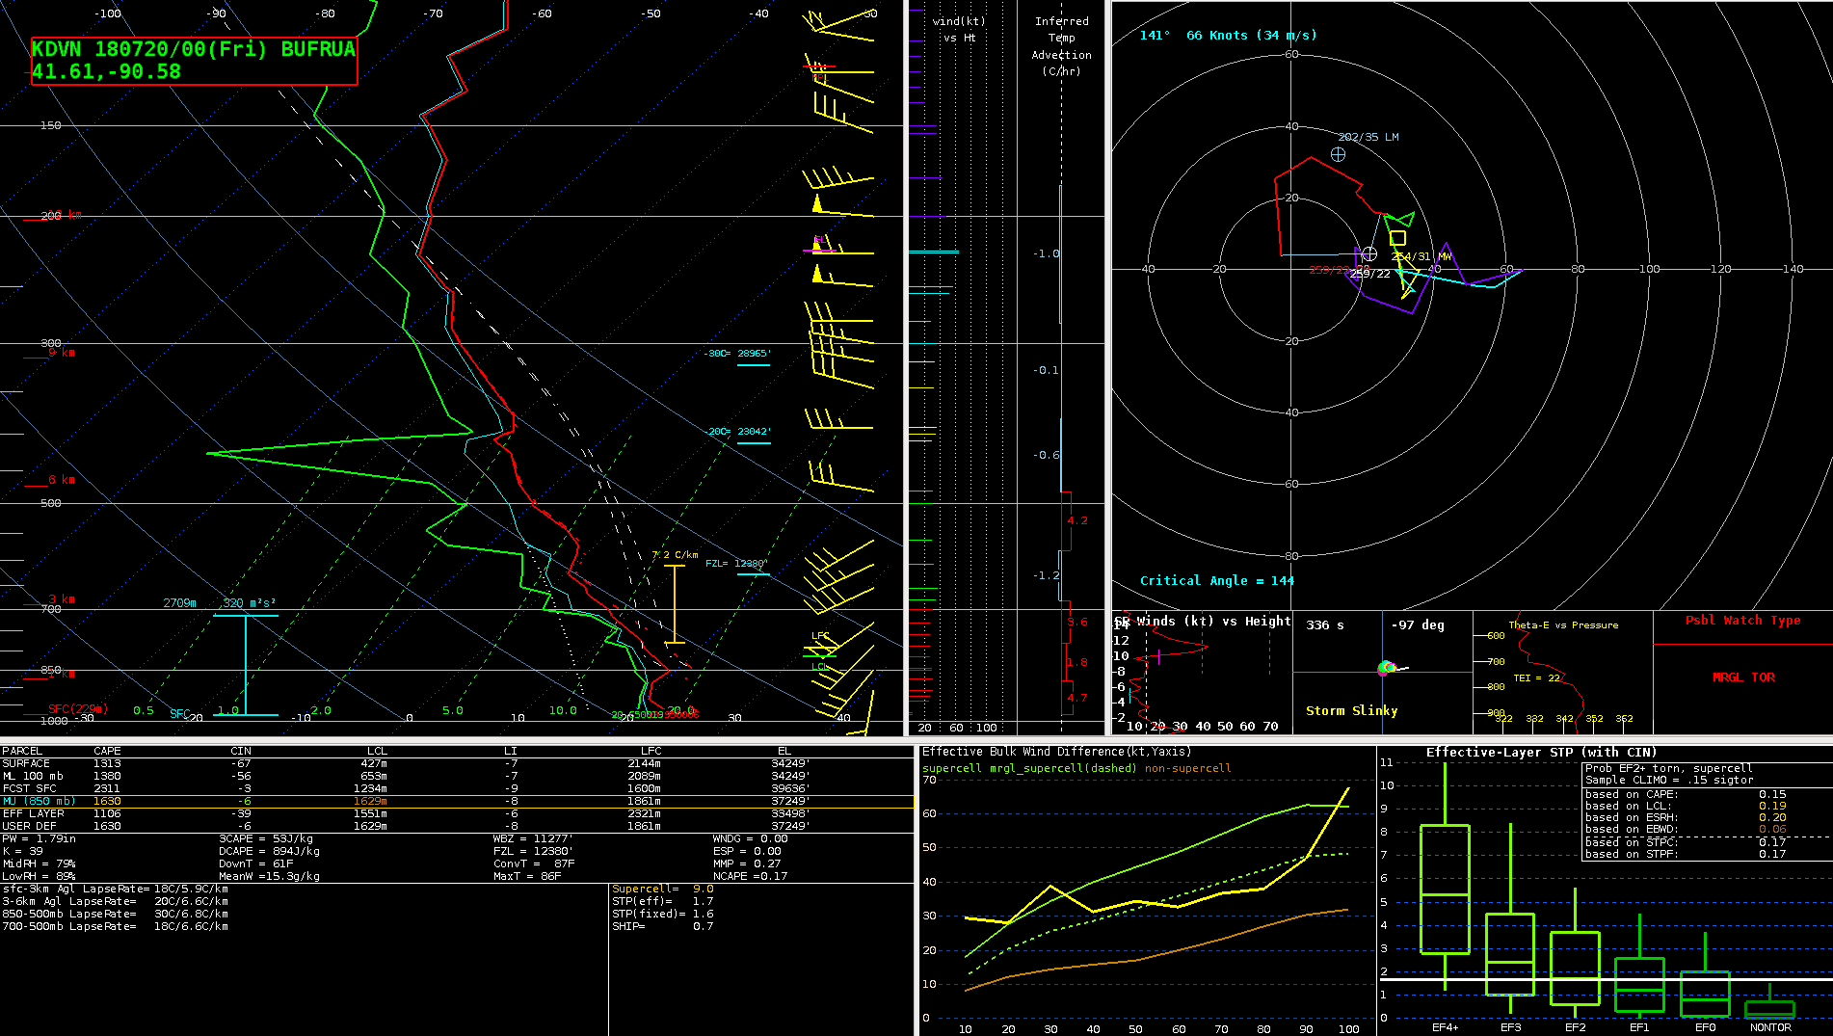

Slide 13
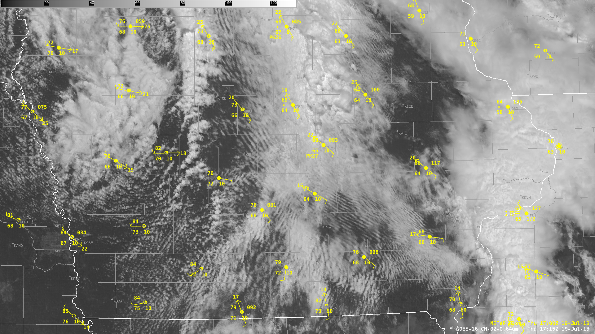

Slide 14
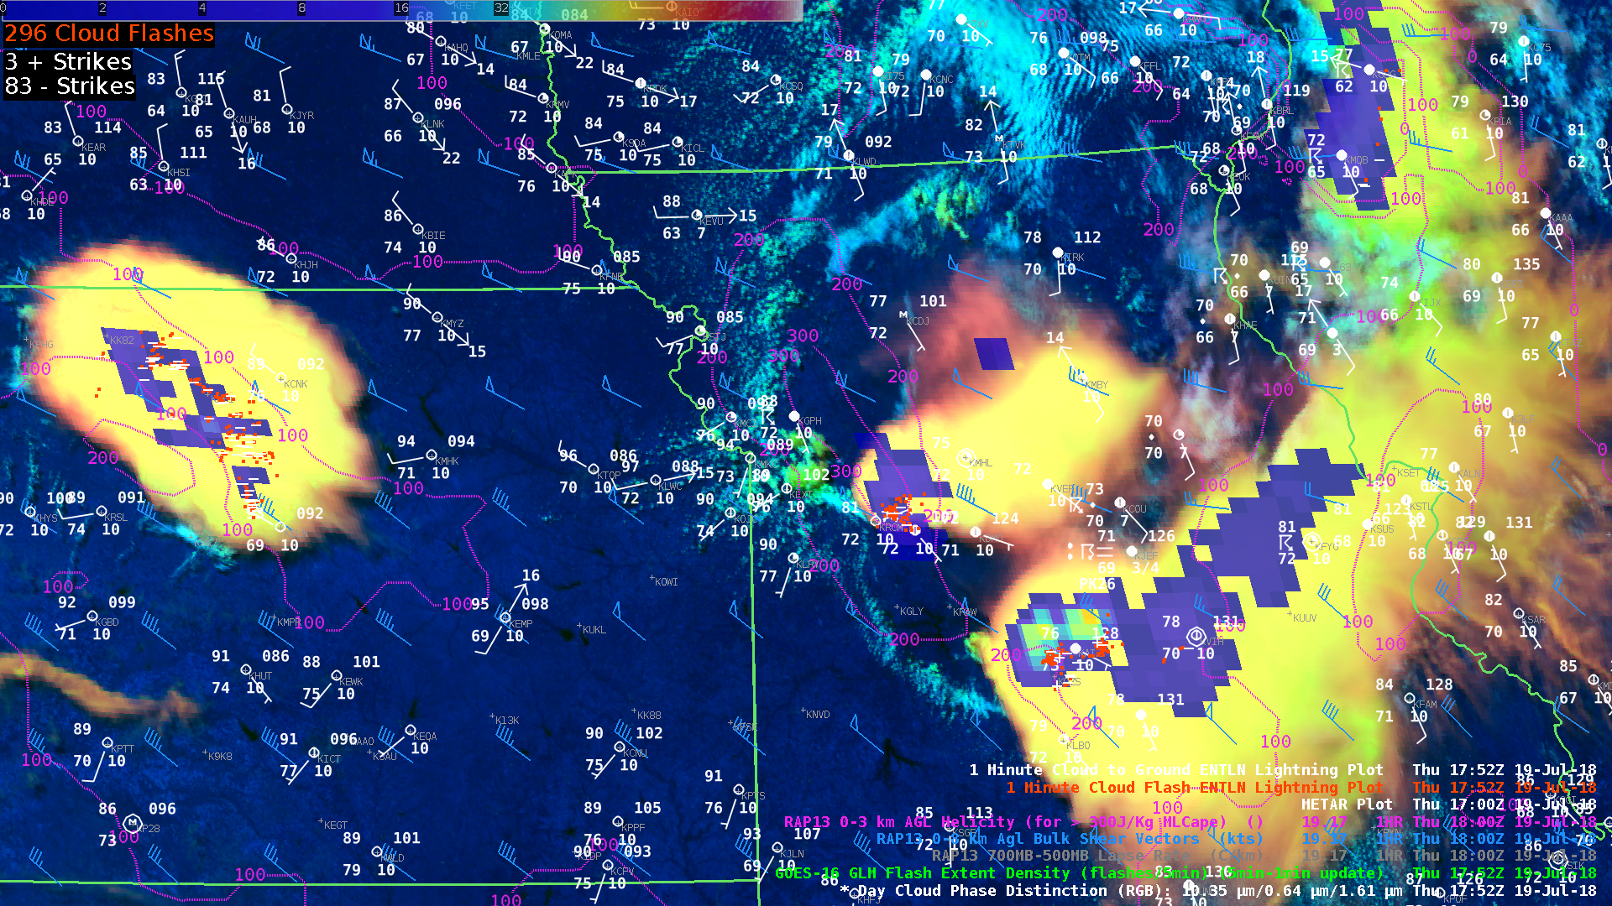

Slide 15
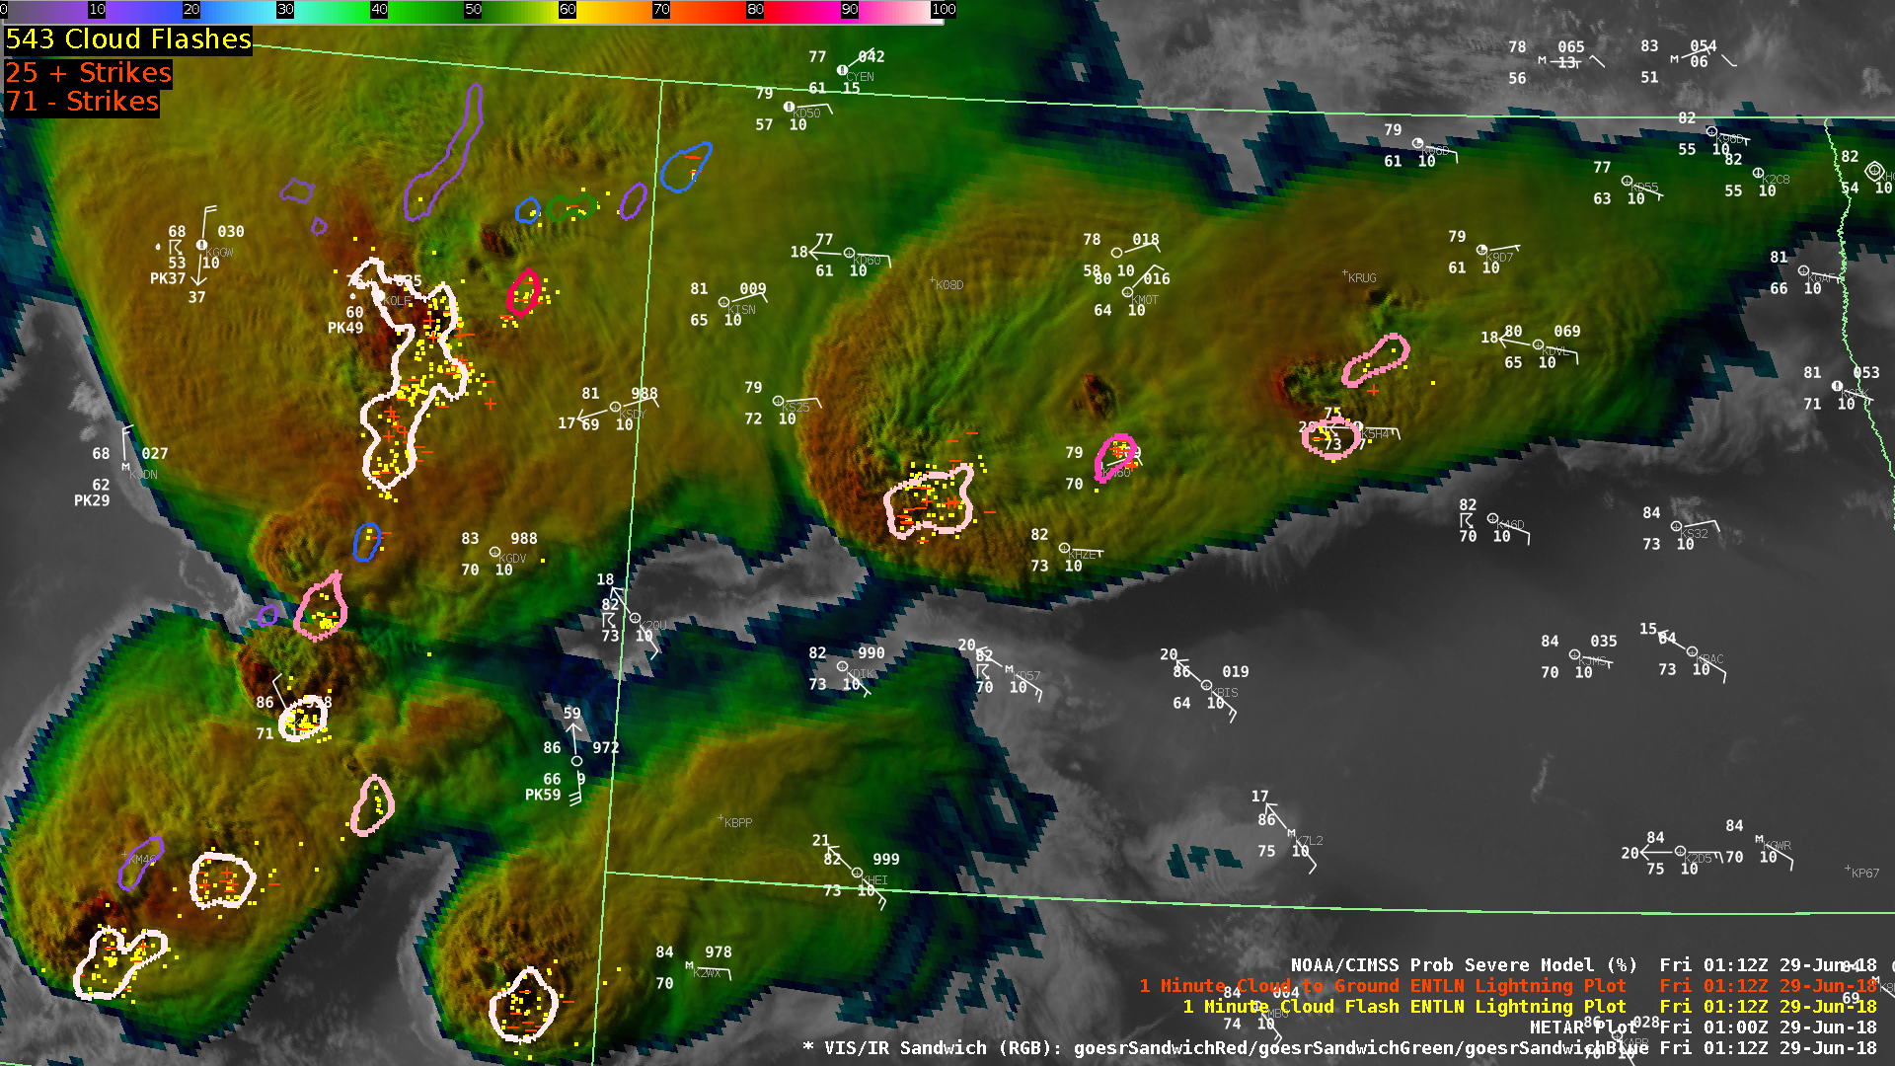
SVR PROB: 98%
Env MUCAPE: 4557 J/kg
Env EBShear: 67.5 kts
MRMS MESH: 0112Z 2.05 in.
Norm Vert Growth Rate: N/A

Slide 16
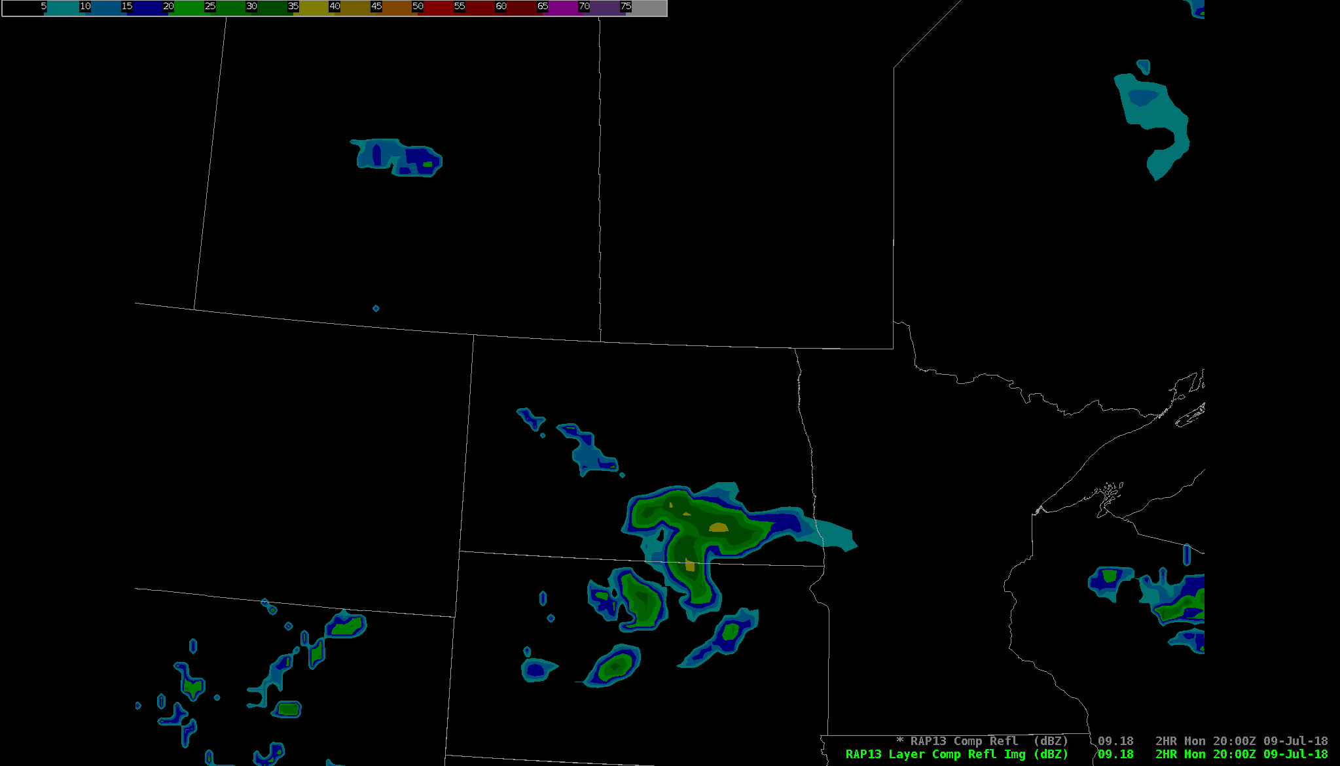
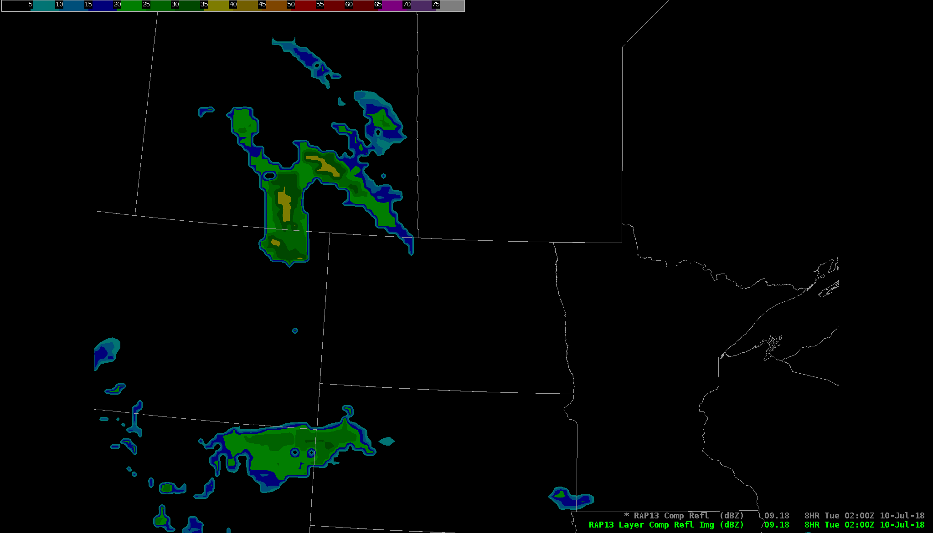
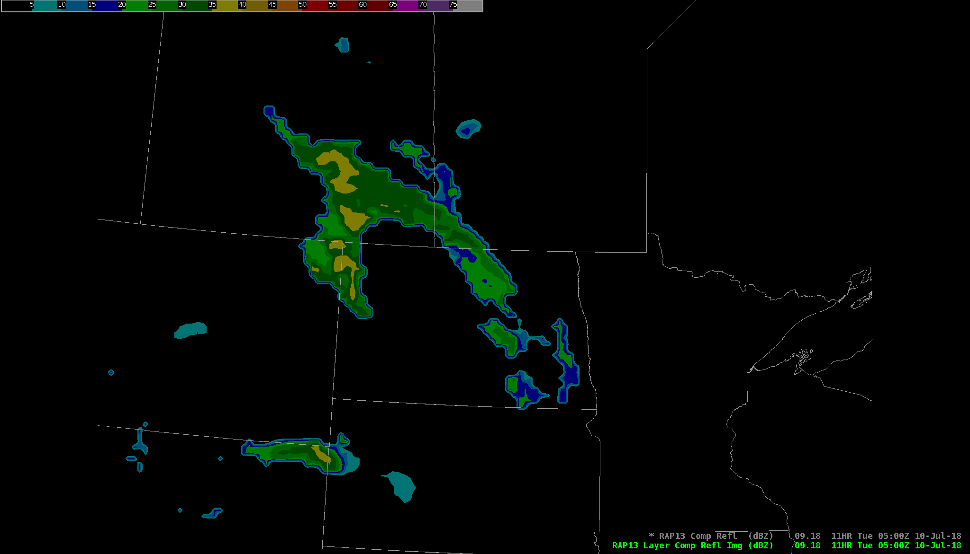
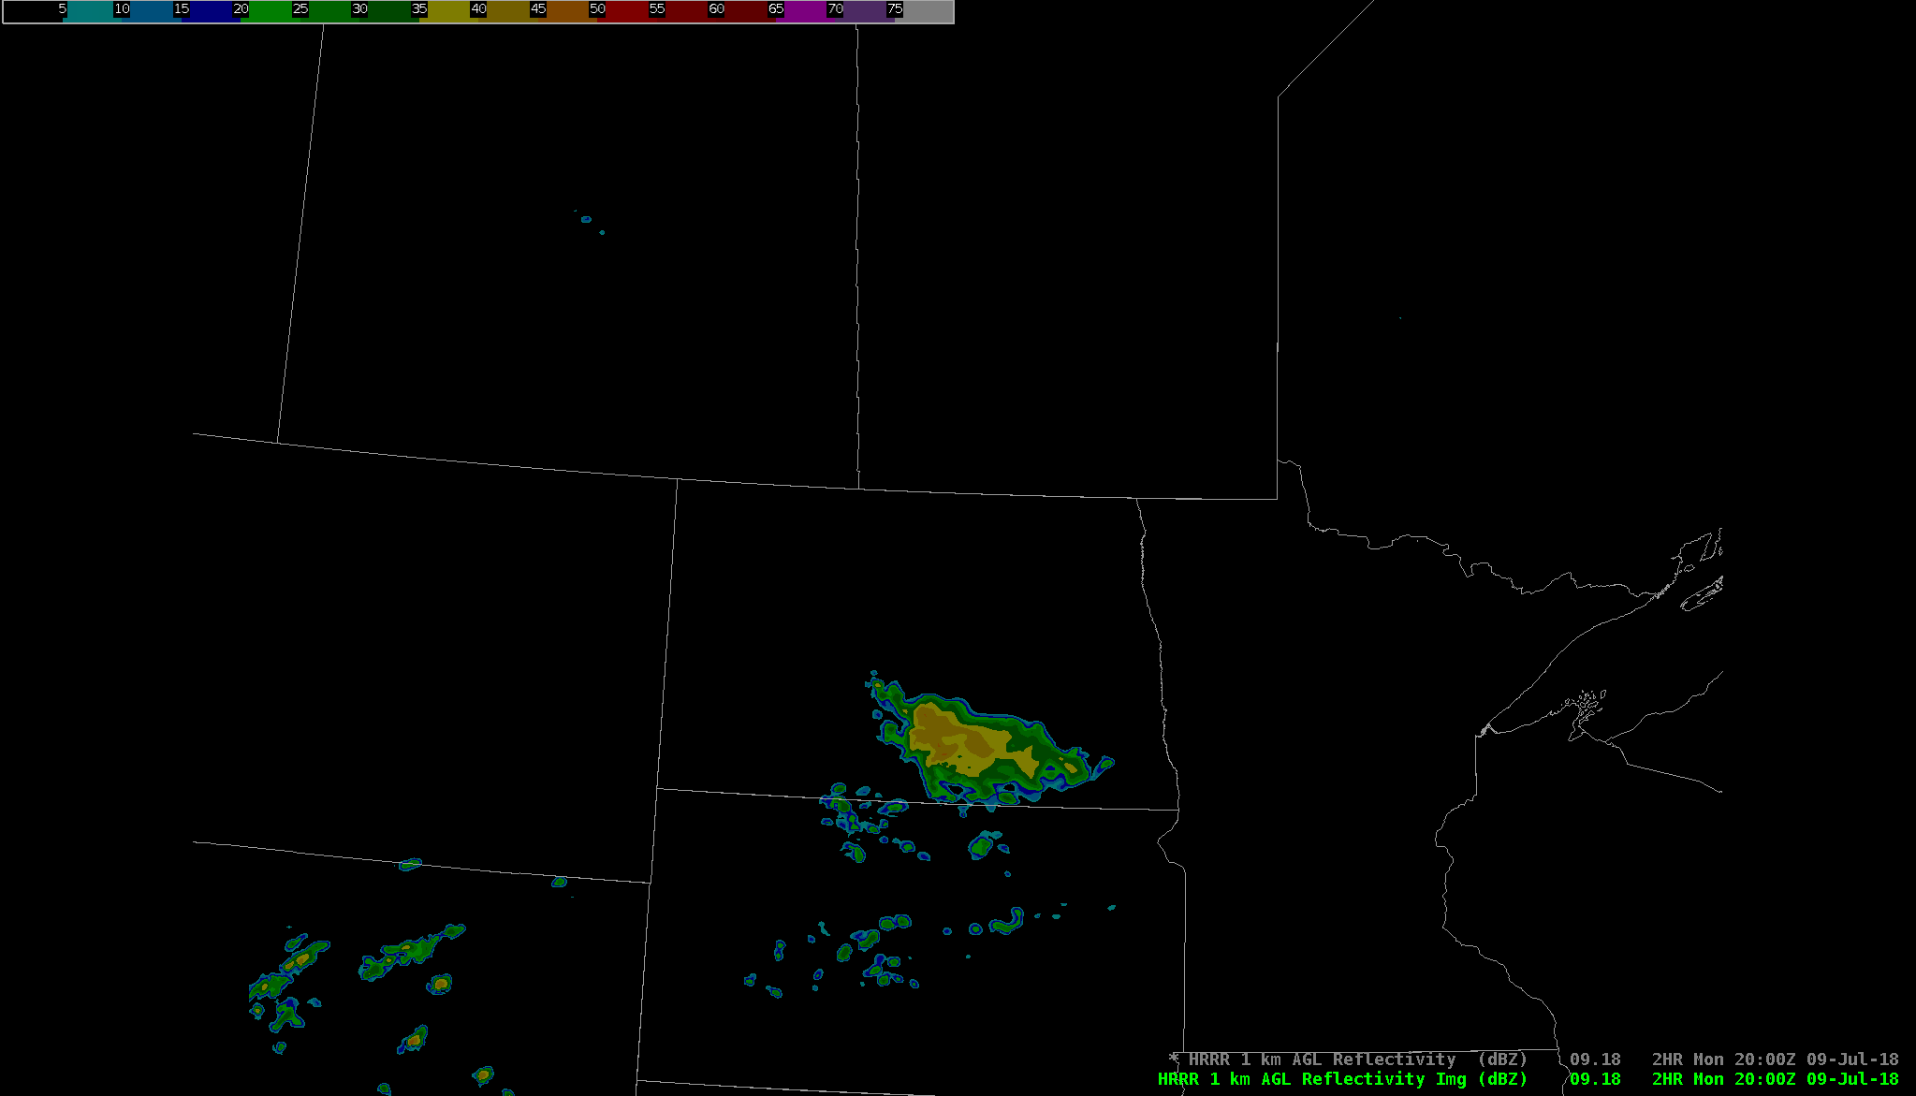
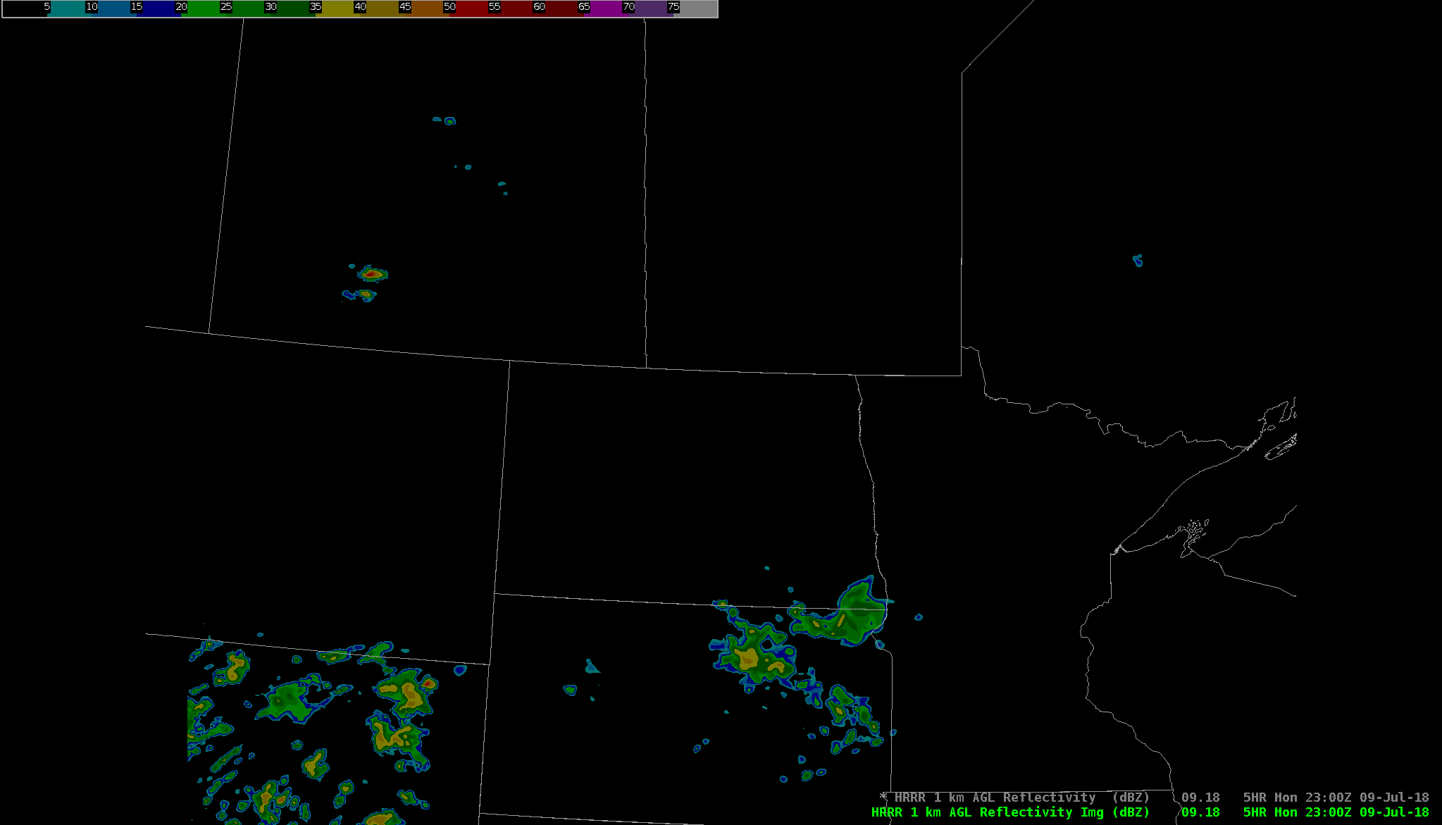
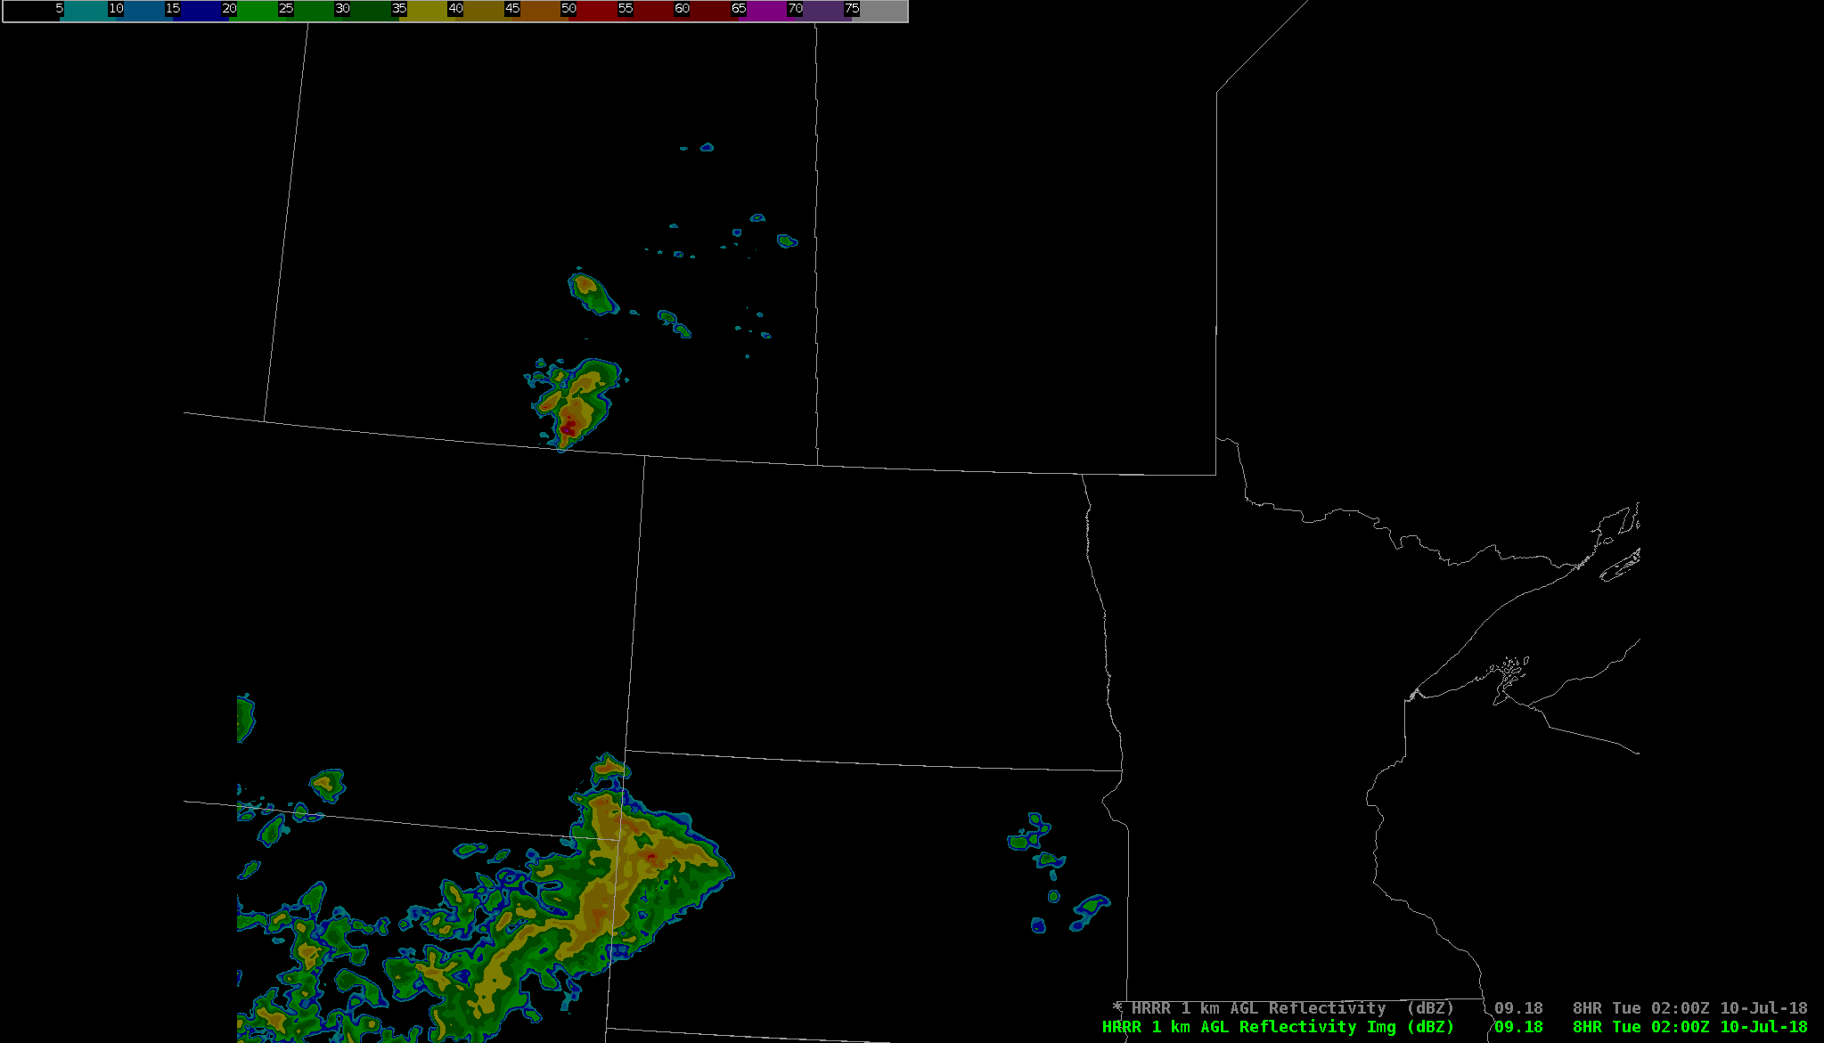
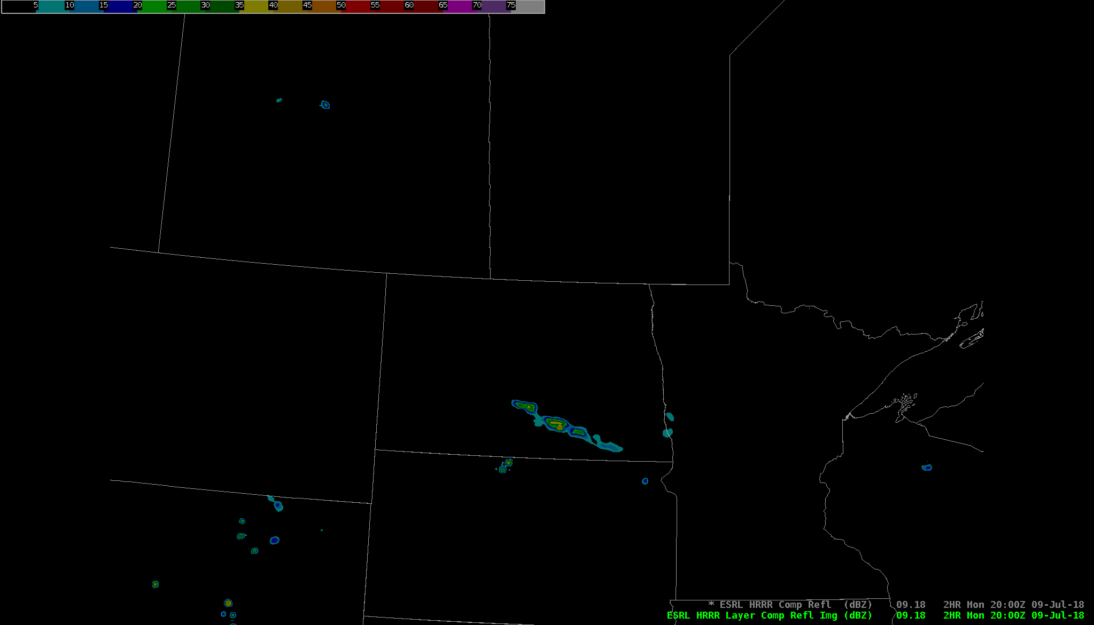
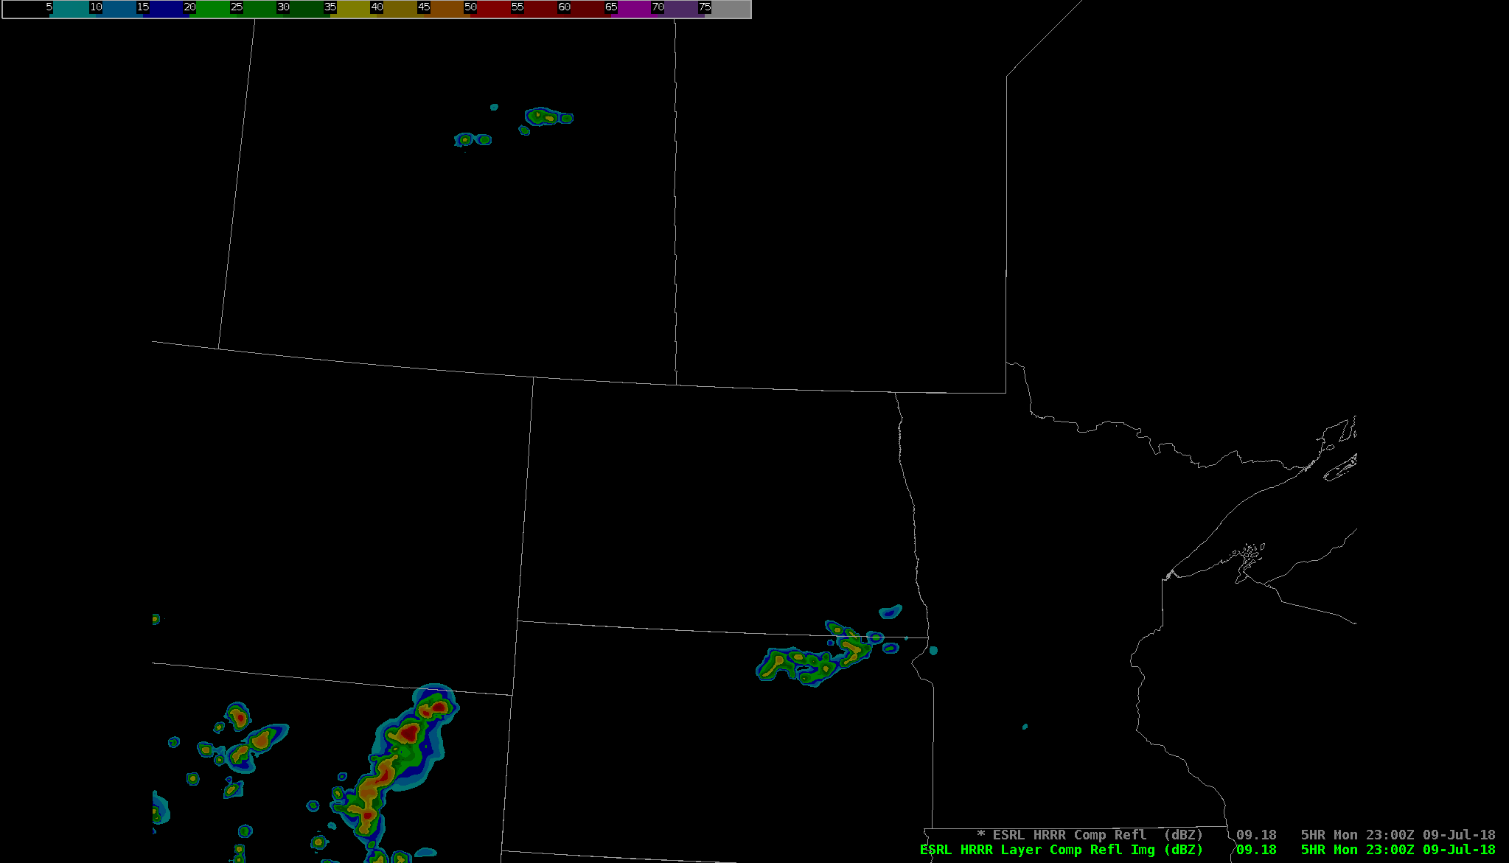
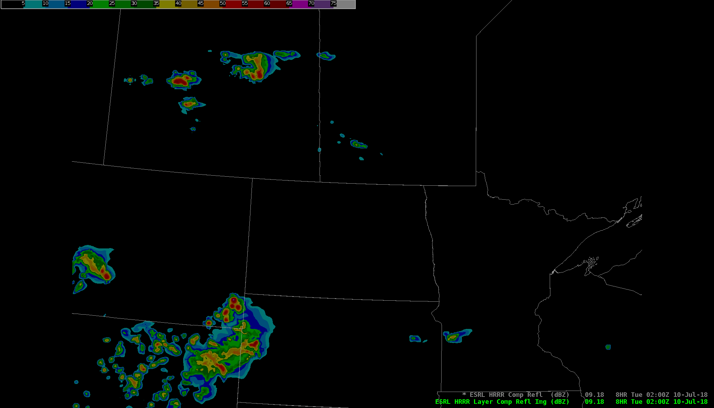
RAP13
20Z
23Z
02Z
OPTNL HRRR
20Z
23Z
02Z
ESRL HRRR
20Z
23Z
02Z
Notes:
Deep layer effective shear 50-60 kts, large DCAPE and outflow-dominant storm morphology in synoptic models.
Storm mode, coverage, timing of development all differ among CAM solutions. ESRL HRRR appears to have best initial/early depiction.

Slide 17
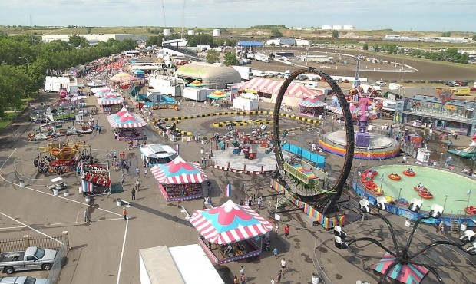
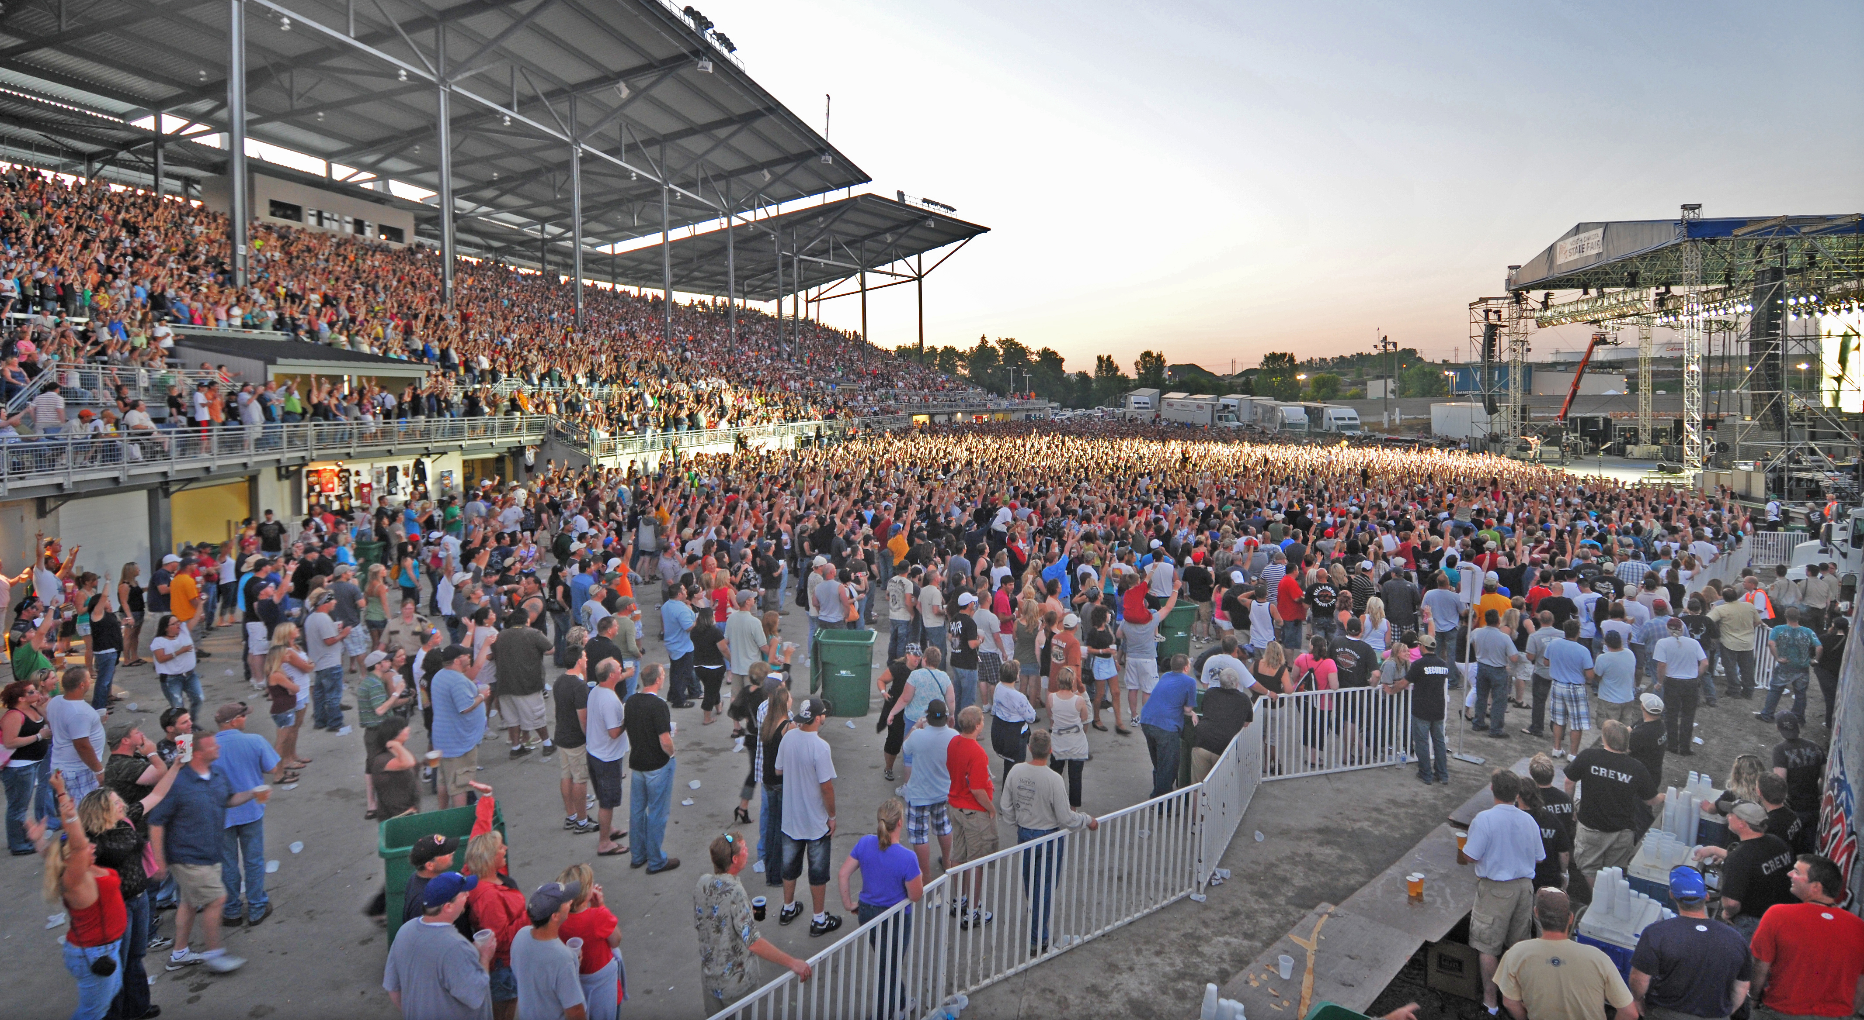
IDSS Event
North Dakota State Fair
Williston, ND
EOC staffed 24/7 during the fair
Critical Weather Thresholds
40+ mph wind
Lightning
Large hail
Heavy rain
Need at least 30 minutes to execute
safe sheltering procedures

Slide 18
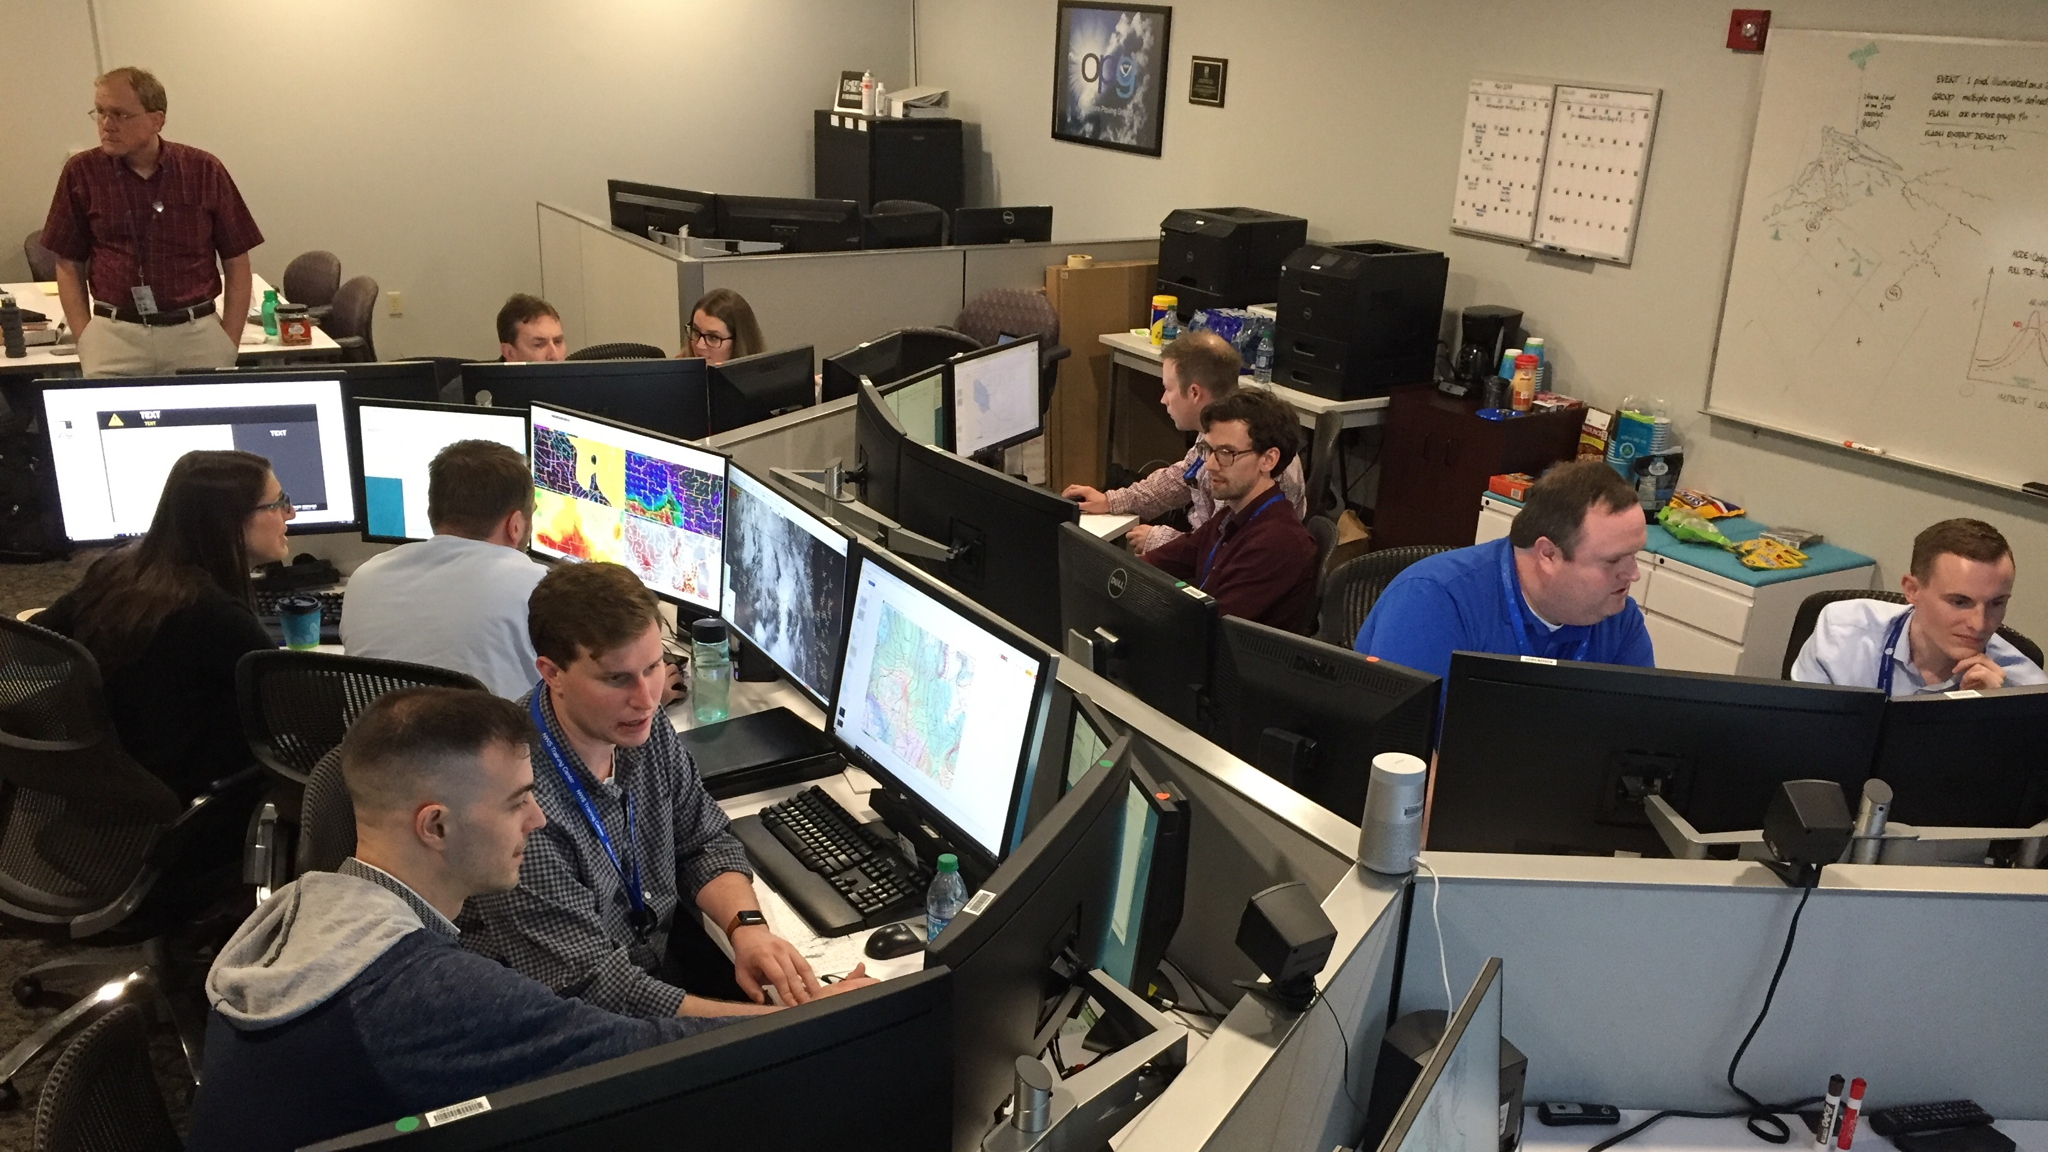
Immersive Experience
Hands-on, job-relevant, collaborative problem-solving exercises
Connect the learning experience to improving job performance
Evaluate viability of adopting a new paradigm in WFO operations
Create a team of mesoanalysis specialists – field “ambassadors”
Notes:
How do we get where we need to be?
ADULT LEARNING THEORY
Endeavor to employ techniques in immersive, interactive experience with 2 goals

Slide 19
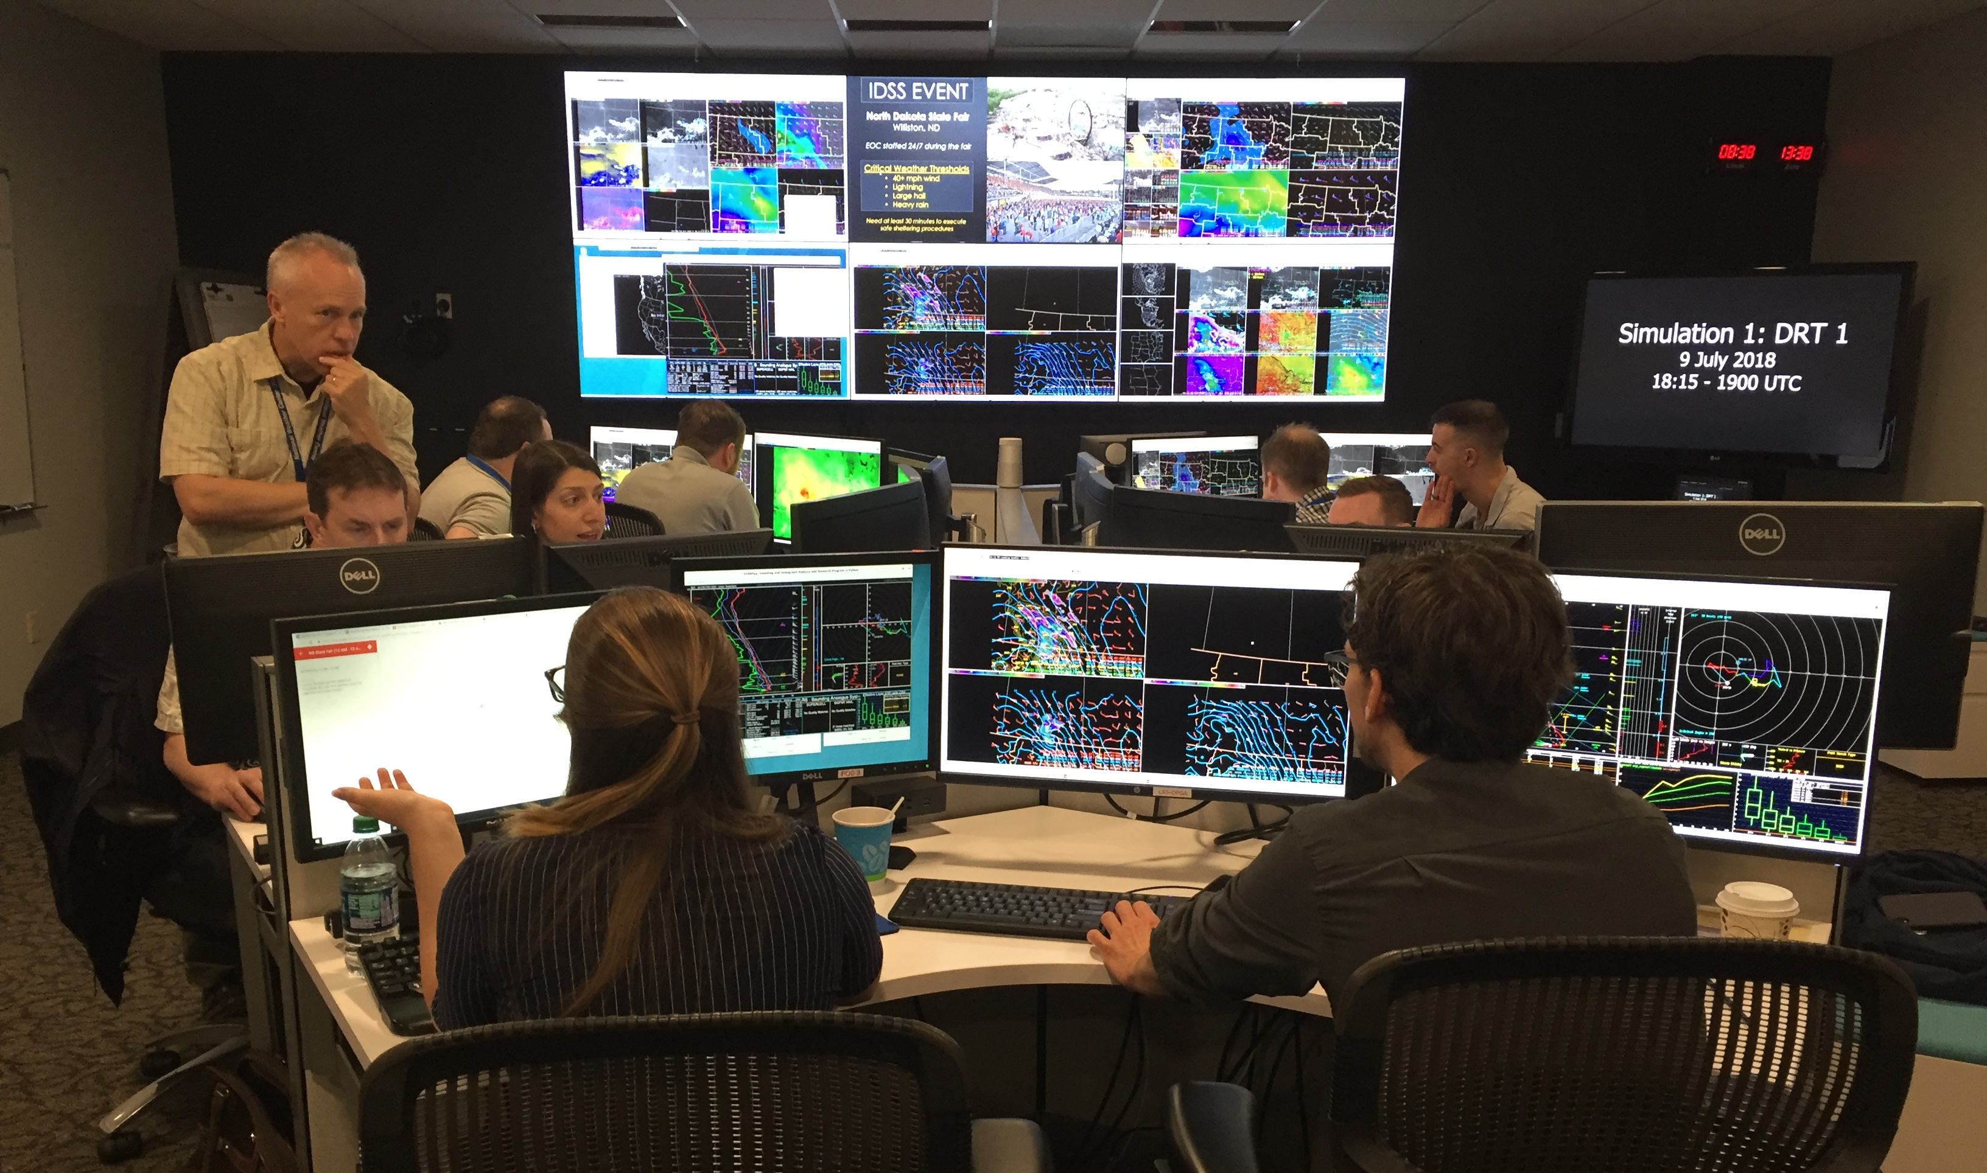
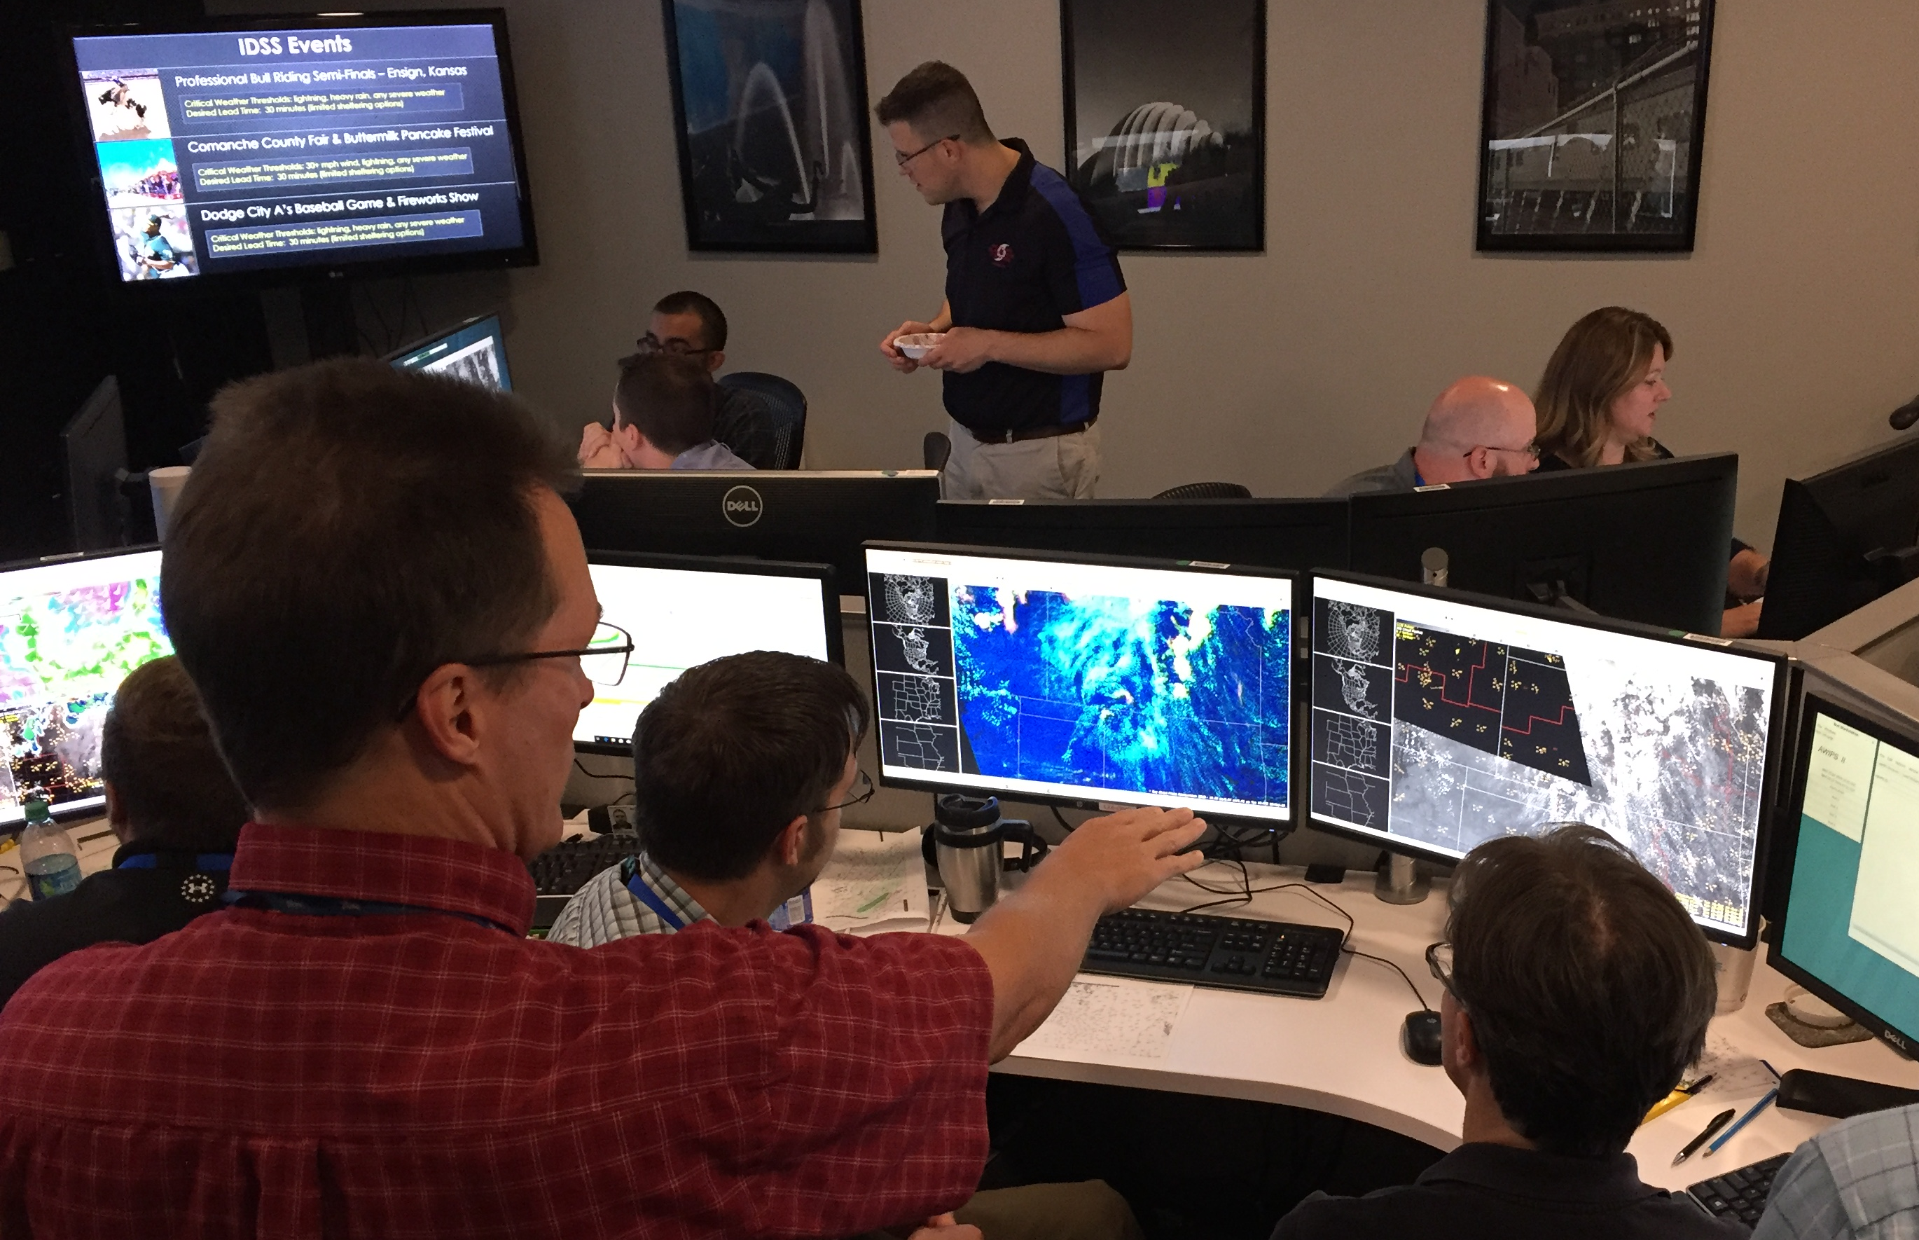
Immersive Experience
Spring/Summer 2019: 3 week-long proof-of-concept experiments
10 WFO forecaster participants per session (+ SME, SPC, EM)
Findings & Recommendations to NWS Leadership in October
Notes:
Exercises increase in complexity
Let participants get comfortable with new techniques
Lead up to capstone case – truly complex

Slide 20
Key Takeaways from Participant Surveys
Forms the basis of an effective CFP for severe convective weather services
Enhances situational awareness and threat assessment
Facilitates continuous flow of information (FACETs paradigm)
Most valuable in highly conditional threat scenarios
Lends itself to synthesizing probabilistic information
Significant knowledge/proficiency gap will need to be addressed
Major mindset shift toward anticipating development rather than reacting to it
Better prepared to predict CI, mode; and communicate associated threats
Clarity on value of the meso role and its contribution to tactical IDSS
Learned to think about, and message, a range of reasonable outcomes
Experiential format and honest feedback accelerated learning
Office culture of open communication critical to successful implementation

Slide 21
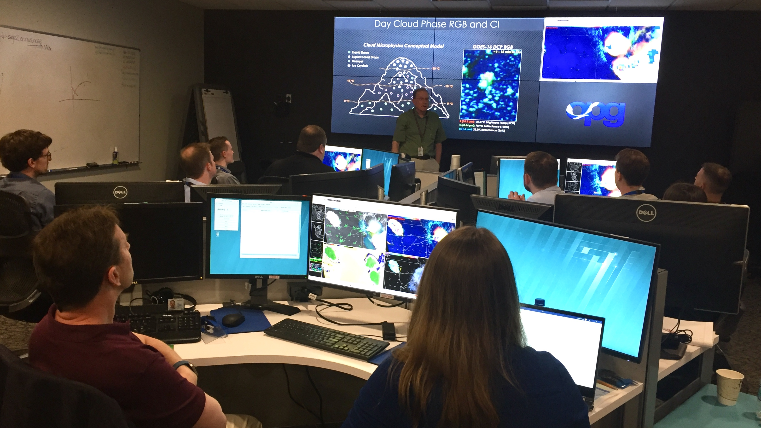
Ideas for Expanding the Reach

Slide 22
Ideas for Expanding the Reach
Experiential Training
in-residence
road shows
practice on blue sky days
multi-office collab sims
Case study webinars, blogs...
(interrupt the cycle of forgetfulness)
Mutual Aid Teams

Slide 23
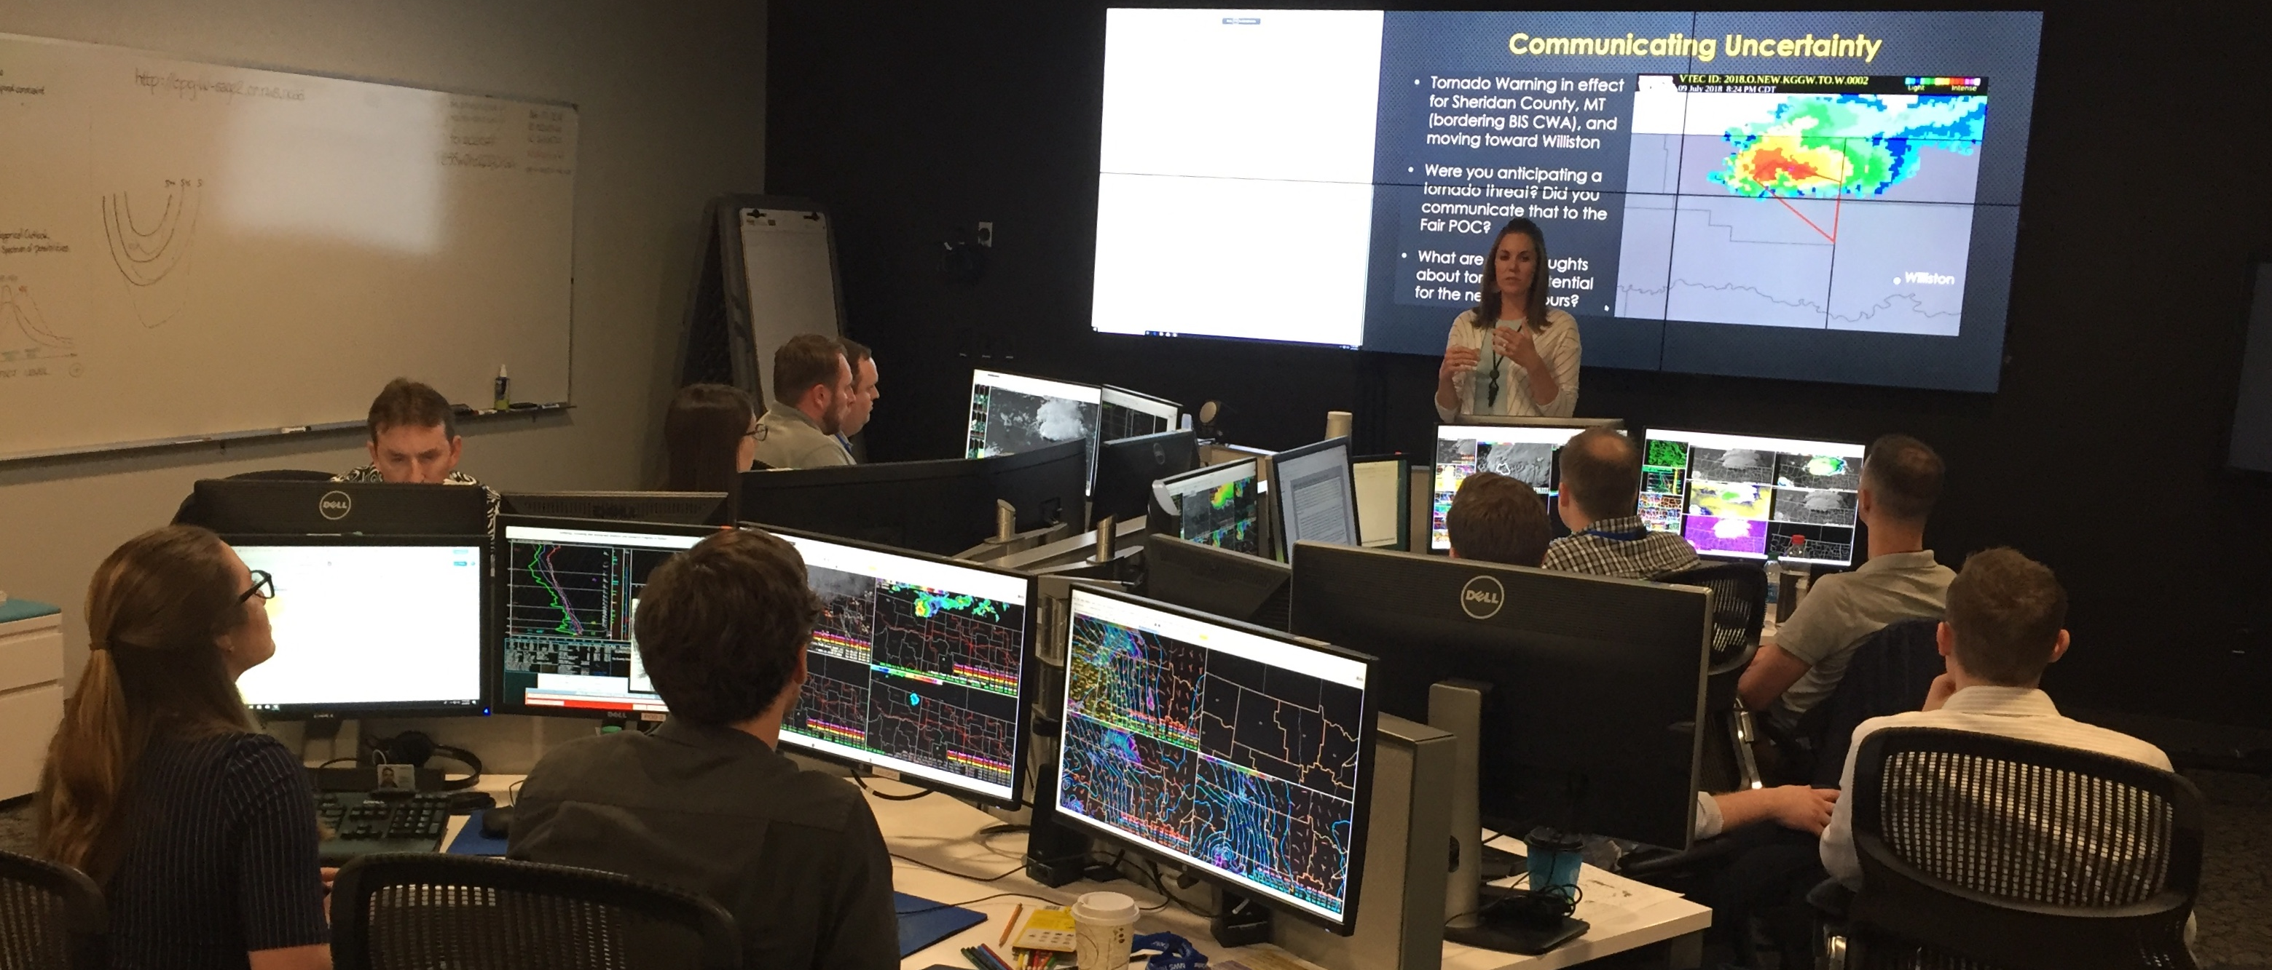
SOO Role - Lead and implement foundational science advancements upon which enhanced services are built.

