Slide 1
Presenting Probabilistic Forecast Information for Decision Support Applications VLab Forum – September 2020
Greg E. Mann, Ph.D.
Science and Operations Officer – WFO Detroit

Slide 2
WFO Detroit – DSS portfolio
Premise: timeseries layered threshold probability presentation
Condenses information for ease of use and direct application to forecaster and client needs
Primary clients
Transportation Sector
Wayne County Airport Authority (WCAA) – Detroit Metro Airport (DTW)
Michigan Department of Transportation (MDOT)
Supporting county/municipal road departments
Cleveland Center Weather Service Unit (CWSU ZOB) – FAA Detroit TRACON (D21)
Homeland Security
U.S. Coast Guard – Sector Detroit
City of Detroit DHS
Water Management
Detroit Water and Sewage
Michigan Department of Environment Great Lakes and Energy (EGLE) – local district

Slide 3
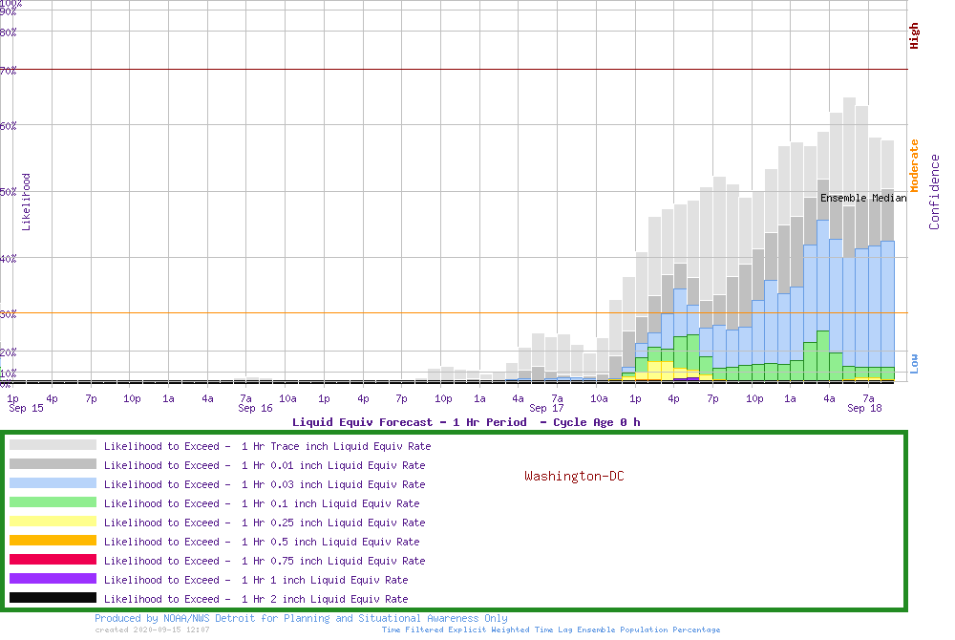
Layered Probability Timelines
Uses all available BUFR data – decaying time lagged to bolster ensemble population sample size
SREF, HREF, GFS, NAM, RAP, HRRR
Time Filter is applied
3h centered moving average
Hourly Based and Hourly Cadence
Precipitation variables also have accumulating centered moving windows (3, 6, and 12 hours)
QPF, Snow, Ice, Sleet, Snow Ratio (character), precipitation type, Wind / Gust, Direction Change, Apparent Temp, WBGT, Freezing Temp, Extreme Temp, CAPE, Ceilings, plus other applications and diagnostics are being tested

Slide 4
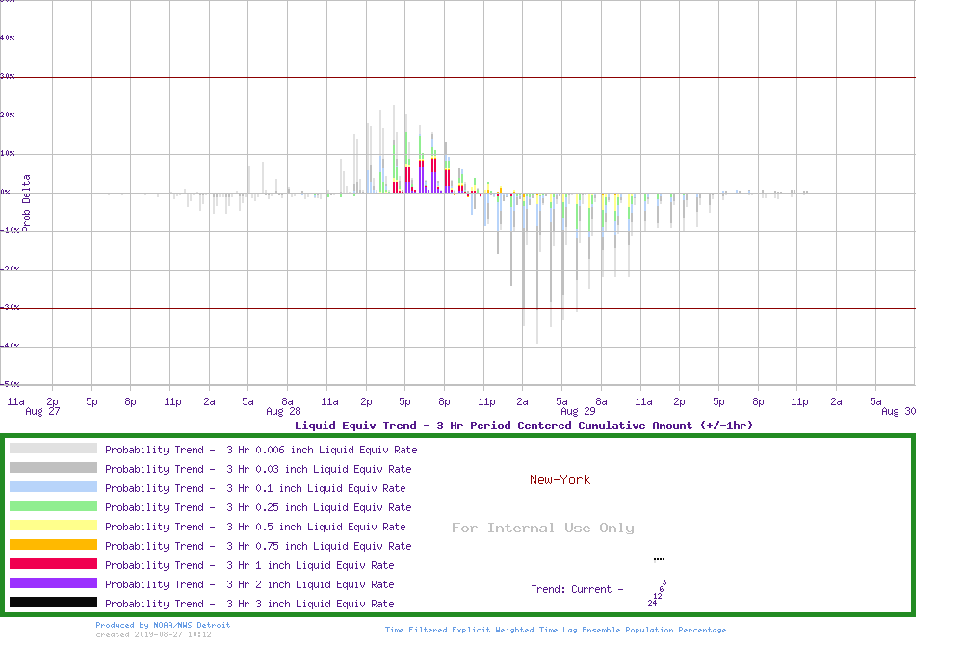
Forecast Tendencies
Trends over the past day from the grand ensemble

Slide 5
Forecast Tendencies
Trends over the past day from the grand ensemble
Very popular with forecasters in conveying changes to end users

Slide 6
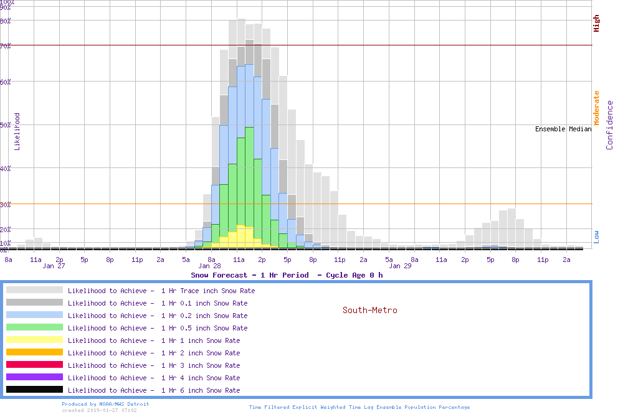
1 hr pSnow window
Prob hourly snow rate reaching 1”
between 11 am and noon is 22%

Slide 7
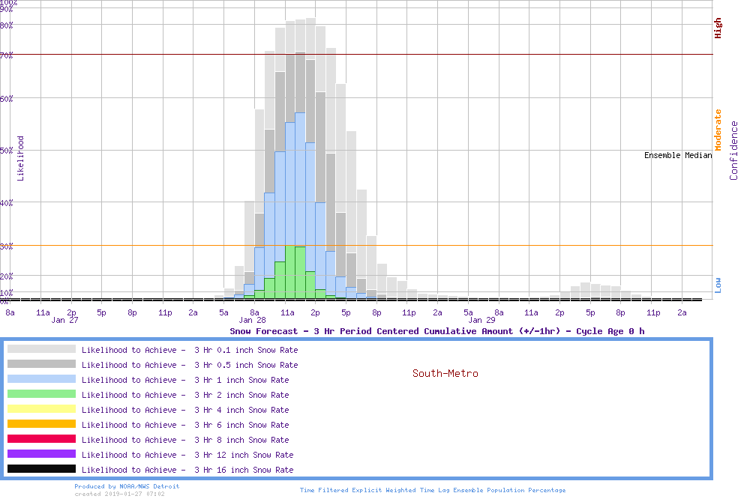
3 hr pSnow centered window
Prob 3 hour snow reaching at least 1”
Centered on noon - between 11 am and 1 pm is 56%

Slide 8
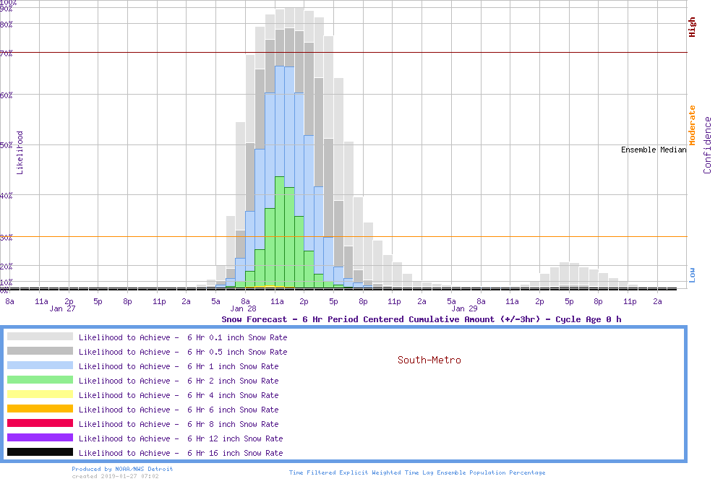
6 hr pSnow centered window
Prob 6 hour snow reaching at least 1”
Centered 6 hour at noon - between 9 am and 3 pm is 67%

Slide 9
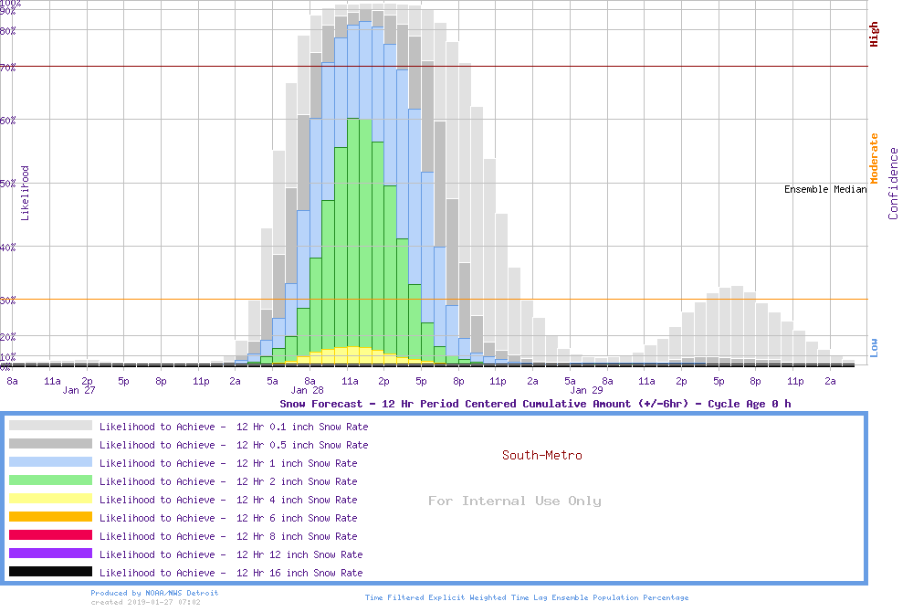
12 hr pSnow centered window
Prob 12 hour snow reaching at least 1”
Centered on noon - between 6 am and 6 pm is 83%

Slide 10
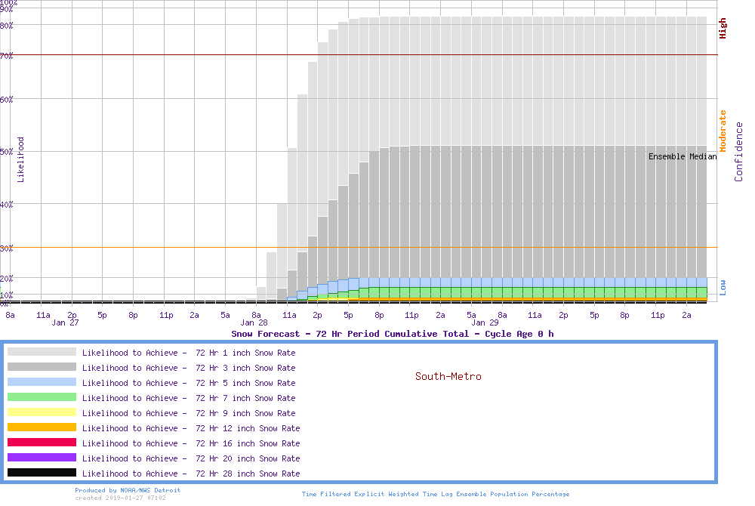
72 hr pSnow window

Slide 11
Snow Liquid Ratio (SLR)
Gray is the total probability of precipitation (note the scale is compressed at the top).
All the other colors in the column for each hour must add up to the total probability of precipitation.
This graphic, whenever used, will be annotated with trends, and the most likely character of the precipitation.

Slide 12
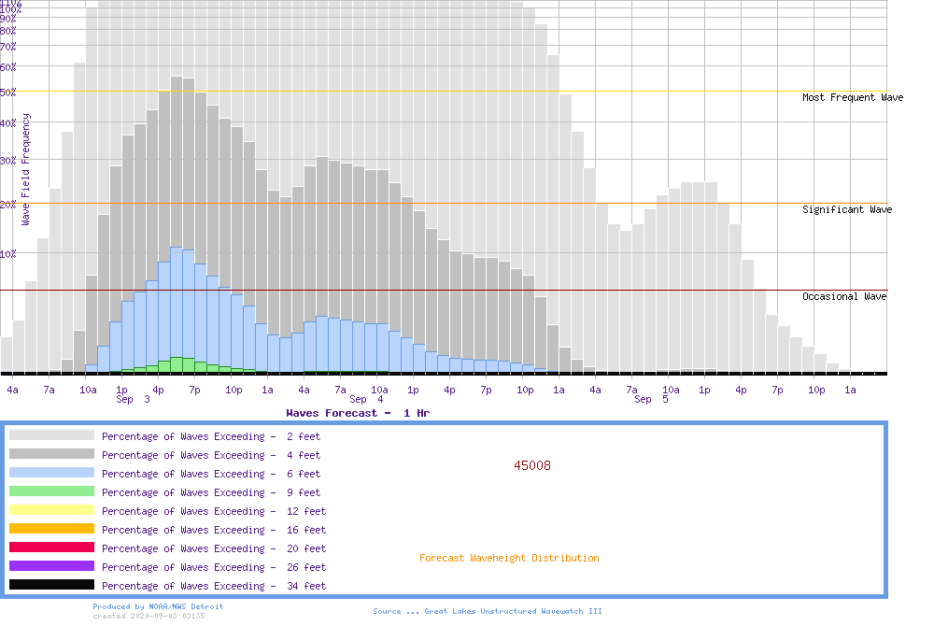
Forecast Decision Aids – Marine

Slide 13
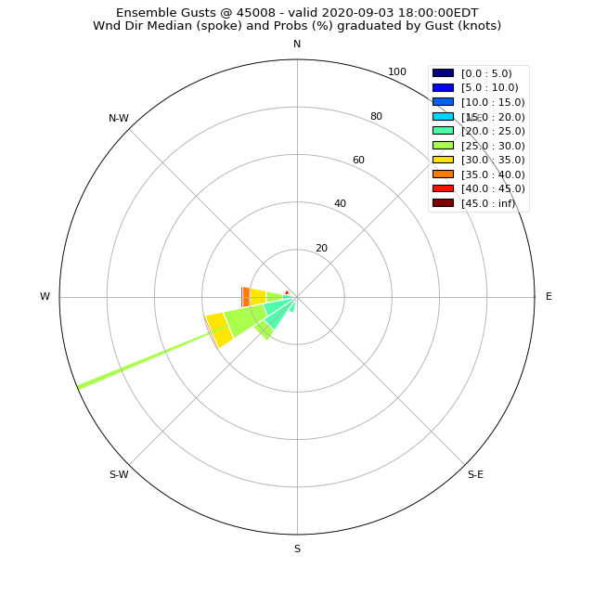
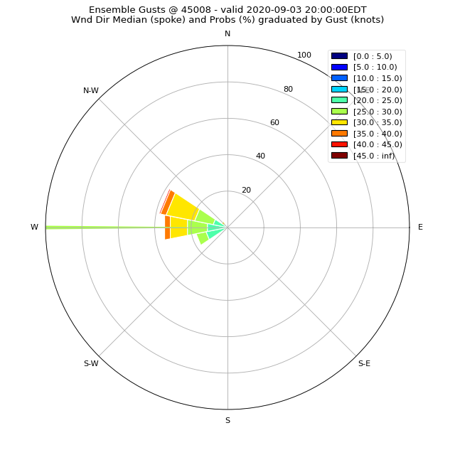
Wind Rose - Marine

Slide 14
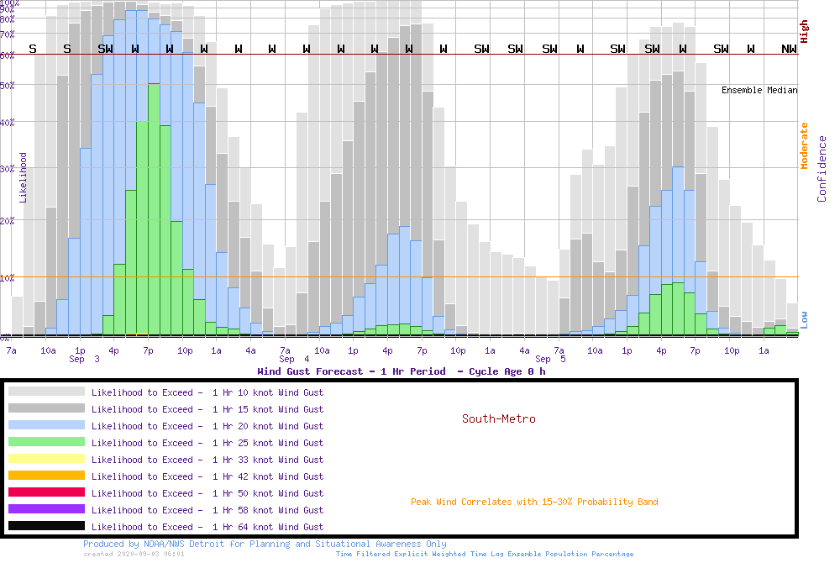
Forecast Decision Aids – Wind Direction Delta
N
N

Slide 15
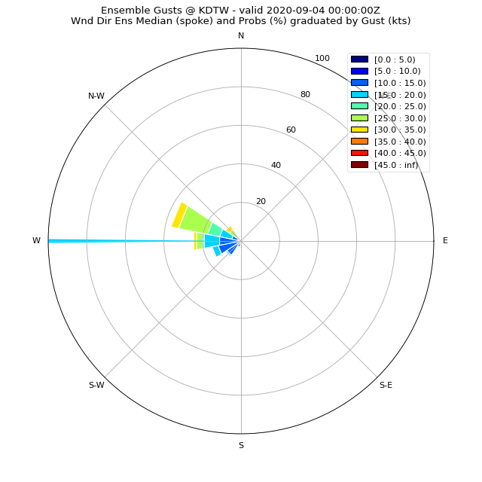
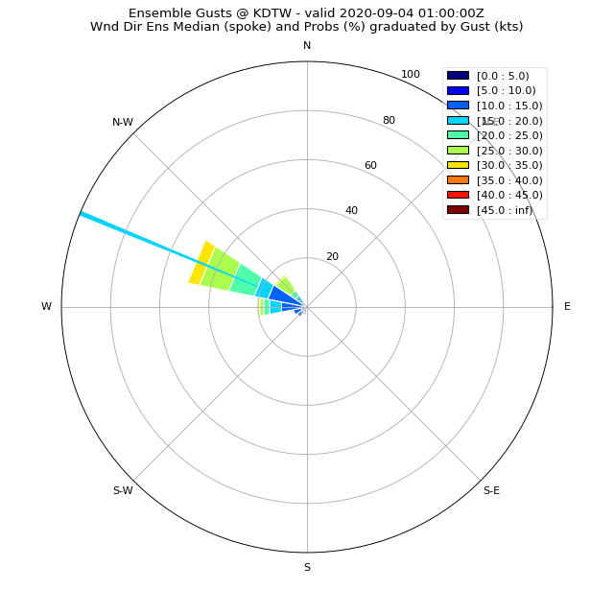
Wind Rose

Slide 16
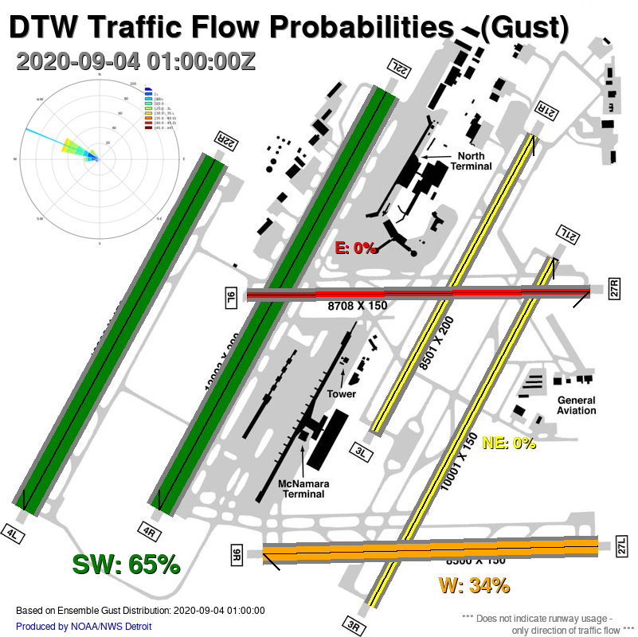
Mapping to Definable Impacts
Internal support for Center Weather Service Unit at FAA Cleveland Center
Traffic Flow for airfield is highly directionally dependent for speeds greater than 6 knots
Impacts arrival flow rates and resultant National Airspace routing
Map ensemble winds to airfield flow decision thresholds

Slide 17
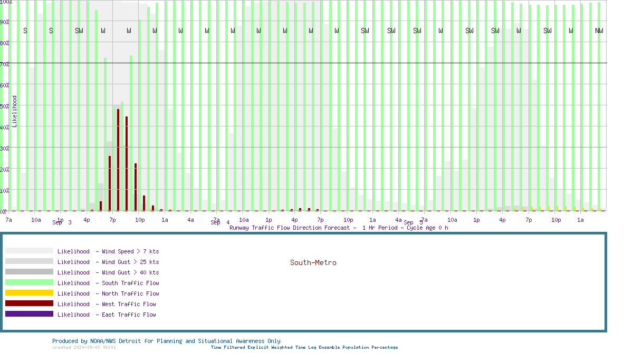
Forecast Decision Aids – Airport Traffic Flow
N

Slide 18
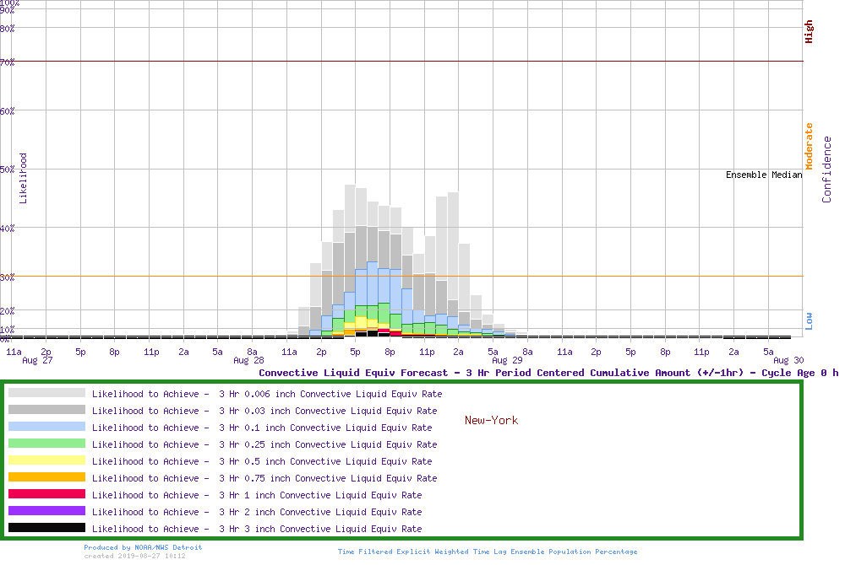
Conditional PQPF - Convection
Filter ensemble output using other diagnostics
Example PQPF where MUCAPE > 100 J/kg

Slide 19
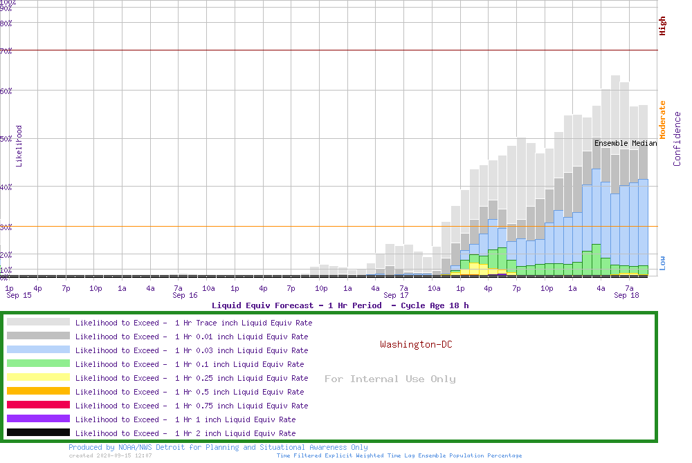
1h PQPF – DCA w/ animated trend

Slide 20
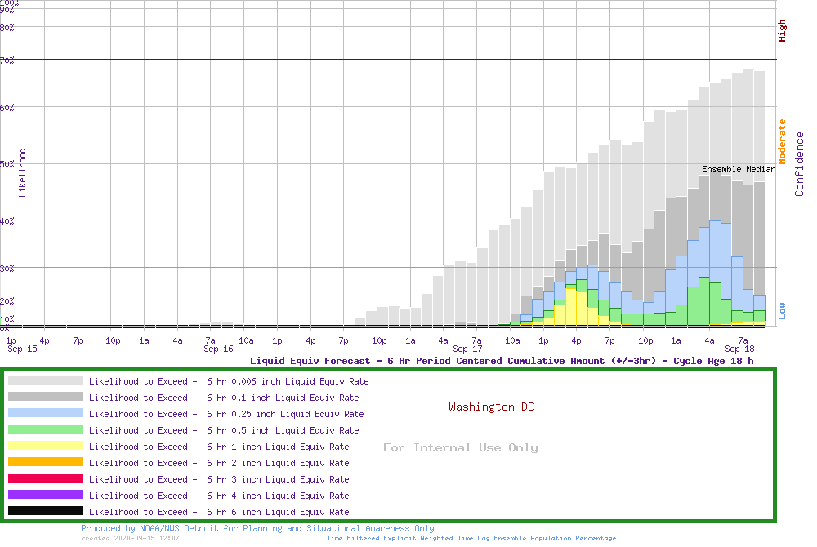
6h PQPF – DCA w/ animated trend

Slide 21
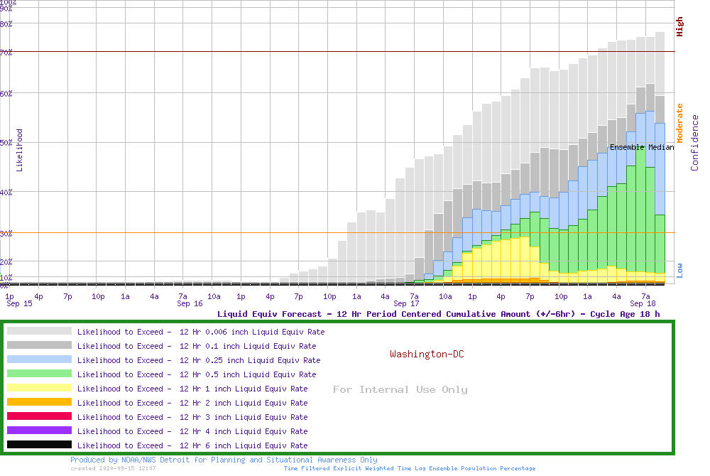
12h PQPF – DCA w/ animated trend

Slide 22
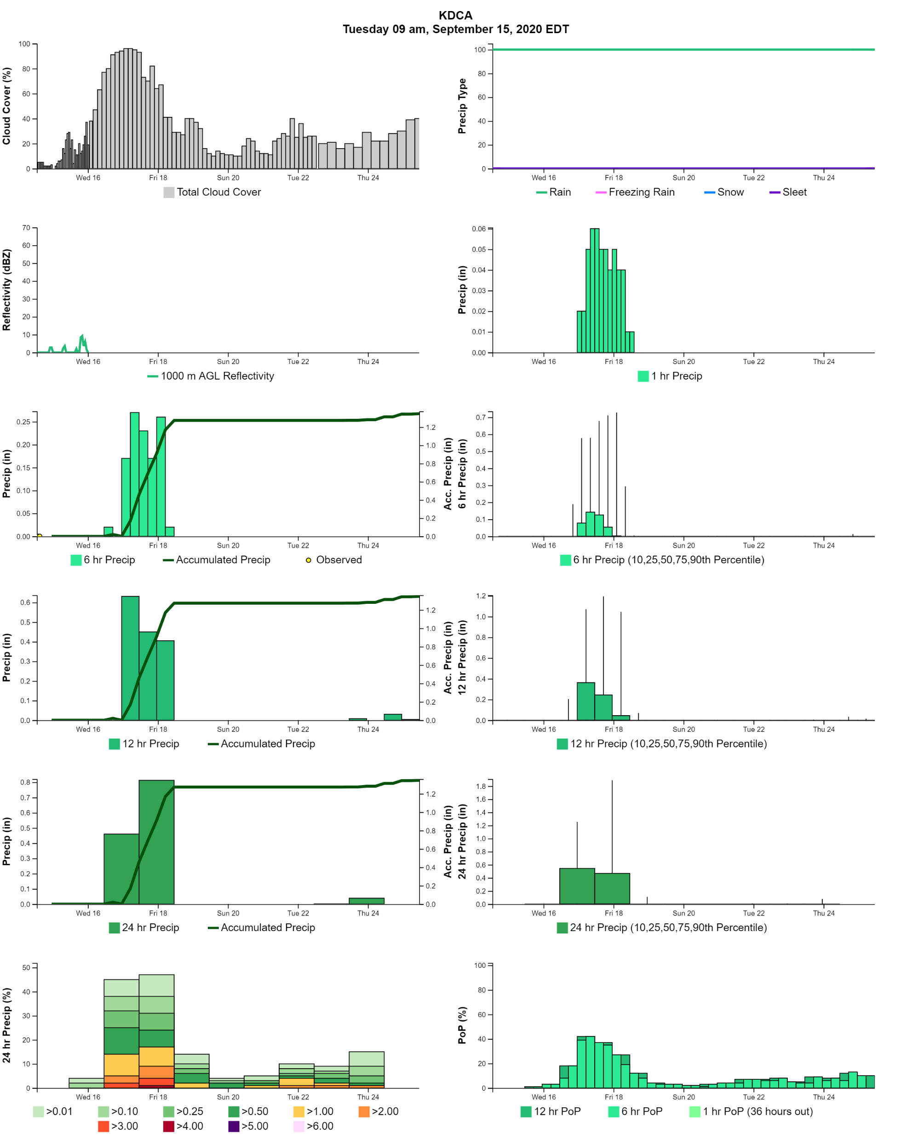
72h PQPF – DCA + NBM view

Slide 23
Some Considerations
Layered information content provides greater context
Must maintain constant amplitude space to allow for comparative assessments
Timelines meet vast majority of WFO client needs more directly
While calibration is nice – ensemble information content depth has great value
Users will use uncalibrated single solution data in the absence of useable ensemble data
Interpretative services must include conditionality to aid decision process – includes informing the forecast process
Simplicity is not desired – rather clarity
Spectra of outcomes is necessary to enable decision-makers to appropriately apply portions of action plans or playbooks
Forecast spectra tendencies provide important additional value
Flexibility to extract and ask questions of the data is paramount

Slide 24
Example Briefings to WCAA
Airport Ground Operations Winter Weather Support

Slide 27
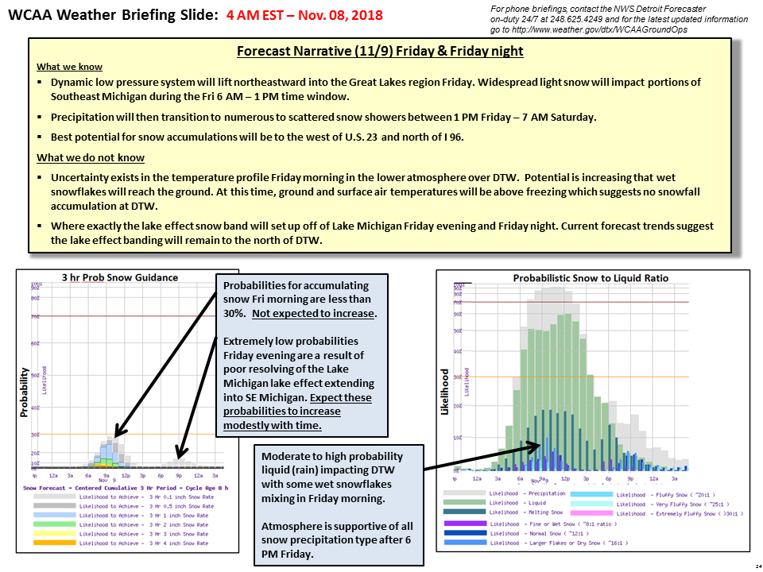

Slide 28
Example – Feb 4, 2019 Freezing Rain (33 hrs in Advance)

